Slide 1

Programmierpraktikum: Datensysteme
01 Kickoff and Introduction
Prof. Dr. Matthias Boehm
Technische Universität Berlin
Berlin Institute for the Foundations of Learning and Data
Big Data Engineering (DAMS Lab)
Last update: Apr 15, 2024

Slide 2





About Me
Since 09/2022 TU Berlin, Germany
  University professor for Big Data Engineering (DAMS)
2018-2022 TU Graz, Austria
  BMK endowed chair for data management + research area manager
  Data management for data science (DAMS), SystemDS & DAPHNE
2012-2018 IBM Research – Almaden, CA, USA
  Declarative large-scale machine learning
  Optimizer and runtime of Apache SystemML
2007-2011 PhD TU Dresden, Germany
  Cost-based optimization of integration flows
  Time series forecasting / in-memory indexing & query processing
DB group

Slide 3
Agenda
Course Organization
Background Data Management
#1 Query Processing on Raw Data (DAMS)
#2 Efficient Duplicate Detection (D2IP)
Course Selection/Enrolment

Slide 4
Course Organization

Slide 5
Basic Course Organization
Language
  Lectures and slides: English (German if preferred)
  Communication and presentations: English/German
  Informal language (first name is fine)
  Offline Q&A in forum, answered by teaching assistants
Course Format
  6 ECTS (4 SWS) bachelor computer science / information systems
  Every-other-week lectures (Mon 4.15pm sharp, including Q&A), attendance optional
Prerequisites
  Basic programming skills in languages such as C, C++, Java, Rust, etc
  Basic understanding of data management SQL / RA (or willingness to fill gaps)

Slide 6

Course Goals and Structure
Objectives
  Apply basic programming skills to more complex problem (in self-organized team work)
  Technical focus on data management and data systems
  Holistic programming projects: prototyping, design, versioning, tests, experiments, benchmarks
Grading: Pass/Fail
  Project Implementation (project source code) [45%]
  Component and Functional Tests (test source code) [10%]
  Runtime Experiments (achieve performance target) [15%]
  Documentation (design document up to 5 pages / code documentation) [15%]
  Result Presentation (10min talk) [15%]
Academic Honesty / No Plagiarism (incl LLMs like ChatGPT)

Slide 7
Sub-Course Offerings
#1 Query Processing on Raw Data
  Capacity: 36+/48
  Organized by DAMS group
  Broad technical focus
  Lectures every-other-week in H 0111
➔ Admitted Students:
  28 + ~5 via email + 73 on ISIS (incl duplicates)
  Total registrations: up to 48
  → 12 teams, 4 students each
#2 Efficient Duplicate Detection
  Capacity: 12/48
  Organized by D2IP group
  Focus on entity resolution
  Lectures in TEL-12? seminar room

Slide 8
Background Data Management

Slide 9

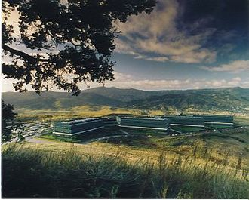
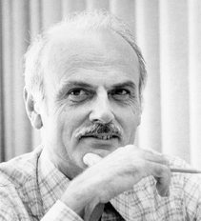
SQL Standard
(SQL-86)
Oracle, IBM DB2, Informix, Sybase → MS SQL
History 1970/1980s
Relational Database Systems
SEQUEL
QUEL
System R @ IBM Research – Almaden
(Jim Gray et al.,
Turing Award ‘98)
Ingres @ UC Berkeley (Stonebraker et al.,
Turing Award ‘14)
Tuple Calculus
Relational Algebra
Relational Model
Edgar F. “Ted” Codd @ IBM
Research (Turing Award ‘81)
Goal: Data Independence
(physical data independence)
  Ordering Dependence
  Indexing Dependence
  Access Path Dependence
[E. F. Codd: A Relational Model of Data for Large Shared Data Banks.
Comm. ACM 13(6), 1970]

Slide 10
Success of SQL / Relational Model
#1 Declarative: what not how
#2 Flexibility:
closure property → composability
Query:
SELECT O_OID, sum(L_Price)
FROM Orders, Lineitem, Customer
WHERE O_OID = L_OID AND O_CID = C_CID
AND O_Odate >= ‘2018-11-14’
AND C_Msegment = ‘AUTOMOBILE’
GROUP BY O_OID
Logical Query Plans
C(P)=1.32M
C(P)=2.2G
C(P)=0.34M
Physical Query Plan
Γ
sum(Price)
Hash
GrpJoin
Γ
Γ
0.001
σ
>=2018-11-14
⋈
⋈
#4 Physical Data
Independence
0.2
σ
Hash
Join
TScan L
⋈
L
⋈
σ
AUTOMOBILE
⋈
σ
σ
σ
L
C
σ
⋈
10K
IXScan
O
C
O
C
O
Date
TScan C
O
1G
L
#3 Automatic Optimization
100M

Slide 11
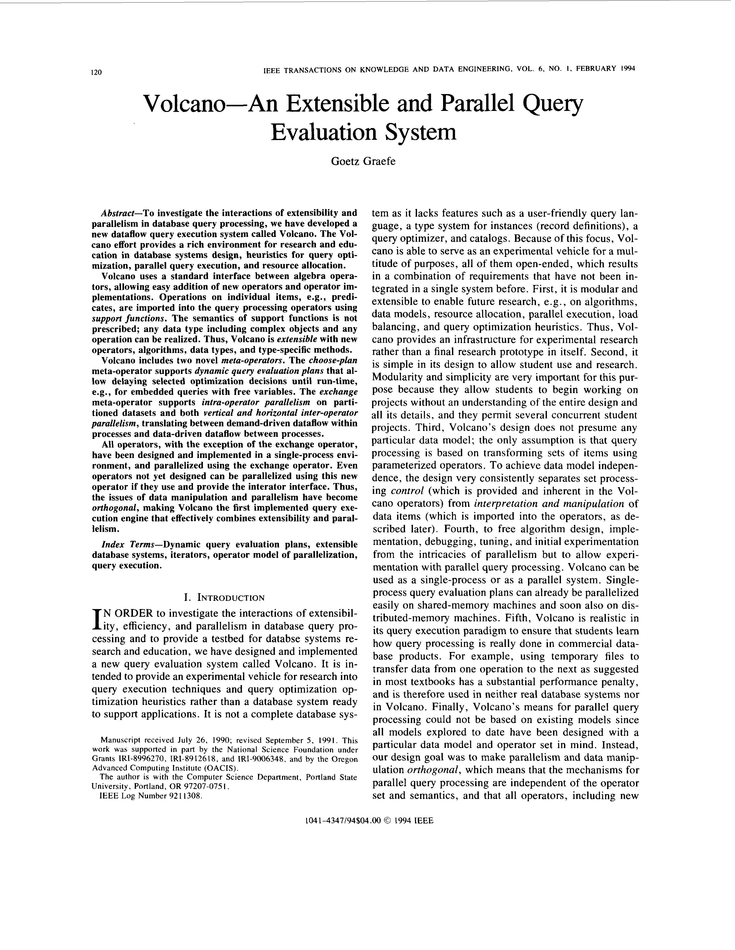
[Goetz Graefe: Volcano - An Extensible and Parallel Query Evaluation System. IEEE Trans. Knowl. Data Eng. 1994]
Query Processing – Iterator Model
Scalable (small memory)
High CPI measures
Volcano Iterator Model
  Open-Next-Close (ONC) interface
  Query execution from root node (pull-based) → Pipelined
Example
σ_{A=7}(R)
Blocking Operators
  Sorting, grouping/aggregation, build-phase of (simple) hash joins
void open() { R.open(); }
void close() { R.close(); }
Record next() {
while( (r = R.next()) != EOF )
if( p(r) ) //A==7
return r;
return EOF;
}
open()
next()
next()
→ EOF
close()
open()
σ_{A=7}
next()
next()
→ EOF
close()
open()
R
next()
next()
next()
next()
→ EOF
close()
PostgreSQL: Init(),
GetNext(), ReScan(), MarkPos(), RestorePos(), End()

Slide 12
#1 Query Processing on Raw Data
(DAMS)

Slide 13



Additional Course Logistics
Staff
  Lecturer: Prof. Dr. Matthias Boehm
  Teaching Assistants: Christina Dionysio, David Justen
Next Dates/Lectures
  Apr 22: Course Selection; team preferences, otherwise assignment
  Apr 29: Background Relational Algebra
  May 13: Background Query Processing
  May 27: Background Query Optimization
  Jun 10: Experiments and Reproducibility
  Jul 01: Project submissions (performance target: 4x faster than reference implementation)
  Jul 08: Project presentations (10min per team, mandatory attendance)
Infrastructure
  Setup your own private Github/Gitlab repository
Each teams gets a mentor
Q&A sessions on demand

Slide 14
Query Processing on Raw Data – Motivation
DBMS for Exploratory Data Analysis
  #1: Define a schema for the data
  #2: Load the data
  #3: Tune the system for the expected workload
Vision
Initial System
Lots of Follow-up Work
  Heterogeneous data sources
  RAW Labs – The NoDB Company:
  https://www.raw-labs.com/
“To DB, or Not to DB”
[Stratos Idreos, Ioannis Alagiannis, Ryan Johnson, Anastasia Ailamaki: Here are my Data Files. Here are my Queries. Where are my Results? CIDR 2011]
[Ioannis Alagiannis, Renata Borovica, Miguel Branco, Stratos Idreos, Anastasia Ailamaki: NoDB: Efficient Query Execution on Raw Data Files. SIGMOD 2012]
SIGMOD’22
Test-of-Time Award
[Manos Karpathiotakis, Ioannis Alagiannis, Anastasia Ailamaki: Fast Queries Over Heterogeneous Data Through Engine Customization. PVLDB 9(12), 2016]

Slide 15
Query Processing on Raw Data – Vision and Goals
SELECT sum(a1), min(a4), max(a3),avg(a2)
FROM R
WHERE a1>v1 AND a1<v2 AND a2>v3 AND a2<v4
Initial Experiments
  DBMS: MonetDB
  Tables w/ 4 int columns
➔ Vision: Hybrid system
Load/Ingest Time
Query
Time

Slide 16
Query Processing on Raw Data – The NoDB Philosophy
Key Principles of
NoDB Philosophy
Directions
  #1 Minimizing the cost of raw data access (special data structures)
  #2 Selectively eliminating raw data access (caching, scheduled raw access)

Slide 17
Query Processing on Raw Data – Efficient CSV Parsing
Parsing and Tokenization
  Needed when accessing raw data
  Parsing: identify row boundaries (\n) → tuple
  Tokenization: identify tuple attributes (delimiter), and convert strings to types
#1 Selective Tokenization
  If query needs 4th and 8th attribute, stop tokenization at 8th attribute
  → no I/O reduction, reduced tokenization effort
#2 Selective Parsing
  If query needs 4th and 8th attribute, convert only 4th and 8th attribute
  Defer parsing 8th attribute if 4th and 8th attribute are used in conjunctive filters
#3 Selective Tuple Formation
  Tuple construction after selections (only qualifying) tuples
Assumes
non-quoted tokens
In PostgreSQL, any physical op can act as projection / selection

Slide 18
Query Processing on Raw Data – Efficient CSV Parsing, cont.
Positional Map
  Store metadata on structure of CSV files
  to navigate and retrieve raw data faster
  Goal: Learn as much as possible from
  data already touched by other queries
  Example: Pos of 4th and 8th attributes
  Allows direct or “close” access
Similar to Database Cracking
  Q1 accesses a4 and a6; Q2 accesses a4 and a9
[Stratos Idreos, Martin L.
Kersten, Stefan Manegold: Database Cracking. CIDR 2007]
Positional Map
can be larger than original data

Slide 19
Query Processing on Raw Data – End-to-end Experiments
Setup
  7.5M rows x 150 columns, 9 queries with different selectivity
  Q1: 100% rows/cols, Q2-5: decrease rows by 20%, Q6-9: decrease cols by 20%
Additional experiments: TPC-H, FITS format, Stats Impact

Slide 20
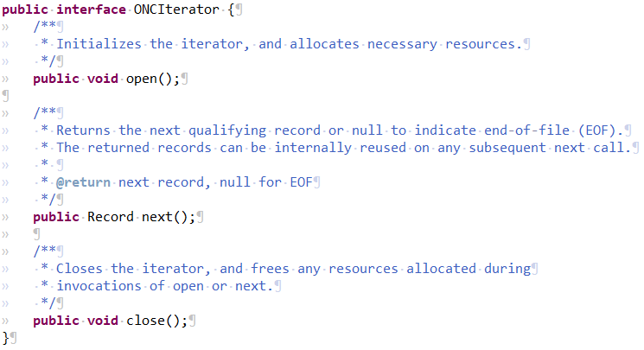
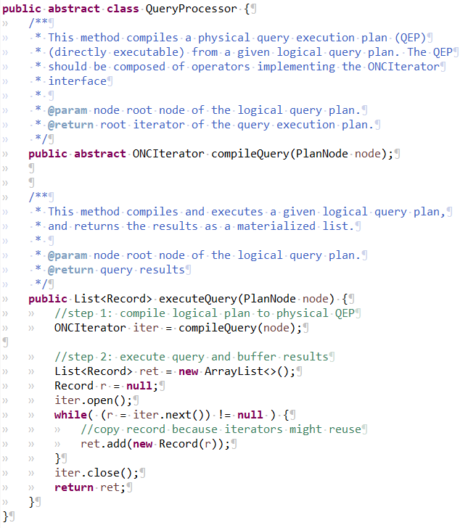
API, Reference Implementation, and Task Description
[https://mboehm7.github.io/teaching/ss24_ppds/index.htm]
Application Programming Interface (API)
  Provided C++ and Java APIs
  Includes basic tests and benchmark
  Other language perfectly fine
Reference Implementation in C++
Task Description for unclear Submission Details
  Published: Apr 13
Test System
  HW: Two Intel Xeon Gold 6338 CPUs@2.2-3.2 GHz
  (64 physical/128 virtual cores), 1 TB DDR4 RAM, 16x SATA SSDs (in RAID-0), 2x A40 GPUs.
  OS: Ubuntu 20.04, C/C++ Compiler: gcc/g++ 11, Java-11: Openjdk 11.0.20

Slide 21
#2 Efficient Duplicate Detection
(D2IP)

Slide 22
Course Selection/Enrolment

Slide 23
Select Your Course
#1 Query Processing on Raw Data (DAMS)
  Capacity: 36+/48
#2 Efficient Duplicate Detection (D2IP)
  Capacity: 12/48
https://tinyurl.com/5c5cbedm

Slide 24
Summary & QA
Thanks
Course Organization
Background Data Management
#1 Query Processing on Raw Data (DAMS)
#2 Efficient Duplicate Detection (D2IP)
Course Selection/Enrolment by Apr 22 EOD
https://tinyurl.com/5c5cbedm

