Slide 1

Programmierpraktikum: Datensysteme
02 Background Relational Algebra
Prof. Dr. Matthias Boehm
Technische Universität Berlin
Berlin Institute for the Foundations of Learning and Data
Big Data Engineering (DAMS Lab)
Last update: Apr 27, 2024

Slide 2

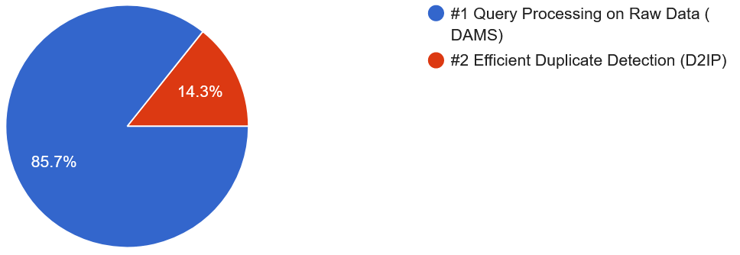
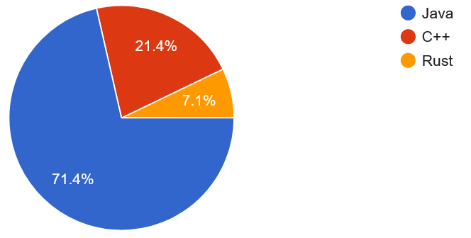
Announcements / Org
#1 Hybrid & Video Recording
  Hybrid lectures (in-person, zoom) with optional attendance
  https://tu-berlin.zoom.us/j/9529634787?pwd=R1ZsN1M3SC9BOU1OcFdmem9zT202UT09
  Zoom video recordings, links from website
  https://mboehm7.github.io/teaching/ss24_ppds/index.htm
#2 Instance Selection
  Selection deadline passed Apr 22 EOD
  Initial team assignments for DAMS groups Apr 29
  Email to matthias.boehm@tu-berlin.de if not assigned
  Project submission by Jul 08
Notes:
Note VASA-1 Microsoft

Slide 3
Recap: Relations and Terminology
Attribute
Domain D (value domain): e.g., Set S, INT, Char[20]
Relation R
  Relation schema RS: Set of k attributes {A₁,…,A_{k}}
  Attribute A_{j}: value domain D_{j} = dom(A_{j})
  Relation: subset of the Cartesian product over
  all value domains D_{j}: R ⊆ D₁ × D₂ × ... × D_{k}, k ≥ 1
Additional Terminology
  Tuple: row of k elements of a relation
  Cardinality of a relation: number of tuples in the relation
  Rank of a relation: number of attributes
  Semantics: Set := no duplicate tuples (in practice: Bag := duplicates allowed)
  Order of tuples and attributes is irrelevant
A1 INT | A2 INT | A3 BOOL
3 | 7 | T
1 | 2 | T
3 | 4 | F
1 | 7 | T
Tuple
cardinality: 4
rank: 3

Slide 4
Relational Algebra vs Tuple Calculus
Calculus-oriented Languages
Comparison
Scheme for Data
Sub Languages
QUEL
ALPHA
Relational Calculus (Tuple Calculus)
bidirectional mapping
possible (relational completeness)
Relational Algebra
[E. F. Codd: Relational Completeness of Data Base Sublanguages. IBM Research Report RJ987, 1972]
(SQL)
Algebra-oriented Languages

Slide 5
Agenda
Relational Algebra
Tuple Calculus
Physical Operators (Preview)

Slide 6


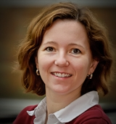

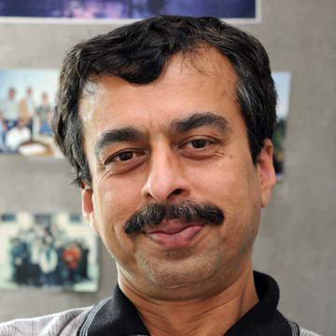




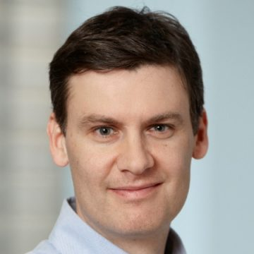
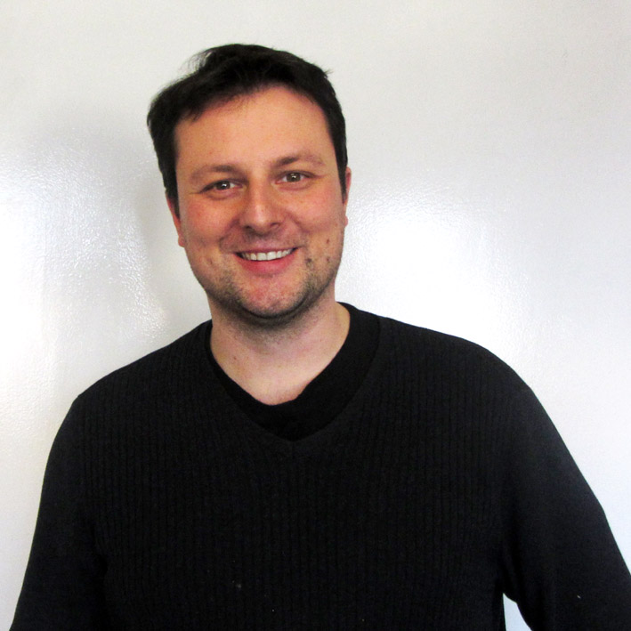






Database Research Self-Assessment 2018
PID | Firstname | Lastname | Affiliation | LID
102 | Anastasia | Ailamaki | EPFL | 1
104 | Peter | Bailis | Stanford
105 | Magdalena | Balazinska | U Washington | 3
107 | Peter | Boncz | CWI | 2
108 | Surajit | Chaudhuri | MS Research | 3
111 | Luna | Dong | Amazon | 3
113 | Juliana | Freire | NYU | 5
115 | Joe | Hellerstein | UC Berkley | 6
116 | Stratos | Idreos | Harvard | 7
117 | Donald | Kossman | MS Research
118 | Tim | Kraska | MIT | 7
120 | Volker | Markl | TU Berlin | 8
122 | Tova | Milo | Tel Aviv University | 9
123 | C. | Mohan | IBM Research | 10
124 | Thomas | Neumann | TU Munich | 11
126 | Fatma | Ozcan | IBM Research | 10
130 | Christopher | Re | Stanford | 4
Notes:
Participants (32): 1 Daniel Abadi, 2 Anastasia Ailamaki, 3 David Andersen, 4 Peter Bailis, 5 Magdalena Balazinska, 6 Phil Bernstein, 7 Peter Boncz, 8 Surajit Chaudhuri, 9 Alvin Cheung, 10 Anhai Doan, 11 Luna Dong, 12 Mike Franklin, 13 Juliana Freire, 14 Alon Halevy, 15 Joe Hellerstein, 16 Stratos Idreos, 17 Donald Kossman, 18 Tim Kraska, 19 Sailesh Krishnamurthy, 20 Volker Markl, 21 Sergey Melnik, 22 Tova Milo, 23 C. Mohan, 24 Thomas Neumann, 25 Beng Chin Ooi, 26 Fatma Ozcan, 27 Jignesh Patel, 28 Andy Pavlo, 29 Raghu Ramakrishnan, 30 Christopher Re, 31 Mike Stonebraker, and 32 Dan Suciu.

Slide 7
Database Research Self-Assessment 2018, cont.
PID | … | Affiliation | LID
102 |  | EPFL | 1
104 |  | Stanford
105 |  | U Washington | 3
107 |  | CWI | 2
108 |  | MS Research | 3
111 |  | Amazon | 3
113 |  | NYU | 5
115 |  | UC Berkley | 6
116 |  | Harvard | 7
117 |  | MS Research
118 |  | MIT | 7
120 |  | TU Berlin | 8
122 |  | Tel Aviv University | 9
123 |  | IBM Research | 10
124 |  | TU Munich | 11
126 |  | IBM Research | 10
130 |  | Stanford | 4
LID | Location
1 | Lausanne, SUI
2 | Amsterdam, NLD
3 | Seattle, USA
4 | Stanford, USA
5 | New York, USA
6 | Berkley, USA
7 | Cambridge, USA
8 | Berlin, GER
9 | Tel Aviv, ISR
10 | San Jose, USA
11 | Munich, GER
Recommended Reading
[Daniel Abadi et al: The Seattle Report on Database Research, SIGMOD Record Vol 48, No 4, Dec 2019]

Slide 8
Relational Algebra

Slide 9
Core Relational Algebra
Relational Algebra
  Operands: relations (normalized, variables for computing new values)
  Operators: traditional set operations and specific relational operations
Basic Operations (minimal)
  Cartesian product R×S
  Union R∪S
  Difference R–S
  Projection π_{i1}, ..., _{im}(R)
  Selection σ_{F}(R)
Derived Operations
  Intersection R∩S
  Join R⨝S
  Division R÷S
Rename ρ_{S}(R)
Traditional
Set Operations
Specific Relational Operations
Basic
Operations
R×S
π_{i1}, ..., _{im}(R)
R∪S
R–S
σ_{F}(R)
Derived
Operations
R∩S
R⨝S
R÷S

Slide 10
Extended Relational Algebra
Extended Relational Algebra
  Relational algebra introduced with set semantics (no duplicates)
  SQL with bag semantics (more flexibility and performance)
  Codd’72: In a practical environment it would need to be augmented by a
  counting and summing capability, together with […] library functions […].
Additional Operations (Ext)
  Duplicate elimination δ(R)
  Grouping γ_{A,f(B)}R
  Sorting τ_{A}(R)
Bag (aka Multiset) Terminology
  Multiplicity: # occurrences of an instance
  Cardinality: # tuples (i.e., # instances weighted by multiplicity)
Set<T>
Bag<T>
Basic
Ext
Derived
A | B
a | b
b | c
a | b

Slide 11
Cartesian Product
Basic
Ext
Derived
  Definition: R×S := {(r,s) | r ∈ R, s ∈ S}
  Set of all pairs of inputs (equivalent in set/bag)
Example
SF Bay Area
LID | Location
4 | Stanford, USA
6 | Berkley, USA
10 | San Jose, USA
PID | Firstname | Lastname | Affiliation | LID
104 | Peter | Bailis | Stanford
130 | Christopher | Re | Stanford | 4
×
PID | Firstname | Lastname | Affiliation | LID | LID | Location
104 | Peter | Bailis | Stanford |  | 4 | Stanford, USA
130 | Christopher | Re | Stanford | 4 | 4 | Stanford, USA
104 | Peter | Bailis | Stanford |  | 6 | Berkley, USA
130 | Christopher | Re | Stanford | 4 | 6 | Berkley, USA
104 | Peter | Bailis | Stanford |  | 10 | San Jose, USA
130 | Christopher | Re | Stanford | 4 | 10 | San Jose, USA

Slide 12
Union
Basic
Ext
Derived
  Definition: R∪S := {x | x ∈ R ∨ x ∈ S}
  Set: set union with duplicate elimination (idempotent: S∪S = S)
  Bag: bag union (commutative but not idempotent)
Example w/
set semantics
Note: Union (∪) has
OR semantics (∨)
Firstname | Lastname | Affiliation
Anastasia | Ailamaki | EPFL
Peter | Boncz | CWI
Volker | Markl | TU Berlin
Thomas | Neumann | TU Munich
Firstname | Lastname | Affiliation
Anastasia | Ailamaki | EPFL
Peter | Boncz | CWI
Volker | Markl | TU Berlin
Thomas | Neumann | TU Munich
Magdalena | Balazinska | U Washington
Juliana | Freire | NYU
Tova | Milo | Tel Aviv University
Firstname | Lastname | Affiliation
Anastasia | Ailamaki | EPFL
Magdalena | Balazinska | U Washington
Juliana | Freire | NYU
Tova | Milo | Tel Aviv University
Union requires compatible schema

Slide 13
Difference
Basic
Ext
Derived
  Definition: R–S := {x | x ∈ R ∧ x ∉ S} (sometimes \)
  Set: set difference
  Bag: element multiplicity of R minus multiplicity min(R,S)
Example w/
bag semantics
Affiliation
Stanford
U Washington
MS Research
Amazon
NYU
UC Berkley
Harvard
MIT
IBM Research
Affiliation
Stanford
U Washington
NYU
UC Berkley
Harvard
MIT
TU Berlin
Stanford
Affiliation
MS Research
Amazon
IBM Research
–
Difference requires compatible schema

Slide 14
Projection and Selection
Basic
Ext
Derived
Example: π_{Affiliation}(R) w/ set semantics
Affiliation
EPFL
Stanford
U Washington
CWI
MS Research
Amazon
NYU
UC Berkley
Harvard
MIT
TU Berlin
Tel Aviv University
IBM Research
TU Munich
Projection π_{i1}, ..., _{im}(R)
  Set: selection of attributes with duplicate elimination
  Bag: selection of attributes
Extended Projection
  Arithmetic expressions: π_{A,A*B}(R)
  Duplicate occurrences: π_{A,A,B}(R)
Selection (restriction) σ_{F}(R)
  Selection of tuples satisfying the predicate F (equivalent in set/bag)
  Example: σ_{Affiliation=‘IBM Research‘}(R)
PID | Firstname | Lastname | Affiliation | LID
123 | C. | Mohan | IBM Research | 10
126 | Fatma | Ozcan | IBM Research | 10

Slide 15
Query Trees
Composition of Complex Queries
  Relational algebra expressions → data flow graph (tree)
  Leaf nodes represent base relations; root node represents result
Example
π_{Firstname,Affiliation,Location} (
σ_{P.LID=L.LID} (
Participant × Location))
Firstname | Affiliation | Location
Anastasia | EPFL | Lausanne, SUI
Magdalena | U Washington | Seattle, USA
Peter | CWI | Amsterdam, NLD
Surajit | MS Research | Seattle, USA
… | … | …
π_{Firstname,Affiliation,Location}
Operations
σ_{P.LID=L.LID}
Intermediates
×
Participant
Location

Slide 16
Intersection
Basic
Ext
Derived
Definition R∩S := R – (R – S) (derived from basic operations)
  Set: set intersection derived from difference
  Bag: bag intersection, with element multiplicity min(R,S)
Example
Firstname | Lastname | Affiliation
Anastasia | Ailamaki | EPFL
Peter | Boncz | CWI
Volker | Markl | TU Berlin
Thomas | Neumann | TU Munich
Note: Intersection (∩) has AND semantics (∧)
Firstname | Lastname | Affiliation
Anastasia | Ailamaki | EPFL
Firstname | Lastname | Affiliation
Anastasia | Ailamaki | EPFL
Magdalena | Balazinska | U Washington
Juliana | Freire | NYU
Tova | Milo | Tel Aviv University
Intersection requires compatible schema

Slide 17
Division
Basic
Ext
Derived
  Definition R÷S := π_{R–S} (R) – π_{R–S}((π_{R–S}(R) × S) – R)
    Find instances in R that satisfy S (e.g., which students took ALL DB courses)
    R÷S := {(a₁, ..., a_{r-s})|∀(b₁, ..., b_{S}) ∈ S : (a₁, ..., a_{r-s}, b₁, ..., b_{s}) ∈ R}
  Example
  Example Derivation
A | B | C | D
a | b | c | d
a | b | e | f
b | c | e | f
e | d | e | f
e | d | c | d
a | b | d | e
S
C | D
c | d
e | f
R÷S
A | B
a | b
e | d
(many-to-one
set containment test)
R
π_{R–S}(R) × S
A | B | C | D
a | b | c | d
a | b | e | f
b | c | c | d
b | c | e | f
e | d | c | d
e | d | e | f
(π_{R–S}(R) × S) – R
π_{R–S} (R) – π_{R–S}(
(π_{R–S}(R) × S) – R)
π_{R–S}(R)
A | B | C | D
b | c | c | d
A | B
a | b
b | c
e | d
A | B
a | b
e | d
π_{R–S}((π_{R–S}(R) × S) – R)
A | B
b | c

Slide 18
(Inner) Join
Basic
Ext
Derived
Definition R⨝S := π... (σ_{F} (R × S))
  Selection of tuples (and attributes) from the catesian product R×S
  (equivalent in set/bag); beware of NULLs: do never match
  Theta Join: R⨝_{Θ}S := σ_{Θ} (R × S); arbitrary condition e.g., Θ ∈ {=, ≠, <, ≤, >, ≥}
  Natural Join: R⨝S; equi join (Θ is =) w/ shared attributes appearing once
Example Natural Join
Participant ⨝ Location
PID | Firstname | Lastname | Affiliation | LID
102 | Anastasia | Ailamaki | EPFL | 1
104 | Peter | Bailis | Stanford
105 | Magdalena | Balazinska | U Washington | 3
PID | Firstname | Lastname | Affiliation | LID | Location
102 | Anastasia | Ailamaki | EPFL | 1 | Lausanne, SUI
105 | Magdalena | Balazinska | U Washington | 3 | Seattle, USA

Slide 19
Other Types of Joins
Outer Joins
  Left outer join ⟕ (tuples of lhs, NULLs for non-existing rhs)
  Right outer join ⟖ (tuples of rhs, NULLs for non-existing lhs)
  Full outer join ⟗
  (tuples of lhs/rhs, NULLs
  for non-existing lhs/rhs)
Semi Join
  Left semi join ⋉ := π_{R}(R⋈S) (filter lhs)
  Right semi join ⋊ (filter rhs)
Anti Join
  Left anti join R ▷ S := R − R ⋉ S (complement of left semi join)
  Right anti join (complement of right semi join)
Participant
⟕ Location
PID | Firstname | Lastname | Affiliation | LID | LID | Location
102 | Anastasia | Ailamaki | EPFL | 1 | 1 | Lausanne, SUI
104 | Peter | Bailis | Stanford | NULL | NULL | NULL
105 | Magdalena | Balazinska | UW | 3 | 3 | Seattle, USA
PID | Firstname | Lastname | Affiliation | LID
120 | Volker | Markl | TU Berlin | 8
124 | Thomas | Neumann | TU Munich | 11
Participant
⋉ σ_{GER} (Location)

Slide 20
Deduplication, Sorting, and Renaming
Basic
Ext
Derived
Duplication Elimination δ(R)
  Convert a bag into a set by removing all duplicate instances
  SQL: use ALL or DISTINCT to indicate w/ or w/o duplicate elimination
Sorting τ_{A}(R)
  Convert a bag into a sorted list of tuples; order lost if used in other ops
  SQL: sequence of attributes with ASC (ascending) or DESC (descending) order
  Example: τ_{Firstname ASC, Lastname ASC}(Participant)
Rename ρ_{S}(R)
  Define new schema (attribute names), but keep tuples unchanged
  Example: ρID, Given Name, Family Name, Affiliation, LID(Participant)

Slide 21
Grouping and Aggregation
Basic
Ext
Derived
Definition γ_{A,f(B)}R
  Grouping: group input tuples R according to unique values in A
  Aggregation: compute aggregate f(B) per group of tuples
  (aggregation w/o grouping possible)
Example
γ_{Affiliation,COUNT(*)}Participant
Classification of Aggregates f(B)
  Additive aggregation functions (SUM, COUNT)
  Semi-additive aggregation functions (MIN, MAX)
  Additively computable aggregation functions (AVG, STDDEV, VAR)
  Aggregation functions (MEDIAN, QUANTILES)
Affiliation | COUNT
EPFL | 1
Stanford | 2
U Washington | 1
CWI | 1
MS Research | 2
Amazon | 1
… | …
IBM Research | 2
TU Munich | 1

Slide 22
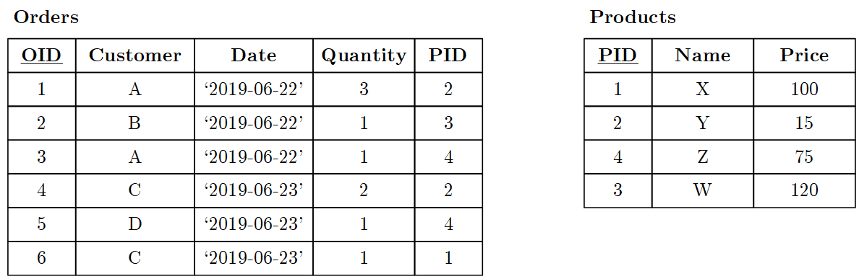
BREAK (and Test Yourself)
Task: Compute the results
for the following queries.
δ
π_{Customer,Date}
σ_{O.PID=P.PID}
γ_{Customer,}
_{sum(O.Quantity*P.Price)}
τ_{count DESC, Customer ASC}
×
⨝_{O.PID=P.PID}
γ_{Customer,count(*)}
Orders
O
σ_{Name∈{Y,Z}}
Orders
O
Products
P
Orders
Products
P
Customer | Count
A | 2
C | 2
B | 1
D | 1
Customer | Sum
A | 120
B | 120
C | 130
D | 75
Customer | Date
A | ‘2019-06-22’
C | ‘2019-06-23’
D | ‘2019-06-23’

Slide 23
Tuple Calculus

Slide 24
Overview Tuple Calculus
Relational Calculus
  Tuple Calculus – tuple relational calculus: {T | p(T)} (tuple → set) ➔ examples: see definition of RA
  (Domain Calculus – domain relational calculus: attribute → set)
Characteristics Tuple Calculus
  Calculus expression does not specify order of operations
  Expressions consist of variables, constants, comparison operators, concatenations, and quantifiers
  Expressions are formulas, free formal variables → result
Example Selection
σ_{A=7}(R) := {t | t∈R ∧ t[A]=7}
tuple variable
predicate
domain of tuple variable
Notes:
Ease of augmentation -> functions at various places whereas in RA cast as relational mappings

Slide 25
Quantifiers
Variables
  Free: unbound variables define the result
  Bound: existential quantifier ∃x and universal quantifier ∀x bind a variable x
Example
Projection
Safe Queries
  Guarantees finite number of tuples (otherwise, unsafe)
  Example unsafe query: {t | t ∉ R}
  Relational completeness: Every safe query expressible in RA and vice versa
π_{A,B}(R) :=
{t | ∃r∈R(t[A]=r[A] ∧ t[B]=r[B])}
(relation T defined with
two attributes A and B)
free variable
bound variable

Slide 26
Relational Algebra vs Tuple Calculus Revisited
E. F. Codd argued for Tuple Calculus
  Criticism RA: operator-centric
  Ease of Augmentation (w/ lib functions)
  Scope for Search Optimization
  Authorization Capabilities
  Closeness to Natural Language
System R Team used SEQUEL + RA
  Criticism Tuple Calculus: too complex
  Iterating over tuples (not set-oriented)
  Quantifiers and bound variables
  Join over all variable attributes and result mapping
Equivalent expressiveness + simplicity of RA + use as IR
➔ Relational Algebra as basis for SQL und DBMS in practice
[E. F. Codd: Relational Completeness of Data Base Sublanguages. IBM Research Report RJ987, 1972]
➔ focus on query language
[Donald D. Chamberlin, Raymond F. Boyce: SEQUEL: A Structured English Query Language. SIGMOD Workshop 1974]

Slide 27
Excursus: The History of System R and SQL
Gem: “The Birth of SQL – Prehistory / System R” (SQL Reunion 1995)
  https://www.mcjones.org/System_R/SQL_Reunion_95/sqlr95-Prehisto.html
  https://www.mcjones.org/System_R/SQL_Reunion_95/sqlr95-System.html
Don Chamberlin: We had this idea, that Codd had developed two languages, called the relational algebra and the relational calculus. […] The relational calculus was a kind of a strange mathematical notation with a lot of quantifiers in it. We thought that what we needed was a language that was different from either one of those, […].
Don Chamberlin: Interestingly enough, Ted Codd didn't participate in that as much as you might expect. He got off into natural language processing […]. He really didn't get involved in the nuts and bolts of System R very much. I think he may have wanted to maintain a certain distance from it in case we didn't get it right. Which I think he would probably say we didn't.
Mike Blasgen: Oh, he has said that, many times.

Slide 28
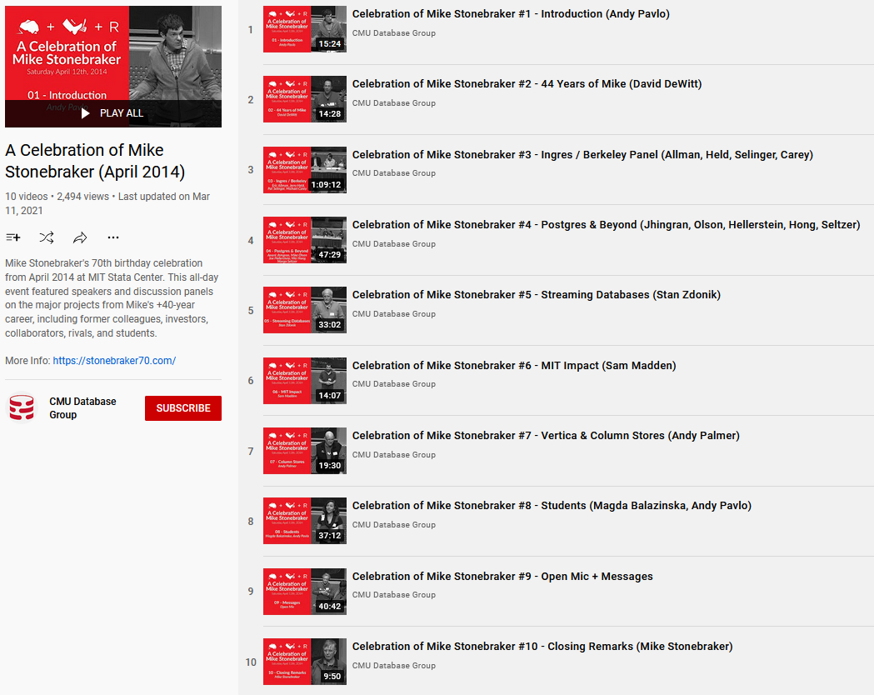
Excursus: Stonebraker at UC Berkeley
Celebration of Mike Stonebraker (70th Year Birthday Party)
  Saturday April 12th, 2014 @ MIT Stata Center
  https://stonebraker70.com/
  https://www.youtube.com/watch?
  v=_UGUDVeSQSI&list=PLSE8ODhjZ
  XjZO802SjzqBFFlkuKglgbZD&t=1s
  Lots of great stories

Slide 29
Physical Operators

Slide 30
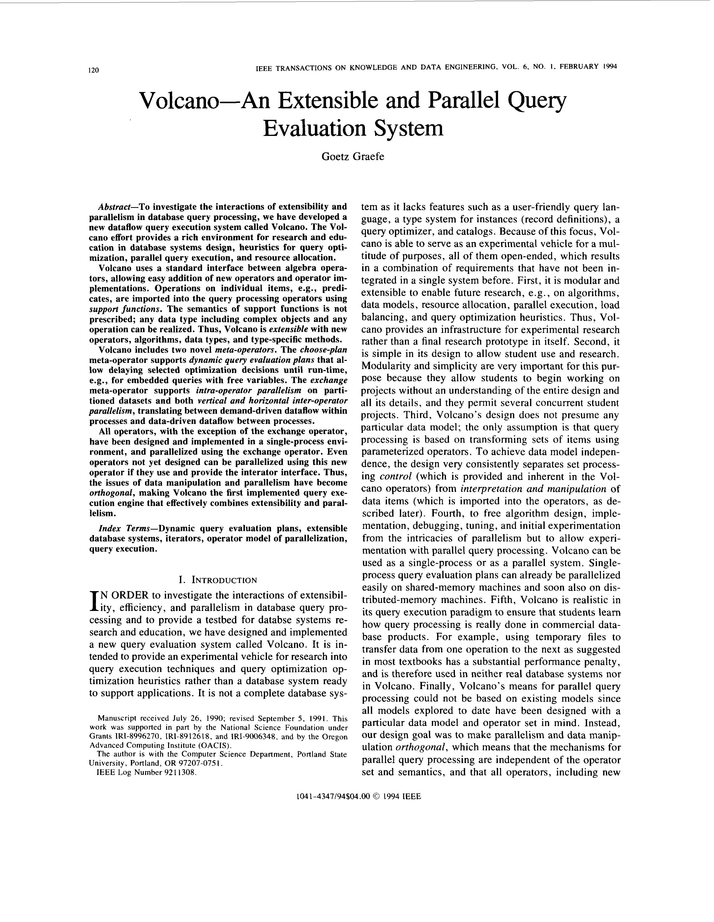
[Goetz Graefe: Volcano - An Extensible and Parallel Query Evaluation System. IEEE Trans. Knowl. Data Eng. 1994]
Query Processing – Iterator Model
Scalable (small memory)
High CPI measures
Volcano Iterator Model
  Open-Next-Close (ONC) interface
  Query execution from root node (pull-based) → Pipelined
Example
σ_{A=7}(R)
Blocking Operators
  Sorting, grouping/aggregation, build-phase of (simple) hash joins
void open() { R.open(); }
void close() { R.close(); }
Record next() {
while( (r = R.next()) != EOF )
if( p(r) ) //A==7
return r;
return EOF;
}
open()
next()
next()
→ EOF
close()
open()
σ_{A=7}
next()
next()
→ EOF
close()
open()
R
next()
next()
next()
next()
→ EOF
close()
PostgreSQL: Init(),
GetNext(), ReScan(), MarkPos(), RestorePos(), End()

Slide 31
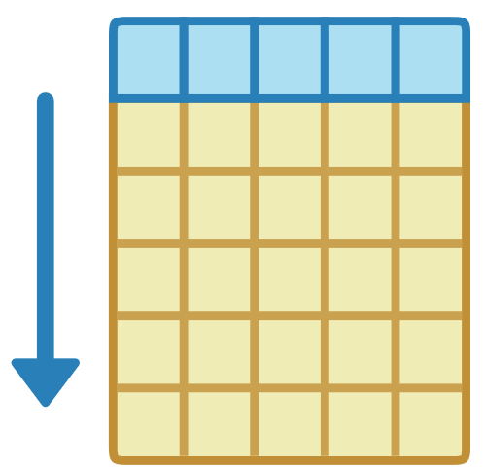
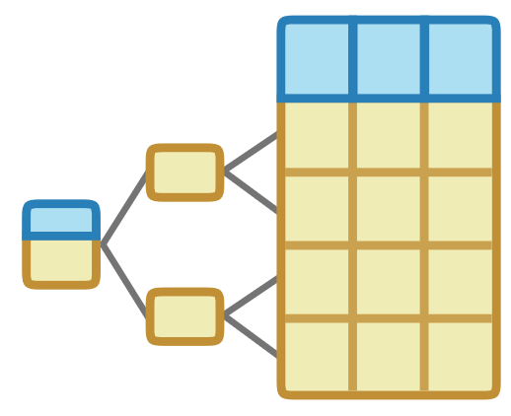
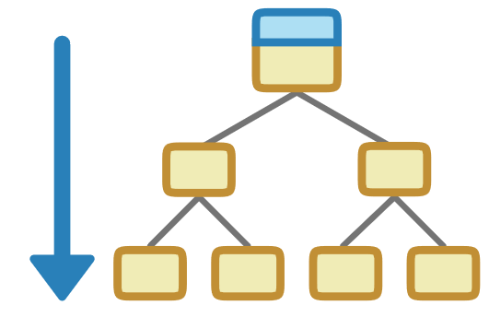

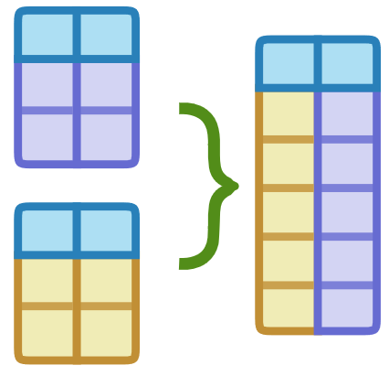
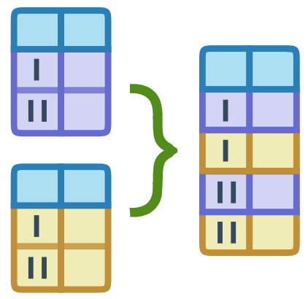
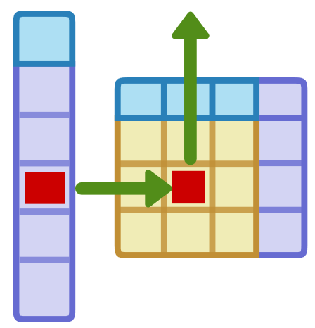
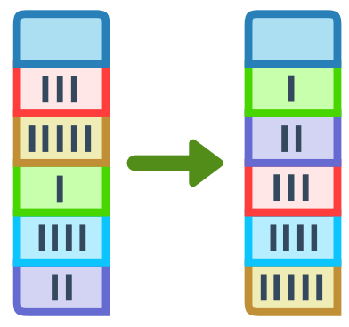
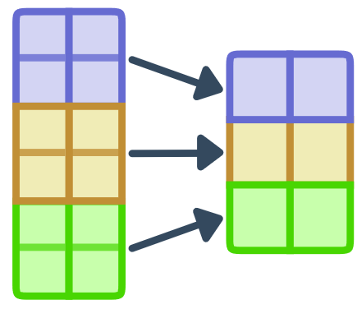
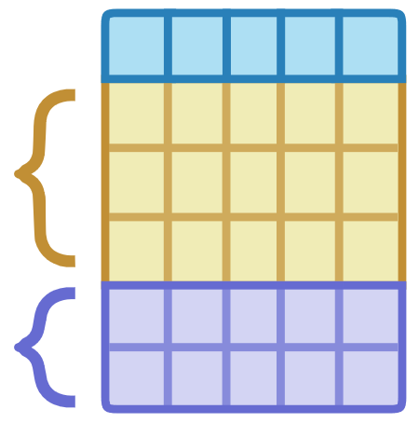
(Selected) Physical Operators in PostgreSQL
[Images: PostgreSQL/11/pgAdmin 4/web/
pgadmin/misc/static/explain/img]
Physical Table Access Operators
  Seq Scan (table scan)
  Index Scan
  Index Only Scan
Physical Join Operators
  Nested Loop Join
  Hash / Hash Join
  Sort / Merge Join
Physical Grouping Operators
  Hash Aggregate
  Group Aggregate
Nested
Hash
Merge
Group (presorted)
Hash

Slide 32
ANALYZE and EXPLAIN
Note: SQL for table creation and insert in the pptx notes.
Step 1: EXPLAIN SELECT * FROM Participant AS R, Locale AS S
WHERE R.LID=S.LID;
Step 2: ANALYZE Participant, Locale;
Step 3: EXPLAIN SELECT *
FROM Participant AS R,
Locale AS S
WHERE R.LID=S.LID;
Hash Join (.. rows=70 width=1592)
Hash Cond:(s.lid = r.lid)
-> Seq Scan on locale s (.. rows=140 width=520)
-> Hash (.. rows=70 width=1072)
-> Seq Scan on participant r (.. rows=70 width=1072)
build side
WHY?
Hash Join (.. rows=17 width=47)
Hash Cond:(r.lid = s.lid)
-> Seq Scan on participant r (.. rows=17 width=30)
-> Hash (.. rows=11 width=17)
-> Seq Scan on locale s (.. rows=11 width=17)
Notes:
CREATE TABLE Locale (
LID INTEGER PRIMARY KEY,
Location VARCHAR(256)
);
CREATE TABLE Participant (
PID INTEGER PRIMARY KEY,
Firstname VARCHAR(128),
Lastname VARCHAR(128),
Affiliation VARCHAR(256),
LID INTEGER REFERENCES Locale
);
INSERT INTO Locale VALUES(1, 'Lausanne, SUI'),(2, 'Amsterdam, NLD'),(3, 'Seattle, USA'),(4, 'Stanford, USA'),(5, 'New York, USA'),(6, 'Berkley, USA'),(7, 'Cambridge, USA'),(8, 'Berlin, GER'),(9, 'Tel Aviv, ISR'),(10, 'San Jose, USA'),(11, 'Munich, GER');
INSERT INTO Participant VALUES(102, 'Anastasia', 'Ailamaki', 'EPFL', 1),(104, 'Peter', 'Bailis', 'Stanford', NULL),(105, 'Magdalena', 'Balazinska', 'U Washington', 3),(107, 'Peter', 'Boncz', 'CWI', 2),(108, 'Surajit', 'Chaudhuri', 'MS Research', 3),(111, 'Luna', 'Dong', 'Amazon', 3),(113, 'Juliana', 'Freire', 'NYU', 5),(115, 'Joe', 'Hellerstein', 'UC Berkley', 6),(116, 'Stratos', 'Idreos', 'Harvard', 7),(117, 'Donald', 'Kossman', 'MS Research', NULL), (118, 'Tim', 'Kraska', 'MIT', 7), (120, 'Volker', 'Markl', 'TU Berlin', 8), (122, 'Tova', 'Milo', 'Tel Aviv University', 9), (123, 'C.', 'Mohan', 'IBM Research', 10), (124, 'Thomas', 'Neumann', 'TU Munich', 11), (126, 'Fatma', 'Ozcan', 'IBM Research', 10), (130, 'Christopher', 'Re', 'Stanford', 4);

Slide 33
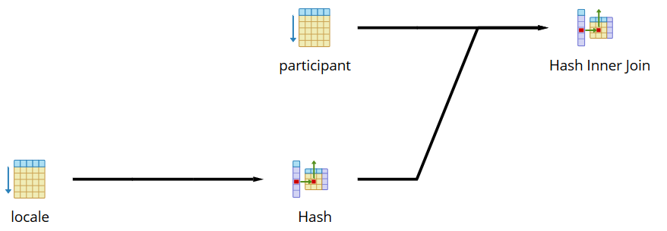
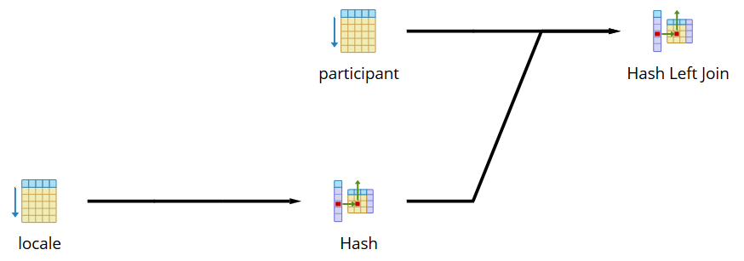
Visual EXPLAIN
SELECT * FROM Participant AS R, Locale AS S
WHERE R.LID=S.LID;
SELECT * FROM Participant AS R LEFT JOIN Locale AS S
ON R.LID=S.LID;
σ_{F}(R × S) → INNER JOIN

Slide 34
Summary & QA
Thanks
Summary
  Fundamentals of relational algebra and tuple calculus
  Preview of query trees and physical operators
Next Lectures
  03 Background Query Processing [May 13]
  04 Background Query Optimization [May 27]
  05 Experiments and Reproducibility [Jun 10]
➔ Please contact your team members and get started

