Slide 1

Architecture of ML Systems (AMLS)
01 Introduction and Overview
Prof. Dr. Matthias Boehm
Technische Universität Berlin
Berlin Institute for the Foundations of Learning and Data
Big Data Engineering (DAMS Lab)
Last update: Apr 17, 2025

Slide 2

Announcements / Org
#1 Hybrid & Video Recording
  Hybrid lectures (in-person, zoom) with optional attendance
  https://tu-berlin.zoom.us/j/9529634787?pwd=R1ZsN1M3SC9BOU1OcFdmem9zT202UT09
  Zoom video recordings, links from website
  https://mboehm7.github.io/teaching/ss25_amls/index.htm
#2 Course Registrations
  TU Berlin ISIS registrations as of Apr 17
  Bachelor/Master/PhD ratio? CS/others ratio?
~300

Slide 3

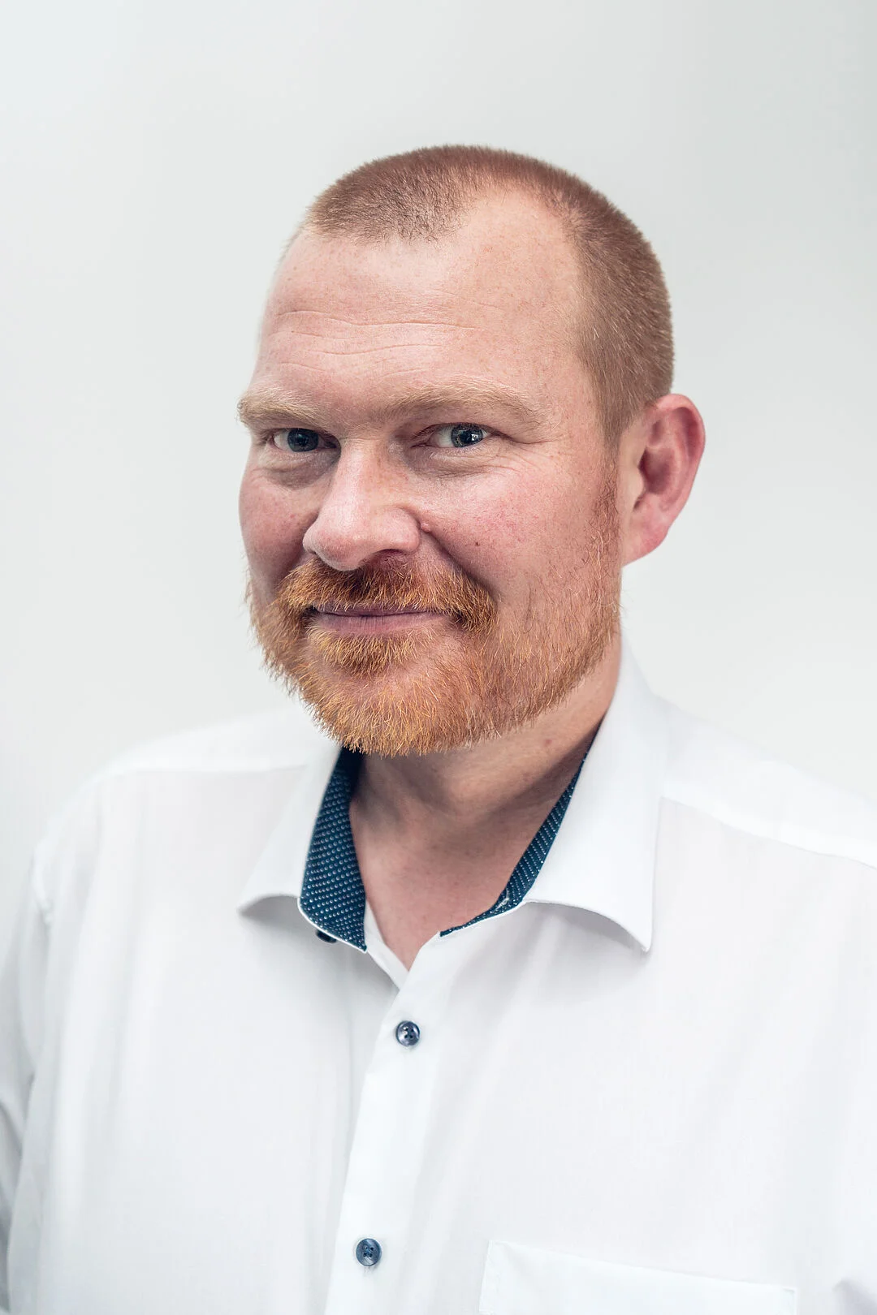
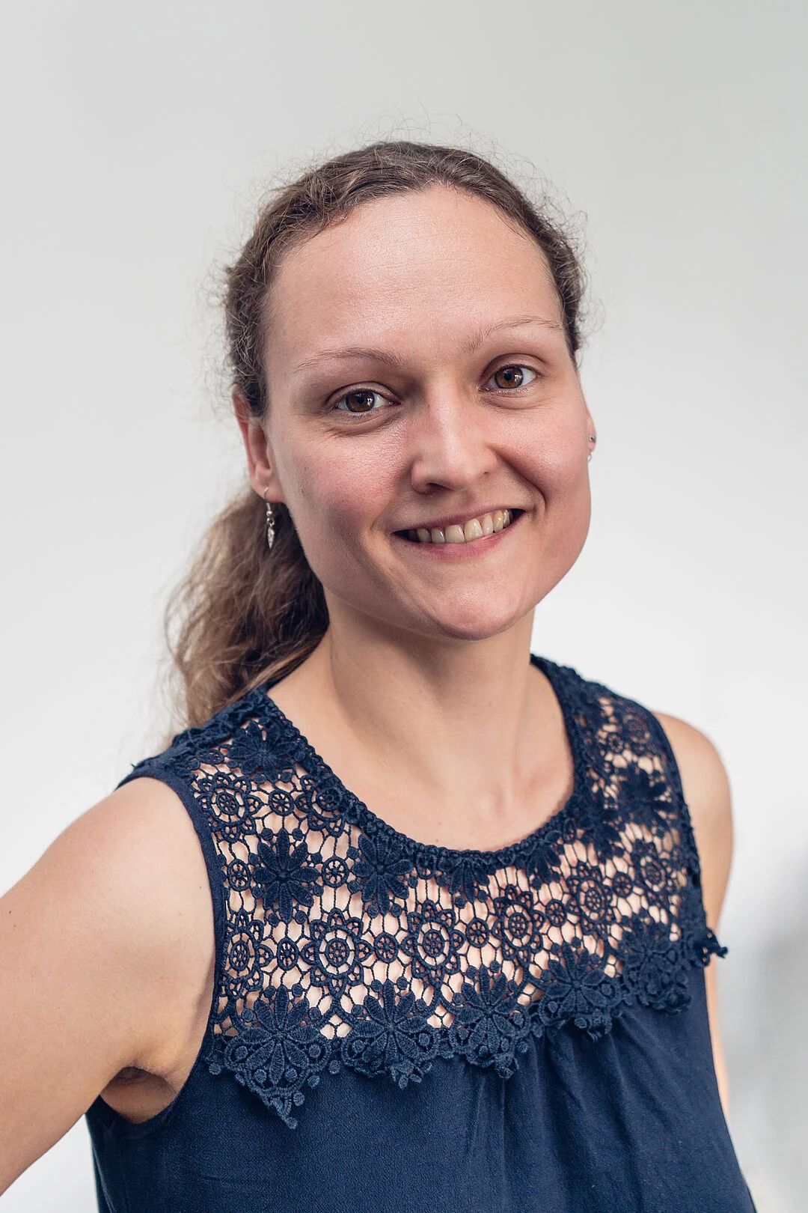
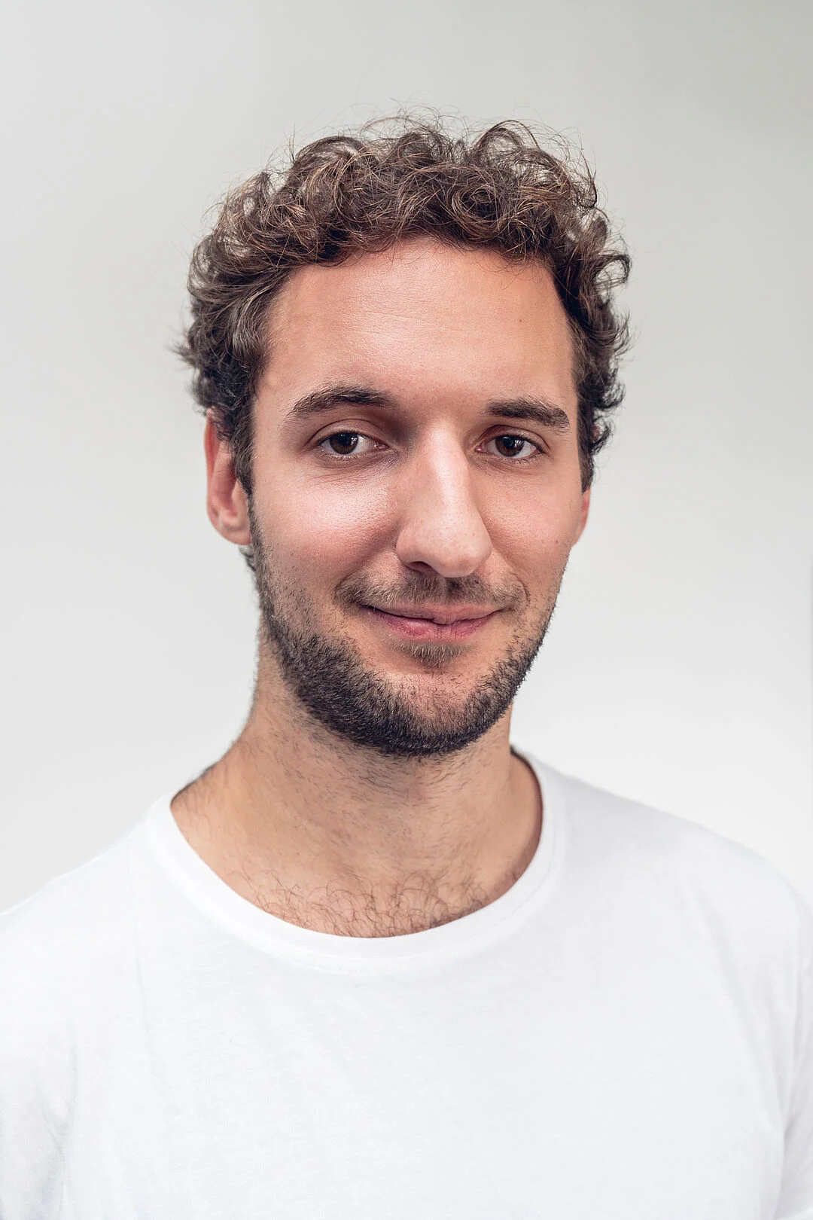
#3 Faculty IV - Team Awareness and Antidiscrimination
https://www.tu.berlin/eecs/awan
Goal
  Low-barrier approachability for spectrum of awareness and antidiscrimination issues
Team
  Irene Hube-Achter (MTSV)
  Matthias Boehm (professors)
  Nadine Karsten (scientific personnel)
  Tom Hersperger (students)
Mission Statement
  Account for heterogeneity and complexity of modern societies at TU Berlin
  All employees and students are committed to
    #1 Treat all persons with fairness and respect
    #2 Ensure a safe environment for all
    #3 Comply with our duty of care towards others
    #4 Actively support the implementation of the above guidelines and contribute
Contact: private email,
eecs-TB-awareness@win.tu-berlin.de,
or AwAn@dams.tu-berlin.de

Slide 4
Agenda
FG Big Data Engineering (DAMS Lab)
Motivation and Goals
Course Organization and Logistics
Course Outline, and Projects
Apache SystemDS and DAPHNE

Slide 5
FG Big Data Engineering (DAMS Lab)
https://www.tu.berlin/dams

Slide 6





About Me
Since 09/2022 TU Berlin, Germany
  University professor for Big Data Engineering (DAMS)
2018-2022 TU Graz, Austria
  BMK endowed chair for data management + research area manager
  Data management for data science (DAMS), SystemDS & DAPHNE
2012-2018 IBM Research – Almaden, CA, USA
  Declarative large-scale machine learning
  Optimizer and runtime of Apache SystemML
2007-2011 PhD TU Dresden, Germany
  Cost-based optimization of integration flows
  Time series forecasting / in-memory indexing & query processing
DB group

Slide 7
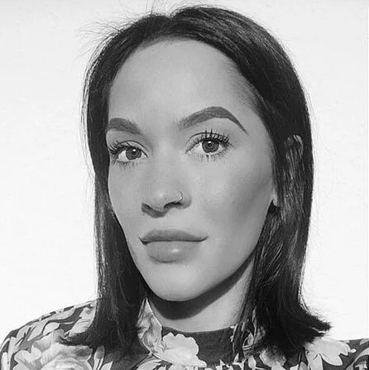
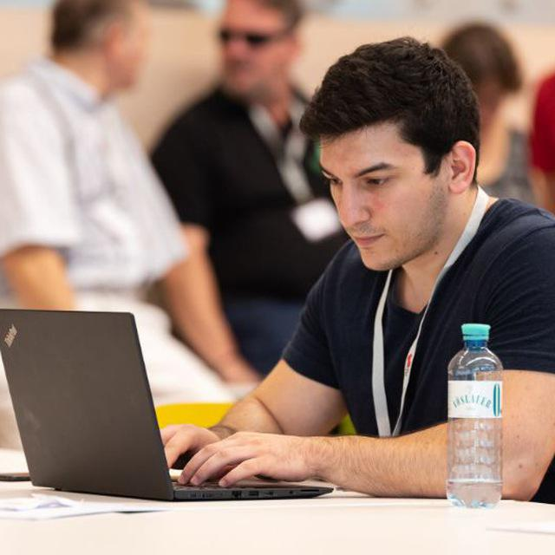
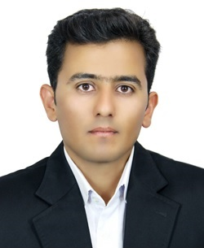



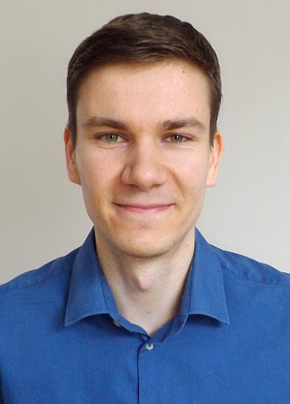




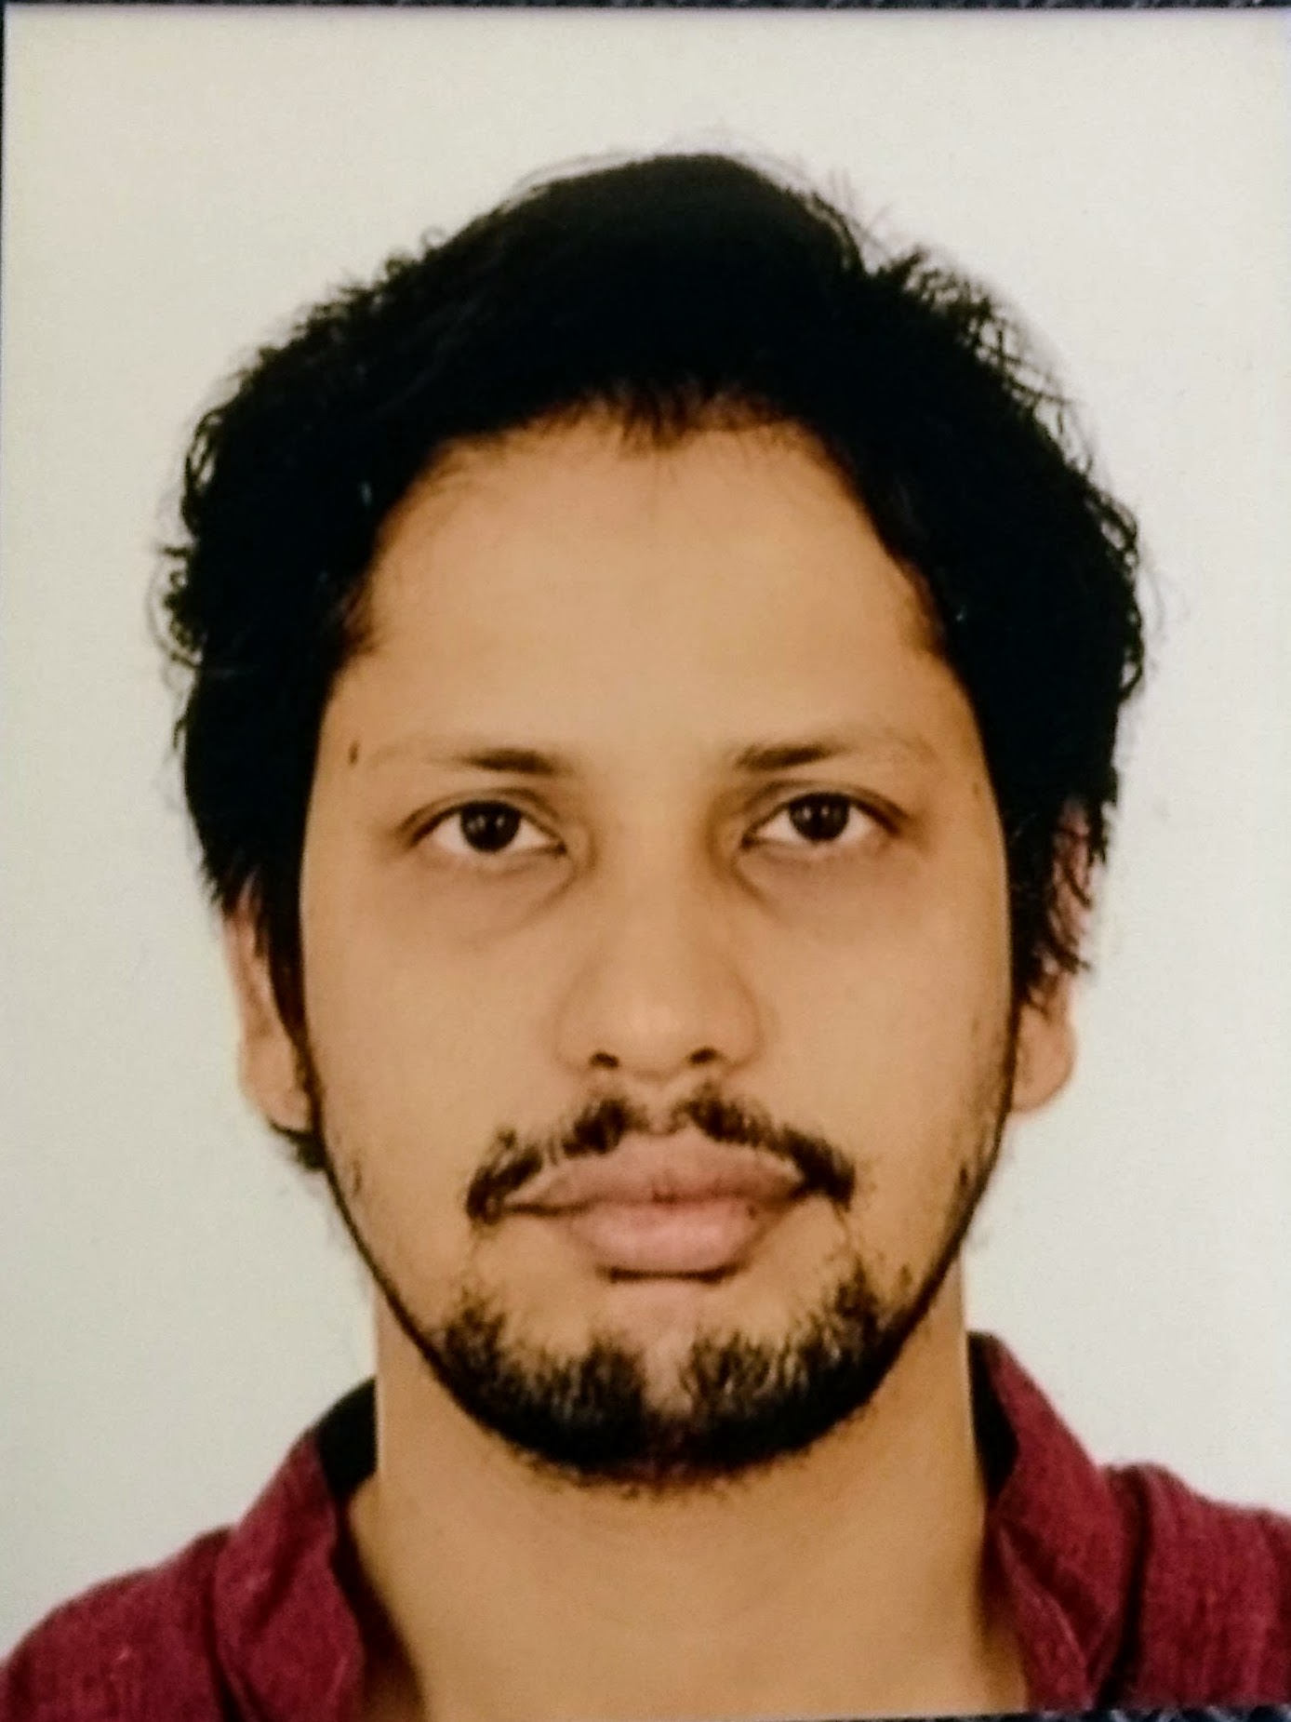
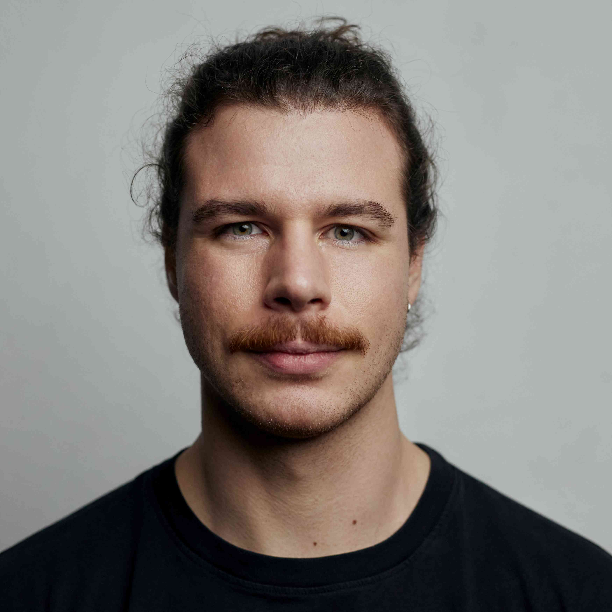
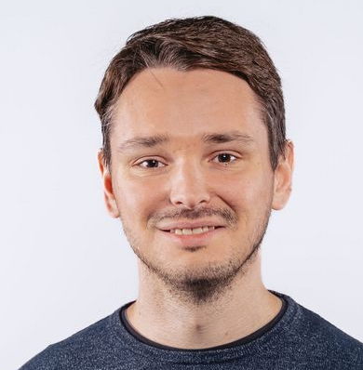


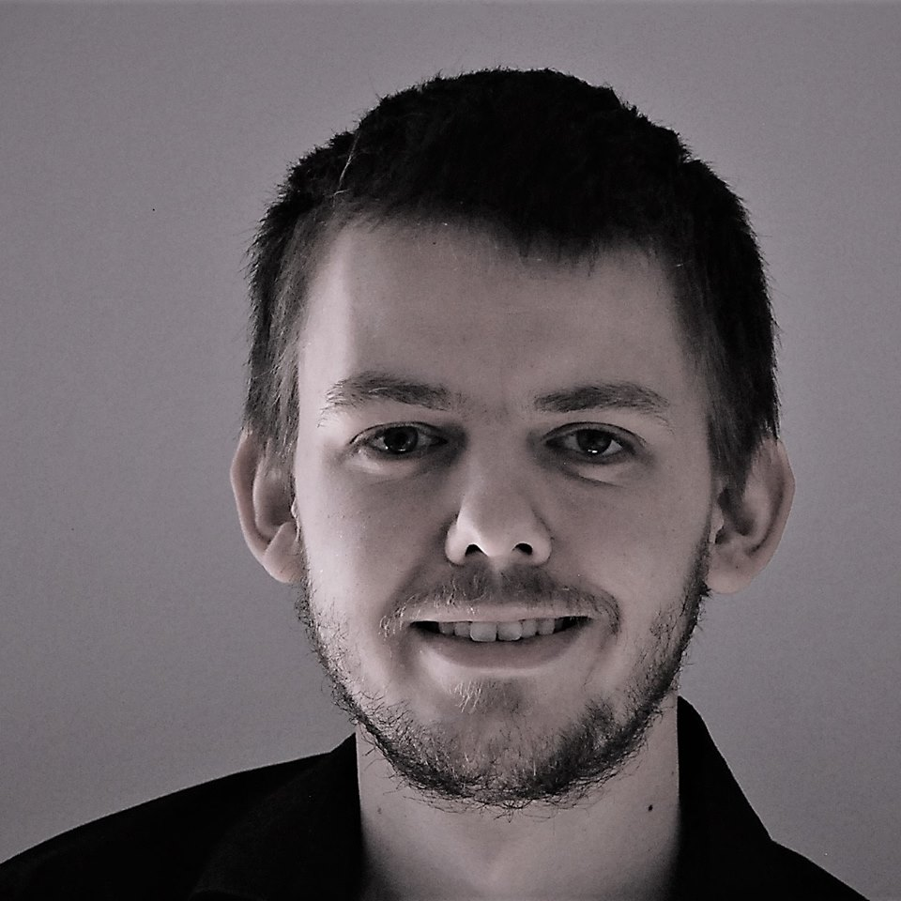
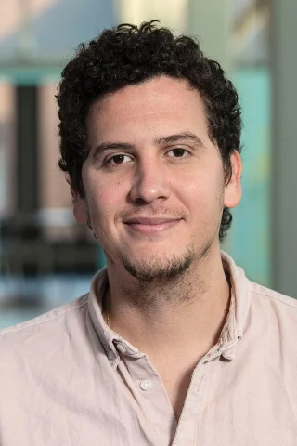


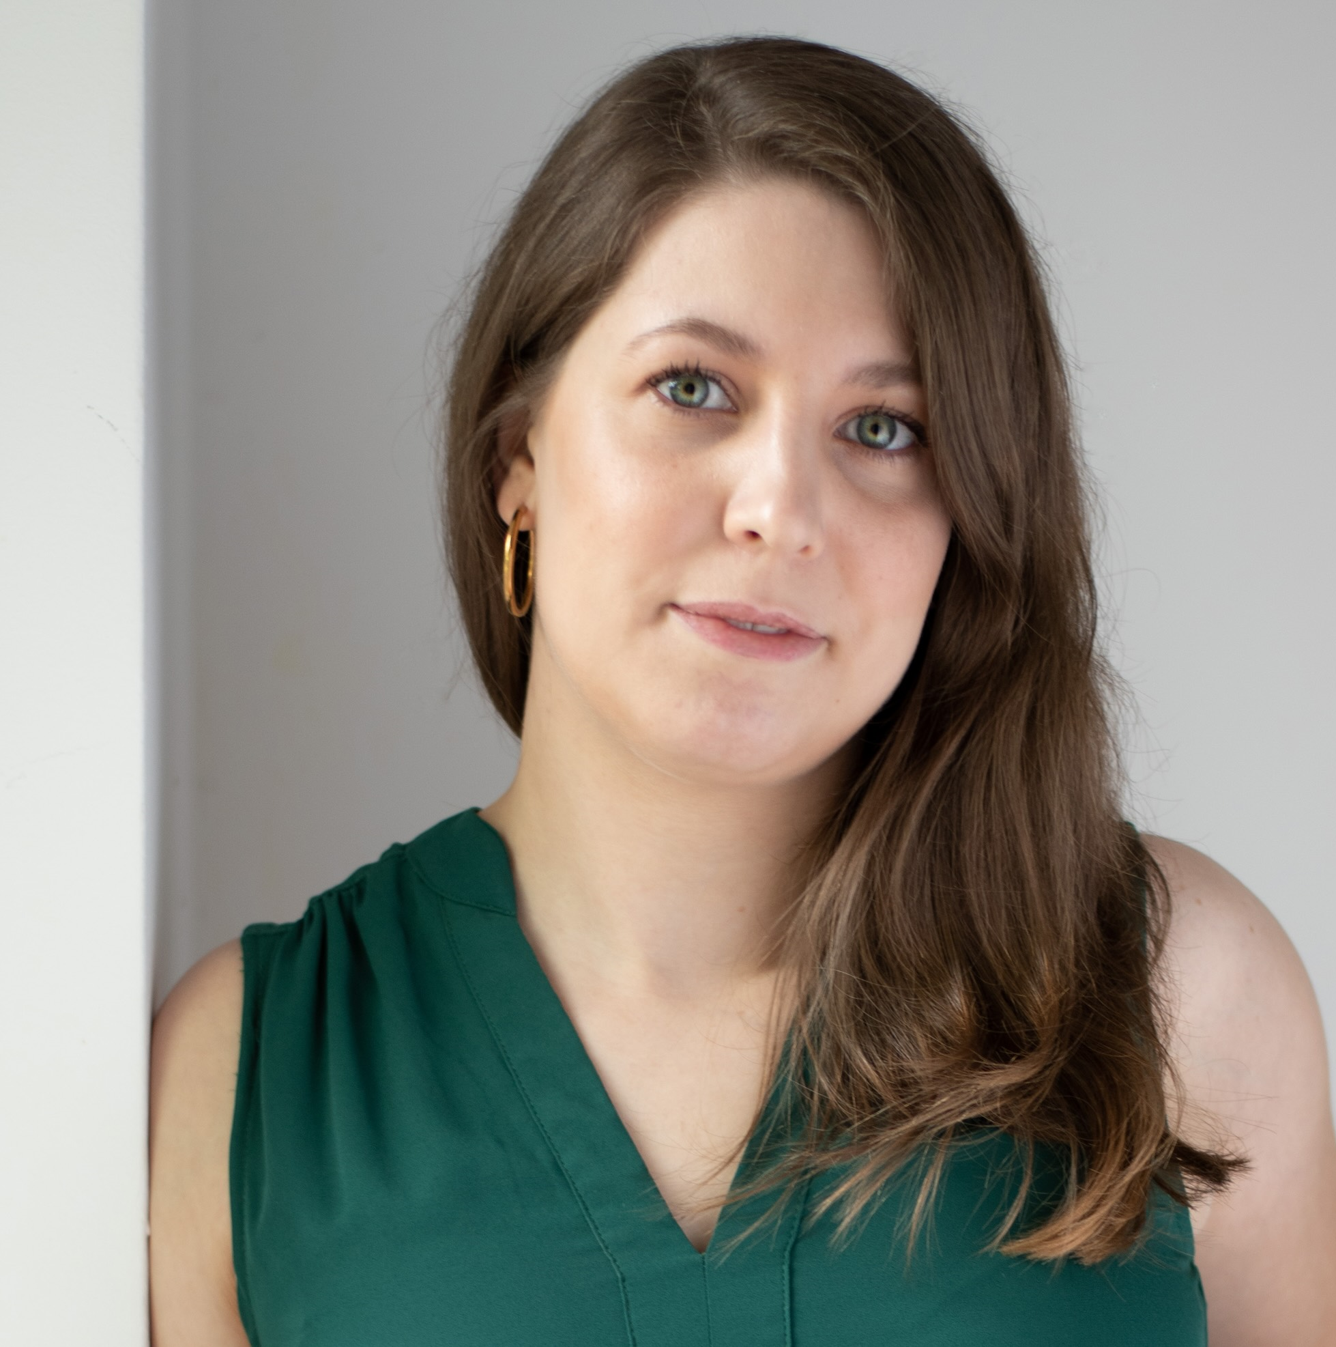

FG Big Data Engineering (DAMS Lab) – Team
Secretary (09/2023)
Sarah Hashmi
Postdoc (01/2021)
Patrick Damme
Postdoc (04/2019)
Arnab Phani
PhD Student (01/2020)
Sebastian Baunsgaard
PhD Student (10/2023)
Christina Dionysio
PhD Student (10/2023)
Philipp Ortner
PhD Student (03/2023)
David Justen
PhD Student (01/2024)
Ramon Schöndorf
PhD Student (02/2023)
Carlos E. Muniz Cuza
PhD Student (10/2024)
Grigorii Turchenko
PhD Student (04/2021)
Saeed Fathollahzadeh
PhD Student (01/2025)
Martin Seyferth
PhD Student (02/2025)
Alexander Wolotschai
PhD Student (04/2025)
Martin Moesmann
3x Student Assistants
25x Bachelor/Master Students
3x Interns and Visitors
→
external
→ BIFOLD GS
external
Graduating 2024/25
Agility Project
external
→ Agility Project
external
BIFOLD GS w/ Steffen Zeuch

Slide 8
FG Big Data Engineering (DAMS Lab) – Teaching
Successfully Established TUB Teaching Portfolio (modules, slides)
Architecture of
Database Systems
(ADBS, WS)
DB system internals
+ prog. project
Architecture of
ML Systems
(AMLS, SoSe)
ML system internals,
data science lifecycle
+ prog. project
Architecture of
ML Systems
(AMLS, SS)
SE Joint ML and DM (MLDM, SoSe+WiSe)
Master
Data Integration and Large-Scale Analysis
(DIA, WS)
SE/PR Large-scale Data Engineering
(LDE, SoSe+WiSe)
Data Integration and Large-Scale Analysis
(DIA, WiSe)
Distributed
Data Management
Bachelor
Intro to Scientific Methods (WS)
Data Management / Databases
(DM, SS+WS)
Data management from user/application perspective
PP Prog.-Practicals Data Systems
(PPDS, SoSe+WiSe)

Slide 9
Motivation and Goals

Slide 10
Example ML Applications (Past/Present)
Transportation / Space
  Lemon car detection and reacquisition (classification, seq. mining)
  Airport passenger flows from WiFi data (time series forecasting)
  Data analysis for driving assistance (blind spot detection, emergency braking, lane centering)
  Automotive vehicle development (ML-assisted simulations, hyper-parameter tuning, ejector optimization)
  Earth observation and local climate zone classification and monitoring, reproducibility, compression
Finance
  Insurance claim cost per customer (model selection, regression)
  Financial analysts survey correlation (bivariate stats w/ new tests)
Health Care
  Breast / lunch / stomach cancer from histopathology images (classification)
  Glucose trends and warnings (clustering, classification)
  Emergency room diagnosis / patient similarity (classification, clustering)
  Patient survival analysis and prediction (Cox regression, Kaplan-Meier)

Slide 11
A Car Reacquisition Scenario
Features
Labels
Machine
Learning
Algorithm
Class skew
Low precision
Warranty Claims
Algorithm
Predictive Models
➔ 25x
improved precision
Repair History
Algorithm
Diagnostic Readouts
Algorithm
+ custom loss functions
+ hyper-parameter tuning

Slide 12
Example ML Applications
Production/Manufacturing
  Paper and fertilizer production (regression/classification, anomalies)
  Semiconductor manufacturing (ion beam tuning), and material degradation modeling (survival analysis)
  Mixed waste stream sorting and recycling (composition, alignment, quality)
Other Domains
  Machine data: errors and correlation (bivariate stats, seq. mining)
  Smart grid: energy demand/RES supply, weather models (forecasting)
Information Extraction
  NLP contracts → rights/obligations (classification, error analysis)
  PDF table recognition and extraction, OCR (NMF clustering, custom)
  Learning explainable linguistic expressions (learned FOL rules, classification)
Algorithm Research (+ various state-of-the art algorithms)
  User/product recommendations via various forms of NMF; word-embeddings via orthogonalized skip-gram
  Localized, supervised metric learning (dim reduction and classification)

Slide 13
What is an ML System?
Classification
Regression
Recommenders
Clustering
Dim Reduction
Neural Networks
Statistics
Data Mining
Machine Learning (ML)
ML Applications
(entire KDD/DS lifecycle)
Rapidly Evolving
Runtime Techniques (Execution, Data Access)
ML System
Compilation Techniques
Distributed Systems
HPC
Data Management
Accelerators
Operating Systems
Prog. Language Compilers
HW Architecture

Slide 14
What is an ML System?, cont.
ML System
  Narrow focus: SW system that executes ML applications
  Broad focus: Entire system (HW, compiler/runtime, ML application)
  Trade-off runtime/resources vs accuracy
  Early days: no standardizations (except some exchange formats), lots of different languages and system architectures, but many shared concepts
Course Objectives
  Architecture and internals of modern (large-scale) ML systems
    Microscopic view of ML system internals
    Macroscopic view of ML pipelines and data science lifecycle
  #1 Understanding of characteristics → better evaluation / usage
  #2 Understanding of effective techniques → build/extend ML systems

Slide 15
Course Organization and Logistics

Slide 16
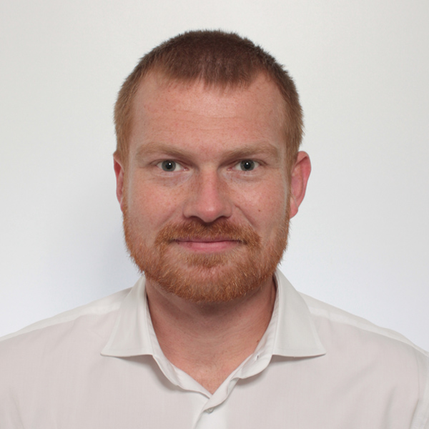
Basic Course Organization
Staff
  Lecturer: Prof. Dr. Matthias Boehm (replacement: Dr. Patrick Damme)
  Teaching Assistants: M.Sc. Sebastian Baunsgaard (projects/exercises)
Language
  Lectures and slides: English
  Communication and examination: English/German
Course Format
  TU Berlin: VL+UE 3+2 SWS, 6 ECTS (3x 1 ECTS + 2x 1.5 ECTS), master / TU Graz: VU 3 SWS, 5 ECTS
  Weekly lectures (start 4.15pm sharp, including Q&A), attendance optional
  Mandatory programming project or exercises (~3 ECTS)
  Recommended papers for additional reading on your own
Prerequisites (preferred)
  Basic courses: data management/databases, distributed systems, applied ML
  Completed bachelor (not mandatory)

Slide 17

Course Logistics
Website
  https://mboehm7.github.io/teaching/ss25_amls/index.htm
  All course material (lecture slides) and dates
Video Recording / Live Streaming Lectures (zoom)
Communication
  Informal language (first name is fine)
  Please, immediate feedback (unclear content, missing background)
  ISIS forum for offline questions, after lecture, and via email/PR discussions
  Office hours: Tue 4pm-5.30pm (Sebastian in B 119) or after lecture
Exam
  Completed project / exercise (checked by me/staff, no plagiarism incl *-GPT)
  Final exam (written exam or delegated oral exams, if >70 students take the exam)
  Grading (project/exercises completion, 100% exam) → new: +5 exam points if exercises >=90 points

Slide 18
Course Logistics, cont.
Course Applicability TU Berlin
  Master programs computer engineering, computer science, electrical engineering,
  information systems management
    Area Data and Software Engineering
    Area Cognitive Systems
    Area Distributed Systems
Course Applicability TU Graz (remote – offered in exceptions)
  Master programs computer science (CS), as well as software engineering and management (SEM)
    Catalog Data Science (compulsory course in major, and elective)
    Catalog Machine Learning (elective course)
    Catalog Interactive and Visual Information Systems (elective course)
    Catalog Software Technology (elective course)
  PhD CS doctoral school list of courses
Free subject course in any other study program

Slide 19
Outline and Projects
Created SoSe 2019, partially based on
[Matthias Boehm, Arun Kumar, Jun Yang: Data Management in Machine Learning Systems. Synthesis Lectures on Data Management, Morgan & Claypool Publishers 2019]
Major updates in
SoSe 2020 – SoSe 2025

Slide 20
Part A: Overview and ML System Internals
B
A
T-shaped course layout
01 Introduction and Overview [Apr 17]
02 Languages, Architectures, and System Landscape [Apr 24]
03 Size Inference, Rewrites, and Operator Selection [Fri, May 02]
04 Operator Fusion and Runtime Adaptation [Fri, May 09]
05 Data- and Task-Parallel Execution [May 15]
06 Parameter Servers [May 22]
07 LLM Training and Inference [Jun 05]
08 Hybrid Execution and HW Accelerators [Jun 12]
09 Caching, Partitioning, Indexing, and Compression [Jun 19]
Labor Day May 01
80y EoWW2 May 08
Ascension of Jesus May 29

Slide 21
Part B: ML Lifecycle Systems
B
A
T-shaped course layout
10 Data Acquisition, Cleaning, and Preparation [Jun 26]
11 Model Selection and Management [Jul 03]
12 Model Debugging, Fairness, and Explainability [Jul 10]
13 Model Serving Systems and Techniques [Jul 17]
  Incl Q&A and Exam Preparation
Planned Written Exams
  Thu Jul 24, 4pm (in ???)
  Thu Jul 31, 4pm (in ???)
  Thu Aug 14, 4pm (in ???)

Slide 22


Programming Projects
Open-Source Projects
  Programming project in context of open-source projects
    Apache SystemDS: https://github.com/apache/systemds
    DAPHNE: https://github.com/daphne-eu/daphne
    Other OSS projects possible, but harder to merge PRs
  Commitment to open source and open communication (PRs, mailing list)
  Remark: Don’t be afraid to ask questions / develop code in public
Objectives
  Non-trivial feature in an ML system (3 ECTS → 75-90 hours)
  OSS processes: Break down into subtasks,
  code/tests/docs, one or more pull-requests per project,
  code review, incorporate review comments, etc
Team
  Individuals or up to three-person teams (w/ separated responsibilities)
Lists of projects available on website
Project/Exercise Selection by May 01 EOD:
https://tinyurl.com/yeyrjyxw

Slide 23
Alternative Exercise (published: Apr 12, submission: Jul 15)
Task: ECG Time Series Classification
  Task Description: https://mboehm7.github.io/
  teaching/ss25_amls/AMLS_2025_Exercise.pdf
  Data Exploration (15): data acquisition,
  data characteristics, train/validation splits
  Modeling (40): train ML models for classifying
  the ECG time series; hyper-parameter tuning
  Data Augmentation and Feature Engineering (30)
  Data Reduction (15): sampling, compression, others
Objectives
  End-to-end development of an ML pipeline for ECG data
  Handle data exploration, modeling and tuning, data augmentation, and compression
Team
  Individuals or up to three-person teams (w/ separated responsibilities)
0:
1:
2:
3:
0 .. Normal heart rhythm
1 .. Tachyarrhythmia
2 .. Other 3 .. Noisy

Slide 24



Apache SystemDS and DAPHNE
https://github.com/apache/systemds
https://github.com/daphne-eu/daphne

Slide 25
Apache SystemDS: A Declarative ML System for the End-to-End Data Science Lifecycle
https://github.com/apache/systemds

Slide 26

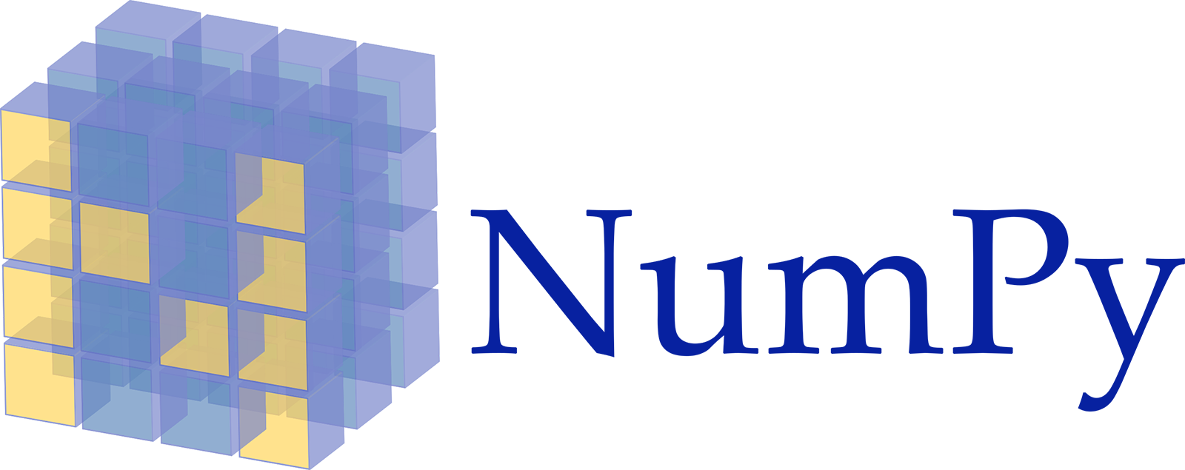











Landscape of ML Systems
Existing ML Systems
  #1 Numerical computing frameworks
  #2 ML Algorithm libraries (local, large-scale)
  #3 Linear algebra ML systems (large-scale)
  #4 Deep neural network (DNN) frameworks
  #5 Model management, and deployment
Exploratory Data-Science Lifecycle
  Open-ended problems w/ underspecified objectives
  Hypotheses, data integration, run analytics
  Unknown value → lack of system infrastructure
  → Redundancy of manual efforts and computation
Data Preparation Problem
  80% Argument: 80-90% time for finding, integrating, cleaning data
  Diversity of tools ➔ boundary crossing, lack of optimization
“Take these datasets and show value or competitive advantage”
[NIPS 2015]
[DEBull 2018]

Slide 27


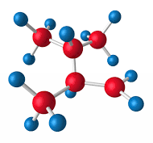

The Data Science Lifecycle
(aka KDD Process, aka CRISP-DM)
Data extraction, schema alignment, entity resolution, data validation, data cleaning, outlier detection, missing value imputation, semantic type detection, data augmentation, feature selection, feature engineering, feature transformations
Key observation: SotA data integration/cleaning based on ML
Data Scientist
Data Integration
Data Cleaning
Data Preparation
Data Integration
Data Cleaning
Data Preparation
Model Selection
Training
Hyper-parameters
Validate & Debug
Deployment
Scoring & Feedback
Exploratory Process
(experimentation, refinements, ML pipelines)
Data/SW Engineer
DevOps Engineer

Slide 28
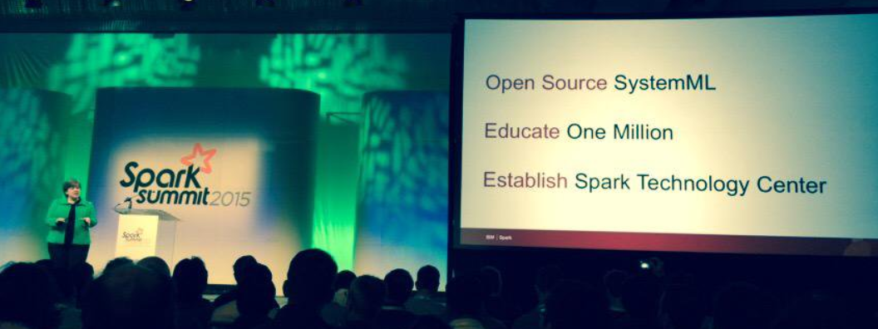




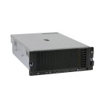

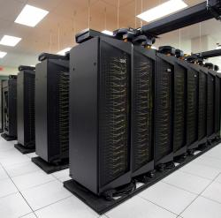
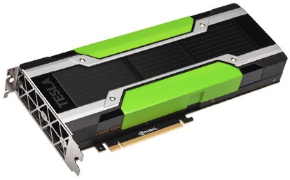
Apache SystemDS [https://github.com/apache/systemds]
DML Scripts
APIs: Command line, JMLC, Python
Spark MLContext, Spark ML,
(Scalable Algorithms + Primitives)
Language
Compiler
07/2020 Renamed to Apache SystemDS
05/2017 Apache Top-Level Project
11/2015 Apache Incubator Project
08/2015 Open-Source Release
[SIGMOD’15,’17,’19,’21abc,’23abc,’24ab]
[PVLDB’14,’16ab,’18,’22]
[ICDE’11,’12,’15]
[EDBT’25][BTW’25ab]
[CIDR’17,’20]
[VLDBJ’18]
[CIKM’22]
[DEBull’14]
[PPoPP’15]
Runtime
Write Once, Run Anywhere
In-Memory Single Node
(scale-up)
Hadoop or Spark Cluster
(scale-out)
Federated
(LA progs, PS)
In-Progress:
GPU
Others: Netezza
Apache Flink
since 2019
since 2014/16
since 2012
since 2010/11
since 2015

Slide 29
Language Abstractions and APIs
Data Independence + Impl-Agnostic Ops
➔ “Separation of Concerns”
User Script
Built-in Functions
Example:
Stepwise
Linear
Regression
X = read(‘features.csv’)
Y = read(‘labels.csv’)
[B,S] = steplm(X, Y,
icpt=0, reg=0.001)
write(B, ‘model.txt’)
m_steplm = function(...) {
while( continue ) {
parfor( i in 1:n ) {
if( !fixed[1,i] ) {
Xi = cbind(Xg, X[,i])
B[,i] = lm(Xi, y, ...)
} }
# add best to Xg
# (AIC)
} }
m_lmCG = function(...) {
while( i<maxi&nr2>tgt ) {
q = (t(X) %*% (X %*% p))
+ lambda * p
beta = ... }
}
m_lm = function(...) {
if( ncol(X) > 1024 )
B = lmCG(X, y, ...)
else
B = lmDS(X, y, ...)
}
Linear Algebra Programs
Feature Selection
Facilitates optimization across data science lifecycle tasks
ML Algorithms
m_lmDS = function(...) {
l = matrix(reg,ncol(X),1)
A = t(X) %*% X + diag(l)
b = t(X) %*% y
beta = solve(A, b) ...}

Slide 30
Basic HOP and LOP DAG Compilation
LinregDS (Direct Solve)
X = read($1);
y = read($2);
intercept = $3;
lambda = 0.001;
...
if( intercept == 1 ) {
ones = matrix(1, nrow(X), 1);
X = append(X, ones);
}
I = matrix(1, ncol(X), 1);
A = t(X) %*% X + diag(I)*lambda;
b = t(X) %*% y;
beta = solve(A, b);
...
write(beta, $4);
HOP DAG
(after rewrites)
8KB
Cluster Config:
driver mem: 20 GB
exec mem: 60 GB
CP
write
Scenario:
X: 10⁸ x 10³, 10¹¹
y: 10⁸ x 1, 10⁸
8MB
16MB
CP
b(solve)
CP
172KB
b(+)
1.6TB
CP
SP
800GB
r(diag)
ba(+*)
ba(+*)
SP
1.6TB
r(t)
8KB
SP
CP
800GB
800MB
dg(rand)
(10³x1,10³)
X
(10⁸x10³,10¹¹)
y
(10⁸x1,10⁸)
Distributed Matrices
  Fixed-size matrix blocks
  Data-parallel operations
LOP DAG
(after rewrites)
16KB
r’(CP)
mapmm(SP)
tsmm(SP)
X_{1,1}
Hybrid Runtime Plans:
  Size propagation / memory estimates
  Integrated CP / Spark runtime
  Dynamic recompilation during runtime
800MB
1.6GB
X_{2,1}
r’(CP)
X
(persisted in MEM_DISK)
X_{m,1}
y

Slide 31
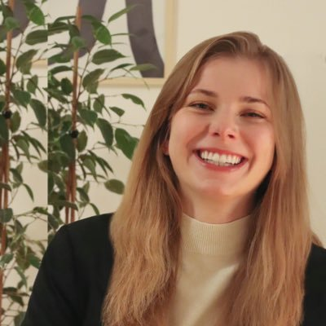
Static and Dynamic Rewrites
trace(X%*%Y) → sum(X*t(Y))
Example Static Rewrites (size-independent)
  Common Subexpression Elimination
  Constant Folding / Branch Removal /
  Block Sequence Merge
  Static Simplification Rewrites
  Right/Left Indexing Vectorization
  For Loop Vectorization
  Spark checkpoint/repartition injection
Example Dynamic Rewrites (size-dependent)
  Dynamic Simplification Rewrites
  Matrix Mult Chain Optimization
Y
O(n³)
O(n²)
X
X
Y ┬
→
*
sum(λ*X) → λ*sum(X)
sum(X+Y) → sum(X)+sum(Y)
rowSums(X) → X, iff ncol(X)=1
sum(X^2) → X%*%t(X), iff ncol(X)=1
t(X)
1kx1k
X
1kx1k
Z
1
t(X)
1kx1k
X
1kx1k
p
1
→
Sparsity Estimation & Sparse DP Enum
[SIGMOD’19]
2,002 MFLOPs
4 MFLOPs
Size propagation and sparsity estimation

Slide 32
Apache SystemDS Architecture
> 500K tests
> 10K DSL tests
[CIDR’20]

Slide 33

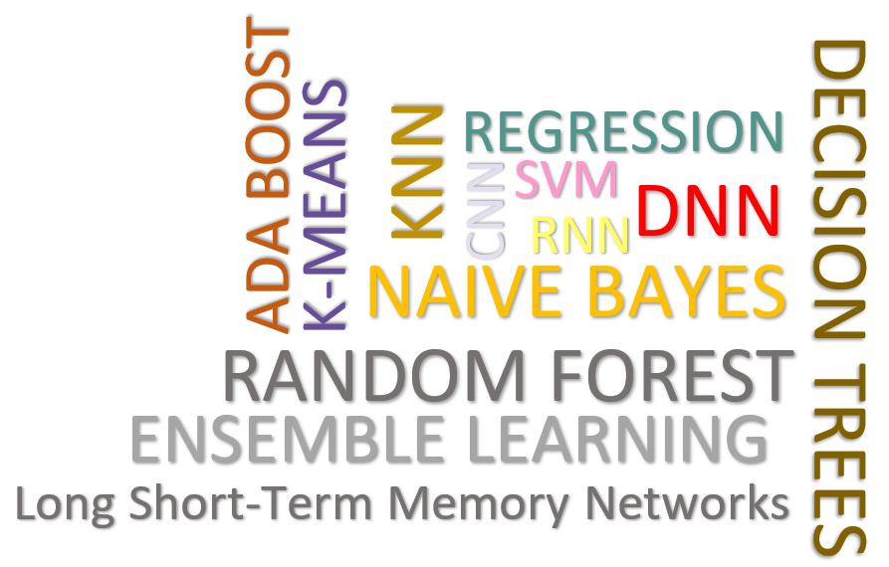
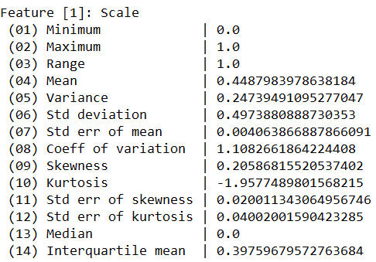
Data Cleaning Pipelines
[SIGMOD’24, under submission]
Automatic Generation of Cleaning Pipelines
  Library of robust, parameterized data cleaning primitives
  Enumeration of DAGs of primitives & hyper-parameter optimization (evolutionary, HB)
Data- and Task-parallel Computation
Data Samples
Logical
O
Physical
LP₁
LP₂
…
LP_{n}
Top-k Pipelines
Target
App
…
…
…
PP₁
PP_{n}
PP₁
PP_{n}
PP₁
PP_{n}
Rules/Objectives
Outlier Detection → MVI → Deduplication → Resolve Mislabels
P_{1:} gmm → imputeFD → mergeDup → delML
P_{n:} outlierBySd→ mice → delDup → voting
Debugging
University | Country
TU Graz | Austria
TU Graz | Austria
TU Graz | Germany
IIT | India
IIT | IIT
IIT | Pakistan
IIT | India
SIBA | Pakistan
SIBA | null
SIBA | null
University | Country
TU Graz | Austria
TU Graz | Austria
TU Graz | Austria
IIT | India
IIT | India
IIT | India
IIT | India
SIBA | Pakistan
SIBA | Pakistan
SIBA | Pakistan
A | B | C | D
0.77 | 0.80 | 1 | 1
0.96 | 0.12 | 1 | 1
0.66 | 0.09 | null | 1
0.23 | 0.04 | 17 | 1
0.91 | 0.02 | 17 | null
0.21 | 0.38 | 17 | 1
0.31 | null | 17 | 1
0.75 | 0.21 | 20 | 1
null | null | 20 | 1
0.19 | 0.61 | 20 | 1
0.64 | 0.31 | 20 | 1
A | B | C | D
0.77 | 0.80 | 1 | 1
0.96 | 0.12 | 1 | 1
0.66 | 0.09 | 17 | 1
0.23 | 0.04 | 17 | 1
0.91 | 0.02 | 17 | 1
0.21 | 0.38 | 17 | 1
0.31 | 0.29 | 17 | 1
0.75 | 0.21 | 20 | 1
0.41 | 0.24 | 20 | 1
0.19 | 0.61 | 20 | 1
0.64 | 0.31 | 20 | 1
Dirty Data
After imputeFD(0.5)
Dirty Data
After MICE

Slide 34



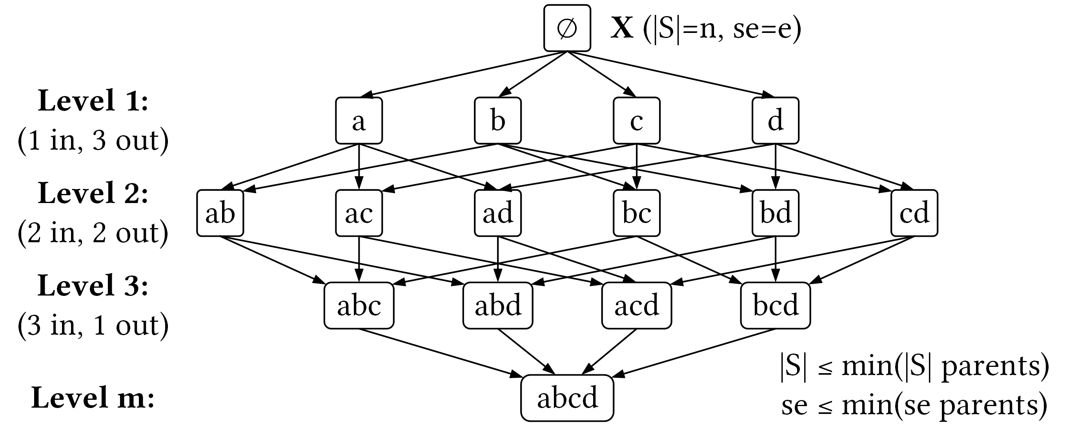
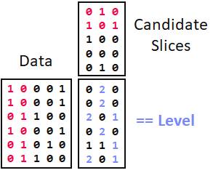

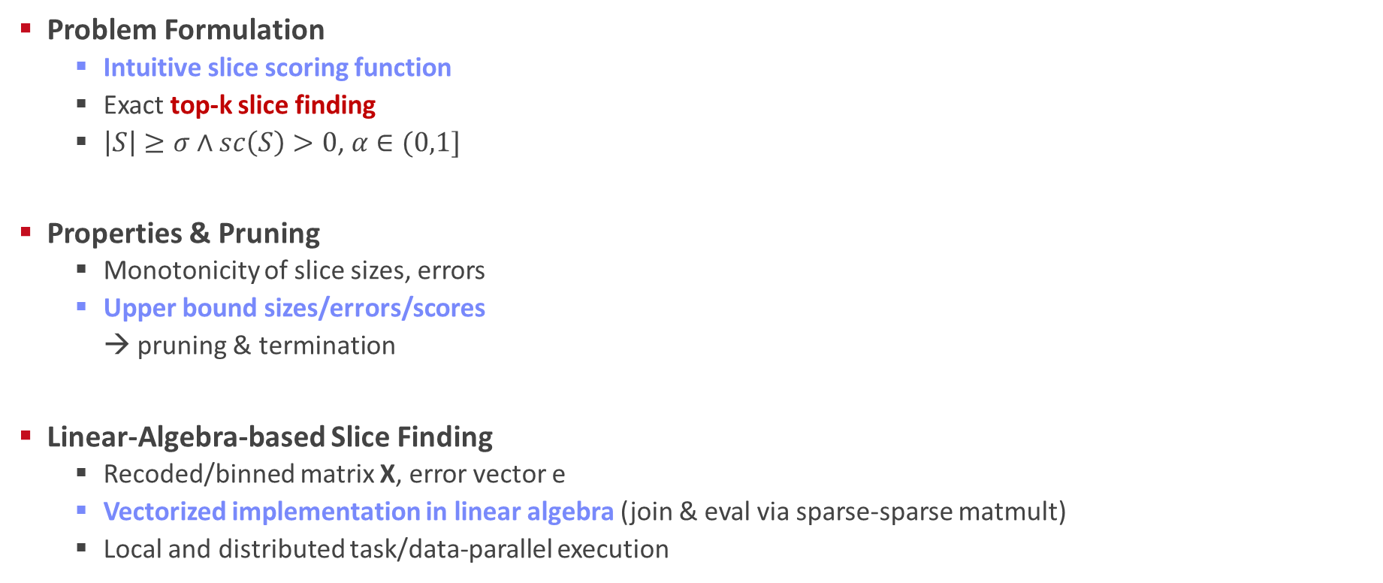
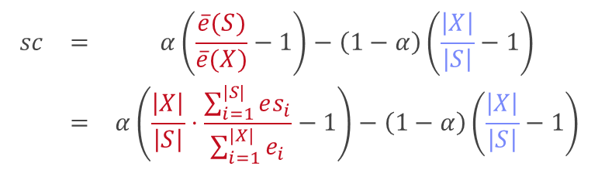
SliceLine for Model Debugging
[SIGMOD’21b, BTW’25b]
[Credit: sliceline,
Silicon Valley, HBO]
Problem Formulation
  Intuitive slice scoring function
  Exact top-k slice finding
  $\left|S\right|≥σ∧sc\left(S\right)>0$, $α∈(0,1]$
Properties & Pruning
  Monotonicity of slice sizes, errors
  Upper bound sizes/errors/scores
  → pruning & termination
Linear-Algebra-based Slice Finding
  Recoded/binned matrix X, error vector e
  Vectorized implementation in linear algebra (join & eval via sparse-sparse matmult)
  Local and distributed task/data-parallel execution
$$\begin{matrix}sc & = & α\left(\frac{\overline{e}(S)}{\overline{e}(X)}−1\right)−\left(1−α\right)\left(\frac{\left|X\right|}{\left|S\right|}−1\right) \\ & = & α\left(\frac{\left|X\right|}{\left|S\right|}⋅\frac{\sum_{i=1}^{|S|}{es_{i}}}{\sum_{i=1}^{|X|}{e_{i}}}−1\right)−\left(1−α\right)\left(\frac{\left|X\right|}{\left|S\right|}−1\right)\end{matrix}$$
slice error
slice size
$$O(2^{l}−\sum_{j=1}^{m}{2^{d_{j}}}+ l+m)$$
Notes:
Compelling properties:
The components are balanced under α = 0.5.
The score of the original X is always sc = 0.
For α = 0 (all weight on size), the maximum feasible score is 0, and no slice smaller than X can reach it.
All components of Equation (1) are either constants, or slice errors and sizes, which makes this function amenable to pruning.

Slide 35
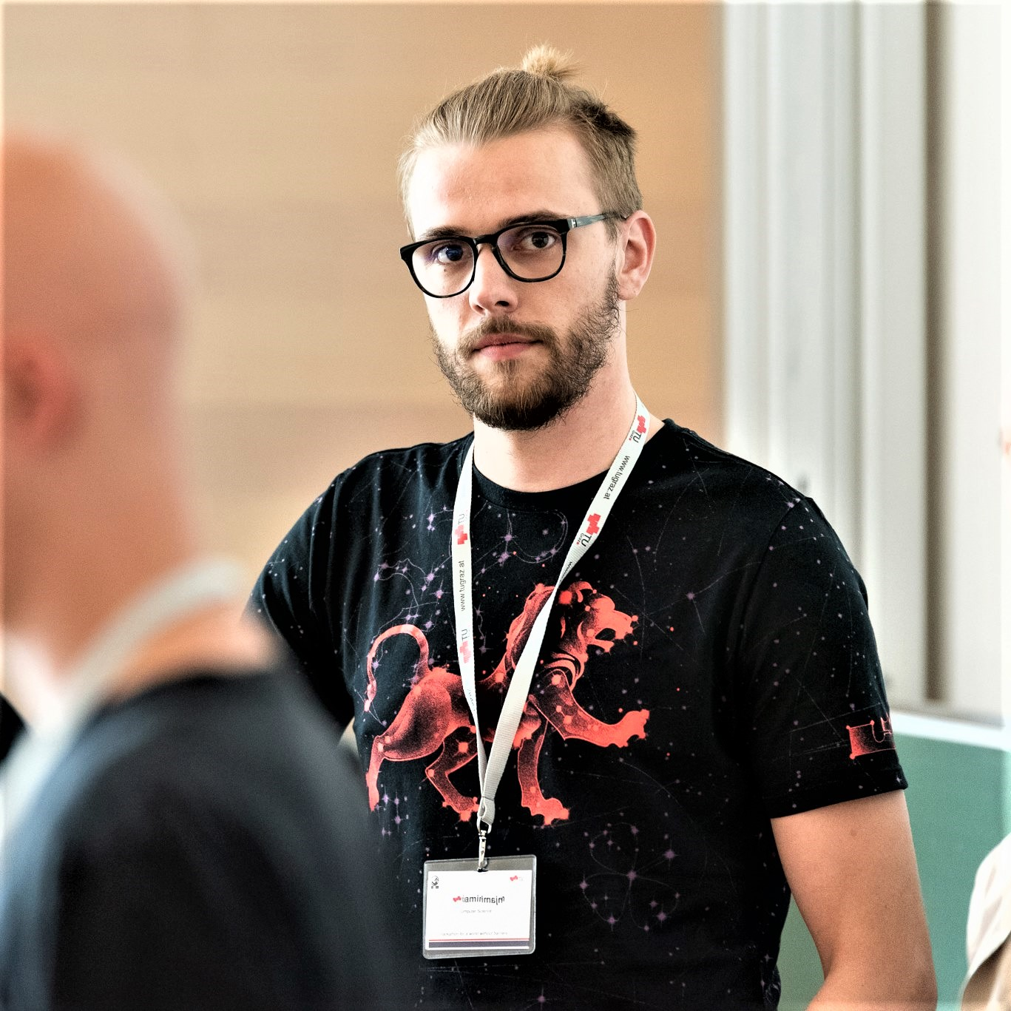
Multi-level Lineage Tracing & Reuse
[CIDR’20, SIGMOD’21a, EDBT’25]
Lineage as Key Enabling Technique
  Trace lineage of ops (incl. non-determinism), dedup for loops/funcs
  Model versioning, data reuse, incr. maintenance, autodiff, debugging
Full Reuse of Intermediates
  Before executing instruction, probe output lineage in cache
  Map<Lineage, MatrixBlock>
  Cost-based/heuristic caching and eviction decisions
  (compiler-assisted)
Partial Reuse of Intermediates
  Problem: Often partial result overlap
  Reuse partial results via dedicated rewrites (compensation plans)
  Example: steplm
Extensions: multi-backend (Local, GPU, Spark),
unified memory management
for( i in 1:numModels )
R[,i] = lm(X, y, lambda[i,], ...)
m_lmDS = function(...) {
l = matrix(reg,ncol(X),1)
A = t(X) %*% X + diag(l)
b = t(X) %*% y
beta = solve(A, b) ...}
m_steplm = function(...) {
while( continue ) {
parfor( i in 1:n ) {
if( !fixed[1,i] ) {
Xi = cbind(Xg, X[,i])
B[,i] = lm(Xi, y, ...)
} }
# add best to Xg (AIC)
} }
X
m>>n
t(X)

Slide 36

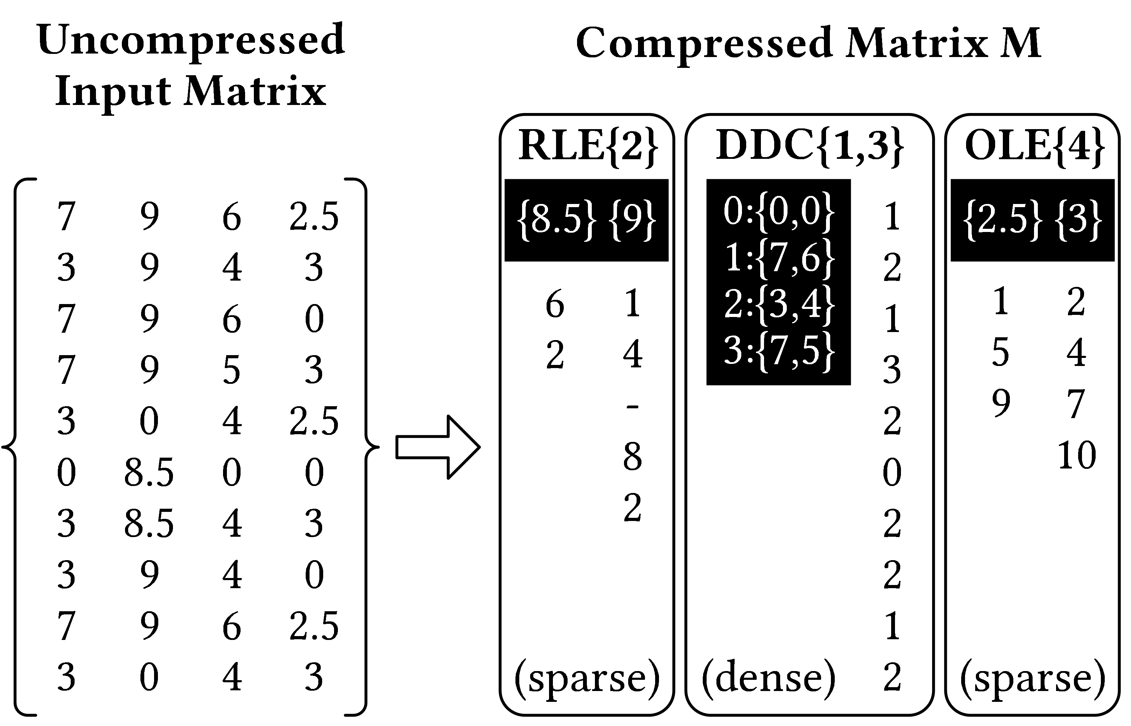
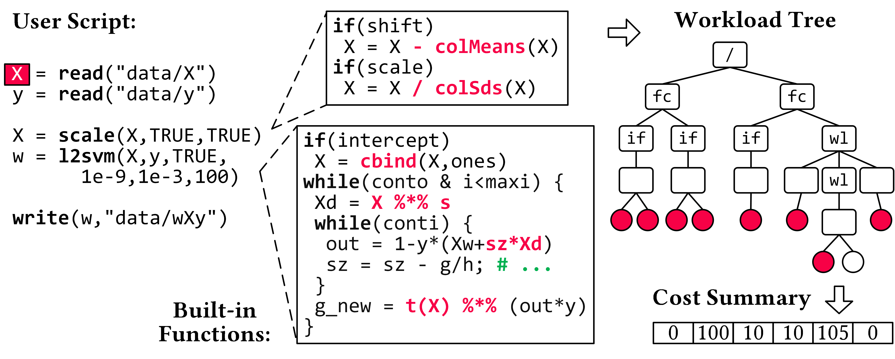
Compressed Linear Algebra Extended
[PVLDB’16a, VLDBJ’18, SIGMOD’23a,
under submission]
Lossless Matrix Compression
  Improved general applicability (adaptive compression time,
  new compression schemes, new kernels, intermediates, workload-aware)
  Sparsity → Redundancy exploitation
  (data redundancy, structural redundancy)
Workload-aware Compression
  Workload summary
  → compression
  Compressed Representation
  → execution planning
BWARE: Compressed Feature Engineering
  Frame compression, compressed I/O
  Compressed feature transformations
  Morphing of compressed data

Slide 37




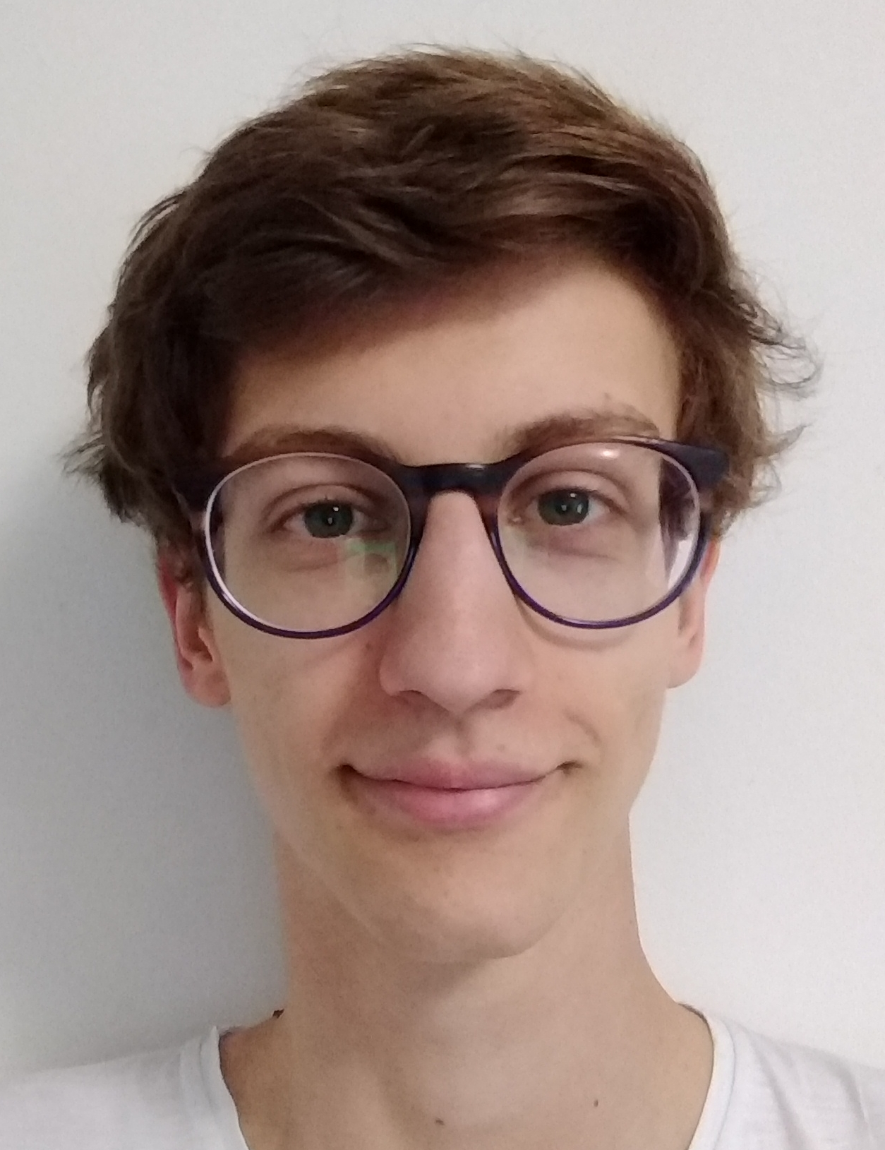
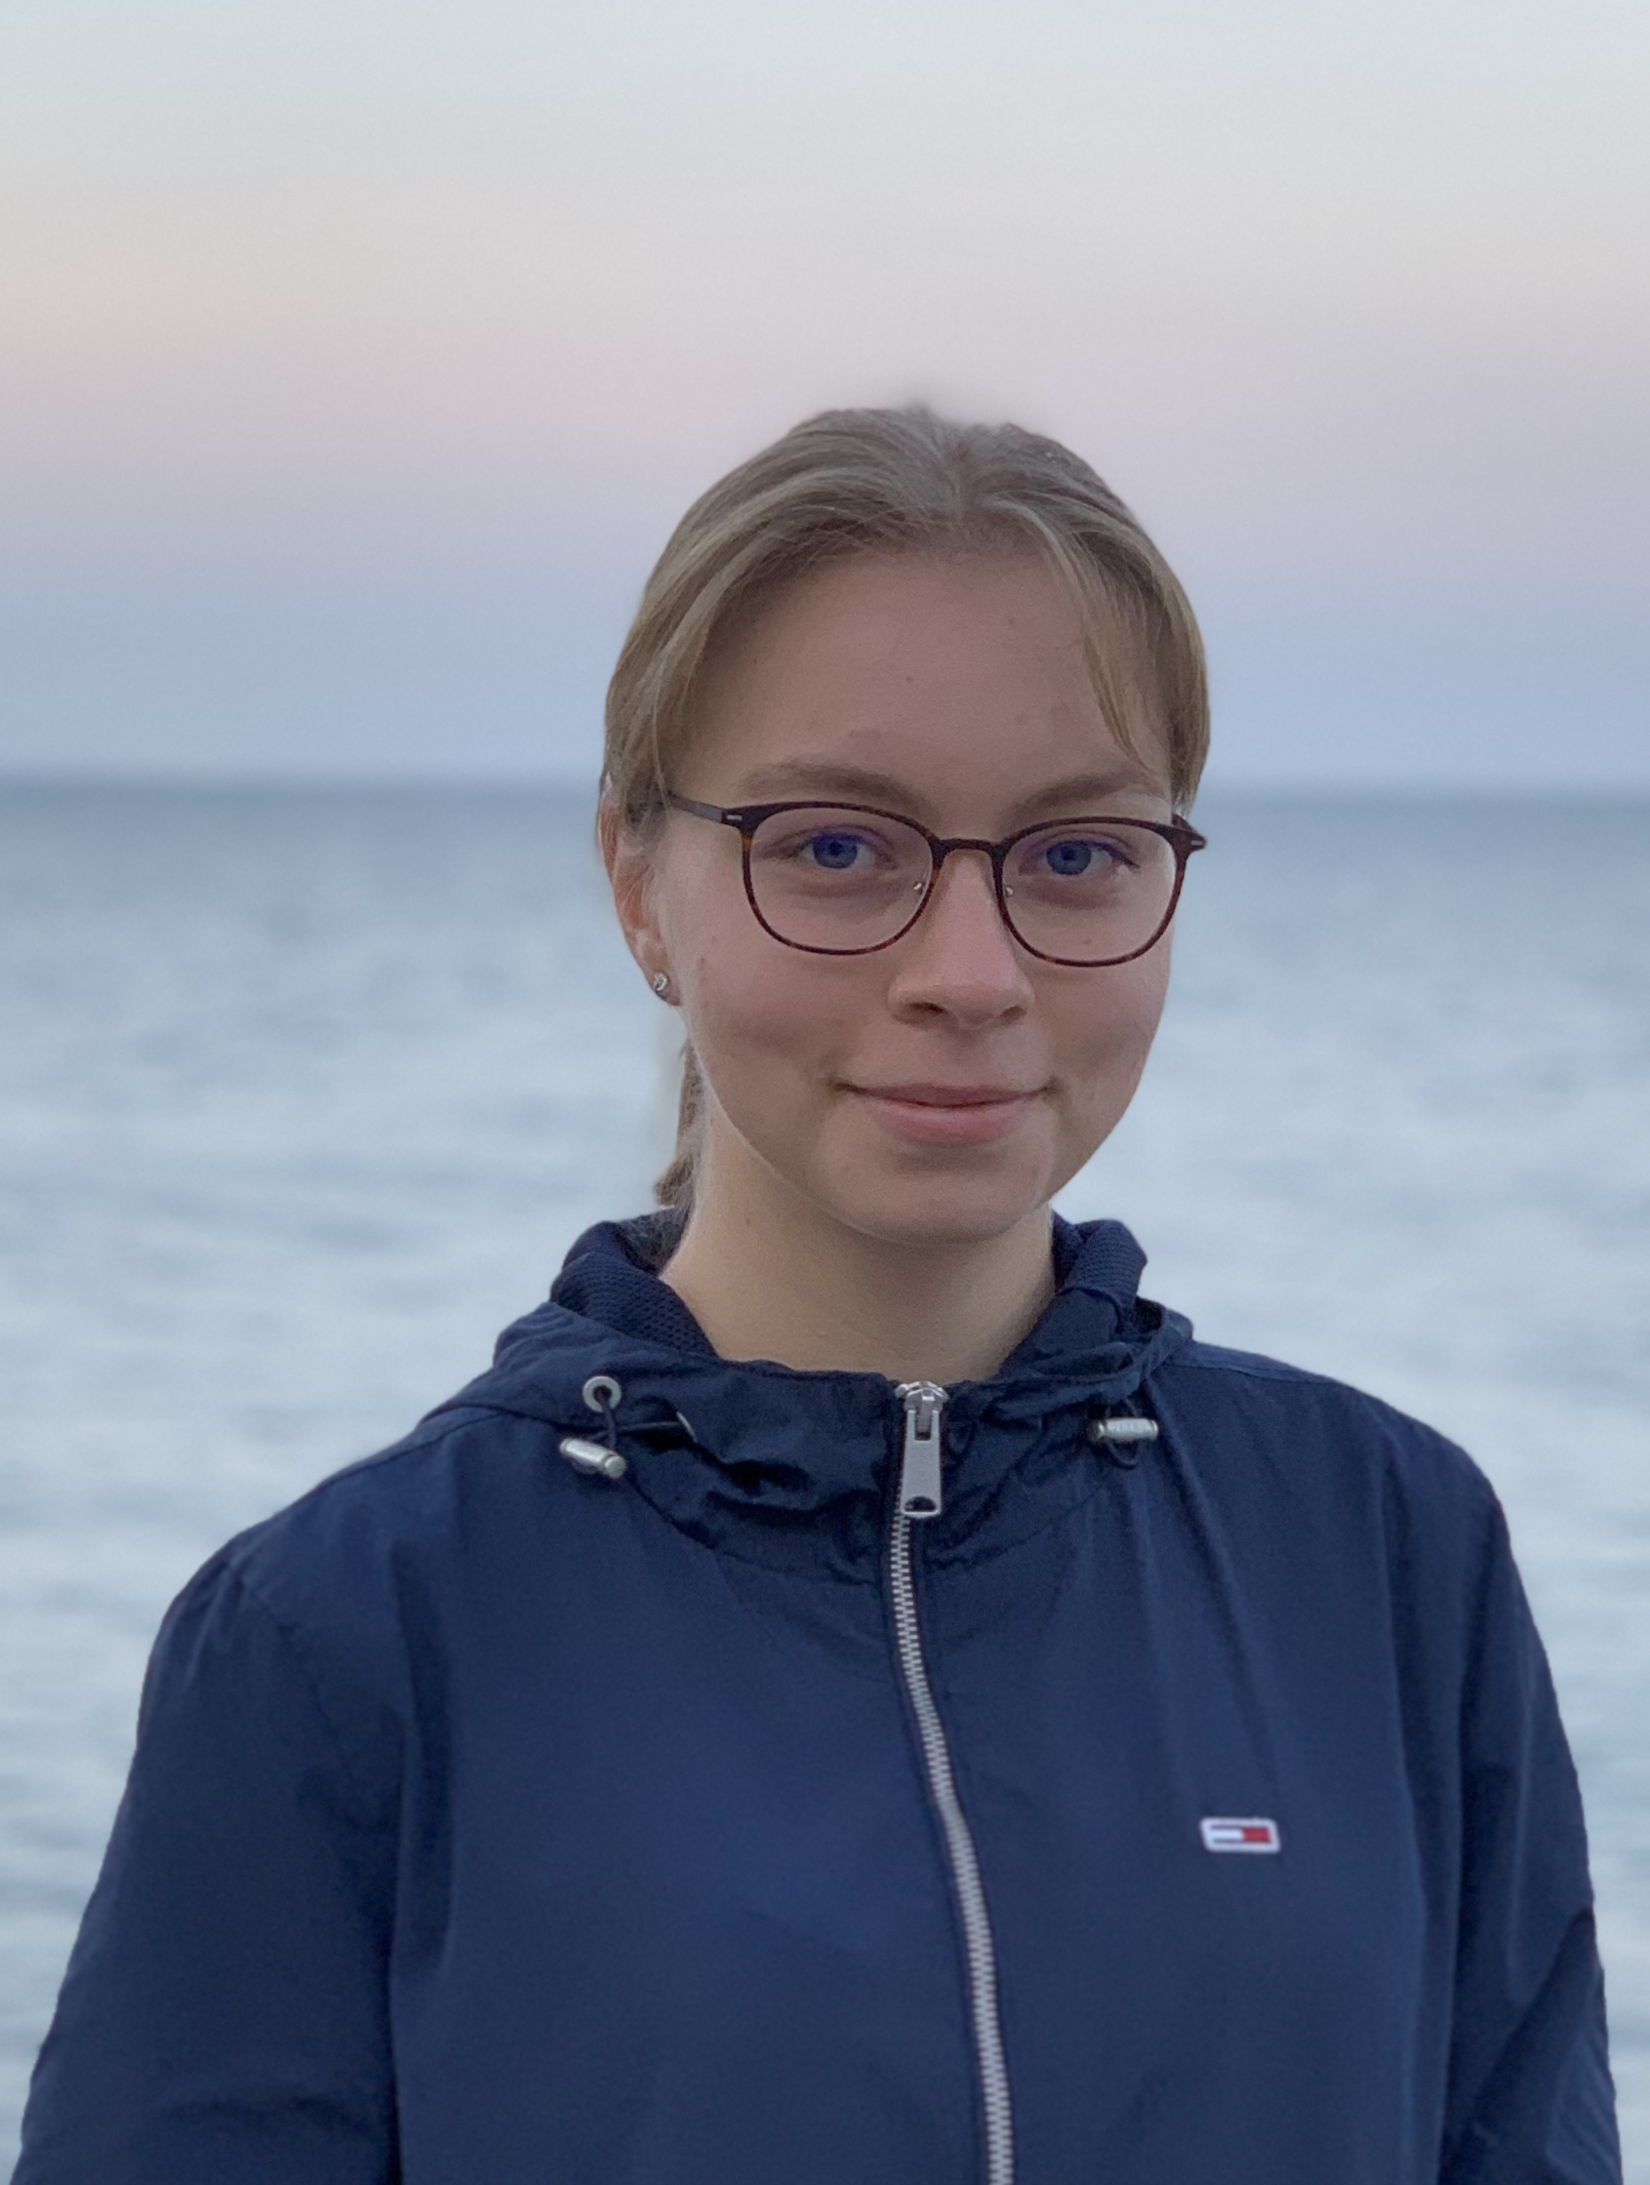
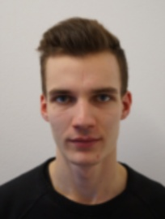

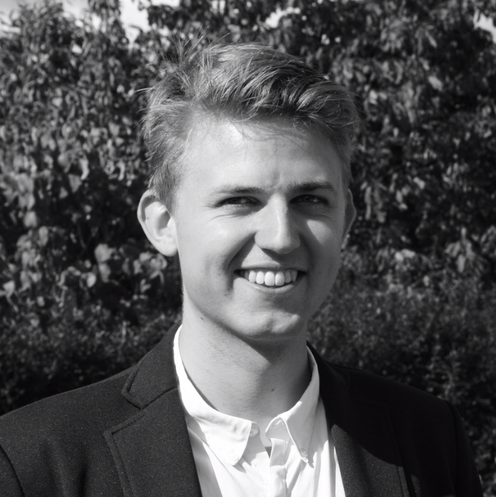
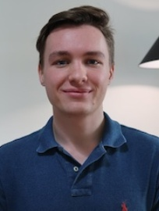
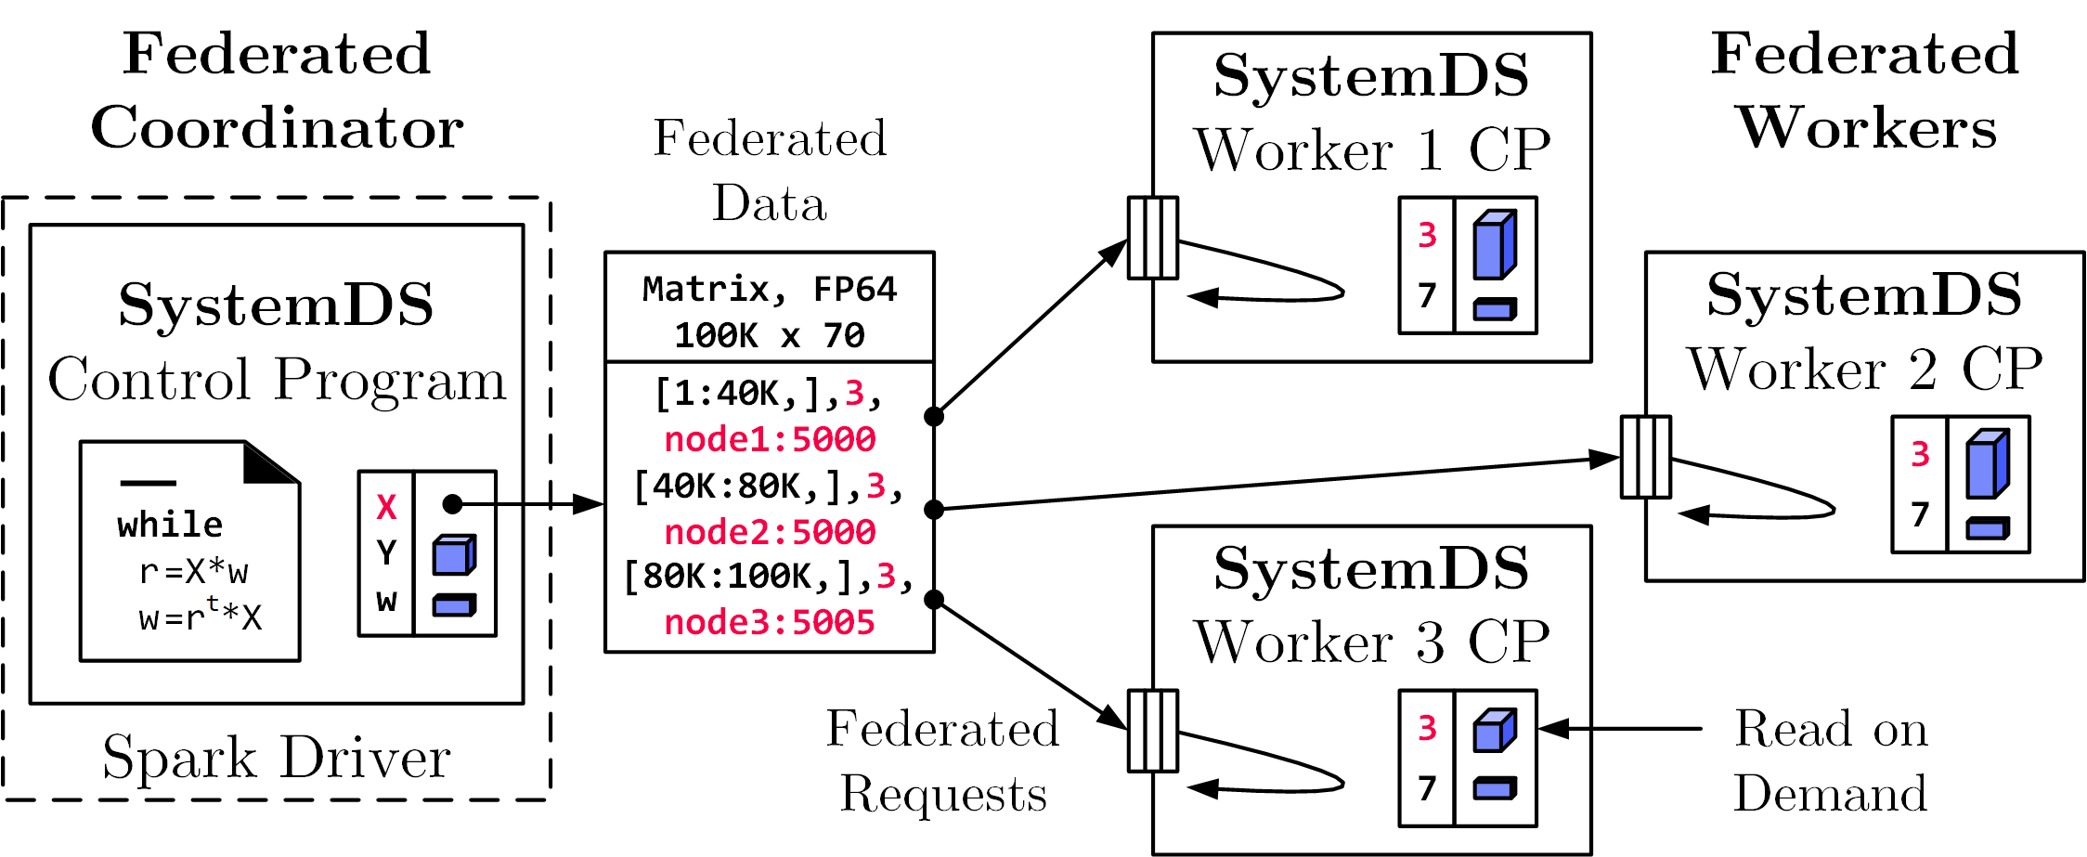
Federated Learning
[SIGMOD’21c]
Federated Backend
  Federated data (matrices/frames) as meta data objects
  Federated linear algebra, (and federated parameter server)
X = federated(addresses=list(node1, node2, node3),
ranges=list(list(0,0), list(40K,70), ..., list(80K,0), list(100K,70)));
Federated Requests:
READ, PUT, GET, EXEC_INST,
EXEC_UDF, CLEAR
➔ Design Simplicity:
(1) reuse instructions
(2) federation hierarchies

Slide 38













DAPHNE: An Open and Extensible System Infrastructure for Integrated Data Analysis Pipelines
https://github.com/daphne-eu/daphne

Slide 39
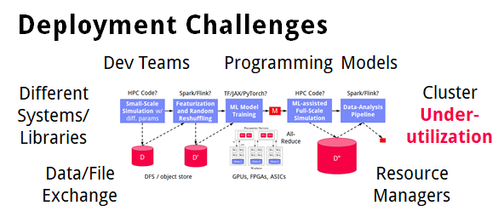
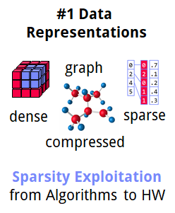
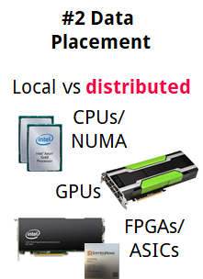
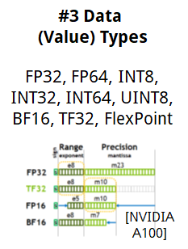
➔ DAPHNE Overall Objective:
Open and extensible system infrastructure
Motivation
Integrated Data Analysis Pipelines
  Open data formats, query processing
  Data preprocessing and cleaning
  ML model training and scoring
  HPC, custom codes, and simulations
Hardware Challenges
  DM+ML+HPC share compilation
  and runtime techniques /
  converging cluster hardware
  End of Dennard scaling:
  P = α CFV² (power density 1)
  End of Moore’s law
  Amdahl’s law: sp = 1/s
  ➔ Increasing Specialization

Slide 40




DAPHNE Use Cases
[Xiao Xiang Zhu et al: So2Sat LCZ42: A Benchmark Dataset for the Classification of Global Local Climate Zones. GRSM 8(3) 2020]
[So2Sat LC42: https://mediatum.ub.tum.de/1454690]
DLR Earth Observation
  ESA Sentinel-1/2 datasets → 4PB/year
  Training of local climate zone classifiers on So2Sat LCZ42
  (15 experts, 400K instances, 10 labels each, 85% confidence, ~55GB H5)
  ML pipeline: preprocessing, ResNet20,
  climate models
IFAT Semiconductor Ion Beam Tuning
KAI Semiconductor Material Degradation
AVL Vehicle Development Process (ejector geometries, KPIs)
ML-assisted simulations, data cleaning, augmentation

Slide 41

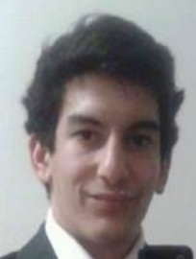
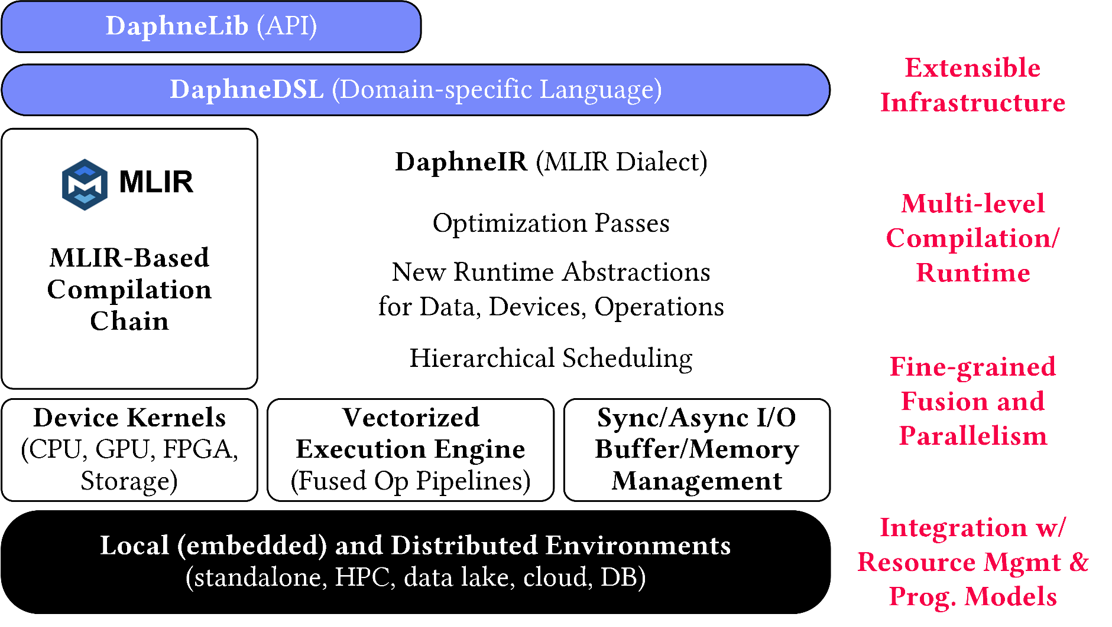
DAPHNE System Architecture
AH
[CIDR’22]
AK
Python API w/ lazy evaluation
MLIR Dialects, Extension Catalog (new data types, kernels,
scheduling algs)
Sideways Entry, DSL-level constraints
(e.g., data/op placement)
LLVM

Slide 42
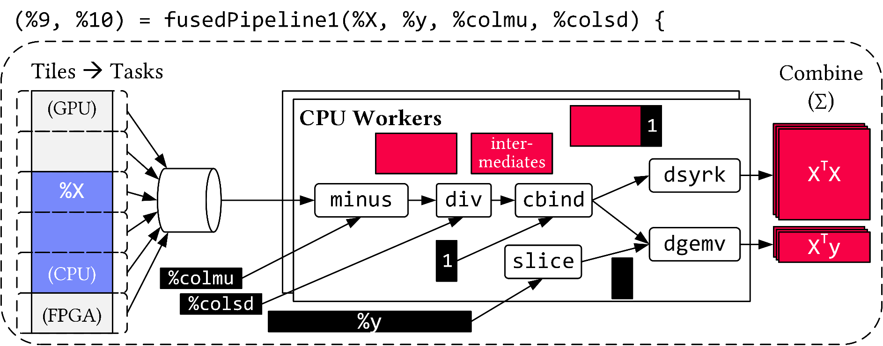
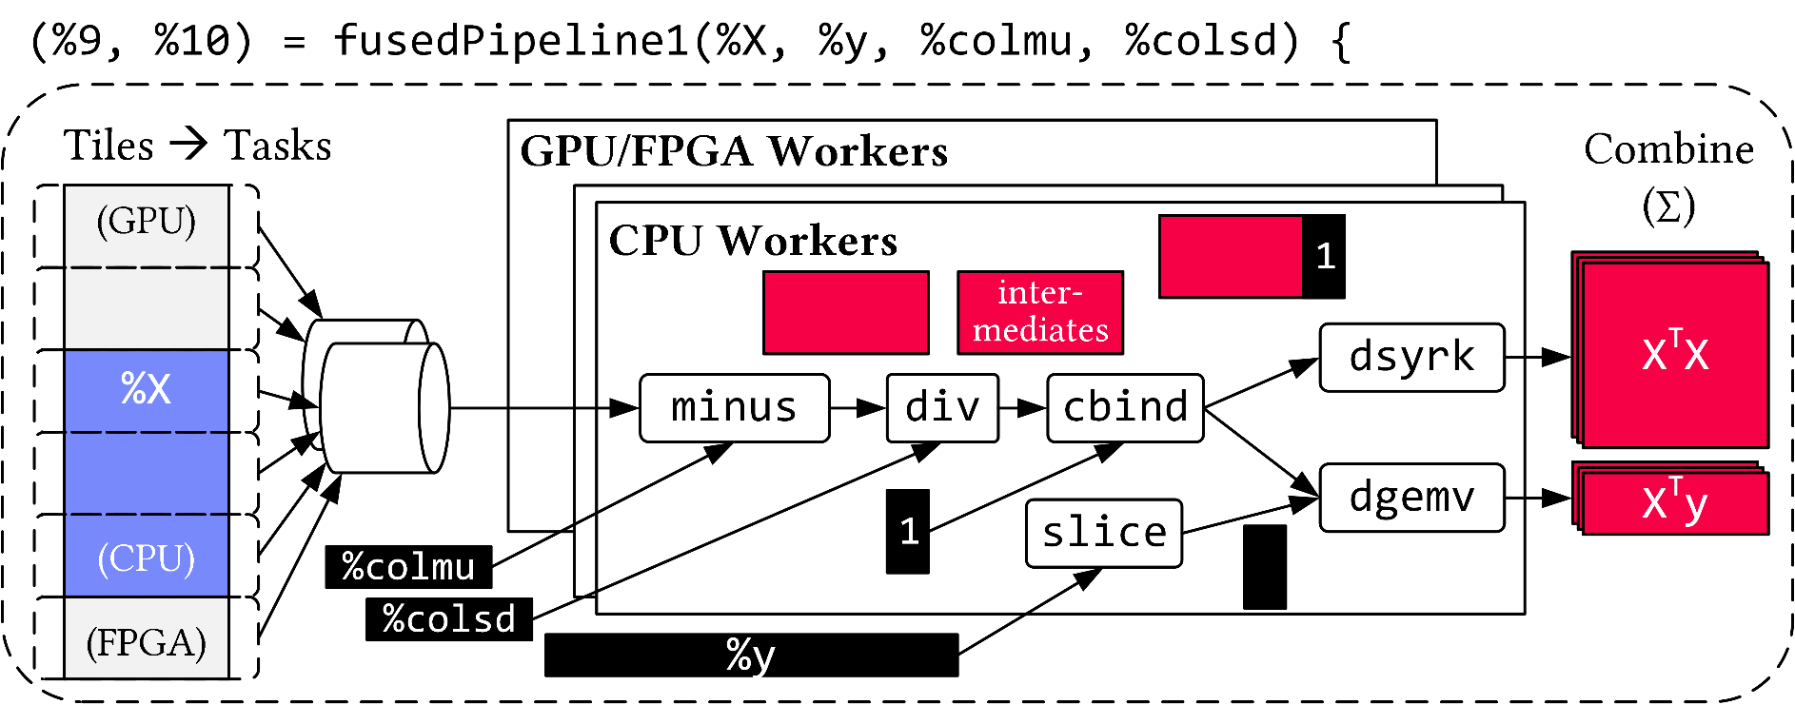
Vectorized (Tiled) Execution
Default Parallelization
Frame & Matrix Ops
Locality-aware,
Multi-device Scheduling
Fused Operator Pipelines
on Tiles/Scalars + Codegen

Slide 43
Thanks
Summary & QA
FG Big Data Engineering (DAMS Lab)
Motivation and Goals
Course Organization and Logistics
Course Outline, and Projects
Apache SystemDS and DAPHNE
Next Lectures (Part A)
  02 Languages, Architectures, and System Landscape [Apr 24]
  03 Size Inference, Rewrites, and Operator Selection [May 02]
  04 Operator Fusion and Runtime Adaptation [May 09]
  05 Data- and Task-Parallel Execution [May 15]
  06 Parameter Servers [May 22]
  07 LLM Training and Inference [Jun 05]
Programming Projects in
SystemDS/DAPHNE, or Alternative Exercise
Project/Exercise Selection by May 01 EOD:
https://tinyurl.com/yeyrjyxw

