Slide 1

Architecture of ML Systems (AMLS)
03 Compilation – Size Inference and Rewrites
Prof. Dr. Matthias Boehm
Technische Universität Berlin
Berlin Institute for the Foundations of Learning and Data
Big Data Engineering (DAMS Lab)
Last update: May 02, 2025

Slide 2

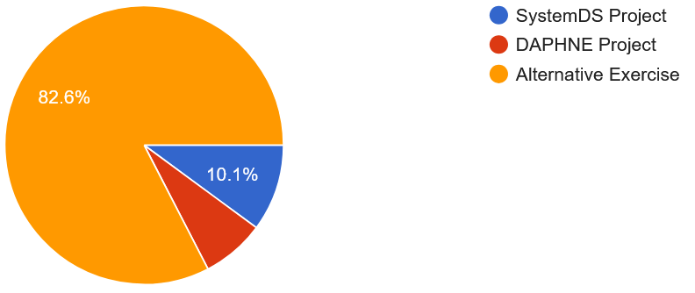
Announcements / Org
#1 Hybrid & Video Recording
  Hybrid lectures (in-person, zoom) with optional attendance
  https://tu-berlin.zoom.us/j/9529634787?pwd=R1ZsN1M3SC9BOU1OcFdmem9zT202UT09
  Zoom video recordings, links from website
  https://mboehm7.github.io/teaching/ss25_amls/index.htm
#2 Reminder Project / Exercise Selection
  Project Selection by May 01 EOD (deadline passed),
  but sign-up for alternative exercise still possible
#3 Office Hours
  Every Tuesday 4pm-5.30pm, in B-119 + zoom
  Questions and answers on projects and exercises
  TA Sebastian Baunsgaard
131/296 registered
(87 student teams)

Slide 3



Agenda
Compilation Overview
Size Inference and Cost Estimation
Rewrites (and Operator Selection)
SystemDS, and several other ML systems

Slide 4
Compilation Overview

Slide 5
Recap: Linear Algebra Systems
Comparison Query Optimization
  Rule- and cost-based rewrites and operator ordering
  Physical operator selection and query compilation
  Linear algebra / other ML operators, DAGs, control flow, sparse/dense formats
#1 Interpretation (operation at-a-time)
  Examples: R, PyTorch, Morpheus [PVLDB’17]
#2 Lazy Expression Compilation (DAG at-a-time)
  Examples: RIOT [CIDR’09], TensorFlow [OSDI’16]
  Mahout Samsara [MLSystems’16]
  Examples w/ control structures: Weld [CIDR’17],
  OptiML [ICML’11], Emma [SIGMOD’15]
#3 Program Compilation (entire program)
  Examples: SystemML [PVLDB’16], Julia
  Cumulon [SIGMOD’13], Tupleware [PVLDB’15]
DB
PL
HPC
Compilers for Large-scale ML
Optimization Scope
1: X = read($1); # n x m matrix
2: y = read($2); # n x 1 vector
3: maxi = 50; lambda = 0.001;
4: intercept = $3;
5: ...
6: r = -(t(X) %*% y);
7: norm_r2 = sum(r * r); p = -r;
8: w = matrix(0, ncol(X), 1); i = 0;
9: while(i<maxi & norm_r2>norm_r2_trgt) 10: {
11: q = (t(X) %*% X %*% p)+lambda*p;
12: alpha = norm_r2 / sum(p * q);
13: w = w + alpha * p;
14: old_norm_r2 = norm_r2;
15: r = r + alpha * q;
16: norm_r2 = sum(r * r);
17: beta = norm_r2 / old_norm_r2;
18: p = -r + beta * p; i = i + 1;
19: }
20: write(w, $4, format="text");

Slide 6
ML Program Compilation / Graphs
while(...) {
q = t(X) %*% (w * (X %*% v)) ...
}
Statement Block Hierarchy
Script:
Operator DAG
(today’s lecture)
  a.k.a. “graph”
  (data flow graph)
  a.k.a. intermediate
  representation (IR)
Runtime Plan
  Compiled runtime plans
  Interpreted plans
q
[Multiple] DAG roots (outputs)
Operation
ba+*
Data Dependency
r(t)
b(*)
[Multiple] Consumers of Intermediates
ba+*
w
No cycles
X
v
[Multiple] DAG leafs (inputs)
SPARK mapmmchain X.MATRIX.DOUBLE w.MATRIX.DOUBLE
v.MATRIX.DOUBLE _mVar4.MATRIX.DOUBLE XtwXv

Slide 7
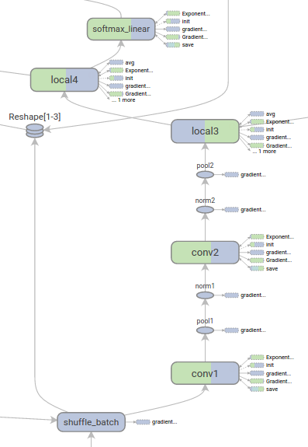
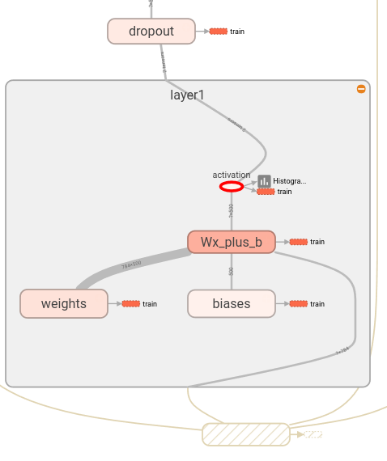
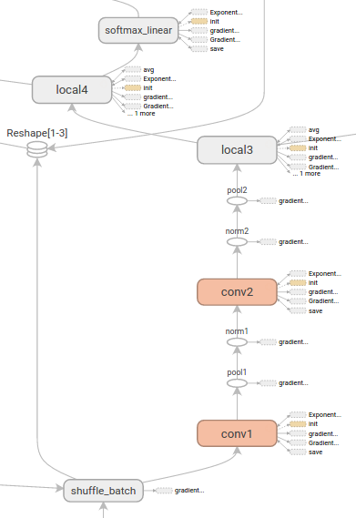
ML Program Compilation / Graphs, cont.
[https://github.com/tensorflow/tensorboard/
blob/master/docs/r1/graphs.md]
Example TF TensorBoard
Tensor Shapes and
Runtime Statistics (time, mem)
Device View (CPU, GPU)
(Node) Structure View
Edge thickness → size,
Color intensity → time
Same color, same device
Same color, same internal structure

Slide 8
Example SystemDS: Compilation Chain
Script
Language
Parsing (syntactic analysis)
[Matthias Boehm et al:
SystemML's Optimizer: Plan Generation for Large-Scale Machine Learning Programs. IEEE Data Eng. Bull 2014]
Live Variable Analysis
Validate (semantic analysis)
HOPs
Construct HOP DAGs
Multiple
Rounds
Static/Dynamic Rewrites
Intra-/Inter-Procedural Analysis
Static/Dynamic Rewrites
Compute Memory Estimates
Dynamic Recompilation
(lecture 04)
LOPs
Construct LOP DAGs
(incl operator selection, hop-lop rewrites)
Generate Runtime Program
Execution Plan

Slide 9
Example SystemDS: Basic HOP and LOP DAG Compilation
LinregDS (Direct Solve)
X = read($1);
y = read($2);
intercept = $3;
lambda = 0.001;
...
if( intercept == 1 ) {
ones = matrix(1, nrow(X), 1);
X = append(X, ones);
}
I = matrix(1, ncol(X), 1);
A = t(X) %*% X + diag(I)*lambda;
b = t(X) %*% y;
beta = solve(A, b);
...
write(beta, $4);
HOP DAG
(after rewrites)
8KB
Cluster Config:
driver mem: 20 GB
exec mem: 60 GB
CP
write
Scenario:
X: 10⁸ x 10³, 10¹¹
y: 10⁸ x 1, 10⁸
8MB
16MB
CP
b(solve)
CP
172KB
b(+)
1.6TB
CP
SP
800GB
r(diag)
ba(+*)
ba(+*)
SP
1.6TB
r(t)
8KB
SP
CP
800GB
800MB
dg(rand)
(10³x1,10³)
X
(10⁸x10³,10¹¹)
y
(10⁸x1,10⁸)
Distributed Matrices
  Fixed-size matrix blocks
  Data-parallel operations
LOP DAG
(after rewrites)
16KB
r’(CP)
mapmm(SP)
tsmm(SP)
X_{1,1}
Hybrid Runtime Plans:
  Size propagation / memory estimates
  Integrated CP / Spark runtime
  Dynamic recompilation during runtime
800MB
1.6GB
X_{2,1}
r’(CP)
X
(persisted in MEM_DISK)
X_{m,1}
y

Slide 10
Size Inference and Cost Estimation
Crucial for Generating Valid Execution Plans
& Cost-based Optimization

Slide 11
Size Propagation / Shape Inference
X = read($1);
y = read($2);
I = matrix(0.001, ncol(X), 1);
A = t(X) %*% X + diag(I);
b = t(X) %*% y;
beta = solve(A, b);
Size Information
  Dimensions (#rows, #columns)
  Sparsity (#nnz/(#rows * #columns))
  ➔ memory estimates and costs
Principle: Worst-case Assumption
  Necessary for guarantees (memory)
DAG-level Size Propagation
  Input: Size information for leaves
  Output: size information for
  all operators, -1 if still unknown
  Propagation based on
  operation semantics (single
  bottom-up pass over DAG)
(10³x1,-1)
write
(10³x1,-1)
(10³x10³,-1)
b(solve)
(10³x10³,10³)
b(+)
(10³x10³,
-1)
(10³x1,
-1)
r(diag)
ba(+*)
ba(+*)
(10³x10⁸,
10¹¹)
(10³x1,10³)
r(t)
dg(rand)
y
(10⁸x1,10⁸)
0.001
u(ncol)
X
(10⁸x10³,10¹¹)

Slide 12
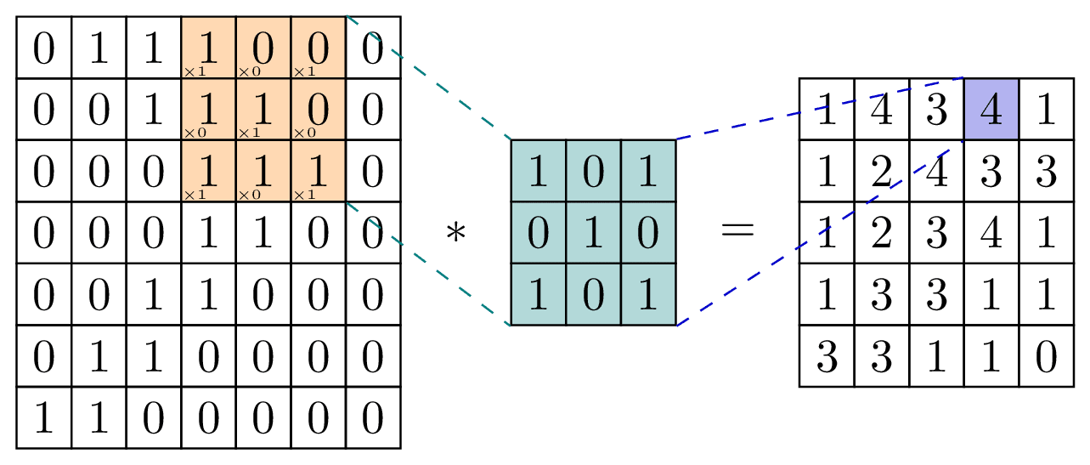
Size Propagation / Shape Inference, cont.
Basic Linear Algebra
Examples
Conv2d Example
  Input: mini-batch of images in
  linearized row representation
  C .. num channels, F .. num filters
  Hin x Win (height x width)
  Stride (default 1), pad (default 0)
Operation | Inputs | Output
Matrix multiplication A%*%B | [M, N] %*% [N, L] | [M, L]
Element-wise matrix-matrix addition A + B | [M, N] + [M, N] | [M, N]
Element-wise matrix-vector addition A + b | [M, N] + [M, 1] | [M, N]
Matrix transposition | [M, N] | [N, M]
Matrix diagonal (M2V) | [M, M] | [M, 1]
Unary matrix aggregation colSums(A) | [M, N] | [1, N]
[N, C*Hin*Win]
[Credit: https://tikz.net/conv2d]
[N, F*Hout*Wout]
Hout = as.integer(floor((Hin + 2*padh - Hf)/strideh + 1))
Wout = as.integer(floor((Win + 2*padw - Wf)/stridew + 1))

Slide 13
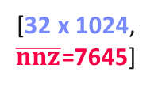
Size Propagation / Shape Inference, cont.
Example Relu
(rectified linear unit)
Example SystemDS
  Hop refreshSizeInformation() (exact)
  Hop inferOutputCharacteristics()
  Compiler explicitly differentiates between
  exact and other size information
  Note: ops like aggregate, ctable, rmEmpty
  challenging but w/ upper bounds
Example TensorFlow
  Operator registrations
  Shape inference functions
[32 x 1024, $\overline{nnz}$=7645]
b(max)
[32 x 1024, nnz=7645]
X
0
REGISTER_OP(“Relu”)
.Input(“features: T”)
.Output(“activations: T”)
.Attr(“T: {realnumbertype, qint8}”)
.SetShapeFn(
shape_inference::UnchangedShape)
[Alex Passos: Inside TensorFlow – Eager execution runtime, https://www.youtube.com/
watch?v=qjx65mD6nrc, Dec 2019]

Slide 14
Constant and Size Propagation
X = read($1); # n x m matrix
y = read($2); # n x 1 vector
maxi = 50; lambda = 0.001;
if(...){ }
r = -(t(X) %*% y);
r2 = sum(r * r);
p = -r;
w = matrix(0, ncol(X), 1);
i = 0;
while(i<maxi & r2>r2_trgt) {
q = (t(X) %*% X %*% p)+lambda*p;
alpha = norm_r2 / sum(p * q);
w = w + alpha * p;
old_norm_r2 = norm_r2;
r = r + alpha * q;
r2 = sum(r * r);
beta = norm_r2 / old_norm_r2;
p = -r + beta * p;
i = i + 1;
}
write(w, $4, format="text");
Constant Propagation
  Relies on live variable analysis
  Propagate constant literals into
  read-only statement blocks
Program-level Size Propagation
  Relies on constant propagation
  and DAG-level size propagation
  Propagate size information across
  conditional control flow: size in leafs,
  DAG-level prop, extract roots
  if: reconcile if and else branch outputs
  while/for: reconcile pre and post loop,
  reset if pre/post different
# m x 1
# m x 1
# m x 1
# m x 1

Slide 15
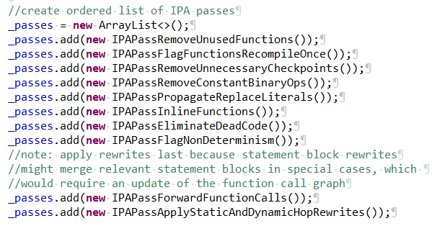
Inter-Procedural Analysis
Intra/Inter-Procedural Analysis (IPA)
  Integrates all size propagation techniques (DAG+program, size+constants)
  Intra-function and inter-function size propagation (called once, consistent sizes, consistent literals)
Additional IPA Passes (selection)
  Inline functions (single statement block, small)
  Dead code elimination and simplification rewrites
  Remove unused functions & flag recompile-once
1M x 1
X = read($X1)
X = foo(X);
if( $X2 != “ ” ) {
X2 = cbind(X,
matrix(1,n,1));
X2 = foo(X2);
}...
eval(“foo”, X)
foo = function (Matrix[Double] A)
return (Matrix[Double] B)
{
B = A – colSums(A);
if( sum(B!=B)>0 )
print(“NaNs encountered.”);
}
1M x 2
? x ?

Slide 16
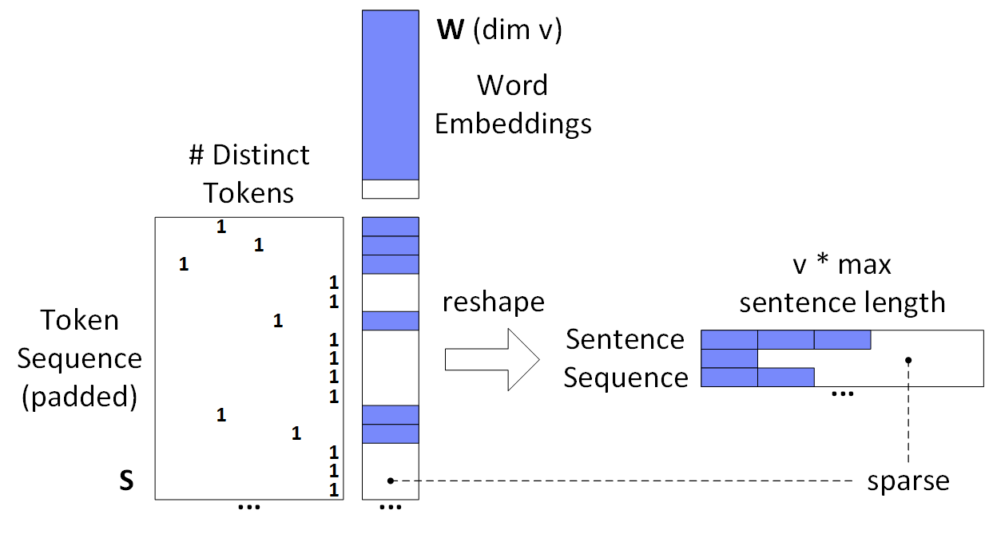
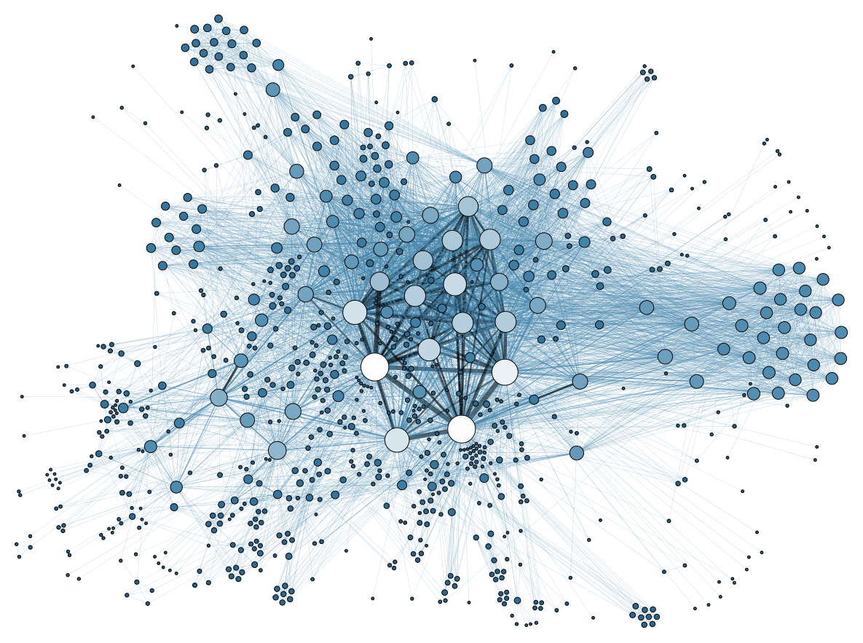
Sparsity Estimation Overview
Motivation
  Sparse input matrices from NLP, graph analytics,
  recommender systems, scientific computing
  Sparse intermediates
  (transform, selection, dropout)
  Selection/permutation matrices
Problem Definition
  Sparsity estimates used for format decisions, output allocation, cost estimates
  Matrix A with sparsity s_{A} = nnz(A)/(mn) and matrix B with s_{B} = nnz(B)/(nl)
  Estimate sparsity s_{C} = nnz(C)/(ml) of matrix product C = A B; d=max(m,n,l)
  Assumptions
    A1: No cancellation errors
    A2: No not-a-number (NaN)
NLP Example
(SentenceCNN)
Common assumptions
➔ Boolean matrix product

Slide 17
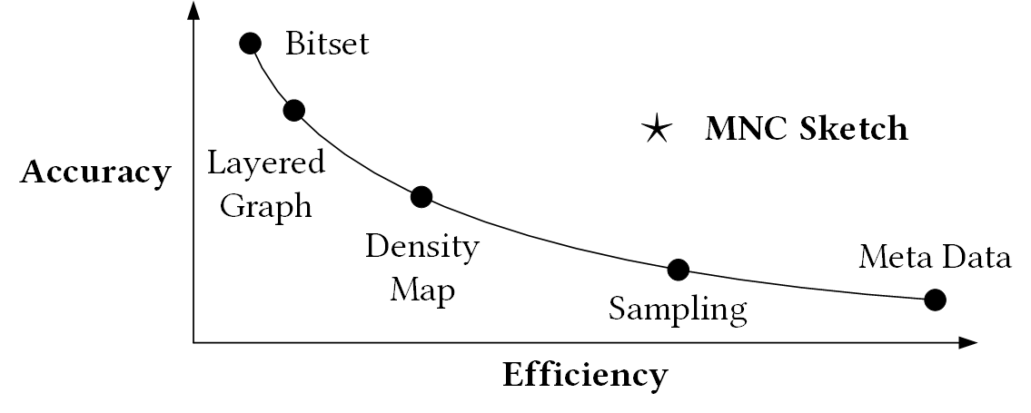
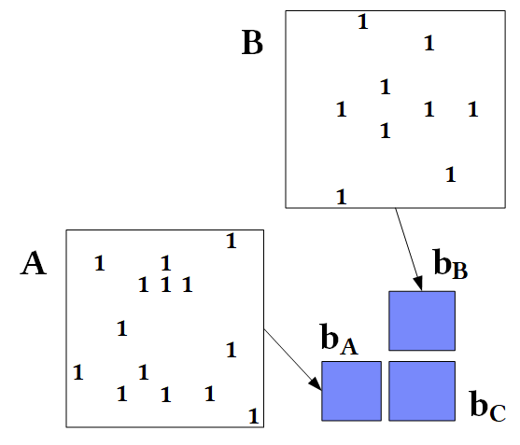
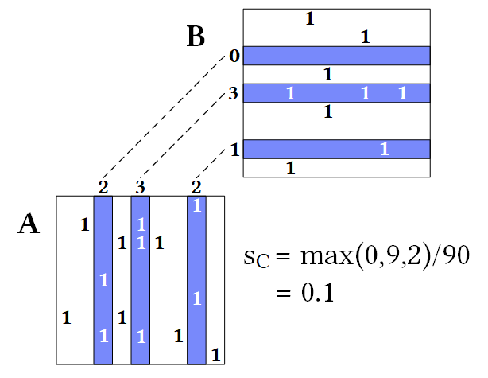


Sparsity Estimation – Estimators
Tradeoffs
Overview
#1 Naïve Metadata Estimators
  Derive the output sparsity solely
  from the sparsity of inputs (e.g., SystemDS)
#2 Naïve Bitset Estimator
  Convert inputs to bitsets, perform Boolean mm (per row)
  Examples: SciDB [SSDBM’11], NVIDIA cuSparse, Intel MKL
#3 Sampling
  Take a sample of aligned columns of A and rows of B
  Sparsity estimated via max of count-products
  Examples: MatFast [ICDE’17], improvements in paper
$${\hat{s}}_{c}=1−{(1−s_{A}s_{B})}^{n}$$
$${\hat{s}}_{c}=\min\left(1,s_{A}n\right)⋅\min{(1, s_{B}n)}$$

Slide 18
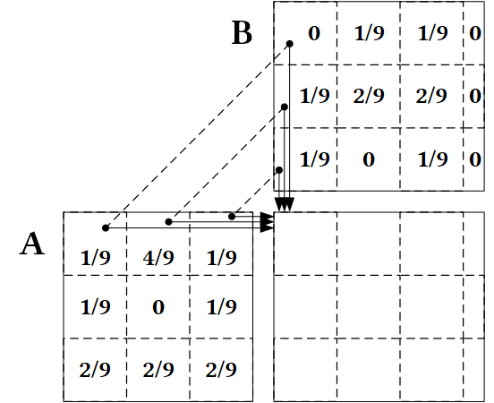
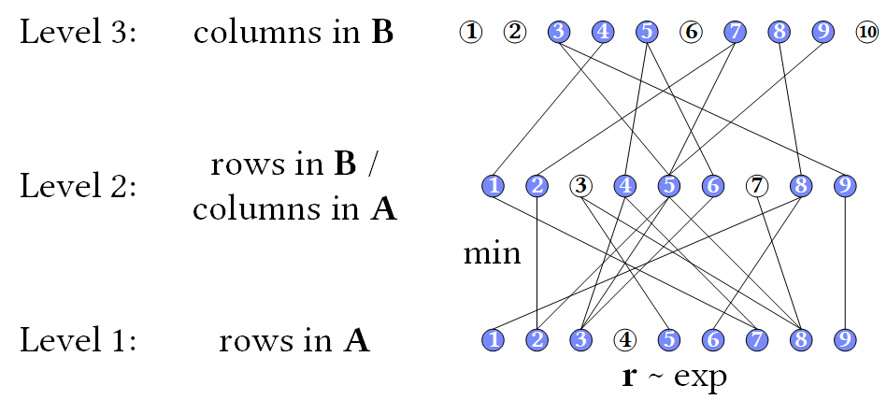
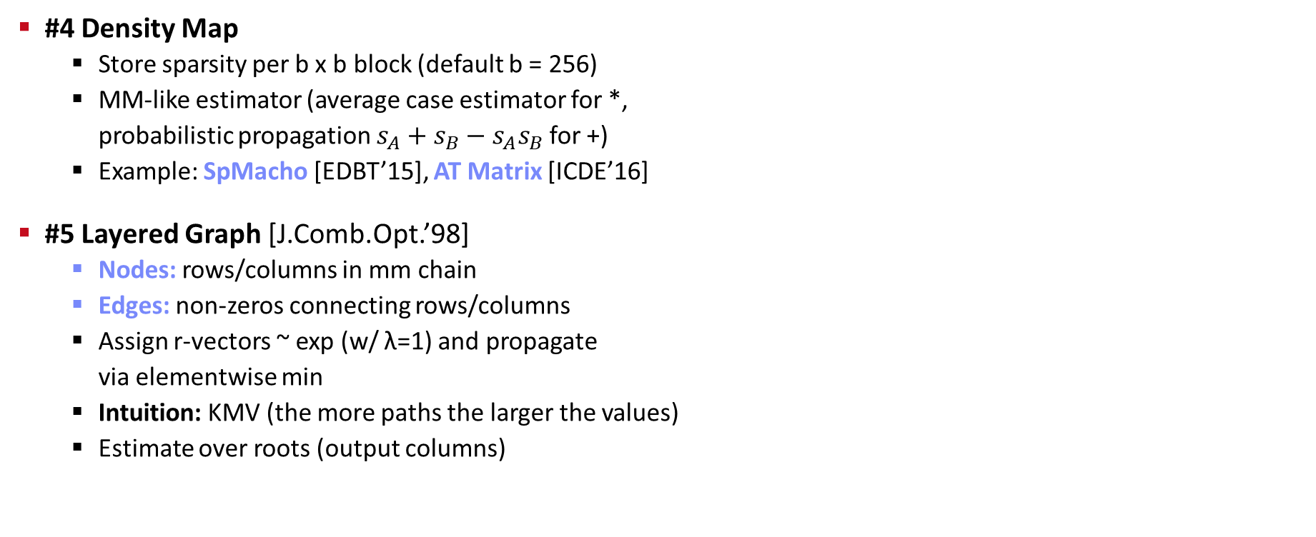
Sparsity Estimation – Estimators, cont.
#4 Density Map
  Store sparsity per b x b block (default b = 256)
  MM-like estimator (average case estimator for *,
  probabilistic propagation $s_{A}+s_{B}−s_{A}s_{B}$ for +)
  Example: SpMacho [EDBT’15], AT Matrix [ICDE’16]
#5 Layered Graph [J.Comb.Opt.’98]
  Nodes: rows/columns in mm chain
  Edges: non-zeros connecting rows/columns
  Assign r-vectors ~ exp (w/ λ=1) and propagate
  via elementwise min
  Intuition: KMV (the more paths the larger the values)
  Estimate over roots (output columns)
[Edith Cohen: Structure Prediction and Computation of Sparse
Matrix Products. Journal of Combinatorial Optimization 1998]
Notes:
Layered Graph: DBLP bibtex shows 1998, but paper 1999

Slide 19
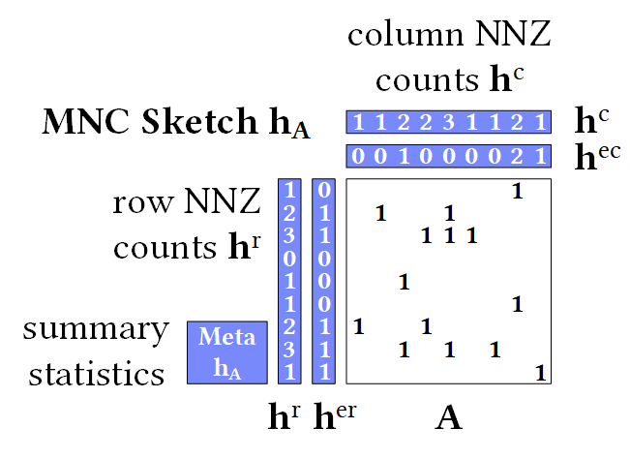
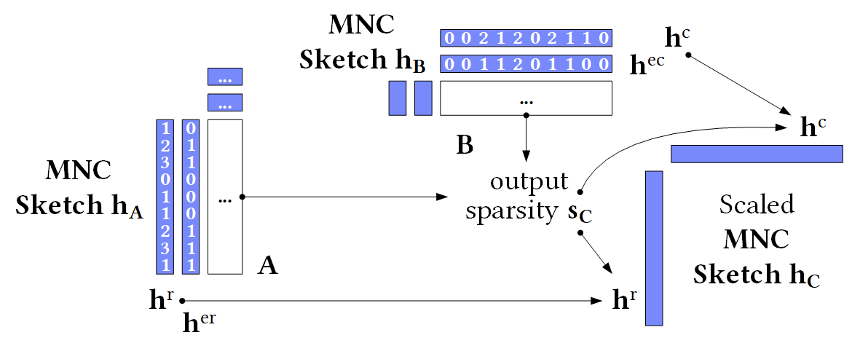
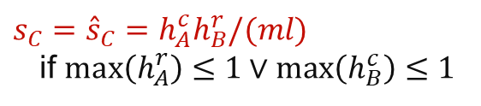
Sparsity Estimation – Estimators, cont.
$s_{C}={\hat{s}}_{C}=h_{A}^{c}h_{B}^{r}/(ml)$
if $max\left(h_{A}^{r}\right)≤1∨\max\left(h_{B}^{c}\right)≤1$
#6 MNC Sketch (Matrix Non-zero Count)
  Create MNC sketch for inputs A and B
  Exploitation of structural properties
  (e.g., 1 non-zero per row, row sparsity)
  Support for matrix expressions
  (reorganizations, elementwise ops)
  Construction: O(d) space, O(nnz) time
  Sketch propagation and estimation
#7 RS Estimator (Row-wise Sparsity)
3 0 2
B
1 7 3
  A
[Johanna Sommer, Matthias Boehm, Alexandre V. Evfimievski, Berthold Reinwald, Peter J. Haas: MNC: Structure-Exploiting Sparsity Estimation for Matrix Expressions. SIGMOD 2019]
[Chunxu Lin, Wensheng Luo, Yixiang Fang, Chenhao Ma, Xilin Liu, Yuchi Ma: On Efficient Large Sparse Matrix Chain Multiplication, SIGMOD 2024]

Slide 20
Memory Estimates and Costing
Memory Estimates
  Matrix memory estimate := based on the dimensions and sparsity,
  decide the format (sparse, dense) and estimate the size in memory
  Operation memory estimate := input, intermediates, output
  Worst-case sparsity estimates (upper bound)
#1 Costing at Logical vs Physical Level
  Costing at physical level takes physical ops
  and rewrites into account but is much more costly
#2 Costing Operators/Graphs vs Plans
  Costing plans requires heuristics for # iterations, branches in general
#3 Analytical vs Trained Cost Models
  Analytical: estimate I/O and compute workload
  Training: build regression models for individual ops
A Personal War Story
Physical, Plans,
Trained
[PVLDB 2014]
Physical, Plans,
Analytical
[SIGMOD 2015]
Logical, Graphs, Analytical
[PVDLB 2018]

Slide 21
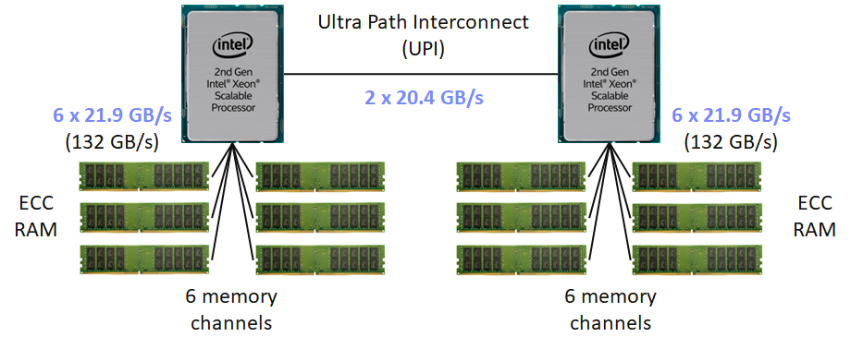
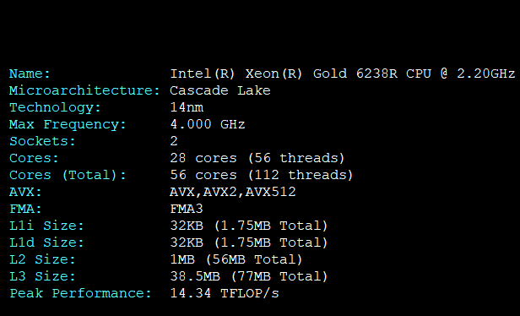
Example Analytical Cost Model
Hardware Setting
  Max Memory Bandwidth:
  2 sockets * 6 channels * 21.9 GB/s = 264 GB/s
  Max Compute:
  2 sockets * 28 cores * 2.2 GHz * 2 FMA units
  * 8 FP64 (AVX512) * 2 (FMA) = 3.85 TFLOP/s
Workload
  Matrix-vector Multiplication (X %*% v)
  X: 1,000,000 x 1,000 in dense FP64 (double)
Costs
  Determine data/compute workload, convert to time
cpufetch output:
FP32 at
max freq
C = max(8GB / 264GB/s, 2GFLOP / 3.85TFLOP/s)
= max(30.3ms, 0.5ms) = 30.3ms

Slide 22
Excursus: Differentiable Programming
Overview Differentiable Programming
  Adoption of auto differentiation concept from ML systems to PLs
  Yann LeCun (Jan 2018)
Example DBMS Fitting
  Implement DBMS components
  as differentiable functions
  E.g.: cost model components
  Q: What about guarantees
  (memory, size)?
“It's really very much like a regular prog[r]am, except it’s
parameterized, automatically differentiated, and trainable/optimizable.”
[Benjamin Hilprecht et al: DBMS Fitting: Why should we learn what we already know? CIDR 2020]

Slide 23
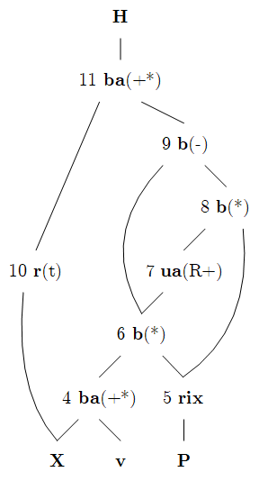
2min BREAK and TEST YOURSELF
Q = P[, 1:K] * (X %*% v);
H = t(X) %*% (Q - P[, 1:K] *
(rowSums(Q) %*% matrix(1,1,K)));
Expression
MLogReg
Compiled DAG
  X: 100,000 x 4,000 / nnz = 1,365,000
  v: 4,000 x 11
  P: 100,000 x 12 (K=11, 12 classes)
Q & A
  What are the dimensions and sparsity of all intermediates?
  What rewrites have been applied Expression → DAG?
  → CSE P[,1:K], rm vector replication
  What other rewrites are possible if ncol(v)==1?
  → rm rowsums(), factorize ((1-P[,1:K])*Q) & ((1-P[,1:K])*P[,1:K])
[4K x 11]
[100K x 11]
[100K x 11]
[4K x 100K]
[100K x 1]
[100K x 11]
[100K x 11]
[100K x 11]
[100K x 4K]
[4K x 11]
[100K x 12]

Slide 24
Rewrites (and Operator Selection)

Slide 25
Traditional PL Rewrites
#1 Common Subexpression Elimination (CSE)
  Step 1: Collect and replace leaf nodes (variable reads and literals)
  Step 2: recursively remove CSEs bottom-up starting at the leafs
  by merging nodes with same inputs (beware non-determinism)
  Example:
R1 = 7 – abs(A * B)
R2 = abs(A * B) + rand()
R1
R2
R1
R2
R1
R2
-
+
-
+
-
+
7
abs
abs
rand
7
abs
abs
rand
7
abs
rand
*
*
*
*
*
A
B
A
B
A
B
A
B

Slide 26
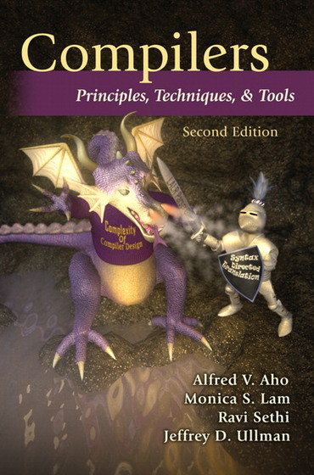
[A. V. Aho, M. S. Lam, R. Sethi, and J. D. Ullman. Compilers – Principles, Techniques, & Tools. Addison-Wesley, 2007]
Traditional PL Rewrites, cont.
Turing Award ‘20
#2 Constant Folding
  After constant propagation,
  fold sub-DAGs over literals into a single literal
  Approach: recursively compile and
  execute runtime instructions with
  special handling of one-side constants
  Example (GLM
  Binomial probit):
ncol_y == 2 & dist_type == 2
& link_type >= 1 & link_type <= 5
2 == 2 & 2 == 2 & 3 >= 1 & 3 <= 5
&
&
TRUE
&
<=
3
5
&
TRUE
&
>=
==
==
3
1
&
TRUE
2
2
2
2
TRUE
TRUE

Slide 27
Traditional PL Rewrites, cont.
LinregDS (Direct Solve)
X = read($1);
y = read($2);
intercept = 0;
lambda = 0.001;
...
if( intercept == 1 ) {
ones = matrix(1, nrow(X), 1);
X = cbind(X, ones);
}
I = matrix(1, ncol(X), 1);
A = t(X) %*% X + diag(I)*lambda;
b = t(X) %*% y;
beta = solve(A, b);
...
write(beta, $4);
#3 Branch Removal
  Applied after constant propagation and constant folding
  True predicate: replace if statement block with if-body blocks
  False predicate: replace if statement
  block with else-body block, or remove
#4 Merge of Statement Blocks
  Merge sequences of unconditional blocks
  (s1,s2) into a single block
  Connect matching DAG roots of s1 with DAG inputs of s2
#5 Dead Code Elimination
  Backwards pass through program to eliminate operations that create
  variables which are not used in subsequent statement blocks
FALSE

Slide 28
[Matthias Boehm et al: SystemML's Optimizer: Plan Generation for Large-Scale Machine Learning Programs. IEEE Data Eng. Bull 2014]
Static/Dynamic Simplification Rewrites
Examples of Static Rewrites
  trace(X%*%Y) → sum(X*t(Y))
  sum(X+Y) → sum(X)+sum(Y)
  (X%*%Y)[7,3] → X[7,]%*%Y[,3]
  sum(t(X)) → sum(X)
  rand()*7 → rand(,min=0,max=7)
  sum(lambda*X) → lambda * sum(X);
Examples of Dynamic Rewrites
  t(X) %*% y → t(t(y) %*% X) s.t. costs
  X[a:b,c:d]=Y → X = Y iff dims(X)=dims(Y)
  (...) * X → matrix(0, nrow(X), ncol(X)) iff nnz(X)=0
  sum(X^2) → t(X)%*%X; rowSums(X) → X iff ncol(X)=1
  sum(X%*%Y) → sum(t(colSums(X))*rowSums(Y)) iff ncol(X)>t
Y
O(n³)
O(n²)
X
X
Y ┬
→
*

Slide 29
Static/Dynamic Simplification Rewrites, cont.
[Rasmus Munk Larsen, Tatiana Shpeisman: TensorFlow Graph Optimizations,
Guest Lecture Stanford 2019]
TF Constant Push-Down
  Add(c1,Add(x,c2)) → Add(x,c1+c2)
  ConvND(c1*x,c2) → ConvND(x,c1*c2)
TF Arithmetic Simplifications
  Flattening: a+b+c+d → AddN(a, b, c, d)
  Hoisting: AddN(x * a, b * x, x * c) → x * AddN(a+b+c)
  Reduce Nodes Numeric: x+x+x → 3*x
  Reduce Nodes Logicial: !(x > y) → x <= y
TF Broadcast Minimization
  (M1+s1) + (M2+s2) → (M1+M2) + (s1+s2)
TF Better use of Intrinsics
  Matmul(Transpose(X), Y) → Matmul(X, Y, transpose_x=True)
SystemML/SystemDS
RewriteElementwise-MultChainOptimization
(orders and collapses matrix, vector, scalar op chains)

Slide 30
Static/Dynamic Simplification Rewrites, cont.
[Zhihao Jia, James J. Thomas, Todd Warszawski, Mingyu Gao, Matei Zaharia, Alex Aiken: Optimizing DNN Computation with Relaxed Graph Substitutions. MLSys 2019]
Relaxed DNN Graph Substitutions
  Allow substitutions that preserve
  semantics, no matter if faster/slower
  Backtracking search
Additional Algorithms
  Partial order of substitutions w/ pruning
  Dynamic programming → substitutions
Increased conv2d
kernel size via padding
ResNet module
1.3x faster on V100 GPUs
[Jingzhi Fang, Yanyan Shen, Yue Wang, Lei Chen: Optimizing DNN Computation Graph using Graph Substitutions. PVLDB 13(11) 2020]

Slide 31
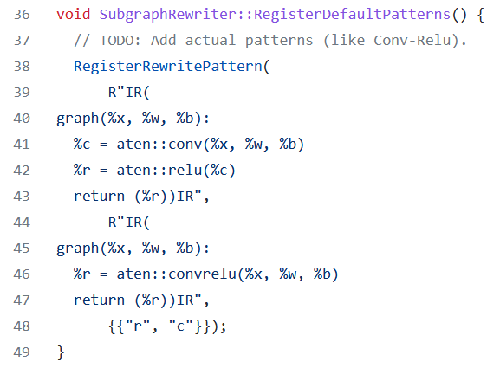
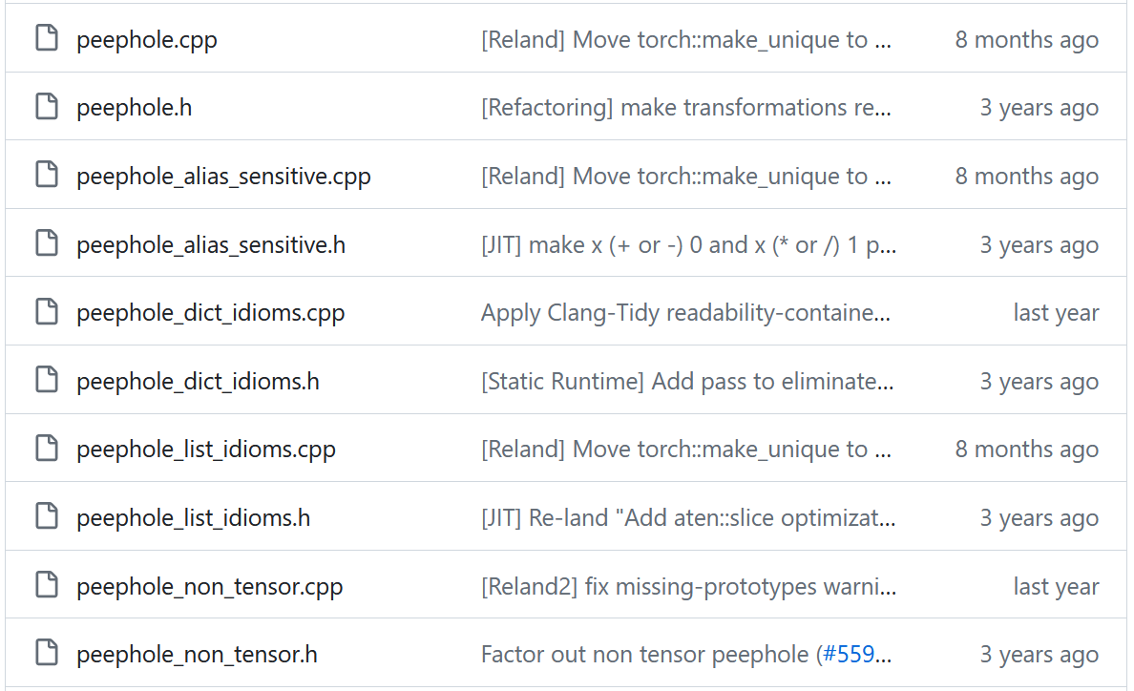
Static/Dynamic Simplification Rewrites, cont.
Rewrites in PyTorch (Torch Script JIT)
  Misc: Canonicalization, erase number types and no-ops
  Fuse linear, fuse relu, fuse graph pipeline
  Inlining and loop unrolling
  Concatenation and fusion rewrites
  Peephole simplifications (e.g., dtype mgmt)
[https://github.com/pytorch/pytorch/blob/master/torch/csrc/jit/passes/subgraph_rewrite.cpp]
subgraph_rewrite.cpp (extracted Mar 17, 2022)
[https://github.com/pytorch/pytorch/tree/main/torch/csrc/jit/passes, extracted May 01, 2024]

Slide 32
Vectorization and Incremental Computation
for(i in a:b)
X[i,1] = Y[i,2] + Z[i,1]
Loop Transformations
(e.g., OptiML, SystemML)
  Loop vectorization
  Loop hoisting
Incremental Computations
  Delta update rules (e.g., LINVIEW, factorized)
  Incremental iterations (e.g., Flink)
“Decremental”/Unlearning (GDPR)
X
y
X[a:b,1] = Y[a:b,2] + Z[a:b,1]
t(X)
A = t(X) %*% X + t(∆X) %*% ∆X
b = t(X) %*% y + t(∆X) %*% ∆y
[Sebastian Schelter: "Amnesia" – Machine Learning Models That Can Forget User Data Very Fast. CIDR 2020]
[Sebastian Schelter, Stefan Grafberger, Ted Dunning: HedgeCut: Maintaining Randomised Trees for Low-Latency Machine Unlearning. SIGMOD 2021]
Notes:
Note: “HedgeCut is a variation of the well-established “Extremely Randomised Trees” (ERT) approach [17], which learns an ensemble of randomized decision trees where attributes and cut-off points to split the data are chosen at random.” ref bottom-right

Slide 33


Update-in-place
Example: Cumulative Aggregate via Strawman Scripts
  But: R, Julia, Matlab, SystemDS, NumPy all provide cumsum(X), etc
Update in place (w/ O(n))
  SystemDS: via rewrites (why do the above scripts apply?)
  R: via reference counting
  Julia: by default, otherwise explicit B = copy(A) necessary
1: cumsumN2 = function(Matrix[Double] A)
2: return(Matrix[Double] B)
3: {
4: B = A; csums = matrix(0,1,ncol(A));
5: for( i in 1:nrow(A) ) {
6: csums = csums + A[i,];
7: B[i,] = csums;
8: }
9: }
1: cumsumNlogN = function(Matrix[Double] A)
2: return(Matrix[Double] B)
3: {
4: B = A; m = nrow(A); k = 1;
5: while( k < m ) {
6: B[(k+1):m,] = B[(k+1):m,] + B[1:(m‐k),];
7: k = 2 * k;
8: }
9: }
copy-on-write → O(n^2)
→ O(n log n)

Slide 34
Excursus: Automatic Rewrite Generation
[Tarek Elgamal et al: SPOOF: Sum-Product Optimization and Operator Fusion for
Large-Scale Machine Learning. CIDR 2017]
[Yisu Remy Wang et al: SPORES: Sum-Product Optimization via Relational Equality Saturation for Large Scale Linear Algebra. PVLDB 13(11) 2020]
SPOOF/SPORES (Sum-Product Optim.)
  Break up LA ops into basic ops (RA)
  Elementary
  sum-product/RA rewrites
  Example:
  sum(W%*%H)
TASO (Super Optimization)
  List of operator specifications and properties
  Automatic generation/verification of graph
  substitutions and data layouts via cost-based backtracking search
[Zhihao Jia et al: TASO: optimizing deep learning computation with automatic generation of graph substitutions. SOSP 2019]

Slide 35
Matrix Multiplication Chain Optimization
Optimization Problem
  Matrix multiplication chain of n matrices M₁, M₂, …M_{n} (associative)
  Optimal parenthesization
  of the product M₁M₂ … M_{n}
Search Space Characteristics
  Naïve exhaustive: Catalan numbers → Ω(4^{n} / n^{3/2}))
  DP applies: (1) optimal substructure,
  (2) overlapping subproblems
  Textbook DP algorithm: Θ(n³) time, Θ(n²) space
    Examples: SystemML ‘14,
    RIOT (‘09 I/O costs), SpMachO (‘15 sparsity)
  Best known: O(n log n)
t(X)
1kx1k
X
1kx1k
Z
1
t(X)
1kx1k
X
1kx1k
p
1
Size propagation and sparsity estimation
→
2,002 MFLOPs
4 MFLOPs
n | C_{n-1}
5 | 14
10 | 4,862
15 | 2,674,440
20 | 1,767,263,190
25 | 1,289,904,147,324
  [T. C. Hu, M. T. Shing: Computation of Matrix
  Chain Products. Part II.
  SIAM J. Comput. 13(2), 1984]
Notes:
Ω .. Lower bound, Θ tight bound, O upper bound

Slide 36
Matrix Multiplication Chain Optimization, cont.
M1 | M2 | M3 | M4 | M5
10x7 | 7x5 | 5x1 | 1x3 | 3x9
Cost matrix m
5
1
m[1,3] = min(
m[1,1] + m[2,3] + p1p2p4,
m[1,2] + m[3,3] + p1p3p4 )
4
222
2
j
i
135
125
= min(
0 + 35 + 10*7*1,
350 + 0 + 10*5*1 )
3
3
= min(
105,
400 )
2
105
56
72
4
1
350
35
15
27
5
0
0
0
0
0
  [T. H. Cormen, C. E. Leiserson, R. L. Rivest, C. Stein: Introduction to Algorithms, Third Edition, The MIT Press, pages 370-377, 2009]
M1
M2
M3
M4
M5

Slide 37
Matrix Multiplication Chain Optimization, cont.
M1 | M2 | M3 | M4 | M5
10x7 | 7x5 | 5x1 | 1x3 | 3x9
Optimal split matrix s
getOpt(s,1,5)
Cost matrix m
5
1
getOpt(s,1,3)
3
getOpt(s,4,5)
4
222
2
3
3
j
i
3
135
125
3
2
1
3
3
4
105
56
72
1
2
3
4
2
4
1
350
35
15
27
5
0
0
0
0
0
( M1 M2 M3 M4 M5 )
( ( M1 M2 M3 ) ( M4 M5 ) )
M1
M2
M3
M4
M5
( ( M1 ( M2 M3 ) ) ( M4 M5 ) )
➔ ((M1 (M2 M3)) (M4 M5))
➔ Open questions: DAGs; other operations, sparsity,
joint opt w/ rewrites, CSE, fusion, and physical operators

Slide 38

Sparsity-aware MMChain Optimization
Sparsity-aware MMChain Opt
  Additional n x n sketch matrix e
  Sketch propagation for optimal subchains
  (currently for all chains)
  Modified cost computation via MNC sketches
  (number FLOPs for sparse instead of dense mm)
Cost matrix M
Optimal split matrix S
Sketch matrix E
Example: n=20 matrices
$$C_{i,j}=\min_{k∈\left[i,j−1\right]}{\begin{aligned}(C_{i,k}+C_{k+1,j} \\ +E_{i,k}.h^{c}E_{k+1,j}.h^{r})\end{aligned}}$$
[Johanna Sommer, Matthias Boehm, Alexandre V. Evfimievski, Berthold Reinwald, Peter J. Haas: MNC: Structure-Exploiting Sparsity Estimation for Matrix Expressions. SIGMOD 2019]

Slide 39
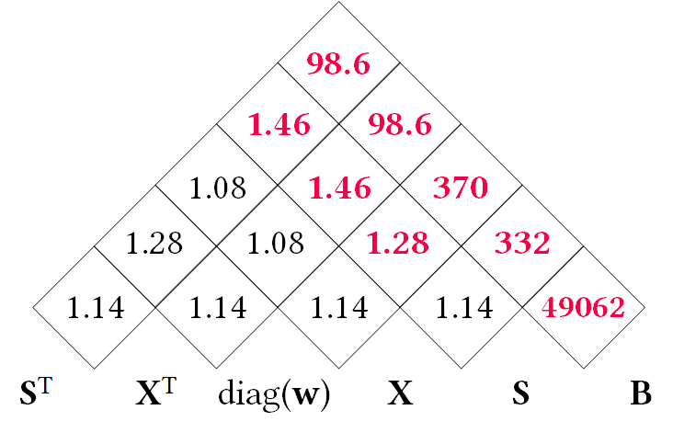
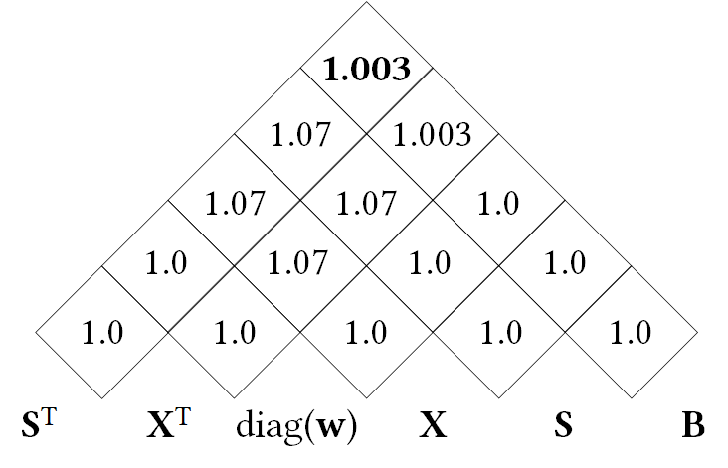
Sparsity-aware MMChain Optimization, cont.
Scale
Example: Deferred Standardization
  Mean subtraction is densifying
  Substitute standardized X with
  X %*% S and optimize mm chain
Accuracy of Sparsity Estimation
  Example Expression
  (substitute X with X %*% S)
  Mnist1m
  Error Density Map
  vs MNC Sketch
X
S
Neg. column means
Shift
Dense output if colMeans non-zero
t(X) %*% diag(w) %*% X %*% B →
t(S) %*% t(X) %*% diag(w) %*% X %*% S %*% B
Density Map
MNC Sketch
MMChain Opt Memo Table

Slide 40
Physical Rewrites and Optimizations
Distributed Caching
  Redundant compute vs. memory consumption and I/O
  #1 Cache intermediates w/ multiple refs (Emma)
  #2 Cache initial read and read-only loop vars (SystemML)
Partitioning
  Many frameworks exploit co-partitioning for efficient joins
  #1 Partitioning-exploiting operators (SystemML, Emma, Samsara)
  #2 Inject partitioning to avoid shuffle per iteration (SystemML)
  #3 Plan-specific data partitioning (SystemML, Dmac, Kasen)
Other Data Flow Optimizations (Emma)
  #1 Exists unnesting (e.g., filter w/ broadcast → join)
  #2 Fold-group fusion (e.g., groupByKey → reduceByKey)
Physical Operator Selection
Node1
Node2
Example Hash Partitioning:
For all (k,v) of R:
hash(k) % numPartitions → pid

Slide 41
Physical Operator Selection
Common Selection Criteria
  Data and cluster characteristics (e.g., data size/shape, memory, parallelism)
  Matrix/operation properties (e.g., diagonal/symmetric, sparse-safe ops)
  Data flow properties (e.g., co-partitioning, co-location, data locality)
#0 Local Operators
  SystemML mm, tsmm, mmchain; Samsara/Mllib local
#1 Special Operators (special patterns/sparsity)
  SystemML tsmm, mapmmchain; Samsara AtA
#2 Broadcast-Based Operators (aka broadcast join)
  SystemML mapmm, mapmmchain
#3 Co-Partitioning-Based Operators (aka improved repartition join)
  SystemML zipmm; Emma, Samsara OpAtB
#4 Shuffle-Based Operators (aka repartition join)
  SystemML cpmm, rmm; Samsara OpAB
t(X) %*% (X%*%v)
1st
pass
v
2nd
pass
X
q┬
X

Slide 42
Sparsity-Exploiting Operators
Goal: Avoid dense intermediates and unnecessary computation
#1 Fused Physical Operators
  E.g., SystemML [PVLDB’16]
  wsloss, wcemm, wdivmm
  Selective computation over
  non-zeros of “sparse driver”
#2 Masked Physical Operators
  E.g., Cumulon MaskMult [SIGMOD’13]
  Create mask of “sparse driver”
  Pass mask to single masked
  matrix multiply operator
sum(W * (X – U %*% t(V))^2)
^2
W
X
U V┬
sum
*
–
/
O / (C %*% E %*% t(B))
mm
C
mm
O
M
E
t(B)

Slide 43
Summary & QA
Basic compilation overview
Size inference and cost estimation
Rewrites and operator selection
➔ Impact of Size Inference and Costs
  Advanced optimization of LA programs requires size inference for cost estimation and validity constraints
➔ Ubiquitous Rewrite Opportunities
  Linear algebra programs have plenty of room for optimization
  Potential for changed asymptotic behavior
Next Lectures
  04 Compilation – Operator Fusion and Runtime Adaptation [May 09]
  (advanced compilation, operator scheduling, JIT compilation, operator fusion / codegen, MLIR)

