Slide 1

Architecture of ML Systems (AMLS)
04 Compilation – Adaptation, Fusion, and JIT
Prof. Dr. Matthias Boehm
Technische Universität Berlin
Berlin Institute for the Foundations of Learning and Data
Big Data Engineering (DAMS Lab)
Last update: May 09, 2025

Slide 2


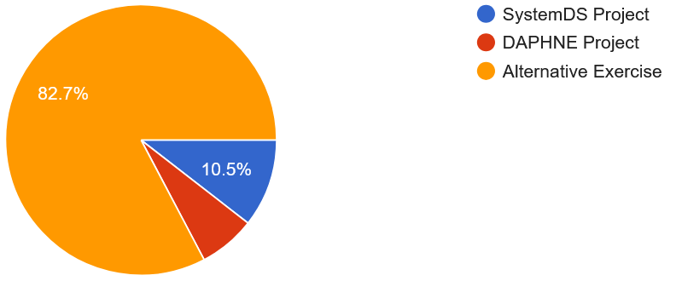
Announcements / Org
#1 Hybrid & Video Recording
  Hybrid lectures (in-person, zoom) with optional attendance
  https://tu-berlin.zoom.us/j/9529634787?pwd=R1ZsN1M3SC9BOU1OcFdmem9zT202UT09
  Zoom video recordings, links from website
  https://mboehm7.github.io/teaching/ss25_amls/index.htm
#2 Projects and Exercises
  Project Selection May 01
  Mentoring emails for projects May 08
  Alternative exercise still possible
Course Achtsamkeits-Meditation
  8-week course and study, start May 26
  Mindfulness-Based Stress Reduction, Mental Health, and Productivity
  Prof. Dr. Maja Adena (TUB) und Mira Fischer (WZB)
  https://wzb.fra1.qualtrics.com/jfe/form/SV_4IbPvSGunfOVCnk
161 students
in 94 teams

Slide 3
Agenda
Motivation and Terminology
Runtime Adaptation
Operator Fusion & JIT Compilation

Slide 4
Motivation and Terminology

Slide 5
Recap: Linear Algebra Systems
Comparison Query Optimization
  Rule- and cost-based rewrites and operator ordering
  Physical operator selection and query compilation
  Linear algebra / other ML operators, DAGs, control flow, sparse/dense formats
#1 Interpretation (operation at-a-time)
  Examples: R, PyTorch, Morpheus [PVLDB’17]
#2 Lazy Expression Compilation (DAG at-a-time)
  Examples: RIOT [CIDR’09], TensorFlow [OSDI’16]
  Mahout Samsara [MLSystems’16]
  Examples w/ control structures: Weld [CIDR’17],
  OptiML [ICML’11], Emma [SIGMOD’15]
#3 Program Compilation (entire program)
  Examples: SystemML [PVLDB’16], Julia
  Cumulon [SIGMOD’13], Tupleware [PVLDB’15]
DB
PL
HPC
Compilers for Large-scale ML
Optimization Scope
1: X = read($1); # n x m matrix
2: y = read($2); # n x 1 vector
3: maxi = 50; lambda = 0.001;
4: intercept = $3;
5: ...
6: r = -(t(X) %*% y);
7: norm_r2 = sum(r * r); p = -r;
8: w = matrix(0, ncol(X), 1); i = 0;
9: while(i<maxi & norm_r2>norm_r2_trgt) 10: {
11: q = (t(X) %*% X %*% p)+lambda*p;
12: alpha = norm_r2 / sum(p * q);
13: w = w + alpha * p;
14: old_norm_r2 = norm_r2;
15: r = r + alpha * q;
16: norm_r2 = sum(r * r);
17: beta = norm_r2 / old_norm_r2;
18: p = -r + beta * p; i = i + 1;
19: }
20: write(w, $4, format="text");

Slide 6
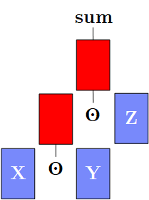
Major Compilation/Runtime Challenges
(aka Why You Should Care)
#1 Unknown/Changing Sizes
  Sizes inference crucial for cost-estimation and validity constraints (e.g., rewrites)
  Tradeoff: optimization scope vs size inference effort
  Challenge: Unknowns ➔ conservative fallback plans; rejected plan generation
#2 Operator Runtime Overhead
  Operators are great for programmability, size inference, simple compilation,
  and efficient kernel implementations (sparse, dense, compressed)
  Tradeoff: general-purpose vs specialization
  Challenges: intermediates, parallelization, complexity of operator combinations
➔ Resource-efficient Training and Inference (runtime, energy, costs)
Y = foo(X)
Z = Y[Ix,]
# nrow(Z)?

Slide 7






Terminology Ahead-of-Time / Just-in-Time
Ahead-of-Time Compilation
  Originating from compiled languages like C, C++
  #1 Program compilation at different abstraction levels
  #2 Inference program compilation & packaging
Just-In-Time Compilation (at runtime for specific data/HW)
  Originating from JIT-compiled languages like Java, C#
  #1 Lazy expression evaluation + optimization
  #2 Program/function compilation with recompilation
Excursus: Java JIT
  #1 Start w/ Java bytecode interpretation by JVM ➔ fast startup
  #2 Tiered JIT compile (cold, warm, hot, very hot, scorching) ➔ performance
  Trace statistics (frequency, time) at method granularity
  Note: -XX:+PrintCompilation
(LLVM)
PL

Slide 8
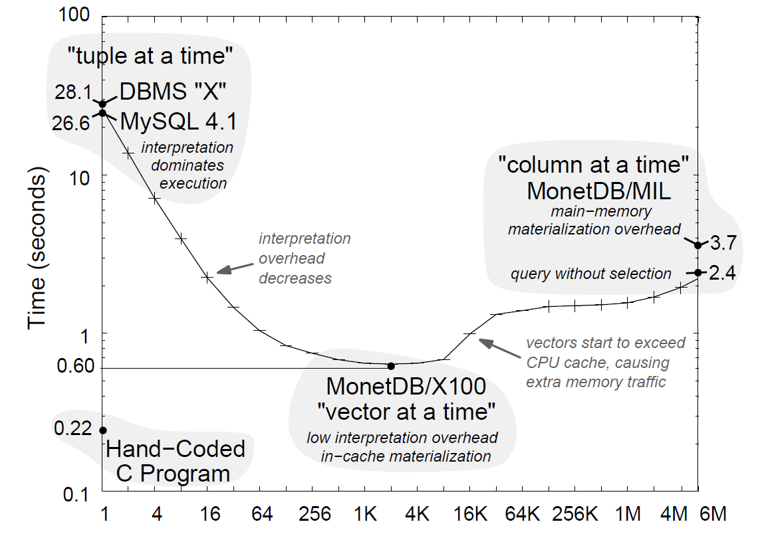
Terminology Runtime Adaptation & JIT
Excursus: Adaptive
Query Processing
  Spectrum of
  Adaptivity
Excursus: Query Execution Strategies
  #1 Volcano Iterator Model
  #2 Materialized Intermediates
  #3 Vectorized (Batched) Execution
  #4 Query Compilation
  Similar: Loop fusion, fission, tiling
[Amol Deshpande, Joseph M. Hellerstein, Shankar Raman: Adaptive query processing: why, how, when, what next. SIGMOD 2006]
DB
DB
HPC
[Peter A. Boncz, Marcin Zukowski, Niels Nes: MonetDB/X100: Hyper-Pipelining Query Execution. CIDR 2005]
Vector Size

Slide 9
Runtime Adaptation
ML Systems w/ Optimizing Compiler

Slide 10
Issues of Unknown or Changing Sizes
Problem of Unknown/Changing Sizes
  Unknown or changing sizes and sparsity of intermediates
  These unknowns lead to very conservative fallback plans (distributed ops)
#1 Control Flow
  Branches and loops
  Complex function call graphs
  User-Defined Functions
#2 Data-Dependencies
  Data-dependent operators
  (e.g., table, rmEmpty, aggregate)
  Computed size expressions
X = read(‘/tmp/X.csv’);
if( intercept )
X = cbind(X, matrix(1,nrow(X),1));
Z = foo(X) + X; # size of + and Z?
Y = table(seq(1,nrow(X)), y);
grad = t(X) %*% (P - Y);
1
3
4
223
1
11
1
1
1
d = dout[,(t-2)*M+1:(t-1)*M];
cur_Q = matrix (0, 1, 2*ncur);
cur_S = matrix (0, 1, ncur*dist);
y
Y

Slide 11
Issues of Unknown or Changing Sizes, cont.
# Example Stepwise Linear Regression
while( continue ) {
parfor( i in 1:n ) {
if( !fixed[1,i] ) {
Xi = cbind(Xg, X[,i])
B[,i] = lm(Xi,y)
}
}
# add best to Xg
# (AIC .. Akaike Information Criterion)
}
#3 Changing Dims and Sparsity
  Iterative feature selection workloads
  Changing dimensions or sparsity
  ➔ Same code with different data
#4 API Limitations
  Precompiled scripts/programs
  (inputs unavailable)
(#5 Compiler Limitations)
➔ Dynamic recompilation techniques as robust fallback strategy
  Shares goals and challenges with adaptive query processing
  However, ML domain-specific techniques and rewrites

Slide 12
Recompilation
Script
~100
ms
Language
[Matthias Boehm et al:
SystemML's Optimizer: Plan Generation for Large-Scale Machine Learning Programs. IEEE Data Eng. Bull 2014]
Parsing (syntactic analysis)
Live Variable Analysis
Validate (semantic analysis)
~10
ms
HOPs
Construct HOP DAGs
Multiple
Rounds
Static/Dynamic Rewrites
Intra-/Inter-Procedural Analysis
~1
ms
Static/Dynamic Rewrites
Static/Dynamic Rewrites
Compute Memory Estimates
Dynamic Recompilation
Compute Memory Estimates
LOPs
Construct LOP DAGs
(incl operator selection, hop-lop rewrites)
Construct LOP DAGs
(incl operator selection, hop-lop rewrites)
Other systems w/ recompile:
SciDB, MatFast
Generate Runtime Program
Generate Runtime Program
Execution Plan

Slide 13
Dynamic Recompilation
Compile-time Decisions
  Split HOP DAGs for recompilation: prevent unknowns but keep DAGs as large as possible;
  split after reads w/ unknown sizes and specific operators
  Mark HOP DAGs for recompilation:
  Spark due to unknown sizes / sparsity
R2
R3
R4
*
rm
abs
Control flow → statement blocks
→ initial recompilation granularity
R2
s
tmp1
tmp2
tmp3
*
R3
R4
(recursive rewrite)
tmp1
R1
rm
abs
R1
tmp3
s
rm
rm
tmp2
abs
+
rm
rm
abs
+
rm
rm
A
B
C
A
A
B
C
A
rm .. removeEmpty(X,
[margin=“rows”,select=I])

Slide 14
Dynamic Recompilation, cont.
Symbol Table
Dynamic Recompilation at Runtime on recompilation hooks
(last level program blocks, predicates, recompile once functions)
  Deep Copy DAG
  Replace Literals
  Update DAG Statistics
  Dynamic Rewrites
  Recompute
  Memory Estimates
  Execution Type
  Selection
  [Codegen]
  Generate
  Runtime Instructions
X | 1Mx100,99M
P | 1Mx7,7M
Y | 1Mx7,7M
[100x7,-1]
CP
[100x-1,-1]
SP
[100x-1,-1]
SP
ba(+*)
[100x1M,99M]
[1Mx7,-1]
[100x1M,-1]
CP
[1Mx-1,-1]
[100x1M,-1]
CP
SP
[1Mx-1,-1]
SP
r(t)
b(-)
X
P
Y
[1Mx100,-1]
[1Mx-1,-1]
[1Mx-1,-1]
[1Mx100,-1]
[1Mx-1,-1]
[1Mx-1,-1]
[1Mx100,99M]
[1Mx7,7M]
[1Mx7,7M]

Slide 15
Dynamic Recompilation, cont.
Recompile Once Functions
  Unknowns due to inconsistent or
  unknown call size information
  IPA marks functions as “recompile once”,
  if it contains loops
  Recompile the entire function on entry
  + disable unnecessary recompile
Recompile parfor Loops
  Unknown sizes and iterations
  Recompile parfor loop on entry
  + disable unnecessary recompile
  Create independent DAGs for
  individual parfor workers
foo = function(Matrix[Double] A)
# recompiled w/ size of A
return (Matrix[Double] C)
{
C = rand(nrow(A),1) + A;
while(...)
C = C / rowSums(C) * s
}
while( continue ) {
parfor( i in 1:n ) {
if( !fixed[1,i] ) {
Xi = cbind(Xg, X[,i])
B[,i] = lm(Xi,y)
}
}
}

Slide 16



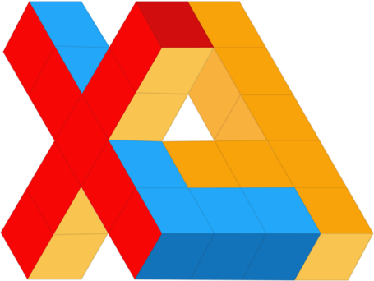

Operator Fusion & JIT Compilation
(aka Code Generation)
Many State-of-the-Art ML Systems,
especially for DNNs and numerical computation

Slide 17
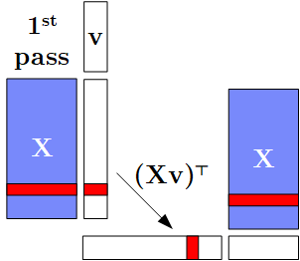
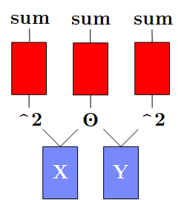
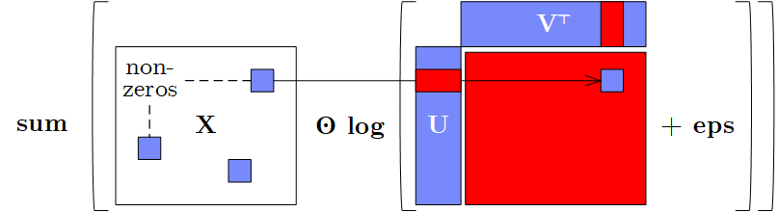
Motivation: Fusion
[Matthias Boehm et al.: On Optimizing Operator Fusion Plans for Large-Scale ML in SystemML. PVLDB 2018]
Data Flow Graphs (better data access)
  DAGs of linear algebra (LA) operations and statistical functions
  Materialized intermediates → ubiquitous fusion opportunities
a) Intermediates
b) Single-Pass
c) Multi-Aggregates
sum(X*Y*Z)
t(X)%*%(X%*%v)
→t(t(X%*%v)%*%X)
d) Sparsity Exploitation

Slide 18
Motivation: Fusion, cont.
Beware: SystemML 1.0,
Julia 0.6.2, TensorFlow 1.5
dense
Cell Template: sum(X*Y*Z)
sparse (0.1)
Row: t(X)%*%(w*(X%*%v))
dense
Outer: sum(X*log(U%*%t(V)+1e-15))
TF w/ manual rewrite
→ t(t(w*(X%*%v))%*%X):
9.2 s to 1.6 s
(compared to Gen 283ms)
20K x 20K,
rank 100

Slide 19
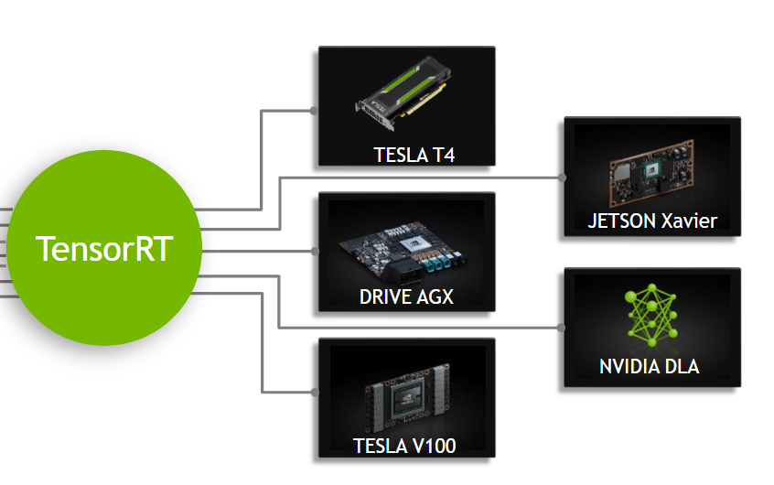
Motivation: Just-In-Time Compilation
Operator Kernels (better code)
  Specialization opportunities: data types, shapes, and operator graphs
  Heterogeneous hardware: CPUs, GPUs, FPGAs, ASICs x architectures
#1 CPU Architecture
  Specialize to available instructions sets
  Register allocation and assignment, etc
#2 Heterogeneous Hardware
  JIT compilation for custom-build
  ASICs with HW support for ML ops
  Different architectures of devices
#3 Custom ML Program
  Operator graphs and sizes
Examples: x86-64, sparc, amd64, arm, ppc
Example: NVIDIA TensorRT
GPU Platforms
[https://docs.nvidia.com/deeplearning/sdk/tensorrt-developer-guide/index.html]
Notes:
Notes: tesla (T4 inference, V100 training) -> datacenter, drive -> automotive; jetson -> embedded (e.g., robotics)

Slide 20
Operator Fusion Overview – Basic Concept
Related Research Areas
  HPC: loop fusion, tiling, and distribution (NP complete)
  DB: query compilation / ML: operator fusion (dependencies given by data flow graph)
Example
Operator
Fusion
Sparse Codegen [Credit: Fredrik Kjolstad]
  https://cs343d.github.io/lectures/lecture7.iteration1.pdf
  https://cs343d.github.io/lectures/lecture8.iteration2.pdf
R
for( i in 1:n )
tmp1[i,1] = s * B[i,1];
for( i in 1:n )
tmp2[i,1] = A[i,1] + tmp1[i,1];
for( i in 1:n )
R[i,1] = tmp2[i,1] * C[i,1];
Memory Bandwidth:
L1 core: 1TB/s
L3 socket: 400GB/s
Mem: 100 GB/s
*
+
C
[https://software.intel.com/
en-us/articles/memory-performance-in-a-nutshell]
A
*
s
B
for( i in 1:n )
R[i,1] = (A[i,1] + s*B[i,1]) * C[i,1];

Slide 21
Excursus: Operator Fusion in Large Language Models (LLMs)
Transformer Architecture
  Key component: attention mechanisms
  Slow/large memory req on long sequences
FlashAttention
  Fused kernel w/ blocking avoids
  materializing NxN attention matrix
Large Language Models
  GPT-2 based on Transformer
  GPT-3 based on SparseTransformer (dense/sparse)
  MPT-7B (May 05, 2023) based on FlashAttention
  https://www.mosaicml.com/blog/mpt-7b
[Ashish Vaswani et al: Attention is All you Need. NeurIPS 2017]
[Tri Dao et al: FlashAttention: Fast and Memory-Efficient Exact Attention with IO-Awareness. NeurIPS 2022]
7.6x
BS/MS/SHK Projects: Fused Kernels for SparseTransformers

Slide 22
Evolution of Operator Fusion in ML Systems
1st Gen: Handwritten Fused Operators
  [BLAS (since 1979): e.g., alpha * X + Y → AXPY]
  Rewrites: e.g., A+B+C → AddN(A, B, C),
  t(X) %*% (w * (X %*% v)) → MMCHAIN
  Sparsity exploiting fused ops:
  e.g., sum(X*log(U%*%t(V)+eps))
2nd Gen: Fusion Heuristics
  Automatic operator fusion via elementary ops
  Heuristics for replacing sub-DAGs w/ fused ops
3rd Gen: Optimized Fusion Plans
  Greedy/exact fusion plan (sub-DAG) selection
  [Greedy/evolutionary kernel implementations]
[Arash Ashari: On optimizing machine learning workloads via kernel fusion. PPOPP 2015]
[Matthias Boehm: SystemML: Declarative Machine Learning on Spark. PVLDB 2016]
[Tarek Elgamal et al: SPOOF: Sum-Product Optimization and Operator Fusion for Large-Scale Machine Learning. CIDR 2017]
[Matthias Boehm et al.: On Optimizing Operator Fusion Plans for Large-Scale ML in SystemML. PVLDB 2018]

Slide 23
Automatic Operator Fusion System Landscape
System | Year | Approach | Sparse | Distr. | Optimization
BTO | 2009 | Loop Fusion | No | No | k-Greedy, cost-based
Tupleware | 2015 | Loop Fusion | No | Yes | Heuristic
Kasen | 2016 | Templates | (Yes) | Yes | Greedy, cost-based
SystemML | 2017 | Templates | Yes | Yes | Exact, cost-based
Weld | 2017 | Templates | (Yes) | Yes | Heuristic
Taco | 2017 | Loop Fusion | Yes | No | Manuel
Julia | 2017 | Loop Fusion | Yes | No | Manuel
Tensorflow XLA | 2017 | Loop Fusion | No | No | Manuel/Heuristic
Tensor Comprehensions | 2018 | Loop Fusion | No | No | Evolutionary, cost-based
TVM | 2018 | Loop Fusion | No | No | ML/cost-based
PyTorch | 2019 | Loop Fusion | No | No | Manual/Heuristic
JAX | 2019 | N/A | No | No | See TF XLA
OpenAI Triton | 2021 | Loop Fusion | (Yes) | Yes | Manuel/Heuristic
JIT
Notes:
#1 Micro Optimizations
Hybrid tile-at-a-time loop fusion, predication, and result allocation
Examples: Tupleware
#2 Cross-Library Optimization
Generic IR based on parallel loops and builders
Examples: Weld
#3 Sparsity Exploitation
Exploit sparsity over chains of operations (compute, size of intermediates)
Examples: SystemML
#4 Iteration Schedules
Decisions on loop ordering (e.g., tensor storage formats, join ordering)
Examples: Taco, TVM, Mateev et al
#5 Optimizing Fusion Plans
Example: SystemML
#6 Autodifferentiation Native Python Code
Example: JAX (Autograd + XLA JIT)

Slide 24
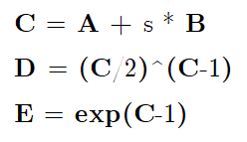
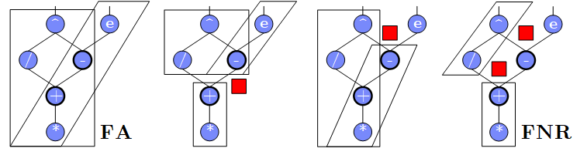
Use Case SystemDS – A Case for Optimizing Fusion Plans
Problem: Fusion heuristics → poor plans for complex DAGs (cost/structure),
sparsity exploitation, and local/distributed operations
Goal: Principled approach for optimizing fusion plans
#1 Materialization Points
(e.g., for multiple consumers)
#2 Sparsity Exploitation
(and ordering of sparse inputs)
#3 Decisions on Fusion Patterns
(e.g., template types)
#4 Constraints
(e.g., memory budget and block sizes)
Y + X * (U %*% t(V))
sparse-safe over X
➔ Search Space that
requires optimization

Slide 25
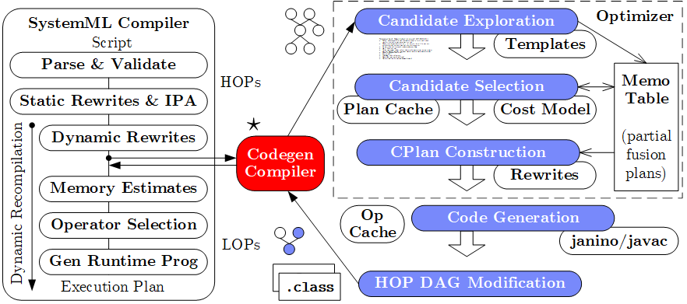
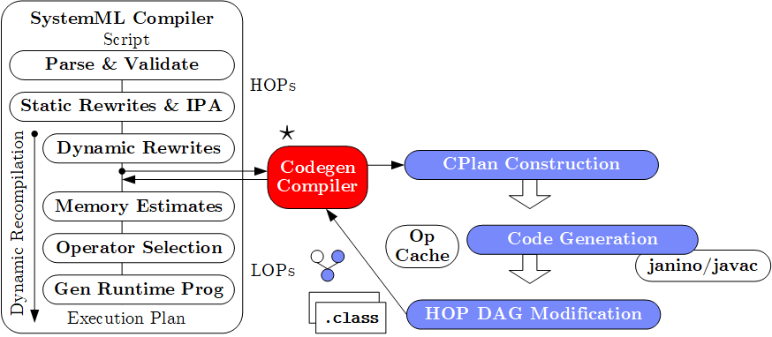
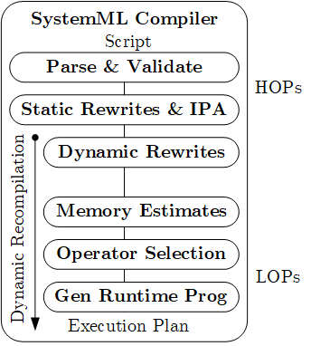

Use Case SystemDS – System Architecture
Practical, exact, cost-based optimizer
[CIDR’17] (w/ fuse-all heuristic)
Lacked maintainability
Poor plans for complex DAGs
and local/distributed operations
Templates:
Cell, Row, MAgg, Outer
w/ different data bindings
CPlan representation and codegen similar in TF XLA (HLO primitives, pre-clustering of nodes, caching, LLVM codegen)

Slide 26
Use Case SystemDS – Codegen Example L2SVM (Cell/MAgg)
L2SVM Inner Loop
# of Vector Intermediates
  Base (w/o fused ops): 10
  Fused (w/ fused ops): 4
1: while(continueOuter & iter < maxi) {
2 #...
3: while(continueInner) {
4: out = 1-Y* (Xw+step_sz*Xd);
5: sv = (out > 0);
6: out = out * sv;
7: g = wd + step_sz*dd
- sum(out * Y * Xd);
8: h = dd + sum(Xd * sv * Xd);
9: step_sz = step_sz - g/h;
10: }} ...

Slide 27
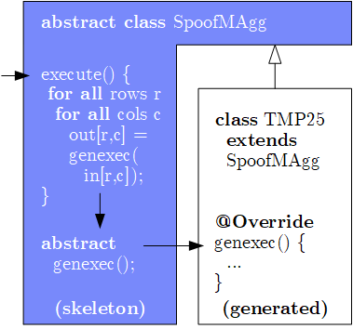
Use Case SystemDS – Codegen Example L2SVM, cont. (Cell/MAgg)
public final class TMP25 extends SpoofMAgg {
public TMP25() {
super(false, AggOp.SUM, AggOp.SUM);
}
protected void genexec(double a, SideInput[] b,
double[] scalars, double[] c, ...) {
double TMP11 = getValue(b[0], rowIndex);
double TMP12 = getValue(b[1], rowIndex);
double TMP13 = a * scalars[0];
double TMP14 = TMP12 + TMP13;
double TMP15 = TMP11 * TMP14;
double TMP16 = 1 - TMP15;
double TMP17 = (TMP16 > 0) ? 1 : 0;
double TMP18 = a * TMP17;
double TMP19 = TMP18 * a;
double TMP20 = TMP16 * TMP17;
double TMP21 = TMP20 * TMP11;
double TMP22 = TMP21 * a;
c[0] += TMP19;
c[1] += TMP22;
} }
Template Skeleton
  Data access (dense,
  sparse, compressed)
  Cache blocking
  Multi-threading
  Final aggregation
# of Vector Intermediates
  Gen (codegen ops): 0

Slide 28
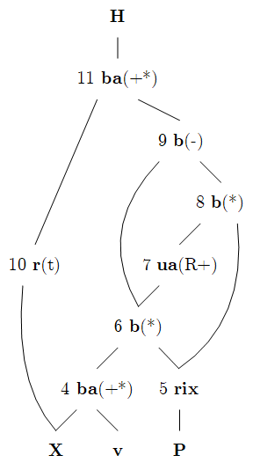
Use Case SystemDS – Codegen Example MLogreg (Row)
MLogreg Inner Loop (main expr on feature matrix X)
1: Q = P[, 1:k] * (X %*% v)
2: H = t(X) %*% (Q - P[, 1:k] * rowSums(Q))
public final class TMP25 extends SpoofRow {
public TMP25() {
super(RowType.COL_AGG_B1_T, true, 5);
}
protected void genexecDense(double[] a, int ai,
SideInput[] b, double[] c,..., int len) {
double[] TMP11 = getVector(b[1].vals(rix),...);
double[] TMP12 = vectMatMult(a, b[0].vals(rix),...);
double[] TMP13 = vectMult(TMP11, TMP12, 0, 0,...);
double TMP14 = vectSum(TMP13, 0, TMP13.length);
double[] TMP15 = vectMult(TMP11, TMP14, 0,...);
double[] TMP16 = vectMinus(TMP13, TMP15, 0, 0,...);
vectOuterMultAdd(a, TMP16, c, ai, 0, 0,...); }
protected void genexecSparse(double[] avals, int[] aix,
int ai, SideInput[] b, ..., int len) {...}
}

Slide 29
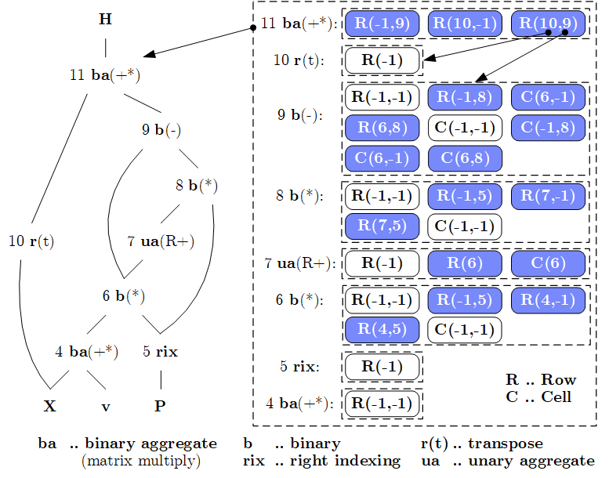
Use Case SystemDS – Candidate Exploration (by example MLogreg)
Memo Table
Memo Table for partial
fusion plans (candidates)
OFMC Template Fusion API
  Open
  Fuse, Merge
  Close
OFMC Algorithm
  Bottom-up Exploration
  (single-pass,
  template-agnostic)
  Linear space and time

Slide 30
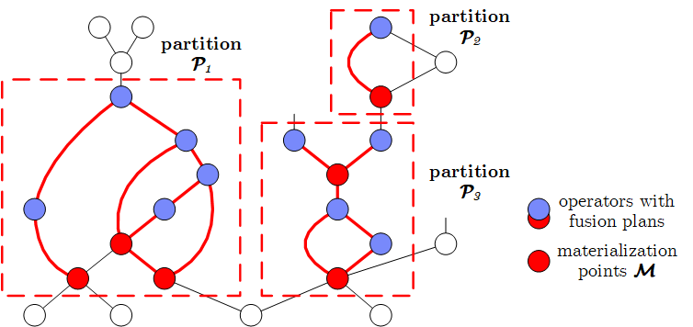
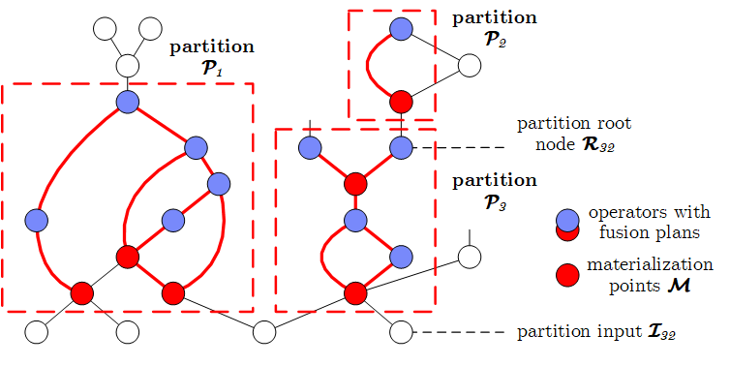
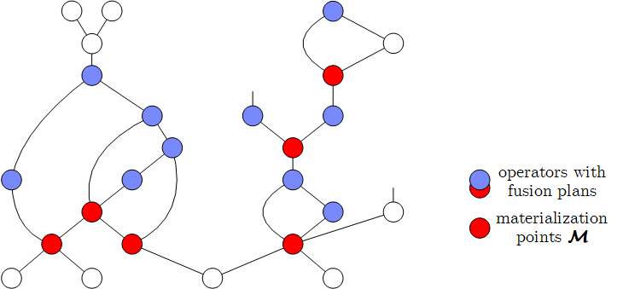
Use Case SystemDS – Candidate Selection (Partitions and Interesting Points)
#1 Determine Plan Partitions
  Materialization
  Points M
  Connected components
  of fusion references (in memo)
  Root and input nodes
  Optimize partitions
  independently
#2 Determine Interesting Points
  Materialization Point Consumers: Each data dependency on materialization points considered separately
  Template / Sparse Switches: Data dependencies where producer has templates non-applicable for consumers
  ➔ Optimizer considers all 2^{|M’i|} plans (with |M’_{i}| ≥ |M_{i}|) per partition

Slide 31
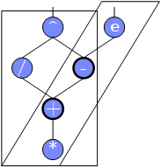
Use Case SystemDS – Candidate Selection, cont. (Costs and Constraints)
Overview Cost Model
  Cost partition with analytical cost model (see 03 Compilation)
  Plan comparisons / fusion errors don’t propagate / dynamic recompilation
#3 Evaluate Costs
  #1: Memoization of already processed sub-DAGs
  #2: Account for shared reads and CSEs within operators
  #3: Account for redundant computation (overlap)
  ➔ DAG traversal and cost vectors per fused operator
  (with memoization of pairs of operators and cost vectors)
#4 Handle Constraints
  Prefiltering violated constraints (e.g., row template in distributed ops)
  Assign infinite costs for violated constraints during costing

Slide 32
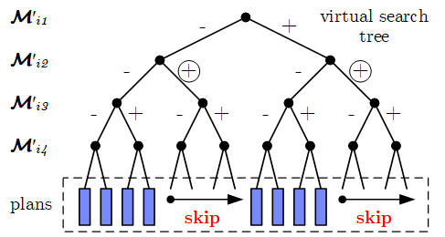
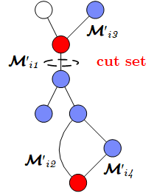
Use Case SystemDS – Candidate Selection, cont. (MPSkipEnum and Pruning)
#5 Basic Enumeration
  Linearized
  search space:
  from - to *
#6 Cost-Based Pruning
  Upper bound: cost C^{U} of best plan q* (monotonically decreasing)
  Opening heuristic: evaluate FA and FNR heuristics first
  Lower bound: C^{LS} (read input, write output, min compute) + dynamic C^{LD}
  (materialize intermediates q) ➔ skip subspace if C^{U} ≤ C^{LS +} C^{LD}
#7 Structural Pruning
  Observation: Assignments can create independent sub problems
  Build reachability graph to determine cut sets
  During enum: probe cut sets, recursive enum, combine, and skip
for( j in 1:pow(2,|M’_{i}|) )
q = createAssignment(j)
C = getPlanCost(P_{i}, q)
maintainBest(q, C)

Slide 33
Ahead-of-Time Compilation
TensorFlow tf.compile
  Compile entire TF graph into binary function w/ low footprint
  Input: Graph, config (feeds+fetches w/ fixes shape sizes)
  Output: x86 binary and C++ header (e.g., inference)
  Specialization for frozen model and sizes
PyTorch Compile
  Compile Python functions into ScriptModule/ScriptFunction
  Lazily collect operations, optimize, and JIT compile
  Explicit jit.script call or @torch.jit.script
[Chris Leary, Todd Wang: XLA – TensorFlow, Compiled!, TF Dev Summit 2017]
a = torch.rand(5)
def func(x):
for i in range(10):
x = x * x # unrolled into graph
return x
jitfunc = torch.jit.script(func) # JIT
jitfunc.save("func.pt")
[Vincent Quenneville-Bélair: How PyTorch Optimizes Deep Learning Computations, Guest Lecture Stanford 2020]

Slide 34
[Rasmus Munk Larsen, Tatiana Shpeisman: TensorFlow Graph Optimizations,
Guest Lecture Stanford 2019]
Excursus: MLIR
Motivation TF Compiler Ecosystem
  Different IRs and compilation
  chains for runtime backends
  Duplication of infrastructure
  and fragile error handling
  Adoption:
MLIR (Multi-level, Machine Learning IR)
  SSA-based IR, similar to LLVM
  Hierarchy of modules, functions, regions, blocks, and operations
  Dialects for different backends (defined ops, customization)
  Systematic lowering
[https://github.com/llvm/torch-mlir]
func @testFunction(%arg0: i32) {
%x = call @thingToCall(%arg0)
: (i32) -> i32
br ^bb1
^bb1:
%y = addi %x, %x : i32
return %y : i32
}
[Chris Lattner et al.: MLIR: Scaling Compiler Infrastructure for Domain Specific Computation. CGO 2021, https://arxiv.org/pdf/2002.11054.pdf]

Slide 35
Excursus: MLIR, cont.
(DAPHNE pre-project prototype)
while(i < max_iter) { # PageRank
p = alpha*(G%*%p) + (1-alpha)*(e%*%u%*%p);
i += 1;
}
module {
func @main() {
%0 = daphne.constant 5.000000e-01 : f64
%1 = daphne.constant 0 : i64
%2 = daphne.constant 1.000000e+00 : f64
%3 = daphne.constant 1 : i64
%4 = daphne.constant 10 : i64
%5 = daphne.rand {cols = 50 : i64, rows = 50 : i64, seed = -1 : i64, sparsity = 7.000000e-02 : f64} : () -> ...
%6, %7, %8 = ...
%9 = daphne.sub %2, %0 : (f64, f64) -> f64
%10:2 = daphne.while (%arg0 = %6, %arg1 = %1) : (!daphne.matrix<50x1xf64>, i64) -> (same) condition: {
%11 = cmpi "ult", %arg1, %4 : i64
daphne.yield %11 : i1
} body: {
%11 = daphne.mat_mul %5, %arg0 : (!daphne.matrix<50x50xf64>, !daphne.matrix<50x1xf64>) -> !daphne.matrix<50x1xf64>
%12 = daphne.mul %11, %0 : (!daphne.matrix<50x1xf64>, f64) -> !daphne.matrix<50x1xf64>
%13 = daphne.mat_mul %8, %arg0 : (!daphne.matrix<1x50xf64>, !daphne.matrix<50x1xf64>) -> !daphne.matrix<1x1xf64>
%14 = daphne.mat_mul %7, %13 : (!daphne.matrix<50x1xf64>, !daphne.matrix<1x1xf64>) -> !daphne.matrix<50x1xf64>
%15 = daphne.mul %9, %14 : (f64, !daphne.matrix<50x1xf64>) -> !daphne.matrix<50x1xf64>
%16 = daphne.add %12, %15 : (!daphne.matrix<50x1xf64>, !daphne.matrix<50x1xf64>) -> !daphne.matrix<50x1xf64>
%17 = daphne.add %arg1, %3 : (i64, i64) -> i64
daphne.yield %16, %17 : !daphne.matrix<50x1xf64>, i64
}
daphne.print %10#0 : !daphne.matrix<50x1xf64>
daphne.return
}
}
Initial translation w/o
much optimization
func @main() {
%G = daphne.rand {rows=50, cols=50, seed=-1, sparsity=0.07} : ...
%initP = daphne.rand {rows=50, cols=1, seed=-1, sparsity=1.0} : ...
%e, %u ...
%alpha = daphne.constant 0.5 : f64
%initI = daphne.constant 0 : i64
%loop:2 = daphne.while(%p = %initP, %i = %initI) :
(!daphne.matrix<?x?xf64>, i64) -> (!daphne.matrix<?x?xf64>, i64) condition: {
%max_iteration = daphne.constant 10 : i64
%c = cmpi "ult", %i, %max_iteration : i64
daphne.yield %c : i1
} body: {
%1 = daphne.mat_mul %G, %p : (!daphne.matrix<?x?xf64>, !daphne.matrix<?x?xf64>) -> !daphne.matrix<?x?xf64>
%2 = daphne.mul %alpha, %1 : (f64, !daphne.matrix<?x?xf64>) -> !daphne.matrix<?x?xf64>
%3 = daphne.mat_mul %e, %u : (!daphne.matrix<?x?xf64>, !daphne.matrix<?x?xf64>) -> !daphne.matrix<?x?xf64>
%4 = daphne.mat_mul %3, %p : (!daphne.matrix<?x?xf64>, !daphne.matrix<?x?xf64>) -> !daphne.matrix<?x?xf64>
%cst1f = daphne.constant 1.0 : f64
%5 = daphne.sub %cst1f, %alpha : (f64, f64) -> f64
%6 = daphne.mul %5, %4 : (f64, !daphne.matrix<?x?xf64>) -> !daphne.matrix<?x?xf64>
%newP = daphne.add %2, %6 : (!daphne.matrix<?x?xf64>, !daphne.matrix<?x?xf64>) -> !daphne.matrix<?x?xf64>
%cst1 = daphne.constant 1 : i64
%nextI = daphne.add %i, %cst1 : (i64, i64) -> i64
daphne.yield %newP, %nextI : !daphne.matrix<?x?xf64>, i64
}
daphne.print %loop#0 : !daphne.matrix<?x?xf64>
daphne.return
}
After Several Optimization Passes
3) Code motion outside loop
1) Shape inference of dimensions
2) Matrix multiplication chain reordered

Slide 36
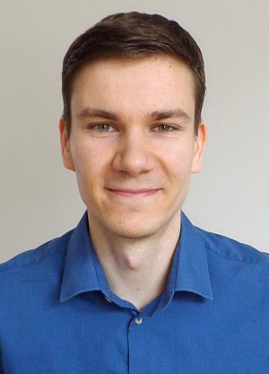

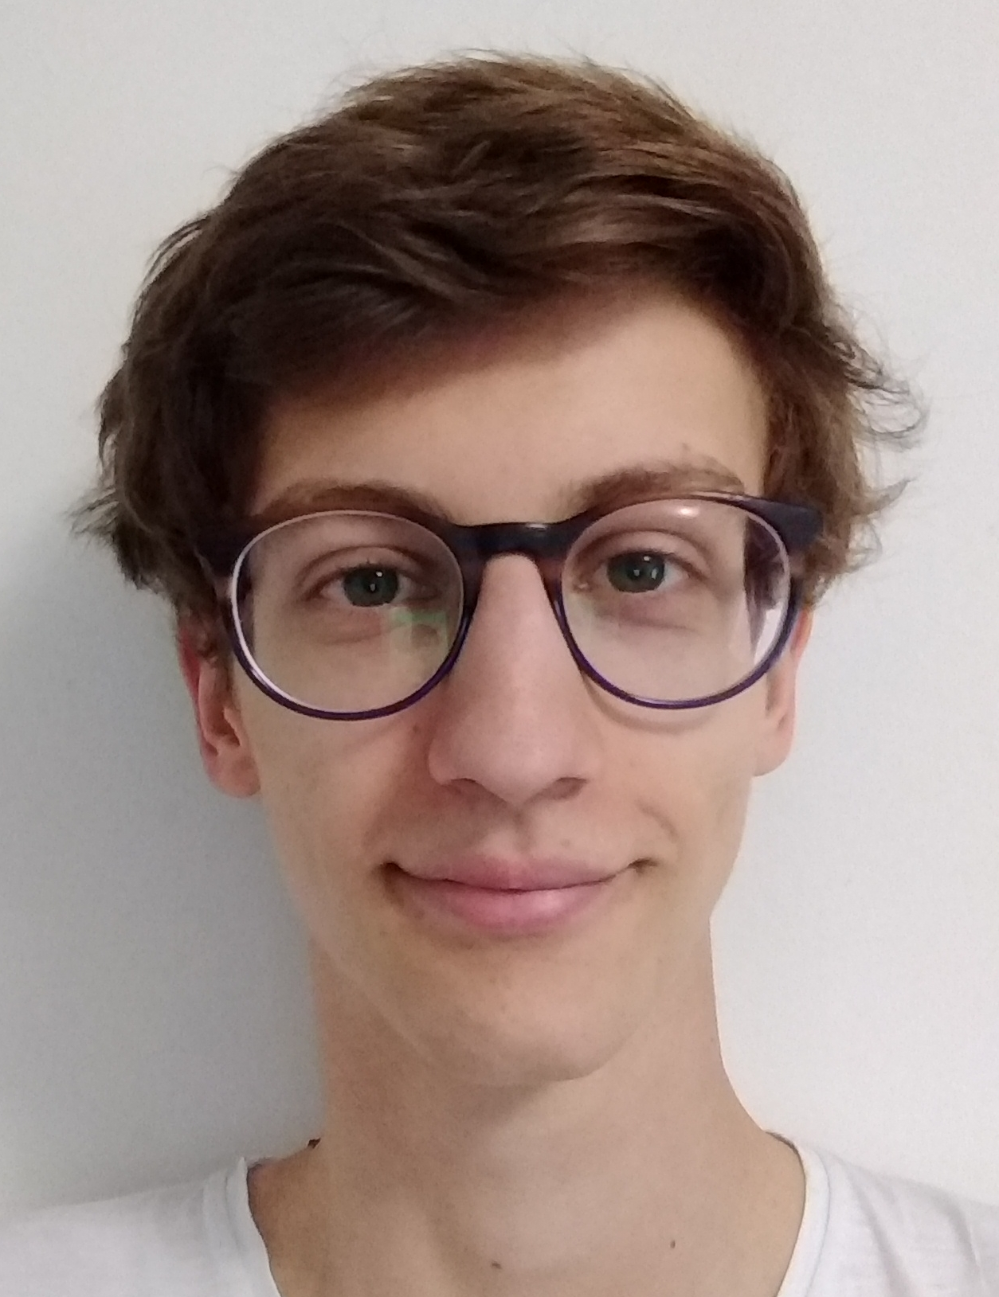
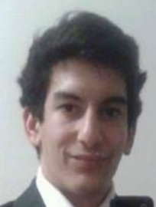
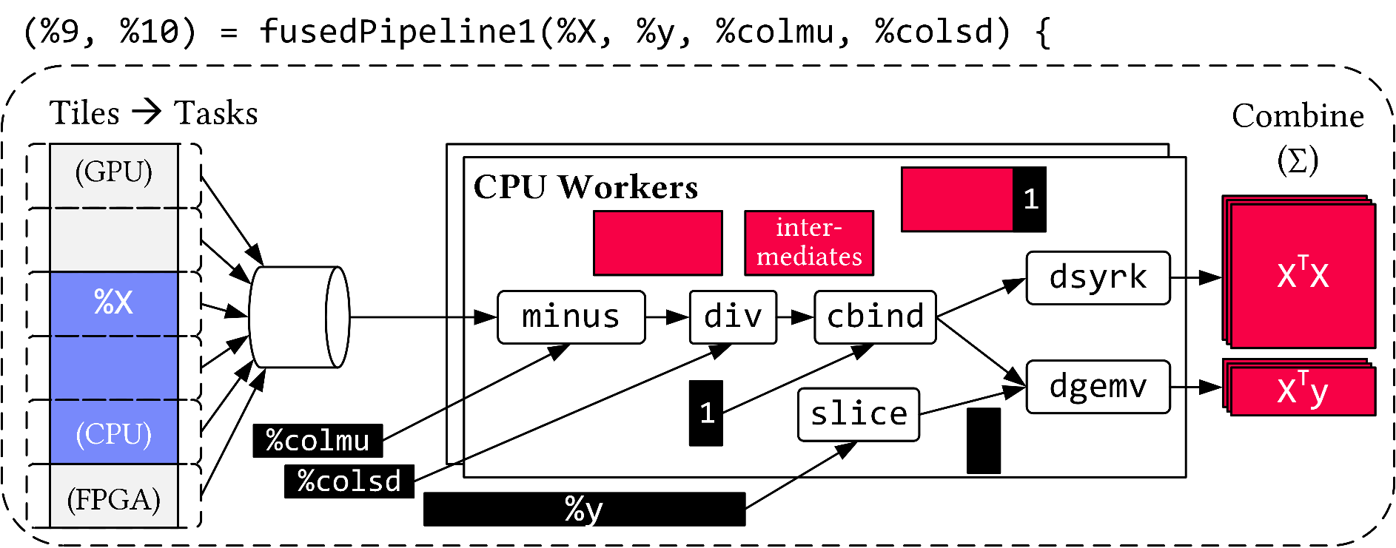
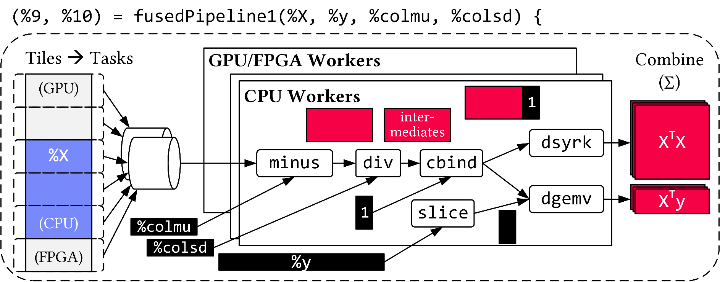
Use Case DAPHNE – Vectorized (Tiled) Execution
AH
AK
Default Parallelization
Frame & Matrix Ops
Locality-aware,
Multi-device Scheduling
Fused Operator Pipelines
on Tiles/Scalars + Codegen

Slide 37
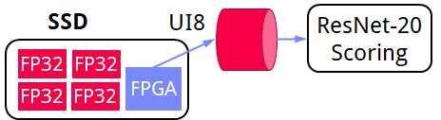
Use Case DAPHNE – Vectorized Execution
#1 Zero-copy Input Slicing
  Create view on sliced input (no-op)
  All kernels work on views
#2 Sparse Intermediates
  Reuse dense/sparse kernels
  Sparse pipeline intermediates for free
#3 Fine-grained Control
  Task sizes (dequeue, data access) vs data binding (cache-conscious ops)
  Scheduling for load balance (e.g., sparse operations)
#4 Computational Storage
  Task queues connect eBPF programs,
  async I/O into buffers, and op pipelines

Slide 38

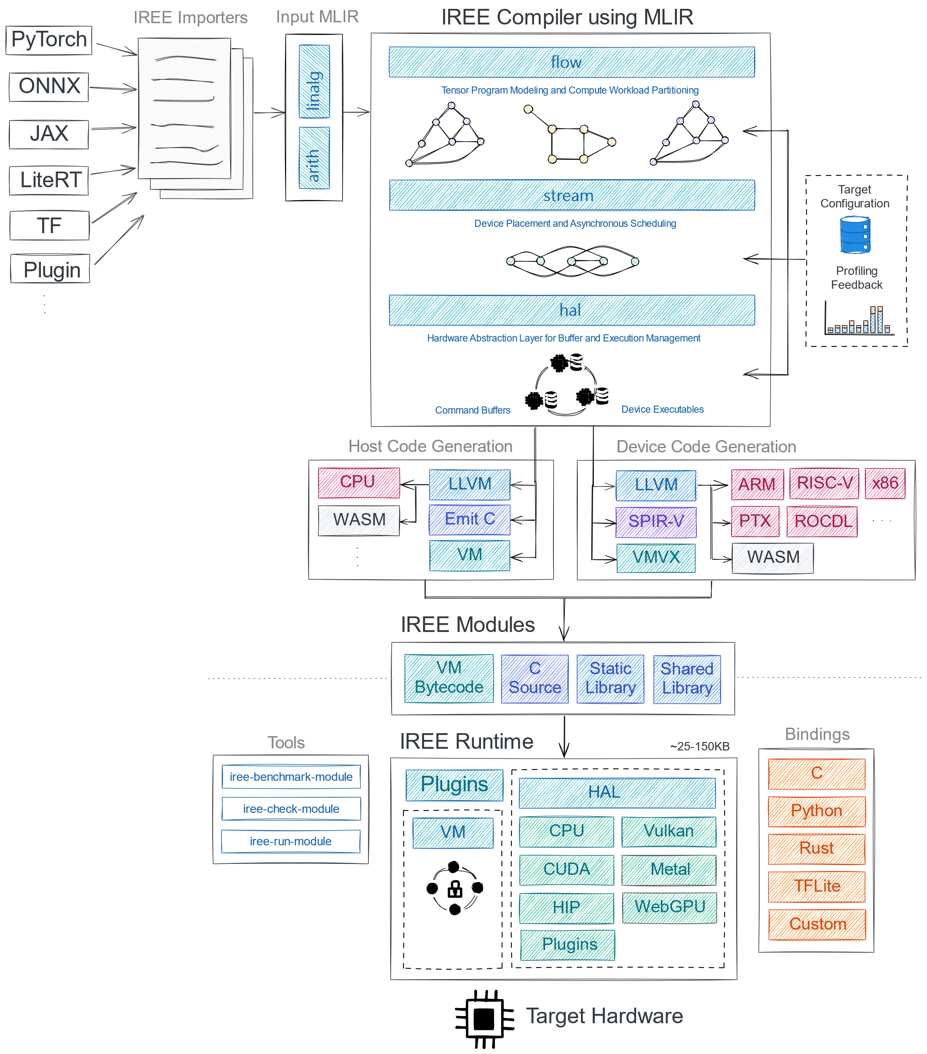
IREE
Overview
  MLIR-based end-to-end
  compiler and runtime
  ML inference in
  data-centers and edge-deployments
  Small deployment footprint
System Architecture
[https://github.com/
iree-org/iree]

Slide 39
Summary & QA
Recommended Reading
Motivation and Terminology
Runtime Adaptation
Operator Fusion & JIT
➔ Impact of Size Inference and Costs (lecture 03)
➔ Ubiquitous Rewrite, Fusion, and Codegen/JIT Opportunities
Next Lectures (Runtime Aspects)
  05 Data- and Task-Parallel Execution (batch/prog) [May 15]
  06 Parameter Servers (mini-batch) [May 22]
  07 LLM Training and Inference [Jun 05]
  08 Hybrid Execution and HW Accelerators [Jun 12]
  09 Caching, Partitioning, Indexing and Compression [Jun 19]
[Chris Leary, Todd Wang: XLA –
TensorFlow, Compiled!, TF Dev Summit 2017, https://www.youtube.com/watch?v=kAOanJczHA0]

