Slide 1

Architecture of ML Systems (AMLS)
05 Data- and Task-Parallel Execution
Prof. Dr. Matthias Boehm
Technische Universität Berlin
Berlin Institute for the Foundations of Learning and Data
Big Data Engineering (DAMS Lab)
Last update: May 15, 2025

Slide 2

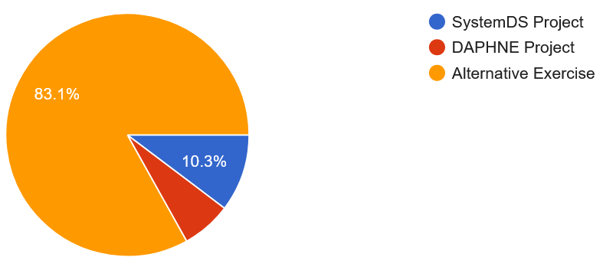
Announcements / Org
#1 Hybrid & Video Recording
  Hybrid lectures (in-person, zoom) with optional attendance
  https://tu-berlin.zoom.us/j/9529634787?pwd=R1ZsN1M3SC9BOU1OcFdmem9zT202UT09
  Zoom video recordings, links from website
  https://mboehm7.github.io/teaching/ss25_amls/index.htm
#2 Projects and Exercises
  Project Selection May 01
  Mentoring emails for projects May 08, two corrections
  Alternative exercise still possible
164 students
in 96 teams

Slide 3
Agenda
Motivation and Terminology
Background MapReduce and Spark
Data-Parallel Execution
Task-Parallel Execution

Slide 4
Motivation and Terminology

Slide 5
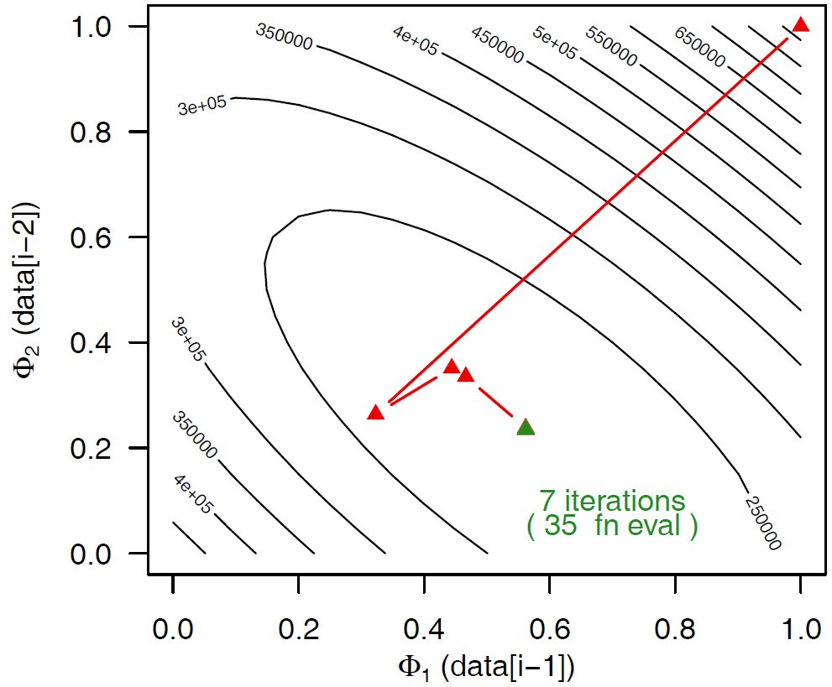
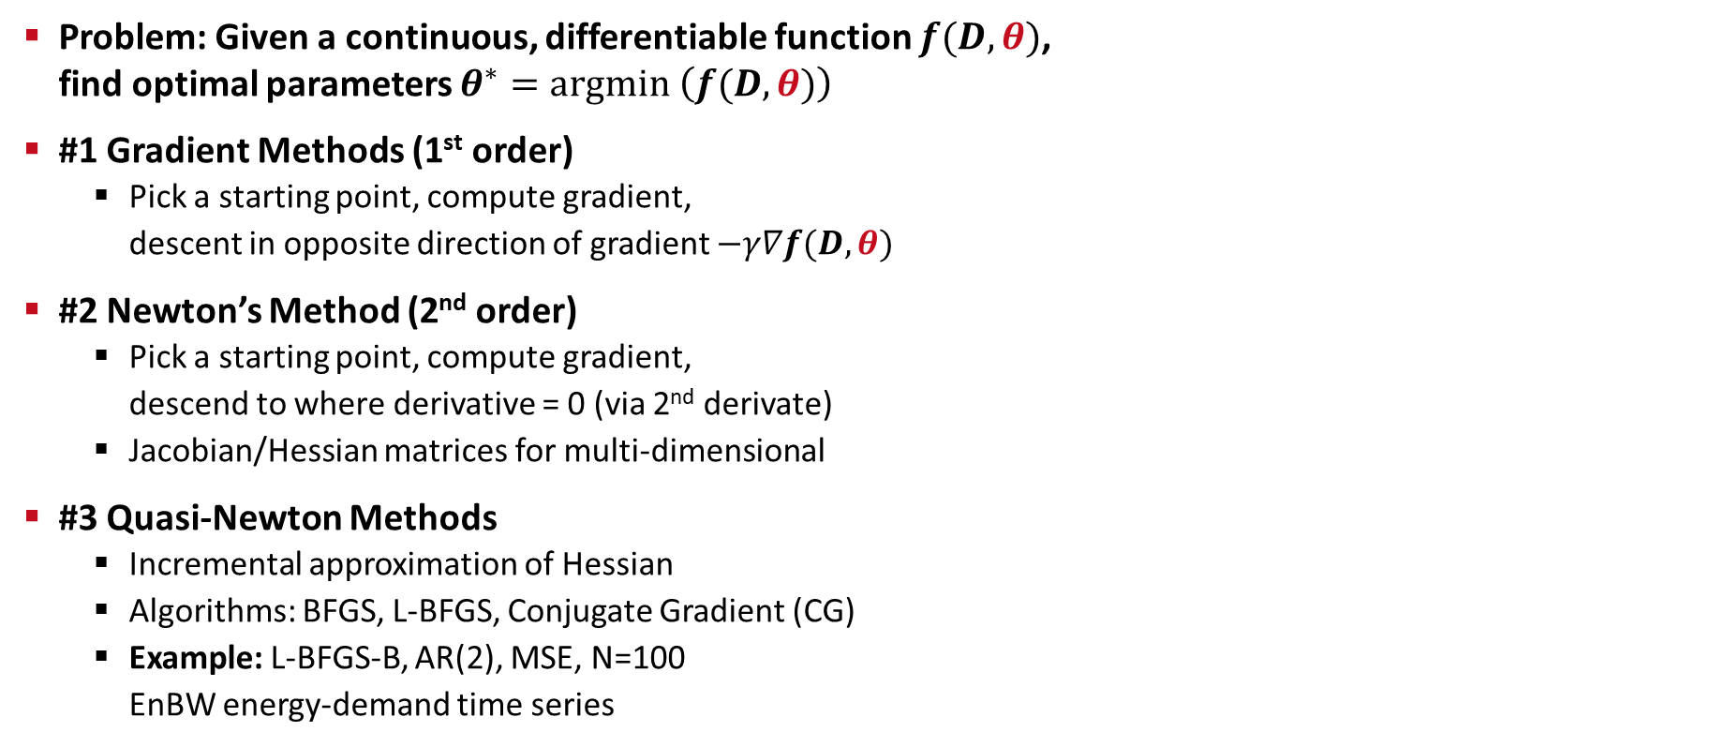
Terminology Optimization Methods
Problem: Given a continuous, differentiable function $f(D,θ)$,
find optimal parameters $θ^{∗}=argmin \left(f(D,θ)\right)$
#1 Gradient Methods (1st order)
  Pick a starting point, compute gradient,
  descent in opposite direction of gradient $−γ∇f(D,θ)$
#2 Newton’s Method (2nd order)
  Pick a starting point, compute gradient,
  descend to where derivative = 0 (via 2nd derivate)
  Jacobian/Hessian matrices for multi-dimensional
#3 Quasi-Newton Methods
  Incremental approximation of Hessian
  Algorithms: BFGS, L-BFGS, Conjugate Gradient (CG)
  Example: L-BFGS-B, AR(2), MSE, N=100
  EnBW energy-demand time series
θ₂
θ₁
x₂
x₃
x₁
x₀
θ₁

Slide 6
Terminology Batch/Mini-batch
Batch ML Algorithms
  Iterative ML algorithms, where each iteration
  uses the entire dataset to compute gradients ΔW
  For (pseudo-)second-order methods, many features
  Dedicated optimizers for traditional ML algorithms
Mini-batch ML Algorithms
  Iterative ML algorithms, where each iteration
  only uses a batch of rows to make the
  next model update (in epochs or w/ sampling)
  For large and highly redundant training sets
  Applies to almost all iterative, model-based
  ML algorithms (LDA, reg., class., factor., DNN)
  Stochastic Gradient Descent (SGD)
Data
W’
Data
Batch 1
W’
Batch 2
W’’
Epoch

Slide 7
Recap: Central Data Abstractions
#1 Files and Objects
  File: Arbitrarily large sequential data in specific file format (CSV, binary, etc)
  Object: binary large object, with certain meta data
#2 Distributed Collections
  Logical multi-set (bag) of key-value pairs
  (unsorted collection)
  Different physical representations
  Easy distribution of pairs
  via horizontal partitioning
  (aka shards, partitions)
  Can be created from single file,
  or directory of files (unsorted)
Key | Value
4 | Delta
2 | Bravo
1 | Alfa
3 | Charlie
5 | Echo
6 | Foxtrot
7 | Golf
1 | Alfa

Slide 8
Terminology Parallelism
Single Data
Multiple Data
SISD
(uni-core)
SIMD
(vector)
Single Instruction
Flynn’s Classification
  SISD, SIMD
  (MISD), MIMD
Example: SIMD Processing
  Streaming SIMD Extensions (SSE)
  Process the same operation on multiple elements
  at a time (packed vs scalar SSE instructions)
  Data parallelism (aka: instruction-level parallelism)
  Example: VFMADD132PD
[Michael J. Flynn, Kevin W. Rudd: Parallel Architectures. ACM Comput. Surv. 28(1) 1996]
MISD
(pipelining)
MIMD
(multi-core)
Multiple Instruction
2009 Nehalem: 128b (2xFP64)
2012 Sandy Bridge: 256b (4xFP64)
2017 Skylake: 512b (8xFP64)
c = _mm512_fmadd_pd(a, b);
a
b
c

Slide 9
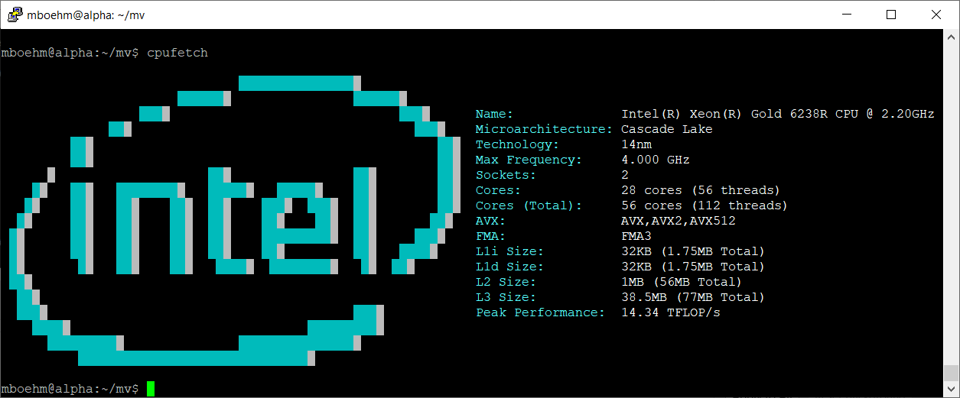
Excursus: Peak Performance
Example Scale-up Node (DM cluster)
  Peak := 2 Sockets * 28 Cores * 2.2 GHz * 2 FMA units * 16 FP32 slots (AVX512) * 2 (FMA)
  = 7.7 TFLOP/s (FP32) = 3.85 TFLOP/s (FP64)
SystemDS matmult w/ BLAS (Intel MKL):
2.23 TFLOP/s (FP64)

Slide 10
Terminology Parallelism, cont.
Distributed, Data-Parallel Computation
  Parallel computation of function foo() ➔ single instruction
  Collection X of data items (key-value pairs) ➔ multiple data
  Data parallelism similar to SIMD but more
  coarse-grained notion of “instruction” and “data”
  ➔ SPMD (single program, multiple data)
Additional Terminology
  BSP: Bulk Synchronous Parallel (global barriers)
  ASP: Asynchronous Parallel (no barriers, often with accuracy impact)
  SSP: Stale-synchronous parallel (staleness constraint on fastest-slowest)
  Other: Fork&Join, Hogwild!, event-based, decentralized
Beware: data parallelism used in very different contexts (e.g., Parameter Server)
Y = X.map(x -> foo(x))
[Frederica Darema: The SPMD Model : Past, Present and Future. PVM/MPI 2001]

Slide 11
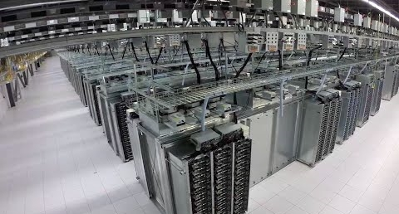
Recap: Fault Tolerance & Resilience
[Google Data Center: https://www.youtube.com/watch?v=XZmGGAbHqa0]
Resilience Problem
  Increasing error rates at scale (soft/hard mem/disk/net errors)
  Robustness for preemption
  Need for cost-effective resilience
Fault Tolerance in Large-Scale Computation
  Block replication in distributed file systems
  ECC; checksums for blocks, broadcast, shuffle
  Checkpointing (all task outputs / on request)
  Lineage-based recomputation for recovery in Spark
ML-specific Approaches (exploit app characteristics)
  Estimate contribution from lost partition to avoid strugglers
  Example: user-defined “compensation” functions
  Model replication and checkpointing (e.g., for LLMs)
[Sebastian Schelter, Stephan Ewen, Kostas Tzoumas, Volker Markl: "All roads lead to Rome": optimistic recovery for distributed iterative data processing. CIKM 2013]

Slide 12
Categories of Execution Strategies
Batch
SIMD/SPMD
Independent
Tasks
MIMD
Mini-batch,
Federated,
RL
Self-supervised, supervised,
RL
05_{a} Data-Parallel Execution
05_{b} Task-Parallel Execution
06 Parameter Servers (data, model)
07 LLM Training
(dense, MoE)
05_{a} Data-Parallel Execution
05_{b} Task-Parallel Execution
08 Hybrid Execution and HW Accelerators
09 Caching, Partitioning, Indexing, and Compression

Slide 13
Background MapReduce and Spark
(Data-Parallel Collection Processing)
Abstractions for Fault-tolerant,
Distributed Storage and Computation

Slide 14

Hadoop History and Architecture
Recap: Brief History
  Google’s GFS [SOSP’03] + MapReduce
  → Apache Hadoop (2006)
  Apache Hive (SQL), Pig (ETL), Mahout (ML), Giraph (Graph)
Hadoop Architecture / Eco System
  Management (Ambari)
  Coordination / workflows
  (Zookeeper, Oozie)
  Storage (HDFS)
  Resources (YARN)
  [SoCC’13]
  Processing
  (MapReduce)
[Jeffrey Dean, Sanjay Ghemawat: MapReduce: Simplified Data Processing on Large Clusters. OSDI 2004]
Worker Node 1
Worker Node n
MR AM
MR task
MR task
MR task
Head Node
MR task
MR task
MR task
MR task
Resource Manager
Node Manager
Node Manager
NameNode
MR Client
DataNode
DataNode
1
3
2
3
2
9

Slide 15
MapReduce – Programming Model
Overview Programming Model
  Inspired by functional programming languages
  Implicit parallelism (abstracts distributed storage and processing)
  Map function: key/value pair → set of intermediate key/value pairs
  Reduce function: merge all intermediate values by key
Example
SELECT Dep, count(*) FROM csv_files GROUP BY Dep
Name | Dep
X | CS
Y | CS
A | EE
Z | CS
map(Long pos, String line) {
parts ← line.split(“,”)
emit(parts[1], 1)
}
CS | 1
CS | 1
EE | 1
CS | 1
reduce(String dep,
Iterator<Long> iter) {
total ← iter.sum();
emit(dep, total)
}
Collection of key/value pairs
CS | 3
EE | 1

Slide 16
MapReduce – Execution Model
#1 Data Locality (delay sched., write affinity)
#2 Reduced shuffle (combine)
#3 Fault tolerance (replication, attempts)
Input CSV files (stored in HDFS)
Map-Phase
map
task
[Reduce-Phase]
Output Files (HDFS)
CSV File 1
Split 11
map
task
Split 12
reduce
task
Out 1
Split 21
map
task
CSV File 2
reduce
task
Out 2
Split 22
map
task
reduce
task
Out 3
CSV File 3
Split 31
map
task
Split 32
map
task
Shuffle, Merge, [Combine]
Sort, [Combine], [Compress]
w/ #reducers = 3

Slide 17

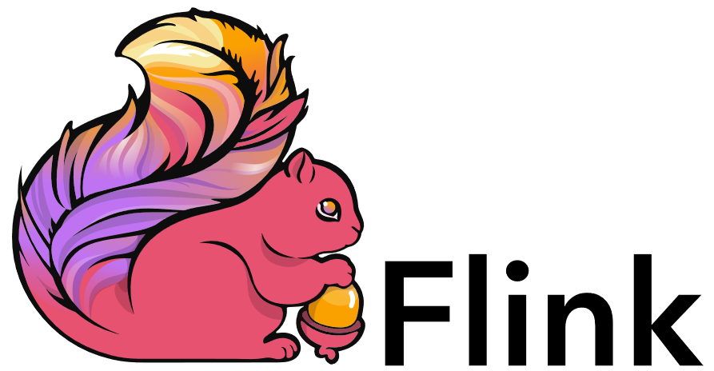
Spark History and Architecture
Summary MapReduce
  Large-scale & fault-tolerant processing w/ UDFs and files ➔ Flexibility
  Restricted functional APIs ➔ Implicit parallelism and fault tolerance
  Criticism: #1 Performance, #2 Low-level APIs, #3 Many different systems
Evolution to Spark (and Flink)
  Spark [HotCloud’10] + RDDs [NSDI’12] → Apache Spark (2014)
  Design: standing executors with in-memory storage, lazy evaluation, fault-tolerance via RDD lineage
  Performance: In-memory storage and fast job scheduling (100ms vs 10s)
  APIs: Richer functional APIs and general computation DAGs,
  high-level APIs (e.g., DataFrame/Dataset), unified platform
➔ But many shared concepts/infrastructure
  Implicit parallelism through dist. collections (data access, fault tolerance)
  Resource negotiators (YARN, Mesos, Kubernetes)
  HDFS and object store connectors (e.g., Swift, S3)

Slide 18
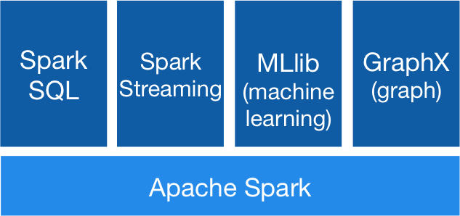


Spark History and Architecture, cont.
[https://spark.apache.org/]
High-Level Architecture
  Different language bindings:
  Scala, Java, Python, R
  Different libraries:
  SQL, ML, Stream, Graph
  Spark core (incl RDDs)
  Different cluster managers:
  Standalone, Mesos, Yarn, Kubernetes
  Different file systems/
  formats, and data sources:
  HDFS, S3, SWIFT, DBs, NoSQL
Focus on a unified platform
for data-parallel computation (Apache Flink w/ similar goals)
Standalone
MESOS
YARN
Kubernetes

Slide 19
Spark Resilient Distributed Datasets (RDDs)
RDD Abstraction
  Immutable, partitioned
  collections of key-value pairs
  Coarse-grained deterministic operations (transformations/actions)
  Fault tolerance via lineage-based re-computation
Operations
  Transformations: define new RDDs
  Actions: return result to driver
Distributed Caching
  Use fraction of worker memory for caching
  Eviction at granularity of individual partitions
  Different storage levels (e.g., mem/disk x serialization x compression)
JavaPairRDD<MatrixIndexes,MatrixBlock>
Type | Examples
Transformation (lazy) | map, hadoopFile, textFile, flatMap, filter, sample, join, groupByKey, cogroup, reduceByKey, cross, sortByKey, mapValues
Action | reduce, save, collect, count, lookupKey
Node1
Node2

Slide 20
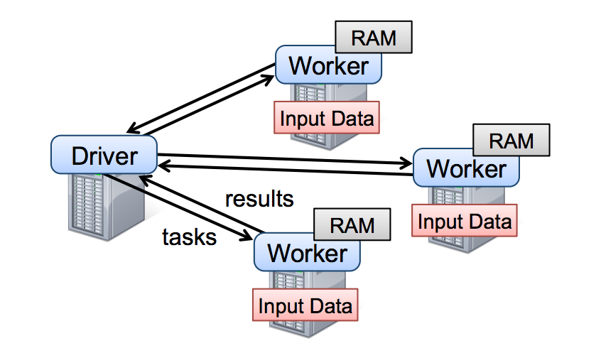
Spark Resilient Distributed Datasets (RDDs), cont.
X.filter(foo())
X.mapValues(foo())
X.reduceByKey(foo())
X.cache()/X.persist(…)
Lifecycle of an RDD
  Note: can’t broadcast
  an RDD directly
sc.parallelize(lst)
Local Data
(value, collection)
Distributed Collection
lst = X.collect()
v = X.reduce(foo())
sc.hadoopFile(f)
sc.textFile(f)
X.saveAsObjectFile(f)
X.saveAsTextFile(f)
File on DFS

Slide 21
Spark Partitions and Implicit/Explicit Partitioning
Spark Partitions
  Logical key-value collections are split into physical partitions
  Partitions are granularity of tasks, I/O, shuffling, evictions
Partitioning via Partitioners
  Implicitly on every data shuffling
  Explicitly via R.repartition(n)
Partitioning-Preserving
  All operations that are guaranteed to keep keys unchanged
  (e.g. mapValues(), mapPartitions() w/ preservesPart flag)
Partitioning-Exploiting
  Join: R3 = R1.join(R2)
  Lookups:
  v = C.lookup(k)
~128MB
Example Hash Partitioning:
For all (k,v) of R:
pid = hash(k) % n
Hash partitioned
⋈
⋈
0: 8, 1, 6
0: 1, 2
% 3
0: 3, 6
0: 6, 3
2: 2, 3, 4
2: 3, 4
2: 2, 5, 8
2: 5, 2
1: 7, 5
1: 5, 6
1: 4, 7, 1
1: 4, 1

Slide 22
Spark Lazy Evaluation, Caching, and Lineage
[Matei Zaharia, Mosharaf Chowdhury, Tathagata Das, Ankur Dave, Justin Ma, Murphy McCauly, Michael J. Franklin, Scott Shenker, Ion Stoica: Resilient Distributed Datasets: A Fault-Tolerant Abstraction for In-Memory Cluster Computing. NSDI 2012]
A
B
partitioning- aware
G
Stage 1
groupBy
C
D
F
reduce
Reduce action triggers DAG compilation and evaluation
DAG compiled into job of multiple stages (3 here), demarcated by wide shuffle dependencies
Lost/evicted cached partitions are
re-evaluated via partition lineage
map
union
E
join
Stage 2
Stage 3
cached

Slide 23




Data-Parallel Execution
Batch ML Algorithms

Slide 24
Background: Matrix Formats
Example
3x3 Matrix
Matrix Block (m x n)
  A.k.a. tiles/chunks, most operations defined here
  Local matrix: single block, different representations
Common Block Representations
  Dense (linearized arrays)
  MCSR (modified CSR)
  CSR (compressed sparse rows), CSC
  COO (Coordinate matrix)
.7
.1
.2
.4
.3
MCSR
CSR
COO
0
2
0
0
.7
0
0
.7
.7
.1
2
2
.1
0
2
.1
0
1
4
0
.2
1
0
.2
Dense (row-major)
.2
.4
5
1
.4
1
1
.4
.7
0
.1
.2
.4
0
0
.3
0
1
1
.3
2
1
.3
.3
O(mn)
O(m + nnz(X))
O(nnz(X))
Notes:
Note: specialized formats like double-compressed CSR existing (indicator for non-zero rows)

Slide 25
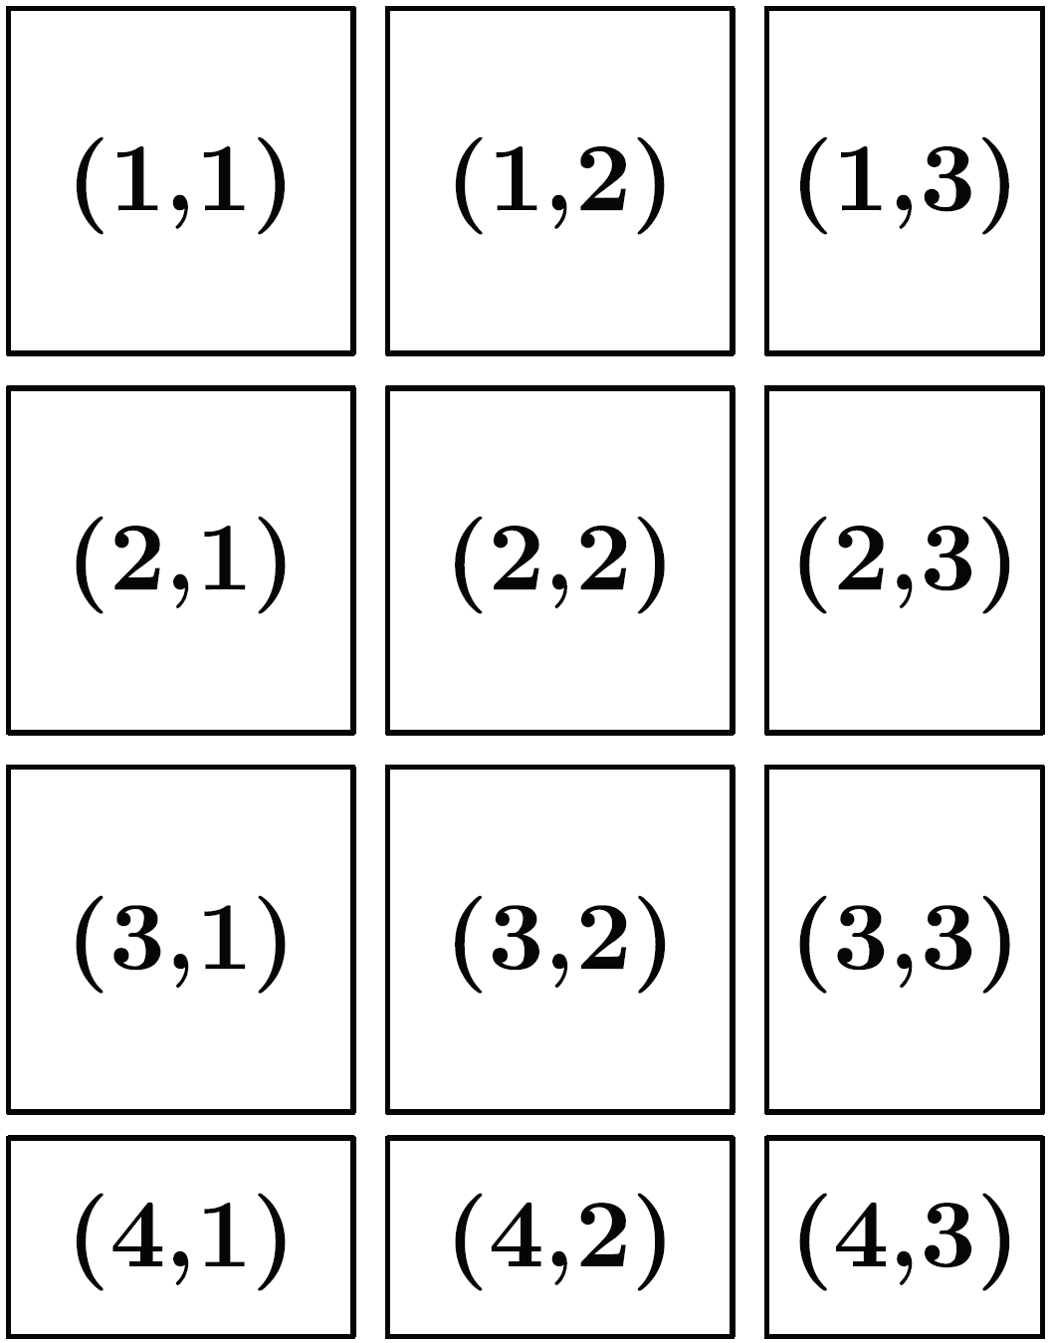
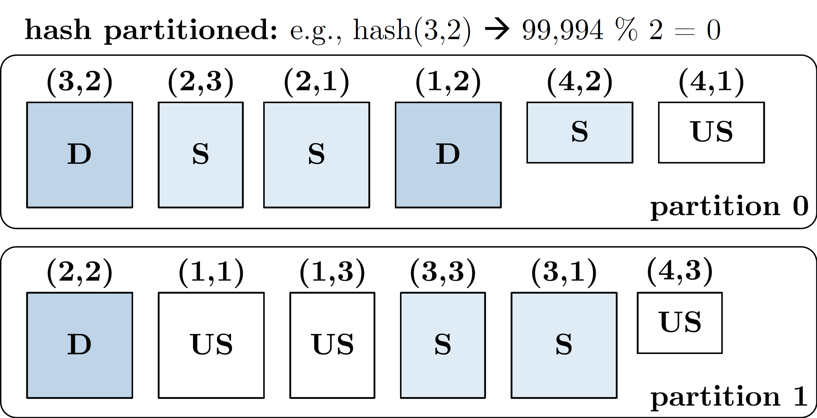
Distributed Matrix Representations
Collection of “Matrix Blocks” (and keys)
  Bag semantics (duplicates, unordered)
  Logical (Fixed-Size) Blocking
  + join processing / independence
  - (sparsity skew)
  E.g., SystemML on Spark:
  JavaPairRDD<MatrixIndexes,MatrixBlock>
  Blocks encoded independently (dense/sparse)
Partitioning
  Logical Partitioning
  (e.g., row-/column-wise)
  Physical Partitioning
  (e.g., hash / grid)
  Influences partition-local aggregation
Logical Blocking 3,400x2,700 Matrix
(w/ B_{c}=1,000)
Physical Blocking
and Partitioning

Slide 26
Distributed Matrix Representations, cont.
#1 Block-partitioned Matrices
  Fixed-size, square or rectangular blocks
  Pros: Input/output alignment, block-local transpose,
  amortize block overheads, bounded mem, cache-conscious
  Cons: Converting row-wise inputs (e.g., text) requires shuffle
  Examples: RIOT, PEGASUS, SystemML, SciDB, Cumulon,
  Distributed R, DMac, Spark Mllib, Gilbert, MatFast, and SimSQL
#2 Row/Column-partitioned Matrices
  Collection of row indexes and rows (or columns respectively)
  Pros: Seamless data conversion and access to entire rows
  Cons: Storage overhead in Java, and cache unfriendly operations
  Examples: Spark MLlib, Mahout Samsara, Emma, SimSQL
#3 Algorithm-specific Partitioning
  Operation and algorithm-centric data representations (e.g., matrix inverse, matrix factorization)

Slide 27
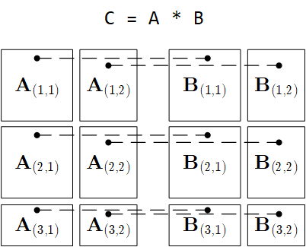
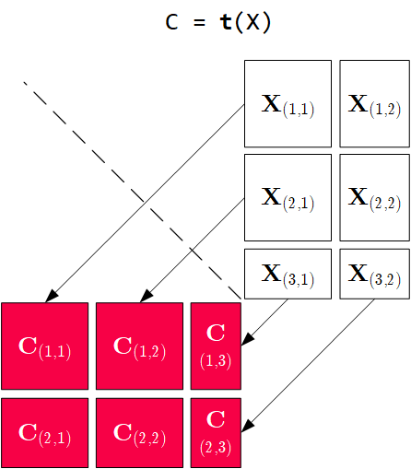
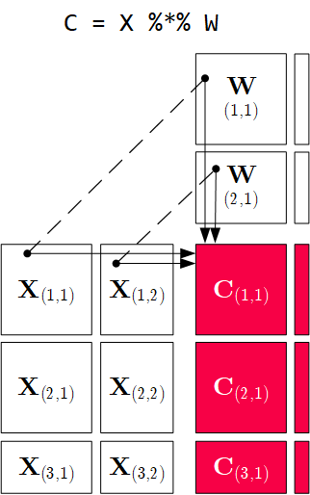
Distributed Matrix Operations
Elementwise Multiplication
(Hadamard Product)
Transposition
Matrix Multiplication
1:N / N:M joins
1:1 join
Note: also with row/column vector rhs

Slide 28
Physical Operator Selection – Example Matrix Multiplication
Common Selection Criteria
  Data and cluster characteristics (e.g., data size/shape, diagonal/symmetric, memory, parallelism)
  Operation and data-flow properties (e.g., sparse-safe ops, co-partitioning, co-location, data locality)
#0 Local Operators
  SystemML mm, tsmm, mmchain; Samsara/Mllib local
#1 Special Operators (special patterns/sparsity)
  SystemML tsmm, mapmmchain; Samsara AtA
#2 Broadcast-Based Operators (aka broadcast join)
  SystemML mapmm, mapmmchain
#3 Co-Partitioning-Based Operators (aka improved repartition join)
  SystemML zipmm; Emma, Samsara OpAtB
#4 Shuffle-Based Operators (aka repartition join)
  SystemML cpmm, rmm; Samsara OpAB
t(X) %*% (X%*%v)
1st
pass
v
2nd
pass
X
q┬
X

Slide 29
Physical Operator Selection – Example Matrix Multiplication, cont.
Examples
Distributed
MM Operators
Y
_{1,1}
Y_{1,1}
Y_{1,2}
Broadcast-based MM (mapmm)
Shuffle-based MM (cpmm)
Y
_{2,1}
Y_{2,1}
Y_{2,2}
X_{1,1}
X_{1,2}
Y_{3,1}
Y_{3,2}
X_{2,1}
X_{2,2}
Y_{4,1}
Y_{4,2}
X_{3,1}
X_{3,2}
X_{1,1}
X_{1,2}
X_{1,3}
X_{1,4}
X_{4,1}
X_{4,2}
X_{2,1}
X_{2,2}
X_{2,3}
X_{2,4}

Slide 30
Partitioning-Preserving Operations
Shuffle is major bottleneck for ML on Spark
Preserve Partitioning
  Op is partitioning-preserving if keys unchanged (guaranteed)
  Implicit: Use restrictive APIs (mapValues() vs mapToPair())
  Explicit: Partition computation w/ declaration of partitioning-preserving
Exploit Partitioning
  Implicit: Operations based on join, cogroup, etc
  Explicit: Custom operators (e.g., zipmm)
Example: Multiclass SVM
  Vectors fit neither into
  driver nor broadcast
  ncol(X) ≤ B_{c}
repart, chkpt X MEM_DISK
parfor(iter_class in 1:num_classes) {
Y_local = 2 * (Y == iter_class) - 1
g_old = t(X) %*% Y_local
...
while( continue ) {
Xd = X %*% s
... inner while loop (compute step_sz)
Xw = Xw + step_sz * Xd;
out = 1 - Y_local * Xw;
out = (out > 0) * out;
g_new = t(X) %*% (out * Y_local) ...
chkpt y_local MEM_DISK
chkpt Xd, Xw MEM_DISK
zipmm

Slide 31
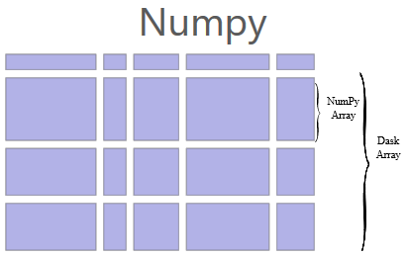
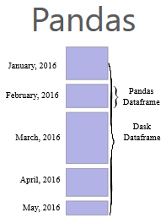
[Matthew Rocklin: Dask: Parallel Computation with Blocked algorithms and Task Scheduling, Python in Science 2015]
[Dask Development Team: Dask: Library for dynamic task scheduling, 2016, https://dask.org]
Dask
Overview Dask
  Multi-threaded and distributed operations for arrays, bags, and dataframes
  dask.array: list of numpy n-dim arrays
  dask.dataframe: list of pandas data frames
  dask.bag:unordered list of tuples (second order functions)
  Local and distributed schedulers:
  threads, processes, YARN, Kubernetes, containers, HPC, and cloud, GPUs
Execution
  Lazy evaluation
  Limitation: requires static size inference
  Triggered via compute()
Discussion
  PySpark Competition (but not out-of-core), scalable ML
  algorithms via https://ml.dask.org/ (partnering w/ scikit-learn)
import dask.array as da
x = da.random.random(
(10000,10000), chunks=(1000,1000))
y = x + x.T
y.persist() # cache in memory
z = y[::2, 5000:].mean(axis=1) # colMeans
ret = z.compute() # returns NumPy array

Slide 32
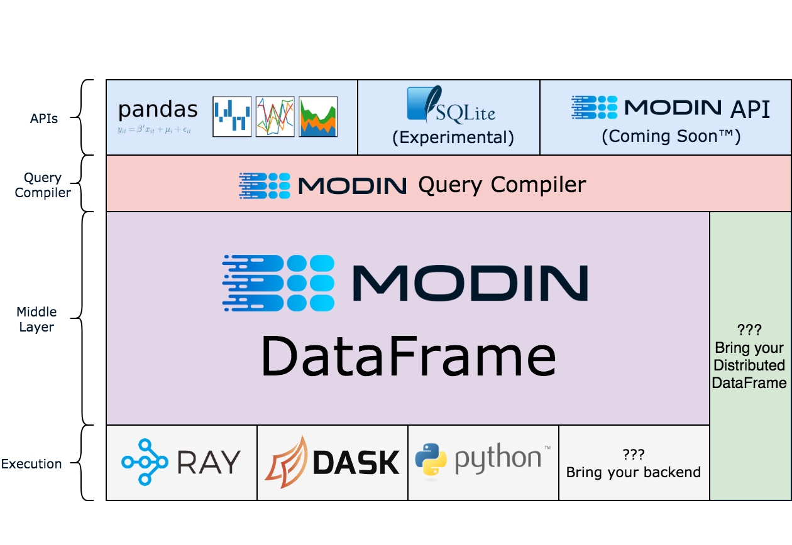
[Devin Petersohn, et al.: Towards Scalable Dataframe Systems. PVLDB 2020]
Modin (UC Berkeley → Ponder → Snowflake)
[Devin Petersohn, et al: Flexible Rule-Based Decomposition and Metadata Independence in Modin: A Parallel Dataframe System. PVLDB 2021]
Overview Modin
  Goal: Enhance Pandas data frames
  Convert Pandas API
  to core algebra expressions
  Different Backends:
  Ray, Dask, MPI
[https://github.com/
modin-project/modin]

Slide 33
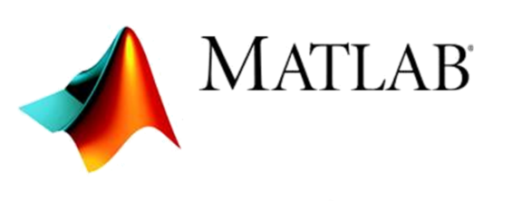




Task-Parallel Execution
Parallel Computation of Independent Tasks,
Emulation of Data-Parallel Operations/Programs

Slide 34

Overview Task-Parallelism
Historic Perspective
  Since 1980s: various parallel Fortran extensions, especially in HPC
  DOALL parallel loops (independent iterations)
  OpenMP (since 1997,Open Multi-Processing)
Motivation: Independent Tasks in ML Workloads
  Use cases: Ensemble learning, cross validation, hyper-parameter tuning,
  complex models with disjoint/overlapping/all data per task
  Challenge #1: Adaptation to data and cluster characteristics
  Challenge #2: Combination with data-parallelism
#pragma omp parallel for reduction(+: nnz)
for (int i = 0; i < N; i++) {
int threadID = omp_get_thread_num();
R[i] = foo(A[i]);
nnz += (R[i]!=0) ? 1 : 0;
}

Slide 35
Parallel For Loops (ParFor)
[M. Boehm et al.: Hybrid Parallelization Strategies for Large-Scale Machine Learning in SystemML. PVLDB 2014]
Hybrid Parallelization Strategies
  Combination of data- and task-parallel ops
  Combination of local and distributed computation
Key Aspects
  Dependency Analysis
  Task partitioning
  Data partitioning, scan sharing, rewrites
  Execution strategies
  Result agg strategies
  ParFor optimizer
reg = 10^(seq(-1,-10))
B_all = matrix(0, nrow(reg), n)
parfor( i in 1:nrow(reg) ) {
B = lm(X, y, reg[i,1]);
B_all[i,] = t(B);
}
Local ParFor
(multi-threaded),
w/ local ops
Remote ParFor
(distributed
Spark job)
Local ParFor,
w/ concurrent distributed ops

Slide 36
Additional ParFor Examples
Pairwise Pearson Correlation
  In practice: uni/bivariate stats
  Pearson‘s R, Anova F, Chi-squared,
  Degree of freedom, P-value,
  Cramers V, Spearman, etc)
Batch-wise CNN Scoring
  Emulate data-parallelism
  for complex functions
prob = matrix(0, Ni, Nc)
parfor( i in 1:ceil(Ni/B) ) {
Xb = X[((i-1)*B+1):min(i*B,Ni),];
prob[((i-1)*B+1):min(i*B,Ni),] =
... # CNN scoring
}
D = read("./input/D");
R = matrix(0, ncol(D), ncol(D));
parfor(i in 1:(ncol(D)-1)) {
X = D[ ,i];
sX = sd(X);
parfor(j in (i+1):ncol(D)) {
Y = D[ ,j];
sY = sd(Y);
R[i,j] = cov(X,Y)/(sX*sY);
} }
write(R, "./output/R");
➔ Conceptual Design:
Coordinator/worker (task: group of parfor iterations)

Slide 37
ParFor Execution Strategies
#1 Task Partitioning
  Fixed-size schemes: naive (1) , static (n/k), fixed (m)
  Self-scheduling: e.g., guided self scheduling, factoring
#2 Data Partitioning
  Local or remote row/column partitioning (incl locality)
#3 Task Execution
  Local (multi-core) execution
  Remote (MR/Spark) execution
#4 Result Aggregation
  With and without compare (non-empty output variable)
  Local in-memory / remote MR/Spark result aggregation
Factoring (n=101, k=4)
(13,13,13,13, 7,7,7,7, 3,3,3,3, 2,2,2,2, 1)
parfor(i in 1:(ncol(D)-1)) {
X = D[ ,i];
sX = sd(X);
parfor(j in (i+1):ncol(D)) {
Y = D[ ,j];

Slide 38
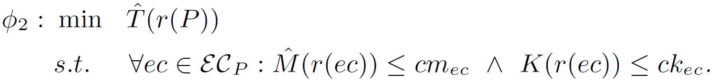
ParFor Optimizer Framework
Design: Runtime optimization for each top-level parfor
Plan Tree P
  Nodes N_{P}
    Exec type et
    Parallelism k
    Attributes A
  Height h
  Exec contexts EC_{P}
Plan Tree
Optimization Objective
Heuristic optimizer w/ transformation-based search strategy
  Cost and memory estimates w/ plan tree aggregate statistics

Slide 39
Task-Parallelism in R
Multi-Threading
  doMC as multi-threaded foreach backend
  Foreach w/ parallel (%dopar%)
  or sequential (%do%) execution
Distribution
  doSNOW as distributed foreach backend
  MPI/SOCK as comm methods
library(doMC)
registerDoMC(32)
R <- foreach(i=1:(ncol(D)-1),
.combine=rbind) %dopar% {
X = D[,i]; sX = sd(X);
Ri = matrix(0, 1, ncol(D))
for(j in (i+1):ncol(D)) {
Y = D[,j]; sY = sd(Y)
Ri[1,j] = cov(X,Y)/(sX*sY);
}
return(Ri);
}
library(doSNOW)
clust = makeCluster(
c(“192.168.0.1”, “192.168.0.2”,
“192.168.0.3”), type=“SOCK”);
registerDoSNOW(clust);
... %dopar% ...
stopCluster(clust);
[https://cran.r-project.org/web/packages/
doSNOW/doSNOW.pdf]
[https://cran.r-project.org/web/packages/
doMC/vignettes/gettingstartedMC.pdf]

Slide 40
Task-Parallelism in Other Systems
matlabpool 32
c = pi; z = 0;
r = rand(1,10)
parfor i = 1 : 10
z = z+1; # reduction
b(i) = r(i); # sliced
end
MATLAB
  Parfor loops for
  multi-process &
  distributed loops
  Use-defined par
Julia
  Dedicated macros:
  @threads
  @distributed
TensorFlow
  User-defined parallel iterations
  Responsible for correct results or
  acceptable approximate results
[Gaurav Sharma, Jos Martin: MATLAB®:
A Language for Parallel Computing. Int. Journal on Parallel Prog. 2009]
a = zeros(1000)
@threads for i in 1:1000
a[i] = rand(r[threadid()])
end
[https://docs.julialang.org/en/v1/
manual/parallel-computing/]
tf.while_loop(cond, body, loop_vars,
parallel_iterations=10,
swap_memory=False,
maximum_iterations=None, ...)
[https://www.tensorflow.org/
api_docs/python/tf/while_loop]

Slide 41
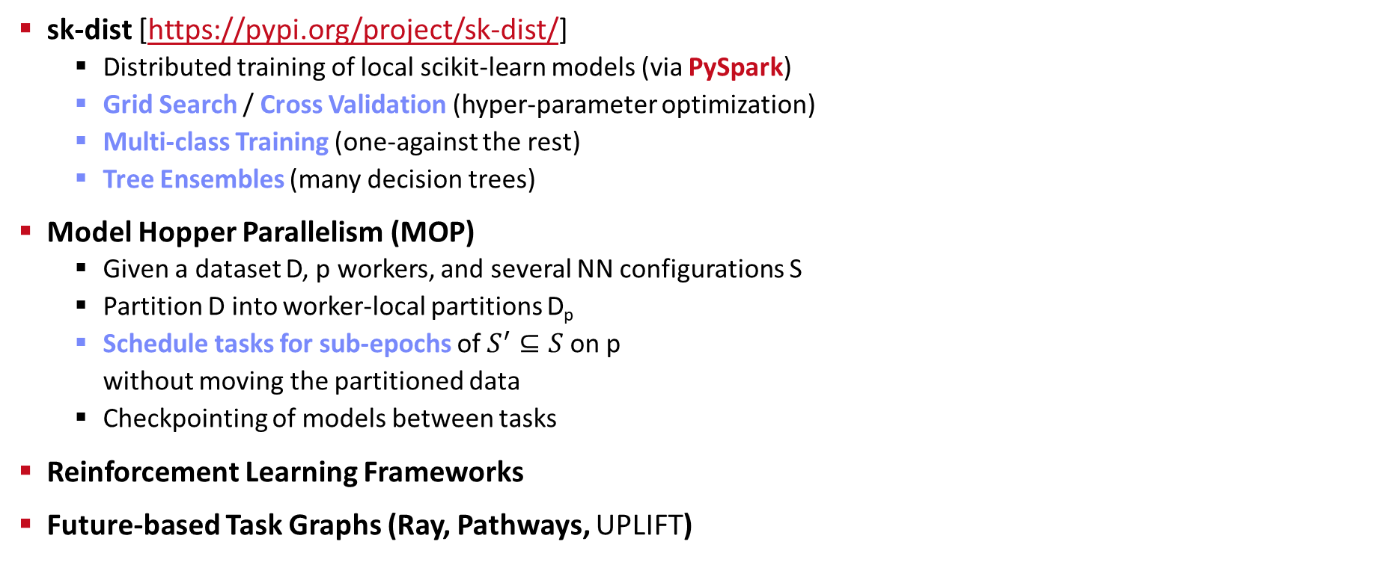
Task-Parallelism in Other Systems, cont.
sk-dist [https://pypi.org/project/sk-dist/]
  Distributed training of local scikit-learn models (via PySpark)
  Grid Search / Cross Validation (hyper-parameter optimization)
  Multi-class Training (one-against the rest)
  Tree Ensembles (many decision trees)
Model Hopper Parallelism (MOP)
  Given a dataset D, p workers, and several NN configurations S
  Partition D into worker-local partitions D_{p}
  Schedule tasks for sub-epochs of $S^{′}⊆S$ on p
  without moving the partitioned data
  Checkpointing of models between tasks
Reinforcement Learning Frameworks
Future-based Task Graphs (Ray, Pathways, UPLIFT)
[Supun Nakandala, Yuhao Zhang, Arun Kumar: Cerebro: Efficient and Reproducible Model Selection on Deep Learning Systems. DEEM@SIGMOD 2019]
[Supun Nakandala, Yuhao Zhang, Arun Kumar: Cerebro: A Data System for Optimized Deep Learning Model Selection. PVLDB 2020]
Part of
Next Lecture

Slide 42
Summary & QA
Categories of Execution Strategies
  Data-parallel execution for batch ML algorithms
  Task-parallel execution for custom parallelization of independent tasks
  Parameter servers (data-parallel vs model-parallel) for mini-batch ML algorithms
#1 Different strategies (and systems) for different ML workloads ➔ Specialization & abstraction
#2 Awareness of underlying execution frameworks
#3 Awareness of effective compilation and runtime techniques
Next Lectures
  06 Parameter Servers (mini-batch) [May 22]
  07 LLM Training and Inference [Jun 05]
  08 Hybrid Execution and HW Accelerators [Jun 12]
  09 Caching, Partitioning, Indexing and Compression [Jun 19]

