Slide 1

Architecture of ML Systems (AMLS)
07 LLM Training and Inference
Prof. Dr. Matthias Boehm
Technische Universität Berlin
Berlin Institute for the Foundations of Learning and Data
Big Data Engineering (DAMS Lab)
Last update: Jun 05, 2025

Slide 2

Announcements / Org
#1 Hybrid & Video Recording
  Hybrid lectures (in-person, zoom) with optional attendance
  https://tu-berlin.zoom.us/j/9529634787?pwd=R1ZsN1M3SC9BOU1OcFdmem9zT202UT09
  Zoom video recordings, links from website
  https://mboehm7.github.io/teaching/ss25_amls/index.htm
#2 Projects & Exercises
  Submission deadline: Jul 15 EOD
  Get started, use the office hour (Tue 4pm-5.30), and mentor meetings
~3 ECTS ➔ 90h

Slide 3
Categories of Execution Strategies
Batch
SIMD/SPMD
Independent
Tasks
MIMD
Mini-batch,
Federated,
RL
Self-supervised, supervised,
RL
05_{a} Data-Parallel Execution
05_{b} Task-Parallel Execution
06 Parameter Servers (data, model)
07 LLM Training
(dense, MoE)
08 Hybrid Execution and HW Accelerators
09 Caching, Partitioning, Indexing, and Compression

Slide 4
Agenda
Basics and Terminology
LLM Data Preprocessing
LLM Pre-Training
LLM Post-Training and Fine-Tuning
LLM Inference
Notes:
TODO ref Stanford course

Slide 5
Basics and Terminology

Slide 6
Large Language Models (LLMs) Overview
Tokens/Words x_{i}
  Sequence of characters, n-grams, or words; dictionary defined upfront
  The larger the tokens, the more efficient but the less effective
LLMs as Generate AI
  Probability distribution p(x₁, …, x_{L})
  Generative models X_{1:L} ~ p(x₁, …, x_{L})
Autoregressive LLMs
  Sequential product of conditional token probabilities
  (by chain rule)
  p(x₁, …, x_{L}) = p(x₁) * p(x₂|x₁) * p(x₃|x₂,x₁) * …
(AMLS, is, an, easy, course)
p(AMLS)
* p(is|AMLS)
* p(an|AMLS,is)
* p(easy|AMLS,is,an)
* p(course|AMLS,is,an,easy)
= 0.7

Slide 7
Transformer Model Architecture
Encoder-Decoder Structure
  Encoder: maps sequence of symbols (x₁, …, x_{n})
  to continuous representation (z₁, …, z_{n})
  Decoder: maps sequence (z₁, …, z_{n}) sequentially
  to output symbol sequence (y₁, …, y_{n})
Additional Features
  Stacked self-attention and fully-connected layers
  Residual connections and layer normalization
  Masked self-attention in decoder to ensure
  model uses only tokens before position i
Encoder
Decoder
Word Embeddings
[Ashish Vaswani, Noam Shazeer, Niki Parmar, Jakob Uszkoreit, Llion Jones, Aidan N. Gomez, Lukasz Kaiser, Illia Polosukhin: Attention is All you Need. NeurIPS 2017]
Notes:
Proposed for machine translation, but general-purpose architecture (message passing among vectors)
https://www.youtube.com/watch?v=9uw3F6rndnA
As of 06/2025: 182,589 citations

Slide 8
[Ashish Vaswani, Noam Shazeer, Niki Parmar, Jakob Uszkoreit, Llion Jones, Aidan N. Gomez, Lukasz Kaiser, Illia Polosukhin: Attention is All you Need. NeurIPS 2017]
Transformer Model Architecture, cont.
Basic Attention Block (Self-Attention)
  Mapping of a queries Q (search terms) and keys K (context words) /
  values V (modification of query) pairs to output
  Scaled dot-product attention (divided by sqrt(d_{k}))
Multi-head Attention Block
  Project queries, keys, values h times
  with different linear projections
  Attend to information from different subspaces
Cross Attention
  Two sequences (in Decoder)
    Key and value vectors from input sequence
    Query vectors from output sequence
size d_{k}
size d_{v}
Notes:
With larger dk dot products grow large, pushing softmax in regions with very small gradients → scaling fixes it

Slide 9
Dense vs Mixture of Experts (MoE) Models
Dense Models
  Stack of transformer layers (e.g., 16 - 128),
  all parameters active during inference
  E.g., GPT-2 and GPT-3 (sparse transformer)
Mixture of Experts
  Ensemble of specialized models (experts)
  Router / gating network selects top-K experts
  E.g., DeepSeek-V3 (8+1 out of 256), [GPT-4]
[Tom B. Brown et al: Language Models are Few-Shot Learners. CoRR abs/2005.14165 (2020), GPT-3]
[Robert A. Jacobs, Michael I. Jordan, Steven J. Nowlan, Geoffrey E. Hinton: Adaptive Mixtures of Local Experts. Neural Comput. 3(1), 1991]
[Michael I. Jordan, Robert A. Jacobs: Hierarchies of Adaptive Experts. NeurIPS 1991]
[DeepSeek-AI: DeepSeek-V3 Technical Report, 2025, https://arxiv.org/pdf/2412.19437 ]

Slide 10
LLM Training and Inference Workflow
Data Collection
Data Pre-processing
(tokenize)
Pre-Training (multiple phases)
Post-Training / Fine-Tuning
LLM Inference
Crawl the Internet
Train Tokenizer
(e.g., common subsequences)
Train LLM on very large data corpus
Fine-tune model on high-quality and/or user data
Test-time compute

Slide 11

LLM Data Preprocessing
[Stanford CS229 Machine Learning, Yann Dubois: Building Large Language Models (LLMs), https://www.youtube.com/watch?v=9vM4p9NN0Ts]

Slide 12


Data Sources
#1 Web Crawling
  Download websites from public internet
  Common crawl 250 billion websites, 2-5 billion new / month
  Other sources: Project Gutenberg (books), Stack Exchange (code),
  Wikipedia, Newspapers (see law suites), LeetCode (code)
#2 Text Extraction
  From HTML and PDF (remove meta data)
#3 Filtering
  Remove undesirable content (e.g., outliers, backlist, low quality)
  Remove duplicates (within and across documents)
#4 Composition
  Mix categories of data (e.g., source code, entertainment, text books)
  Synthetic and multi-modal data
[https://commoncrawl.org/]
[Dong Huang, Yuhao Qing, Weiyi Shang, Heming Cui, Jie Zhang: EffiBench: Benchmarking the Efficiency of Automatically Generated Code. NeurIPS 2024]
~15T Tokens
(usually 1 epoch)

Slide 13
Data Sources, cont.
Composition of
the Pile by Category
[Leo Gao et al: The Pile: An 800GB Dataset of Diverse Text for Language Modeling. CoRR abs/2101.00027, 2021, https://arxiv.org/pdf/2101.00027]
Notes:
Tree map of Pile components by effective size

Slide 14
Tokenization
Purpose
  Split input strings into sequence of tokens
  Robustness to typos and different languages (more general than words)
Common Approach
  Often Token := 3-4 characters (n-grams),
  sometimes longer words or individual characters
  Special handling of numbers (single digit vs full number)
  and source code (handling indentation)
Byte-Pair Encoding (BPE)
  Large text corpus, start with single characters
  Merge common pairs of tokens into token
  Repeat until num merges / dictionary size
(AML, Sis, ane, asy, cou, rse)
[Rico Sennrich, Barry Haddow, Alexandra Birch: Neural Machine Translation of Rare Words with Subword Units. ACL 2016]
[Taku Kudo, John Richardson: SentencePiece: A simple and language independent subword tokenizer… EMNLP 2018 (Gemini)]]

Slide 15
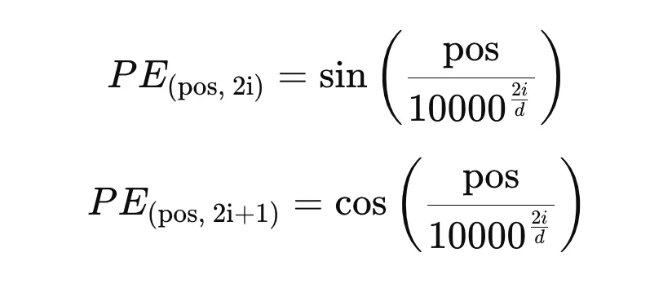
Positional Embeddings
[https://cyrilzakka.github.io/
llm-playbook/nested/fixed-pos-embed.html]
Challenge
  Transformers/self-attention by themselves invariant to permutations of input sequences
  Positional embeddings combine word embeddings and token positions
Fixed Positional Embeddings
  Absolute positional encoding, which requires fixed sequence
  length or scaling; token pos, embedding index i, embedding dim d
  Add positional embedding to word embedding of input token
  Example: Sinusoidal Positional Encoding
Rotary Positional Embedding (RoPE)
  Relative positional encoding
  Rotate queries and keys with rotation relative to position in sequence
even i:
odd i:
[https://medium.com/autonomous-agents/math-behind-positional-embeddings-in-transformer-models-921db18b0c28]

Slide 16
LLM Pre-Training

Slide 17
Scaling Laws
Predictable Performance w/ increasing Compute / Data Size / #Parameters
[Jared Kaplan et al: Scaling Laws for Neural Language Models. CoRR abs/2001.08361, 2020, https://arxiv.org/pdf/2001.08361]
Notes:
~ 40 token / parameter

Slide 18

Scaling Laws, cont.
IsoFLOP Curves
[Jared Kaplan et al: Scaling Laws for Neural Language Models. CoRR abs/2001.08361, 2020]
[Jordan Hoffmann et al.: Training Compute-Optimal Large Language Models. CoRR abs/2203.15556, 2022, https://arxiv.org/pdf/2203.15556]

Slide 19
Training Regimes
Data/Model Selection
  Given a fixed FLOPs budget, select model size & # training tokens
  Training range of models → Fit curve for scaling
Pre-Training
  Train selected model in single-pass over data
  State-of-the-art: 15T tokens; e.g., DeepSeek-V3: 14.8T tokens
Context-Length Extensions
  Phase 1: max context length extended to 32K tokens
  Phase 2: max context length extended to 128K tokens
Fine-Tuning
  Overfitting on high-quality data, Supervised Fine-Tuning (SFT)
  Reinforcement Learning (RL); RL from Human Feedback (RLFH)
[DeepSeek-AI: DeepSeek-V3 Technical Report, 2025, https://arxiv.org/pdf/2412.19437 ]

Slide 20
Models and Training Cost
OpenAI GPT
  GPT-3: 4.5M USD, GPT-4: 100M USD
Google Gemini
  Gemini 1.0 Ultra: 192M USD
Meta Llama
  Llama-3.1: 170M USD
DeepSeek
  DeepSeek-V3: 5.3M USD
Mistral
  Mistral Large: 41M USD
X Grok
  Grok-2: 107M USD
[https://www.wired.com/story/openai-ceo-sam-altman-the-age-of-giant-ai-models-is-already-over/]
[https://www.visualcapitalist.com/the-surging-cost-of-training-ai-models/]

Slide 21
Employed Types of Parallelism
Pipeline Parallelism
(Model Parallelism)
Data Parallelism
Expert Parallelism
Example DeepSeek-V3 Training
  16-way Pipeline Parallelism
  ZeRO-1 Data Parallelism (partitioning of parameters/gradients/optimizer state)
  64-way Expert Parallelism on 8 nodes
Tensor Parallelism
Layer 3
Layer 3
Layer 3
Layer 3
Layer 3
Math
Expert
Layer 2
Layer 2
Layer 2
Layer 2
Layer 2
Code
Expert
Image
Expert
Layer 1
Layer 1
Layer 1
Layer 1
Layer 1
Router
Batch
Batch
Batch
device/thread

Slide 22
[Rewon Child, Scott Gray, Alec Radford, Ilya Sutskever: Generating Long Sequences with Sparse Transformers, CoRR 2019, https://arxiv.org/pdf/1904.10509]
Sparse Transformers (e.g., GPT-3)
Transformer
O(n^2 * d)
Sparse Transformer Strided
Sparse Transformer Fixed/Blocked
O(n * √n * d)
Current
Position
(Query)
Attention Positions

Slide 23
LLM Post-Training and Fine-Tuning

Slide 24
Training Objective and Losses
Objective: Classify next token (multi-class classification)
  Cross-entropy loss
  Min –log(p(x))
p(x|AMLS,is,an)
Target
AMLS
is
an
easy
difficult
course
0
0
0
1
0
0

Slide 25
Types of Post-Training
#1 Foundation Model Fine-Tuning
  Fine-tuning for specific high-quality data (e.g., Wikipedia), and tasks (e.g., coding) through feedback
  Overfitting to high-quality data
#2 Model Distillation and Quantization
  Transferring knowledge from large teacher model to small student model
  Goal: reduce inference costs / resource requirements (# layers, model dim, attention heads)
  Example: Llama 3.2 (09/2024): 90B, 11B, 3B, 1B parameters + FP32 / FP16 / UINT8 quantized variants
#3 User-level Fine-Tuning
  Specialize the LLM through user- and domain-specific data
  Create model variants (pro: effectiveness, con: number of models)

Slide 26
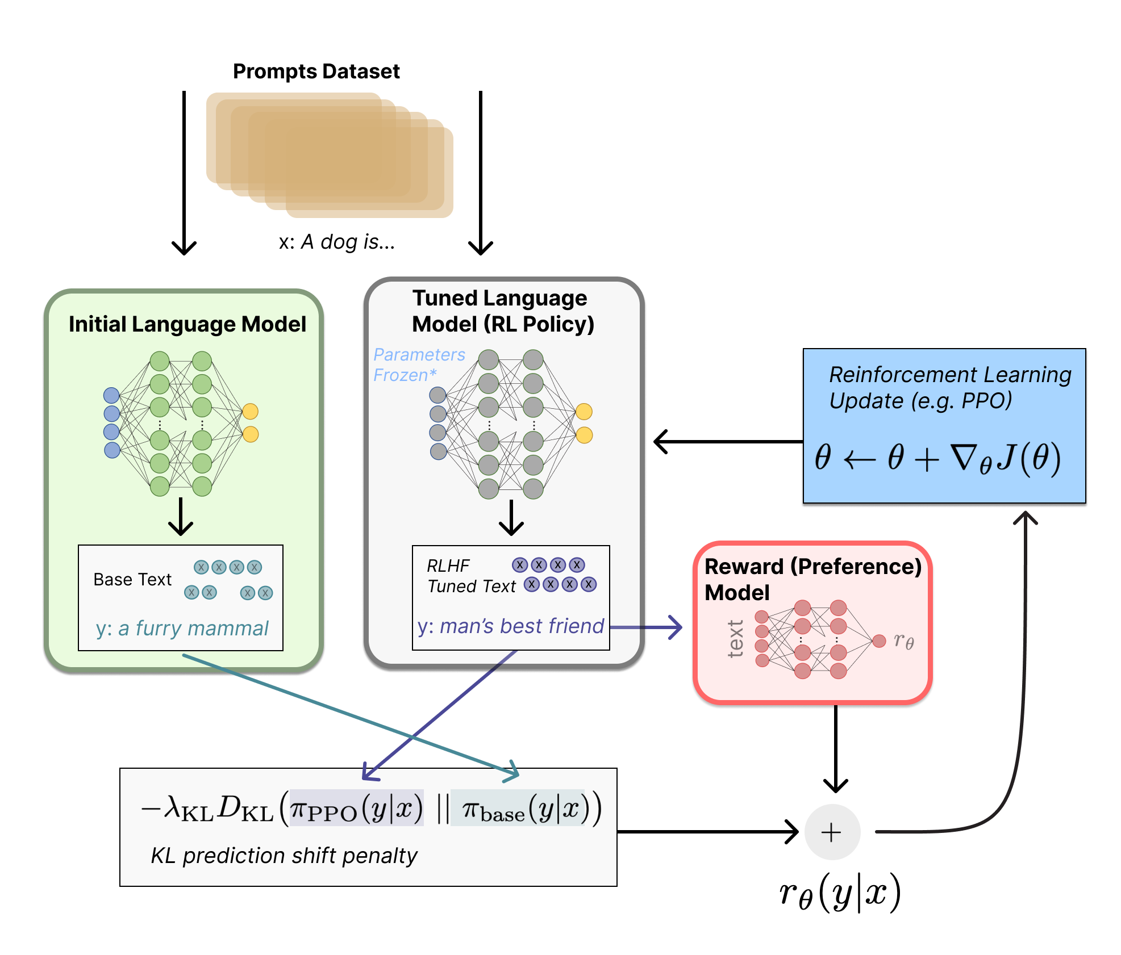
SFT and RLHF
Supervised Fine-Tuning (SFT)
  Fine-tune LLM with language modeling (next word prediction) and desired output (human feedback)
  Example prompts and expected answers (free form text) → limited by human ability / costs
  Example: GPT-3 → ChatGPT
Reinforcement Learning from Human Feedback (RLHF)
  Aks fine-tuned LLM to generate two different answers
  → humans ranks the answers
  #1 Train Reward Model RM for classifying preferences
  #2 Proximal Policy Optimization (PPO) with RM
  Freeze model parameters and LoRA Low-Rank Adaptation for LLMs
[https://huggingface.co/blog/rlhf]
[Edward J. Hu, Yelong Shen, Phillip Wallis, Zeyuan Allen-Zhu, Yuanzhi Li, Shean Wang, Lu Wang, Weizhu Chen: LoRA: Low-Rank Adaptation of Large Language Models. ICLR 2022]
Notes:
As of 06/2025: LoRA cited 14,491

Slide 27
User-Level Fine-Tuning Tools
Example LlamaFactory
[Yaowei Zheng, Richong Zhang, Junhao Zhang, Yanhan Ye, Zheyan Luo, Yongqiang Ma: LlamaFactory: Unified Efficient Fine-Tuning of 100+ Language Models. CoRR abs/2403.13372 (2024), https://arxiv.org/pdf/2403.13372]

Slide 28
LLM Inference

Slide 29
Prompting Strategies
#1 Zero-shot
  General question answering and task processing, often via prompt templates
  No provided examples, best effort results
#2 Few-shot
  Give general instruction and few examples; one-shot as an extreme case (“human instruction”)
  LLM executes task while considering the pattern of examples
DSPy
  Programmatic, compositional interaction with LLMs
Jail Breaking
  Append special prefixed/suffixes for getting refused answers from LLM
  Example: optimized suffix search for probability of “Sure”
[https://github.com/stanfordnlp/dspy]
[Maksym Andriushchenko, Francesco Croce, Nicolas Flammarion: Jailbreaking Leading Safety-Aligned LLMs with Simple Adaptive Attacks. CoRR 2024
https://arxiv.org/pdf/2404.02151v4]

Slide 30
LLM Inference Overview
Overview
Model Variants
  Large and small models
  Quantized models
Service API Costs
  Billed by input/output tokens
  GPT-4.1: 2/8$ per 1M input/output tokens; 0.5$ / 1M cached input tokens
  GPT-4.1-mini: 0.4/1.6$ per 1M input/output tokens; 0.1$ / 1M cached input tokens
Service
API
LLM
Prompt
Outputs
Conversational State
Open-Weight
LLM
Probabilities

Slide 31

LLM Offline and Online Inference
vLLM: LLM Inference and Serving
  Management of attention key/value cache
  Batching of incoming requests, eviction mechanisms
  HuggingFace models and hardware accelerators
[https://docs.vllm.ai/en/stable/
getting_started/examples/basic.html#]
from vllm import LLM, SamplingParams
# Sample prompts.
prompts = [
"Hello, my name is",
"The president of the United States is",
"The capital of France is",
"The future of AI is",
]
# Create a sampling params object.
sampling_params = SamplingParams(
temperature=0.8, top_p=0.95)
...
# Create an LLM.
llm = LLM(model="facebook/opt-125m")
# Generate texts from the prompts (RequestOutput)
outputs = llm.generate(prompts, sampling_params)
# Print the outputs.
print("\nGenerated Outputs:\n" + "-" * 60)
for output in outputs:
prompt = output.prompt
generated_text = output.outputs[0].text
print(f"Prompt: {prompt!r}")
print(f"Output: {generated_text!r}")
print("-" * 60)

Slide 32
Key-Value (KV) Caching
Basic Idea
  For every token, compute squared attention to all previous tokens → large overlap
  Establish KV cache to compute rows of keys/values just ones
Without KV Cache
With
KV Cache
AMLS
is
an
easy
course
5
AMLS
is
an
easy
course
1
4
4
1
1
3
3
3
1
1
1
2
2
2
2
1
1
1
1
1
1
1
1
1
1
1
1
1
1

Slide 33
Test-Time Compute
Overview: Leverage multiple LLM
invocations for improved accuracy
at expense of compute costs
[Charlie Snell, Jaehoon Lee, Kelvin Xu, Aviral Kumar: Scaling LLM Test-Time Compute Optimally can be More Effective than Scaling Model Parameters. CoRR abs/2408.03314 (2024) https://arxiv.org/pdf/2408.03314]

Slide 34
Summary & QA
Basics and Terminology
LLM Data Preprocessing
LLM Pre-Training
LLM Post-Training and Fine-Tuning
LLM Inference
Next Lectures (Part A)
  08 Hybrid Execution and HW Accelerators [Jun 12]
  09 Caching, Partitioning, Indexing and Compression [Jun 19]

