Slide 1

Architecture of ML Systems (AMLS)
08 Data Access Methods
Prof. Dr. Matthias Boehm
Technische Universität Berlin
Berlin Institute for the Foundations of Learning and Data
Big Data Engineering (DAMS Lab)
Last update: Jun 17, 2025

Slide 2

Announcements / Org
#1 Hybrid & Video Recording
  Hybrid lectures (in-person, zoom) with optional attendance
  https://tu-berlin.zoom.us/j/9529634787?pwd=R1ZsN1M3SC9BOU1OcFdmem9zT202UT09
  Zoom video recordings, links from website
  https://mboehm7.github.io/teaching/ss25_amls/index.htm
#2 Exam Registration
  Thu July 24, 4-6pm (A 151, max 50) → 14 registrations
  Thu July 31, 4-6pm (EW 201, max 47) → 24 registrations
  Thu Aug 14, 4-6pm (A 151, max 50) → 12 registrations

Slide 3
Categories of Execution Strategies
Batch
SIMD/SPMD
Independent
Tasks
MIMD
Mini-batch,
Federated,
RL
Self-supervised, supervised,
RL
05_{a} Data-Parallel Execution
05_{b} Task-Parallel Execution
06 Parameter Servers (data, model)
07 LLM Training
(dense, MoE)
08 Hybrid Execution and HW Accelerators
09 Caching, Partitioning, Indexing, and Compression

Slide 4
Agenda
Motivation, Background, and Overview
Caching, Partitioning, and Indexing
Lossy and Lossless Compression
Iterative, I/O-bound ML algorithms
➔ Data access crucial for performance
X
while(!converged) {
… q = X %*% v …
}
Data
Weights
Training | read-only | updated
Inference/Scoring | new data | read-only

Slide 5
Motivation, Background, and Overview

Slide 6
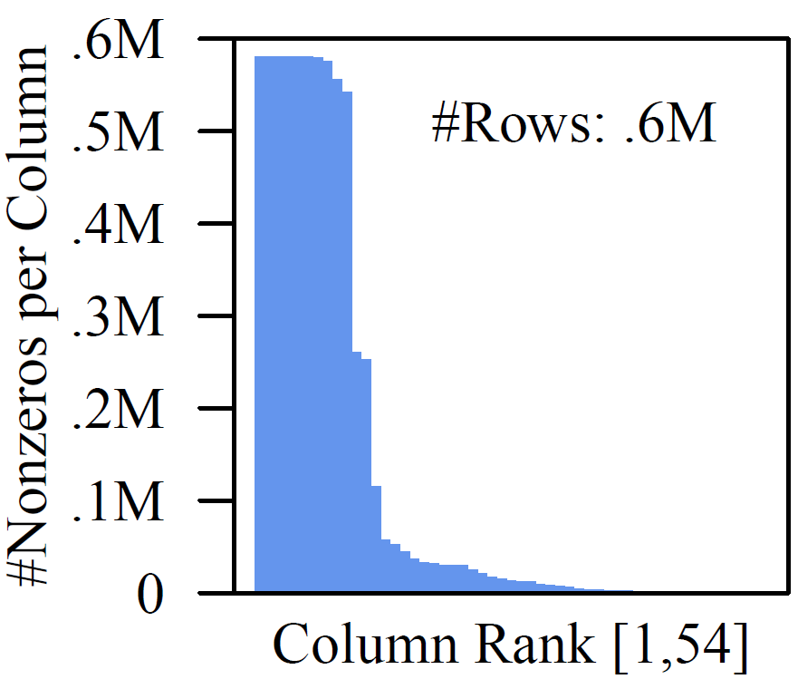
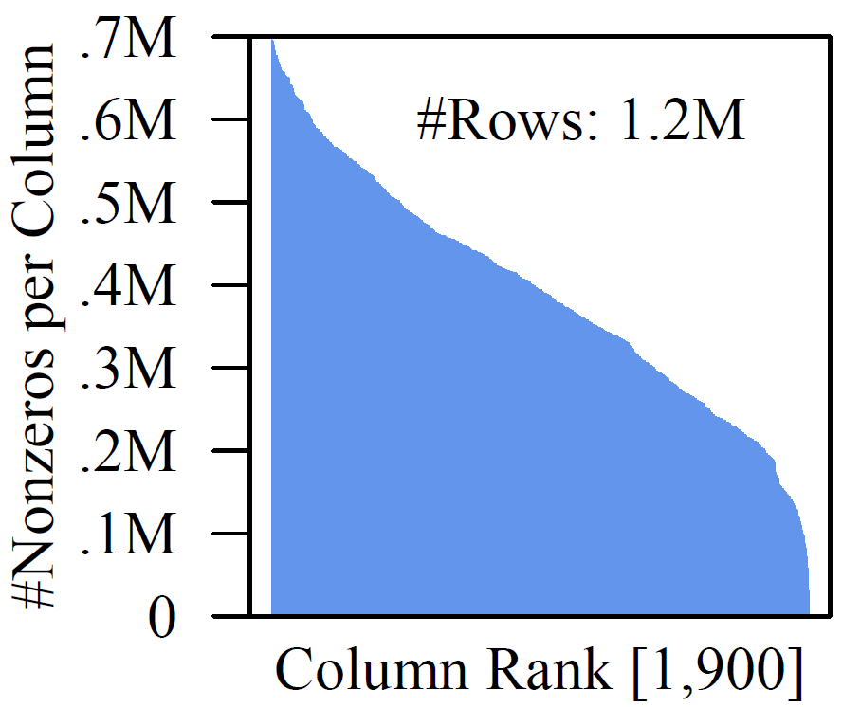
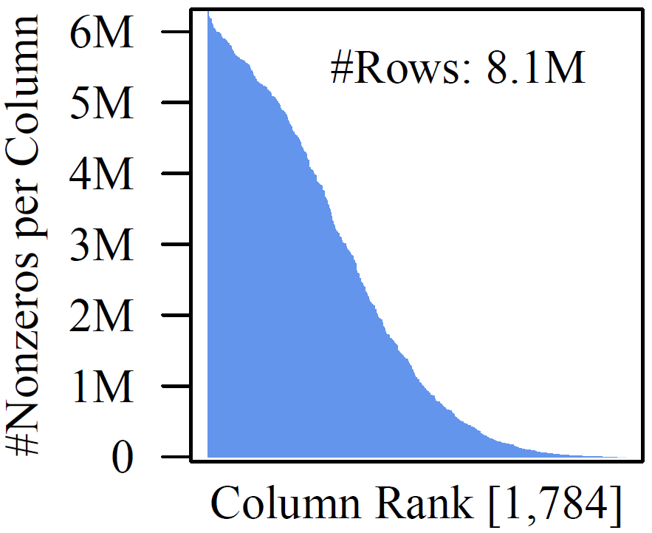
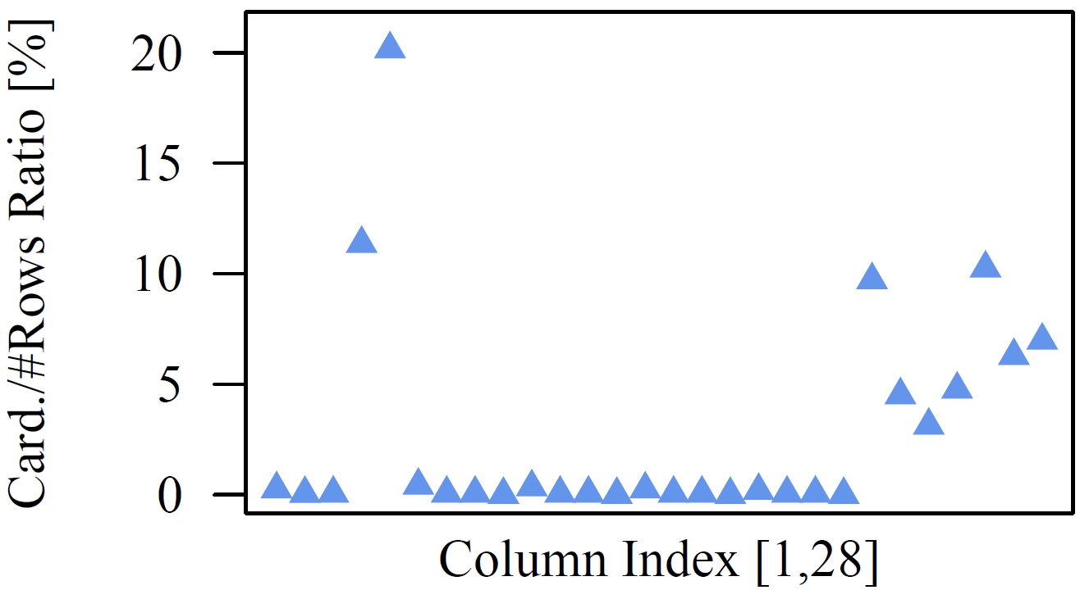
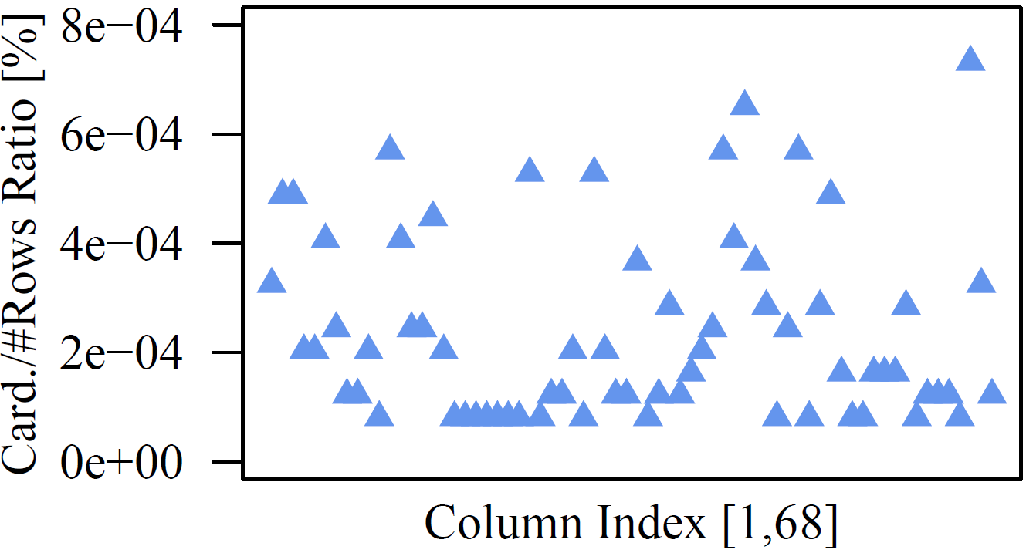
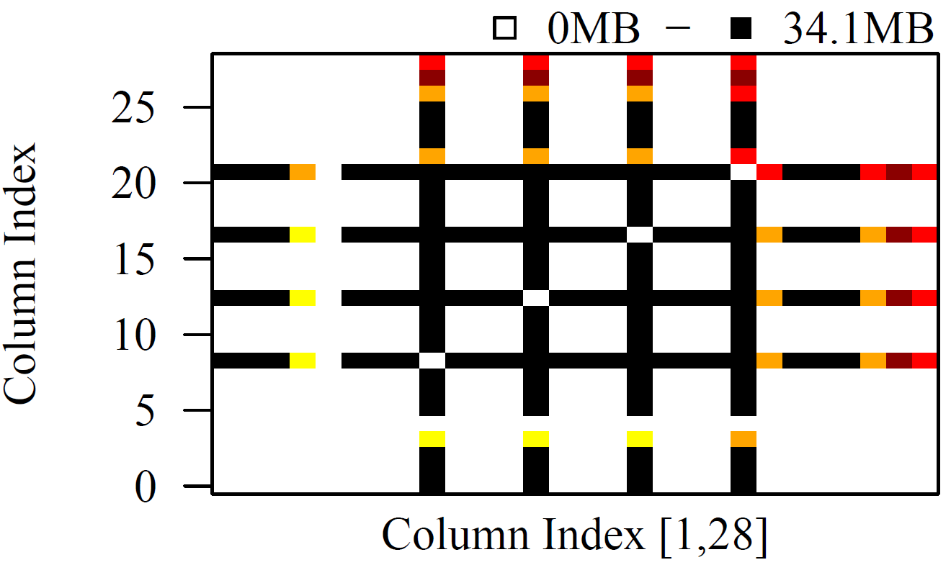
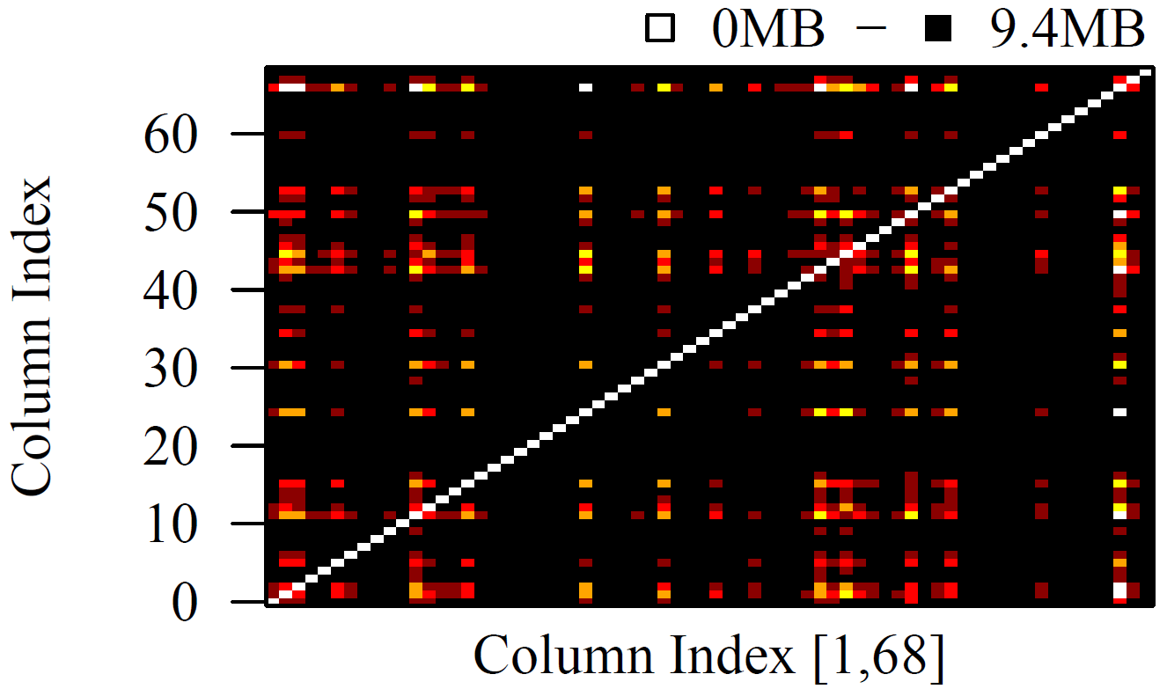
Motivation: Data Characteristics
Covtype
ImageNet
Mnist8m
Tall and Skinny
(#rows >> #cols)
Non-Uniform Sparsity
Small Column
Cardinalities
Small Val Range
Column
Correlations
(on census:
12.8x → 35.7x)
Higgs
Census
Notes:
Note: small column cardinalities (e.g., categorical, dummy-coded)

Slide 7
Recap: Background Matrix Formats
Example
3x3 Matrix
Matrix Block (m x n)
  A.k.a. tiles/chunks, most operations defined here
  Local matrix: single block, different representations
Common Block Representations
  Dense (linearized arrays)
  MCSR (modified CSR)
  CSR (compressed sparse rows), CSC
  COO (Coordinate matrix)
.7
.1
.2
.4
.3
MCSR
CSR
COO
0
2
0
0
.7
0
0
.7
.7
.1
2
2
.1
0
2
.1
0
1
4
0
.2
1
0
.2
Dense (row-major)
.2
.4
5
1
.4
1
1
.4
.7
0
.1
.2
.4
0
0
.3
0
1
1
.3
2
1
.3
.3
O(mn)
O(m + nnz(X))
O(nnz(X))
Notes:
Note: specialized formats like double-compressed CSR existing (indicator for non-zero rows)

Slide 8
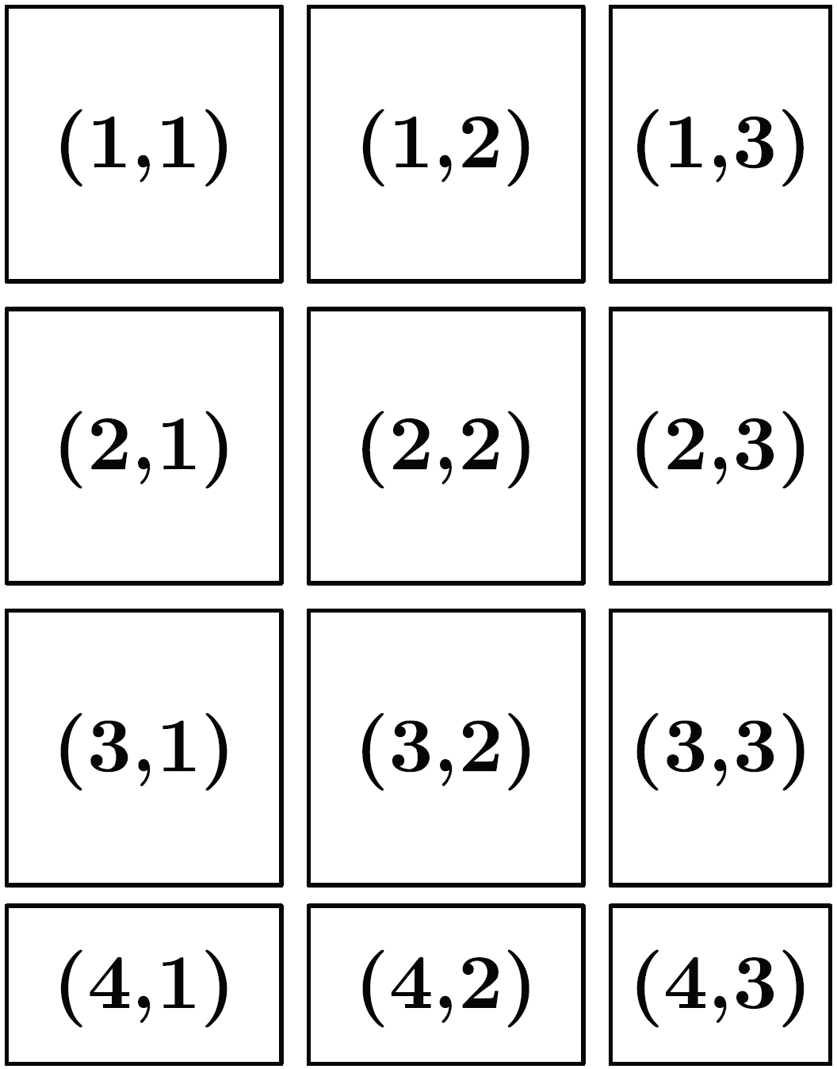
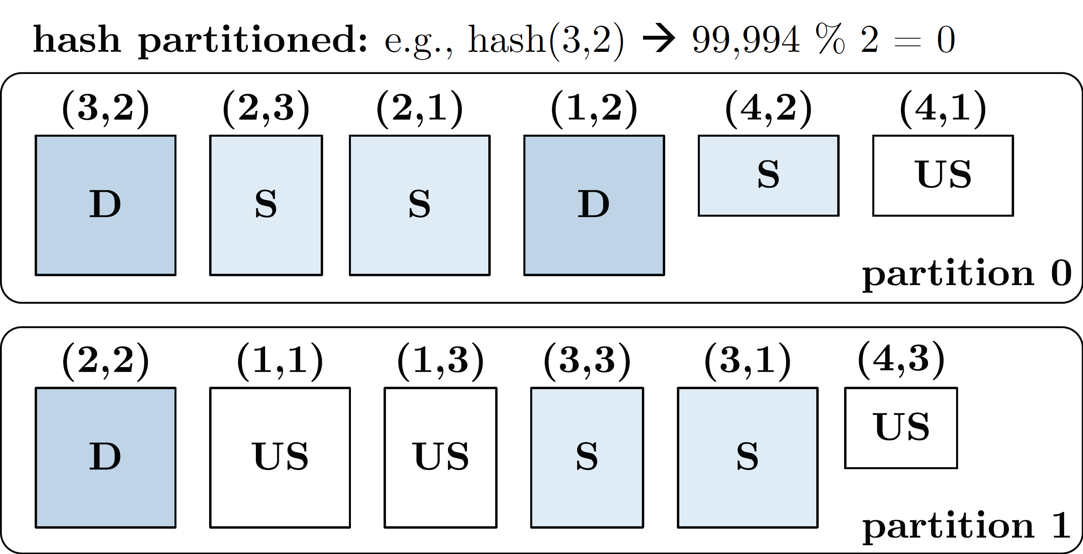
Recap: Distributed Matrix Representations
Collection of “Matrix Blocks” (and keys)
  Bag semantics (duplicates, unordered)
  Logical (Fixed-Size) Blocking
  + join processing / independence
  - (sparsity skew)
  E.g., SystemML on Spark:
  JavaPairRDD<MatrixIndexes,MatrixBlock>
  Blocks encoded independently (dense/sparse)
Partitioning
  Logical Partitioning
  (e.g., row-/column-wise)
  Physical Partitioning
  (e.g., hash / grid)
  Influences partition-local aggregation
Logical Blocking 3,400x2,700 Matrix
(w/ B_{c}=1,000)
Physical Blocking
and Partitioning

Slide 9

Overview Data Access Methods
Node1
Node2
#1 (Distributed) Caching
  Keep read only feature matrix in (distributed) memory
#2 Buffer Pool Management
  Graceful eviction of intermediates, out-of-core ops
#3 Scan Sharing (and operator fusion)
  Reduce the number of scans as well as read/writes
#4 NUMA-Aware Partitioning and Replication
  Matrix partitioning / replication → data locality
#5 Index Structures
  Out-of-core data, I/O-aware ops, updates
#6 Compression
  Fit larger datasets into available memory
Socket1
Socket2

Slide 10
Caching, Partitioning, and Indexing
#2 Buffer Pool Management
#3 Scan Sharing (and operator fusion)
#4 NUMA-Aware Partitioning and Replication
#5 Index Structures

Slide 11
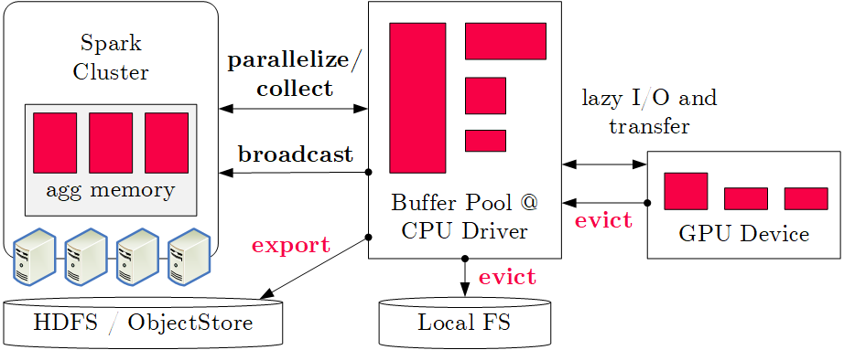
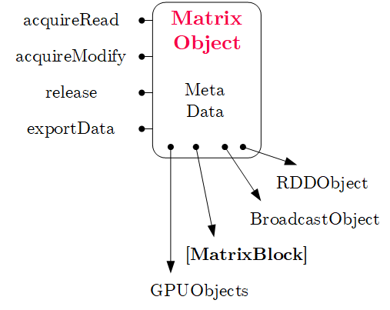
Buffer Pool Management
#1 Classic Buffer Management (SystemDS)
  Hybrid plans of in-memory and distributed ops
  Graceful eviction
  of intermediate
  variables
#2 Algorithm-Specific Buffer Management
  Operations/algorithms over out-of-core matrices and factor graphs
  Examples: RIOT [CIDR’2009] (ops),
  Elementary [SIGMOD’13] (factor graphs),
  PreVision (out-of-core linear algebra programs)
[Kyoseung Koo, Sohyun Kim, Wonhyeon Kim, Yoojin Choi, Juhee Han, Bogyeong Kim, Bongki Moon: PreVision: An Out-of-Core Matrix Computation System with Optimal Buffer Replacement. SIGMOD 2024]

Slide 12
k
Scan Sharing
n
#1 Batching
  One-pass evaluation of multiple configurations
  Use cases: EL, CV, feature selection,
  hyper parameter tuning, multi-user scoring
  E.g.: TUPAQ [SoCC’16], Columbus [SIGMOD’14]
#2 Fused Operator DAGs
  Avoid unnecessary scans, (e.g., mmchain)
  Avoid unnecessary writes / reads
  Multi-aggregates, redundancy
  E.g.: SystemML codegen [PVLDB’18]
#3 Runtime Piggybacking
  Merge concurrent data-parallel jobs
  “Wait-Merge-Submit-Return”-loop
  E.g.: SystemML parfor [PVLDB’14]
X
O(m*n) read
O(m*n*k) compute
m >> n >> k
m
Multi-Aggregate
sum
sum
sum
a = sum(X^2)
b = sum(X*Y)
c = sum(Y^2)
u(^2)
b(*)
u(^2)
X
Y
parfor( i in 1:numModels )
while( !converged )
q = X %*% v; ...

Slide 13
In-Memory Partitioning (NUMA-aware)
NUMA-Aware Model and Data Replication
  Model Replication (06 Parameter Servers)
    PerCore (BSP epoch), PerMachine (Hogwild!),
    PerNode (hybrid)
  Data Replication
    Partitioning (sharding)
    Full replication
AT MATRIX (Adaptive Tile Matrix)
  Recursive NUMA-aware partitioning
  into dense/sparse tiles
  Inter-tile (worker teams) and intra-tile
  (threads in team) parallelization
  Job scheduling framework from SAP HANA
  (horizontal range partitioning, socket-local
  queues with task-stealing)
[Ce Zhang, Christopher Ré: DimmWitted: A Study of Main-Memory Statistical Analytics. PVLDB 2014]
Machine
Node 1
Node 2
C1
C2
C3
C4
RAM
RAM
[David Kernert, Wolfgang Lehner, Frank Köhler: Topology-aware optimization of big sparse matrices and matrix multiplications on main-memory systems. ICDE 2016]

Slide 14
Distributed Partitioning
Example Hash Partitioning:
For all (k,v) of R:
hash(k) % numPartitions → pid
Spark RDD Partitioning
  Implicitly on every data shuffling
  Explicitly via R.repartition(n)
Distributed Joins
  R3 = R1.join(R2)
Single-Key Lookups v = C.lookup(k)
  Without partitioning: scan all keys
  (reads/deserializes out-of-core data)
  With partitioning: lookup partition,
  scan keys of partition
Multi-Key Lookups
  Without partitioning: scan all keys
  With partitioning:
  lookup relevant partitions
0: 8, 1, 6
0: 1, 2
% 3
0: 3, 6
0: 6, 3
2: 2, 3, 4
2: 3, 4
2: 2, 5, 8
2: 5, 2
1: 7, 5
1: 5, 6
1: 4, 7, 1
1: 4, 1
//build hashset of required partition ids
HashSet<Integer> flags = new HashSet<>();
for( MatrixIndexes key : filter )
flags.add(partitioner.getPartition(key));
//create partition pruning rdd
ppRDD = PartitionPruningRDD.create(in.rdd(),
new PartitionPruningFunction(flags));

Slide 15
[Rudolf Bayer, Edward M. McCreight: Organization and Maintenance of Large Ordered Indices. Acta Inf. (1) 1972]
Recap: B-Tree Overview
History B-Tree
  Bayer and McCreight 1972, Block-based, Balanced, Boeing Labs
  Multiway tree (node size = page size); designed for DBMS
  Extensions: B+-Tree/B*-Tree (data only in leafs, double-linked leaf nodes)
Definition B-Tree (k, h)
  All paths from root to leafs have equal length h
  All nodes (except root) have [k, 2k] key entries
  All nodes (except root, leafs) have [k+1, 2k+1] successors
  Data is a record or a reference to the record (RID)
All nodes adhere to max constraints
k=2
P₀
Key K₁
Data D₁
P₁
Key K₂
Data D₂
P₂
Key K₃
Data D₃
P₃
Key K₄
Data D₄
P₄
Subtree w/
keys ≤ K₁
Subtree w/
K₂ < keys ≤ K₃

Slide 16
Recap: B-Tree Overview, cont.
25
B-Tree Search
  Scan/binary search
  within nodes
  Descend along
  matching
  key ranges
B-Tree Insertion
  Insert into leaf nodes
  Split the 2k+1 entries
  into two leaf nodes
B-Tree Deletion
  Lookup key and delete if existing
  Move entry from fullest successor; if underflow merge with sibling
10
20
30
40
2
5
7
8
41
42
45
46
13
14
15
18
32
35
38
22
24
26
27
28
30
40
30
40
45
2k+1
1
overflow
41
42
45
46
47
41
42
46
47
first k
last k

Slide 17
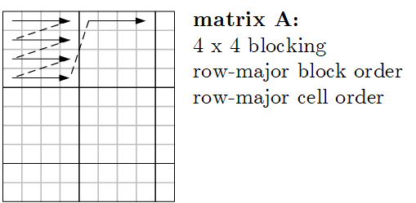
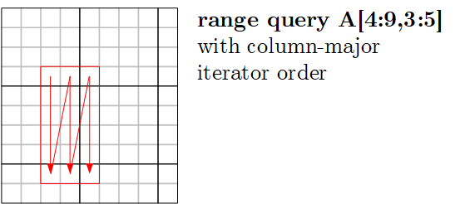
Linearized Array B-Tree (LAB-Tree)
Basic Ideas
  B-tree over linearized array representation
  (e.g., row-/col-major, Z-order, UDF)
  New leaf splitting strategies; dynamic leaf storage format (sparse and dense)
  Various flushing policies for update batching (all, LRU, smallest page, largest page,
  largest page probabilistically, largest group)
[Yi Zhang, Kamesh Munagala, Jun Yang: Storing Matrices on Disk: Theory and Practice Revisited. PVLDB 2011]
#1 Example linearized storage order
#2 Example linearized iterator order

Slide 18
Adaptive Tile (AT) Matrix
[David Kernert, Wolfgang Lehner, Frank Köhler: Topology-aware optimization of big sparse matrices and matrix multiplications on main-memory systems. ICDE 2016]
Basic Ideas
  Two-level blocking and NUMA-aware
  range partitioning (tiles, blocks)
  Z-order linearization, and recursive quad-tree partitioning
  to find var-sized tiles (tile contains N blocks)
Density Map
(see sparsity est.)
Input Matrix
Z-ordering
block
tiles
Notes:
Note: similar grouping for packing vectors for GPU structured sparsity

Slide 19
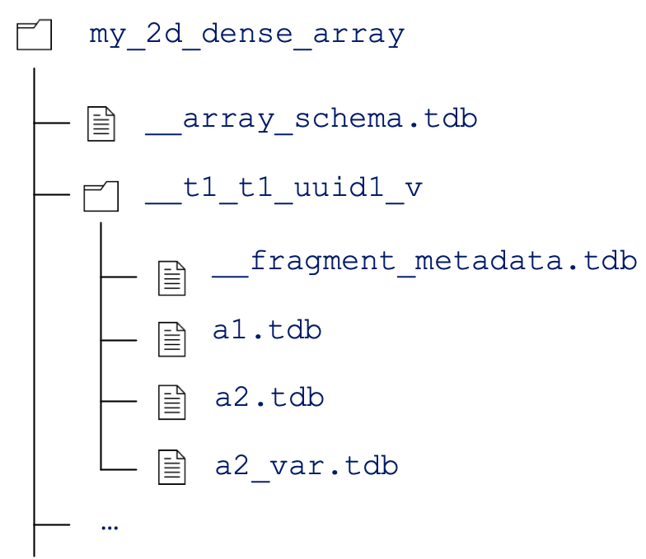
TileDB Storage Manager
[Stavros Papadopoulos, Kushal Datta, Samuel Madden, Timothy G. Mattson: The TileDB Array Data Storage Manager. PVLDB 2016]
Basic Ideas
  Storage manager for 2D arrays of
  different data types (incl. vector, 3D)
  Two-level blocking (space/data tiles),
  update batching via fragments
https://docs.tiledb.com
Notes:
TileDB Inc startup, $20M funding: TileDB Cloud, a commercial SaaS offering for planet-scale data sharing and serverless distributed computations.

Slide 20
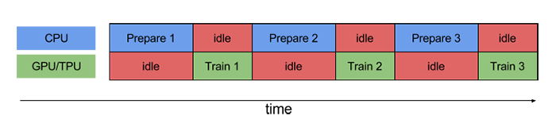
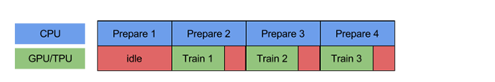

Pipelining for Mini-batch Algorithms
Motivation
  Overlap data access and computation in mini-batch algorithms (e.g., DNN)
  ➔ Simple pipelining of I/O and compute via queueing / prefetching
Example TensorFlow
  #1 Queueing
  and Threading
  #2 Dataset API
  Prefetching
  #3 Reuse via
  Data Echoing
dataset = dataset.batch(batch_size=32)
dataset = dataset.prefetch(buffer_size=1)
[https://ai.googleblog.com/2020/05/
speeding-up-neural-network-training.html]

Slide 21
Lossy and Lossless Compression
#6 Compression

Slide 22
Recap: Database Compression Schemes
106
Null Suppression
  Compress integers by omitting leading zero
  bytes/bits (e.g., NS, gamma)
Run-Length Encoding
  Compress sequences of equal values by
  runs of (value, start, run length)
Dictionary Encoding
  Compress column w/ few distinct values
  as pos in dictionary (→ code size)
Delta Encoding
  Compress sequence w/ small changes
  by storing deltas to previous value
Frame-of-Reference Encoding
  Compress values by storing delta to reference value
  (outlier handling)
00000000
00000000
00000000
01101010
11
01101010
1 1 1 1 7 7 7 7 7 3 3 3 3 3 3 ...
1,1,4
7,5,5
3,10,6
1 7 7 3 1 7 1 3 3 7 1 3 3 7 3 ...
1,3,7
dictionary (code size 2 bit)
1 3 3 2 1 3 1 2 2 3 1 2 2 3 2 ...
20 21 22 20 19 18 19 20 21 20 ...
0 1 1 -2 -1 -1 1 1 1 -1...
20 21 22 20 71 70 71 69 70 21 ...
21
70
22
-1 0 1 -1 1 0 1 -1 0 -1 ...

Slide 23
Overview Lossless Compression Techniques
#1 Block-Level General-Purpose Compression
  Heavyweight or lightweight compression schemes
  Decompress matrices block-wise for each operation
  E.g.: Spark RDD compression (Snappy/LZ4), SciDB SM [SSDBM’11],
  TileDB SM [PVLDB’16], NetCDF, HDF5 at chunk granularity
#2 Block-Level Matrix Compression
  Compress matrix block with homogeneous encoding scheme
  Perform LA ops over compressed representation
  E.g.: CSR-VI (dict) [CF’08], cPLS (grammar) [KDD’16],
  TOC (LZW w/ trie) [SIGMOD’19]
#3 Column-Group-Level Matrix Compression
  Compress column groups w/ heterogeneous schemes
  Perform LA ops over compressed representation
  E.g.: SystemML CLA (RLE, OLE, DDC, UC) [PVLDB’16]
decompress
& deserialize
M
Storage
Manager
Dict.
comp. M
comp.
M
D1
D2

Slide 24
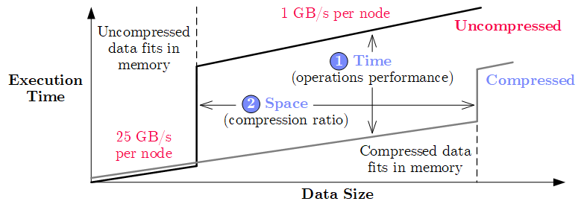
[Ahmed Elgohary, Matthias Boehm et al: Compressed Linear Algebra for Large-Scale Machine Learning. PVLDB 2016]
CLA: Compressed Linear Algebra
Key Idea
  Use lightweight database compression techniques
  Perform LA operations on compressed matrices
Goals of CLA
  Operations performance close to uncompressed
  Good compression ratios
X
while(!converged) {
… q = X %*% v …
}
[SIGMOD Record’17, VLDBJ’18, CACM’19]

Slide 25
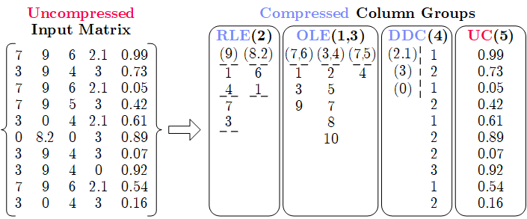
CLA: Compressed Linear Algebra, cont. (2)
Overview Compression Framework
  Column-wise matrix compression (values + compressed offsets / references)
  Column co-coding (column groups, encoded as single unit)
  Heterogeneous column encoding formats (w/ dedicated physical encodings)
Column Encoding Formats
  Offset-List (OLE)
  Run-Length (RLE)
  Dense Dictionary Coding (DDC)*
  Uncompressed Columns (UC)
Automatic Compression Planning (sampling-based)
  Select column groups and formats per group (data dependent)
* DDC1/2 in VLDBJ’18

Slide 26
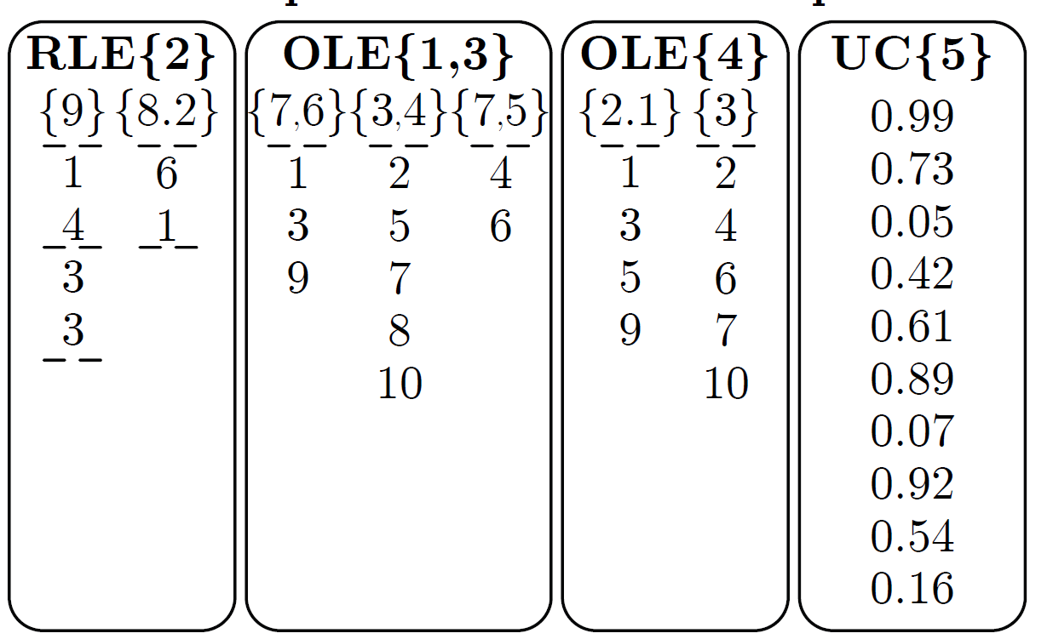
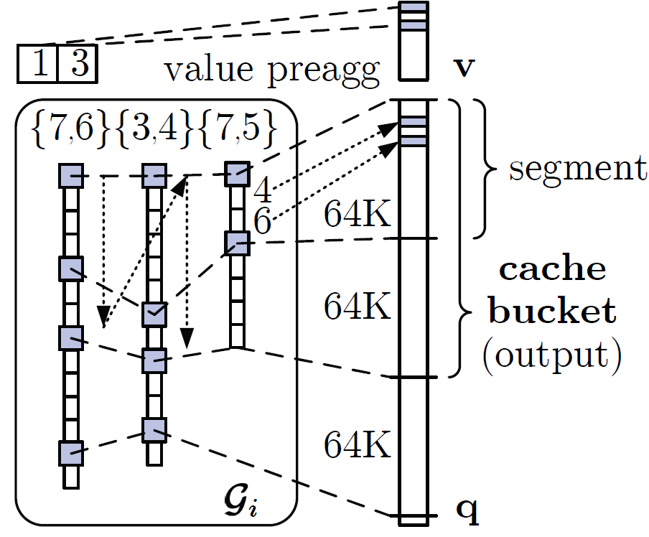
CLA: Compressed Linear Algebra, cont. (3)
Matrix-Vector Multiplication
  Naïve: for each tuple,
  pre-aggregate values,
  add values at offsets to q
  Example: q = X v, with
  Cache-conscious:
  Horizontal, segment-aligned scans, maintain positions
Vector-Matrix Multiplication
  Naïve: cache-unfriendly on input (v)
  Cache-conscious: again use horizontal, segment-aligned scans
v = (7, 11, 1, 3, 2)
v = (7, 11, 1, 3, 2)
v = (7, 11, 1, 3, 2)
v = (7, 11, 1, 3, 2)
v = (7, 11, 1, 3, 2)
v = (7, 11, 1, 3, 2)
9*11=99
➔ cache unfriendly
on output (q)
90.2
55
25
54
6.3
9
0
99
99
154
154
154
160.3
160.3
162.3
162.3
0
99
99
99
124
124
124
133
134.5
134.5
0
99
99
154
154
154
160.3
160.3
160.4
160.4
0
99
99
99
99
153
153
162
162.8
162.8
0
0
0
0
25
25
31.3
31.3
32.5
32.5
0
0
90.2
90.2
90.2
144.2
144.2
153.2
155
155
0
99
99
99
124
124
124
133
133.1
133.1
0
99
99
99
124
124
124
124
125.8
125.8
0
99
99
154
154
154
160.3
160.3
161.4
161.4
0
0
0
0
25
25
25
34
34.3
34.3

Slide 27
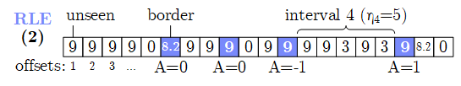
CLA: Compressed Linear Algebra, cont. (4)
Estimating Compressed Size: S^{C} = min(S^{OLE}, S^{RLE}, S^{DDC})
  # of distinct tuples d_{i}: “Hybrid generalized jackknife” estimator [JASA’98]
  # of non-zero tuples z_{i}: Scale from sample with “coverage” adjustment
  # of runs r_{ij}: maxEnt model +
  independent-interval approx. (~ Ising-Stevens)
Compression Planning
  #1 Classify compressible columns
    Draw random sample of rows (from transposed X)
    Classify C^{C} and C^{UC} based on estimate compression ratio
  #2 Group compressible columns (exhaustive O(m^{m}), greedy O(m³))
    Bin-packing-based column partitioning
    Greedy grouping per bin w/ pruning and memoization O(m²)
  #3 Compression
    Extract uncompressed offset lists and exact compression ratio
    Graceful corrections and UC group creation

Slide 28
CLA: Compressed Linear Algebra, cont. (5)
Experimental Setup
  LinregCG, 10 iterations (incl. compression), InfiMNIST data generator
  1+6 node cluster (216GB memory), Spark 2.3, SystemML 1.1
Open Challenges
  Ultra-sparse datasets, tensors, automatic operator fusion
  Operations beyond matrix-vector/unary, applicability to deep learning?
End-to-End Performance [sec]
Dataset |  | Gzip | Snappy | CLA
Higgs |  | 1.93 | 1.38 | 2.17
Census |  | 17.11 | 6.04 | 35.69
Covtype |  | 10.40 | 6.13 | 18.19
ImageNet |  | 5.54 | 3.35 | 7.34
Mnist8m |  | 4.12 | 2.60 | 7.32
Airline78 |  | 7.07 | 4.28 | 7.44
Compression Ratios
90GB
540GB
1.1TB

Slide 29

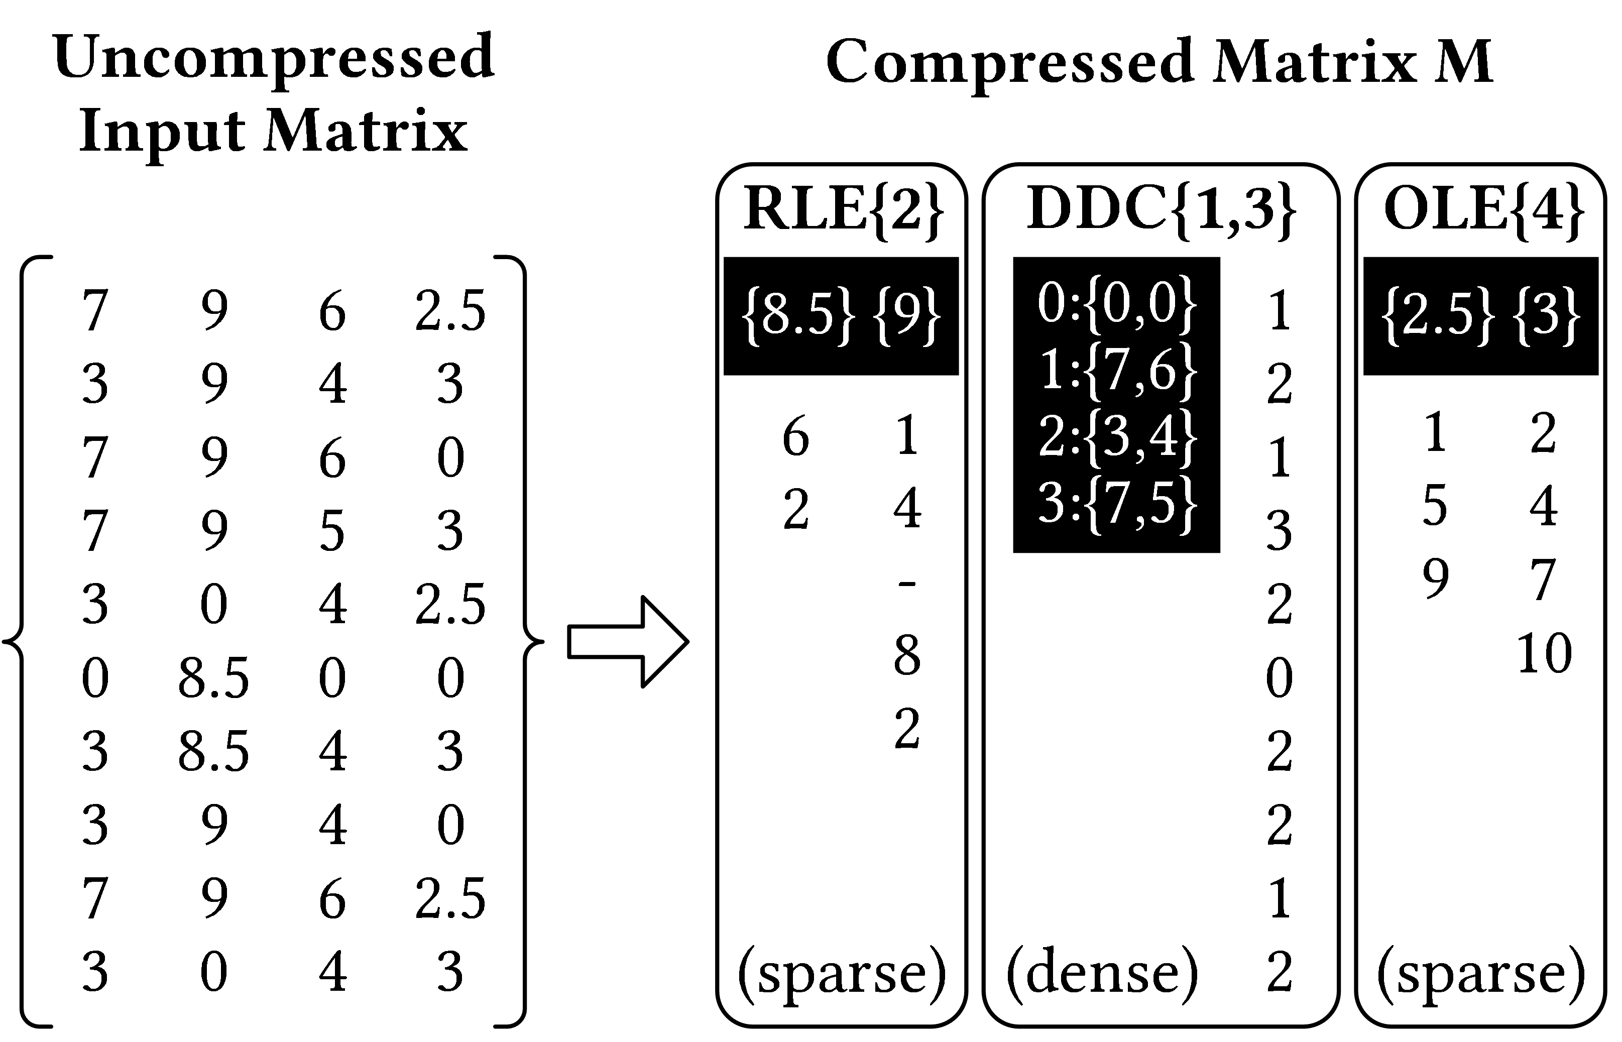
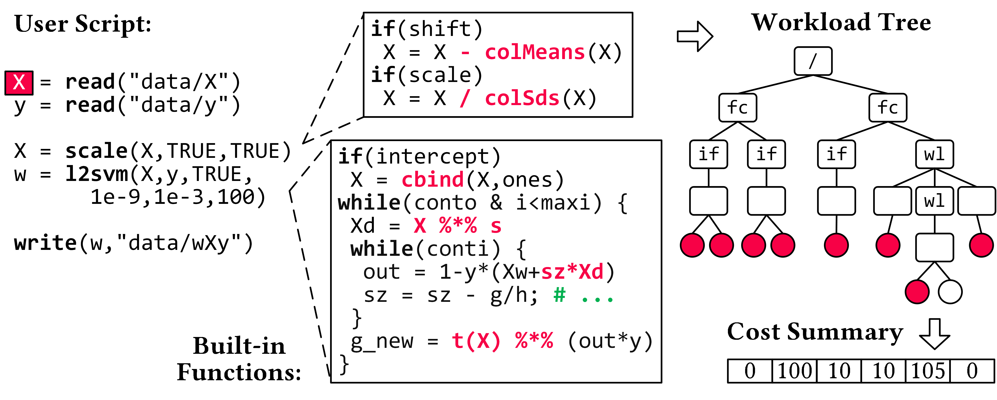
Compressed Linear Algebra Extended
[Sebastian Baunsgaard, Matthias Boehm: AWARE: Workload-aware, Redundancy-exploiting Linear Algebra, SIGMOD 2023]
Lossless Matrix Compression
  Improved general applicability (adaptive compression time,
  new compression schemes, new kernels, intermediates, workload-aware)
  Sparsity → Redundancy exploitation
  (data redundancy, structural redundancy)
Workload-aware Compression
  Workload summary
  → compression
  Compressed Representation
  → execution planning
Next Steps
  Frame compression, compressed I/O
  Compressed feature transformations
  Morphing of compressed data

Slide 30
Block-level Compression w/ D-VI, CSR-VI, CSX
CSR-VI (CSR-Value Indexed) / D-VI
  Create dictionary for distinct values
  Encode 8 byte values as 1, 2, or 4-byte codes
  (positions in the dictionary)
  Extensions w/ delta coding of indexes
  Example CSR-VI matrix-vector multiply
  c = A %*% b
[Kornilios Kourtis, Georgios I. Goumas, Nectarios Koziris: Optimizing sparse matrix-vector multiplication using index and value compression. CF 2008]
[Vasileios Karakasis et al.: An Extended Compression Format for the Optimization of Sparse Matrix-Vector Multiplication. IEEE Trans. Parallel Distrib. Syst. 2013]
for(int i=0; i<a.nrow; i++) {
int pos = A.rptr[i];
int end = A.rptr[i+1];
for(int k=pos; k<end; k++)
b[i] += dict[A.val[k]] * b[A.ix[k]];
}
CSR
0
0
.7
2
2
.1
4
0
.2
value decoding
(MV over compressed representation)
5
1
.4
1
.3

Slide 31
Tuple-oriented Compression (TOC)
Motivation
  DNN and ML often trained with mini-batch SGD
  Effective compression for small batches (#rows)
[Fengan Li, Lingjiao Chen, Yijing Zeng, Arun Kumar, Xi Wu, Jeffrey F. Naughton, Jignesh M. Patel: Tuple-oriented Compression for Large-scale Mini-batch Stochastic Gradient Descent, SIGMOD 2019]

Slide 32
Tuple-oriented Compression (TOC), cont.
Example
Compression Ratios
[Fengan Li, Lingjiao Chen, Yijing Zeng, Arun Kumar, Xi Wu, Jeffrey F. Naughton, Jignesh M. Patel: Tuple-oriented Compression for Large-scale Mini-batch Stochastic Gradient Descent, SIGMOD 2019]
dense baseline?
Take-away: specialized lossless matrix compression
➔ reduce memory bandwidth requirements and #FLOPs

Slide 33

Lossy Compression
Overview
  Extensively used in DNN (runtime vs accuracy) ➔ data format + compute
  Careful manual application regarding data and model
  Note: ML algorithms approximate by nature + noise generalization effect
Background Floating Point Numbers (IEEE 754)
  Sign s, Mantissa m, Exponent e: value = s * m * 2e (simplified)
[IEEE 754-228 Revision:
https://ieeexplore.ieee.org/
document/4610935]
Precision | Sign | Mantissa | Exponent
Double (FP64) | 1 | 52 | 11
Single (FP32) | 1 | 23 | 8
Half (FP16) | 1 | 10 | 5
Quarter (FP8) | 1 | 3 | 4
Half-Quarter (FP4) | 1 | 1 | 2
[bits]
Unums/Posits (2015),
with regime bits:
Notes:
Note: John Gustafson: The End of Error: Unum Computing, 2015 -> posit (hardware-friendly unum)

Slide 34
Low and Ultra-low FP Precision
see 05 Execution Strategies, SIMD
→ speedup/reduced energy
Model Training w/ low FP Precision
  Trend: from FP32/FP16 to FP8
  #1: Precision of intermediates (weights, act, errors, grad) → loss in accuracy
  #2: Precision of accumulation → impact on convergence (swamping small+Large)
  #3: Precision of weight updates → loss in accuracy
Example ResNet18
on ImageNet
[Naigang Wang et al.: Training Deep Neural Networks with 8-bit Floating Point Numbers. NeurIPS 2018]

Slide 35

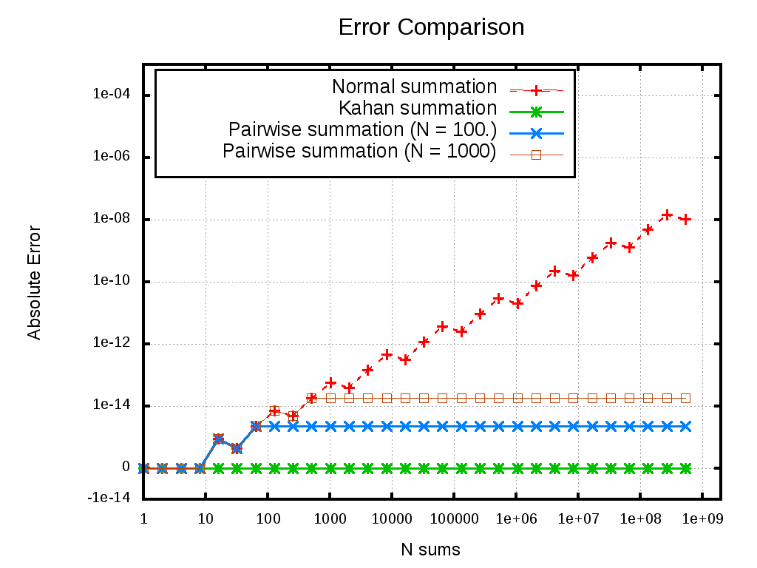

Low and Ultra-low FP Precision, cont.
sumOld = sum;
sum = sum + (input + corr);
corr = (input + corr) – (sum – sumOld);
[Yuanyuan Tian, Shirish Tatikonda, Berthold Reinwald: Scalable and Numerically Stable Descriptive Statistics in SystemML. ICDE 2012]
Numerical Stable Accumulation
  #1 Sorting ASC + Summation
  #2 Kahan Summation
  w/ error independent
  of number of values n
  #3 Pairwise Summation
  (divide & conquer)
#4 Chunk-based Accumulation
  Divide long dot products into smaller chunks
  Hierarchy of partial sums → FP16 accumulators
#5 Stochastic Rounding
  Replace nearest w/ prob. rounding
uak+: 5.000000005E17 //sum(seq(1,1e9))
ua+: 5.0000000109721722E17
ua+: 5.0000000262154688E17 //rev
[https://github.com/
NaveenKaliannan/
FloatingPointSummation]
[N. Wang et al.: Training
Deep Neural Networks with
8-bit Floating Point Numbers. NeurIPS 2018]
Notes:
Note: reproducibility of example Kahan addition
n = 1e9
x1 = seq(1,n);
x2 = seq(n,1);
ones = matrix(1,n,1)
print("baseline: "+(n*(n+1)/2));
print("agg1 : "+as.scalar(t(ones)%*%x1));
print("agg2 : "+as.scalar(t(ones)%*%x2));
print("kagg1 : "+sum(x1));
print("kagg2 : "+sum(x2));

Slide 36
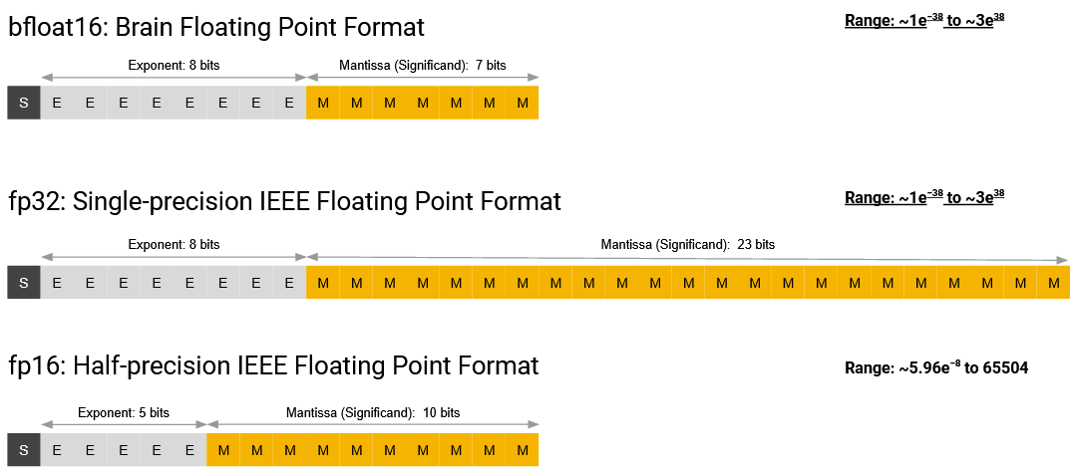

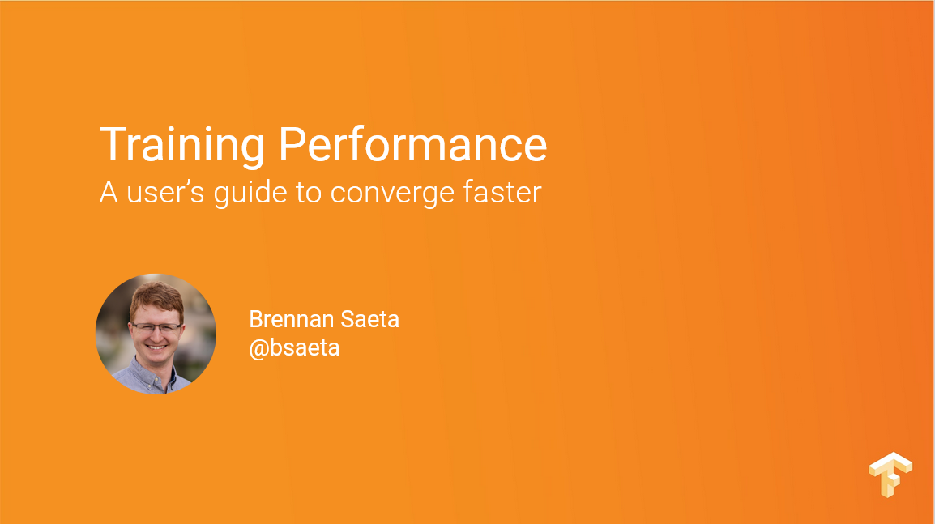
Low and Ultra-low FP Precision – New Datatypes
Google bfloat16
  “Brain” Float16 w/ range of FP32
  Drop in replacement for FP32,
  no need for loss scaling
Intel FlexPoint
  Blocks of values w/ shared exponent
  (N=16bit w/ M=5bit exponent)
  Example: flex16+5
NVIDIA TF32
  Range of FP32
  w/ precision of FP16
  FP8 variants
[Brennan Saeta: Training
Performance A user’s guide to converge faster, TF Dev Summit 2018]
[Urs Köster et al.: Flexpoint: An Adaptive Numerical Format for Efficient Training of Deep Neural Networks. NeurIPS 2017]
[NVIDIA A100 Tensor Core GPU Architecture - UNPRECEDENTED ACCELERATION AT EVERY SCALE, Whitepaper, Aug 2020]
[NVIDIA H100 Tensor Core GPU Architecture, Whitepaper, May 2023]

Slide 37
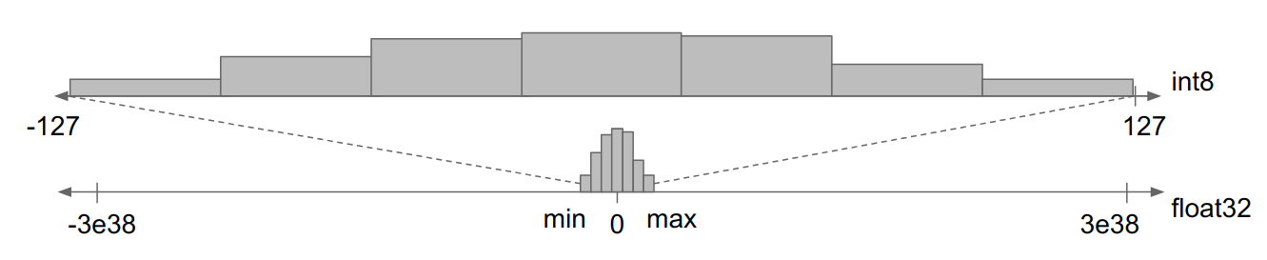
Recommended “Reading”
[Inside TensorFlow: Model Optimization Toolkit (Quantization and Pruning), 2020, https://www.youtube.com/watch?v=4iq-d2AmfRU ]
Fixed-Point Arithmetic
Motivation
  Forward-pass for model scoring (inference) can be done in UINT8 and below
  Static, dynamic, and learned quantization
  schemes (weights and inputs)
Quantization (reduce value domain)
  Split value domain into N buckets such that k = log₂ N
  can encode the data
  a) Static Quantization (e.g., min/max)
  per tensor or per tensor channel
  b) Learned Quantization Schemes
    Dynamic programming
    Various heuristics
    Example systems:
    ZipML, SketchML
[https://blog.tensorflow.org/2020/04/quantization-aware-
training-with-tensorflow-model-optimization-toolkit.html]
[Hantian Zhang, Jerry Li, Kaan Kara, Dan Alistarh, Ji Liu, Ce Zhang: ZipML: Training Linear Models with End-to-End Low Precision, and a Little Bit of Deep Learning. ICML 2017]

Slide 38
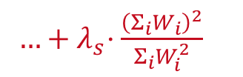
Other Lossy Techniques
#1 Sparsification/Pruning (reduce #non-zeros)
  Value clipping: zero-out very small values
  below a threshold to reduce size of weights
  Training w/ target sparsity: remove connections
  Training w/ penalty terms of number-of-nonzeros
  (or differentiable approximations)
  Hoyer-Square regularizer:
  Post-Training Quantization (PTQ) vs.
  Quantization-aware Training (QAT)
#2 Connection Sampling
  Sample mask for weights
  Independent subnet training without
  synchronization (see 06 Parameter Servers)
Sparse Accuracy | NNZ
78.1% @ sp=1.0 | 27.1M
78.0% @ sp=0.5 | 13.6M
76.1% @ sp=0.25 | 6.8M
74.6% @ sp=0.125 | 3.3M
[https://blog.tensorflow.org/
2019/05/tf-model-optimization-toolkit-pruning-API.html]
$$W^{′}=arg \min_{W}{{ E}_{D}(W)+λ⋅R(W)+…+λ_{S}⋅Σ_{i=1}^{n}{(W}_{i}≠0)}$$
[Huanrui Yang, Wei Wen, Hai Li: DeepHoyer: Learning Sparser Neural Network with Differentiable Scale-Invariant Sparsity Measures. ICLR 2020]
$…{+ λ}_{s}⋅\frac{{\left(Σ_{i}W_{i}\right)}^{2}}{Σ_{i}W_{i}^{2}}$
[Binhang Yuan et al.: Distributed Learning of Fully Connected Neural Networks using Independent Subnet Training, PVLDB 2022]

Slide 39
Other Lossy Techniques, cont.
#3 Mantissa Truncation
  Truncate m of FP32 from 23bit to 16bit
  E.g., TensorFlow (transfers), PStore
#4 Aggregated Data Representations
  a) Dim reduction (e.g., auto encoders)
  b) No FK-PK joins in Factorized Learning
  (foreign key as lossy compressed rep)
#5 Sampling
  User specifies approximation contract for error
  (regression/classification) and scale
  Min sample size for max likelihood estimators
[Souvik Bhattacherjee et al: PStore: an efficient storage framework for managing scientific data. SSDBM 2014]
[Amir Ilkhechi et al: DeepSqueeze: Deep Semantic Compression for Tabular Data, SIGMOD 2020]
[Arun Kumar et al: To Join or Not to Join?: Thinking Twice about Joins before Feature Selection. SIGMOD 2016]
[Yongjoo Park et al: BlinkML: Efficient Maximum Likelihood Estimation with Probabilistic Guarantees. SIGMOD 2019]
Notes:
Mixed precision training, ICLR 2018, https://openreview.net/pdf?id=r1gs9JgRZ

Slide 40
Summary & QA
Motivation, Background, and Overview
Caching, Partitioning, and Indexing
Lossy and Lossless Compression
Next Lectures (Part B)
  10 Data Acquisition, Cleaning, and Preparation [Jun 26]
  11 Model Selection and Management [Jul 03]
  12 Model Debugging, Fairness, Explainability [Jul 10]
  13 Model Serving Systems and Techniques [Jul 17]
  Q&A and Exam Preparation [Jul 17]
High Impact on Performance/Energy
(Part B:
ML Lifecycle Systems)

