Slide 1

Architecture of ML Systems (AMLS)
10 Data Acquisition and Preparation
Prof. Dr. Matthias Boehm
Technische Universität Berlin
Berlin Institute for the Foundations of Learning and Data
Big Data Engineering (DAMS Lab)
Last update: Jun 26, 2025

Slide 2

Announcements / Org
#1 Hybrid & Video Recording
  Hybrid lectures (in-person, zoom) with optional attendance
  https://tu-berlin.zoom.us/j/9529634787?pwd=R1ZsN1M3SC9BOU1OcFdmem9zT202UT09
  Zoom video recordings, links from website
  https://mboehm7.github.io/teaching/ss25_amls/index.htm
#2 Exam Registration
  Thu July 24, 4-6pm (A 151, max 50) → 14 registrations
  Thu July 31, 4-6pm (EW 201, max 47) → 28 registrations
  Thu Aug 14, 4-6pm (A 151, max 50) → 13 registrations
#3 Projects & Exercises
  Submission deadline: Jul 15 EOD
  Get started, use the office hour (Tue 4pm-5.30), and mentor meetings

Slide 3


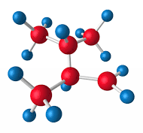

Recap: The Data Science Lifecycle
(aka KDD Process, aka CRISP-DM)
Data extraction, schema alignment, entity resolution, data validation, data cleaning, outlier detection, missing value imputation, semantic type detection, data augmentation, feature selection, feature engineering, feature transformations
Key observation: SotA data integration/cleaning based on ML
Data Scientist
Data Integration
Data Cleaning
Data Preparation
Data Integration
Data Cleaning
Data Preparation
Model Selection
Training
Hyper-parameters
Validate & Debug
Deployment
Scoring & Feedback
Exploratory Process
(experimentation, refinements, ML pipelines)
Data/SW Engineer
DevOps Engineer

Slide 4
The 80% Argument
Data Sourcing Effort
  Data scientists spend 80-90% time on finding, integrating, cleaning datasets
Technical Debts in ML Systems
  Glue code, pipeline jungles, dead code paths
  Plain-old-data types (arrays), multiple languages, prototypes
  Abstraction and configuration debts
  Data testing, reproducibility, process management, and cultural debts
[Michael Stonebraker, Ihab F. Ilyas: Data Integration: The Current Status and the Way Forward.
IEEE Data Eng. Bull. 41(2) (2018)]
[D. Sculley et al.: Hidden
Technical Debt in Machine Learning Systems. NeurIPS 2015]
ML

Slide 5
Agenda
Data Acquisition, Integration, and Validation
Feature Transformations and Engineering
Data Preparation and Cleaning
Data Augmentation (next week)
“least enjoyable tasks in data science lifecycle”
Data Integration and Large-Scale Analysis (DIA)
(WiSe, bachelor/master)

Slide 6
Data Acquisition, Integration,
and Data Validation
Data Integration for ML and
ML for Data Integration

Slide 7
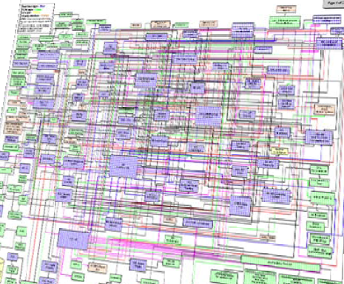
Data Sources and Heterogeneity
Terminology
  Integration (Latin integer = whole): consolidation of data objects / sources
  Homogeneity (Greek homo/homoios = same): similarity
  Heterogeneity: dissimilarity, different representation / meaning
Heterogeneous IT Infrastructure
  Common enterprise IT infrastructure contains >100s of
  heterogeneous and distributed systems and applications
  E.g., health care data management: 20 - 120 systems
Multi-Modal Data (example health care)
  Structured patient data, patient records incl. prescribed drugs
  Knowledge base drug APIs (active pharmaceutical ingredients) + interactions
  Doctor notes (text), diagnostic codes, outcomes
  Radiology images (e.g., MRI scans), patient videos
  Time series (e.g., EEG, ECoG, heart rate, blood pressure)
[Credit: Albert Maier]

Slide 8
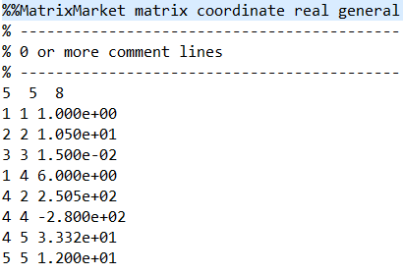
Types of Data Formats
General-Purpose Formats
  CSV (comma separated values), JSON (javascript object notation), XML, Protobuf
  CLI/API access to DBs, KV-stores, doc-stores, time series DBs, etc
Sparse Matrix Formats
  Matrix market: text IJV (row, col, value)
  Libsvm: text compressed sparse rows
  Scientific formats: NetCDF, HDF5
Large-Scale Data Formats
  Parquet (columnar file format)
  Arrow (cross-platform columnar in-memory data)
Domain-Specific Formats
  Health care: DICOM images, HL7 messages (health-level seven, XML)
  Automotive: MDF (measurements), CDF (calibrations), ADF (auto-lead XML)
  Smart production: OPC (open platform communications)

Slide 9
[J. Hammer, M. Stonebraker, and O. Topsakal: THALIA: Test Harness for the Assessment of Legacy Information Integration Approaches. U Florida, TR05-001, 2005]
Types of Heterogeneity
Heterogeneity
Semantic Heterogeneity
Structural Heterogeneity
Attribute Heterogeneity
Missing
Data
1. Synonyms/homonyms
6. Nulls (Missing Values)
9. Same attribute in different structure
2. Simple mapping (mathematical)
7. Virtual columns
8. Semantic incompatibility
10. Handling Sets/Lists
[Saeed Fathollahzadeh, Essam Mansour, Matthias Boehm: CatDB: Data-catalog-guided, LLM-based, Generation of Data-centric ML Pipelines, PVLDB 2025 + SIGMOD 2025 Demo]
3. Different data types
11. Attribute name
w/o semantics
4. Complex mappings
5. Language expressions
12. Attribute composition

Slide 10
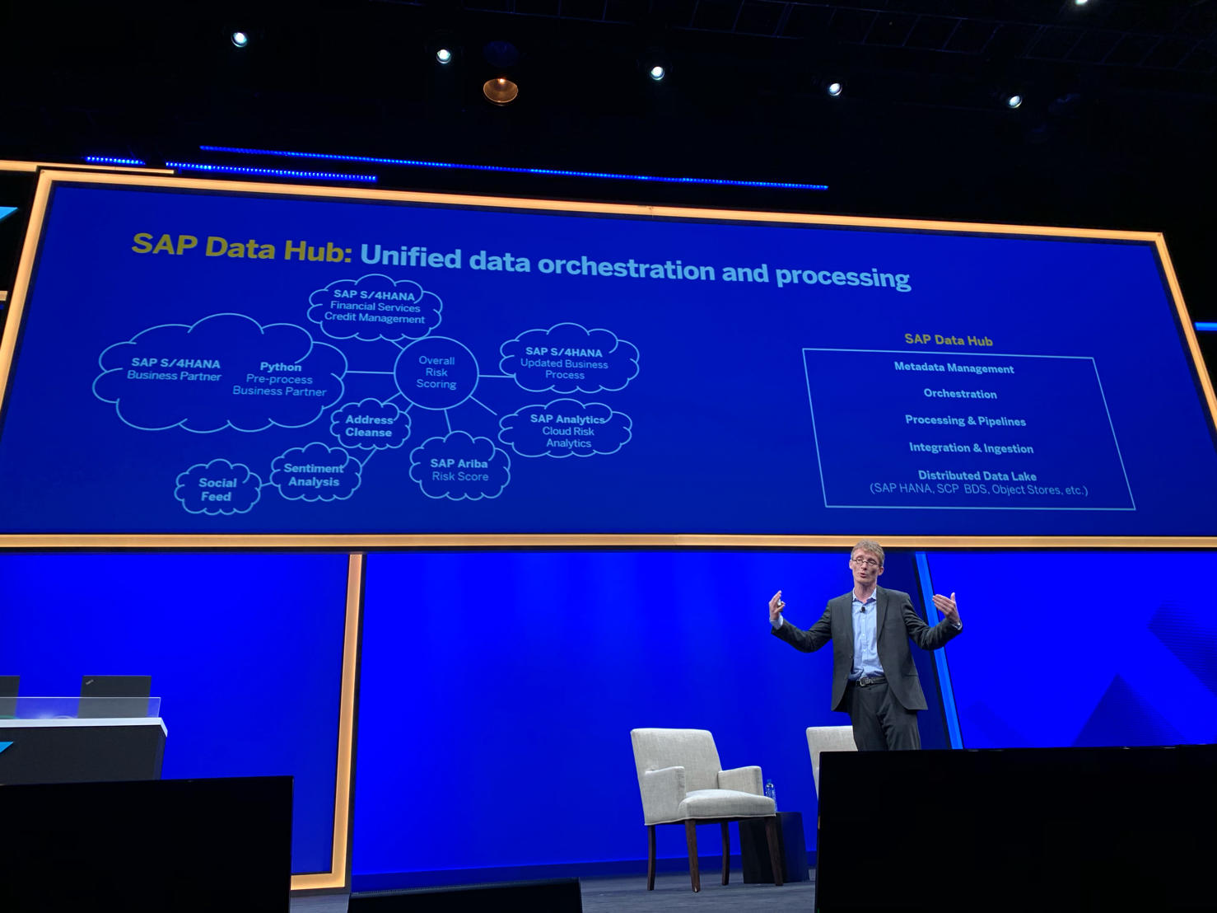
Identification of Data Sources
Data Catalogs
  Data curation in repositories for finding datasets in data lakes
  Metadata and provenance
  Augment data with open and linked data sources
Examples
[Alon Y. Halevy et al: Goods: Organizing Google's Datasets. SIGMOD 2016]
[Dan Brickley, Matthew Burgess, Natasha F. Noy: Google Dataset Search: Building a search engine for datasets in an open Web ecosystem. WWW 2019]
SAP Data Hub
[Omar Benjelloun, Shiyu Chen, Natasha Noy: Google Dataset Search by the Numbers, https://arxiv.org/pdf/2006.06894]
Google Dataset Search
[SAP Sapphire Now 2019]
500K → 30M datasets

Slide 11
Schema Detection and Integration
Syntactic Schema Detection
  Sample of the input dataset
  Extract basic data types via rules, and regular expressions
Feature Type Detection
  Numerical vs Categorical vs Ordinal
  Rules and trained ML model
Semantic Type Detection
  Extract common semantic feature types
  (e.g., location, date, rank, name)
StructType(
StructField(pid,IntegerType,true),
StructField(name,StringType,true),
StructField(pos,StringType,true),
StructField(jnum,IntegerType,true),
StructField(ncid,IntegerType,true),
StructField(tid,IntegerType,true))
./data/players.csv:
pid,name,pos,jnum,ncid,tid
5435,Miroslav Klose,FW,11,789,144
6909,Manuel Neuer,GK,1,163,308
Dataset<Row> ds = sc.read()
.format("csv")
.option("header", true)
.option("inferSchema", true)
.option("samplingRatio", 0.001)
.load("./data/players.csv");
[Vraj Shah, Jonathan Lacanlale, Premanand Kumar, Kevin Yang, Arun Kumar: Towards Benchmarking Feature Type Inference for AutoML Platforms, SIGMOD 2021]
[Madelon Hulsebos et al: Sherlock: A Deep Learning Approach to Semantic Data Type Detection. KDD 2019]
GitTables (Uni Amsterdam) https://gittables.github.io/
Notes:
Note: semantic schema detection http://webdatacommons.org/webtables/goldstandardV2.html

Slide 12
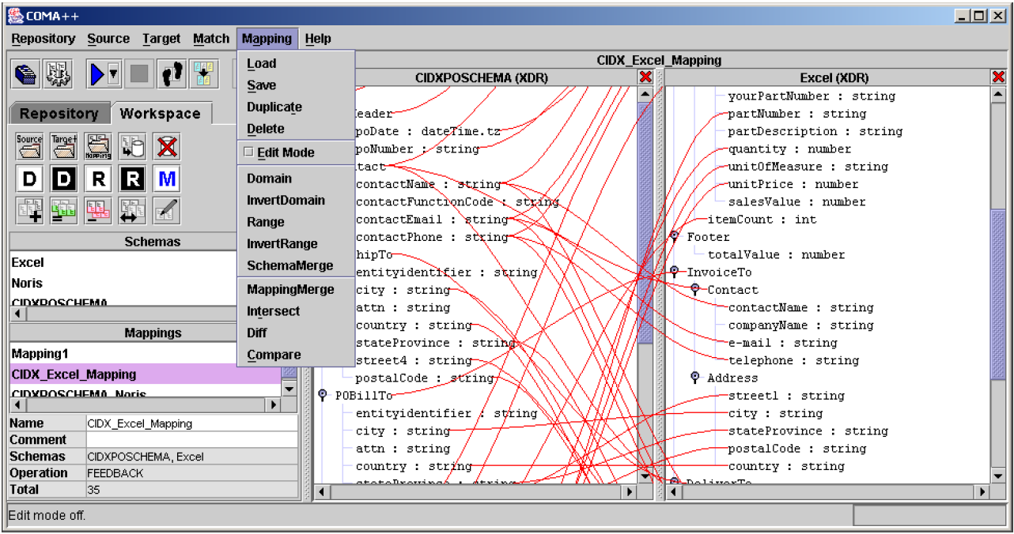
Schema Detection and Integration, cont.
Schema Matching
  Semi-automatic mapping of schemas S1 to S2 → output: schema correspondences
  Approaches: Schema- vs instance-based;
  element- vs structure-based; linguistic vs rules
  One-to-one matching: stable marriage problem
  Many-to-one matching: hospitals-residents / college-admission problems
Schema Mapping
  Given two schemas and correspondences, generate transformation program
  → output: executable data transformation
  Challenges: complex mappings (1:N cardinality), new values, PK-FK relations and nesting, creation of duplicates, different data types, sematic preserving
Schema Detection
Schema Matching
Schema Mapping
INSERT INTO Orders
SELECT BELNR,
SUMME, DATUM
FROM Bestellungen
[Credit: Erhard Rahm]

Slide 13
Corrupted Data
Heterogeneity of Data Sources
  Update anomalies on denormalized data / eventual consistency
  Changes of app/preprocessing over time (US vs us) → inconsistencies
Human Error
  Errors in semi-manual data collection, laziness (see default values), bias
  Errors in data labeling (especially if large-scale: crowd workers / users)
Measurement/Processing Errors
  Unreliable HW/SW and measurement equipment (e.g., batteries)
  Harsh environments (temperature, movement) → aging
Uniqueness & duplicates
Contradictions & wrong values
Missing Values
[Credit: Felix Naumann]
Ref. Integrity
ID | Name | BDay | Age | Sex | Phone | Zip
3 | Smith, Jane | 05/06/1975 | 44 | F | 999-9999 | 98120
3 | John Smith | 38/12/1963 | 55 | M | 867-4511 | 11111
7 | Jane Smith | 05/06/1975 | 24 | F | 567-3211 | 98120
Zip | City
98120 | San Jose
90001 | Lost Angeles
Typos

Slide 14
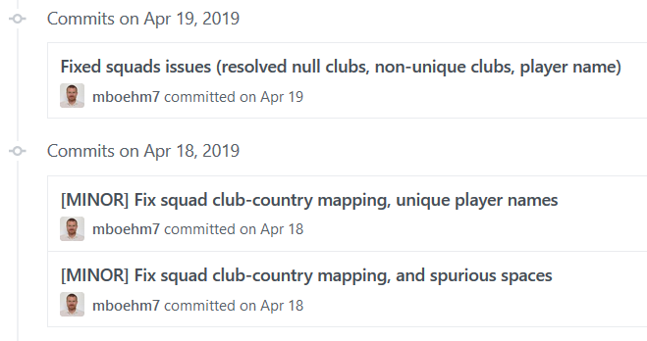
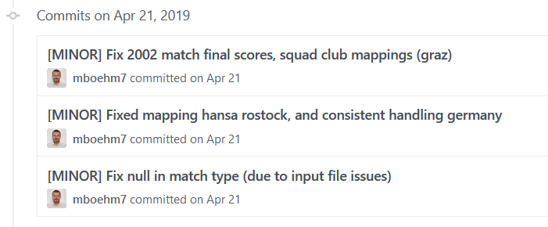
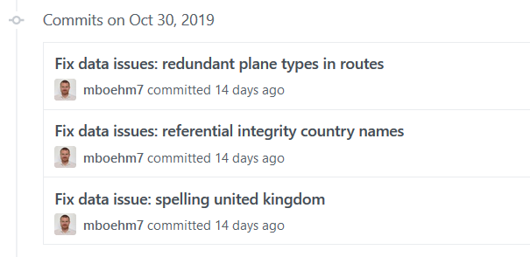

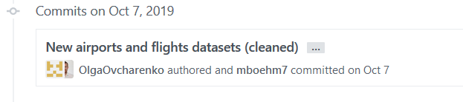



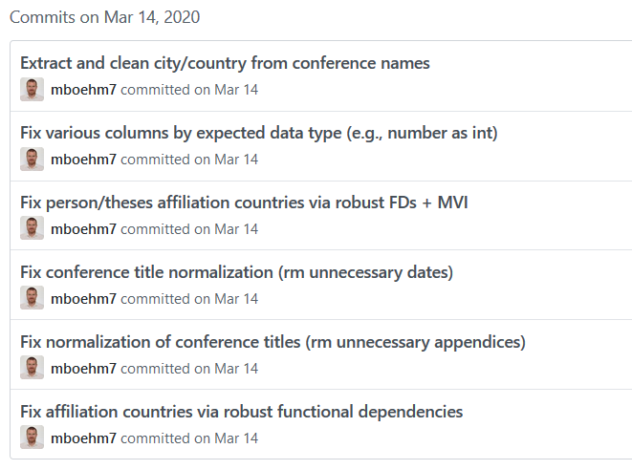
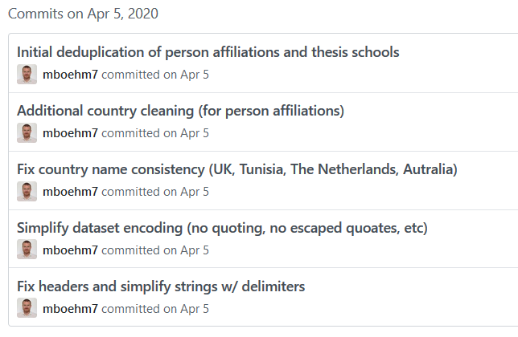
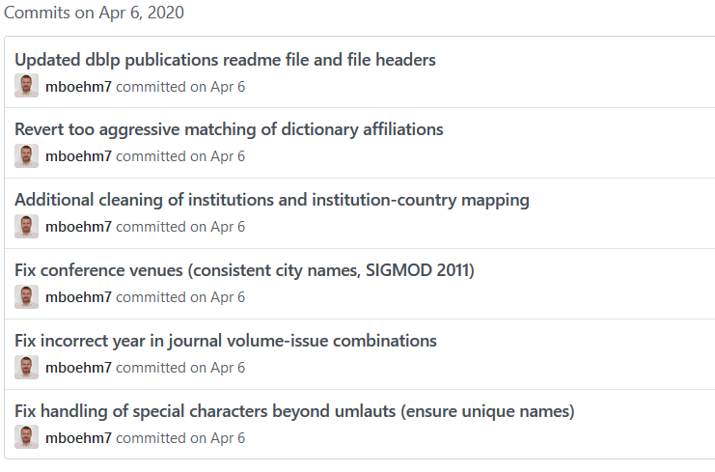
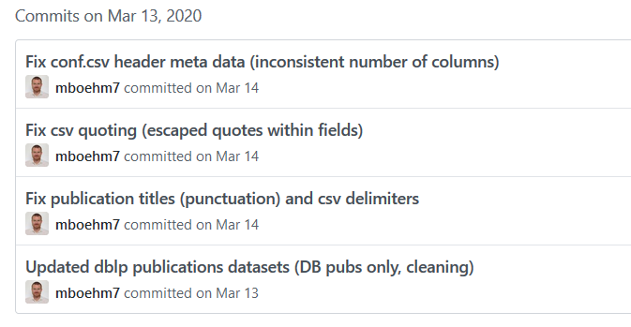
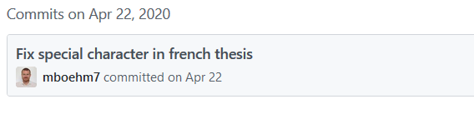
Examples (aka errors are everywhere)
DM SS’19
(Soccer World Cups)
DM WS’19/20
(Airports and Airlines)
DM SS’20
(DBLP Publications)
☺

Slide 15
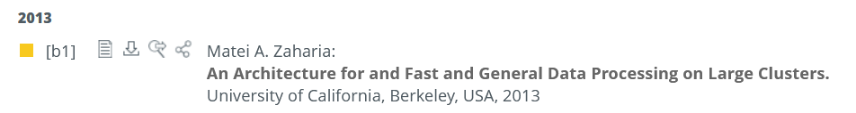


Examples (aka errors are everywhere), cont.
DM SS’20, cont.
(DBLP Publications)
→ as a great, curated dataset
DM WS’20/21 (Movies and Actors)
DM SS’21 (Summer Olympics)
DM WS’21/22 (AT Elections)
DM SS’22 (Graz Districts)
Wrong meta data from UC Berkeley
Misplaced data (wrong affiliation, MIT)
Best-effort automated cleaning
Reference impl data ingestion into relational
schema + expected results of query processing
Decentralized validation (~600 students)

Slide 16
Data Integration for ML and ML for DI
#1 Data Extraction
  Extracting structured data from un/semi-structured data
  Rule- and ML-based extractors, combination w/ CNN
#2 Schema Alignment
  Schema matching for consolidating data from heterogeneous systems
  Spatial and Temporal alignment via provenance and query processing
  (e.g., sensor readings for object along a production pipeline)
#3 Entity Linking
  Linking records to entities (deduplication)
  Blocking, pairwise matching, clustering, ML, Deep ML (via entity embedding)
#4 Data Fusion
  Resolve conflicts, necessary in presence of erroneous data
  Rule- and ML-based, probabilistic GM, Deep ML (RBMs, graph embeddings)
[Xin Luna Dong, Theodoros Rekatsinas: Data Integration and Machine Learning: A Natural Synergy. SIGMOD 2018]

Slide 17
Data Validation
[Neoklis Polyzotis, Sudip Roy, Steven Euijong Whang, Martin Zinkevich: Data Management Challenges in Production Machine Learning. Tutorial, SIGMOD 2017]
Validity checks on expected shape
before training first model
Check a feature’s min, max, and most common value
  Ex: Latitude values must be within the range [-90, 90] or [-π/2, π/2]
The histograms of continuous or categorical values are as expected
  Ex: There are similar numbers of positive and negative labels
Whether a feature is present in enough examples
  Ex: Country code must be in at least 70% of the examples
Whether a feature has the right number of values (i.e., cardinality)
  Ex: There cannot be more than one age of a person
(Google Research)

Slide 18
Data Validation, cont.
[Sebastian Schelter, Dustin Lange, Philipp Schmidt, Meltem Celikel, Felix Bießmann, Andreas Grafberger: Automating Large-Scale Data Quality Verification. PVLDB 2018]
Constraints
and Metrics
for quality
check UDFs
Approach
  #1 Quality checks on basic metrics, computed in Apache Spark
  #2 Incremental maintenance of metrics and quality checks
(Amazon Research)
Organizational Lesson: benefit of shared vocabulary/procedures
Technical Lesson: fast/scalable; reduce manual and ad-hoc analysis

Slide 19
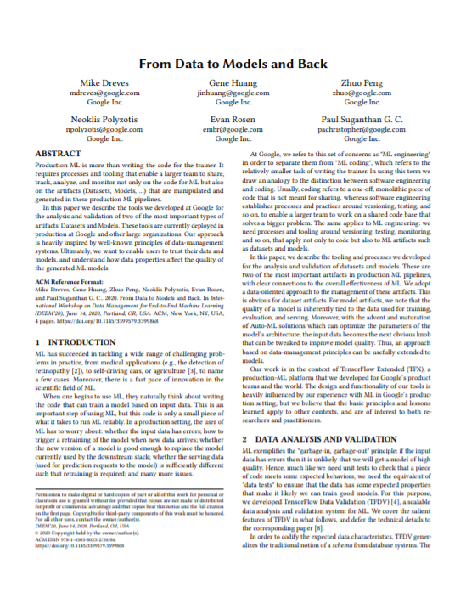
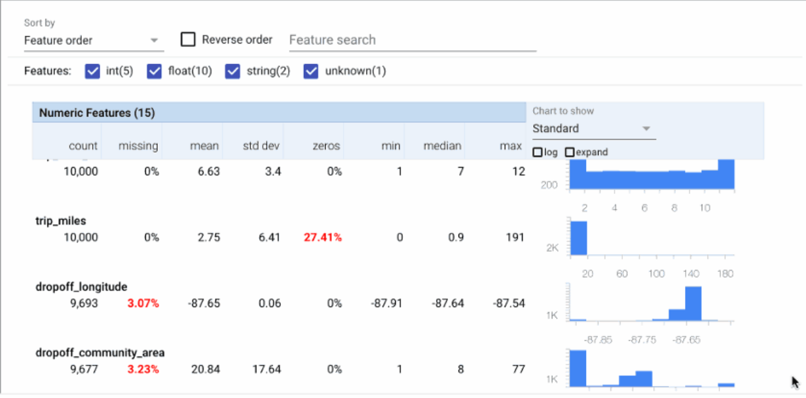

Data Validation, cont.
TensorFlow Data Validation (TFDV)
  Library or TFX components
  Stats, schema extraction, validation checks, anomaly detection
[Mike Dreves; Gene Huang; Zhuo Peng; Neoklis Polyzotis; Evan Rosen; Paul Suganthan: From Data to Models and Back. DEEM 2020]
[Eric Breck, Neoklis Polyzotis, Sudip Roy, Steven Whang, Martin Zinkevich: Data Validation for Machine Learning. MLSys 2019]
[Emily Caveness et al: TensorFlow Data Validation: Data Analysis and Validation in Continuous ML Pipelines. SIGMOD 2020]
(Google)

Slide 20
Feature Transformations and
Feature Engineering

Slide 21
Overview Feature Engineering
Terminology
  Matrix X of m observations (rows) and n features (columns)
  Continuous features: numerical values (aka scale features)
  Categorical features: non-numerical values, represent groups
  Ordinal features: non-numerical values, associated ranking
  Feature space: multi-dimensional space of features → curse of dimensionality
Feature Engineering
  Bring multi-modal data and features into numeric representation
  Use domain expertise to expose predictive features to ML model training
Excursus: Representation Learning
  Neural networks combine representation learning and model training (pros and cons: learned, repeatable)
  Mostly homogeneous inputs (e.g., image), research on multi-modal learning
➔ Principle: If same accuracy, prefer simple model (cheap, robust, explainable)

Slide 22
Recoding
Summary
  Numerical encoding of categorical features (arbitrary strings)
  Map distinct values to integer domain (potentially combined w/ one-hot)
City | State
San Jose | CA
New York | NY
San Francisco | CA
Seattle | WA
New York | NY
Boston | MA
San Francisco | CA
Los Angeles | CA
Seattle | WA
Dictionaries
City | State
1 | 1
2 | 2
3 | 1
4 | 3
2 | 2
5 | 4
3 | 1
6 | 1
4 | 3
{San Jose : 1,
New York : 2,
San Francisco : 3,
Seattle : 4,
Boston : 5,
Los Angeles : 6}
{CA : 1,
NY : 2,
WA : 3,
MA : 4}

Slide 23
Feature Hashing
Summary
  Numerical encoding of categorical features (arbitrary strings)
  Hash input to k buckets via hash(value) % k (often combined w/ one-hot)
City
San Jose
New York
San Francisco
Seattle
New York
Boston
San Francisco
Los Angeles
Seattle
City
1
0
1
1
1
4
1
3
1
for
k = 5:
1993955031 % 5 → 1
1382994575 % 5 → 0
1540367136 % 5 → 1
-661909336 % 5 → 1
1993955031 % 5 → 1
1995575789 % 5 → 4
1540367136 % 5 → 1
Efficient, but collisions
-425347233 % 5 → 3
-661909336 % 5 → 1

Slide 24
Binning (see also Quantization, Binarization)
Summary
  Encode of numerical features to integer domain (often combined w/ one-hot)
  Equi-width: split (max-min)-range into k equal-sized buckets
  Equi-height: compute data-driven ranges for k balanced buckets
Sqft
928.5
451
570.3
1,273
1,239
711.3
1,114
867
Equal-sized numerical buckets
(with k=3)
Sqft-Bins
2
1
1
3
3
1
3
2
min = 451
max = 1,273
range = 822
[451, 725) → 1
[725, 999) → 2
[999, 1,273] → 3
Allows modelling small, medium, large apartments

Slide 25
One-hot Encoding (see also Dummy Coding)
Summary
  Encode integer feature of cardinality d into sparse 0/1 vector of length d
  Feature vectors of input features concatenated in sequence
City | State
1 | 1
2 | 2
3 | 1
4 | 3
2 | 2
5 | 4
3 | 1
6 | 1
4 | 3
C1 | C2 | C3 | C4 | C5 | C6 | S1 | S2 | S3 | S4
1 | 0 | 0 | 0 | 0 | 0 | 1 | 0 | 0 | 0
0 | 1 | 0 | 0 | 0 | 0 | 0 | 1 | 0 | 0
0 | 0 | 1 | 0 | 0 | 0 | 1 | 0 | 0 | 0
0 | 0 | 0 | 1 | 0 | 0 | 0 | 0 | 1 | 0
0 | 1 | 0 | 0 | 0 | 0 | 0 | 1 | 0 | 0
0 | 0 | 0 | 0 | 1 | 0 | 0 | 0 | 0 | 1
0 | 0 | 1 | 0 | 0 | 0 | 1 | 0 | 0 | 0
0 | 0 | 0 | 0 | 0 | 1 | 1 | 0 | 0 | 0
0 | 0 | 0 | 1 | 0 | 0 | 0 | 0 | 1 | 0

Slide 26
Hybrid Feature Transformations
Combinations
  Different encoders for different columns
  Binning + one-hot encoding
  Recoding + one-hot encoding
  Feature hashing + one-hot encoding
Top-K Recoding/Feature Hashing
  Recoding top-k most frequent values (no collisions in frequent values)
  Feature Hashing for others (collisions, but bounded #)
  “Vocabulary encoding” w/ single code for N/A
Infrequent / Unknown Values
  E.g., sk-learn OneHotEncoder → values below min_frequency in single category
Pipelines of Encoders and Data Preparation
Primitives
City | Count
New York | 8,336,817
San Jose | 1,026,350
San Francisco | 883,305
Seattle | 704,352
Boston | 684,379
… | …
Graz | 291,072
1
2
3
[Doris Xin et al: Production Machine Learning Pipelines: Empirical Analysis and Optimization Opportunities, SIGMOD 2021]
Feature Hashing k=2
Notes:
Note: Google paper finds that on average 53% of the features are categorical (per feature, on average 10.6 million unique values)

Slide 27
Derived Features
X = cbind(X,
matrix(1, nrow(X), 1));
#1 Intercept Computation
  Add a column of ones to X for
  computing the intercept as a weight
  Applies to regression and classification
#2 Non-Linear Relationships / Interaction Features
  Can be explicitly materialized as feature combinations
  Example: Assumptions of underlying physical system
  Arbitrary complex feature interactions: e.g., X₁^2 * X₂
#3 Windowing
  Tumbling or sliding window over time series
  Compute aggregates or existence of events
# y ~ b1*X1 + b2*X1^2 + b3*X1*X2
X = cbind(X1, X1^2, X1*X2);
size = 2min, step = 1min

Slide 28
NLP Features
Basic NLP Feature Extraction
  Sentence/word tokenization: split into sentences/words (e.g., via stop words)
  Part of Speech (PoS) tagging: label words verb, noun, adjectives (syntactic)
  Semantic role labeling:
  label entities with their roles in actions (semantic)
Bag of Words (BOW) and N-Grams
  Represent sentences
  as bag (multisets)
  Bi-grams: bag-of-words for 2-sequences of words (order preserving)
  N-grams: generalization of bi-grams to arbitrary-length sequences
Who did what to whom at where?
A | B | C | D | E
2 | 2 | 1 | 0 | 1
1 | 0 | 0 | 3 | 2
A B C A B E.
A D E D E D.

Slide 29

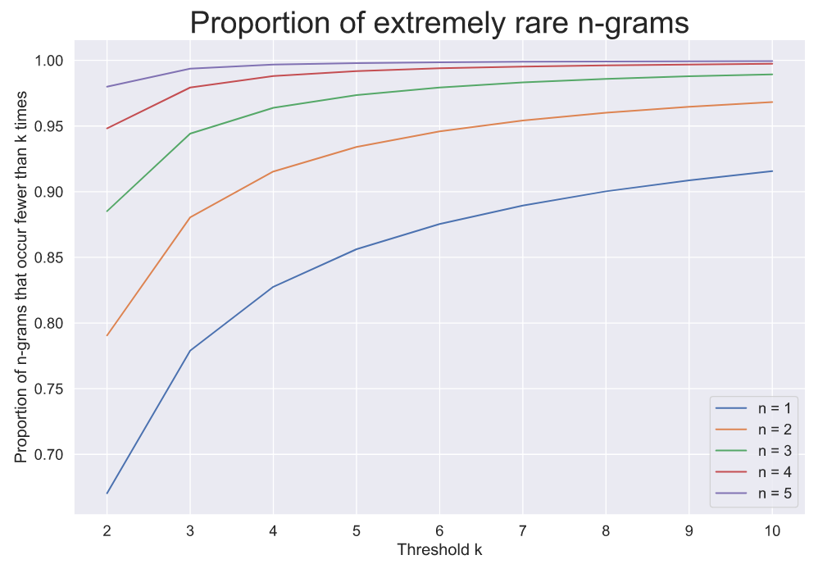
NLP Features, cont.
Common N-Grams
  Prune n-grams that appear <5 times, → 99.3% reduction
  Lattice-based pruning (Apriori monotonicity property)
Example
  Amazon Reviews Dataset
  67% of words
  appear just once
[John Hallman: Efficient Featurization of Common N-grams via Dynamic Programming. https://sisudata.com/blog/efficient-featurization-common-ngrams-via-dynamic-programming, 2021]

Slide 30
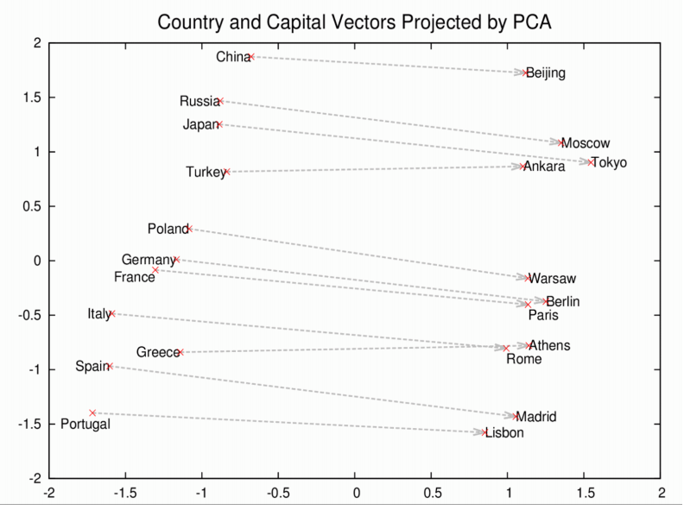
[Tomas Mikolov, Kai Chen, Greg Corrado, Jeffrey Dean: Efficient Estimation of Word Representations in Vector Space. ICLR (Workshop) 2013]
NLP Features, cont.
github.com/dav/word2vec
Word Embeddings
  Trained (word → vector)
  mappings (~ 50-300 dims)
  Word2vec: continuous
  bag-of-words (CBOW) or
  continuous skip-gram
  Subsampling frequent words
  Semantic preserving
  arithmetic operations
  (+ ~ * of context distributions)
Follow-up Work
  Often pre-trained word embeddings;
  fine-tuning if necessary for task/domain
  Various extensions/advancements: Sentence2Vec, Doc2Vec, Node2Vec
  BERT, RoBERTa, ALBERT, StructBERT / GPT
w_{t-2}
Skip-gram
w_{t-2}
CBOW
w_{t-1}
w_{t-1}
∑
w
w
∑
w_{t+1}
w_{t+1}
w_{t+2}
w_{t+2}
vec(Paris) ≈ vec(Berlin)
– vec(Germany) + vec(France)
[https://wiki.pathmind.com/word2vec]
[Jacob Devlin et al. : BERT: Pre-training of Deep Bidirectional Transformers for Language Understanding. NAACL-HLT (1) 2019]
[Tom B. Brown et al: Language Models are Few-Shot Learners. (GPT-3), CoRR 2020, https://arxiv.org/pdf/2005.14165.pdf]
Notes:
Note: Word2vec later published at NeurIPS 2013 (Tomas Mikolov, Ilya Sutskever, Kai Chen, Gregory S. Corrado, Jeffrey Dean: Distributed Representations of Words and Phrases and their Compositionality. NeurIPS 2013: 3111-3119)
BERT: transformer – bidirectional (like LSTM)
GPT: transformer – unidirectional (autoregressive)

Slide 31

Example Spark ML
API Design
  Transformers: Feature transformations and learned models
  Estimators: Algorithm that can be fit to produce a transformer
  Compose ML pipelines from chains of transformers and estimators
Example
Pipeline
// define pipeline stages
tokenizer = Tokenizer(inputCol="text", outputCol="words")
hashingTF = HashingTF(inputCol=tokenizer.getOutputCol(),
outputCol="features")
lr = LogisticRegression(maxIter=10, regParam=0.001)
// create pipeline transformer via fit
pipeline = Pipeline(stages=[tokenizer, hashingTF, lr])
model = pipeline.fit(training)
// use of resulting ML pipeline
prediction = model.transform(test)
[https://spark.apache.org/docs/
2.4.3/ml-pipeline.html]

Slide 32

Example SystemML/SystemDS
Feature Transformation
during Training
FX
transformencode
X
Y
FY
Training
B
MX
MY
# read tokenized words
FX = read(“./input/FX”, data_type=FRAME); # sentence id, word, count
FY = read(“./input/FY”, data_type=FRAME); # sentence id, labels
# encode and one-hot encoding
[X0, MX] = transformencode(target=FX, spec=“{recode:[2]}”);
[Y0, MY] = transformencode(target=FY, spec=“{recode:[2]}”);
X = table(X0[,1], X0[,2], X0[,3]); # bag of words
Y = table(Y0[,1], Y0[,2]); # bag of words
# model training via multi-label, multi-nominal logical regression
B = mlogreg(X, Y);

Slide 33
Example SystemML/SystemDS, cont.
MX
MY
B
Feature Transformation
during Scoring
ΔFX
transformapply
ΔX
Scoring
ΔFŶ
transformdecode
ΔŶ
# read tokenized words of test sentences
dFX = read(“./input/dFX”, data_type=FRAME); # sentence id, word, count
# encode and one-hot encoding
dX0 = transformapply(target=dFX, spec=“{recode:[2]}”, meta=MX);
dX = table(dX0[,1], dX0[,2], dX0[,3]); # bag of words
# model scoring and postprocessing (reshape, attach sentence ID, etc)
dYhat = (X %*% B) >= theta; ...;
# decode output labels: sentence id, label word
dFYhat = transformdecode(target=dYhat, spec=“{recode:[2]}”, meta=MY);

Slide 34
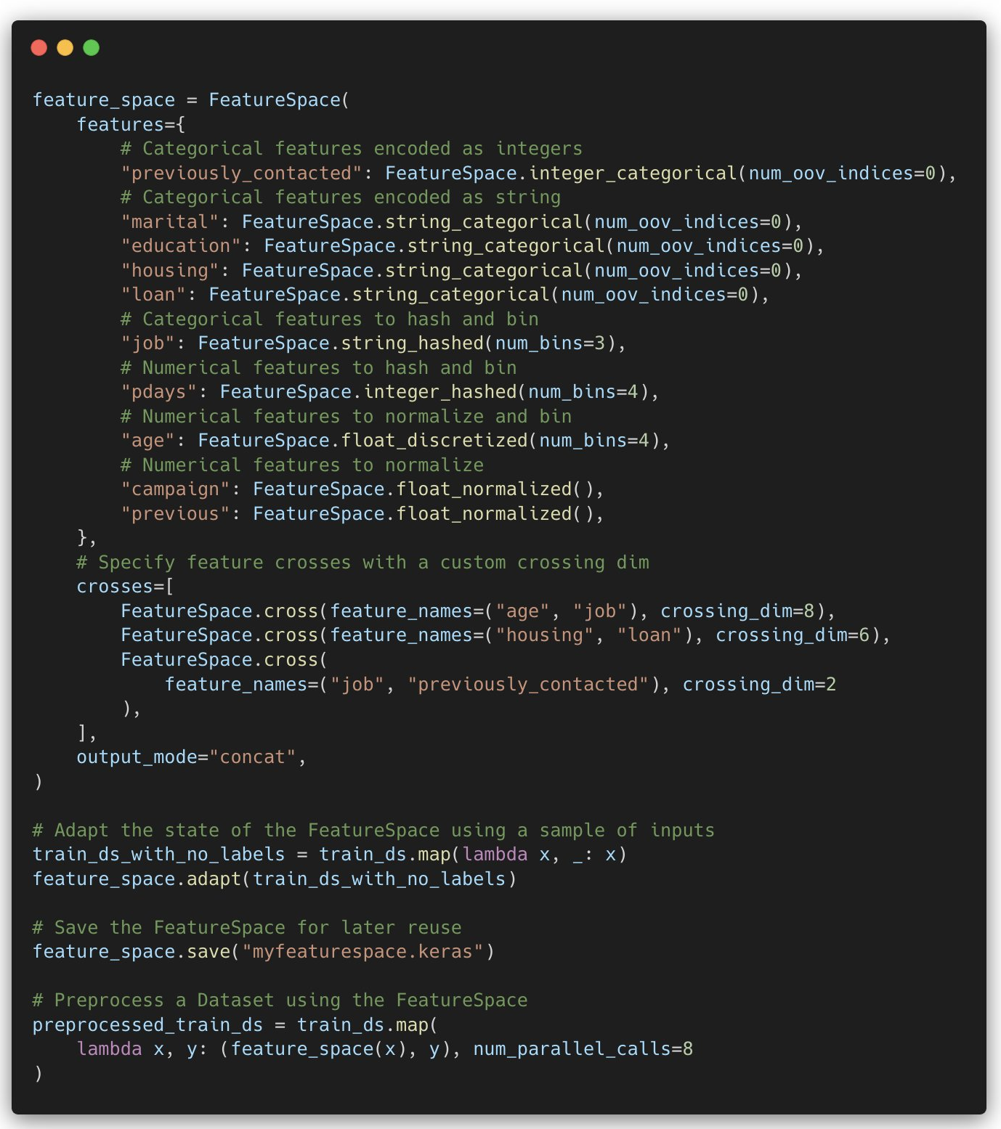
Example Keras FeatureSpace
Feature Transformation,
Normalization, and
Interaction Features
[https://keras.io/examples/structured_data/feature_space_advanced/]

Slide 35


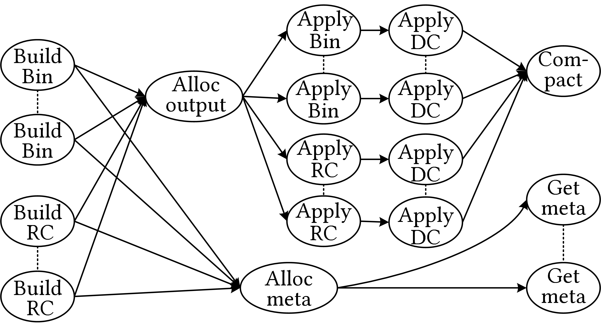
[Arnab Phani, Lukas Erlbacher, Matthias Boehm: UPLIFT: Parallelization Strategies for Feature Transformations in Machine Learning Workloads, PVLDB 2022]
Parallelizing Feature Transformations
Feature Transformations
  Numeric: pass-through, H/W binning + one-hot
  Categorical: recoding, feature hashing + one-hot
  Text/Graph embeddings
Parallelization
  Fine-grained, future-based task graph
  Optimization via task graph rewrites
  (s.t. mem budget)
  Different operations and
  parallelization strategies
FTBench
  15 feature transformation use cases
large dictionaries;
many build (groupby, sort) and apply (FK-PK join) ops

Slide 36
Data Preparation and Cleaning

Slide 37

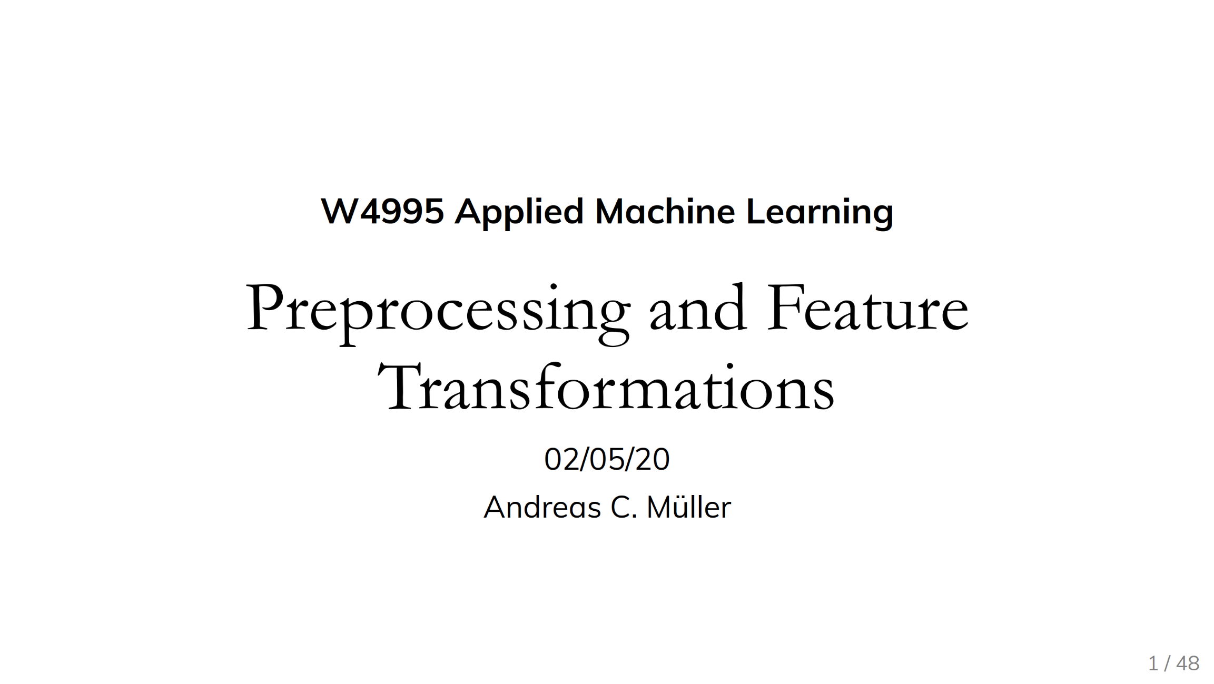
Standardization/Normalization
X = X – colMeans(X);
X = X / sqrt(colVars(X));
#1 Standardization
  Centering and scaling to mean 0 and variance 1
  Ensures well-behaved training
  (and distance computation)
  Densifying operation / NaNs
  Batch normalization in DNN: standardization of activations
#2 (Min-Max) Normalization
  Rescale values into common range [0,1]
  Avoid bias to large-scale features
  Does not handle outliers
X = replace(X, pattern=NaN,
replacement=0); #robustness
X = (X – colMins(X))
/ (colMaxs(X) – colMins(X));
Recommended Reading
[Andreas C. Mueller: Preprocessing and Feature Transformations, Applied ML Lecture 2020, https://www.youtube.com/watch?v=XpOBSaktb6s]

Slide 38

Standardization/Normalization, cont.
#3 Deferred Standardization
  Avoid densifying dataset upfront by pushing
  standardization into inner loop iterations
  Let matrix-multiplication chain optimization + rewrites do the rest
Example GLM/lmCG
[Credit: Alexandre (Sasha) V. Evfimievski]
# operation w/ early standardized X
q = t(X) %*% diag(w) %*% X %*% B;
Input w/ column of ones (intercept)
Substitute X with
X %*% S
X
# operation w/ deferred standardization
q = t(S) %*% t(X) %*% diag(w)
%*% X %*% S %*% B;
Scale
S
q = t(S) %*% (t(X) %*% (diag(w)
%*% (X %*% (S %*% B))));
Shift

Slide 39
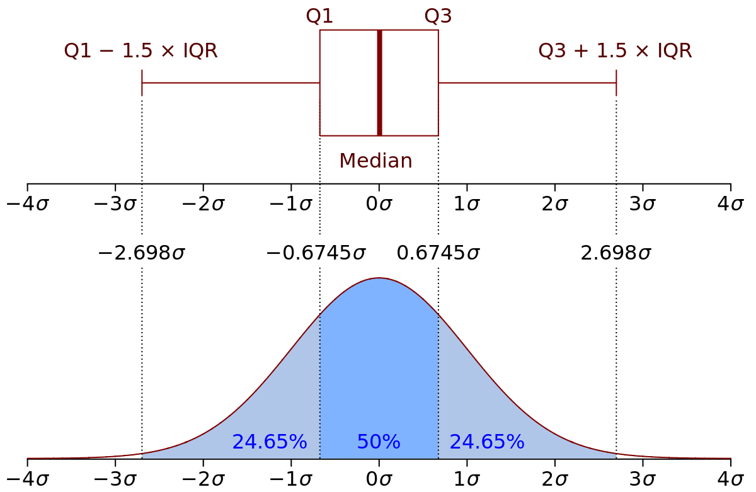

Winsorizing and Trimming
Recap: Quantiles
  Quantile Q_{p} w/ $p∈(0,1)$ defined as $P\left[X≤x\right]=p$
Winsorizing
  Replace tails of data distribution at
  user-specified threshold
  Quantiles / std-dev ➔ Reduce skew
Truncation/Trimming
  Remove tails of data distribution
  at user-specified threshold
Largest Difference from Mean
[Credit:
https://en.wikipedia.org]
# compute quantiles for lower and upper
ql = quantile(X, 0.05);
qu = quantile(X, 0.95);
# replace values outside [ql,qu] w/ ql and qu
Y = min(qu, max(ql, X));
# remove values outside [ql,qu]
I = X < qu | X > ql;
Y = removeEmpty(X, “rows”, select = I);
SystemDS: winsorize() outlier()
outlierByIQR()
outlierBySd()
# determine largest diff from mean
I = (colMaxs(X)-colMeans(X))
> (colMeans(X)-colMins(X));
Y = ifelse(xor(I,op), colMaxs(X), colMins(X));
Notes:
Box and whisker plots
SystemDS: quantiles via sort+pick, quickselect possible
Iterative winsoring/trimming to X std-devs of mean also possible

Slide 40
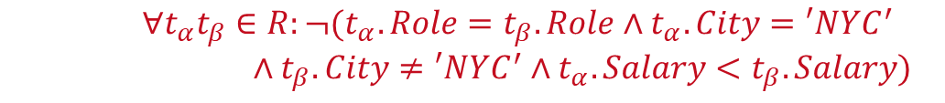
Constraints and Outliers
Route
(Airline, From, To)
Planes
(Semi-)Automatic Approach: Expectations!
  PK → Values must be unique and defined (not null)
  Exact PK-FK → Inclusion dependencies
  Noisy PK-FK → Robust inclusion dependencies |R[X]∈S[Y]| / |R[X]| > δ
  Semantics of attributes → Value ranges / # distinct values
  Invariant to capitalization: Patterns → regular expressions
Formal Constraints
  Functional dependencies (FD), conditional FDs (CFD), metric dependencies
  Inclusion dependencies, matching dependencies
  Denial constraints
Outlier Terminology
  Outlier Detection: detect and remove unwanted data points
  Anomaly Detection: detect and extract rare/unusual/interesting events
Age=9999?
2019-11-15 vs Nov 15, 2019
$$∀t_{α}t_{β}∈R:¬(t_{α}.Role=t_{β}.Role∧t_{α}.City=′NYC^{′}$$
$∧t_{β}.City≠′NYC^{′}∧t_{α}.Salary<t_{β}.Salary)$

Slide 41
Outliers and Outlier Detection
Types of Outliers
  Point outliers: single data points far from the data distribution
  Contextual outliers: noise or other systematic anomalies in data
  Sequence (contextual) outliers: sequence of values w/ abnormal shape/agg
  Univariate vs multivariate analysis
  Beware of underlying assumptions (distributions)
Types of Outlier Detection
  Type 1 Unsupervised: No prior knowledge
  of data, similar to unsupervised clustering
  → expectations: distance, # errors
  Type 2 Supervised: Labeled normal and abnormal
  data, similar to supervised classification
  Type 3 Normal Model: Represent normal behavior,
  similar to pattern recognition → expectations: rules/constraints
[Varun Chandola, Arindam Banerjee, Vipin Kumar: Anomaly detection: A survey. ACM Comput. Surv. 2009]
[Victoria J. Hodge, Jim Austin: A Survey of Outlier Detection Methodologies. Artif. Intell. Rev. 2004]

Slide 42
Missing Value Imputation
Missing Value
  Application context defines if 0 is missing value or not
  If differences between 0 and missing values, use NA or NaN
Basic Value Imputation
  General-purpose: replace by user-specified constant
  Continuous variables: replace by mean
  Categorical variables: replace by median or mode
Iterative Algorithms (chained-equation imputation)
  Train ML model to predict missing information
  (feature k → label, split data into observed/missing)
  Noise reduction: feature subsets + averaging
Dynamic Imputation
  Data exploration w/ on-the-fly imputation
  Optimal placement of imputation operations
MCAR
SystemDS: mice()
Train X, y
MAR
Score
[Jose Cambronero, John K. Feser, Micah Smith, Samuel Madden: Query Optimization for Dynamic Imputation. PVLDB 2017]
Notes:
Mice: multi-variante imputation by chained equations

Slide 43

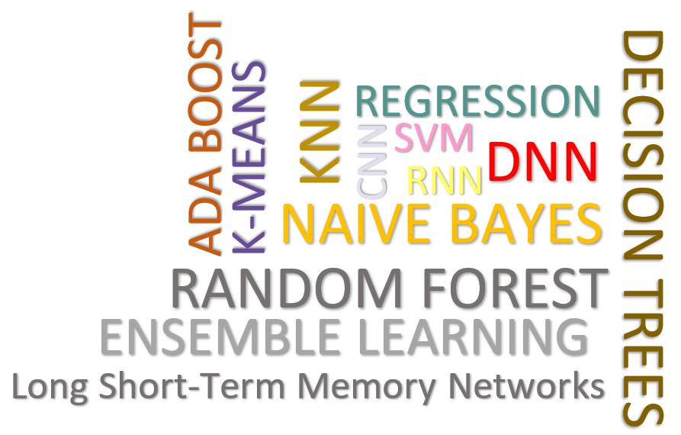
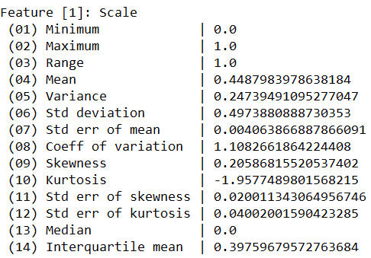
[Shafaq Siddiqi, Roman Kern, Matthias Boehm: SAGA: A Scalable Framework for Optimizing Data Cleaning Pipelines for Machine Learning Applications, SIGMOD 2024,
Best Paper Honorable Mention]
Data Cleaning Pipelines
Automatic Generation of Cleaning Pipelines
  Library of robust, parameterized data cleaning primitives,
  Enumeration of DAGs of primitives & hyper-parameter optimization (evolutionary, HB)
Data- and Task-parallel Computation
Data Samples
Logical
O
Physical
LP₁
LP₂
…
LP_{n}
Top-k Pipelines
Target
App
…
…
…
PP₁
PP_{n}
PP₁
PP_{n}
PP₁
PP_{n}
Rules/Objectives
Outlier Detection → MVI → Deduplication → Resolve Mislabels
P_{1:} gmm → imputeFD → mergeDup → delML
P_{n:} outlierBySd→ mice → delDup → voting
Debugging
University | Country
TU Graz | Austria
TU Graz | Austria
TU Graz | Germany
IIT | India
IIT | IIT
IIT | Pakistan
IIT | India
SIBA | Pakistan
SIBA | null
SIBA | null
University | Country
TU Graz | Austria
TU Graz | Austria
TU Graz | Austria
IIT | India
IIT | India
IIT | India
IIT | India
SIBA | Pakistan
SIBA | Pakistan
SIBA | Pakistan
A | B | C | D
0.77 | 0.80 | 1 | 1
0.96 | 0.12 | 1 | 1
0.66 | 0.09 | null | 1
0.23 | 0.04 | 17 | 1
0.91 | 0.02 | 17 | null
0.21 | 0.38 | 17 | 1
0.31 | null | 17 | 1
0.75 | 0.21 | 20 | 1
null | null | 20 | 1
0.19 | 0.61 | 20 | 1
0.64 | 0.31 | 20 | 1
A | B | C | D
0.77 | 0.80 | 1 | 1
0.96 | 0.12 | 1 | 1
0.66 | 0.09 | 17 | 1
0.23 | 0.04 | 17 | 1
0.91 | 0.02 | 17 | 1
0.21 | 0.38 | 17 | 1
0.31 | 0.29 | 17 | 1
0.75 | 0.21 | 20 | 1
0.41 | 0.24 | 20 | 1
0.19 | 0.61 | 20 | 1
0.64 | 0.31 | 20 | 1
Dirty Data
After imputeFD(0.5)
Dirty Data
After MICE

Slide 44
Summary & QA
[Andreas C. Mueller: Preprocessing and Feature Transformations, Applied ML Lecture 2020]
“Coming up with features is difficult, time-consuming, requires expert knowledge. "Applied machine learning" is basically feature engineering”
– Andrew Ng
Data Acquisition, Integration, and Validation
Feature Transformations and Feature Engineering
Data Preparation and Cleaning
Next Lectures (Part B)
  11 Model Selection and Management [Jul 03]
  12 Model Debugging, Fairness, Explainability [Jul 10]
  13 Model Serving Systems and Techniques [Jul 17]
  Q&A and Exam Preparation [Jul 17]
➔ Trend towards “Data-centric AI”
(since 2021/2022)
Notes:
Note: Andreas Mueller dabl: https://github.com/dabl/dabl
https://www.youtube.com/watch?v=h92RMJi4mRM

