Slide 1

Architecture of ML Systems (AMLS)
11 Model Selection and Management
Prof. Dr. Matthias Boehm
Technische Universität Berlin
Berlin Institute for the Foundations of Learning and Data
Big Data Engineering (DAMS Lab)
Last update: Jul 03, 2025

Slide 2

Announcements / Org
#1 Hybrid & Video Recording
  Hybrid lectures (in-person, zoom) with optional attendance
  https://tu-berlin.zoom.us/j/9529634787?pwd=R1ZsN1M3SC9BOU1OcFdmem9zT202UT09
  Zoom video recordings, links from website
  https://mboehm7.github.io/teaching/ss25_amls/index.htm
#2 Exam Registration
  Thu July 24, 4-6pm (A 151, max 50) → 14 registrations
  Thu July 31, 4-6pm (EW 201, max 47) → 41 registrations
  Thu Aug 14, 4-6pm (A 151, max 50) → 24 registrations
#3 Projects & Exercises
  Submission deadline: Jul 15 EOD
  Get started, use the office hour (Tue 4pm-5.30), and mentor meetings
#4 PhD Position on ML System Internals
  https://www.jobs.tu-berlin.de/en/job-postings/194921, Deadline Jul 18

Slide 3


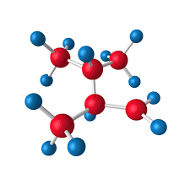

Recap: The Data Science Lifecycle
(aka KDD Process, aka CRISP-DM)
Data Scientist
Data Integration
Data Cleaning
Data Preparation
Model Selection
Training
Hyper-parameters
Validate & Debug
Deployment
Scoring & Feedback
Exploratory Process
(experimentation, refinements, ML pipelines)
Data/SW Engineer
DevOps Engineer

Slide 4
Agenda
Data Augmentation
Model Selection Techniques
Model Management & Provenance

Slide 5
Data Augmentation

Slide 6
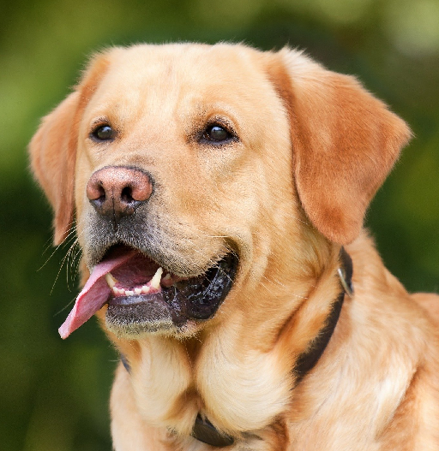
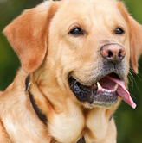
Motivation and Basic Data Augmentation
Motivation Data Augmentation
  Complex ML models / deep NNs need lots of
  labeled data to avoid overfitting ➔ expensive
  Augment training data by synthetically generated labeled data
Translations & Reflections
  Random 224x224 patches and their
  reflections (from 256x256 images
  with known labels)
  Increased data by 2048x
  Test: corner/center patches
  + reflections → prediction
Alternating Intensities
  Intuition: object identity is invariant to illumination and color intensity
  PCA on dataset → add eigenvalues times a random variable N(0,0.1)
[Alex Krizhevsky, Ilya Sutskever, Geoffrey E. Hinton: ImageNet Classification with Deep Convolutional Neural Networks. NeurIPS 2012]
AlexNet (see Section 4.1)

Slide 7
Basic Data Augmentation
Scaling and Normalization
  Standardization: subtract per-channel global pixel means
  Normalization: normalized to range [-1,1] (see min-max)
General Principles
  #1: Movement/selection (translation, rotation, reflection, cropping)
  #2: Distortions (stretching, shearing, lens distortions, color, mixup of images)
  In many different combinations ➔ often trial & error / domain expertise
Excursus: Reducing Training Time
  Transfer learning: Use pre-trained model on ImageNet;
  freeze lower NN layers, fine-tune last layers w/ domain-specific data
  Multi-scale learning: Use cropping and scaling to train
  256 x 256 model as starting point for a more compute-intensive
  384x384 model (no changes required for CNNs)
[Karen Simonyan, Andrew Zisserman: Very Deep Convolu-tional Networks for Large-Scale Image Recognition. ICLR 2015]
Notes:
Note multi-scale learning: model is trained to recognize objects over a wide range of scales

Slide 8
Basic Data Augmentation, cont.
Distortions
  Translations, rotations, skewing
  Compute for every pixel a new target
  location via rand displacement fields)
Cutout
  Randomly masking out square regions of input images
  Size more important than shape
[Patrice Y. Simard, David Steinkraus, John C. Platt: Best Practices for Convolutional Neural Networks Applied to Visual Document Analysis. ICDAR 2003]
[Terrance Devries, Graham W. Taylor: Improved Regularization of Convolutional Neural Networks with Cutout. CoRR 2017]
Notes:
Others: Mixup (combine images and one-hot labels with weights): https://keras.io/examples/vision/mixup/

Slide 9
Domain Randomization
Training on Simulated Images
  Random rendering of objects with non-realistic textures
  Large variability for generalization to real world objects
Pre-Training on Simulated Images
  Random 3D objects and flying distractors
  w/ random textures
  Random lights and rendered onto
  random background
[Josh Tobin et al.: Domain randomization for transferring deep neural networks from simulation to the real world. IROS 2017]
[Jonathan Tremblay et al.: Training Deep Networks With Synthetic Data: Bridging the Reality Gap by Domain Randomization. CVPR Workshops 2018]

Slide 10
Learning Data Augmentation Policies
AutoAugment
  Search space of DA policies
  Goal: Find best augmentation policy (e.g., via
  reinforcement learning, evolutionary algorithms)
  #1: Image processing functions
  (translation, rotation, color normalization)
  #2: Probabilities of applying these functions
Data Augmentation GAN (DAGAN)
  Image-conditional generative model for
  creating within-class images from inputs
  No need for known invariants
[Ekin Dogus Cubuk, Barret Zoph, Dandelion Mané, Vijay Vasudevan, Quoc V. Le: AutoAugment: Learning Augmentation Policies from Data. CVPR 2019]
➔ New state-of-the art top-1 error on ImageNet and CIFAR10
Real input image
[Antreas Antoniou, Amos J. Storkey, Harrison Edwards: Augmenting Image Classifiers Using Data Augmentation Generative Adversarial Networks. ICANN 2018]
Notes:
Note AutoAugment: sample policies (of 5 sub policies of 2 image operations each, probability and magnitude): shearX, Invert, Solarize, AutoContrast, Equalize + hyper parameters

Slide 11
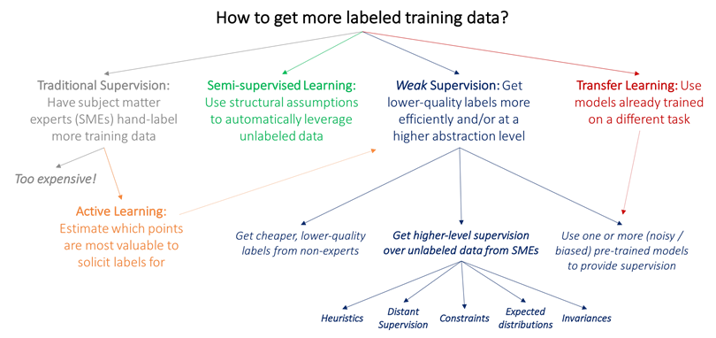
[Alex Ratner, Paroma Varma, Braden Hancock,
Chris Ré, and others: Weak Supervision: A New Programming Paradigm for Machine Learning, ai.stanford.edu/blog/weak-supervision/, 2019]
Weak Supervision
Heuristically Generated Training Data
  Hand labeling expensive and time consuming, but abundant unlabeled data
  Changing labeling guidelines
  ➔ labeling heuristics
basic data augmentation

Slide 12
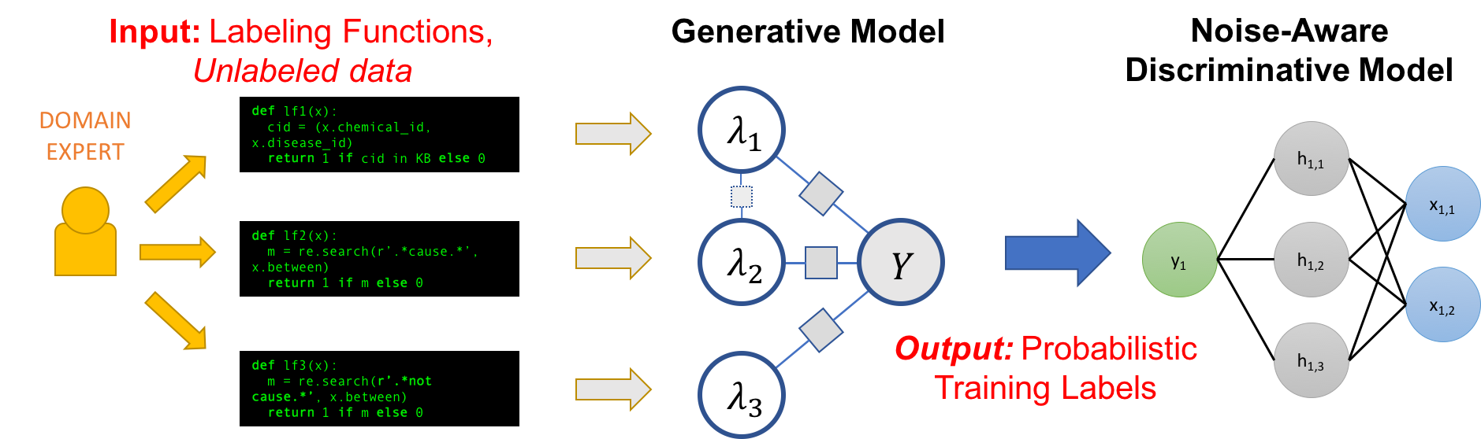
Weak Supervision, cont.
(coverage α_{i}, accuracy β_{i})
Data Programming
Overview
[Alexander J. Ratner, Christopher De Sa, Sen Wu, Daniel Selsam, Christopher Ré: Data Programming: Creating Large Training Sets, Quickly. NeurIPS 2016]
[Paroma Varma, Christopher Ré: Snuba: Automating Weak Supervision to Label Training Data. PVLDB 2018]
[Alexander Ratner, Stephen H. Bach, Henry R. Ehrenberg, Jason Alan Fries, Sen Wu, Christopher Ré: Snorkel: Rapid Training Data Creation with Weak Supervision. PVLDB 2017]
[Stephen H. Bach, Daniel Rodriguez, Yintao Liu, Chong Luo, Haidong Shao, Cassandra Xia, Souvik Sen, Alexander Ratner, Braden Hancock, Houman Alborzi, Rahul Kuchhal, Christopher Ré, Rob Malkin: Snorkel DryBell: A Case Study in Deploying Weak Supervision at Industrial Scale. SIGMOD 2019]

Slide 13
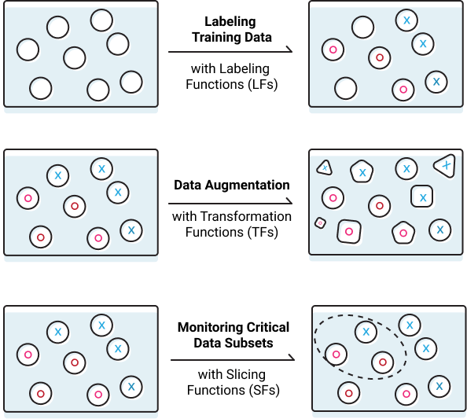

Weak Supervision, cont.
Excursus: Snorkel
[https://www.snorkel.org/]
  Programmatically Building
  and Managing Training Data
Effects of Augmentation
  #1 Regularization for reduced generalization error,
  not always training error (penalization of model complexity)
  #2 Invariance increase by averaging features of augmented data points
  ➔ Data Augmentation as a Kernel
    Kernel metric for augmentation selection
    Affine transforms on approx. kernel features
11 Model Selection & Management
12 Model Debugging Techniques
[Tri Dao et al: A Kernel Theory of Modern Data Augmentation. ICML 2019]
Notes:
Snorkel AI Lands $100M at $1.3B Valuation. REDWOOD CITY, CA, Snorkel AI announced it has raised $100 million in Series D; May 2025

Slide 14
Model Selection Techniques

Slide 15
[Chris Thornton, Frank Hutter, Holger H. Hoos, Kevin Leyton-Brown: Auto-WEKA: combined selection and hyperparameter optimization of classification algorithms. KDD 2013]
AutoML Overview
#1 Model Selection
  Given a dataset and ML task (e.g., classification or regression)
  Select the model (type) that performs best
  (e.g.: LogReg, Naïve Bayes, SVM, Decision Tree, Random Forest, DNN)
#2 Hyper Parameter Tuning
  Given a model and dataset, find best hyper parameter values (e.g.,
  learning rate, regularization, kernels, kernel parameters, tree params)
Validation: Generalization Error
  Goodness of fit to held-out data (e.g., 80-20 train/test)
  Cross validation (e.g., leave one out → k=5 runs w/ 80-20 train/test)
AutoML Systems/Services
  Often providing both model selection and hyper parameter search
  Integrated ML system, often in distributed/cloud environments

Slide 16


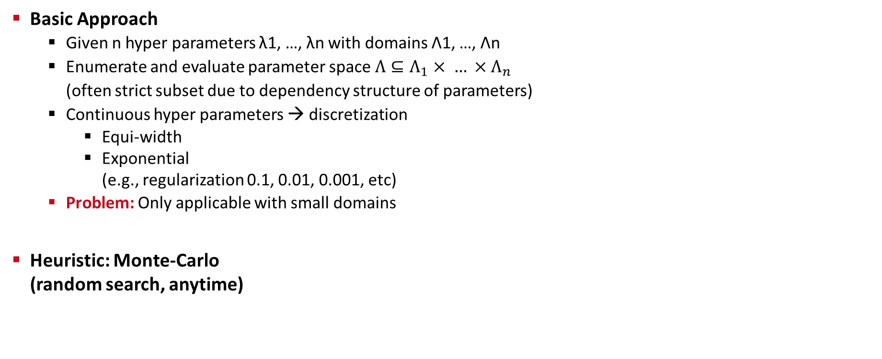
Basic Grid Search
Basic Approach
  Given n hyper parameters λ1, …, λn with domains Λ1, …, Λn
  Enumerate and evaluate parameter space $Λ⊆Λ_{1}× … ×Λ_{n}$
  (often strict subset due to dependency structure of parameters)
  Continuous hyper parameters → discretization
    Equi-width
    Exponential
    (e.g., regularization 0.1, 0.01, 0.001, etc)
  Problem: Only applicable with small domains
Heuristic: Monte-Carlo
(random search, anytime)
gridSearch()
GridSearchCV()
Non-convex or unknown parameter space
1
β
0
α
1

Slide 17
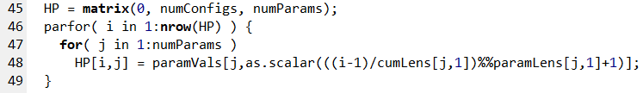
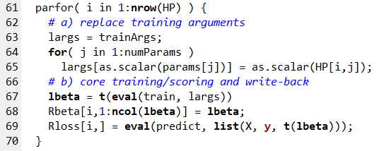
Basic Grid Search, cont.
Example Adult Dataset (train 32,561 x 14)
  Binary classification (>50K), https://archive.ics.uci.edu/ml/datasets/adult
  #1 MLogReg defaults w/ one-hot categoricals Accuracy (%): 82.35
  #2 MLogReg defaults w/ one-hot + binning Accuracy (%): 84.73
  #3 GridSearch MLogReg: Accuracy (%): 90.07
Example SystemDS
gridSearch
params = list("icpt", "reg", "numBins");
paramRanges = list(seq(0,2), 10^seq(3,-6), 10^seq(1,4));
# Materialize Configs
05 Data- and Task-Parallel Execution
Notes:
Note: shown training loss, but w/ grid search on train/val up to ~87%

Slide 18
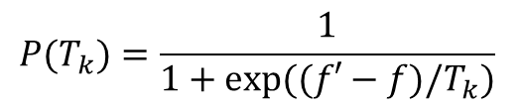
Basic Iterative Algorithms
Exploration vs exploitation
Simulated Annealing
  Decaying temperature schedules: T_{k+1} = α ∙ T_{k}
  #1 Generate neighbor in ε-env of old point
  #2 Accept better points and worse points w/
Recursive Random Search
  Repeated restart
  Sample and evaluate points
  Determine best and shrink area
  if optimum unchanged
  Realign area if new optimum found
$$P(T_{k})=\frac{1}{1+exp⁡((f′−f)/T_{k})}$$
[Tao Ye, Shivkumar Kalyanaraman: A recursive random search algorithm for large-scale network parameter configuration. SIGMETRICS 2003]
Parameter Space

Slide 19
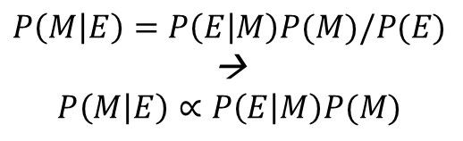
[Chris Thornton, Frank Hutter, Holger H. Hoos, Kevin Leyton-Brown: Auto-WEKA: combined selection and hyperparameter optimization of classification algorithms. KDD 2013]
Bayesian Optimization
Overview BO
  Sequential Model-Based Optimization
  Fit a probabilistic model based on the first n-1
  evaluated hyper parameters
  Use model to select next candidate
  Gaussian process (GP) models, or
  tree-based Bayesian Optimization
Underlying Foundations
  The posterior probability of a model M given
  evidence E is proportional to the likelihood of
  E given M multiplied by prior probability of M
  Prior knowledge: e.g., smoothness, noise-free
  Maximize acquisition function:
  GP high objective (exploitation) and high prediction uncertainty (exploration)
$$P\left(M | E\right)=P\left(E | M\right)P(M)/P(E)$$
→
$$P\left(M | E\right)∝P\left(E | M\right)P(M)$$
after
next
before
Notes:
Note: posterior P(M|E) encodes updated beliefs, from prior P(M) and observed samples P(E|M)

Slide 20




Bayesian Optimization, cont.
[https://ekamperi.github.io/machine learning/2021/06/11/acquisition-functions.html]
Example 1D Problem
  Gaussian Process
  4 iterations
Example Acquisition Functions:
#1 Upper Confidence Bound (UCB)
#2 Probability of Improvement (PI)
[Eric Brochu, Vlad M. Cora, Nando de Freitas: A Tutorial on Bayesian Optimization of Expensive Cost Functions, with Application to Active User Modeling and Hierarchical Reinforcement Learning. CoRR 2010]
#3 Expected Improvement (EI)
Notes:
EI: phi(x) is the probability density function

Slide 21
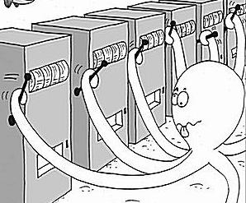
Multi-armed Bandits and Hyperband
[Credit:
blogs.mathworks.com]
Overview Multi-armed Bandits
  Motivation: model types have different quality
  Select among k model types → k-armed bandit problem
  Running score for each arm → scheduling policy
Hyperband
  Non-stochastic setting, without parametric assumptions
  Pure exploration algorithm for infinite-armed bandits
  Based on Successive Halving
    Successively discarding the worst-performing half of arms
    Extended by doubling budget of arms in each iteration
    (no need to configure k, random search included)
[Sébastien Bubeck, Nicolò Cesa-Bianchi: Regret Analysis of Stochastic and Nonstochastic Multi-armed Bandit Problems. Foundations and Trends in Machine Learning 2012]
5 buckets with R=81 resources and η = 3 (exploitation vs exploration)
[Lisha Li, Kevin G. Jamieson, Giulia DeSalvo, Afshin Rostamizadeh, Ameet Talwalkar: Hyperband: A Novel Bandit-Based Approach to Hyperparameter Optimization. JMLR 2017]

Slide 22
Selected AutoML Systems
Auto Weka
  Bayesian optimization with
  28 learners, 11 ensemble/meta methods
Auto Sklearn
  Bayesian optimization with
  15 classifiers, 14 feature prep, 4 data prep
TuPaQ
  Multi-armed bandit and large-scale
TPOT
  Genetic programming
Other Services/Systems
  Azure ML, Amazon ML, Google AutoML, H20 AutoML
  AutoKeras (tuners: greedy, bayesian, hyperband, or random)
[Chris Thornton et al: Auto-WEKA: combined selection and hyperparameter optimization of classification algorithms. KDD 2013]
[Lars Kotthoffet al: Auto-WEKA 2.0: Automatic model selection and hyper-parameter optimization in WEKA. JMLR 2017]
[Matthias Feurer et al: Auto-sklearn: Efficient and Robust Automated Machine Learning. Automated Machine Learning 2019]
[Evan R. Sparks, Ameet Talwalkar, Daniel Haas, Michael J. Franklin, Michael I. Jordan, Tim Kraska: Automating model search for large scale machine learning. SoCC 2015]
[Randal S. Olson, Jason H. Moore: TPOT: A Tree-Based Pipeline Optimization Tool for Automating Machine Learning. Automated Machine Learning 2019]
[Hantian Zhang, Luyuan Zeng, Wentao Wu, Ce Zhang: How Good Are Machine Learning Clouds for Binary Classification with Good Features? CoRR 2017]

Slide 23
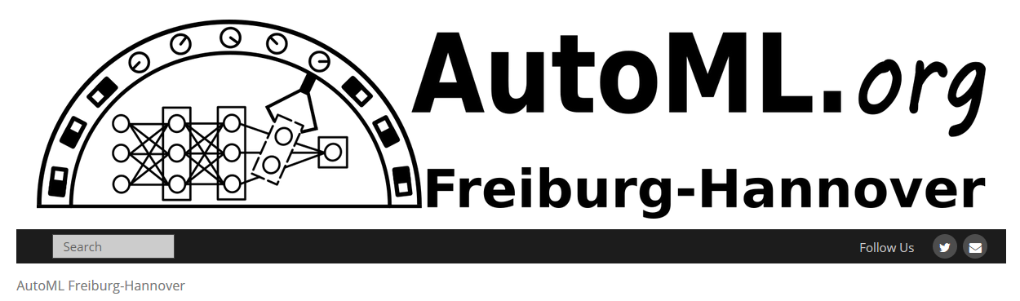
Selected AutoML Systems, cont.
Alpine Meadow
  Logical and physical ML pipelines
  Multi-armed bandit for pipeline selection
  Bayesian optimization for hyper-parameters
Dabl (Data Analysis Baseline Library)
  Tools for simple data preparation and ML training
  Hyperband (successive halving) for optimization
BOHB
  Bayesian optimization & hyperband
  Queue-based parallelization of successive halving
AutoML (https://www.automl.org/)
Paper Collections/Benchmarks
  HPOBench/NASBench
[Zeyuan Shang et al: Democratizing Data Science through Interactive Curation of ML Pipelines. SIGMOD 2019]
[https://amueller.github.io/
dabl/dev/user_guide.html]
[Stefan Falkner, Aaron Klein, Frank Hutter: BOHB: Robust and Efficient Hyper-parameter Optimization at Scale. ICML 2018]
Notes:
BOHB: combine BO and HB to get fast convergence and strong anytime performance

Slide 24
Neural Architecture Search
Motivation
  Design neural networks (type of layers / network)
  is often trial & error process
  Accuracy vs necessary computation characterizes an architecture
  ➔ Automatic neural architecture search
#1 Search Space of Building Blocks
  Define possible operations (e.g., identity,
  3x3/5x5 separable convolution, avg/max pooling)
  Define approach for connecting operations
  (pick 2 inputs, apply op, and add results)
Exploration of cell designs
[Hieu Pham, Melody Y. Guan, Barret Zoph, Quoc V. Le, Jeff Dean: Efficient Neural Architecture Search via Parameter Sharing. ICML 2018]

Slide 25
Neural Architecture Search, cont.
#2 Search Strategy
  Classical evolutionary algorithms
  Recurrent neural networks (e.g., LSTM)
  Bayesian optimization (with special distance metric)
#3 Optimization Objective
  Max accuracy (min error)
  Multi-objective
  (accuracy and runtime)
Excursus: Model Scaling
  Automatically scale-up small
  model for better accuracy
  EfficientNet
[Barret Zoph, Quoc V. Le: Neural Architecture Search with Reinforcement Learning. ICLR 2017]
[Kirthevasan Kandasamy, Willie Neiswanger, Jeff Schneider, Barnabás Póczos, Eric P. Xing: Neural Architecture Search with Bayesian Optimisation and Optimal Transport. NeurIPS 2018]
[Mingxing Tan, Quoc V. Le: EfficientNet: Rethinking Model Scaling for Convolutional Neural Networks. ICML 2019]
Notes:
NASNet (1800GPU days, 5 years GPU utilization)

Slide 26
Neural Architecture Search, cont.
Problem: Computational Resources
  Huge computational requirements for NAS (even on small datasets)
  ➔ #1 Difficult to reproduce, and #2 barrier-to-entry
Excursus: NAS-Bench-101
  423K unique convolutional architectures
  Training and evaluated ALL architectures, multiple times on CIFAR-10
  Shared dataset: 5M trained models
Outer Skeleton
[Chris Ying, Aaron Klein, Eric Christiansen, Esteban Real, Kevin Murphy, Frank Hutter: NAS-Bench-101: Towards Reproducible Neural Architecture Search. ICML 2019]

Slide 27
Model Management & Provenance

Slide 28
Overview Model Management
How did you create that model?
Did you consider X?
Motivation
  Exploratory data science process → trial and error
  (preparation, feature engineering, model selection)
  Different personas (data engineer, ML expert, devops)
Problems
  No record of experiments, insights lost along the way
  Difficult to reproduce results
  Cannot search for or query models
  Difficult to collaborate
Overview
  Experiment tracking and visualization
  Coarse-grained ML pipeline provenance and versioning
  Fine-grained data provenance (data-/ops-oriented)
[Manasi Vartak: ModelDB: A system to manage machine learning models, Spark Summit 2017]

Slide 29
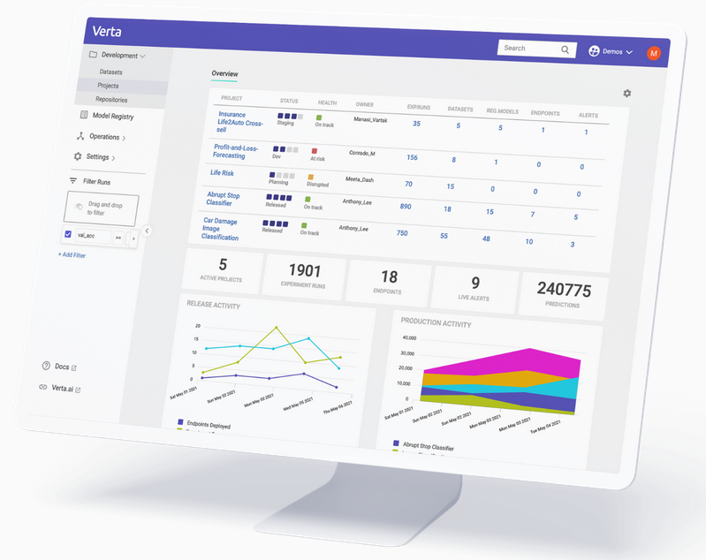
Model Management Systems (MLOps)
ModelHub
  Versioning system for DNN models, including provenance tracking
  DSL for model exploration and enumeration queries
  (model selection + hyper parameters)
  Model versions stored as deltas
ModelDB → Verta.ai
  Model and provenance logging for ML pipelines
  via programmatic APIs
  Support for different ML systems
  (e.g., spark.ml, scikit-learn, others)
  GUIs for capturing meta data and metric visualization
[Hui Miao, Ang Li, Larry S. Davis, Amol Deshpande: ModelHub: Deep Learning Lifecycle Management. ICDE 2017]
[Manasi Vartak, Samuel Madden: MODELDB: Opportunities and Challenges in Managing Machine Learning Models. IEEE Data Eng. Bull. 2018]
[Verta Enterprise
MLOps Platform https://www.verta.ai/
platform/ ]

Slide 30



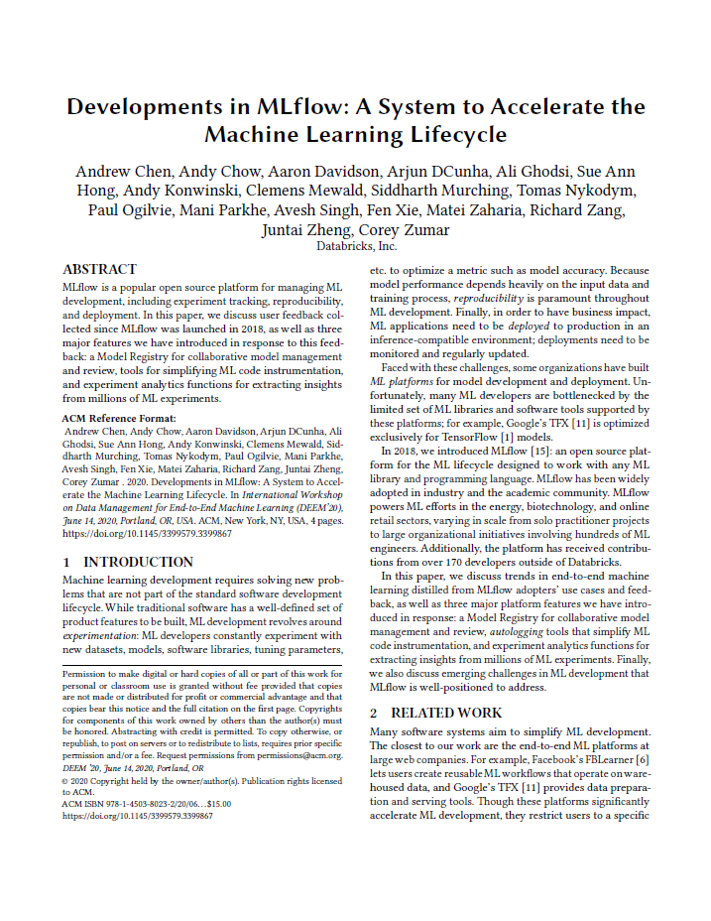
Model Management Systems (MLOps), cont.
MLflow
  An open-source platform for the machine learning lifecycle
  Use of existing ML systems and various language bindings
  MLflow Tracking: logging and querying experiments
  MLflow Projects: packaging/reproduction of ML pipeline results
  MLflow Models: deployment of models in various services/tools
  MLflow Model Registry: cataloging models and managing deployment
[Matei Zaharia, Andrew Chen, Aaron Davidson, Ali Ghodsi, Sue Ann Hong, Andy Konwinski, Siddharth Murching, Tomas Nykodym, Paul Ogilvie, Mani Parkhe, Fen Xie, Corey Zumar: Accelerating the Machine Learning Lifecycle with MLflow. IEEE Data Eng. Bull. 41(4) 2018]
[Andrew Chen, Andy Chow, Aaron Davidson, Arjun DCunha, Ali Ghodsi, Sue Ann Hong, Andy Konwinski, Clemens Mewald, Siddharth Murching, Tomas Nykodym, Paul Ogilvie, Mani Parkhe, Avesh Singh, Fen Xie, Matei Zaharia, Richard Zang, Juntai Zheng, Corey Zumar: Developments in MLflow: A System to Accelerate the Machine Learning Lifecycle. DEEM@SIGMOD 2020]

Slide 31
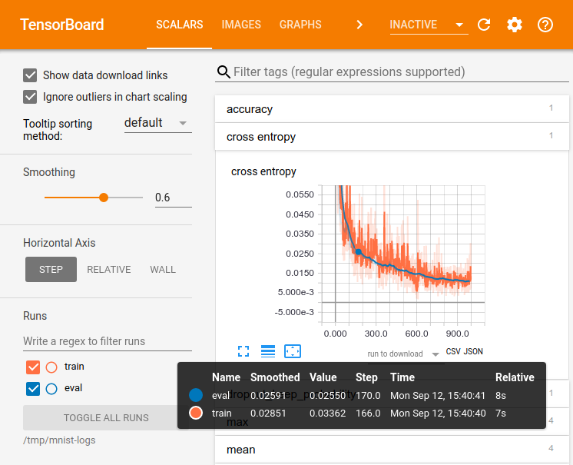
Experiment Tracking
TensorFlow: TensorBoard
  Suite of visualization tools
  Explicitly track and write
  summary statistics
  Visualize behavior over
  time and across experiments
  Different folders for
  model versioning?
Other Tools:
  Integration w/ TensorBoard
  Lots of custom logging
  and plotting tools
[Credit: https://www.tensorflow.org/guide/ summaries_and_tensorboard]

Slide 32
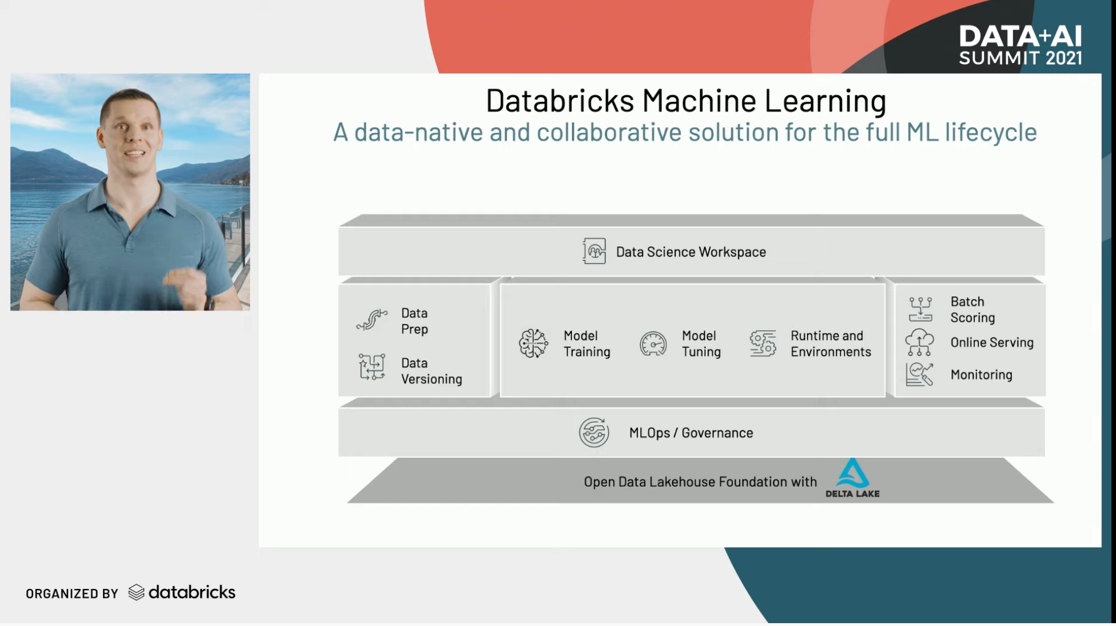
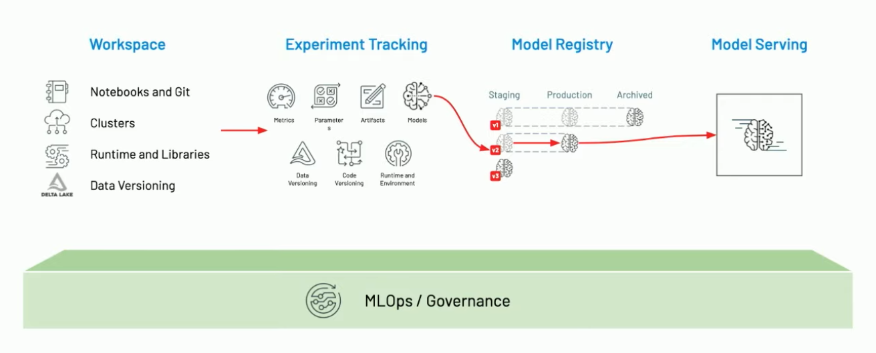
ML Lifecycle Management
[Clemens Mewald: Announcing Databricks Machine Learning, Feature Store, AutoML, Keynote Data+ AI Summit 2021]
Databricks Machine Learning
  MLOps, Feature Store, AutoML
MLOps = DataOps + DevOps + ModelOps

Slide 33
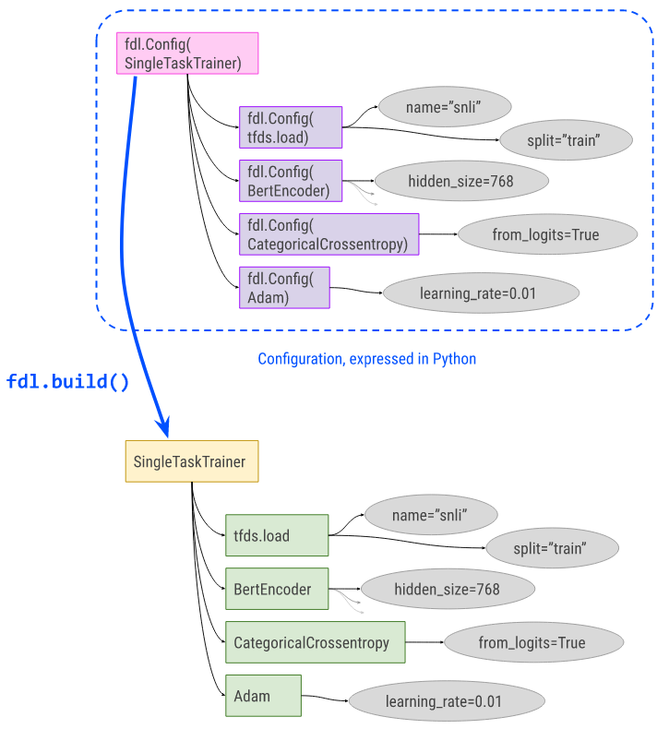
Configuration Management
https://github.com/
google/ml_collections
#1 ML Collections
  Dictionary-like data structures for configurations
  of experiments and models (hyper-parameters, loss, optimizer)
  ConfigDict and FrozenConfigDict
#2 Fiddle
  Configurations for model training via build() for creating training instances
  Auto-config for creating a config object from a (control-flow-free) function
  Explain and visualization
#3 Croissant Metadata
  Meta data format (JSON) for ML datasets (dataset metadata,
  resources, structure) → used by NeurIPS’24 workshop
  Integrations with data repositories, data loaders, dataset search
https://github.com/
google/fiddle
[Mubashara Akhtar et al: Croissant: A Metadata Format for ML-Ready Datasets, DEEM@SIGMOD’24 Workshop]
Notes:
Croissant won best short paper: https://x.com/LuisOala/status/1800199628069179408

Slide 34
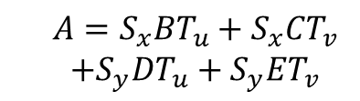
Provenance for ML Pipelines (fine-grained)
DEX: Dataset Versioning
  Versioning of datasets, stored with delta encoding
  Checkout, intersection, union queries over deltas
  Query optimization for finding efficient plans
MISTIQUE: Intermediates of ML Pipelines
  Capturing, storage, querying of intermediates
  Lossy deduplication and compression
  Adaptive querying/materialization for finding efficient plans
Linear Algebra Provenance
  Provenance propagation by decomposition
  Annotate parts w/ provenance polynomials (contributing inputs + impact)
[Amit Chavan, Amol Deshpande: DEX: Query Execution in a Delta-based Storage System. SIGMOD 2017]
[Manasi Vartak et al: MISTIQUE: A System to Store and Query Model Intermediates for Model Diagnosis. SIGMOD 2018]
A
B
C
D
E
[Zhepeng Yan, Val Tannen, Zachary G. Ives: Fine-grained Provenance for Linear Algebra Operators. TaPP 2016]
$$A=S_{x}BT_{u}+S_{x}CT_{v}$$
$+S_{y}DT_{u}+S_{y}ET_{v}$
S_{x}
S_{y}
T_{u}
T_{v}

Slide 35
Provenance for ML Pipelines (coarse-grained)
[Credit: https://databricks.com/
blog/2018/06/05 ]
MLflow
  Programmatic API for tracking parameters,
  experiments, and results
  autolog() for specific params
Flor (on Ground)
  DSL embedded in python for managing the workflow development
  phase of the ML lifecycle
  DAGs of actions, artifacts, and literals
  Data context generated by activities in Ground
Dataset Relationship Management
  Reuse, reveal, revise, retarget, reward
  Code-to-data relationships (data provenance)
  Data-to-code relationships (potential transforms)
import mlflow
mlflow.log_param("num_dimensions", 8)
mlflow.log_param("regularization", 0.1)
mlflow.log_metric("accuracy", 0.1)
mlflow.log_artifact("roc.png")
https://rise.cs.berkeley.edu/projects/jarvis/
[Joseph M. Hellerstein et al: Ground: A Data Context Service. CIDR 2017]
[Zachary G. Ives, Yi Zhang, Soonbo Han, Nan Zheng,: Dataset Relationship Management. CIDR 2019]

Slide 36
Provenance for ML Pipelines (coarse-grained), cont.
HELIX
  Goal: focus on iterative development w/ small
  modifications (trial & error)
  Caching, reuse, and recomputation
  Reuse as Max-Flow problem
  → NP-hard → heuristics
  Materialization to disk for future reuse
Collaborative Optimizer
[Doris Xin, Stephen Macke, Litian Ma, Jialin Liu, Shuchen Song, Aditya G. Parameswaran: Helix: Holistic Optimization for Accelerating Iterative Machine Learning. PVLDB 2018]
load
recompute
[Behrouz Derakhshan, Alireza Rezaei Mahdiraji, Ziawasch Abedjan, Tilmann Rabl, Volker Markl: Optimizing Machine Learning Workloads in Collaborative Environments. SIGMOD 2020]
Notes:
Note: reuse poly, but materialization opt NP-hard

Slide 37


Lineage Tracing & Reuse in SystemDS
Problem
  Exploratory data science (data preprocessing, model configurations)
  Reproducibility and explainability of trained models (data, parameters, prep)
  Lineage/Provenance as Key Enabling Technique:
  Model versioning, reuse of intermediates, incremental maintenance,
  auto differentiation, and debugging (query processing over lineage)
Efficient Lineage Tracing
  Tracing of inputs, literals,
  and non-determinism
  Trace lineage of
  logical operations
  Deduplication for loops/functions
  Program/output reconstruction
[Arnab Phani, Benjamin Rath, Matthias Boehm: LIMA: Fine-grained Lineage Tracing and Reuse in Machine Learning Systems, SIGMOD 2021]

Slide 38
Lineage Tracing & Reuse in SystemDS, cont.
Multi-level, Lineage-based Reuse
  Lineage trace uniquely identifies intermediates
  Reuse intermediates at function / block / operation level
Full Reuse of Intermediates
  Before executing instruction, probe output lineage in cache
  Map<Lineage, MatrixBlock>
  Cost-based/heuristic caching and eviction decisions
  (compiler-assisted)
Partial Reuse of Intermediates
  Problem: Often partial result overlap
  Reuse partial results via dedicated rewrites (compensation plans)
  Example: steplm
Next Steps: multi-backend, unified mem mgmt
for( i in 1:numModels )
R[,i] = lm(X, y, lambda[i,], ...)
m_lmDS = function(...) {
l = matrix(reg,ncol(X),1)
A = t(X) %*% X + diag(l)
b = t(X) %*% y
beta = solve(A, b) ...}
m_steplm = function(...) {
while( continue ) {
parfor( i in 1:n ) {
if( !fixed[1,i] ) {
Xi = cbind(Xg, X[,i])
B[,i] = lm(Xi, y, ...)
} }
# add best to Xg (AIC)
} }
X
m>>n
t(X)
Notes:
Note: inspired by earlier work on COLUMBUS, KeystoneML, Helix, PRETZEL, MISTIQUE, Alpine Meadow

Slide 39
Summary & QA
Data Augmentation
Model Selection Techniques
Model Management & Provenance
Next Lectures (Part B)
  12 Model Debugging, Fairness, Explainability [Jul 10]
  13 Model Serving Systems and Techniques [Jul 17]
  Q&A and Exam Preparation [Jul 17]

