Slide 1

Programmierpraktikum: Datensysteme
01 Kickoff and Introduction
Prof. Dr. Matthias Boehm
Technische Universität Berlin
Berlin Institute for the Foundations of Learning and Data
Big Data Engineering (DAMS Lab)
Last update: Apr 13, 2025

Slide 2

Announcements / Org
#1 Hybrid & Video Recording
  Hybrid lectures (in-person, zoom) with optional attendance
  https://tu-berlin.zoom.us/j/9529634787?pwd=R1ZsN1M3SC9BOU1OcFdmem9zT202UT09
  Zoom video recordings, links from website
  https://mboehm7.github.io/teaching/ss25_ppds/index.htm
#2 Course Registrations
  TU Berlin ISIS / Fak IV Meta registrations as of Apr 13
  Bachelor/Master ratio? CS/WINF/others ratio?
~85
~32

Slide 3

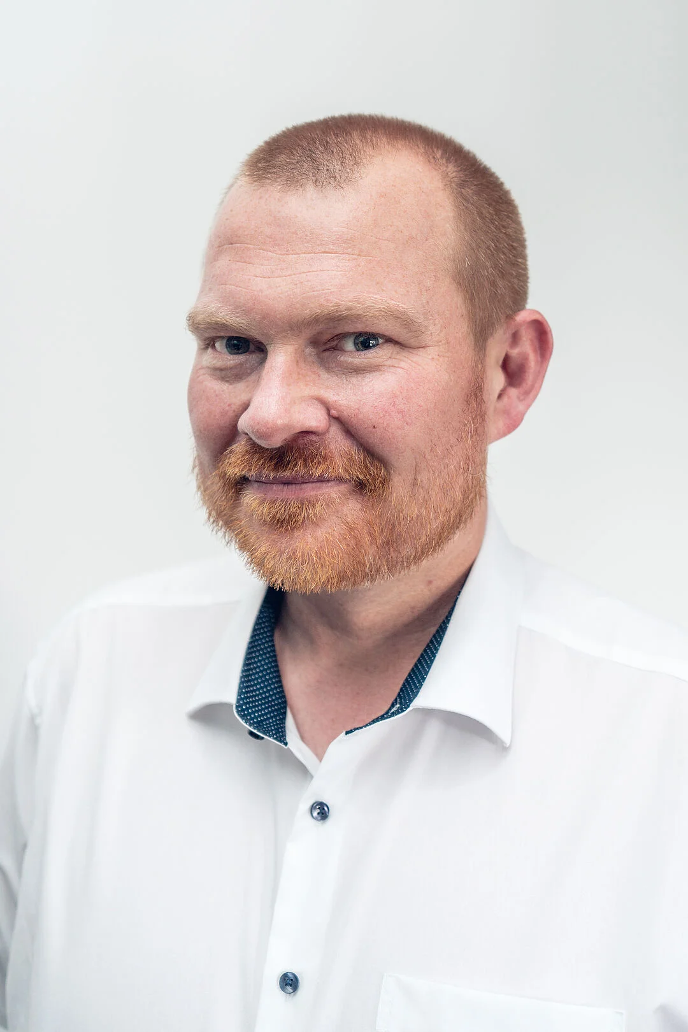
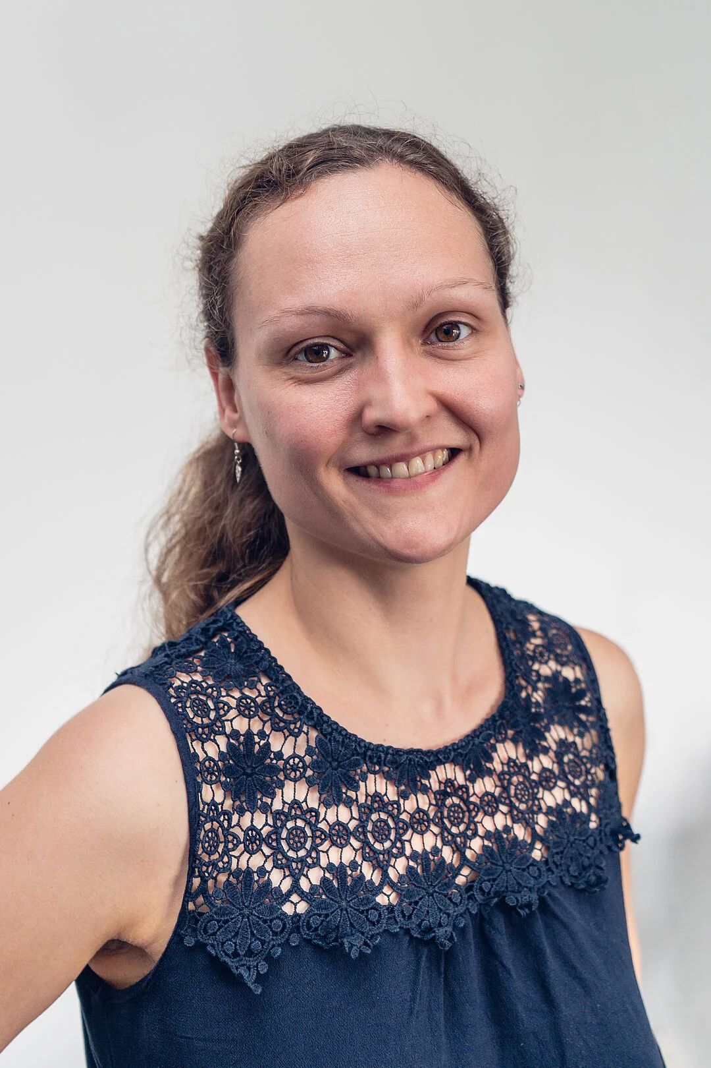
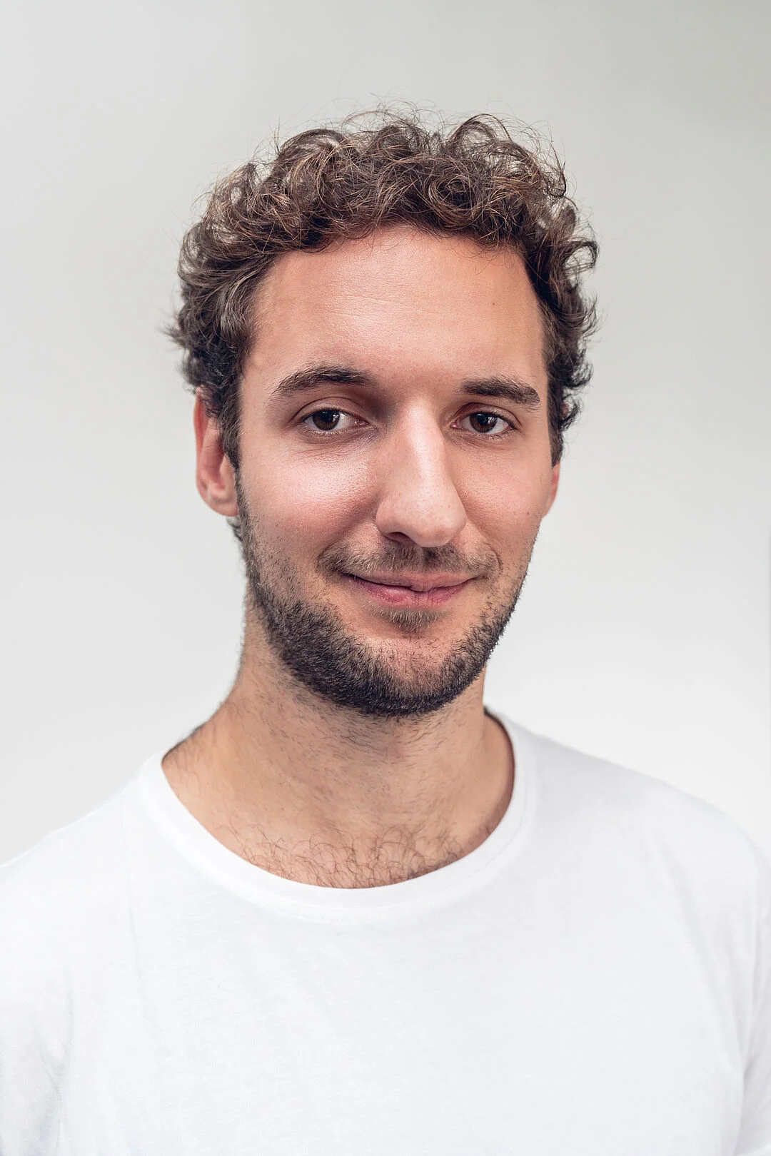
#3 Faculty IV - Team Awareness and Antidiscrimination
https://www.tu.berlin/eecs/awan
Goal
  Low-barrier approachability for spectrum of awareness and antidiscrimination issues
Team
  Irene Hube-Achter (MTSV)
  Matthias Boehm (professors)
  Nadine Karsten (scientific personnel)
  Tom Hersperger (students)
Mission Statement
  Account for heterogeneity and complexity of modern societies at TU Berlin
  All employees and students are committed to
    #1 Treat all persons with fairness and respect
    #2 Ensure a safe environment for all
    #3 Comply with our duty of care towards others
    #4 Actively support the implementation of the above guidelines and contribute
Contact: private email,
eecs-TB-awareness@win.tu-berlin.de,
or AwAn@dams.tu-berlin.de

Slide 4
Agenda
Course Organization
#1 Efficient Join Pipeline Executor (DAMS)
#2 Duplicate Detection (D2IP)
#3 Provenance Tracking in ML Pipelines (DEEM)
Course Selection/Enrolment

Slide 5
Course Organization

Slide 6
Basic Course Organization
Language
  Lectures and slides: English (German if preferred)
  Communication and presentations: English/German
  Informal language (first name is fine)
  Offline Q&A in forum, answered by teaching assistants
Course Format
  6 ECTS (4 SWS) bachelor computer science / information systems
  Every-other-week lectures (Mon 4.15pm sharp, including Q&A), attendance optional
Prerequisites
  Basic programming skills in languages such as C, C++, Java, Rust, Python, etc
  Basic understanding of data management SQL / RA (or willingness to fill gaps)

Slide 7

Course Goals and Structure
Objectives
  Apply basic programming skills to more complex problem (in self-organized team work)
  Technical focus on data management and data systems
  Holistic programming projects: prototyping, design, versioning, tests, experiments, benchmarks
Grading: Pass/Fail
  Project Implementation (project source code) [45%]
  Component and Functional Tests (test source code) [10%]
  Runtime Experiments (achieve performance target) [15%]
  Documentation (design document up to 5 pages / code documentation) [15%]
  Result Presentation (10min talk) [15%]
Academic Honesty / No Plagiarism (incl LLMs like ChatGPT)

Slide 8
Sub-Course Offerings
#1 Efficient Join Pipeline Executor
  Capacity: 28/60
  Organized by DAMS group
  Focus on query processing
  Lectures every-other-week in B 106
#2 Duplicate Detection
  Capacity: 16/60
  Organized by D2IP group
  Focus on entity resolution
#2 Provenance Tracking in ML Pipelines
  Capacity: 16/60
  Organized by DEEM group
  Focus on ML pipelines
➔ Admitted Students:
  32 + 28 on ISIS (incl duplicates)
  Total registrations: up to 60
  → 15 teams, 4 students each

Slide 9
#1 Efficient Join Pipeline Executor (DAMS)

Slide 10





About Me
Since 09/2022 TU Berlin, Germany
  University professor for Big Data Engineering (DAMS)
2018-2022 TU Graz, Austria
  BMK endowed chair for data management + research area manager
  Data management for data science (DAMS), SystemDS & DAPHNE
2012-2018 IBM Research – Almaden, CA, USA
  Declarative large-scale machine learning
  Optimizer and runtime of Apache SystemML
2007-2011 PhD TU Dresden, Germany
  Cost-based optimization of integration flows
  Time series forecasting / in-memory indexing & query processing
DB group

Slide 11

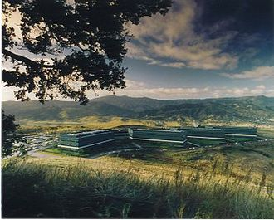
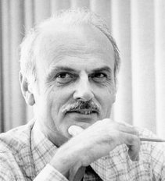
SQL Standard
(SQL-86)
Oracle, IBM DB2, Informix, Sybase → MS SQL
History 1970/1980s
Relational Database Systems
SEQUEL
QUEL
System R @ IBM Research – Almaden
(Jim Gray et al.,
Turing Award ‘98)
Ingres @ UC Berkeley (Stonebraker et al.,
Turing Award ‘14)
Tuple Calculus
Relational Algebra
Relational Model
Edgar F. “Ted” Codd @ IBM
Research (Turing Award ‘81)
Goal: Data Independence
(physical data independence)
  Ordering Dependence
  Indexing Dependence
  Access Path Dependence
[E. F. Codd: A Relational Model of Data for Large Shared Data Banks.
Comm. ACM 13(6), 1970]

Slide 12
Success of SQL / Relational Model
#1 Declarative: what not how
#2 Flexibility:
closure property → composability
Query:
SELECT O_OID, sum(L_Price)
FROM Orders, Lineitem, Customer
WHERE O_OID = L_OID AND O_CID = C_CID
AND O_Odate >= ‘2018-11-14’
AND C_Msegment = ‘AUTOMOBILE’
GROUP BY O_OID
Logical Query Plans
C(P)=1.32M
C(P)=2.2G
C(P)=0.34M
Physical Query Plan
Γ
sum(Price)
Hash
GrpJoin
Γ
Γ
0.001
σ
>=2018-11-14
⋈
⋈
#4 Physical Data
Independence
0.2
σ
Hash
Join
TScan L
⋈
L
⋈
σ
AUTOMOBILE
⋈
σ
σ
σ
L
C
σ
⋈
10K
IXScan
O
C
O
C
O
Date
TScan C
O
1G
L
#3 Automatic Optimization
100M

Slide 13
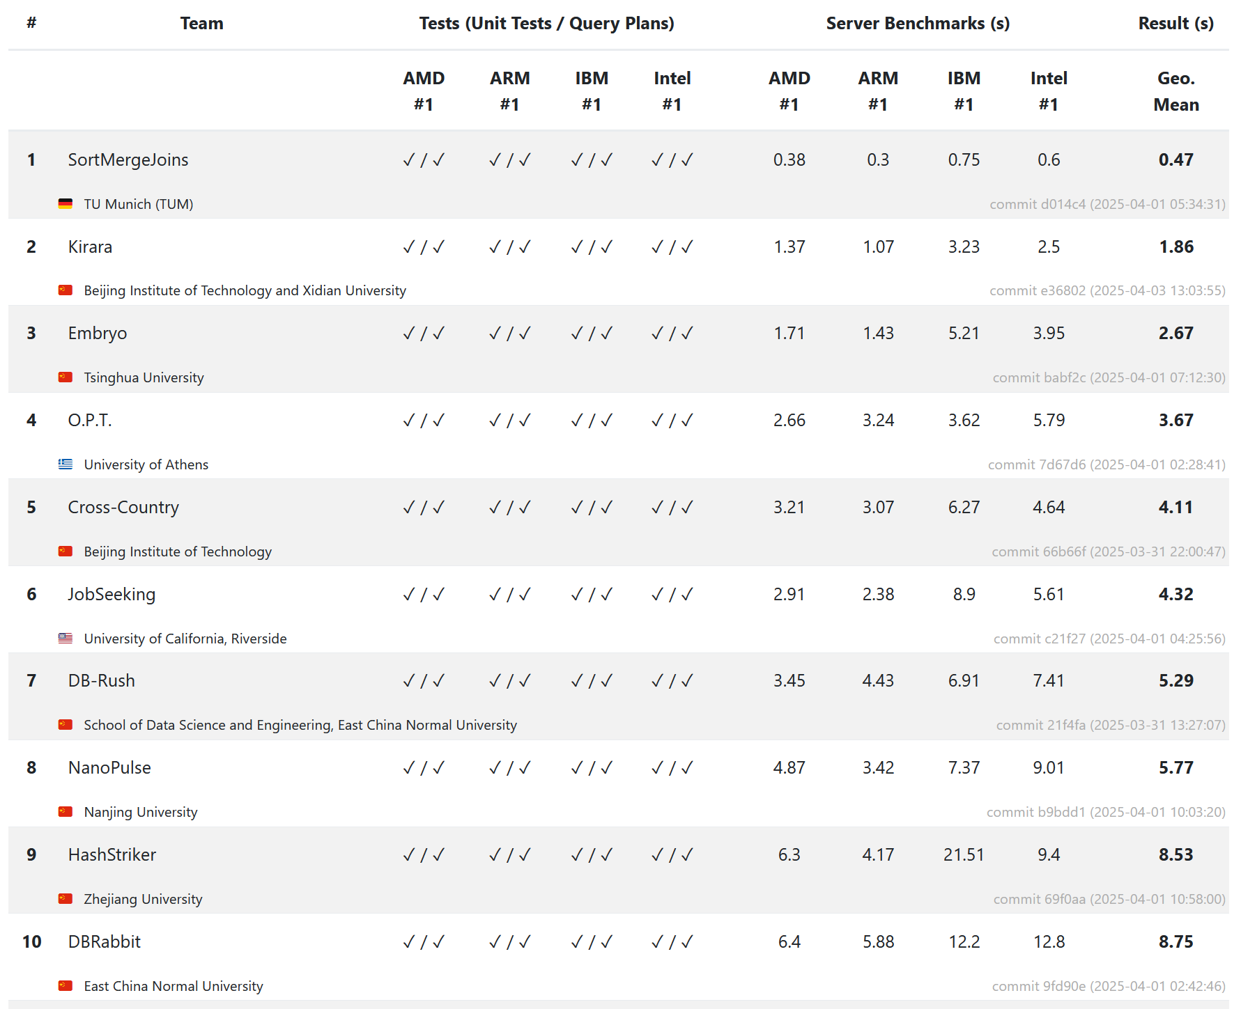
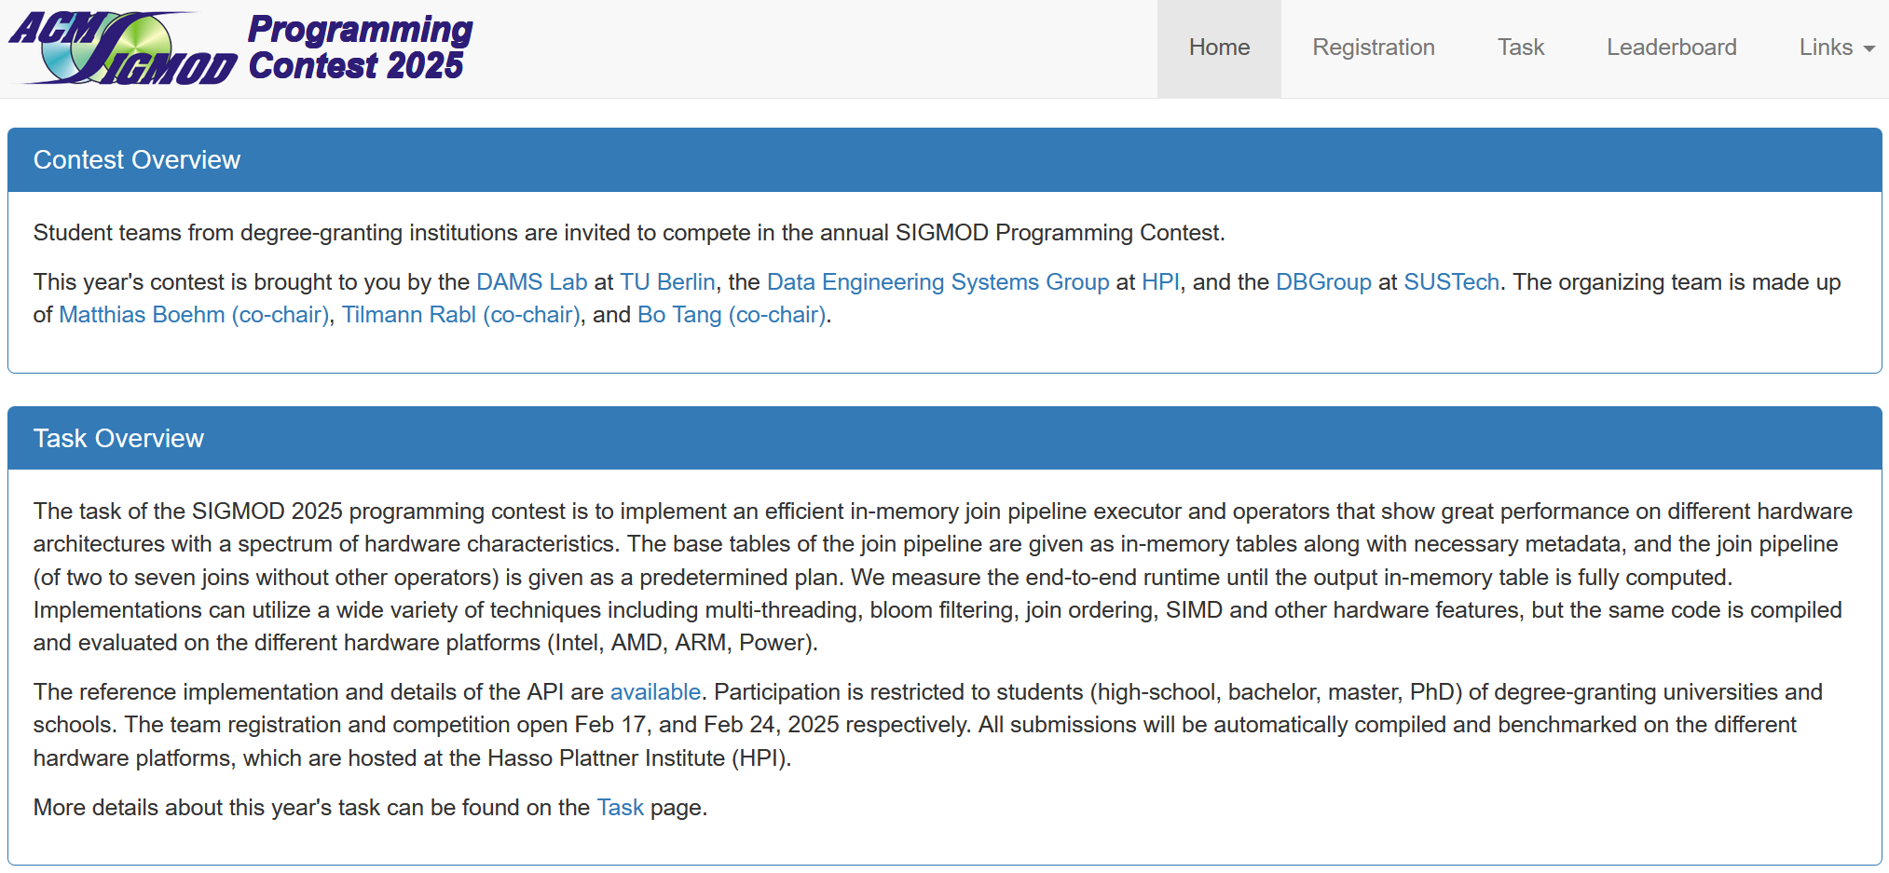
Overview SIGMOD’25 Programming Contest
https://sigmod-contest-2025.github.io/index.html
Task Overview
  Implement an efficient in-memory join pipeline executor
  Aim performance on different hardware architectures
  Base tables are given as columnar in-memory tables
  Measures end-to-end runtime until outputs are computed

Slide 14
Overview Join Pipelines
SELECT *
FROM R1, R3,
(SELECT R2.z, count(*)
FROM R2
WHERE R2.y=3
GROUP BY R2.z) R2
WHERE R1.x=7
AND R1.a=R3.b
AND R2.z=R3.c
⋈_{a=b}
σ_{x=7}
⋈_{z=c}
R1
γ_{COUNT(*);Z}
σ_{y=3}
R2
R3

Slide 15
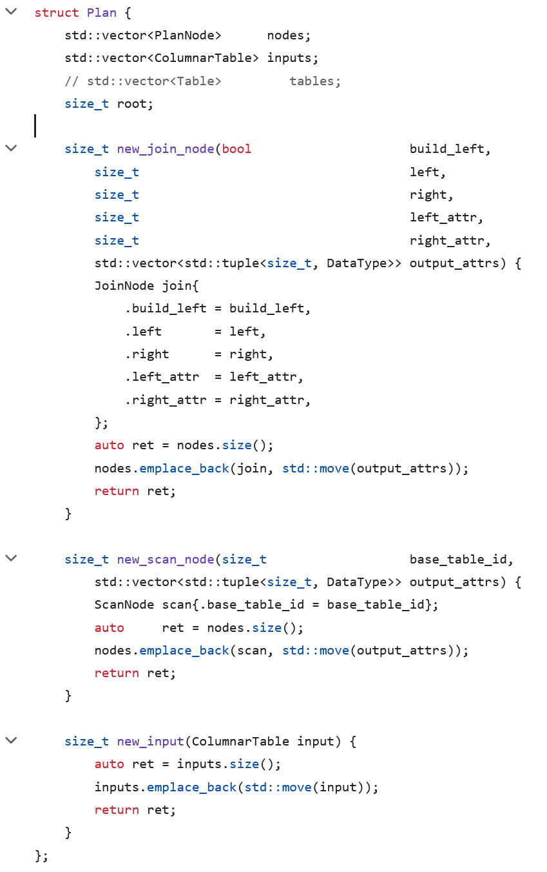
Application Programming Interface (API)
https://github.com/SIGMOD-25-Programming-Contest/base
namespace Contest {
void* build_context();
void destroy_context(void*);
ColumnarTable execute(
const Plan& plan, void* context);
} // namespace Contest
./download_imdb.sh;
./build/build_database imdb.db;
./build/run plans.json;

Slide 16
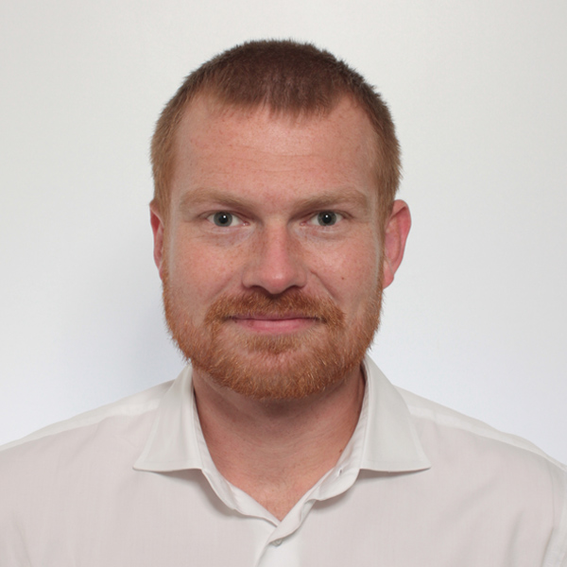

Additional Course Logistics
Staff
  Lecturer: Prof. Dr. Matthias Boehm
  Teaching Assistant: Christina Dionysio, and others if needed
Next Dates/Lectures
  Apr 20: Course Selection; team preferences, otherwise assignment
  Apr 28: Background Query Processing
  May 05: Background Query Compilation and Parallelization
  May 26: Background Query Optimization
  Jun 16: Experiments and Reproducibility
  Jul 08: Project submissions (performance target: speedup > #pcores over reference)
  Jul 14: Project presentations (10min per team, mandatory attendance)
Infrastructure
  Setup your own private Github/Gitlab repository
Each teams gets a mentor
Q&A sessions on demand

Slide 17
#2 Duplicate Detection (D2IP)

Slide 18
#3 Provenance Tracking in ML Pipelines (DEEM)

Slide 19
Course Selection/Enrolment

Slide 20
Select Your Course
Thanks
#1 Efficient Join Pipeline Executor (DAMS)
  Capacity: 28/60
#2 Duplicate Detection (D2IP)
  Capacity: 16/60
#3 Provenance Tracking in ML Pipeline (DEEM)
  Capacity: 16/60
Course Selection/Enrolment by Apr 20 EOD
https://tinyurl.com/4kyhwz37

