Slide 1

Programmierpraktikum: Datensysteme
02 Background Query Processing
Prof. Dr. Matthias Boehm, Christina Dionysio
Technische Universität Berlin
Berlin Institute for the Foundations of Learning and Data
Big Data Engineering (DAMS Lab)
Last update: Apr 23, 2025

Slide 2

Announcements / Org
#1 Hybrid & Video Recording
  Hybrid lectures (in-person, zoom) with optional attendance
  https://tu-berlin.zoom.us/j/9529634787?pwd=R1ZsN1M3SC9BOU1OcFdmem9zT202UT09
  Zoom video recordings, links from website
  https://mboehm7.github.io/teaching/ss24_ppds/index.htm
#2 Reminder Project Work
  Selection deadline passed Apr 20 EOD (extended until Apr 24)
  Team assignments for DAMS groups May 05
Q&A

Slide 3
Agenda
Overview Query Processing
Plan Execution Strategies
Physical Plan Operators

Slide 4
Overview Query Processing

Slide 5

DBMS System Architecture
[Theo Härder, Erhard Rahm: Datenbank-systeme: Konzepte und Techniken der Implementierung, 2001]
Set-Oriented Interface
SELECT * FROM R
Data
System
Data System (Nonprocedural access)
Record-Oriented Interface
FIND NEXT record
(Data) Access System
(Navigational access)
Internal Record Interface
B-Tree
getNext
Access
System
(Record) Storage System
(Access path mgmt)
ACCESS
page j
System buffer Interface
Storage
System
Buffer Management
(Propagation control)
File Interface
READ
block k
Operating System
(File Mgmt)
Device Interface

Slide 6
Overview Query Processing
SELECT * FROM TopScorer
WHERE Count>=4
Name | Count
James Rodríguez | 6
Thomas Müller | 5
Robin van Persie | 4
Neymar | 4
Parsing
AST/IR
Semantic Analysis
IR
Query Rewrites
Plan Execution
IR
Plan Optimization
QEP
Plan Caching
Compile Time
Runtime

Slide 7
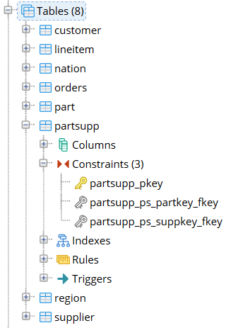
Database Catalog
[Meikel Poess: TPC-H. Encyclopedia of Big Data Technologies 2019]
Catalog Overview
  Meta data of all database objects
  (tables, constraints, indexes) → mostly read-only
  Accessible through SQL, but internal APIs
  Organized by schemas (CREATE SCHEMA tpch;)
SQL Information_Schema
  Schema with tables for all tables, views, constraints, etc
  Defined as views over PostgreSQL catalog tables
  Example: check for existence of accessible table
pgAdmin
graphical representation
SELECT 1 FROM information_schema.tables
WHERE table_schema = ‘tpch’
AND table_name = ‘customer’

Slide 8
Plan Caching
Motivation
  Query rewriting, optimization and plan generation is expensive
  Cache and reuse compile plans (stored procedures, prepared/parameterized statements, ad-hoc queries)
Structure
  SQL query test
  Compiled query plans
  Statistics
    Usage counts
    Last run timestamp
    Max/avg runtime
    Compile time
Examples: MS SQL Server, IBM DB2
#1 Probe Plan Cache
hash(SQL)
SQL | Plan | Stats
SELECT * FROM | QEP1: x-y-z | #5, 23ms
SELECT a FROM | QEP7: a-b | #100, 6ms
CREATE PROC | … | …
#2 Check schema valid,
statistics up-to-date
#3 Reuse or Recompilation

Slide 9
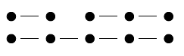
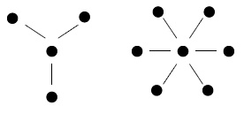
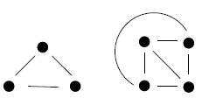
[Guido Moerkotte, Building Query Compilers (Under Construction), 2020,
http://pi3.informatik.uni-mannheim.de/
~moer/querycompiler.pdf]
Query and Plan Types
Query Types
  Nodes: Tables
  Edges: Join conditions
  Determine hardness of query optimization
  (w/o cross products)
Join Tree Types / Plan Types
  Data flow graph
  of tables and joins
  (logical/physical query trees)
  Edges: data dependencies
  (execution order: bottom-up)
Chains
Stars
Cliques
Left-Deep Tree
Right-Deep Tree
Zig-Zag Tree
Bushy Tree

Slide 10
Result Caching
Motivation
  Read-mostly data and same queries over unchanged inputs
  Cache and reuse small result sets (e.g., aggregation queries, distinct)
Structure
  Similar to materialized-views
  (cached intermediates)
  Store results of queries w/ result_cache hint
  in subarea of buffer pool, reuse via hint
  Drop cached results if underlying base data changes
  Also: Function result cache (memoization)
Examples: Oracle (from 11g)
[https://oracle.readthedocs.io/en/latest/plsql/cache/alternatives/result-cache.html]
SELECT /*+ result_cache*/ *
FROM TopScorer
WHERE Count>=4
Buffer pool
pages

Slide 11
Plan Execution Strategies

Slide 12
Overview Execution Strategies
Different execution strategies (processing models) with different pros/cons
(e.g., memory requirements, DAGs, efficiency, reuse)
#1 Iterator Model (mostly row stores)
#2 Materialized Intermediates (mostly column stores)
#3 Vectorized (Batched) Execution (row/column stores)
#4 Query Compilation (row/column stores)
#5 Data-Centric Processing (row stores)
Query-
centric
Data-
centric

Slide 13
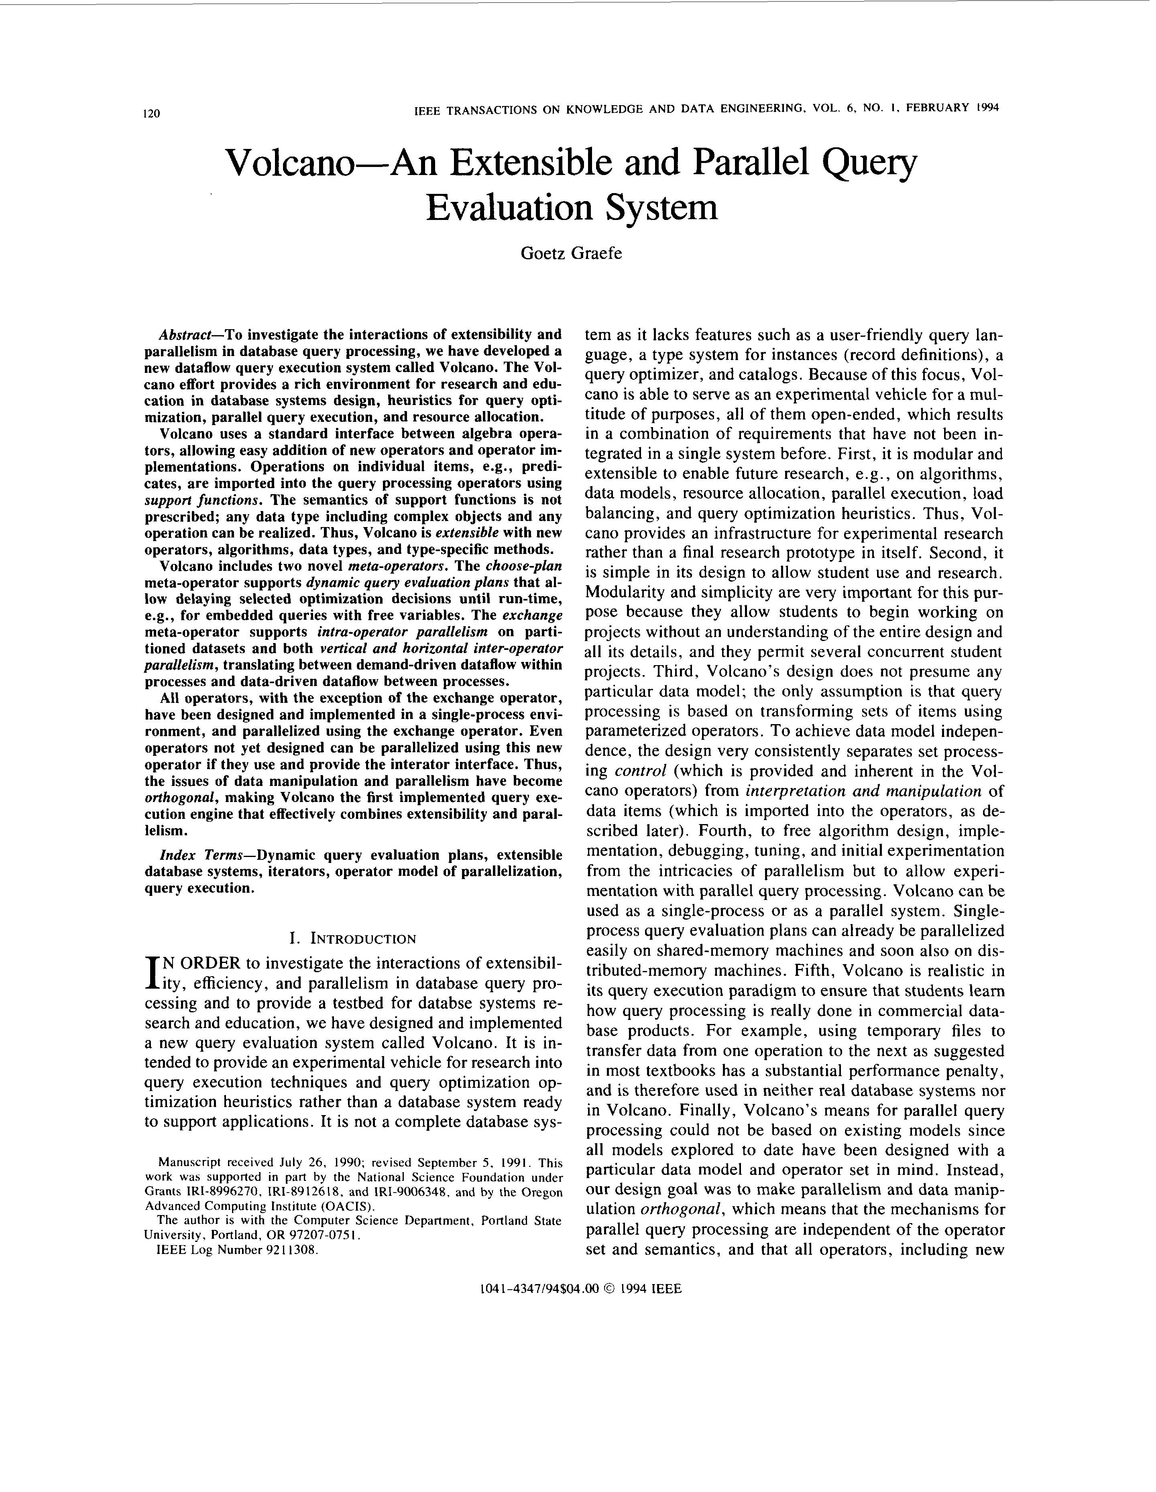
[Goetz Graefe: Volcano - An Extensible and Parallel Query Evaluation System. IEEE Trans. Knowl. Data Eng. 1994]
Iterator Model – Overview
Scalable (small memory)
High CPI measures
Volcano Iterator Model
  Open-Next-Close (ONC) interface
  Query execution from root node (pull-based) → Pipelined
Example
σ_{A=7}(R)
Blocking Operators
  Sorting, grouping/aggregation, build-phase of (simple) hash joins
void open() { R.open(); }
void close() { R.close(); }
Record next() {
while( (r = R.next()) != EOF )
if( p(r) ) //A==7
return r;
return EOF;
}
open()
next()
next()
→ EOF
close()
open()
σ_{A=7}
next()
next()
→ EOF
close()
open()
R
next()
next()
next()
next()
→ EOF
close()
PostgreSQL: Init(),
GetNext(), ReScan(), MarkPos(), RestorePos(), End()

Slide 14

Iterator Model – Predicate Evaluation
Operator Predicates
  Examples: arbitrary selection predicates and join conditions
  Operators parameterized with in-memory expression trees/DAGs
  Expression evaluation engine (interpretation)
Example Selection σ
  $\left(A=7∧B≠8\right) ∨ D=9$
|
A | B | C | D
7 | 8 | Product 1 | 10
14 | 8 | Product 3 | 11
7 | 3 | Product 7 | 7
3 | 3 | Product 2 | 1
&
==
D
9
==
!=
A
7
B
8

Slide 15
Materialized Intermediates (column-at-a-time)
SELECT count(DISTINCT o_orderkey)
FROM orders, lineitem
WHERE l_orderkey = o_orderkey
AND o_orderdate >= date ’1996-07-01’
AND o_orderdate < date ’1996-07-01’
+ interval ’3’ month
AND l_returnflag = ’R’;
Column-oriented storage
Efficient array operations
DAG processing
Reuse of intermediates
Memory requirements
Unnecessary read/write from and to memory
Binary
Association Tables (BATs:=OID/Val)
[Milena Ivanova, Martin L. Kersten, Niels J. Nes, Romulo Goncalves: An architecture for recycling intermediates in a column-store. SIGMOD 2009]

Slide 16
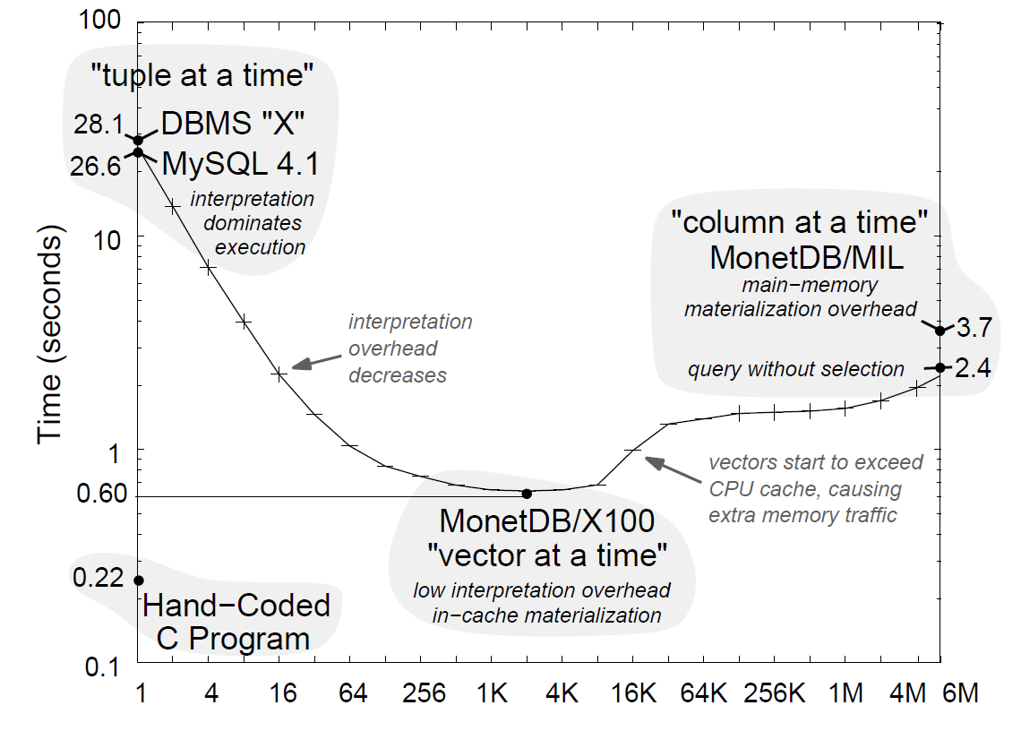
Vectorized Execution (vector-at-a-time)
Column-oriented storage
Efficient array operations
Memory/cache efficiency
DAG processing
Reuse of intermediates
Idea: Pipelining of
vectors (sub columns)
s.t. vectors fit in
CPU cache hierarchy
Workload: TPCH Q1
[Peter A. Boncz, Marcin Zukowski, Niels Nes: MonetDB/X100: Hyper-Pipelining Query Execution.
CIDR 2005]
Vector Size (# Tuples)

Slide 17
Vectorized Execution (vector-at-a-time), cont.
Motivation
  Iterator Model: many function calls,
  no instruction-level parallelism
  Materialized: mem-bandwidth-bound
Hyper-Pipelining
  Operators work on vectors
  Pipelining of vectors (sub-columns)
  Vector sizes according to cache size
  Pre-compiled function primitives
  ➔ Generalization of execution strategies
for(int i=0;i<n;i++)
out[i] = in[i]<L
[Peter A. Boncz, Marcin Zukowski, Niels Nes: MonetDB/X100: Hyper-Pipelining Query Execution. CIDR 2005]
[Marcin Zukowski, Peter A. Boncz, Niels Nes, Sándor Héman:
MonetDB/X100 - A DBMS In The CPU Cache. IEEE Data Eng. Bull. 2005]

Slide 18
Query Compilation
Idea: Data-centric, not op-centric processing + LLVM code generation
Operator Trees
(w/o and w/ pipeline boundaries)
Compiled Query
(conceptual, not LLVM)
[Thomas Neumann: Efficiently Compiling Efficient Query Plans for Modern Hardware. PVLDB 2011]

Slide 19
Data-Centric / Continuous Scan Processing
Crescando (ETH Zurich)
  Amadeus use case: latency <2s, freshness <2s,
  query diversity/update load, linear scale-out/scale-up
  ClockScan: cooperative scan
  Index Union Update Join: update-data join
  (write, and read cursor)
DataPath System (Rice University)
  Push-based, data-centric processing model
  Multi-query optimization → DAG of operations (bit-strings to map tuples to queries)
  I/O system pushed chunks to operators
  Load shedding on overload and explicit scheduling
[Philipp Unterbrunner et al.: Predictable Performance for Unpredictable Workloads. PVLDB 2(1) 2009]
Indexed Queries / Unindexed queries
Q
Continuous Scan
[Subi Arumugam, Alin Dobra, Christopher M. Jermaine, Niketan Pansare, Luis Leopoldo Perez: The DataPath system: a data-centric analytic processing engine for large data warehouses. SIGMOD 2010]

Slide 20
Physical Plan Operators

Slide 21
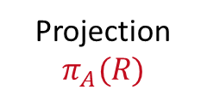
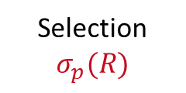
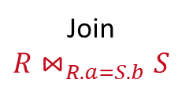
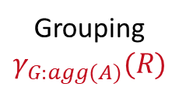
Overview Plan Operators
Multiple Physical Operators
  Different physical operators for different data and query characteristics
  Physical operators can have vastly different costs
Examples (supported in most DBMS)
  Logical Plan
  Operators
  Physical Plan
  Operators
Selection
$$σ_{p}(R)$$
Projection
$$π_{A}(R)$$
Grouping
$$γ_{G:agg(A)}(R)$$
Join
$$R{\text{⋈}}_{R.a=S.b}S$$
TableScan
IndexScan
ALL
ALL
SortGB
HashGB
NestedLoopJN
SortMergeJN
HashJN

Slide 22
Table and Index Scan
Table Scan vs Index Scan
  For highly selective predicates, index scan
  asymptotically much better than table scan
  Index scan higher per tuple overhead
  (break even ~5% output ratio)
Index Scan Example σ_{7≤A≤106}(R)
  IX ASC on A
RID List Handling
  IX often returns TIDs
  Fetch, Sort + Fetch
  AND: RIDs(x) ∩ RIDs(y)
  OR: RIDs(x) ∪ RIDs(y)
Table Scan
Index Scan
ix
sorted
void open() { IX.open(); }
void close() { IX.close(); }
Record next() {
if(r == null)
return r=IX.get(Low); // A=7
if((r=IX.next()).K ≤ Upper) // A≤106
return r;
return EOF;
}

Slide 23
Nested Loop Join
Overview
  Most general join operator (no order, no indexes, arbitrary predicates θ)
  Poor asymptotic behavior (very slow)
Algorithm
(pseudo code)
Complexity
  Complexity: Time: O(N * M), Space: O(1)
  Pick smaller table as inner if it fits entirely in memory (buffer pool)
⋈_{RID=SID}
N = |R|
M = |S|
for each s in S
for each r in R
if( r.RID θ s.SID )
emit concat(r, s)
R | RID
 | 9
 | 1
 | 7
SID | S
7
3
1
9
7
How to implement next()?

Slide 24
Block Nested Loop / Index Nested Loop Joins
for each block b_{R} in R
for each block b_{S} in S
for each r in b_{R}
for each s in b_{S}
if( r.RID θ s.SID )
emit concat(r, s)
Block Nested Loop Join
  Avoid I/O by blocked data access
  Read blocks of b_{R} and b_{S} R and S pages
  Complexity unchanged but
  potentially much fewer scans
Index Nested Loop Join
  Use index to locate qualifying tuples
  (==, >=, >, <=, <)
  Complexity (for equivalence predicates):
  Time: O(N * log M), Space: O(1)
for each r in R
for each s in S.IX(θ,r.RID)
emit concat(r,s)
ix
S

Slide 25
Sort-Merge Join
Overview
  Sort Phase: sort the input tables R and S (w/ external sort algorithm)
  Merge Phase: step-wise merge with lineage scan
Algorithm
(Merge, PK-FK)
Complexity
  Time (unsorted vs sorted): O(N log N + M log M) vs O(N + M)
  Space (unsorted vs sorted): O(N + M) vs O(1)
Record next() {
while( curR!=EOF && curS!=EOF ) {
if( curR.RID < curS.SID )
curR = R.next();
else if( curR.RID > curS.SID )
curS = S.next();
else if( curR.RID == curS.SID ) {
t = concat(curR, curS);
curS = S.next(); //FK side
return t;
} }
return EOF;
}
produced sorted output
⋈_{RID=SID}
N = |R|
M = |S|
SID | S
1
3
7
7
9
… | R_ID
 | 9
 | 1
 | 7
S_ID | …
7
3
1
9
7
R | RID
 | 1
 | 7
 | 9

Slide 26
Hash Join
Overview
  Build Phase: read table S and build a hash table H_{S} over join key
  Probe Phase: read table R and probe H_{S} with the join key
Algorithm
(Build+Probe, PK-FK)
Complexity
  Time: O(N + M), Space: O(N)
  Classic hashing: p in-memory partitions of Hr w/ p scans of R and S
Record next() {
// build phase (first call)
while( (r = R.next()) != EOF )
Hr.put(r.RID, r);
// probe phase
while( (s = S.next()) != EOF )
if( Hr.containsKey(s.SID) )
return concat(Hr.get(s.SID), s);
return EOF;
}
N = |R|
M = |S|
⋈_{RID=SID}
… | R_ID
 | 9
 | 1
 | 7
SID | S
7
3
1
9
7
 | H_{R,RID}
9
1
7
h(x)
Notes:
Note: example hash functions: crc (cyclic redundancy check), MurmurHash, CityHash, FarmHash, XXHash

Slide 27
[Zachary G. Ives, Daniela Florescu, Marc Friedman, Alon Y. Levy, Daniel S. Weld: An Adaptive Query Execution System for Data Integration. SIGMOD 1999]
Double-Pipelined Hash Join
Overview and Algorithm
  Join of bounded streams (or unbounded w/ time-based invalidation)
  Equi join predicate, symmetric and non-blocking
  For every incoming tuple (e.g. left):
  probe (right)+emit, and build (left)
H_{R,RID}
1, 2, 7
⋈_{RID=SID}
H_{R,RID}
1, 2
H_{R,RID}
1, 1, 2, 7
H_{S,SID}
1, 7, 7
H_{R,RID}
H_{S,SID}
1, 7
H_{R,RID}
1, 1, 2
H_{S,SID}
7
H_{S,SID}
1 | ab
7 | zy
2 | cd
1 | xw
emit 1(abxw)
emit 1(efxw)
1 | ef
7 | vu
emit 7(ghvu)
Stream
R
Stream
S
emit 7(ghzy)
7 | gh

Slide 28
Partitioned Hash Join
Range-Partitioned
  Co-partitioning tuples from R and S
  into partitions defined by key ranges
  Local hash join over partitions
  Fit local hash table in caches
  Partitioning shuffles rows/RIDs
Radix Hash Join
  Multi-pass radix partitioning
  (first 2,3,etc bits of hash)
  Better locality during partitioning (TLB, L1/L2)
[Credit: Changkyu Kim et al, VLDB’09]
[Stefan Manegold, Peter A. Boncz, Martin L. Kersten: Optimizing Main-Memory Join on Modern Hardware. IEEE Trans. Knowl. Data Eng. 14(4) 2002]

Slide 29
Hash vs Sort-Merge Joins, Revisited … Revisited
[Changkyu Kim et al: Sort vs. Hash Revisited: Fast Join Implementation on Modern Multi-Core CPUs. PVLDB 2(2) 2009]
PVLDB’09
PVDLB’12
PVLDB’13 / TKDE’15
SIGMOD’16
Interesting Perspective
  Large-small table joins
  Compare query runtime
[Martina-Cezara Albutiu et al: Massively
Parallel Sort-Merge Joins in Main Memory Multi-Core Database Systems. PVLDB 5(10) 2012]
[Cagri Balkesen, Gustavo Alonso, Jens Teubner,
M. Tamer Özsu: Multi-Core, Main-Memory Joins: Sort vs. Hash Revisited. PVLDB 7(1) 2013]
[Stefan Schuh, Xiao Chen, Jens Dittrich: An Experimental Comparison of Thirteen Relational Equi-Joins in Main Memory. SIGMOD 2016]
[Thomas Neumann: Comparing Join Implementations, http://databasearchitects.blogspot.com/2016/04/comparing-join-implementations.html, 04/2016]
Notes:
Note: comparison by query runtime (if TID joins, partitioning -> destroys sorting of TIDs which makes fetch much more expensive)

Slide 30
[Maximilian Bandle, Jana Giceva, Thomas Neumann: To partition, or not to partition, that is the join question in a real system, SIGMOD 2021]
Bloom Filters
Bloom Radix-Partitioned Join (BRJ)
  Motivation: partitioning probe side can be very expensive
  Second partitioning pass of
  build side materializes the bloom filter
  Filter probe side before partitioning
Comparison w/
Bloom Filter over RJ
  Micro: negative
  TPC-H: positive
key=7
h1
h3
1 | 0 | 1 | 0 | 1 | 1
Notes:
Note: comparison by query runtime (if TID joins, partitioning -> destroys sorting of TIDs which makes fetch much more expensive)

Slide 31
Experiments
Micro Benchmarks RJ, BRJ, BHJ
  https://github.com/opcm/pcm
TPC-H
Benchmark
Notes:
LM: late materialization

Slide 32
Sort-GroupBy and Hash-GroupBy
Recap: Classification of Aggregates (DM, DIA)
  Additive, semi-additive, additively-computable, others
Sort Group-By
  Similar to sort-merge join (Sort, GroupAggregate)
  Sorted group output
Hash Group-By
  Similar to hash join (HashAggregate)
  Higher temporary memory consumption
  Unsorted group output
  #1 w/ tuple grouping
  #2 w/ direct aggregation (e.g., count)
  Beware: cache-unfriendly if many groups (size(H) > L2/L3 cache)
  γ_{A,count(*)}(R)
sort
O(N log N)
X X X X X X Y Y Y Y Y Y Y Z Z Z Z Z
aggregate O(N)
X,6
Y,7
Z,5
build & agg
O(N)
 | H_{A,Agg}
Y
X
Z
γ_{A,count(*)}
R
Notes:
Note: quantile/median requires sort per partition -> sort group-by
Postgres: GroupAggregate, HashAggregate

Slide 33
Summary & QA
Thanks
Overview Query Processing
Plan Execution Strategies
Physical Plan Operators
Next Lectures
  03 Background Query Compilation and Parallelization [May 12]
  04 Background Query Optimization [May 26]
  05 Experiments and Reproducibility [Jun 09]
➔ Please contact your team members and get started

