Slide 1

Programmierpraktikum: Datensysteme
03 Background Query Compilation & Parallelization
Prof. Dr. Matthias Boehm
Technische Universität Berlin
Berlin Institute for the Foundations of Learning and Data
Big Data Engineering (DAMS Lab)
Last update: May 11, 2025

Slide 2


Announcements / Org
#1 Hybrid & Video Recording
  Hybrid lectures (in-person, zoom) with optional attendance
  https://tu-berlin.zoom.us/j/9529634787?pwd=R1ZsN1M3SC9BOU1OcFdmem9zT202UT09
  Zoom video recordings, links from website
  https://mboehm7.github.io/teaching/ss25_ppds/index.htm
#2 Team Assignment
  2 teams with 4 and 5 persons, respectively
#3 Next Lecture
  May 26, 2025; 4pm by Christina due to Matthias traveling to Paris
#4 Course Achtsamkeits-Meditation
  8-week course and study, start May 26
  Mindfulness-Based Stress Reduction, Mental Health, and Productivity
  Prof. Dr. Maja Adena (TUB) und Mira Fischer (WZB)
  https://wzb.fra1.qualtrics.com/jfe/form/SV_4IbPvSGunfOVCnk

Slide 3
Recap: Overview Query Processing
SELECT * FROM TopScorer
WHERE Count>=4
Name | Count
James Rodríguez | 6
Thomas Müller | 5
Robin van Persie | 4
Neymar | 4
Parsing
AST/IR
Semantic Analysis
IR
Query Rewrites
Plan Execution
Plan Execution
IR
Plan Optimization
QEP
Plan Caching
QEP
Plan Caching
Compile Time
Runtime

Slide 4
Agenda
Vectorization and SIMD
Query Compilation
Query Parallelization

Slide 5
Vectorization and SIMD
SIMD Instruction-level Parallelism (aka Vectorization)
Vectorized Execution Model → Cache-friendly / Auto-SIMD

Slide 6
Terminology Parallelism
Single Data
Multiple Data
SISD
(uni-core)
SIMD
(vector)
Single Instruction
Flynn’s Classification
  SISD, SIMD
  (MISD), MIMD
Example: SIMD Processing
  Streaming SIMD Extensions (SSE)
  Process the same operation on multiple elements
  at a time (packed vs scalar SSE instructions)
  Data parallelism (aka: instruction-level parallelism)
  Example: VFMADD132PD
[Michael J. Flynn, Kevin W. Rudd: Parallel Architectures. ACM Comput. Surv. 28(1) 1996]
MISD
(pipelining)
MIMD
(multi-core)
Multiple Instruction
2009 Nehalem: 128b (2xFP64)
2012 Sandy Bridge: 256b (4xFP64)
2017 Skylake: 512b (8xFP64)
c = _mm512_fmadd_pd(a, b);
a
b
c

Slide 7
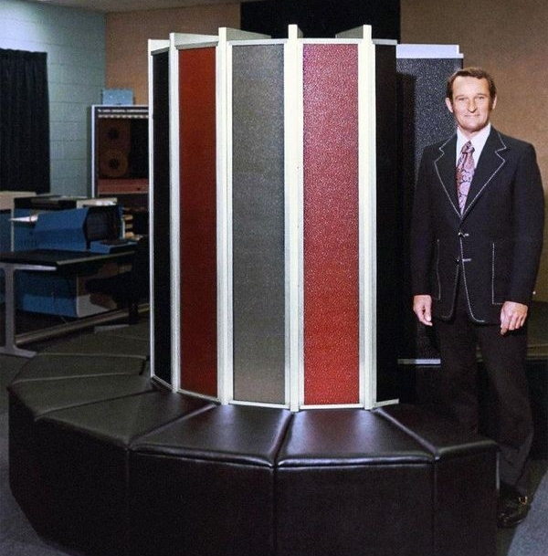
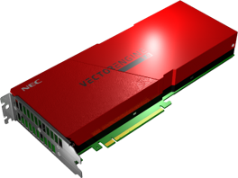
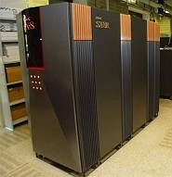
Background Vector Processors
[https://www.computerhistory
.org/tdih/september/28/]
GRAY-1
  8 x (64 elements x 8B) vector registers
  INT and FP arithmetic @ 80 MHz
  Vector and scalar instructions
NEC Vector Engine v2 20A/20B
  8/10 vector cores w/ scalar/vector processing units
  Vector width: 256 x 8B = 16,384 bit
  1.6 GHz, 3.07/6.14 TFLOPs, 1.53 TB/s
Others: CPUs, GPUs, FPGAs, DSPs
[Richard M. Russell: The CRAY-1 Computer System. CACM 21(1) 1978]
@ZAMG
[https://en.wikichip.org/wiki/nec/microarchitectures/sx-aurora]
[https://www.zamg.ac.at/cms/en/images/
weather/nec/image_view_fullscreen]

Slide 8
[Jingren Zhou, Kenneth A. Ross: Implementing database operations using SIMD instructions. SIGMOD 2002]
SIMD Data Processing
Overview
  Process multiple elements at once
  Avoid conditional branch instructions
  Assuming column-wise storage, and vectors of fixed-sized values
Example Selection
  16x32b
x
7 | 1 | 2 | 9 | 3 | 8 | 6 | 7 | 3 | 4 | 9 | 2 | 4 | 5 | 6 | 9
mask = x>=5
1 | 0 | 0 | 1 | 0 | 1 | 1 | 1 | 0 | 0 | 1 | 0 | 0 | 1 | 1 | 1
V = SIMD_bitmap(mask)
77391
// [0, 2^(S-1)]
All match extraction from y

Slide 9
[Jingren Zhou, Kenneth A. Ross: Implementing database operations using SIMD instructions. SIGMOD 2002]
SIMD Data Processing, cont.
Example Aggregations
  Convert non-matched elements to zero
  Aggregate into vector register,
  final agg/extraction
Auto Vectorization
  GCC 7.2
  Clang 5.0
  ICC 18
[Timo Kersten, Viktor Leis, Alfons Kemper, Thomas Neumann, Andrew Pavlo, Peter A. Boncz: Everything You Always Wanted to Know About Compiled and Vectorized Queries But Were Afraid to Ask. PVLDB 11(13) 2018]

Slide 10
Vectorized Execution (vector-at-a-time)
Motivation
  Iterator Model: many function calls,
  no instruction-level parallelism
  Materialized: mem-bandwidth-bound
Hyper-Pipelining
  Operators work on vectors
  Pipelining of vectors (sub-columns)
  Vector sizes according to cache size
  Pre-compiled function primitives
  ➔ Generalization of execution strategies
for(int i=0;i<n;i++)
out[i] = in[i]<L
[Peter A. Boncz, Marcin Zukowski, Niels Nes: MonetDB/X100: Hyper-Pipelining Query Execution. CIDR 2005]
[Marcin Zukowski, Peter A. Boncz, Niels Nes, Sándor Héman: MonetDB/X100 - A DBMS In The CPU Cache. IEEE Data Eng. Bull. 28(2), 2005]

Slide 11
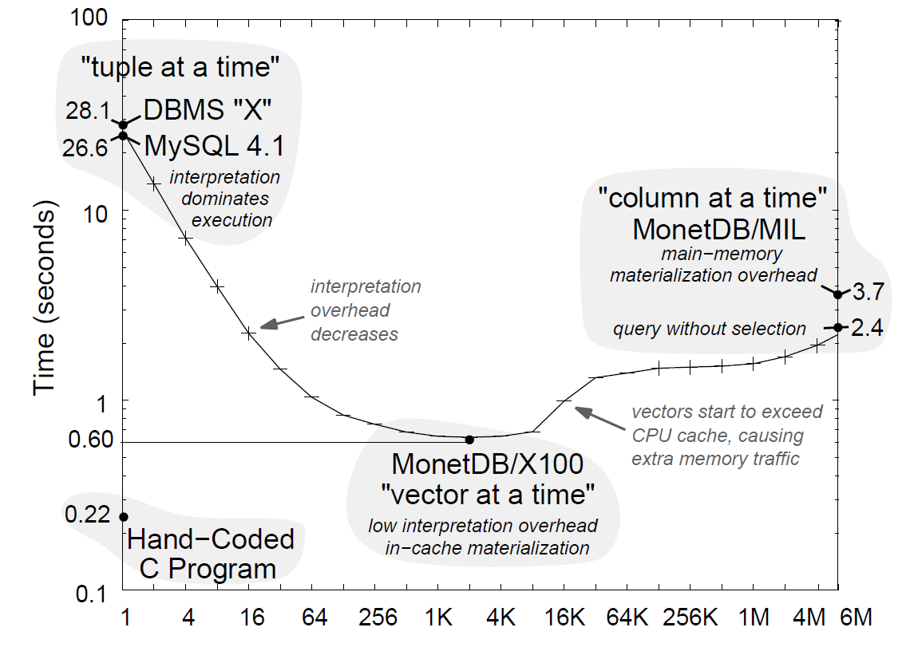
Vectorized Execution (vector-at-a-time)
Column-oriented storage
Efficient array operations
Memory/cache efficiency
DAG processing
Reuse of intermediates
Idea: Pipelining of
vectors (sub columns)
s.t. vectors fit in
CPU cache hierarchy
Workload: TPCH Q1
[Peter A. Boncz, Marcin Zukowski, Niels Nes: MonetDB/X100: Hyper-Pipelining Query Execution.
CIDR 2005]
Vector Size (# Tuples)

Slide 12
Query Compilation
Holistic Query Evaluation
Data-centric Query Evaluation
Compilation and/or Vectorization

Slide 13
Query Compilation Motivation
Background
  Traditional DBMS assume data >> main memory (I/O dominates)
  Modern in-memory DBMS → CPU/memory efficiency crucial
Example
SELECT sum(price*(1+tax))
FROM Orders
WHERE oid >= 100 AND oid <= 200
GROUPBY category
[Juliusz Sompolski, Marcin Zukowski, Peter A. Boncz: Vectorization vs. compilation in query execution. DaMoN 2011]
compile
for(int i = 0; i < N; i++)
if(oid[i] >= 100 && oid[i] <= 200)
ret[category] += price[i]*(1+tax[i]);

Slide 14
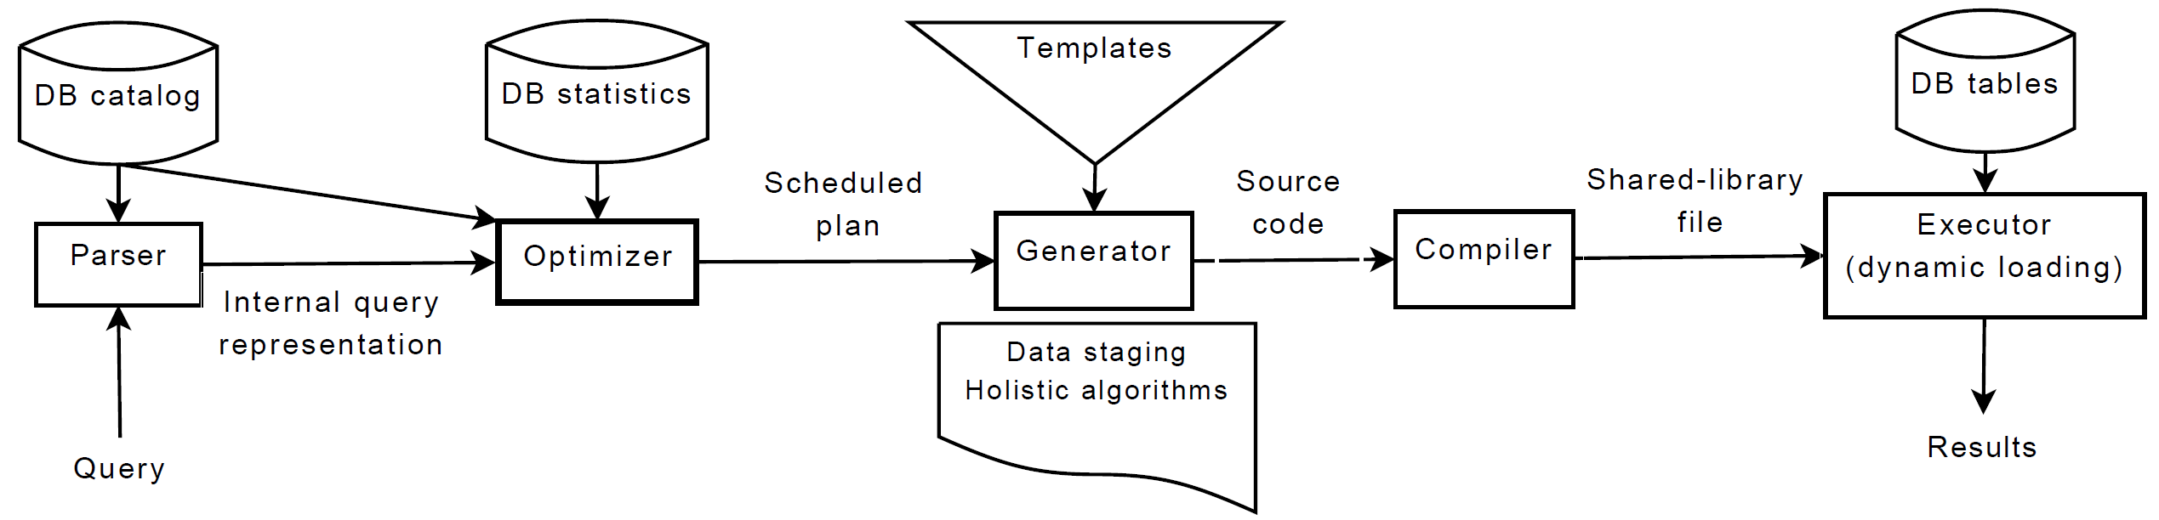
[Konstantinos Krikellas, Stratis Viglas, Marcelo Cintra: Generating code for holistic query evaluation. ICDE 2010]
Holistic Query Evaluation
[Konstantinos Krikellas: The case for holistic query evaluation, PhD Thesis, University of Edinburgh, 2010]
Query Processing Architecture
  HIQUE: Holistic Integrated Query Engine
  Holistic: Query-awareness + HW-awareness
  Codegen as underlying principle of efficient query evaluation
Codegen and compilation step

Slide 15
Holistic Query Evaluation, cont.
Code Generation Approach
  #1 Data Staging: input tables, selection, projection, pre-processing
  #2 Holistic Query Instantiation: join, group-by, order-by
// function prototypes ...
// function implementations
Result executeQuery() {
tmp1 = executeQ1(…);
tmp2 = executeQ2(…);
tmp3 = executeQ3(tmp1,tmp2,…);
return executeQ4(tmp3,…);
}
… executeO1(…){…}
… executeO2(…){…}
… executeO3(…){…}
… executeO4(…){…}
Q4
γ_{SUM(S_Qty); P_Name}
Q3
⋈_{P_PID=S_PID}
σ _{S_Date>=‘2011-01-01‘}
Sales
Q2
Products
Q1
Materialized Intermediates

Slide 16
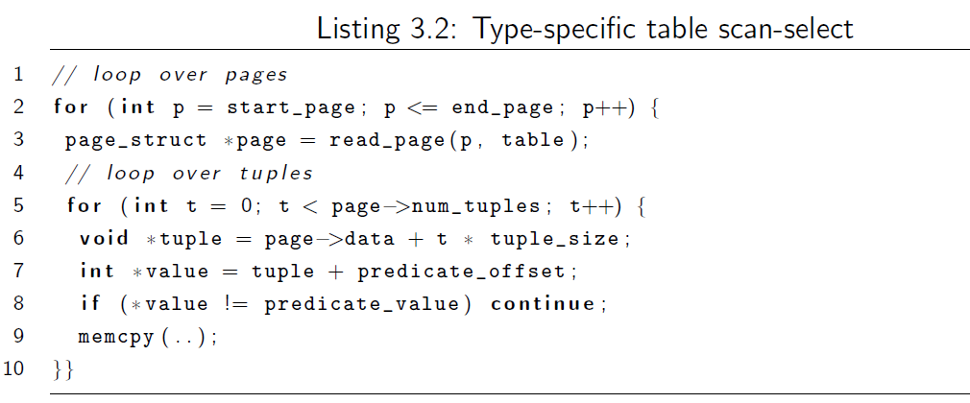
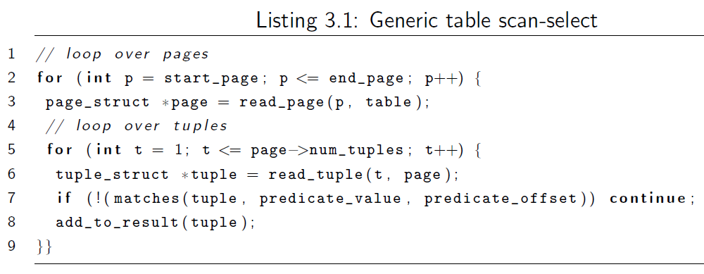
Holistic Query Evaluation, cont.
Code Generation Approach, cont.
  Types: known attribute types → no separate function calls (access, eval)
  Size: fixed-length tuples → direct access, cache-conscious blocking
  Operations: interleaved operations on cached data
#1 Data Staging
σ _{x=7}
R

Slide 17
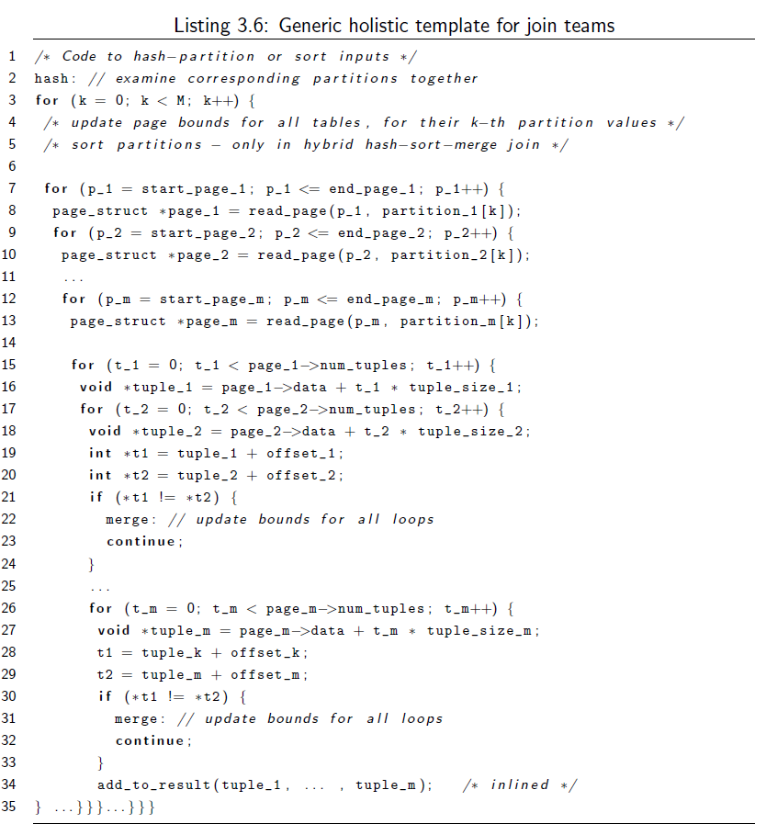
Holistic Query Evaluation, cont.
M=1 for merge join
#2 Holistic Query Instantiation
  Join Teams
    Join operators with
    predicate on same attribute
    Single generated function
  Alternatives
    Holistic nested loop join
    Holistic merge join
    (cooperative staging)
    Holistic partitioned join
    Holistic hybrid hash-
    sort-merge join
for merge join
for merge join

Slide 18
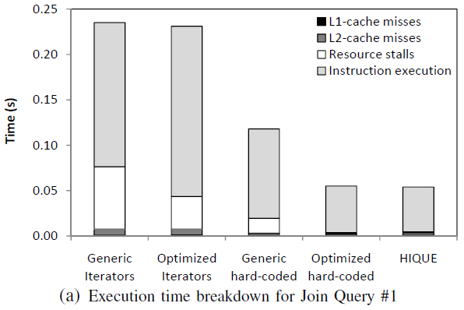
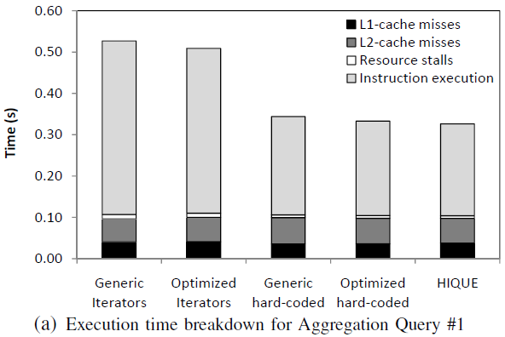
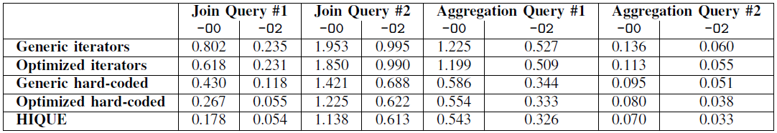
Holistic Query Evaluation, cont.
Runtime
Break-Down
Compiler
Optimizations
26% instructions
37% data access
1% function calls

Slide 19
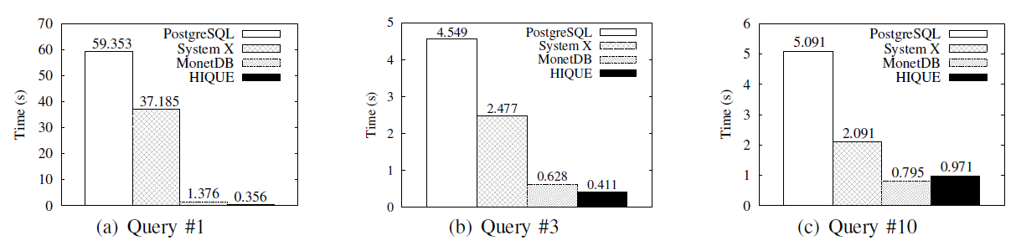
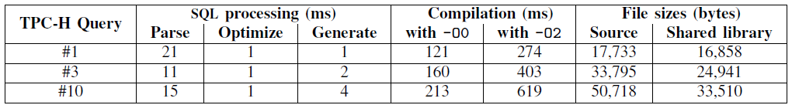
Holistic Query Evaluation, cont.
Comparison
TPC-H
Queries
Code
Generation
Overhead
Compilation time dominates execution time

Slide 20
[Thomas Neumann: Efficiently Compiling Efficient Query Plans for Modern Hardware. PVLDB 2011,
VLDB 2021 Test of Time Award]
Data-centric Query Evaluation
Motivation
  Algebraic operator model useful
  for reasoning, but not necessarily
  a good idea for query processing
  Code compilation overhead
Data-centric Processing (not operator-centric)
  Keep data in CPU registers as long as possible (no op boundaries)
  Data is pushed towards operators (code and data locality)
  Queries are compiled into native machine code using LLVM
⋈
⋈
⋈
U
⋈
U
⋈
T
⋈
T
Materialized Intermediates
R
S
R
S

Slide 21
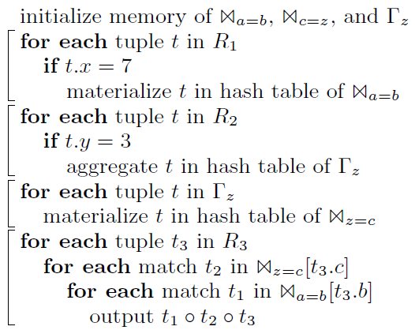
SELECT * FROM R1,R3,
(SELECT R2.z, count(*)
FROM R2 WHERE R2.y = 3
GROUP BY R2.z) R2
WHERE R1.x = 7 AND R1.a = R3.b
AND R2.z = R3.c
Data-centric Query Evaluation, cont.
Example Plan with Pipeline Boundaries
  Pipeline breaker: op takes a tuple out of register
  Full pipeline breaker: blocking op
Compiled Query (not LLVM)
⋈_{a=b}
σ_{x=7}
⋈_{z=c}
R
γ_{COUNT(*);Z}
σ_{y=3}
R2
R3

Slide 22
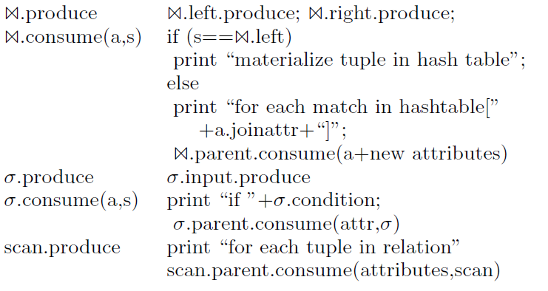
Data-centric Query Evaluation, cont.
Data-Centric Operator Model
  Conceptual data-centric operator model, used during compilation
  #1 produce(): produce result tuples (top-down)
  #2 consume(attributes, source): receive input tuples (bottom-up)
Example
⋈_{a=b}
σ_{x=7}
R

Slide 23
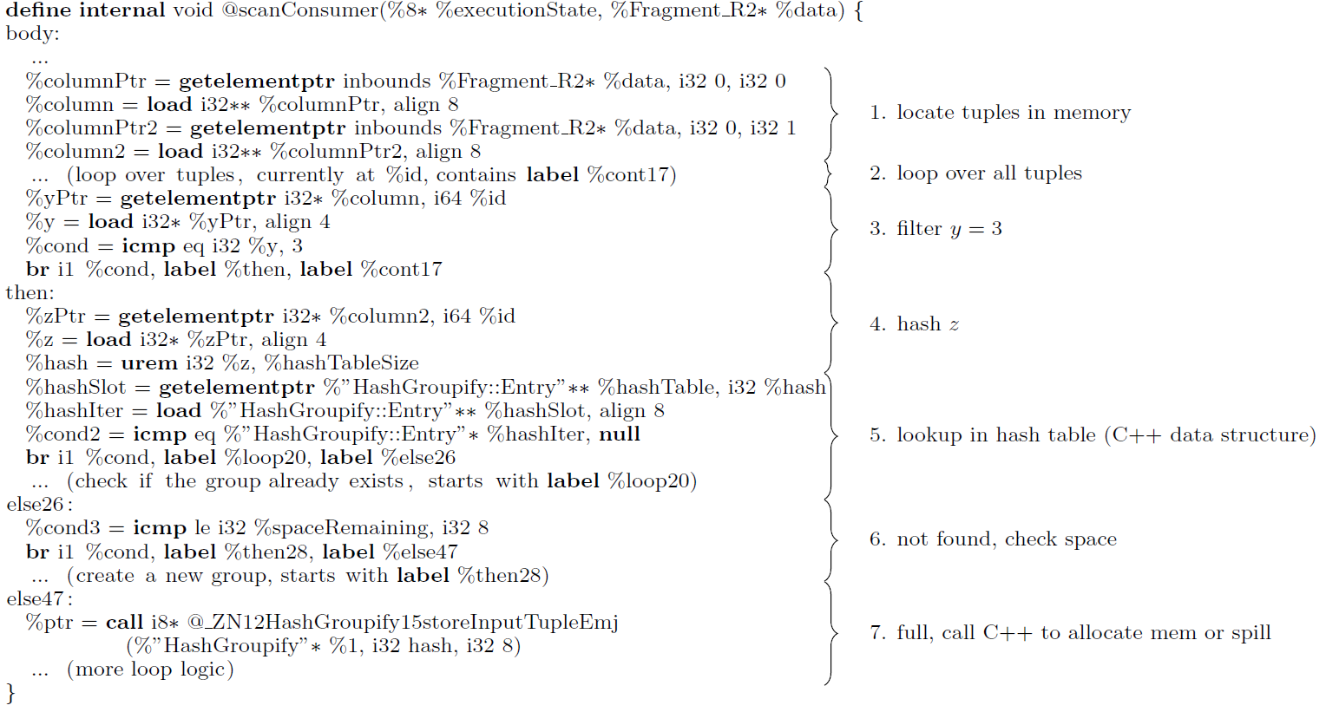
Data-centric Query Evaluation, cont.
Example
LLVM Fragment:
γ_{COUNT(*);Z}(σ_{y=3}(R2))

Slide 24
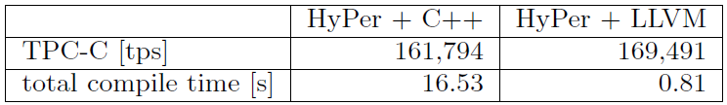
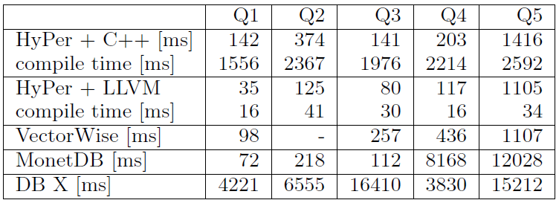
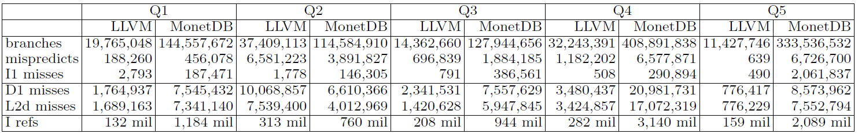
Data-centric Query Evaluation, cont.
Experiments
  TPC-CH (extended
  TPC-C+TPC-H)
Code Quality
  Instruction cache
  misses (L1i)
  Data cache
  misses (L1d, L2d)

Slide 25
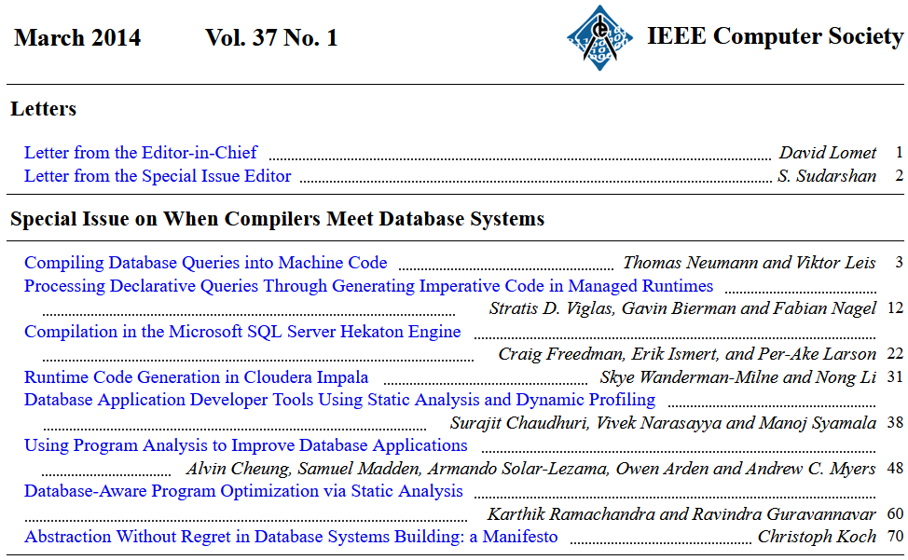
Other Systems w/ Query Compilation
[http://sites.computer.org/debull/A14mar/issue1.htm]
IEEE Data
Engineering
Bulletin
HyPer
HIQUE
Hekaton
Impala
LegoBase/
ScaLite

Slide 26
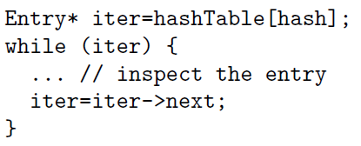
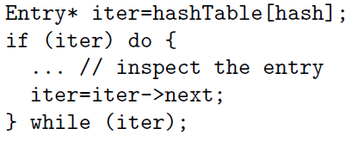
Specialized Code Generation
Improved Branch Prediction
  No-branch:
  pos+=pred(data[i])
  Hash table lookup
SIMD Loop Tiling and Fission
  Loop tiling (vectorization) for SIMD
  Loop fission into parallel and serial ops
existing entry (~ true)
[Thomas Neumann: Efficiently Compiling Efficient Query Plans for Modern Hardware. PVLDB 2011]
end of chain (~ false)
[Andrew Crotty, Alex Galakatos, Kayhan Dursun, Tim Kraska, Carsten Binnig, Ugur Çetintemel, Stan Zdonik: An Architecture for Compiling UDF-centric Workflows. PVLDB 8(12) 2015]

Slide 27
Compilation w/ SIMD, Prefetch, Decompress
Relaxed Operator Fusion (ROF)
  Introduce buffered stage boundary
  for vectorized execution
  SIMD operations after boundary
  (w/ repacking after SIMD ops)
  Prefetching before boundary
Data Blocks
  Hot and cold (compressed) blocks
  SIMD predicated evaluation on blocks,
  output unpacking into vectors of 8192 tuples
  Vector tuples fed into
  JIT-compiled pipelines
[Prashanth Menon, Andrew Pavlo, Todd C. Mowry: Relaxed Operator Fusion for In-Memory Databases: Making Compilation, Vectorization, and Prefetching Work Together At Last. PVLDB 11(1) 2017]
[Harald Lang el al: Data Blocks: Hybrid OLTP and OLAP on Compressed Storage using both Vectorization and Compilation. SIGMOD 2016]
Notes:
SARGable: Search ARGument able – use in index lookup

Slide 28
[Timo Kersten et al.: Everything You Always Wanted to Know About Compiled and Vectorized Queries But Were Afraid to Ask. PVLDB 11(13) 2018]
Compilation vs Vectorized Execution
Motivation
  SotA: compilation or vectorization
  Typer: Test data-centric query eval (HyPer)
  Tectorwise: Test vectorized eval (VectorWise)
Selected Results
  Neither system clearly dominated
  Both with large differences to others
Notes:
Typer: fewer instructions due to tuples in registers (no load and store)
Tectorwise: better at hiding cache miss latency (hash probes in tight loop -> out of order execution)

Slide 29
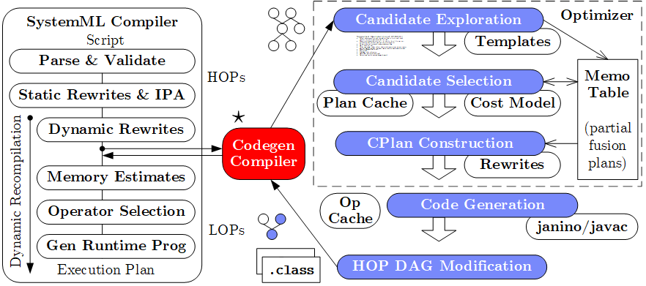
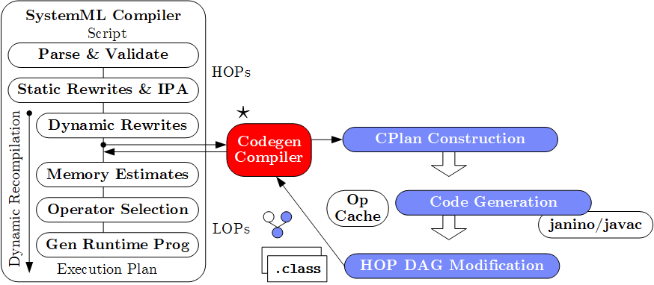
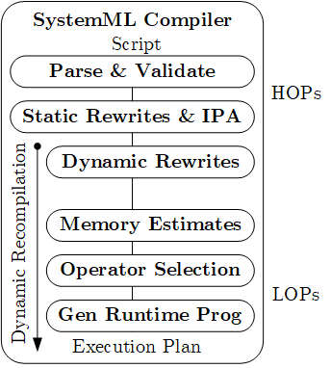



Excursus: SystemDS Codegen
[CIDR’17, PVLDB’18]
Practical, exact, cost-based optimizer
[CIDR’17] (w/ fuse-all heuristic)
Lacked maintainability
Poor plans for complex DAGs
and local/distributed operations
Templates:
Cell, Row, MAgg, Outer
w/ different data bindings
CPlan representation and codegen similar in TF XLA (HLO primitives, pre-clustering of nodes, caching, LLVM codegen)

Slide 30
Excursus: SystemDS Codegen – Example L2SVM (Cell/MAgg)
L2SVM Inner Loop
# of Vector Intermediates
  Base (w/o fused ops): 10
  Fused (w/ fused ops): 4
1: while(continueOuter & iter < maxi) {
2 #...
3: while(continueInner) {
4: out = 1-Y* (Xw+step_sz*Xd);
5: sv = (out > 0);
6: out = out * sv;
7: g = wd + step_sz*dd
- sum(out * Y * Xd);
8: h = dd + sum(Xd * sv * Xd);
9: step_sz = step_sz - g/h;
10: }} ...

Slide 31
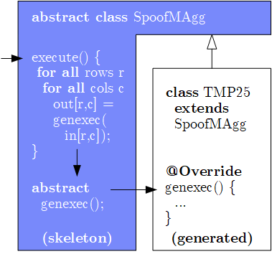
Excursus: SystemDS Codegen – Example L2SVM, cont. (Cell/MAgg)
public final class TMP25 extends SpoofMAgg {
public TMP25() {
super(false, AggOp.SUM, AggOp.SUM);
}
protected void genexec(double a, SideInput[] b,
double[] scalars, double[] c, ...) {
double TMP11 = getValue(b[0], rowIndex);
double TMP12 = getValue(b[1], rowIndex);
double TMP13 = a * scalars[0];
double TMP14 = TMP12 + TMP13;
double TMP15 = TMP11 * TMP14;
double TMP16 = 1 - TMP15;
double TMP17 = (TMP16 > 0) ? 1 : 0;
double TMP18 = a * TMP17;
double TMP19 = TMP18 * a;
double TMP20 = TMP16 * TMP17;
double TMP21 = TMP20 * TMP11;
double TMP22 = TMP21 * a;
c[0] += TMP19;
c[1] += TMP22;
} }
Template Skeleton
  Data access (dense,
  sparse, compressed)
  Cache blocking
  Multi-threading
  Final aggregation
# of Vector Intermediates
  Gen (codegen ops): 0

Slide 32
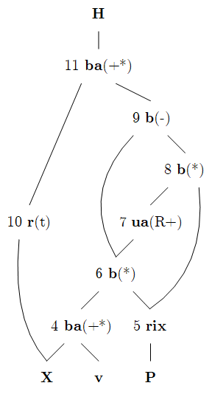
Excursus: SystemDS Codegen – Example MLogreg (Row)
MLogreg Inner Loop (main expr on feature matrix X)
1: Q = P[, 1:k] * (X %*% v)
2: H = t(X) %*% (Q - P[, 1:k] * rowSums(Q))
public final class TMP25 extends SpoofRow {
public TMP25() {
super(RowType.COL_AGG_B1_T, true, 5);
}
protected void genexecDense(double[] a, int ai,
SideInput[] b, double[] c,..., int len) {
double[] TMP11 = getVector(b[1].vals(rix),...);
double[] TMP12 = vectMatMult(a, b[0].vals(rix),...);
double[] TMP13 = vectMult(TMP11, TMP12, 0, 0,...);
double TMP14 = vectSum(TMP13, 0, TMP13.length);
double[] TMP15 = vectMult(TMP11, TMP14, 0,...);
double[] TMP16 = vectMinus(TMP13, TMP15, 0, 0,...);
vectOuterMultAdd(a, TMP16, c, ai, 0, 0,...); }
protected void genexecSparse(double[] avals, int[] aix,
int ai, SideInput[] b, ..., int len) {...}
}
“vectorized
row ops”

Slide 33
Query Parallelization
Intra- and Inter-Operator Parallelism
Fine-grained Pipeline Parallelism
Workload Management / Inter-Query Parallelism

Slide 34
Overview Query Parallelism
Types of
Parallelism
Beware: Danger of Interference
  #1 Locks and latches on hot data items → increasing TX aborts
  #2 Temporary memory/IO requirements (see buffer pool management)
  #3 CPU and cache interference (e.g., context switches)
  #4 Throughput vs latency vs freshness vs fairness vs priorities
  ➔ Dedicated DB workload management & DB schedulers
Inter-Query
Inter-Operator
Intra-Operator
Queries
and TXs
Bushy Plans
Pipelining
Data Partitions
MT Ops, SIMD
Multi-threaded / Distributed

Slide 35
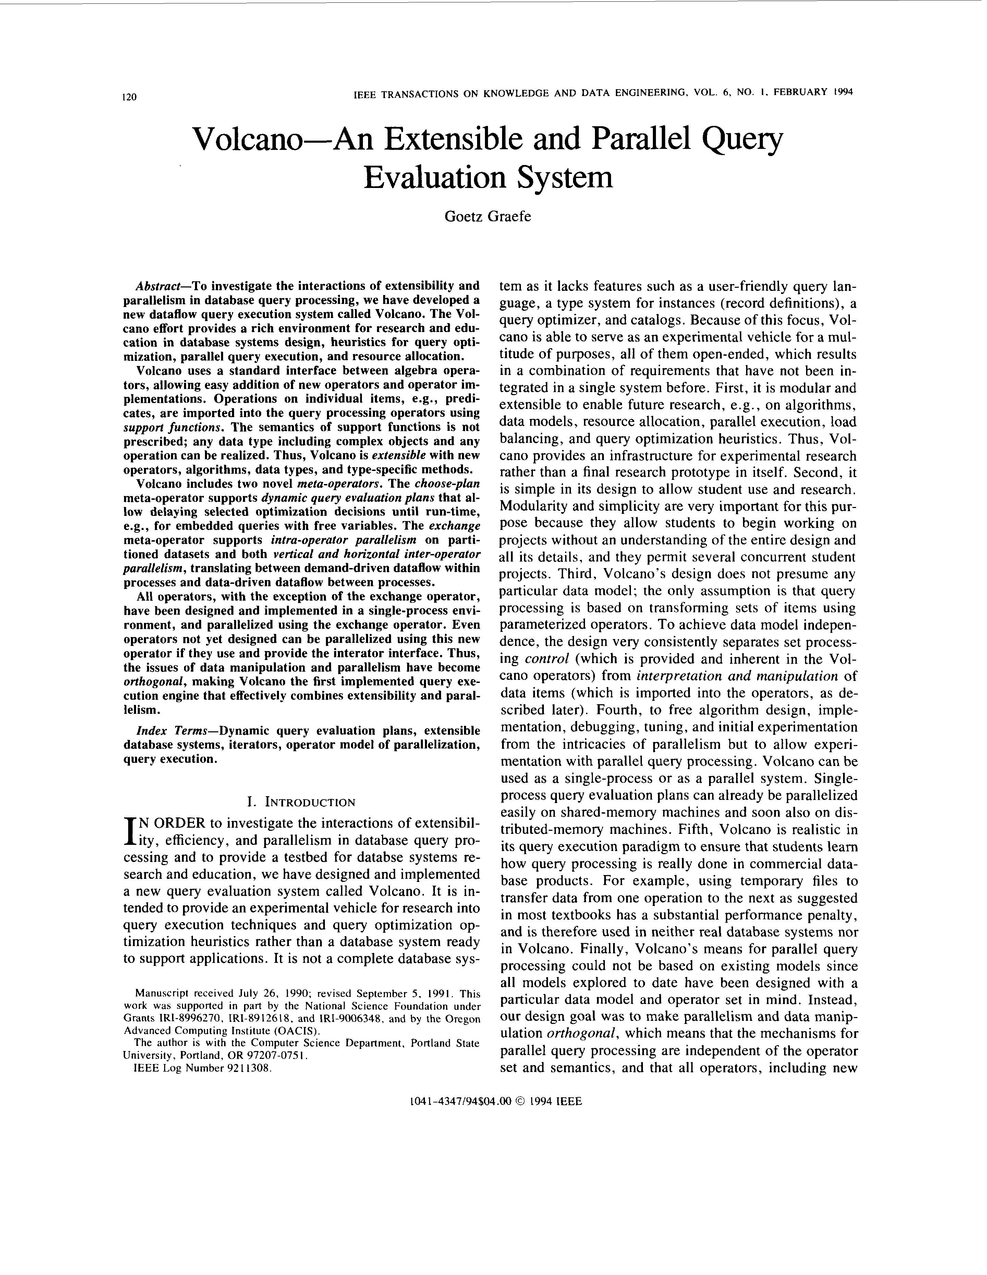
[Goetz Graefe: Volcano - An Extensible and Parallel Query Evaluation System. IEEE Trans. Knowl. Data Eng. 1994]
Recap: Iterator Model Overview
Scalable (small memory)
High CPI measures
Volcano Iterator Model
  Open-Next-Close (ONC) interface
  Query execution from root node (pull-based) → Pipelined
Example
σ_{A=7}(R)
Blocking Operators
  Sorting, grouping/aggregation, build-phase of (simple) hash joins
void open() { R.open(); }
void close() { R.close(); }
Record next() {
while( (r = R.next()) != EOF )
if( p(r) ) //A==7
return r;
return EOF;
}
open()
next()
next()
→ EOF
close()
open()
σ_{A=7}
next()
next()
→ EOF
close()
open()
R
next()
next()
next()
next()
→ EOF
close()
PostgreSQL: Init(),
GetNext(), ReScan(), MarkPos(), RestorePos(), End()

Slide 36
[Goetz Graefe: Encapsulation of Parallelism in the Volcano Query Processing System. SIGMOD 1990]
Intra- and Inter-Operator Parallelism
Overview
  Seamless parallelization in iterator model via dedicated exchange operator
  Avoid unnecessary overhead for local subplans
Inter-Operator Parallelism
  Vertical parallelism in terms of pipelining
  Open: create new process
  Next: transfer packets of records
  (1 .. 32,000)
  Close: shutdown child processes
γ_{B,count(*)}
σ(R)
⋈
γ
XCHG
σ(R)
⋈
γ
⋈
σ(R)
⋈
γ
XCHG
XCHG
σ_{A=7}
S
R

Slide 37

[Goetz Graefe: Encapsulation of Parallelism in the Volcano Query Processing System. SIGMOD 1990]
Intra- and Inter-Operator Parallelism, cont.
Intra-Operator Parallelism
  Horizontal parallelism on data partitions
  Partitioning of inputs and intermediates
  (“support functions” and multiple queues)
  Process creation via propagation tree (fork tree)
  Partitioning: round-robin/range/hash
Example Hash Partitioning:
  For all k $∈$ R / k $∈$ S
  pid = hash(k) % n
XCHG
⋈
⋈
XCHG
XCHG
σ_{A=7}
S
R

Slide 38
Excursus: MapReduce – Execution Model
#1 Data Locality (delay sched., write affinity)
#2 Reduced shuffle (combine)
#3 Fault tolerance (replication, attempts)
Input CSV files (stored in HDFS)
Map-Phase
map
task
[Reduce-Phase]
Output Files (HDFS)
CSV File 1
Split 11
map
task
Split 12
reduce
task
Out 1
Split 21
map
task
CSV File 2
reduce
task
Out 2
Split 22
map
task
reduce
task
Out 3
CSV File 3
Split 31
map
task
Split 32
map
task
Shuffle, Merge, [Combine]
Sort, [Combine], [Compress]
w/ #reducers = 3

Slide 39
[Viktor Leis, Peter A. Boncz, Alfons Kemper, Thomas Neumann: Morsel-driven parallelism: a NUMA-aware query evaluation framework for the many-core age. SIGMOD 2014]
Fine-grained Parallelism
Motivation
  Non-uniform memory architecture (NUMA)
  Load imbalance / serial fraction due to plan-driven parallelism
Scheduler (dispatcher)
  Fixed number of workers to
  avoid over-provisioning
  Morsel: segment of tuples (e.g., 100K)
  Task: operator pipeline on morsel
  Task distribution at runtime w/
  static partitioning + work stealing
  NUMA data locality
Hybrid Interpreted/compiled
  Exchange plans at morsel granularity
[André Kohn, Viktor Leis, Thomas Neumann: Adaptive Execution of Compiled Queries. ICDE 2018]
Notes:
Note: non-partitioned hash join, + lazy page allocation of HT -> pseudo-randomly interleaved

Slide 40
[Kayhan Dursun, Carsten Binnig, Ugur Çetintemel, Garret Swart, Weiwei Gong: A Morsel-Driven Query Execution Engine for Heterogeneous Multi-Cores. PVLDB 12(12) 2019]
Fine-grained Parallelism, cont.
Motivation, cont.
  Dark silicon due to
  power and thermal constraints
  Sparc M7 platform w/ on-die ASIC,
  Data Analytics Accelerator (DAX)
Extensions
  Pipeline decomposition
  for function-specific cores
  Cost-based work
  submission to accelerator
  DAX: scan&filter, select, semi-join
Similar Abstractions for CPU/GPU balancing

Slide 41
Excursus: DAPHNE Vectorized/Tiled Execution
Example
  Data placement on CPUs, GPUs, FPGAs
  Fused pipeline for scale() and lmDS()

Slide 42
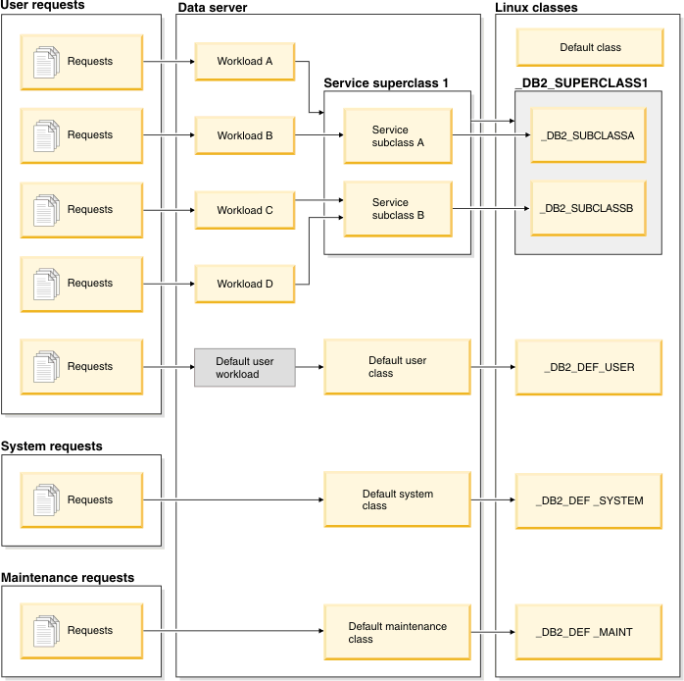
Workload Management
Example: DB2 Workload Management
  Concurrency thresholds
  for incoming requests
  Stop/continue/remap on
  violated thresholds
  Map DB2 service classes
  to Linux classes
  Linux cgroups (control groups)
  for resource isolation
[https://www.ibm.com/support/knowledgecenter/SSEPGG_11.5.0/com.ibm.db2.luw.admin.wlm.doc/doc/c0053451.html]
[https://www.ibm.com/support/knowledgecenter/SSEPGG_11.5.0/com.ibm.db2.luw.admin.wlm.doc/doc/c0053465.html]
Notes:
User vs system and maintenance requests

Slide 43
[Robert Kallman et al.: H-store: a high-performance, distributed main memory trans-action processing system. PVLDB 1(2) 2008]
Workload Management, cont.
[Michael Stonebraker, Samuel Madden, Daniel J. Abadi, Stavros Harizopoulos, Nabil Hachem, Pat Helland: The End of an Architectural Era (It's Time for a Complete Rewrite). VLDB 2007]
Example H-Store → VoltDB
  Cluster of single-threaded
  storage and execution engines
  No disk-based logging or locking

Slide 44

Workload Management – Prioritization
SAP HANA
  Main column store and delta CSB tree
  Thread pool for network clients
  Scheduler for heavy-weight requests
  (single- or multi-task intra-query parallelism)
UDFs via
  OpenMP (since 1997,
  Open Multi-Processing)
  DOALL parallel loops
  (independent iterations)
  SAP HANA: custom OpenMP
  backend for intercepting tasks
  → DB job scheduler (w/ priorities)
[Iraklis Psaroudakis, Florian Wolf, Norman May, Thomas Neumann, Alexander Böhm, Anastasia Ailamaki, Kai-Uwe Sattler: Scaling Up Mixed Workloads: A Battle of Data Freshness, Flexibility, and Scheduling. TPCTC 2014]
“[…] the default configuration of SAP HANA favors analytical throughput over transactional throughput”
#pragma omp parallel for reduction(+: nnz)
for (int i = 0; i < N; i++) {
int threadID = omp_get_thread_num();
R[i] = foo(A[i], threadID);
nnz += (R[i]!=0) ? 1 : 0;
}
[Florian Wolf, Iraklis Psaroudakis, Norman May, Anastasia Ailamaki, Kai-Uwe Sattler: Extending database task schedulers for multi-threaded application code. SSDBM 2015]

Slide 45
Summary & QA
Thanks
Vectorization and SIMD
Query Compilation
Query Parallelization
Next Lectures
  04 Background Query Optimization [May 26, Christina]
  05 Experiments and Reproducibility [Jun 09]
  Project Submissions [Jul 08 EOD]
  Project Presentations all Teams [Jul 14]

