Slide 1

Programmierpraktikum: Datensysteme
04 Background Query Optimization
Prof. Dr. Matthias Boehm, Christina Dionysio
Technische Universität Berlin
Berlin Institute for the Foundations of Learning and Data
Big Data Engineering (DAMS Lab)
Last update: May 24, 2025

Slide 2

Announcements / Org
#1 Hybrid & Video Recording
  Hybrid lectures (in-person, zoom) with optional attendance
  https://tu-berlin.zoom.us/j/9529634787?pwd=R1ZsN1M3SC9BOU1OcFdmem9zT202UT09
  Zoom video recordings, links from website
  https://mboehm7.github.io/teaching/ss25_ppds/index.htm
#2 Next Lecture
  Jun 09 → Jun 16, 4pm in B-106 (due to SIGMOD conference)
  In-person, livestream, video recording

Slide 3
Recap: Overview Query Processing
SELECT * FROM TopScorer
WHERE Count>=4
Name | Count
James Rodríguez | 6
Thomas Müller | 5
Robin van Persie | 4
Neymar | 4
Parsing
AST/IR
Semantic Analysis
IR
Query Rewrites
Plan Execution
Query Rewrites
IR
Plan Optimization
QEP
Plan Caching
Plan Optimization
QEP
Compile Time
Runtime

Slide 4
Agenda
Query Rewriting and Unnesting
Cardinality and Cost Estimation
Join Enumeration / Ordering

Slide 5
Query Rewriting and Unnesting

Slide 6
Query Rewrites
Query Rewriting
  Rewrite query into equivalent form that may be processed more efficiently or give more freedom
  #1 Same query can be expressed differently, avoid hand-tuning
  #2 Complex queries may have redundancy
A Simple Example
  Catalog meta data:
  custkey is unique
20+ years of experience on
query rewriting
SELECT DISTINCT custkey, name
FROM TPCH.Customer
rewrite
SELECT custkey, name
FROM TPCH.Customer
[Hamid Pirahesh, T. Y. Cliff Leung, Waqar Hasan: A Rule Engine for Query Transformation in Starburst and IBM DB2 C/S DBMS. ICDE 1997]

Slide 7
Standardization and Simplification
Normal Forms of Boolean Expressions
  Conjunctive normal form (P₁₁ OR ... OR P_{1n}) AND ... AND (P_{m1} OR ... OR P_{mp})
  Disjunctive normal form (P₁₁ AND ... AND P_{1q}) OR ... OR (P_{r1} AND ... AND P_{rs})
Transformation Rules
for Boolean Expressions
Rule Name | Examples
Commutativity rules | A OR B ⇔ B OR A A AND B ⇔ B AND A
Associativity rules | (A OR B) OR C ⇔ A OR (B OR C) (A AND B) AND C ⇔ A AND (B AND C)
Distributivity rules | A OR (B AND C) ⇔ (A OR B) AND (A OR C) A AND (B OR C) ⇔ (A AND B) OR (A AND C)
De Morgan’s rules | NOT (A AND B) ⇔ NOT (A) OR NOT (B) NOT (A OR B) ⇔ NOT (A) AND NOT (B)
Double-negation rules | NOT(NOT(A)) ⇔ A
Idempotence rules | A OR A ⇔ A A AND A ⇔ A A OR NOT(A) ⇔ TRUE A AND NOT (A) ⇔ FALSE A AND (A OR B) ⇔ A A OR (A AND B) ⇔ A A OR FALSE ⇔ A A OR TRUE ⇔ TRUE A AND FALSE ⇔ FALSE

Slide 8
Standardization and Simplification, cont.
Elimination of Common Subexpressions
  (A₁=a₁₁ OR A₁=a₁₂) AND (A₁=a₁₂ OR A₁=a₁₁) → A₁=a₁₁ OR A₁=a₁₂
Propagation of Constants
  A ≥ B AND B = 7 → A ≥ 7 AND B = 7
Detection of Contradictions
  A ≥ B AND B > C AND C ≥ A → A > A → FALSE
Use of Constraints
  A is primary key/unique: π_{A} → no duplicate elimination necessary
  MAR_STATUS=‘married’ → TAX_CLASS≥3: (MAR_STATUS=‘married’ AND TAX_CLASS=1) → FALSE
Elimination of Redundancy (set semantics)
  R⋈R → R, R∪R → R, R−R → Ø
  R⋈(σ_{p}R) → σ_{p}R, R∪(σ_{p}R) → R, R−(σ_{p}R) → σ_{⌐p}R
  (σ_{p1}R)⋈(σ_{p2}R) → σ_{p1ᴧp2}R, (σ_{p1}R)∪(σ_{p2}R) → σ_{p1vp2}R
R⋈_{a=b}(σ_{b>0}(S)) →
(σ_{a>0}(R))⋈_{a=b}(σ_{b>0}(S))
Notes:
Additional redundancy example: (σ_{p1}R)−(σ_{p2}R) → σ_{p1ᴧ⌐p2}R

Slide 9
[Won Kim: On Optimizing an
SQL-like Nested Query. ACM
Trans. Database Syst. 1982]
Query Unnesting
Case 1: Type-A Nesting
  Inner block is not
  correlated and
  computes an aggregate
  Solution: Compute the aggregate
  once and insert into outer query
Case 2: Type-N Nesting
  Inner block is not correlated
  and returns a set of tuples
  Solution: Transform into
  a symmetric form (via join)
SELECT OrderNo FROM Order
WHERE ProdNo =
(SELECT MAX(ProdNo)
FROM Product WHERE Price<100)
$X = SELECT MAX(ProdNo)
FROM Product WHERE Price<100
SELECT OrderNo FROM Order
WHERE ProdNo = $X
SELECT OrderNo FROM Order
WHERE ProdNo IN
(SELECT ProdNo
FROM Product WHERE Price<100)
SELECT OrderNo
FROM Order O, Product P
WHERE O.ProdNo = P.ProdNo
AND P.Price < 100

Slide 10
[Won Kim: On Optimizing an
SQL-like Nested Query. ACM
Trans. Database Syst. 1982]
Query Unnesting, cont.
Case 3: Type-J Nesting
  Un-nesting of correlated
  sub-queries w/o aggregation
Case 4: Type-JA Nesting
  Un-nesting of correlated
  sub-queries w/ aggregation
  Further un-nesting
  via case 3 and 2
SELECT OrderNo FROM Order O
WHERE ProdNo IN
(SELECT ProdNo FROM Project P
WHERE P.ProjNo = O.OrderNo
AND P.Budget > 100,000)
SELECT OrderNo
FROM Order O, Project P
WHERE O.ProdNo = P.ProdNo
AND P.ProjNo = O.OrderNo
AND P.Budget > 100,000
SELECT OrderNo FROM Order O
WHERE ProdNo IN
(SELECT MAX(ProdNo)
FROM Project P
WHERE P.ProjNo = O.OrderNo
AND P.Budget > 100,000)
SELECT OrderNo FROM Order O
WHERE ProdNo IN
(SELECT ProdNo FROM
(SELECT ProjNo, MAX(ProdNo)
FROM Project
WHERE Budget > 100.000
GROUP BY ProjNo) P
WHERE P.ProjNo = O.OrderNo)
Notes:
Note JA: max ProdNo only #distinct ProjNo solutions
Note Unnesting Arbitrary Queries Neumann (via cross-product, #distinct)

Slide 11
Unnesting Arbitrary Queries
Overview
  General transformation for elimination of dependent joins
  Guaranteed lower or equal cost / reuse of subsequent rewrites
#1 Simple Unnesting
  Move dependent predicates up as far as possible
  Transforms dependent into regular join if adjacent
#2 General Unnesting
  Translate dependent join into
  regular and deduplicated dependent join
  Push down dependent join, turn dependent join over base relation into regular join
  Specific optimizations (e.g., sideways information passing), other rewrites
[Thomas Neumann, Alfons Kemper: Unnesting Arbitrary Queries. BTW 2015]
Notes:
Note dependent join: execute right hand side once for every left tuple

Slide 12
Selections and Projections
1) Grouping of Selections
2) Grouping of Projections
3) Pushdown of Selections
4) Pushdown of Projections
Example
Transformation
Rules
Restructuring Algorithm
  #1 Split n-ary joins into binary joins
  #2 Split multi-term selections
  #3 Push-down selections as far as possible
  #4 Group adjacent selections again
  #5 Push-down projections as far as possible
σ_{x>y}
π_{A}
σ_{p(R)}
⋈_{A=B}
π_{C}
π_{C}
σ_{x>yᴧp=q}
π_{A}
σ_{p=q}
π_{A,B}
⋈_{A=B}
σ_{p(R)}
S
⋈_{A=B}
⋈_{A=B}
R
R
R
R
R
S
R
R
S
π_{A,C}
π_{B}
R
S
Input: Standardized, simplified, and un-nested query graph
Output: Restructured
query graph

Slide 13
Example Query Restructuring
τ_{count} _{DESC}
SELECT Name, count
FROM TopScorer
WHERE count>=4
AND Pos=‘FW’
σ_{count>=4}
π_{Name,count}
σ_{count>=4ᴧPos=FW}
γ_{Name,count(*)}
CREATE VIEW TopScorer AS
SELECT P.Name, P.Pos, count(*)
FROM Players P, Goals G
WHERE P.Pid=G.Pid
AND G.GOwn=FALSE
GROUP BY P.Name, P.Pos
ORDER BY count(*) DESC
τ_{count} _{DESC}
π_{Name}
γ_{Name,Pos,count(*)}
⋈_{Pid}
σ_{Gown=F}
π_{Pid,Name}
π_{Pid}
⋈_{Pid}
σ_{Pos=FW}
σ_{Gown=F}
Additional metadata: P.Name is unique
Players
Goals
π_{Pid,Name,Pos}
π_{Pid,Gown}
Players
Goals

Slide 14
Cardinality and Cost Estimation

Slide 15


[Guido Moerkotte, Building Query Compilers (Under Construction), 2020,
http://pi3.informatik.uni-mannheim.de/
~moer/querycompiler.pdf]
Overview Cost Models
Overall Cost Models
  I/O costs (number of read pages, tuples)
  Computation costs (CPU costs, tuples)
  Others: Memory, Energy
  Aggregate operator costs (specific vs general) w/ awareness of parallelism
Cost Model Inputs
  Base relations: number of pages, number of tuples, avg tuple length
  Intermediates: number of tuples → Cardinality estimation
Common Assumptions
  No Skew: uniform value distributions of attributes
  Independence: no correlation among attributes
  ➔ underestimation ➔ poor plans
$$C=C_{I/O}+C_{CPU}$$
$$C=\max{(C_{I/O},C_{CPU})}$$
(estimated)
(real)
10
590
σ_{Model= ‘Golf‘}
1,000
5,000
σ_{Make=‘VW‘}
Cars
10,000
10,000
Notes:
Note: nested-loop joins in bushy trees require materialization or multiplication of subtree-costs for inner

Slide 16

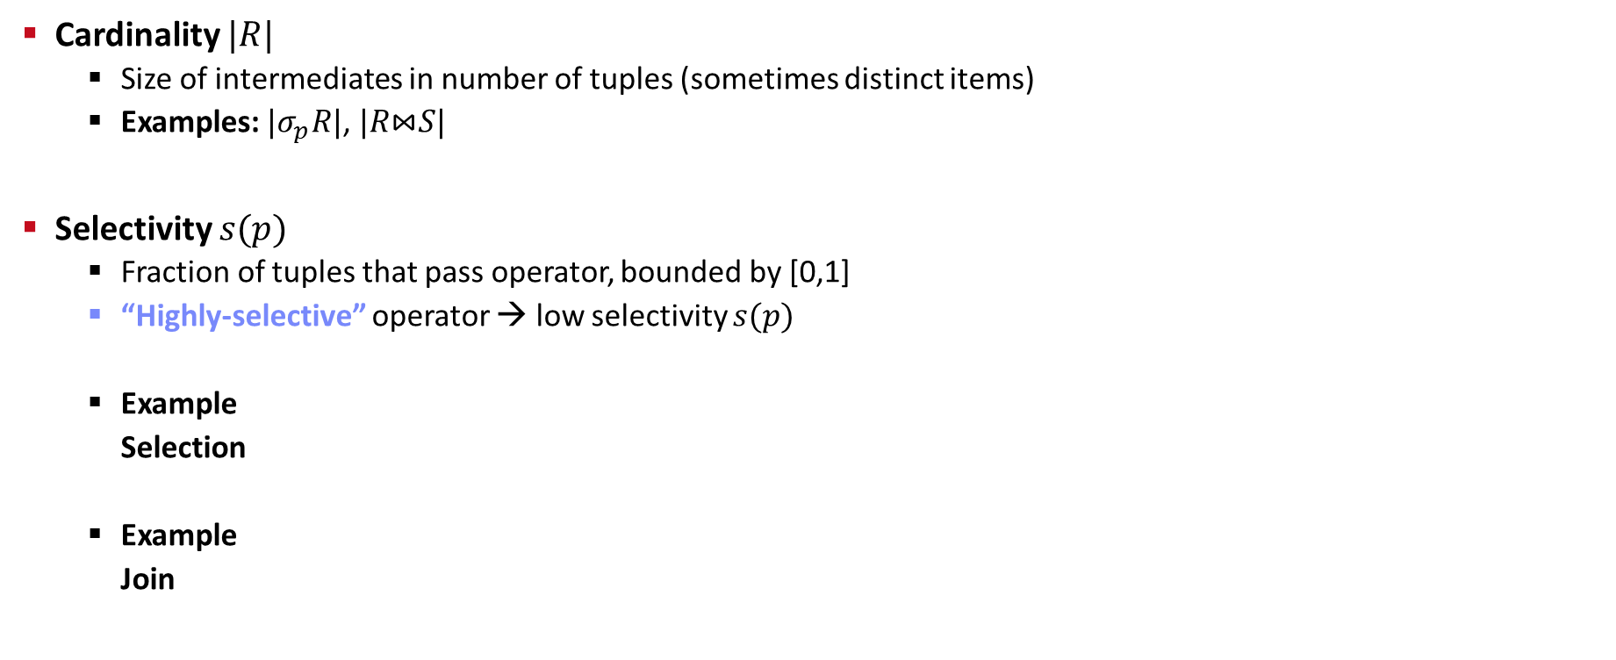

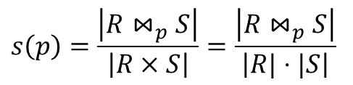

[Guido Moerkotte, Building Query Compilers, 2020]
Cardinality and Selectivity
Cardinality $|R|$
  Size of intermediates in number of tuples (sometimes distinct items)
  Examples: $|σ_{p}R|$, $|R\text{⋈}S|$
Selectivity $s(p)$
  Fraction of tuples that pass operator, bounded by [0,1]
  “Highly-selective” operator → low selectivity $s(p)$
  Example
  Selection
  Example
  Join
$$s(p)=\frac{|σ_{p}R|}{|R|}$$
$$\left|σ_{p}R\right|=s\left(p\right)⋅|R|$$
$$s\left(p\right)=\frac{\left|R{\text{⋈}}_{p}S\right|}{\left|R×S\right|}=\frac{\left|R{\text{⋈}}_{p}S\right|}{\left|R|⋅|S\right|}$$
$$\left|R{\text{⋈}}_{p}S\right|= s\left(p\right)⋅\left|R\right|⋅|S|$$

Slide 17
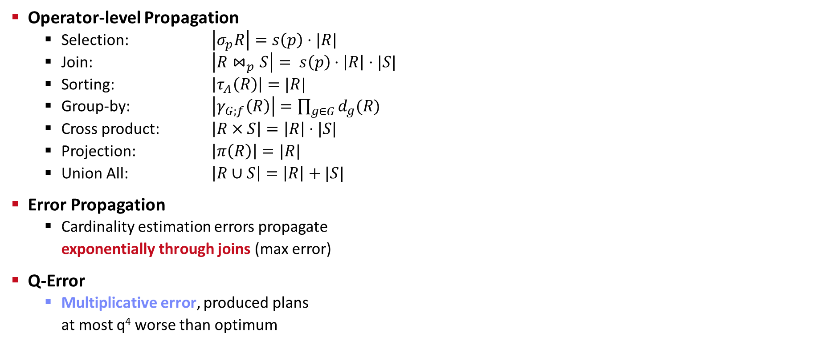
[Guido Moerkotte, Building Query Compilers, 2020]
Cardinality Propagation
Operator-level Propagation
  Selection: $\left|σ_{p}R\right|=s\left(p\right)⋅|R|$
  Join: $\left|R{\text{⋈}}_{p}S\right|= s\left(p\right)⋅\left|R\right|⋅|S|$
  Sorting: $\left|τ_{A}\left(R\right)\right|=|R|$
  Group-by: $\left|γ_{G;f}\left(R\right)\right|=\prod_{g∈G}{d_{g}(R)}$
  Cross product: $\left|R×S\right|=\left|R\right|⋅|S|$
  Projection: $\left|π\left(R\right)\right|=|R|$
  Union All: $\left|R∪S\right|=\left|R\right|+|S|$
Error Propagation
  Cardinality estimation errors propagate
  exponentially through joins (max error)
Q-Error
  Multiplicative error, produced plans
  at most q⁴ worse than optimum
Recursive propagation over query tree
[Yannis E. Ioannidis, Stavros Christodoulakis: On the Propagation of Errors in the Size of Join Results. SIGMOD 1991]
[Guido Moerkotte, Thomas Neumann, Gabriele Steidl: Preventing Bad Plans by Bounding the Impact of Cardinality Estimation Errors. PVLDB 2(1) 2009]
Notes:
Note: q^2 estimation error (e.g., negative for selected, positive for optimal) -> q^4

Slide 18
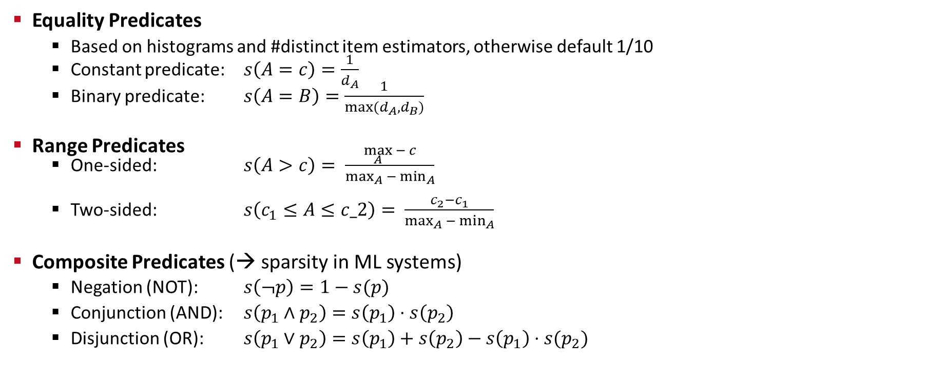
[Patricia G. Selinger et al.: Access Path Selection in a Relational Database Management System. SIGMOD 1979]
Cardinality Propagation, cont.
Equality Predicates
  Based on histograms and #distinct item estimators, otherwise default 1/10
  Constant predicate: $s\left(A=c\right)=\frac{1}{d_{A}}$
  Binary predicate: $s\left(A=B\right)=\frac{1}{max⁡(d_{A}, d_{B})}$
Range Predicates
  One-sided: $s\left(A>c\right)= \frac{\max_{A}{− c}}{{\max_{}}_{A}{− {\min_{}}_{A}}}$
  Two-sided: $s\left(c_{1}≤A≤c_2\right)= \frac{c_{2}−c_{1}}{{\max_{}}_{A}{− {\min_{}}_{A}}}$
Composite Predicates (→ sparsity in ML systems)
  Negation (NOT): $s\left(¬p\right)=1−s(p)$
  Conjunction (AND): $s\left(p_{1}∧p_{2}\right)=s\left(p_{1}\right)⋅s\left(p_{2}\right)$
  Disjunction (OR): $s\left(p_{1}∨p_{2}\right)=s\left(p_{1}\right)+s\left(p_{2}\right)−s\left(p_{1}\right)⋅s(p_{2})$
//assumes uniformity
//assumes matching domains
//assumes independence

Slide 19
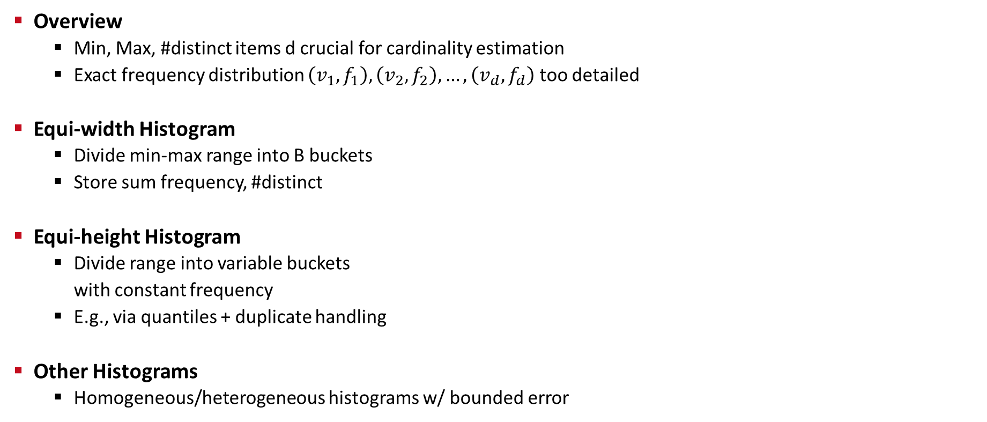
[Guido Moerkotte, Building Query Compilers, 2020]
Cardinality Estimation
Overview
  Min, Max, #distinct items d crucial for cardinality estimation
  Exact frequency distribution $\left(v_{1},f_{1}\right),\left(v_{2},f_{2}\right),…,\left(v_{d},f_{d}\right)$ too detailed
Equi-width Histogram
  Divide min-max range into B buckets
  Store sum frequency, #distinct
Equi-height Histogram
  Divide range into variable buckets
  with constant frequency
  E.g., via quantiles + duplicate handling
Other Histograms
  Homogeneous/heterogeneous histograms w/ bounded error
143
(5)
125
(3)
71
(4)
9 (2)
0
5
10
15
20
87
(5)
87
(3)
87
(3)
87
(3)
0
6
9
12
20
[Carl-Christian Kanne, Guido Moer-kotte: Histograms reloaded: the merits of bucket diversity. SIGMOD 2010]

Slide 20
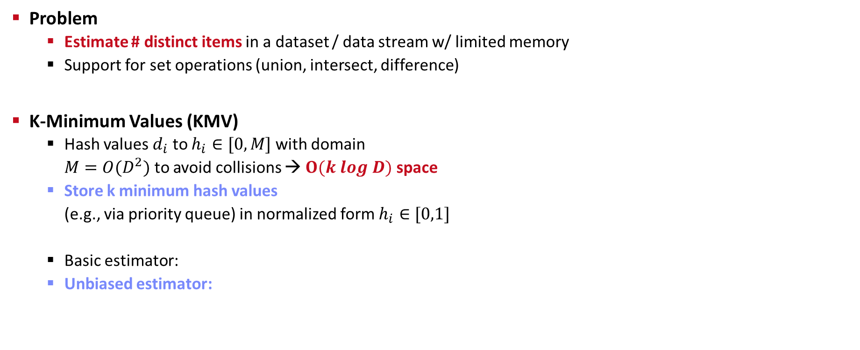


Number of Distinct Items
Problem
  Estimate # distinct items in a dataset / data stream w/ limited memory
  Support for set operations (union, intersect, difference)
K-Minimum Values (KMV)
  Hash values $d_{i}$ to $h_{i}∈[0,M]$ with domain
  $M=O(D^{2})$ to avoid collisions → $O(k log D)$ space
  Store k minimum hash values
  (e.g., via priority queue) in normalized form $h_{i}∈[0,1]$
  Basic estimator:
  Unbiased estimator:
Duplicates yield same hash!
0
1
U_{(k=4)}=0.24
$${\hat{D}}_{k}^{BE}=k/U_{(k)}$$
Example:
16.67 vs 12.5
$${\hat{D}}_{k}^{UB}=(k−1)/U_{(k)}$$
[Kevin S. Beyer, Peter J. Haas, Berthold Reinwald, Yannis Sismanis, Rainer Gemulla: On synopses for distinct-value estimation under multiset operations. SIGMOD 2007]
Notes:
Note: birthday problem argument -> collisions avoided if M much larger than D, so D^2

Slide 21

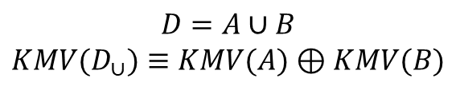
Number of Distinct Items, cont.
KMV Set Operations
  Union/intersection directly on partition synopses
  Difference via Augmented KMV
  (AKMV) that include counters of
  multiplicities of k-minimum values
HyperLogLog
  Hash values and maintain maximum
  # of leading zeros p → $\hat{D}=2^{p}$
  Stochastic averaging over M streams
  (p maintained in M registers)
  HyperLogLog++
  Updatable HyperLogLog, with
  sampling for multi-column estimates
0
1
$$D=A∪B$$
$$KMV(D_{∪})≡KMV(A)⊕KMV(B)$$
[P. Flajolet, Éric Fusy, O. Gandouet, and F. Meunier: Hyperloglog: The analysis of a near-optimal cardinality estimation algorithm. AOFA 2007]
[Stefan Heule, Marc Nunkesser, Alexander Hall: HyperLogLog in practice: algorithmic engineering of a state of the art cardinality estimation algorithm. EDBT 2013]
[Michael J. Freitag, Thomas Neumann: Every Row Counts: Combining Sketches and Sampling for Accurate Group-By Result Estimates. CIDR 2019]
Notes:
Note: HyperLogLog extension of LogLog algorithm (2003) and Flajolet–Martin algorithm (1985)

Slide 22
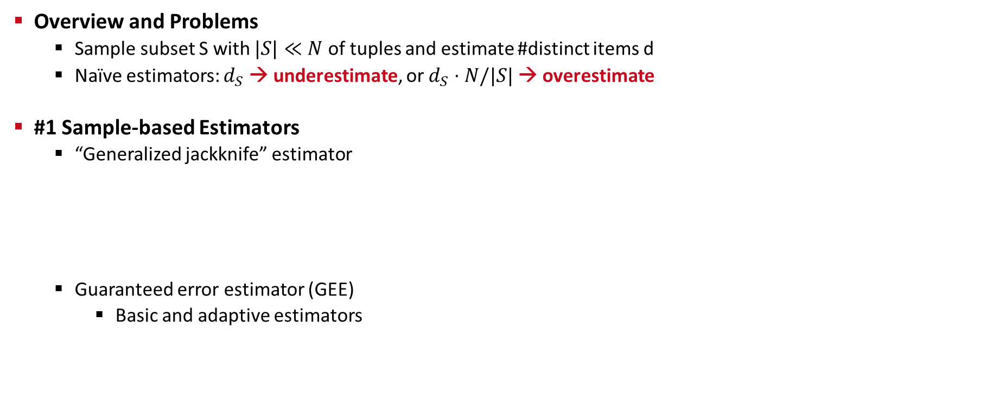


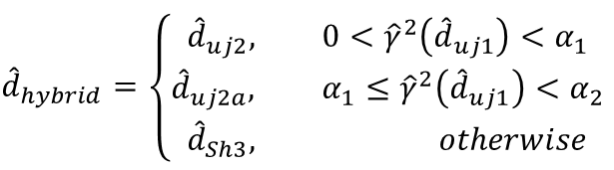
Sample-based Cardinality Estimation
Overview and Problems
  Sample subset S with $|S|≪N$ of tuples and estimate #distinct items d
  Naïve estimators: $d_{S}$ → underestimate, or $d_{S}⋅N/|S|$ → overestimate
#1 Sample-based Estimators
  “Generalized jackknife” estimator
  Guaranteed error estimator (GEE)
    Basic and adaptive estimators
squared coefficient
of variation
simple estimator
[P. J. Haas and L. Stokes: Estimating the Number of Classes in a Finite Population, J. Amer. Statist. Assoc., 93(444), 1998]
$${\hat{d}}_{hybrid}=\left\{\begin{aligned}{\hat{d}}_{uj2}, 0<{\hat{γ}}^{2}\left({\hat{d}}_{uj1}\right)<α_{1} \\ &{\hat{d}}_{uj2a}, α_{1}≤{\hat{γ}}^{2}\left({\hat{d}}_{uj1}\right)<α_{2} \\ {\hat{d}}_{Sh3}, otherwise\end{aligned}\right.$$
$$\hat{d}=d_{S}+K⋅f_{1}/N$$
$$\hat{d}=\sqrt{\frac{N}{|S|}}f_{1}+\sum_{i=2}^{|S|}{f_{i}}$$
[Moses Charikar, Surajit Chaudhuri, Rajeev Motwani, Vivek R. Narasayya: Towards Estimation Error Guarantees for Distinct Values. PODS 2000]
Notes:
Note: coverage computation based on number of singletons (tuples appearing once in the sample)
Estimator implementations: https://github.com/apache/systemds/tree/master/src/main/java/org/apache/sysds/runtime/compress/estim/sample

Slide 23

Sample-based Cardinality Estimation, cont.
#2 Sample Views
  Random sampling + materialized views
  w/ statistical guarantees
  Query feedback (actual card)
#3 Index-based Join Sampling
  Joins on samples might result in $∅$
  Use existing indexes to explore
  intermediate results bottom-up
[Per-Åke Larson, Wolfgang Lehner, Jingren Zhou, Peter Zabback: Cardinality estimation using sample views with quality assurance. SIGMOD 2007]
[Viktor Leis, Bernhard Radke, Andrey Gubichev, Alfons Kemper, Thomas Neumann: Cardinality Estimation Done Right: Index-Based Join Sampling. CIDR 2017]

Slide 24
Excursus: Robust Query Optimization
Overview Picasso Project
  Plan diagram: plan choice over selectivity ranges
  Cost diagram: estimated plan execution costs over ranges
Towards
Robust Optimization
Duplicate Islands
Plan Switch Points
Venetian Blinds
Footprint Pattern
[Naveen Reddy, Jayant R. Haritsa: Analyzing Plan Diagrams of Database Query Optimizers. VLDB 2005]
Notes:
Plan switch point: join order changed
Venetian blinds: alternation between left and right deep trees
Footprint: hash vs sort-merge join at top join

Slide 25
Excursus: Robust Query Optimization, cont.
[Harish Doraiswamy, Pooja N. Darera, Jayant R. Haritsa:
On the Production of Anorexic Plan Diagrams. VLDB 2007]
[Harish Doraiswamy, Pooja N. Darera, Jayant R. Haritsa:
Identifying robust plans through plan diagram reduction. PVLDB 1(1) 2008]
[M. Abhirama, Sourjya Bhaumik, Atreyee Dey, Harsh Shrimal, Jayant R. Haritsa:
On the Stability of Plan Costs and the Costs of Plan Stability. PVLDB 3(1) 2010]
[Goetz Graefe, Wey Guy, Harumi A. Kuno, Glenn N. Paulley:
Robust Query Processing (Dagstuhl Seminar 12321). Dagstuhl Reports 2(8) 2012]
[Anshuman Dutt, Jayant R. Haritsa:
Plan bouquets: query processing without selectivity estimation. SIGMOD 2014]
[Jayant R. Haritsa: Robust Query Processing: Mission Possible. PVLDB 13(12) 2020]
Adaptive Query Processing
(learned cardinalities, re-optimization)

Slide 26
Join Enumeration / Ordering

Slide 27
[Guido Moerkotte, Building Query Compilers, 2020]
Plan Optimization Overview
Plan Generation Overview
  Selection of physical access path and plan operators
  Selection of execution order of plan operators (joins, group-by)
  Input: logical query plan → Output: optimal physical query plan
  Costs of query optimization should not exceed yielded improvements
Interesting Properties
  Interesting orders (sorted vs unsorted),
  partitioning (e.g., join column), pipelining
  Avoid unnecessary sorting operations
Simple Cost Functions
  Join-specific cost functions
  (Cnlj, Chj, Csmj)
  Cardinalities Cout
[Ihab F. Ilyas, Jun Rao, Guy M. Lohman, Dengfeng Gao, Eileen Tien Lin: Estimating Compilation Time of a Query Optimizer. SIGMOD 2003]

Slide 28
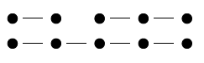
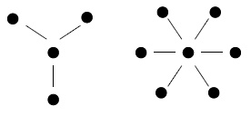
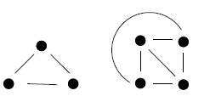
[Guido Moerkotte, Building Query Compilers, 2020]
Query and Plan Types
Query Types
  Nodes: Tables
  Edges: Join conditions
  Determine hardness of query optimization
  (w/o cross products)
Join Tree Types / Plan Types
  Data flow graph
  of tables and joins
  (logical/physical query trees)
  Edges: data dependencies
  (execution order: bottom-up)
Chains
Stars
Cliques
Left-Deep Tree
Right-Deep Tree
Zig-Zag Tree
Bushy Tree

Slide 29
[Guido Moerkotte, Building Query Compilers, 2020]
Join Ordering Problem
Join Ordering
  Given a join query graph, find the optimal join ordering
  In general, NP-hard; but polynomial algorithms exist for special cases
Search Space
  Dependent on
  query & plan types
  Note: if we allow
  cross products
  similar to cliques
  (fully connected)
 | Chain (no CP) |  |  | Star (no CP)
 | left-deep | zig-zag | bushy | left- deep | zig-zag/ bushy
n | 2^{n-1} | 2^{2n-3} | 2^{n-1}C(n-1) | 2(n-1)! | 2^{n-1}(n-1)!
5 | 16 | 128 | 224 | 48 | 384
10 | 512 | ~131K | ~2.4M | ~726K | ~186M
Clique / CP (cross product)
left- deep | zig-zag | bushy
n! | 2^{n-2}n! | n! C(n-1)
120 | 960 | 1,680
~3.6M | ~929M | ~17.6G
C(n) … Catalan Numbers

Slide 30
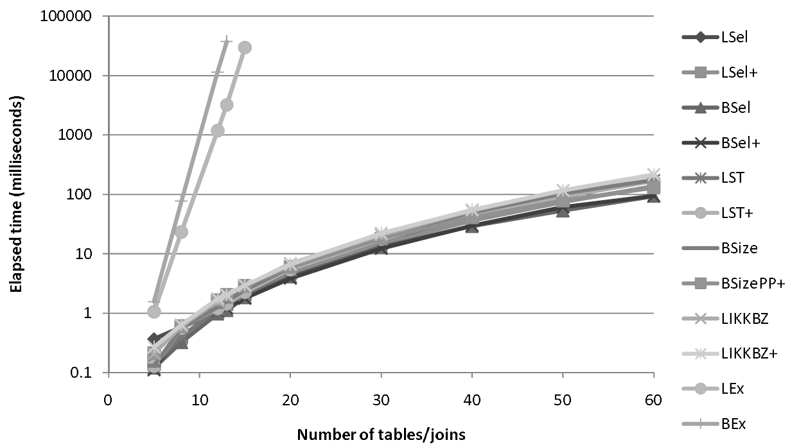
Join Order Search Strategies
All (unknown)
Actual
Explored
Tradeoff: Optimal (or good) plan vs compilation time
#1 Naïve Full Enumeration
  Infeasible for reasonably large queries (long tail up to 1000s of joins)
#2 Exact Dynamic Programming / Memoization
  Guarantees optimal plan, often too expensive (beyond 20 relations)
  Bottom-up vs top-down approaches
#3 Greedy / Heuristic Algorithms
#4 Approximate Algorithms
  E.g., Genetic algorithms, simulated annealing, MIL programming
Example PostgreSQL
  Exact optimization (DPSize) if < 12 relations (geqo_threshold)
  Genetic algorithm for larger queries
  Join methods: NLJ, SMJ, HJ
DP Enum
Heuristics
[Nicolas Bruno, César A. Galindo-Legaria, Milind Joshi: Polynomial heuristics for query optimization. ICDE 2010]

Slide 31
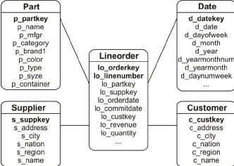
Star Schema Benchmark
Greedy Join Ordering
Example
  Part ⋈ Lineorder ⋈ Supplier ⋈ σ(Customer) ⋈ σ(Date), left-deep plans
# | Plan | Costs
1 | Lineorder ⋈ Part | 30M
 | Lineorder ⋈ Supplier | 20M
 | Lineorder ⋈ σ(Customer) | 90K
 | Lineorder ⋈ σ(Date) | 40K
 | Part ⋈ Customer | N/A
 | … | …
# | Plan | Costs
3 | ((Lineorder ⋈ σ(Date)) ⋈ σ(Customer)) ⋈ Part | 120M
 | ((Lineorder ⋈ σ(Date)) ⋈ σ(Customer)) ⋈ Supplier | 105M
4 | (((Lineorder ⋈ σ(Date)) ⋈ σ(Customer)) ⋈ Supplier) ⋈ Part | 135M
2 | (Lineorder ⋈ σ(Date)) ⋈ Part | 150K
 | (Lineorder ⋈ σ(Date)) ⋈ Supplier | 100K
 | (Lineorder ⋈ σ(Date)) ⋈ σ(Customer) | 75K
Note: Simple O(n²) algorithm for left-deep trees;
O(n³) algorithms for bushy trees existing (e.g., GOO .. Greedy operator ordering)

Slide 32
[Guido Moerkotte, Building Query Compilers, 2020]
Greedy Join Ordering, cont.
Basic Algorithms
  GreedyJO-1: sort by relation weights (e.g., card)
  GreedyJO-2: greedy selection of next best relation
  GreedyJO-3: Greedy-JO-2 w/ start from each relation
GOO
Algorithm
Previous example as a hybrid w/ O(n²)
// Greedy Operator Ordering
[Leonidas Fegaras: A New Heuristic for Optimizing Large Queries. DEXA 1998]

Slide 33
Dynamic Programming Join Ordering
Exact Enumeration via Dynamic Programming
  #1: Optimal substructure (Bellman’s Principle of Optimality)
  #2: Overlapping subproblems allow for memorization
Bottom-Up (Dynamic Programming)
  Split in independent sub-problems (optimal plan
  per set of quantifiers and interesting properties),
  solve sub-problems, combine solutions
  Algorithms: DPsize, DPsub, DPcpp
Top-Down (Memoization)
  Recursive generation of join trees
  w/ memorization and pruning
  Algorithms: Cascades, MinCutLazy,
  MinCutAGat, MinCutBranch
[Guido Moerkotte, Thomas Neumann: Analysis of Two Existing and One New Dynamic Programming Algorithm for the Generation of Optimal Bushy Join Trees without Cross Products. VLDB 2006]
[Goetz Graefe: The Cascades Framework for Query Optimization. IEEE Data Eng. Bull. 18(3) 1995]
[Pit Fender: Algorithms for Efficient Top-Down Join Enumeration. PhD Thesis, University of Mannheim 2014]

Slide 34
[Patricia G. Selinger et al.: Access Path Selection in a Relational Database Management System. SIGMOD 1979]
Dynamic Programming Join Ordering, cont.
DPSize Algorithm
  Pioneered by Pat Selinger et al.
  Implemented in
  IBM DB2, Postgres, etc
disjoint
connected
[Wook-Shin Han, Wooseong Kwak, Jinsoo Lee, Guy M. Lohman, Volker Markl: Parallelizing query optimization. PVLDB 1(1) 2008]

Slide 35
Dynamic Programming Join Ordering, cont.
DPSize Example
  Simplified: no interesting properties
Q1+Q3, Q2+Q2, Q3+Q1
Q1+Q2, Q2+Q1
Q1+Q1
Q4 | Plan
{C,D,L,P} | ((L⋈C)⋈D)⋈P, P⋈((L⋈C)⋈D)
{C,D,L,S} | …
{C,L,P,S} | …
{D,L,P,S} | …
Q3 | Plan
{C,D,L} | (L⋈C)⋈D, D⋈(L⋈C), (L⋈D)⋈C, C⋈(L⋈D)
{C,L,P} | (L⋈C)⋈P, P⋈(L⋈C), (P⋈L)⋈C, C⋈(P⋈L)
{C,L,S} | …
{D,L,P} | …
{D,L,S} | …
{L,P,S} | …
Q2 | Plan
{C,L} | L⋈C, C⋈L
{D,L} | L⋈D, D⋈L
{L,P} | L⋈P, P⋈L
{L,S} | L⋈S, S⋈L
{C,D} | N/A
… | …
Q1 | Plan
{C} | Tbl, IX
{D} | Tbl, IX
{L} | …
{P} | …
{S} | …
Q1+Q4, Q2+Q3,
Q3+Q2, Q4+Q1
Q5 | Plan
{C,D,L,P,S} | …
Notes:
NOTE: The plan generation algorithm also includes the selection of physical operators (NLJ, SMJ, HJ)

Slide 36
[Viktor Leis, Andrey Gubichev, Atanas Mirchev, Peter A. Boncz, Alfons Kemper, Thomas Neumann: How Good Are Query Optimizers, Really? PVLDB 9(3) 2015]
Join Order Benchmark (JOB)
Data: Internet Movie Data Bases (IMDB)
Workload: 33 query templates, 2-6 variants / 3-16 joins per query
underestimate

Slide 37


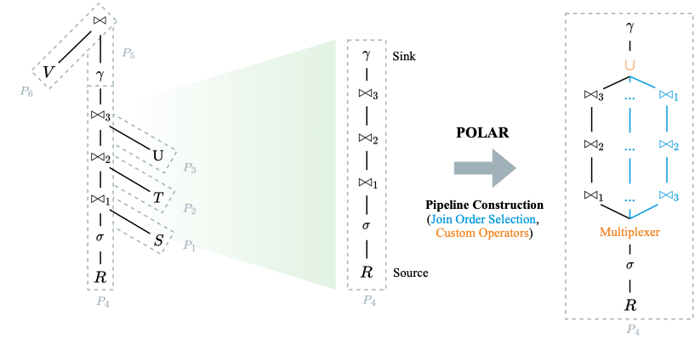
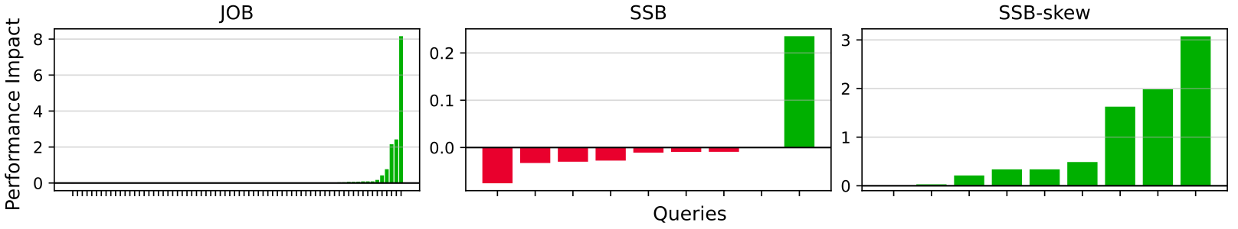
Excursus: POLAR: Non-invasive, Low Overhead
Adaptive Query Processing
→ BIFOLD GS (DAMS/DIMA)
[DIMA/DAMS @ VLDB’24]
Simple Integration and Low Overhead
  Separate compilation and execution
  Reuse optimizers and operators
Join Order Selection
  Discretize selectivities (predicates and joins)
  Sample the selectivity space
  Optimize plan for sample, include original plan
Determine Plans of Least Resistance
  Measure # intermediates during runtime
  Explore join plans via tuple routing w/ bounded regret
Next Steps
  DuckDB extension in DuckDB OSS repo (BS Paul Pohlitz)
  Skewed data generation (BS Marcel Scholand)

Slide 38
Summary & QA
Thanks
Query Rewriting and Unnesting
Cardinality and Cost Estimation
Join Enumeration / Ordering
Next Lectures
  05 Experiments and Reproducibility [Jun 09 → Jun 16 in B-106]
  Project Submissions [Jul 08 EOD]
  Project Presentations all Teams [Jul 14]

