Slide 1

Programmierpraktikum: Datensysteme
05 Background Experiments and Reproducibility
Prof. Dr. Matthias Boehm
Technische Universität Berlin
Berlin Institute for the Foundations of Learning and Data
Big Data Engineering (DAMS Lab)
Last update: Jun 14, 2025

Slide 2

Announcements / Administrative Items
#1 Video Recording
  Hybrid lectures: in-person B-106, zoom live streaming, video recording
  https://tu-berlin.zoom.us/j/9529634787?pwd=R1ZsN1M3SC9BOU1OcFdmem9zT202UT09
#2 Project Submission
  Jul 08: Project Submissions (DAMS instance: online submission in ISIS by 11.59pm):
  https://isis.tu-berlin.de/mod/assign/view.php?id=2070748
  Jul 14: Project Presentations (in-person)

Slide 3
Agenda
Experiments and Result Presentation
Reproducibility and RDM
Use Case: SliceLine Reproducibility

Slide 4
Experiments and Result Presentation
In Computer Science (Data Management)
[Ioana Manolescu, Stefan Manegold: Performance Evaluation in Database Research: Principles and Experiences, ICDE 2008]

Slide 5
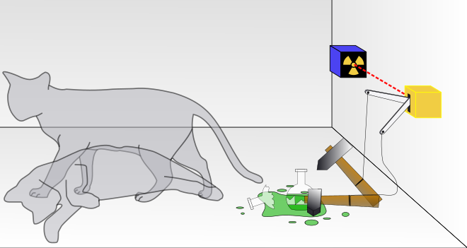
Motivation
Worst Mistake: Schrödinger's Results
  Postpone implementation and experiments till last before the deadline
  No feedback, no reaction time (experiments require many iterations)
  Karl Popper: falsifiability of scientific results → refutable by evidence
Continuous Experiments
  Run experiments during survey / prototype building
  Systematic experiments ➔ observations and ideas for improvements
  Don’t be afraid of throw away prototypes that don’t work
Good Research Fires Itself
  Initial experiments give directions for further improvements
  Problem-oriented methodology
Reproducible Research
=
Great, Trustworthy Research

Slide 6
Types of Experiments
#1 Exploratory Experiments
  Tests for functional correctness
  Unstructured experiments for initial feedback → eval feasibility
#2 Micro Benchmarks
  Measure specific aspects in controlled and understandable scope
  Bottom-up approach
#3 Benchmarks
  Evaluate on community/own benchmarks
  Examples: TPC-C, TPC-H, TPC-DS, JOB, MLPerf
#4 End-to-end Applications
  Evaluate in larger scope of real datasets and query workloads
  Examples: Customer workload, ML pipelines (dataprep, training, eval)
Programming Practical:
#1 Micro-benchmarks for insert/get/getNext x
data type performance
#2 MIT benchmark for multi-threaded index maintenance and usage
[Additional benchmarks for skewed skews, etc]

Slide 7
From Idea to Experiments
Overview
  Proper planning helps to keep you from “getting lost”
  Repeatable experiments simplify your own work
  There is no single way how to do it right
  There are many ways how to do it wrong
Basic Planning
  Which data / data sets should be used?
  Which workload / queries should be run?
  Which hardware & software should be used?
  Metrics: What to measure? How to measure?
  Comparison: How to compare?
  CSI: How to find out what is going on?
[I. Manolescu, S/ Manegold: Performance Evaluation in Database Research: Principles and Experiences, ICDE 2008]
[Credit: Pınar Tözün]

Slide 8
Dataset Selection
Synthetic Data
  Generate data with specific data characteristics
  Systematic evaluation w/ datasize, sparsity, etc
  Inappropriate for certain topics: compression, ML accuracy
“Real” Data Repositories
  Wide selection of available datasets w/ different characteristics
  UCI ML Repository: https://archive.ics.uci.edu/ml/index.php
  Florida Sparse Matrix Collection: https://sparse.tamu.edu/
  Google dataset search: https://datasetsearch.research.google.com/
  Common Datasets in ML: ImageNet, Mnist, CIFAR, KDD, Criteo, Adult
  Common Datasets in DM: Census, Taxi, Airlines, DBLP, benchmarks etc
Representative
of real data distributions?
Representative for variety of workloads / common case?

Slide 9
Benchmarks
Overview
  Community- and organization-driven creation of agreed benchmarks
  Benchmarks can define a field and foster innovation
#1 Data Management
  Query processing: 007, TPC-C, TPC-E, TPC-H, TPC-DS (w/ audit)
  Join ordering: JOB
#2 “Big Data”
  MR/Spark: BigBench, HiBench, SparkBench
  Array Databases: GenBase
#3 Machine Learning Systems
  SLAB, DAWNBench, MLPerf, MLBench, AutoML Bench, Meta Worlds, TPCx-AI
[Michael J. Carey, David J. DeWitt, Jeffrey F. Naughton: The oo7 Benchmark. SIGMOD 1993]
[http://www.tpc.org/tpch/]
(See AMLS course
for details)

Slide 10
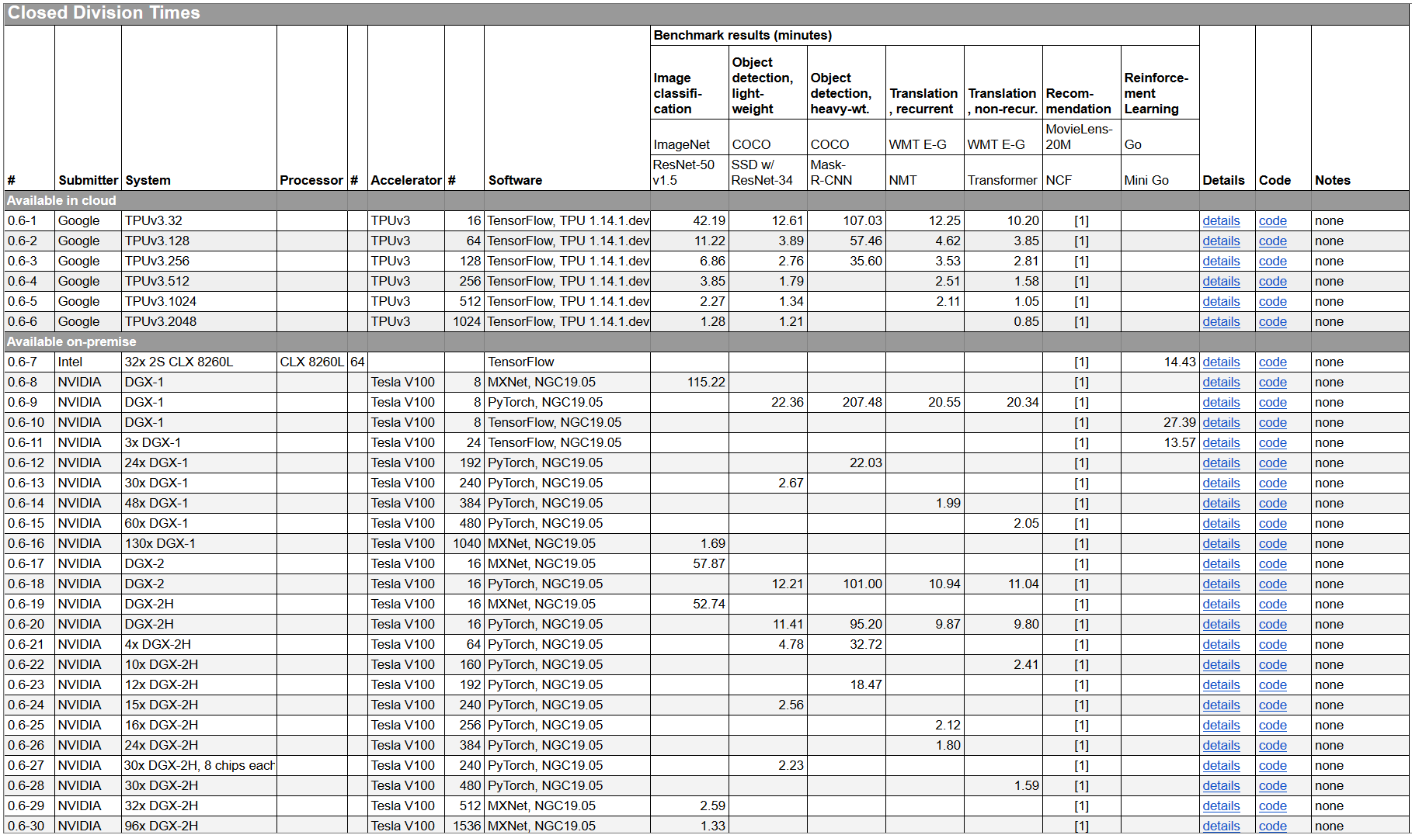

Benchmarks, cont.
MLPerf v0.6:
https://mlperf.org/training-results-0-6/,
MLPerf v0.7:
https://mlperf.org/training-results-0-7
… MLPerf v2.1 (11/2022)
V0.6
96 x DGX-2H = 96 * 16
= 1536 V100 GPUs
➔ ~ 96 * $400K = $35M – $40M
[https://www.forbes.com/sites/
tiriasresearch/2019/06/19/
nvidia-offers-a-turnkey-supercomputer-the-dgx-superpod/#693400f43ee5]
Notes:
V07: up to 4096 (regular), 16384 (HPC)

Slide 11
Baselines
#1 Primary Baseline
  Existing algorithm or system infrastructure
  Main comparison point, usually with same runtime operations
  Beware: Avoid speedup-only results (need absolute numbers for grounding)
#2 Additional Baselines
  Alternative systems w/ different runtime and compiler
  Usually, not directly comparable but important for grounding
  E.g.,: for SystemDS → R, Julia, Spark, TensorFlow, PyTorch
Problem of Weak Baselines
  Authors want to show improvements
  Successive improvements over state-of-the-art don’t add up
[Timothy G. Armstrong, Alistair Moffat, William Webber, Justin Zobel: Improvements That Don't Add Up: Ad-Hoc Retrieval Results Since 1998. CIKM 2009]
[Maurizio Ferrari Dacrema, Paolo Cremonesi, Dietmar Jannach: Are We Really Making Much Progress? A Worrying Analysis of Recent Neural Recommendation Approaches. RecSys 2019]

Slide 12
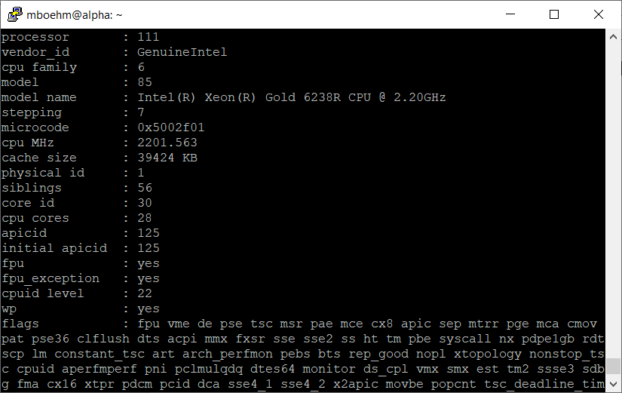
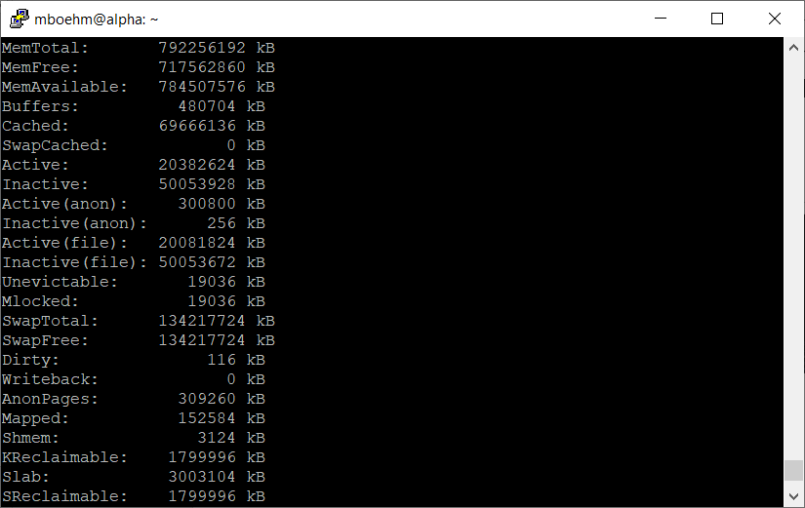
Presentation – Experimental Setting
Hardware Selection
  Multiple nodes for distributed computation
  Avoid too outdated HW (irrelevance)
Find Balanced Level of Detail
  Underspecified: “We ran all experiments on an Intel CPU”
  Over-specified:
  cat /proc/cpuinfo
  cat /proc/meminfo
Recommendation
  HW components: #nodes, CPUs, memory, network, I/O
  SW components: OS, programming language, versions, other software
  Baselines and configuration → Use recent versions of baseline systems
  Data and workloads w/ data sizes, parameters, configurations

Slide 13


Presentation – Figures
Axes
  Use Informative axes labels with units (e.g., Total Execution Time [ms])
  Don’t cheat or mislead readers and reviewers
  Start y-axis at 0 for linear scale (w/ log-scale impossible)
100
Yours
100
Yours
Runtime
90
Mine
Runtime [s]
Runtime [s]
50
80
Mine
Aha, so 12%
0
1
2
3
What are the units? Where are the tics?
This is a misleading y axis

Slide 14
Presentation – Figures, cont.
Fair Ranges of Parameters
  Evaluate common ranges of values
  Don’t hide important information → good scientific practice
If there are multiple relevant parameters, show them all
For log-scale you can’t start at 0
[J. Sommer, M. Boehm, A. V. Evfimievski, B. Reinwald, P. J. Haas: MNC: Structure-Exploiting Sparsity Estimation for Matrix Expressions. SIGMOD 2019]
Don’t limit range to make you look good

Slide 15
[I. Manolescu, S/ Manegold: Performance Evaluation in Database Research: Principles and Experiences, ICDE 2008]
Presentation – Figures, cont.
Plots Types
  Barplot for categories
  Plot + Line/linepoints for continuous parameters
  Visible font sizes (similar to text)
Legends
  Order them by appearance
  Attach directly to graph
Human brain is a
poor join processor
Humans get frustrated

Slide 16
Presentation – Figures, cont.
Diversity & Consistency
  Diversity: if applicable use mix of different plot types and tables
  Consistency: use consistent colors and names for same baselines
Labeling
  Make the plots
  self-contained
  Simplifies skimming and
  avoids join with text
[Matthias Boehm et al: SystemDS: A Declarative Machine Learning System for the End-to-End Data Science Lifecycle. CIDR 2020]

Slide 17
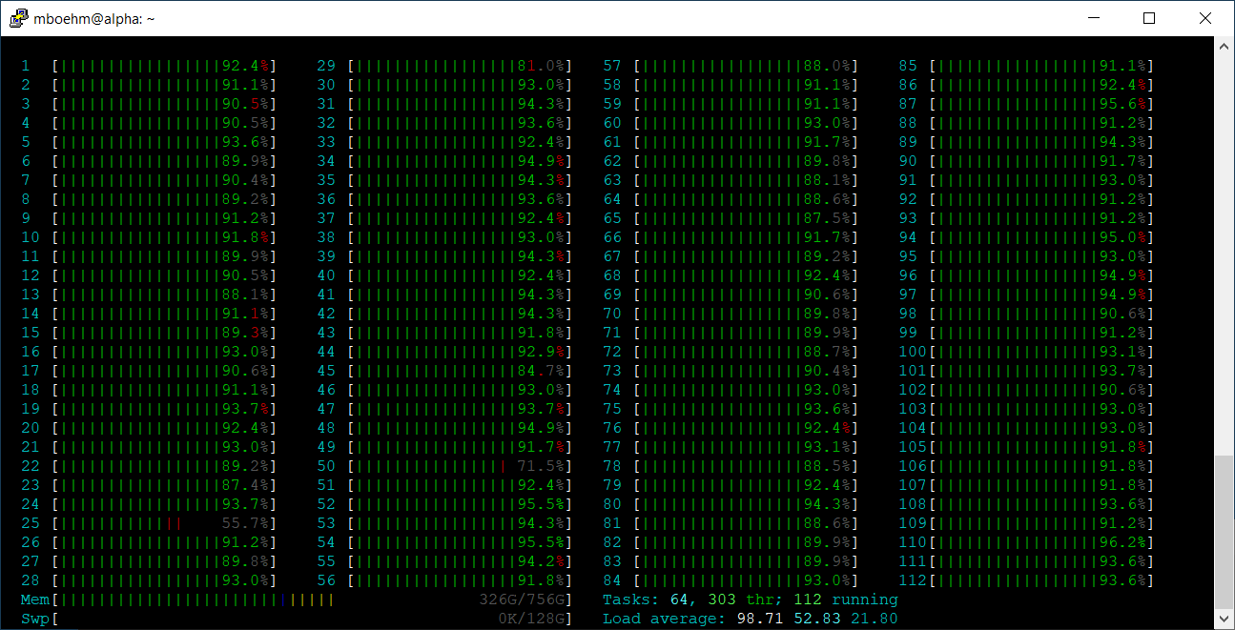
Presentation – Result Interpretation
Use the Right OS Tools
  System-specific tracing/statistics
  top / htop / iotop (looks CPU bound)
  perf -stat -d ./run.sh
  (no, it’s memory-bandwidth bound)
Performance counter stats for './run.sh':
12721364.53 msec task-clock # 83.640 CPUs utilized
463352 context-switches # 0.036 K/sec
5455536095415 instructions # 0.14 insn per cycle (62.50%)
335314473273 branches # 26.358 M/sec (62.50%)
1463380955 branch-misses # 0.44% of all branches (62.50%)
2185062643097 L1-dcache-loads # 171.763 M/sec (62.50%)
142845949268 L1-dcache-load-misses # 6.54% of all L1-dcache hits (62.50%)
3375555316 LLC-loads # 0.265 M/sec (50.00%)
1016330404 LLC-load-misses # 30.11% of all LL-cache hits (50.00%)
152.096000108 seconds time elapsed
12052.466691000 seconds user
674.704421000 seconds sys
Don’t just report
the results but try
to understand and explain them

Slide 18
Presentation – Result Interpretation, cont.
Use the Right PL Tools / Flags
  E.g., Understanding
  Java JIT compilation
  -XX:+PrintCompilation
  E.g., Understanding
  HW Cache Hierarchy (L1i 32KB)
  -XX:-DontCompileHugeMethods
[Matthias Boehm et al: On Optimizing Operator Fusion Plans for Large-Scale Machine Learning in SystemML. PVLDB 11(12) 2018]

Slide 19
Reproducibility and RDM
In Computer Science (Data Management)

Slide 20
Research Data Management (RDM)
Overview
  Ensure reproducibility of research results and conclusions
  Common problem:
  Create value for others (compare, reuse, understand, extend)
  EU Projects: Mandatory proposal section & deliverable on RDM plan
RDM @ TU Graz
  TU Graz RDM Policy since 12/2019,
  as well as faculty-specific RDM policies
  https://www.tugraz.at/sites/rdm/home/
RDM @ TU Berlin
  TU Berlin RDM Policy since 10/2019
  https://www.tu.berlin/en/ub/szf/information-tips/
  what-is-research-data-management
  https://www.static.tu.berlin/fileadmin/www/10000000/
  Arbeiten/Wichtige_Dokumente/RDM-Policy_TUBerlin_2023_en.pdf
“All code and data was on the student’s laptop and the student left / the laptop crashed.”
“Ensure that research data, code and any other materials needed to reproduce research findings are appropriately documented, stored and shared in a research data repository in accordance with the FAIR principles (Findable, Accessible, Interoperable and Reusable) for at least 10 years from the end of the research project, unless there are valid reasons not to do so. [...] Develop a written data management strategy for managing research outputs within the first 12 months of the PhD study […].”
“The minimum storage period for research data is ten years after either the assignment of a persistent identifier or the publication of the related work following research project completion, whichever is later.”

Slide 21

FAIR Data Principles
[https://www.go-fair.org/fair-principles/]
#1 Findable
  Metadata and data have globally unique persistent identifiers
  Data describes w/ rich meta data; registered/indexes and searchable
#2 Accessible
  Metadata and data retrievable via open, free and universal commnication protocols
  Metadata accessible even when data no longer available
#3 Interoperable
  Metadata and data use a formal, accessible, and broadly applicable format
  Metadata and data use FAIR vocabularies and qualified references
#4 Reusable
  Metadata and data described with plurality of accurate and relevant attributes
  Clear license, associated with provenance, meets community standards

Slide 22
[Xiao Xiang Zhu et al: So2Sat LCZ42: A Benchmark Dataset for the Classification of Global Local Climate Zones. GRSM 2020]
RDM in Practice – Example So2Sat LCZ42
[So2Sat LC42 Dataset
https://mediatum.ub.tum.de/1454690]
Data and ML Pipelines
  ESA Sentinel-1/2 datasets → 4PB/year
  Training of local climate zone classifiers on
  So2Sat LCZ42 (15 experts, 400K instances,
  10 labels each, 85% confidence, ~55GB H5)
  ML pipeline: preprocessing, ResNet18,
  climate models
Label Creation/ Validation
  Team learning
  Labeling w/ checks
  Label validation
  Quantitative validation w/ 10
  expert votes on correctness
Notes:
Notes: Confusion matrices (values in %) of the original labels the final labels (refined by majority voting) vs. the votes cast bythe label validation crew for the polygons of the evaluation cities selected in Tables II and III: (a) original labels polygon-wise assessment, (b) original labels pixel-wise, (c) final labels polygon-wise, and (d) final labels pixel-wise
Unfortunately, not many European cities contain LCZ class 7 (light-weight low-rise), which mostly describes informal settlements (e.g., slums). Therefore, we included the polygons of class 7 for an additional 9 cities that are representative of the 9 major non-European geographical regions of the world

Slide 23
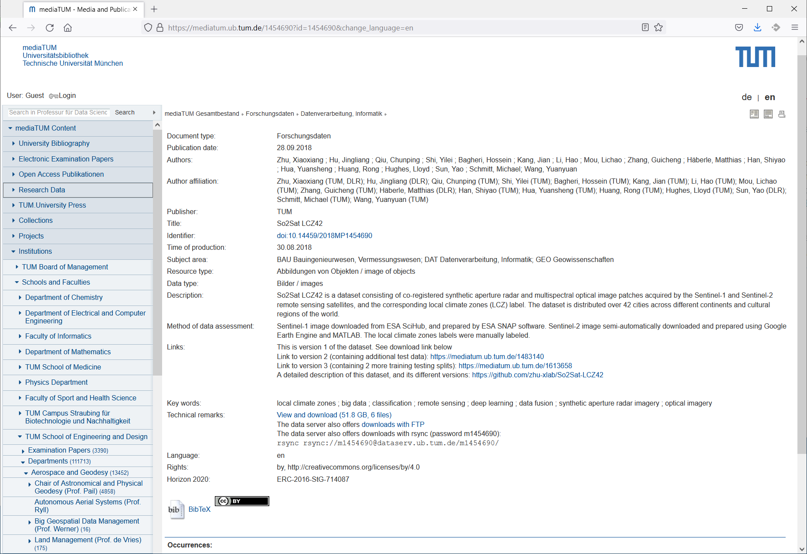
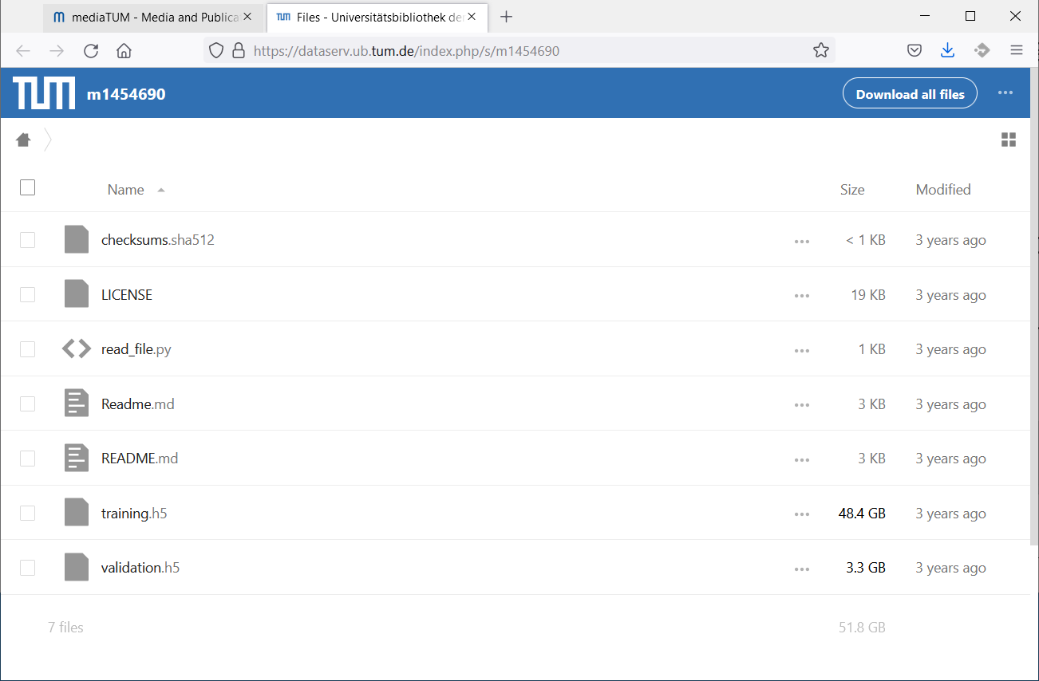
RDM in Practice – Example So2Sat LCZ42, cont.
[So2Sat LC42 Dataset
https://mediatum.ub.tum.de/1454690]

Slide 24
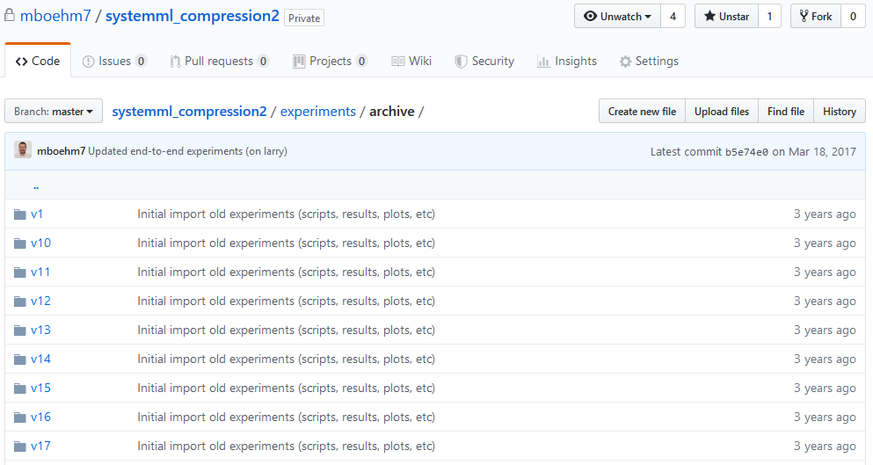
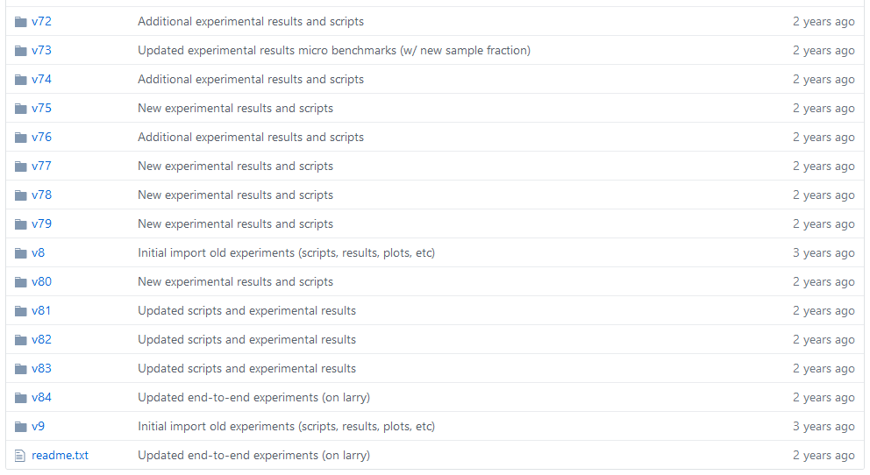
RDM in Practice @ DAMS
Code and Artifacts
  Apache SystemDS: https://github.com/apache/systemds (OSS)
    Complete code history, src/bin releases (SystemDS 3.1.0 in Mar/2023)
    DIA / AMLS programming projects in SystemDS
  Additional private github repos for student projects / prototypes
Central Paper Repository
  All paper submissions w/ latex sources, figures, reviews, rebuttals, etc
  All paper-related experiments
    Archive: append-only experimental results
    Plots: scripts and figures of plots
    Results: latest results used for the current plots
    Scripts: data preparation, baselines, benchmarks
    ➔ Automate your experiments as much as possible

Slide 25



SIGMOD Reproducibility Process
Overview
  Accepted papers can submit package, verified by committee
  ACM Results Replicated / ACM Artifacts Available labels
  Most Reproducible Paper Award ($750, visibility)
#1 Replicability (aka Repeatability)
  Recreate result data and graphs shown in the final paper
  Expected: same trend of baseline comparisons, parameter influence
#2 Reproducibility
  Verify robustness of results wrt parameters and environments
  Examples: different data and workload characteristics, hardware

Slide 26
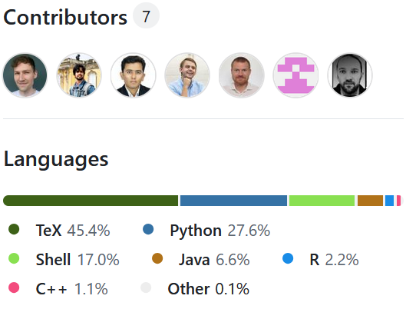
SIGMOD Reproducibility Process, cont.
Ideal Reproducibility Submission
  “At a minimum the authors should provide a complete set of scripts to install the system, produce the data, run experiments and produce the resulting graphs along with a detailed Readme file that describes the process step by step so it can be easily reproduced by a reviewer. The ideal reproducibility submission consists of
    installs all systems needed,
    generates or fetches all needed input data,
    reruns all experiments and generates all results,
    generates all graphs and plots, and finally,
    recompiles the sources of the paper
  ... to produce a new PDF for the paper that contains the new graphs. “
DAMS Reproducibility Repository
  Full reproducibility packages of (almost) all research papers
  https://github.com/damslab/reproducibility
[Credit:
db-reproducibility.
seas.harvard.edu/
#Guidelines]

Slide 27
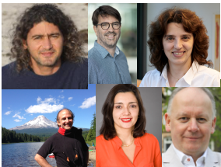
Excursus: SIGMOD Contributions Award 2020
The SIGMOD 2020 Contributions Award recognizes the innovative work in the data management community to encourage scientific reproducibility of our publications. Reproducibility was introduced at the 2008 SIGMOD Conference and since then has influenced how the community approaches experimental evaluation.
Philippe Bonnet (ITU Copenhagen)
Stratos Idreos
(Harvard)
Ioana Manolescu
(Ecole Polytechnique)
Dennis Shasha
(NYU)
Stefan Manegold
(CWI Amsterdam)
Juliana Freire
(NYU)

Slide 28
Tools for Automation
Motivation
  Tooling for running artifacts in a self-contained manner
  Metadata storage in semi-structured formats like JSON/XML
Examples
Name | Target | Link
CK | ML Systems | http://ctuning.org
CWL | Analysis Workflows | http://commonwl.org
Popper | Container Workflows | https://github.com/ systemslab/popper
ReproZip | General-purpose Bundles | http://reprozip.org
Sciunit | Self-contained Experiments Bundles | http://sciunit.run
Sumatra | Numerical Simulations | https://github.com/ open-research/sumatra

Slide 29


Use Case: SliceLine Reproducibility
[Svetlana Sagadeeva, Matthias Boehm:
SliceLine: Fast, Linear-Algebra-based Slice Finding for ML Model Debugging, SIGMOD 2021]
[Credit: sliceline,
Silicon Valley, HBO]
[https://github.com/damslab/reproducibility/tree/master/sigmod2021-sliceline-p218]

Slide 30

Overview SliceLine Reproducibility Scripts
./runAll.sh
#!/bin/bash
# clean original results
rm -R results/*;
rm -R plots/*;
# setup, run experiments, plots
./run1SetupDependencies.sh;
./run2SetupSystemDS.sh;
./run3DownloadData.sh;
./run4PrepareLocalData.sh; # on scale-up node
./run5LocalExperiments.sh; # on scale-up node
./run6PrepareDistData.sh; # on scale-out cluster
./run7DistExperiments.sh; # on scale-out cluster
./run8PlotResults.sh;

Slide 31
1) Setup Dependencies and Apache SystemDS
./run1SetupDependencies.sh;
./run2SetupSystemDS.sh;
./run3DownloadData.sh;
./run4PrepareLocalData.sh;
./run5LocalExperiments.sh;
./run6PrepareDistData.sh;
./run7DistExperiments.sh;
./run8PlotResults.sh;
sudo apt update
sudo apt install -y openjdk-8-jdk-headless
sudo apt install -y maven
sudo apt install -y git
sudo apt install -y r-base
export JAVA_HOME=/usr/lib/jvm/java-1.8.0-openjdk-amd64
sudo Rscript exp/setup/installDependencies.R
Dependencies
Apache SystemDS
# clone Apache SystemDS repository
rm -rf systemds #cleanup
git clone https://github.com/apache/systemds.git
# checkout commit hash as of camera-ready version
cd systemds
git checkout -b reproducibility 627825c25d5a5938a772a78ce037c57e68611998
# build systemds and prepare all dependencies
mvn clean package -P distribution

Slide 32
2) Download Data
./run1SetupDependencies.sh;
./run2SetupSystemDS.sh;
./run3DownloadData.sh;
./run4PrepareLocalData.sh;
./run5LocalExperiments.sh;
./run6PrepareDistData.sh;
./run7DistExperiments.sh;
./run8PlotResults.sh;
Download and Simple Preprocessing
# Adult
curl https://archive.ics.uci.edu/ml/machine-learning-databases/adult/adult.data -o data/Adult.csv;
sed -i '$d' data/Adult.csv; # fix empty line at end of file
# KDD'98
curl https://archive.ics.uci.edu/ml/.../epsilon_mirror/cup98lrn.zip -o data/cup98lrn.zip;
unzip data/cup98lrn.zip -d data;
mv data/cup98LRN.txt data/KDD98.csv;
rm data/cup98lrn.zip;
sed -i 's/-/ /g' data/KDD98.csv; # fix suffix - at 5th column (numerical)
# note: workaround for macOS issue: sed -i '' 's/-/ /g' data/KDD98.csv;
# CriteoD21 (this one might take a while, only needed for distributed experiments)
curl http://azuremlsampleexperiments.blob.core.windows.net/criteo/day_21.gz -o data/Criteo_D21.gz;
gzip -d data/Criteo_D21.gz;
mv data/Criteo_D21 data/Criteo_D21.csv;

Slide 33
5) Local Experiments
./run1SetupDependencies.sh;
./run2SetupSystemDS.sh;
./run3DownloadData.sh;
./run4PrepareLocalData.sh;
./run5LocalExperiments.sh;
./run6PrepareDistData.sh;
./run7DistExperiments.sh;
./run8PlotResults.sh;
run5LocalExperiments.sh → run Experiment 1, 2, 3, 4a, 4b, 4c, 5
runExperiment1.sh
#!/bin/bash
CMD="java -Xmx600g -Xms600g -cp ./lib/*:./SystemDS.jar org.apache.sysds.api.DMLScript "
for config in 1 2 3 4 5
do
for rep in {1..3} #for all repetitions
do
start=$(date +%s%N)
$CMD -f exp/explocal/SlicingExp1_${config}.dml -exec singlenode -stats \
-args data/Salaries_X.csv data/Salaries_o_e.csv ${config} results/Experiment1_p${config}.dat
end=$(date +%s%N)
echo ${config}","$((($end-$start) / 1000000)) >> results/Experiment1_times.dat
done
done

Slide 34
8) Plot Results
./run1SetupDependencies.sh;
./run2SetupSystemDS.sh;
./run3DownloadData.sh;
./run4PrepareLocalData.sh;
./run5LocalExperiments.sh;
./run6PrepareDistData.sh;
./run7DistExperiments.sh;
./run8PlotResults.sh;
Rscript exp/plotting/Experiment1a.r;
Rscript exp/plotting/Experiment1b.r;
Calling R Scripts
Plotting
pdf(file="plots/Experiment1a.pdf",
width=5, height=4.0, family="serif", pointsize=14)
data1 = …
plot_colors <- c("cornflowerblue","gray40","black","orange","orangered")
plot(points, data3,
type="o", pch=19, cex=1.1, col=plot_colors[3], ylim = c(0.5,3500000),
xlab="", ylab="", axes=FALSE, bg=plot_colors[3], log="y", lwd=1.1, lty=1)
legend( "topright",
c("No dedup","No parents, sc, ss"), col=plot_colors[5:4],
pch=c(15,15), lty=c(1), lwd=c(1.1), bty="n");
legend( 1.5, 600,
c("No parents, sc","No parents", "All"), col=plot_colors[3:1],
pt.bg=plot_colors[3:1], pch=c(19,25,17), lty=c(1), lwd=c(1.1), bty="n");
dev.off()

Slide 35
Parting Thoughts: Conflicting Questions (and Answers)
#1 Larger System Development
  Your research does not benefit from a general improvement
  New work by others creates more work for you
#2 What if Results are Unconvincing
  Despite effort baselines are sometimes better
  Can influence by baselines, workload, presentation
  Several suicide cases
#3 What if Results were Wrong
  Creating the reproducibility package after acceptance
  can reveal bugs in the original experiments
  Should you rerun all experiments
Always do the “right thing”TM,
research is a long game and persistently attached to your name
Talk to your Supervisor (and or trusted BIFOLD persons);
and always stay ethical
Talk to your Supervisor,
do the “right thing”TM,
yes always admit mistakes
(camera-ready, errata, website)

Slide 36
Summary & QA
Thanks
Experiments and Result Presentation
Reproducibility and RDM
Use Case: SliceLine Reproducibility
Upcoming Dates
  Jul 08: Project Submissions (for DAMS instance: online submission in ISIS by 11.59pm):
  https://isis.tu-berlin.de/mod/assign/view.php?id=2070748
  Jul 14: Project Presentations (in-person)

