Slide 1

Architecture of ML Systems (AMLS)
02 Languages, Architectures, and System Landscape
Prof. Dr. Matthias Boehm
Technische Universität Berlin
Berlin Institute for the Foundations of Learning and Data
Big Data Engineering (DAMS Lab)
Last update: Apr 23, 2026

Slide 2

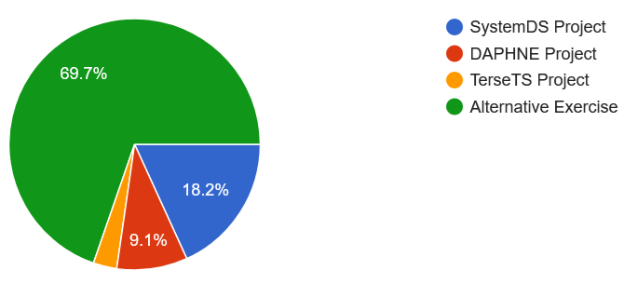
Announcements / Org
#1 Hybrid & Video Recording
  Hybrid lectures (in-person, zoom) with optional attendance
  https://tu-berlin.zoom.us/j/9529634787?pwd=R1ZsN1M3SC9BOU1OcFdmem9zT202UT09
  Zoom video recordings, links from website
  https://mboehm7.github.io/teaching/ss26_amls/index.htm
#2 Course Registrations
  TU Berlin: 340 (TUB ISIS registrations)
#3 Projects / Alternative Exercise
  Task description on course website since Apr 12
  Project Selection by Apr 30, Submission by July 15
  https://forms.gle/pQiGCgzcHd3hCDbM9
~340
~35

Slide 3
Agenda
Data Science Lifecycle
ML Systems Stack
Language Abstractions
ML Systems Benchmarks

Slide 4
Data Science Lifecycle

Slide 5


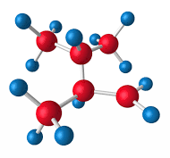

Data-centric View:
Application/workload/system perspectives
The Data Science Lifecycle
(aka KDD Process, aka CRISP-DM)
Data extraction, schema alignment, entity resolution, data validation, data cleaning, outlier detection, missing value imputation, semantic type detection, data augmentation, feature selection, feature engineering, feature transformations
Key observation: SotA data integration/cleaning based on ML
Data Scientist
Data Integration
Data Cleaning
Data Preparation
Data Integration
Data Cleaning
Data Preparation
Model Selection
Training
Hyper-parameters
Validate & Debug
Deployment
Scoring & Feedback
Exploratory Process
(experimentation, refinements, ML pipelines)
Data/SW Engineer
DevOps Engineer

Slide 6
The Data Science Lifecycle, cont.
Classic KDD Process
(Knowledge Discovery in Databases)
  Descriptive
  (association rules,
  clustering)
  Predictive
Evaluate
Mining
Transform
Preprocess
Select
[Usama M. Fayyad, Gregory Piatetsky-Shapiro, Padhraic Smyth: From Data Mining to Knowledge Discovery in Databases. AI Magazine 17(3) (1996)]

Slide 7
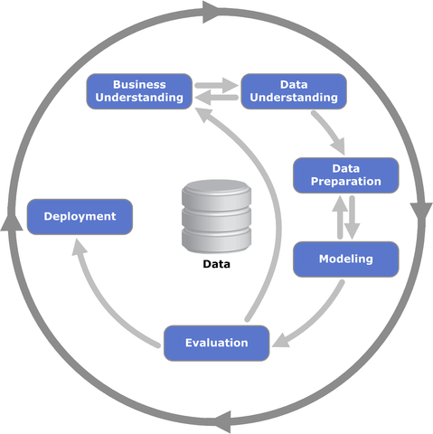
The Data Science Lifecycle, cont.
[https://statistik-dresden.de/archives/1128]
CRISP-DM
  CRoss-Industry
  Standard Process for
  Data Mining
  Additional focus on
  business understanding
  and deployment

Slide 8
The 80% Argument
Data Sourcing Effort
  Data scientists spend 80-90% time on finding
  relevant datasets and data integration/cleaning.
Technical Debts in ML Systems
  Glue code, pipeline jungles,
  dead code paths
  Plain-old-data types,
  multiple languages, prototypes
  Abstraction and configuration debts
  Data testing, reproducibility,
  process management, and cultural debts
[Michael Stonebraker, Ihab F. Ilyas: Data Integration: The Current Status and the Way Forward.
IEEE Data Eng. Bull. 41(2) (2018)]
ML
[D. Sculley et al.: Hidden Technical Debt in Machine Learning Systems. NeurIPS 2015]

Slide 9
A Text Classification Scenario
Token Features
Sentences
ΔFX
Example ML Pipeline
Training and Scoring
Feature Extraction
(e.g., doc structure, sentences, tokenization, n-grams)
Sentence Classification
Sentence Classification
…
(e.g., ⨝, ∪)
M
“Model”
(weights, meta data)
FX
transformencode
X
Y
large-scale, distributed training
FY
Training
B
MX
MY
ΔFX
transformapply
ΔX
embedded scoring
Scoring
ΔFŶ
transformdecode
ΔŶ

Slide 10
ML Systems Stack

Slide 11
What is an ML System?
Classification
Regression
Recommenders
Clustering
Dim Reduction
Neural Networks
Statistics
Data Mining
Machine Learning (ML)
ML Applications
(entire KDD/DS lifecycle)
Rapidly Evolving
Runtime Techniques (Execution, Data Access)
ML System
Compilation Techniques
Distributed Systems
HPC
Data Management
Accelerators
Operating Systems
Prog. Language Compilers
HW Architecture

Slide 12
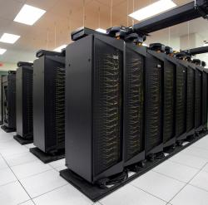
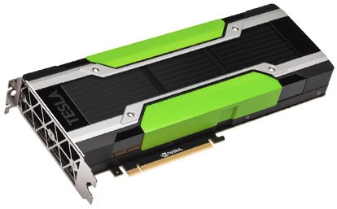
Driving Factors for ML
[Credit: Andrew Ng’14]
Improved Algorithms and Models
  Success across data and application domains
  (e.g., health care, finance, transport, production)
  More complex models which leverage large data
Availability of Large Data Collections
  Increasing automation and monitoring ➔ data
  (simplified by cloud computing & services, annotation services)
  Feedback loops, simulation/data prog./augmentation
  → Trend: self-supervised learning (*-GPT-x)
HW & SW Advancements
  Higher performance of hardware and infrastructure (cloud)
  Open-source large-scale computation frameworks,
  ML systems, and vendor-provides libraries
Feedback Loop
Data
Usage
Model

Slide 13
Stack of ML Systems
Validation & Debugging
Deployment & Scoring
Hyper-parameter Tuning
Training
ML Apps & Algorithms
Supervised, unsupervised, RL
linear algebra, libs, AutoML
Model and Feature Selection
Language Abstractions
Eager interpretation, lazy evaluation, prog. compilation
Improve accuracy vs. performance vs. resource requirements
➔ Specialization & Heterogeneity
Data Programming & Augmentation
Fault Tolerance
Approximation, lineage, checkpointing, checksums, ECC
Data Preparation
(e.g., one-hot, binning)
Execution Strategies
Local, distributed, cloud
(data, task, parameter server)
Data Representations
Dense & sparse tensor/matrix;
compress, partition, cache
Data Integration & Data Cleaning
HW & Infrastructure
CPUs, NUMA, GPUs, FPGAs, ASICs, RDMA, SSD/NVM

Slide 14
Accelerators (GPUs, FPGAs, ASICs)
Memory- vs Compute-intensive
  CPU: dense/sparse, large mem, high mem-bandwidth, moderate compute
  GPU: dense, small mem, slow PCI, very high bandwidth/compute
Graphics Processing Units (GPUs)
  Extensively used for deep learning training and scoring
  NVIDIA Volta: “tensor cores” for 4x4 mm → 64 2B FMA instruction
Field-Programmable Gate Arrays (FPGAs)
  Customizable HW accelerators for prefiltering, compression, DL
  Examples: Microsoft Catapult/Brainwave Neural Processing Units (NPUs)
Application-Specific Integrated Circuits (ASIC)
  Spectrum of chips: DL accelerators to computer vision
  Examples: Google TPUs (64K 2B FMA), NVIDIA DLA, Intel NNP, IBM TrueNorth
Quantum: Examples: IBM Q (Qiskit), Google Sycamore (Cirq → TensorFlow Quantum)
DL
Apps
Lang
Roofline Analysis
Faults
Ops
ML
Exec
Data
Operational Intensity
HW

Slide 15
Data Representation
ML- vs DL-centric Systems
  ML: dense and sparse matrices or tensors, different sparse
  formats (CSR, CSC, COO), frames (heterogeneous)
  DL: mostly dense tensors,
  relies on embeddings for NLP, graphs
Data-Parallel Operations for ML
  Distributed matrices: RDD<MatrixIndexes,MatrixBlock>
  Data properties: distributed caching, partitioning, compression
Lossy Compression ➔ Acc/Perf-Tradeoff
  Sparsification (reduce non-zero values)
  Quantization (reduce value domain), learned
  Data types: bfloat16, Intel Flexpoint (mantissa, exp)
Apps
Lang
Example Word Embedding:
vec(Berlin) – vec(Germany)
+ vec(France) ≈ vec(Paris)
Faults
Exec
Data
HW
Node1
Node2
[Credit: Song Han’16]

Slide 16



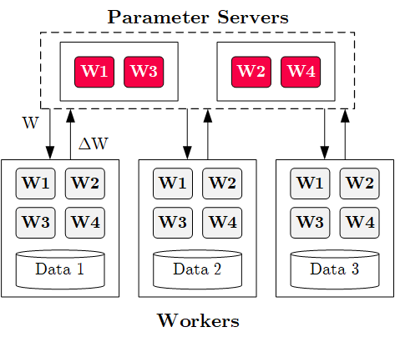




Execution Strategies
Batch Algorithms: Data and Task Parallel
  Data-parallel operations
  Different physical operators
Mini-Batch Algorithms: Parameter Server
  Data-parallel and model-parallel PS
  Update strategies (e.g.,
  async, sync, backup)
  Data partitioning strategies
  Federated ML (trend since 2018)
Lots of PS Decisions ➔ Acc/Perf-Tradeoff
  Configurations (#workers, batch size/param schedules, update type/freq)
  Transfer optimizations: lossy compression, sparsification, residual accumulation,
  gradient clipping, and momentum corrections
Apps
Lang
Faults
Exec
Data
HW

Slide 17
Fault Tolerance & Resilience
Resilience Problem
  Increasing error rates at scale (soft/hard mem/disk/net errors)
  Robustness for preemption
  Need cost-effective resilience
Fault Tolerance in Large-Scale Computation
  Block replication (min=1, max=3) in distributed file systems
  ECC; checksums for blocks, broadcast, shuffle
  Checkpointing (MapReduce: all task outputs; Spark/DL: on request)
  Lineage-based recomputation for recovery in Spark
ML-specific Schemes (exploit app characteristics)
  Estimate contribution from lost partition to avoid stragglers
  Example: user-defined “compensation” functions
Apps
Lang
Faults
Exec
Data
HW
[Bianca Schroeder, Eduardo Pinheiro, Wolf-Dietrich Weber: DRAM errors in the wild: a large-scale field study. SIGMETRICS 2009]
[Sebastian Schelter, Stephan Ewen, Kostas Tzoumas, Volker Markl: "All roads lead to Rome": optimistic recovery for distributed iterative data processing. CIKM 2013]

Slide 18
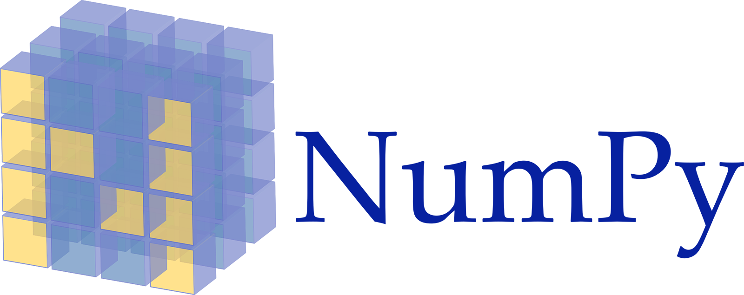

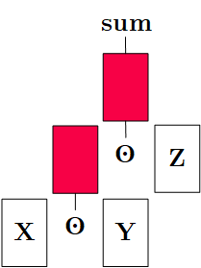
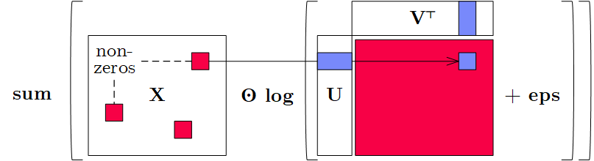
Language Abstractions
Optimization Scope
  #1 Eager Interpretation (debugging, no opt)
  #2 Lazy expression evaluation
  (some opt, avoid materialization)
  #3 Program compilation (full opt, difficult)
Optimization Objective
  Most common: min time s.t. memory constraints
  Multi-objective: min cost s.t. time, min time s.t. acc, max acc s.t. time
Trend: Fusion and Code Generation
  Custom fused operations
  Examples: SystemML, Weld, Taco,
  Julia, TF XLA,TVM, TensorRT
Apps
Lang
Faults
Exec
Data
HW
Sparsity-Exploiting Operator

Slide 19
ML Applications
ML Algorithms (cost/benefit – time vs acc)
  Unsupervised/supervised; batch/mini-batch; first/second-order ML
  Mini-batch DL: variety of NN architectures and SGD optimizers
Specialized Apps: Video Analytics in NoScope
  Difference detectors / specialized
  models for “short-circuit evaluation”
AutoML (time vs acc)
  Not algorithms but tasks (e.g., doClassify(X, y) + search space)
  Examples: MLBase, Auto-WEKA, TuPAQ, Auto-sklearn, Auto-WEKA 2.0
  AutoML services at Microsoft Azure, Amazon AWS, Google Cloud
Data Programming and Augmentation (acc?)
  Generate noisy labels for pre-training
  Exploit expert rules, simulation models, rotations/shifting,
  and labeling IDEs (Software 2.0)
Apps
Lang
Faults
[Credit: Daniel Kang‘17]
Exec
Data
HW
[Chris Thornton, Frank Hutter, et al: Auto-WEKA: combined selection and hyperparameter optimization of classification algorithms. KDD 2013]
[Credit: Jonathan Tremblay‘18]

Slide 20
Language Abstractions

Slide 21
Landscape of ML Systems
JAX
AIDA
Dask
Ludwig
TUPAQ
Mlbase
Tupleware
GraphLab
Kasen
HP Distributed R
Pathways
Emma
Glade
Cümülön(-D)
OptiML
Cumulon
RIOT-DB
OpenAI Triton
OctoML
SystemDS
DMac
LINVIEW
Photon ML
RIOT
SystemML
DAPHNE
Horovod
Hemingway
Mahout Samsara
SAP HANA
MS (Rev) R
vLLM
Velox
F
Brainwash
BigR
SciDB
Ray
ORE
R
Longview
TensorDB
DeepDive
Fa
AzureML
R4ML
Matlab
SimSQL
Columbus
ModelDB
Octave
Orion
Zombie
ScalOps
MXNet
BUDS
Julia
CNTK
Weka
Santoku
LibFM
KeystoneML
Torch
PyTorch
Keras
scikit-learn
Sherlock
ModelHub
BigDL
TensorFlow
SPSS
Hamlet
Singa
VW
Flink ML
DL4J
Mahout
RAPIDS
Theano
Caffe
SAS
Spark ML
MADlib
Bismarck
Spark R

Slide 22

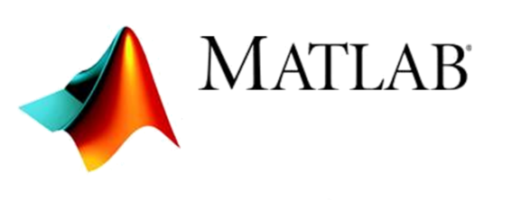



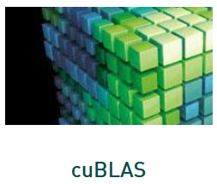

Landscape of ML Systems, cont.
including Classification of SystemML/SystemDS
#1 Language Abstraction
#2 Execution Strategies
Linear Algebra Programs
Parameter Server
(Modell-Parallel)
Computation Graphs
Task-Parallel Constructs
Algorithm Libraries
Data-Parallel Operations
Operator Libraries
Collections
Local (single node)
Graphs
Matrices
HW accelerators (GPUs, FPGAs, ASICs)
Tensors
Frames
Distributed
#4 Data Types
#3 Distribution

Slide 23

UDF-based Systems
User-defined Functions (UDF)
  Data type: Input usually collections of cells, rows, or blocks
  Implement loss and overall optimizer by yourself / UDF abstractions
  Examples: data-parallel (e.g., Spark MLlib)
  or In-DBMS analytics (MADlib, AIDA)
Example SQL
Matrix Product in SQL
SELECT A.i, B.j,
SUM(A.val*B.val)
FROM A, B
WHERE A.j = B.i
GROUP BY A.i, B.j;
Matrix Product w/ UDF
SELECT A.i, B.j,
dot(A.row, B.col)
FROM A, B;
Optimization w/ UDA
Init(state)
Accumulate(state,data)
Merge(state,data)
Finalize(state,data)

Slide 24
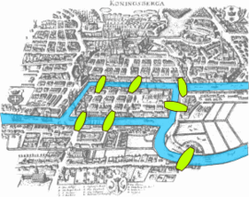
[Grzegorz Malewicz et al: Pregel:
a system for large-scale graph processing. SIGMOD 2010,
SIGMOD 2020 Test of Time Award]
Graph-based Systems
Google Pregel
  Name: Seven Bridges of Koenigsberg (Euler 1736)
  “Think-like-a-vertex” (vertex-centric processing)
  Iterative processing in super steps, comm.: message passing
Programming Model
  Represent graph as collection of vertices w/ edge (adjacency) lists
  Implement algorithms via Vertex API
  Terminate if all vertices halted / no more msgs
1
2
3
4
5
7
6
2
[1, 3, 4]
7
[5, 6]
Worker 1
public abstract class Vertex {
public String getID();
public long superstep();
public VertexValue getValue();
public compute(Iterator<Message> msgs);
public sendMsgTo(String v, Message msg);
public void voteToHalt();
}
4
[1, 2]
1
[1, 2, 4]
5
[6, 7]
[2]
Worker 2
3
6
[5, 7]
Notes:
Note: Euler showed 1736 that there cannot be a route that crosses every bridge just once (Seven Bridges of Koenigsberg) because there can be at most 2 nodes (begin, end) that have an uneven number of bridges (enter,exit).

Slide 25
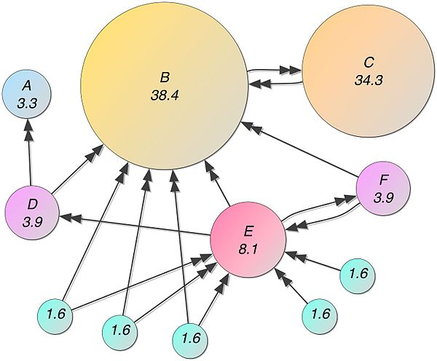
Graph-based Systems, cont.
Example1: Connected Components
  Connected components
  of graph (subgraphs
  of connected nodes)
  Propagate max(current, msgs)
  if != current to neighbors,
  terminate if no msgs
Example 2: Page Rank
  Ranking of webpages by importance / impact
  #1: Initialize vertices to 1/numVertices()
  #2: In each super step
    Compute current vertex value:
    value = 0.15/numVertices()+0.85*sum(msg)
    Send to all neighbors:
    value/numOutgoingEdges()
Step 0
Step 1
Step 2
Step 3
converged
1
4
4
2
3
4
3
4
4
4
5
4
7
4
7
7
6
7
7
7
7
[Credit: https://
en.wikipedia.org/
wiki/PageRank]

Slide 26
Graph-based Systems, cont.
# initialize state with vertex ids
c = seq(1,nrow(G));
diff = Inf;
iter = 1;
# iterative computation of connected components
while( diff > 0 & (maxi==0 | iter<=maxi) ) {
u = max(rowMaxs(G * t(c)), c);
diff = sum(u != c)
c = u; # update assignment
iter = iter + 1;
}
Excursus: Graph Processing
via Sparse Linear Algebra
  SystemDS’
  components()
  SystemDS’
  pageRank()
alpha = ifdef(argAlpha, 0.85);
while( i < maxi ) {
# power iteration on G w/ Gij = 1/degree
p = alpha*(G %*% p) + (1-alpha)*(e %*% u %*% p);
i += 1;
}
[Jure Leskovec, Anand Rajaraman, Jeffrey D. Ullman: Mining of Massive Datasets, Stanford 2014]

Slide 27
Linear Algebra Systems
Comparison Query Optimization
  Rule- and cost-based rewrites and operator ordering
  Physical operator selection and query compilation
  Linear algebra / other ML operators, DAGs, control flow, sparse/dense formats
#1 Interpretation (operation at-a-time)
  Examples: R, PyTorch, Morpheus [PVLDB’17]
#2 Lazy Expression Compilation (DAG at-a-time)
  Examples: RIOT [CIDR’09], TensorFlow [OSDI’16]
  Mahout Samsara [MLSystems’16]
  Examples w/ control structures: Weld [CIDR’17],
  OptiML [ICML’11], Emma [SIGMOD’15]
#3 Program Compilation (entire program)
  Examples: SystemML [PVLDB’16], Julia
  Cumulon [SIGMOD’13], Tupleware [PVLDB’15]
DB
PL
HPC
Compilers for Large-scale ML
Optimization Scope
1: X = read($1); # n x m matrix
2: y = read($2); # n x 1 vector
3: maxi = 50; lambda = 0.001;
4: intercept = $3;
5: ...
6: r = -(t(X) %*% y);
7: norm_r2 = sum(r * r); p = -r;
8: w = matrix(0, ncol(X), 1); i = 0;
9: while(i<maxi & norm_r2>norm_r2_trgt) 10: {
11: q = (t(X) %*% X %*% p)+lambda*p;
12: alpha = norm_r2 / sum(p * q);
13: w = w + alpha * p;
14: old_norm_r2 = norm_r2;
15: r = r + alpha * q;
16: norm_r2 = sum(r * r);
17: beta = norm_r2 / old_norm_r2;
18: p = -r + beta * p; i = i + 1;
19: }
20: write(w, $4, format="text");

Slide 28
[Dan Moldovan et al.: AutoGraph: Imperative-style Coding with Graph-based Performance. SysML 2019.]
Linear Algebra Systems, cont.
Note: TF 2.0
Some
Examples …
(1.x)
X = read("./X");
y = read("./y");
p = t(X) %*% y;
w = matrix(0,ncol(X),1);
while(...) {
q = t(X) %*% X %*% p;
...
}
var X = drmFromHDFS("./X")
val y = drmFromHDFS("./y")
var p = (X.t %*% y).collect
var w = dense(...)
X = X.par(256).checkpoint()
while(...) {
q = (X.t %*% X %*% p)
.collect
...
}
# read via queues
sess = tf.Session()
# ...
w = tf.Variable(tf.zeros(...,
dtype=tf.float64))
while ...:
v1 = tf.matrix_transpose(X)
v2 = tf.matmult(X, p)
v3 = tf.matmult(v1, v2)
q = sess.run(v3)
...
(Custom DSL
w/ R-like syntax;
program compilation)
(Embedded DSL in Scala;
lazy evaluation)
(Embedded DSL in Python;
lazy [and eager] evaluation)

Slide 29
ML Libraries / Model Zoos
#1 Fixed Algorithm Implementations
  Often on top of existing linear
  algebra or UDF abstractions
#2 Model Zoos / APIs
  Pre-trained models
  Hugging Face
  (https://huggingface.co/models)
  YOLOv2 – v7
  PyTorch/TensorFlow
  Model Zoos
SparkML/ MLlib
Single-node Example (Python)
from numpy import genfromtxt
from sklearn.linear_model \
import LinearRegression
X = genfromtxt('X.csv')
y = genfromtxt('y.csv')
reg = LinearRegression()
.fit(X, y)
out = reg.score(X, y)
Distributed Example (Spark Scala)
import org.apache.spark.ml
.regression.LinearRegression
val X = sc.read.csv('X.csv')
val y = sc.read.csv('y.csv')
val Xy = prepare(X, y).cache()
val reg = new LinearRegression()
.fit(Xy)
val out reg.transform(Xy)

Slide 30


DNN Frameworks
AMLS’24 Project:
Additional DNN Optimizers
High-level DNN Frameworks
  Language abstraction for DNN construction and model fitting
  Examples:
  Caffe, Keras
Low-level DNN Frameworks
  Examples: TensorFlow, MXNet, PyTorch, CNTK
model = Sequential()
model.add(Conv2D(32, (3, 3), padding='same',
input_shape=x_train.shape[1:]))
model.add(Activation('relu'))
model.add(Conv2D(32, (3, 3)))
model.add(Activation('relu'))
model.add(
MaxPooling2D(pool_size=(2, 2)))
model.add(Dropout(0.25))
...
opt = keras.optimizers.rmsprop(
lr=0.0001, decay=1e-6)
# Let's train the model using RMSprop
model.compile(loss='cat…_crossentropy',
optimizer=opt,
metrics=['accuracy'])
model.fit(x_train, y_train,
batch_size=batch_size,
epochs=epochs,
validation_data=(x_test, y_test),
shuffle=True)

Slide 31
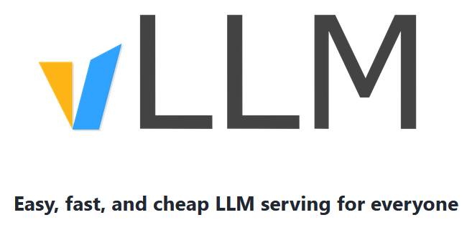
LLM Offline and Online Inference
vLLM: LLM Inference and Serving
  Management of attention key/value cache
  Batching of incoming requests, eviction mechanisms
  HuggingFace models and hardware accelerators
[https://docs.vllm.ai/en/stable/
getting_started/examples/basic.html#]
from vllm import LLM, SamplingParams
# Sample prompts.
prompts = [
"Hello, my name is",
"The president of the United States is",
"The capital of France is",
"The future of AI is",
]
# Create a sampling params object.
sampling_params = SamplingParams(
temperature=0.8, top_p=0.95)
...
# Create an LLM.
llm = LLM(model="facebook/opt-125m")
# Generate texts from the prompts (RequestOutput)
outputs = llm.generate(prompts, sampling_params)
# Print the outputs.
print("\nGenerated Outputs:\n" + "-" * 60)
for output in outputs:
prompt = output.prompt
generated_text = output.outputs[0].text
print(f"Prompt: {prompt!r}")
print(f"Output: {generated_text!r}")
print("-" * 60)

Slide 32
Feature-centric Tools
AMLS’25 Project: Extended Feature Transformations
DeepDive
  Knowledge base construction via SQL/MLNs
  Grounding: SQL queries → factor graph
  Inference: statistical inference on factor graph
  Incremental maintenance via sampling / variational approach
Overton (Apple)
  Building, monitoring, improving ML pipelines
  High-level abstractions: tasks and payloads
  Data slicing, multi-task learning, data augmentation
Ludwig (Uber AI)
  Data types and configuration files
  Encoders, combiners, decoders
  Example “visual question answering”:
[Jaeho Shin et al: Incremental Knowledge Base Construction Using DeepDive. PVLDB 2015]
[Christopher Ré et al: Overton: A Data System for Monitoring and Improving Machine-Learned Products, CIDR 2020]
[Piero Molino, Yaroslav Dudin, Sai Sumanth Miryala: Ludwig: a type-based declarative deep learning toolbox. CoRR 2019]
Notes:
MLN: markov logic networks
Bi-LSTM: bidirectional long-term short-term memory
Variational approach: store sparse factor graph (with fewer factors) to approximate distribution

Slide 33
ML Systems Benchmarks

Slide 34
“Big Data” Benchmarks w/ ML Components
[Ahmad Ghazal et al: BigBench: towards an industry standard benchmark for big data analytics. SIGMOD 2013]
BigBench → TPCx-AI
  30 workloads (6 statistics, 17 data mining)
  Different data sources, processing types
  Note: TPCx-BB, TPCx-HS [TPCTC 2016], TPCx-AI (09/2021)
HiBench (Intel)
  MapReduce Micro benchmarks (WC, TeraSort)
  IR/ML (e.g., PageRank, K-means, Naïve Bayes)
GenBase
  Preprocessing and ML in array databases
SparkBench
  Existing library algorithms (ML, Graph, SQL, stream)
  ML: LogReg, SVM, matrix factorization, PageRank
[Tilmann Rabl et al: TPCx-AI - An Industry Standard Benchmark for Artificial Intelligence and Machine Learning Systems. PVLDB 2023]
[Lan Yi, Jinquan Dai: Experience from Hadoop Benchmarking with HiBench: From Micro-Benchmarks Toward End-to-End Pipelines. WBDB 2013]
[Rebecca Taft et al: GenBase: a complex analytics genomics benchmark. SIGMOD 2014]
[Dakshi Agrawal et al:
SparkBench - A Spark Performance Testing Suite. TPCTC 2015]

Slide 35

Linear Algebra and DNN Benchmarks
AMLS’25 / DIA’25/26 Project:
SSB Benchmark Implementation
SLAB: Scalable LA Benchmark (UCSD)
  Ops: TRANS, NORM, GRM, MVM, ADD, GMM
  Pipelines/Decompositions: MMC, SVD
  Algorithms: OLS, LogReg, NMF, HRSE
DAWNBench (Stanford)
  Image Classification ImageNet: 93% top-5 val err
  Image Classification CIFAR10: 94% test accuracy
  Question Answering SQuAD: 0.75 F1 measure
MLPerf
  Image classification ImageNet, object detection
  COCO, translation WMT En-Ger, recommendation
  MovieLens, reinforcement learning Go
  Train to target accuracy
  Open (diff model) vs closed divisions
[Anthony Thomas, Arun Kumar: A Comparative Evaluation of Systems for Scalable Linear Algebra-based Analytics. PVLDB 2018]
[Cody Coleman et al.: DAWNBench: An End-to-End Deep Learning Benchmark and Competition, ML Systems Workshop 2017]
[Peter Mattson et al.: MLPerf Training
Benchmark, MLSys 2020]
[https://mlcommons.org/en/training-normal-11/, https://mlcommons.org/en/training-hpc-10/]

Slide 36
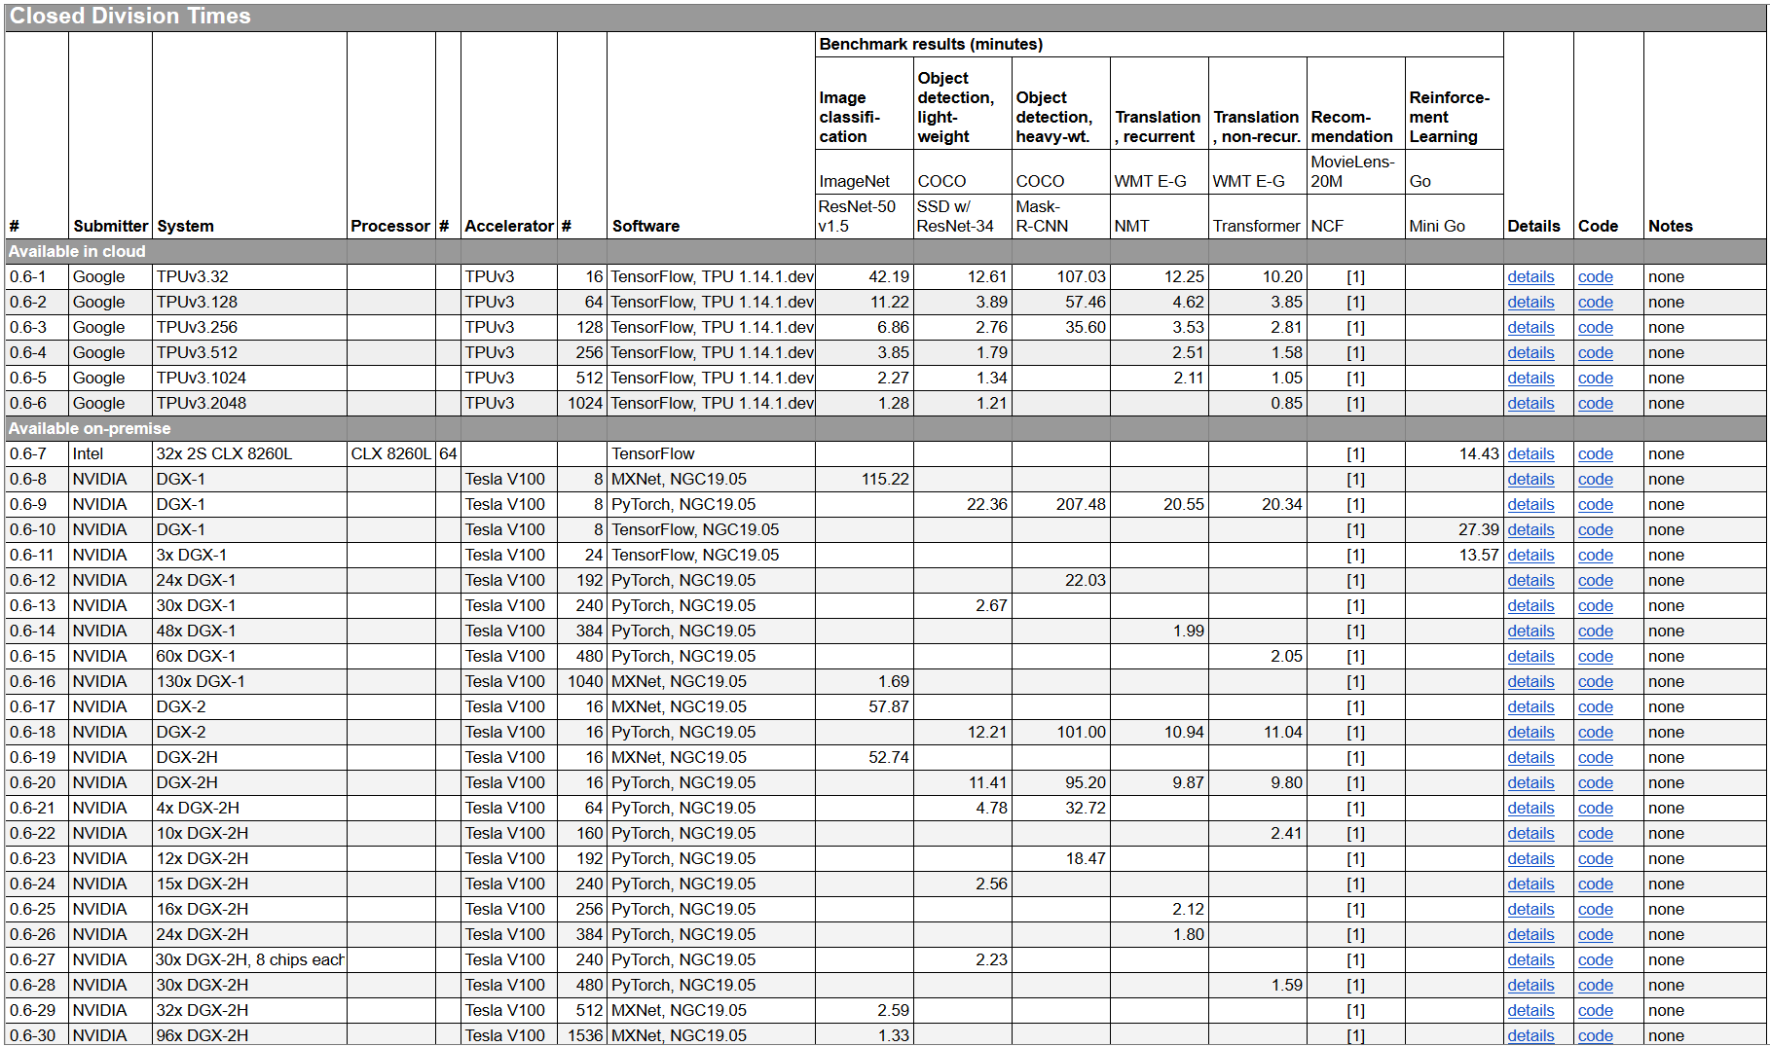
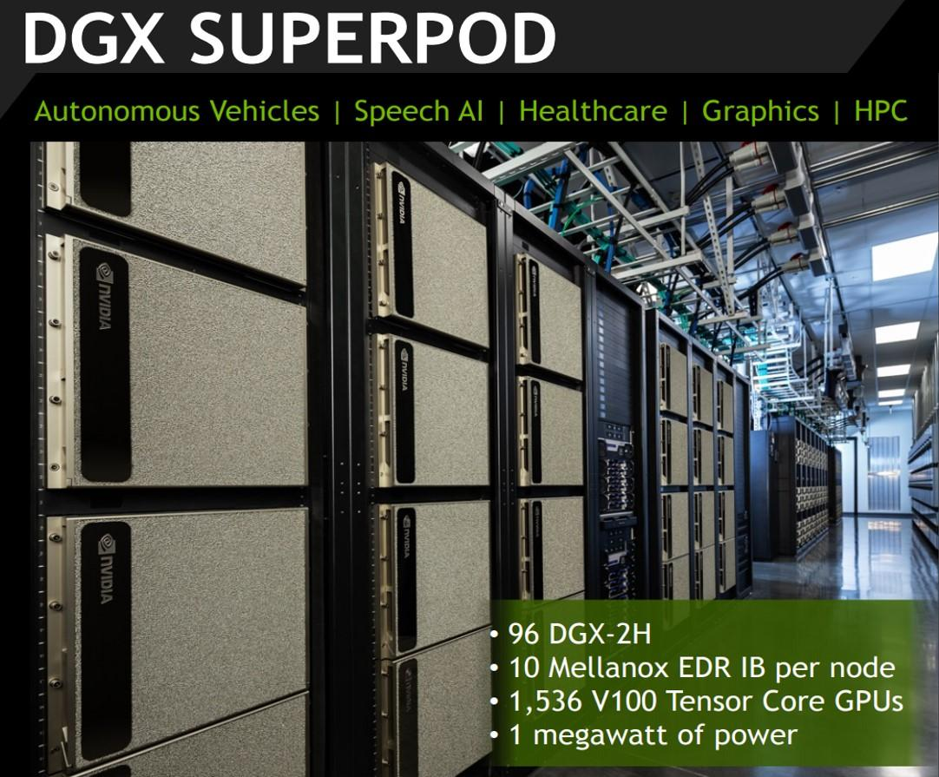
DNN Benchmarks, cont.
MLPerf v0.6:
https://mlperf.org/training-results-0-6/,
MLPerf v0.7:
https://mlperf.org/training-results-0-7
… MLPerf v2.1 (11/2022)
V0.6
96 x DGX-2H = 96 * 16
= 1536 V100 GPUs
➔ ~ 96 * $400K = $35M – $40M
[https://www.forbes.com/sites/
tiriasresearch/2019/06/19/
nvidia-offers-a-turnkey-supercomputer-the-dgx-superpod/#693400f43ee5]
Notes:
V07: up to 4096 (regular), 16384 (HPC)

Slide 37
AutoML and Data Cleaning
MLBench
  Compare AutoML w/ human experts (Kaggle)
  Classification, regression; AUC vs Runtime
(Open Source) AutoML Benchmark
  39 classification datasets, AUC metric, 10-fold CV
  Extensible metrics, OS AutoML frameworks, datasets
CleanML
  Train/Test on dirty vs clean data (2x2)
  Missing values, outliers, duplicates, mislabels
Meta Worlds Benchmark
  Meta-reinforcement and multi-task learning
  50 robotic tasks (e.g., get coffee, open window)
Feature Type Inference
  Dirty/clean ML model training/test
[Yu Liu et.al: MLBench: Benchmarking Machine Learning Services Against Human Experts. PVLDB 2018]
[Pieter Gijsbers et al.:
An Open Source AutoML Benchmark. Automated ML Workshop 2019]
[Peng Li et al: CleanML: A Benchmark for Joint Data Cleaning and Machine Learning, ICDE 2021]
[Tianhe Yu et al: Meta-World: A Bench-mark and Evaluation for Multi-Task and Meta Reinforce-ment Learning, CoRL 2019]
[Vraj Shah et al.: Towards Benchmarking Feature
Type Inference for AutoML Platforms, SIGMOD 2021]

Slide 38
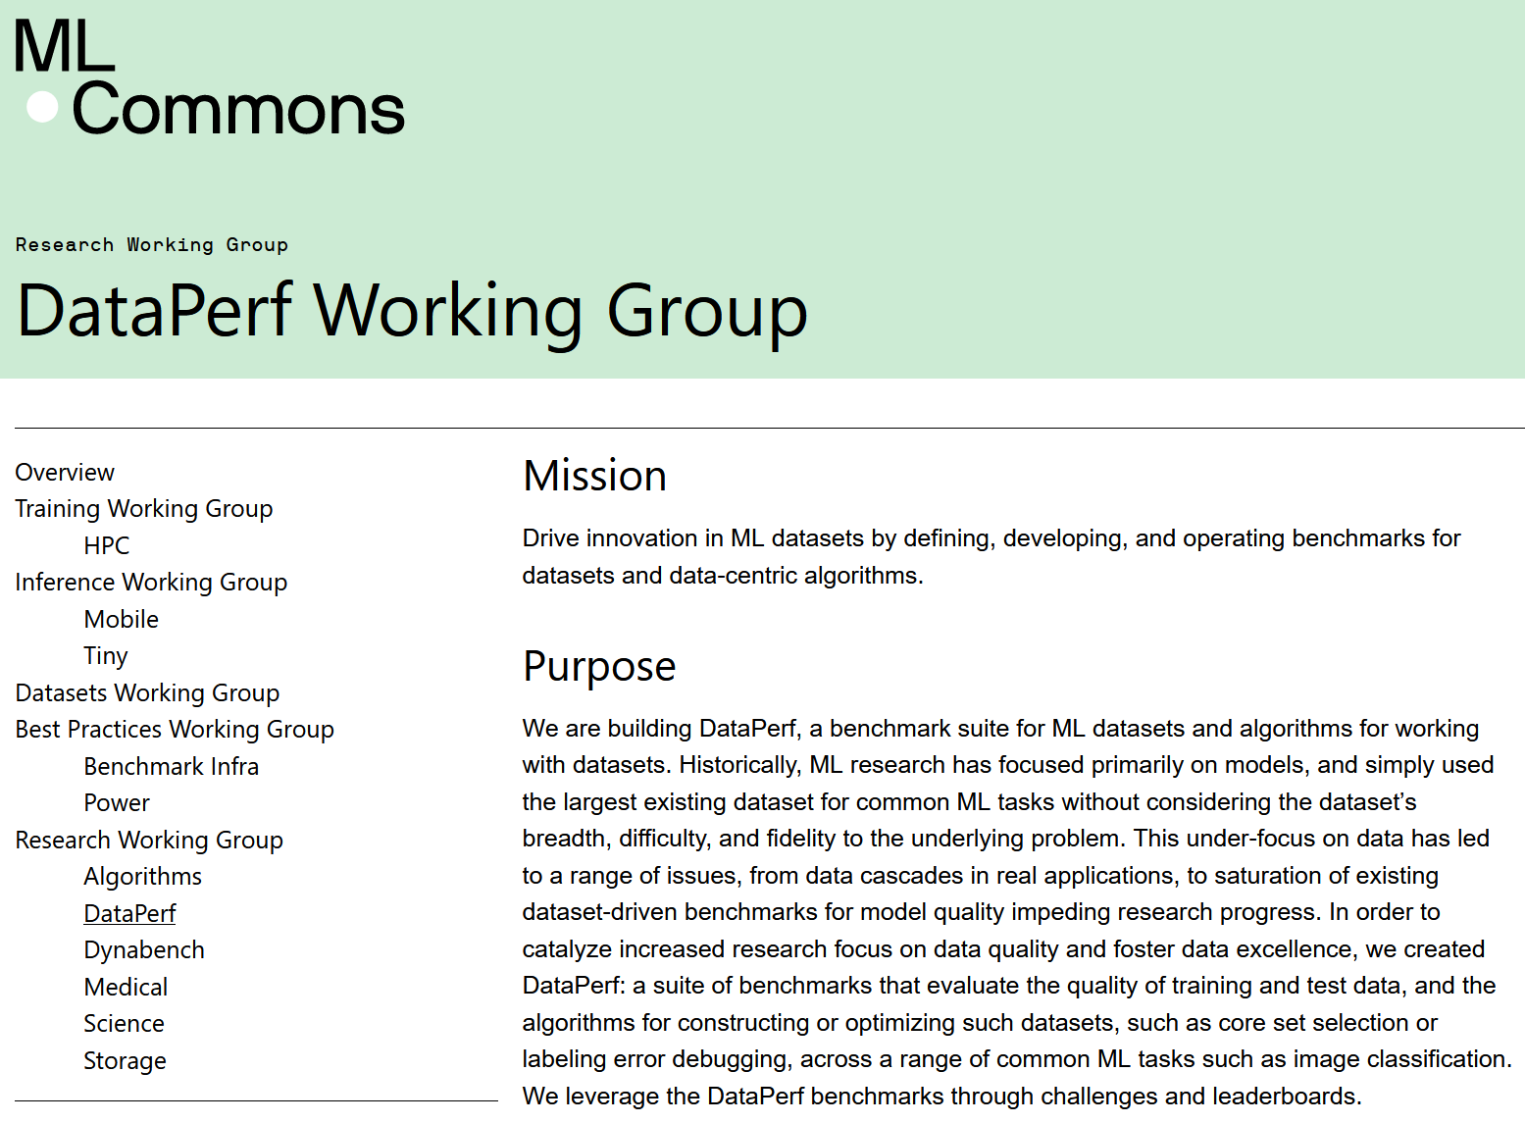
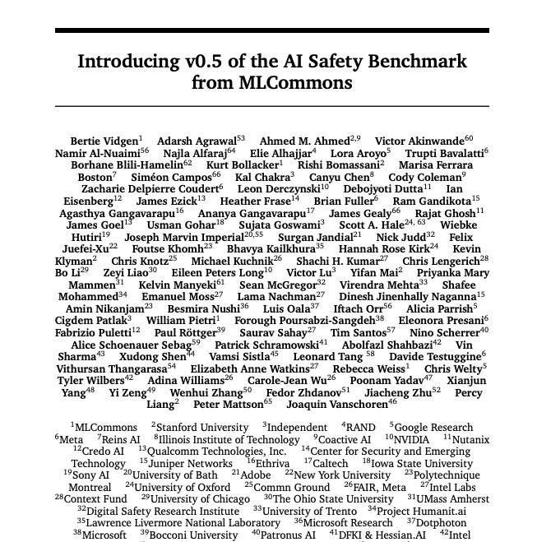
Data-centric ML and other Directions
Excursus: ML-Commons Working Groups
https://mlcommons.org/working-groups/
#1 DataPerf Working Group
  Renamed to Data-centric ML Research Working Group
  https://mlcommons.org/en/groups/research-dataperf/
#2 AI Safety Working Group
  v0.5: chatbots w/ typical, malicious, vulnerable users
  Defines 13 hazard categories
  https://mlcommons.org/working-groups/ai-safety/ai-safety/
And many more: e.g., datasets, metadata, medical domain
[https://huggingface.co/papers/2404.12241]

Slide 39
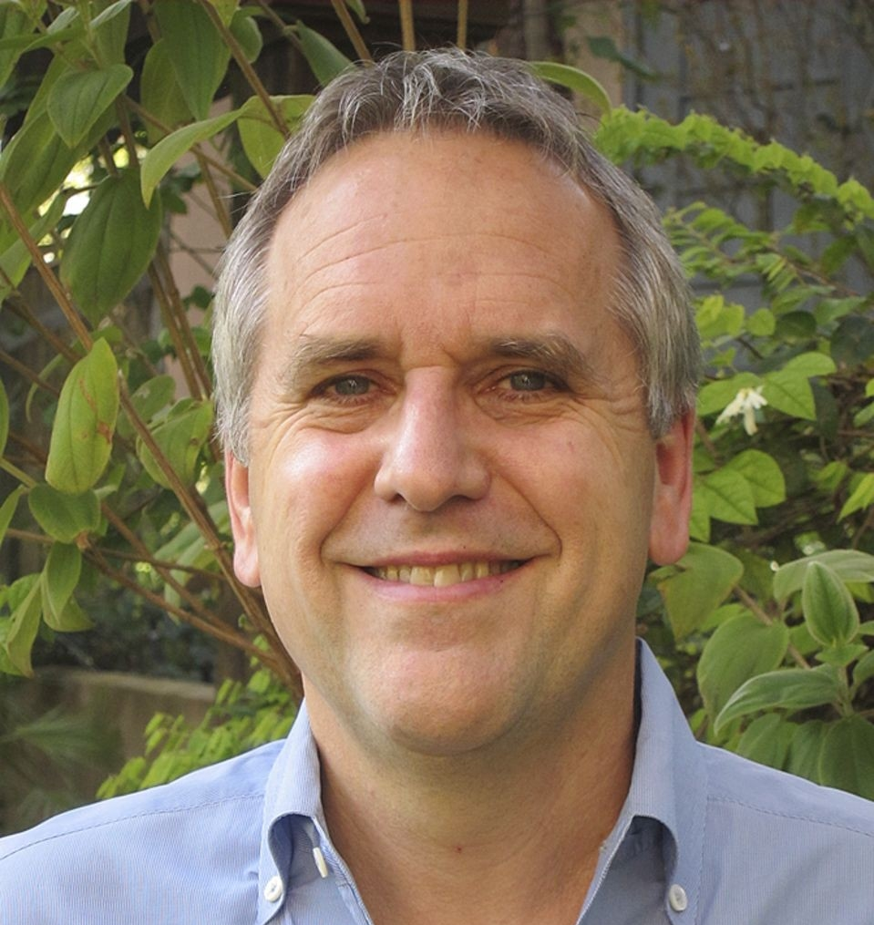
Summary & QA
Data Science Lifecycle
ML Systems Stack
Language Abstractions
ML System Benchmarks
Recommended Reading (a critical perspective on a broad sense of ML systems)
  [M. Jordan: SysML: Perspectives and Challenges. Keynote at SysML 2018]
  “ML […] is far from being a solid engineering
  discipline that can yield robust, scalable solutions
  to modern data-analytic problems”
  https://www.youtube.com/watch?v=4inIBmY8dQI

