Slide 1

Architecture of ML Systems (AMLS)
08 Hardware Accelerators
Prof. Dr. Matthias Boehm
Technische Universität Berlin
Berlin Institute for the Foundations of Learning and Data
Big Data Engineering (DAMS Lab)
Last update: Jun 11, 2026

Slide 2

Announcements / Org
#1 Hybrid & Video Recording
  Hybrid lectures (in-person, zoom) with optional attendance
  https://tu-berlin.zoom.us/j/9529634787?pwd=R1ZsN1M3SC9BOU1OcFdmem9zT202UT09
  Zoom video recordings, links from website
  https://mboehm7.github.io/teaching/ss26_amls/index.htm
#2 Exam Registration
  Thu July 23, 4-6pm (room TBD) → 5 registrations
  Thu Aug 06, 4-6pm (room TBD) → 5 registrations
  Thu Aug 27, 4-6pm (room TBD) → 1 registrations

Slide 3
Categories of Execution Strategies
Batch
SIMD/SPMD
Independent
Tasks
MIMD
Mini-batch,
Federated,
RL
Self-supervised, supervised,
RL
05_{a} Data-Parallel Execution
05_{b} Task-Parallel Execution
06 Parameter Servers (data, model)
07 LLM Training
(dense, MoE)
08 Hybrid Execution and HW Accelerators
09 Caching, Partitioning, Indexing, and Compression

Slide 4
Agenda
Motivation and Terminology
GPUs in ML Systems
FPGAs in ML Systems
ASICs and other HW Accelerators

Slide 5
Motivation and Terminology

Slide 6
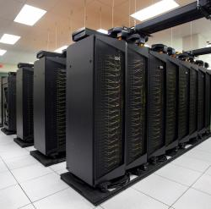
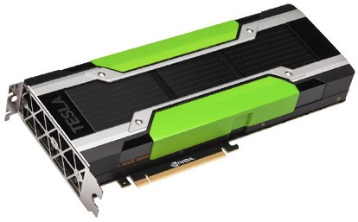
Recap: Driving Factors for ML
[Credit: Andrew Ng’14]
Improved Algorithms and Models
  Success across data and application domains
  (e.g., health care, finance, transport, production)
  More complex models which leverage large data
Availability of Large Data Collections
  Increasing automation and monitoring ➔ data
  (simplified by cloud computing & services, annotation services)
  Feedback loops, simulation/data prog./augmentation
  → Trend: self-supervised learning (*-GPT-x)
HW & SW Advancements
  Higher performance of hardware and infrastructure (cloud)
  Open-source large-scale computation frameworks,
  ML systems, and vendor-provides libraries
Feedback Loop
Data
Usage
Model

Slide 7
DNN Challenges
#1 Larger Models
and Scoring Time
#2 Training Time
  ResNet18: 10.76% error, 2.5 days training
  ResNet50: 7.02% error, 5 days training
  ResNet101: 6.21% error, 1 week training
  ResNet152: 6.16% error, 1.5 weeks training
#3 Energy Efficiency
But, LLM Scaling Laws (see 08)
[Song Han: Efficient Methods and Hardware for Deep Learning, Stanford cs231n, 2017]

Slide 8
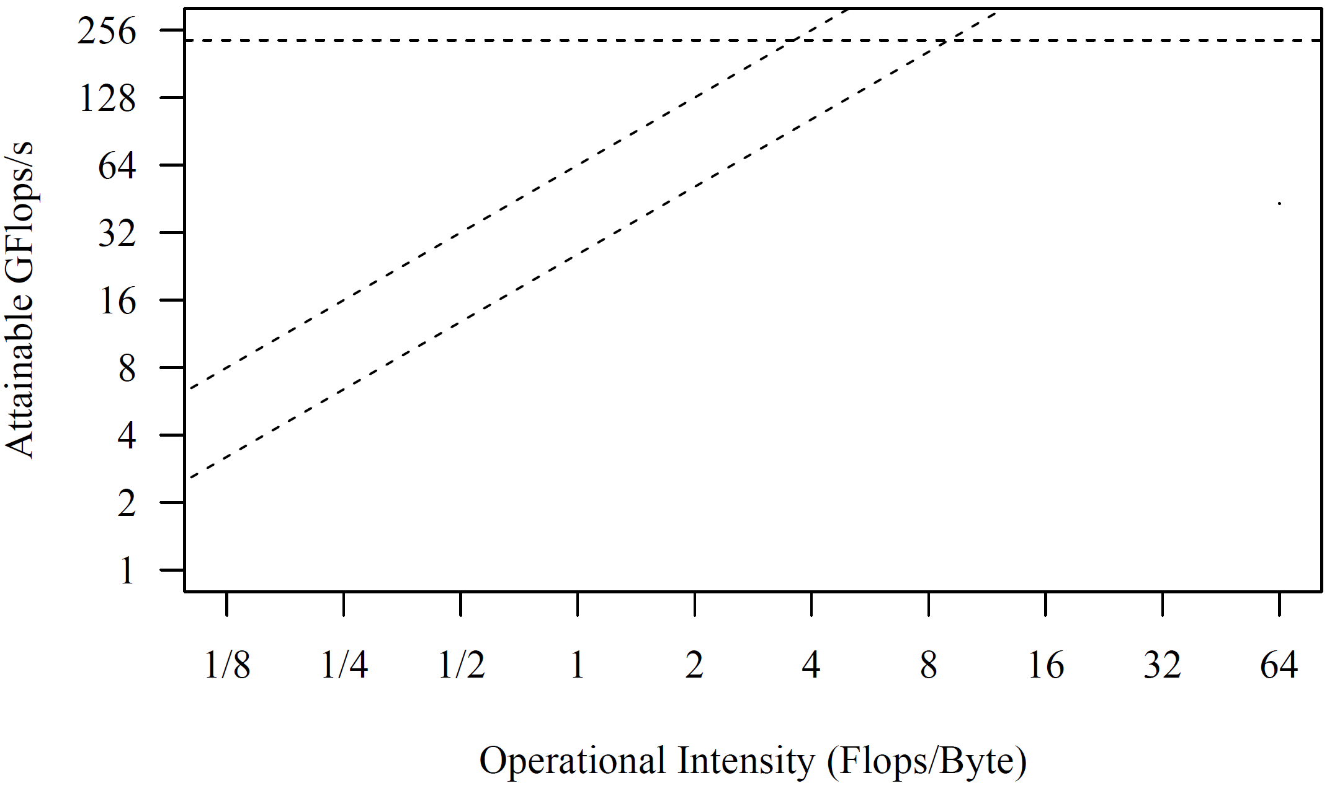
Excursus: Roofline Analysis
Setup: 2x6 E5-2440 @2.4GHz–2.9GHz, DDR3 RAM @1.3GHz (ECC)
  Max mem bandwidth (local): 2 sock x 3 chan x 8B x 1.3G trans/s → 2 x 32GB/s
  Max mem bandwidth (QPI, full duplex) → 2 x 12.8GB/s
  Max floating point ops: 12 cores x 2*4dFP-units x 2.4GHz → 2 x 115.2GFlops/
Roofline Analysis
  Off-chip memory traffic
  Peak compute
(Experiments from 2017)
SystemML BLAS
36x
SystemML
MM (n=768)
[S. Williams, A. Waterman, D. A. Patterson: Roofline: An Insightful Visual Performance Model for Multicore Architectures. Commun. ACM 2009]
SystemML
Mt(Mv)
SystemML
Mv
➔ IO-bound traditional ML
➔ compute-bound DNN

Slide 9
[S. Markidis, E. Laure, N. Jansson, S. Rivas-Gomez and S. W. D. Chien: Moore’s Law and Dennard Scaling]
HW Challenges
P = α CFV² (power density 1)
(P .. Power, C .. Capacitance,
F .. Frequency, V .. Voltage)
#1 End of Dennard Scaling (~2005)
  Law: power stays proportional to the area of the transistor
  Ignored leakage current / threshold voltage
  → increasing power density S² (power wall, heat) → stagnating frequency
#2 End of Moore’s Law (~2010-20)
  Law: #transistors/performance/
  CPU frequency doubles every
  18/24 months
  Original: # transistors per chip
  doubles every two years
  at constant costs
  Now increasing costs (10/7/5nm)
➔ Consequences: Dark Silicon and Specialization
Notes:
Dennard Scaling: (scaling factor S of transistors)
* # transistors: S^2
* Capacitance: 1/S
* Frequency: S
* Device power V: 1/(S^2)
* Alpha 1/2
(but V cannot be further reduced due to leakage (noise of neighboring transistors); capacity (current) of transistor -> the smaller the transistor, the smaller the frequency)
Gordon Moore (co-founder of Intel)

Slide 10
Towards Specialized Hardware
HW Devices
HW Specialization
Additional Specialization
  Data Transfer & Types: e.g., low-precision, quantization
  Sparsity Exploitation: e.g., sparsification, exploit across ops,
  defer weight decompression just before instruction execution
  Near-Data Processing: e.g., operations in main memory, storage class memory (SCM),
  secondary storage (e.g., SSDs), and tertiary storage (e.g., tapes)
General Purpose
Specialized HW
CPU
GPU
FPGAs
ASICs
SIMD
Throughput-oriented, specialized instructions
programmable
logic
fixed logic
08 Caching, Indexing and Compression
Notes:
Tradeoff: reconfiguration (CPU high, ASIC impossible) vs energy efficiency (ASIC high, CPU low)

Slide 11
GPUs in ML Systems

Slide 12
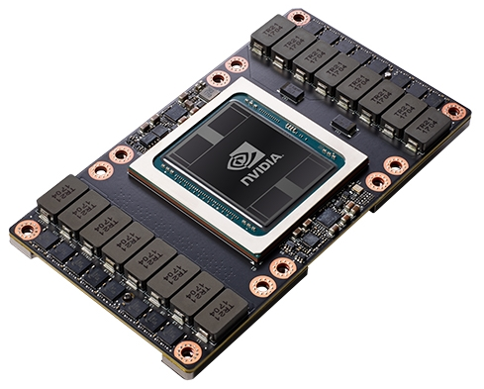
NVIDIA Volta V100 – Specifications
Tesla V100 NVLink
  FP64: 7.8 TFLOPs, FP32: 15.7 TFLOPs
  DL FP16: 125 TFLOPs
  NVLink: 300GB/s
  Device HBM: 32 GB (900 GB/s)
  Power: 300 W
Tesla V100 PCIe
  FP64: 7 TFLOPs, FP32: 14 TFLOPs
  DL FP16: 112 TFLOPs
  PCIe: 32 GB/s
  Device HBM: 16 GB (900 GB/s)
  Power: 250 W
[Credit: https://nvidia.com/de-de/
data-center/tesla-v100/]
Notes:
2017

Slide 13
[NVIDIA Tesla V100 GPU Architecture - THE WORLD’S MOST ADVANCED DATA CENTER GPU, Whitepaper, Aug 2017]
NVIDIA Volta V100 – Architecture
6 GPU Processing Clusters (GPCs)
  7 Texture Processing
  Clusters (TPC)
  14 Streaming
  Multiprocessors (SM)

Slide 14
NVIDIA Volta V100 – SM Architecture
FP64 cores: 32 / FP32 cores: 64
INT32 cores: 64
“Tensor cores”: 8
Max warps /SM: 64
Threads/warp: 32

Slide 15
Single Instruction Multiple Threads (SIMT)
32 Threads grouped to warps and execute in SIMT model
Pascal P100
Execution Model
  Warps use a single
  program counter + active mask
Volta V100
Execution Model
  Independent thread scheduling
  Per-thread program counters
  and call stacks
  New __syncwarp() primitive
  (if needed) + convergence optimizer
Thread Divergence

Slide 16
NVIDIA Volta V100 – Tensor Cores
“Tensor Core”
  Specialized instruction for 4x4 by 4x4 fused matrix multiply
  Two FP16 inputs and FP32 accumulator
  Exposed as warp-level matrix operations w/ special load, mm, acc, and store
[Bill Dally: Hardware for Deep Learning. SysML 2018]
64 FMA
operations
D = A %*% B + C

Slide 17
NVIDIA Ampere A100
Specification
  7nm, 8 GPC x 8 TPC * 2 SM = 128 SMs, 40GB HBM
  FP64: 9.7 TFLOPs / FP64 TensorCore: 19.5 TFLOPs
  FP32 19.5 TFLOPs, FP16: 78 TFLOPs, BF16: 39 TFLOPs
  TF32 TensorCore 156 TFLOPs / 312 TFLOPs (sparse)
  FP16 TensorCore 312 TFLOPs / 624 TFLOPs (sparse), INT8, INT4
New Features
  New generation of “TensorCores” (FP64, new data types: TF32, BF16)
  Fine-grained sparsity exploitation
  Multi-instance GPU (MIG) virtualization: up to 7 virtual GPU instances
  Link technologies: NVLink 3 (25GB/s bidirectional) x 12 links = 600GB/s
  Submission of task graphs (launch a workflow of kernels)
[NVIDIA A100 Tensor Core GPU Architecture - UNPRECEDENTED ACCELERATION AT
EVERY SCALE, Whitepaper, Aug 2020]

Slide 18
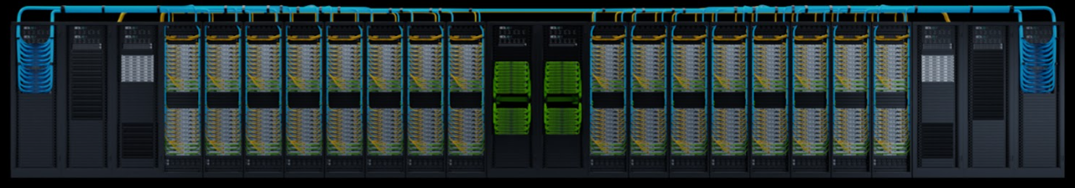
NVIDIA Hopper H100, GH200
Specification SXM5 / PCIe
  7nm, 7/8 GPC x 9 TPC * 2 SM = 114/144 SMs, 80GB HBM
  FP64: 25.6 TFLOPs / FP64 TensorCore: 66.9 TFLOPs
  FP32 66.9 TFLOPs, FP16: 134 TFLOPs, BF16: 134 TFLOPs
  TF32 TensorCore 495 TFLOPs / 989 TFLOPs (sparse)
  FP16 TensorCore 989 TFLOPs / 1979 TFLOPs (sparse),
  FP8 TensorCore 1979 TFLOPs / 3958 TFLOPs (sparse), INT8
New Features
  Dedicated Transformer Engine (hybrid FP8 and FP16)
  HBM3 memory and 50MB L2 cache; TMA - tensor mem. acc. (async copy)
  2nd Gen Multi-instance GPU (MIG) virtualization: up to 7 virtual GPUs
  Confidential computing (trusted execution environments)
  Improved link technologies (NVLink 4, NVSwitch 3, PCIe 5)
NVIDIA Grace Hopper DGX GH200
  256 H100 GPUs in 16 Racks, 96L1 + 36L2 NVSwitches
[NVIDIA H100 Tensor Core GPU Architecture
EXCEPTIONAL PERFORMANCE, SCALABILITY, AND SECURITY FOR THE DATA CENTER, Whitepaper, May 2023]
H100
GH200 (GPU+
ARM CPU)
[https://www.hpcwire.com/2023/05/28/nvidia-announces-new-1-exaflops-ai-supercomputer-grace-hopper-in-full-production/]

Slide 19
NVIDIA Blackwell B100, B200, GB200
[NVIDIA Blackwell Architecture Technical Brief: Powering the New Era of Generative AI and Accelerated Computing, Whitepaper, 04/2024]
New Features
  B100/B200 chips with 2 dies, cache-coherence, and
  10 TB/s chip-to-chip high-bandwidth interface (NV-HBI)
  2nd Gen Transformer Engine (hybrid FP8 and FP16)
  FP4 TensorCore + UINT4 quantization
  NVLink v5 (2x900GB/s) and NVLink switch chip (130TB/s bandwidth)
GB200 Superchip
  1 Grace CPU and 2 Blackwell GPUs (see right)
  FP64: 90 TFLOPs; FP32: 180 TFLOP
  TF32 dense/sparse: 2.5/5 PFLOPs; BF16: 5/10 PFLOPs
  FP8 dense/sparse: 10/20 PFLOPs; FP4: 20/40 PFLOPs
NVL72
  36 GB200 superchips in one rack (72 GPUs, see right)
  FP4 dense/sparse: 0.7/1.4 EFLOPs

Slide 20

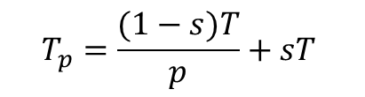
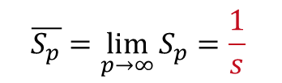
Excursus: Amdahl’s Law
Amdahl’s law
  Given a fixed problem size, Amdahl’s law gives the maximum speedup
  T is the execution time, s is the serial fraction, and p the number of processors
Examples
  Serial fraction s = 0.01 → max S_{p} = 100
  Serial fraction s = 0.05 → max S_{p} = 20
  Serial fraction s = 0.1 → max S_{p} = 10
  Serial fraction s = 0.5 → max S_{p} = 2
Execution Time
$$T_{p}=\frac{(1−s)T}{p}+sT$$
Speedup
$$S_{p}=\frac{T}{T_{p}}$$
Upper-Bound Speedup
$$\overline{S_{p}}=\lim_{p→∞}{S_{p}}=\frac{1}{s}$$

Slide 21
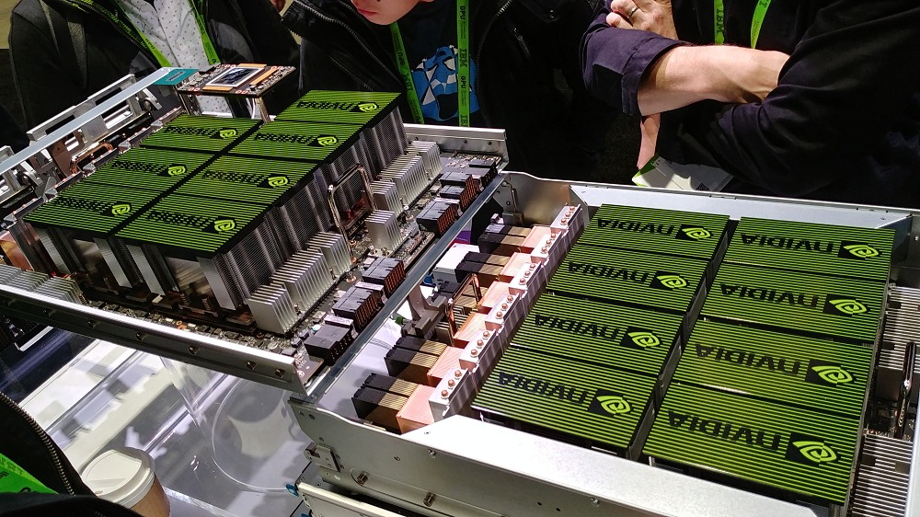
GPUs for DNN Training
GPUs for DNN Training (2009)
  Deep belief networks
  Sparse coding
Multi-GPU Learning (Now)
  Exploit multiple GPUs with a mix of
  data- and model-parallel parameter servers
  Dedicated ML systems for multi-GPU learning
  Dedicated HW: e.g., NVIDIA DGX-1 (8xP100),
  NVIDIA DGX-2 (16xV100, NVSwitch),
  NVIDIA DGX A100 (8x A100, NVSwitch, Mellanox)
  NVIDIA DGX H100 (8x H100, Mellanox InfiniBand)
DNN Framework support
  All specialized DNN frameworks have very good support for GPU training
  Most of them also support multi-GPU training
[Rajat Raina, Anand Madhavan, Andrew Y. Ng: Large-scale deep unsupervised learning using graphics processors. ICML 2009]

Slide 22
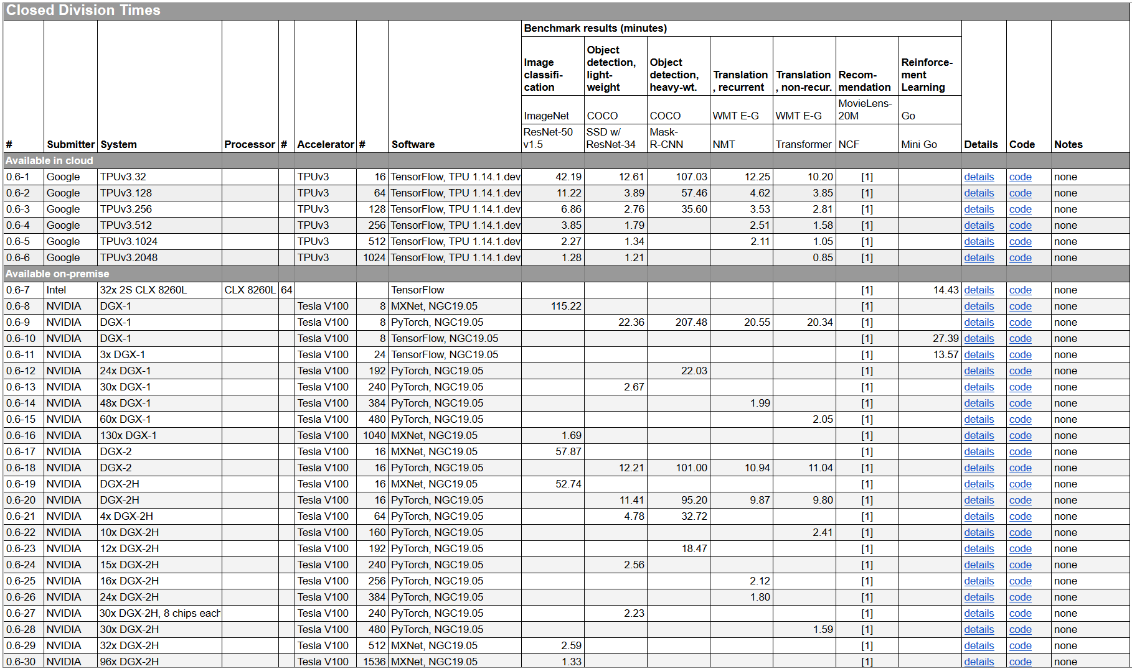
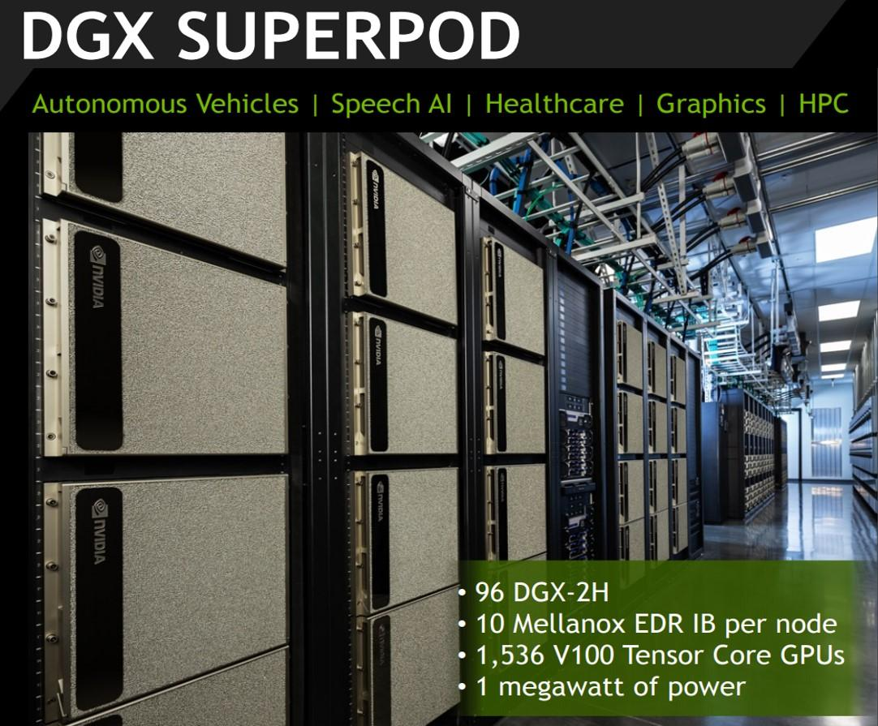
Recap: DNN Benchmarks
MLPerf v0.6:
https://mlperf.org/training-results-0-6/,
MLPerf v0.7:
https://mlperf.org/training-results-0-7
… MLPerf v2.1 (11/2022)
V0.6
96 x DGX-2H = 96 * 16
= 1536 V100 GPUs
➔ ~ 96 * $400K = $35M – $40M
[https://www.forbes.com/sites/
tiriasresearch/2019/06/19/
nvidia-offers-a-turnkey-supercomputer-the-dgx-superpod/#693400f43ee5]
Notes:
V07: up to 4096 (regular), 16384 (HPC)

Slide 23
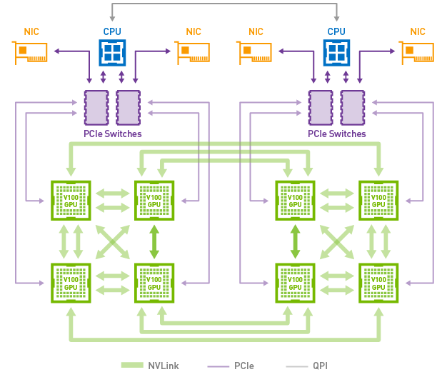
GPU Link Technologies
Classic PCI Express
  Peripheral Component Interconnect Express (default)
  v3 x16 lanes: 16GB/s, v4 (2017) x16 lanes: 32GB/s, v5 (2019) x16 lanes: 64GB/s
#1 NVLink
  Proprietary technology
  Requires NVLink-enabled CPU (e.g., IBM Power 8/9)
  Connect GPU-GPU and GPU-CPU
  NVLink 1: 80+80 GB/s
  NVLink 2: 150+150 GB/s
  NVLink 3: 600 GB/s, NVLink 4: 900GB/s, NVLink 5: 2x 900GB/s
#2 NVSwitch
  Fully connected GPUs, each communicating at 300GB/s
  NVSwitch 2 and 3: from 7.2 Tbits/sec to 13.6 Tbits/sec

Slide 24
GPU Link Technologies, cont.
Recap: Amdahl’s Law
Experimental Setup
  SnapML, 4 IBM Power x 4 V100 GPUs, NVLink 2.0
  200 million training examples of the Criteo dataset (> GPU mem)
  Train a logistic regression model
[Celestine Dünner et al.: Snap ML: A Hierarchical Framework for Machine Learning. NeurIPS 2018]
PCIe v3 Interconnect
NVLink Interconnect

Slide 25
Handling Memory Constraints
#1 Live Variable Analysis
  Remove intermediates ASAP
  Examples: SystemML, TensorFlow, MXNet, Superneurons, MONeT
#2 GPU-CPU Eviction
  Evict variables from GPU to CPU memory under memory pressure
  Examples: SystemML, Superneurons, GeePS, (TensorFlow)
#3 Recomputation
  Recompute inexpensive operations (e.g., activations of forward pass)
  Examples: MXNet, Superneurons, MONet, keras.remat()
#4 Reuse Allocations
  Reuse allocated matrices and tensors via free lists, but fragmentation
  Examples: SystemML, Superneurons, MONet
#5 Physical Operator Selection
  Different tradeoffs of performance and size of intermediates (MONet)
[Linnan Wang et al: Superneurons: dynamic GPU memory management for training deep neural networks. PPOPP 2018]
Problem: Limited
Device Memory
Notes:
MONeT: Aashaka Shah, Chao-Yuan Wu, Jayashree Mohan, Vijay Chidambaram, Philipp Krähenbühl: Memory Optimization for Deep Networks. ICLR 2021

Slide 26
Hybrid CPU/GPU Execution
Manual Placement
  Most DNN frameworks allow manual placement of
  variables and operations on individual CPU/GPU devices
  Heuristics and intuition of human experts
Automatic Placement
  Sequence-to-sequence model to predict which
  operations should run on which device
  Examples:
  [Azalia Mirhoseini et al: Device Placement Optimization with Reinforcement Learning. ICML 2017]
Neural
MT graph
Inception V3
Notes:
Note: white: CPU; colors: different GPU devices
Sequence-to-sequence model with attention (encoder-decoder → operator sequence to device sequence)

Slide 27


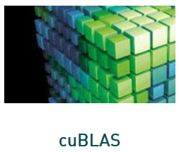

Sparsity in DNN
State-of-the-art
  Very limited support of sparse tensors in TensorFlow, PyTorch, etc
  GPU operations for linear algebra (cuSparse), early support in ASICs
  Problem: Irregular structures of sparse matrices/tensors
Common Techniques
  #1: Blocking/clustering of rows/columns by number of non-zeros
  #2: Padding rows/columns to common number of non-zeros
Example A100 Sparsity Exploitation
  Constraint: 2 non-zeros in block of 4
  Structured valued pruning → accuracy impact
  Regular access pattern
[NVIDIA A100 Tensor Core GPU Architecture, Whitepaper, Aug 2020]
Notes:
Open Problem
Many sources of sparsity (inputs, transformations, selections)
Broader support for efficient sparsity exploitation required

Slide 28
FPGAs in ML Systems

Slide 29
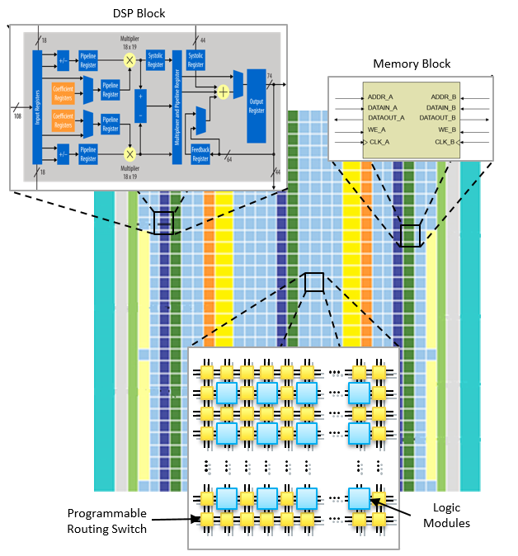
FPGA Overview
[Credit: https://intel.com]
FPGA Definition
  Integrated circuit that allows
  configuring custom hardware designs
  Reconfiguration in <1s
  HW description language:
  e.g., VHDL, Verilog
FPGA Components
  #1 lookup table (LUT) as logic gates
  #2 flip-flops (registers)
  #3 interconnect network
  Additional memory and DSP blocks
Notes:
VHDL: Very High Speed Integrated Circuit Hardware Description Language
LUTs (bit-oriented logic, 4-input, 6-input lookup tables) → 24x17bits 403 LUTs multiply vs 17 LUTs add
DSP (word-oriented multiply-accumulate)

Slide 30
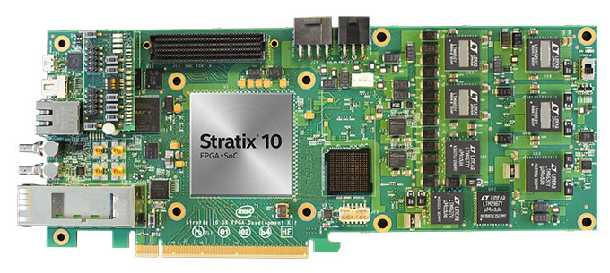
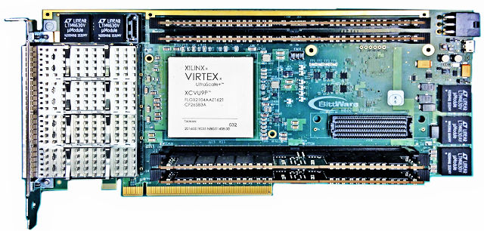
Example FPGA Characteristics
Intel (Altera) Stratix 10 SoC FPGA
  64bit quad-core ARM
  10 TFLOPs FP32
  80GFLOPs/W
  Other configurations w/ HBM2
Xilinx Virtex UltraSCALE+
  DSP: 21.2 TMACs
  64MB on-chip memory
  8GB HBM2 w/ 460GB/s
Notes:
Other Intel FPGA families: Stratix (high-end), Arria (embedded), Cyclone (cost), MAX (mobile)

Slide 31
FPGAs in Microsoft’s Data Centers
[Adrian M. Caulfield et al.: A cloud-scale acceleration architecture. MICRO 2016]
Microsoft Catapult
  Dual-socket Xeon w/ PCIe-attached FPGA
  Pre-filtering neural networks, compression, and other workloads
Notes:
NIC .. network interface card

Slide 32
FPGAs in Microsoft’s Data Centers, cont.
[Eric S. Chung et al: Serving DNNs in Real Time at Datacenter Scale with Project Brainwave. IEEE Micro 2018]
Microsoft Brainwave
  ML serving w/ low latency (e.g., Bing)
  Intel Stratix 10 FPGA
  Distributed model parallelism,
  precision-adaptable
  Peak 39.5 TFLOPs
Brainwave NPU
  Neural
  processing unit
  Dense matrix-vector
  multiplication

Slide 33
FPGAs in other ML Systems
In-DB Acceleration of Advanced Analytics (DAnA)
  Compilation of python DSL into micro instructions
  for multi-threaded FPGA-execution engine
  Striders to directly interact with the buffer pool
MLWeaving
  Adapted BitWeaving to numeric matrices
  Data layout basis for Any-Precision Learning
  Related FPGA implementation of SGD,
  matrix-vector multiplication for GLM
  Manual Selection + Heuristics
Efficient FPGA implementations
of specific operations and algorithms
Specialized neural network topologies
[Divya Mahajan et al: In-RDBMS Hardware Acceleration of Advanced Analytics. PVLDB 2018]
[Zeke Wang et al: Accelerating Generalized Linear Models with MLWeaving. PVLDB 2019]

Slide 34
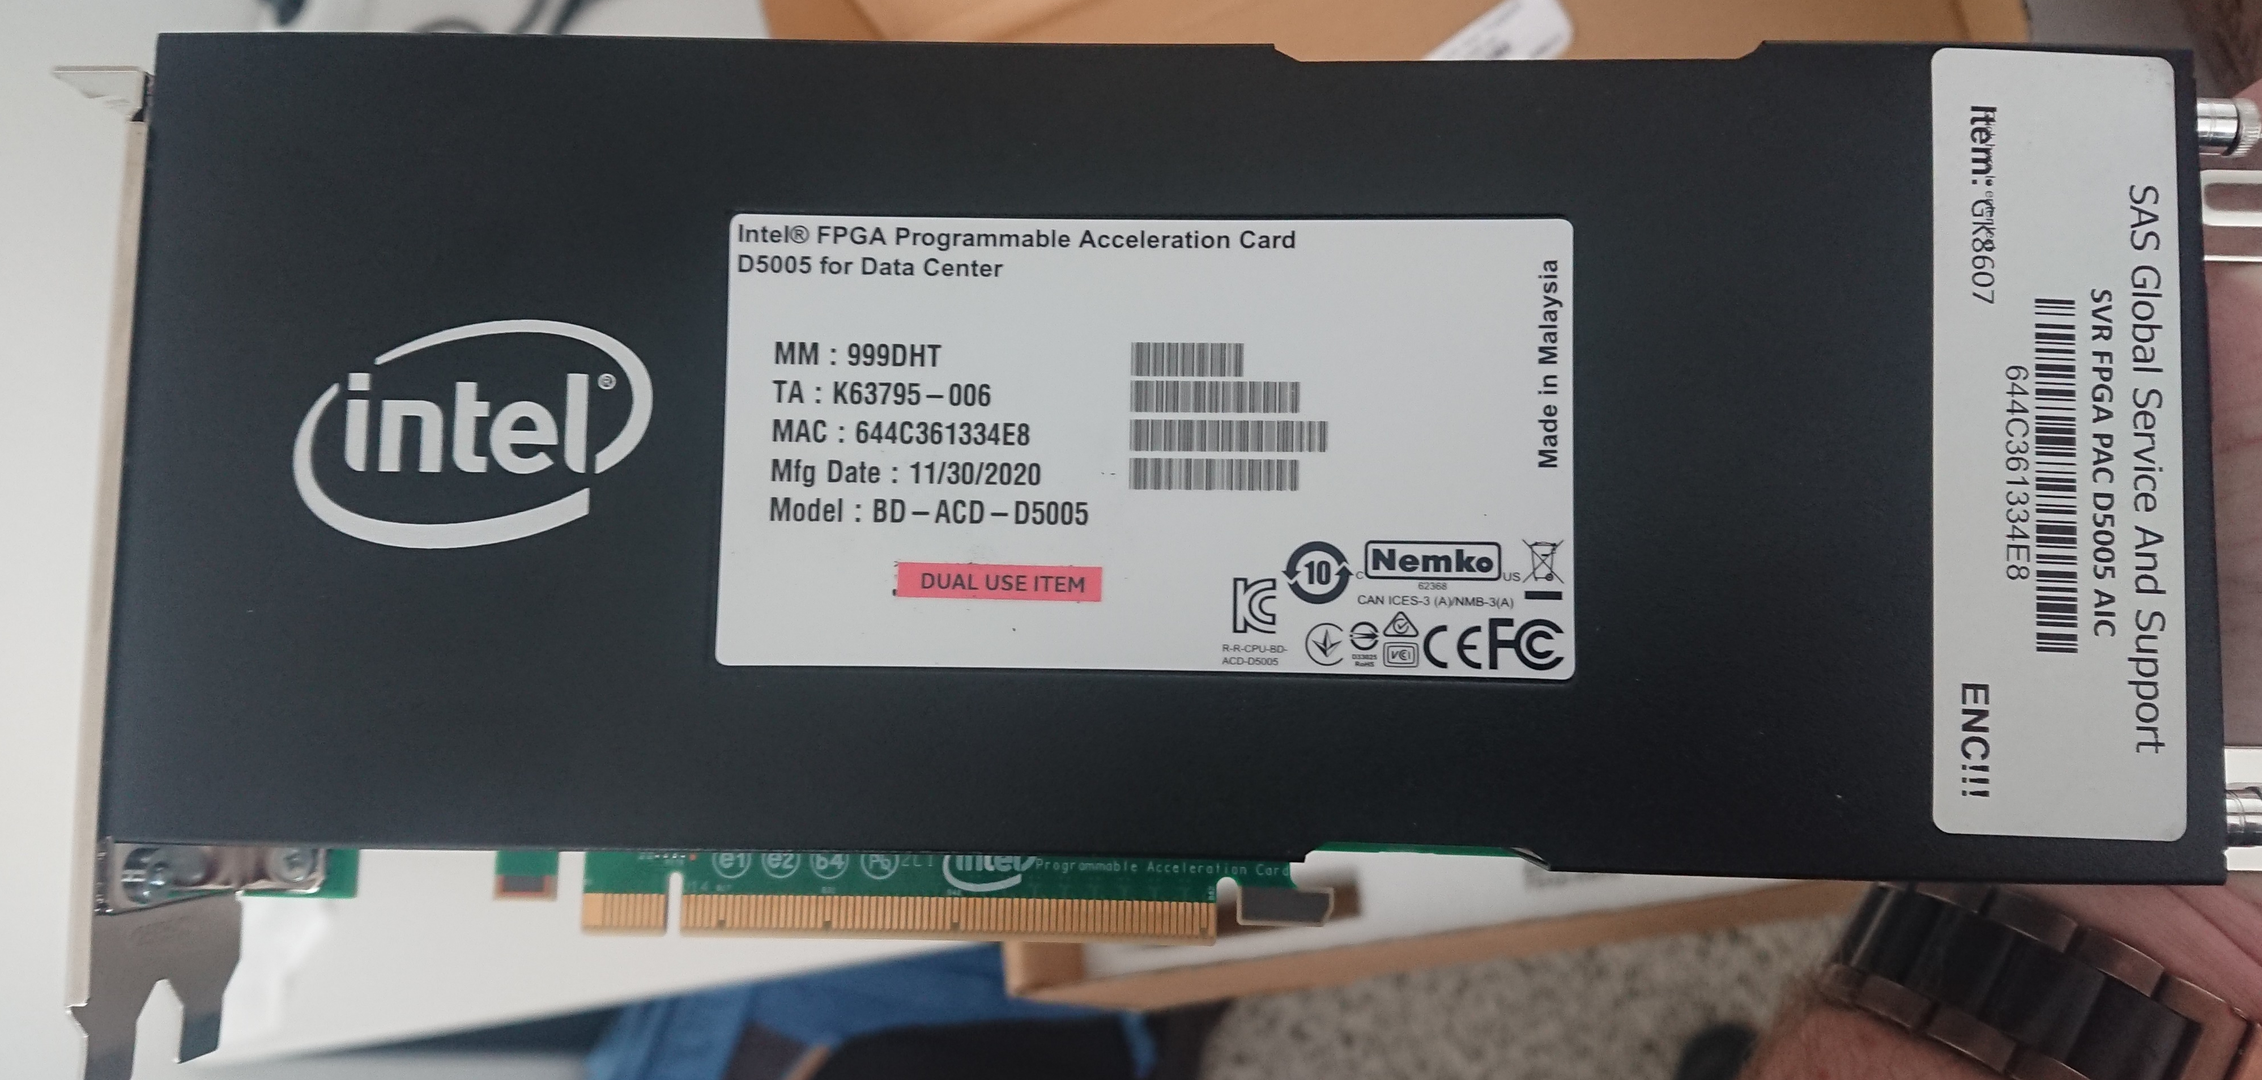
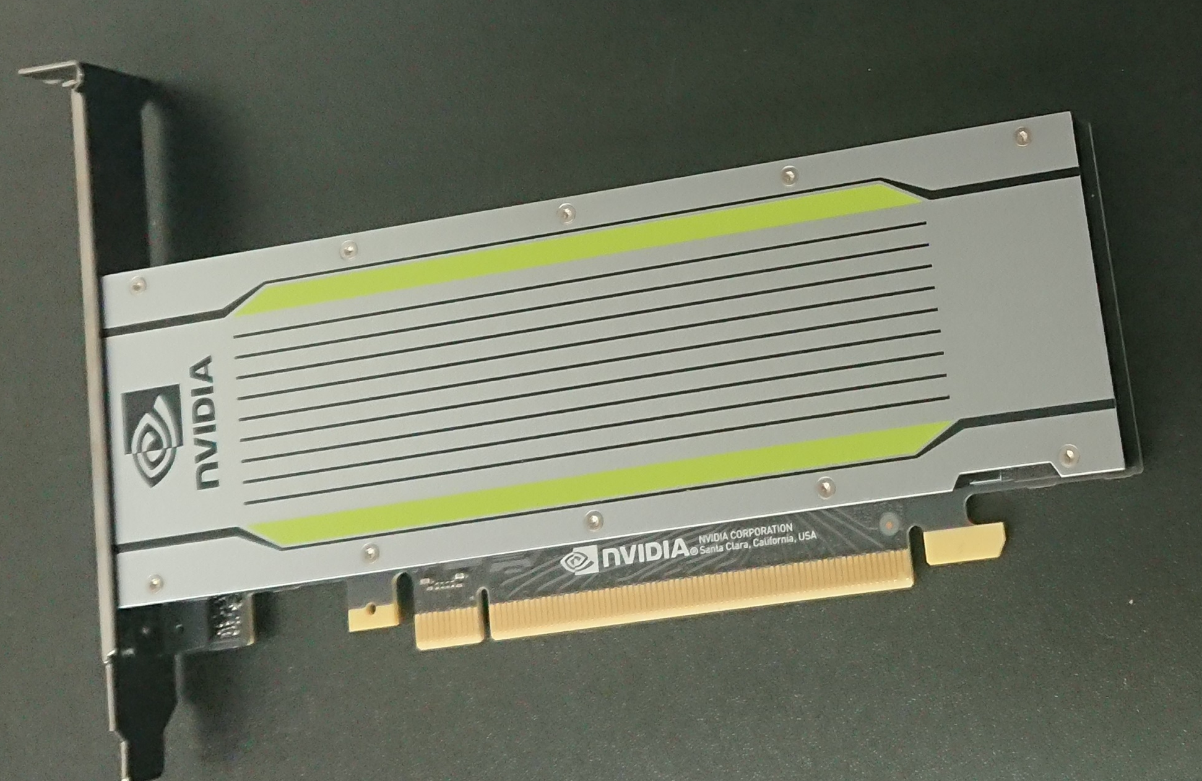
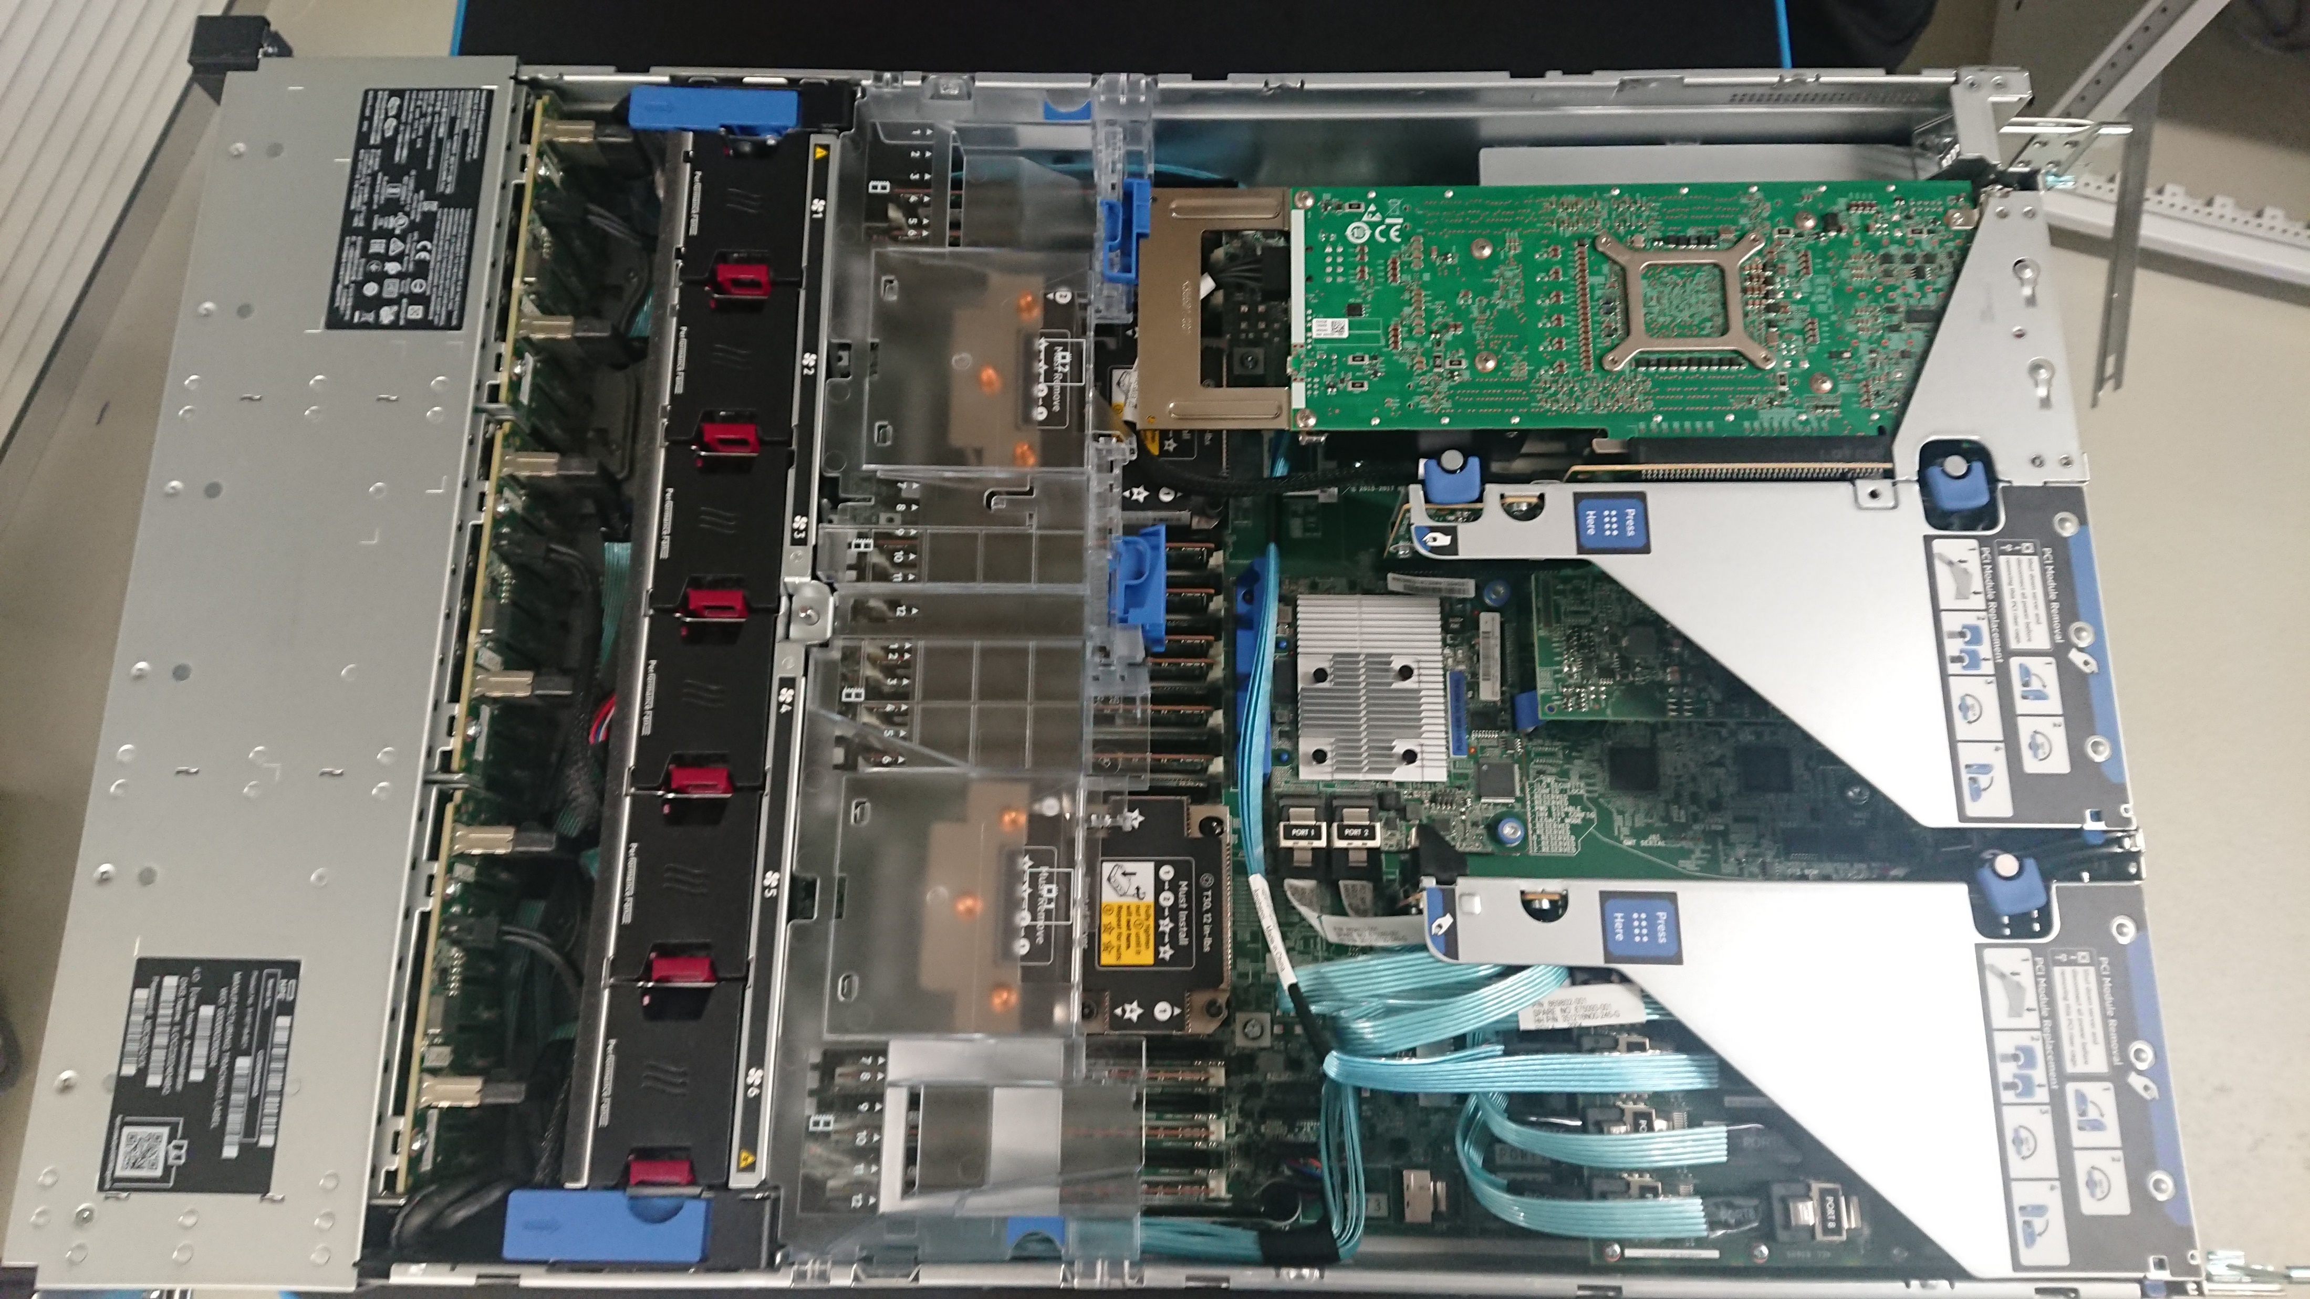
Example DM Cluster Node
Setup: 2x Intel Xeon Gold 6238 (112 vcores, 7.7 TFLOP/s),
768 GB DDR4 RAM, 12x 2TB SSDs, NVIDIA T4 GPU (8.1 TFLOP/s,
16 GB), and Intel FPGA PAC D5005 (w/ Stratix 10SX FPGA, 32 GB)
Intel PAC D5005
Stratix 10 FPGA
2 x Intel Xeon
Gold 6238R
Broadcom 2x10G
RDMA Ethernet
12+2 x SSD: 25TB
768 GB RAM
Adaptec 12G SAS
Nvidia Tesla T4

Slide 35
ASICs and other HW Accelerators

Slide 36
Overview ASICs
Motivation
  Additional improvements of performance, power/energy
  ➔ Additional specialization via custom hardware
#1 General ASIC DL Accelerators
  HW support for matrix multiply, convolution and activation functions
  Examples: Google TPU, NVIDIA DLA (in NVIDIA Xavier SoC), Intel Nervana NNP
#2 Specialized ASIC Accelerators
  Custom instructions for specific domains such as computer vision
  Example: (Cadence) Tensilica Vision processor (image processing)
#3 Other Accelerators/Technologies (some skepticism)
  a) Neuromorphic computing / spiking neural networks
  (e.g., SyNAPSE → IBM TrueNorth, HP memristor for computation storage)
  b) Analog computing (especially for ultra-low precision/quantization)
Notes:
Also: https://developer.android.com/ndk/guides/neuralnetworks Android NN API deprecated

Slide 37
[Norman P. Jouppi et al: In-Datacenter Performance Analysis of a Tensor Processing Unit. ISCA 2017]
Tensor Processing Unit (TPU v1)
Motivation
  Cost-effective ML scoring (no training)
  Latency- and throughput-oriented
  Improve cost-performance over GPUs by 10x
Architecture
  256x256 8bit matrix multiply unit
  (systolic array → pipelining)
  64K MAC per cycle
  (92 TOPs at 8 bit)
  50% if one input 16bit
  25% if all inputs 16 bit

Slide 38
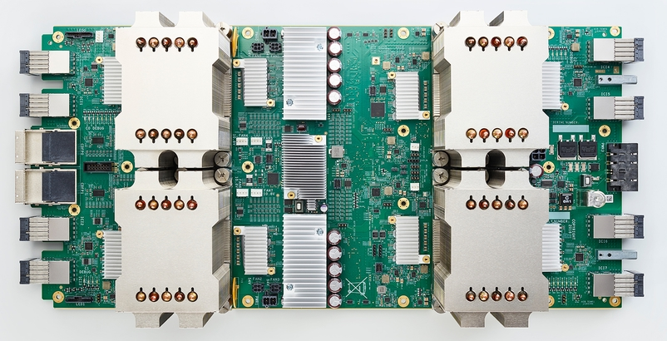
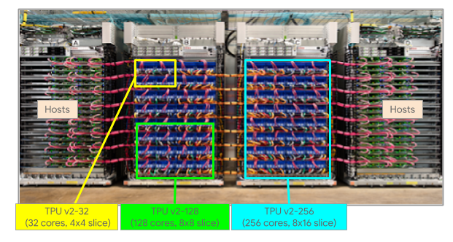
Tensor Processing Unit (TPU v2)
Motivation
  Cost effective ML training (not scoring) because
  edge device w/ custom inference but training in data centers
  Unveiled at Google I/O 2017
  Board w/ 4 TPU chips
  Pod w/ 64 boards
  and custom high-speed network
  Shelf w/ 2 boards or 1 processor
Cloud Offering (beta)
  Min 32 cores
  Max 512 cores

Slide 39
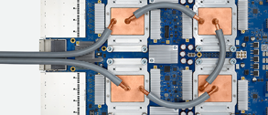
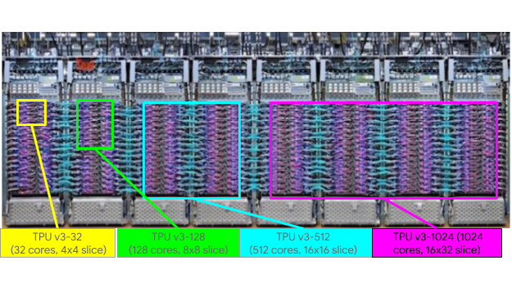
Tensor Processing Unit (TPU v3)
Motivation
  Competitive cost-performance compared to state-of-the-art GPUs
  Unveiled at Google I/O 2018
  Added liquid cooling
  Twice as many racks per pod, twice as many TPUs per rack
  ➔ TPUv3 promoted as
  8x higher performance than TPUv2
Cloud Offering (beta)
  Min 32 cores
  Max 2048 cores (~100PFLOPs)
[TOP 500 Supercomputers:
Summit @ Oak Ridge NL (‘18):
200.7 PFLOP/s (2.4M cores)]

Slide 40
[Norman P. Jouppi et al: TPU v4: An Optically Reconfigurable Supercomputer for Machine Learning with Hardware Support for Embeddings. ISCA 2023]
Tensor Processing Unit (TPU v4)
[https://cloud.google.com/blog/products/compute/
google-unveils-worlds-largest-publicly-available-ml-cluster]
Motivation
  More chips → twisted 3D torus topology
  (reconfigurable optical interconnect, for fault tolerance)
  Operational since 2020, unveiled at Google I/O 2021,
  paper 2023
  SparseCore (e.g., for sparse gather/scatter)
  275 TFLOPs BF16 or INT8
Cloud Offering
  4096 chips in 64 racks
  1.1 EFLOPs BF16 or INT8
  Min 64 chips, max 4096
(8 of 64 racks of a TPUv4 pod)

Slide 41
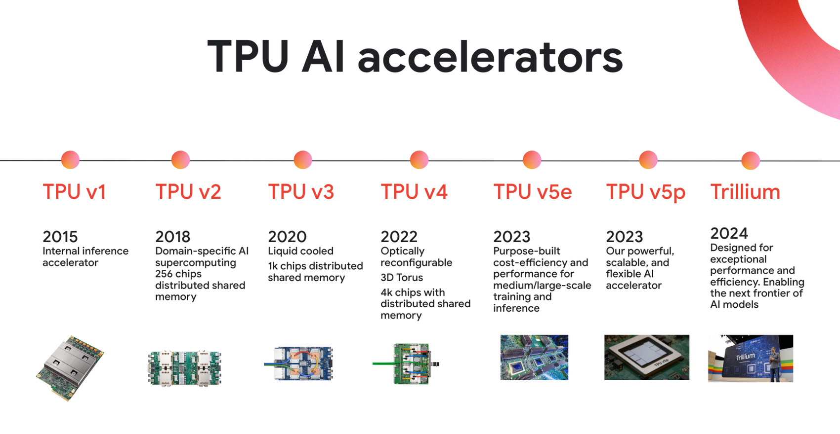
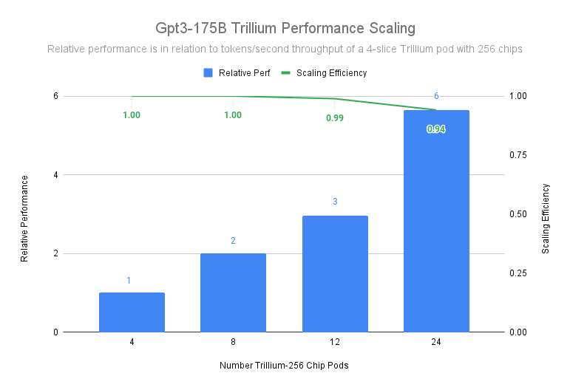
Tensor Processing Unit over Time
[https://cloud.google.com/transform/ai-specialized-chips-tpu-history-gen-ai]
[https://cloud.google.com/blog/products/ai-machine-learning/introducing-cloud-tpu-v5p-and-ai-hypercomputer]
[https://cloud.google.com/blog/
products/compute/trillium-tpu-is-ga]
2025 Ironwood: [https://blog.google/products/google-cloud/ironwood-tpu-age-of-inference/]
Notes:
Trillium announced Dec 2024, for Training and Inference (collection scheduling with replicas)
Ironwood Apr 2025 for Inference
2026: TPUv7

Slide 42

[Tianqi Chen et al: TVM:
An Automated End-to-End Optimizing Compiler for Deep Learning. OSDI 2018]
Recap: Operator Fusion and Code Generation
TVM: Code Generation for HW Accelerators
  Graph- /operator-level optimizations for
  embedded and HW accelerators
  Lack of low-level instruction set!
  Schedule Primitives
    Loop Transform
    Thread Binding
    Compute Locality
    Tensorization
    Latency Hiding
➔ Apache

Slide 43
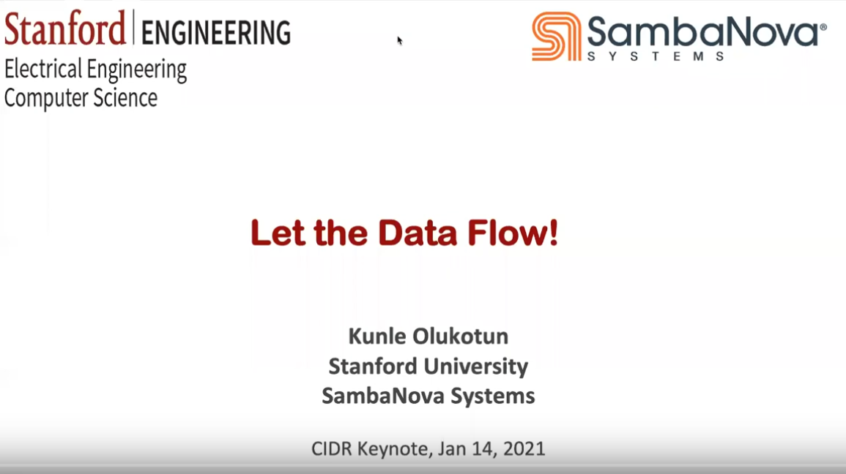
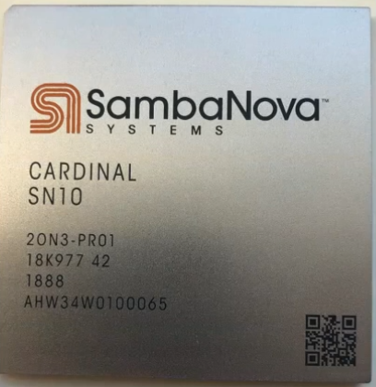
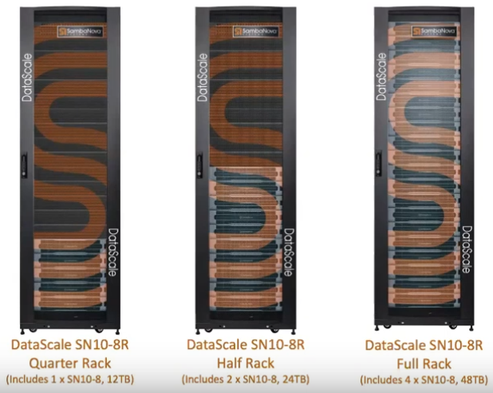
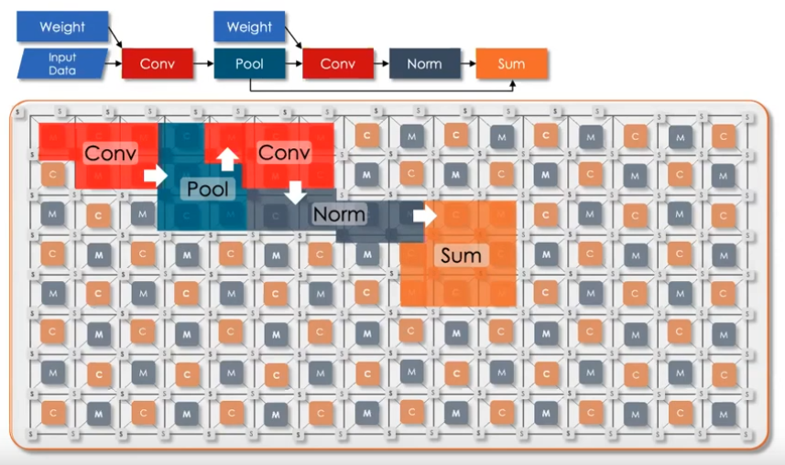
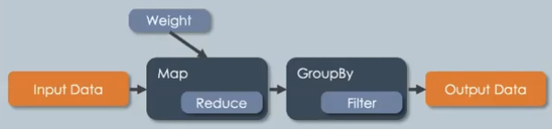
[Kunle Olukotun: Let the Data Flow!,
CIDR 2021, https://www.youtube.com/watch?v=iHhHHBuk3W4,
SDSC 2020, https://www.youtube.com/watch?v=E7se0KEa4BY]
SambaNova
Overview
  Reconfigurable data flow architecture
  Based on hierarchical parallel patterns (map, zip, reduce, flatMap, groupBy)
  Reconfigurable Dataflow Unit (RDU), but more coarse-grained than FPGAs
  100s of TFLOPs, 100s MB on chip
Mapping of Dataflow Computation
  DNN / ML
  Graph processing
  SQL query processing
reconfigure
in ~1-10ms
Notes:
VC capital: total $1.1B funding (676M by Apr 13 2021), $5B valuation (2021)
https://www.crunchbase.com/organization/sambanova-systems

Slide 44
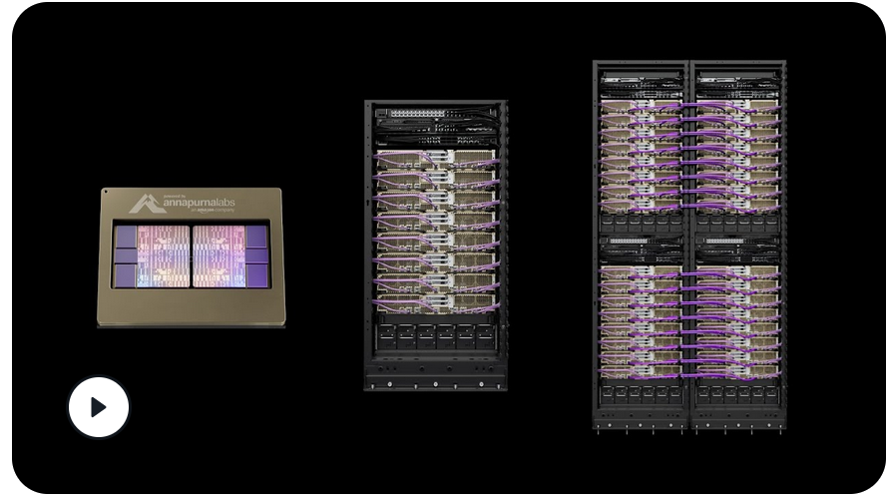
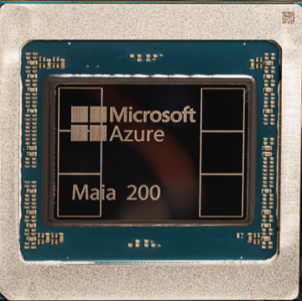
Other Specialized Chips (3nm)
[https://awsdocs-neuron.readthedocs-hosted.com/en/latest/about-neuron/arch/neuron-hardware/neuron-core-v4.html#neuroncores-v4-arch]
AWS Trainium Accelerator
  Current Generation: Trainium3
  8x NeuronCore-v4 (based on systolic arrays):
    2,517 MXFP8/MXFP4 TFLOPS
    671 BF16/FP16/TF32 TFLOPS
    2,517 FP16/BF16/TF32 sparse TFLOP
  Ultra-Server similar to TPU pods
Microsoft Maia 200
  Dedicated AI inference chip
  10 PFLOPS in 4-bit precision (FP4)
  5 PFLOPS of 8-bit (FP8) performance
[https://blogs.microsoft.com/blog/2026/01/26/maia-200-the-ai-accelerator-built-for-inference/]

Slide 45
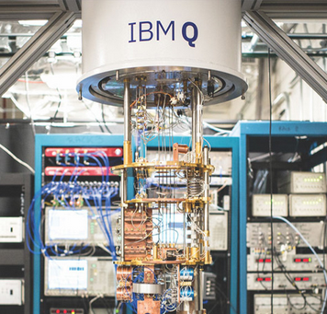
Excursus: Quantum Machine Learning
Background (Schrödinger's cat)
  Concepts: superposition, entanglement, de-coherence / uncertainty
IBM Q
  Hardware and software stack for quantum computing
  Qiskit: OSS Python framework [https://qiskit.org/]
  Experiment w/ quantum computers up to 20 qubit
  Gates: Hadamard, NOT, Phases, Pauli, barriers transposed conjugate, if, measurement
Early ML (Systems) Work
  Training quantum neural networks
  (relied on quantum search in O(√N)
  SVM classification w/ large feature space
  TensorFlow Quantum (TFQ), on OSS Cirq
  for hybrid models [https://www.tensorflow.org/quantum]
[Bob Ricks, Dan Ventura: Training a Quantum Neural Network. NeurIPS 2003]
[Vojtěch Havlíček et al: Supervised learning with quantum-enhanced feature spaces. Nature 2019]
Notes:
* Note on contradiction in Schrödinger's cat thought experiment (missing entanglement): https://arxiv.org/pdf/1603.07986.pdf
* Grover quantum search → polynomial speedup to exponential problem → randomized search
* SVM: quantum variational classifier + quantum kernel estimator
* TFQ for hybrid DNN models and circuits

Slide 46
ML Hardware Fallacies and Pitfalls
Recommended Reading
  [Jeff Dean, David A. Patterson, Cliff Young: A New Golden Age in Computer
  Architecture: Empowering the Machine-Learning Revolution. IEEE Micro 2018]
#1 Fallacy: Throughput over Latency
  Given the large size of the ML problems, the HW focus should be
  op/s (throughput) rather than time to solution (latency)
#2 Fallacy: Runtime over Accuracy
  Given large speedup, ML researchers would be willing to sacrifice accuracy
#3 Pitfall: Designing HW using last year’s models
  MNIST, CIFAR-10 datasets too easy, AlexNet no longer representative
  See 02 System Architecture & Landscape – ML System Benchmarks
#4 Pitfall: Designing ML HW assuming ML system is untouchable
  Towards hardware-software co-design (algorithm, system internals)

Slide 47
Trend: ML-based Chip Placement
Motivation
  ASICs: custom chips for ML
  ML for improved chip placement (part of chip design process
Deep RL for Chip Design
  Goal: optimize power, performance, and area s.t.
  constraints on routing congestion and density
  Approximate reward functions
  for effective evaluation ~100K
  (wire length, grid rows/columns,
  macro order, cell placement, routing congestion)
Example TPUv4 Block
  White macros (e.g., mem)
  Green standard cells
[Azalia Mirhoseini, Anna Goldie, et al: Chip Placement with Deep
Reinforcement Learning. CoRR 2020]
[Azalia Mirhoseini, Anna Goldie, et al: A Graph Placement Methodology for Fast Chip Design. Nature 2021]
https://www.youtube.com/watch?v=gSBYf25bWyo
Notes:
Note: NYT story on Satrajit Chatterjee – May 2, 2022; anonymous paper (Mar 2022) “Stronger Baselines for Evaluating Deep Reinforcement Learning in Chip Placement”

Slide 48
Summary & QA
Increasing importance of specialization:
End of Moore’s Law
End of Dennard Scaling
Different Levels of Hardware Specialization
  General-purpose CPUs and GPUs
  FPGAs, DNN ASICs, and other technologies
Next Lectures (Part A)
  09 Caching, Partitioning, Indexing and Compression [Jun 18]
  10 Data Acquisition, Cleaning, and Preparation [Jun 25]
  11 Model Selection and Management [Jul 02]
  12 Model Debugging, Fairness, Explainability [Jul 09]
  13 Model Serving Systems and Techniques [Jul 16]
  Q&A and Exam Preparation [Jul 16]
(Part A:
Overview and ML System Internals)
(Part B:
ML Lifecycle Systems)

