Slide 1

Architecture of ML Systems (AMLS)
13 Model Deployment and Serving
Prof. Dr. Matthias Boehm
Technische Universität Berlin
Berlin Institute for the Foundations of Learning and Data
Big Data Engineering (DAMS Lab)
Last update: Jul 16, 2026

Slide 2

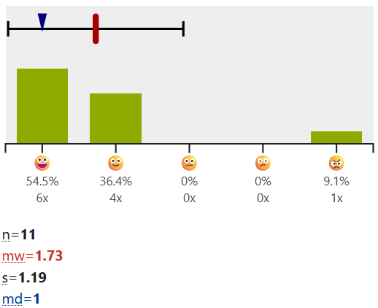
Announcements / Org
#1 Hybrid & Video Recording
  Hybrid lectures (in-person, zoom) with optional attendance
  https://tu-berlin.zoom.us/j/9529634787?pwd=R1ZsN1M3SC9BOU1OcFdmem9zT202UT09
  Zoom video recordings, links from website
  https://mboehm7.github.io/teaching/ss26_amls/index.htm
#2 ISIS Course Evaluation
  July 06 – July 17, in ISIS course, two days left
#3 Exercise/Project Submissions (deadline Jul 19 EOD)
  ?? submissions alternative exercise
  17+? submissions SystemDS/DAPHNE projects
#4 Exam Registration
  Thu July 23, 4-6pm (EW 202+203, 45+20 seats) → 60 registrations
  Thu Aug 06, 4-6pm (EW 202+203, 45+20 seats) → 55 registrations
  Thu Aug 27, 4-6pm (EW 202, 25 seats) → 18 registrations
Notes:
Big picture and context, goals
Slides too complicated; past projects too specific
More exam seats

Slide 3


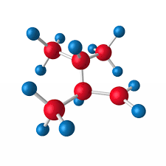

Recap: The Data Science Lifecycle
(aka KDD Process, aka CRISP-DM)
Data-centric View:
Application perspective
Workload perspective
System perspective
Data Scientist
Data Integration
Data Cleaning
Data Preparation
Model Selection
Training
Hyper-parameters
Validate & Debug
Deployment
Scoring & Feedback
Exploratory Process
(experimentation, refinements, ML pipelines)
Data/SW Engineer
DevOps Engineer

Slide 4
Agenda
Model Exchange and Serving
Model Monitoring and Updates

Slide 5
Model Exchange and Serving

Slide 6
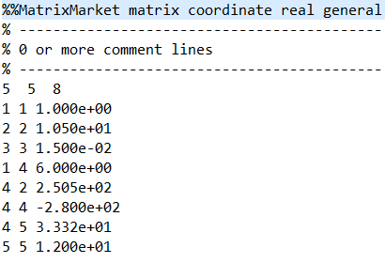


Model Exchange Formats
Definition Deployed Model
  #1 Trained ML model (weight/parameter matrix)
  #2 Trained weights AND operator graph / entire ML pipeline
  ➔ especially for DNN (many weight/bias tensors, hyper parameters, etc)
Recap: Data Exchange Formats (model + meta data)
  General-purpose formats: CSV, JSON, XML, Protobuf
  Sparse matrix formats: matrix market, libsvm
  Scientific formats: NetCDF, HDF5
  ML-system-specific binary formats (e.g., SystemDS, PyTorch serialized)
Problem ML System Landscape
  Different languages and frameworks, including versions
  Lack of standardization → DSLs for ML is wild west

Slide 7
Model Exchange Formats, cont.
Why Open Standards?
  Open source allows inspection but no control
  Open governance necessary for open standard
  Cons: needs adoption, moves slowly
#1 Predictive Model Markup Language (PMML)
  Model exchange format in XML, created by Data Mining Group 1997
  Package model weights, hyper parameters, and limited set of algorithms
#2 Portable Format for Analytics (PFA)
  Attempt to fix limitations of PMML, created by Data Mining Group
  JSON and AVRO exchange format
  Minimal functional math language → arbitrary custom models
  Scoring in JVM, Python, R
[Nick Pentreath: Open Standards for Machine Learning Deployment, bbuzz 2019]

Slide 8
Model Exchange Formats, cont.
#3 Open Neural Network Exchange (ONNX)
  Model exchange format (data and operator graph) via Protobuf
  First Facebook and Microsoft, then IBM, Amazon → PyTorch, MXNet
  Focused on deep learning and tensor operations
  ONNX-ML: support for traditional ML algorithms
  Scoring engine: https://github.com/Microsoft/onnxruntime
  Cons: low level (e.g., fused ops), DNN-centric → ONNX-ML
TensorFlow Saved Models
  TensorFlow-specific exchange format for model and operator graph
  Freezes input weights and literals, for additional optimizations
  (e.g., constant folding, quantization, etc)
  Cloud providers may not be interested in open exchange standards
python/systemds/
onnx_systemds

Slide 9


ML Systems for Serving
#1 Embedded ML Serving
  TensorFlow Lite and new language bindings (small footprint,
  dedicated HW acceleration, APIs, and models: MobileNet, SqueezeNet)
  TorchScript: Compile Python functions into ScriptModule/ScriptFunction
  SystemML JMLC (Java ML Connector), IREE (data centers / edge – small footprint)
#2 ML Serving Services
  Motivation: Complex DNN models, ran on dedicated HW
  RPC/REST interface for applications
  TensorFlow Serving: configurable serving w/ batching
  TorchServe: Specialized model for HW, batching/parallelism
  Clipper: Decoupled multi-framework scoring, w/ batching and result caching
  Pretzel: Batching and multi-model optimizations in ML.NET
  Rafiki: Optimizations for accuracy s.t. latency constraints, batching, multi-model opt
Google Translate 140B words/day
→ 82K GPUs in 2016
PyTorch TorchServe Config
models={
"resnet-152": {"1.0": {
"minWorkers": 1,
"maxWorkers": 1,
"batchSize": 8,
"maxBatchDelay": 50,
"responseTimeout": 120
}}}
[Christopher Olston et al: TensorFlow-Serving: Flexible, High-Performance ML Serving. ML Systems@NeurIPS 2017]
[Daniel Crankshaw et al: Clipper: A Low-Latency Online Prediction Serving System. NSDI 2017]
[Yunseong Lee et al.: PRETZEL: Opening the Black Box of Machine Learning Prediction Serving Systems. OSDI 2018]
[Wei Wang et al: Rafiki: Machine Learning as an Analytics Service System. PVLDB 2018]
Notes:
https://rise.cs.berkeley.edu/blog/a-short-history-of-prediction-serving-systems/
https://www.usenix.org/sites/default/files/conference/protected-files/nsdi17_slides_crankshaw.pdf
Google Translate: https://arxiv.org/pdf/1609.08144.pdf

Slide 10



[Joseph M. Hellerstein et al: Serverless Computing: One Step Forward, Two Steps Back. CIDR 2019]
Serverless Computing
Definition Serverless
  FaaS: functions-as-a-service (event-driven, stateless input-output mapping)
  Infrastructure for deployment and auto-scaling of APIs/functions
  Examples: Amazon Lambda, Microsoft Azure Functions, etc
Example
Lambda Functions
Event Source (e.g., cloud services)
Other APIs and Services
Auto scaling
Pay-per-request
(1M x 100ms = 0.2$)
import com.amazonaws.services.lambda.runtime.Context;
import com.amazonaws.services.lambda.runtime.RequestHandler;
public class MyHandler implements RequestHandler<Tuple, MyResponse> {
@Override
public MyResponse handleRequest(Tuple input, Context context) {
return expensiveModelScoring(input); // with read-only model
}
}

Slide 11
Example SystemDS JMLC
Token Features
Sentences
ΔX
Example
Scenario
Challenges
  Scoring part of larger end-to-end pipeline
  External parallelization w/o materialization
  Simple synchronous scoring
  Data size (tiny ΔX, huge model M)
  Seamless integration & model consistency
Feature Extraction
(e.g., doc structure, sentences, tokenization, n-grams)
Sentence Classification
Sentence Classification
…
(e.g., ⨝, ∪)
“Model”
M
➔ Embedded scoring
➔ Latency ⇒ Throughput
➔ Minimize overhead per ΔX
➔ Token inputs & outputs

Slide 12
Example SystemDS JMLC, cont.
Distributed representation:
? x ncol(F) blocks
(shuffle-free
conversion of
csv / datasets)
Background: Frame
  Abstract data type with schema (BIN, INT64, FP64, STR)
  Column-wise block layout, with ragged arrays
  Local and distributed operations
Data Preparation
via Transform
Schema
FX
transformencode
…
X
Y
FY
Training
B
MX
MY
ΔFX
transformapply
ΔX
Scoring
ΔFŶ
transformdecode
ΔŶ

Slide 13
Example SystemML JMLC, cont.
Typical compiler/runtime overheads:
Script parsing and config: ~100ms
Validation, compile, IPA: ~10ms
HOP DAG (re-)compile: ~1ms
Instruction execute: <0.1μs
Motivation
  ➔ Embedded scoring
  ➔ Latency ⇒ Throughput
  ➔ Minimize overhead per ΔX
Example
1: Connection conn = new Connection();
2: PreparedScript pscript = conn.prepareScript(
getScriptAsString(“glm-predict-extended.dml”),
new String[]{“FX”,“MX”,“MY”,“B”}, new String[]{“FY”});
3: // ... Setup constant inputs
4: for( Document d : documents ) {
5: FrameBlock FX = ...; //Input pipeline
6: pscript.setFrame(“FX”, FX);
7: FrameBlock FY = pscript.executeScript().getFrame(“FY”);
8: // ... Remaining pipeline
9: }
// single-node, no evictions,
// no recompile, no multithread.
// execute precompiled script
// many times

Slide 14
k
Serving Optimizations – Batching
n
Recap: Model Batching (see 08 Data Access)
  One-pass evaluation of multiple configurations
  EL, CV, feature selection, hyper parameter tuning
  E.g.: TUPAQ [SoCC’16], Columbus [SIGMOD’14]
Data Batching
  Batching to utilize the HW more efficiently under SLA
  Use case: multiple users use the same model (wait and collect requests)
  Adaptive: additive increase, multiplicative decrease
X
O(m*n) read
O(m*n*k) compute
m >> n >> k
m
n
X₁
Benefits for multi-class / complex models
Fewer kernel launches,
Parallelization
m
X₂
[Clipper @ NSDI’17]
X₃

Slide 15
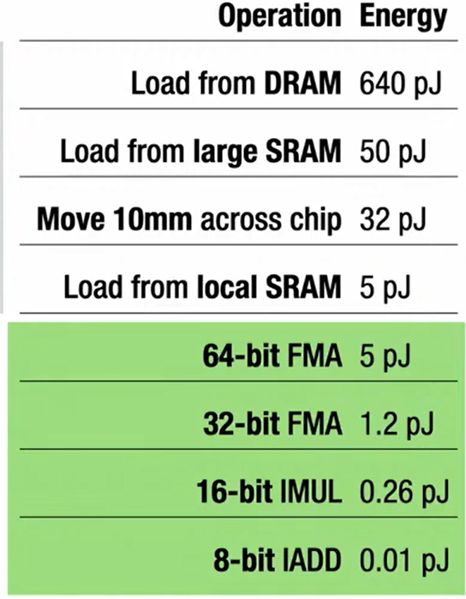
Serving Optimizations – Quantization
08 Data Access
Methods
Quantization
  Lossy compression via ultra-low precision / fixed-point
  Ex.: 62.7% energy spent on data movement
Quantization for Model Scoring
  Usually much smaller data types (e.g., UINT8)
  Quantization of model weights, and sometimes also activations
  → reduced memory requirements and better latency / throughput (SIMD)
[Amirali Boroumand et al.: Google Workloads for Consumer Devices: Mitigating Data Movement Bottlenecks. ASPLOS 2018]
import tensorflow as tf
converter = tf.lite.TFLiteConverter.from_saved_model(saved_model_dir)
converter.optimizations = [tf.lite.Optimize.OPTIMIZE_FOR_SIZE]
tflite_quant_model = converter.convert()
[Jonathan Ragan-Kelly: The Future of Fast Code: Giving Hardware What It Wants, PLDI 2024 Keynote (inspired by Bill Dally on 14nm)]
[Credit: https://www.tensorflow.org/lite/performance/post_training_quantization ]

Slide 16
Serving Optimizations – Sparsification / Quantization, cont.
Sparsification
Quantization
LogReg on Covtype
LogReg on Criteo
[Credit: Arnab Phani
(DEEM@TU Berlin)]
[Credit: Xiaozhe Yao (ETH Zurich)]

Slide 17
Serving Optimizations – MQO
Result Caching
  Establish a function cache for X → Y
  (memoization of deterministic function evaluation)
  E.g., translation use case
Multi Model Optimizations
  Same input fed into multiple partially redundant model evaluations
  Common subexpression elimination between prediction programs
  In PRETZEL, programs compiled into physical stages and
  registered with the runtime + caching for stages
  (decided based on hashing the inputs)
[Yunseong Lee et al.: PRETZEL: Opening the Black Box of Machine Learning Prediction Serving Systems. OSDI 2018]

Slide 18


Serving Optimizations – Compilation
04 Adaptation,
Fusion, and JIT
TensorFlow tf.compile
  Compile entire TF graph into binary function w/ low footprint
  Input: Graph, config (feeds+fetches w/ fixes shape sizes)
  Output: x86 binary and C++ header (e.g., inference)
  Specialization for frozen model and sizes
PyTorch Compile
  Compile Python functions into ScriptModule/ScriptFunction
  Lazily collect operations, optimize, and JIT compile
  Explicit jit.script call or @torch.jit.script
[Chris Leary, Todd Wang:
XLA – TensorFlow, Compiled!, TF Dev Summit 2017]
a = torch.rand(5)
def func(x):
for i in range(10):
x = x * x # unrolled into graph
return x
jitfunc = torch.jit.script(func) # JIT
jitfunc.save("func.pt")
[Vincent Quenneville-Bélair: How PyTorch Optimizes Deep Learning Computations, Guest Lecture Stanford 2020]

Slide 19
[Supun Nakandala et al: A Tensor
Compiler for Unified Machine Learning
Prediction Serving. OSDI 2020,
https://github.com/microsoft/hummingbird]
Serving Optimizations – Model Vectorization
Compile ML scoring pipelines into tensor ops (3 strategies w/ different redundancy)
#1 Matmult (GEMM)
predicate map
[m x #inodes]
predicate values
[1 x #inodes]
predicate compare
[1 x #inodes]
input [n x m]
paths ∑
[1 x #paths]
selected path
class map
[#paths x #classes]
bucket paths [#inodes x #paths]
1 (lhs) / 0 / -1 (rhs)
Notes:
Note: A can be avoided expanding B to m (e.g., with infinity)
How To Proof its Correctness? (not provided)
#1 Only 1 values in C matter for successful paths
(-1 mostly ignored because comparison false, only for deviating sum for unsuccessful path)
➔ no cancelation of positive and negative decisions in path sums
#2 Paths in Decision Tree are Disjoint (no overlap)
#3 Predicate Positions need to Match Rows in Lhs and Column in Rhs
#4 Duplicate Path Sums Allowed (but appear in different columns in output)

Slide 20
1
Serving Optimizations – Model Vectorization, cont.
2
3
5
6
4
9
#2 Tree Traversal (TT)
  Traversal for batch of records via value indexing / table()
  and ifelse(Tv<Tt, Tl, Tr)
7
8
Input data
T_{l}
F1
F2
F3
F4
F5
1
N_{L}
2
5
4
7
5
6
7
8
9
F1
F2
F3
F4
F5
1
F1
F2
F3
F4
F5
1
N_{R}
3
6
9
8
5
6
7
8
9
Nodes position of individual tuples
N_{F}
3
2
5
3
1
1
1
1
1
T_{F}
N_{T}
0.5
2.0
5.5
2.4
0
0
0
0
0
t(N_{C})
0
0
0
0
1
0
0
1
1
0
0
0
0
0
1
1
0
0

Slide 21
Serving Optimizations – Model Vectorization, cont.
Batch Scoring Experiments
Forest Inference Library (FIL)
Azure NC6 v2
(6 vcores, 112GB, P1 GPU)
Batch of 10K records
[seconds]
Lowest Cost
w/ K80

Slide 22
Serving Optimizations – Model Distillation
Model Distillation
  Ensembles of models → single NN model
  Specialized models for different classes
  (found via differences to generalist model)
  Trained on soft targets (softmax w/ temperature T)
Example Experiments
  Automatic Speech Recognition
  Frame classification accuracy,
  and word error rate
[Geoffrey E. Hinton, Oriol Vinyals, Jeffrey Dean: Distilling the Knowledge in a Neural Network. CoRR 2015]
System | Test Frame Accuracy | Word Error Rate
Baseline | 58.9% | 10.9%
10x Ensemble | 61.1% | 10.7%
Distilled 1x Model | 60.8% | 10.7%
Notes:
Temperature to also utilize the similarities of incorrect classes (w/ very low probability) -> higher temperature, softer distribution of class probabilities
Speech recordings (raw mel spectrogram frames)
Frame-level phoneme state labels

Slide 23
Serving Optimizations – Model Distillation, cont.
LLaMA 2 Model Variants
  mmlu dataset
  Tradeoff normalized
  accuracy and costs
  Simple router model
  for improved tradeoff
[Credit:
Runsheng
Benson Guo (UWaterloo)]

Slide 24
Serving Optimizations – Specialization
NoScope Architecture
  Baseline: YOLOv2 on 1 GPU
  per video camera @30fps
  Optimizer to find filters
#1 Model Specialization
  Given query and baseline model
  Trained shallow NN (based on AlexNet) on output of baseline model
  Short-circuit if prediction with high confidence
#2 Difference Detection
  Compute difference to ref-image/earlier-frame
  Short-circuit w/ ref label if no significant difference
[Daniel Kang et al: NoScope: Optimizing Deep CNN-Based Queries over Video Streams at Scale. PVLDB 2017]

Slide 25
Model Monitoring and Updates
Part of Model Management and MLOps
(see 10 Model Selection & Management)

Slide 26
Model Deployment Workflow
Data Integration
Data Cleaning
Data Preparation
Model Selection
Training
Hyper-parameters
#1 Model
Deployment
MX
MY
B
#2 Continuous Data Validation / Concept Drift Detection
Model Serving
Prediction Requests
#3 Model
Monitoring
#4 Periodic / Event-based Re-Training & Updates
(automatic / semi-manual)
DevOps Engineer

Slide 27
Monitoring Deployed Models
[Neoklis Polyzotis, Sudip Roy, Steven Whang, Martin Zinkevich: Data Management Challenges in Production Machine Learning, SIGMOD 2017]
Robustness (e.g., data, latency)
and model accuracy
Goals:
#1 Check Deviations Training/Serving Data
  Different data distributions, distinct items → impact on model accuracy?
  → See 09 Data Acquisition and Preparation (Data Validation)
#2 Definition of Alerts
  Understandable and actionable
  Sensitivity for alerts (ignored if too frequent)
#3 Data Fixes
  Identify problematic parts
  Impact of fix on accuracy
  How to backfill into training data
During serving: 0.11?
“The question is not whether something is ‘wrong’. The question is whether it gets fixed”
Notes:
Note: Kolmogorov-Smirnov Test for equality of probability distributions
Kolmogorov distance: max(F(x)-G(x)) where F and G are empirical distribution functions on proportion of Xi values less than x; for all x

Slide 28
Monitoring Deployed Models, cont.
[Neoklis Polyzotis, Sudip Roy, Steven Whang, Martin Zinkevich: Data Management Challenges in Production Machine Learning, SIGMOD 2017]
Alert Guidelines
  Make them actionable
  missing field,
  field has new values,
  distribution changes
  Question data AND constraints
  Combining repairs:
  principle of minimality
Complex Data Lifecycle
  Adding new features to production ML pipelines is a complex process
  Data does not live in a DBMS; data often resides in multiple storage systems
  that have different characteristics
  Collecting data for training can be hard and expensive
less actionable
[George Beskales et al: On the relative trust between inconsistent data and inaccurate constraints. ICDE 2013]
[Xu Chu, Ihab F. Ilyas: Qualitative Data Cleaning. Tutorial, PVLDB 2016]

Slide 29
[A. Bifet, J. Gama, M. Pechenizkiy, I. Žliobaitė: Handling Concept Drift: Importance, Challenges & Solutions, PAKDD 2011]
Concept Drift
Recap Concept Drift (features → labels)
  Change of statistical properties / dependencies (features-labels)
  Requires re-training, parametric approaches for deciding when to retrain
#1 Input Data Changes
  Population change (gradual/sudden), but also new categories, data errors
  Covariance shift p(x) with constant p(y|x)
#2 Output Data Changes
  Label shift p(y)
  Constant conditional feature distributed p(x|y)
  Goals: Fast adaptation; noise vs change, recurring contexts, small overhead

Slide 30
[A. Bifet, J. Gama, M. Pechenizkiy, I. Žliobaitė: Handling Concept Drift: Importance, Challenges & Solutions, PAKDD 2011]
Concept Drift, cont.
Approach 1: Periodic Re-Training
  Training: window of latest data + data selection/weighting
  Alternatives: incremental maintenance, warm starting, online learning
Approach 2: Event-based Re-Training
  Change detection (supervised, unsupervised)
  Often model-dependent, specific techniques for time series
  Drift Detection Method: binomial distribution, if error outside scaled
  standard-deviation → raise warnings and alerts
  Adaptive Windowing (ADWIN):
  window W, append data to W, drop
  old values until avg windows W=W1-W2
  similar (below epsilon), raise alerts
  Kolmogorov-Smirnov distance / Chi-Squared:
  univariate statistical tests training/serving
[Albert Bifet, Ricard Gavaldà:
Learning from Time-Changing Data with Adaptive Windowing. SDM 2007]
[https://scikitmultiflow.readthedocs.io/
en/stable/api/generated/
skmultiflow.drift_detection.ADWIN.html]
Notes:
Note: scikit-multiflow .. A machine learning package for streaming data in Python, The other ancestor of River.

Slide 31
[Sebastian Schelter, Tammo Rukat, Felix Bießmann: Learning to Validate the Predictions of Black Box Classifiers on Unseen Data. SIGMOD 2020]
Concept Drift, cont.
Model-agnostic Performance Predictor
  Approach 2: Event-based Re-Training
  User-defined error generators
  Synthetic data corruption → impact on black-box model
  Train performance predictor (regression/classification at threshold t)
  for expected prediction quality on percentiles of target variable ŷ
Results
PPM
Notes:
Note baselines:
• Relational shift detection (REL): This baseline approach applies shift detection techniques to the raw input data instead of the model outputs. We apply multiple univariate shift detection tests between the columns of the training and serving data (Kolmogorov-Smirnov tests for numeric columns, and χ2-tests for categorical columns).
• Black Box-Shift Detection (BBSE) for assigned class probabilities from Lipton et al. [13], which evaluates a Kolmogorov-
Smirnov test between the softmax outputs of the black box model on the test and serving data.
• Black Box-Shift Detection (BBSEh) [20] for predicted classes, which evaluates a χ2-test between the counts of the predicted classes of the black box model on the test and serving data.

Slide 32
[Maximilian Böther, Ties Robroek, Viktor Gsteiger, Robin Holzinger, Xianzhe Ma, Pinar Tözün, Ana Klimovic: Modyn: Data-Centric Machine Learning Pipeline Orchestration, SIGMOD 2025]
Concept Drift, cont.
Yearbook Dataset
  Frontal-facing American
  high-school seniors
  1905 - 2013
  Classification:
  male/female, smiles
  hair-styles
[https://shiry.ttic.edu/projects/yearbooks/yearbooks.html]

Slide 33
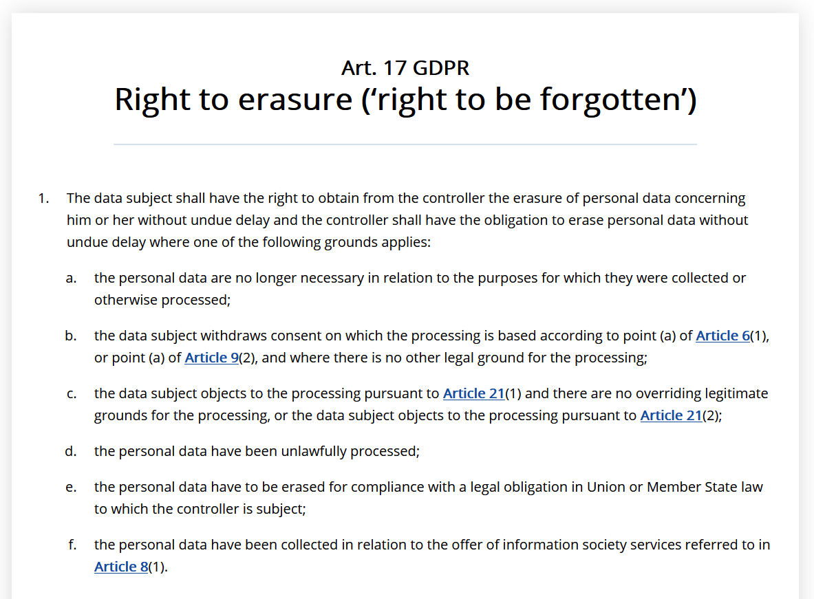
[https://gdpr.eu/article-17-right-to-be-forgotten/]
GDPR (General Data Protection Regulation)
GDPR “Right to be Forgotten”
  Recent laws such as GDPR require
  companies and institutions to
  delete user data upon request
  Personal data must not only be deleted
  from primary data stores but also from
  ML models trained on it (Recital 75)
Example Deanonymization
  Recommender systems: models retain user similarly
  Social network data / clustering / KNN
  Large language models (e.g., GPT-3)
X
U V┬
≈
[Sebastian Schelter: "Amnesia" - Machine Learning Models That Can Forget User Data Very Fast. CIDR 2020]
See incremental computations in
03 Sizes Inferences and Rewrites
Notes:
Note: As mentioned, the GDPR consists of two components: the articles and recitals. The articles constitute the legal requirements organizations must follow to demonstrate compliance. The recitals provide additional information and supporting context to supplement the articles

Slide 34
[Sebastian Schelter, Stefan Grafberger, Ted Dunning: HedgeCut: Maintaining Randomised Trees for Low-Latency Machine Unlearning, SIGMOD 2021]
GDPR (General Data Protection Regulation), cont.
HedgeCut Overview
  Extremely Randomized Trees (ERT): ensemble of
  DTs w/ randomized attributes and cut-off points
  Online unlearning requests < 1ms
  w/o retraining for few points
Handling of Non-robust Splits

Slide 35
Summary & QA
Thanks
Model Exchange and Serving
Model Monitoring and Updates
#1 Exam Preparation – Ask Questions in the Forum
#2 Exam Registration
  Thu July 23, 4-6pm (EW 202+203, 45+20 seats) → 60 registrations
  Thu Aug 06, 4-6pm (EW 202+203, 45+20 seats) → 55 registrations
  Thu Aug 27, 4-6pm (EW 202, 25 seats) → 18 registrations

Slide 36
Example AMLS Exams (90min for 100/100 points)
https://mboehm7.github.io/teaching/ss25_amls/ExamAMLS25_v1.pdf
https://mboehm7.github.io/teaching/ss25_amls/ExamAMLS25_v2.pdf
https://mboehm7.github.io/teaching/ss25_amls/ExamAMLS25_v3.pdf
No Lecture Materials or Mobile Devices
Architecture of ML Systems (AMLS)
14 Q&A and Exam Preparation [continues 5.45pm]
Prof. Dr. Matthias Boehm
Technische Universität Berlin
Berlin Institute for the Foundations of Learning and Data
Big Data Engineering (DAMS Lab)
Last update: Jul 15, 2025

Slide 37
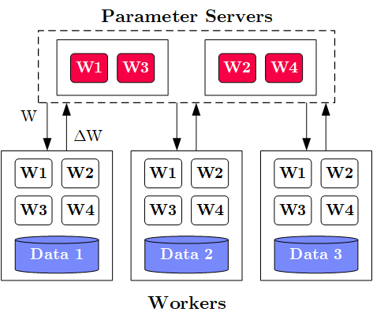
Task 1 Parameter Servers [question appeared in every exam]
10/100
Task 1a: Describe the overall system architecture of data-parallel parameter servers,
explain its components and interaction among these components [10/100 points]
System Architecture
  M Parameter Servers w/ model
  N Workers w/ data partitions
  Optional Coordinator
Interactions
  Workers pull model from parameter servers,
  slice a mini-batch of data, run a forward and
  backward pass to compute gradients,
  which are pushed back to parameter serves
  Parameter servers wait for gradients,
  aggregate the gradients/models, and
  perform a global model update
M
W .. Model
ΔW .. Gradient
N

Slide 38
Task 1 Parameter Servers, cont. [question appeared in every exam]
16/100
Task 1b: Describe synchronous (BSP) and asynchronous (ASP) update strategies in
data-parallel parameter servers and name their advantages and disadvantages. [6/100 points]
 | Synchronous | Asynchronous
Description
Advantages
Disadvantages
 | Synchronous | Asynchronous
Description | Per-batch or -n-batches synchronization barrier (wait for all workers before update) | Every pushed gradient updates the model, workers obtain model immediately
Advantages | Consistent learning process and model updates | No waiting for stragglers
Disadvantages | Workers wait for slowest worker (repeatedly) | Workers use stale models, potential divergence

Slide 39
Task 2 Data Preparation
26/100
Task 2a: Given the raw input data below, apply recoding and one-hot encoding to all categorical columns, and binning with 3 equi-width bins to all numerical columns. [10/100 points]
A | B | C
Low | 0 | S
High | 3 | M
Med | 7 | L
Low | 9 | XL
Low | 15 | M
Low | 7 | M
Med | 4 | L
High | 12 | XL
High | 13 | L
ALow | AMed | AHigh | B | CS | CM | CL | CXL
1 | 0 | 0 | 1 | 1 | 0 | 0 | 0
0 | 0 | 1 | 1 | 0 | 1 | 0 | 0
0 | 1 | 0 | 2 | 0 | 0 | 1 | 0
1 | 0 | 0 | 2 | 0 | 0 | 0 | 1
1 | 0 | 0 | 3 | 0 | 1 | 0 | 0
1 | 0 | 0 | 2 | 0 | 1 | 0 | 0
0 | 1 | 0 | 1 | 0 | 0 | 1 | 0
0 | 0 | 1 | 3 | 0 | 0 | 0 | 1
0 | 0 | 1 | 3 | 0 | 0 | 1 | 0
Notes:
Q: how many rows and columns

Slide 40
Task 2 Data Preparation, cont.
38/100
Task 2b: What is feature hashing and what is its advantage over recoding? [3/100 points]
  Hash values and compute modulo with user-provided k
  Reduces the number of distinct items, and thus columns in one-hot-encoded representation
Task 2c: Describe the text encodings bag-of-word and word-embeddings. [6/100 points]
  Bag-of-word: encode sentence as a vector of token counts
  (how often every distinct token appeared in the sentence)
  Word Embedding: continuous bag-of-words,
  learned numerical vectors for predicting the context words from a word or a word from its context
Task 2d: What is data augmentation and name 2 concrete techniques. [3/100 points]
  Synthetically generate labeled examples from small real labeled dataset through transformations
  Examples: rotations, reflections, shearing, noise modulation
A | B | C | D | E
2 | 2 | 1 | 0 | 1

Slide 41
Task 3 Model Selection
46/100
Task 3a: Describe the task of hyper-parameter tuning by example of GridSearch. Assume three hyper-parameters with 10 discretized values each, how many models do we need to train? [8/100 points]
Hyper Parameter Tuning
  Given a model and dataset, find best hyper parameter values
  (e.g., learning rate, regularization, kernel parameters, tree params)
  by training the model and evaluating it on the validation set.
Grid Search
  Discretize continuous parameters (linearly or exponentially)
  Every hyper-parameter is a dimension of a hyper-cube
  For all combinations, train and evaluate the model
Example: 10^3 = 1000 trained models
1
β
0
α
1

Slide 42
Task 3 Model Selection, cont.
56/100
Task 3b: Explain Bayesian Optimization as a more directed search strategy,
and how it balances exploitation and exploration? [5/100 points]
  Use lightweight ML models like Gaussian Processes
  to find next points
  Acquisition function to balance exploitation (expected mean)
  and exploration (uncertainty, expected variance)
Task 3c: Describe the problem of neural architecture search, and how to deal with
multiple optimization objectives (e.g., accuracy and runtime). [5/100 points]
  Automatically compose neural network architectures from building blocks
  Search strategies: evolutionary algorithms and Bayesian optimization
  Multi-objective optimization:
  (1) linearization, (2) pareto front to user, (3) primary objective w/ constraints on other dims

Slide 43
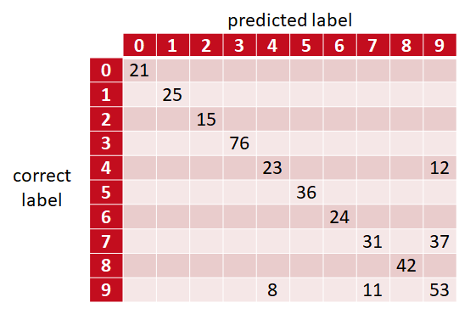
Task 4 Model Debugging
64/100
Task 4a: Describe sources of bias in machine learning and name examples how to
ensure fairness when building ML models with examples. [4/100 points]
  Sources: selection bias, sample bias, data bias (e.g., NMAR), confirmation bias
  Fairness constraints: monotonicity, group fairness constraints
Task 4b: Explain the concept of a confusion matrix
and describe it in detail. [4/100 points]
  Matrix of correct versus predicted labels
  Cells contain counts or relative frequencies
  of correct/predicted pair occurrences
  Enables understanding which classes are
  “confused” with each other

Slide 44
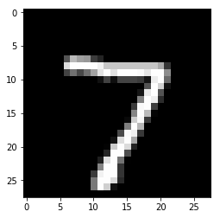
Task 4 Model Debugging, cont.
68/100
Task 4c: Explain the concept of occlusion-based explanations by example of classifying
below hand-written digit as a seven [4/100].
Slide black/gray square over input image
Measure how feature maps (layer activation)
and classifier output change
Show a heat map
of these changes

Slide 45
Task 5 Compilation Techniques
76/100
Task 5a: Describe the purpose of the rewrite common subexpression elimination (CSE) and
sketch an algorithm to perform CSE on a directed acyclic graph (DAG) of operators. [5/100 points]
  Convert tree/graph of operators with redundant
  common subexpressions into redundancy-free operator graph
  Step 1: Collect and replace leaf nodes
  (variable reads and literals)
  Step 2: recursively remove CSEs bottom-up
  starting at the leaves by merging nodes with
  same inputs (beware non-determinism)
Task 5b: Explain the concept of operator fusion and
how it can improve runtime performance [3/100 points]
  Merge sequence or sub-DAG of data-dependent operators into a single operator
  Performance Improvements: avoid unnecessary allocation, reduced write/read memory bandwidth requirements / cache locality, additional specialization (e.g., data types, dimensions)
R1
R2
R1
R2
-
+
-
+
7
abs
abs
rand
7
abs
rand
*
*
*
A
B
A
B
A
B

Slide 46
Task 5 Compilation Techniques
83/100
Task 5c: Assume an example chain of matrix multiplications (A B C D E), describe the
problem of matrix multiplication chain optimization, and a dynamic programming algorithm
for solving it efficiently [7/100 points]
Matrix Multiplication is associative, mmchain
opt aims to find optimal parenthesization
Dynamic programming applies because
(1) optimal substructure, and
(2) overlapping subproblems
Bottom-up sub-chain optimization
via composition from solved subproblems
Top-down read-out of optimal split matrix
5
1
Cost matrix m
4
222
2
j
i
3
135
125
3
2
105
56
72
4
1
350
35
15
27
5
0
0
0
0
0
M1
M2
M3
M4
M5
Notes:
Also by example of a concrete chain

Slide 47
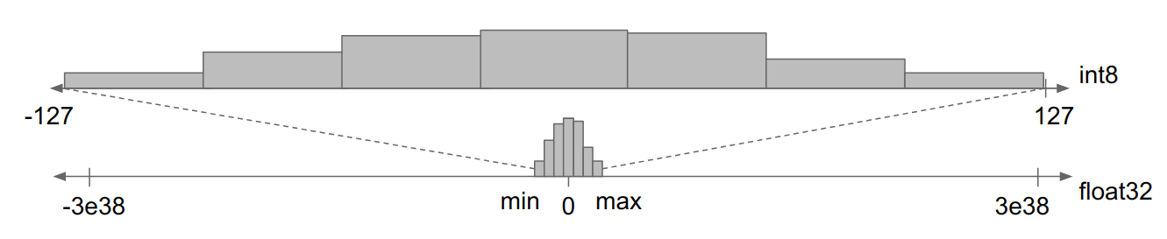
Task 6 Data Access Optimizations
91/100
Task 6a: Describe min-max quantization of an FP64 (floating point) representation into UINT8 (integer).
Why does such an encoding increase training and/or inference performance? [8/100 points]
Determine min/max range of matrix
Split range into 2^8 = 256 buckets/bins
Encode FP64 values in a bin via binID (lossy, but order-preserving)
➔ Performance Improvements
  (1) Reduced memory bandwidth requirements
  (2) Increased instruction parallelism (e.g., AVX512: 8 FP64 → 64 UINT8 ops)
  (3) Reduced energy consumption
FP64
Min/Max Quantization
[Jonathan Ragan-Kelly: The Future of Fast Code: Giving Hardware What It Wants, PLDI 2024 Keynote (inspired by Bill Dally on 14nm)]

Slide 48
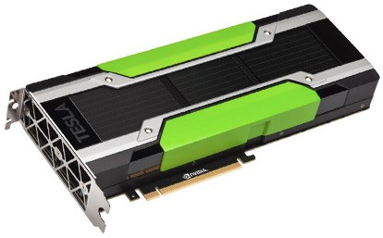
Task 7 Model Deployment
100/100
Task 7a: Consider a deployed model M in a cloud serving
environment and assume 1000s of clients. Explain three
strategies for improving model scoring throughput
at the serving site. [9/100 points]
Caching / Reuse of input-prediction pairs (fewer model invocations)
Batching of client requests / vectorization
(fewer kernel launches, utilize compute better, less sync barriers)
Quantization of input data (data transfer to serving systems, instruction parallelism)
Inference Program Compilation
Specialized, Smaller Models
client requests
M
Serving System
predictions

Slide 49
Final Questions & Answering
THANKS
and
GOOD LUCK!

