Slide 1

Programmierpraktikum: Datensysteme 01 Kickoff and Introduction
Prof. Dr. Matthias Boehm
Technische Universität Berlin
Berlin Institute for the Foundations of Learning and Data
Big Data Engineering (DAMS Lab)
Last update: Apr 13, 2026

Slide 2

Announcements / Org
#1 Hybrid & Video Recording
Hybrid lectures (in-person, zoom) with optional attendance https://tu-berlin.zoom.us/j/9529634787?pwd=R1ZsN1M3SC9BOU1OcFdmem9zT202UT09
Zoom video recordings, links from website https://mboehm7.github.io/teaching/ss26_ppds/index.htm
#2 Course Registrations
TU Berlin ISIS / Fak IV Meta registrations as of Apr 13
Bachelor/Master ratio? CS/WINF/others ratio?
26 meta
~65 all

Slide 3

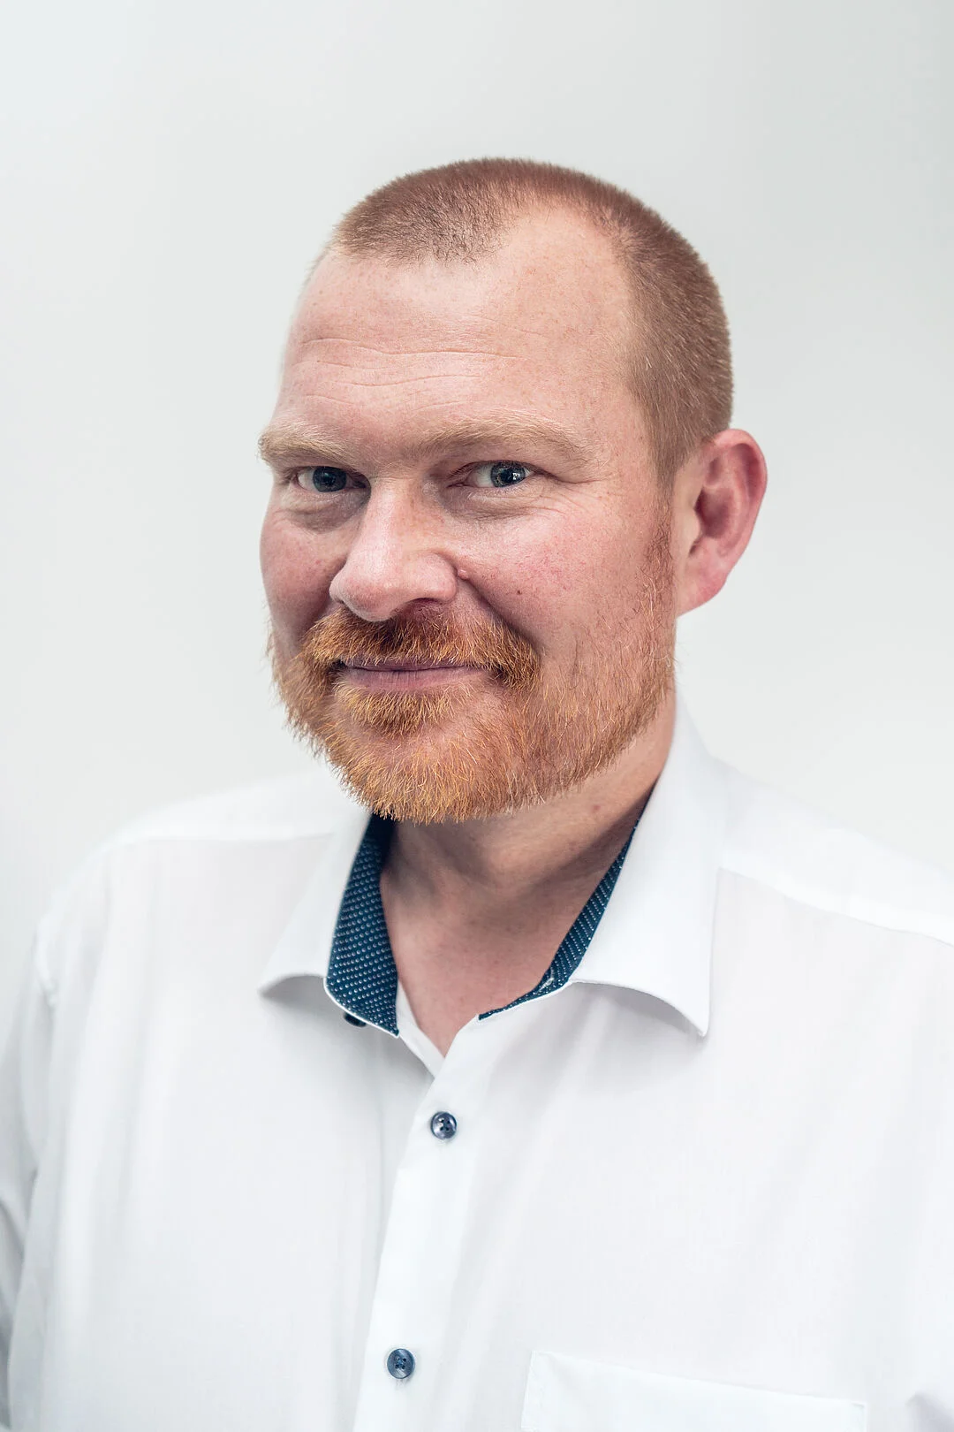
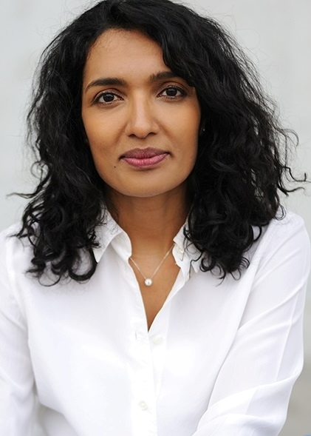
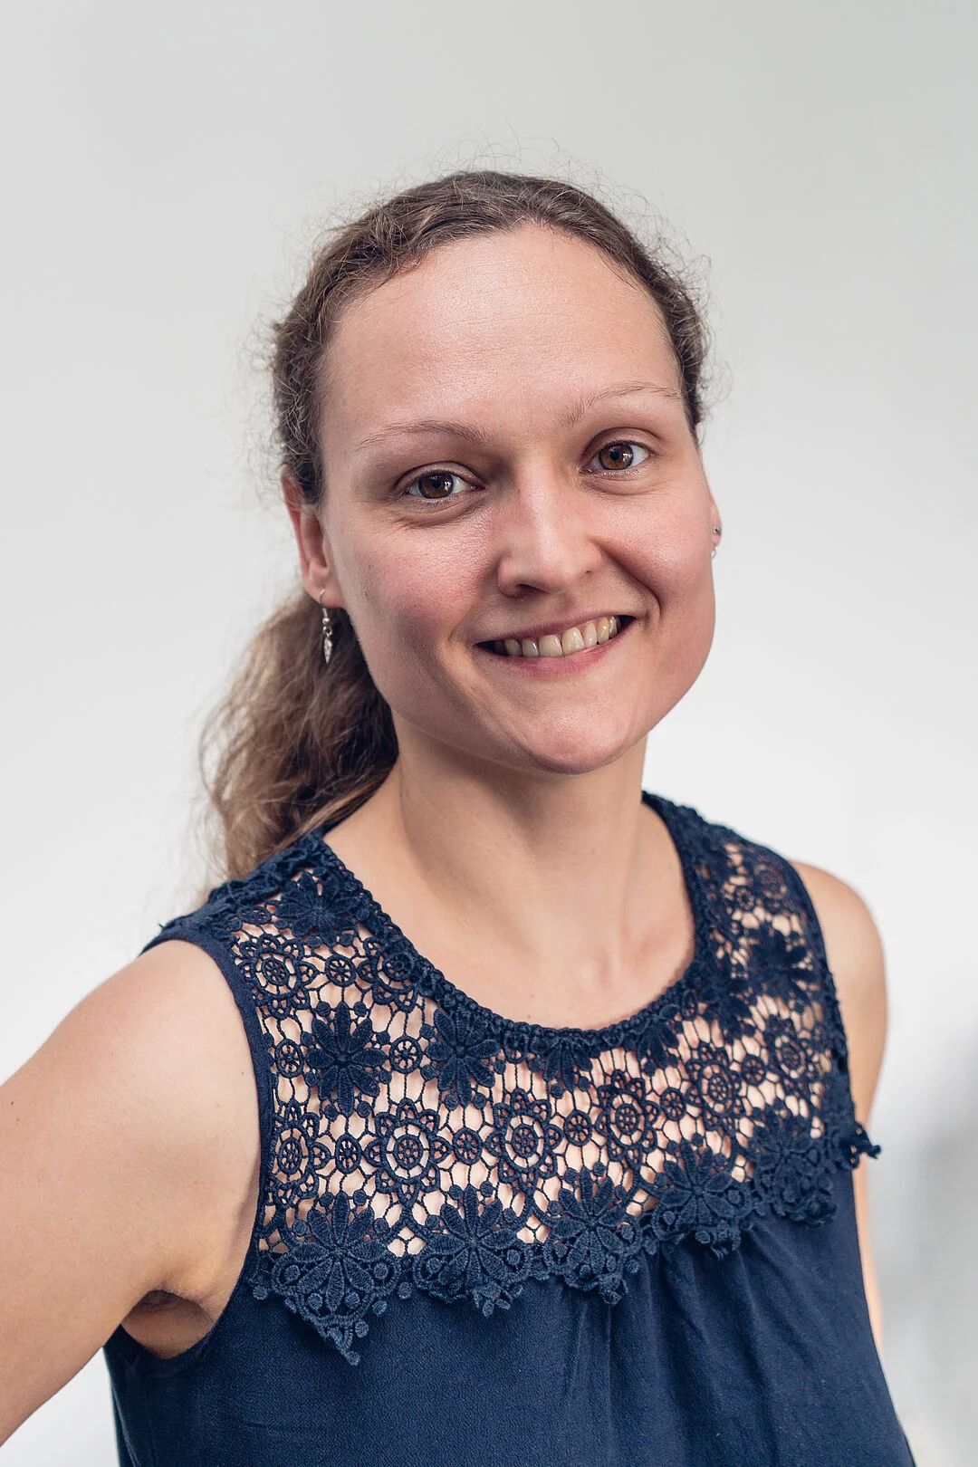
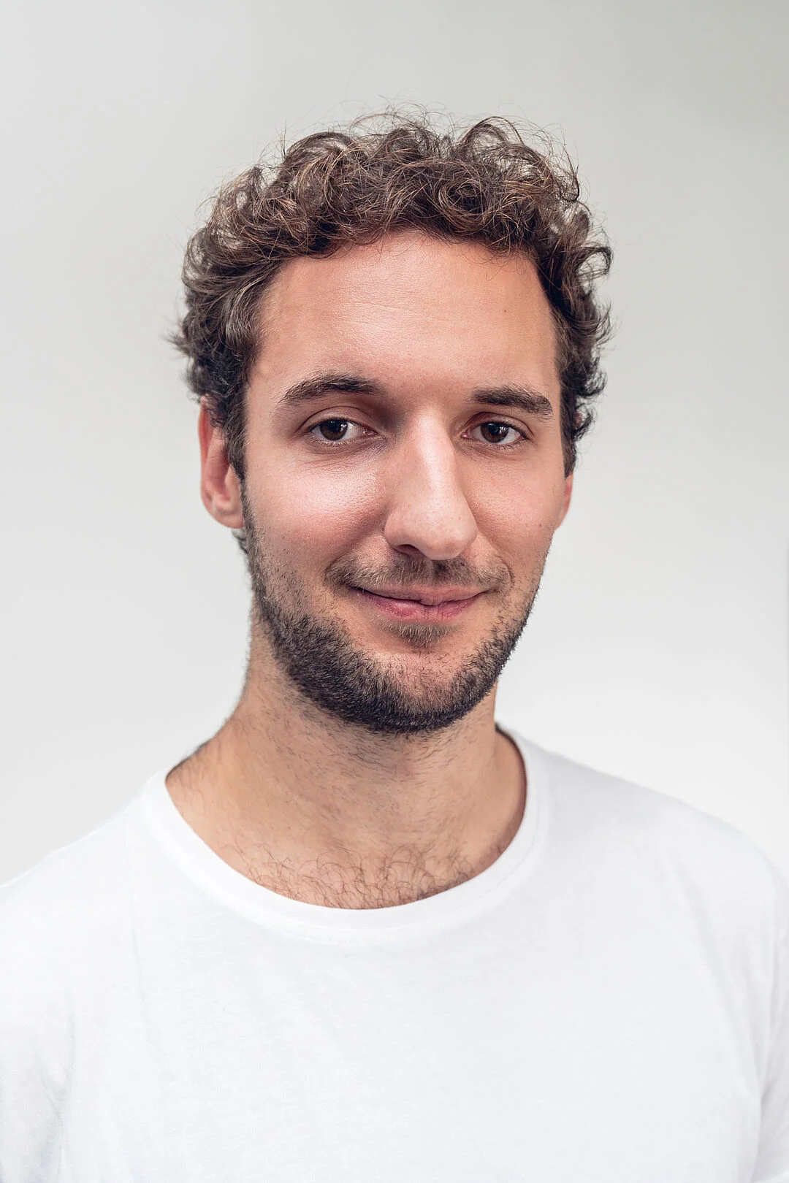
#3 Faculty IV - Team Awareness and Antidiscrimination
https://www.tu.berlin/eecs/awan
Goal
Low-barrier approachability for spectrum of awareness and antidiscrimination issues
Team
Irene Hube-Achter (MTSV)
Matthias Boehm (professors)
Ceenu George (professors)
Nadine Karsten (scientific staff)
Tom Hersperger (students)
Mission Statement
Account for heterogeneity and complexity of modern societies at TU Berlin
#1 Treat all persons with fairness and respect
#2 Ensure a safe environment for all
#3 Comply with our duty of care towards others
#4 Actively support the implementation of the above guidelines and contribute
Contact: private email,
eecs-TB-awareness@win.tu-berlin.de, or AwAn@dams.tu-berlin.de
Notes:
All employees and students are committed to

Slide 4
Agenda
Course Organization
#1 Efficient Join Pipeline Executor (DAMS)
#2 Duplicate Detection (D2IP)
#3 Provenance Tracking in ML Pipelines (DEEM)
#4 Fairness Auditing for ML Pipelines (DEEM)
Course Selection/Enrolment

Slide 5
Course Organization

Slide 6
Basic Course Organization
Language
Lectures and slides: English (German if preferred)
Communication and presentations: English/German
Informal language (first name is fine)
Offline Q&A in forum, answered by teaching assistants
Course Format
6 ECTS (4 SWS) bachelor computer science / information systems
Every-other-week lectures (Mon 4.15pm sharp, including Q&A), attendance optional
Prerequisites
Basic programming skills in languages such as C, C++, Java, Rust, Python, etc
Basic understanding of data management SQL / RA (or willingness to fill gaps)

Slide 7

Course Goals and Structure
Objectives
Apply basic programming skills to more complex problem (in self-organized team work)
Technical focus on data management and data systems
Holistic programming projects: prototyping, design, versioning, tests, experiments, benchmarks
Grading: Pass/Fail
Project Implementation (project source code) [45%]
Component and Functional Tests (test source code) [10%]
Runtime Experiments (achieve performance target) [15%]
Documentation (design document up to 5 pages / code documentation) [15%]
Result Presentation (10min talk) [15%]
Academic Honesty / No Plagiarism (incl LLMs like ChatGPT)

Slide 8
Sub-Course Offerings
#1 Efficient Join Pipeline Executor
Capacity: 16/48
Organized by DAMS group
Focus on query processing
#2 Duplicate Detection
Capacity: 16/48
Organized by D2IP group
Focus on entity resolution
#3 Provenance Tracking in ML Pipelines #4 Fairness Auditing for ML Pipelines
Capacity: 16/48
Organized by DEEM group
Focus on ML pipelines
➔ Admitted Students:
67 on ISIS (incl duplicates)
Total registrations: up to 60 → 15 teams, 4 students each

Slide 9
#1 Efficient Join Pipeline Executor (DAMS)

Slide 10




About Me
Since 09/2022 TU Berlin, Germany
University professor for Big Data Engineering (DAMS)
2018-2022 TU Graz, Austria
BMK endowed chair for data management + research area manager
Data management for data science (DAMS), SystemDS & DAPHNE
2012-2018 IBM Research – Almaden, CA, USA
Declarative large-scale machine learning
Optimizer and runtime of Apache SystemML
2007-2011 PhD TU Dresden, Germany
Cost-based optimization of integration flows
Time series forecasting / in-memory indexing & query processing
DB group

Slide 11

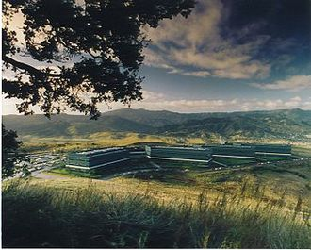
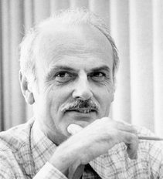
SQL Standard (SQL-86)
Oracle, IBM DB2, Informix, Sybase → MS SQL
History 1970/1980s Relational Database Systems
SEQUEL
QUEL
System R @ IBM Research – Almaden (Jim Gray et al., Turing Award ‘98)
Ingres @ UC Berkeley (Stonebraker et al., Turing Award ‘14)
Tuple Calculus
Relational Algebra
Relational Model
Edgar F. “Ted” Codd @ IBM Research (Turing Award ‘81)
Goal: Data Independence
(physical data independence)
Ordering Dependence
Indexing Dependence
Access Path Dependence
[E. F. Codd: A Relational Model of Data for Large Shared Data Banks. Comm. ACM 13(6), 1970]

Slide 12
Success of SQL / Relational Model
#1 Declarative: what not how
#2 Flexibility: closure property → composability
Query:
SELECT O_OID, sum(L_Price)
FROM Orders, Lineitem, Customer
WHERE O_OID = L_OID AND O_CID = C_CID
AND O_Odate >= ‘2018-11-14’
AND C_Msegment = ‘AUTOMOBILE’
GROUP BY O_OID
Logical Query Plans
C(P)=1.32M
C(P)=2.2G
C(P)=0.34M
Physical Query Plan
Γ
sum(Price)
Hash GrpJoin
Γ
Γ
0.001
σ
>=2018-11-14
⋈
⋈
#4 Physical Data Independence
0.2
σ
Hash Join
TScan L
⋈
L
⋈
σ
AUTOMOBILE
⋈
σ
σ
σ
L
C
σ
⋈
10K
IXScan O
C
O
C
O
Date
TScan C
O
1G
L
#3 Automatic Optimization
100M

Slide 13
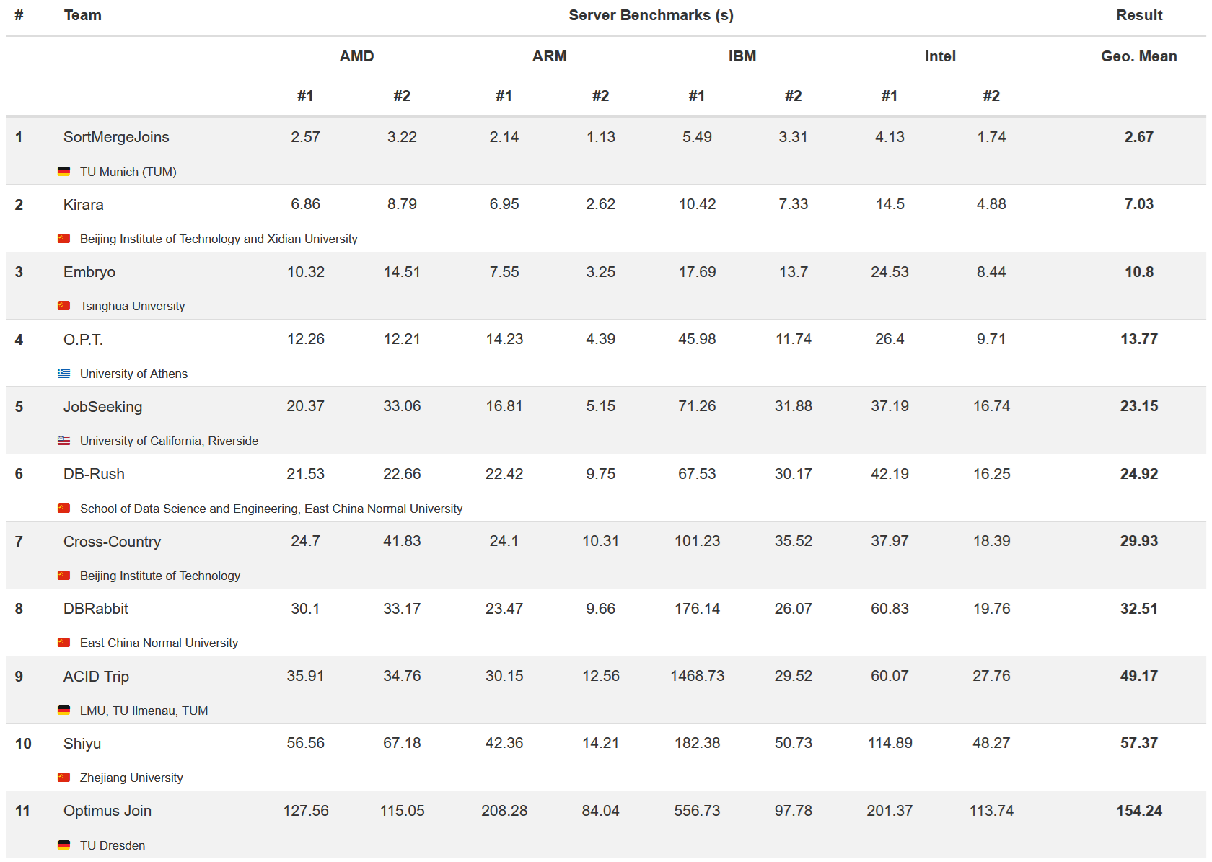
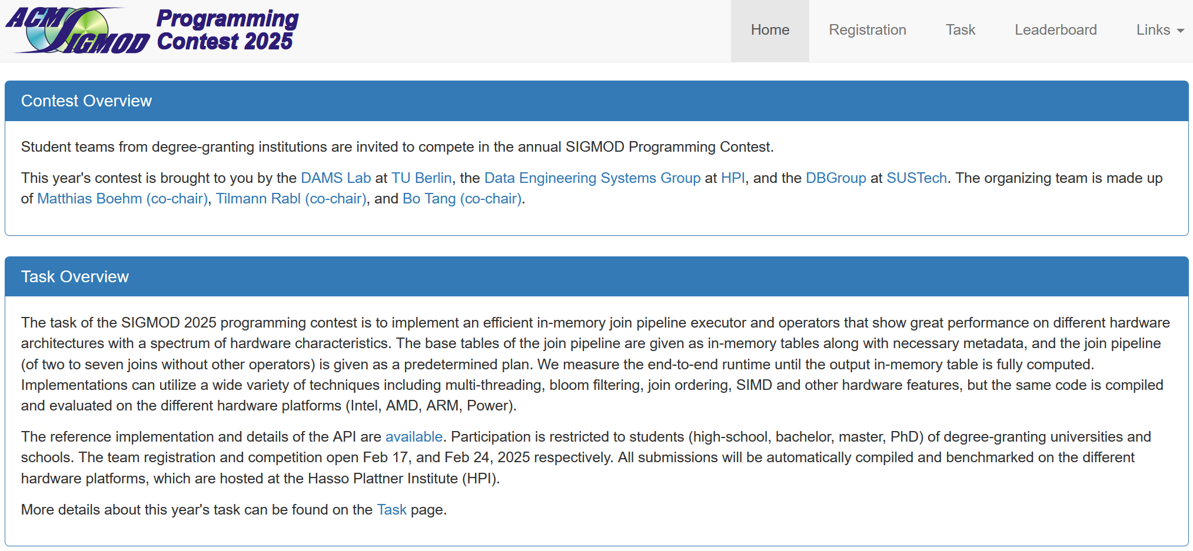
Overview SIGMOD’25 Programming Contest https://sigmod-contest-2025.github.io/index.html
Task Overview
Implement efficient in-memory join pipeline executor
Aim performance on different hardware architectures
Base tables are given as columnar in-memory tables
Measures end-to-end runtime until outputs computed

Slide 14
Overview Join Pipelines
SELECT *
FROM R1, R3,
(SELECT R2.z, count(*)
FROM R2
WHERE R2.y=3
GROUP BY R2.z) R2
WHERE R1.x=7
AND R1.a=R3.b
AND R2.z=R3.c
⋈_{a=b}
σ_{x=7}
⋈_{z=c}
R1
γ_{COUNT(*);Z}
σ_{y=3}
R2
R3

Slide 15
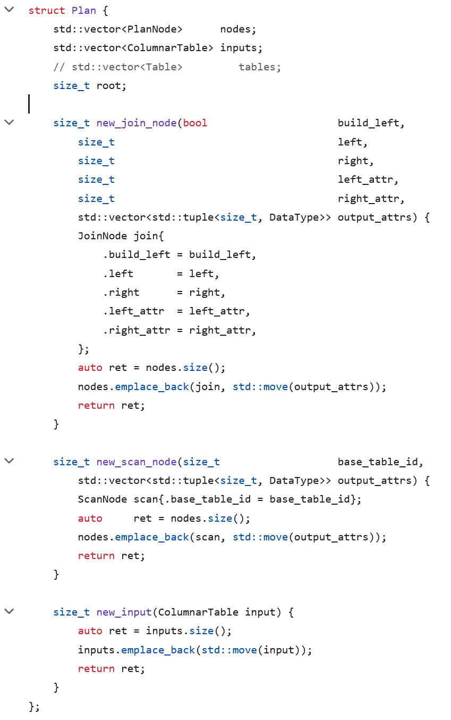
Application Programming Interface (API) https://github.com/SIGMOD-25-Programming-Contest/base
namespace Contest {
void* build_context();
void destroy_context(void*);
ColumnarTable execute( const Plan& plan, void* context);
} // namespace Contest
./download_imdb.sh;
./build/build_database imdb.db;
./build/run plans.json;

Slide 16
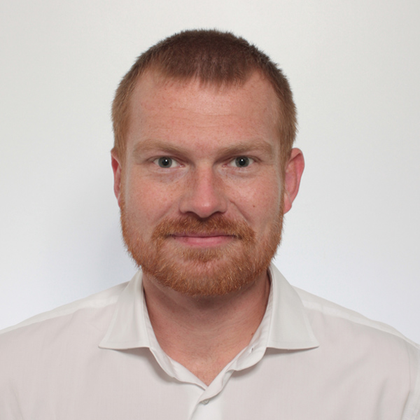
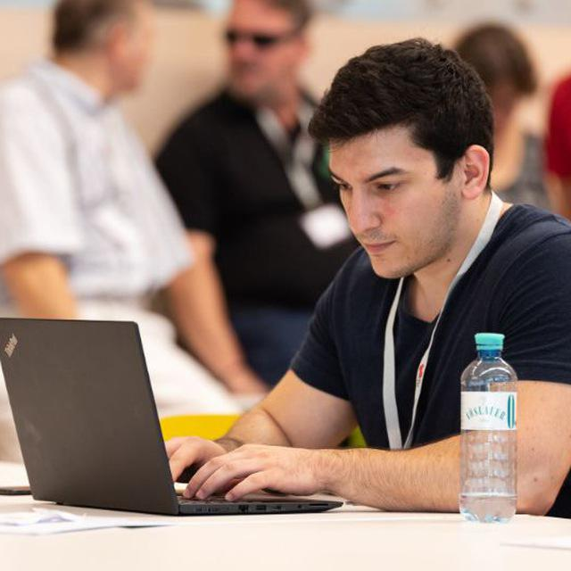
Additional Course Logistics
Staff
Lecturer: Prof. Dr. Matthias Boehm
Teaching Assistant: Philipp Ortner, and others if needed
Next Dates/Lectures
Apr 19: Course Selection; team preferences, otherwise assignment
Apr 27: Background Query Processing
May 11: Background Query Compilation and Parallelization
Jun 08: Background Query Optimization
Jun 22: Experiments and Reproducibility
Jul 01: Project submissions (performance target: speedup > #pcores over reference)
Jul 06: Project presentations (10min per team, mandatory attendance)
Infrastructure
Setup your own private Github/Gitlab repository
Each teams gets a mentor
Q&A sessions on demand

Slide 17
#2 Duplicate Detection (D2IP)

Slide 18
#3 Provenance Tracking in ML Pipelines (DEEM)

Slide 19
#4 Fairness Auditing for ML Pipelines (DEEM)

Slide 20
Course Selection/Enrolment

Slide 21
Select Your Course
Thanks
#1 Efficient Join Pipeline Executor (DAMS)
Capacity: 16/48
#2 Duplicate Detection (D2IP)
Capacity: 16/48
#3 Provenance Tracking in ML Pipeline (DEEM) #4 Fairness Auditing for ML Pipelines (DEEM)
Capacity: 16/48
Course Selection/Enrolment by Apr 19 EOD
https://forms.gle/i6xFTMxHWSJabYHR8

