Slide 1
Architecture of DB Systems
01 Introduction and Overview
Last update: Oct 05, 2021

Slide 2


Announcements/Org
#1 Video Recording
  Link in TUbe & TeachCenter (lectures will be public)
  Optional attendance (independent of COVID)
  Hybrid, in-person but video-recorded lectures
    HS i5 + Webex: https://tugraz.webex.com/meet/m.boehm
#2 COVID-19 Precautions (HS i5)
  Room capacity: 24/48 (green/yellow), 12/48 (orange/red)
  TC lecture registrations (limited capacity, contact tracing)
#3 Course Registration (as of Oct 06)
  Architecture of Database Systems (ADBS)
WS20/21: 73 (0)
WS21/22: 94 (0)

Slide 3
Agenda
Data Management Group
Course Organization
Course Motivation and Goals
Course Outline and Projects
Excursus: DAPHNE Project

Slide 4
Data Management Group
https://damslab.github.io/

Slide 5




About Me
Data Management Group
09/2018 TU Graz, Austria
  BMK endowed chair for data management
  Data management for data science
  (ML systems internals, end-to-end data science lifecycle)
2012-2018 IBM Research – Almaden, USA
  Declarative large-scale machine learning
  Optimizer and runtime of Apache SystemML
2011 PhD TU Dresden, Germany
  Cost-based optimization of integration flows
  Systems support for time series forecasting
  In-memory indexing and query processing
https://github.com/
apache/systemds
DB group

Slide 6
Data Management Courses
Data Management Group
Architecture of
Database Systems
(ADBS, WS)
DB system internals
+ prog. project
Architecture of
ML Systems
(AMLS, SS)
ML system internals
Prog. projects in SystemDS
[github.com/apache/systemds]
Master
Data Integration and Large-Scale Analysis
(DIA, WS)
Distributed
Data Management
Bachelor
Intro to Scientific Writing (WS)
Data Management / Databases
(DM, SS+WS)
Data management from user/application perspective

Slide 7
Course Organization

Slide 8
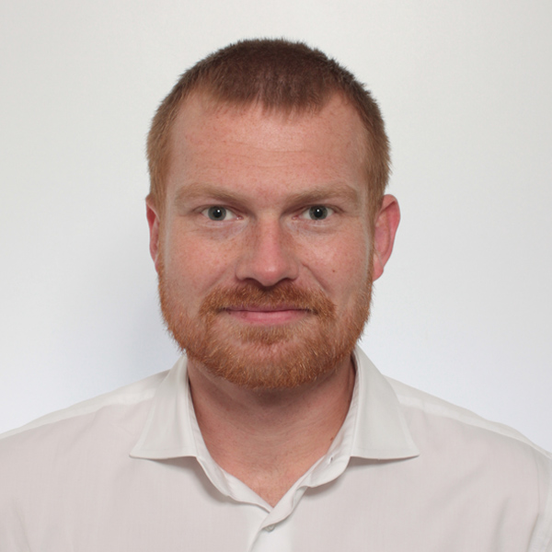
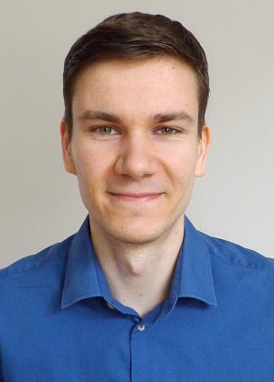
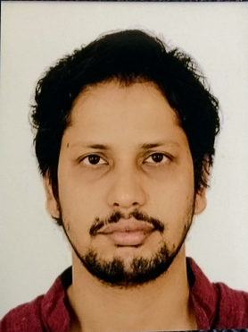
Basic Course Organization
Course Organization
Staff
  Lecturer: Univ.-Prof. Dr.-Ing. Matthias Boehm, ISDS
  Assistants: Dr.-Ing. Patrick Damme, M.Tech. Arnab Phani
Language
  Lectures and slides: English
  Communication and examination: English/German
Course Format
  VU 2/1, 5 ECTS (2x 1.5 ECTS + 1x 2 ECTS), bachelor/master
  Weekly lectures (Wed 6.15pm, including Q&A), attendance optional
  Mandatory programming project (2 ECTS)
  Recommended papers for additional reading on your own
Prerequisites
  Preferred: course Data Management / Databases is very good start
  Sufficient: basic understanding of SQL / RA (or willingness to fill gaps)
  Basic programming skills in low-level language (C, C++)

Slide 9
Course Logistics
Course Organization
Website
  https://mboehm7.github.io/teaching/ws2122_adbs/index.htm
  All course material (lecture slides) and dates
Video Recording Lectures (TUbe)
Communication
  Informal language (first name is fine)
  Please, immediate feedback (unclear content, missing background)
  Newsgroup: N/A – email is fine, summarized in following lectures
  Office hours: by appointment or after lecture
Exam
  Completed programming project (checked by me/staff)
  Final written exam (oral exam if <15 students take the exam)
  Grading (30% project/exercises completion, 70% exam)
NEW

Slide 10
Course Logistics, cont.
Course Organization
Course Applicability
  Master programs computer science (CS), as well as
  software engineering and management (SEM)
    Catalog Data Science (elective course in major/minor)
    Catalog Software Technology (elective course in major/minor)
  Free subject course in any other study program or university

Slide 11
Course Motivation and Goals

Slide 12

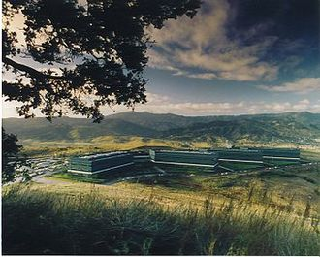
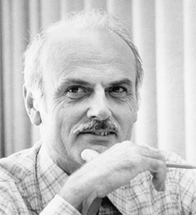
History 1970/80s
(relational)
Course Motivation and Goals
SQL Standard
(SQL-86)
Oracle, IBM DB2, Informix, Sybase → MS SQL
SEQUEL
QUEL
System R @ IBM Research – Almaden
(Jim Gray et al.,
Turing Award ‘98)
Ingres @ UC Berkeley (Stonebraker et al.,
Turing Award ‘14)
Tuple Calculus
Relational Algebra
Relational Model
Edgar F. “Ted” Codd @ IBM
Research (Turing Award ‘81)
Goal: Data Independence
(physical data independence)
  Ordering Dependence
  Indexing Dependence
  Access Path Dependence
[E. F. Codd: A Relational Model of Data for Large Shared Data Banks.
Comm. ACM 13(6), 1970]

Slide 13
Success of SQL / Relational Model
Course Motivation and Goals
Query:
SELECT O_OID, sum(L_Price)
FROM Orders, Lineitem, Customer
WHERE O_OID = L_OID AND O_CID = C_CID
AND O_Odate >= ‘2018-11-14’
AND C_Msegment = ‘AUTOMOBILE’
GROUP BY O_OID
#1 Declarative: what not how
#2 Flexibility:
closure property → composability
Logical Query Plans
C(P)=2.2G
Physical Query Plan
C(P)=1.32M
C(P)=0.34M
#4 Physical Data
Independence
Γ
Hash
GrpJoin
sum(Price)
Γ
Γ
0.001
σ
>=2018-11-14
Hash
Join
⋈
⋈
0.2
σ
TScan L
AUTOMOBILE
⋈
L
⋈
σ
⋈
IXScan
O
σ
σ
σ
σ
L
C
10K
⋈
C
Date
TScan C
O
C
O
O
1G
L
#3 Automatic Optimization
100M
Notes:
Cost model: cout (sum of cardinalities of all intermediates)

Slide 14

DBMS Architecture
Course Motivation and Goals
[Theo Härder, Erhard Rahm: Datenbanksysteme: Konzepte und Techniken der Implementierung, 2001]
Coarse-grained System Architecture
Metadata Management
Data System
Transaction Management
Access System
Storage System

Slide 15
DBMS Architecture, cont.
Course Motivation and Goals
[Theo Härder, Erhard Rahm: Datenbanksysteme: Konzepte und Techniken der Implementierung, 2001]
Q_{i}
Set-Oriented Interface
SELECT * FROM R
Data
System
Data System (Nonprocedural access)
Record-Oriented Interface
FIND NEXT record
(Data) Access System
(Navigational access)
Internal Record Interface
B-Tree
getNext
Access
System
(Record) Storage System
(Access path mgmt)
ACCESS
page j
System buffer Interface
Storage
System
Buffer Management
(Propagation control)
File Interface
READ
block k
Operating System
(File Mgmt)
Device Interface

Slide 16
Course Goals
Course Motivation and Goals
New Workloads
Constantly Changing Environment
  New application and data analysis workloads
  Heterogeneous and changing hardware characteristics
#1 Architecture and internals of traditional/modern DB systems
#2 Understanding of DB characteristics → better evaluation / usage
#3 Understanding of effective techniques → build/extend DB systems (these fundamental techniques are broadly applicable in other systems)
DBMS
New HW/Env

Slide 17
Course Outline and Projects

Slide 18
Course Outline
Course Outline and Projects
A: System Architecture and Data Access
01 Introduction and Overview [Oct 06]
02 DB System Architectures [Oct 13]
03 Data Layouts and Bufferpool Management [Oct 20]
04 Index Structures and Partitioning [Oct 27]
05 Compression Techniques [Nov 03, Patrick]
B: Query Processing and Optimization
06 Query Processing (operators, execution models) [Nov 10]
07 Query Compilation and Parallelization [Nov 17]
08 Query Optimization (rewrites, costs, join ordering) [Nov 24]
10 Adaptive Query Processing [Dec 01]

Slide 19
Course Outline, cont.
Course Outline and Projects
C: Emerging Topics
11 Cloud Database Systems [Dec 15]
12 Modern Concurrency Control [Jan 12, Arnab]
13 Modern Storage and HW Accelerators [Jan 19]
14 Selected Trends & Project Results [Jan 26, Patrick & Arnab]

Slide 20
Overview Programming Project
Course Outline and Projects
Team
  1-3 person teams (w/ clearly separated responsibilities)
Task: Efficient Group-by Aggregation
  Column-oriented frame storage w/ materialized intermediates
  Multi-threaded group-by aggregation w/ multiple group-by columns,
  additive aggregation functions, different data types / characteristics
  C test / performance suites → correct and minimum perf
  Programming language: no restrictions, but C or C++ recommended
Timeline
  Oct 19: Test drivers, reference implementation available
  Jan 21, 11.59pm: Final programming project deadline
Prices Top-k Submissions
  Research assistant positions / payed master theses in DAPHNE project
Notes:
Note previous semester: transactional in-memory index, get/set/scan/insert/delete, order-preserving
Note DM: physical operators for correctness not performance

Slide 21
Overview Programming Project, cont.
Course Outline and Projects
Recap: Classification of Aggregates (DM, DIA)
  Additive, semi-additive, additively-computable, others
#1 Sort Group-By
  Similar to sort-merge join
  (Sort, GroupAggregate)
  Sorted group output
#2 Hash Group-By
  Similar to hash join (HashAggregate)
  Higher temporary memory consumption
  Unsorted group output
  #1 w/ tuple grouping
  #2 w/ direct aggregation (e.g., count)
  Beware: cache-unfriendly if many groups (size(H) > L2/L3 cache)
  γ_{A,count(*)}(R)
sort
O(N log N)
X X X X X X Y Y Y Y Y Y Y Z Z Z Z Z
aggregate O(N)
X,6
Y,7
Z,5
build & agg
O(N)
 | H_{A,Agg}
Y
X
Z
γ_{A,count(*)}
R
Notes:
Note: quantile/median requires sort per partition -> sort group-by
Postgres: GroupAggregate, HashAggregate

Slide 22
Overview Programming Project, cont.
Course Outline and Projects
API Sketch
  Materialized inputs, outputs
  Multiple group by attributes
  Multiple aggregated attributes
  Aggregation functions: sum/min/max
Data Characteristics
  Frames w/ column-oriented storage
  Data Types: INT16, INT32, INT64
  Varying # distinct values,
  skew, missing values
Performance Target
  Relative to [naïve, tuned] reference impl (TBD)
  Perf target scaled by team size
  γ_{sum(C)}(R)
  γ_{A,sum(C)}(R)
  γ_{A,B,sum(C)}(R)
  γ_{A,B,sum(C),sum(D)}(R)
i32
i16
i64
i64
A
B
C
D
getNumRows()
getNumCols
getRow(size_t r)
getCol(size_t c)

Slide 23
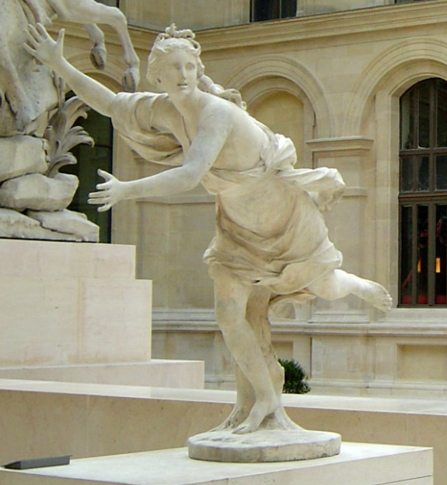

DAPHNE:
Integrated Data Analysis Pipelines for
Large-Scale DM, HPC, and ML
Motivation, Vision, and System Architecture
https://daphne-eu.github.io/
[Louvre, Paris]
Notes:
#1 Acronym
#2 DAPHNE: Greek mythology - daughter of the river god Peneus, associated with fountains, wells, springs, streams; Apollo -> large industry interest

Slide 24
HW Challenges
DAPHNE Motivation and System Architecture
[S. Markidis, E. Laure, N. Jansson, S. Rivas-Gomez and S. W. D. Chien: Moore’s Law and Dennard Scaling]
#1 End of Dennard Scaling (~2005)
  Law: power stays proportional
  to the area of the transistor
  Ignored leakage current / threshold voltage
  → increasing power density S² (power wall, heat) → stagnating frequency
#2 End of Moore’s Law (~2010-20)
  Law: #transistors/performance/
  CPU frequency doubles every
  18/24 months
  Original: # transistors per chip
  doubles every two years
  at constant costs
  Now increasing costs (10/7/5nm)
#3 Amdahl’s Law (speedup limitations)
P = α CFV² (power density 1)
(P .. Power, C .. Capacitance,
F .. Frequency, V .. Voltage)
➔ Dark Silicon and Specialization
Notes:
Dennard Scaling: (scaling factor S of transistors)
* # transistors: S^2
* Capacitance: 1/S
* Frequency: S
* Device power V: 1/(S^2)
* Alpha 1/2
(but V cannot be further reduced due to leakage (noise of neighboring transistors); capacity (current) of transistor -> the smaller the transistor, the smaller the frequency)
Gordon Moore (co-founder of Intel)

Slide 25
HW Challenges, cont.
DAPHNE Motivation and System Architecture
HW Specialization
Additional Specialization
  Data Transfer & Types: e.g., low-precision, quantization; new data types
  Sparsity Exploitation: e.g., sparsification, exploit across operations,
  defer weight decompression just before instruction execution
  Near-Data Processing: e.g., operations in main memory, storage class memory (SCM), secondary storage (e.g., SSDs), and tertiary storage (e.g., tapes)
HW Devices
General Purpose
Specialized HW
CPU
GPU
FPGAs
ASICs
SIMD
Throughput-oriented, specialized instructions
programmable
logic
fixed logic
➔ Heterogeneity and Utilization Challenges
Notes:
Tradeoff: reconfiguration (CPU high, ASIC impossible) vs energy efficiency (ASIC high, CPU low)

Slide 26
Productivity & Overhead Challenges
DAPHNE Motivation and System Architecture
Productivity and Systems Support
  ML pipelines and HPC still require substantial manual effort
  Different programming models, cluster environments, redundancy
Overhead and Low Utilization
  Separate, statically provisioned clusters
  Lack of interoperability, coarse-grained file exchange
Lack of Common System Infrastructure
  Conceptual ideas reused, but redundantly implemented
  Open-source systems in DM, ML, HPC often company-controlled
Productivity &
Specialization from use cases to HW infrastructure
➔ DAPHNE Overall Objective:
An open and extensible systems infrastructure (DM/ML/HPC)

Slide 27
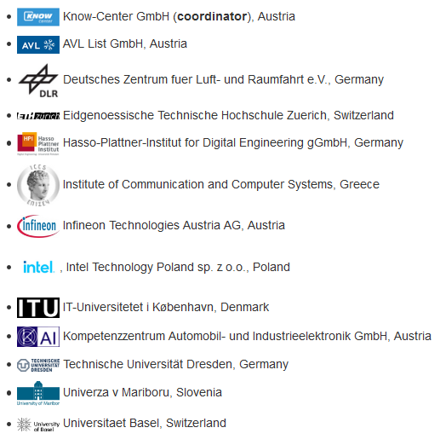
DAPHNE Consortium
DAPHNE Motivation and System Architecture
Data Management
High-Performance
Computing (HPC)
ML Systems
ML/NLP/
Sim&Optimization
Application Domains
Academia and Industry
➔ Advancements through Creation
(EuroHPC Center)

Slide 28
Use Cases
DAPHNE Motivation and System Architecture
[Xiao Xiang Zhu et al: So2Sat LCZ42: A Benchmark Dataset for the Classification of Global Local Climate Zones. GRSM 8(3) 2020]
DLR Earth Observation
  ESA Sentinel-1/2 datasets → 4PB/year
  Training of local climate zone classifiers on
  So2Sat LCZ42 (15 experts, 400K instances,
  10 labels each, 85% confidence, ~55GB H5)
  ML pipeline: preprocessing, ResNet20,
  climate models
KAI Semiconductor Device Reliability
IFAT Semiconductor Ion Beam Tuning
AVL Vehicle Dev Process (ejector geometries, fuel cells)
ML-assisted simulations (e.g., fluids, materials) + data analysis
[So2Sat LC42 Dataset
https://mediatum.ub.tum.de/1454690]

Slide 29
System Architecture
DAPHNE Motivation and System Architecture
Notes:
Note: preliminary results on query processing, linear models (CPU), and ResNet-20 (GPU)

Slide 30
Summary and Q&A
Course Goals
  #1 Architecture and internals of traditional/modern DB systems
  #2 Understanding of DB characteristics → better evaluation / usage
  #3 Understanding of effective techniques → build/extend DB systems
  (these fundamental techniques are broadly applicable in other systems)
Programming Project
  Column-oriented frame storage w/ materialized intermediates
  Multi-threaded group-by aggregation w/ multiple group-by columns,
  additive aggregation functions, different data types / characteristics
Next Lectures
  02 DB System Architectures [Oct 13]
  03 Data Layouts and Bufferpool Management [Oct 20]
  04 Index Structures and Partitioning [Oct 27]
  05 Compression Techniques [Nov 03]

