Slide 1

Architecture of DB Systems
04 Index Structures and Partitioning
Last update: Oct 27, 2021

Slide 2


Announcements/Org
#1 Video Recording
  Link in TUbe & TeachCenter (lectures will be public)
  Optional attendance (independent of COVID)
  Hybrid, in-person but video-recorded lectures
    HS i5 + Webex: https://tugraz.webex.com/meet/m.boehm
#2 COVID-19 Precautions (HS i5)
  Room capacity: 24/48 (green/yellow), 12/48 (orange/red)
  TC lecture registrations (limited capacity, contact tracing)
#3 Programming Projects
  Initial test suite, benchmark, and make file on website
  Fix for minor memory alloc/free issues
  https://mboehm7.github.io/teaching/ws2122_adbs/Project_Setup_v2.zip
max
24/90

Slide 3
Agenda
Overview Access Methods
Index Structures
Partitioning and Pruning
Adaptive and Learned Access Methods

Slide 4
Overview Access Methods

Slide 5

DBMS Architecture, cont.
Overview Access Methods
[Theo Härder, Erhard Rahm: Datenbanksysteme: Konzepte und Techniken der Implementierung, 2001]
Q_{i}
Set-Oriented Interface
SELECT * FROM R
Data
System
Data System (Nonprocedural access)
Record-Oriented Interface
FIND NEXT record
(Data) Access System
(Navigational access)
Internal Record Interface
B-Tree
getNext
Access
System
(Record) Storage System
(Access path mgmt)
ACCESS
page j
System buffer Interface
Storage
System
Buffer Management
(Propagation control)
File Interface
READ
block k
Operating System
(File Mgmt)
Device Interface

Slide 6
Access Methods and Physical Design
Overview Access Methods
Performance Tuning via Physical Design
  Select physical data structures for relational schema and query workload
  #1: User-level, manual physical design by DBA (database administrator)
  #2: User/system-level automatic physical design via advisor tools
Example
Base
Tables
SELECT * FROM R, S, T
WHERE R.c = S.d AND S.e = T.f
AND R.b BETWEEN 12 AND 73
R
S
T
⋈
Mat
Views
MV₁
MV₂
⋈_{e=f}
⋈_{c=d}
Parti-
tioning
T
10
σ_{12≤R.b≤73}
S
Physical
Access Paths
1000000
B⁺-Tree
BitMap
Hash
R
Compression
Notes:
Mat views and partitioning → logical access paths
Index structures and compression → physical access paths

Slide 7

Overview Index Structures
Overview Access Methods
Table Scan
Index Scan
Table Scan vs Index Scan
  For highly selective predicates, index scan
  asymptotically much better than table scan
  Index scan higher overhead (~5% break even)
    IXScan → TID-Sort → TID-Fetch
    Multi-column predicates: TID-list intersection
Use Cases for Indexes
ix
sorted
Lookups /
Range Scans
Unique
Constraints
Index Nested Loop Joins
Aggregates
(count, min/max)
contains
key 107?
$$\text{⋈}$$
ix
size=
7100
table data
ix
R
ix
ix
S

Slide 8
Additional Terminology
Overview Access Methods
Create Index
  Create a secondary (nonclustered)
  index on a set of attributes
  Clustered: tuples sorted by index
  Non-clustered: sorted attribute with tuple references
  Can specify uniqueness, order, and indexing method
  PostgreSQL methods: btree, hash, gist, and gin
Binary Search
  pos = binarySearch(data,key=23)
  Given sorted data, find key position
  (insert position if non-existing)
  k-ary search for SIMD data-parallelism
  Interpolation search: probe expected pos in key range
  (e.g., search([1:10000], 9700))
CREATE INDEX ixStudLname
ON Students USING btree
(Lname ASC NULLS FIRST);
ix
table data
10 13 14 17 18 19 23 25 27 29
10 13 14 17 18 19 23 25 27 29
10 13 14 17 18 19 23 25 27 29

Slide 9
Index Structures

Slide 10
Classification of Index Structures
Index Structures
[Theo Härder, Erhard Rahm: Datenbanksysteme: Konzepte und Techniken der Implementierung, 2001]
1D Access Methods
ND Access Methods
  Linearization of ND key space + 1D indexing (Z order, Gray code, Hilbert curve)
  Multi-dimensional trees and hashing (e.g., UB tree, k-d tree, gridfile)
  Spatial index structures (e.g., R tree)
1D Access Methods
Key Comparison
Key Transformation
Sequential
Tree-Based
Sort-Based
Hash-Based
Sequential Lists
Linked Lists
Binary Search Trees
Multiway Trees (B-Tree)
Prefix Trees (Tries)
Static
Dynamic
Notes:
TODO: discuss ND techniques in more detail

Slide 11
B-Tree Overview
Index Structures
[Rudolf Bayer, Edward M. McCreight: Organization and Maintenance of Large Ordered Indices. Acta Inf. (1) 1972]
History B-Tree
  Bayer and McCreight 1972, Block-based, Balanced, Boeing Labs
  Multiway tree (node size = page size); designed for DBMS
  Extensions: B+-Tree/B*-Tree (data only in leafs, double-linked leaf nodes)
Definition B-Tree (k, h)
  All paths from root to leafs have equal length h
  All nodes (except root) have [k, 2k] key entries
  All nodes (except root, leafs) have [k+1, 2k+1] successors
  Data is a record or a reference to the record (RID)
All nodes adhere to max constraints
k=2
P₀
Key K₁
Data D₁
P₁
Key K₂
Data D₂
P₂
Key K₃
Data D₃
P₃
Key K₄
Data D₄
P₄
Subtree w/
keys ≤ K₁
Subtree w/
K₂ < keys ≤ K₃

Slide 12
B-Tree Search
Index Structures
25
Example B-Tree k=2
  Get 38 → D38
  Get 20 → D20
  Get 6 → NULL
Lookup Q_{K} within a node
  Scan / binary search keys for Q_{K}, if K_{i}=Q_{K}, return D_{i}
  If node does not contain key
    If leaf node, abort search w/ NULL (not found), otherwise
    Decent into subtree Pi with K_{i} < Q_{K} ≤ K_{i+1}
Range Scan Q_{L<K<U}
  Lookup Q_{L} and call next K while K<Q_{U} (keep current position and node stack)
10
20
30
40
2
5
7
8
41
42
45
46
13
14
15
18
32
35
38
22
24
26
27
28

Slide 13
B-Tree Insert
Index Structures
Basic Insertion Approach
  Always insert into leaf nodes!
  Find position similar to lookup, insert and maintain sorted order
  If node overflows (exceeds 2k entries) ➔ node splitting
Node Splitting Approach
  Split the 2k+1 entries into two leaf nodes
  Left node: first k entries
  Right node: last k entries
  (k+1)th entry inserted into parent node
  ➔ can cause recursive splitting
  Special case: root split (h++)
B-Tree is self-balancing
30
40
2k+1
41
42
45
46
47
overflow
30
40
45
1
41
42
46
47
first k
last k

Slide 14
B-Tree Insert, cont. (Example w/ k=1)
Index Structures
Insert 1
Insert 5
Insert 2
(split)
Insert 6
Insert 7
(split)
Insert 4
Insert 8
Insert 3
(2x split)
1
2
6
1
4
5
7
1
5
2
6
2
1
4
5
7
8
1
5
4
2
2
6
1
5
6
1
3
5
7
8
2
6
1
5
7

Slide 15
B-Tree Delete
Index Structures
Basic Deletion Approach
  Lookup deletion key, abort if non-existing
  Case inner node: move entry from fullest successor node into position
  Case leaf node: if underflows (<k entries) ➔ merge w/ sibling
Example
  Case
  inner
  Case
  leaf
4
4
2
6
2
7
1
3
5
7
8
1
3
5
8
4
under-
flow
4
2
7
7
4
7
1
3
5
8
1
2
5
8
1
2
5
8
underflow
Notes:
Note: in case inner, direct merge of 2 and 4 not possible, as 6 separates the two leaf nodes 5 and (7,8)

Slide 16
B-Tree Insert and Delete w/ k=2
Index Structures
10
20
Insert/Delete Examples
  Original
  Insert 16
  Insert 26
  Delete 20
  Delete 16
3
5
7
4
11
18
19
25
28
30
31
10
20
3
5
7
4
11
16
18
25
28
30
31
10
20
28
3
5
7
4
11
16
18
25
26
30
31
30
31
30
31
10
18
28
3
5
7
4
11
16
18
25
26
30
31
30
31
30
31
10
28
3
5
7
4
11
18
25
26
30
31
30
31

Slide 17
B-tree – Advanced Aspects
Index Structures
[Goetz Graefe: Modern B-Tree Techniques. Found. Trends Databases 3(4): 203-402, 2011]
Variable-Length Fields
  In-page slot-array to variable length fields → direct lookup
  With fixed page size, no guarantees on min/max entries
  Various approaches: overflow pages, pick separators during bulk loading
Concurrent Access
  DB locks: only leaf nodes for B+ tree in practice at value/value ranges
  Concurrent threads require page latching (parent-child)
Duplicate Keys
  #1 use prefix truncation for compression → store common prefix once)
  #2 concatenate key-TID for unique lockups w/ O(log N)
  Duplicate records as replicates or once w/ counter
Notes:
SQLLite: overflow pages for variable length fields (larger page size/4)

Slide 18
Other In-Memory Trees
Index Structures
Balanced Binary Trees
  Red-Black Tree, AVL Tree
  (left/right height diff 1)
  T tree (combines pros
  of AVL and B trees)
CSB⁺-Tree
  Align node size to cache line (64B)
  Reduce pointers via node groups
  More keys, higher fan-out, at cost of slower insert
Skip Lists
  Linked list with multiple levels
  Fraction p w/ level i pointers
[G. M. Adel'son-Vel'skii and E. M. Landis: An algorithm for the organization of information, Soviet Mathematics Doklady, 3, 1962]
[Tobin J. Lehman, Michael J. Carey: A Study of Index Structures for Main Memory Database Management Systems. VLDB 1986]
2
4
5
7
left
right
2
[Jun Rao, Kenneth A. Ross: Making B+-Trees Cache Conscious in Main Memory. SIGMOD 2000]
1
5
insert 17
[William Pugh: Skip Lists: A Probabilistic Alternative to Balanced Trees. CACM 1990]

Slide 19
Hashing Overview
Index Structures
Static vs Dynamic Hashing
  Hash table of buckets B, compute h=hash(key), find bucket B[h mod |B|]
  Static: pre-allocation of buckets, over- and under-provisioning
  (open addressing: linear probe, robin hood, cuckoo)
  Dynamic: extend as needed (chained bucket, extendible, linear hashing)
Chained Bucket Hashing
  Handle hash collisions via
  overflow list of linked buckets
  Reorganization if fill factor reached
  On disk: buckets are pages
Common Hash Functions
  MurmurHash 2, MurmurHash 3, Jenkins, CRC
  Google CityHash, Google FarmHash, Facebook
  XXHash3 (http://cyan4973.github.io/xxHash/)
hashing
17
2
7
1
3
5
15
18
2
Key comparisons
9
16
14
20
[Andy Palvo: Database Systems – Hash Tables, CMU Lecture, 2019]

Slide 20
Extendible Hashing
Index Structures
[Ronald Fagin, Jürg Nievergelt, Nicholas Pippenger, H. Raymond Strong: Extendible Hashing - A Fast Access Method for Dynamic Files. TODS 4(3), 1979]
Overview
  Dynamic resizing on demand, w/o rehashing/reassigning tuples to pages
  h=hash(key), use d bits and directory of 2^{d} entries
  (with max table size, then bucket chaining)
  Directory entries point to buckets, multiple refs to one bucket possible
Example d = 1
Example d = 2
0
A
B
1
C
0
A
1
B
C
00
01
A
[Thomas Neumann: Datenbanksysteme und moderne CPU-Architekturen – Access Paths, TU Munich, 2019]
D
10
11
B
C
D

Slide 21
Linear Hashing
Index Structures
[Theo Härder, Erhard Rahm: Datenbanksysteme: Konzepte und Techniken der Implementierung, 2001]
Overview
  Improved Extensible Hashing scheme, w/o exponential directory growth
  First start chaining, then incrementally split individual buckets (in order)
p=0
h0
h0
h0
h0
h0
105
111
512
413
144
Before
790
076
477
243
335
837
888
995
002
055
117
010
h1
p=1
h0
h0
h0
h0
h1
790
111
512
413
144
105
After
Split
010
076
477
243
335
837
888
995
002
055
117

Slide 22
Overview Prefix Trees (Tries)
Index Structures
Overview
  From information retrieval, mostly for string indexing
  Trie: “A tree for storing strings in which there is one node for every
  common prefix. The strings are stored in extra leaf nodes.” (NIST DADS)
PATRICIA Trie
  Extended binary (character-level)
  trie, with compressed substrings
Variants
  Radix Tree, key alteration radix tree (Kart),
  digital search trees
SIGKDD
SIGMETRICS
SIGMOD
SIGPLAN
SIG
[Donald R. Morrison: PATRICIA - Practical Algorithm To Retrieve Information Coded in Alphanumeric. J. ACM 15(4) 1968]
KDD
PLAN
M
ETRICS
OD

Slide 23
Generalized Prefix Tree
Index Structures
[Matthias Boehm et al: Efficient In-Memory Indexing with Generalized Prefix Trees. BTW 2011]
Generalized Prefix Tree (IXByte)
  Arbitrary data types (byte sequences)
  Variable prefix length k’
  Node size: s = 2^{k’} references
  Fixed maximum height h = k/k‘
  Secondary index structure
Characteristics
  Partitioned data structure
  Deterministic paths
  Order-preserving
  Update-friendly
Trie
Expansion
& Bypass
0
0
6
11
Node size (k’=4): 128B → 64B
Notes:
Byte order: big-endian (asc order left to right)

Slide 24
Adaptive Radix Trees
Index Structures
[Viktor Leis, Alfons Kemper, Thomas Neumann: The adaptive radix tree: ARTful Indexing for Main-Memory Databases. ICDE 2013]
Motivation and Overview
  Small trie height/high fan-out, but
  with low space overhead
  Prefix k’=8 → 256 children
  Adaptive nodes 4, 16, 48, 256 entries
  Lazy expansion and path compression
Node Types
Linear/binary search for keys
256 element arrays of indexes / child pointers

Slide 25
Hybrid Prefix Trees
Index Structures
 | Binary | B-Tree | CSB-Tree | Hash | T-Tree | Trie
Prefix Hash Tree ’70 |  |  |  | X |  | X
Prefix B-Tree ’77 |  | X |  |  |  | X
Ternary Search Tree ’97 | X |  |  |  |  | X
Partial Keys ’01 |  | X |  |  | X | X
Burst-Trie ’02 | X | X | X | X | X | X
HAT-Trie ’07 |  |  |  | X |  | X
J⁺-Tree ’09 |  | X |  |  | X | X
CS-Prefix Tree ’09 |  |  | X |  |  | X
SuRF ’18 |  |  |  | X |  | X

Slide 26
Partitioning and Pruning
Coarse-grained Table Partitioning
Fine-grained Physical Partitioning and Sketching

Slide 27
Overview Partitioning Strategies
Partitioning and Pruning
Horizontal Partitioning
  Relation partitioning into disjoint subsets
Vertical Partitioning
  Partitioning of attributes with
  similar access pattern
Hybrid Partitioning
  Combination of horizontal and vertical
  fragmentation (hierarchical partitioning)
Derived Horizontal
Partitioning
Physical Partitioning Schemes
  Hash Partitioning, Round-Robin, Radix Partitioning, etc
⋊

Slide 28
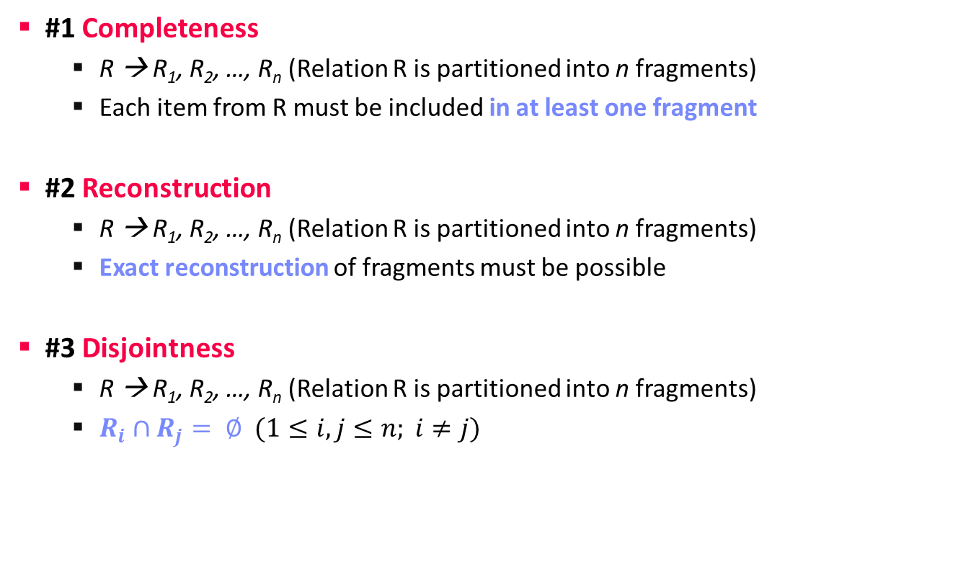
Correctness Properties
Partitioning and Pruning
#1 Completeness
  R → R₁, R₂, …, R_{n} (Relation R is partitioned into n fragments)
  Each item from R must be included in at least one fragment
#2 Reconstruction
  R → R₁, R₂, …, R_{n} (Relation R is partitioned into n fragments)
  Exact reconstruction of fragments must be possible
#3 Disjointness
  R → R₁, R₂, …, R_{n} (Relation R is partitioned into n fragments)
  $R_{i}∩R_{j}= ∅ (1≤i,j≤n; i≠j)$

Slide 29

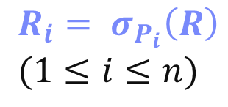
Horizontal Partitioning
Partitioning and Pruning
Row Partitioning into n Fragments R_{i}
  Complete, disjoint, reconstructable
  Schema of fragments is equivalent
  to schema of base relation
Partitioning
  Split table by n selection predicates P_{i}
  (partitioning predicate) on attributes of R
  Beware of attribute domain and skew
Reconstruction
  Union of all fragments
  Bag semantics, but no
  duplicates across partitions
$$R_{i}= σ_{P_{i}}\left(R\right) \\ (1≤i≤n)$$
$$R=\bigcup_{1≤i≤n}{R_{i}}$$
∪
∪
R3
R1
R2

Slide 30
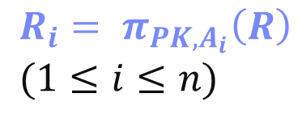
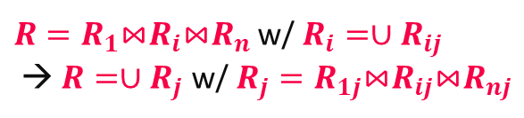
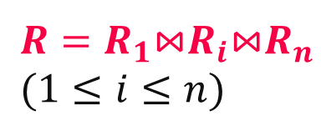
Vertical Fragmentation
Partitioning and Pruning
Column Partitioning into n Fragments Ri
  Complete, reconstructable, but not disjoint
  (primary key for reconstruction via join)
  Completeness: each attribute must
  be included in at least one fragment
Partitioning
  Partitioning via projection
  Redundancy of primary key
Reconstruction
  Natural join over primary key
Hybrid horizontal/vertical partitioning
PK
A1
A2
PK
A1
$$R_{i}= π_{{PK,A}_{i}}\left(R\right) \\ (1≤i≤n)$$
PK
A2
$R=R_{1}$⋈$R_{i}$⋈$R_{n}$
$$(1≤i≤n)$$
$R=R_{1}$⋈$R_{i}$⋈$R_{n}$ w/ $R_{i}=∪R_{ij}$
→ $R=∪R_{j}$ w/ $R_{j}=R_{1j}$⋈$R_{ij}$⋈$R_{nj}$

Slide 31

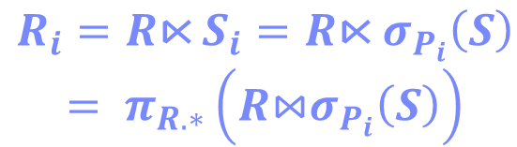
Derived Horizontal Fragmentation
Partitioning and Pruning
Row Partitioning R into n fragements
R_{i}, with partitioning predicate on S
  Potentially complete (not guaranteed),
  restructable, disjoint
  Foreign key / primary key relationship determines correctness
Partitioning
  Selection on independent relation S
  Semi-join with dependent relation R
  to select partition R_{i}
Reconstruction
  Equivalent to horizontal partitioning
  Union of all fragments
⋊
Austria
$R_{i}=R\text{⋉}$ $S_{i}=R\text{⋉} σ_{P_{i}}\left(S\right)$
$$= π_{R.∗}\left(R\text{⋈}σ_{P_{i}}\left(S\right)\right)$$
$$R=\bigcup_{1≤i≤n}{R_{i}}$$

Slide 32
Exploiting Table Partitioning
Partitioning and Pruning
Partitioning and query rewriting
  #1 Manual partitioning and rewriting
  #2 Automatic rewriting (spec. partitioning)
  #3 Automatic partitioning and rewriting
Example PostgreSQL (#2)
J# | Pos | Name
1 | GK | Manuel Neuer
12 | GK | Ron-Robert Zieler
22 | GK | Roman Weidenfeller
2 | DF | Kevin Großkreutz
4 | DF | Benedikt Höwedes
5 | DF | Mats Hummels
15 | DF | Erik Durm
16 | DF | Philipp Lahm
17 | DF | Per Mertesacker
20 | DF | Jérôme Boateng
3 | MF | Matthias Ginter
6 | MF | Sami Khedira
7 | MF | Bastian Schweinsteiger
8 | MF | Mesut Özil
9 | MF | André Schürrle
13 | MF | Thomas Müller
14 | MF | Julian Draxler
18 | MF | Toni Kroos
19 | MF | Mario Götze
21 | MF | Marco Reus
23 | MF | Christoph Kramer
10 | FW | Lukas Podolski
11 | FW | Miroslav Klose
CREATE TABLE Squad(
JNum INT PRIMARY KEY,
Pos CHAR(2) NOT NULL,
Name VARCHAR(256)
) PARTITION BY RANGE(JNum);
CREATE TABLE Squad10 PARTITION OF Squad
FOR VALUES FROM (1) TO (10);
CREATE TABLE Squad20 PARTITION OF Squad
FOR VALUES FROM (10) TO (20);
CREATE TABLE Squad24 PARTITION OF Squad
FOR VALUES FROM (20) TO (24);
Notes:
Note: error on non-existing partition range, default partition possible.

Slide 33
Exploiting Table Partitioning, cont.
Partitioning and Pruning
Example, cont.
SELECT * FROM Squad
WHERE JNum > 11 AND JNum < 20
σ_{JNum>11 ∧ JNum<20}
∪
∪
∪
σ_{JNum>11}
_{∧ JNum<20}
σ_{JNum>11}
∪
S24
σ_{JNum>11}
_{∧ JNum<20}
σ_{JNum>11}
_{∧ JNum<20}
S24
S10
S20
JNum in [20,24)
S20
S10
S20
JNum in [1,10)
JNum in [10,20)

Slide 34
Zone Maps
Partitioning and Pruning
[Guido Moerkotte: Small Materialized Aggregates: A Light Weight Index Structure for Data Warehousing. VLDB 1998]
Small Materialized Aggregates (SMA)
  Data stored in zones (pages, blocks, or partitions)
  Maintain SMA (e.g., min, max, count, sum) as summary per zone
  Global vs local storage, eager vs lazy maintenance on updates
Query Processing
  Partition pruning for selection predicates
  Precomputed partial aggregates (see materialized views)
Zone Map / SMA
81
136
Header
115
175
Header
Min | 3
Max | 7
Count | 203
tuple
Min | 6
Max | 71
Count | 144
tuple
Table Scan for σ_{B=10}(R)

Slide 35
Column Imprints
Partitioning and Pruning
[Lefteris Sidirourgos, Martin L. Kersten: Column imprints: a secondary index structure. SIGMOD 2013]
Column Imprints
  Zone = cache line (64 Byte)
  Column imprint = union of one-hot vectors
  Sampled histogram → bins (max 64 bins)
Compression
  CL Dictionary
  (next x CLs,
  repeat flag)
Query Processing
  Cacheline pruning for selection predicates (point, range)
  imprint & predicate (predicate w/ potentially many bits for ranges)

Slide 36
Probabilistic Set Containment
Partitioning and Pruning
Motivation
  Many use cases for applying cheap pre-filters
  Requirement: no false negatives, small number of false positives (FP)
#1 Bloom Filter
  Array X of m bits, initialized w/ zeros
  k different hash functions applied on each key
  Insert: k x h_{i}(key), set all hashed positions to 1
  Query: k x h_{i}(key), return (sum(X[h_{i}(key)])==k)
#2 Cuckoo Filter
  Cuckoo hash table with key signatures
  2 hash functions w/ displacements
  Allows deletes, duplicates, smaller FP rate
key=7
h1
h3
1 | 0 | 1 | 0 | 1 | 1
[Harald Lang, Thomas Neumann, Alfons Kemper,
Peter A. Boncz: Performance-Optimal Filtering: Bloom overtakes Cuckoo at High-Throughput. PVLDB 12(5), 2019]

Slide 37
Adaptive and Learned
Access Methods

Slide 38
Database Cracking
Adaptive and Learned Access Methods
[Pedro Holanda et al: Progressive Indexes: Indexing for Interactive Data Analysis. PVLDB 2019]
Core Idea: Queries trigger physical
reorganization (partitioning and indexing)
[Stratos Idreos, Martin L.
Kersten, Stefan Manegold: Database Cracking. CIDR 2007]
A
17
3
8
6
2
12
13
4
15
A_{CRK}
3
4
2
the more we crack, the more we learn
A_{CRK}
2
4
3
8
6
8
6
copy
in-place
12
15
17
13
12
13
#1 Automatic Partitioning
#2 AVL/B-tree over Partitions
17
15

Slide 39
Learned Index Structures
Adaptive and Learned Access Methods
[Tim Kraska, Alex Beutel, Ed H. Chi, Jeffrey Dean, Neoklis Polyzotis: The Case for Learned Index Structures. SIGMOD 2018]
A Case For Learned Index Structures
  Sorted data array, predict position of key
  Hierarchy of simple models (stages models)
  Tries to approximate the CDF similar to interpolation search (uniform data)
Follow-up Work
on SageDBMS
Systems for ML,
ML for Systems
[Tim Kraska, Mohammad Alizadeh, Alex Beutel, Ed H. Chi, Ani Kristo, Guillaume Leclerc, Samuel Madden, Hongzi Mao, Vikram Nathan: SageDB: A Learned Database System. CIDR 2019]

Slide 40
Learned Index Structures, cont.
Adaptive and Learned Access Methods
FITing-Tree
  Adapt to underlying
  data and patterns
  Piecewise linear functions
  Maximum pos error guarantees
  Segment pages w/ free space
PGM-index
  Piecewise geometric model index
  Recursive, compressed segment tree
RadixSpline
  Lookup table to spline points,
  selected w/ max error guarantee
[Alex Galakatos, Michael Markovitch, Carsten Binnig, Rodrigo Fonseca, Tim Kraska: FITing-Tree: A Data-aware Index Structure. SIGMOD 2019]
[Paolo Ferragina, Giorgio Vinciguerra: The PGM-index: a fully-dynamic compressed learned index with provable worst-case bounds. PVLDB 13(8) 2020]
[Andreas Kipf, Ryan Marcus, Alexander van Renen, Mihail Stoian, Alfons Kemper, Tim Kraska, Thomas Neumann: RadixSpline: a single-pass learned index. aiDM@SIGMOD 2020]

Slide 41
Learned Partitioning Schemes
Adaptive and Learned Access Methods
Query-Data Routing Tree (qd-Tree)
  Binary decision tree, with data
  blocks at leaf nodes (min size constraint)
  Given dataset, and workload,
  find tree that minimized number of accessed tuples
  Deep reinforcement learning
Query Processing
  Get list of blocks that
  need to be evaluated
[Zongheng Yang el al: Qd-tree: Learning Data Layouts for Big Data Analytics. SIGMOD 2020]

Slide 42
Summary and Q&A
Overview Access Methods
Index Structures
Partitioning and Pruning
Adaptive and Learned Access Methods
Programming Projects
  Initial test suite, benchmark, make file, and reference implementation
  Start your own implementation in next weeks
Next Lectures (Part A)
  05 Compression Techniques [Nov 03]

