Slide 1

Data Management
08 Query Processing
Last update: Nov 29, 2021

Slide 2


Announcements/Org
#1 Video Recording
  Link in TUbe & TeachCenter (lectures will be public)
  Optional attendance (independent of COVID)
  Virtual lectures (recorded) until end of the year
  https://tugraz.webex.com/meet/m.boehm
#2 Exercise Submissions
  Grading Exercise 1: upload tomorrow, Exercise 2: before Xmas
  Exercise 2 due Nov 30 + 7 late days;
  Note: updated data/Q08 results (Q06 and Q07 result correction pending)
  → 5 extra points for every submission (30/25 possible, 8 “free”)
  Exercise 3: already published, discussed next lecture, due Dec 21

Slide 3
Query Optimization and Query Processing
2014
Goal: Basic Understanding of Internal Query Processing
  Query rewriting and query optimization
  Query processing and physical plan operators
  Performance debugging & reuse of concepts and techniques
  Overview, detailed techniques discussed in ADBS (WS 2020)
SELECT * FROM TopScorer
WHERE Count>=4
WHAT
Name | Count
James Rodríguez | 6
Thomas Müller | 5
Robin van Persie | 4
Neymar | 4
CREATE VIEW TopScorer AS
SELECT P.Name, Count(*)
FROM Players P, Goals G
WHERE P.Pid=G.Pid
AND G.GOwn=FALSE
GROUP BY P.Name
ORDER BY Count(*) DESC
Yes, but HOW to we get there efficiently

Slide 4
Agenda
Query Rewriting and Optimization
Plan Execution Strategies
Physical Plan Operators

Slide 5
Query Rewriting and Optimization

Slide 6
Overview Query Optimization
Query Rewriting and Optimization
SELECT * FROM TopScorer
WHERE Count>=4
Name | Count
James Rodríguez | 6
Thomas Müller | 5
Robin van Persie | 4
Neymar | 4
Parsing
AST/IR
Semantic Analysis
IR
Query Rewrites
Plan Execution
IR
Plan Optimization
QEP
Plan Caching
Compile Time
Runtime
Notes:
Query Semantics: NFST -> normalization/binding subexpressions, factorization and semantic analysis (check schema, etc)

Slide 7
Query Rewrites
Query Rewriting and Optimization
Query Rewriting
  Rewrite query into semantically equivalent form that may be
  processed more efficiently or give the optimizer more freedom
  #1 Same query can be expressed differently, avoid hand-tuning
  #2 Complex queries may have redundancy
A Simple Example
  Catalog meta data:
  custkey is unique
25+ years of experience
on query rewriting
SELECT DISTINCT custkey, name
FROM TPCH.Customer
rewrite
SELECT custkey, name
FROM TPCH.Customer
[Hamid Pirahesh, T. Y. Cliff Leung, Waqar Hasan: A Rule Engine for Query Transformation in Starburst and IBM DB2 C/S DBMS. ICDE 1997]

Slide 8
Standardization and Simplification
Query Rewriting and Optimization
Normal Forms of Boolean Expressions
  Conjunctive normal form (P₁₁ OR ... OR P_{1n}) AND ... AND (P_{m1} OR ... OR P_{mp})
  Disjunctive normal form (P₁₁ AND ... AND P_{1q}) OR ... OR (P_{r1} AND ... AND P_{rs})
Transformation Rules for Boolean Expressions
Rule Name | Examples
Commutativity rules | A OR B ⇔ B OR A A AND B ⇔ B AND A
Associativity rules | (A OR B) OR C ⇔ A OR (B OR C) (A AND B) AND C ⇔ A AND (B AND C)
Distributivity rules | A OR (B AND C) ⇔ (A OR B) AND (A OR C) A AND (B OR C) ⇔ (A AND B) OR (A AND C)
De Morgan’s rules | NOT (A AND B) ⇔ NOT (A) OR NOT (B) NOT (A OR B) ⇔ NOT (A) AND NOT (B)
Double-negation rules | NOT(NOT(A)) ⇔ A
Idempotence rules | A OR A ⇔ A A AND A ⇔ A A OR NOT(A) ⇔ TRUE A AND NOT (A) ⇔ FALSE A AND (A OR B) ⇔ A A OR (A AND B) ⇔ A A OR FALSE ⇔ A A OR TRUE ⇔ TRUE A AND FALSE ⇔ FALSE

Slide 9
Standardization and Simplification, cont.
Query Rewriting and Optimization
Elimination of Common Subexpressions
  (A₁=a₁₁ OR A₁=a₁₂) AND (A₁=a₁₂ OR A₁=a₁₁) → A₁=a₁₁ OR A₁=a₁₂
Propagation of Constants
  A ≥ B AND B = 7 → A ≥ 7 AND B = 7
Detection of Contradictions
  A ≥ B AND B > C AND C ≥ A → A > A → FALSE
Use of Constraints
  A is primary key/unique: π_{A} → no duplicate elimination necessary
  Rule MAR_STATUS = ‘married’ → TAX_CLASS ≥ 3:
  (MAR_STATUS = ‘married’ AND TAX_CLASS = 1) → FALSE
Elimination of Redundancy (set semantics)
  R⋈R → R, R∪R → R, R−R → Ø
  R⋈(σ_{p}R) → σ_{p}R, R∪(σ_{p}R) → R, R−(σ_{p}R) → σ_{⌐p}R
  (σ_{p1}R)⋈(σ_{p2}R) → σ_{p1ᴧp2}R, (σ_{p1}R)∪(σ_{p2}R) → σ_{p1vp2}R
R⋈_{a=b}(σ_{b>0}(S)) →
(σ_{a>0}(R))⋈_{a=b}(σ_{b>0}(S))
Notes:
Additional redundancy example: (σ_{p1}R)−(σ_{p2}R) → σ_{p1ᴧ⌐p2}R

Slide 10
Query Unnesting
Query Rewriting and Optimization
[Won Kim: On Optimizing an
SQL-like Nested Query. ACM
Trans. Database Syst. 1982]
Case 1: Type-A Nesting
  Inner block is not correlated and computes an aggregate
  Solution: Compute the aggregate once and insert into outer query
Case 2: Type-N Nesting
  Inner block is not correlated and returns a set of tuples
  Solution: Transform into a symmetric form (via join)
SELECT OrderNo FROM Order
WHERE ProdNo =
(SELECT MAX(ProdNo)
FROM Product WHERE Price<100)
$X = SELECT MAX(ProdNo)
FROM Product WHERE Price<100
SELECT OrderNo FROM Order
WHERE ProdNo = $X
SELECT OrderNo FROM Order
WHERE ProdNo IN
(SELECT ProdNo
FROM Product WHERE Price<100)
SELECT OrderNo
FROM Order O, Product P
WHERE O.ProdNo = P.ProdNo
AND P.Price < 100

Slide 11
Query Unnesting, cont.
Query Rewriting and Optimization
[Won Kim: On Optimizing an
SQL-like Nested Query. ACM
Trans. Database Syst. 1982]
Case 3: Type-J Nesting
  Un-nesting of correlated sub-queries w/o aggregation
Case 4: Type-JA Nesting
  Un-nesting of correlated sub-queries w/ aggregation
  Further un-nesting via case 3 and 2
SELECT OrderNo FROM Order O
WHERE ProdNo IN
(SELECT ProdNo FROM Project P
WHERE P.ProjNo = O.OrderNo
AND P.Budget > 100,000)
SELECT OrderNo
FROM Order O, Project P
WHERE O.ProdNo = P.ProdNo
AND P.ProjNo = O.OrderNo
AND P.Budget > 100,000
SELECT OrderNo FROM Order O
WHERE ProdNo IN
(SELECT MAX(ProdNo)
FROM Project P
WHERE P.ProjNo = O.OrderNo
AND P.Budget > 100,000)
SELECT OrderNo FROM Order O
WHERE ProdNo IN
(SELECT ProdNo FROM
(SELECT ProjNo, MAX(ProdNo)
FROM Project
WHERE Budget > 100.000
GROUP BY ProjNo) P
WHERE P.ProjNo = O.OrderNo)
Notes:
Note JA: max ProdNo only #distinct ProjNo solutions
Note Unnesting Arbitrary Queries Neumann (via cross-product, #distinct)

Slide 12
Selections and Projections
Query Rewriting and Optimization
Example Transformation Rules
Restructuring Algorithm
  #1 Split n-ary joins into binary joins
  #2 Split multi-term selections
  #3 Push-down selections as far as possible
  #4 Group adjacent selections again
  #5 Push-down projections as far as possible
1) Grouping of Selections
2) Grouping of Projections
3) Pushdown of Selections
4) Pushdown of Projections
σ_{x>y}
π_{A}
σ_{p(R)}
⋈_{A=B}
π_{C}
π_{C}
σ_{x>yᴧp=q}
π_{A}
σ_{p=q}
π_{A,B}
⋈_{A=B}
σ_{p(R)}
S
⋈_{A=B}
⋈_{A=B}
R
R
R
R
R
S
R
R
S
π_{A,C}
π_{B}
R
S
Input: Standardized, simplified, and un-nested query graph
Output: Restructured
query graph

Slide 13
Example Query Restructuring
Query Rewriting and Optimization
τ_{count} _{DESC}
SELECT * FROM TopScorer
WHERE count>=4
AND Pos=‘FW’
σ_{count>=4ᴧPos=FW}
σ_{count>=4}
τ_{count} _{DESC}
γ_{Name,count(*)}
CREATE VIEW TopScorer AS
SELECT P.Name, P.Pos, count(*)
FROM Players P, Goals G
WHERE P.Pid=G.Pid
AND G.GOwn=FALSE
GROUP BY P.Name, P.Pos
ORDER BY count(*) DESC
γ_{Name,Pos,count(*)}
π_{Name}
σ_{Gown=F}
⋈_{Pid}
⋈_{Pid}
π_{Pid,Name}
π_{Pid}
Additional metadata: P.Name is unique
Players
Goals
σ_{Pos=FW}
σ_{Gown=F}
π_{Pid,Name,Pos}
π_{Pid,Gown}
Players
Goals

Slide 14
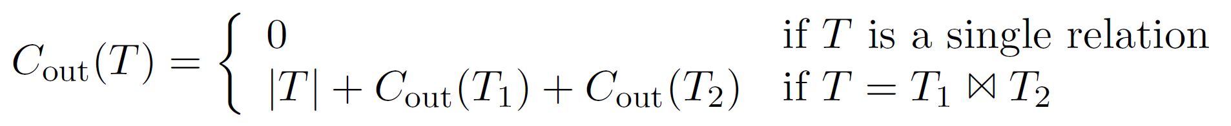
Plan Optimization Overview
Query Rewriting and Optimization
Plan Generation
  Selection of physical access path and plan operators
  Selection of execution order of plan operators
  Input: logical query plan → Output: optimal physical query plan
  Costs of query optimization should not exceed yielded improvements
Different Cost Models
  Relies on statistics (cardinalities, selectivities via histograms + estimators)
  Operator-specific and general-purpose cost models
  I/O costs (number of read pages, tuples)
  Computation costs (CPU costs, path lengths)
  Memory (temporary memory requirements)
  Beware assumptions of optimizers
  (no skew, independence, no correlation)
(estimated)
(real)
10
590
σ_{Model= ‘Golf‘}
1,000
5,000
σ_{Make=‘VW‘}
Cars
10,000
10,000

Slide 15
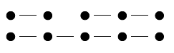
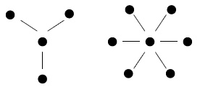
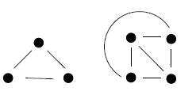
Query and Plan Types
Query Rewriting and Optimization
[Guido Moerkotte, Building Query Compilers (Under Construction), 2020,
http://pi3.informatik.uni-mannheim.de/
~moer/querycompiler.pdf]
Query Types
  Nodes: Tables
  Edges: Join conditions
  Determine hardness
  of query optimization (w/o cross products)
Join Tree Types / Plan Types
  Data flow graph of tables and joins (logical/physical query trees)
  Edges: data dependencies (fixed execution order: bottom-up)
Chains
Stars
Cliques
Left-Deep Tree
Right-Deep Tree
Zig-Zag Tree
Bushy Tree

Slide 16
Join Ordering Problem
Query Rewriting and Optimization
Join Ordering
  Given a join query graph, find the optimal join ordering
  In general, NP-hard; but polynomial algorithms exist for special cases
Search Space
  Dependent on query and plan types
  Note: if we allow cross products similar to cliques (fully connected)
 | Chain (no CP) |  |  | Star (no CP)
 | left-deep | zig-zag | bushy | left- deep | zig-zag/ bushy
n | 2^{n-1} | 2^{2n-3} | 2^{n-1}C(n-1) | 2(n-1)! | 2^{n-1}(n-1)!
5 | 16 | 128 | 224 | 48 | 384
10 | 512 | ~131K | ~2.4M | ~726K | ~186M
Clique / CP (cross product)
left- deep | zig-zag | bushy
n! | 2^{n-2}n! | n! C(n-1)
120 | 960 | 1,680
~3.6M | ~929M | ~17.6G
C(n) … Catalan Numbers

Slide 17
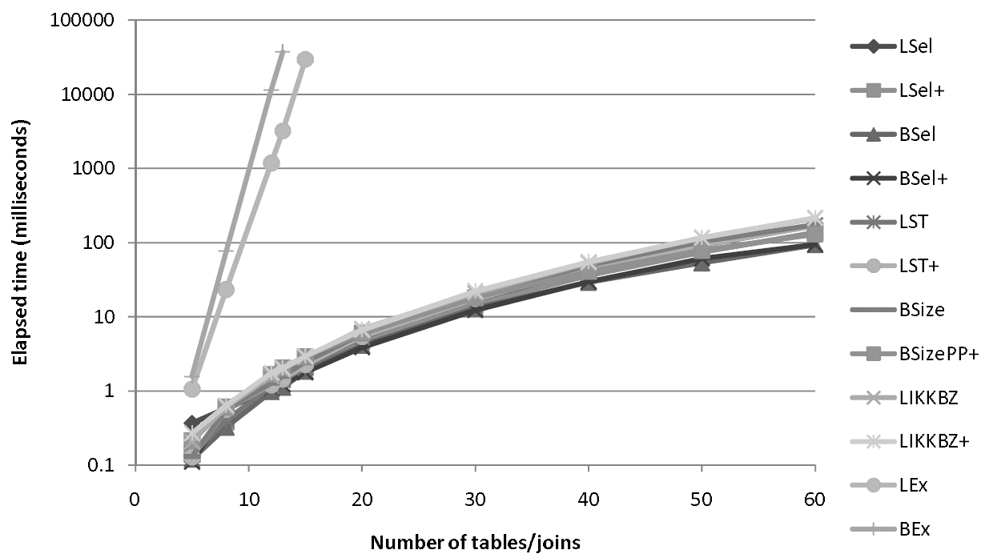
Join Order Search Strategies
Query Rewriting and Optimization
All (unknown)
Actual
Tradeoff: Optimal (or good) plan vs compilation time
#1 Naïve Full Enumeration
  Infeasible for reasonably large queries (long tail up to 1000s of joins)
#2 Exact Dynamic Programming
  Guarantees optimal plan, often too expensive (beyond 20 relations)
  Bottom-up vs top-down approaches
#3 Greedy / Heuristic Algorithms
#4 Approximate Algorithms
  E.g., Genetic algorithms,
  simulated annealing
Example PostgreSQL
  Exact optimization (DPSize) if < 12
  relations (geqo_threshold)
  Genetic algorithm for larger queries
  Join methods: NLJ, SMJ, HJ
Explored
DP Enum
Heuristics
[Nicolas Bruno, César A. Galindo-Legaria, Milind Joshi: Polynomial heuristics for query optimization. ICDE 2010]

Slide 18
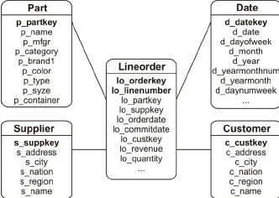
Greedy Join Ordering
Query Rewriting and Optimization
Star Schema Benchmark
Example
  Part ⋈ Lineorder ⋈ Supplier ⋈ σ(Customer) ⋈ σ(Date), left-deep plans
# | Plan | Costs
1 | Lineorder ⋈ Part | 30M
 | Lineorder ⋈ Supplier | 20M
 | Lineorder ⋈ σ(Customer) | 90K
 | Lineorder ⋈ σ(Date) | 40K
 | Part ⋈ Customer | N/A
 | … | …
# | Plan | Costs
3 | ((Lineorder ⋈ σ(Date)) ⋈ σ(Customer)) ⋈ Part | 120M
 | ((Lineorder ⋈ σ(Date)) ⋈ σ(Customer)) ⋈ Supplier | 105M
4 | (((Lineorder ⋈ σ(Date)) ⋈ σ(Customer)) ⋈ Supplier) ⋈ Part | 135M
2 | (Lineorder ⋈ σ(Date)) ⋈ Part | 150K
 | (Lineorder ⋈ σ(Date)) ⋈ Supplier | 100K
 | (Lineorder ⋈ σ(Date)) ⋈ σ(Customer) | 75K
Note: Simple O(n²) algorithm for left-deep trees;
O(n³) algorithms for bushy trees existing (e.g., GOO)
Notes:
GOO .. Greedy operator ordering

Slide 19
Dynamic Programming Join Ordering
Query Rewriting and Optimization
Exact Enumeration via Dynamic Programming
  #1: Optimal substructure (Bellman’s Principle of Optimality)
  #2: Overlapping subproblems allow for memoization
  Approach DPSize: Split in independent subproblems (optimal plan per set of quantifiers and interesting properties), solve subproblems, combine solutions
Example
Q1+Q3, Q2+Q2, Q3+Q1
Q1+Q2, Q2+Q1
Q1+Q1
Q4 | Plan
{C,D,L,P} | ((L⋈C)⋈D)⋈P, P⋈((L⋈C)⋈D)
{C,D,L,S} | …
{C,L,P,S} | …
{D,L,P,S} | …
Q3 | Plan
{C,D,L} | (L⋈C)⋈D, D⋈(L⋈C), (L⋈D)⋈C, C⋈(L⋈D)
{C,L,P} | (L⋈C)⋈P, P⋈(L⋈C), (P⋈L)⋈C, C⋈(P⋈L)
{C,L,S} | …
{D,L,P} | …
{D,L,S} | …
{L,P,S} | …
Q2 | Plan
{C,L} | L⋈C, C⋈L
{D,L} | L⋈D, D⋈L
{L,P} | L⋈P, P⋈L
{L,S} | L⋈S, S⋈L
{C,D} | N/A
… | …
Q1 | Plan
{C} | Tbl, IX
{D} | Tbl, IX
{L} | …
{P} | …
{S} | …
Q1+Q4, Q2+Q3,
Q3+Q2, Q4+Q1
Q5 | Plan
{C,D,L,P,S} | …
Notes:
NOTE: The plan generation algorithm also includes the selection of physical operators (NLJ, SMJ, HJ)

Slide 20
BREAK (and Test Yourself)
Query Rewriting and Optimization
Rewrite the following RA expressions – assuming two relations R(a, b, c) and S(d, e, f) – into equivalent expressions with lower costs. (5 points)
  σ_{b=7}(R ⋈ S)
  (σ_{e>3}(S)) ∩ (σ_{f<7}(S))
  π_{a,b}(R ⋈_{a=d} S)
  R ∪ (σ_{d<e ᴧ e<f ᴧ f<d}(S))
  σ_{b=3}(γ_{b,max(c)}(R))
  → σ_{b=7}(R) ⋈ S
  → σ_{e>3 ᴧ f<7}(S)
  → π_{a,b}(R) ⋉_{a=d} S
  → R ∪ Ø → R
  → γ_{3,max(c)}(σ_{b=3}(R))

Slide 21


BREAK (and Test Yourself), cont.
Query Rewriting and Optimization
Assume relations R(a,b,c) and S(d,e), and indicate in the table below whether or not the two RA expressions per row are equivalent in bag semantics. For non-equivalent expressions briefly explain why. (5 points)
Equivalent?

Slide 22
Plan Execution Strategies

Slide 23
Overview Query Processing
Plan Execution Strategies
SELECT * FROM TopScorer
WHERE Count>=4
Name | Count
James Rodríguez | 6
Thomas Müller | 5
Robin van Persie | 4
Neymar | 4
Parsing
AST/IR
Semantic Analysis
IR
Query Rewrites
Plan Execution
IR
Plan Optimization
QEP
Plan Caching
Compile Time
Runtime

Slide 24
Overview Execution Strategies
Plan Execution Strategies
Different execution strategies (processing models) with different pros/cons (e.g., memory requirements, DAGs, efficiency, reuse)
#1 Iterator Model (mostly row stores)
#2 Materialized Intermediates (mostly column stores)
#3 Vectorized (Batched) Execution (row/column stores)
#4 Query Compilation (row/column stores)
High-level overview, details in ADBS

Slide 25
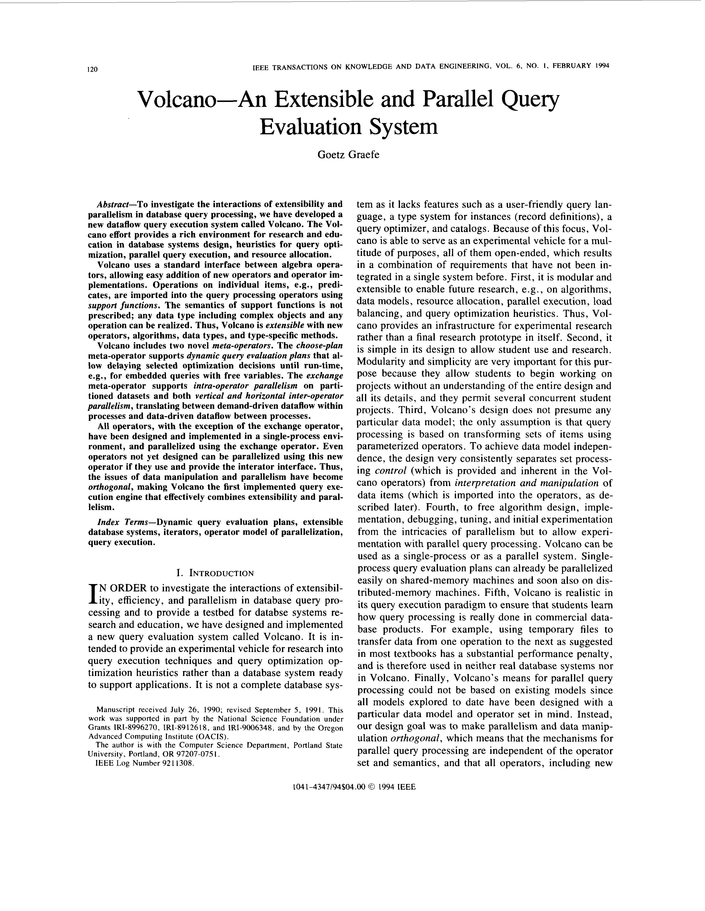
Iterator Model
Plan Execution Strategies
Scalable (small memory)
High CPI measures
Volcano Iterator Model
  Pipelined & no global knowledge
  Open-Next-Close (ONC) interface
  Query execution from root node (pull-based)
Example σ_{A=7}(R)
Blocking Operators
  Sorting, grouping/aggregation,
  build-phase of (simple) hash joins
[Goetz Graefe: Volcano - An Extensible and Parallel Query Evaluation System. IEEE Trans. Knowl. Data Eng. 1994]
open()
void open() { R.open(); }
void close() { R.close(); }
Record next() {
while( (r = R.next()) != EOF )
if( p(r) ) //A==7
return r;
return EOF;
}
next()
next()
→ EOF
close()
open()
σ_{A=7}
next()
next()
→ EOF
close()
open()
R
next()
next()
next()
next()
→ EOF
close()
PostgreSQL: Init(),
GetNext(), ReScan(), MarkPos(), RestorePos(), End()

Slide 26

Iterator Model – Predicate Evaluation
Plan Execution Strategies
Operator Predicates
  Examples: arbitrary selection predicates and join conditions
  Operators parameterized with in-memory expression trees/DAGs
  Expression evaluation engine (interpretation)
Example Selection σ
  $\left(A=7∧B≠8\right) ∨ D=9$
|
A | B | C | D
7 | 8 | Product 1 | 10
14 | 8 | Product 3 | 11
7 | 3 | Product 7 | 7
3 | 3 | Product 2 | 1
&
==
D
9
==
!=
A
7
B
8

Slide 27
Materialized Intermediates (column-at-a-time)
Plan Execution Strategies
SELECT count(DISTINCT o_orderkey)
FROM orders, lineitem
WHERE l_orderkey = o_orderkey
AND o_orderdate >= date ’1996-07-01’
AND o_orderdate < date ’1996-07-01’
+ interval ’3’ month
AND l_returnflag = ’R’;
Binary
Association Tables (BATs:=OID/Val)
Column-oriented storage
Efficient array operations
DAG processing
Reuse of intermediates
Memory requirements
Unnecessary read/write from and to memory
[Milena Ivanova, Martin L. Kersten, Niels J. Nes, Romulo Goncalves: An architecture for recycling intermediates in a column-store. SIGMOD 2009]

Slide 28
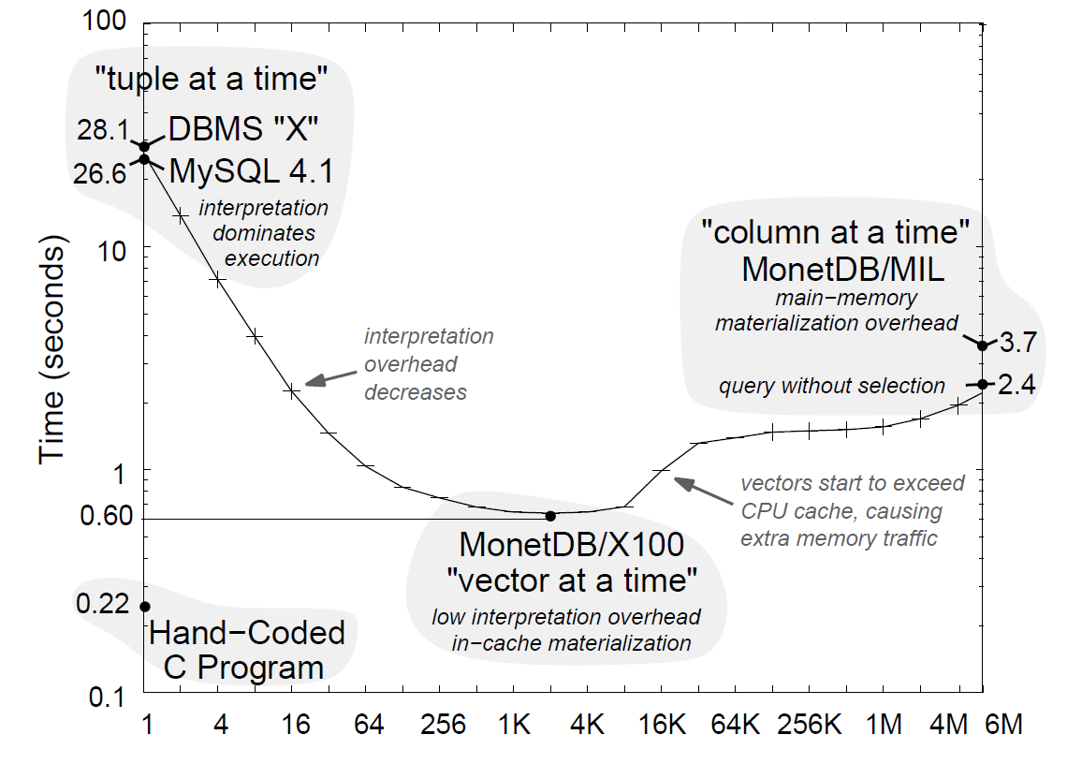
Vectorized Execution (vector-at-a-time)
Plan Execution Strategies
Idea: Pipelining of vectors (sub columns) s.t. vectors fit in CPU cache
Column-oriented storage
Efficient array operations
Memory/cache efficiency
DAG processing
Reuse of intermediates
Workload: TPCH Q1
[Peter A. Boncz, Marcin Zukowski, Niels Nes: MonetDB/X100: Hyper-Pipelining Query Execution.
CIDR 2005]
Vector Size (# Tuples)

Slide 29
Query Compilation
Plan Execution Strategies
Idea: Data-centric, not op-centric processing + LLVM code generation
Operator Trees
(w/o and w/ pipeline boundaries)
Compiled Query
(conceptual, not LLVM)
[Thomas Neumann: Efficiently Compiling Efficient Query Plans for Modern Hardware. PVLDB 2011]

Slide 30
Physical Plan Operators

Slide 31
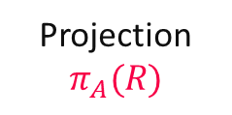
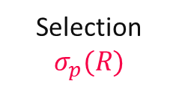
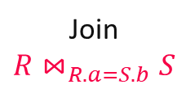
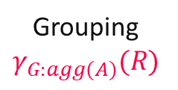
Overview Plan Operators
Physical Plan Operators
Multiple Physical Operators
  Different physical operators for different data and query characteristics
  Physical operators can have vastly different costs
Examples (supported in most DBMS)
  Logical Plan
  Operators
  Physical Plan
  Operators
Selection
$$σ_{p}(R)$$
Projection
$$π_{A}(R)$$
Grouping
$$γ_{G:agg(A)}(R)$$
Join
$$R{\text{⋈}}_{R.a=S.b}S$$
TableScan
IndexScan
ALL
ALL
SortGB
HashGB
NestedLoopJN
SortMergeJN
HashJN
Lecture 07
This Lecture
Exercise 3

Slide 32
Nested Loop Join
Physical Plan Operators
Overview
  Most general join operator (no order, no indexes, arbitrary predicates θ)
  Poor asymptotic behavior (very slow)
Algorithm (pseudo code)
Complexity
  Complexity: Time: O(N * M), Space: O(1)
  Pick smaller table as inner if it fits entirely in memory (buffer pool)
⋈_{RID=SID}
N = |R|
M = |S|
for each s in S
for each r in R
if( r.RID θ s.SID )
emit concat(r, s)
R | RID
 | 9
 | 1
 | 7
SID | S
7
3
1
9
7
How to implement next()?

Slide 33
Block Nested Loop / Index Nested Loop Joins
Physical Plan Operators
Block Nested Loop Join
  Avoid I/O by blocked data access
  Read blocks of b_{R} and b_{S} R and S pages
  Complexity unchanged but
  potentially much fewer scans
Index Nested Loop Join
  Use index to locate qualifying tuples
  (==, >=, >, <=, <)
  Complexity (for equivalence predicates):
  Time: O(N * log M), Space: O(1)
for each block b_{R} in R
for each block b_{S} in S
for each r in b_{R}
for each s in b_{S}
if( r.RID θ s.SID )
emit concat(r, s)
for each r in R
for each s in S.IX(θ,r.RID)
emit concat(r,s)
ix
S

Slide 34
Sort-Merge Join
Physical Plan Operators
Overview
  Sort Phase: sort the input tables R and S (w/ external sort algorithm)
  Merge Phase: step-wise merge with lineage scan
Algorithm (Merge, PK-FK)
Complexity
  Time (unsorted vs sorted): O(N log N + M log M) vs O(N + M)
  Space (unsorted vs sorted): O(N + M) vs O(1)
produced sorted output
⋈_{RID=SID}
N = |R|
M = |S|
Record next() {
while( curR!=EOF && curS!=EOF ) {
if( curR.RID < curS.SID )
curR = R.next();
else if( curR.RID > curS.SID )
curS = S.next();
else if( curR.RID == curS.SID ) {
t = concat(curR, curS);
curS = S.next(); //FK side
return t;
} }
return EOF;
}
SID | S
1
3
7
7
9
… | R_ID
 | 9
 | 1
 | 7
S_ID | …
7
3
1
9
7
R | RID
 | 1
 | 7
 | 9

Slide 35
Hash Join
Physical Plan Operators
Overview
  Build Phase: read table S and build a hash table H_{S} over join key
  Probe Phase: read table R and probe H_{S} with the join key
Algorithm (Build+Probe, PK-FK)
Complexity
  Time: O(N + M), Space: O(N)
  Classic hashing: p in-memory partitions of Hr w/ p scans of R and S
N = |R|
M = |S|
⋈_{RID=SID}
Record next() {
// build phase (first call)
while( (r = R.next()) != EOF )
Hr.put(r.RID, r);
// probe phase
while( (s = S.next()) != EOF )
if( Hr.containsKey(s.SID) )
return concat(Hr.get(s.SID), s);
return EOF;
}
… | R_ID
 | 9
 | 1
 | 7
SID | S
7
3
1
9
7
 | H_{R,RID}
9
1
7
h(x)
Notes:
Note: example hash functions: crc (cyclic redundancy check), MurmurHash, CityHash, FarmHash, XXHash

Slide 36
Sort-GroupBy and Hash-GroupBy
Physical Plan Operators
Recap: Classification of Aggregates (04 Relational Algebra)
  Additive, semi-additive, additively-computable, others
Sort Group-By
  Similar to sort-merge join
  (Sort, GroupAggregate)
  Sorted group output
Hash Group-By
  Similar to hash join (HashAggregate)
  Higher temporary memory consumption
  Unsorted group output
  #1 w/ tuple grouping
  #2 w/ direct aggregation (e.g., count)
  Beware: cache-unfriendly if many groups (size(H) > L2/L3 cache)
  γ_{A,count(*)}(R)
sort
O(N log N)
X X X X X X Y Y Y Y Y Y Y Z Z Z Z Z
aggregate O(N)
X,6
Y,7
Z,5
build & agg
O(N)
 | H_{A,Agg}
Y
X
Z
γ_{A,count(*)}
R
Notes:
Note: quantile/median requires sort per partition -> sort group-by
Postgres: GroupAggregate, HashAggregate

Slide 37
Summary and Q&A
Query Rewriting and Optimization
Plan Execution Strategies
Physical Plan Operators
Next Lectures
  09 Transaction Processing and Concurrency [Dec 06]
  10 NoSQL (key-value, document, graph) [Dec 13]
  Holidays (Exercise 3 due Dec 21, and Exercise 4 published Dec 28)
  11 Distributed Storage and Data Analysis [Jan 10]
  12 Data Stream Processing Systems and Q&A [Jan 17]

