Slide 1

Architecture of DB Systems
10 Cloud DBMSs
Last update: Dec 06, 2023

Slide 2

Announcements/Org
#1 Lecture Format
  Introduction virtual, remaining lectures blocked Dec 04 - Dec 07
  Optional attendance
  Hybrid, in-person but live-streaming / video-recorded lectures
    HS i10 + Zoom: https://tu-berlin.zoom.us/j/9529634787?
    pwd=R1ZsN1M3SC9BOU1OcFdmem9zT202UT09

Slide 3
Agenda
Cloud Computing Background
PaaS: SQL on Hadoop
SaaS: Cloud DBs and Cloud DWHs
FaaS: Serverless Database Systems

Slide 4
Cloud Computing Background

Slide 5
Motivation Cloud Computing
Cloud Computing Background
Definition Cloud Computing
  On-demand, remote storage and compute resources, or services
  User: computing as a utility (similar to energy, water, internet services)
  Cloud provider: computation in data centers / multi-tenancy
Service Models
  IaaS: Infrastructure as a service (e.g., storage/compute nodes)
  PaaS: Platform as a service (e.g., distributed systems/frameworks)
  SaaS: Software as a Service (e.g., email, databases, office, github)
➔ Transforming IT Industry/Landscape
  Since ~2010 increasing move from on-prem to cloud resources
  System software licenses become increasingly irrelevant
  Few cloud providers dominate IaaS/PaaS/SaaS markets (w/ 2018 revenue):
  Microsoft Azure Cloud ($ 32.2B), Amazon AWS ($ 25.7B), Google Cloud (N/A), IBM Cloud ($ 19.2B), Oracle Cloud ($ 5.3B), Alibaba Cloud ($ 2.1B)
Notes:
2023: Microsoft Cloud 110B (https://office365itpros.com/2023/07/27/microsoft-cloud-revenue-110b/)

Slide 6
Motivation Cloud Computing, cont.
Cloud Computing Background
100%
Argument #1: Pay as you go
  No upfront cost for infrastructure
  Variable utilization ➔ over-provisioning
  Pay per use or acquired resources
Argument #2: Economies of Scale
  Purchasing and managing IT infrastructure at scale ➔ lower cost
  (applies to both HW resources and IT infrastructure/system experts)
  Focus on scale-out on commodity HW over scale-up ➔ lower cost
Argument #3: Elasticity
  Assuming perfect scalability, work done
  in constant time * resources
  Given virtually unlimited resources
  allows to reduce time as necessary
Utili-zation
Time
100 days @ 1 node
≈
1 day @ 100 nodes
(but beware Amdahl’s law: max speedup sp = 1/s)

Slide 7
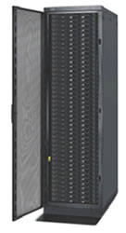

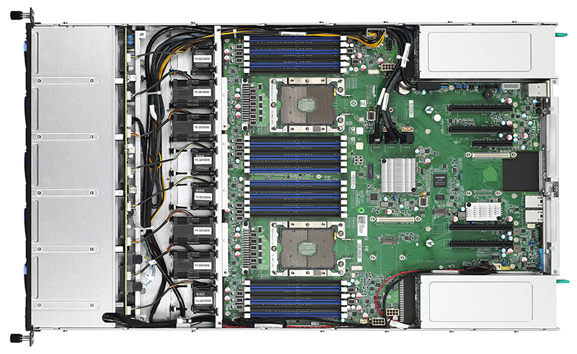

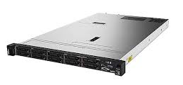


Anatomy of a Data Center
Cloud Computing Background
Commodity CPU:
Xeon E5-2440: 6/12 cores
Xeon Gold 6148: 20/40 cores
Server:
Multiple sockets, RAM, disks
Rack:
16-64 servers +
top-of-rack switch
Data Center:
>100,000 servers
Cluster:
Multiple racks + cluster switch
[Google
Data Center, Eemshaven, Netherlands]

Slide 8
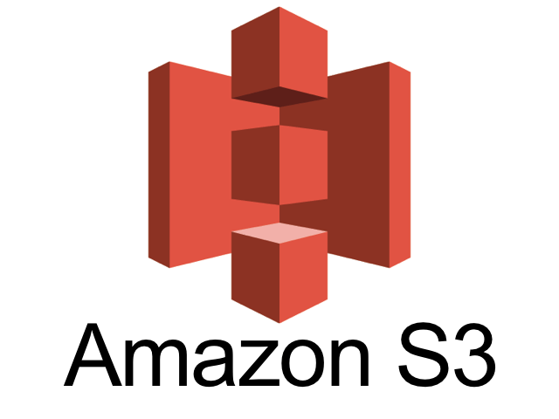
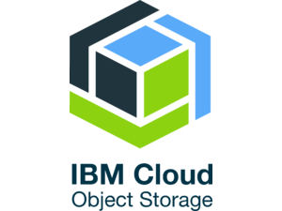
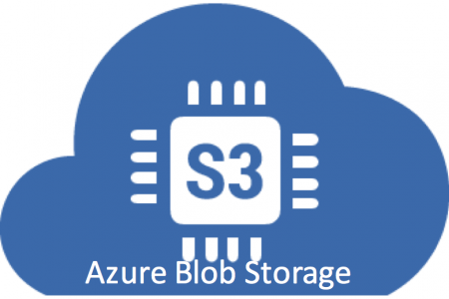

Infrastructure as a Service (IaaS)
Cloud Computing Background
Overview
  Resources for compute, storage, networking as a service
  ➔ Virtualization as key enabler (simplicity and auto-scaling)
  Target user: sys admin / developer
Storage
  Amazon AWS Simple Storage Service (S3)
  OpenStack Object Storage (Swift)
  IBM Cloud Object Storage
  Microsoft Azure Blob Storage
Compute
  Amazon AWS Elastic Compute Cloud (EC2)
  Microsoft Azure Virtual Machines (VM)
  IBM Cloud Compute
Computing
as a utility

Slide 9
PaaS: SQL on Hadoop

Slide 10
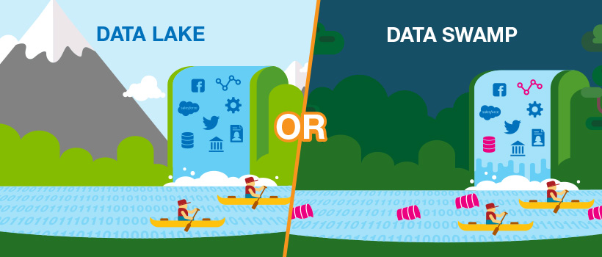
Data-parallel Computation
PaaS: SQL on Hadoop
Concept “Data Lake”
  Store massive amounts of structured
  and un/semi-structured data
  (append only, no update in place)
  No need for architected schema or
  upfront costs (unknown analysis)
  Typically: file storage in open, raw formats (inputs and intermediates)
Distributed Storage and Analysis
  Central abstraction: distributed collection
  Different physical representations
  Easy distribution of pairs
  via horizontal partitioning
  (aka shards, partitions)
  Frameworks: Hadoop MR, Spark, Flink
  Deployment: on-prem and/or cloud
[Credit: www.collibra.com]
Key | Value
4 | Delta
2 | Bravo
1 | Alfa
3 | Charlie
5 | Echo
6 | Foxtrot
7 | Golf
1 | Alfa

Slide 11
Recap: MapReduce – Execution Model
PaaS: SQL on Hadoop
#1 Data Locality (delay sched., write affinity)
#2 Reduced shuffle (combine)
#3 Fault tolerance (replication, attempts)
Input CSV files (stored in HDFS)
Map-Phase
map
task
[Reduce-Phase]
Output Files (HDFS)
CSV File 1
Split 11
map
task
Split 12
reduce
task
Out 1
Split 21
map
task
CSV File 2
reduce
task
Out 2
Split 22
map
task
reduce
task
Out 3
CSV File 3
Split 31
map
task
Split 32
map
task
Shuffle, Merge, [Combine]
Sort, [Combine], [Compress]
w/ #reducers = 3

Slide 12
A History on “SQL on Hadoop”
PaaS: SQL on Hadoop
[Daniel Abadi, Shivnath Babu, Fatma Ozcan, Ippokratis Pandis: Tutorial: SQL-on-Hadoop Systems. PVLDB 8(12) 2015]
Criticism MapReduce for Data Analytics
  Little control of data flow, simplicity leads to inefficiencies
  Fault tolerance not always necessary
  Lack of integration into existing eco system of data analysis
SQL on Hadoop
  Query engines on distributed file systems and open storage formats
  (e.g., CSV, Sequence files, Avro, Parquet, OCR, Arrow)
  Challenges w.r.t. metadata (schema/stats), and resource management
  Non-relational data (e.g., JSON), and unclean, irregular, unreliable data
  ➔ Specialized “SQL on Hadoop” systems (with open / native storage formats)
(see DM Exercise 4)
[Andrew Pavlo et al.: A comparison of approaches to large-scale data analysis. SIGMOD 2009]
[Spyros Blanas et al.: A comparison of join algorithms for log processing in MapReduce. SIGMOD 2010]
Notes:
Note: Parquet, OCR, Arrow → Column-oriented formats

Slide 13



A History on “SQL on Hadoop” – Systems
PaaS: SQL on Hadoop
Hadoop Eco-system
  HBase: logical tables, CRUD, key-value storage on HDFS
  Hive: SQL queries executed as MapReduce jobs (OLAP)
  Hive on Tez/Spark: SQL queries executed as DAGs of operations
Proprietary Systems
  MS SCOPE
  HadoopDB/Hadapt
  → Teradata (2014)
  Facebook Presto
  Cloudera Impala
  IBM BigSQL
[Ronnie Chaiken et al.: SCOPE: easy and efficient parallel processing of massive data sets. PVLDB 1(2) 2008]
[Azza Abouzeid et al.: HadoopDB: An Architectural Hybrid of MapReduce and DBMS Technologies for Analytical Workloads. PVLDB 2(1) 2009]
[Marcel Kornacker et al.: Impala: A Modern,
Open-Source SQL Engine for Hadoop. CIDR 2015]
[Scott C. Gray, Fatma Ozcan, Hebert Pereyra, Bert van der Linden and Adriana Zubiri: SQL-on-Hadoop without compromise,
IBM Whitepaper 2014]

Slide 14
A History on “SQL on Hadoop” – SparkSQL
PaaS: SQL on Hadoop
Overview SparkSQL
  New dataframe / dataset abstractions
  with various data source (+ pushdown)
  SQL and programmatic APIs
  Rewrite ruleset for query optimization
  Off-heap data storage (sun.misc.Unsafe)
  Whole-stage code generation
Query Planning
[Reynold S. Xin, Josh Rosen, Matei Zaharia, Michael J. Franklin, Scott Shenker, Ion Stoica: Shark: SQL and rich analytics at scale. SIGMOD 2013]
[Michael Armbrust et al.: Spark SQL: Relational Data Processing in Spark. SIGMOD 2015]

Slide 15
Example Delta Lake (and Lakehouse Architecture)
PaaS: SQL on Hadoop
DWH
Data Lake
Lakehouse
SQL
Data Frames
Metadata APIs
TXs
DCtlg
Open Formats
Versioning
[Michael Armbrust et al: Delta Lake: High-Performance ACID Table Storage over Cloud Object Stores. PVLDB 13(12) 2020]
[Michael Armbrust, Ali Ghodsi, Reynold Xin, Matei Zaharia: Lakehouse: A New Generation
of Open Platforms that Unify Data Ware-housing and Advanced Analytics, CIDR 2021]
[Alexander Behm: Photon: A
High-Performance Query Engine for the Lakehouse, CIDR 2022]

Slide 16
SaaS: Cloud DBs and Cloud DWHs

Slide 17

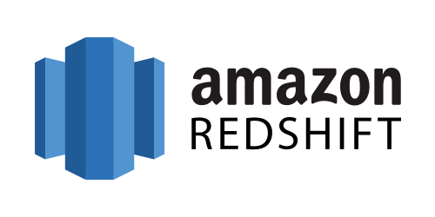
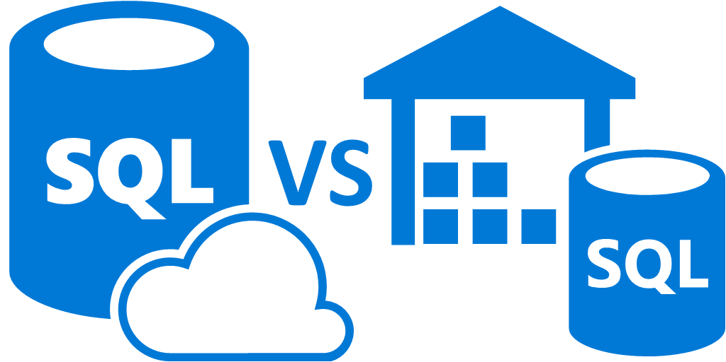
Cloud Databases (DBaaS)
SaaS: Cloud DBs and Cloud DWHs
Motivation DBaaS
  Simplified setup, maintenance, tuning and auto scaling
  Multi-tenant systems (scalability, learning opportunities)
  Different types based on workload (OLTP vs OLAP, NoSQL)
Elastic Data Warehouses
  Motivation: Intersection of data warehousing,
  cloud computing, distributed storage
  Example Systems
    #1 Snowflake
    #2 Google BigQuery (Dremel)
    #3 Amazon Redshift
    #4 ByteDance ByConity
    Azure SQL Data Warehouse /
    #5 Azure SQL Database Hyperscale (Socrates)
Microsoft
Commonalities:
SQL, column stores,
data on object store / DFS, elastic cloud scaling

Slide 18

Example Snowflake
SaaS: Cloud DBs and Cloud DWHs
[Benoît Dageville et al.: The Snowflake Elastic Data Warehouse. SIGMOD 2016]
Motivation (impl started late 2012)
  Enterprise-ready DWH solution for the cloud (elasticity, semi-structured)
  Pure SaaS experience, high availability, cost efficient
Cloud Services
  Manage virtual DHWs,
  TXs, and queries
  Meta data and catalogs
Virtual Warehouses
  Query execution in EC2
  Caching/intermediates
Data Storage
  Storage in AWS S3
  PAX / hybrid columnar
  Min-max pruning
Notes:
Note: Sep 2020 -> IPO (initial public offering), 33B eval

Slide 19
Example Google BigQuery
SaaS: Cloud DBs and Cloud DWHs
[Sergey Melnik et al.: Dremel: Interactive Analysis of Web-Scale Datasets. PVLDB 3(1) 2010]
Background Dremel
  Scalable and fast in-situ analysis of read-only nested data (DFS, BigTable)
  Data model: protocol buffers - strongly-typed nested records
  Storage model: columnar storage of nested data
  (efficient splitting and assembly records)
  Query execution via multi-level serving tree
BigQuery System Architecture
  Public impl of internal Dremel system (2012)
  SQL over structured, nested data (OLAP, BI)
  Extensions: web Uis, REST APIs and ML
  Data storage: Colossus (NextGen GFS)
[Kazunori Sato: An Inside Look at Google BigQuery, Google BigQuery White Paper 2012.]

Slide 20
Example Amazon Redshift
SaaS: Cloud DBs and Cloud DWHs
[Anurag Gupta et al.: Amazon Redshift and the Case for Simpler Data Warehouses. SIGMOD 2015]
Motivation (release 02/2013)
  Simplicity and cost-effectiveness
  (fully-managed DWH at petabyte scale)
System Architecture
  Data plane: data storage and SQL execution
  Control plane: workflows for monitoring,
  and managing databases, AWS services
Data Plane
  Initial engine licensed from ParAccel
  Leader node + sliced compute nodes
  in EC2 (with local storage)
  Replication across nodes + S3 backup
  Query compilation in C++ code
  Support for flat and nested files
[Mengchu Cai et al.: Integrated Querying of SQL database data and S3 data in Amazon Redshift.
IEEE Data Eng. Bull. 41(2) 2018]

Slide 21
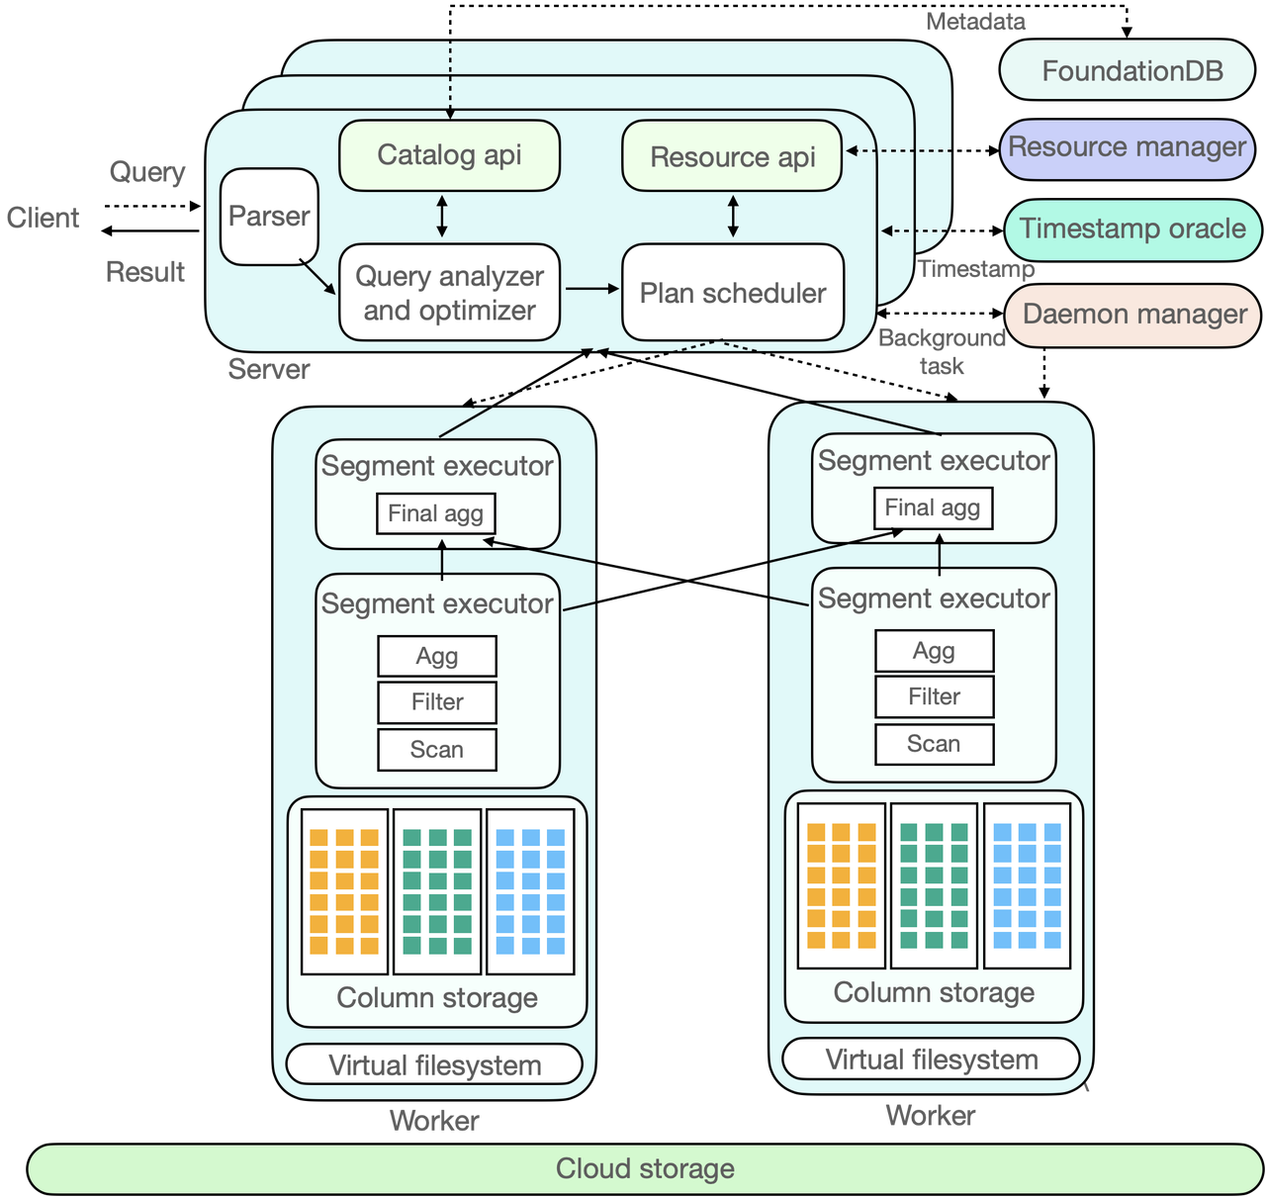
Example ByteDance ByConity
SaaS: Cloud DBs and Cloud DWHs
System Architecture
  Virtual Warehouses
  (disaggregated
  storage and compute)
  On-demand elasticity
  Column store on
  object storage (e.g., S3)
  Open-source
  (https://github.com/
  ByConity/ByConity)
[https://byconity.github.io/blog/
2023-05-24-byconity-announcement-opensources-its-cloudnative-data-warehouse]

Slide 22
Example Amazon Aurora (OLTP)
SaaS: Cloud DBs and Cloud DWHs
[Alexandre Verbitski, et al.: Amazon Aurora: Design Considerations for High Throughput Cloud-Native Relational Databases. SIGMOD 2017]
Motivation
  Separate logging & storage from DB engine
  Redo processing via a multi-tenant scale-out storage service
System Architecture
  Storage as an independent
  fault-tolerant and
  self-healing service
  Only writes redo
  log records to storage
  → reduced network I/O
  Backup and recovery as
  continuous async operations
Aurora Limitless (Nov 27, 2023)
  Serverless endpoint and automatic elasticity
[https://aws.amazon.com/about-aws/whats-new/2023/11/amazon-aurora-limitless-database/]

Slide 23
Example Microsoft Hyperscale (OLTP)
SaaS: Cloud DBs and Cloud DWHs
[Panagiotis Antonopoulos et al.: Socrates: The New SQL Server in the Cloud. SIGMOD 2019]
Overview
  Challenges of monolithic DBMSs in the cloud
  (cost-elasticity → scale-out/in data movement, availability/SW updates)
  Socrates: new OLTP cloud database system Azure DB Hyperscale
Key Features
  Separated Compute, Storage, Log
  SQL Server compute node w/
  secondary and SSD-based caching
  128GB Page Servers → up to 100TB DB
  Log server (landing zone,
  long-term log storage)
  Azure storage layer
  Period checkpointing
[Microsoft Mechanics: What is Azure Database Hyperscale?, https://www.youtube.com/watch?v=Z9AFnKI7sfI]
Notes:
Note: single primary (read/write), up to four secondary (read only); shared page servers

Slide 24
Example Dynamo (KV Store)
SaaS: Cloud DBs and Cloud DWHs
[Giuseppe DeCandia et al: Dynamo: amazon's highly available key-value store. SOSP 2007]
Motivation
  Simple, highly-available data storage for small objects in ~1MB range
  Aim for good load balance (99.9th percentile SLAs)
#1 System Interface
  Simple get(k, ctx) and put(k, ctx) ops
#2 Partitioning
  Consistent hashing of nodes and keys
  on circular ring for incremental scaling
  Nodes hold multiple virtual nodes
  for load balance (add/rm, heterogeneous)
#3 Replication
  Each data item replicated N times
  (at coord node and N-1 successors)
  Eventual consistency with async update
  propagation based on vector clocks
  Replica synchronization via Merkle trees
Amazon
e-Commerce Platform
Notes:
Notes:
* vector clocks (node, counter) for capturing causality between versions
* Replica synchronization via anti-entropy and Merkle-trees

Slide 25
FaaS: Serverless Database Systems

Slide 26



Serverless Computing
FaaS: Serverless Database Systems
[Joseph M. Hellerstein et al: Serverless Computing: One Step Forward, Two Steps Back. CIDR 2019]
Definition Serverless
  FaaS: functions-as-a-service (event-driven, stateless input-output mapping)
  Infrastructure for deployment and auto-scaling of APIs/functions
  Examples: Amazon Lambda, Microsoft Azure Functions, etc
Example
Lambda Functions
Event Source (e.g., cloud services)
Other APIs and Services
Auto scaling
Pay-per-request
(1M x 100ms = 0.2$)
import com.amazonaws.services.lambda.runtime.Context;
import com.amazonaws.services.lambda.runtime.RequestHandler;
public class MyHandler implements RequestHandler<Tuple, MyResponse> {
@Override
public MyResponse handleRequest(Tuple input, Context context) {
return expensiveStatelessComputation(input);
}
}
Notes:
Others: Google Cloud Functions, IBM OpenWhisk
Disadvantages: communication over storage, unaware of distributed computation
Limitations: restricted network connectivity (no inbound /within connectivity NAT), limited running time, stateless, limited cache between invocations, lack of control of scheduling

Slide 27
Applications
FaaS: Serverless Database Systems
Embarrassingly-Parallel Use Cases
  Stateless image/video processing (thumbnails, encoding, rendering)
  ML inference/scoring (e.g., object classification and detection)
  Distributed compilation, unit testing
Data Analytics – CloudSort
(http://sortbenchmark.org/)
  Minimum cost for sorting 100TB
  500x slower on serverless compared to VMs → reason: slow data shuffling
  Multi-round, hybrid shuffle (w/ same range partitioner)
    Small, fast storage (e.g., Redis)
    for intermediates per round
    Large, slow storage (S3) output
  Final merge of runs into S3
[Qifan Pu, Shivaram Venkataraman, Ion Stoica: Shuffling, Fast and Slow: Scalable Analytics on Serverless Infrastructure. NSDI 2019] (Locus)
Notes:
Note: S3: saturates at make IOPs independent of requests, pay per request → many small shuffle files is a problem.

Slide 28
FaaS Query Processing – Starling (MIT)
FaaS: Serverless Database Systems
[Matthew Perron, Raul Castro Fernandez, David J. DeWitt, Samuel Madden: Starling: A Scalable Query Engine on Cloud Functions. SIGMOD 2020]
Motivation
  Avoid pre-provisioning, and data loading
  Pay per query w/ competitive performance
  Tunable cost-performance per query
Starling Query Processing
  Coordinator compiles queries, and
  schedules tasks
  Open input formats (CSV, ORC, Parquet)
  Intermediates stored in S3
  Shuffling: Mitigate many file problem by
  writing single file per task, read portions
  Data centric query compilation
  Task pipelining and straggler mitigation

Slide 29
FaaS Query Processing – Lambada (ETH)
FaaS: Serverless Database Systems
Potential Analysis
  Simulation of scan 1TB from S3
  (2min VM startup, 4s fun startup)
  Short startup + demand scaling
  Interactive analytics on cold data
  (e.g., Hydrology, HE Physics)
Lambada Query Processing
  Driver on client machine
  w/ batched, two-level invocation
  Data-parallel execution solely
  with serverless workers (lambda funs)
  Parquet scan operator (sel/proj pushdown)
  Exchange operators for join/sort/group-by
  (communication through shared storage)
~220 calls/s
(batched)
[Ingo Müller et al: Lambada: Interactive Data Analytics on Cold Data Using Serverless Cloud Infrastructure. SIGMOD 2020]
Notes:
Note: two-level invocation: sqrt(P) driver-1st, sqrt(P) each 1st – 2nd level

Slide 30
FaaS Query Processing – Lambada (ETH), cont.
FaaS: Serverless Database Systems
[Michal Wawrzoniak et al: Boxer: Data Analytics on Network-enabled Serverless Platforms, CIDR 2021]
Function-to-function TCP Networking
  Problem: FaaS functions behind NAT
  NAT Hole Punching (e.g., P2P research, exchange network addresses)
  Setup and communication processes
TPC-H
Performance
NAT
λ
λ
Name service
λ
TCP
λ
Boxer lib intercepts connect(), exchanges IP info, and established normal TCP connection
EC2
λ
Notes:
NAT (network address translation)

Slide 31
FaaS Query Processing – Cloudburst (UC Berkeley)
FaaS: Serverless Database Systems
[Vikram Sreekanti et al: Cloudburst: Stateful Functions-as-a-Service. PVLDB 13(11) 2020]
Motivation
  Autoscaling serverless computing,
  with low-latency mutable state ➔ broader class of apps
  State sharing and mutable caches co-located w/ functions (data locality)
Architecture
  VM orchestration via
  Kubernetes
  Logical disaggregation
  with physical co-location
  Functions interact w/
  the cache not KV-Store
  Anna periodically
  propagates key updates
  Coordination-free consistency
  (via lattice data types: MapLattice)
Prototype not compatible w/
Public Cloud Lambda Functions
Notes:
MapLattice: a convergent and commutative replicated data-types (CRDT), bounded join semilattice -> least upper bound operator is commutative, associative, idempotent

Slide 32
Summary and Q&A
Cloud Computing Background
PaaS: SQL on Hadoop
SaaS: Cloud DBs and Cloud DWHs
FaaS: Serverless Database Systems
Next Lectures (Part C)
  11 Modern Concurrency Control
  12 Modern Storage and HW Accelerators [Dec 07, 3pm]
Is FaaS/serverless the right underlying abstraction for query processing?
(general-purpose, startup time,
price model, elasticity)

