Slide 1

Data Integration and Large-scale Analysis (DIA)
07 Data Provenance and Data Catalogs
Prof. Dr. Matthias Boehm
Technische Universität Berlin
Berlin Institute for the Foundations of Learning and Data
Big Data Engineering (DAMS Lab)
Last update: Nov 30, 2023

Slide 2

Announcements / Administrative Items
#1 Video Recording
  Hybrid lectures: in-person H 0107, zoom live streaming, video recording
  https://tu-berlin.zoom.us/j/9529634787?pwd=R1ZsN1M3SC9BOU1OcFdmem9zT202UT09
#2 Lectures
  Dec 07: no lecture because blocked ADBS course Dec 04 - Dec 07 at TU Graz
  Moved lecture 08 Cloud Fundamentals to Dec 14 and 09 Cloud Scheduling to Dec 21
#3 Exercises/Projects
  Reminder: exercise/project submissions by Feb 01 (no extensions)
  Make use of office hours Wed 4.30pm-6pm in TEL 0811

Slide 3
Agenda
Motivation and Terminology
Data Provenance
Data Catalogs

Slide 4
Motivation and Terminology

Slide 5

Excursus: FAIR Data Principles
[https://www.go-fair.org/fair-principles/]
#1 Findable
  Metadata and data have globally unique persistent identifiers
  Data describes w/ rich meta data; registered/indexes and searchable
#2 Accessible
  Metadata and data retrievable via open, free and universal commnication protocols
  Metadata accessible even when data no longer available
#3 Interoperable
  Metadata and data use a formal, accessible, and broadly applicable format
  Metadata and data use FAIR vocabularies and qualified references
#4 Reusable
  Metadata and data described with plurality of accurate and relevant attributes
  Clear license, associated with provenance, meets community standards

Slide 6
Terminology of Provenance/Lineage
Data Provenance
  Track and understand data origins and transformations of data
  (where?, when?,
  who?, why?, how?)
  Contains meta data, context, and modifications (transform, enrichment)
  Synonyms: data provenance (arts) data lineage (royals), data pedigree (horses)
Blockchain
  Data structure logging transactions in verifiable and permanent way
Data Catalogs (curation/governance)
  Directory of datasets including data provenance (meta data, artifacts)
  Raw/original, curated datasets, derived data products
Measure / Acquire
Data Cleaning
Data Prep
Model Training
M
Model Serving

Slide 7

Application and Goals of Provenance
a) High-Level Goals
#1 Versioning and Reproducibility (analogy experiments)
#2 Explainability, Interpretability, Verification
b) Low-Level Goals
#3 Full and Partial Reuse of Intermediates
#4 Incremental Maintenance of MatViews, Models, etc
#5 Tape/log of Executed Operations → Auto Differentiation
#6 Recomputation for Caching / Fault Tolerance
#7 Debugging via Lineage Query Processing

Slide 8
Data Provenance

Slide 9
Overview Data Provenance
Def Data Provenance
  Information about the origin and creation process of data
Example
  Debugging suspicious query results
Customer | Sum
A | 7620
B | 120
C | 130
D | 75
SELECT Customer, sum(O.Quantity*P.Price)
FROM Orders O, Products P
WHERE O.PID = P.PID
GROUP BY Customer
OID | Customer | Date | Quantity | PID
1 | A | 2019-06-22 | 3 | 2
2 | B | 2019-06-22 | 1 | 3
3 | A | 2019-06-22 | 101 | 4
4 | C | 2019-06-23 | 2 | 2
5 | D | 2019-06-23 | 1 | 4
6 | C | 2019-06-23 | 1 | 1
PID | Product | Price
1 | X | 100
2 | Y | 15
4 | Z | 75
3 | W | 120
OID | Customer | Date | Quantity | PID
1 | A | 2019-06-22 | 3 | 2
2 | B | 2019-06-22 | 1 | 3
3 | A | 2019-06-22 | 101 | 4
4 | C | 2019-06-23 | 2 | 2
5 | D | 2019-06-23 | 1 | 4
6 | C | 2019-06-23 | 1 | 1
PID | Product | Price
1 | X | 100
2 | Y | 15
4 | Z | 75
3 | W | 120

Slide 10
Overview Data Provenance, cont.
An Abstract View
  Data: schema, structure → data items
  Data composition (granularity): attribute, tuple, relation
  Transformation: consumes inputs, produces outputs
  Hierarchical transformations: query w/ views, query block, operators
  Additional: env context (OS, libraries, env variables, state), users
Goal: Tracing of Derived Results
  Inputs and parameters
  Steps involved in creating the result
  ➔ Store and query data & provenance
  General Data Protection
  Regulation (GDPR)?
[Boris Glavic: CS595 Data Provenance – Introduction to Data Provenance, Illinois Institute of Technology, 2012]
[Zachary G. Ives: Data Provenance: Challenges, Benefits, Research, NIH Webinar 2016]
Read file1
Sort rows
Compute median
Write to file2
Prov.

Slide 11
Classification of Data Provenance
Overview
  Base query Q(D) = O with database D = {R₁, …, R_{n}}
  Forward lineage query: L_{f}(R_{i}”, O’) from subset of input relation to output
  Backward lineage query: L_{b}(O’, R_{i}) from subset of outputs to base tables
#1 Lazy Lineage Query Evaluation
  Rewrite (invert) lineage queries as relational queries over input relations
  No runtime overhead but slow lineage query processing
#2 Eager Lineage Query Evaluation
  Materialize annotations (data/transforms) during base query evaluation
  Runtime overhead but fast lineage query processing
  Lineage capture: Logical (relational)
  vs physical (instrumented physical ops)
[Fotis Psallidas, Eugene Wu: Smoke: Fine-grained Lineage at Interactive Speed. PVLDB 2018]

Slide 12

[Boris Glavic: CS595 Data Provenance – Provenance Models and Systems, Illinois Institute of Technology, 2012]
Why-Provenance
Overview Why
  Goal: Which input tuples contributed to an output tuple t in query Q
  Representation: Set of witnesses w for tuple t (set semantics!)
    $w⊆I$ (subset of all tuples in instance I)
    $t∈Q(w)$ (tuple in result of query over w)
Example Witnesses
Customer | Date | PID
A | 2019-06-22 | 2
B | 2019-06-22 | 3
A | 2019-06-22 | 2
PID | Product
1 | X
2 | Y
4 | Z
3 | W
o1
p1
o2
p2
SELECT Customer, Product
FROM Orders O, Products P
WHERE O.PID=P.PID
o3
p3
p4
  Witnesses for t1:
  w1 = {o1,p2}, w2 = {o3,p2},
  w3 = {o1,o3,p2}, …, wn = I
  Minimal witnesses for t1:
  w1 = {o1,p2}, w2 = {o3,p2}
Customer | Product
A | Y
B | W
t1
t2

Slide 13
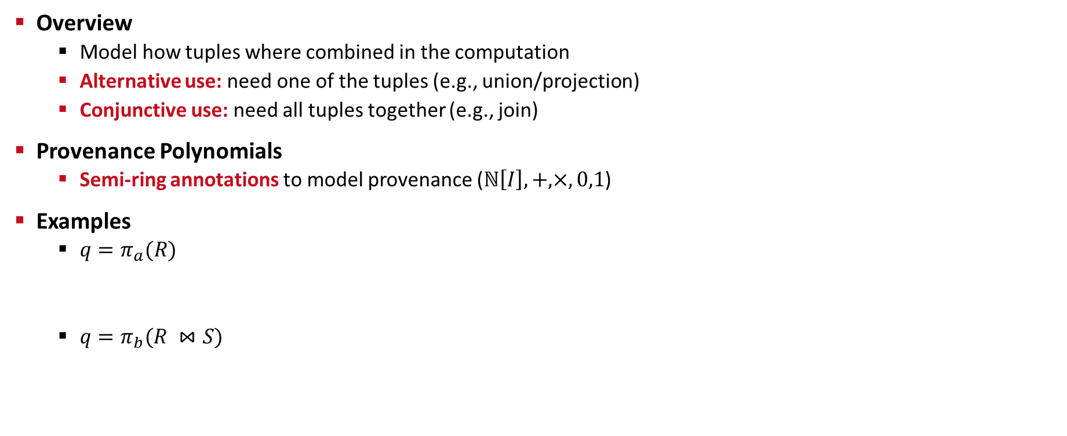
[Boris Glavic: CS595 Data Provenance – Provenance Models and Systems, Illinois Institute of Technology, 2012]
How-Provenance
Overview
  Model how tuples where combined in the computation
  Alternative use: need one of the tuples (e.g., union/projection)
  Conjunctive use: need all tuples together (e.g., join)
Provenance Polynomials
  Semi-ring annotations to model provenance ($ℕ\left[I\right], +,×, 0,1$)
Examples
  $q=π_{a}(R)$
  $q=π_{b}(R ⋈S)$
a | b
1 | 2
1 | 3
a
1
r1
r1 + r2
r2
Provenance Polynomials
a | b
1 | P
2 | G
3 | M
c | a
S | 1
S | 2
W | 2
r1
s1
b
P
G
r1 x s1
r2
s2
(r2 x s2) + (r2 x s3)
s3

Slide 14
How-Provenance, cont.
Example Exam Question:
Given below tables R and S (with tuples r_{i} and s_{i}), query Q and results O,
specify the provenance polynomials for every tuple in O. [3 points]
A: r1 x s1 + r3 x s1 + r2 x s3
(equivalent: (r1 + r3) x s1 + r2 x s3)
B: r2 x s2
C: r2 x s4

Slide 15
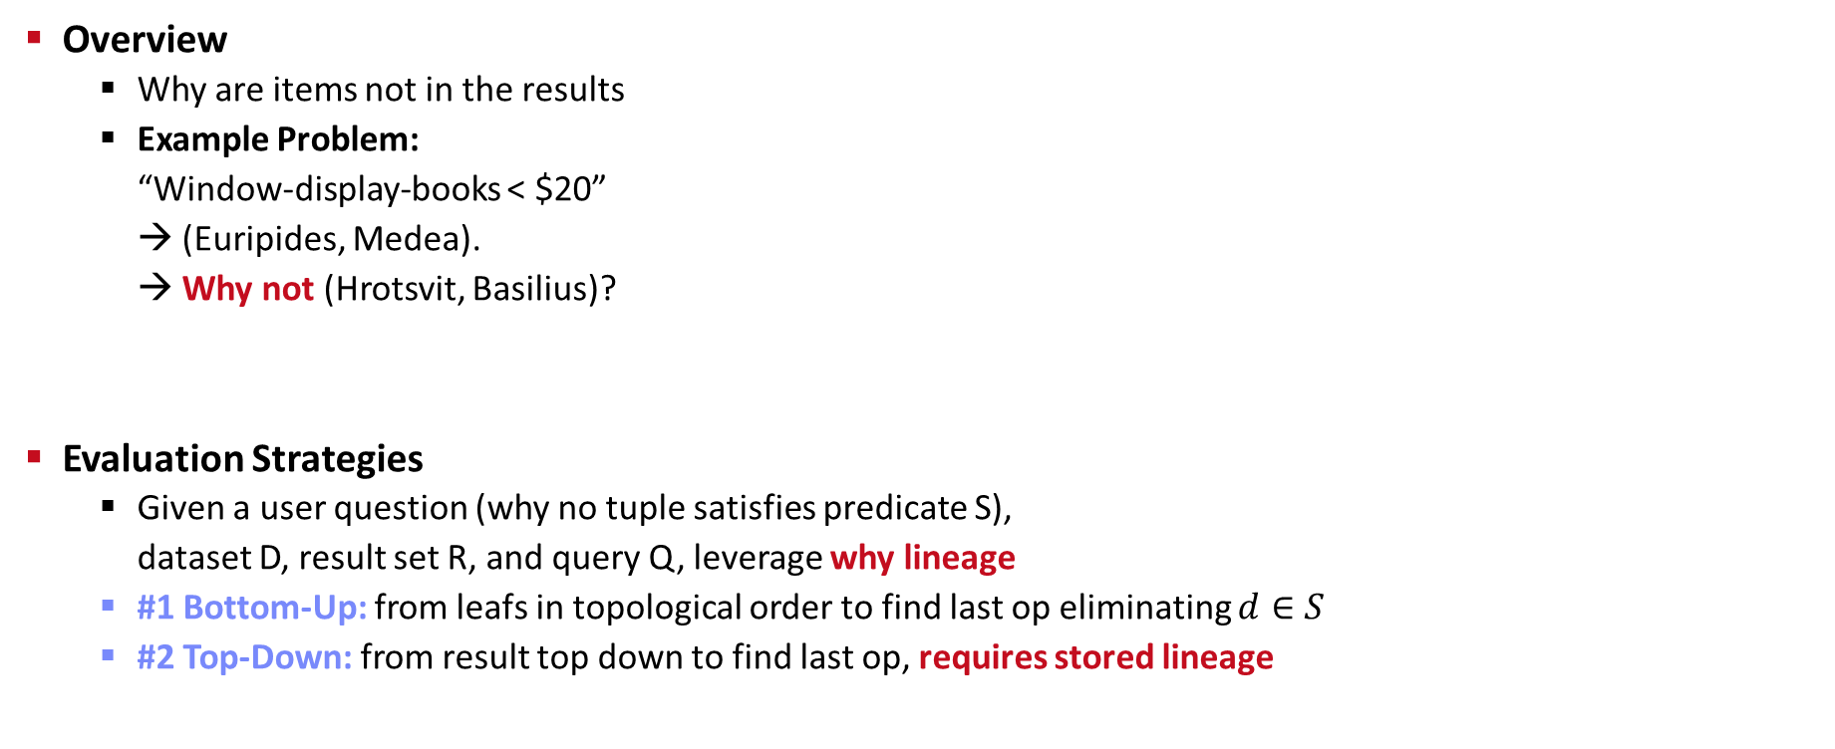
Why Not?-Provenance
[Adriane Chapman, H. V. Jagadish: Why not? SIGMOD 2009]
Overview
  Why are items not in the results
  Example Problem:
  “Window-display-books < $20”
  → (Euripides, Medea).
  → Why not (Hrotsvit, Basilius)?
Evaluation Strategies
  Given a user question (why no tuple satisfies predicate S),
  dataset D, result set R, and query Q, leverage why lineage
  #1 Bottom-Up: from leafs in topological order to find last op eliminating $d∈S$
  #2 Top-Down: from result top down to find last op, requires stored lineage
<= 20$?
Not in
book store?
Bug in the
query / system?

Slide 16
Provenance for ML Pipelines (fine-grained)
DEX: Dataset Versioning
  Versioning of datasets, stored with delta encoding
  Checkout, intersection, union queries over deltas
  Query optimization for finding efficient plans
MISTIQUE: Intermediates of ML Pipelines
  Capturing, storage, querying of intermediates
  Lossy deduplication and compression
  Adaptive querying/materialization for finding efficient plans
Linear Algebra Provenance
  Provenance propagation by decomposition
  Annotate parts w/ provenance polynomials (contributing inputs + impact)
[Amit Chavan, Amol Deshpande: DEX: Query Execution in a Delta-based Storage System. SIGMOD 2017]
[Manasi Vartak et al: MISTIQUE: A System to Store and Query Model Intermediates for Model Diagnosis. SIGMOD 2018]
A
B
C
D
E
[Zhepeng Yan, Val Tannen, Zachary G. Ives: Fine-grained Provenance for Linear Algebra Operators. TaPP 2016]
$$A=S_{x}BT_{u}+S_{x}CT_{v}$$
$+S_{y}DT_{u}+S_{y}ET_{v}$
S_{x}
S_{y}
T_{u}
T_{v}

Slide 17
Provenance for ML Pipelines (coarse-grained)
[Credit: https://databricks.com/
blog/2018/06/05 ]
MLflow
  Programmatic API for tracking parameters,
  experiments, and results
  autolog() for specific params
Flor (on Ground)
  DSL embedded in python for managing the workflow development
  phase of the ML lifecycle
  DAGs of actions, artifacts, and literals
  Data context generated by activities in Ground
Dataset Relationship Management
  Reuse, reveal, revise, retarget, reward
  Code-to-data relationships (data provenance)
  Data-to-code relationships (potential transforms)
import mlflow
mlflow.log_param("num_dimensions", 8)
mlflow.log_param("regularization", 0.1)
mlflow.log_metric("accuracy", 0.1)
mlflow.log_artifact("roc.png")
https://rise.cs.berkeley.edu/projects/jarvis/
[Joseph M. Hellerstein et al: Ground: A Data Context Service. CIDR 2017]
[Zachary G. Ives, Yi Zhang, Soonbo Han, Nan Zheng,: Dataset Relationship Management. CIDR 2019]

Slide 18
Provenance for ML Pipelines (coarse-grained), cont.
HELIX
  Goal: focus on iterative development w/ small
  modifications (trial & error)
  Caching, reuse, and recomputation
  Reuse as Max-Flow problem
  → NP-hard → heuristics
  Materialization to disk for future reuse
Collaborative Optimizer
[Doris Xin, Stephen Macke, Litian Ma, Jialin Liu, Shuchen Song, Aditya G. Parameswaran: Helix: Holistic Optimization for Accelerating Iterative Machine Learning. PVLDB 2018]
load
recompute
[Behrouz Derakhshan, Alireza Rezaei Mahdiraji, Ziawasch Abedjan, Tilmann Rabl, Volker Markl: Optimizing Machine Learning Workloads in Collaborative Environments. SIGMOD 2020]
Notes:
Note: reuse poly, but materialization opt NP-hard

Slide 19


Lineage Tracing & Reuse in SystemDS
Problem
  Exploratory data science (data preprocessing, model configurations)
  Reproducibility and explainability of trained models (data, parameters, prep)
  Lineage/Provenance as Key Enabling Technique:
  Model versioning, reuse of intermediates, incremental maintenance,
  auto differentiation, and debugging (query processing over lineage)
Efficient Lineage Tracing
  Tracing of inputs, literals,
  and non-determinism
  Trace lineage of
  logical operations
  Deduplication for loops/functions
  Program/output reconstruction
[Arnab Phani, Benjamin Rath, Matthias Boehm: LIMA: Fine-grained Lineage Tracing and Reuse in Machine Learning Systems, SIGMOD 2021]

Slide 20

Lineage Tracing & Reuse in SystemDS, cont.
Multi-level, Lineage-based Reuse
  Lineage trace uniquely identifies intermediates
  Reuse intermediates at function / block / operation level
Full Reuse of Intermediates
  Before executing instruction, probe output lineage in cache
  Map<Lineage, MatrixBlock>
  Cost-based/heuristic caching and eviction decisions
  (compiler-assisted)
Partial Reuse of Intermediates
  Problem: Often partial result overlap
  Reuse partial results via dedicated rewrites (compensation plans)
  Example: steplm
Next Steps: multi-backend, unified mem mgmt
for( i in 1:numModels )
R[,i] = lm(X, y, lambda[i,], ...)
m_lmDS = function(...) {
l = matrix(reg,ncol(X),1)
A = t(X) %*% X + diag(l)
b = t(X) %*% y
beta = solve(A, b) ...}
m_steplm = function(...) {
while( continue ) {
parfor( i in 1:n ) {
if( !fixed[1,i] ) {
Xi = cbind(Xg, X[,i])
B[,i] = lm(Xi, y, ...)
} }
# add best to Xg (AIC)
} }
X
m>>n
t(X)
Notes:
Note: inspired by earlier work on COLUMBUS, KeystoneML, Helix, PRETZEL, MISTIQUE, Alpine Meadow

Slide 21
User 2
Recap: Database (Transaction) Log
User 3
User 1
DBMS
Database Architecture
  Page-oriented storage on disk and in memory (DB buffer)
  Dedicated eviction algorithms
  Modified in-memory pages marked as
  dirty, flushed by cleaner thread
  Log: append-only TX changes
  Data/log often placed on different devices
  and periodically archived (backup + truncate)
Write-Ahead Logging (WAL)
  The log records of changes to some (dirty) data page must be
  on stable storage before the data page (UNDO - atomicity)
  Force-log on commit or full buffer (REDO - durability)
  Recovery: forward (REDO) and backward (UNDO) processing
  Log sequence number (LSN)
DB Buffer
Log Buffer
P7
P3’
P1
P7
P3
Data
Log
[C. Mohan, Donald J. Haderle, Bruce G. Lindsay, Hamid Pirahesh, Peter M. Schwarz: ARIES: A Transaction Recovery Method Supporting Fine-Granularity Locking and Partial Rollbacks Using Write-Ahead Logging. TODS 1992]

Slide 22
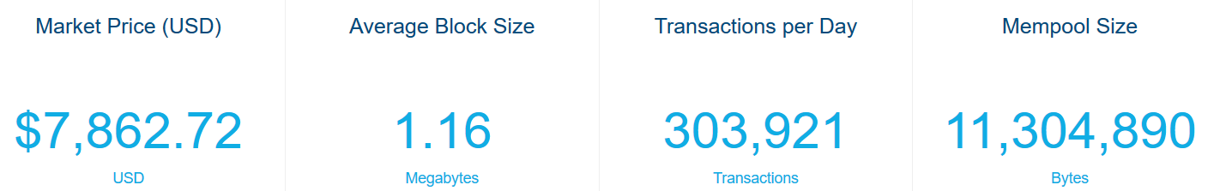
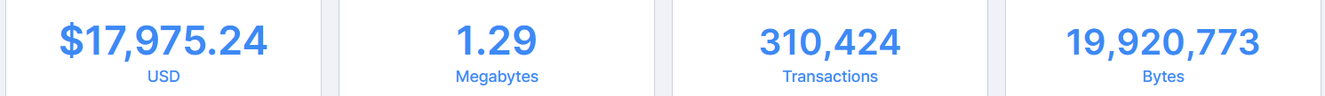
[Satoshi Nakamoto: Bitcoin: A Peer-to-Peer Electronic Cash System, White paper 2008]
Bitcoin and Blockchain Fundamentals
Motivation
  Peer-to-peer (decentralized, anonymous) electronic cash/payments
  Non-reversible transactions w/o need for trusted third party
  Statistics
  Nov 21 2019:
  Nov 19 2020:
Transaction Overview
  Electronic coin defined as chain of digital signatures
  Transfer by signing hash of previous TX and public key of next owner
  Double-spending problem (without global verification)
Permissioned/Private Blockchains
  Blockchain as shared, replicated, permissioned ledger (TX log):
  consensus, provenance, immutability
[https://www.blockchain.
com/charts]
Notes:
2023: 573K TXs; 229 MB mempool

Slide 23
[Satoshi Nakamoto: Bitcoin: A Peer-to-Peer Electronic Cash System, White paper 2008]
Blockchain Data Structure
Timestamp Server
  Decentralized timestamp server: chain of hashes ➔ public ledger
Proof-of-Work
  Scanning for value (nonce) whose SHA-256 hash begins with a number of
  zero bits → exponential in number of zeros
  # zero bits determined by MA of avg blocks/hour
  Hard to recompute for chain, easy to check
  Majority decision: CPU time, longest chain
Enforces order dependency
➔ No double-spending
Hash
Hash
Block
Block
TX
TX
TX
TX
TX
Hash
00110111
Prev hash
nonce
TX
TX
TX
Merkel tree (hash tree)
Notes:
Note: Nov 19 difficulty 17 zero bits, adjusted every 216 blocks so ~1 block every 10 minutes

Slide 24
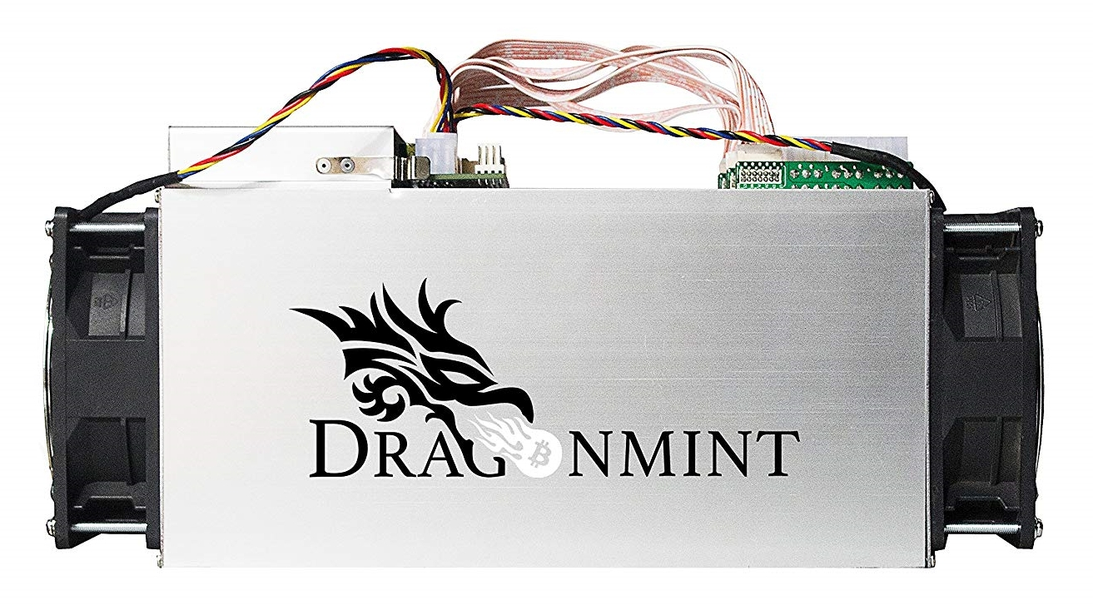
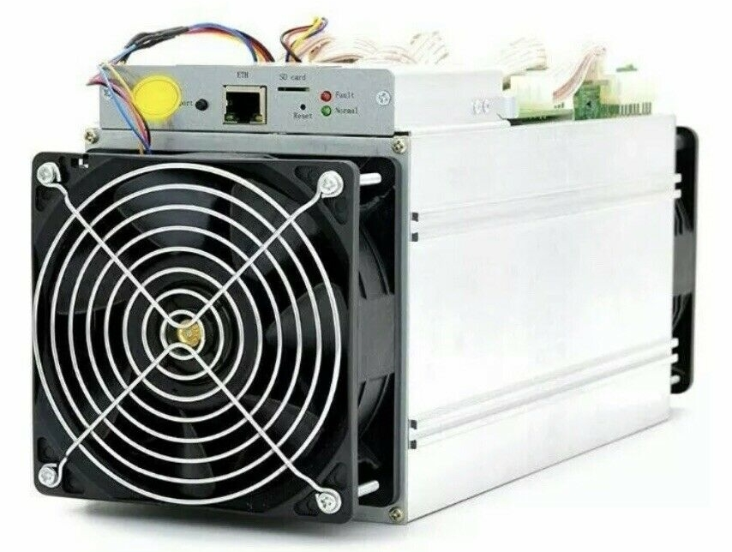
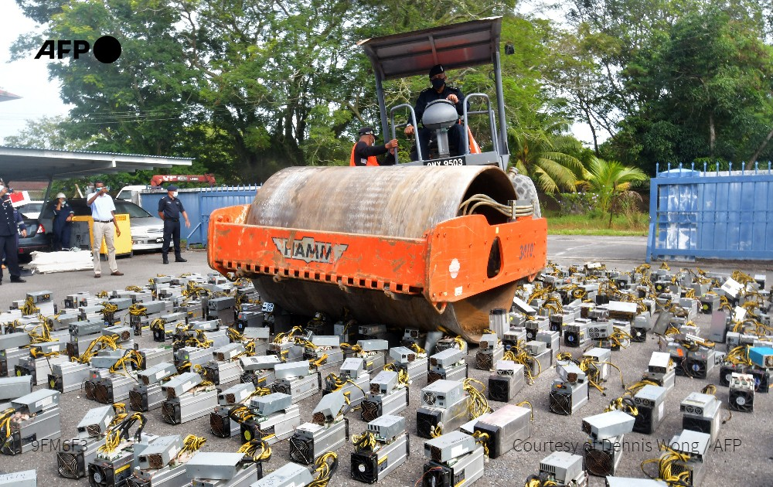
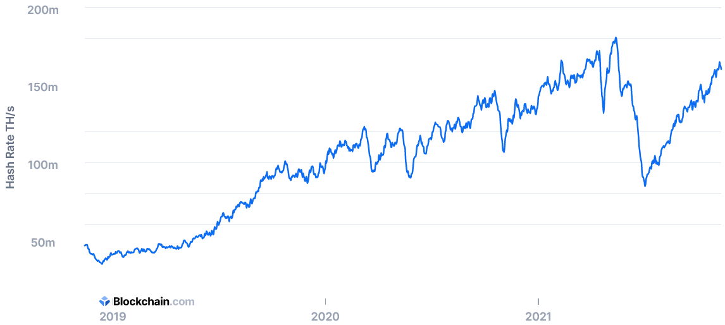
Blockchain Data Structure, cont.
Bitcoin Mining
  HW: from CPU to GPUs/FPGAs/ASICs (10-70 TH/s @ 2-3KW)
  Usually mining pools → “mining cartels”
Hash Rate of Bitcoin Network
  ~10 min per block (144 blocks per day)
180 EH
@Malaysia
Nov 12, 2021:
~160 EH
Nov 25, 2023:
~494 EH
[https://www.blockchain.com/en/charts/hash-rate?
daysAverageString=7&timespan=180days, Nov 12 2021]

Slide 25

“means of showing that one invested a non-trivial amount of effort related to some statement”
Blockchain Consensus Mechanisms
Proof of Work (PoW)
  Validation by performing work, existence of HW resources
  High HW cost of attacks
  Wasted work, resources, energy (only first block, no real outcome, e-waste)
Proof of Stake (PoS)
  Validation by stake-weighted random node selection
  Intrinsic coin cost, less HW resources/energy
  Untested attack mitigation?
Proof of Space/Capacity
  Upfront creation of “plot files”, store nonces+hashes,
  find solutions, occasional validation
  HW costs of attacks, use of unused space
  Moderate adoption
Ethereum 2.0
→ PoS/sharding
over time
[https://www.chia.net/]
[Stefan Dziembowski, Sebastian Faust, Vladimir Kolmogorov, Krzysztof Pietrzak: Proofs of Space. IACR Cryptol. 2013]

Slide 26
Discussion Blockchain
➔ Recommendation: Investigate business requirements/context,
decide on technical properties and acceptable trade-offs
[Sujaya Maiyya, Victor Zakhary, Mohammad Javad Amiri, Divyakant Agrawal, Amr El Abbadi: Database and Distributed Computing Foundations of Blockchains. SIGMOD 2019]
DM
03 MoM & Replication
10/11 Distributed Storage/Compute
Many established techniques
SotA toward scalable/efficient blockchains
(especially for permissioned blockchains)

Slide 27
Data Catalogs

Slide 28
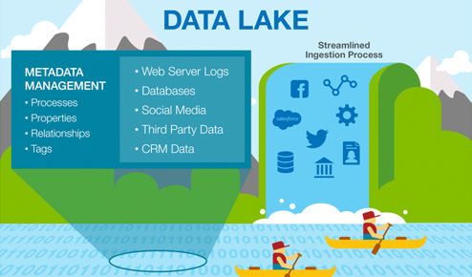

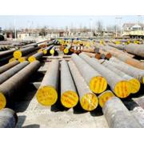


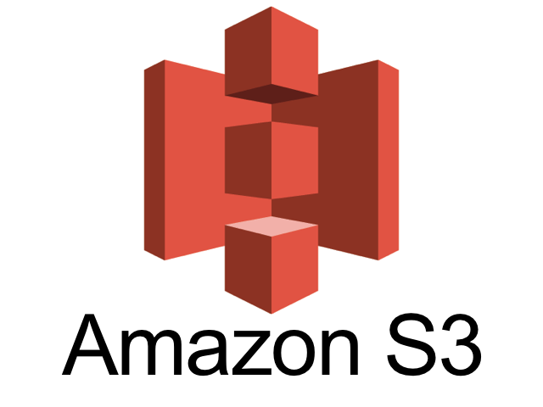
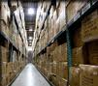
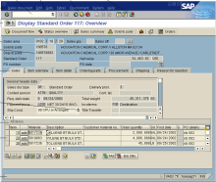
Recap: Complementary System Architectures
#1 Information System Pyramid
Distributed Computation
Frameworks
Operational Systems
Strategic
Systems
Analytical Systems
DSS
Vertical Integration
(e.g., ETL)
#2 Data
Lake
Audio, Image, Video, Text, Streams, Logs
DWH
Catalogs
Distributed Data Stores
Material
ERP
CRM
SCM
eCommerce
Horizontal Integration (e.g., EAI)

Slide 29
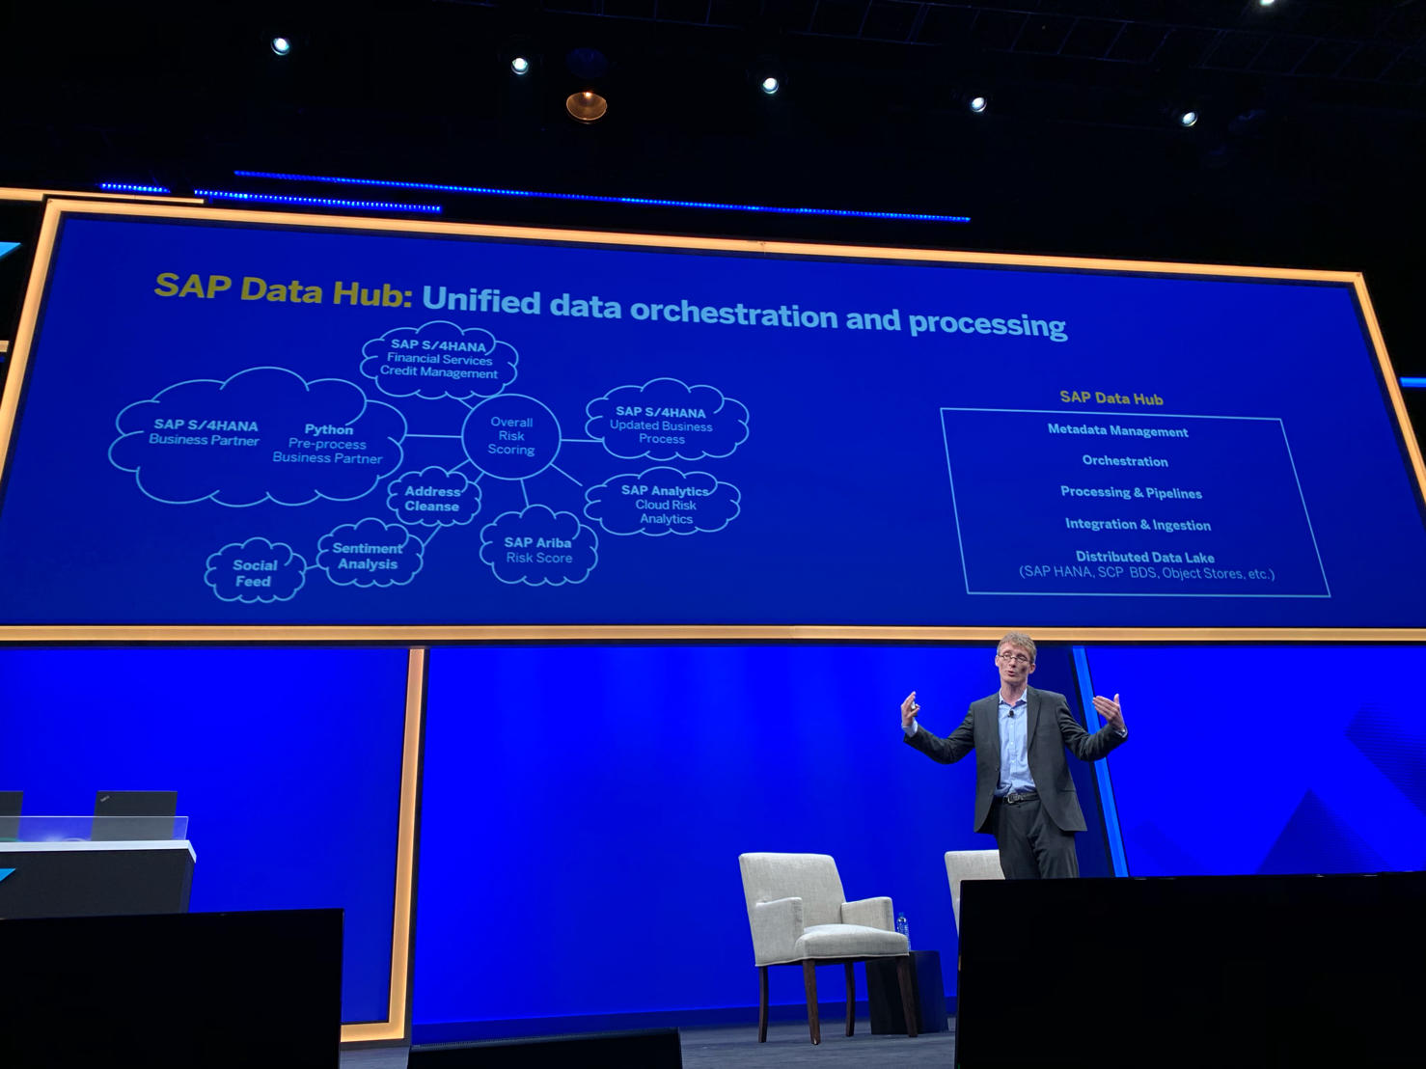
Overview Data Catalogs
Data Catalogs
  Data curation in repositories for finding datasets in data lakes
  Metadata and provenance
  Augment data with open and linked data sources
Examples
[Alon Y. Halevy et al: Goods: Organizing Google's Datasets. SIGMOD 2016]
[Dan Brickley, Matthew Burgess, Natasha F. Noy: Google Dataset Search: Building a search engine for datasets in an open Web ecosystem. WWW 2019]
SAP Data Hub
Google Dataset Search
[SAP Sapphire Now 2019]

Slide 30
[BMWi: GAIA-X: Driver of digital innovation in Europe – Featuring the next generation of data infrastructure, 2020]
GAIA-X Initiative & Integration
GAIA-X
Architecture
Overview
Digital
Platform
Data
Platform

Slide 31
Key Features of a Data Catalog
#1 Dictionary of Datasets
  Basic overview, links, and curation of available datasets
  Raw/original, curated datasets, derived data products
#2 Rich Meta Data Collection
  Format, schema, and access information of datasets
  Data profiling, data validation results, and data quality scores
#3 Lineage/Provenance
  Coarse or fine-grained lineage, incl applied data integration and cleaning process
  Optionally artifacts to reproduce datasets from sources
#4 Data Discovery, Governance, and Sharing
  Find related “joinable” datasets (e.g., over spatial-temporal keys)
  Efficient discovery and sharing of federated data sources

Slide 32

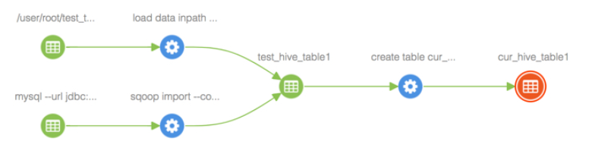
Apache Atlas
[https://atlas.apache.org]
Apache Atlas Overview
  Metadata management and governance capabilities
  Build catalog (data classification, cross-component lineage)
Example
  Configure Atlas hooks
  w/ Hadoop components
  Automatic tracking of
  lineage and side effects
[https://www.cloudera.com/tutorials/cross-component-lineage-with-apache-atlas-across-apache-sqoop-hive-kafka-storm/.html]

Slide 33
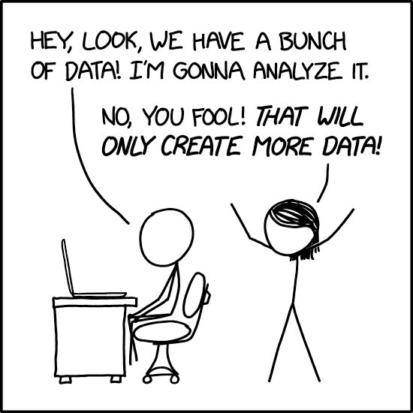
Summary and Q&A
Motivation and Terminology
Data Provenance
Data Catalogs
Next Lectures (Large-scale Data Management and Analysis)
  08 Cloud Computing Fundamentals [Dec 14]
  09 Cloud Resource Management and Scheduling [Dec 21]
  10 Distributed Data Storage [Jan 11]
  11 Distributed, Data-Parallel Computation [Jan 18]
  12 Distributed Stream Processing [Jan 25]
  13 Distributed Machine Learning Systems [Feb 01]
[https://xkcd.com/
2582/]

