Slide 1

Data Integration and Large-scale Analysis (DIA)
10 Distributed Storage
Prof. Dr. Matthias Boehm
Technische Universität Berlin
Berlin Institute for the Foundations of Learning and Data
Big Data Engineering (DAMS Lab)
Last update: Dec 19, 2024

Slide 2

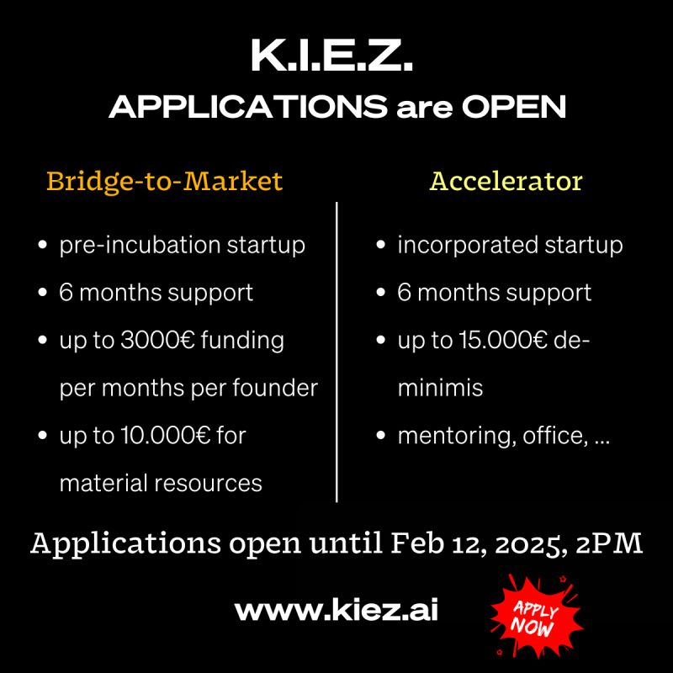
Announcements / Administrative Items
#1 Video Recording
  Hybrid lectures: in-person H 0107, zoom live streaming, video recording
  https://tu-berlin.zoom.us/j/9529634787?pwd=R1ZsN1M3SC9BOU1OcFdmem9zT202UT09
#2 Exercises/Projects
  Reminder: exercise/project submissions by Jan 30 EOD (no extensions)
  Make use of office hours Wed 5pm-6pm
#3 K.I.E.Z. Applications
  Künstliche Intelligenz Entrepreneurship Zentrum:
  https://linkedin.com/company/kiez-ai/)
  Startups can get support for Apr-Sep 2025.
  Bridge-to-Market: https://lnkd.in/dSzDTY-n
  Accelerator: https://lnkd.in/dE_WWTct

Slide 3
Course Outline Part B:
Large-Scale Data Management and Analysis
12 Distributed Stream
Processing
13 Distributed Machine Learning Systems
11 Distributed Data-Parallel Computation
Compute/
Storage
10 Distributed Data Storage
09 Cloud Resource Management and Scheduling
Infra
08 Cloud Computing Fundamentals

Slide 4
Agenda
Motivation and Terminology
Object Stores and Distributed File Systems
Key-Value Stores and Cloud DBMS

Slide 5
Motivation and Terminology

Slide 6
Overview Distributed Data Storage
Global
Q
Recap: Distributed DBS (03 Replication, MoM, and EAI)
  Distributed DB: Virtual (logical) DB, appears like a
  local DB but consists of multiple physical DBs
  Components for global query processing
  Virtual DBS (homo.) vs federated DBS (hetero.)
Cloud and Distributed Data Storage
  Motivation: size (large-scale), semi-structured/nested , fault tolerance
  #1 Cloud and Distributed Storage
    Block storage: files split into blocks, read/write (e.g., SAN, AWS EBS)
    Object storage: objects of limited size (e.g., 5TB), get/put (e.g., AWS S3)
    Distributed file systems: file system on block/object stores (NFS, HDFS)
  #2 Database as a Service
    NoSQL stores: Key-value stores, document stores
    Cloud DBMSs (SQL, for OLTP and OLAP workloads)
DB₁
Q’
Q’’’
Q’’
DB₂
DB₄
DB₃

Slide 7
Central Data Abstractions
#1 Files and Objects
  File: Arbitrarily large sequential data in specific file format (CSV, binary, etc)
  Object: binary large object, with certain meta data
#2 Distributed Collections
  Logical multi-set (bag) of key-value pairs
  (unsorted collection)
  Different physical representations
  Easy distribution of pairs
  via horizontal partitioning
  (aka shards, partitions)
  Can be created from single file,
  or directory of files (unsorted)
Key | Value
4 | Delta
2 | Bravo
1 | Alfa
3 | Charlie
5 | Echo
6 | Foxtrot
7 | Golf
1 | Alfa

Slide 8

Data Lakes
Concept “Data Lake”
  Store massive amounts of un/semi-structured, and structured data (append only, no update in place)
  No need for architected schema or upfront costs (unknown analysis)
  Typically: file storage in open, raw formats (inputs and intermediates)
  ➔ Distributed storage and analytics for scalability and agility
Criticism: Data Swamp
  Low data quality (lack of schema,
  integrity constraints, validation)
  Missing meta data (context) and
  data catalog for search
  ➔ Requires proper data curation / tools
  According to priorities (data governance)
[Credit: www.collibra.com]

Slide 9
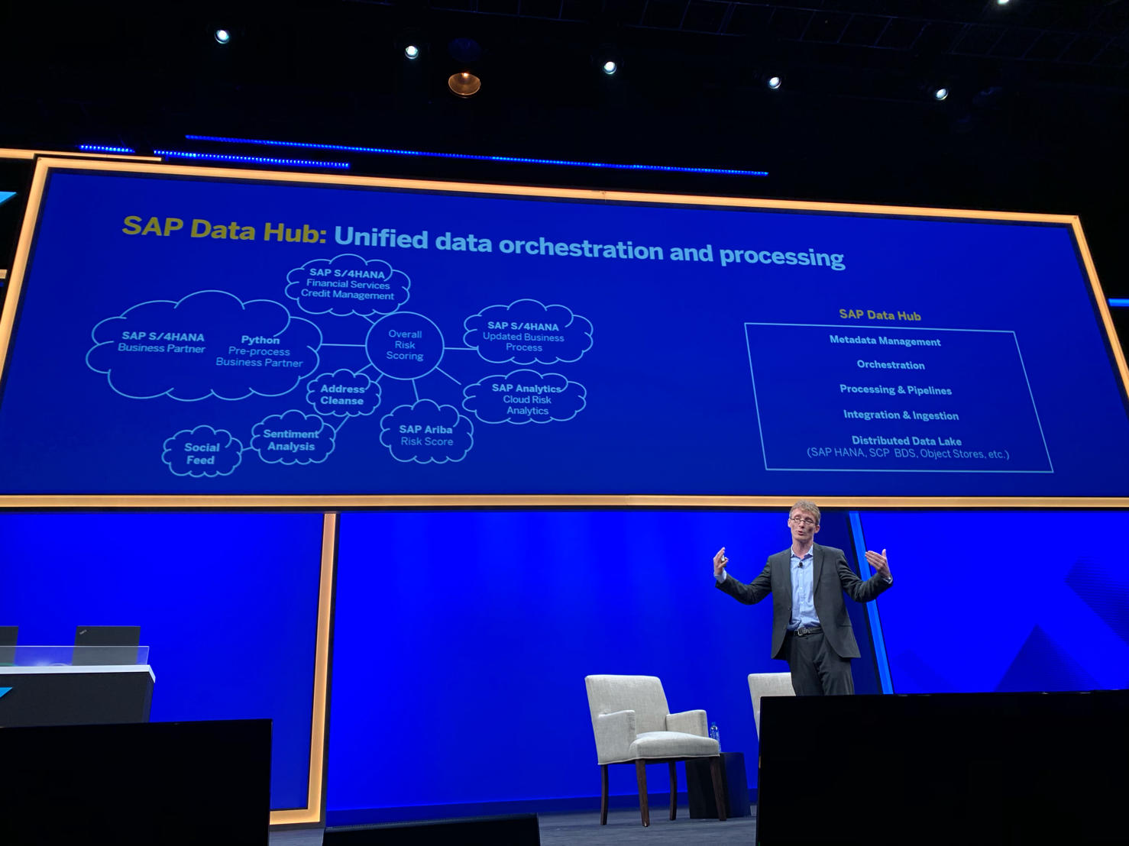
Catalogs of Data and Artefacts
Recap FAIR Data Principles
(see 07 Data Provenance)
Data Catalogs
  Data curation in repositories for finding datasets in data lakes
  Metadata and provenance
  Augment data with open and linked data sources
Examples
[Alon Y. Halevy et al: Goods: Organizing Google's Datasets. SIGMOD 2016]
[Dan Brickley, Matthew Burgess, Natasha F. Noy: Google Dataset Search: Building a search engine for datasets in an open Web ecosystem. WWW 2019]
SAP Data Hub
[Omar Benjelloun, Shiyu Chen, Natasha Noy: Google Dataset Search by the Numbers, https://arxiv.org/pdf/2006.06894]
Google Dataset Search
[SAP Sapphire Now 2019]
500K → 30M datasets

Slide 10
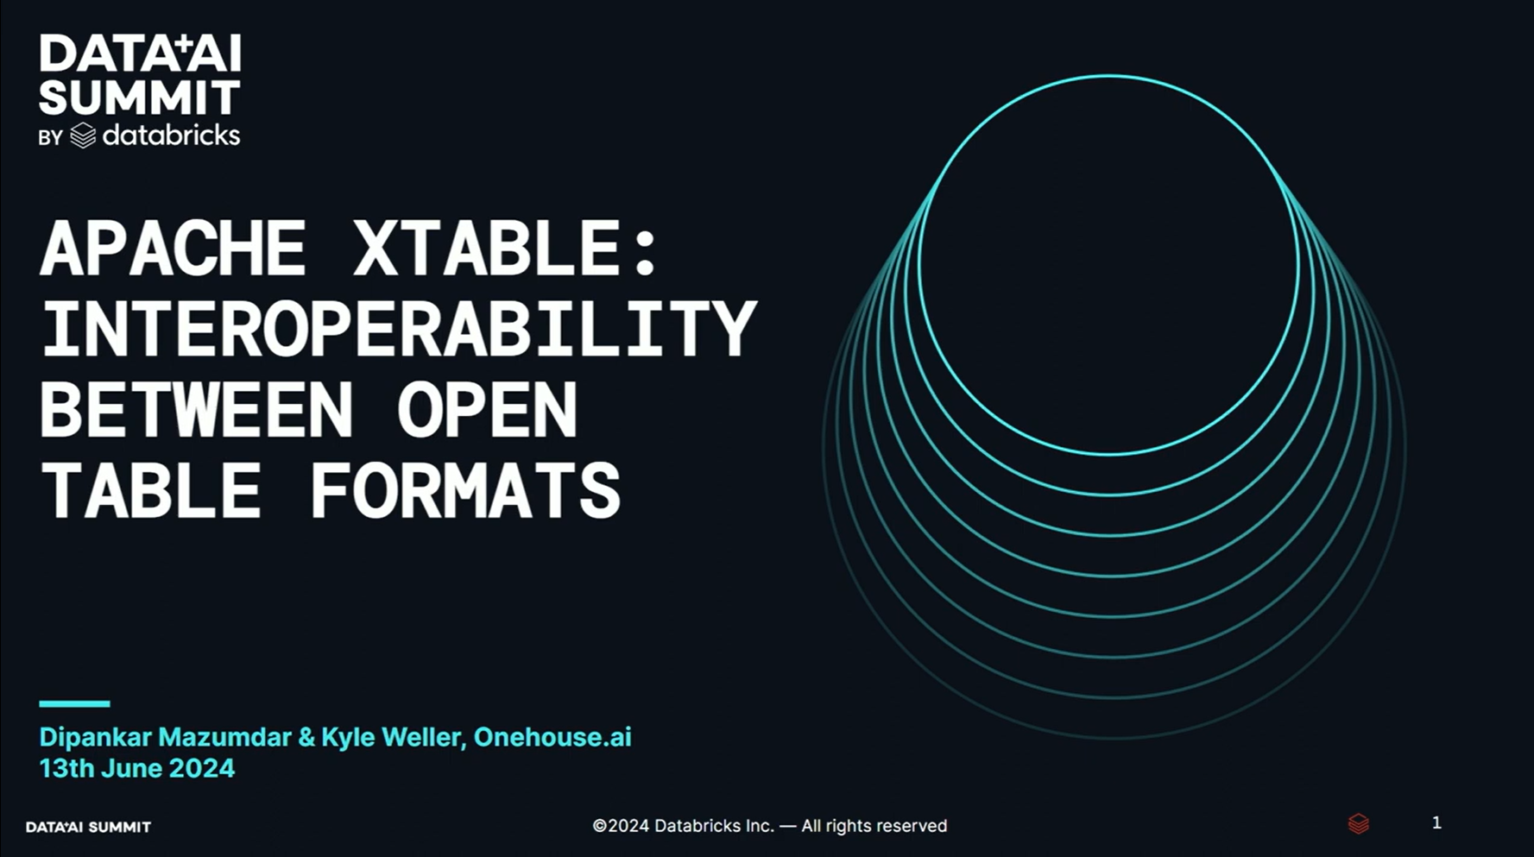
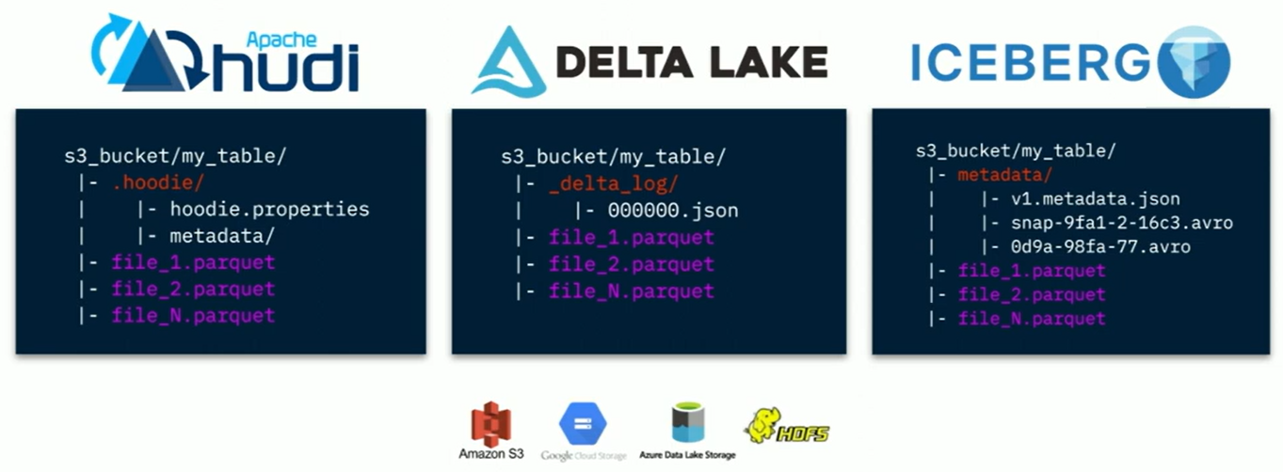
Open Table Formats (File Format + Metadata)
[Dipankar Mazumdar, Kyle Weller: Apache XTable (incubating): Interoperability Among Lakehouse Table Formats Databricks, Data AI Summit 2024.
https://youtu.be/T-ee0xdJ7yM?list=PLTPXxbhUt-YW18S6p5wNu1SJxoF24S_UB]
Open Table Formats
  Data in open formats (e.g., parquet, orc, avro)
  Meta data (e.g., schema, transaction logs)
  Examples: Hudi (Uber, 2017),
  Iceberg (Netflix/Snowflake, 2018), Delta Lake (Databricks, 2019) → and unfortunately diverging
Apache XTable
  Cross-table converter
  for table formats
  (lightweight: meta data only)
  Community contributions by
  Microsoft, Google,
  Snowflake, Databricks
  https://github.com/apache/
  incubator-xtable

Slide 11
Excursus: Research Data Management (RDM)
Overview
  Ensure reproducibility of research results and conclusions
  Common problem:
  Create value for others (compare, reuse, understand, extend)
  EU Projects: Mandatory proposal section & deliverable on RDM plan
RDM @ TU Graz
  TU Graz RDM Policy since 12/2019,
  as well as faculty-specific RDM policies
  https://www.tugraz.at/sites/rdm/home/
RDM @ TU Berlin
  TU Berlin RDM Policy since 10/2019
  https://www.tu.berlin/en/ub/szf/information-tips/
  what-is-research-data-management
  https://www.static.tu.berlin/fileadmin/www/10000000/
  Arbeiten/Wichtige_Dokumente/RDM-Policy_TUBerlin_2023_en.pdf
“All code and data was on the student’s laptop and the student left / the laptop crashed.”
“Ensure that research data, code and any other materials needed to reproduce research findings are appropriately documented, stored and shared in a research data repository in accordance with the FAIR principles (Findable, Accessible, Interoperable and Reusable) for at least 10 years from the end of the research project, unless there are valid reasons not to do so. [...] Develop a written data management strategy for managing research outputs within the first 12 months of the PhD study […].”
“The minimum storage period for research data is ten years after either the assignment of a persistent identifier or the publication of the related work following research project completion, whichever is later.”

Slide 12

FAIR Data Principles
[https://www.go-fair.org/fair-principles/]
#1 Findable
  Metadata and data have globally unique persistent identifiers
  Data describes w/ rich meta data; registered/indexes and searchable
#2 Accessible
  Metadata and data retrievable via open, free and universal commnication protocols
  Metadata accessible even when data no longer available
#3 Interoperable
  Metadata and data use a formal, accessible, and broadly applicable format
  Metadata and data use FAIR vocabularies and qualified references
#4 Reusable
  Metadata and data described with plurality of accurate and relevant attributes
  Clear license, associated with provenance, meets community standards

Slide 13
Object Stores and Distributed File Systems

Slide 14
Object Storage
Recap: Key-Value Stores
  Key-value mapping, where values can be of a variety of data types
  APIs for CRUD operations; scalability via sharding (objects or object segments)
Object Store
  Similar to key-value stores, but: optimized for large objects in GBs and TBs
  Object identifier (key), meta data, and object as binary large object (BLOB)
  APIs: often REST APIs, SDKs, sometimes implementation of DFS APIs
Key Techniques
  Partitioning
  Replication & Distribution
  Erasure Coding
  (partitioning + parity)
Partitioning
D₁
Replication
D₁₁
D₁₂
D
D₂
D₂₁
D₂₂
D₃
D₃₁
D₃₂
Distribution
D₁₁
D₁₂
D₂₁
D₃₂
D₂₂
D₃₁

Slide 15


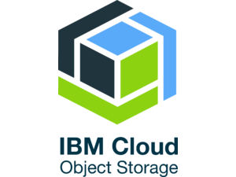
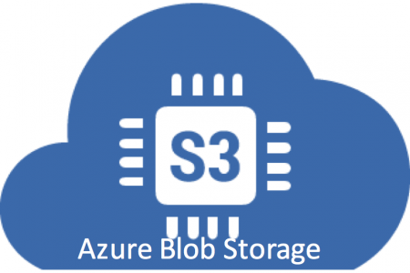
Object Storage, cont.
Example Object Stores / Protocols
  Amazon Simple Storage Service (S3)
  OpenStack Object Storage (Swift)
  IBM Object Storage
  Microsoft Azure Blob Storage
Example Amazon S3
  Reliable object store for photos, videos, documents or any binary data
  Bucket: Uniquely named, static data container
  Object: key, version ID, value, metadata, access control
  Single (5GB)/multi-part (5TB) upload and direct/BitTorrent download
  Storage classes: STANDARD, STANDARD_IA, GLACIER, DEEP_ARCHIVE
  Operations: GET/PUT/LIST/DEL, and SQL over CSV/JSON objects
  Eventual consistency → Dec 1 2020: read-after-write and list consistency
http://s3.aws-eu-central-1.
amazonaws.com/mboehm7datab

Slide 16

[Sanjay Ghemawat, Howard Gobioff, Shun-Tak Leung: The Google file system. SOSP 2003]
Hadoop Distributed File System (HDFS)
Brief Hadoop History
  Google’s GFS + MapReduce [ODSI’04] → Apache Hadoop (2006)
  Apache Hive (SQL), Pig (ETL), Mahout/SystemML (ML), Giraph (Graph)
HDFS Overview
  Hadoop’s distributed file system, for large clusters and datasets
  Implemented in Java, w/ native libraries for compression, I/O, CRC32
  Files split into 128MB blocks, replicated (3x), and distributed
Client
Hadoop Distributed File System (HDFS)
Name Node
Data Node
Data Node
Data Node
Data Node
Data Node
Data Node
M
1
2
3
4
5
6
Head Node
Worker Nodes (shared-nothing cluster)

Slide 17
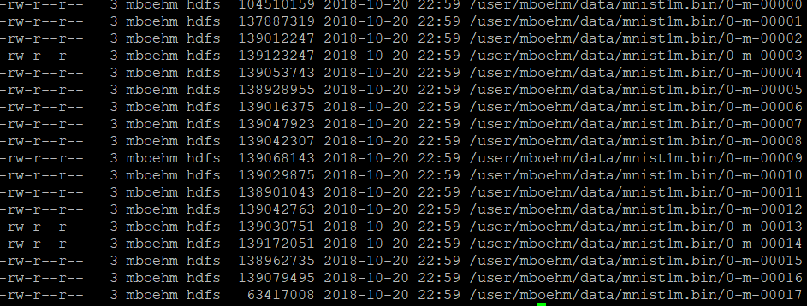
HDFS Daemon Processes
hadoop fs -ls ./data/mnist1m.bin
HDFS NameNode
  Master daemon that manages file system
  namespace and access by clients
  Metadata for all files (e.g., replication,
  permissions, sizes, block ids, etc)
  FSImage: checkpoint of FS namespace
  EditLog: write-ahead-log (WAL) of file write operations (merged on startup)
HDFS DataNode
  Worker daemon per cluster node that manages block storage (list of disks)
  Block creation, deletion, replication as individual files in local FS
  On startup: scan local blocks and send block report to name node
  Serving block read and write requests
  Send heartbeats to NameNode (capacity, current transfers) and receives replies
  (replication, removal of block replicas)
Notes:
Note: multiple fsimage/editlogs can be configured + synchronously written for fault tolerance

Slide 18
HDFS InputFormats and RecordReaders
Overview InputFormats
  InputFormat: implements access to distributed collections in files
  Split: record-aligned block of file (aligned with HDFS block size)
  RecordReader: API for reading key-value pairs from file splits
  Examples: FileInputFormat, TextInputFormat, SequenceFileInputFormat
Example
Text Read
FileInputFormat.addInputPath(job, path); # path: dir/file
TextInputFormat infmt = new TextInputFormat();
InputSplit[] splits = infmt.getSplits(job, numSplits);
LongWritable key = new LongWritable();
Text value = new Text();
for(InputSplit split : splits) {
RecordReader<LongWritable,Text> reader = infmt.getRecordReader(split,job,Reporter.NULL);
while( reader.next(key, value) )
... //process individual text lines
}

Slide 19
HDFS InputFormats and RecordReaders, cont.
Sequence Files
  Binary files for key/value pairs, w/ optional compression (MR/Spark I/O, MR intermediates)
  InputFormat with readers, writers, and sorters
Example Uncompressed SequenceFile
  Header: SEQ+version (4 bytes), keyClassName, valueClassName,
  compression, blockCompression, compressor class (codec), meta data
  Splittable binary representation of key-value pair collection
Header
Record
Record
Record
Record
Sync
Sync
Record Length
Key Length
Key
Value
SystemDS: values are
1k x 1k matrix blocks

Slide 20
HDFS Write and Read
Client
D
1. Create foo.txt
HDFS Client
D₁
HDFS Write
  #1 Client RPC to NameNode
  to create file → lease/replica DNs
  #2 Write blocks to DNs, pipelined
  replication to other DNs
  #3 DNs report to NN via heartbeat
HDFS Read
  #1 Client RPC to NameNode
  to open file → DNs for blocks
  #2 Read blocks sequentially from
  closest DN w/ block
  InputFormats and RecordReaders
  as abstraction for multi-part files
  (incl. compression/encryption)
2
D₂
foo.txt: D1-1,2
D2-1,2
3
Name Node
Data Node
Data Node
M
1
2
D₁
D₂
D₁
D₂
1. Open foo.txt
HDFS Client
D₁
2
D₂
foo.txt: D1-1,2
D2-1,2
Name Node
Data Node
Data Node
M
1
2
D₁
D₂
D₁
D₂
Notes:
Note: writes synchronous but pipelined replication; if less than k data nodes returned (errors, loaded) write still successful if replication > min.replication

Slide 21
HDFS Data Locality
Data Locality
  HDFS is generally rack-aware (node-local, rack-local, other)
  Schedule reads from closest data node
  Replica placement (rep 3): local DN, other-rack DN, same-rack DN
  MapReduce/Spark: locality-aware execution (function vs data shipping)
Custom Locality Information
  Custom InputFormat and
  FileSplit implementations
  Return customized mapping
  of locations on getLocations()
  Can use block locations of arbitrary files
public class MyFileSplit extends FileSplit
{
public MyFileSplit(FileSplit x, ...) {}
@Override
public String[] getLocations() {
return new String[]{“node1”,“node7”};
}
}
FileStatus st = fs.getFileStatus(new Path(fname));
BlockLocation[] tmp1 = fs.getFileBlockLocations(st, 0, st.getLen());

Slide 22
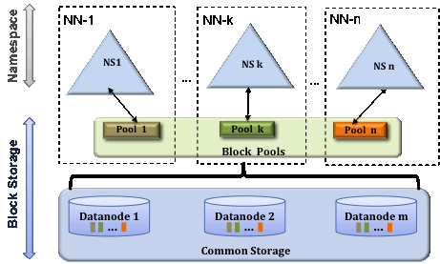
HDFS Federated NameNodes
HDFS Federation
  Eliminate NameNode as
  namespace scalability bottleneck
  Independent NameNodes,
  responsible for name spaces
  DataNodes store blocks of all NameNodes
  Client-side mount tables
GFS Multiple Cells
  “We also ended up doing what we call a "multi-cell"
  approach, which basically made it possible to put
  multiple GFS masters on top of a pool of chunkservers.”
  -- Sean Quinlan
[Credit: https://hadoop.apache.org/docs/current/hadoop-project-dist/hadoop-hdfs/Federation.html]
[Kirk McKusick, Sean Quinlan: GFS: evolution on fast-forward. Commun. ACM 53(3) 2010]

Slide 23
Other DFS
HDFS FileSystem Implementations (subset)
  LocalFileSystem (file), DistributedFileSystem (hdfs)
  FTPFileSystem, HttpFileSystem, ViewFilesystem (ViewFs – mount table)
  NativeS3FileSystem (s3, s3a), NativeSwiftFileSystem, NativeAzureFileSystem
  Other proprietary: IBM GPFS, Databricks FS (DBFS)
Google Colossus
  More fine-grained accesses, Google Cloud Storage
High-Performance Computing
  IBM GPFS (General Parallel File System) / Spectrum Scale
  BeeGFS (Fraunhofer GFS) – focus on usability, storage/metadata servers
  Lustre (Linux + Cluster) – GPL license, LNET protocol / metadata / object storage
  RedHat GFS2 (Global File System) – Linux cluster file system, close to local
  NAS (Network Attached Storage), SAN (Storage Area Network)
  GekkoFS (Uni Mainz / Barcelona SC) – data-intensive HPC applications
[WIRED: Google Remakes Online Empire With 'Colossus', https://www.wired.com/2012/07/google-colossus/]
Scope: Focus on high IOPs (instead of bandwidth)
with block write

Slide 24

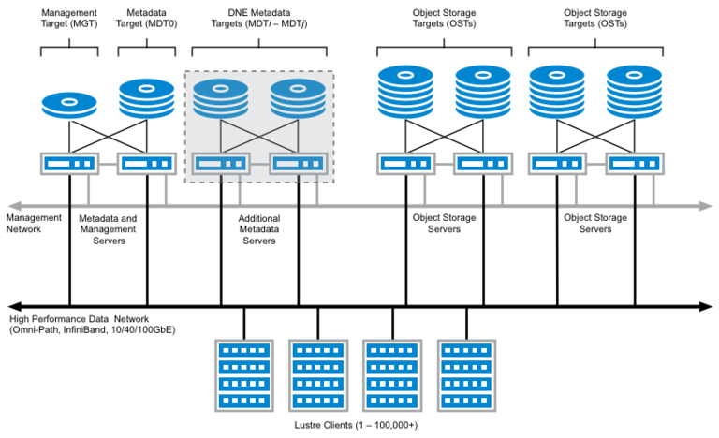
Lustre Filesystem
Overview and
System Architecture
  Widely used, open-source,
  POSIX-compliant,
  distributed parallel file system
  Primary domain:
  high-performance computing
  and simulation environments
[https://wiki.lustre.org/
Introduction_to_Lustre]

Slide 25
Key-Value Stores and Cloud DBMS

Slide 26

Motivation and Terminology
Motivation
  Basic key-value mapping via simple API
  (more complex data models can be mapped to key-value representations)
  Reliability at massive scale on commodity HW (cloud computing)
System Architecture
  Key-value maps, with values of different data types
  APIs for CRUD operations (create, read, update, delete)
  Scalability via sharding (horizontal partitioning)
Example Systems
  Dynamo (2007, AP) → Amazon DynamoDB (2012)
  Redis (2009, CP/AP)
users:1:a
“Inffeldgasse 13, Graz”
users:1:b
“[12, 34, 45, 67, 89]”
users:2:a
“Mandellstraße 12, Graz”
users:2:b
“[12, 212, 3212, 43212]”
[Giuseppe DeCandia et al:
Dynamo: amazon's highly available key-value store. SOSP 2007]
Notes:
Notes:
* Dynamo + SimpleDB → DynamoDB

Slide 27
[Giuseppe DeCandia et al:
Dynamo: amazon's highly available key-value store. SOSP 2007]
Example Systems: Dynamo
Motivation
  Simple, highly-available data storage for small objects in ~1MB range
  Aim for good load balance (99.9th percentile SLAs)
#1 System Interface
  Simple get(k, ctx) and put(k, ctx) ops
#2 Partitioning
  Consistent hashing of nodes and keys on circular ring
  for incremental scaling
  Nodes hold multiple virtual nodes for load balance
  (add/rm, heterogeneous)
#3 Replication
  Each data item replicated N times (at coord node and N-1 successors)
  Eventual consistency w/ async update propagation via vector clocks
  Replica synchronization via Merkle trees
Amazon
e-Commerce Platform
Notes:
Notes:
* vector clocks (node, counter) for capturing causality between versions
* Replica synchronization via anti-entropy and Merkle-trees

Slide 28










Example Systems, cont.
Redis Data Types
  Redis is not a plain KV-store, but “data structure server” with persistent log (appendfsync no/everysec/always)
  Key: ASCII string (max 512MB, common key schemes: comment:1234:reply.to)
  Values: strings, lists, sets, sorted sets, hashes (map of string-string), etc
Redis APIs
  SET/GET/DEL: insert a key-value pair, lookup value by key, or delete by key
  MSET/MGET: insert or lookup multiple keys at once
  INCRBY/DECBY: increment/decrement counters
  Others: EXISTS, LPUSH, LPOP, LRANGE, LTRIM, LLEN, etc
Other systems
  Classic KV stores (AP): Riak, Aerospike, Voldemort,
  LevelDB, RocksDB, FoundationDB, Memcached
  Wide-column stores: Google BigTable (CP),
  Apache HBase (CP), Apache Cassandra (AP)

Slide 29
[Patrick E. O'Neil, Edward Cheng, Dieter Gawlick, Elizabeth J. O'Neil: The Log-Structured Merge-Tree (LSM-Tree). Acta Inf. 1996]
Log-structured Merge Trees
LSM Overview
  Many KV-stores rely on LSM-trees as their storage engine
  (e.g., BigTable, DynamoDB, LevelDB, Riak, RocksDB, Cassandra, HBase)
  Approach: Buffers writes in memory, flushes data as sorted runs to storage,
  merges runs into larger runs of next level (compaction)
System Architecture
  Writes in C0
  Reads against C0 and C1
  (w/ buffer for C1)
  Compaction (rolling merge):
  sort, merge, including deduplication
C0
in-memory
buffer (C0)
max capacity T
writes
reads
compaction
C1_{t}
on-disk storage (C1)
C1_{t+1}
Notes:
Note: LSM write optimized by buffering writes, read-optimized by sort-merging on-disk runs
C1 and Ci also trees similar to B-tree but nodes kept 100% full single node pages packed into multi-page blocks
→ Better insert performance, worse lookup costs

Slide 30
Log-structured Merge Trees, cont.
LSM Tiering
  Keep up to T-1 runs per level L
  Merge all runs of L_{i} into 1 run of L_{i+1}
    L1
    L2
    L3
LSM Leveling
  Keep 1 run per level L
  Merge run of Li with Li+1
    L1
    L2
    L3
write-optimized
read-optimized
[Niv Dayan: Log-Structured-Merge Trees, Comp115 guest lecture, 2017]
[Stratos Idreos, Mark Callaghan: Key-Value Storage Engines (Tutorial), SIGMOD 2020]

Slide 31


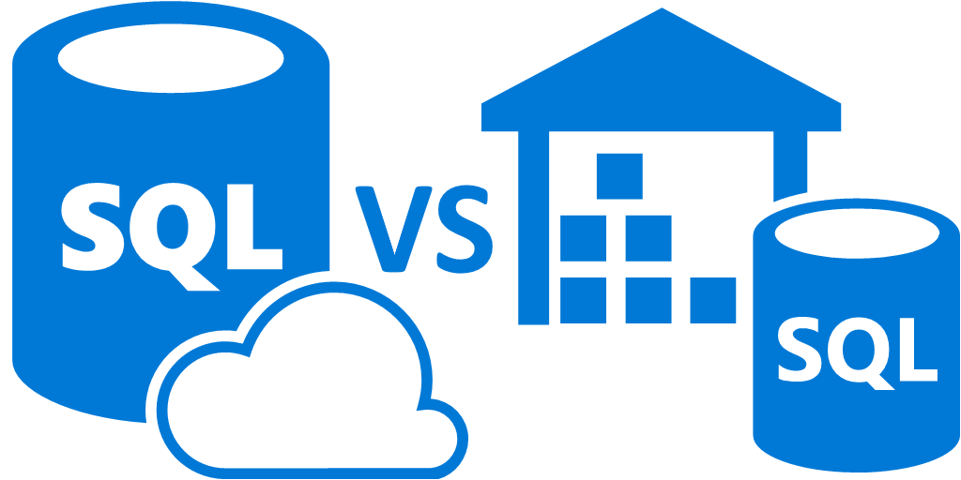
Cloud Databases (DBaaS)
Motivation DBaaS
  Simplified setup, maintenance, tuning and auto scaling
  Multi-tenant systems (scalability, learning opportunities)
  Different types based on workload (OLTP vs OLAP, NoSQL)
Elastic Data Warehouses
  Motivation: Intersection of data warehousing, cloud computing, distributed storage
  Example Systems
    #1 Snowflake
    #2 Google BigQuery (Dremel)
    #3 Amazon Redshift
    #4 ByteDance ByConity
    Azure SQL Data Warehouse /
    #5 Azure SQL Database Hyperscale (Socrates)
Microsoft
02 Data Warehousing,
ETL, and SQL/OLAP
Commonalities:
SQL, column stores,
data on object store / DFS, elastic cloud scaling

Slide 32

[Benoît Dageville et al.: The Snowflake Elastic Data Warehouse. SIGMOD 2016]
Example Snowflake
Motivation (impl started late 2012)
  Enterprise-ready DWH solution for the cloud (elasticity, semi-structured)
  Pure SaaS experience, high availability, cost efficient
Cloud Services
  Manage virtual DHWs, TXs, and queries
  Meta data and catalogs
Virtual Warehouses
  Query execution in EC2 w/ caching/intermediates
Data Storage
  Storage in AWS S3
  PAX / hybrid columnar
  Min-max pruning
Notes:
Note: Sep 2020 -> IPO (initial public offering), 33B eval -> Jan 2024: enterprise value 62B

Slide 33
[Sergey Melnik et al.: Dremel: Interactive Analysis of Web-Scale Datasets. PVLDB 3(1) 2010]
Example Google BigQuery
Background Dremel
  Scalable and fast in-situ analysis of read-only nested data (DFS, BigTable)
  Data model: protocol buffers - strongly-typed nested records
  Storage model: columnar storage of nested data
  (efficient splitting and assembly records)
  Query execution via multi-level serving tree
BigQuery System Architecture
  Public impl of internal Dremel system (2012)
  SQL over structured, nested data (OLAP, BI)
  Extensions: web Uis, REST APIs and ML
  Data storage: Colossus (NextGen GFS)
[Kazunori Sato: An Inside Look at Google BigQuery, Google BigQuery White Paper 2012.]

Slide 34
[Anurag Gupta et al.: Amazon Redshift and the Case for Simpler Data Warehouses. SIGMOD 2015]
Example Amazon Redshift
[Mengchu Cai et al.: Integrated Querying of SQL database data and S3 data in Amazon Redshift.
IEEE Data Eng. Bull. 41(2) 2018]
Motivation (release 02/2013)
  Simplicity and cost-effectiveness
  (fully-managed DWH at petabyte scale)
System Architecture
  Data plane: data storage and SQL execution
  Control plane: workflows for monitoring,
  and managing databases, AWS services
Data Plane
  Initial engine licensed from ParAccel
  Leader node + compute nodes in EC2
  (w/ local storage)
  Replication across nodes + S3 backup
  Query compilation in C++ code
  Support for flat and nested files

Slide 35
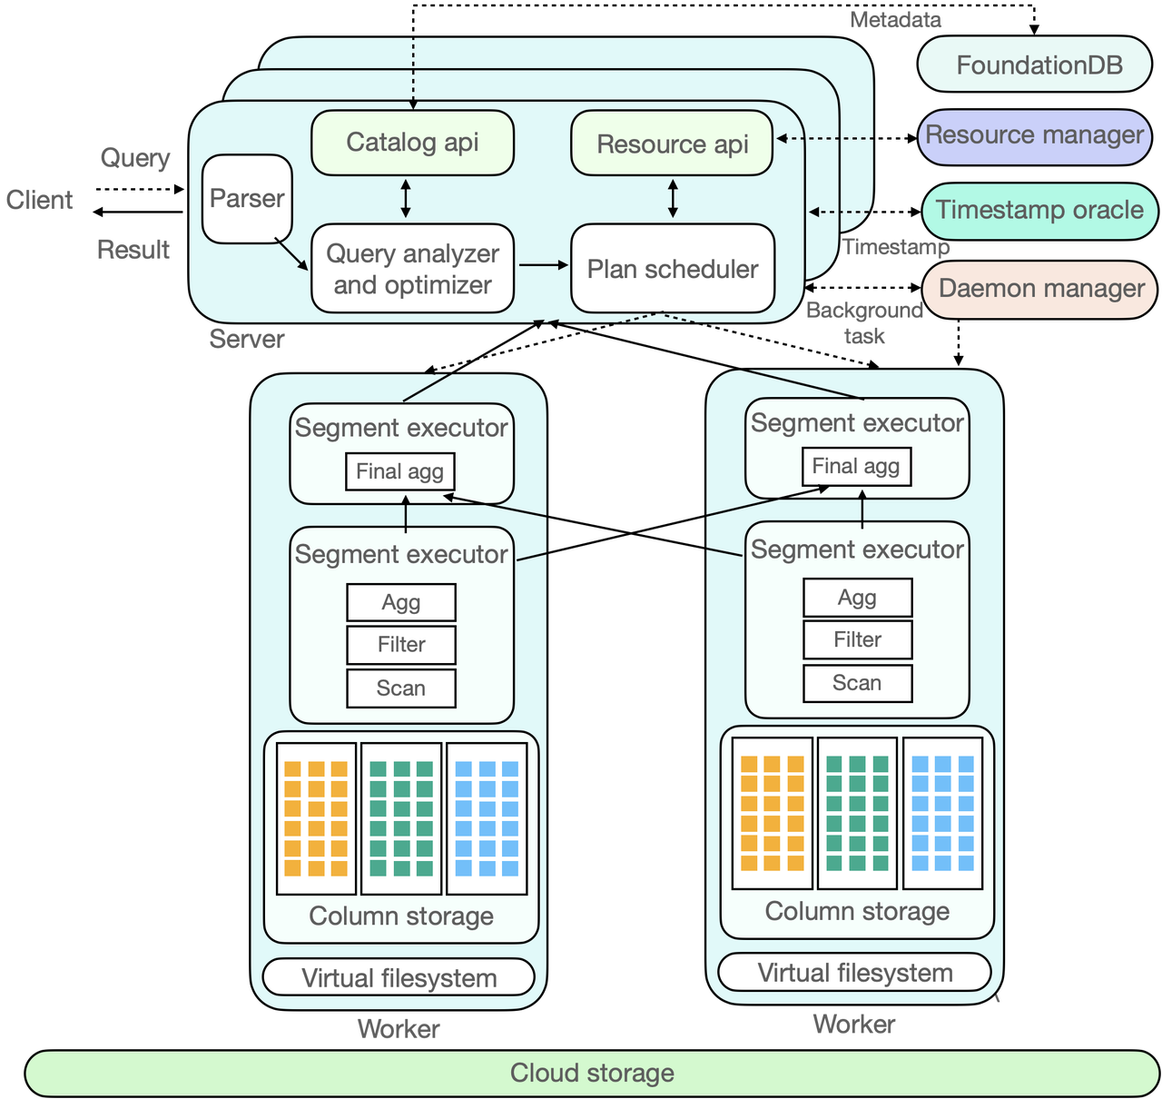
Example ByteDance ByConity
System Architecture
  Virtual Warehouses
  (disaggregated storage and compute)
  On-demand elasticity
  Column store on object storage (e.g., S3)
  Open-source
  (https://github.com/ByConity/ByConity)
[https://byconity.github.io/blog/
2023-05-24-byconity-announcement-opensources-its-cloudnative-data-warehouse]

Slide 36
Summary and Q&A
Motivation and Terminology
Object Stores and Distributed File Systems
Key-Value Stores and Cloud DBMS
Next Lectures (Large-scale Data Management and Analysis)
  11 Distributed, Data-Parallel Computation [Jan 09]
  12 Distributed Stream Processing [Jan 16]
  13 Distributed Machine Learning Systems [Jan 23]
  Exercise/Project Submission [Jan 30]
  Written Exam v1 [Feb 06]
  Written Exam v2 [Feb 13]

