Slide 1

Data Integration and Large-scale Analysis (DIA)
13 Distributed Machine Learning Systems
Prof. Dr. Matthias Boehm
Technische Universität Berlin
Berlin Institute for the Foundations of Learning and Data
Big Data Engineering (DAMS Lab)
Last update: Jan 19, 2025

Slide 2



Announcements / Administrative Items
#1 Video Recording
  Hybrid lectures: in-person H 0107, zoom live streaming, video recording
  https://tu-berlin.zoom.us/j/9529634787?pwd=R1ZsN1M3SC9BOU1OcFdmem9zT202UT09
#2 Exercise/Project Submission
  Submission deadline: Jan 30, 11.59pm
  Pull-requests submitted (not necessarily merged) by deadline
#3 Course Evaluation
  Lecture: https://befragung.tu-berlin.de/evasys/online.php?pswd=JNXRG
  Exercise: https://befragung.tu-berlin.de/evasys/online.php?pswd=1X7EN
  Evaluation period: Jan 13 – Jan 24
Lecture
Exercise

Slide 3
Course Outline Part B:
Large-Scale Data Management and Analysis
12 Distributed Stream
Processing
13 Distributed Machine Learning Systems
11 Distributed Data-Parallel Computation
Compute/
Storage
10 Distributed Data Storage
09 Cloud Resource Management and Scheduling
Infra
08 Cloud Computing Fundamentals

Slide 4
FG Big Data Engineering (DAMS Lab) – Teaching
Architecture of
Database Systems
(ADBS, WS)
DB system internals
+ prog. project
Architecture of
ML Systems
(AMLS, SoSe)
ML system internals,
data science lifecycle
+ prog. project
Architecture of
ML Systems
(AMLS, SS)
SE Joint ML and DM (MLDM, SoSe+WiSe)
Master
Data Integration and Large-Scale Analysis
(DIA, WS)
SE/PR Large-scale Data Engineering
(LDE, SoSe+WiSe)
Data Integration and Large-Scale Analysis
(DIA, WiSe)
Distributed
Data Management
Bachelor
Intro to Scientific Methods (WS)
Data Management / Databases
(DM, SS+WS)
Data management from user/application perspective
PP Prog.-Practicals Data Systems
(PPDS, SoSe+WiSe)

Slide 5
Agenda
Landscape of ML Systems
Distributed Linear Algebra
Distributed Parameter Servers
Q&A and Exam Preparation

Slide 6
Landscape of ML Systems

Slide 7
What is an ML System?
Classification
Regression
Recommenders
Clustering
Dim Reduction
Neural Networks
Statistics
Data Mining
Machine Learning (ML)
ML Applications
(entire KDD/DS lifecycle)
Rapidly Evolving
Runtime Techniques (Execution, Data Access)
ML System
Compilation Techniques
Distributed Systems
HPC
Data Management
Accelerators
Operating Systems
Prog. Language Compilers
HW Architecture

Slide 8


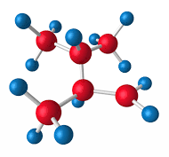

Data-centric View:
Application/workload/system perspectives
The Data Science Lifecycle
(aka KDD Process, aka CRISP-DM)
Data extraction, schema alignment, entity resolution, data validation, data cleaning, outlier detection, missing value imputation, semantic type detection, data augmentation, feature selection, feature engineering, feature transformations
Key observation: SotA data integration/cleaning based on ML
Data Scientist
Data Integration
Data Cleaning
Data Preparation
Data Integration
Data Cleaning
Data Preparation
Model Selection
Training
Hyper-parameters
Validate & Debug
Deployment
Scoring & Feedback
Exploratory Process
(experimentation, refinements, ML pipelines)
Data/SW Engineer
DevOps Engineer

Slide 9
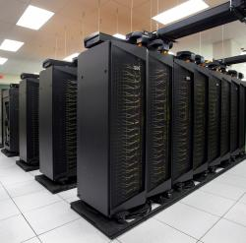
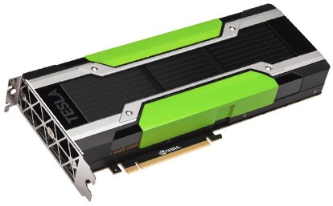
Driving Factors for ML
[Credit: Andrew Ng’14]
Improved Algorithms and Models
  Success across data and application domains
  (e.g., health care, finance, transport, production)
  More complex models which leverage large data
Availability of Large Data Collections
  Increasing automation and monitoring ➔ data
  (simplified by cloud computing & services, annotation services)
  Feedback loops, simulation/data prog./augmentation
  → Trend: self-supervised learning (*-GPT-x)
HW & SW Advancements
  Higher performance of hardware and infrastructure (cloud)
  Open-source large-scale computation frameworks,
  ML systems, and vendor-provides libraries
Feedback Loop
Data
Usage
Model

Slide 10
Stack of ML Systems
Validation & Debugging
Deployment & Scoring
Hyper-parameter Tuning
Training
ML Apps & Algorithms
Supervised, unsupervised, RL
linear algebra, libs, AutoML
Model and Feature Selection
Language Abstractions
Eager interpretation, lazy evaluation, prog. compilation
Improve accuracy vs. performance vs. resource requirements
➔ Specialization & Heterogeneity
Data Programming & Augmentation
Fault Tolerance
Approximation, lineage, checkpointing, checksums, ECC
Data Preparation
(e.g., one-hot, binning)
Execution Strategies
Local, distributed, cloud
(data, task, parameter server)
Data Representations
Dense & sparse tensor/matrix;
compress, partition, cache
Data Integration & Data Cleaning
HW & Infrastructure
CPUs, NUMA, GPUs, FPGAs, ASICs, RDMA, SSD/NVM

Slide 11
Accelerators (GPUs, FPGAs, ASICs)
Memory- vs Compute-intensive
  CPU: dense/sparse, large mem, high mem-bandwidth, moderate compute
  GPU: dense, small mem, slow PCI, very high bandwidth/compute
Graphics Processing Units (GPUs)
  Extensively used for deep learning training and scoring
  NVIDIA Volta: “tensor cores” for 4x4 mm → 64 2B FMA instruction
Field-Programmable Gate Arrays (FPGAs)
  Customizable HW accelerators for prefiltering, compression, DL
  Examples: Microsoft Catapult/Brainwave Neural Processing Units (NPUs)
Application-Specific Integrated Circuits (ASIC)
  Spectrum of chips: DL accelerators to computer vision
  Examples: Google TPUs (64K 2B FMA), NVIDIA DLA, Intel NNP, IBM TrueNorth
Quantum: Examples: IBM Q (Qiskit), Google Sycamore (Cirq → TensorFlow Quantum)
DL
Apps
Lang
Roofline Analysis
Faults
Ops
ML
Exec
Data
Operational Intensity
HW

Slide 12
Data Representation
ML- vs DL-centric Systems
  ML: dense and sparse matrices or tensors, different sparse
  formats (CSR, CSC, COO), frames (heterogeneous)
  DL: mostly dense tensors,
  relies on embeddings for NLP, graphs
Data-Parallel Operations for ML
  Distributed matrices: RDD<MatrixIndexes,MatrixBlock>
  Data properties: distributed caching, partitioning, compression
Lossy Compression ➔ Acc/Perf-Tradeoff
  Sparsification (reduce non-zero values)
  Quantization (reduce value domain), learned
  Data types: bfloat16, Intel Flexpoint (mantissa, exp)
Apps
Lang
Example Word Embedding:
vec(Berlin) – vec(Germany)
+ vec(France) ≈ vec(Paris)
Faults
Exec
Data
HW
Node1
Node2
[Credit: Song Han’16]

Slide 13




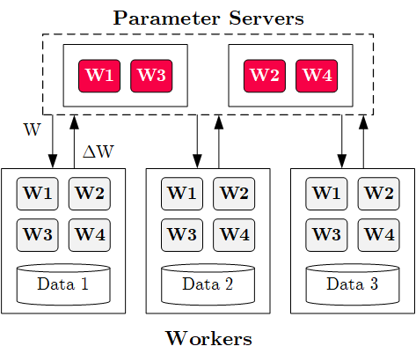




Execution Strategies
Batch Algorithms: Data and Task Parallel
  Data-parallel operations
  Different physical operators
Mini-Batch Algorithms: Parameter Server
  Data-parallel and model-parallel PS
  Update strategies (e.g.,
  async, sync, backup)
  Data partitioning strategies
  Federated ML (trend since 2018)
Lots of PS Decisions ➔ Acc/Perf-Tradeoff
  Configurations (#workers, batch size/param schedules, update type/freq)
  Transfer optimizations: lossy compression, sparsification, residual accumulation,
  gradient clipping, and momentum corrections
Apps
Lang
Faults
Exec
Data
HW

Slide 14
Fault Tolerance & Resilience
Resilience Problem
  Increasing error rates at scale (soft/hard mem/disk/net errors)
  Robustness for preemption
  Need cost-effective resilience
Fault Tolerance in Large-Scale Computation
  Block replication (min=1, max=3) in distributed file systems
  ECC; checksums for blocks, broadcast, shuffle
  Checkpointing (MapReduce: all task outputs; Spark/DL: on request)
  Lineage-based recomputation for recovery in Spark
ML-specific Schemes (exploit app characteristics)
  Estimate contribution from lost partition to avoid stragglers
  Example: user-defined “compensation” functions
Apps
Lang
Faults
Exec
Data
HW
[Bianca Schroeder, Eduardo Pinheiro, Wolf-Dietrich Weber: DRAM errors in the wild: a large-scale field study. SIGMETRICS 2009]
[Sebastian Schelter, Stephan Ewen, Kostas Tzoumas, Volker Markl: "All roads lead to Rome": optimistic recovery for distributed iterative data processing. CIKM 2013]

Slide 15
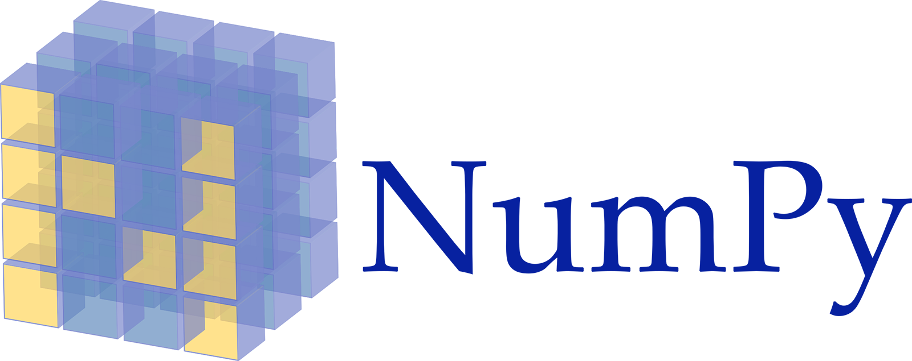

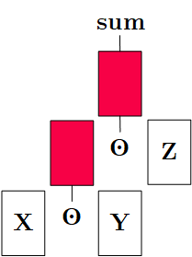
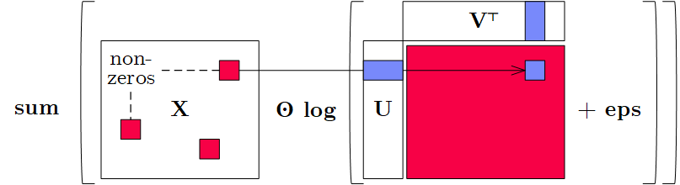
Language Abstractions
Optimization Scope
  #1 Eager Interpretation (debugging, no opt)
  #2 Lazy expression evaluation
  (some opt, avoid materialization)
  #3 Program compilation (full opt, difficult)
Optimization Objective
  Most common: min time s.t. memory constraints
  Multi-objective: min cost s.t. time, min time s.t. acc, max acc s.t. time
Trend: Fusion and Code Generation
  Custom fused operations
  Examples: SystemML, Weld, Taco,
  Julia, TF XLA,TVM, TensorRT
Apps
Lang
Faults
Exec
Data
HW
Sparsity-Exploiting Operator

Slide 16
ML Applications
ML Algorithms (cost/benefit – time vs acc)
  Unsupervised/supervised; batch/mini-batch; first/second-order ML
  Mini-batch DL: variety of NN architectures and SGD optimizers
Specialized Apps: Video Analytics in NoScope
  Difference detectors / specialized
  models for “short-circuit evaluation”
AutoML (time vs acc)
  Not algorithms but tasks (e.g., doClassify(X, y) + search space)
  Examples: MLBase, Auto-WEKA, TuPAQ, Auto-sklearn, Auto-WEKA 2.0
  AutoML services at Microsoft Azure, Amazon AWS, Google Cloud
Data Programming and Augmentation (acc?)
  Generate noisy labels for pre-training
  Exploit expert rules, simulation models, rotations/shifting,
  and labeling IDEs (Software 2.0)
Apps
Lang
Faults
[Credit: Daniel Kang‘17]
Exec
Data
HW
[Chris Thornton, Frank Hutter, et al: Auto-WEKA: combined selection and hyperparameter optimization of classification algorithms. KDD 2013]
[Credit: Jonathan Tremblay‘18]

Slide 17

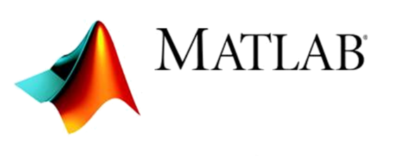



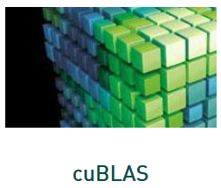



Landscape of ML Systems
including Classification of SystemML/SystemDS
#1 Language Abstraction
#2 Execution Strategies
Linear Algebra Programs
Parameter Server
(Modell-Parallel)
Computation Graphs
Task-Parallel Constructs
Algorithm Libraries
Data-Parallel Operations
Operator Libraries
Collections
Local (single node)
Graphs
Matrices
HW accelerators (GPUs, FPGAs, ASICs)
Tensors
Frames
Distributed
#4 Data Types
#3 Distribution

Slide 18
Distributed Linear Algebra

Slide 19
Linear Algebra Systems
Comparison Query Optimization
  Rule- and cost-based rewrites and operator ordering
  Physical operator selection and query compilation
  Linear algebra / other ML operators, DAGs, control flow, sparse/dense formats
#1 Interpretation (operation at-a-time)
  Examples: R, PyTorch, Morpheus [PVLDB’17]
#2 Lazy Expression Compilation (DAG at-a-time)
  Examples: RIOT [CIDR’09], TensorFlow [OSDI’16]
  Mahout Samsara [MLSystems’16]
  Examples w/ control structures: Weld [CIDR’17],
  OptiML [ICML’11], Emma [SIGMOD’15]
#3 Program Compilation (entire program)
  Examples: SystemML [PVLDB’16], Julia
  Cumulon [SIGMOD’13], Tupleware [PVLDB’15]
DB
PL
HPC
Compilers for Large-scale ML
Optimization Scope
1: X = read($1); # n x m matrix
2: y = read($2); # n x 1 vector
3: maxi = 50; lambda = 0.001;
4: intercept = $3;
5: ...
6: r = -(t(X) %*% y);
7: norm_r2 = sum(r * r); p = -r;
8: w = matrix(0, ncol(X), 1); i = 0;
9: while(i<maxi & norm_r2>norm_r2_trgt) 10: {
11: q = (t(X) %*% X %*% p)+lambda*p;
12: alpha = norm_r2 / sum(p * q);
13: w = w + alpha * p;
14: old_norm_r2 = norm_r2;
15: r = r + alpha * q;
16: norm_r2 = sum(r * r);
17: beta = norm_r2 / old_norm_r2;
18: p = -r + beta * p; i = i + 1;
19: }
20: write(w, $4, format="text");

Slide 20
[Dan Moldovan et al.: AutoGraph: Imperative-style Coding with Graph-based Performance. SysML 2019.]
Linear Algebra Systems, cont.
Note: TF 2.0
Some
Examples …
(1.x)
X = read("./X");
y = read("./y");
p = t(X) %*% y;
w = matrix(0,ncol(X),1);
while(...) {
q = t(X) %*% X %*% p;
...
}
var X = drmFromHDFS("./X")
val y = drmFromHDFS("./y")
var p = (X.t %*% y).collect
var w = dense(...)
X = X.par(256).checkpoint()
while(...) {
q = (X.t %*% X %*% p)
.collect
...
}
# read via queues
sess = tf.Session()
# ...
w = tf.Variable(tf.zeros(...,
dtype=tf.float64))
while ...:
v1 = tf.matrix_transpose(X)
v2 = tf.matmult(X, p)
v3 = tf.matmult(v1, v2)
q = sess.run(v3)
...
(Custom DSL
w/ R-like syntax;
program compilation)
(Embedded DSL in Scala;
lazy evaluation)
(Embedded DSL in Python;
lazy [and eager] evaluation)

Slide 21

ML Libraries / Model Zoos
#1 Fixed algorithm implementations
  Often on top of existing linear
  algebra or UDF abstractions
#2 Model Zoos / APIs
  Pre-trained models
  Hugging Face
  (https://huggingface.co/models)
  YOLOv2 – v7
  PyTorch/TensorFlow
  Model Zoos
SparkML/ MLlib
Single-node Example (Python)
from numpy import genfromtxt
from sklearn.linear_model \
import LinearRegression
X = genfromtxt('X.csv')
y = genfromtxt('y.csv')
reg = LinearRegression()
.fit(X, y)
out = reg.score(X, y)
Distributed Example (Spark Scala)
import org.apache.spark.ml
.regression.LinearRegression
val X = sc.read.csv('X.csv')
val y = sc.read.csv('y.csv')
val Xy = prepare(X, y).cache()
val reg = new LinearRegression()
.fit(Xy)
val out reg.transform(Xy)

Slide 22


DNN Frameworks
AMLS’23 Project:
Additional DNN Optimizers
High-level DNN Frameworks
  Language abstraction for DNN construction and model fitting
  Examples:
  Caffe, Keras
Low-level DNN Frameworks
  Examples: TensorFlow, MXNet, PyTorch, CNTK
model = Sequential()
model.add(Conv2D(32, (3, 3), padding='same',
input_shape=x_train.shape[1:]))
model.add(Activation('relu'))
model.add(Conv2D(32, (3, 3)))
model.add(Activation('relu'))
model.add(
MaxPooling2D(pool_size=(2, 2)))
model.add(Dropout(0.25))
...
opt = keras.optimizers.rmsprop(
lr=0.0001, decay=1e-6)
# Let's train the model using RMSprop
model.compile(loss='cat…_crossentropy',
optimizer=opt,
metrics=['accuracy'])
model.fit(x_train, y_train,
batch_size=batch_size,
epochs=epochs,
validation_data=(x_test, y_test),
shuffle=True)

Slide 23
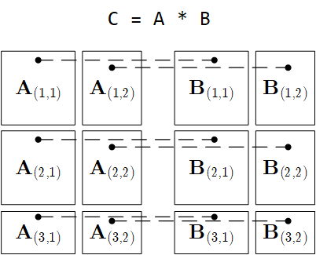
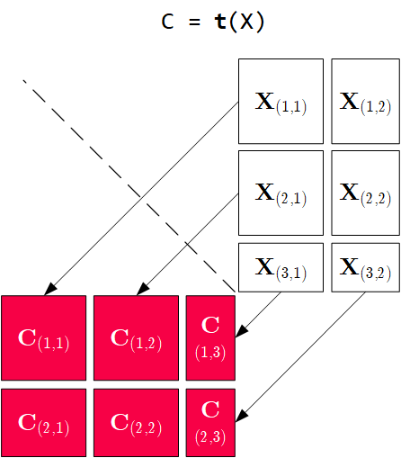
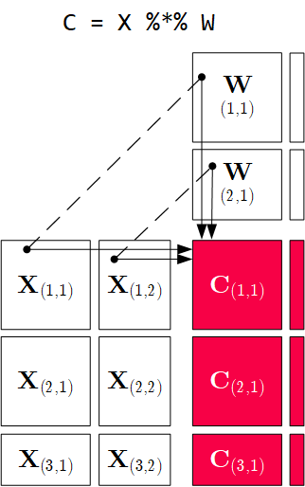
Distributed Matrix Operations
Elementwise Multiplication
(Hadamard Product)
Transposition
Matrix Multiplication
1:N / N:M joins
1:1 join
Note: also with row/column vector rhs

Slide 24
Physical Operator Selection
Common Selection Criteria
  Data and cluster characteristics (e.g., data size/shape, memory, parallelism)
  Matrix/operation properties (e.g., diagonal/symmetric, sparse-safe ops)
  Data flow properties (e.g., co-partitioning, co-location, data locality)
#0 Local Operators
  SystemML mm, tsmm, mmchain; Samsara/Mllib local
#1 Special Operators (special patterns/sparsity)
  SystemML tsmm, mapmmchain; Samsara AtA
#2 Broadcast-Based Operators (aka broadcast join)
  SystemML mapmm, mapmmchain
#3 Co-Partitioning-Based Operators (aka improved repartition join)
  SystemML zipmm; Emma, Samsara OpAtB
#4 Shuffle-Based Operators (aka repartition join)
  SystemML cpmm, rmm; Samsara OpAB
t(X) %*% (X%*%v)
1st
pass
v
2nd
pass
X
q┬
X

Slide 25
Physical Operator Selection – Example Matrix Multiplication, cont.
Examples
Distributed
MM Operators
Y
_{1,1}
Y_{1,1}
Y_{1,2}
Broadcast-based MM (mapmm)
Shuffle-based MM (cpmm)
Y
_{2,1}
Y_{2,1}
Y_{2,2}
X_{1,1}
X_{1,2}
Y_{3,1}
Y_{3,2}
X_{2,1}
X_{2,2}
Y_{4,1}
Y_{4,2}
X_{3,1}
X_{3,2}
X_{1,1}
X_{1,2}
X_{1,3}
X_{1,4}
X_{4,1}
X_{4,2}
X_{2,1}
X_{2,2}
X_{2,3}
X_{2,4}

Slide 26
Sparsity-Exploiting Operators
Goal: Avoid dense intermediates and unnecessary computation
#1 Fused Physical Operators
  E.g., SystemML [PVLDB’16]
  wsloss, wcemm, wdivmm
  Selective computation over
  non-zeros of “sparse driver”
#2 Masked Physical Operators
  E.g., Cumulon MaskMult [SIGMOD’13]
  Create mask of “sparse driver”
  Pass mask to single masked
  matrix multiply operator
sum(W * (X – U %*% t(V))^2)
^2
W
X
U V┬
sum
*
–
/
O / (C %*% E %*% t(B))
mm
C
mm
O
M
E
t(B)

Slide 27
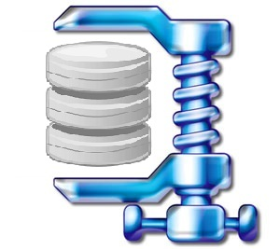
Overview Data Access Methods
Node1
Node2
#1 (Distributed) Caching
  Keep read only feature matrix in (distributed) memory
#2 Buffer Pool Management
  Graceful eviction of intermediates, out-of-core ops
#3 Scan Sharing (and operator fusion)
  Reduce the number of scans as well as read/writes
#4 NUMA-Aware Partitioning and Replication
  Matrix partitioning / replication → data locality
#5 Index Structures
  Out-of-core data, I/O-aware ops, updates
#6 Compression
  Fit larger datasets into available memory
Socket1
Socket2

Slide 28
Distributed Parameter Servers

Slide 29
Background: Mini-batch ML Algorithms
Mini-batch ML Algorithms
  Iterative ML algorithms, where each iteration
  only uses a batch of rows to make the next
  model update (in epochs or w/ sampling)
  For large and highly redundant training sets
  Applies to almost all iterative, model-based
  ML algorithms (LDA, reg., class., factor., DNN)
  Stochastic Gradient Descent (SGD)
Statistical vs Hardware Efficiency (batch size)
  Statistical efficiency: # accessed data points to achieve certain accuracy
  Hardware efficiency: number of independent computations to
  achieve high hardware utilization (parallelization at different levels)
  Beware higher variance / class skew for too small batches!
➔ Training Mini-batch ML algorithms sequentially is hard to scale
Data
Batch 1
W’
Batch 2
W’’
Epoch

Slide 30
Background: Mini-batch DNN Training (LeNet)
[Yann LeCun, Leon Bottou, Yoshua Bengio, and Patrick Haffner: Gradient-Based Learning Applied to Document Recognition, Proc of the IEEE 1998]
# Initialize W1-W4, b1-b4
# Initialize SGD w/ Nesterov momentum optimizer
iters = ceil(N / batch_size)
for( e in 1:epochs ) {
for( i in 1:iters ) {
X_batch = X[((i-1) * batch_size) %% N + 1:min(N, beg + batch_size - 1),]
y_batch = Y[((i-1) * batch_size) %% N + 1:min(N, beg + batch_size - 1),]
## layer 1: conv1 -> relu1 -> pool1
## layer 2: conv2 -> relu2 -> pool2
## layer 3: affine3 -> relu3 -> dropout
## layer 4: affine4 -> softmax
outa4 = affine::forward(outd3, W4, b4)
probs = softmax::forward(outa4)
## layer 4: affine4 <- softmax
douta4 = softmax::backward(dprobs, outa4)
[doutd3, dW4, db4] = affine::backward(douta4, outr3, W4, b4)
## layer 3: affine3 <- relu3 <- dropout
## layer 2: conv2 <- relu2 <- pool2
## layer 1: conv1 <- relu1 <- pool1
# Optimize with SGD w/ Nesterov momentum W1-W4, b1-b4
[W4, vW4] = sgd_nesterov::update(W4, dW4, lr, mu, vW4)
[b4, vb4] = sgd_nesterov::update(b4, db4, lr, mu, vb4)
}
}
NN Forward
Pass
NN Backward
Pass
→ Gradients
Model
Updates
Notes:
Note: number of layers = layer ops w/ weights

Slide 31
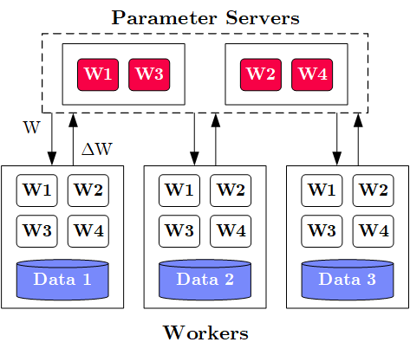
Overview Parameter Servers
M
System Architecture
  M Parameter Servers
  N Workers
  Optional Coordinator
Key Techniques
  Data partitioning D → workers Di
  (e.g., disjoint, reshuffling)
  Updated strategies
  (e.g., synchronous, asynchronous)
  Batch size strategies
  (small/large batches, hybrid methods)
W .. Model
ΔW .. Gradient
N
Notes:
Note: Nabla vs Delta operators

Slide 32
History of Parameter Servers
1st Gen: Key/Value
  Distributed key-value store for
  parameter exchange and synchronization
  Relatively high overhead
2nd Gen: Classic Parameter Servers
  Parameters as dense/sparse matrices
  Different update/consistency strategies
  Flexible configuration and fault tolerance
3rd Gen: Parameter Servers w/
improved data communication
  Prefetching and range-based pull/push
  Lossy or lossless compression w/ compensations
Examples
  TensorFlow, MXNet, PyTorch, CNTK, Petuum
[Alexander J. Smola, Shravan M. Narayanamurthy: An Architecture for Parallel Topic Models. PVLDB 2010]
[Jeffrey Dean et al.: Large Scale Distributed Deep Networks. NeurIPS 2012]
[Mu Li et al: Scaling Distributed Machine Learning with the Parameter Server. OSDI 2014]
[Jiawei Jiang, Bin Cui, Ce Zhang, Lele Yu: Heterogeneity-aware Distributed Parameter Servers. SIGMOD 2017]
[Jiawei Jiang et al: SketchML: Accelerating Distributed Machine Learning with Data Sketches. SIGMOD 2018]
Notes:
Note: PVLDB’2010 paper used Memcached for parameter exchange

Slide 33
Basic Worker Algorithm (batch)
for( i in 1:epochs ) {
for( j in 1:iterations ) {
params = pullModel(); # W1-W4, b1-b4 lr, mu
batch = getNextMiniBatch(data, j);
gradient = computeGradient(batch, params);
pushGradients(gradient);
}
}
[Jeffrey Dean et al.: Large Scale Distributed Deep Networks. NeurIPS 2012]

Slide 34
Extended Worker Algorithm (nfetch batches)
nfetch batches require
local gradient accrual and local model update
gradientAcc = matrix(0,...);
for( i in 1:epochs ) {
for( j in 1:iterations ) {
if( step mod nfetch = 0 )
params = pullModel();
batch = getNextMiniBatch(data, j);
gradient = computeGradient(batch, params);
gradientAcc += gradient; # parallel to updateModel
params = updateModel(params, gradients);
step++;
if( step mod nfetch = 0 ) {
pushGradients(gradientAcc); step = 0;
gradientAcc = matrix(0, ...);
}
} }
[Jeffrey Dean et al.: Large Scale Distributed Deep Networks. NeurIPS 2012]

Slide 35
Update Strategies
Bulk Synchronous Parallel (BSP)
  Update model w/
  accrued gradients
  Barrier for N workers
Asynchronous Parallel (ASP)
  Update model for each gradient
  No barrier
Synchronous w/ Backup Workers
  Update model w/
  accrued gradients
  Barrier for N of N+b workers
Batch 1
Batch 2
Batch 3
Batch 1
Batch 2
Batch 3
Batch 1
Batch 2
Batch 3
Batch 1
Batch 2
Batch 3
Batch 1
Batch 2
Batch 3
but, stale model updates
Batch 1
Batch 2
Batch 3
Batch 1
Batch 2
Batch 3
Batch 1
Batch 2
Batch 3
Batch 1
Batch 2
Batch 3
Batch 1
Batch 2
Batch 3
[Martín Abadi et al: TensorFlow: A System for Large-Scale Machine Learning. OSDI 2016]
Batch 1
Batch 2
Batch 3
Batch 1
Batch 2
Batch 3

Slide 36


Federated Learning – Problem Setting and Overview
Motivation Federated ML
  Learn model w/o central data consolidation
  Privacy + data/power caps vs personalization and sharing
  Applications Characteristics
    #1 On-device data more relevant than server-side data
    #2 On-device data is privacy-sensitive or large
    #3 Labels can be inferred naturally from user interaction
  Example: Language modeling for mobile keyboards and voice recognition
Challenges
  Massively distributed (data stored across many devices)
  Limited and unreliable communication
  Unbalanced data (skew in data size, non-IID )
  Unreliable compute nodes / data availability
W
ΔW
[Jakub Konečný: Federated Learning - Privacy-Preserving Collaborative Machine Learning without Centralized Training Data, UW Seminar 2018]

Slide 37
Federated Learning – A Federated ML Training Algorithm
while( !converged ) {
1. Select random subset (e.g. 1000)
of the (online) clients
2. In parallel, send current parameters θ_{t}
to those clients
2a. Receive parameters θ_{t} from server [pull]
2b. Run some number of minibatch SGD steps,
producing θ’
2c. Return θ’-θ_{t} (model averaging) [push]
3. θ_{t+1} = θ_{t} + data-weighted average of client updates
}
[Brendan McMahan, Eider Moore, Daniel Ramage, Seth Hampson, Blaise Agüera y Arcas: Communication-Efficient Learning of Deep Networks from Decentralized Data. AISTATS 2017]
At each client

Slide 38
Example DIA Exams (90min for 100/100 points)
https://mboehm7.github.io/teaching/ws2021_dia/ExamDIA_v1.pdf
https://mboehm7.github.io/teaching/ws2122_dia/ExamDIA_v1.pdf
https://mboehm7.github.io/teaching/ws2324_dia/ExamDIA_v1.pdf
No Lecture Materials or Mobile Devices
Data Integration and Large-scale Analysis (DIA)
14 Q&A and Exam Preparation [continues at 6pm]
Prof. Dr. Matthias Boehm
Technische Universität Berlin
Berlin Institute for the Foundations of Learning and Data
Big Data Engineering (DAMS Lab)
Last update: Jan 19, 2025

Slide 39
Task 1: Entity Resolution
16/100
a) Explain the phases of a typical entity resolution pipeline and discuss example techniques
for the individual phases. [16/100 points]
Prepare Data
Blocking/Sorting
Matching
Clustering
A2
A2
A
r1, r4
A1
C1
D1
A1
A1
A2
B1
B2
C2
C1
C2
C
r2, r7
C1
C2
B3
D1
D1
D
r3
B1
B2
B1
B2
r5, r6, r8
B3
B3
B
Notes:
Step 1: data cleaning, normalization, schema mapping
Step 2: blocking via blocking keys, sorting + window, blocking via ML / LSH
Step 3: similarity+threshold, ML via classification
Step 4: connected components, correlation/Markov clustering

Slide 40
Task 1: Entity Resolution, cont.
20/100
b) Assume two publication datasets A and B that need deduplication.
Explain the following two categories of schema matching techniques. [4/100 points]
Schema-based Matching:
  Find similarities among (groups of) attributes of S1 and S2
  Examples: match paper title and author attributes
  based on attribute similarity
Instance-based Matching:
  Find similarities among (groups of) attributes of S1 and S2,
  with the help of instance data in S1 and S2
  Examples: match paper titles and author attributes
  based on term frequencies, string similarity of example papers
  (e.g., after capitalization of words, splitting of author lists)

Slide 41
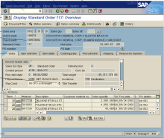
Task 2: Data Warehousing
25/100
a) Describe the system architecture of a data warehouse, name its components, and briefly describe
their purpose. [5/100 points]
Data Mart 1
Data Mart 2
Data Mart 3
Analysis-centric independent subsets
(e.g., geo, org, functional)
subject-oriented, integrated, time-varying, non-volatile collection of data
Data Warehouse
(consolidated raw data, aggregates, metadata)
Materialized, non-volatile integration
Async replication,
and ETL vs ELT
Staging Area
Operational source
systems
S₁
S₃
S₄
S₂

Slide 42
Task 2: Data Warehousing, cont.
30/100
b) Given below entity relationship (ER) diagram, create the corresponding star and snowflake schemas. Data types can be ignored, but indicate primary and foreign key constraints. [5+5/100 points]
Star
Schema
Users
UID
Name
City
Country
Movies
MID
Name
Length
Genre
Ratings
MID
UID
DID
Score
Dates
DID
Day
Month
Year

Slide 43
Task 2: Data Warehousing, cont.
35/100
Snowflake
Schema
Cities
City
Country
Users
UID
Name
City
Movies
MID
Name
Length
GID
Ratings
MID
UID
DID
Score
Months
Month
Year
Genre
GID
GName
Dates
DID
Day
Month
Years
Year

Slide 44
Task 3: Data Cleaning
44/100
a) In the context of missing value imputation, describe the following
types of missing data. [9/100 points]
Missing Completely at Random (MCAR):
  Missing values are randomly distributed across all records
Missing at Random (MAR):
  Missing values are randomly distributed within one
  or more sub-groups of records
  Missing values depend on the recorded but not
  on the missing values, and can be recovered
Not Missing at Random (NMAR):
  Missing data depends on the missing values themselves
  E.g., missing low salary, age, weight, etc.
ID | Position | Salary ($)
1 | Manager | null
2 | Secretary | 2200
3 | Manager | 3600
4 | Technician | null
5 | Technician | 2500
6 | Secretary | null
(3500)
(2400)
(2000)
ID | Position | Salary ($)
1 | Manager | 3500
2 | Secretary | 2200
3 | Manager | 3600
4 | Technician | null
5 | Technician | 2500
6 | Secretary | 2000
ID | Position | Salary ($)
1 | Manager | 3500
2 | Secretary | null
3 | Manager | 3600
4 | Technician | 2500
5 | Technician | 2500
6 | Secretary | null

Slide 45
Task 3: Data Cleaning, cont.
49/100
b) Given the data below, name two techniques for missing value imputation
(1x MCAR, 1x MAR), and impute the values. [5/100 points]
  MCAR: mean imputation
  (4500+2000+4000+2500)/4 = 3250
  MAR: linear regression, functional dependencies
  (Age * 100) = 5000 and 3500

Slide 46
Task 3: Data Cleaning, cont.
55/100
c) Explain the difference between Outlier Detection and Anomaly Detection,
with at least one example strategy for each. [6/100 points]
Outlier Detection
  Remove likely incorrect values from data analysis
  Classification, clustering, pattern recognition (e.g., outlierByIQR)
Anomaly Detection
  Find rare / anomalous data points / subsequences
  Classification / max k-nearest neighbor (e.g., matrix profile)
Q1
median
Q3
Q1 – 1.5 * IQR
IQR
Q3 + 1.5 * IQR
Outlier

Slide 47
Task 4: Data Provenance
60/100
a) Explain the general goal and concept of data provenance, and
distinguish why-provenance and how-provenance. [5/100 points]
Data Provenance:
  Track and understand data origins and transformations of data (where?, when?, who?, why?, how?)
  Information about the origin and creation process of data
Why-Provenance:
  Which input tuples contributed to an output tuple t in query Q
  Representation: Set of witnesses w for tuple t
How-Provenance:
  How tuples where combined in the computation of an output
  Representation: provenance polynomials

Slide 48
Task 4: Data Provenance, cont.
63/100
b) Given below tables R and S (w/ tuples r_{i} and s_{i}), query Q and the results O,
specify the provenance polynomials for tuples in O. [3/100 points]
A: r1 x s1 + r3 x s1 + r2 x s3
(equivalent: (r1 + r3) x s1 + r2 x s3)
B: r2 x s2
C: r2 x s4

Slide 49
Task 5: Cloud Computing
67/100
a) Explain the motivation of cloud computing in terms of overall goal,
key drivers, and advantages. [4/100 points]
Argument #1: Pay as you go
  No upfront cost for infrastructure
  Variable utilization ➔ over-provisioning
  Pay per use or acquired resources
Argument #2: Economies of Scale
  Purchasing and managing IT infrastructure at scale ➔ lower cost
  (applies to both HW resources and IT infrastructure/system experts)
  Focus on scale-out on commodity HW over scale-up ➔ lower cost
Argument #3: Elasticity
  Assuming perfect scalability, work done in constant time * resources
  Given virtually unlimited resources allows to reduce time as necessary
“Computing as utility”
100%
Utili-zation
Time

Slide 50
Task 5: Cloud Computing, cont.
70/100
b) Explain the concept of resource allocation for multiple resources such as CPU and memory (dominant resource calculation in YARN). [3/100 points]
Multi-Metric Scheduling
  Multiple metrics: dominant resource calculator
  All constraints of relevant metrics must be respected
  Focus on bottleneck
  resource during scheduling
12/48GB
8GB
2
32GB
6/8GB
1/32GB
2/8GB
1
6
8GB

Slide 51
Task 6: Distributed, Data-parallel Computation
90/100
Given a distributed dataset (left), describe a data-parallel approach of imputing the missing values (NULL) of Attr1 with its mode, and Attr2 with its mean. Describe strategies for improving the performance. Finally, fill in the concrete imputed values (right). [12+5+3/100 points]
1: data-parallel group-by [Attr1,count]
→ (X:5),(Y,3),(Z,1)
2: data-parallel sum(Attr2)
→ 37
3: data-parallel count(Attr2)
→ 10
4: Apply mode and mean to input data
with shuffling
X
3.7
Performance Improvements:
Pre-aggregation/combine (groupByKey → reduceByKey)
Caching for multi-pass computation
Fusion of passes 1-3 with multiple outputs
X
3.7
X

Slide 52
Task 7: Stream Processing
94/100
Assume an input stream S with schema S(A,T) (where T is event time, and A is an integer column) and a continuous query Q with stream window aggregation. Compute the maximum output stream rate (tuples/second) for the following windows. [4/100 points]
Tumbling Window
(size 200ms):
Sliding Window
(size 500ms, step 100ms):
Max 200 tuples/s
Max 3 tuples/window
→ 15 Tuples/s
→ 30 Tuples/s

Slide 53
Task 7: Stream Processing, cont.
100/100
b) Explain the following three techniques for handling overload situations
in stream processing engines? [6/100 points]
#1 Back Pressure
  Graceful handling of overload w/o data loss
  Slow down sources
  E.g., blocking queues
#2 Load Shedding
  #1 Random-sampling-based load shedding
  #2 Relevance-based load shedding
  #3 Summary-based load shedding (synopses)
#3 Distributed Stream Processing
  Data flow partitioning (distribute the query)
  Key range partitioning (distribute the data stream
A
B
C
3ms
9ms
2ms
Self-adjusting operator scheduling
Pipeline runs at rate of slowest op

Slide 54
Summary and Q&A
Landscape of ML Systems
Distributed Linear Algebra
Distributed Parameter Servers
Q&A and Exam Preparation
#1 Project/Exercise Submission
  Create pull-request or submit exercises by Jan 30 EOD
#2 Exam Registration
  Feb 06, 4pm, Feb 13, 4pm (start 4.15pm, end 5.45pm, 24 seats per exam)
  Mar 26, 9.30am (start 9.45pm, end 11.15pm, 104 seats)
Thanks

