Slide 1

Programmierpraktikum: Datensysteme
01 Kickoff and Introduction
Prof. Dr. Matthias Boehm
Technische Universität Berlin
Berlin Institute for the Foundations of Learning and Data
Big Data Engineering (DAMS Lab)
Last update: Oct 13, 2024

Slide 2
Agenda
Course Organization
Background Data Management
#1 Disk-based B-Trees (DAMS)
#2 Duplicate Detection (D2IP)
#3 Provenance Tracking in ML Pipelines (DEEM)
Course Selection/Enrolment

Slide 3
Course Organization

Slide 4
Basic Course Organization
Language
  Lectures and slides: English (German if preferred)
  Communication and presentations: English/German
  Informal language (first name is fine)
  Offline Q&A in forum, answered by teaching assistants
Course Format
  6 ECTS (4 SWS) bachelor computer science / information systems
  Every-other-week lectures (Mon 4.15pm sharp, including Q&A), attendance optional
Prerequisites
  Basic programming skills in languages such as C, C++, Java, Rust, etc
  Basic understanding of data management SQL / RA (or willingness to fill gaps)

Slide 5

Course Goals and Structure
Objectives
  Apply basic programming skills to more complex problem (in self-organized team work)
  Technical focus on data management and data systems
  Holistic programming projects: prototyping, design, versioning, tests, experiments, benchmarks
Grading: Pass/Fail
  Project Implementation (project source code) [45%]
  Component and Functional Tests (test source code) [10%]
  Runtime Experiments (achieve performance target) [15%]
  Documentation (design document up to 5 pages / code documentation) [15%]
  Result Presentation (10min talk) [15%]
Academic Honesty / No Plagiarism (incl LLMs like ChatGPT)

Slide 6
Sub-Course Offerings
#1 Disk-based B-Trees
  Capacity: 48/80
  Organized by DAMS group
  Focus on index structures
  Lectures every-other-week in H 0111
#2 Duplicate Detection
  Capacity: 16/80
  Organized by D2IP group
  Focus on entity resolution
#2 Provenance Tracking in ML Pipelines
  Capacity: 16/80
  Organized by D2IP group
  Focus on entity resolution
➔ Admitted Students:
  5 + 48 on ISIS (incl duplicates)
  Total registrations: up to 80
  → 20 teams, 4 students each

Slide 7
Background Data Management

Slide 8

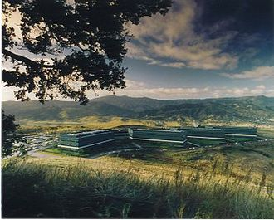
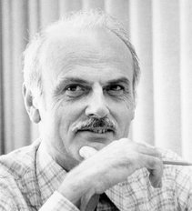
SQL Standard
(SQL-86)
Oracle, IBM DB2, Informix, Sybase → MS SQL
History 1970/1980s
Relational Database Systems
SEQUEL
QUEL
System R @ IBM Research – Almaden
(Jim Gray et al.,
Turing Award ‘98)
Ingres @ UC Berkeley (Stonebraker et al.,
Turing Award ‘14)
Tuple Calculus
Relational Algebra
Relational Model
Edgar F. “Ted” Codd @ IBM
Research (Turing Award ‘81)
Goal: Data Independence
(physical data independence)
  Ordering Dependence
  Indexing Dependence
  Access Path Dependence
[E. F. Codd: A Relational Model of Data for Large Shared Data Banks.
Comm. ACM 13(6), 1970]

Slide 9
Success of SQL / Relational Model
#1 Declarative: what not how
#2 Flexibility:
closure property → composability
Query:
SELECT O_OID, sum(L_Price)
FROM Orders, Lineitem, Customer
WHERE O_OID = L_OID AND O_CID = C_CID
AND O_Odate >= ‘2018-11-14’
AND C_Msegment = ‘AUTOMOBILE’
GROUP BY O_OID
Logical Query Plans
C(P)=1.32M
C(P)=2.2G
C(P)=0.34M
Physical Query Plan
Γ
sum(Price)
Hash
GrpJoin
Γ
Γ
0.001
σ
>=2018-11-14
⋈
⋈
#4 Physical Data
Independence
0.2
σ
Hash
Join
TScan L
⋈
L
⋈
σ
AUTOMOBILE
⋈
σ
σ
σ
L
C
σ
⋈
10K
IXScan
O
C
O
C
O
Date
TScan C
O
1G
L
#3 Automatic Optimization
100M

Slide 10
#1 Disk-based B-Trees (DAMS)

Slide 11





About Me
Since 09/2022 TU Berlin, Germany
  University professor for Big Data Engineering (DAMS)
2018-2022 TU Graz, Austria
  BMK endowed chair for data management + research area manager
  Data management for data science (DAMS), SystemDS & DAPHNE
2012-2018 IBM Research – Almaden, CA, USA
  Declarative large-scale machine learning
  Optimizer and runtime of Apache SystemML
2007-2011 PhD TU Dresden, Germany
  Cost-based optimization of integration flows
  Time series forecasting / in-memory indexing & query processing
DB group

Slide 12



Additional Course Logistics
Staff
  Lecturer: Prof. Dr. Matthias Boehm
  Teaching Assistants: Christina Dionysio, Ramon Schöndorf
Next Dates/Lectures
  Oct 21: Course Selection; team preferences, otherwise assignment
  Oct 28: Background Index Structures
  Nov 11: Background Buffer Pool
  Nov 28: Background Transaction Processing
  Dec 12: Experiments and Reproducibility
  Jan 27: Project submissions (performance target: 20K transactions/second)
  Feb 03: Project presentations (10min per team, mandatory attendance)
Infrastructure
  Setup your own private Github/Gitlab repository
Each teams gets a mentor
Q&A sessions on demand

Slide 13
User 2
Overview Database (Transaction) Log
User 3
User 1
DBMS
Database Architecture
  Page-oriented storage on disk and in memory (DB buffer)
  Dedicated eviction algorithms
  Modified in-memory pages marked as
  dirty, flushed by cleaner thread
  Log: append-only TX changes
  Data/log often placed on different devices
  and periodically archived (backup + truncate)
Write-Ahead Logging (WAL)
  The log records of changes to some (dirty) data page must be
  on stable storage before the data page (UNDO - atomicity)
  Force-log on commit or full buffer (REDO - durability)
  Recovery: forward (REDO) and backward (UNDO) processing
  Log sequence number (LSN)
DB Buffer
Log Buffer
P7
P3’
P1
P7
P3
Data
Log
[C. Mohan, Donald J. Haderle, Bruce G. Lindsay, Hamid Pirahesh, Peter M. Schwarz: ARIES: A Transaction Recovery Method Supporting Fine-Granularity Locking and Partial Rollbacks Using Write-Ahead Logging. TODS 1992]

Slide 14
B-Tree Overview
History B-Tree
  Bayer and McCreight 1972, Block-based, Balanced, Boeing Labs
  Multiway tree (node size = page size); designed for DBMS
  Extensions: B+-Tree/B*-Tree (data only in leafs, double-linked leaf nodes)
Definition B-Tree (k, h)
  All paths from root to leafs have equal length h
  All nodes (except root) have [k, 2k] key entries
  All nodes (except root, leafs) have [k+1, 2k+1] successors
  Data is a record or a reference to the record (RID)
[Rudolf Bayer, Edward M. McCreight: Organization and Maintenance of Large Ordered Indices. Acta Inf. (1) 1972]
All nodes adhere to max constraints
P₀
Key K₁
Data D₁
P₁
Key K₂
Data D₂
P₂
Key K₃
Data D₃
P₃
Key K₄
Data D₄
P₄
k=2
Subtree w/
keys ≤ K₁
Subtree w/
K₂ < keys ≤ K₃
pointers are page IDs

Slide 15
B-Tree Overview – Search
25
Example B-Tree k=2
  Get 38 → D38
  Get 20 → D20
  Get 6 → NULL
Lookup Q_{K} within a node
  Scan / binary search keys for Q_{K}, if K_{i}=Q_{K}, return D_{i}
  If node does not contain key
    If leaf node, abort search w/ NULL (not found), otherwise
    Decent into subtree Pi with K_{i} < Q_{K} ≤ K_{i+1}
Range Scan Q_{L<K<U}
  Lookup Q_{L} and call next K while K<Q_{U} (keep current position and node stack)
10
20
30
40
2
5
7
8
41
42
45
46
13
14
15
18
32
35
38
22
24
26
27
28

Slide 16
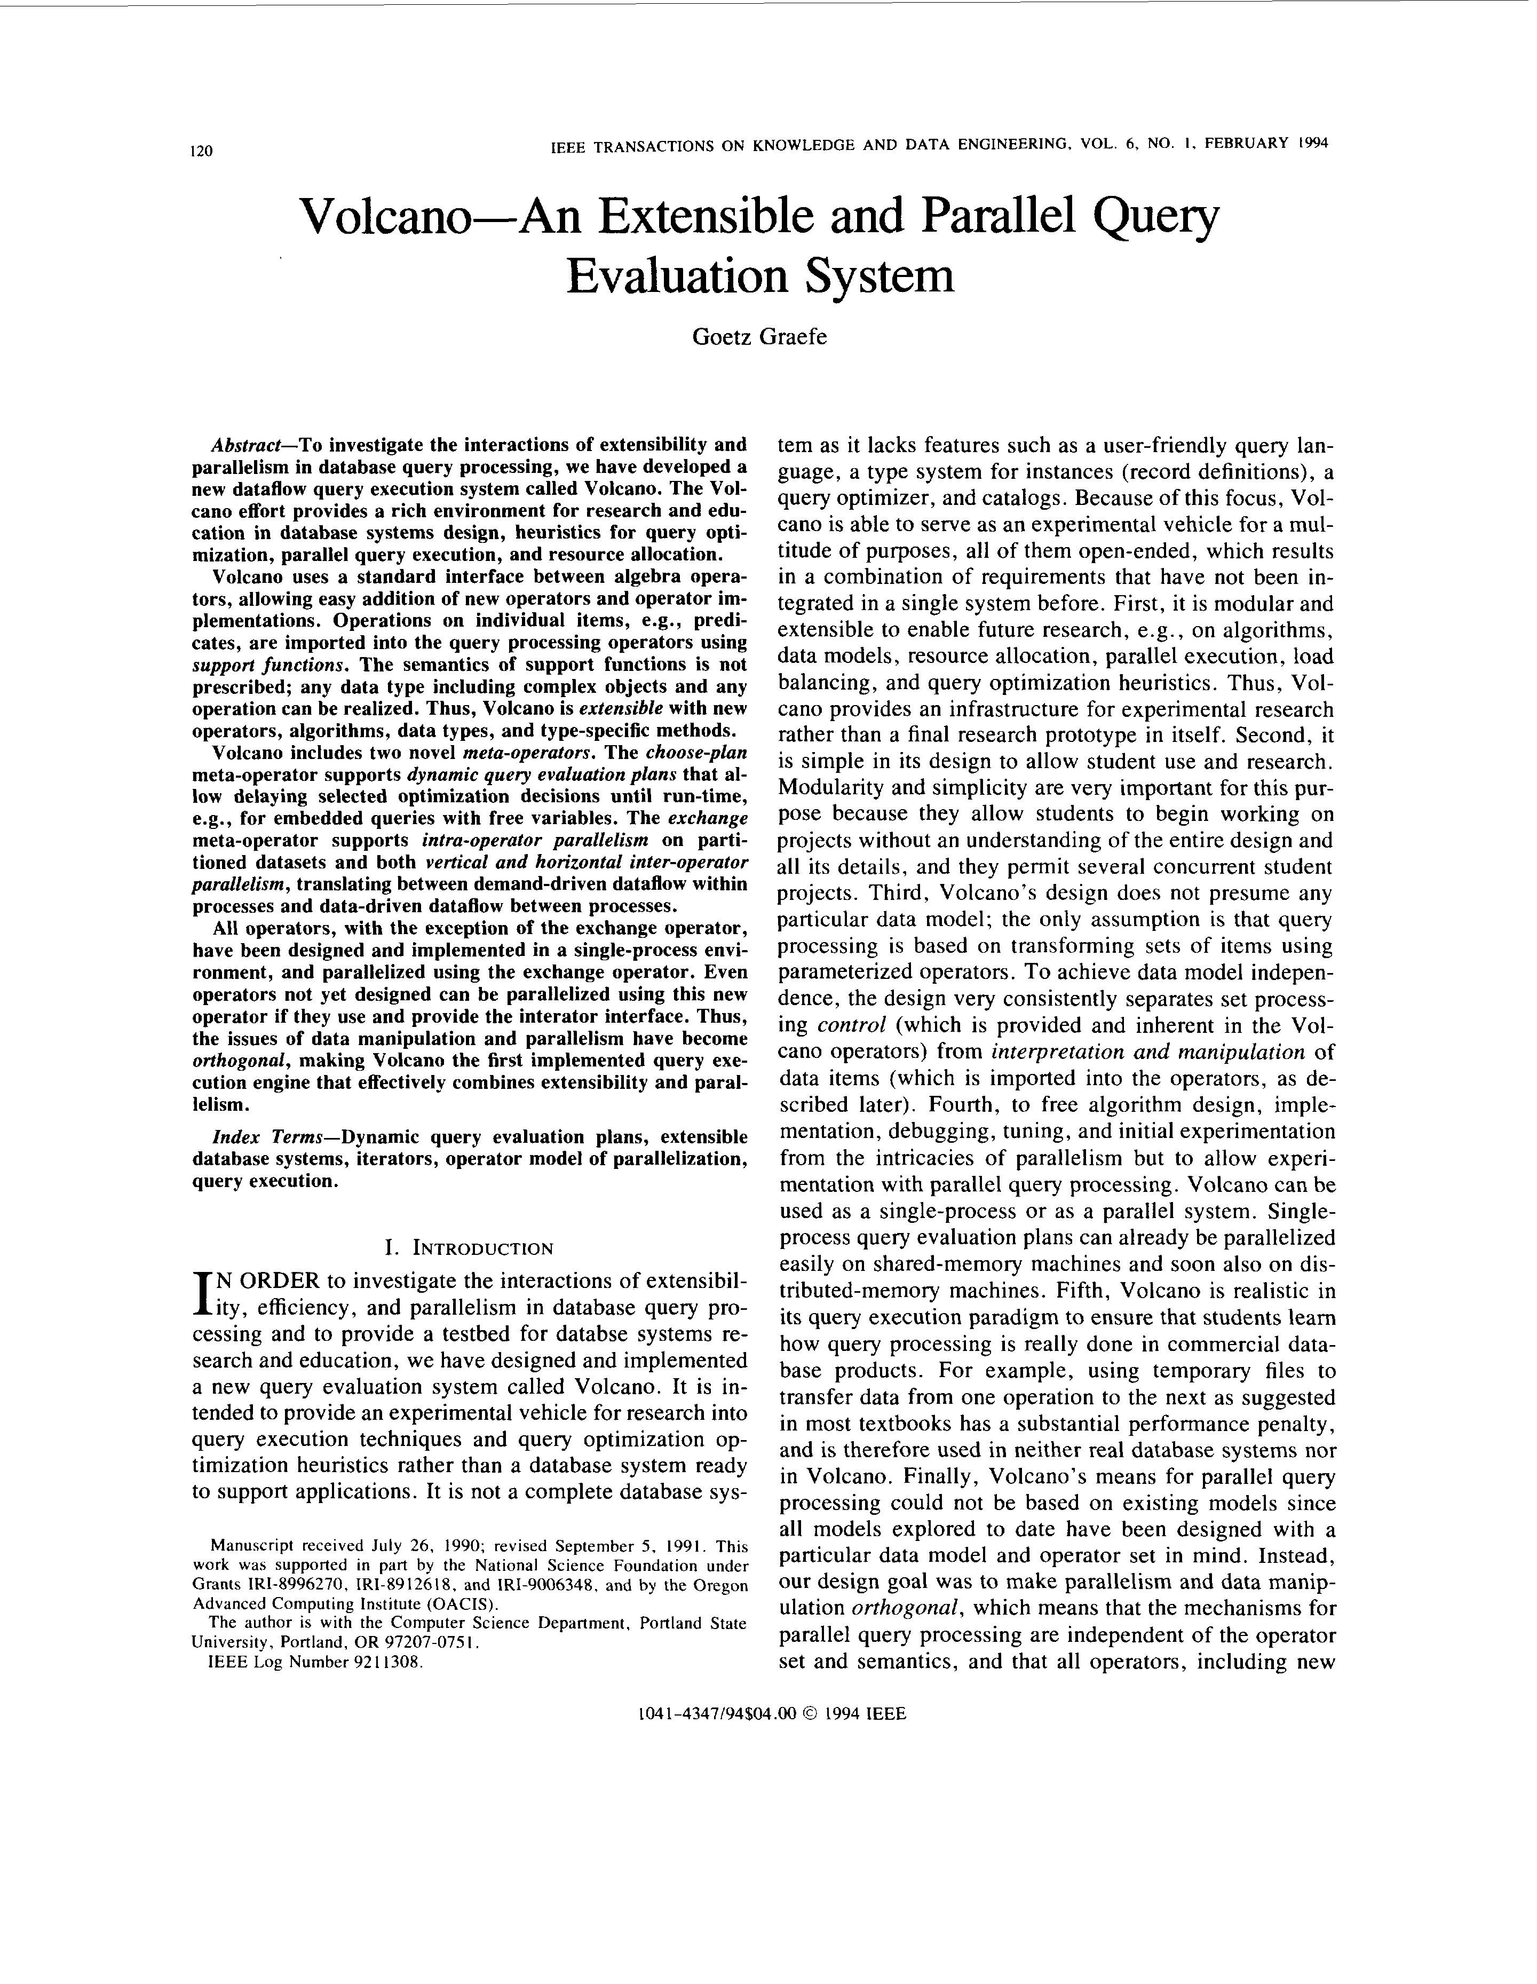
[Goetz Graefe: Volcano - An Extensible and Parallel Query Evaluation System. IEEE Trans. Knowl. Data Eng. 1994]
Query Processing – Iterator Model
Scalable (small memory)
High CPI measures
Volcano Iterator Model
  Open-Next-Close (ONC) interface
  Query execution from root node (pull-based) → Pipelined
Example
σ_{A=7}(R)
Blocking Operators
  Sorting, grouping/aggregation, build-phase of (simple) hash joins
void open() { R.open(); }
void close() { R.close(); }
Record next() {
while( (r = R.next()) != EOF )
if( p(r) ) //A==7
return r;
return EOF;
}
open()
next()
next()
→ EOF
close()
open()
σ_{A=7}
next()
next()
→ EOF
close()
open()
R
next()
next()
next()
next()
→ EOF
close()
PostgreSQL: Init(),
GetNext(), ReScan(), MarkPos(), RestorePos(), End()

Slide 17

Overview Programming Project
Team
  4 person teams (self-organized team work, but everybody needs to contribute)
Task: SIGMOD’09
Programming Contest
  Transactional, in-memory index for
  VARCHAR128, INT32, INT64 w/ duplicates
  C test / performance suites, multi-threaded concurrent operations
  Programming language: C or C++ recommended, Java or Rust
  WiSe 23/24: in-memory indexing w/ perf target 400K TXN/second
  WiSe 24/25: disk-based b-tree w/ perf target 20K TXN/second
  no VARCHAR and fixed payload length
Example Speedtest Output:
Creating 100 indices
Populating indices 100
Time to populate: 29ms
Testing the indices
Time to test: 1106ms
Testing complete.
NUM_DEADLOCK: 0
NUM_TXN_FAIL: 0
NUM_TXN_COMP: 1,600,000
Overall time to run: 1135ms

Slide 18
API Summary
Create a functional implementation of the provided application programming interface (API) that ensures result correctness and high performance for different data types and characteristics
API
Functions
server.h
// Index Handling
ErrCode create(KeyType type, char *name, size_t pageSize);
ErrCode drop(char *name);
ErrCode openIndex(const char *name, IdxState **idxState);
ErrCode closeIndex(IdxState *idxState);
// Transaction Handling
ErrCode beginTransaction(TxnState **txn);
ErrCode abortTransaction(TxnState *txn);
ErrCode commitTransaction(TxnState *txn); //guarantee durability!
// Read and Write Operations
ErrCode get(IdxState *idxState, TxnState *txn, Record *record);
ErrCode getNext(IdxState *idxState, TxnState *txn, Record *record);
ErrCode insertRecord(IdxState *idxState, TxnState *txn, Key *k, const char* payload);
ErrCode deleteRecord(IdxState *idxState, TxnState *txn, Record *record);

Slide 19
#2 Duplicate Detection (D2IP)

Slide 20
#3 Provenance Tracking in ML Pipelines (DEEM)

Slide 21
Course Selection/Enrolment

Slide 22
Select Your Course
#1 Disk-based B-Trees (DAMS)
  Capacity: 48/80
#2 Duplicate Detection (D2IP)
  Capacity: 16/80
#3 Provenance Tracking in ML Pipeline (DEEM)
  Capacity: 16/80
https://forms.gle/HFvzPCHHpcyZis8KA

Slide 23
Summary & QA
Thanks
Course Organization
Background Data Management
#1 Disk-based B-Trees (DAMS)
#2 Duplicate Detection (D2IP)
#3 Provenance Tracking in ML Pipelines (DEEM)
Course Selection/Enrolment by Oct 21 EOD
https://forms.gle/HFvzPCHHpcyZis8KA

