Slide 1

Data Integration and Large-scale Analysis (DIA) 01 Introduction and Overview
Prof. Dr. Matthias Boehm
Technische Universität Berlin
Berlin Institute for the Foundations of Learning and Data
Big Data Engineering (DAMS Lab)
Last update: Oct 16, 2025

Slide 2





FG Big Data Engineering (DAMS Lab) – About Me
Since 09/2022 TU Berlin, Germany
University professor for Big Data Engineering (DAMS)
2018-2022 TU Graz, Austria
BMK endowed chair for data management + research area manager
Data management for data science (DAMS), SystemDS & DAPHNE
2012-2018 IBM Research – Almaden, CA, USA
Declarative large-scale machine learning
Optimizer and runtime of Apache SystemML
2007-2011 PhD TU Dresden, Germany
Cost-based optimization of integration flows
Time series forecasting / in-memory indexing & query processing
DB group

Slide 3
FG Big Data Engineering (DAMS Lab) – Teaching
Architecture of Database Systems (ADBS, WS)
DB system internals + prog. project
Architecture of ML Systems (AMLS, SoSe)
ML system internals, data science lifecycle + prog. project
Architecture of ML Systems (AMLS, SS)
SE Joint ML and DM (MLDM, SoSe+WiSe)
Master
Data Integration and Large-Scale Analysis (DIA, WS)
SE/PR Large-scale Data Engineering (LDE, SoSe+WiSe)
Data Integration and Large-Scale Analysis (DIA, WiSe)
Distributed Data Management
Bachelor
Intro to Scientific Methods (WS)
Data Management / Databases (DM, SS+WS)
Data management from user/application perspective
PP Prog.-Practicals Data Systems (PPDS, SoSe+WiSe)

Slide 4


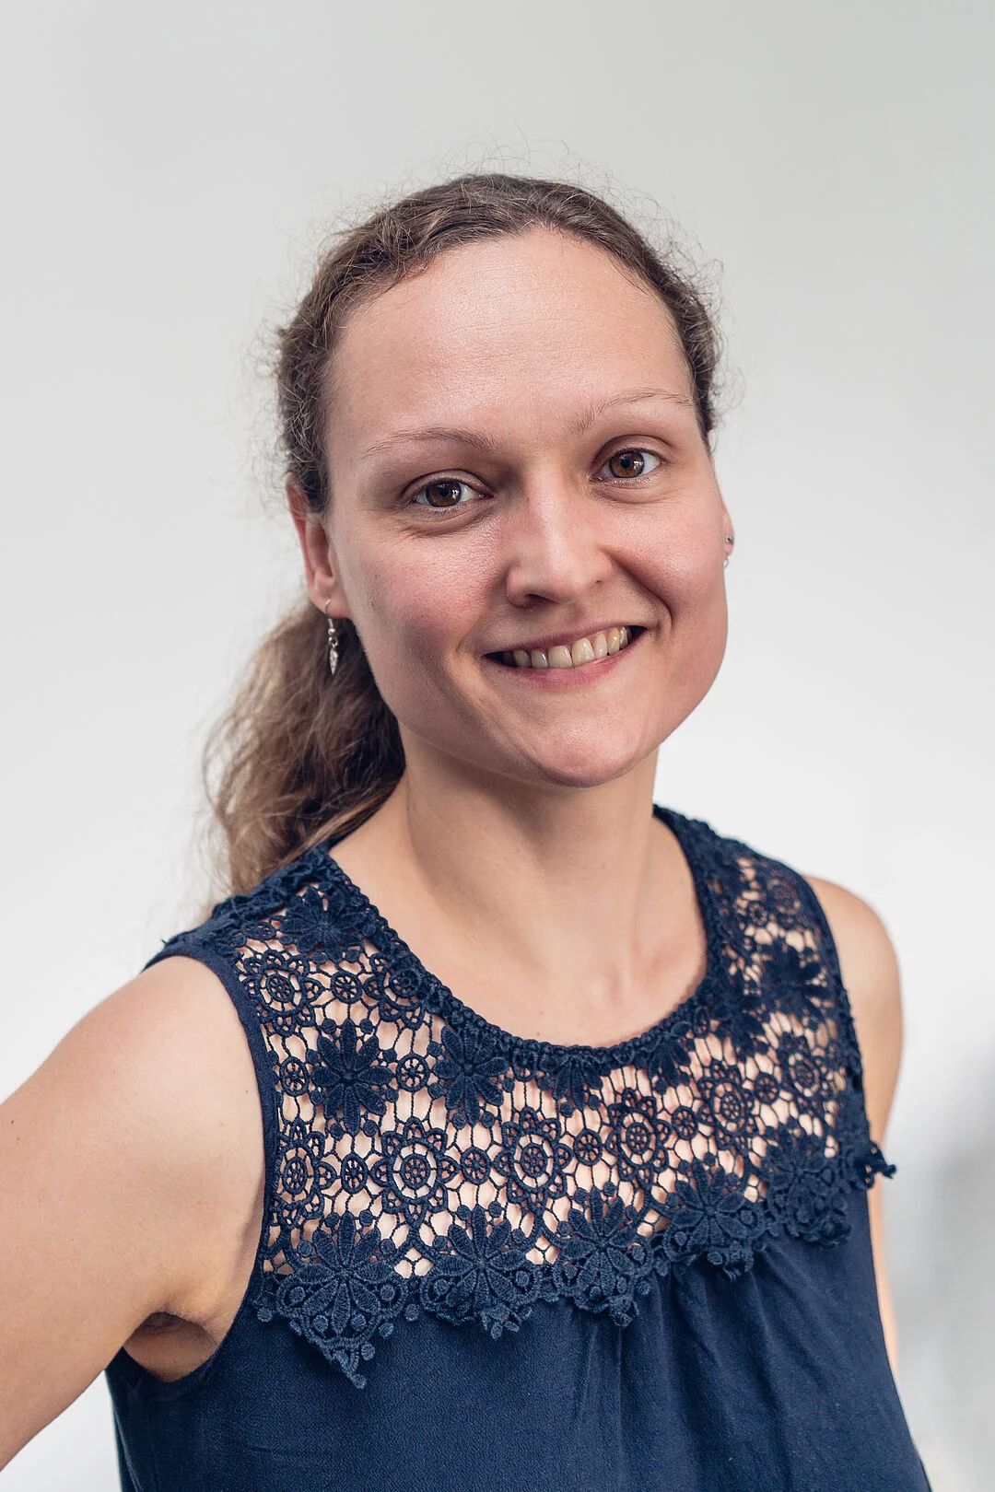

Faculty IV - Team Awareness and Antidiscrimination
https://www.tu.berlin/eecs/awan
Goal
Low-barrier approachability for spectrum of awareness and antidiscrimination issues
Team
Irene Hube-Achter (MTSV)
Matthias Boehm (professors)
Nadine Karsten (scientific personnel)
Tom Hersperger (students)
Mission Statement
Account for heterogeneity and complexity of modern societies at TU Berlin
All employees and students are committed to
#1 Treat all persons with fairness and respect
#2 Ensure a safe environment for all
#3 Comply with our duty of care towards others
#4 Actively support the implementation of the above guidelines and contribute
Contact: private email,
eecs-TB-awareness@win.tu-berlin.de, or AwAn@dams.tu-berlin.de

Slide 5
Agenda
Course Organization
Course Motivation and Goals
Course Outline and Projects/Exercise
Excursus: Apache SystemDS

Slide 6
Course Organization

Slide 7
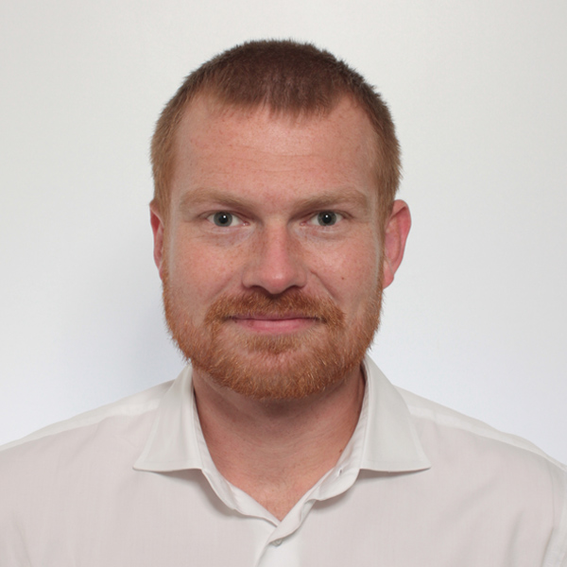
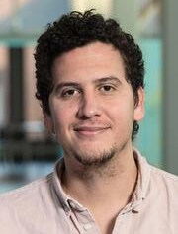
Course Logistics
Staff
Lecturer: Prof. Dr. Matthias Boehm, DAMS
Teaching Assistant: Carlos E. Muniz Cuza, DAMS
Language
Lectures and slides: English
Communication and examination: English/German
Course Format
VL/UE 3/2 SWS, 6 ECTS (3 ECTS + 3 ECTS), bachelor/master; no capacity restrictions
Weekly lectures (Thu 4.15pm sharp, in-person & zoom livestreaming/recording), optional attendance
Mandatory exercises or programming project (3 ECTS), office hour Wed 5pm-6pm (sharp)
Recommended papers for additional reading on your own
Prerequisites
Basic understanding of SQL / RA (or willingness to fill gaps)
Basic programming skills (Python, R, Java, C++)
279 Reg (as of Oct 16)

Slide 8


Course Logistics, cont.
Website / ISIS Course / Zoom
https://mboehm7.github.io/teaching/ws2526_dia/index.htm (public)
https://isis.tu-berlin.de/course/view.php?id=44995 (TUB-internal)
https://tu-berlin.zoom.us/j/9529634787?pwd=R1ZsN1M3SC9BOU1OcFdmem9zT202UT09
Communication
Informal language (first name is fine); immediate feedback welcome
ISIS Forum for offline Q&A on projects/exercises as well as
TA Office hours: TBD second week
Academic Honesty / No Plagiarism (incl LLMs like ChatGPT)
Exam
Exam Prerequisite: Completed exercises or project (checked by teaching assistants)
Final written exam (oral exam if <35 students take the exam): Feb 05, 4pm / Feb 12, 4pm / Mar 12, 4pm
Grading (project/exercises pass/fail, 100% exam) → 5 extra points in exam if exercises with >= 90%

Slide 9
Course Applicability
Bachelor study programs computer science, information systems management, computer engineering, and electrical engineering
Master study programs computer science, information systems management, computer engineering, and electrical engineering
Data and software engineering
Cognitive systems
Distributed systems and networks
Free subject course in any other study program or university
(currently reorganization StuPO WS26/27 bachelor computer science → DIA in ”Data Systems” catalog)
Different than “Data Integration: Algorithms and Systems (DI)”

Slide 10
Course Motivation and Goals

Slide 11
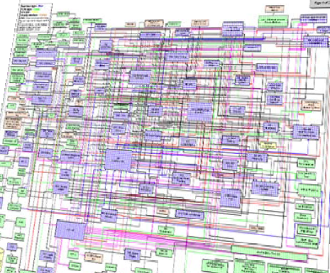
Data Sources and Heterogeneity
Terminology
Integration (Latin integer = whole): consolidation of data objects / sources
Homogeneity (Greek homo/homoios = same): similarity
Heterogeneity: dissimilarity, different representation / meaning
Heterogeneous IT Infrastructure
Common enterprise IT infrastructure contains >100s of heterogeneous and distributed systems and applications
E.g., health care data management: 20 - 120 systems
Multi-Modal Data (example health care)
Structured patient data, patient records incl. prescribed drugs
Knowledge base drug APIs (active pharmaceutical ingredients) + interactions
Doctor notes (text), diagnostic codes, outcomes
Radiology images (e.g., MRI scans), patient videos
Time series (e.g., EEG, ECoG, heart rate, blood pressure)
[Credit: Albert Maier]

Slide 12


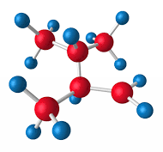

Recap: The Data Science Lifecycle
(aka KDD Process, aka CRISP-DM)
Data-centric View:
Application perspective
Workload perspective System perspective
Data Scientist
Data Integration Data Cleaning Data Preparation
Data Integration Data Cleaning Data Preparation
Model Selection Training Hyper-parameters
Validate & Debug Deployment Scoring & Feedback
Exploratory Process (experimentation, refinements, ML pipelines)
Data/SW Engineer
DevOps Engineer

Slide 13
The 80% Argument
Data Sourcing Effort
Data scientists spend 80-90% time on finding, integrating, cleaning datasets
Technical Debts in ML Systems
Glue code, pipeline jungles, dead code paths
Plain-old-data types (arrays), multiple languages, prototypes
Abstraction and configuration debts
Data testing, reproducibility, process management, and cultural debts
[Michael Stonebraker, Ihab F. Ilyas: Data Integration: The Current Status and the Way Forward. IEEE Data Eng. Bull. 41(2) (2018)]
[D. Sculley et al.: Hidden Technical Debt in Machine Learning Systems. NeurIPS 2015]
ML

Slide 14

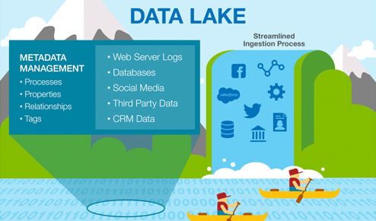

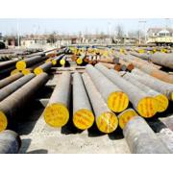



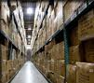
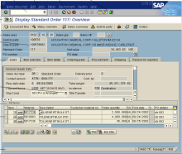
Complementary System Architectures
#1 Information System Pyramid
Distributed Computation
Frameworks
Operational Systems
Strategic Systems
Analytical Systems
DSS
Vertical Integration (e.g., ETL)
#2 Data Lake
Audio, Image, Video, Text, Streams, Logs
DWH
Catalogs
Distributed Data Stores
Material
ERP
CRM
SCM
eCommerce
Horizontal Integration (e.g., EAI)

Slide 15
Course Goals
Common Data and System Characteristics
Heterogeneous data sources and formats, often distributed
Large data collections → distributed data storage and analysis
#1 Major data integration architectures
#2 Key techniques for data integration and cleaning
#3 Methods for large-scale data storage and analysis

Slide 16
Course Outline and Projects/Exercise

Slide 17
Part A: Data Integration and Preparation
Data Integration Architectures
01 Introduction and Overview [Oct 16]
02 Data Warehousing, ETL, and SQL/OLAP [Oct 23]
03 Message-oriented Middleware, EAI, and Replication [Oct 30]
Key Integration Techniques
04 Schema Matching and Mapping [Nov 06]
05 Entity Linking and Deduplication [Nov 13]
06 Data Cleaning and Data Fusion [Nov 20]
07 Data Provenance and Catalogs [Nov 27]

Slide 18
Part B: Large-Scale Data Management & Analysis
Cloud Computing
08 Cloud Computing Foundations [Dec 04]
09 Cloud Resource Management and Scheduling [Dec 11]
10 Distributed Data Storage [Dec 18]
Large-Scale Data Analysis
11 Distributed, Data-Parallel Computation [Jan 15]
12 Distributed Stream Processing [Jan 22]
13 Distributed Machine Learning Systems [Jan 29] + Q&A and Exam Preparation

Slide 19

Overview Projects or Exercises
Team
1-3 person teams (w/ clearly separated responsibilities)
Objectives
Non-trivial programming project in DIA context (3 ECTS → 80-90 hours)
Preferred: Open-source contribution to Apache SystemDS https://github.com/apache/systemds (from HW to high-level scripting)
https://issues.apache.org/jira/secure/ Dashboard.jspa?selectPageId=12335852#Filter-Results/12365413
Alternative Exercise: “Berlin Public Transport Data Analysis”
Timeline
Oct 31: Binding project/exercise selection (via google forms)
Jan 30: Project/exercise submission deadline
https://tinyurl.com/ aytk6bw6

Slide 20
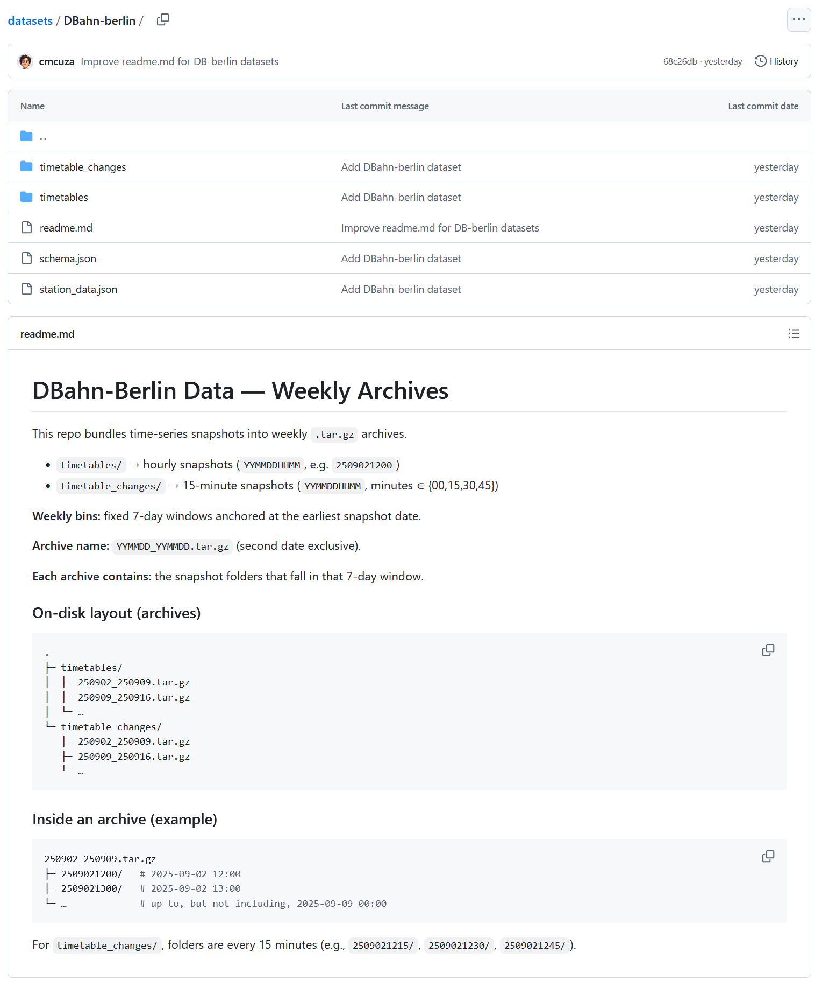
DIA Exercise (alternative to projects), cont.
[https://github.com/damslab/datasets/ tree/master/DBahn-berlin]

Slide 21


Apache SystemDS: A Declarative ML System for the End-to-End Data Science Lifecycle
https://github.com/apache/systemds

Slide 22
What is an ML System?
Classification
Regression
Recommenders
Clustering
Dim Reduction
Neural Networks
Statistics
Data Mining
Machine Learning (ML)
ML Applications (entire KDD/DS lifecycle)
Rapidly Evolving
Runtime Techniques (Execution, Data Access)
ML System
Compilation Techniques
Distributed Systems
HPC
Data Management
Accelerators
Operating Systems
Prog. Language Compilers
HW Architecture

Slide 23

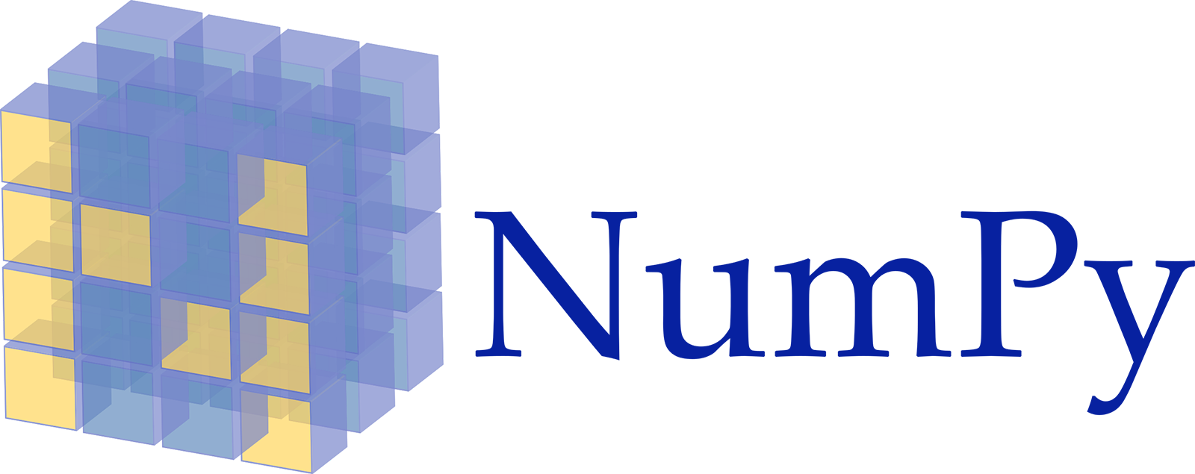












Landscape of ML Systems
Existing ML Systems
#1 Numerical computing frameworks
#2 ML Algorithm libraries (local, large-scale)
#3 Linear algebra ML systems (large-scale)
#4 Deep neural network (DNN) frameworks
#5 Model management, and deployment
Exploratory Data-Science Lifecycle
Open-ended problems w/ underspecified objectives
Hypotheses, data integration, run analytics
Unknown value → lack of system infrastructure → Redundancy of manual efforts and computation
Data Preparation Problem
80% Argument: 80-90% time for finding, integrating, cleaning data
Diversity of tools ➔ boundary crossing, lack of optimization
“Take these datasets and show value or competitive advantage”
[NIPS 2015]
[DEBull 2018]

Slide 24
The Data Science Lifecycle
(aka KDD Process, aka CRISP-DM)
Data extraction, schema alignment, entity resolution, data validation, data cleaning, outlier detection, missing value imputation, semantic type detection, data augmentation, feature selection, feature engineering, feature transformations
Key observation: SotA data integration/cleaning based on ML
Data Scientist
Data Integration Data Cleaning Data Preparation
Data Integration Data Cleaning Data Preparation
Model Selection Training Hyper-parameters
Validate & Debug Deployment Scoring & Feedback
Exploratory Process (experimentation, refinements, ML pipelines)
Data/SW Engineer
DevOps Engineer

Slide 25
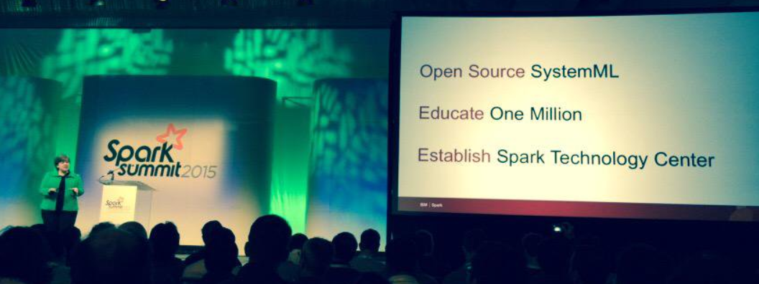



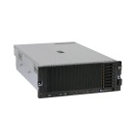

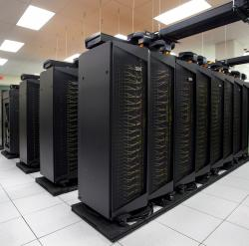
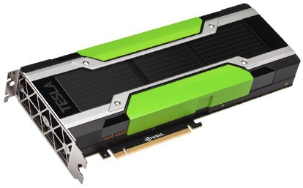
Apache SystemDS [https://github.com/apache/systemds]
DML Scripts
APIs: Command line, JMLC, Python Spark MLContext, Spark ML, (Scalable Algorithms + Primitives)
Language
Compiler
07/2020 Renamed to Apache SystemDS 05/2017 Apache Top-Level Project 11/2015 Apache Incubator Project
08/2015 Open Source Release
[SIGMOD’15,’17,’19,’21abc,’23abc,’24ab]
[PVLDB’14,’16ab,’18,’22]
[ICDE’11,’12,’15]
[EDBT’25][BTW’25ab]
[CIDR’17,’20]
[VLDBJ’18] [TODS’26]
[CIKM’22] [DEBull’14]
[PPoPP’15]
Runtime
Write Once, Run Anywhere
In-Memory Single Node (scale-up)
Hadoop or Spark Cluster (scale-out)
Federated (LA progs, PS)
In-Progress:
GPU
Others: Netezza
Apache Flink
since 2019
since 2014/16
since 2012
since 2010/11
since 2015

Slide 26
Language Abstractions and APIs
Data Independence + Impl-Agnostic Ops ➔ “Separation of Concerns”
User Script
Built-in Functions
Example: Stepwise Linear Regression
X = read(‘features.csv’)
Y = read(‘labels.csv’)
[B,S] = steplm(X, Y,
icpt=0, reg=0.001)
write(B, ‘model.txt’)
m_steplm = function(...) {
while( continue ) {
parfor( i in 1:n ) {
if( !fixed[1,i] ) {
Xi = cbind(Xg, X[,i])
B[,i] = lm(Xi, y, ...)
} }
# add best to Xg # (AIC)
} }
m_lmCG = function(...) {
while( i<maxi&nr2>tgt ) {
q = (t(X) %*% (X %*% p)) + lambda * p
beta = ... }
}
m_lm = function(...) {
if( ncol(X) > 1024 )
B = lmCG(X, y, ...)
else
B = lmDS(X, y, ...)
}
Linear Algebra Programs
Feature Selection
Facilitates optimization across data science lifecycle tasks
ML Algorithms
m_lmDS = function(...) {
l = matrix(reg,ncol(X),1)
A = t(X) %*% X + diag(l)
b = t(X) %*% y
beta = solve(A, b) ...}

Slide 27
Basic HOP and LOP DAG Compilation
LinregDS (Direct Solve)
X = read($1);
y = read($2);
intercept = $3;
lambda = 0.001;
...
if( intercept == 1 ) {
ones = matrix(1, nrow(X), 1);
X = append(X, ones);
}
I = matrix(1, ncol(X), 1);
A = t(X) %*% X + diag(I)*lambda;
b = t(X) %*% y;
beta = solve(A, b); ...
write(beta, $4);
HOP DAG (after rewrites)
8KB
Cluster Config:
driver mem: 20 GB
exec mem: 60 GB
CP
write
Scenario: X: 10⁸ x 10³, 10¹¹ y: 10⁸ x 1, 10⁸
8MB
16MB
CP
b(solve)
CP
172KB
b(+)
1.6TB
CP
SP
800GB
r(diag)
ba(+*)
ba(+*)
SP
1.6TB
r(t)
8KB
SP
CP
800GB
800MB
dg(rand) (10³x1,10³)
X
(10⁸x10³,10¹¹)
y (10⁸x1,10⁸)
Distributed Matrices
Fixed-size matrix blocks
Data-parallel operations
LOP DAG (after rewrites)
16KB
r’(CP)
mapmm(SP)
tsmm(SP)
X_{1,1}
Hybrid Runtime Plans:
Size propagation / memory estimates
Integrated CP / Spark runtime
Dynamic recompilation during runtime
800MB
1.6GB
X_{2,1}
r’(CP)
X
(persisted in MEM_DISK)
X_{m,1}
y

Slide 28

Static and Dynamic Rewrites
trace(X%*%Y) → sum(X*t(Y))
Example Static Rewrites (size-independent)
Common Subexpression Elimination
Constant Folding / Branch Removal / Block Sequence Merge
Static Simplification Rewrites
Right/Left Indexing Vectorization
For Loop Vectorization
Spark checkpoint/repartition injection
Example Dynamic Rewrites (size-dependent)
Dynamic Simplification Rewrites
Matrix Mult Chain Optimization
Y
O(n³)
O(n²)
X
X
Y ┬
→
*
sum(λ*X) → λ*sum(X)
sum(X+Y) → sum(X)+sum(Y)
rowSums(X) → X, iff ncol(X)=1
sum(X^2) → X%*%t(X), iff ncol(X)=1
t(X) 1kx1k
X 1kx1k
Z
1
t(X) 1kx1k
X 1kx1k
p
1
→
Sparsity Estimation & Sparse DP Enum [SIGMOD’19]
2,002 MFLOPs
4 MFLOPs
Size propagation and sparsity estimation

Slide 29
Apache SystemDS Architecture
> 500K tests
> 10K DSL tests
[CIDR’20]

Slide 30

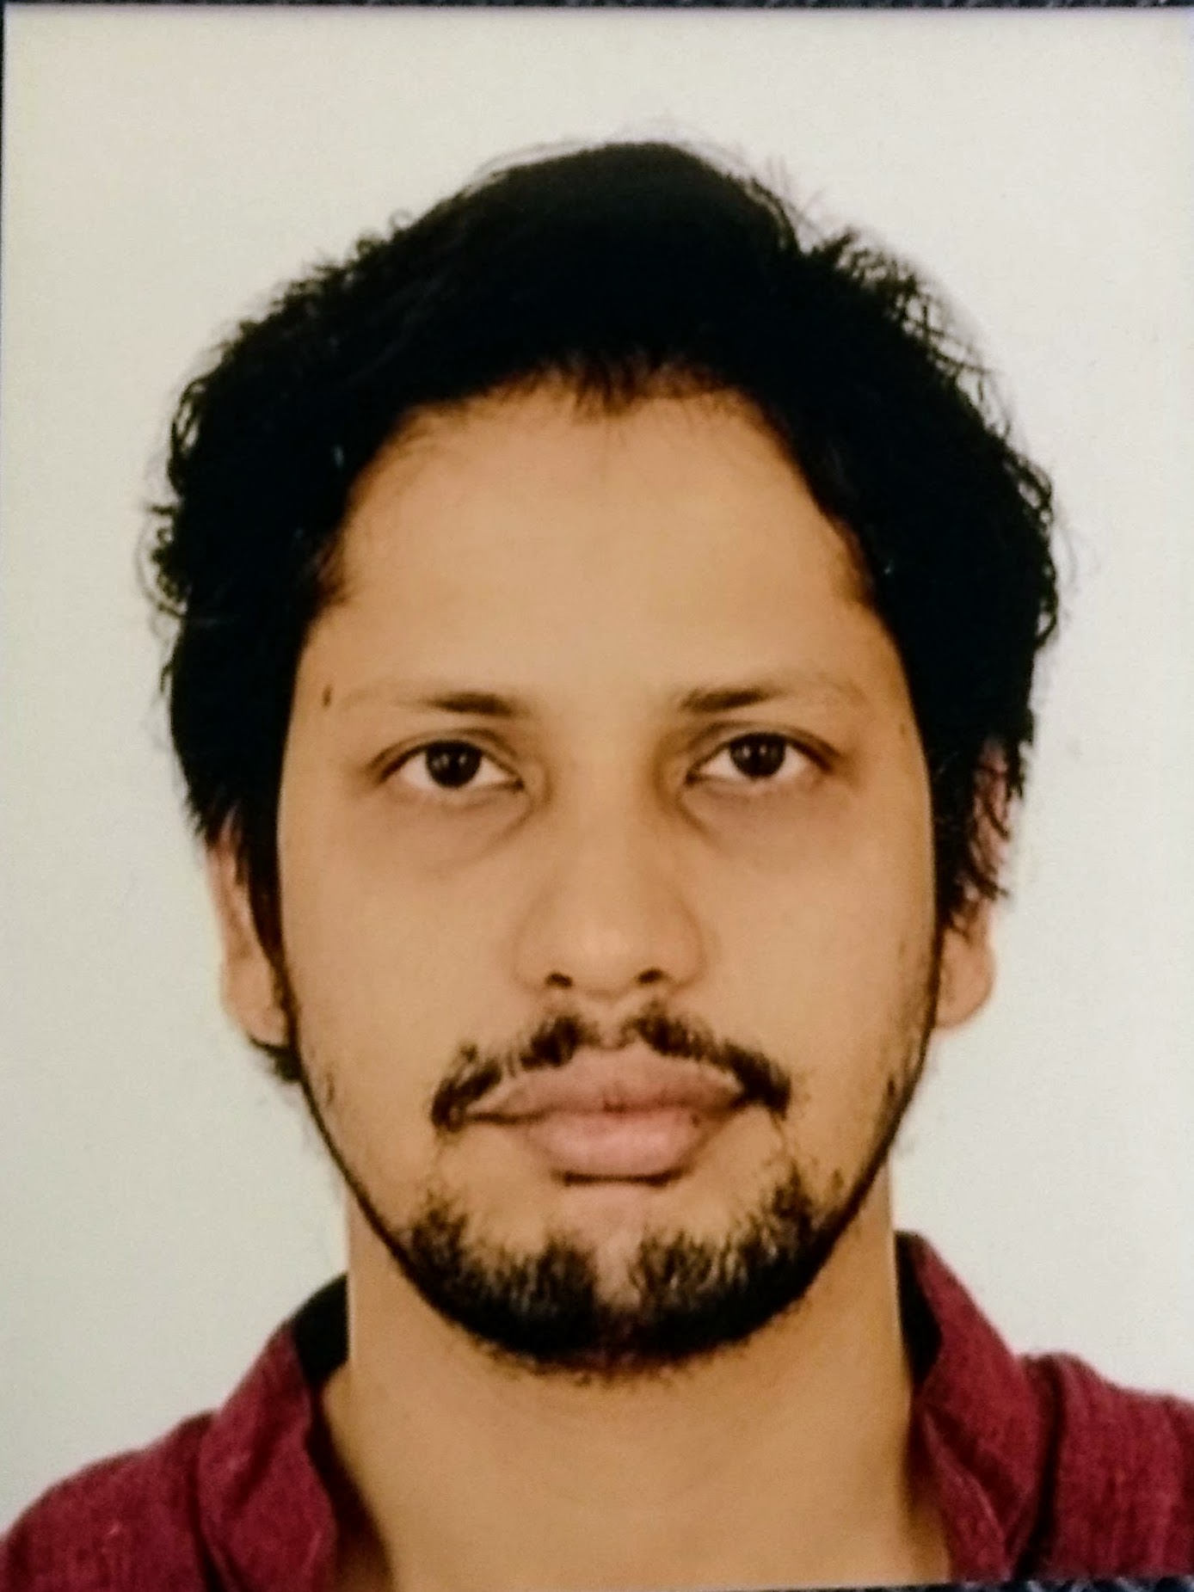

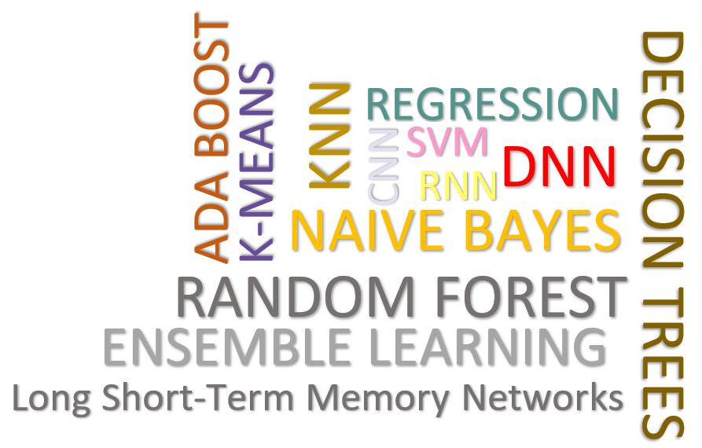
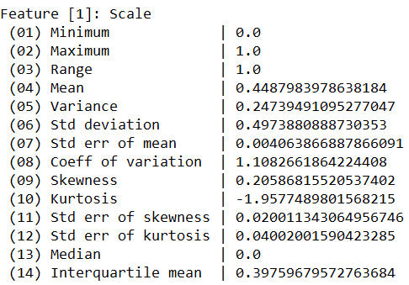
Data Cleaning Pipelines
[SIGMOD’24a, TODS’26]
Automatic Generation of Cleaning Pipelines
Library of robust, parameterized data cleaning primitives,
Enumeration of DAGs of primitives & hyper-parameter optimization (evolutionary, HB)
[best paper runner-up w/ Shafaq and Roman]
Data- and Task-parallel Computation
Data Samples
Logical
O
Physical
LP₁
LP₂
…
LP_{n}
Top-k Pipelines
Target App
…
…
…
PP₁
PP_{n}
PP₁
PP_{n}
PP₁
PP_{n}
Rules/Objectives
Outlier Detection → MVI → Deduplication → Resolve Mislabels
P_{1:} gmm → imputeFD → mergeDup → delML
P_{n:} outlierBySd→ mice → delDup → voting
Debugging
University | Country
TU Graz | Austria
TU Graz | Austria
TU Graz | Germany
IIT | India
IIT | IIT
IIT | Pakistan
IIT | India
SIBA | Pakistan
SIBA | null
SIBA | null
University | Country
TU Graz | Austria
TU Graz | Austria
TU Graz | Austria
IIT | India
IIT | India
IIT | India
IIT | India
SIBA | Pakistan
SIBA | Pakistan
SIBA | Pakistan
A | B | C | D
0.77 | 0.80 | 1 | 1
0.96 | 0.12 | 1 | 1
0.66 | 0.09 | null | 1
0.23 | 0.04 | 17 | 1
0.91 | 0.02 | 17 | null
0.21 | 0.38 | 17 | 1
0.31 | null | 17 | 1
0.75 | 0.21 | 20 | 1
null | null | 20 | 1
0.19 | 0.61 | 20 | 1
0.64 | 0.31 | 20 | 1
A | B | C | D
0.77 | 0.80 | 1 | 1
0.96 | 0.12 | 1 | 1
0.66 | 0.09 | 17 | 1
0.23 | 0.04 | 17 | 1
0.91 | 0.02 | 17 | 1
0.21 | 0.38 | 17 | 1
0.31 | 0.29 | 17 | 1
0.75 | 0.21 | 20 | 1
0.41 | 0.24 | 20 | 1
0.19 | 0.61 | 20 | 1
0.64 | 0.31 | 20 | 1
Dirty Data
After imputeFD(0.5)
Dirty Data
After MICE

Slide 31


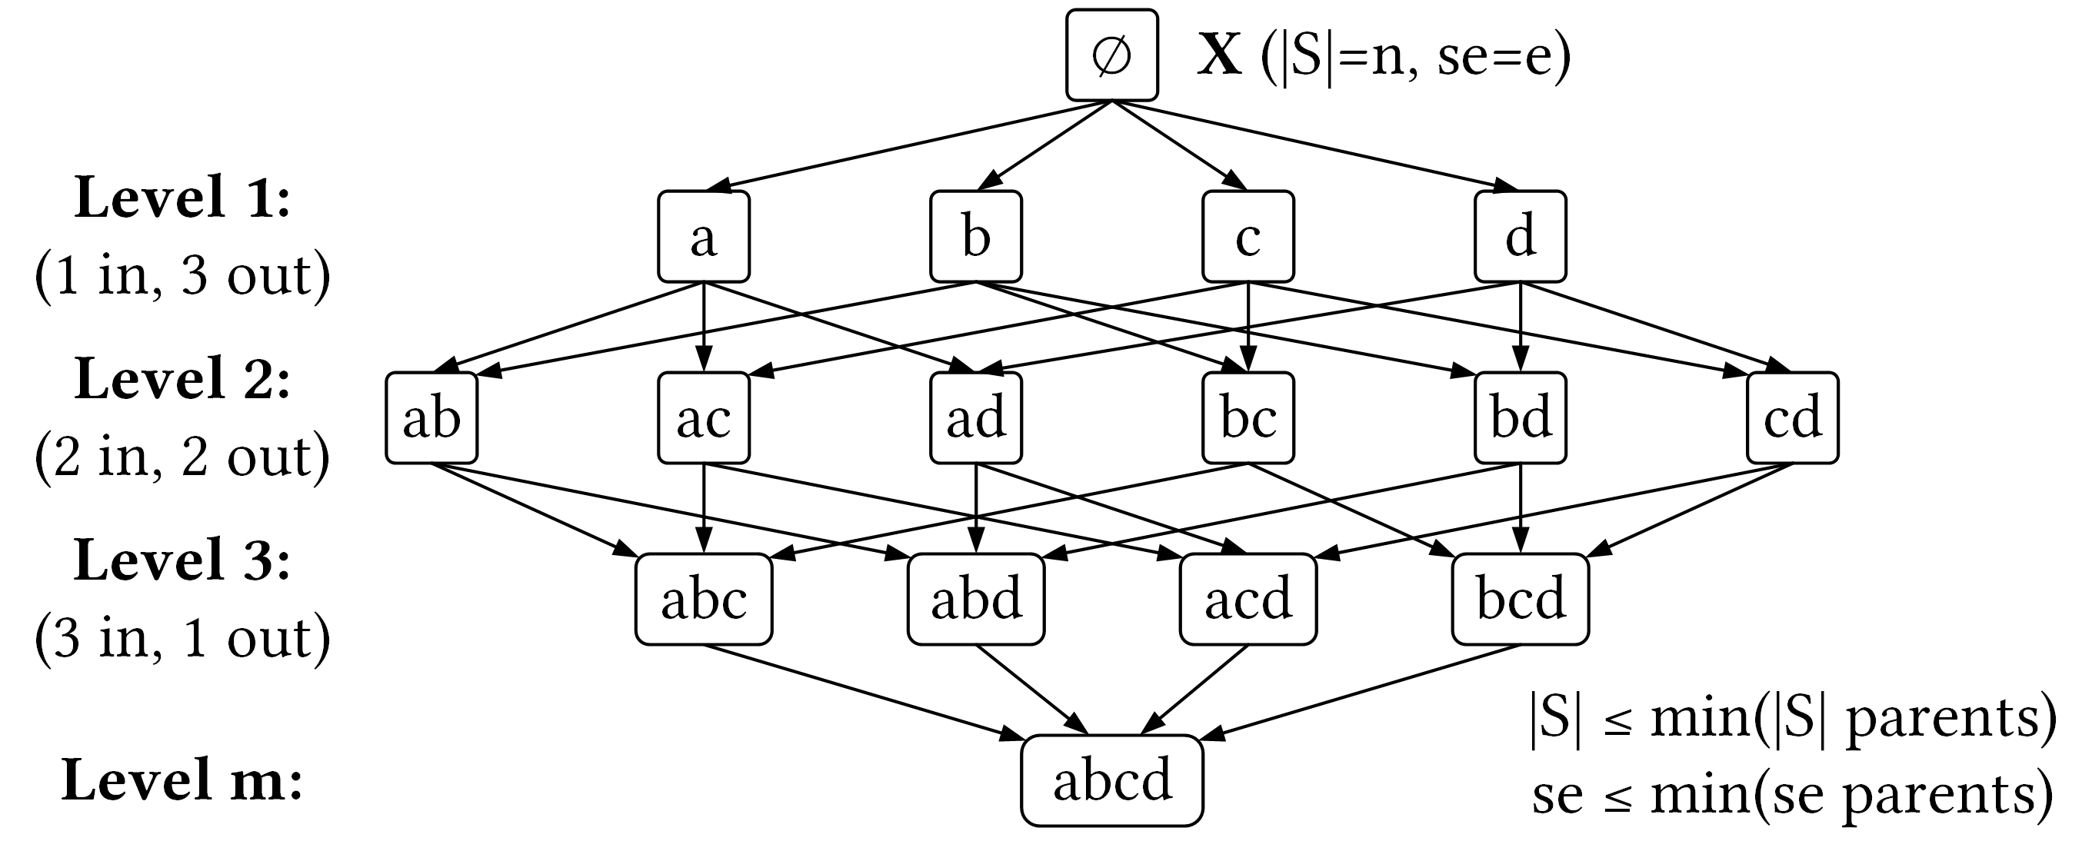
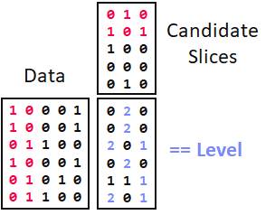

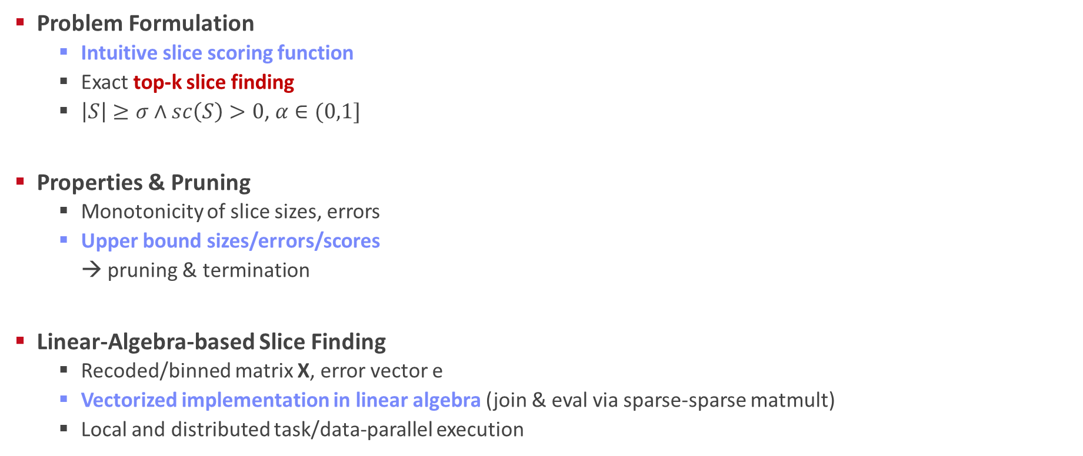
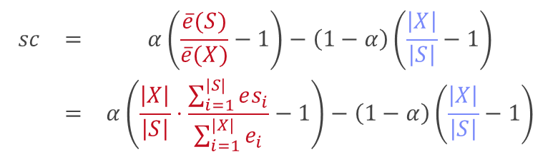
SliceLine for Model Debugging
[SIGMOD’21b, BTW’25a]
[Credit: sliceline, Silicon Valley, HBO]
Problem Formulation
Intuitive slice scoring function
Exact top-k slice finding
$\left|S\right|≥σ∧sc\left(S\right)>0$, $α∈(0,1]$
Properties & Pruning
Monotonicity of slice sizes, errors
Upper bound sizes/errors/scores → pruning & termination
Linear-Algebra-based Slice Finding
Recoded/binned matrix X, error vector e
Vectorized implementation in linear algebra (join & eval via sparse-sparse matmult)
Local and distributed task/data-parallel execution
$$\begin{matrix}sc & = & α\left(\frac{\overline{e}(S)}{\overline{e}(X)}−1\right)−\left(1−α\right)\left(\frac{\left|X\right|}{\left|S\right|}−1\right) \\ & = & α\left(\frac{\left|X\right|}{\left|S\right|}⋅\frac{\sum_{i=1}^{|S|}{es_{i}}}{\sum_{i=1}^{|X|}{e_{i}}}−1\right)−\left(1−α\right)\left(\frac{\left|X\right|}{\left|S\right|}−1\right)\end{matrix}$$
slice error
slice size
$$O(2^{l}−\sum_{j=1}^{m}{2^{d_{j}}}+ l+m)$$
Notes:
Compelling properties:
The components are balanced under α = 0.5.
The score of the original X is always sc = 0.
For α = 0 (all weight on size), the maximum feasible score is 0, and no slice smaller than X can reach it.
All components of Equation (1) are either constants, or slice errors and sizes, which makes this function amenable to pruning.

Slide 32


Multi-level Lineage Tracing & Reuse
[CIDR’20, SIGMOD’21a, EDBT’25]
Lineage as Key Enabling Technique
Trace lineage of ops (incl. non-determinism), dedup for loops/funcs
Model versioning, data reuse, incr. maintenance, autodiff, debugging
Full Reuse of Intermediates
Before executing instruction, probe output lineage in cache Map<Lineage, MatrixBlock>
Cost-based/heuristic caching and eviction decisions (compiler-assisted)
Partial Reuse of Intermediates
Problem: Often partial result overlap
Reuse partial results via dedicated rewrites (compensation plans)
Example: steplm
Next Steps: multi-backend, unified mem mgmt
for( i in 1:numModels )
R[,i] = lm(X, y, lambda[i,], ...)
m_lmDS = function(...) {
l = matrix(reg,ncol(X),1)
A = t(X) %*% X + diag(l)
b = t(X) %*% y
beta = solve(A, b) ...}
m_steplm = function(...) {
while( continue ) {
parfor( i in 1:n ) {
if( !fixed[1,i] ) {
Xi = cbind(Xg, X[,i])
B[,i] = lm(Xi, y, ...)
} }
# add best to Xg (AIC)
} }
X
m>>n
t(X)

Slide 33

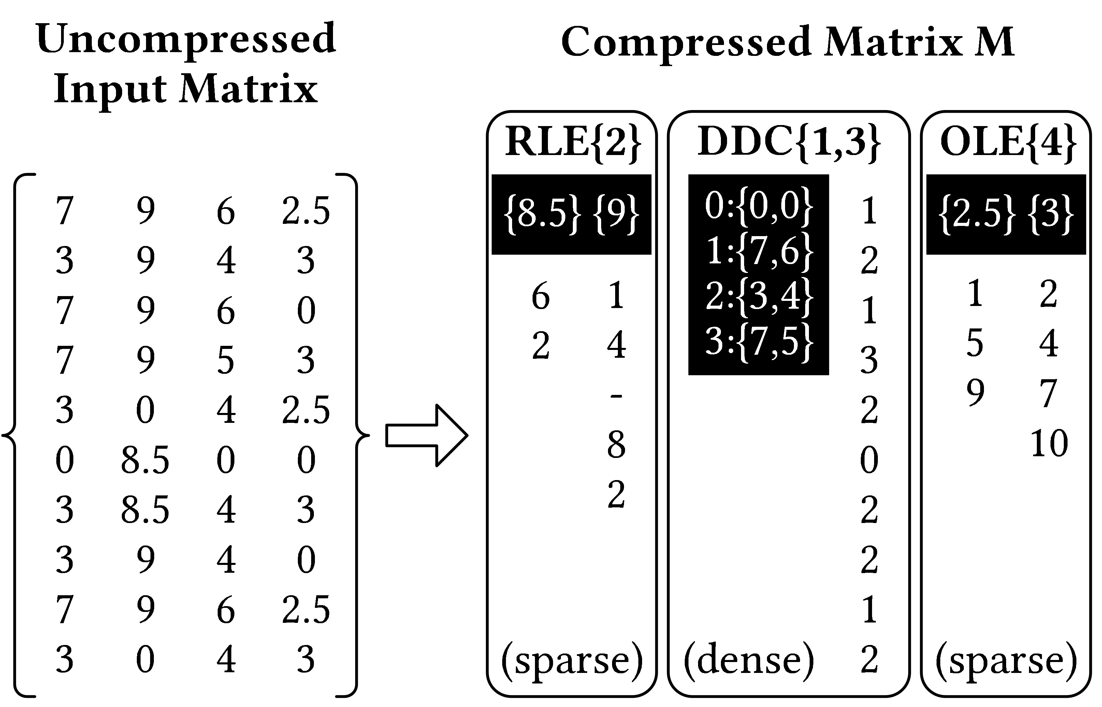
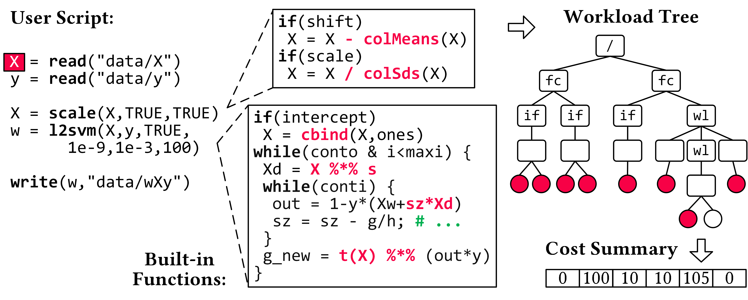
Compressed Linear Algebra Extended
[PVLDB’16a, VLDBJ’18, SIGMOD’23a, under submission]
Lossless Matrix Compression
Improved general applicability (adaptive compression time, new compression schemes, new kernels, intermediates, workload-aware)
Sparsity → Redundancy exploitation (data redundancy, structural redundancy)
Workload-aware Compression
Workload summary → compression
Compressed Representation → execution planning
Next Steps
Frame compression, compressed I/O
Compressed feature transformations
Morphing of compressed data

Slide 34






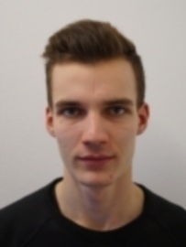



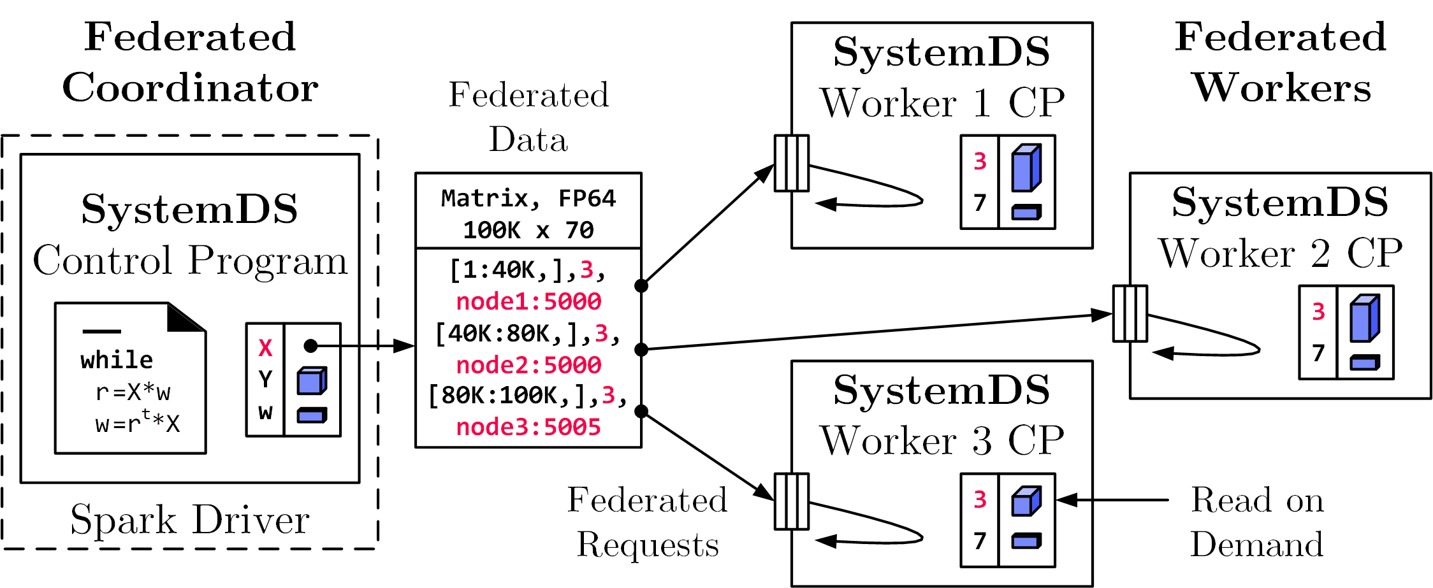
Federated Learning
[SIGMOD’21c, CIKM’22]
Federated Backend
Federated data (matrices/frames) as meta data objects
Federated linear algebra, (and federated parameter server)
X = federated(addresses=list(node1, node2, node3),
ranges=list(list(0,0), list(40K,70), ..., list(80K,0), list(100K,70)));
Federated Requests: READ, PUT, GET, EXEC_INST, EXEC_UDF, CLEAR
➔ Design Simplicity: (1) reuse instructions (2) federation hierarchies

Slide 35
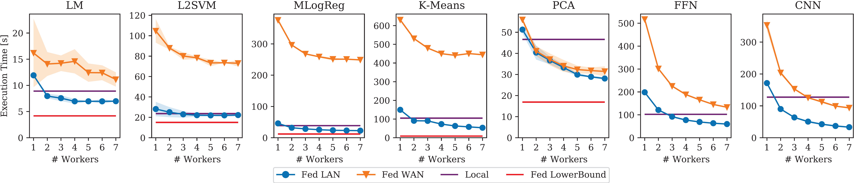
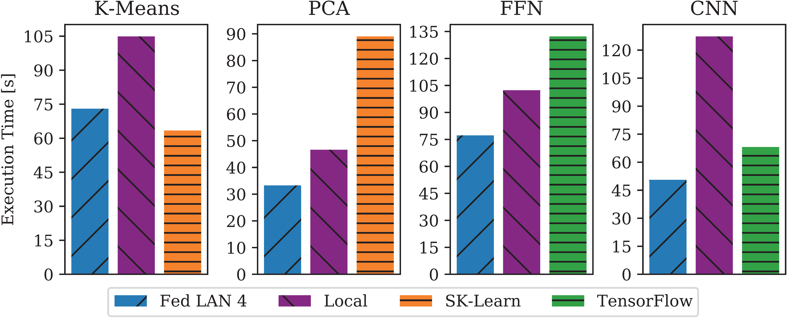
Reproducible Results
Federated Learning – Experiments
Workloads and Baselines
LM: linear regression, lmCG
L2SVM: l2-regularized SVM
MLogReg: multinomial logreg
K-Means: Lloyd’s alg. w/ K-Means++ init
PCA: principal component analysis
FFN: fully-connected feed-forward NN
CNN: convolutional NN
Comparisons w/ Scikit-learn and TensorFlow

Slide 36
Summary and Q&A
Thanks
Course Goals
#1 Major data integration architectures
#2 Key techniques for data integration and cleaning
#3 Methods for large-scale data storage and analysis
Programming Projects
Unique project in Apache SystemDS (teams or individuals), or
Exercise on data engineering /ML pipeline
Project selection by Oct 31 EOD
Next Lectures
02 Data Warehousing, ETL, and SQL/OLAP [Oct 23]
03 Message-oriented Middleware, EAI, and Replication [Oct 30]
https://tinyurl.com/ aytk6bw6

