Slide 1

Data Integration and Large-scale Analysis (DIA)
02 Data Warehousing, ETL, and SQL/OLAP
Prof. Dr. Matthias Boehm
Technische Universität Berlin
Berlin Institute for the Foundations of Learning and Data
Big Data Engineering (DAMS Lab)
Last update: Oct 23, 2025

Slide 2

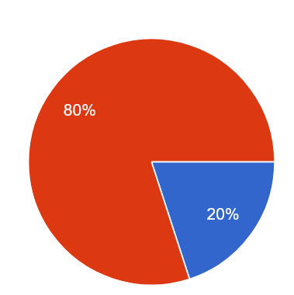


Announcements / Administrative Items
#1 Video Recording
  Hybrid lectures: in-person BH-N 243, zoom live streaming, video recording
  https://tu-berlin.zoom.us/j/9529634787?pwd=R1ZsN1M3SC9BOU1OcFdmem9zT202UT09
#2 Project Selection
  Binding project/exercise selection by Oct 31
  Via the following form (so far 20):
#3 SystemDS JIRA Accounts
  No need for a JIRA account; # accounts limited by ASF; assignment after completion
https://tinyurl.com/aytk6bw6

Slide 3

Agenda
Data Warehousing (DWH)
Extraction, Transformation, Loading (ETL)
SQL/OLAP Extensions
Architecture & Logical Design
Physical Schema Design
ETL Pipeline Design
DWH Usage
SQL, SQL/OLAP, Data Mining, Machine Learning

Slide 4
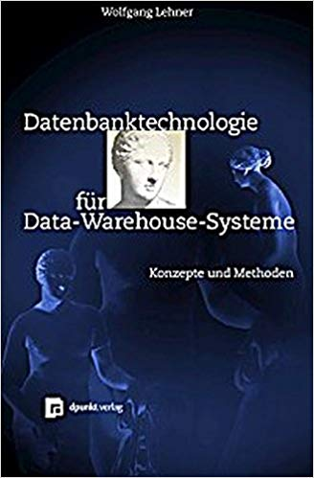
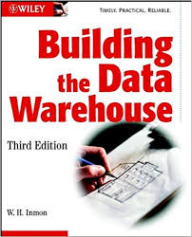
Data Warehousing (DWH)
[Wolfgang Lehner: Datenbanktechnologie für Data-Warehouse-Systeme. Konzepte und Methoden, Dpunkt Verlag, 1-373, 2003]

Slide 5

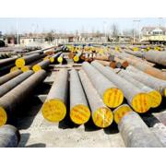

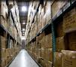
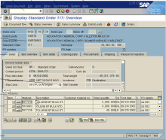
Motivation and Tradeoffs
Operational Systems
Analytical Systems
Goal: Queries over consolidated and cleaned data of several,
potentially heterogeneous, data sources
Tradeoffs
  Analytical query performance: write vs read optimized data stores
  Virtualization: overhead of remote access, source systems affected
  Consistency: sync vs async changes, time regime → up-to-date?
  Others: history, flexibility, redundancy, effort for data exchange
?
OLAP (Online Analytical Processing)
Material
ERP
CRM
SCM
eCommerce

Slide 6



Data Warehouse Architecture
Data Mart 1
Data Mart 2
Data Mart 3
Analysis-centric independent subsets
(e.g., geo, org, functional)
Data Warehouse
(consolidated raw data, aggregates, metadata)
Materialized,
non-volatile integration
Staging Area
Async replication,
and ETL vs ELT
S₁
S₃
S₄
Operational
source systems
S₂

Slide 7
Data Warehouse Architecture, cont.
Data Warehouse (DWH)
    “A data warehouse is a subject-oriented, integrated, time-varying,
    non-volatile collection of data in support of the management's
    decision-making process.” (Bill Inmon)
  #1 Subject-oriented: analysis-centric organization (e.g., sales) → Data Mart
  #2 Integrated: consistent data from different data sources
  #3 Time-varying: History (snapshots of sources), and temporal modelling
  #4 Non-volatile: Read-only access, limited to periodic data loading by admin
Different DWH Instantiations
  Single DWH system with virtual/materialized views for data marts
  Separate systems for consolidated DWH and aggregates/data marts (dependent data marts)
  Data-Mart-local staging areas and ETL (independent data marts)

Slide 8

Multi-dimensional Modeling: Data Cube
Make
Central Metaphor: Data Cube
  Qualifying data (categories, dimensions)
  Quantifying data (cells)
  Often sparse (0 for empty cells)
Multi-dimensional Schema
  Set of dimension hierarchies (D¹,…, D^{n})
  Set of measures (M¹,...,M^{m})
Dimension Hierarchy
  Partially-ordered set D of categorical attributes ({D₁,...,D_{n}, Top_{D}};→)
  Generic maximum element
  Existing minimum element
  (primary attribute)
Location
Color
Top_{D}
Year
Quarter
$$∀i\left(1≤i≤n\right):D_{i}→Top_{D}$$
Month
Week
$$∃i\left(1≤i≤n\right)∀j(1≤i≤n, i≠j):D_{i}→D_{j}$$
Day

Slide 9
Multi-dimensional Modeling: Data Cube, cont.
Top
Dimension Hierarchy, cont.
  Classifying (categorical) vs descriptive attributes
  Orthogonal dimensions: there are
  no functional dependencies between
  attributes of different dimensions
Fact F
  Base tuples w/ measures of summation type
  Granularity G as subset of categorical attributes
Measure M
  Computation function over non-empty subset of facts f(F₁, …, F_{k}) in schema
  Scalar function vs aggregation function
  Granularity G as subset of categorical attributes
Region
Nation
Addr
Customer
Status
Phone
Price
Order

Slide 10
Multi-dimensional Modeling: Operations
Slicing
  Select a “slice” of the cube by specifying a filter condition
  on one of the dimensions (categorical attributes)
  Same data granularity but subset of dimensions
Dicing
  Select a “sub-cube” by specifying a filter
  condition on multiple dimensions
  Complex Boolean expressions possible
  Sometimes slicing used synonym
Expression
“Slicing & Dicing”
(i.e., break information into smaller parts; look at it from different perspectives)
Example: Location=Berlin AND Color=White AND Make=BMW

Slide 11
Multi-dimensional Modeling: Operations, cont.
Roll-up (similar Merge - remove dim)
  Aggregation of facts or measures into coarser-grained aggregates (measures)
  Same dimensions but different granularity
Drill-Down (similar Split add dim)
  Disaggregation of measures into finer-grained measures
Roll-up
Drill-Down

Slide 12
Multi-dimensional Modeling: Operations, cont.
Drill-Across
  Navigate to neighboring cells at same granularity (changed selection)
Drill-Through
  Drill-Down to smallest
  granularity of underlying
  data store (e.g., RDBMS)
  E.g., find relational tuples
Pivot
  Rotate cube by
  exchanging
  dimensions
FName | LName | Local | Make | Color
Matthias | Boehm | Berlin | BMW | White
… | … | … | … | …
Make
Color
Location
Location
Make
Color

Slide 13
Aggregation Types
Recap: Classification of Aggregates
  Additive aggregation functions (SUM, COUNT)
  Semi-additive aggregation functions (MIN, MAX)
  Additively computable aggregation functions (AVG, STDDEV, VAR)
  Aggregation functions (MEDIAN, QUANTILES)
Summation Types of Measures
  FLOW: arbitrary aggregation possible
  STOCK: aggregation possible, except over temporal dim
  VPU: value-per-unit typically (e.g., price)
Necessary Conditions for Aggregation
    Disjointness of category attributes
    Completeness
    Type compatibility
    Example TU Graz CS Studies
      Aggregation across study programs: not ok
      Aggregation across time: not ok
[Hans-Joachim Lenz, Arie Shoshani: Summarizability in OLAP and Statistical Data Bases. SSDBM 1997]
[TUGraz online]
# Stud | 16/17 | 17/18 | 18/19 | 19/20 | 20/21 | Total
CS | 1,153 | 1,283 | 1,321 | 1,343 | 1368 | ?
SEM | 928 | 970 | 939 | 944 | 985 | ?
ICE | 804 | 868 | 846 | 842 | 849 | ?
Total | 2,885 | 3,121 | 3,106 | 3,129 | 3,202 | ?
Notes:
TU Graz: ~17000 students, is it correct to say CS-related 18% of students?
Statistics: bachelor and master
https://online.tugraz.at/tug_online/Studierendenstatistik.html?pAuswertung=8&pSJ=1664&pSemester=W&pGruppierung=1&pVerteilungsschluessel=TRUE
TU Graz: ~17000 students, is it correct to say CS-related 18% of students?
Statistics: bachelor and master
https://online.tugraz.at/tug_online/Studierendenstatistik.html?pAuswertung=8&pSJ=1664&pSemester=W&pGruppierung=1&pVerteilungsschluessel=TRUE

Slide 14

Excursus: Other Misleading Statistics
Problem Setting
  100 people (90 vaccinated, 10 non-vaccinated)
  5 infected vaccinated,
  2 infected non-vaccinated
P(vacc|infected) = 5/7 = 0.71 → misleading
P(infected|vacc) = 5/90 = 0.056
P(infected|non-vacc) = 2/10 = 0.2
[https://twitter.com/howie_hua/
status/1421502809862664197]
[see also
Simpson’s Paradox
in 06 Data Cleaning]

Slide 15
Aggregation Types, cont.
Additivity
Type Compatibility
(addition/
subtraction)
 | FLOW | STOCK: Temporal Agg? |  | VPU
 |  | Yes | No
MIN/MAX | ✔ | ✔ |  | ✔
SUM | ✔ | ✘ | ✔ | ✘
AVG | ✔ | ✔ |  | ✔
COUNT | ✔ | ✔ |  | ✔
 | FLOW | STOCK | VPU
FLOW | FLOW | STOCK | ✘
STOCK |  | STOCK | ✘
VPU |  |  | VPU

Slide 16
Data Cube Mapping and MDX
-- MDX Example
SELECT
{[Measures].[Sales],
[Measures].[Tax]} ON COLUMNS,
{[Date].[Fiscal].[Year].&[2002],
[Date].[Fiscal].[Year].&[2003] } ON ROWS
FROM [Adventure Works]
WHERE ([Sales Territory].[Southwest])
MOLAP (Multi-Dim. OLAP)
  OLAP server with native
  multi-dimensional data storage
  Dedicated query language:
  Multidimensional Expressions (MDX)
  E.g., IBM Cognos Powerplay, Essbase
ROLAP (Relation OLAP)
  OLAP server w/ storage in RDBMS
  E.g., all commercial RDBMS vendors
HOLAP (Hybrid OLAP)
  OLAP server w/ storage in RDBMS
  and multi-dimensional in-memory
  caches and data structures
[https://docs.microsoft.com/
en-us/analysis-services/
multidimensional-models/mdx]
Requires mapping to relational model
[Example systems:
https://en.wikipedia.org/wiki/
Comparison_of_OLAP_servers]

Slide 17
Recap: Relational Data Model
Domain D (value domain): e.g., Set S, INT, Char[20]
Relation R
  Relation schema RS: Set of k attributes {A₁,…,A_{k}}
  Attribute A_{j}: value domain D_{j} = dom(A_{j})
  Relation: subset of the Cartesian product
  over all value domains D_{j}
  R ⊆ D₁ × D₂ × ... × D_{k}, k ≥ 1
Additional Terminology
  Tuple: row of k elements of a relation
  Cardinality of a relation: number of tuples in the relation
  Rank of a relation: number of attributes
  Semantics: Set := no duplicate tuples (in practice: Bag := duplicates allowed)
  Order of tuples and attributes is irrelevant
Attribute
A1 INT | A2 INT | A3 BOOL
3 | 7 | T
1 | 2 | T
3 | 4 | F
1 | 7 | T
Tuple
cardinality: 4
rank: 3

Slide 18
ROLAP –
Star Schema
Product
Order
ProductID
ProdName
ProdDescr
Category
CategoryDescr
UnitPrice
OrderID
Order Date
Fact Table
Salesperson
OrderID
SalespersonID
CustomerID
ProdID
DateID
CityID
Quantity
Total Price
SalespersonID
SalespersonName
City
Quota
Date
DateID
Date
Customer
CustomerID
Customer Name
Customer Address
City
City
CityID
City
State
Country
Denormalized
Dimension Tables
Notes:
Performance (few joins)
Simplicity and tuning opportunities
Redundancy due to denormalization
Update anomalies

Slide 19

ROLAP –
Snowflake Schema
Product
Order
ProductID
ProdName
ProdDescr
CategoryName
UnitPrice
OrderID
Order Date
Category
Fact Table
CategoryName
CategoryDescr
Salesperson
OrderID
SalespersonID
CustomerID
ProdID
DateID
CityID
Quantity
Total Price
SalespersonID
SalespersonName
City
Quota
Date
Month
Year
DateID
Date
Month
Month
Year
Year
Customer
CustomerID
Customer Name
Customer Address
City
City
State
“Normalized”
Dimension Tables
CityID
CityName
StateName
StateName
Country
Train Data Modeling w/ Past Exams, e.g.,
https://mboehm7.github.io/teaching/ws2324_dia/ExamDIA_v2.pdf

Slide 20
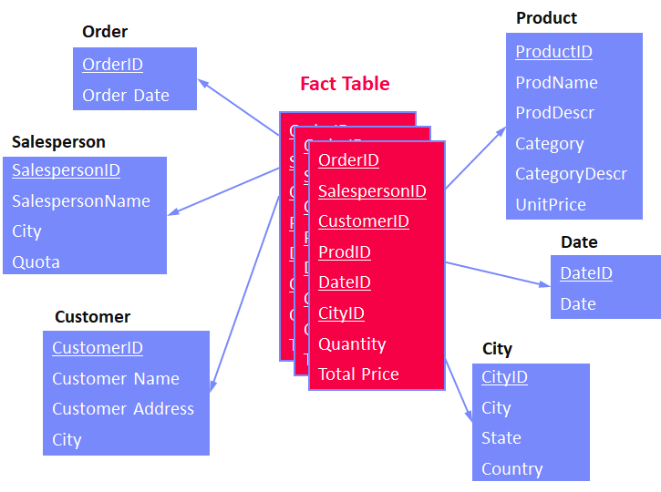
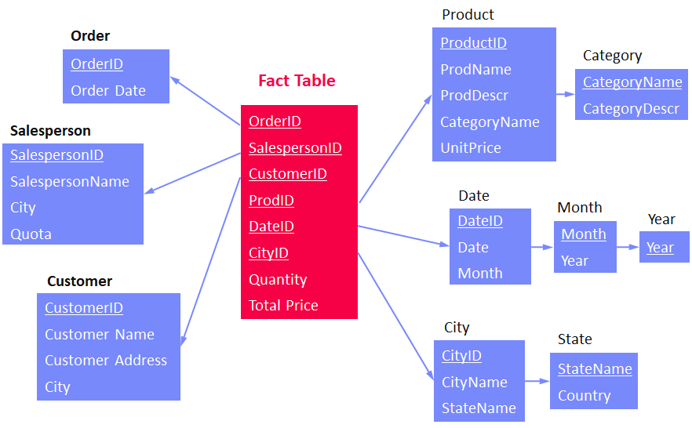
ROLAP – Other Schemas
Galaxy Schema
  Similar to star-schema but with multiple fact tables
  and potentially shared dimension tables
  Multiple stars → Galaxy
Snow-Storm Schema
  Similar to snow-flake-schema but with multiple fact tables
  and potentially shared dimension tables
  Multiple snow flakes → snow storm
OLAP Benchmark Schemas
  TPC-H (8 tables, normalized schema)
  SSB (5 tables, star schema, simplified TPC-H)
  TPC-DS (24 tables, snow-storm schema)
[Raghunath Othayoth Nambiar, Meikel Poess: The Making of TPC- DS. VLDB 2006]
“TPC-D and its successors, TPC-H and TPC-R assumed a 3rd Normal Form (3NF) schema.
However, over the years the industry has expanded towards star schema approaches.”

Slide 21
Evolution of DWH/OLAP Workloads
Goals: Advanced analytics and Operational BI
Reporting
Analysis
Forecasting
Operational BI
What did happen?
Why did it happen?
What will happen?
What happens
right now?
State-of-the-Art (SotA):
Column stores /
HTAP systems
w/ (multi-stage)
write buffers
Create reports with pre-defined queries.
Increasing number of ad-hoc queries.
Extension of the
analytical model (advanced analytics).
Continuous streams of
ad-hoc queries and
propagated updates.
Step 1
Step 2
Step 3
Step 4
Batch
Adhoc
Analytics
Updates

Slide 22

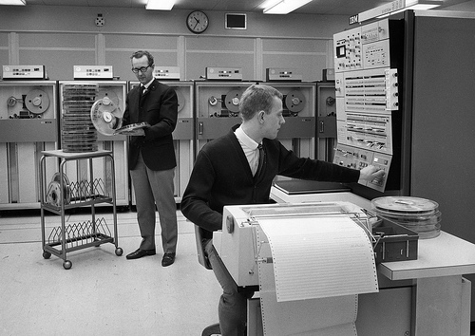

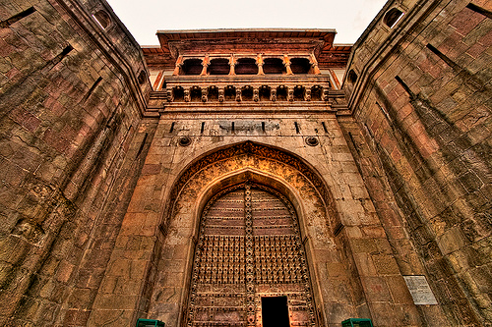
Excursus: MAD Skills
In the days of Kings and Priests
  Computers and Data: Crown Jewels
  Executives depend on computers
    But cannot work with them directly
  The DBA “Priesthood”
    And their Acronymia: EDW, BI, OLAP
The Architected Enterprise DWH
  Rational behavior … for a bygone era
  “There is no point in bringing data … into the data
  warehouse environment without integrating it.”
  —Bill Inmon, Building the Data Warehouse, 2005

Slide 23
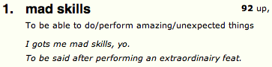



Excursus: MAD Skills, cont.
Magnetic
  „Attract data and practitioners“
  Use all available data, irrespective of data quality
Agile
  „Rapid iteration: ingest, analyze, productionalize“
  Continuous and fast evolution of
  physical and logical structures (ELT, no ETL)
Deep
  „Sophisticated analytics in Big Data“
  Ad-hoc advanced analytics and statistics
[J. Cohen, B. Dolan, M. Dunlap, J. M. Hellerstein, C. Welton: MAD Skills: New Analysis Practices for Big Data. PVLDB 2(2) 2009]

Slide 24
Trend: Cloud Data Warehousing
[Google, Kazunori Sato: An Inside Look at Google BigQuery, Google White Paper 2012]
#1 Google Big Query
#2 Amazon Redshift
#3 Microsoft Azure Data Warehouse
#4 IBM BlueMix dashDB
#5 Snowflake Data Warehouse
[Anurag Gupta, Deepak Agarwal, Derek Tan, Jakub Kulesza, Rahul Pathak, Stefano Stefani, Vidhya Srinivasan: Amazon Redshift and the Case for Simpler Data Warehouses. SIGMOD 2015]
10 Distributed Data Storage
(w/ more details on internals of Cloud DBMS)
[IBM: IBM dashDB - Cloud-based
data warehousing as-a-service, built for analytics, IBM White Paper 2015]
[Benoît Dageville et al.: The Snowflake
Elastic Data Warehouse. SIGMOD 2016]

Slide 25


BREAK and Test Yourself!
The central metaphor of multi-dimensional modeling is the data cube, described by
dimensions and measures. Which of the following Date dimension hierarchies are well-formed.
Mark each hierarchy as valid (✓) or invalid (x) and name the violations. [5 points]
(dims not independent)
(no bottom element)
(no top element)

Slide 26
Extraction, Transformation, Loading (ETL)

Slide 27
Extract-Transform-Load (ETL) Overview
Overview
  ETL process refers to the overall process of obtaining data from the source systems,
  cleaning and transforming it, and loading it into the DWH
  Subsumes many integration and cleaning techniques
#1 ETL
  Extract data from heterogeneous sources
  Transform data via dedicated data flows or in staging area
  Load cleaned and transformed data into DWH
#2 ELT
  Extract data from heterogeneous sources
  Load raw data directly into DWH
  Perform data transformations inside the DWH via SQL
  ➔ allows for automatic optimization of execution plans

Slide 28
[J. Hammer, M. Stonebraker, and O. Topsakal: THALIA: Test Harness for the Assessment of Legacy Information Integration Approaches. U Florida, TR05-001, 2005]
Types of Heterogeneity
Heterogeneity
Semantic Heterogeneity
Structural Heterogeneity
Attribute Heterogeneity
Missing
Data
1. Synonyms/homonyms
6. Nulls (Missing Values)
9. Same attribute in different structure
2. Simple mapping (mathematical)
7. Virtual columns
8. Semantic incompatibility
10. Handling Sets
3. Different data types
11. Attribute name
w/o semantics
4. Complex mappings
5. Language expressions
12. Attribute composition

Slide 29
Corrupted Data
Heterogeneity of Data Sources
  Update anomalies on denormalized data / eventual consistency
  Changes of app/preprocessing over time (US vs us) → inconsistencies
Human Error
  Errors in semi-manual data collection, laziness (see default values), bias
  Errors in data labeling (especially if large-scale: crowd workers / users)
Measurement/Processing Errors
  Unreliable HW/SW and measurement equipment (e.g., batteries)
  Harsh environments (temperature, movement) → aging
Uniqueness & duplicates
Contradictions & wrong values
Missing Values
[Credit: Felix Naumann]
Ref. Integrity
ID | Name | BDay | Age | Sex | Phone | Zip
3 | Smith, Jane | 05/06/1975 | 44 | F | 999-9999 | 98120
3 | John Smith | 38/12/1963 | 55 | M | 867-4511 | 11111
7 | Jane Smith | 05/06/1975 | 24 | F | 567-3211 | 98120
Zip | City
98120 | San Jose
90001 | Lost Angeles
Typos

Slide 30
ETL – Planning and Design Phase
Architecture, Flows, and Schemas
  #1 Plan requirements, architecture, tools
  #2 Design high-level integration flows (systems, integration jobs)
  #3 Data understanding (copy/code books, meta data)
  #4 Design dimension loading (static, dynamic incl keys)
  #5 Design fact table loading
Data Integration and Cleaning
  #5 Types of data sources (snapshot, APIs, query language, logs)
  #6 Prepare schema mappings → see 04 Schema Matching and Mapping
  #7 Change data capture and incremental loading (diff, aggregates)
  #8 Transformations, enrichments, and deduplication → 05 Entity Linking
  #9 Data validation and cleansing → see 06 Data Cleaning and Data Fusion
Optimization
  #10 Partitioning schemes for loaded data (e.g., per month)
  #11 Materialized views

Slide 31
Events and Change Data Capture
Goal: Monitoring operations of data sources for detecting changes
#1 Explicit Messages/Triggers
  Setup update propagation from the source systems to middleware
  Asynchronously propagate the updates into the DWH
#2 Log-based Capture
  Parse system logs / provenance to retrieve changes since last loading
  Sometimes combined w/ replication ➔ 03 MoM, EAI, and Replication
  Leverage explicit audit columns or internal timestamps
#3 Snapshot Differences
  Compute difference between old and new snapshot (e.g., files) before loading
  Broadly applicable but more expensive

Slide 32

Example ETL Flows
[Alkis Simitsis, Kevin Wilkinson, Petar Jovanovic: xPAD: a platform for analytic data flows. SIGMOD 2013]
Example Flows
(Pentaho Data Integration,
since 2015 Hitachi)
Other Tools
  IBM InfoSphere, Informatica, SAP BO, MS Integration Services
  OSS: Pentaho, Scriptella ETL, CloverETL, Talend, Luigi, PETL (Python)
[Matthias Boehm, Uwe Wloka, Dirk Habich, Wolfgang Lehner:
GCIP: exploiting the generation and optimization of integration processes. EDBT 2009]

Slide 33
Example ETL Flows - ETL via Apache Spark
Example
  Distributed ETL pipeline processing
//load csv and postgres tables
val csvTable = spark.read.csv("/source/path")
val jdbcTable = spark.read.format("jdbc")
.option("url", "jdbc:postgresql:...")
.option("dbtable", "TEST.PEOPLE")
.load()
//join tables, filter and write as parquet
csvTable
.join(jdbcTable, Seq("name"), "outer")
.filter("id <= 2999")
.write.mode("overwrite")
.format("parquet")
.saveAsTable("outputTableName")
[Xiao Li: Building Robust ETL Pipelines with Apache Spark, Spark Summit 2017]
11 Distributed, Data-Parallel Computation

Slide 34
SQL/OLAP Extensions

Slide 35
SQL Standard (ANSI/ISO/IEC), since SQL:2003
x: ... a part
(x) ... a package
1: Framework
3: CLI
4: PSM
9: MED
10: OLB
13: JRT
14: XML
16:PGQ
Call Level Interface
Persistent Stored Modules
Management
of External Data
Object Language Bindings
Java Routines and Types
Extensible Markup Language
…
Property
Graph
Query
11: Schemata
In SQL:2023
2: Foundation
(2) Enhanced Integrity Management
(7) Enhanced Objects
optional features
(1) Enhanced Date/Time Fac.
(8) Active Databases
(6) Basic Objects
(10) OLAP
mandatory features
Core SQL (all SQL:92 entry, some extended SQL:92/SQL:99)
Notes:
NOTE:
Part 7 SQL/Temporal SQL:2003 withdrawn, integrated in SQL:2011
JSON support in SQL:2016
SQL/PGQ (graph processing) introduced in SQL:2023

Slide 36
Overview Multi-Groupings
Recap: GROUP BY
  Group tuples by categorical variables
  Aggregate per group
Grouping
Extensions
Year | Quarter | Revenue
2004 | 1 | 10
2004 | 2 | 20
2004 | 3 | 10
2004 | 4 | 20
2005 | 1 | 30
SELECT Year, SUM(Revenue)
FROM Sales
GROUP BY Year
Year | SUM
2004 | 60
2005 | 30
GROUP BY
GROUPING SETS
ROLLUP
CUBE
GROUPING

Slide 37
GROUP BY GROUPING SETS
((<attribute-list>), …)
Multi-Groupings – Grouping Sets
Semantics
  Grouping by multiple group-by attribute lists w/ consistent agg function
  Equivalent to multiple GROUP BY, connected by UNION ALL
Example
Year | Quarter | SUM
- | - | 90
2004 | - | 60
2005 | - | 30
2004 | 1 | 10
2004 | 2 | 20
2004 | 3 | 10
2004 | 4 | 20
2005 | 1 | 30
Year | Quarter | Revenue
2004 | 1 | 10
2004 | 2 | 20
2004 | 3 | 10
2004 | 4 | 20
2005 | 1 | 30
SELECT Year, Quarter, SUM(Revenue)
FROM R
GROUP BY GROUPING SETS
((), (Year), (Year,Quarter))

Slide 38
GROUP BY ROLLUP
(<attribute-list>)
Multi-Groupings – Rollup (see also multi-dim ops)
Semantics
  Hierarchical grouping along dimension hierarchy
  GROUP BY ROLLUP (A1,A2,A3)
  := GROUP BY GROUPING SETS((),(A1),(A1,A2),(A1,A2,A3))
Example
Year | Quarter | SUM
- | - | 90
2004 | - | 60
2005 | - | 30
2004 | 1 | 10
2004 | 2 | 20
2004 | 3 | 10
2004 | 4 | 20
2005 | 1 | 30
Year | Quarter | Revenue
2004 | 1 | 10
2004 | 2 | 20
2004 | 3 | 10
2004 | 4 | 20
2005 | 1 | 30
SELECT Year, Quarter, SUM(Revenue)
FROM R
GROUP BY ROLLUP(Year,Quarter)

Slide 39
Multi-Groupings – Rollup, cont. and Grouping
∪
Operator Implementation
  Aggregation towers for (semi-)additive aggregation functions
  Example
GROUPING Semantics
  With ROLLUP or CUBE to identify aggregates
  NULL group vs NULL due to aggregation
  Example
γ_{sum()}
SELECT Year, Quarter, SUM(Revenue)
FROM R
GROUP BY ROLLUP(Year,Quarter)
γ_{Year;sum()}
γ_{Year,Quarter;sum()}
R
Team | Revenue | Agg
NULL | 10 | 0
Sales | 40 | 0
Tech | 20 | 0
NULL | 70 | 1
SELECT Team, SUM(Revenue),
GROUPING(Team) AS Agg
FROM R
GROUP BY ROLLUP (Team)

Slide 40
GROUP BY CUBE(<attribute-list>)
Multi-Groupings – Cube
Year | Quarter | SUM
- | - | 90
2004 | - | 60
2005 | - | 30
- | 1 | 40
- | 2 | 20
- | 3 | 10
- | 4 | 20
2004 | 1 | 10
2004 | 2 | 20
2004 | 3 | 10
2004 | 4 | 20
2005 | 1 | 30
Semantics
  Computes aggregate for all 2^{n} combinations
  for n grouping attributes
  Equivalent to enumeration via GROUPING SETS
Example
SELECT Year, Quarter,
SUM(Revenue)
FROM R
GROUP BY CUBE(Year,Quarter)
Year | Quarter | Revenue
2004 | 1 | 10
2004 | 2 | 20
2004 | 3 | 10
2004 | 4 | 20
2005 | 1 | 30

Slide 41
Multi-Groupings – Cube, cont.
{}
Operator Implementation
  Aggregation lattice for (semi-)additive
  aggregation functions
  But: multiple alternative paths
  → how to select the cheapest?
Recap: Physical Group-By Operators
  SortGroupBy / -Aggregate
  HashGroupBy / -Aggregate
Cube Implementation Strategies
  #1 Some operators can share sorted order (e.g., {A,B} -> {A})
  #2 Subsets with different cardinality → pick smallest intermediates
{A}
{B}
{C}
{A,B}
{A,C}
{B,C}
{A,B,C}

Slide 42
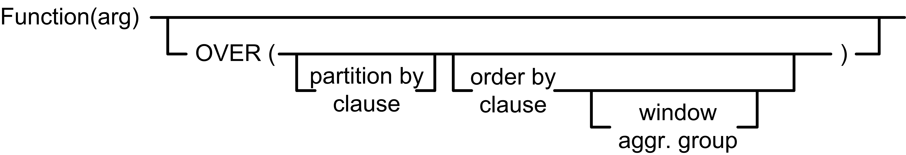
Overview Reporting Functions
Motivation and Problem
  Scalar functions as well as grouping + aggregation
  For many advanced use cases not flexible enough
Reporting Functions
  Separate partitioning (grouping) and aggregation via OVER
  Allows local
  partitioning via
  windows and
  ranking/numbering
optional
Aggregation function
Partitioning (similar to GROUP BY)
Sorting order per partition
Window definition wrt current tuple

Slide 43
Reporting Functions – Aggregation Function
Semantics
  Operates over window and returns value for every tuple
  RANK(), DENSE_RANK(), PERCENT_RANK(), CUME_DIST(), ROW_NUMBER()
Example
SELECT Year, Quarter,
RANK() OVER (ORDER BY Revenue ASC) AS Rank1,
DENSE_RANK() OVER (ORDER BY Revenue ASC) AS DRank1,
FROM R
Year | Quarter | Revenue
2004 | 1 | 10
2004 | 2 | 20
2004 | 3 | 10
2004 | 4 | 20
2005 | 1 | 30
Year | Quarter | Rank1 | DRank1
2004 | 1 | 1 | 1
2004 | 3 | 1 | 1
2004 | 2 | 3 | 2
2004 | 4 | 3 | 2
2005 | 1 | 5 | 3
OVER() represents all tuples

Slide 44
Reporting Functions – Partitioning
Semantics
  Select tuples for aggregation via PARTITON BY <attribute-list>
Example
SELECT Year, Quarter, Revenue,
SUM(Revenue) OVER(PARTITION BY Year)
FROM R
Year | Quarter | Revenue
2004 | 1 | 10
2004 | 2 | 20
2004 | 3 | 10
2004 | 4 | 20
2005 | 1 | 30
Year | Quarter | Revenue | SUM
2004 | 1 | 10 | 60
2004 | 2 | 20 | 60
2004 | 3 | 10 | 60
2004 | 4 | 20 | 60
2005 | 1 | 30 | 30

Slide 45


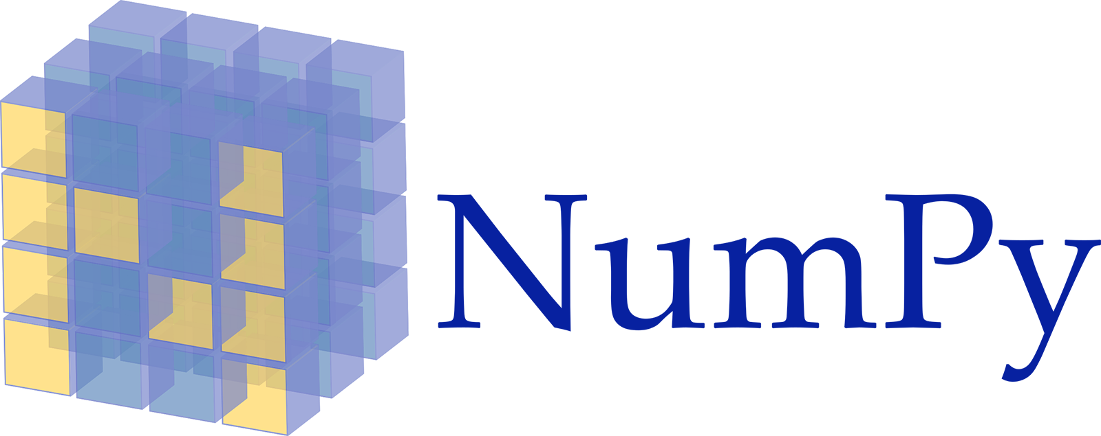

Reporting Functions – Partition Sorting
Semantics
  Define computation per partition via ORDER BY <attribute-list>
  Note: ORDER BY allows cumulative computation → cumsum()
Example
SELECT Year, Quarter, Revenue,
SUM(Revenue) OVER(PARTITION BY Year ORDER BY Quarter)
FROM R
Year | Quarter | Revenue
2004 | 1 | 10
2004 | 2 | 20
2004 | 3 | 10
2004 | 4 | 20
2005 | 1 | 30
Year | Quarter | Revenue | SUM
2004 | 1 | 10 | 10
2004 | 2 | 20 | 30
2004 | 3 | 10 | 40
2004 | 4 | 20 | 60
2005 | 1 | 30 | 30

Slide 46
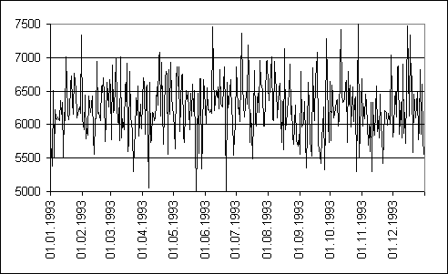
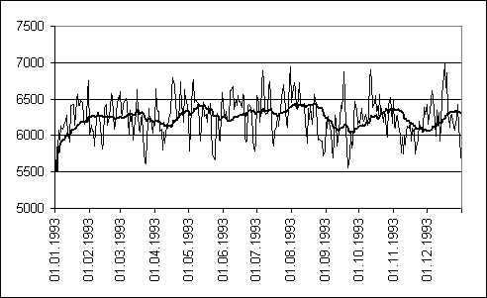
Reporting Functions – Windowing
Measurements
Moving AVGs
Semantics
  Define window for computation
  (e.g., for moving average, cumsum)
Example
[Viktor Leis, Kan Kundhikanjana, Alfons Kemper, Thomas Neumann: Efficient Processing of Window Functions in Analytical SQL Queries. PVLDB 2015]
Year | Quarter | Revenue
2004 | 1 | 10
2004 | 2 | 20
2004 | 3 | 10
2004 | 4 | 20
2005 | 1 | 30
SELECT Year, Quarter, Revenue,
AVG(Revenue)
OVER (ORDER BY Year, Quarter
ROWS BETWEEN 1 PRECEDING
AND CURRENT ROW)
FROM R
Year | Quarter | Revenue | AVG
2004 | 1 | 10 | 10
2004 | 2 | 20 | 15
2004 | 3 | 10 | 15
2004 | 4 | 20 | 15
2005 | 1 | 30 | 25

Slide 47
Summary and Q&A
Data Warehousing (DWH)
  DWH architecture
  Multidimensional modeling
Extraction, Transformation, Loading (ETL)
  ETL process, errors, and data flows
SQL/OLAP Extensions
  Multi-grouping operations
  Reporting functions
Next Lectures (Data Integration Architectures)
  03 Message-oriented Middleware, EAI, and Replication [Oct 30]
  04 Schema Matching and Mapping [Nov 06]
  05 Entity Linking and Deduplication [Nov 13]
  06 Data Cleaning and Data Fusion [Nov 20]
“There is a profound cultural assumption in the business world that if only we could see all of our data, we could manage our businesses more effectively. This cultural assumption is so deeply rooted that we take it for granted. Yet this is the mission of the data warehouse, and this is why the data warehouse is a permanent entity […] even as it morphs and changes its shape.”
-- Ralph Kimball, Joe Caserta;
2004

