Slide 1

Data Integration and Large-scale Analysis (DIA)
03 Replication and Message-oriented Middleware
Prof. Dr. Matthias Boehm
Technische Universität Berlin
Berlin Institute for the Foundations of Learning and Data
Big Data Engineering (DAMS Lab)
Last update: Oct 24, 2025

Slide 2

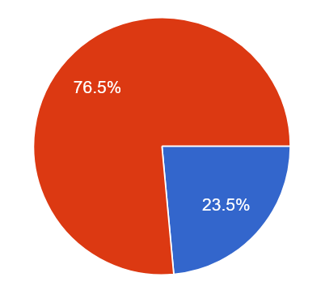


Announcements / Administrative Items
#1 Video Recording
  Hybrid lectures: in-person BH-N 243, zoom live streaming, video recording
  https://tu-berlin.zoom.us/j/9529634787?pwd=R1ZsN1M3SC9BOU1OcFdmem9zT202UT09
#2 Project Selection
  Binding project/exercise selection by Oct 31
  Via the following form (so far 34):
https://tinyurl.com/aytk6bw6

Slide 3
Agenda
Motivation and Terminology
Distributed TX & Replication Techniques
Asynchronous Messaging
Message-oriented Integration Platforms

Slide 4
Motivation and Terminology

Slide 5

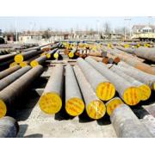


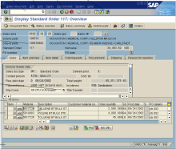
Recap: Information System Pyramid
Operational Systems
Strategic
Systems
Analytical Systems
DSS
Vertical Integration
(e.g., ETL)
Lecture 02
DWH
Material
ERP
CRM
SCM
eCommerce
Horizontal Integration (e.g., EAI)
Lecture 03 (today)

Slide 6

Messaging
[Credit: https://www.gstatic.com/
onebox/dictionary/etymology]
Def: Message
  Piece of information in certain structure
  Send from source (transmitter) over channel to destination (receiver)
  Syntax: different message formats (binary, text, XML, JSON, Protobuf)
  Semantic: different domain-specific message schemas (aka data models)
Synchronous Messaging
  Strict consistency requirements
  Overhead for distributed transactions via 2PC
  Low local autonomy, usually data-driven
Asynchronous Messaging
  Loose coupling, eventual consistency requirements
  Batching for efficient replication and updates
  Latency of update propagation
S2
S1
S3
S1
S2

Slide 7
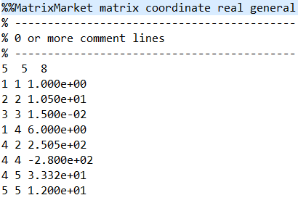
Types of Data Formats
General-Purpose Formats
  CLI/API access to DBs, KV-stores, doc-stores, time series DBs, etc
  CSV (comma separated values)
  JSON (javascript object notation), XML, Protobuf
Sparse Matrix Formats
  Matrix market: text IJV (row, col, value)
  Libsvm: text compressed sparse rows
  Scientific formats: NetCDF, HDF5
Large-Scale Data Formats
  ORC, Parquet (column-oriented file formats)
  Arrow (cross-platform columnar in-memory data)
Domain-specific Formats: often binary, structured text, XML

Slide 8
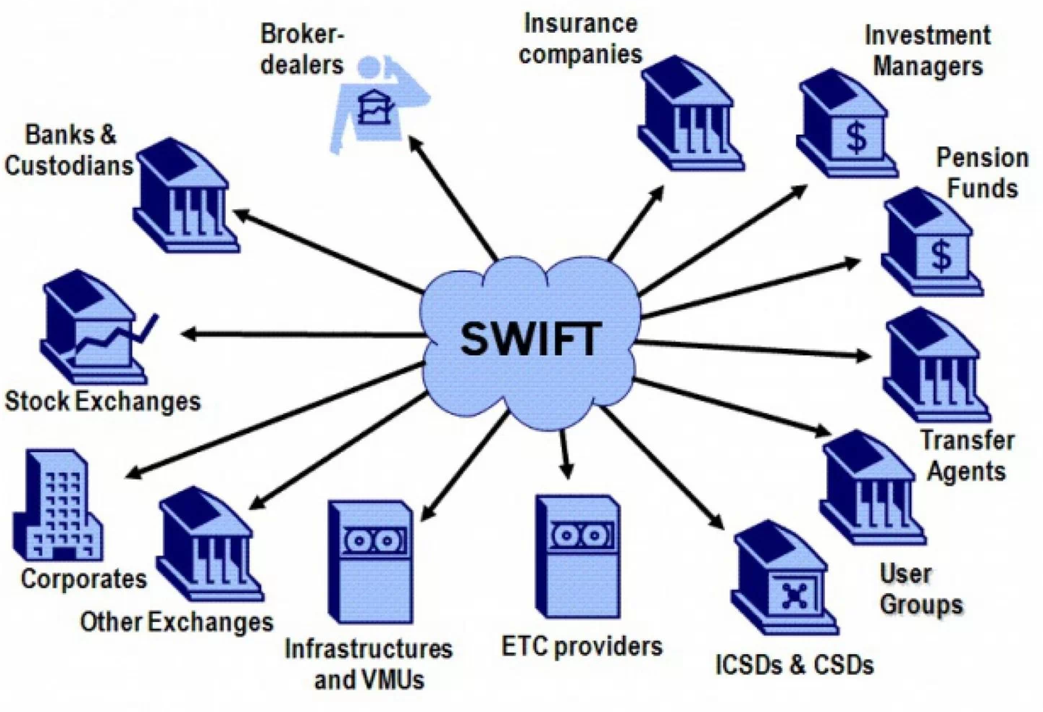
Example Domain-specific Message Formats
Finance: SWIFT
  Society for Worldwide Interbank Financial Telecommunication
  >10,000 orgs (banks, stock exchanges, brokers and traders)
  Network and message formats for financial messaging
  MT and MX (XML, ISO 20022) messages
Health Care: HL/7, DICOM
  Health Level 7 (HL7) messages for clinical/admin data exchange (v2.x structured text msgs, v3 XML-based msgs)
  Digital Imaging and Communications in Medicine (DICOM)
Automotive: ATF, MDF
  Association for Standardisation of Automation and Measuring Systems (ASAM)
  E.g., Open Transport Data Format (ATF), Measurement Data Format (MDF), calibrations (CDF),
  auto-lead XML (ADF), open platform communications (OPC)
➔ Sometimes Large-scale analytics over histories of messages (e.g., health care analytics,
fraud detection, money laundering)
[https://ihodl.com]

Slide 9
Types of Message-Oriented Middleware
#1 Distributed TXs & Replication
#2 Message Queueing
  Persistent message queues with well-defined delivery semantics
  Loose coupling of connected systems or services (e.g., availability)
#3 Publish Subscribe
  Large number of subscribers to messages of certain topics/predicates
  Published messages forwarded to qualifying subscriptions
#4 Integration Platforms
  Inbound/outbound adapters for external systems
  Sync and async messaging, message transformations, enrichment

Slide 10
Distributed TX & Replication Techniques

Slide 11
Distributed Database Systems
Global
Q
DB₁
Distributed DBS
  Distributed database: Virtual (logical) database
  that appears like a local database but consists
  of multiple physical databases
  Multiple local DBMS, components for global query processing
  Terminology: virtual DBS (homogeneous), federated DBS (heterogeneous)
Challenges
  Tradeoffs: Transparency – autonomy, consistency – efficiency/fault tolerance
  #1 Global view and query language → schema architecture
  #2 Distribution transparency → global catalog
  #3 Distribution of data → data partitioning
  #4 Global queries → distributed join operators, etc
  #5 Concurrent transactions → 2PC
  #6 Consistency of copies → replication
Q’
Q’’’
Q’’
DB₂
DB₄
DB₃
Beware: Meaning of “Transparency” (invisibility) here

Slide 12
Two-Phase Commit (2PC)
Recap: Database Transaction
  A transaction (TX) is a series of steps that brings a database from
  a consistent state into another (not necessarily different) consistent state
  ACID properties (atomicity, consistency, isolation, durability)
Problems in Distributed DBS
  Node failures, and communication failures (e.g., network partitioning)
  ➔ Distributed TX processing to ensure consistent view
  (atomicity/durability)
Two-Phase Commit (via 4*(n-1) msgs)
  Phase 1 PREPARE: check for successful completion, logging
  Phase 2 COMMIT: commit/abort, release locks,
  and other cleanups
  What happens if nodes unavailable, or report errors on prepare
Global
TX
Coordinator
ready
DB₁
ready
prepare
TX
TX
prepare
commit
TX
commit
DB₂
DB₄
DB₃
ready
Cohorts
prepare
commit

Slide 13

Two-Phase Commit (2PC), cont.
Excursus: Wedding Analogy
  Coordinator: marriage registrar
  Phase 1: Ask for willingness
  Phase 2: If all willing, declare marriage
#1 Problem: Many Messages
  4(n-1) messages in successful case, otherwise additional msgs
#2 Problem: Blocking Protocol
  Local node PREPARE → FAILED ➔ TX is guaranteed to be aborted
  Local node PREPARE → READY ➔ waiting for global response
  Failure of coordinator+cohort, or participating coordinator → outcome unknown
Other Problems
  Atomicity in heterogeneous systems w/o XA
  Deadlock detection, optimistic concurrency control, etc
Note: APIs for automatic vs programmatic 2PC

Slide 14
Extended Distributed Commit Protocols
2PC Improvements
  Hierarchical Commit: establish message tree from coordinator to local nodes
  ➔ parallelization of message handling over inner nodes
  Presumed Abort: assume abort if there are no commit log entries
  ➔ asynchronous logging of aborts, no ACK on abort
1PC (fewer messages)
  Combine TX operations w/ PREPARE to reduce 2(n-1) messages
  Local nodes enter waiting state earlier
3PC (non-blocking)
  a) CAN COMMIT? Yes/no
  b) PREPARE COMMIT? Ack
  c) COMMIT? Ack
  Cohorts can collectively decide on commit if at least one in PREPARE-COMMIT
Protocol | # Msgs
1PC | 2(n-1)
2PC | 4(n-1)
3PC | 6(n-1)

Slide 15
Replication Overview
T1
Replication Transparency
Replication
  Redundancy of stored fragments
  Availability/efficiency (read) vs
  update overhead / storage
Replication
Techniques
VDBMS
Node 1
Replication
Node 2
Copy-Update Strategies
All
Selected
ROWA
ROWAA
Predetermined
Consensus
Primary Copy
Majority Consensus
Dynamic Voting
Hierarchical Quorum

Slide 16


Replication Techniques
logical
ROWA
  Read-One/Write-All
  Read: good performance/availability
  Write: high overhead and
  only successful if all available
ROWAA
  Read-One/Write-All-Available
  Relaxed availability requirement
  for write operations
physical
logical
physical
„Update anywhere-anytime-anyway transactional replication has unstable behavior as the workload scales up: a ten-fold increase in nodes and traffic gives a thousand fold increase in deadlocks or reconciliations. Master copy replication
(primary copy) schemes reduce this problem.”
[Jim Gray, Pat Helland, Patrick E. O'Neil, Dennis Shasha: The Dangers of Replication and a Solution, SIGMOD 1996]

Slide 17
Replication Techniques, cont.
Primary Copy
  Update single primary copy synchronously
  Asynchronous propagation of updates to other replicates, read from all
  Pro: Higher update performance, good locality, and availability
  Con: Potentially stale read on secondary copies (w/ and w/o locks)
  Load balancing: place PC of different objects on different nodes
Primary Copy
SC₁
Secondary Copies
T1: write r₁(x)
PC
SC₂
sync
async
SC₃

Slide 18


Replication Techniques, cont.
Consensus Protocols
  Basic idea: voting if read/write access is permissible (w.r.t. serializability)
  Each replicate has vote → all votes Q
  Read quorum Q_{R} and write quorum Q_{W}
#1 Majority Consensus
  Read requires Q_{R} > Q/2, lock all and read newest replica
  Write requires Q_{W} > Q/2, lock and update all
#2 Dynamic Quorums
  Problem: network partitioning → retain vote for updated replica
#3 Hierarchical Quorums
  Obtain majority of nodes (here two)
  in multiple levels of the tree
Overlap Rules:
Q_{R} + Q_{W} > Q
Q_{W} > Q/2
g₁
g₂
g₃
1
2
3
4
5
6
7
8
9

Slide 19
Asynchronous Messaging

Slide 20

Message Queueing
Message
  Atomic packet of data + meta data, wrapped as a message
Message Queue
  FIFO or priority queue of messages
  In-memory, sometimes with persistent storage
  backend and transactional semantics
  Internal IDs, receive time
Remote Message Queues
  Loose coupling of applications
  (no direct API calls, etc)
  Independent of HW and OS
4
Storage
3
2
App 1
App 2
Message channel

Slide 21
Recap: Message Delivery Guarantees
#1 At Most Once
  “Send and forget”, ensure data is never counted twice
  Might cause data loss on failures
#2 At Least Once
  “Store and forward” or acknowledgements from receiver,
  replay stream from a checkpoint on failures
  Might create incorrect state (processed multiple times)
#3 Exactly Once
  “Store and forward” w/ guarantees regarding state updates and sent msgs
  Often via dedicated transaction mechanisms

Slide 22

BREAK and Test Yourself!
Assume a message-oriented middleware with a single FIFO message queue. Indicate, in the table below, true (✓) properties of the following three message delivery guarantees. [5 points]
 | At Most Once | At Least Once | Exactly Once
Requires Message Persistence
Requires Delivery TX Mechanism
Prevents Message Outrun
Prevents Message Loss
Prevents Message Double Delivery

Slide 23


Example Systems
IBM MQSeries
  Message-oriented middleware for async queue communication
  Connections/objects: MQCONN, MQDISC, MQOPEN, MQCLOSE
  Queue ops: MQCRTMH, MQPUT, MQGET, MQSET, MQINQ, MQSTAT
  Transactions: MQBEGIN, MQBACK, MQCMIT
JMS (Java Message Service)
  J2EE API of messaging services in Java (messages, queues, sessions, etc)
  JMS providers: e.g., IBM Websphere MQ, Apache ActiveMQ, RabbitMQ
AWS Simple Queueing Service (SQS)
  Message queueing service for loose coupling of micro services
  Default queue: best effort order, at-least-once, high throughput
  FIFO: guarantees FIFO order, and exactly-once

Slide 24
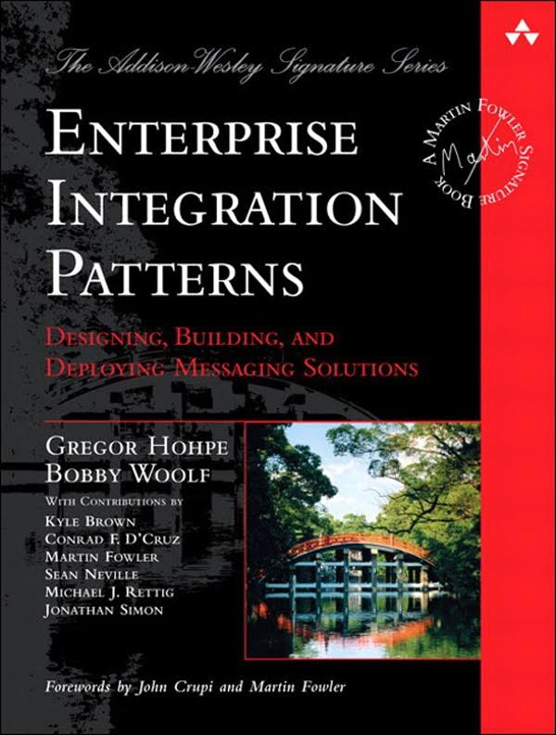

[Gregor Hohpe, Bobby Woolf: Enterprise Integration Patterns, Addison-Wesley, 2004]
Parallel Message Processing
#1 Pipeline Parallelism
  “Pipes and filters”: leverage pipeline parallelism
  of chains of operators
  More complex w/ routing / control flow
  (possible via punctuations)
#2 Operator Parallelism
  Multi-threaded execution of multiple messages within one operator
  (pattern “competing consumers”)
  Requires robustness against partial out-of-order, or resequencing
#3 Key Range Partitioning
  Explicit routing to independent pipelines
  (patterns “message router”, “content-based router”)
  Ordering requirements only within each pipeline
o₁
o₂
o₃
o₁
o₂
o₃
o₁
o₂
o₃
o₁
o₂
o₃
o₁
o₂
o₃
o₁
o₂
o₃

Slide 25
Publish/Subscribe Architecture
Overview
Publish-Subscribe
(Pub/Sub)
Key Characteristics
  Often imbalance between few publishers and many subscribers
  Topics: explicit or implicit (e.g., predicates) groups of messages to publish into or subscribe from
  Addition and deletion of subscribers rare compared to message load
  ECA (event condition action) evaluation model
  Often at-least-once guarantee
M
Subscriber 1
N
Publisher 1
Subscriber 2
Topics
Topics
Topics
Publisher 2
Subscriber 3
Subscriber 4
Alternative Exercise:
Streaming Full Text Search
[https://mboehm7.github.io/teaching/ws2425_dia/DIA_2024_Exercise.pdf]

Slide 26
Publish/Subscribe Architecture, cont.
Subscriber Filtering
  Complex predicates of range filters, equi-predicates, and negation
  Goal: Avoid naïve scan over all subscriber predicates / topics
Matching Algorithm
  Matching event against a set of subscriptions
  Approach: sorting and
  parallel search tree
[Guruduth Banavar et al: An Efficient Multicast Protocol for Content-Based Publish-Subscribe Systems. ICDCS 1999]
*
1
a1
*
2
*
2
a2
1
Example Publish
{a₁=1, a₂=2, a₃=3, a₄=1, a₅=2}
*
3
*
3
1
2
*
3
a3
*
1
1
1
2
1
2
*
1
1
2
1
*
a4
4
*
3
2
1
*
2
3
*
1
2
3
a5
Notes:
Note: WL Subskriptionssysteme – minor example errors
Note 2: see XGBoost handling of default paths for missing values

Slide 27

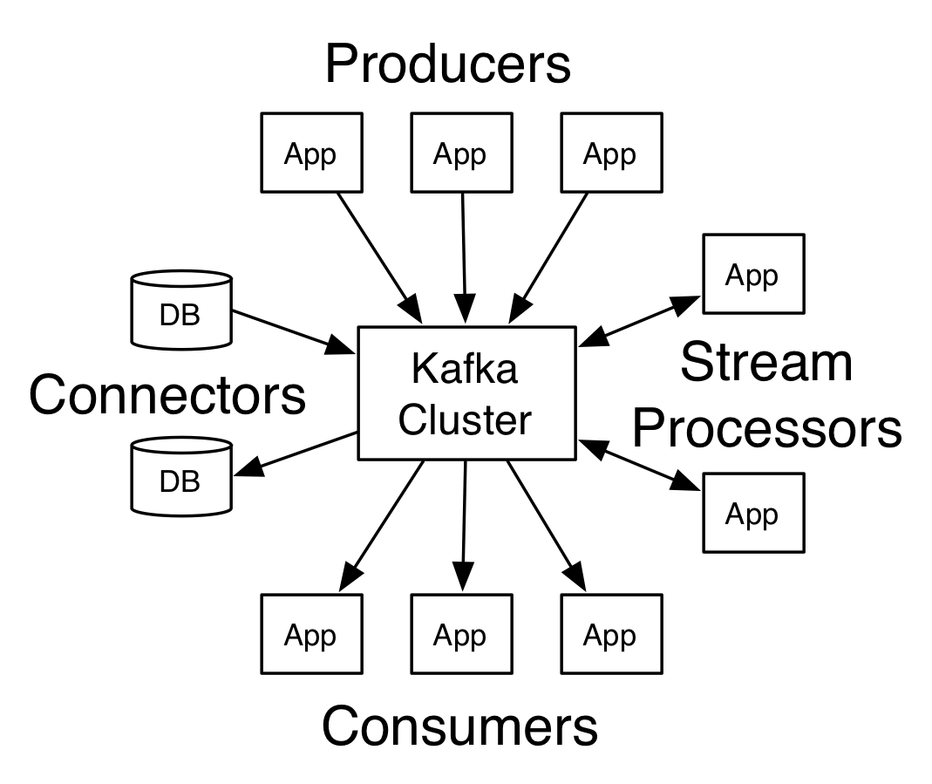
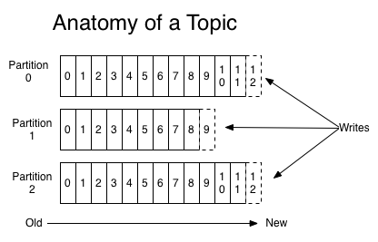
Apache Kafka
[https://kafka.apache.org/
documentation]
Overview System Architecture
  Publish & Subscribe system w/ partitioned topics
  Storage of data streams in distributed,
  fault-tolerant cluster (replicated)
  Configurable retention periods (e.g., days)
  APIs: producer API, consumer API,
  streams API, Connector API
Topics
  Explicit categories w/ user-defined
  (semantic) partitioning
  Partitions are ordered, immutable
  sequences of records (log) w/ offsets
  Current offset per consumer stored
Notes:
Example Deutsche Bahn: 1.6M status messages/day through kafka

Slide 28
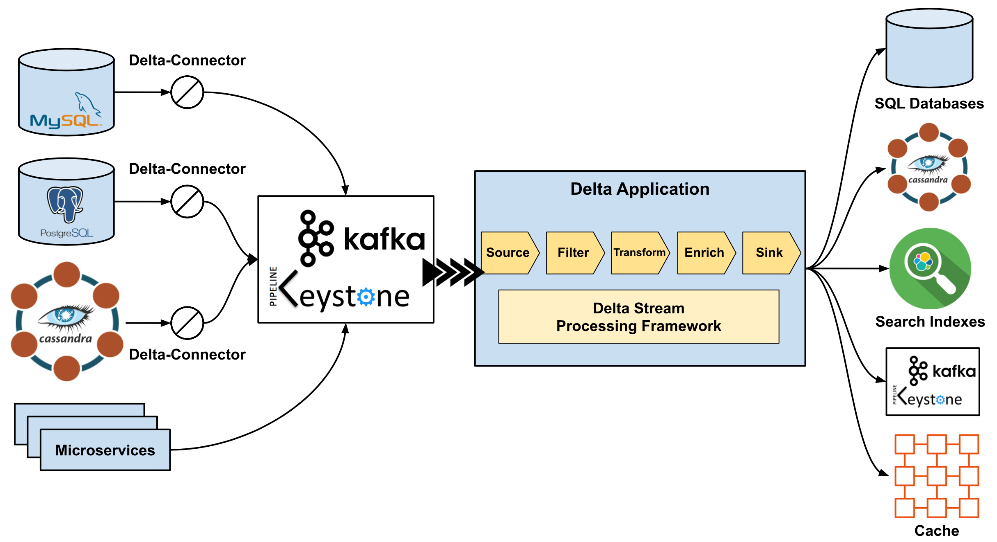
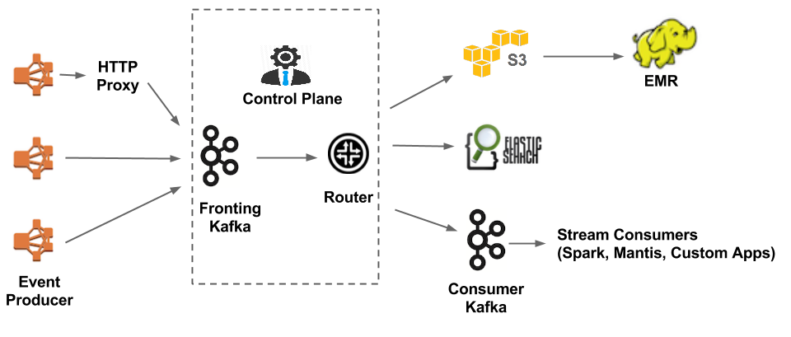
[https://medium.com/netflix-techblog/delta-a-data-synchronization-and-enrichment-platform-e82c36a79aee, Oct 15 2019]
Apache Kafka, cont.
Netflix Delta
  A Data Synchronization
  and Enrichment Platform
  DSL and UDF APIs for custom
  filters and transformations
Netflix Keystone
(Kafka frontend)
  ~500G events/day
  (5M events/s peak)
  ~1.3PB/day
[https://medium.com/netflix-techblog/evolution-of-the-netflix-data-pipeline-da246ca36905]
Notes:
Netflix Keystone since 2015, 100s of event types, 8.6M events/s and 21GB/s peak

Slide 29
Message-oriented Integration Platforms

Slide 30
Overview Message-oriented Integration Platforms
Motivation
  Integration of many applications and systems via common IR
  Beware: syntactic vs semantic data models
Evolving Names
  Enterprise Application Integration (EAI)
  Enterprise Service Bus (ESB)
  Message Broker
Example Systems
  IBM App Connect Enterprise (aka Integration Bus, aka Message Broker)
  MS Azure Integration Services + Service Bus (aka Biztalk Server)
  SAP Process Integration (aka Exchange Infrastructure)
  SQL AG TransConnect
Middleware

Slide 31
Common System
Architecture
Modeling
(Flow Design)
Deploy
External System
SWIFT Inbound Adapter
sync
Orchestration Engine
RDBMS
Outbound Adapter
External System
Message Flows
External System
HL/7 Adapter
File Adapter
External System
async
…
HL/7 Adapter
External System
External System
SAP
Adapter
Scheduler
SAP Adapter
External System
Temporary Data Store

Slide 32
Common System Architecture, cont.
#1 Synchronous Message Processing
  Event: client input message
  Client system blocks until message flow executed to
  output messages delivered to target systems
#2 Asynchronous Message Processing
  Event: client input message from queue
  Client system blocks until input message stored in queue
  Asynchronous message flow processing and output message delivery (streaming)
  Optional acknowledgement, when input message successfully processed
#3 Scheduled Processing
  Event: time-based scheduled message flows (CronJobs)
  Periodic data replication and loading (e.g., ETL use cases)

Slide 33
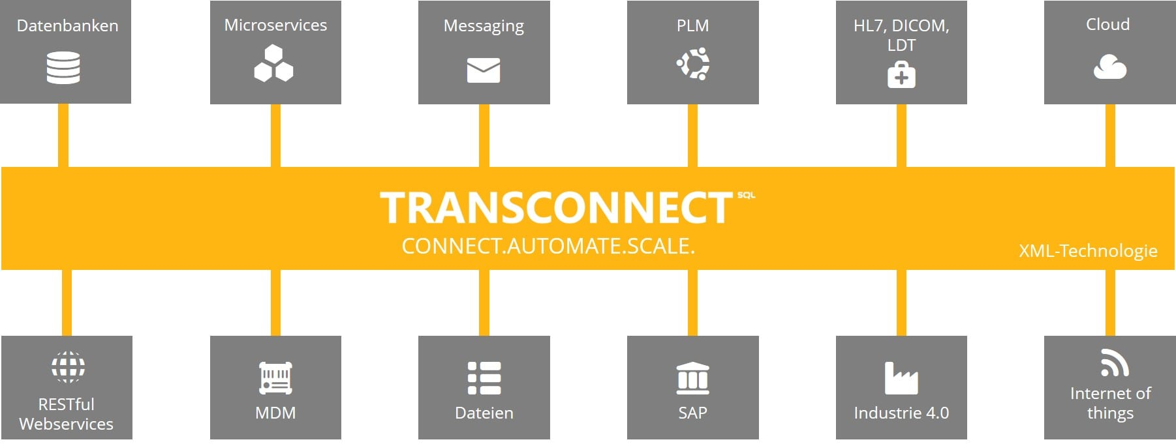
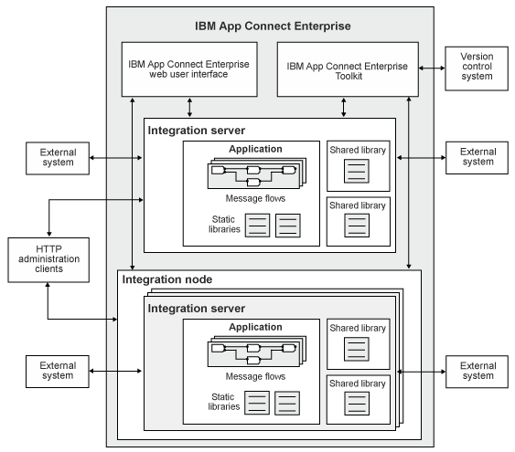
Commercial Systems
[IBM App Connect Enterprise: https://www.ibm.com/support/
knowledgecenter/en/SSTTDS_11.0.0/
com.ibm.etools.mft.doc/ab20551_.htm]
[SQL AG: https://
www.transconnect-online.de/]
[https://azure.microsoft.com/mediahandler/files/
resourcefiles/azure-integration-services/
Azure-Integration-Services-Whitepaper-v1-0.pdf]

Slide 34
Message Delivery Guarantees, cont.
Example
Exactly-Once
Remote ID Maintenance
w/ TX capability
Local ID Maintenance
w/ TX capability
w/o TX capability: at-least-once
[Credit: SQL AG - https://www.transconnect-online.de/]

Slide 35
Recap: XML (Extensible Markup Language)
<?xml version=“1.0“ encoding=“UTF-8“?>
<data>
<student id=“1”>
<course id=“INF.01014UF” name=“Databases”/>
<course id=“706.550” name=“AMLS”/>
</student>
<student id=“5”>
<course id=“706.004” name=“Databases 1”/>
</student>
</data>
XML Data Model
  Meta language to define specific exchange formats
  Document format for semi-structured data
  Well formedness
  XML schema / DTD
XPath (XML Path Language)
  Query language for
  accessing collections of nodes of an XML document
  Axis specifies for ancestors, descendants, siblings, etc
XSLT (XML Stylesheet Language Transformations)
  Schema mapping (transformation) language for XML documents
XQuery
  Query language to extract, transform, and analyze XML documents
/data/student[@id=‘1’]/course/@name
“Databases”
“AMLS”

Slide 36
XSLT in Integration Platforms
Problem
  XML often used as external and internal data representation
  Different schemas (message types) ➔ requires mapping
XSLT Overview
  XSLT processor transforms input XML document
  according to XML stylesheet to output XML documents
  Subtree specifications via XPath, loops, branches,
  built-in functions for text processing, etc
  Streaming: STX or XSLT 3.0 streaming
  CSV and JSON input/output possible
Note: Similar tools/libraries for JSON
tf.xsl
in
xml
XSLT Processor
out
xml

Slide 37
XSLT Example
<?xml version="1.0" encoding="UTF-8"?>
<xsl:stylesheet version="2.0“ xmlns:xsl="http://www.w3.org/1999/XSL/Transform">
<xsl:template match="/">
<xsl:element name=“suppliers">
<xsl:for-each select="/resultsets/resultset[@Tablename='Supplier']/row">
<xsl:element name=“supplier">
<xsl:attribute name=“ID"><xsl:value-of select="Suppkey"/></xsl:attribute>
<xsl:element name="Name"><xsl:value-of select="SuppName"/></xsl:element>
<xsl:element name="Address"><xsl:value-of select="SuppAddress"/></xsl:element>
</xsl:element>
</xsl:for-each>
</xsl:element>
</xsl:template>
</xsl:stylesheet>
<resultssets>
<resultset Tablename=“Supplier”>
<row>
<Suppkey>7</Suppkey>
<SuppName>MB</Suppname>
<SuppAddress>1035 Coleman Rd</SuppAddress>
</row>
<row> … </row>
</resultset>
</resultsets>
<suppliers>
<supplier ID=“7”>
<Name>MB</Name>
<Address>1035 Coleman Rd</Address>
</supplier>
<supplier> … </supplier>
<suppliers>

Slide 38
Summary and Q&A
Distributed TX & Replication Techniques
  Distributed commit protocols
  Different replication techniques
Message-oriented Middleware
  Asynchronous Messaging
  (message queueing, publish/subscribe)
  Message-oriented Integration Platforms
  (system architecture, systems, transformations)
Next Lectures (Data Integration Architectures)
  04 Schema Matching and Mapping [Nov 06]
  05 Entity Linking and Deduplication [Nov 13]
  06 Data Cleaning and Data Fusion [Nov 20]
  07 Data Provenance and Catalogs [Nov 27]
Macroscopic View
Microscopic View

