Slide 1

Data Integration and Large-scale Analysis (DIA)
04 Schema Matching and Mapping
Prof. Dr. Matthias Boehm
Technische Universität Berlin
Berlin Institute for the Foundations of Learning and Data
Big Data Engineering (DAMS Lab)
Last update: Nov 01, 2025

Slide 2

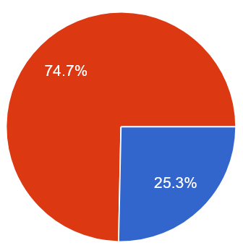
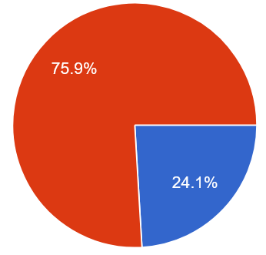
Announcements / Administrative Items
#1 Video Recording
  Hybrid lectures: in-person BH-N 243, zoom live streaming, video recording
  https://tu-berlin.zoom.us/j/9529634787?pwd=R1ZsN1M3SC9BOU1OcFdmem9zT202UT09
#2 Project Selection
  Summary: 133 responses
  Late registrations for exercise is possible,
  anyway written exam with enough capacity
  SystemDS teams get mentor assigned via email by Nov 08,
  reach out otherwise matthias.boehm@tu-berlin.de
  Exercise teams can attend the office hour and start working
WiSe 2024/25:
45 exercise teams
15 SystemDS teams
109 students total
WiSe 2025/26:
79 exercise teams
27 SystemDS teams
163 students total

Slide 3
Agenda
Motivation and Terminology
Schema Detection
Schema Matching
Schema Mapping

Slide 4
Motivation and Terminology

Slide 5
Are you kidding me? I have 100s of systems/apps and 1000s* of tables/attributes
Recap: XSLT Example
<?xml version="1.0" encoding="UTF-8"?>
<xsl:stylesheet version="2.0“ xmlns:xsl="http://www.w3.org/1999/XSL/Transform">
<xsl:template match="/">
<xsl:element name=“suppliers">
<xsl:for-each select="/resultsets/resultset[@Tablename='Supplier']/row">
<xsl:element name=“supplier">
<xsl:attribute name=“ID"><xsl:value-of select="Suppkey"/></xsl:attribute>
<xsl:element name="Name"><xsl:value-of select="SuppName"/></xsl:element>
<xsl:element name="Address"><xsl:value-of select="SuppAddress"/></xsl:element>
</xsl:element>
</xsl:for-each>
</xsl:element>
</xsl:template>
</xsl:stylesheet>
* [Rudolf Munz: Datenmanagement für SAP Applikationen, BTW, 2007: 67,000 tables, 700,000 columns, 10,000 views, 13,000 indexes]
<resultssets>
<resultset Tablename=“Supplier”>
<row>
<Suppkey>7</Suppkey>
<SuppName>MB</Suppname>
<SuppAddress>1035 Coleman Rd</SuppAddress>
</row>
<row> … </row>
</resultset>
</resultsets>
<suppliers>
<supplier ID=“7”>
<Name>MB</Name>
<Address>1035 Coleman Rd</Address>
</supplier>
<supplier> … </supplier>
<suppliers>

Slide 6

Schema Matching and Mapping
Schema Matching
  Given: two or more relational/hierarchical schemas (and data)
  Find schema mappings in terms of logical attribute correspondences
Schema Mapping
  Given: logical attribute correspondences between schemas
  Compile physical schema mapping programs (SQL, XSLT, XQuery, etc)
Well, I don’t even
have a schema
Schema Detection
Schema Matching
Schema Mapping
INSERT INTO Orders
SELECT BELNR,
SUMME, DATUM
FROM Bestellungen

Slide 7
Schema Mapping vs. Schema Integration
Schema Integration
  Use case: DWH schema (lecture 02), virtual/federated DBMS (lecture 03)
  Schema integration: map existing schemas into consolidated schema
  Schema mapping orthogonal, but both deal with semantic and structural heterogeneity
Integrated Schema
Schema Mapping
Schema Mapping
2
4
1
3
DWH
Schema 1
Schema 2
2
2
4
1
3
Schema Mapping
3
Source 1
Source 2

Slide 8
[J. Hammer, M. Stonebraker, and O. Topsakal: THALIA: Test Harness for the Assessment of Legacy Information Integration Approaches. U Florida, TR05-001, 2005]
Recap: Types of Heterogeneity
➔ Scope
Heterogeneity
Semantic Heterogeneity
Structural Heterogeneity
Attribute Heterogeneity
Missing
Data
1. Synonyms/homonyms
6. Nulls (Missing Values)
9. Same attribute in different structure
2. Simple mapping (mathematical)
7. Virtual columns
8. Semantic incompatibility
10. Handling Sets
3. Different data types
11. Attribute name
w/o semantics
4. Complex mappings
5. Language expressions
12. Attribute composition

Slide 9
Schema Detection
Schema Detection
Schema Matching
Schema Mapping
INSERT INTO Orders
SELECT BELNR,
SUMME, DATUM
FROM Bestellungen

Slide 10

Atomic Data Type Detection
Overview
  Problem: Given CSV, JSON, XML files, detect data types of attributes
  Approach: Basic extraction rules, regular expressions over data sample
Example: Schema Inference
  Infer schema for dataframe/dataset columns from sample
  Basic types: Decimal, Boolean, Double, Integer, Long, String
  Infer schema from java objects via class reflection
StructType(
StructField(pid,IntegerType,true),
StructField(name,StringType,true),
StructField(pos,StringType,true),
StructField(jnum,IntegerType,true),
StructField(ncid,IntegerType,true),
StructField(tid,IntegerType,true))
Dataset<Row> ds = sc.read()
.format("csv")
.option("header", true)
.option("inferSchema", true)
.option("samplingRatio", 0.001)
.load("./data/players.csv");
./data/players.csv:
pid,name,pos,jnum,ncid,tid
4614,Hannes Reinmayr,FW,14,1313,258
5435,Miroslav Klose,FW,11,789,144
6909,Manuel Neuer,GK,1,163,308
Notes:
Note: regular expressions + ranges for detecting different numerical types

Slide 11
Structure Extraction from Nested Documents
Structure Extraction Overview
  Problem: JSON/JSONL, XML documents with optional attributes, subtrees
  Approach: Scan data, build maximum tree w/ attached meta data
  Meta data := counts or appearances (e.g., document/line IDs)
Example JSON Schema Extraction
  Structure Identification Graph
  (appearances, data types, etc)
  Reduced Structure
  Identification Graph
[Meike Klettke, Uta Störl, Stefanie Scherzinger: Schema Extraction and Structural Outlier Detection for JSON-based NoSQL Data Stores. BTW 2015]
blogpost
2
_id
2
title
2
author
2
date
2
likes
1
Comment
comments
2
content
2
date
2
Notes:
Note: JSON properties, nested objects, arrays

Slide 12
[Ziawasch Abedjan, Lukasz Golab, Felix Naumann: Data Profiling: A Tutorial. SIGMOD 2017]
Data Profiling
[Dong Deng et al: The Data Civilizer System. CIDR 2017]
#1 Inclusion Dependency (ID) Discovery
  ID from R[X] to S[Y] indicates that all values in R[X] must appear
  in S[Y] → potential indication of FK relationship from R[X] to S[Y]
  Robust inclusion dependency: |R[X] ∈ S[Y]| / |R[X]| > δ
  PK-FK candidate refinement
  (e.g., coverage, similarity, value ranges)
#2 Functional Dependency (FD) Discovery
  FDs indicative of relational schema
  (key candidates, normalization)
  Discover minimal, non-trivial dependencies
  Extend candidates along set containment lattice
    A → C allows pruning {AB} → C (non-minimal)
    NOT(A → B) allows pruning A → BC

Slide 13
[Madelon Hulsebos et al: Sherlock: A Deep Learning Approach to Semantic Data Type Detection. KDD 2019]
Semantic Data Type Detection
Problem
  Detect semantic types of columns (e.g., location, date, name)
  Use cases: improved data cleaning, schema matching via semantic types
Sherlock: DNN-based Type Detection
  78 semantic types from T2Dv2 → VizNet extraction
  1,588 features from each column, incl global stats
  Formulation of type detection as multi-class classification problem
http://webdatacommons.org/
webtables/goldstandardV2.html
(DBPedia, Webtables)
(cardinality, uniqueness, avg #numerical chars)

Slide 14
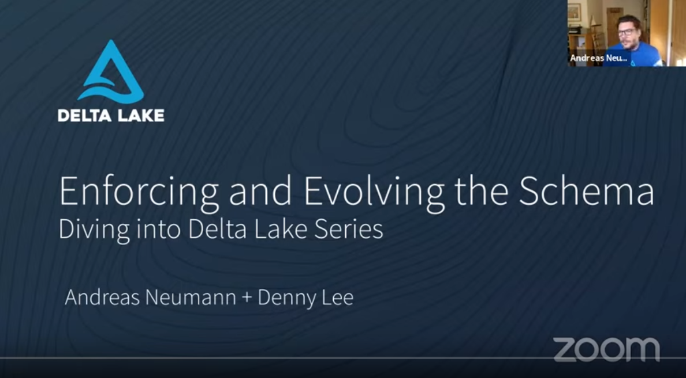
Schema Enforcement and Evolution
Schema Enforcement
  Given schema of syntactic and semantic types
  #1 Raise errors on invalid data ingestion (ACID consistency and atomicity)
  #2 Leverage schema constraints for automatic data cleaning
Schema Evolution
  Incremental modification of schema
  Handle changes of source data (additional columns, different data types)
  Copy vs. in-place modifications (e.g., data type int → string)
  Example: Delta Lake
[Andreas Neumann, Denny Lee: Enforcing and Evolving the Schema – Diving into Delta Lake Series, https://databricks.com/de/blog/
2019/09/24/diving-into-delta-lake-schema-enforcement-evolution.html, 2020]

Slide 15

[Saeed Fathollahzadeh, Essam Mansour, Matthias Boehm: CatDB: Data-catalog-guided, LLM-based, Generation of Data-centric ML Pipelines,
under submission]
LLM-based Schema Refinements
Problems
  #1 Different representations
  for same categorical value
  #2 Concatenated lists /
  composite features
Approach
  Identify candidates of string features
  Create prompt of feature name and distinct values
  Let the LLM (GPT, Gemini, Llama) create a mapping of original to reduce value set
  and infer feature types → iterative refinement through multiple LLM interactions
Results (w/ Gemini-1.5)

Slide 16
Schema Matching
Schema Detection
Schema Matching
Schema Mapping
INSERT INTO Orders
SELECT BELNR,
SUMME, DATUM
FROM Bestellungen

Slide 17
[Philip A. Bernstein, Jayant Madhavan, Erhard Rahm: Generic Schema Matching, Ten Years Later. PVLDB 2011 (test of time award)]
Overview Schema Matching
Motivation
  Large and convoluted schemas (# tables, # attributes, structure)
  Goal: generation of matching candidates (refined by user)
Problem Definition
  Given: two schemas S1 and S2
  Goal: Generate correspondences
  between S1 and S2
  Correspondence:
  relationship between
  M elements in S1 and N elements in S2
  Mapping expression:
  function how elements are related
  (directional or non-directional)
S2
BookInfo
ID | CHAR(15) PK
AuthorID | INT REF AuthorInfo
BookTitle | VARCHAR(128)
ListPrice | FLOAT
DiscPrice | FLOAT
S1
Books
ISBN | CHAR(15) PK
Title | VARCHAR(96)
Author | VARCHAR(64)
Price | FLOAT
AuthorInfo
AuthorID | INT PK
LastName | VARCHAR(32)
FirstName | VARCHAR(32)

Slide 18
System Architecture and Matching Process
Input Schemas
Model Pool
Mapping Pool
S₁
Att1 | Att2 | Att3
S₁
Mappings
Att4 | Att5
[Erhard Rahm, Hong-Hai Do David Aumueller, Sabine Massmann: Matching Large Schemas with COMA++, 2005]
Att1 | Att2 | Att3
DAG IR
S₂
S₂
Mapping Manipulation
Matcher Configs
Matcher 1
matcher
{S₁₁,S₁₂,…}
S₁₁ ↔ S₂₁
S₁₂ ↔ S₂₂
S₁₃ ↔ S₂₃
Matcher 2
S₁
{S₂₁,S₂₂,…}
Matcher 3
S₂
Component Identification
Matcher Execution
Similarity
Combination
Correspon-
dences

Slide 19
[Erhard Rahm, Philip A. Bernstein: A survey of approaches to automatic schema matching. VLDB J. 2001]
Classification of Matching Techniques
Different Types of Matchers
  Schema- vs Instance-based
  Cardinalities: 1:1, 1:N, N:M
  Combined Matchers
  (hybrid, composite)
Schema-based
Instance-based
Element
Structure
Element
Linguistic
Constraints
Constraints
Linguistic
Constraints
Name sim, description sim
Type sim,
key properties
parent-child, graph structure
Word freq, key terms
Value patterns and ranges

Slide 20
Selected Matchers
Schema Matching
Schema-based
Instance-based
Linguistic Approaches
  Syntactic
    Affix (suffix, prefix)
    N-grams
    EditDistance
  Semantic
    Synonyms
    Hierarchy → taxonomies
    Language → dictionaries
Example Trigram
  Jaccard Similarity
  = 2|S1 ∩ S2| / (|S1|+|S2|)
  = 8/16 = 0.5
Name | Street | City
Emma Schmidt | Luisenstrasse 90 | Munich, 80333
Klaus Schumann | Koenigsstrasse 7 | Dresden, 01199
Firstname | Lastname | Street | Num | ZIP | City
Susanne | Froehlich | Weststrasse | 2 | 01187 | Dresden
Thomas | Kunze | Dammweg | 45 | 12437 | Berlin
Name |  |  |  |  | __N | _Na | Nam | ame | me_ | e__
Lastname | __L | _La | Las | ast | stn | tna | nam | ame | me_ | e__
(alignment irrelevant – bag semantics)

Slide 21
Selected Matchers, cont.
Schema Matching
Schema-based
Instance-based
Constraint-Based Approaches
  Elements: data types, domains, key attributes, constraints
  Structure: relationships between elements, combinations of data types,
  neighborhood, specialization and composition
Example Similarity Flooding
  Create map pairs A x B (PCG)
  Propagation coefficients: 1/|out(v)| (IPG)
  Initial sim, adjusted by neighborhood sim until fixpoint (converged)
[Sergey Melnik, Hector Garcia-Molina, Erhard Rahm: Similarity Flooding: A Versatile Graph Matching Algorithm and Its Application to Schema Matching. ICDE 2002]

Slide 22
Selected Matchers, cont.
Schema Matching
Schema-based
Instance-based
Problem Schema-based
  Attribute names might differ vastly (CustNa vs Name, CustSt vs Street)
  ➔ Instance-based matching, but need for data
#1 Linguistic Approaches
  Word frequencies, bigrams, trigrams, etc
  Keywords, abbreviations
#2 Constraint-based Approaches
  Elements: data types and lengths,
  value domains, patterns
  Structure: combinations of element constraints
Street | City
Luisenstrasse 90 | Munich, 80333
Koenigsstrasse 7 | Dresden, 01199
Street | Num | ZIP | City
Weststrasse | 2 | 01187 | Dresden
Dammweg | 45 | 12437 | Berlin
City
Munich, 80333
Dresden, 01199
5-letter numeric codes
ZIP
01187
12437

Slide 23
Combining Matchers
#1 Reuse
  Exploitation of transitive similarity
  Fast and efficient matching, but potential for lost mappings
  (e.g., S3 misses attributes)
#2 Refinement
  Chaining: matcher M_{n+1} works on mappings of M_{n}
  ➔ efficiency but potential for lost mappings
  Context-sensitive matching: Matching context of schema components,
  matching elements within components
#3 Composite Matchers
  Select combination of complementary
  matchers in form of ensemble
  Aggregation of similarity (e.g., trigram, synonym → avg/min/max)
S1 ≅ S3 ∧ S3 ≅ S2
→ S1 ≅ S2
Matcher 1
Matcher 2
Matcher 1
Matcher 2
Combiner
Matcher 3

Slide 24
[Philip A. Bernstein, Jayant Madhavan, Erhard Rahm: Generic Schema Matching, Ten Years Later. PVLDB 2011]
Efficiency and Scalability
Problem
  Large schemas and matching complexity; all-pair problem O(n*m)
#1 Early Search Space Pruning
  Faster matchers used to eliminate unlikely matches
  Reduce schema sizes for expensive matchers
#2 Partition-based Matching
  Blocking into independent fragments
  Match elements of similar fragment
#3 Parallel Matching
  Process different steps/fragments in parallel
#4 Custom Similarity Matrices
  Sparse matrices (adjacency lists) w/ nesting
Divide & Conquer
1
1
1
2
3
3
2
1
2
[Philip A. Bernstein, Sergey Melnik, Michalis Petropoulos, Christoph Quix: Industrial-Strength Schema Matching. SIGMOD Record 2004]

Slide 25
DIA WS19/20 Project: Stable Marriage Algorithms in Linear Algebra: https://github.com/apache/systemds/
blob/main/scripts/builtin/stableMarriage.dml
Excursus: Stable Marriage Problem
Problem Definition
  For common correspondences, global schema matching relates to the
  stable marriage (1:1) and hospitals/residence (1:N) problems
Example Stable Marriage
  Stable matching: there is no match (A, B), preferable
  for both A and B over their current matches
  Input are bidirectional similarity
  (preference ranking)
  Deferred Acceptance Algorithm
Alternatively:
Maximal weight matching
A, B, C, D
1: (3,6), (9,3), (0,9), (6,6)
2: (6,9), (0,0), (9,0), (3,9)
3: (3,0), (9,6), (6,3), (0,0)
4: (6,3), (0,9), (3,6), (9,3)
while(!converged)
#1 unmatched As propose to
highest-ranked, unasked Bs
#2 Bs accept highest-ranked
proposal (even if matched)
Group A:
1: B, D, A, C
2: C, A, D, B
3: B, C, A, D
4: D, A, C, B
Group B:
A: 2, 1, 4, 3
B: 4, 3, 1, 2
C: 1, 4, 3, 2
D: 2, 1, 4, 3
Notes:
Note: unasked Bs in algorithm refers to Bs that have not been asked by a specific A

Slide 26
Schema Matching Tools
Commercial Tools
  Most message-oriented middleware, EAI, ETL tools provide mapping UIs
  (w/ basic string similarity for matching)
  Many data modeling tools also support matching/mapping
Academic Prototypes
[Erhard Rahm: Towards Large-Scale Schema and Ontology Matching. Schema Matching and Mapping 2011]

Slide 27

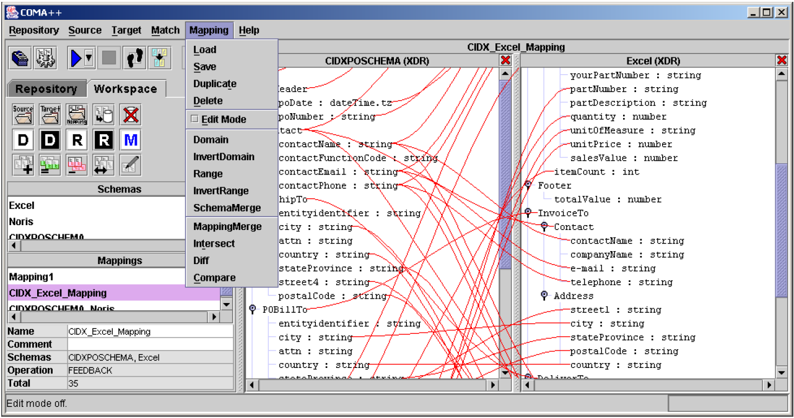
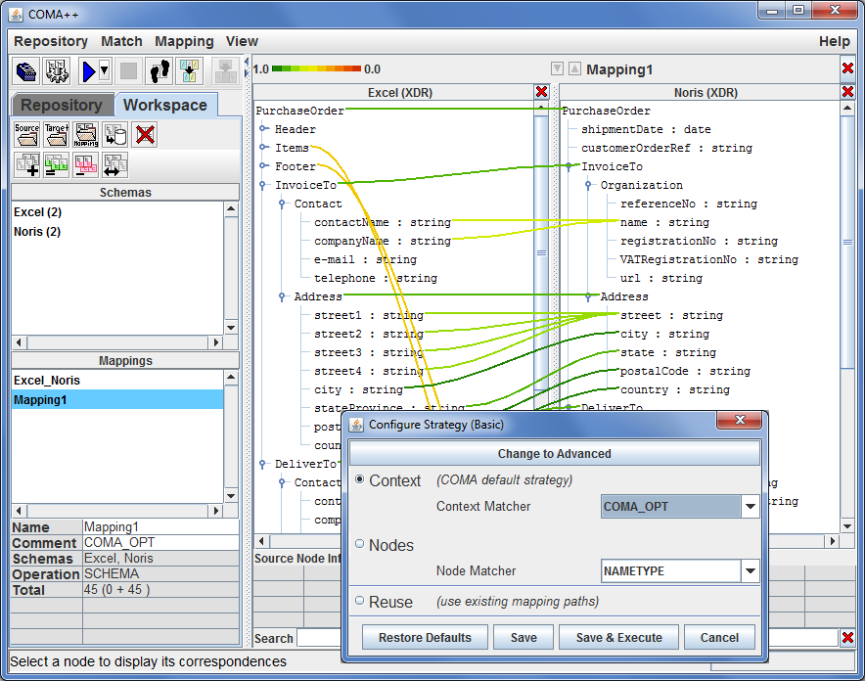
Schema Matching Tools, cont.
COMA system for combining match algorithms in a flexible way)
COMA ++
COMA 3.0
  2011/2012
  Ontology Merging
  Workflow Management
[Hong Hai Do, Erhard Rahm: COMA - A System for Flexible Combination of Schema Matching Approaches. VLDB 2002]
[David Aumueller, Hong Hai Do, Sabine Massmann, Erhard Rahm: Schema and ontology matching with COMA++. SIGMOD 2005]
[Credit:
https://dbs.uni-leipzig.de/
de/Research/coma.html]

Slide 28
[Felix Naumann: Informationsintegration – Schema Mapping, HPI Lecture, 2012]
Schema Mapping
Schema Detection
Schema Matching
Schema Mapping
INSERT INTO Orders
SELECT BELNR,
SUMME, DATUM
FROM Bestellungen

Slide 29
Schema Mapping Overview
Problem
  Given: two schemas w/ high-level mapping
  Generate concrete transformation program/query (SQL, XSLT, XQuery)
Schema Mapping Process (systematic lowering)
  High-level mapping: intra- and inter-schema correspondences
  Low-level mapping: mapping that ensures consistency with constraints of target schema and user intend
  Transformation query: transformation from one into the other schema, backend-specific (query generation)
Example
Article
artPK
title
Publication
pubID
title
date
Transformation Query:
INSERT INTO Publication
SELECT artPK, title, NULL
FROM Article

Slide 30

Mapping Interpretations
Without Intra-Schema
Correspondences
INSERT INTO Publication
(SELECT artPK AS pubID,
title AS title,
NULL AS date,
NULL AS author
FROM Article)
UNION ALL
(SELECT NULL AS pubID,
NULL AS title,
NULL AS date,
name AS author
FROM Author)
Article
artPK
title
pages
Publication
pubID
title
date
author
Author
artFK
name

Slide 31
Mapping Interpretations, cont.
With Intra-Schema
Correspondences
INSERT INTO Publication
SELECT artPK, title,
NULL, name
FROM Article, Author
WHERE artPK = artFK
Article
artPK
title
pages
Publication
pubID
title
date
author
Note: Inner join acts as filter (no articles w/o authors, NOT NULL constraints)
Author
artFK
name
INSERT INTO Publication
SELECT artPK, title, NULL, name
FROM Article LEFT OUTER JOIN Author
ON artPK = artFK

Slide 32
Mapping Interpretations, cont.
From Denormalized to
Normalized Form
  Skolem Function (SK): unique key generation from tuple values t[X]
  of an attribute set X
Publication
title
date
author
Article
artPK
title
pages
INSERT INTO Article
SELECT DISTINCT
SK(title), title, NULL
FROM Publication
Author
artFK
name
INSERT INTO Author
SELECT SK(title), author
FROM Publication

Slide 33
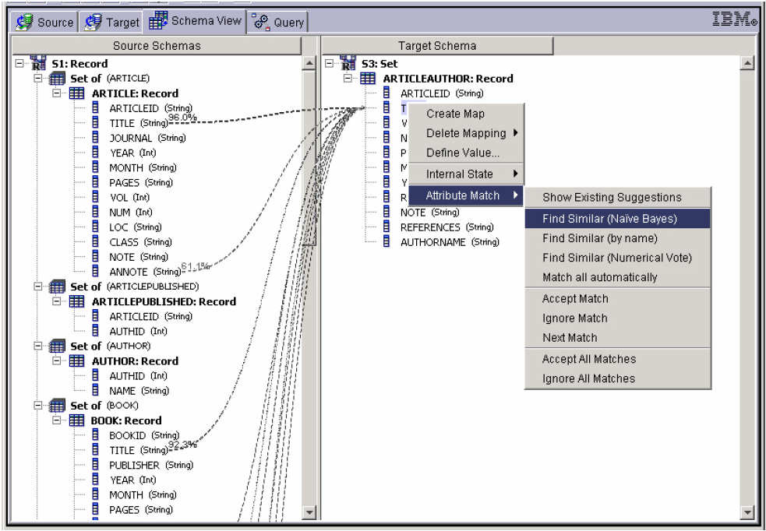
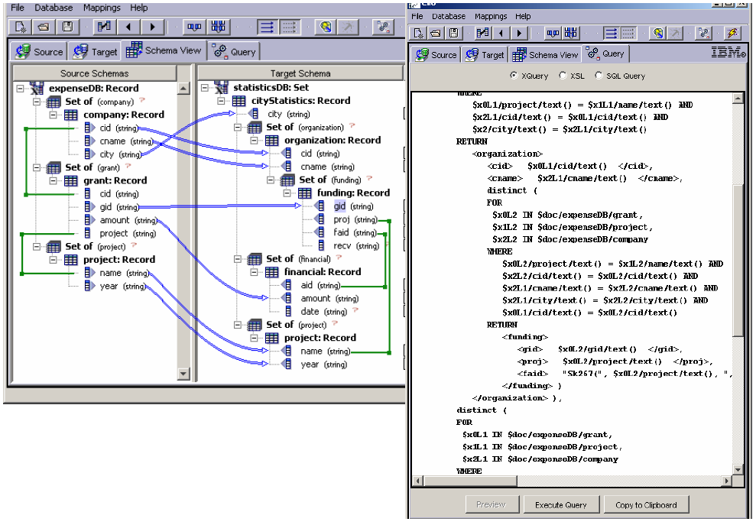
Schema Mapping Tools
Clio (IBM Research – Almaden)
[Laura M. Haas, Mauricio A. Hernández, Howard Ho, Lucian Popa, Mary Roth: Clio grows up: from research prototype to industrial tool. SIGMOD 2005]
[Mauricio A. Hernández, Renée J. Miller, Laura M. Haas: Clio: A Semi-Automatic Tool For Schema Mapping. SIGMOD 2001]

Slide 34
[Saeed Fathollahzadeh, Matthias Boehm: GIO: Generating Efficient Matrix and Frame Readers for Custom Data Formats by Example, SIGMOD 2023]
Excursus: GIO – Generating Readers for
Custom Data Formats
GIO Overview
  Identify mapping rules from custom data formats to frames/matrix by example
  Generate efficient multi-threaded frame/matrix readers
  Support for flat or nested structure, optional key or positional attributes, multiple custom delimiters or prefixes, multi-line records, attribute sequences, co-appearances, and repeating groups of attributes

Slide 35
[Philip A. Bernstein, Sergey Melnik: Model Management 2.0: Manipulating Richer Mappings. SIGMOD 2007]
Summary and Q&A
Motivation and Terminology
Schema Detection
Schema Matching
Schema Mapping
Next Lectures (Data Integration Architectures)
  05 Entity Linking and Deduplication [Nov 13]
  06 Data Cleaning and Data Fusion [Nov 20]
  07 Data Provenance and Catalogs [Nov 27]
“Given the existence of all these tools, why is it still so labor-intensive to develop engineered mappings? To some extent, it is an unavoidable consequence of ambiguity in the meaning of the data to be integrated. If there is a specification of the schemas, it often says little about integrity constraints, units of measure, data quality, intended usage, data lineage, etc. Given that the specification of meaning is weak and the mapping must be precisely engineered, it seems hopeless to fully automate the process anytime soon. A human must be in the loop.”
The 80% Argument

