Slide 1

Data Integration and Large-scale Analysis (DIA)
05 Entity Linking and Deduplication
Prof. Dr. Matthias Boehm
Technische Universität Berlin
Berlin Institute for the Foundations of Learning and Data
Big Data Engineering (DAMS Lab)
Last update: Nov 08, 2025

Slide 2

Announcements / Administrative Items
#1 Video Recording
  Hybrid lectures: in-person BH-N 243, zoom live streaming, video recording
  https://tu-berlin.zoom.us/j/9529634787?pwd=R1ZsN1M3SC9BOU1OcFdmem9zT202UT09
#2 Project Assignments
  133 → 151 project selection responses, no more SystemDS projects accepted
  Emails for project/mentor assignment sent out Nov 08/09
  (if you selected a SystemDS project but got no email, contact matthias.boehm@tu-berlin.de)
#3 PhD Position at DAMS Lab
  Topic: ML system internals, https://www.jobs.tu-berlin.de/en/job-postings/198985
  Application deadline: Nov 21, 2025

Slide 3
Agenda
Motivation and Terminology
Entity Resolution Concepts
Entity Resolution Tools

Slide 4
Motivation and Terminology

Slide 5
Recap: Corrupted/Inconsistent Data
Heterogeneity of Data Sources
  Update anomalies on denormalized data / eventual consistency
  Changes of app/preprocessing over time (US vs us) → inconsistencies
Human Error
  Errors in semi-manual data collection, laziness (see default values), bias
  Errors in data labeling (especially if large-scale: crowd workers / users)
Measurement/Processing Errors
  Unreliable HW/SW and measurement equipment (e.g., batteries)
  Harsh environments (temperature, movement) → aging
No Global Keys
Uniqueness & duplicates
Contradictions & wrong values
Missing Values
[Credit: Felix Naumann]
Ref. Integrity
ID | Name | BDay | Age | Sex | Phone | Zip
3 | Smith, Jane | 05/06/1975 | 44 | F | 999-9999 | 98120
3 | John Smith | 38/12/1963 | 55 | M | 867-4511 | 11111
7 | Jane Smith | 05/06/1975 | 24 | F | 567-3211 | 98120
Zip | City
98120 | San Jose
90001 | Lost Angeles
Typos

Slide 6
[Douglas Burdick, Ronald Fagin, Phokion G. Kolaitis, Lucian Popa, Wang-Chiew Tan: Expressive power of entity-linking frameworks. J. Comput. Syst. Sci. 2019]
Terminology
Entity Linking
  “Entity linking is the problem of creating links among records
  representing real-world entities that are related in certain ways.”
  “As an important special case, it includes entity resolution, which is
  the problem of identifying or linking duplicate entities
Other Terminology
  Entity Linking → Entity Linkage, Record Linkage
  Entity Resolution → Data Deduplication, Entity/Record Matching
Applications
  Named entity recognition and disambiguation
  Archiving, knowledge bases and graphs
  Recommenders / social networks
  Financial institutions (persons and legal entities)
  Travel agencies, transportation, health care
☺
Barack Obama
Barack Hussein Obama II
The US president (2016)
Barack and Michelle are married ….

Slide 7
Example Applications: Classical Deduplication
Example 1: DBLP, ACM, Google Scholar Publications
  (title, authors, venue, year)
  Basic preprocessing via title capitalization, etc
  How about leveraging the linked PDF papers?
Example 2: Amazon, Google Products
  (name, description, manufacturer, price)
  NLP for matching medium and long descriptions, e.g., word embeddings
  How about leveraging the product images (different angles)
Benchmark Datasets
  Availability of ground truth
In practice:
multi-modal data, and feature engineering
https://dbs.uni-leipzig.de/
research/projects/object_matching/
benchmark_datasets_for_entity_resolution
https://dbgroup.ing.unimo.it/
sigmod21contest/

Slide 8

Example Applications: Plagiarism Detection for Autograding
Background
  WS20/21: automatic grading system for Data Management exercises
  Overview: export submissions, run ingestion programs, execute queries,
  compare results and test queries, auto comments/grades, upload
  Problem: Increasing automation requires better plagiarism detection
Plagiarism Detection via Entity Resolution
  https://issues.apache.org/jira/browse/SYSTEMDS-3191 (DIA WiSe23/24)
  Data preparation: file names/properties, runtime, correctness
  Blocking: by programming language, results sets
  Matching
    Exact matches via basic diff + threshold
    Code similarity via SotA embeddings
  Clustering
    Connected components within each block (min sim threshold)
[Fangke Ye et al: MISIM: An End-to-End Neural Code Similarity System. CoRR 2020
arxiv.org/pdf/2006.05265.pdf]

Slide 9
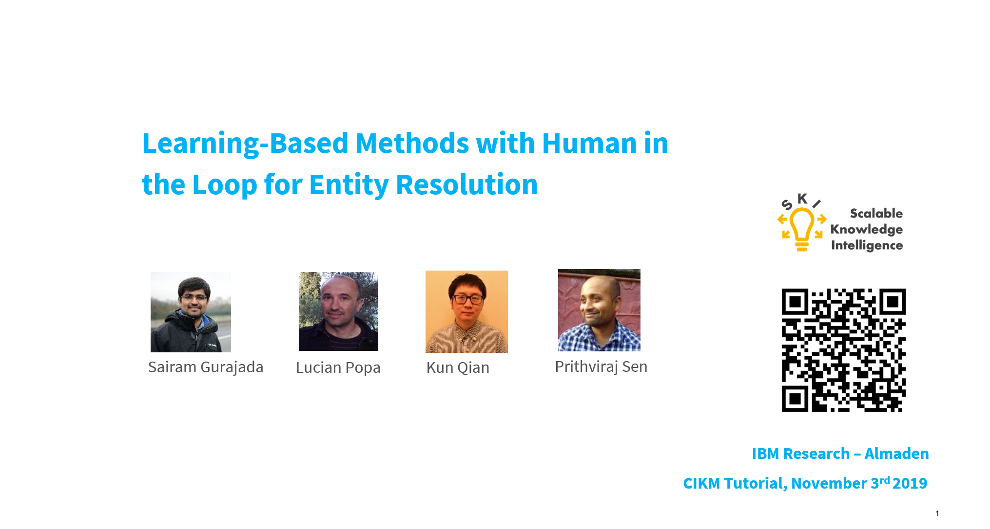
Entity Resolution Concepts
[Xin Luna Dong, Theodoros Rekatsinas: Data Integration and Machine Learning: A Natural Synergy. Tutorials, SIGMOD 2018, PVLDB 2018, KDD 2019]
[Sairam Gurajada, Lucian Popa, Kun Qian, Prithviraj Sen: Learning-Based Methods with Human in the Loop for Entity Resolution, Tutorial, CIKM 2019]
[Felix Naumann, Ahmad Samiei, John Koumarelas: Master project seminar for Distributed Duplicate Detection. Seminar, HPI WS 2016]

Slide 10
[Ivan Fellegi, Alan Sunter: A Theory for Record Linkage, J. American. Statistical Assoc., pp. 1183-1210, 1969]
Problem Formulation
Entity Resolution
  “Recognizing those records in two files which represent identical persons, objects, or events”
  Given two data sets A and B
  Decide for all pairs of records a_{i} – b_{j} in A x B
  if match (link), no match (non-link), or not enough evidence (possible-link)
Naïve Deduplication
  UNION DISTINCT
  via hash group-by or sort group-by
  Problem: only exact matches
➔ Similarity Measures
  Token-based: e.g., Jaccard J(A,B) = |A ∩ B| / |A ∪ B|
  Edit-based: e.g., Levenshtein lev(A,B) → min(replace, insert, delete)
  Phonetic similarity (e.g., soundex, metaphone), Python lib Jellyfish
Name | Position | Affiliation | Research
Matthias Boehm | RSM | IBM Research – Almaden | Apache SystemML
Matthias Böhm | Prof | TU Graz | Apache SystemDS
Matthias Böhm | Prof | TU Berlin | Apache SystemDS

Slide 11

Entity Resolution Pipeline
Prepare Data
Blocking/Sorting
Matching
Clustering
A2
A2
A
r1, r4
A1
C1
D1
A1
A1
A2
B1
B2
C2
C1
C2
C
r2, r7
C1
C2
B3
D1
D1
D
r3
B1
B2
B1
B2
r5, r6, r8
B3
B3
B

Slide 12
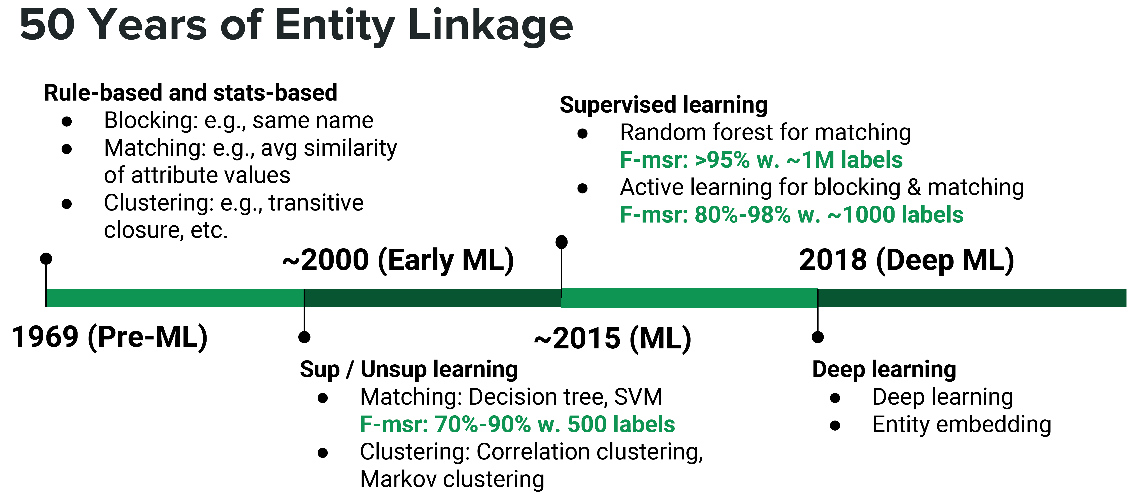
Entity Linking Approaches
[Xin Luna Dong, Theodoros Rekatsinas: Data Integration and Machine Learning: A Natural Synergy. PVLDB 2018]

Slide 13
Step 1: Data Preparation
#1 Schema Matching and Mapping
  See lecture 04 Schema Matching and Mapping
  Create homogeneous schema for comparison
  Split composite attributes
#2 Normalization
  Removal of special characters and white spaces
  Stemming
  Capitalization (to upper/lower)
  Remove redundant works, resolve abbreviations
#3 Data Cleaning
  See lecture 06 Data Cleaning and Data Fusion
  Correct data corruption and inconsistencies
Autonomous, heterogeneous systems
likes/liked/likely/liking → like
Like / like → LIKE

Slide 14
Step 2: Blocking and Sorting
#1 Naïve All-Pairs
  Brute-force, naïve approach → n*(n-1)/2 pairs → O(n²) complexity
#2 Blocking / Partitioning
  Efficiently create small blocks of similar records for pair-wise matching
  Basic: equivalent values on selected attributes (name)
  Predicates: whole field, token field, common integer, same x char start, n-grams
  Hybrid: disjunctions/conjunctions
  Blocking Keys:
  Learned: Minimal rule set via greedy algorithms
  ➔ Significant reduction: 1M records → 1T pairs
  ➔ 10K partitions w/ 100 records → 100M pairs (10,000x)
→ JR01111
John Roberts | 20 Main St | Plainville | MA | 01111
[Nicholas Chammas, Eddie Pantrige: Building a Scalable Record Linkage System, Spark+AI Summit 2018]

Slide 15
Step 2: Blocking, cont.
#3 Sorted Neighborhood
  Define sorting keys (similar to blocking keys; e.g., publication year)
  Sort records by sorting keys
  Define sliding window of size m (e.g., size 100, step 90) or value range (2 years)
  and compute all-pair matching within sliding window
#4 Blocking via Word Embeddings and LSH/DL
  Compute word/attribute embeddings + tuple embeddings
  Locality-Sensitive Hashing (LSH) for blocking
  K hash functions h(t) → k-dim hash-code
  L hash tables, each k hash functions
Distributed Tuple Representation
[Muhammad Ebraheem et al: Distributed Representations of Tuples for Entity Resolution. PVLDB 2018]
[Saravanan Thirumuruganathan et al. Deep Learning for Blocking in Entity Matching […]. PVLDB 2021]
h1=[-1, 1,1], h2=[ 1,1, 1],
h3=[-1,-1,1], h4=[-1,1,-1],
V %*% H
v[t1]=[0.45,0.8,0.85]
v[t2]=[0.4,0.85,0.75]
[1.2,2.1,-0.4,-0.5]
[1.2,2.0,-0.5,-0.3]
[1,1,-1,-1]
[1,1,-1,-1]
[12]
[12]
Hash bucket
Notes:
V = matrix(c(0.45,0.8,0.85,0.4,0.85,0.75),2,3,byrow=TRUE)
H = matrix(c(-1,1,1,1,1,1,-1,-1,1,-1,1,-1), 3, 4)
V %*% H

Slide 16
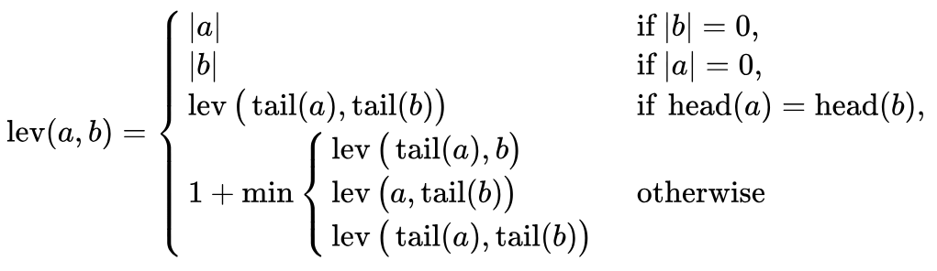
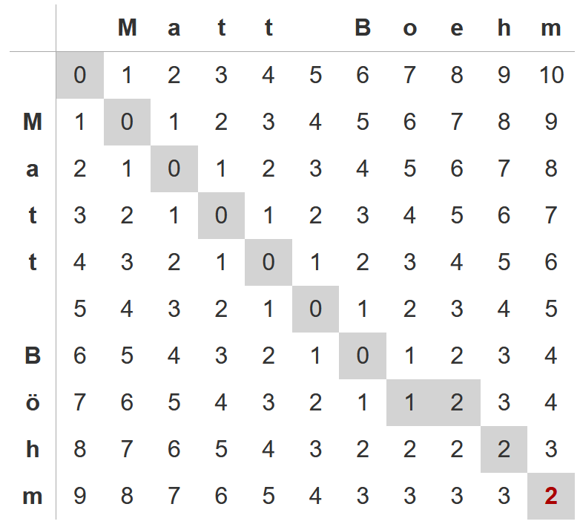
Step 3: Matching
#1 Basic Similarity Measures
  Pick similarity measure sim(r, r’) and thresholds: high θ_{h} (and low θ_{l})
  Record similarity: avg attribute similarity; attribute similarity on token/n-gram/character-level
  Match: sim(r, r’) > θ_{h} Non-match: sim(r, r’) < θ_{l}
  possible match: θ_{l} < sim(r, r’) < θ_{h}
Examples sim(“Matt Böhm”, “Matt Boehm”)
Levenshtein Distance: 2
Jaccard Similarity
(token-level, set semantics)
Trigram Similarity
A: {__M, _Ma, Mat, att, tt_, t_B,
_Bö, Böh, öhm, hm_, m__}
B: {__M, _Ma, Mat, att, tt_, t_B,
_Bo, Boe, oeh, ehm, hm_, m__}
sim = 2*|A ∩ B| / (|A|+|B|)
= 2*8 / (11+12) = 0.696
A: {Matt, Böhm}
B: {Matt, Boehm}
sim = |A ∩ B|/|A ∪ B|
= 1 / 3 = 0.333
[https://phiresky.github.io/levenshtein-demo/]

Slide 17
Step 3: Matching - #2 Learned Matchers
Traditional ML for ER
  Phase 1: Learned string similarity measures for selected attributes
  Phase 2: Training matching decisions from similarity metrics
  Selection of samples for labeling (sufficient, suitable, balanced)
  Example ML Algorithms: SVM and decision trees,
  logistic regression, random forest, XGBoost
Deep Learning for ER
  Automatic representation learning from text (avoid feature engineering)
  Leverage pre-trained word embeddings for semantics (no syntactic limitations)
[Mikhail Bilenko, Raymond J. Mooney: Adaptive duplicate detection using learnable string similarity measures. KDD 2003]
[Hanna Köpcke, Andreas Thor, Erhard Rahm: Evaluation of entity resolution approaches on real-world match problems. PVLDB 2010]
[Xin Luna Dong: Building a Broad Knowledge Graph for
Products. ICDE 2019]

Slide 18
Step 3: Matching - #2 Learned Matchers, cont.
Example DeepER
Example Magellan
  DL for text and dirty data
[Muhammad Ebraheem et al: Distributed Representations of Tuples for Entity Resolution. PVLDB 2018]
[Sidharth Mudgal et al: Deep Learning for Entity Matching: A Design Space Exploration. SIGMOD 2018]
Abs Difference / Hadamard Prod.
Distributed Tuple Representation

Slide 19
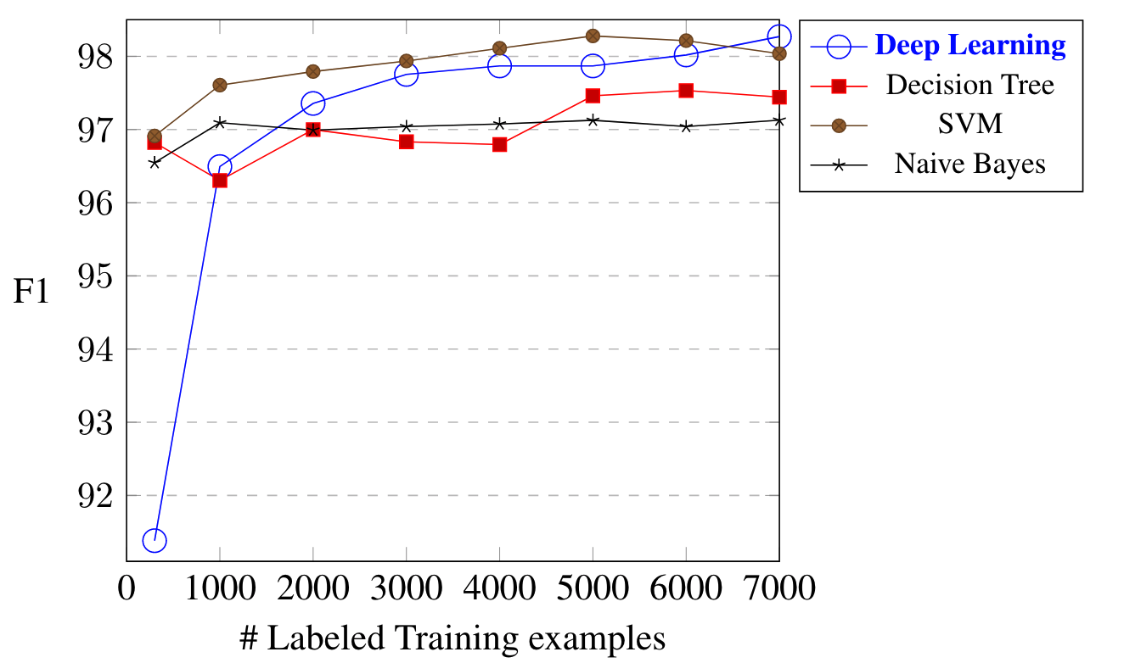

[Sairam Gurajada, Lucian Popa, Kun Qian, Prithviraj Sen: Learning-Based Methods with Human in the Loop for Entity Resolution, Tutorial, CIKM 2019]
Step 3: Matching - #2 Learned Matchers, cont.
DBLP-ACM
Labeled Data
  Scarce (experts)
  Class skew
➔ Transfer Learning
  Learn model from high-resource ER scenario (w/ regularization)
  Fine-tune using low-resource examples
➔ Active Learning
  Select instances for tuning to min labeling
$$F_{1}=2⋅ \frac{precision⋅recall}{precision+recall}$$
[Jungo Kasai et al: Low-resource Deep Entity Resolution with Transfer and Active Learning. ACL 2019]

Slide 20
Step 4: Clustering
Recap: Connected Components
  Determine connected components of a graph (subgraphs of connected nodes)
  Propagate max(current, msgs) if != current to neighbors, terminate if no msgs
Clustering Approaches
  Basic: connected components (transitive closure) w/ edges sim > θ_{h}
  → Issues: big clusters and dissimilar records
  Correlation clustering: +/- cuts based on sims → global opt NP-hard
  Markov clustering: stochastic flow simulation via random walks
Step 0
Step 1
Step 2
Step 3
converged
1
4
4
2
3
4
3
4
4
4
5
4
7
4
7
7
6
7
7
7
7
[Oktie Hassanzadeh, Fei Chiang, Renée J. Miller, Hyun Chul Lee: Framework for Evaluating Clustering Algorithms in Duplicate Detection. PVLDB 2009]

Slide 21
[Anja Gruenheid, Xin Luna Dong, Divesh Srivastava: Incremental Record Linkage. PVLDB 2014]
Incremental Data Deduplication
Goals
  Incremental stream of updates → previously computed results obsolete
  Same or similar results AND significantly faster than batch computation
Approach
  End-to-end incremental record linkage for new and changing records
  Incremental maintenance of similarity graph and incremental graph clustering
  Initial graph created by correlation clustering
  Greedy update approach in polynomial time
    Directly connect components from increment ΔG into Q
    Merge of pairs of clusters to obtain better result?
    Split of cluster into two to obtain better result?
    Move nodes between two clusters to obtain better result?

Slide 22
BREAK and Test Yourself!
Explain the phases of a typical entity resolution pipeline and name two example techniques
for each individual phase. [16/100 points]
Prepare Data
Blocking/Sorting
Matching
Clustering
A2
A2
A
r1, r4
A1
C1
D1
A1
A1
A2
B1
B2
C2
C1
C2
C
r2, r7
C1
C2
B3
D1
D1
D
r3
B1
B2
B1
B2
r5, r6, r8
B3
B3
B
Notes:
Step 1: data cleaning, normalization, schema mapping
Step 2: blocking via blocking keys, sorting + window, blocking via ML / LSH
Step 3: similarity+threshold, ML via classification
Step 4: connected components, correlation/Markov clustering

Slide 23
Entity Resolution Tools
Example Systems and Tools (spectrum),
Additional links: https://github.com/OlivierBinette/Awesome-Entity-Resolution

Slide 24
Python Dedupe
https://docs.dedupe.io/en/latest/API-documentation.html
https://dedupeio.github.io/dedupe-examples/docs/csv_example.html
Overview
  Python library for data deduplication (entity resolution)
  By default: logistic regression matching (and blocking)
Example
fields = [
{'field':'Site name', 'type':'String'},
{'field':'Address', 'type':'String'}]
deduper = dedupe.Dedupe(fields)
# sample data and active learning
deduper.sample(data, 15000)
dedupe.consoleLabel(deduper)
Do these records refer
to the same thing?
(y)es / (n)o /
(u)nsure / (f)inished
# learn blocking rules and pairwise classifier
deduper.train()
# Obtain clusters as lists of (RIDs and confidence)
threshold = deduper.threshold(data, recall_weight=1)
clustered_dupes = deduper.match(data, threshold)

Slide 25
Magellan (University Wisconsin-Madison)
[Pradap Konda et al.: Magellan: Toward Building Entity Matching Management Systems. PVLDB 2016]
System Architecture
  How-to guides for users
  Tools for individual steps of entire ER pipeline
  Build on top of existing Python/big data stack
  Scripting environment for power users
User
[Yash Govind et al: Entity Matching Meets Data Science: A Progress Report from the Magellan Project. SIGMOD 2019]

Slide 26
[Kun Qian, Lucian Popa, Prithviraj Sen: SystemER: A Human-in-the-loop System for Explainable Entity Resolution. PVLDB 2019]
SystemER (IBM Research – Almaden)
Learns explainable ER rules (in HIL)
DBLP.title = ACM.title
AND DBLP.year = ACM.year
AND jaccardSim(DBLP.authors,ACM.authors)>0.1
AND jaccardSim(DBLP.venue,ACM.venue)>0.1
→ SamePaper(DBLP.id,ACM.id)
[Mauricio A. Hernández, Georgia Koutrika, Rajasekar Krishnamurthy, Lucian Popa, Ryan Wisnesky: HIL: a high-level scripting language for entity integration. EDBT 2013]

Slide 27
[Sainyam Galhotra, Donatella Firmani, Barna Saha, and Divesh Srivastava: BEER: Blocking for Effective Entity Resolution, SIGMOD 2021]
BEER (UMass/Roma/AT&T Labs)
Feedback after 1% sample

Slide 28
Summary and Q&A
Fundamental Data Integration Technique
w/ lots of applications + remaining challenges
Motivation and Terminology
Entity Resolution Concepts
Entity Resolution Tools
Next Lectures (Data Integration Architectures)
  06 Data Cleaning and Data Fusion [Nov 20]
  07 Data Provenance and Catalogs [Nov 27]

