Slide 1

Data Integration and Large-scale Analysis (DIA)
08 Cloud Computing Fundamentals
Prof. Dr. Matthias Boehm
Technische Universität Berlin
Berlin Institute for the Foundations of Learning and Data
Big Data Engineering (DAMS Lab)
Last update: Dec 04, 2025

Slide 2

Announcements / Administrative Items
#1 Video Recording
  Hybrid lectures: in-person BH-N 243, zoom live streaming, video recording
  https://tu-berlin.zoom.us/j/9529634787?pwd=R1ZsN1M3SC9BOU1OcFdmem9zT202UT09
#2 Exercises/Projects
  Reminder: exercise/project submissions by Jan 30 (no extensions)
  Make use of virtual / in-person (FR-766) office hours Wed 4.30pm-6pm
#3 Exam Registration
  Three exams now open for registrations in Moses
  Written exams Feb 05, 4pm (BH-N 243), Feb 12, 4pm (BH-N 243), and Mar 12, 4pm (A 151)

Slide 3
Course Outline Part B:
Large-Scale Data Management and Analysis
12 Distributed Stream
Processing
13 Distributed Machine Learning Systems
11 Distributed Data-Parallel Computation
Compute/
Storage
10 Distributed Data Storage
09 Cloud Resource Management and Scheduling
Infra
08 Cloud Computing Fundamentals

Slide 4
Agenda
Motivation and Terminology
Cloud Computing Service Models
Cloud, Fog, and Edge Computing

Slide 5
Motivation and Terminology

Slide 6
Motivation Cloud Computing
Definition Cloud Computing
  On-demand, remote storage and compute resources, or services
  User: computing as a utility (similar to energy, water, internet services)
  Cloud provider: computation in data centers / multi-tenancy
Service Models
  IaaS: Infrastructure as a service (e.g., storage/compute nodes)
  PaaS: Platform as a service (e.g., distributed systems/frameworks)
  SaaS: Software as a Service (e.g., email, databases, office, github)
➔ Transforming IT Industry/Landscape
  Since ~2010 increasing move from on-prem to cloud resources
  System software licenses become increasingly irrelevant
  Few cloud providers dominate IaaS/PaaS/SaaS markets (w/ 2018 revenue):
  Microsoft Azure Cloud ($ 32.2B), Amazon AWS ($ 25.7B), Google Cloud (N/A), IBM Cloud ($ 19.2B),
  Oracle Cloud ($ 5.3B), Alibaba Cloud ($ 2.1B)
“Computing as
a Utility”
Notes:
2023: Microsoft Cloud 110B (https://office365itpros.com/2023/07/27/microsoft-cloud-revenue-110b/)

Slide 7
Motivation Cloud Computing, cont.
100%
Argument #1: Pay as you go
  No upfront cost for infrastructure
  Variable utilization ➔ over-provisioning
  Pay per use or acquired resources
Argument #2: Economies of Scale
  Purchasing and managing IT infrastructure at scale ➔ lower cost
  (applies to both HW resources and IT infrastructure/system experts)
  Focus on scale-out on commodity HW over scale-up ➔ lower cost
Argument #3: Elasticity
  Assuming perfect scalability, work done in constant time * resources
  Given virtually unlimited resources allows to reduce time as necessary
Utili-zation
Time
100 days @ 1 node
≈
1 day @ 100 nodes
(but beware Amdahl’s law: max speedup sp = 1/s)

Slide 8
[Peter Mell and Timothy Grance: The NIST Definition of Cloud Computing, NIST 2011]
Characteristics and Deployment Models
Extended Definition
  ANSI recommended definitions for service types, characteristics, deployment models
Characteristics
  On-demand self service: unilateral resource provision
  Broad network access: network accessibility
  Resource pooling: resource virtualization / multi-tenancy
  Rapid elasticity: scale out/in on demand
  Measured service: utilization monitoring/reporting
Deployment Models
  Public cloud: general public, on premise of cloud provider
  Hybrid cloud: combination of two or more of the above
  Community cloud: single community (one or more orgs)
  Private cloud: single org, on/off premises
MS Azure Private Cloud
IBM Cloud Private
Notes:
Notes characteristics: remotely available, pay as you go, shared infrastructure, high scalability

Slide 9
Cloud Computing Service Models
“Computing as a utility”

Slide 10
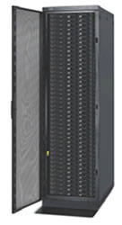
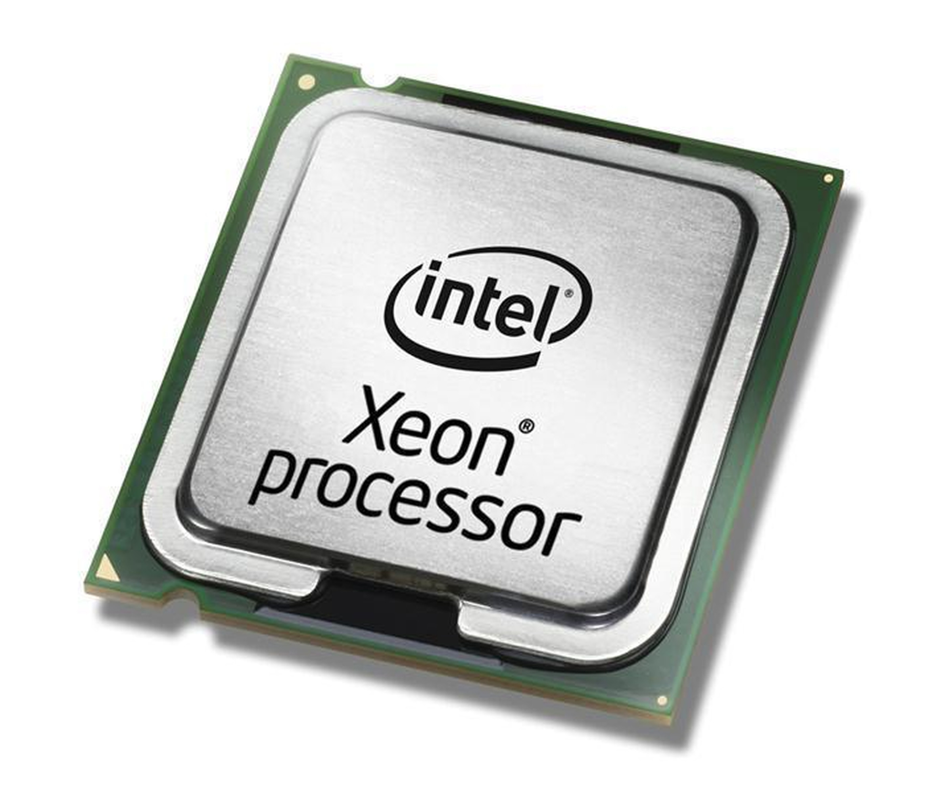
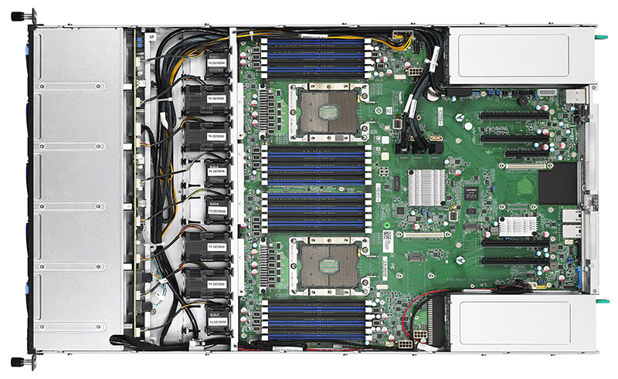
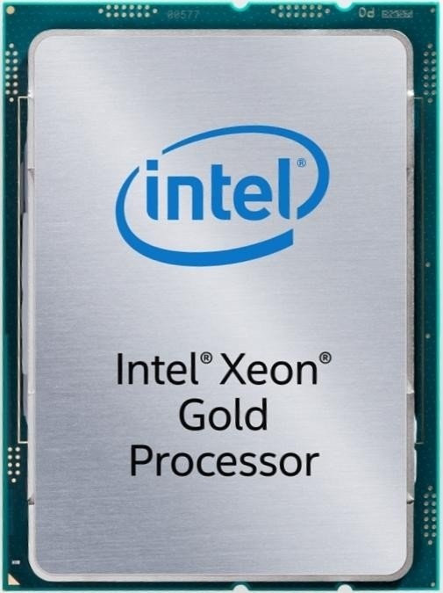
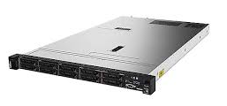
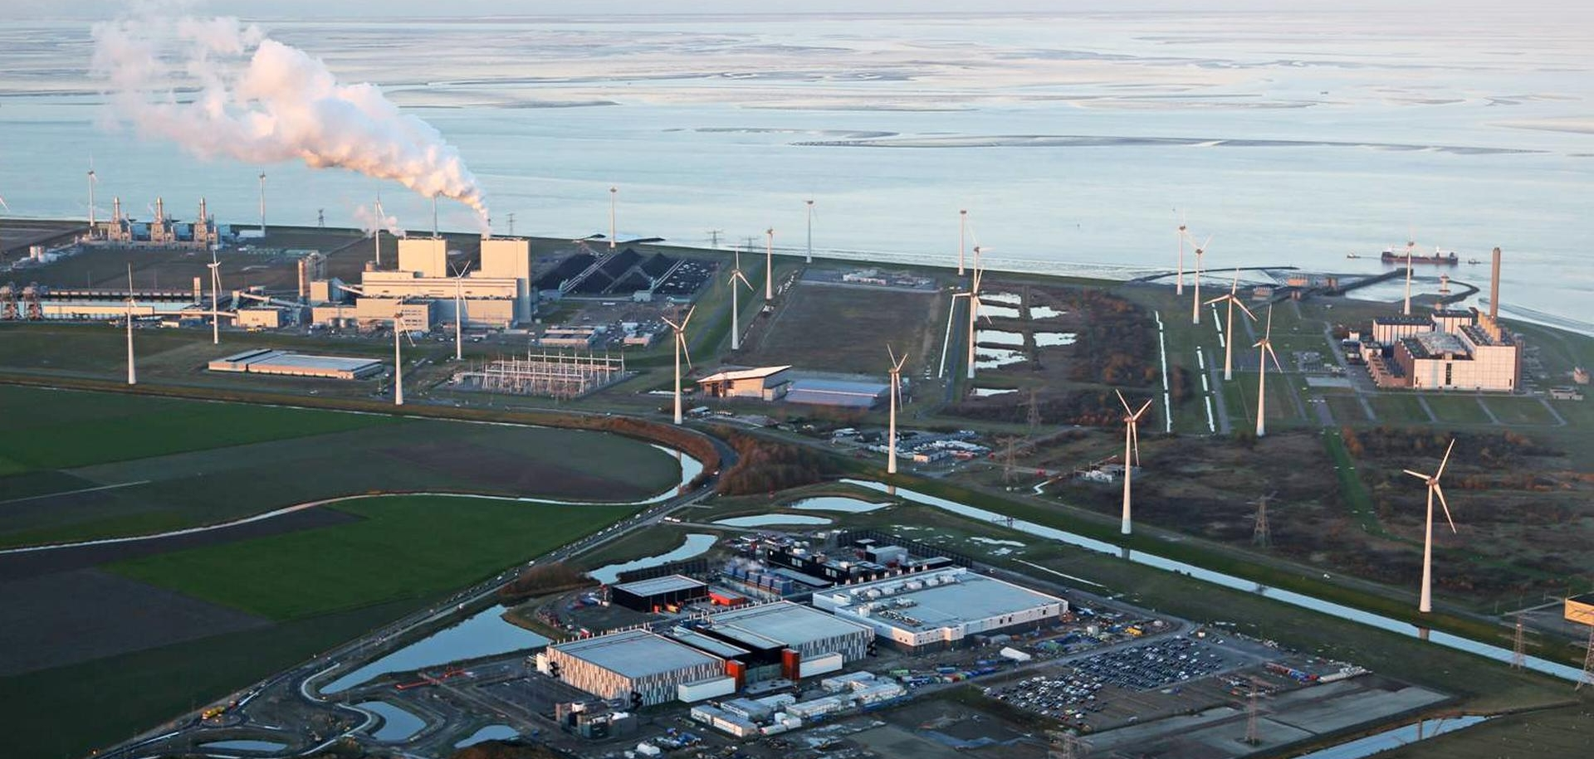
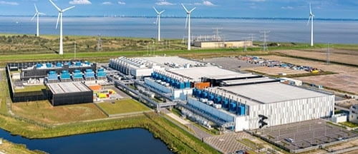
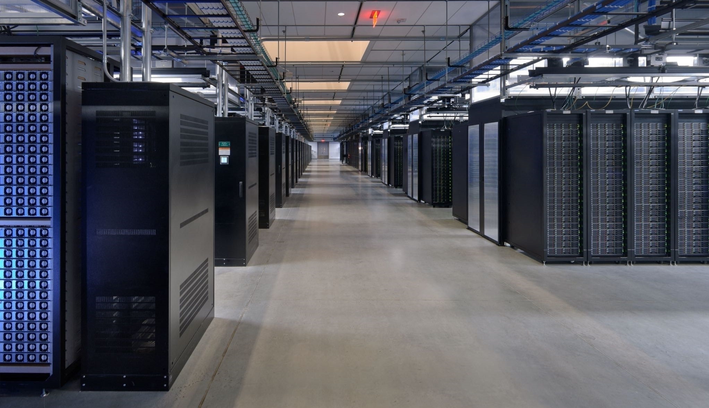
Anatomy of a Data Center
Commodity/Server CPUs:
Xeon E5-2440: 6/12 cores
Xeon Gold 6148: 20/40 cores
Xeon Gold 6430: 64/128 cores
Server:
Multiple sockets, RAM, disks
Rack:
16-64 servers +
top-of-rack switch
Data Center:
>100,000 servers
Cluster:
Multiple racks + cluster switch
[Google
Data Center, Eemshaven, Netherlands]
Notes:
RWE power plant: 1.5MW hard coal, biomass

Slide 11
[Christos Kozyrakis and Matei Zaharia: CS349D: Cloud Computing Technology, lecture, Stanford 2018]
Fault Tolerance
Yearly Data Center Failures
  ~0.5 overheating (power down most machines in <5 mins, ~1-2 days)
  ~1 PDU failure (~500-1000 machines suddenly disappear, ~6 hrs)
  ~1 rack-move (plenty of warning, ~500-1000 machines powered down, ~6 hrs)
  ~1 network rewiring (rolling ~5% of machines down over 2-day span)
  ~20 rack failures (40-80 machines instantly disappear, 1-6 hrs)
  ~5 racks go wonky (40-80 machines see 50% packet loss)
  ~8 network maintenances (~30-minute random connectivity losses)
  ~12 router reloads (takes out DNS and external vIPs for a couple minutes)
  ~3 router failures (immediately pull traffic for an hour)
  ~dozens of minor 30-second blips for dns
  ~1000 individual machine failures (2-4% failure rate, at least twice)
  ~thousands of hard drive failures (1-5% of all disks will die)

Slide 12
Fault Tolerance, cont.
Other Common Issues
  Configuration issues, partial SW updates, SW bugs
  Transient errors: no space left on device, memory corruption, stragglers
Recap: Error Rates at Scale
  Cost-effective commodity hardware
  Error rate increases with increasing scale
  Fault Tolerance for distributed/cloud storage and data analysis
➔ Cost-effective Fault Tolerance
  BASE (basically available, soft state, eventual consistency)
  Effective techniques
    ECC (error correction codes), CRC (cyclic redundancy check) for detection
    Resilient storage: replication/erasure coding, checkpointing, and lineage
    Resilient compute: task re-execution / speculative execution

Slide 13
Virtualization
#1 Native Virtualization
  Simulates most of the HW interface
  Unmodified guest OS to run in isolation
  Examples: VMWare, Parallels, AMI (HVM)
#2 Para Virtualization
  No HW interface simulation, but special API (hypercalls)
  Requires modified quest OS to use hyper calls, trapped by hypervisor
  Examples: Xen, KVM, Hyper-V, AMI (PV)
#3 OS-level Virtualization
  OS allows multiple secure virtual servers
  Guest OS appears isolated but same as host OS
  Examples: Solaris/Linux containers, Docker
#4 Application-level Virtualization
  Examples: Java VM (JVM), Ethereum VM (EVM), Python virtualenv
Applications
Libraries
Operating System
Hardware
[Prashant Shenoy: Distributed and Operating Systems - Module 1: Virtualization, UMass Amherst, 2019]

Slide 14
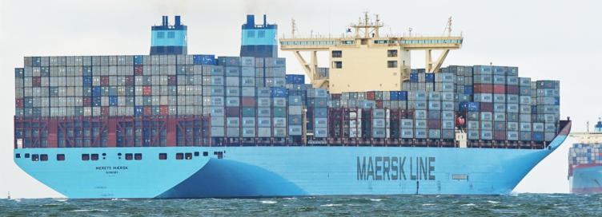


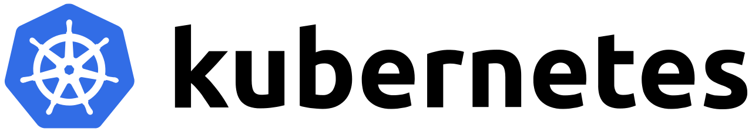

Containerization
Docker Containers
  Shipping container analogy
    Arbitrary, self-contained goods, standardized units
    Containers reduced loading times ➔ efficient international trade
  #1 Self-contained package of necessary SW and data (read-only image)
  #2 Lightweight virtualization w/ shared OS and resource isolation via cgroups
Cluster Schedulers (see Lecture 09)
  Container orchestration: scheduling,
  deployment, and management
  Resource negotiation with clients
  Typical resource bundles (CPU, memory, device)
  Examples: Kubernetes, Mesos, (YARN),
  Amazon ECS, Microsoft ACS, Docker Swarm
[Brendan Burns, Brian Grant, David Oppen-heimer, Eric Brewer, John Wilkes: Borg, Omega, and Kubernetes. CACM 2016]
➔ from machine- to application-oriented scheduling

Slide 15
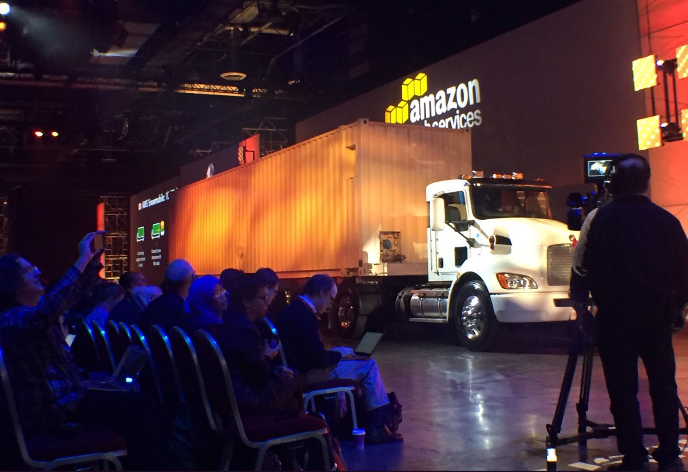
Excursus: AWS Snowmobile (since 2016)
Snowmobile Service
  Data transfer on-premise
  → cloud via 100PB trucks
Real-World
“Containerization”
☺
100PB (1Gb Link)
~26 years → weeks
[https://aws.amazon.com/snowmobile/?nc1=h_ls]

Slide 16
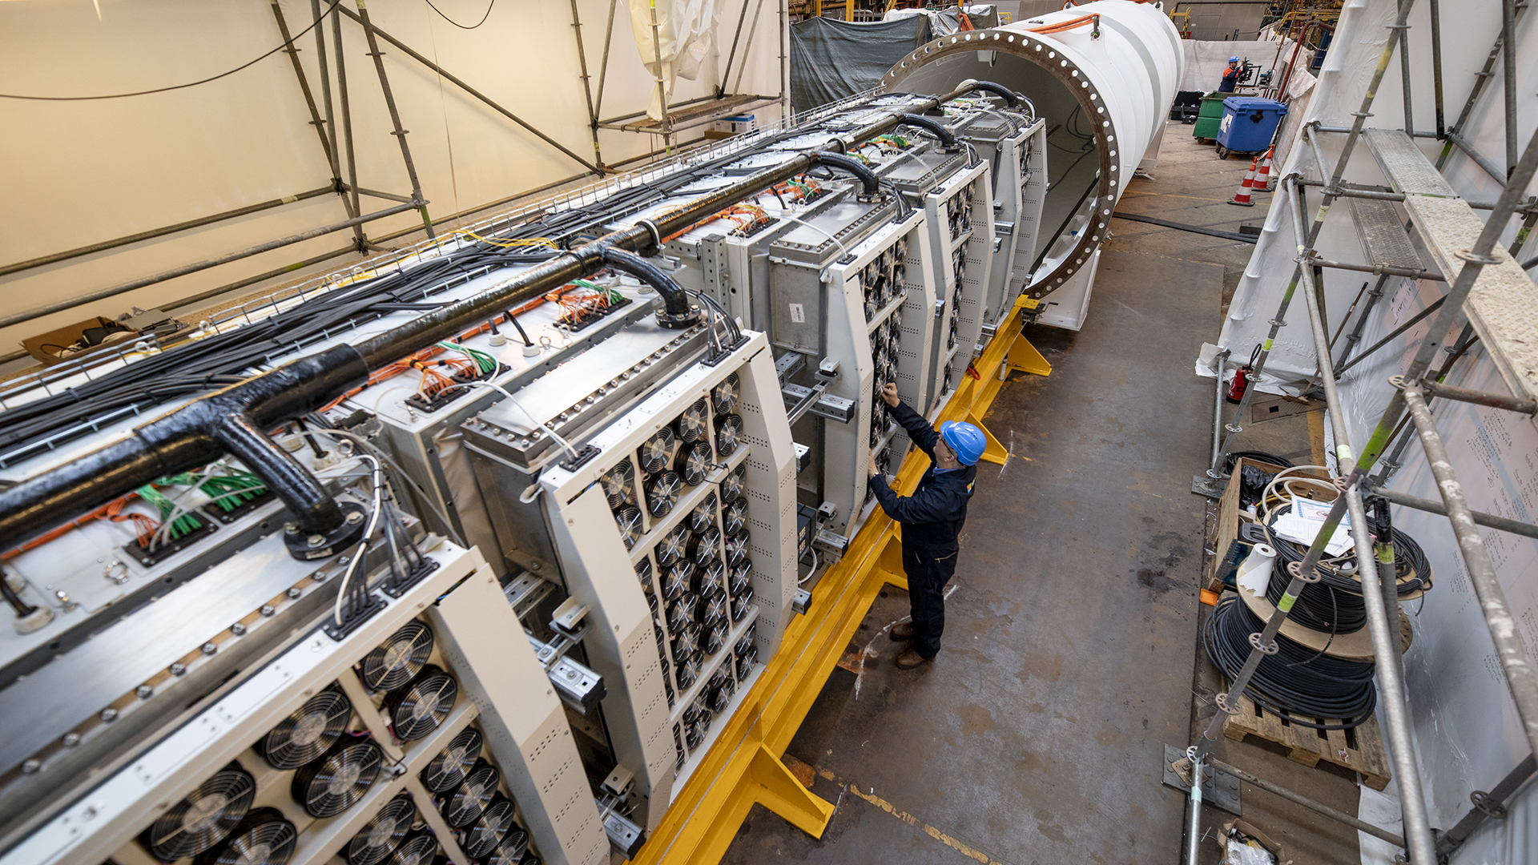
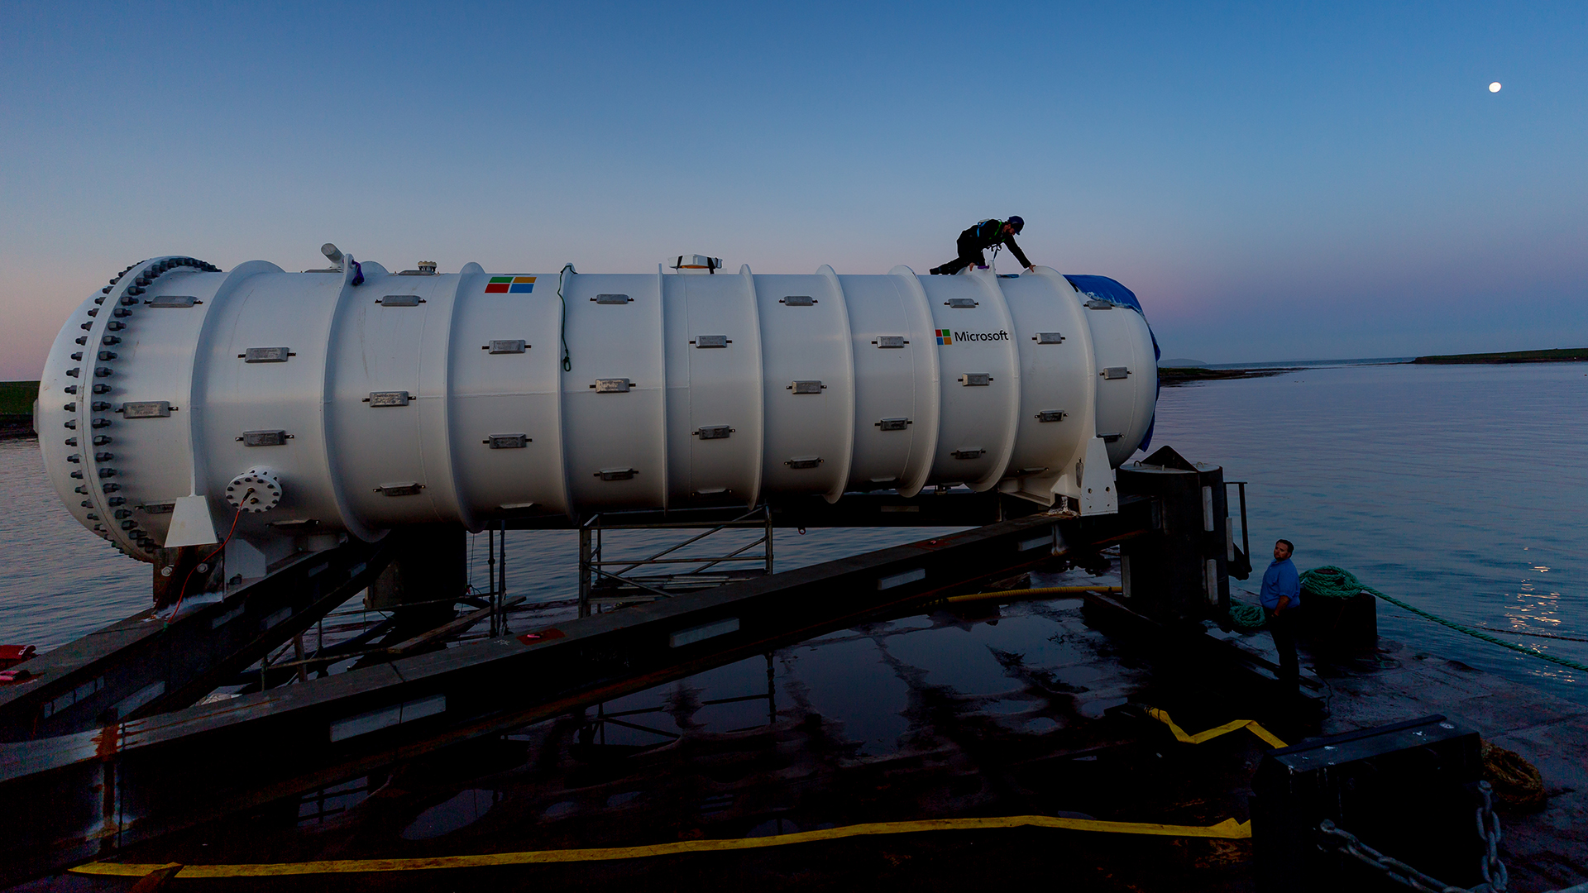
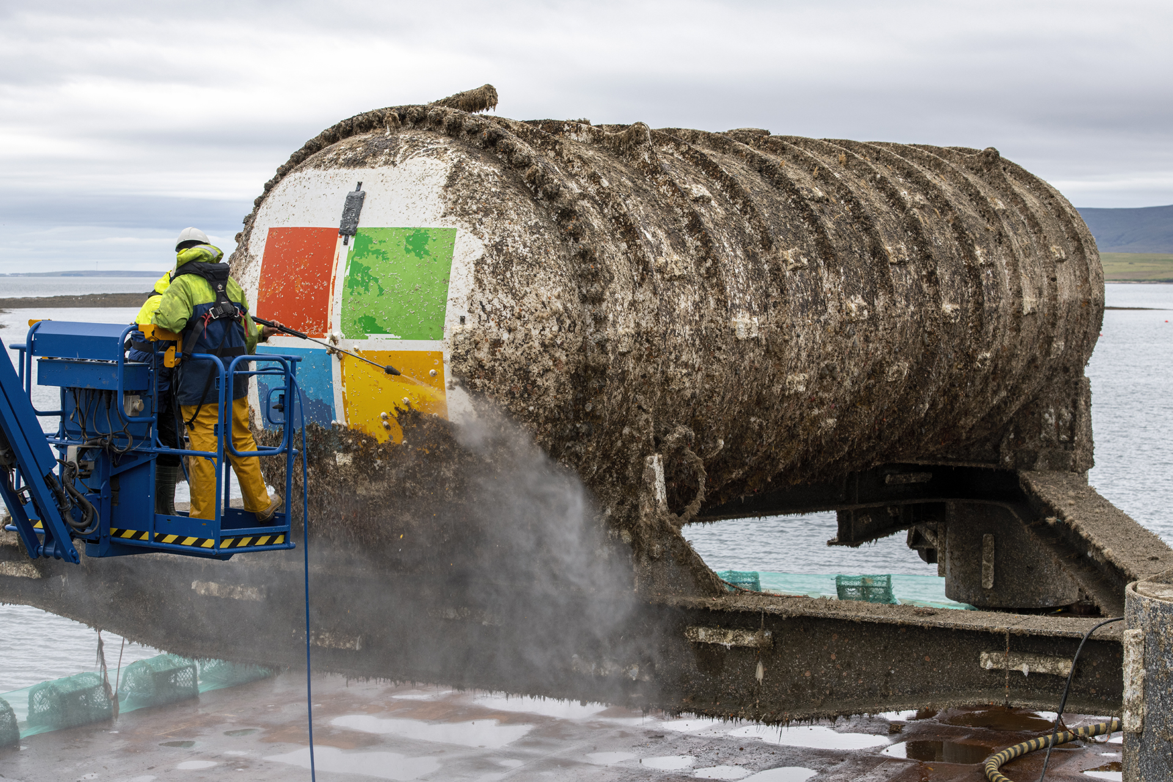
Excursus: Microsoft Underwater Datacenter
Study for feasibility, and if logistically,
environmentally, economically practical
[https://news.microsoft.com/features/under-the-sea-microsoft-tests-a-datacenter-thats-quick-to-deploy-could-provide-internet-connectivity-for-years/, 06/2018]
[https://news.microsoft.com/innovation-stories/project-natick-underwater-datacenter/, 09/2020]

Slide 17
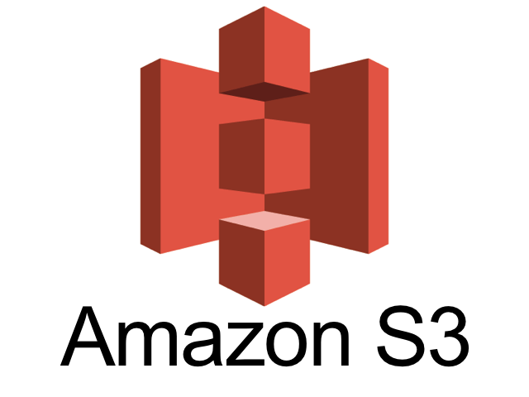
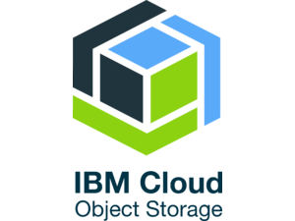
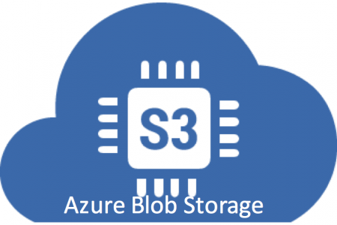

Infrastructure as a Service (IaaS)
Overview
  Resources for compute, storage, networking as a service
  ➔ Virtualization as key enabler (simplicity and auto-scaling)
  Target user: sys admin / developer
Storage
  Amazon AWS Simple Storage Service (S3)
  OpenStack Object Storage (Swift)
  IBM Cloud Object Storage
  Microsoft Azure Blob Storage
Compute
  Amazon AWS Elastic Compute Cloud (EC2)
  Microsoft Azure Virtual Machines (VM)
  IBM Cloud Compute

Slide 18
Infrastructure as a Service (IaaS), cont.
> aws2 configure
Example AWS Setup
  Create user and security credentials
Example AWS S3 File Upload
  Setup and configure S3 bucket
  WebUI or cmd for interactions
Example AWS EC2
Instance Lifecycle
AWS Access Key ID [None]: XXX
AWS Secret Access Key [None]: XXX
Default region name [None]: eu-central-1
Default output format [None]:
> aws2 s3 cp data s3://mboehm7datab/air --recursive
> aws2 s3 ls s3://mboehm7datab/air --recursive
2019-12-05 15:26:45 20097 air/Airlines.csv
2019-12-05 15:26:45 260784 air/Airports.csv
2019-12-05 15:26:45 6355 air/Planes.csv
2019-12-05 15:26:45 1001153 air/Routes.csv
> aws2 ec2 allocate-hosts --instance-type m4.large \
--availability-zone eu-central-1a --quantity 2

Slide 19
Platform as a Service (PaaS)
Overview
  Provide environment setup (libraries, configuration), platforms, and services
  to specific applications ➔ additional charges
  Target user: developer
Example AWS Elastic MapReduce (EMR)
  Environment for Apache Hadoop, MapReduce, and Spark over S3 data,
  incl entire eco system of tools and libraries
> clusterId=$(aws emr create-cluster --applications Name=Spark \
--ec2-attributes ... --instance-type m4.large --instance-count 100 \
--steps '[{"Args":["spark-submit","--master","yarn",'${sparkParams}'"--class", \
"org.apache.sysds.api.DMLScript","./SystemDS.jar","-f","./test.dml"], ...]' \
--scale-down-behavior TERMINATE_AT_INSTANCE_HOUR --region eu-central-1)
> aws emr wait cluster-running --cluster-id $clusterId
> aws emr wait cluster-terminated --cluster-id $clusterId

Slide 20

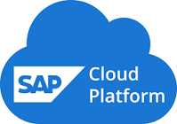
Software as a Service (SaaS)
Overview
  Provide application as a service, often via simple web interfaces
  Challenges/opportunities: multi-tenant systems (privacy, scalability, learning)
  Target user: end users
Examples
  Email/chat services: Google Mail (Gmail), Slack
  Writing and authoring services: Microsoft Office 365, Overleaf
  Enterprise: Salesforces, ERP as a service (SAP HANA Cloud)
  Database as a Service (DBaaS)
[Stefan Aulbach, Torsten Grust, Dean Jacobs, Alfons Kemper, Jan Rittinger: Multi-tenant databases for software as a service: schema-mapping techniques. SIGMOD 2008]

Slide 21
[Dan Ardelean, Amer Diwan, Chandra Erdman: Performance Analysis of Cloud Applications. NSDI 2018]
Software as a Service (SaaS), cont.
EU/US
Performance Analysis on Gmail Data
  Coordinated bursty tracing via time
  Vertical context injection into kernel logs
(a) Variations in rate and mix of user visible requests (UVR)
(b) Variations in rate and mix of essential non-UVR work
(validate, update, repair, compact)
(c) Variations due to
one-off events
(4x lightning Belgium DC → reconstruct)
Notes:
Note: TU Graz email SMTP due to database backup schedule

Slide 22



[Joseph M. Hellerstein et al: Serverless Computing: One Step Forward, Two Steps Back. CIDR 2019]
Serverless Computing (FaaS)
Definition Serverless
  FaaS: functions-as-a-service (event-driven, stateless input-output mapping)
  Infrastructure for deployment and auto-scaling of APIs/functions
  Examples: Amazon Lambda, Microsoft Azure Functions, etc
Example
Lambda Functions
Event Source (e.g., cloud services)
Other APIs and Services
Auto scaling
Pay-per-request
(1M x 100ms = 0.2$)
import com.amazonaws.services.lambda.runtime.Context;
import com.amazonaws.services.lambda.runtime.RequestHandler;
public class MyHandler implements RequestHandler<Tuple, MyResponse> {
@Override
public MyResponse handleRequest(Tuple input, Context context) {
return expensiveModelScoring(input); // with read-only model
}
}

Slide 23
[Joseph M. Hellerstein et al: Serverless Computing: One Step Forward, Two Steps Back. CIDR 2019]
Serverless Computing (FaaS), cont.
Advantages (One Step Forward)
  Auto-scaling (the workload drives the allocation and deallocation of resources)
  Use cases: embarrassingly parallel functions, orchestration functions
  (of proprietary auto scaling services), function composition (workflows)
Disadvantages (Two Steps Backward)
  Lacks efficient data processing (limited lifetime of state/caches,
  I/O bottlenecks due to lack of co-location)
  Hinders distributed systems development (communication through
  slow storage, no specialized hardware)
➔ “Taken together, these challenges seem both interesting and sur-mountable. [...] Whether we call the new results ‘serverless computing’ or something else, the future is fluid.”

Slide 24
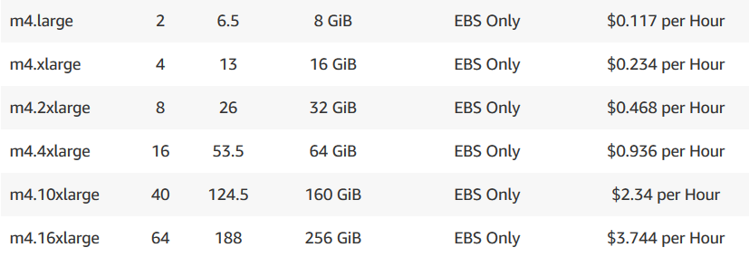
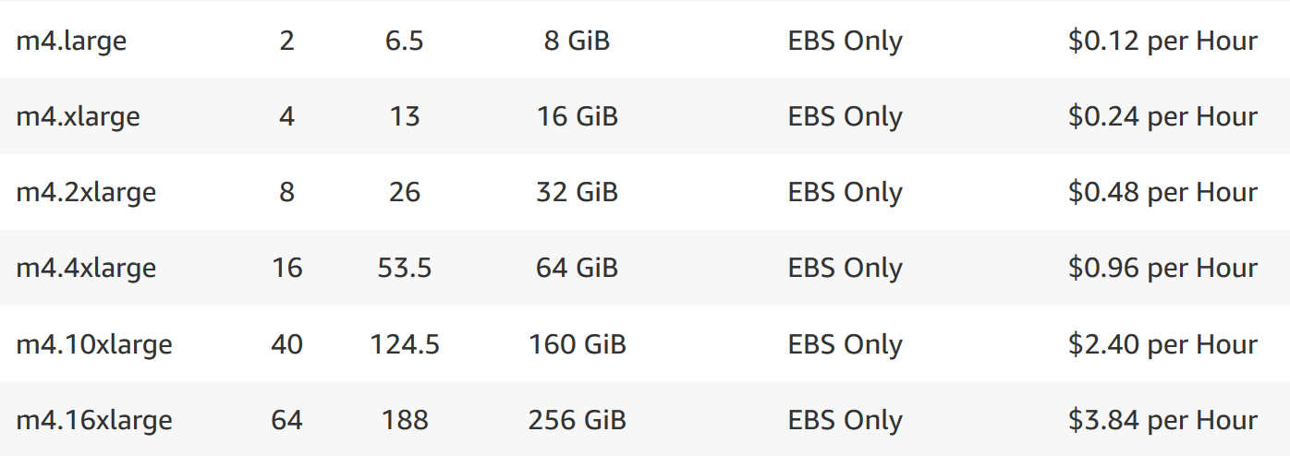
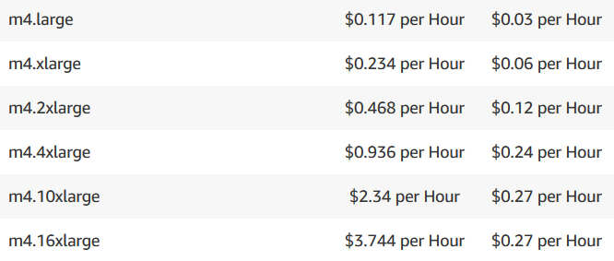
Example AWS Pricing (current gen)
vCores
Mem
as of 12/2019
Amazon EC2 (Elastic Compute Cloud)
  IaaS offering of different node types and generations
  On-demand, reserved, and spot instances
Amazon ECS (Elastic Container Service)
  PaaS offering for Docker containers
  Automatic setup of Docker environment
Amazon EMR (Elastic Map Reduce)
  PaaS offering for Hadoop workloads
  Automatic setup of YARN, HDFS, and frameworks like Spark
  Prices in addition to EC2 prices
Pricing according to EC2 (in EC2 launch mode)
Notes:
Note: scale-out cheaper than scale-up; pricing granularity: hour or second (depending on instance type, min 60 seconds if second granularity)

Slide 25
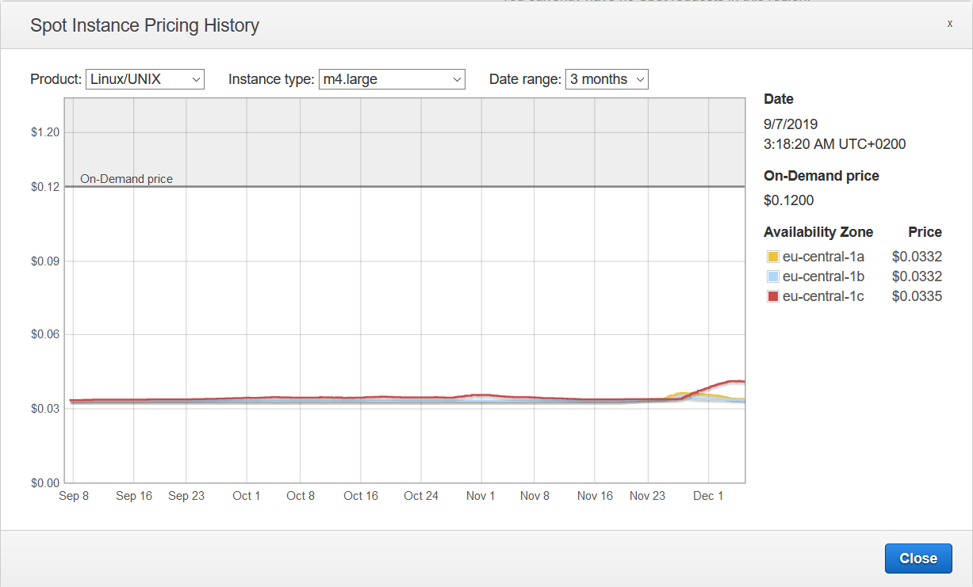
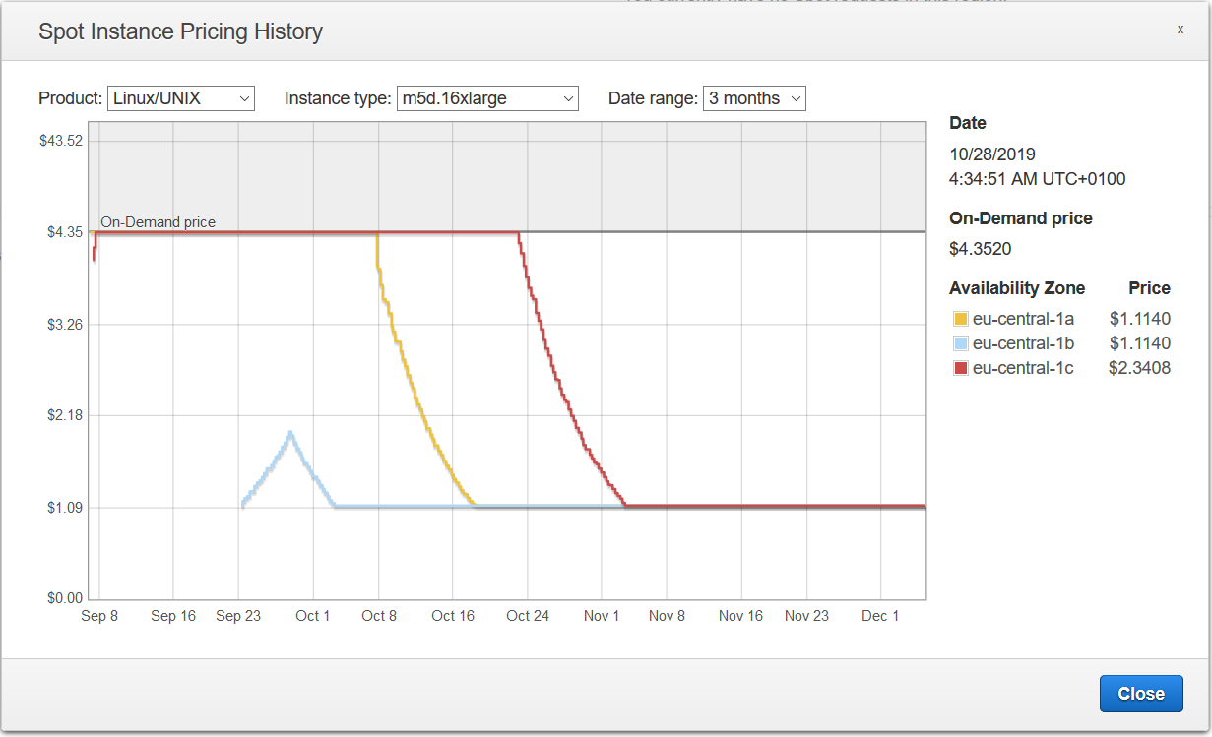
Example AWS Pricing (current gen), cont.
Spot Instances
  Unused cloud recourses for much lower prices → bidding market
  Interruption behavior: hibernate, stop, terminate
Example
Instance
Types
Self-regulating effect
(m4.large, 2 vCPU, 8GB)
(m5d.24xlarge, 96 vCPU, 384GB)
[AWS EC2 Management Console, Spot Requests, Dec 05 2019]

Slide 26
Cloud, Fog, and Edge Computing

Slide 27

Cloud vs Fog vs Edge Overview
[Maria Gorlatova: Special Topics: Edge Computing; IoT Meets the Cloud – The Origins of Edge Computing, Duke University 2018]
Overview Edge Computing
  Huge number of mobile / IoT devices
  Edge computing for latency, bandwidth, privacy
Fog & Edge Computing
  Different degrees of
  application decentralization
  Reasons: energy,
  performance, data
  Natural hierarchy, heterogeneity
  Cloud as enabler for vibrant
  web ecosystem
  → fog/edge for IoT the same?
NebulaStream
(TU Berlin & BIFOLD FG DIMA)
[https://nebula.stream]

Slide 28
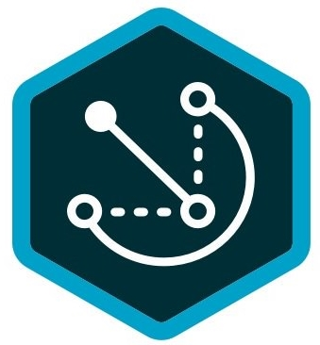
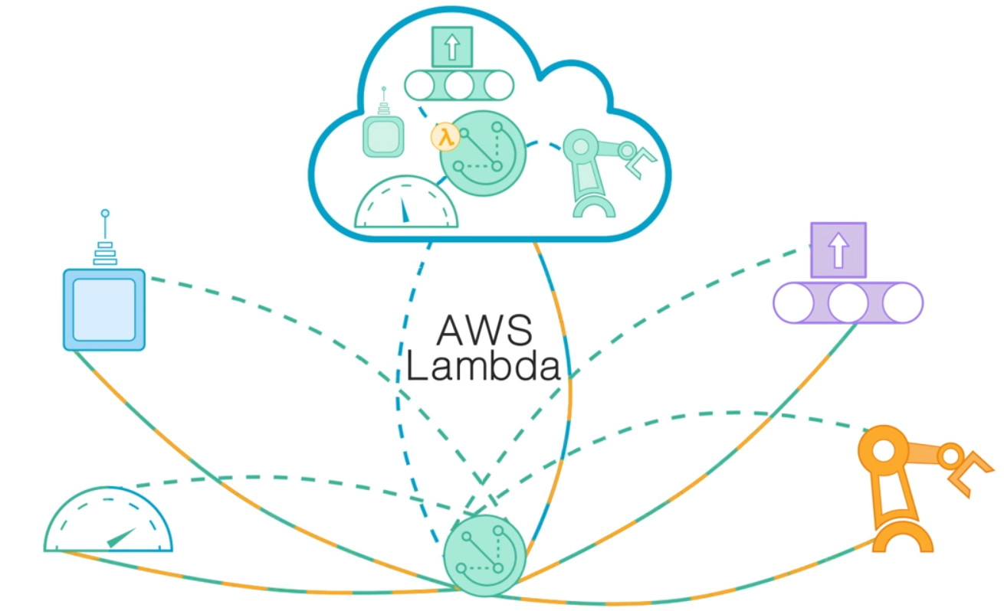
Example: AWS Greengrass
[Credit: https://aws.amazon.com/
greengrass/?nc1=h_ls]
Overview AWS Greengrass
  Combine cloud computing and groups of IoT devices
  Cloud configuration, group cores, connected devices to groups
  Run lambda functions (FaaS) in cloud,
  fog, and edge – partial autonomy
System Architecture
  Central configuration and deployment
  Decentralized operation
Customer Use cases:
“My data doesn’t reach the cloud”

Slide 29
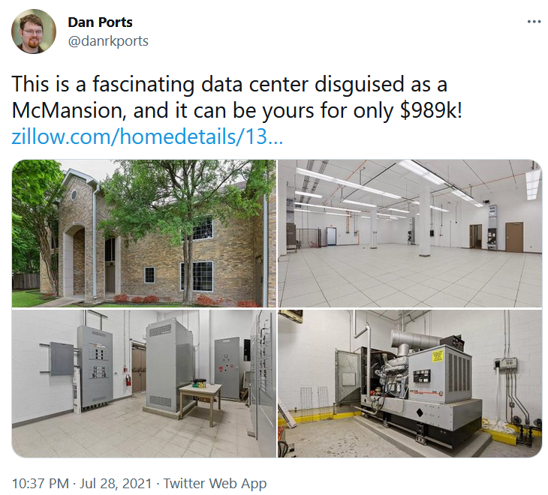
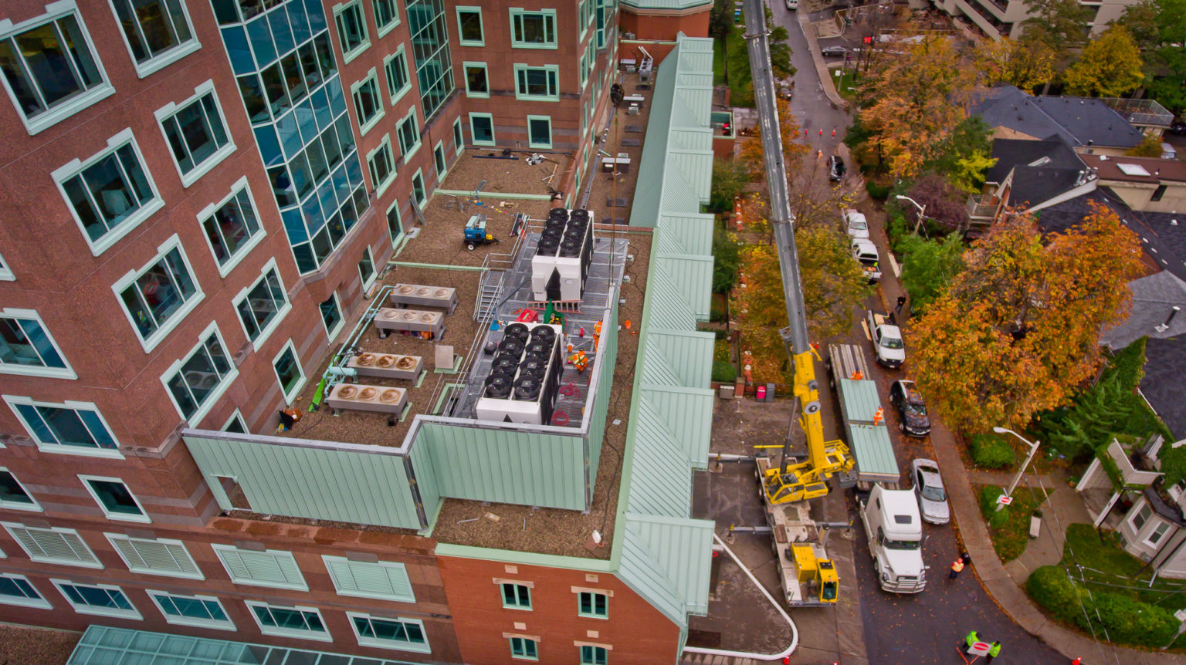
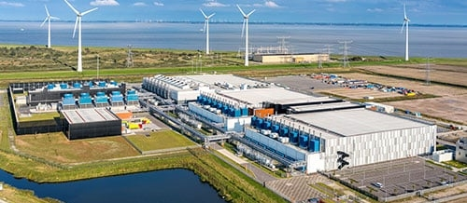
Excursus: Decentralized Infrastructure
Public/Private Infrastructure Projects
  Hierarchy of endpoints/data centers
  Analogy: “City-Planning”
[Credit: University of Maribor]

Slide 30

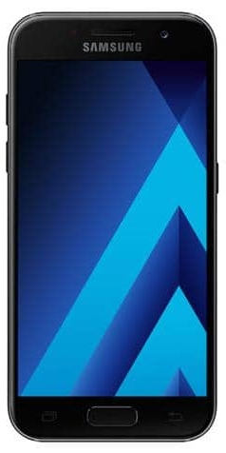


[Keith Bonawitz et al.: Towards Federated Learning at Scale: System Design. SysML 2019]
Federated Machine Learning
Overview Federated ML
  Learn model w/o central data consolidation
  Privacy vs personalization and sharing (example: voice recognition)
  Adaptation of parameter server architecture, w/ random
  client sampling and distributed agg
  Training when phone idle, charging, and on WiFi
Example Data Ownership
  Thought experiment: B uses machine
  from A to test C’s equipment.
  Who owns the data?
  Negotiated in bilateral contracts
  Spectrum of Data Ownership: Federated learning might create new markets
W
ΔW
D1
D2
D3
XXXXXXXX
XXXXXXXXXXXXXXXXXXXXXXX
XXXXXXXX
XXXXX
Machine Vendor A
Middle Person B
Customer C

Slide 31
Spectrum of Data Sharing
Fine-grained Spectrum
  Spectrum of technologies with performance/privacy/utility tradeoffs
  Different applications with different requirements → Potential for new markets
Increasing Utility/Perf
Increasing Privacy
Private Data (no sharing)
Privacy-
enhancing Technologies
(FHE, MPC, Differential Privacy)
Aggregates (Federated ML, Federated w/
secure comm.)
Anonymized
Data
(k-anonymity, pseudonyms)
Surrogate
Data
(char-preserving
synthetic data, dataset distillation)
Public Data (full sharing, sharing w/ partners)
  Key Property: no reconstruction of private raw data

Slide 32




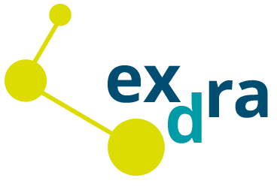



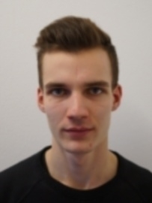
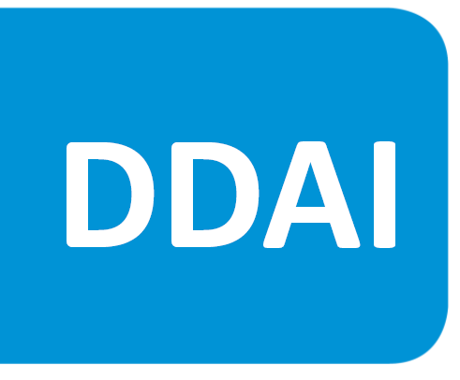



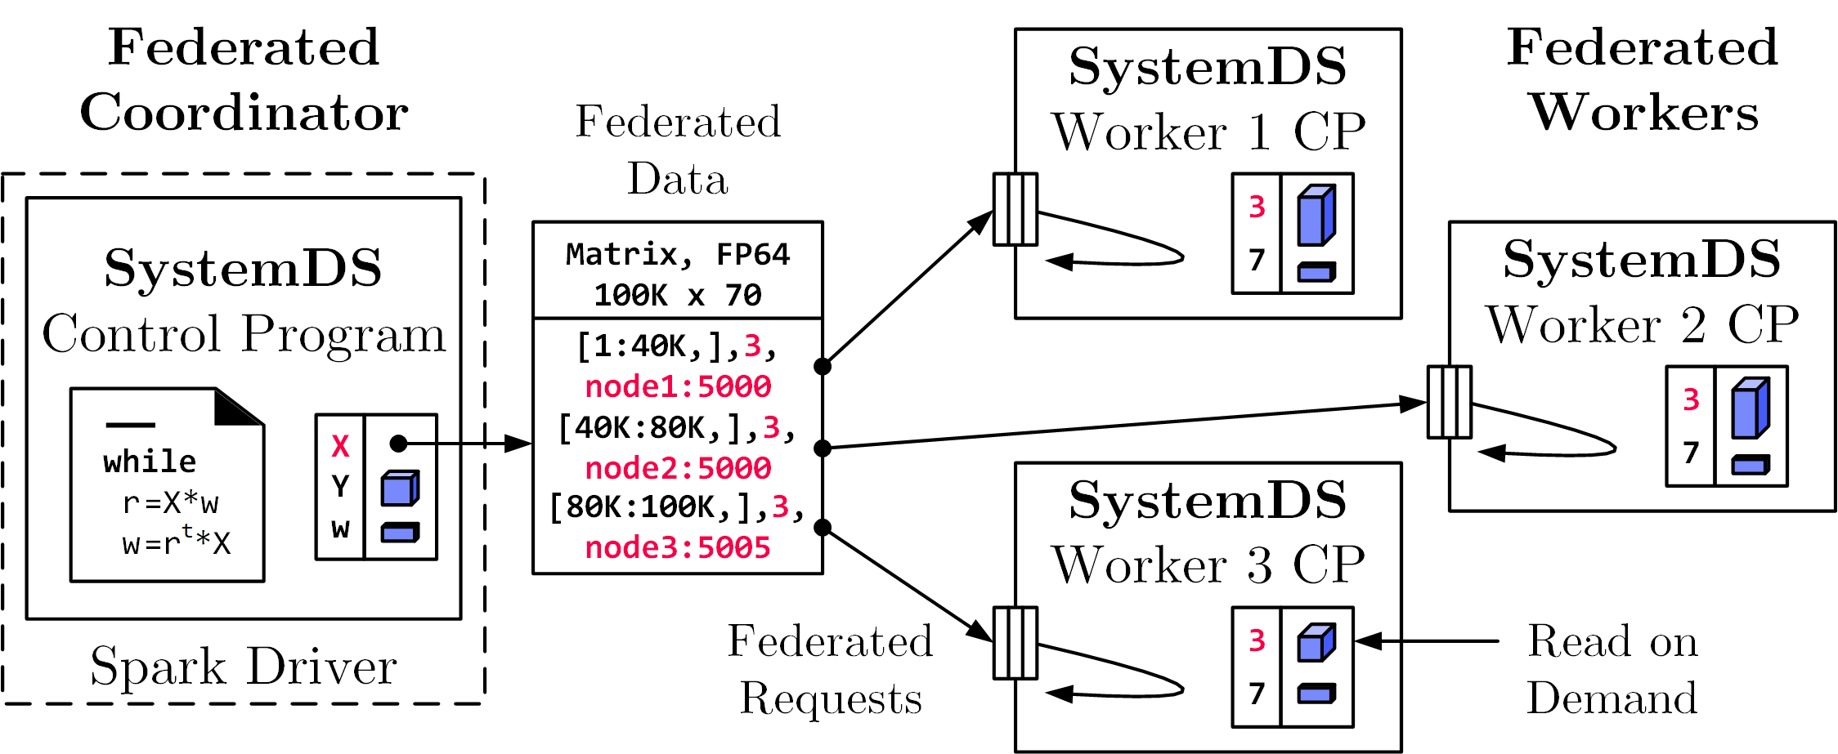
Federated Learning in SystemDS
[SIGMOD’21, CIKM’22]
Federated Backend
  Federated data (matrices/frames) as meta data objects
  Federated linear algebra, (and federated parameter server)
X = federated(addresses=list(node1, node2, node3),
ranges=list(list(0,0), list(40K,70), ..., list(80K,0), list(100K,70)));
Federated Requests:
READ, PUT, GET, EXEC_INST,
EXEC_UDF, CLEAR
➔ Design Simplicity:
(1) reuse instructions
(2) federation hierarchies

Slide 33

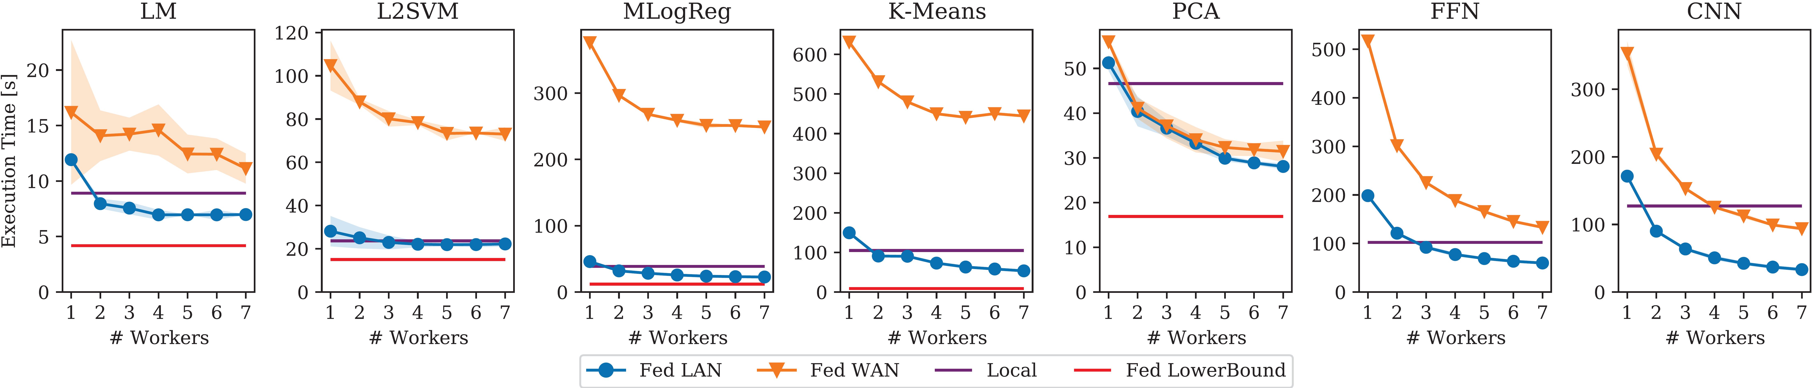
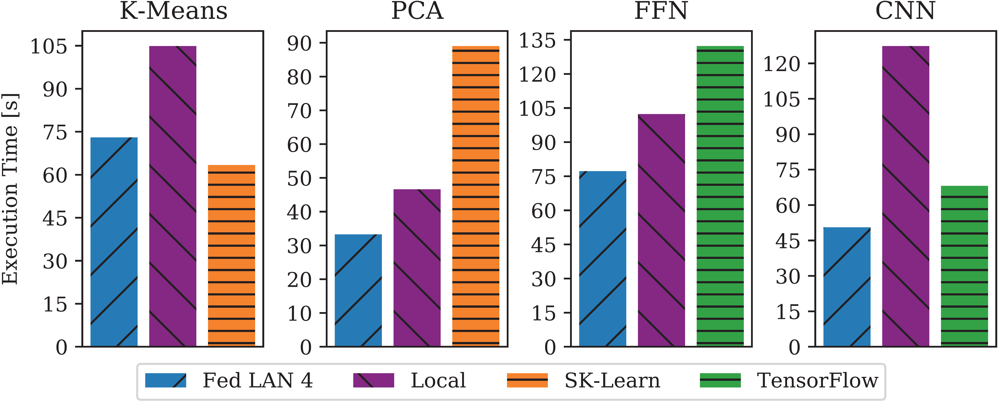
Reproducible Results
Federated Learning in SystemDS – Experiments
Workloads and Baselines
  LM: linear regression, lmCG
  L2SVM: l2-regularized SVM
  MLogReg: multinomial logreg
  K-Means: Lloyd’s alg. w/ K-Means++ init
  PCA: principal component analysis
  FFN: fully-connected feed-forward NN
  CNN: convolutional NN
Comparisons w/
Scikit-learn and TensorFlow

Slide 34
Summary and Q&A
Cloud Computing Motivation and Terminology
Cloud Computing Service Models
Cloud, Fog, and Edge Computing
Next Lectures (Large-scale Data Management and Analysis)
  09 Cloud Resource Management and Scheduling [Dec 11]
  10 Distributed Data Storage [Dec 18]
  Holidays
  11 Distributed, Data-Parallel Computation [Jan 15]
  12 Distributed Stream Processing [Jan 22]
  13 Distributed Machine Learning Systems [Jan 29]

