Slide 1

Data Integration and Large-scale Analysis (DIA)
09 Cloud Resource Management and Scheduling
Prof. Dr. Matthias Boehm
Technische Universität Berlin
Berlin Institute for the Foundations of Learning and Data
Big Data Engineering (DAMS Lab)
Last update: Dec 07, 2025

Slide 2

Announcements / Administrative Items
#1 Video Recording
  Hybrid lectures: in-person BH-N 243, zoom live streaming, video recording
  https://tu-berlin.zoom.us/j/9529634787?pwd=R1ZsN1M3SC9BOU1OcFdmem9zT202UT09
#2 Exercises/Projects
  Reminder: exercise/project submissions by Jan 30 (no extensions)
  Make use of virtual / in-person (FR-766) office hours Wed 5pm-6pm

Slide 3
Course Outline Part B:
Large-Scale Data Management and Analysis
12 Distributed Stream
Processing
13 Distributed Machine Learning Systems
11 Distributed Data-Parallel Computation
Compute/
Storage
10 Distributed Data Storage
09 Cloud Resource Management and Scheduling
Infra
08 Cloud Computing Fundamentals

Slide 4
Agenda
Motivation, Terminology, and Fundamentals
Resource Allocation, Isolation, and Monitoring
Task Scheduling and Elasticity

Slide 5
Motivation, Terminology, and Fundamentals

Slide 6
Recap: Motivation Cloud Computing
Definition Cloud Computing
  On-demand, remote storage and compute resources, or services
  User: computing as a utility (similar to energy, water, internet services)
  Cloud provider: computation in data centers / multi-tenancy
Service Models
  IaaS: Infrastructure as a service (e.g., storage/compute nodes)
  PaaS: Platform as a service (e.g., distributed systems/frameworks)
  SaaS: Software as a Service (e.g., email, databases, office, github)
➔ Transforming IT Industry/Landscape
  Since ~2010 increasing move from on-prem to cloud resources
  System software licenses become increasingly irrelevant
  Few cloud providers dominate IaaS/PaaS/SaaS markets (w/ 2018 revenue):
  Microsoft Azure Cloud ($ 32.2B), Amazon AWS ($ 25.7B), Google Cloud (N/A), IBM Cloud ($ 19.2B),
  Oracle Cloud ($ 5.3B), Alibaba Cloud ($ 2.1B)
“Computing as
a Utility”
Notes:
2023: Microsoft Cloud 110B (https://office365itpros.com/2023/07/27/microsoft-cloud-revenue-110b/)

Slide 7
Recap: Motivation Cloud Computing, cont.
100%
Argument #1: Pay as you go
  No upfront cost for infrastructure
  Variable utilization ➔ over-provisioning
  Pay per use or acquired resources
Argument #2: Economies of Scale
  Purchasing and managing IT infrastructure at scale ➔ lower cost
  (applies to both HW resources and IT infrastructure/system experts)
  Focus on scale-out on commodity HW over scale-up ➔ lower cost
Argument #3: Elasticity
  Assuming perfect scalability, work done in constant time * resources
  Given virtually unlimited resources allows to reduce time as necessary
Utili-zation
Time
100 days @ 1 node
≈
1 day @ 100 nodes
(but beware Amdahl’s law: max speedup sp = 1/s)

Slide 8
Scheduling is a fundamental computer science technique
(at many different levels)
Overview Resource Management & Scheduling
Resource Bundles
  Logical containers (aka nodes/instances) of different resources (vcores, mem)
  Disk capacity, disk and network bandwidth
  Accelerator devices (GPUs, FPGAs), etc
Resource
Management
Resource Selection
Resource Allocation
Resource Isolation & Monitoring
Task Scheduling
4x m5.large
(2vCPU, 8GB Mem)
12/48GB
10/12 vc
8
2

Slide 9
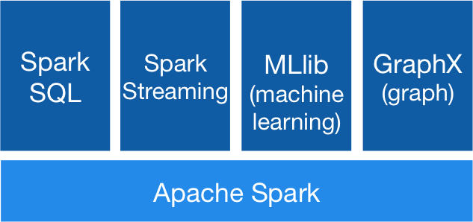




Overview Resource Management & Scheduling, cont.
[https://spark.apache.org/]
High-Level Architecture
  Different language bindings:
  Scala, Java, Python, R
  Different libraries: SQL, ML, Stream, Graph
  Spark core (incl RDDs)
  Different file systems/formats, and
  data sources: HDFS, S3, DBs, NoSQL
  Different cluster managers:
  Standalone, Mesos, Yarn, Kubernetes
➔ Separation of concerns:
resource allocation vs task scheduling
Standalone
MESOS
YARN
Kubernetes

Slide 10
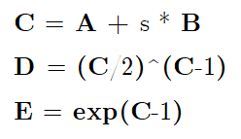
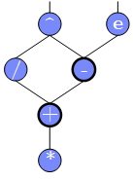
[Eleni D. Karatza: Cloud Performance Resource Allocation and Scheduling Issue, Aristotle University of Thessaloniki 2018]
Scheduling Problems
Bag-of-Tasks Scheduling
  Job of independent (embarrassingly parallel) tasks
  Examples: EC2 instances, map tasks
Gang Scheduling
  Job of frequently communicating parallel tasks
  Examples: MPI programs, parameter servers
DAG Scheduling
  Job of tasks with precedence constraints (e.g., data dependencies)
  Examples: Op scheduling Spark, TensorFlow, SystemDS
Real-Time Scheduling
  Job or task with associated deadline (soft/hard)
  Examples: rendering, car control
A
s
B
Notes:
Note: real-time scheduling w/ regular or irregular deadlines

Slide 11
Scheduling Problems, cont.
Operator-Device Placement
  Given neural network, multiple devices → operator placement (parallelism, data transfer)
  Sequence-to-sequence model to predict which operations should run on which device
  Example: ML Workloads
    white: CPU; colors: different GPU devices
  [Azalia Mirhoseini et al: Device Placement Optimization with Reinforcement Learning. ICML 2017]
Neural Machine Translation
(RNN)
Inception V3
(CNN)

Slide 12
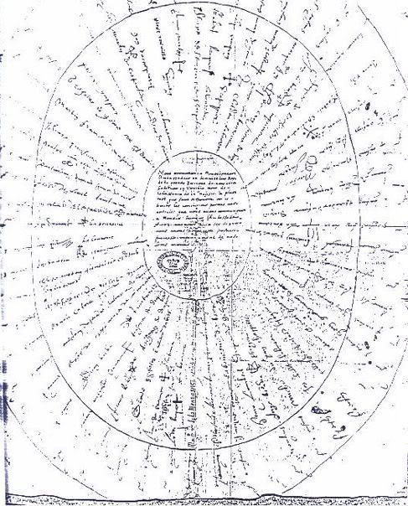
Basic Scheduling Metrics and Algorithms
Common Metrics
  Mean time to completion (total runtime for job), and max-stretch (completion/work – relative slowdown)
  Mean response time (job waiting time for resources);
  Throughput (jobs per time unit)
  Constraints / SLOs: max monetary costs, max latency, deadline
#1 FIFO (first-in, first-out)
  Simple queueing and processing in order
  Problem: Single long-running job can stall many short jobs
#2 SJF (shortest job first)
  Sort jobs by expected runtime and execute in order ascending
  Problem: Starvation of long-running jobs
#3 Round-Robin (FAIR)
  Allocate similar time (tasks, time slices) to all jobs
Service Level Agreements (SLA)
→ Service Level Objectives (SLO)
→ Service Level Indicators (SLI)
[Credit: https://en.wikipedia.org
(French "ruban rond" – English round ribbon)]

Slide 13
Resource Allocation, Isolation, and Monitoring
Resource Selection
Resource Allocation
Resource Isolation & Monitoring
Task Scheduling

Slide 14
Resource Selection
#1 Manual Selection
  Rule of thumb (I/O, mem, CPU characteristics of app)
  Data characteristics, and framework configurations, experience
Example
Spark Submit
export HADOOP_CONF_DIR=/etc/hadoop/conf
SPARK_HOME=../spark-2.4.0-bin-hadoop2.7
$SPARK_HOME/bin/spark-submit \
--master yarn --deploy-mode client \
--driver-java-options "-server –Xms40g –Xmn4g" \
--driver-memory 40g \
--num-executors 10 \
--executor-memory 100g \
--executor-cores 32 \
SystemDS.jar -f test.dml -stats -explain -args …

Slide 15
Resource Selection, cont.
#2 Application-Agnostic, Reactive
  Dynamic allocation based on workload characteristics
  Examples: Spark dynamic allocation, Databricks AutoScaling
#3 Application-Aware, Proactive
  Estimate time/costs of job under different configurations
  (what-if scenario analysis)
  Min $costs under time constraint
  Min runtime under $cost constraint
[Herodotos Herodotou, Fei Dong, Shivnath Babu: No one (cluster) size fits all: automatic cluster sizing for data-intensive analytics. SoCC 2011]
(fixed MR job w/ 6 nodes)

Slide 16

Resource Negotiation and Allocation
“Tetris Analogy”
(w/ expiration and queues)
Problem Formulation
  N nodes with memory and CPU constraints
  Stream of jobs with memory and CPU requirements
  Assign jobs to nodes (or to minimal number of nodes)
  ➔ Knapsack problem (bin packing problem)
In Practice: Heuristics
  Major concern: scheduling efficiency
  (online, cluster bottleneck)
  Approach: Sample queues, best/next-fit selection
  Multiple metrics: dominant resource calculator
12/48GB
8GB
2
32GB
6/8GB
1/32GB
2/8GB
1
6
[https://blog.cloudera.com/managing-cpu-resources-in-your-hadoop-yarn-clusters/]
8GB
Notes:
Note: story Spark driver and executor on same node → long scheduling delay → slows down ALL executors

Slide 17
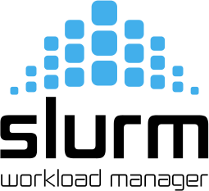
Slurm Workload Manager
Slurm Overview
  Simple Linux Utility for Resource Management (SLURM)
  Heavily used in HPC clusters (e.g., MPI gang scheduling)
Scheduler Design
  Allocation/placement of requested resources
  Considers nodes, sockets, cores, HW threads,
  memory, GPUs, file systems, SW licenses
  Job submit options:
  sbatch (async job script), salloc (interactive); srun (sync job submission and scheduling)
  Configuration: cluster, node count (ranges), task count, mem, etc
  Constraints via filters: sockets-per-node, cores-per-socket, threads-per-core
  mem, mem-per-cpu, mincpus, tmp min-disk-space
  Elasticity via re-queueing
[Don Lipari: The SLURM Scheduler Design, User Group Meeting, 2012]

Slide 18
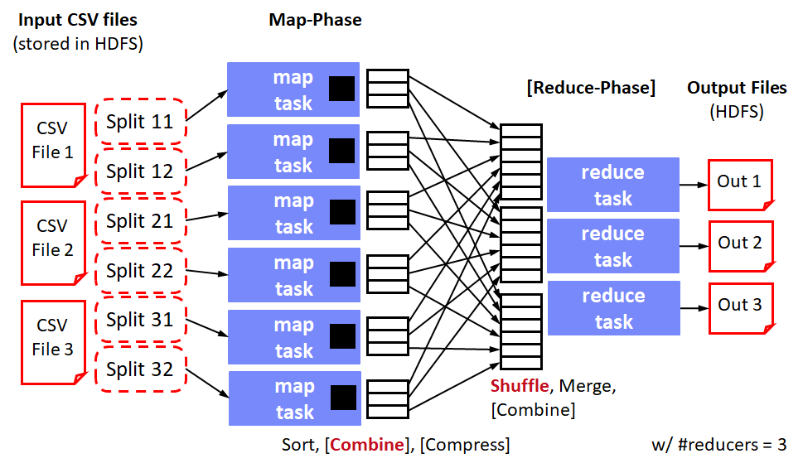
Background: Hadoop JobTracker (anno 2012)
Overview
  Hadoop cluster w/ fixed configuration of n map slots, m reduce slots
  (fixed number and fixed memory config map/reduce tasks)
  JobTracker schedules map and reduce tasks to slots
  FIFO and FAIR schedulers, account for data locality
Data Locality
  Levels: data local, rack local, different rack
  Delay scheduling (with FAIR scheduler)
  wait 1-3s for data local slot
Problem
  Intermixes resource allocation and task scheduling → Scalability problems in large clusters
  Forces every application into MapReduce programming model
[Matei Zaharia et al: Delay scheduling: a simple technique for achieving locality and fairness in cluster scheduling. EuroSys 2010]

Slide 19

[Benjamin Hindman et al: Mesos: A Platform for Fine-Grained Resource Sharing in the Data Center. NSDI 2011]
Mesos Resource Management
Overview Mesos
  Fine-grained, multi-framework cluster sharing
  Scalable and efficient scheduling
  → delegated to frameworks
  Resource offers
Notes:
Example users: apple, twitter, ebay, Netflix, CERN

Slide 20
[Benjamin Hindman et al: Mesos: A Platform for Fine-Grained Resource Sharing in the Data Center. NSDI 2011]
Mesos Resource Management, cont.
Resource Offers
  Mesos master decides how many resources to offer
  Framework scheduler decides which offered resources to accept/reject
  Challenge: long waiting times, lots of offers
  → filter specification
Offered resources
Reported available resources
Mesosphere Marathon: container orchestration
(e.g., Docker)

Slide 21
[Vinod Kumar Vavilapalli et al: Apache Hadoop YARN: yet another resource negotiator. SoCC 2013]
YARN Resource Management
Overview YARN
  Hadoop 2 decoupled resource scheduler (negotiator)
  Independent of programming model,
  multi-framework cluster sharing
  Resource Requests
Resource Scheduling via
Resource Manager
Task Scheduling via Application Masters (AMs)
Resource Isolation via
Node Managers

Slide 22
YARN Resource Management, cont.
// Set up the container launch context for the application master
ContainerLaunchContext amContainer =
Records.newRecord(ContainerLaunchContext.class);
amContainer.setCommands(Collections.singletonList(command));
amContainer.setLocalResources(constructLocalResourceMap(yconf));
amContainer.setEnvironment(constructEnvionmentMap(yconf));
Example Apache
SystemML AM
Submission
(anno 2014)
// Set up resource type requirements for ApplicationMaster
Resource capability = Records.newRecord(Resource.class);
capability.setMemory((int)computeMemoryAllocation(memHeap));
capability.setVirtualCores(numCores);
// Finally, set-up ApplicationSubmissionContext for the application
String qname = _dmlConfig.getTextValue(DMLConfig.YARN_APPQUEUE);
appContext.setApplicationName(APPMASTER_NAME); // application name
appContext.setAMContainerSpec(amContainer);
appContext.setResource(capability);
appContext.setQueue(qname); // queue (w/ min/max capacity constraints)
// Submit application (non-blocking)
yarnClient.submitApplication(appContext);

Slide 23
YARN Resource Management, cont.
Capacity Scheduler
  Hierarchy of queues w/ shared resource among sub queues
  Soft (and optional hard) [min, max]
  constraints of max resources
  Default queue-user mapping
  No preemption during runtime
  (only redistribution over queues)
Fair Scheduler
  All applications get same resources over time
  Fairness decisions on memory requirements,
  but dominant resource fairness possible too
data science
root
indexing

Slide 24
Hydra: Federated RM @ Microsoft
Overview Hydra
  Federated RM for internal MS big-data cluster
  Leverage sub-clusters w/ YARN RM + router
  AM-RM proxy (communication across sub clusters)
  Global policy generator + state store for runtime adaptation
Deployment
Statistics
[Carlo Curino et al.: Hydra: a federated resource manager for data-center scale analytics. NSDI 2019]
[https://www.youtube.com/watch?v=k_X13YamZXY&feature=emb_logo]
>250K servers
>500K daily jobs
>1 ZB data processed
>1T tasks scheduled
(~2G tasks daily)
>70K QPS (scheduling)
~60% avg CPU util

Slide 25

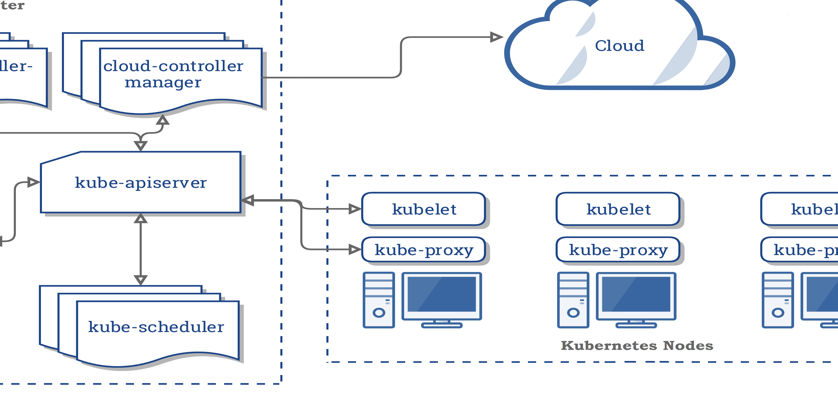
Kubernetes Container Orchestration
Overview Kubernetes
  Open-source system for automating, deployment, and
  management of containerized applications
  Container: resource isolation and application image
System Architecture
  Pod: 1 or more containers w/ individual IP
  Kubelet: node manager
  Controller: app master
  API Server + Scheduler
  Namespaces, quotas, access control,
  auth., logging & monitoring
  Wide variety of applications
➔ from machine- to application-oriented scheduling
KV Store
[https://kubernetes.io/docs/concepts/
overview/components/]
Notes:
Note: Kubernetes name – helmsman/pilot & seven of nine (friendlier borg) → seven spokes

Slide 26
Kubernetes Container Orchestration, cont.
Pod Scheduling (Placement)
  Default scheduler: kube-scheduler, custom schedulers possible
  #1 Filtering: finding feasible nodes for pod
  (resources, free ports, node selector, requested volumes, mem/disk pressure)
  #2 Scoring: score feasible nodes → select highest score
  (spread priority, inter-pod affinity, requested priority, image locality)
  Tuning: # scored nodes: max(50, percentageOfNodesToScore [1,100])
  (sample taken round robin across zones)
  ➔ Binding: scheduler notifies API server

Slide 27
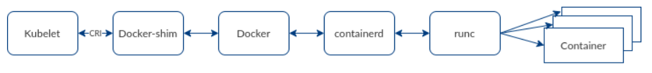

Container Runtime
Container Stack
  Docker as stack of development and runtime services
  containerd: high-level daemon for image management
  runc: low-level container runtime
Kubernetes deprecated Docker (as of 12/2020)
  Container Runtime Interface (CRI)
  Integrate other runtimes: cri-containerd, cri-o (Open Container Initiative)
[https://www.inovex.de/blog/containers-docker-containerd-nabla-kata-firecracker/]
[Credit:
www.inovex.de]
[https://kubernetes.io/blog/
2016/12/container-runtime-interface-cri-in-kubernetes/]
Notes:
Note: docker images created via docker build still runnable

Slide 28
Resource Isolation
Overview Key Primitives
  Platform-dependent resource isolation primitives → container runtime
  Linux namespaces: restricting visibility
  Linux cgroups: restricting usage
Cgroups (Control Groups)
  Developed by Google engineers → Kernel 2.6.24 (2008)
  Resource metering and limiting (memory, CPU, block I/O, network)
  Each subsystem has a hierarchy (tree) with each node = group of processes
  Soft and hard limits on groups
    Mem hard limit → triggers OOM killer (physical, kernel, total)
    CPU → set weights (time slices)/no limits, cpuset to pin groups to CPUs
Linux Containers
(e.g., basis of Docker)
[Jérôme Petazzoni: Cgroups, name-spaces and beyond: What are containers made from? DockerConEU 2015.]
[https://www.youtube.com/watch?v=sK5i-N34im8&feature=youtu.be]
Notes:
NOTE: Linux Containers, Solaris Projects [Mesos paper]

Slide 29
Resource Isolation, cont.
[https://developer.ibm.com/hadoop/
2017/06/30/deep-dive-yarn-cgroups/]
Example YARN
  Set max CPU time per node manager
  Container weights: cores/total cores
  OOM killer if mem w/ overhead exceeded
Lesson Learned
  “The resource isolation provided by containers has enabled Google
  to drive utilization significantly higher than industry norms. [..] Borg
  uses containers to co-locate batch jobs with latency-sensitive,
  user-facing jobs on the same physical machines.”
  “The isolation is not perfect, though: containers cannot prevent
  interference in resources that the operating-system kernel doesn’t
  manage, such as level 3 processor caches and memory bandwidth […]”
<property>
<name>yarn.nodemanager.resource.
percentage-physical-cpu-limit<name>
<value>60</value>
</property>
(hard → strict/soft)
[Abhishek Verma et al. Large-scale cluster management at Google with Borg. EuroSys 2015]
[Malte Schwarzkopf et al.: Omega: flexible, scalable schedulers for large compute clusters. EuroSys 2013]
[Brendan Burns et al.: Borg, Omega, and Kubernetes. ACM Queue 14(1): 10 (2016)]
Notes:
Note: Borg → Borglet

Slide 30
Task Scheduling and Elasticity
Resource Selection
Resource Allocation
Resource Isolation & Monitoring
Task Scheduling

Slide 31
Task Scheduling Overview
Problem Formulation
  Given computation job and set of resources (servers, threads)
  Distribute job in pieces across resources
#1 Job-Task Partitioning
  Split job into sequence of N tasks
#2 Task Placement / Execution
  Assign tasks to K resources for execution
Goal: Min Job Completion Time
  Beware: Max runtime per resource
  determines job completion time
Computation Job
t₁
t₂
t₃
t₄
t₅
t₆
Node 1
Node 2
Node 1:
t₁
t₂
t₃
t₅
Node 2:
t₄
t₆
Job done

Slide 32
Example Hyper-param Tuning
parfor(i in 1:800)
R[i,] = lm(X,y,reg[i])
Task Scheduling – Partitioning
Static Partitioning
  M = K tasks, task size ceil(N/K)
  Low overhead, poor load balance
Fixed Partitioning
  M = N/d tasks, task size d
  E.g., # iterations, # tuples to process
Self-Scheduling
  Exponentially decreasing task sizes d
  → M = log N tasks (w/ min task size)
  Low overhead and good load balance at end
  Guided self scheduling
  Factoring: waves of task w/ equal size
400
400
100
100
100
100
100
100
100
100
200
100
50
50
200
100
50
50
[Susan Flynn Hummel, Edith Schonberg, Lawrence E. Flynn: Factoring: a practical and robust method for scheduling parallel loops. SC 1991]

Slide 33
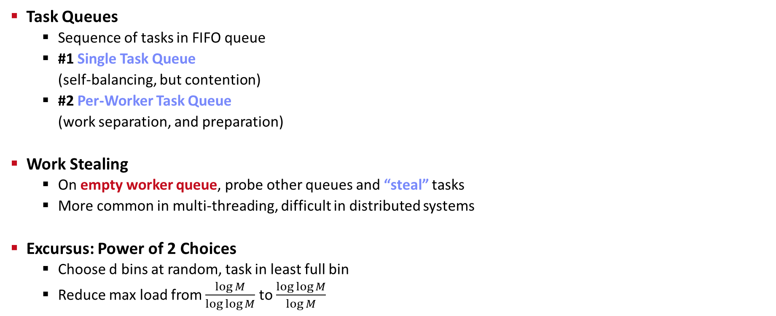
Task Scheduling – Placement
Task Queues
  Sequence of tasks in FIFO queue
  #1 Single Task Queue
  (self-balancing, but contention)
  #2 Per-Worker Task Queue
  (work separation, and preparation)
Work Stealing
  On empty worker queue, probe other queues and “steal” tasks
  More common in multi-threading, difficult in distributed systems
Excursus: Power of 2 Choices
  Choose d bins at random, task in least full bin
  Reduce max load from $\frac{\log{M}}{\log{\log{M}}}$ to $\frac{\log{\log{M}}}{\log{M}}$
Node 1
Node 2
Node 1
Node 2
“Airport”
“Super Market”
[Michael D. Mitzenmacher: The Power of Two Choices in Randomized Load Balancing, PhD Thesis UC Berkeley 1996]

Slide 34
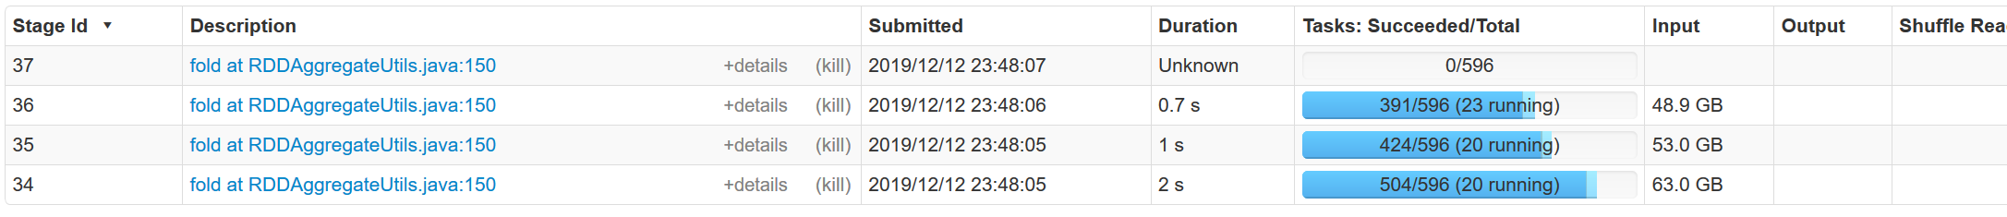
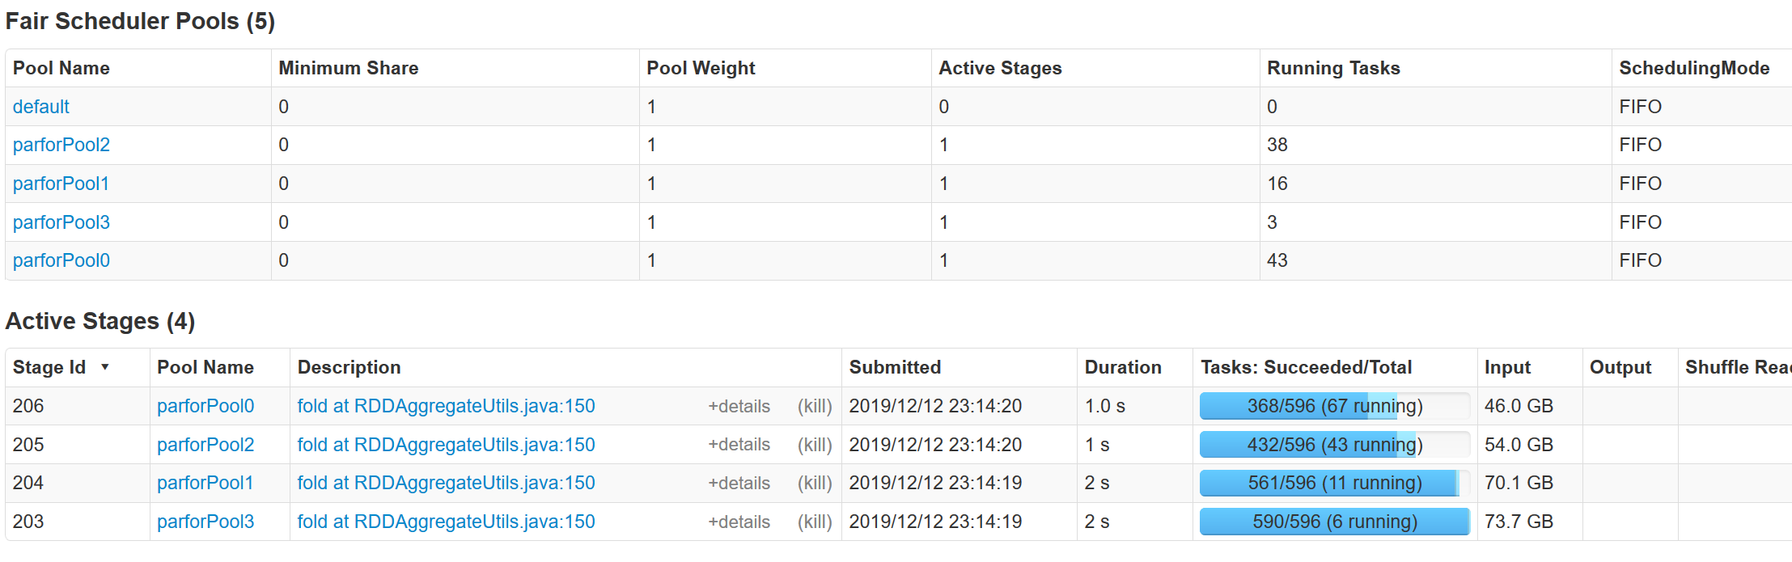
Spark Task Scheduling
SystemDS Example (80GB):
X = rand(rows=1e7,cols=1e3)
parfor(i in 1:4)
for(j in 1:10000)
print(sum(X)) #spark job
Overview
  Schedule job DAGs in stages (shuffle barriers)
  Default task scheduler: FIFO; alternative: FAIR
FIFO
FAIR

Slide 35
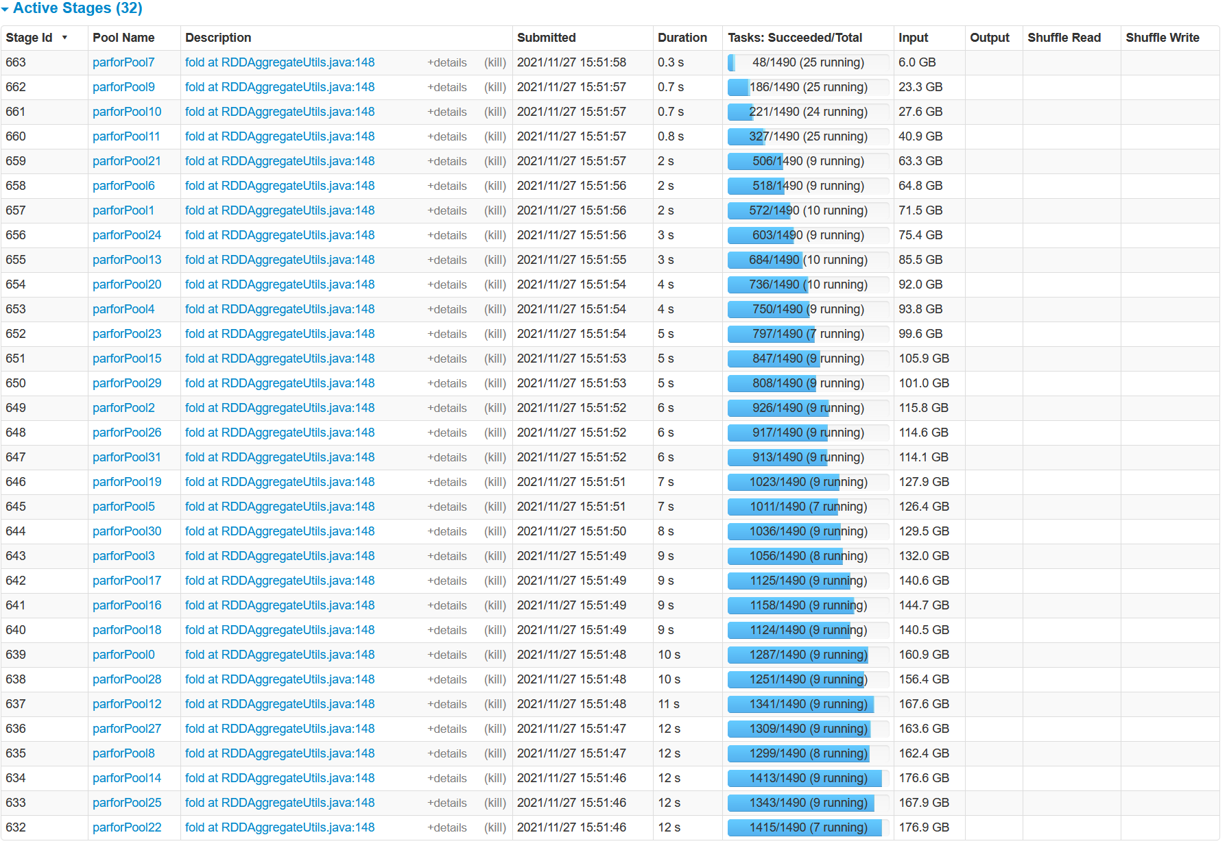
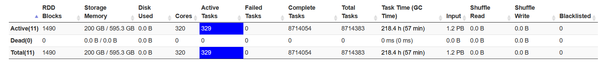
Spark Task Scheduling, cont.
FAIR scheduling
w/ k=32
concurrent jobs
and 200GB
FAIR:
Share 320 cores among 32 concurrent jobs
→ ~10 tasks/job
Elapsed:
~40min

Slide 36
Spark Task Scheduling, cont.
<allocations>
<pool name=“data_science">
<schedulingMode>FAIR</schedulingMode>
<weight>1</weight> <minShare>6</minShare>
</pool>
<pool name=“indexing">
<schedulingMode>FIFO</schedulingMode>
<weight>2</weight> <minShare>8</minShare>
</pool>
</allocations>
Fair Scheduler Configuration
  Pools with shares of cluster
  Scheduling modes: FAIR, FIFO
  weight: relative to equal share
  minShare: min numCores
Spark on Kubernetes
  Run Spark in shared cluster
  with Docker container apps,
  Distributed TensorFlow, etc
  Custom controller, and
  shuffle service (dynAlloc)
$SPARK_HOME/bin/spark-submit \
--master k8s://https://<k8s-api>:<k8s-api-port> \
--deploy-mode cluster
--driver-java-options "-server -Xms40g -Xmn4g" \
--driver-memory 40g \
--num-executors 10 \
--executor-memory 100g \
--executor-cores 32 \
--conf spark.kubernetes.container.image=<sparkimg> \
SystemDS.jar -f test.dml -stats -explain -args …

Slide 37
Spark Dynamic Allocation
[https://spark.apache.org/docs/
latest/job-scheduling.html]
Configuration for YARN/Mesos
  Set spark.dynamicAllocation.enabled = true
  Set spark.shuffle.service.enabled = true (robustness w/ stragglers)
Executor Addition/Removal
  Approach: look at task pressure (pending tasks / idle executors)
  Increase exponentially (add 1, 2, 4, 8) if
  pending tasks for spark.dynamicAllocation.schedulerBacklogTimeout
  Decrease executors they are idle for spark.dynamicAllocation.executorIdleTimeout
spark-submit \
--conf spark.shuffle.service.enabled=true \
--conf spark.dynamicAllocation.enabled=true \
--conf spark.dynamicAllocation.minExecutors=0 \
--conf spark.dynamicAllocation.initialExecutors=1 \
--conf spark.dynamicAllocation.maxExecutors=20

Slide 38
[Kay Ousterhout, Patrick Wendell, Matei Zaharia, Ion Stoica: Sparrow: distributed, low latency scheduling. SOSP 2013]
Sparrow Task Scheduling
Sparrow Overview
  Decentralized, randomized task scheduling with constraints, fair sharing
  Problems: Low latency, quality placement, fault tolerance, high throughput
Approach
  Baselines: Random, Per-task (power of two choices)
  New Techniques: Batch Scheduling, Late Binding
Baseline: Per-task sampling
Batch sampling w/ late binding
Notes:
Batch scheduling -> better tail latency
Late binding: Queue length alone bad indicator of time, race conditions with multiple schedulers

Slide 39

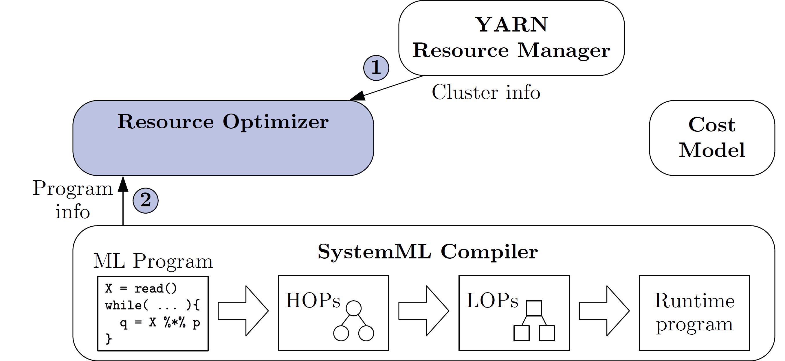
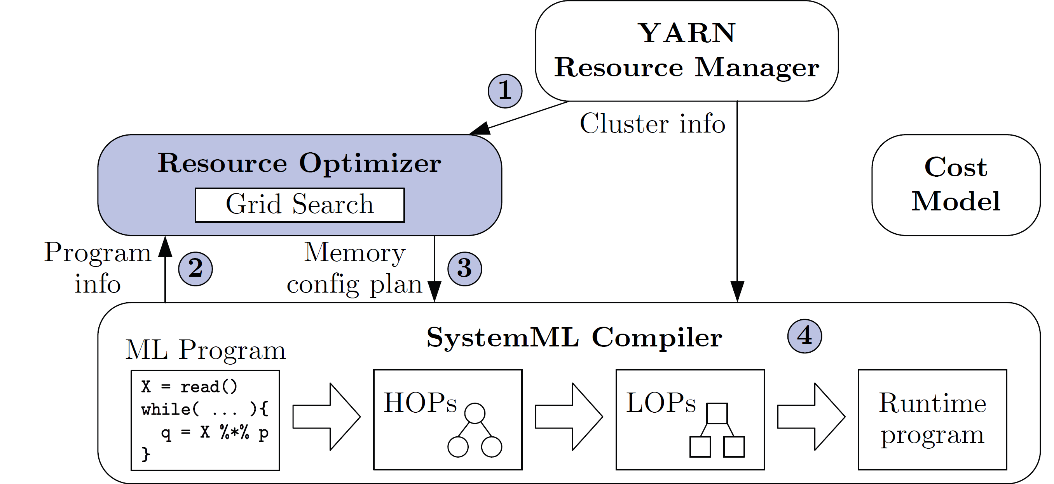
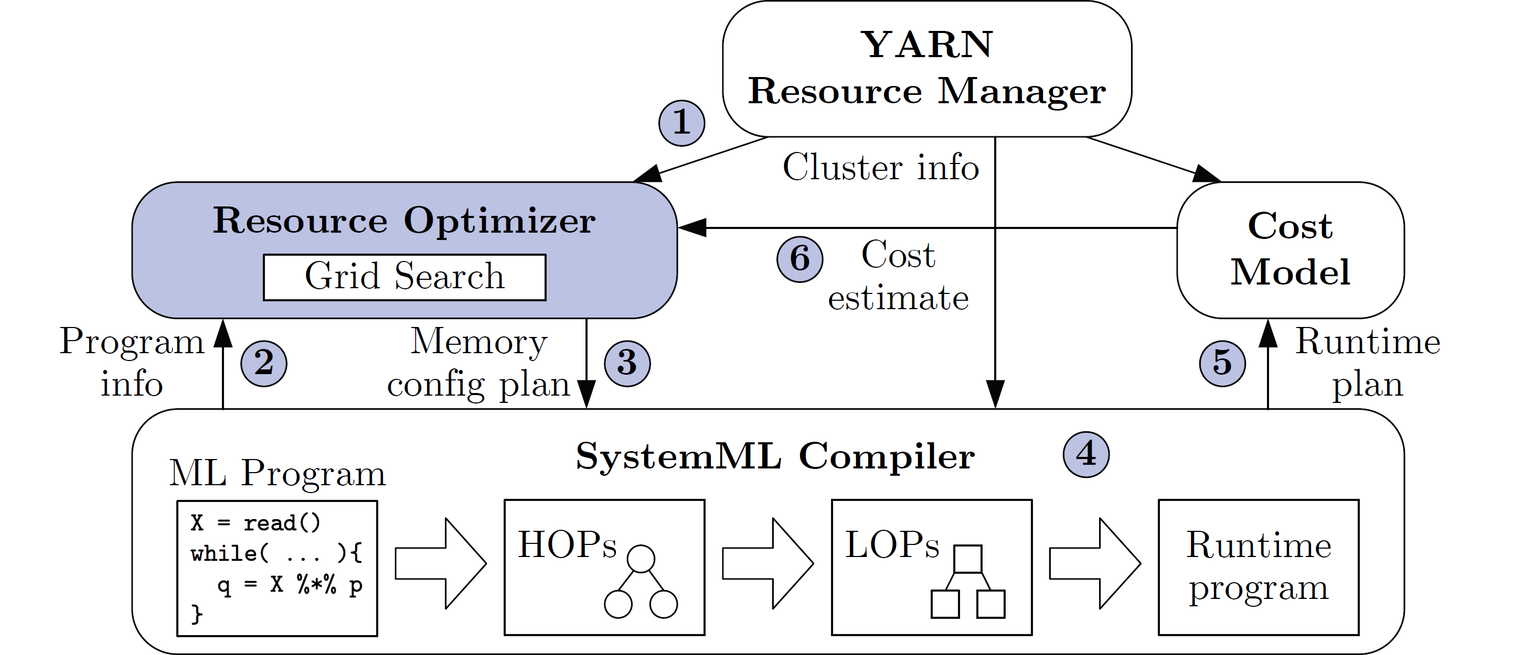
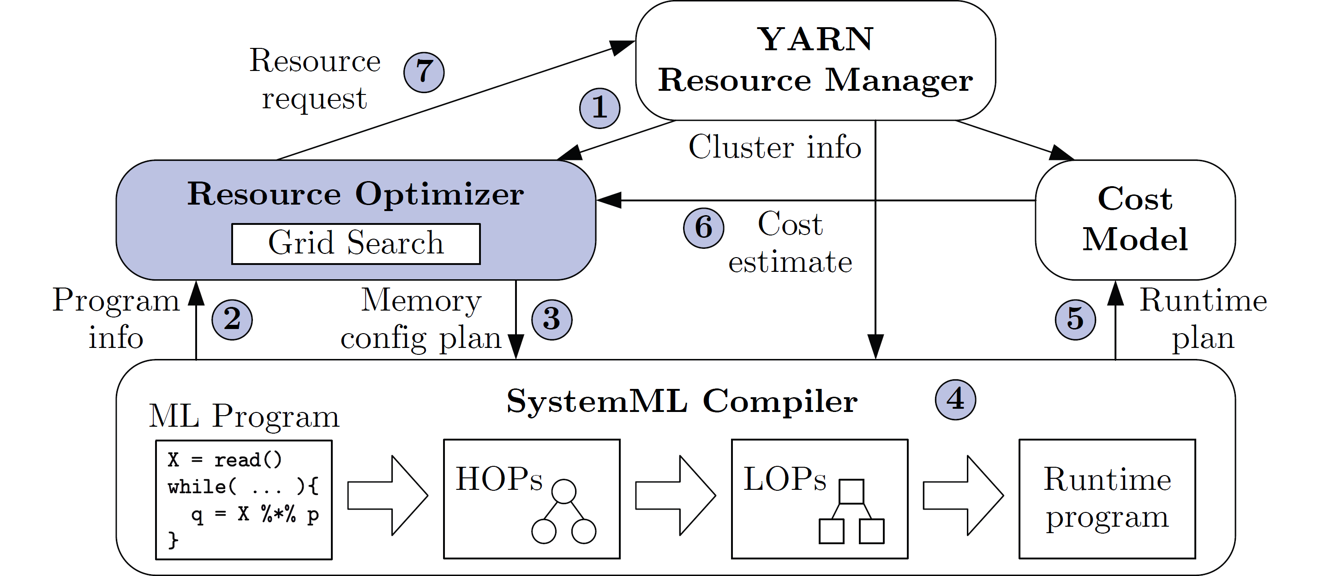
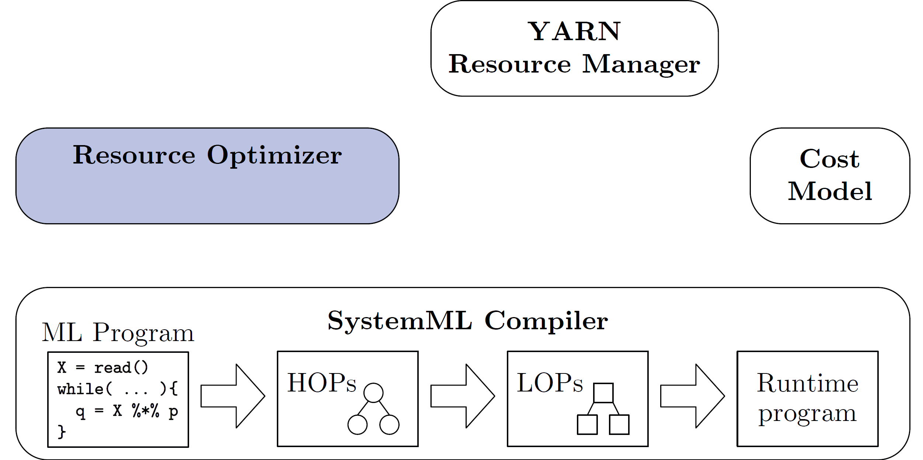
[Botong Huang et al.: Resource Elasticity for Large-Scale Machine Learning. SIGMOD 2015]
Resource Elasticity in SystemML
Resource Optimizer for ML Workloads
  Optimize ML program resource configurations via online what-if analysis and plan generation
  Minimize cost w/o unnecessary overprovisioning, program-aware enumeration (e.g., mem estimates)
Deployment
  Initial Compilation
  Dynamic
  Recompilation
  during Runtime
Master Thesis
Lachezar Nikolov (2024): Cloud Resource Elasticity in SystemDS
Data & Script

Slide 40



[Joseph M. Hellerstein et al: Serverless Computing: One Step Forward, Two Steps Back. CIDR 2019]
Serverless Computing (FaaS)
Definition Serverless
  FaaS: functions-as-a-service (event-driven, stateless input-output mapping)
  Infrastructure for deployment and auto-scaling of APIs/functions
  Examples: Amazon Lambda, Microsoft Azure Functions, etc
Example
Lambda Functions
Event Source (e.g., cloud services)
Other APIs and Services
Auto scaling
Pay-per-request
(1M x 100ms = 0.2$)
import com.amazonaws.services.lambda.runtime.Context;
import com.amazonaws.services.lambda.runtime.RequestHandler;
public class MyHandler implements RequestHandler<Tuple, MyResponse> {
@Override
public MyResponse handleRequest(Tuple input, Context context) {
return expensiveModelScoring(input); // with read-only model
}
}

Slide 41
Summary and Q&A
Motivation, Terminology, and Fundamentals
Resource Allocation, Isolation, and Monitoring
Task Scheduling and Elasticity
Next Lectures (Large-scale Data Management and Analysis)
  10 Distributed Data Storage [Dec 18]
  Holidays
  11 Distributed, Data-Parallel Computation [Jan 15]
  12 Distributed Stream Processing [Jan 22]
  13 Distributed Machine Learning Systems [Jan 29]

