Slide 1

Data Integration and Large-scale Analysis (DIA)
11 Distributed, Data-parallel Computation
Prof. Dr. Matthias Boehm
Technische Universität Berlin
Berlin Institute for the Foundations of Learning and Data
Big Data Engineering (DAMS Lab)
Last update: Jan 15, 2026

Slide 2


Announcements / Administrative Items
#1 Video Recording
  Hybrid lectures: in-person BH-N 243, zoom live streaming, video recording
  https://tu-berlin.zoom.us/j/9529634787?pwd=R1ZsN1M3SC9BOU1OcFdmem9zT202UT09
#2 Exercise Submission (Jan 30 EOD, 10MB)
  2/279 submissions so far
#3 Exam Registration
  1st Exam Slot: Feb 05, 4pm (start 4.15pm, end 5.45pm, BH-N 243, 27/30 seats)
  2nd Exam Slot: Feb 12, 4pm (start 4.15pm, end 5.45pm, BH-N 243, 15/30 seats)
  3rd Exam Slot: Mar 12, 4pm (start 9.45am, end 5.45am, A 151, 5/60 seats)
#4 Course Evaluation in WiSe 2025/26
  https://befragung.tu-berlin.de/evasys/online.php?pswd=XGS9H
  Evaluation period: Jan 12 – Jan 23

Slide 3
Course Outline Part B:
Large-Scale Data Management and Analysis
12 Distributed Stream
Processing
13 Distributed Machine Learning Systems
11 Distributed Data-Parallel Computation
Compute/
Storage
10 Distributed Data Storage
09 Cloud Resource Management and Scheduling
Infra
08 Cloud Computing Fundamentals

Slide 4
Agenda
Motivation and Terminology
Data-Parallel Collection Processing
Data-Parallel Data-Frame Operations
Data-Parallel Computation in SystemDS

Slide 5
Motivation and Terminology

Slide 6
Recap: Central Data Abstractions
#1 Files and Objects
  File: Arbitrarily large sequential data in specific file format (CSV, binary, etc)
  Object: binary large object, with certain meta data
#2 Distributed Collections
  Logical multi-set (bag) of key-value pairs
  (unsorted collection)
  Different physical representations
  Easy distribution of pairs
  via horizontal partitioning
  (aka shards, partitions)
  Can be created from single file,
  or directory of files (unsorted)
Key | Value
4 | Delta
2 | Bravo
1 | Alfa
3 | Charlie
5 | Echo
6 | Foxtrot
7 | Golf
1 | Alfa

Slide 7
[Michael E. Thomadakis: The Architecture of the Nehalem Processor and Nehalem-EP SMP Platforms, Report, 2010]
Excursus: Nehalem Architecture
Multi-core CPU
  4 core w/ hyper-threading
  Per core: L1i/L1d, L2 cache
  Per CPU: L3 cache (8MB)
  3 memory channels
  (8B width, max 1.333Ghz)
Instruction Pipeline
  Frontend: Instruction Fetch,
  Pre-Decode, and Decode
  Backend: Rename/Allocate,
  Scheduler, Execute, Write-Back
Out-of-Order Execution Engine (IPC=4)
  128b FP Multiply
  128b FP Add
QPI … Quick Path Interconnect

Slide 8
Terminology Parallelism
Single Data
Multiple Data
SISD
(uni-core)
SIMD
(vector)
Single Instruction
Flynn’s Classification
  SISD, SIMD
  (MISD), MIMD
Example: SIMD Processing
  Streaming SIMD Extensions (SSE)
  Process the same operation on multiple elements
  at a time (packed vs scalar SSE instructions)
  Data parallelism (aka: instruction-level parallelism)
  Example: VFMADD132PD
[Michael J. Flynn, Kevin W. Rudd: Parallel Architectures. ACM Comput. Surv. 28(1) 1996]
MISD
(pipelining)
MIMD
(multi-core)
Multiple Instruction
2009 Nehalem: 128b (2xFP64)
2012 Sandy Bridge: 256b (4xFP64)
2017 Skylake: 512b (8xFP64)
c = _mm512_fmadd_pd(a, b);
a
b
c

Slide 9
Terminology Parallelism, cont.
Distributed, Data-Parallel Computation
  Parallel computation of function foo() ➔ single instruction
  Collection X of data items (key-value pairs) ➔ multiple data
  Data parallelism similar to SIMD but more
  coarse-grained notion of “instruction” and “data”
  ➔ SPMD (single program, multiple data)
Additional Terminology
  BSP: Bulk Synchronous Parallel (global barriers)
  ASP: Asynchronous Parallel (no barriers, often with accuracy impact)
  SSP: Stale-synchronous parallel (staleness constraint on fastest-slowest)
  Other: Fork&Join, Hogwild!, event-based, decentralized
Beware: data parallelism used in very different contexts (e.g., Parameter Server)
Y = X.map(x -> foo(x))
[Frederica Darema: The SPMD Model : Past, Present and Future. PVM/MPI 2001]

Slide 10
Data-Parallel Collection Processing

Slide 11

Hadoop History and Architecture
Recap: Brief History
  Google’s GFS [SOSP’03] + MapReduce
  → Apache Hadoop (2006)
  Apache Hive (SQL), Pig (ETL), Mahout/SystemML (ML), Giraph (Graph)
Hadoop Architecture / Eco System
  Management (Ambari)
  Coordination / workflows
  (Zookeeper, Oozie)
  Storage (HDFS)
  Resources (YARN)
  [SoCC’13]
  Processing
  (MapReduce)
[Jeffrey Dean, Sanjay Ghemawat: MapReduce: Simplified Data Processing on Large Clusters. OSDI 2004]
Worker Node 1
Worker Node n
MR AM
MR task
MR task
MR task
Head Node
MR task
MR task
MR task
MR task
Resource Manager
Node Manager
Node Manager
NameNode
MR Client
DataNode
DataNode
1
3
2
3
2
9

Slide 12
MapReduce – Programming Model
Overview Programming Model
  Inspired by functional programming languages
  Implicit parallelism (abstracts distributed storage and processing)
  Map function: key/value pair → set of intermediate key/value pairs
  Reduce function: merge all intermediate values by key
Example
SELECT Dep, count(*) FROM csv_files GROUP BY Dep
Name | Dep
X | CS
Y | CS
A | EE
Z | CS
map(Long pos, String line) {
parts ← line.split(“,”)
emit(parts[1], 1)
}
CS | 1
CS | 1
EE | 1
CS | 1
reduce(String dep,
Iterator<Long> iter) {
total ← iter.sum();
emit(dep, total)
}
Collection of key/value pairs
CS | 3
EE | 1

Slide 13
MapReduce – Execution Model
#1 Data Locality (delay sched., write affinity)
#2 Reduced shuffle (combine)
#3 Fault tolerance (replication, attempts)
Input CSV files (stored in HDFS)
Map-Phase
map
task
[Reduce-Phase]
Output Files (HDFS)
CSV File 1
Split 11
map
task
Split 12
reduce
task
Out 1
Split 21
map
task
CSV File 2
reduce
task
Out 2
Split 22
map
task
reduce
task
Out 3
CSV File 3
Split 31
map
task
Split 32
map
task
Shuffle, Merge, [Combine]
Sort, [Combine], [Compress]
w/ #reducers = 3

Slide 14
MapReduce – Query Processing
Basic Unary Operations
  Selections (brute-force), projections
  Ordering (e.g., TeraSort): Sample, pick k quantiles; shuffle-based partition sort
  Additive and semi-additive aggregation with grouping, distinct
Binary Operations
  Set operations (union, intersect, difference) and joins
  Different physical operators for R ⨝ S
    Broadcast join: broadcast S, build HT S, map-side HJOIN
    Repartition join: shuffle (repartition) R and S, reduce-side MJOIN
    Improved repartition join: avoid buffering via key-tag sorting
    Directed join (pre/co-partitioned): map-only, R input, S read side-ways
Hybrid SQL-on-Hadoop Systems
  E.g.: Hadapt (HadoopDB), Impala, IBM BigSQL, Presto, Drill, Actian
[Spyros Blanas et al.: A comparison of join algorithms for log processing in MapReduce. SIGMOD 2010]
[Daniel Abadi, Shivnath Babu, Fatma Ozcan, Ippokratis Pandis: Tutorial: SQL-on-Hadoop Systems. PVLDB 2015]

Slide 15

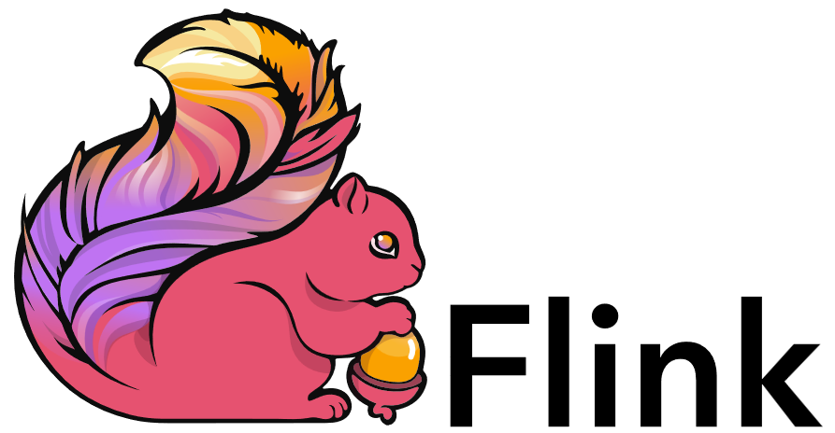
Spark History and Architecture
Summary MapReduce
  Large-scale & fault-tolerant processing w/ UDFs and files ➔ Flexibility
  Restricted functional APIs ➔ Implicit parallelism and fault tolerance
  Criticism: #1 Performance, #2 Low-level APIs, #3 Many different systems
Evolution to Spark (and Flink)
  Spark [HotCloud’10] + RDDs [NSDI’12] → Apache Spark (2014)
  Design: standing executors with in-memory storage, lazy evaluation, fault-tolerance via RDD lineage
  Performance: In-memory storage and fast job scheduling (100ms vs 10s)
  APIs: Richer functional APIs and general computation DAGs,
  high-level APIs (e.g., DataFrame/Dataset), unified platform
➔ But many shared concepts/infrastructure
  Implicit parallelism through dist. collections (data access, fault tolerance)
  Resource negotiators (YARN, Mesos, Kubernetes)
  HDFS and object store connectors (e.g., Swift, S3)

Slide 16
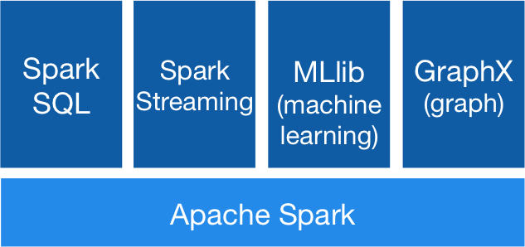


Spark History and Architecture, cont.
[https://spark.apache.org/]
High-Level Architecture
  Different language bindings:
  Scala, Java, Python, R
  Different libraries:
  SQL, ML, Stream, Graph
  Spark core (incl RDDs)
  Different cluster managers:
  Standalone, Mesos, Yarn, Kubernetes
  Different file systems/
  formats, and data sources:
  HDFS, S3, SWIFT, DBs, NoSQL
Focus on a unified platform
for data-parallel computation (Apache Flink w/ similar goals)
Standalone
MESOS
YARN
Kubernetes

Slide 17
Spark Resilient Distributed Datasets (RDDs)
RDD Abstraction
  Immutable, partitioned
  collections of key-value pairs
  Coarse-grained deterministic operations (transformations/actions)
  Fault tolerance via lineage-based re-computation
Operations
  Transformations: define new RDDs
  Actions: return result to driver
Distributed Caching
  Use fraction of worker memory for caching
  Eviction at granularity of individual partitions
  Different storage levels (e.g., mem/disk x serialization x compression)
JavaPairRDD<MatrixIndexes,MatrixBlock>
Type | Examples
Transformation (lazy) | map, hadoopFile, textFile, flatMap, filter, sample, join, groupByKey, cogroup, reduceByKey, cross, sortByKey, mapValues
Action | reduce, save, collect, count, lookupKey
Node1
Node2

Slide 18
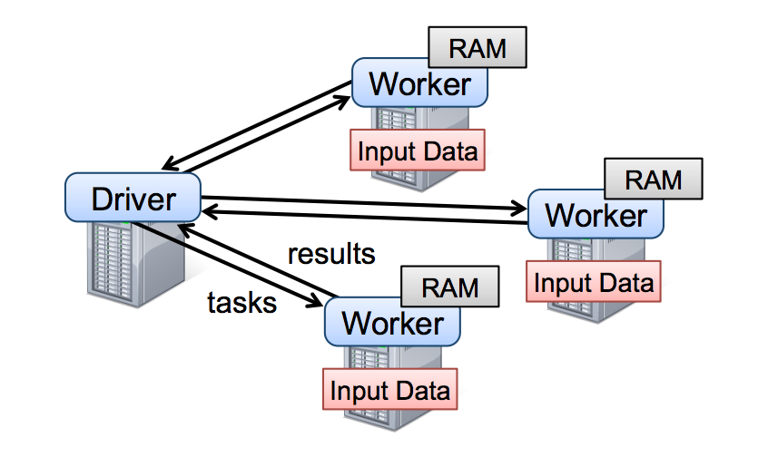
Spark Resilient Distributed Datasets (RDDs), cont.
X.filter(foo())
X.mapValues(foo())
X.reduceByKey(foo())
X.cache()/X.persist(…)
Lifecycle of an RDD
  Note: can’t broadcast
  an RDD directly
sc.parallelize(lst)
Local Data
(value, collection)
Distributed Collection
lst = X.collect()
v = X.reduce(foo())
sc.hadoopFile(f)
sc.textFile(f)
X.saveAsObjectFile(f)
X.saveAsTextFile(f)
File on DFS

Slide 19
Spark Partitions and Implicit/Explicit Partitioning
Spark Partitions
  Logical key-value collections are split into physical partitions
  Partitions are granularity of tasks, I/O, shuffling, evictions
Partitioning via Partitioners
  Implicitly on every data shuffling
  Explicitly via R.repartition(n)
Partitioning-Preserving
  All operations that are guaranteed to keep keys unchanged
  (e.g. mapValues(), mapPartitions() w/ preservesPart flag)
Partitioning-Exploiting
  Join: R3 = R1.join(R2)
  Lookups:
  v = C.lookup(k)
~128MB
Example Hash Partitioning:
For all (k,v) of R:
pid = hash(k) % n
Hash partitioned
⋈
⋈
0: 8, 1, 6
0: 1, 2
% 3
0: 3, 6
0: 6, 3
2: 2, 3, 4
2: 3, 4
2: 2, 5, 8
2: 5, 2
1: 7, 5
1: 5, 6
1: 4, 7, 1
1: 4, 1

Slide 20
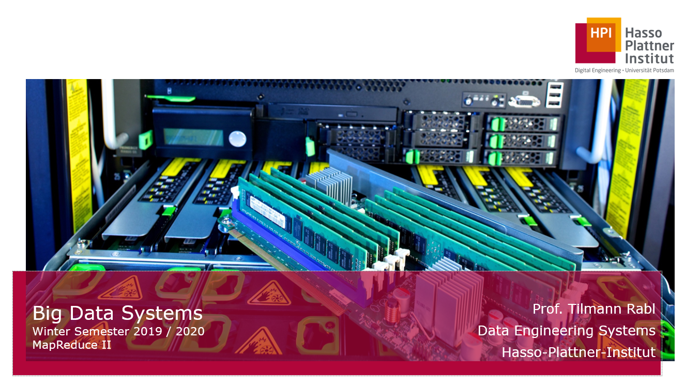
Spark Scheduling Process
[Tilmann Rabl:
Big Data Systems,
HPI WS2019/20]
RDD Objects
DAGScheduler
TaskScheduler
Workers
Scheduler
Backend
Threads
DAG
TaskSet
Task
Block manager
rdd1.join(rdd2)
.reduceByKey(…)
.filter(…)
split graph into stages of tasks
launch tasks at workers
execute tasks
build
operator DAG
submit each stage as ready
retry failed or straggling tasks
store and serve blocks

Slide 21
Spark Lazy Evaluation, Caching, and Lineage
[Matei Zaharia, Mosharaf Chowdhury, Tathagata Das, Ankur Dave, Justin Ma, Murphy McCauly, Michael J. Franklin, Scott Shenker, Ion Stoica: Resilient Distributed Datasets: A Fault-Tolerant Abstraction for In-Memory Cluster Computing. NSDI 2012]
A
B
partitioning- aware
G
Stage 1
groupBy
C
D
F
reduce
Reduce action triggers DAG compilation and evaluation
DAG compiled into job of multiple stages (3 here), demarcated by wide shuffle dependencies
Lost/evicted cached partitions are
re-evaluated via partition lineage
map
union
E
join
Stage 2
Stage 3
cached
Notes:
Notes:
Dryad-­‐like DAGs
Pipelines functions within a stage
Locality & data reuse aware
Partitioning-­‐aware to avoid shuffles

Slide 22
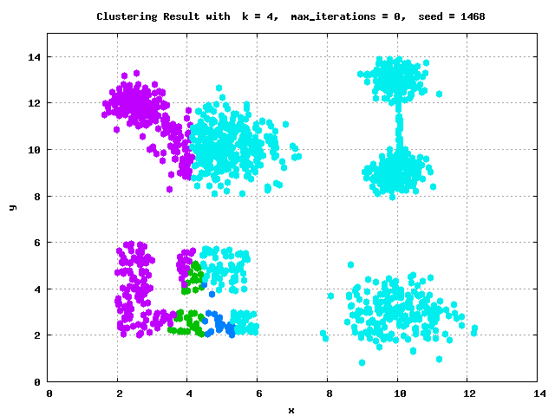
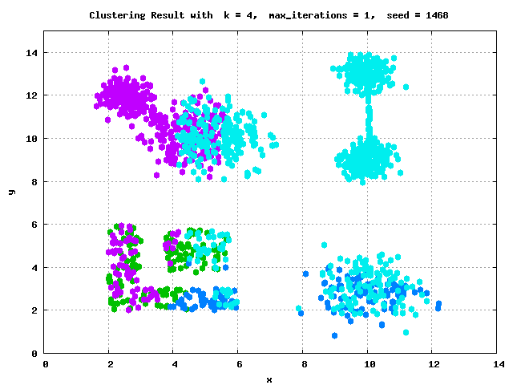
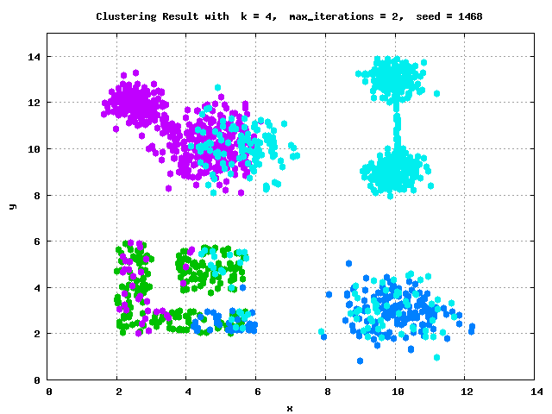
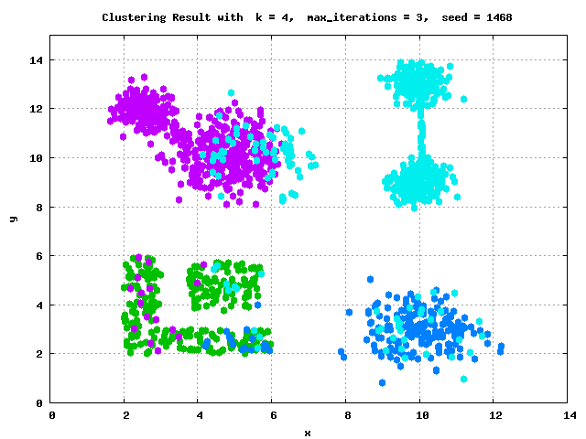
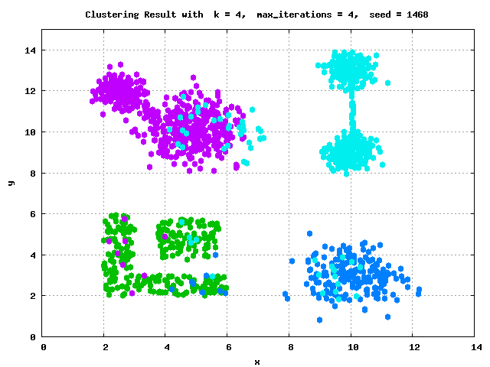

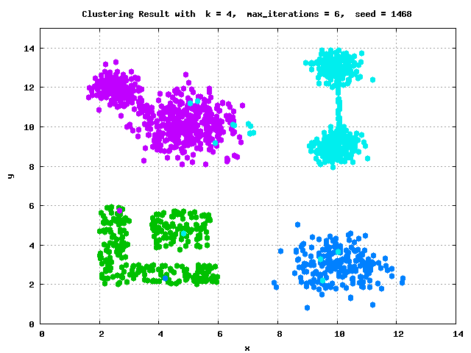




Example: k-Means Clustering
k-Means Algorithm
  Given dataset D and number of clusters k, find cluster centroids
  (“mean” of assigned points) that minimize within-cluster variance
  Euclidean distance: sqrt(sum((a-b)^2))
Pseudo
Code
function Kmeans(D, k, maxiter) {
  C‘ = randCentroids(D, k);
  C = {};
  i = 0; //until convergence
  while( C‘ != C & i<=maxiter ) {
  C = C‘;
  i = i + 1;
  A = getAssignments(D, C);
  C‘ = getCentroids(D, A, k);
  }
  return C‘
  }

Slide 23
Example: k-Means Clustering in Spark
// create spark context (allocate configured executors)
JavaSparkContext sc = new JavaSparkContext();
// read and cache data, initialize centroids
JavaRDD<Row> D = sc.textFile(“hdfs:/user/mboehm/data/D.csv“)
.map(new ParseRow()).cache(); // cache data in spark executors
Map<Integer,Mean> C = asCentroidMap(D.takeSample(false, k));
// until convergence
while( !equals(C, C2) & i<=maxiter ) {
C2 = C; i++;
// assign points to closest centroid, recompute centroid
Broadcast<Map<Integer,Row>> bC = sc.broadcast(C)
C = D.mapToPair(new NearestAssignment(bC))
.foldByKey(new Mean(0), new IncComputeCentroids())
.collectAsMap();
}
return C;
Note: Existing library algorithm
[https://github.com/apache/spark/blob/master/mllib/src/
main/scala/org/apache/spark/mllib/clustering/KMeans.scala]
Notes:
Spark Local Mode
Download and unzip Spark https://spark.apache.org/downloads.html,
or pull dependency into IDE project via maven or similar tools
Setup prerequisites and path variables
Test spark-shell, spark-submit, or in your IDE
NOTE: in local mode, operations run in driver JVM and I/O to local FS
Amazon AWS EMR (Elastic Map Reduce)

Slide 24
Data-Parallel Data-Frame Operations

Slide 25
Origins of DataFrames
Recap: Data Preparation Problem
  80% Argument: 80-90% time for finding, integrating, cleaning data
  Data scientists prefer scripting languages and in-memory libraries
R and Python DataFrames
  R data.frame/dplyr and Python pandas DataFrame for
  seamless data manipulations (most popular packages/features)
  DataFrame: table with a schema
  Descriptive stats and basic math, reorganization, joins, grouping, windowing
  Limitation: Only in-memory, single-node operations
Example
Pandas
import pandas as pd
df = pd.read_csv(‘data/tmp1.csv’, index_col=2)
df.head() # df w/ indexes A-Z
df = pd.concat(df, df[[‘A’,’C’]], axis=1) # cbind

Slide 26
Spark DataFrames and DataSets
Overview Spark DataFrame
  DataFrame is a distributed collection of rows
  with named/typed columns
  Relational operations (e.g., projection, selection, joins, grouping, aggregation)
  DataSources (e.g., json, jdbc, parquet, hdfs, s3, avro, hbase, csv, cassandra)
DataFrame and Dataset APIs
  DataFrame was introduced as basis for Spark SQL
  DataSets allow more customization and compile-time analysis errors (Spark 2)
Example DataFrame
DataFrame = Dataset[Row]
logs = spark.read.format("json").open("s3://logs")
logs.groupBy(logs.user_id).agg(sum(logs.time))
.write.format("jdbc").save("jdbc:mysql//...")
[Michael Armbrust: Structuring Apache Spark – SQL, DataFrames, Datasets, and Streaming, Spark Summit 2016]
→ PySpark

Slide 27
SparkSQL and DataFrame/Dataset
Overview SparkSQL
  Shark (~2013): academic prototype for SQL on Spark
  SparkSQL (~2015): reimplementation from scratch
  Common IR and compilation of SQL and DataFrame operations
Catalyst:
Query Planning
Performance features
  #1 Whole-stage code generation via Janino
  #2 Off-heap memory (sun.misc.Unsafe) for caching and certain operations
  #3 Pushdown of selection, projection, joins into data sources (+ join ordering)
[Michael Armbrust et al.: Spark SQL: Relational Data Processing in Spark. SIGMOD 2015]

Slide 28

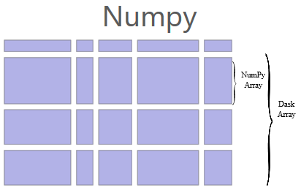
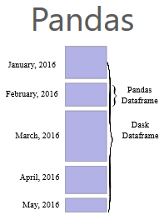
[Matthew Rocklin: Dask: Parallel Computation with Blocked algorithms and Task Scheduling, Python in Science 2015]
[Dask Development Team: Dask: Library for dynamic task scheduling, 2016, https://dask.org]
Dask
Overview Dask
  Multi-threaded and distributed operations for arrays, bags, and dataframes
  dask.array: list of numpy n-dim arrays
  dask.dataframe: list of pandas data frames
  dask.bag:unordered list of tuples (second order functions)
  Local and distributed schedulers:
  threads, processes, YARN, Kubernetes, containers, HPC, and cloud, GPUs
Execution
  Lazy evaluation
  Limitation: requires static size inference
  Triggered via compute()
Discussion
  PySpark Competition (but not out-of-core), scalable ML
  algorithms via https://ml.dask.org/ (partnering w/ scikit-learn)
import dask.array as da
x = da.random.random(
(10000,10000), chunks=(1000,1000))
y = x + x.T
y.persist() # cache in memory
z = y[::2, 5000:].mean(axis=1) # colMeans
ret = z.compute() # returns NumPy array
Notes:
Note: somewhat in competition w/ PySpark (but not out-of-core)

Slide 29
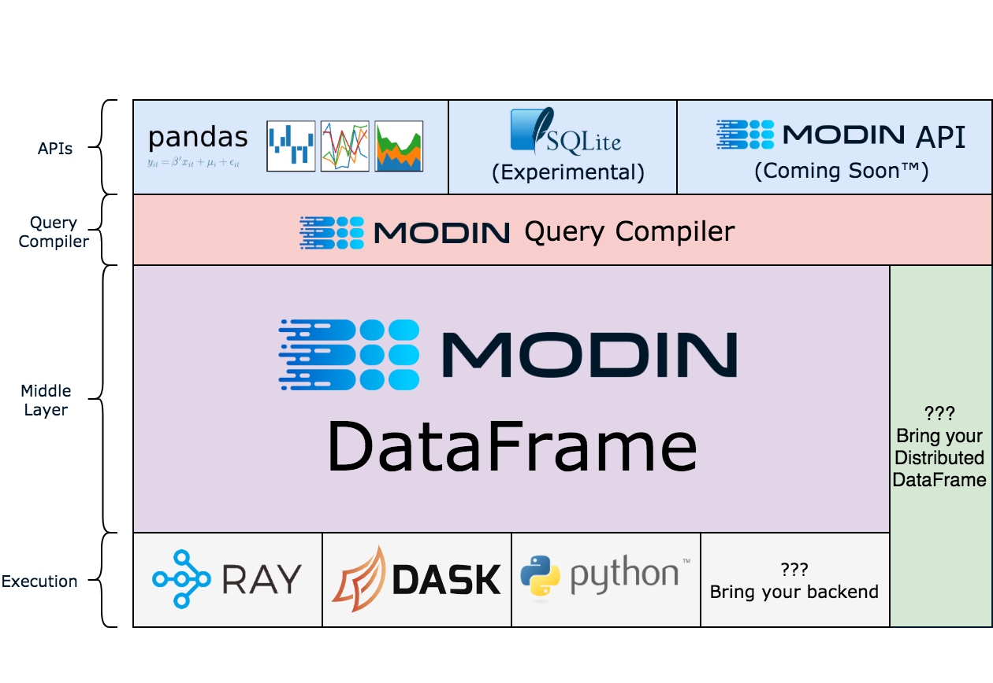
[Devin Petersohn, et al.: Towards Scalable Dataframe Systems. PVLDB 2020]
Modin (UC Berkeley → Ponder → Snowflake)
[Devin Petersohn, et al: Flexible Rule-Based Decomposition and Metadata Independence in Modin: A Parallel Dataframe System. PVLDB 2021]
Overview Modin
  Goal: Enhance Pandas data frames
  Convert Pandas API
  to core algebra expressions
  (map, explode,
  groupby, reduce)
  Different Backends:
  Ray, Dask, MPI
[https://github.com/
modin-project/modin]

Slide 30
Data-Parallel Computation in SystemDS
[Matthias Boehm et al.: SystemDS: A Declarative Machine Learning System for the End-to-End Data Science Lifecycle. CIDR 2020]
[Matthias Boehm et al.: SystemML: Declarative Machine Learning on Spark. PVLDB 2016]
[Amol Ghoting et al.: SystemML: Declarative Machine Learning
on MapReduce. ICDE 2011]

Slide 31
Background: Matrix Formats
Example
3x3 Matrix
Matrix Block (m x n)
  A.k.a. tiles/chunks, most operations defined here
  Local matrix: single block, different representations
Common Block Representations
  Dense (linearized arrays)
  MCSR (modified CSR)
  CSR (compressed sparse rows), CSC
  DCSR (double compressed sparse rows)
  COO (Coordinate matrix)
.7
.1
Past DIA/AMLS projects
(Jannik Lindemann, Rene Richard Enjilian): DCSR, CSC
.2
.4
.3
MCSR
CSR
COO
0
2
0
0
.7
0
0
.7
.7
.1
2
2
.1
0
2
.1
0
1
4
0
.2
1
0
.2
Dense (row-major)
.2
.4
5
1
.4
1
1
.4
.7
0
.1
.2
.4
0
0
.3
0
1
1
.3
2
1
.3
.3
O(mn)
O(m + nnz(X))
O(nnz(X))
Notes:
Note: specialized formats like double-compressed CSR existing (indicator for non-zero rows)

Slide 32
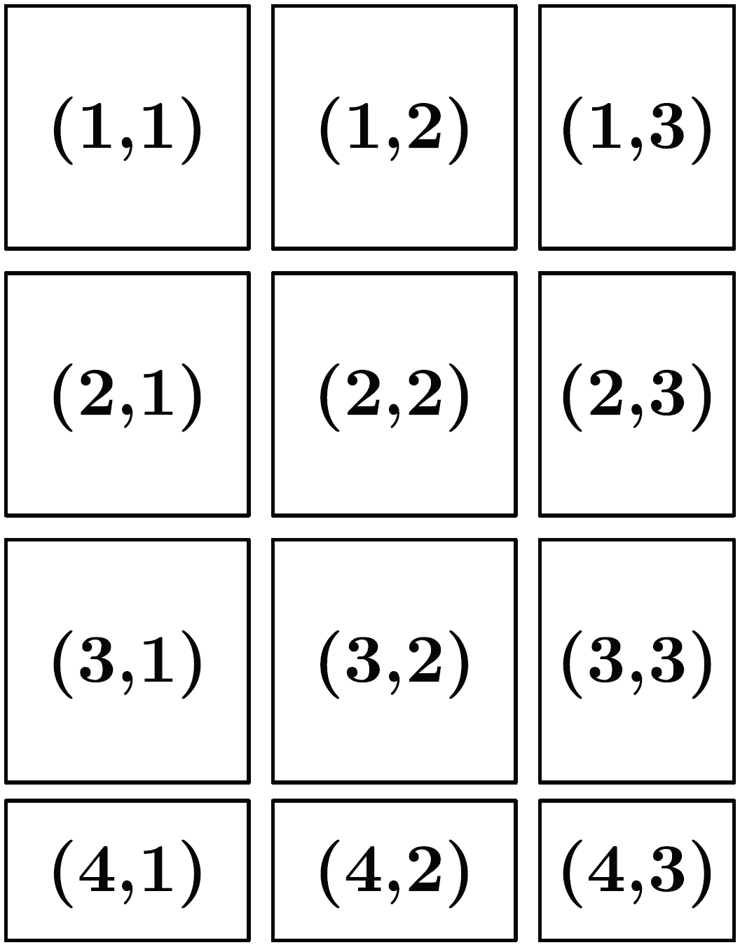
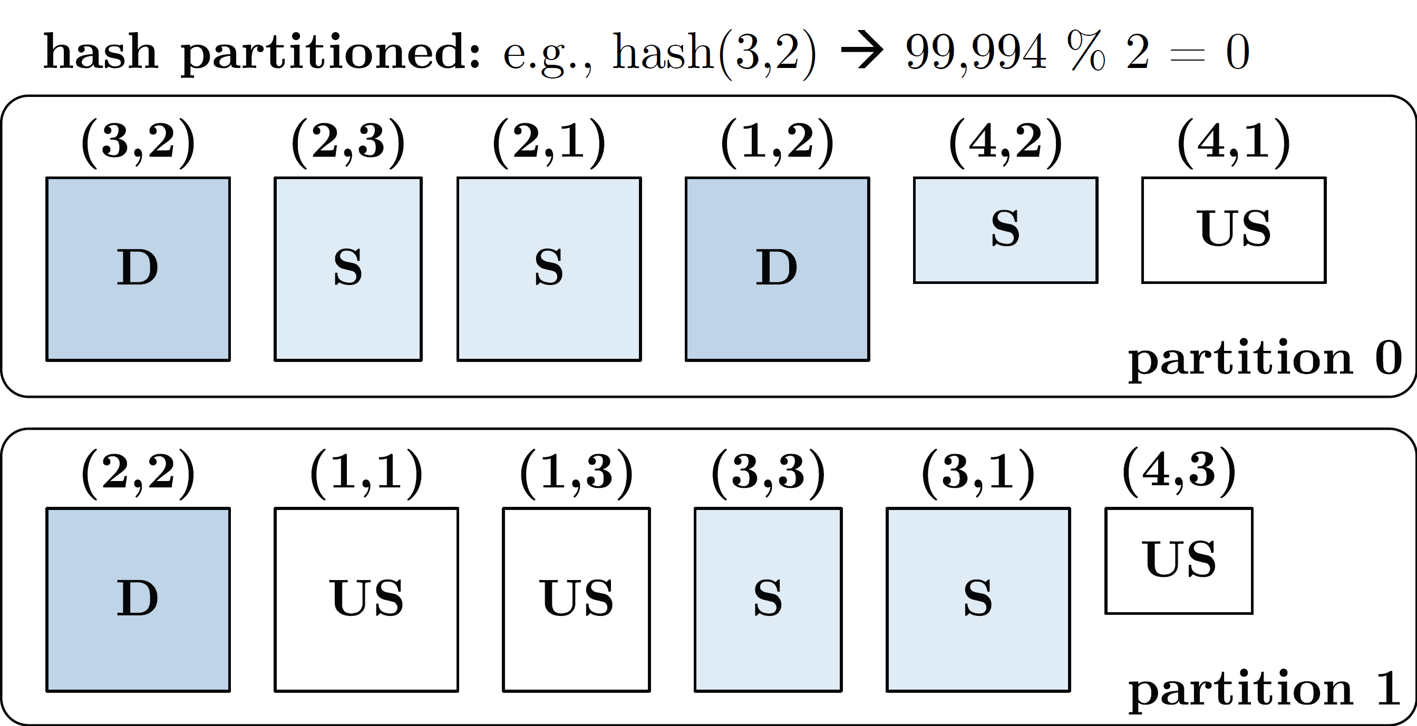
Distributed Matrix Representations
Collection of “Matrix Blocks” (and keys)
  Bag semantics (duplicates, unordered)
  Logical (Fixed-Size) Blocking
  + join processing / independence
  - (sparsity skew)
  E.g., SystemML on Spark:
  JavaPairRDD<MatrixIndexes,MatrixBlock>
  Blocks encoded independently (dense/sparse)
Partitioning
  Logical Partitioning
  (e.g., row-/column-wise)
  Physical Partitioning
  (e.g., hash / grid)
  Influences partition-local aggregation
Logical Blocking 3,400x2,700 Matrix
(w/ B_{c}=1,000)
Physical Blocking
and Partitioning

Slide 33
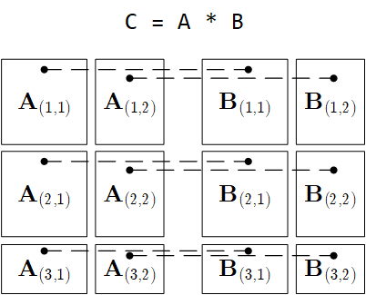
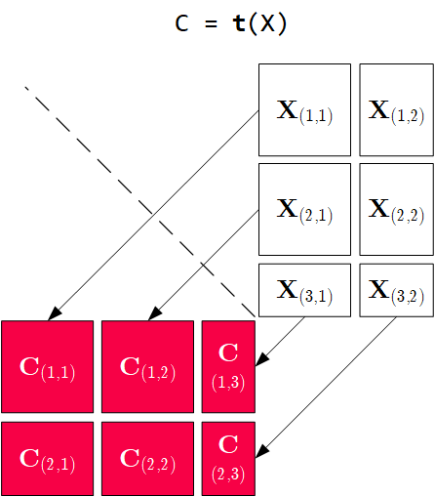
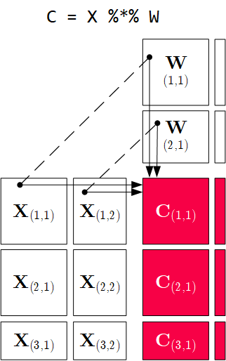
Q: How to implement these operations with Spark RDD Operations?
Distributed Matrix Operations
Elementwise Multiplication
(Hadamard Product)
Transposition
Matrix Multiplication
1:N / N:M joins
1:1 join
Note: also with row/column vector rhs

Slide 34
Partitioning-Preserving Operations
Shuffle is major bottleneck for ML on Spark
Preserve Partitioning
  Op is partitioning-preserving if keys unchanged (guaranteed)
  Implicit: Use restrictive APIs (mapValues() vs mapToPair())
  Explicit: Partition computation w/ declaration of partitioning-preserving
Exploit Partitioning
  Implicit: Operations based on join, cogroup, etc
  Explicit: Custom operators (e.g., zipmm)
Example: Multiclass SVM
  Vectors fit neither into
  driver nor broadcast
  ncol(X) ≤ B_{c}
repart, chkpt X MEM_DISK
parfor(iter_class in 1:num_classes) {
Y_local = 2 * (Y == iter_class) - 1
g_old = t(X) %*% Y_local
...
while( continue ) {
Xd = X %*% s
... inner while loop (compute step_sz)
Xw = Xw + step_sz * Xd;
out = 1 - Y_local * Xw;
out = (out > 0) * out;
g_new = t(X) %*% (out * Y_local) ...
chkpt y_local MEM_DISK
chkpt Xd, Xw MEM_DISK
zipmm

Slide 35
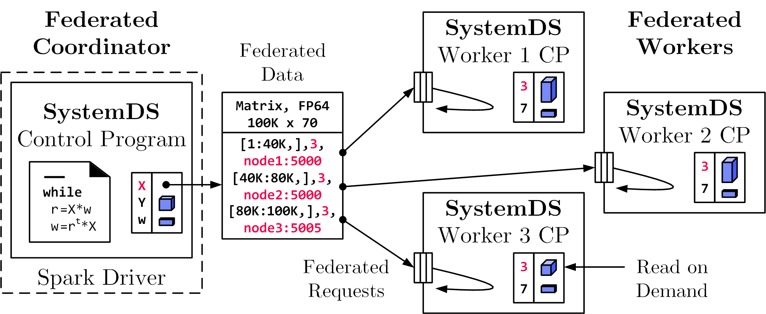
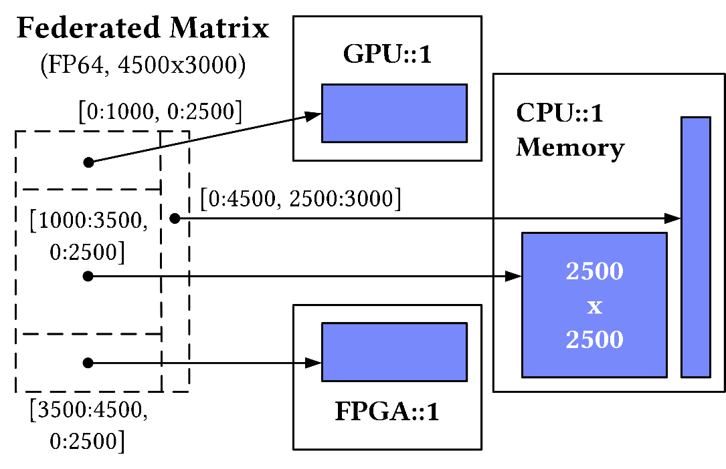
Federated Matrices / Frames
Federated Matrices
  Metadata on coordinator
  Disjoint tiles at federated sites
  Data-parallel operations
  on federated data
Generalization to
Multi-device Settings

Slide 36
Summary and Q&A
Motivation and Terminology
Data-Parallel Collection Processing
Data-Parallel Data-Frame Operations
Data-Parallel Computation in SystemDS
Next Lectures (Large-scale Data Management and Analysis)
  12 Distributed Stream Processing [Jan 22]
  incl. 5min for filling out the course evaluation
  13 Distributed Machine Learning Systems [Jan 29]
  incl. Q&A and Exam Preparation

