Slide 1

Programmierpraktikum: Datensysteme
01 Kickoff and Introduction
Prof. Dr. Matthias Boehm
Technische Universität Berlin
Berlin Institute for the Foundations of Learning and Data
Big Data Engineering (DAMS Lab)
Last update: Oct 11, 2025

Slide 2

Announcements / Org
#1 Hybrid & Video Recording
  Hybrid lectures (in-person, zoom) with optional attendance
  https://tu-berlin.zoom.us/j/9529634787?pwd=R1ZsN1M3SC9BOU1OcFdmem9zT202UT09
  Zoom video recordings, links from website
  https://mboehm7.github.io/teaching/ws2526_ppds/index.htm
#2 Course Registrations
  TU Berlin ISIS / Fak IV Meta registrations
  Bachelor/Master ratio? CS/WINF/others ratio?
~12
~48

Slide 3


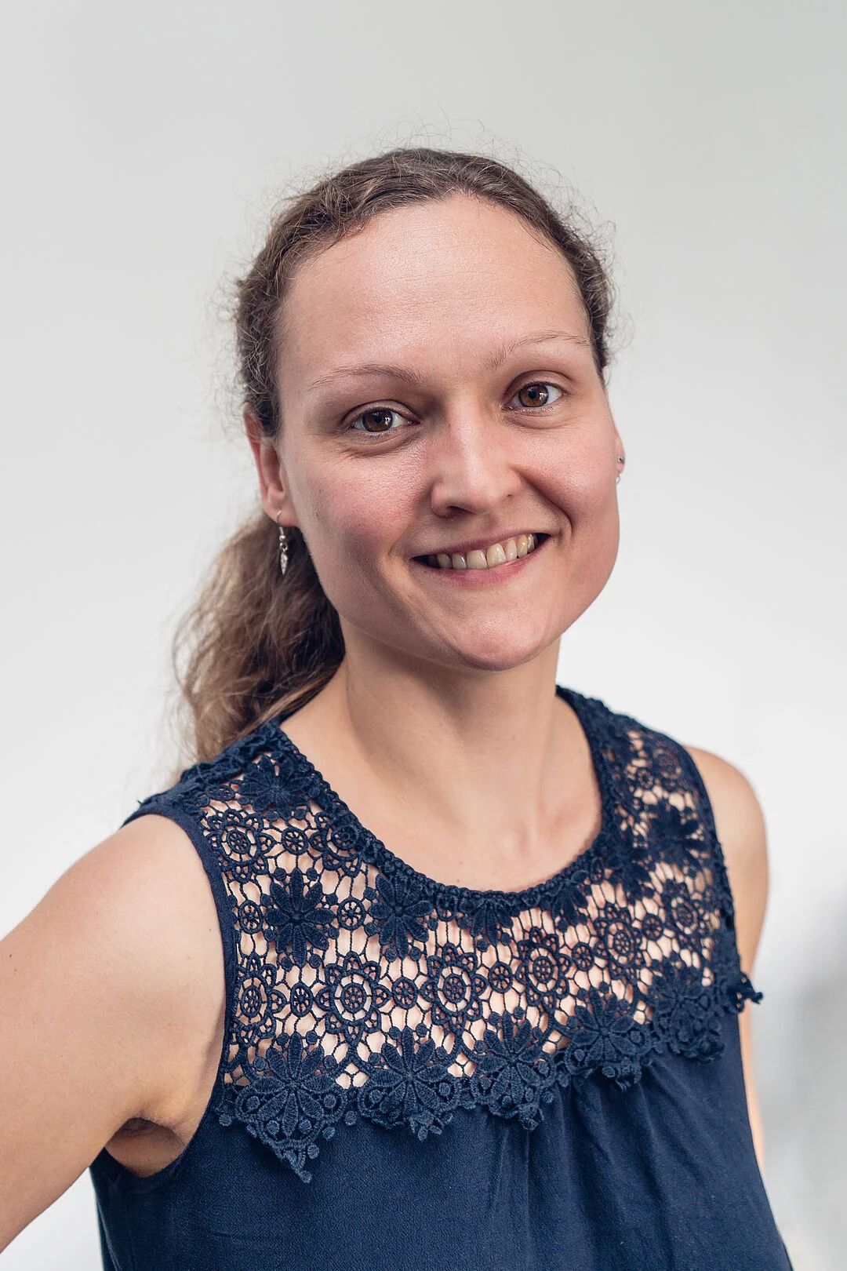

#3 Faculty IV - Team Awareness and Antidiscrimination
https://www.tu.berlin/eecs/awan
Goal
  Low-barrier approachability for spectrum of awareness and antidiscrimination issues
Team
  Irene Hube-Achter (MTSV)
  Matthias Boehm (professors)
  Nadine Karsten (scientific personnel)
  Tom Hersperger (students)
Mission Statement
  Account for heterogeneity and complexity of modern societies at TU Berlin
  All employees and students are committed to
    #1 Treat all persons with fairness and respect
    #2 Ensure a safe environment for all
    #3 Comply with our duty of care towards others
    #4 Actively support the implementation of the above guidelines and contribute
Contact: private email,
eecs-TB-awareness@win.tu-berlin.de,
or AwAn@dams.tu-berlin.de

Slide 4
Agenda
Course Organization
#1 Transactional In-memory Indexing (DAMS)
#2 Duplicate Detection (D2IP)
#3 Provenance Tracking in ML Pipelines (DEEM)
Course Selection/Enrolment

Slide 5
Course Organization

Slide 6
Basic Course Organization
Language
  Lectures and slides: English (German if preferred)
  Communication and presentations: English/German
  Informal language (first name is fine)
  Offline Q&A in forum, answered by teaching assistants
Course Format
  6 ECTS (4 SWS) bachelor computer science / information systems
  Every-other-week lectures (Mon 4.15pm sharp, including Q&A), attendance optional
Prerequisites
  Basic programming skills in languages such as C, C++, Java, Rust, Python, etc
  Basic understanding of data management SQL / RA (or willingness to fill gaps)

Slide 7

Course Goals and Structure
Objectives
  Apply basic programming skills to more complex problem (in self-organized team work)
  Technical focus on data management and data systems
  Holistic programming projects: prototyping, design, versioning, tests, experiments, benchmarks
Grading: Pass/Fail
  Project Implementation (project source code) [45%]
  Component and Functional Tests (test source code) [10%]
  Runtime Experiments (achieve performance target) [15%]
  Documentation (design document up to 5 pages / code documentation) [15%]
  Result Presentation (10min talk) [15%]
Academic Honesty / No Plagiarism (incl LLMs like ChatGPT)

Slide 8
Sub-Course Offerings
#1 Transactional In-memory Indexing
  Capacity: 12/36
  Organized by DAMS group
  Focus on query processing
  Lectures every-other-week in H 0111
#2 Duplicate Detection
  Capacity: 12/36
  Organized by D2IP group
  Focus on entity resolution
#2 Provenance Tracking in ML Pipelines
  Capacity: 12/36
  Organized by DEEM group
  Focus on ML pipelines
➔ Admitted Students:
  12 + 48 on ISIS (incl duplicates)
  Total registrations: up to 36
  → 9 teams, 4 students each

Slide 9
#1 Transactional In-memory Indexing (DAMS)

Slide 10





About Me
Since 09/2022 TU Berlin, Germany
  University professor for Big Data Engineering (DAMS)
2018-2022 TU Graz, Austria
  BMK endowed chair for data management + research area manager
  Data management for data science (DAMS), SystemDS & DAPHNE
2012-2018 IBM Research – Almaden, CA, USA
  Declarative large-scale machine learning
  Optimizer and runtime of Apache SystemML
2007-2011 PhD TU Dresden, Germany
  Cost-based optimization of integration flows
  Time series forecasting / in-memory indexing & query processing
DB group

Slide 11

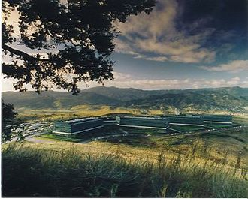
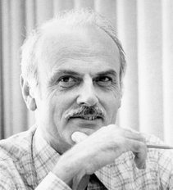
SQL Standard
(SQL-86)
Oracle, IBM DB2, Informix, Sybase → MS SQL
History 1970/1980s
Relational Database Systems
SEQUEL
QUEL
System R @ IBM Research – Almaden
(Jim Gray et al.,
Turing Award ‘98)
Ingres @ UC Berkeley (Stonebraker et al.,
Turing Award ‘14)
Tuple Calculus
Relational Algebra
Relational Model
Edgar F. “Ted” Codd @ IBM
Research (Turing Award ‘81)
Goal: Data Independence
(physical data independence)
  Ordering Dependence
  Indexing Dependence
  Access Path Dependence
[E. F. Codd: A Relational Model of Data for Large Shared Data Banks.
Comm. ACM 13(6), 1970]

Slide 12
Success of SQL / Relational Model
#1 Declarative: what not how
#2 Flexibility:
closure property → composability
Query:
SELECT O_OID, sum(L_Price)
FROM Orders, Lineitem, Customer
WHERE O_OID = L_OID AND O_CID = C_CID
AND O_Odate >= ‘2018-11-14’
AND C_Msegment = ‘AUTOMOBILE’
GROUP BY O_OID
Logical Query Plans
C(P)=1.32M
C(P)=2.2G
C(P)=0.34M
Physical Query Plan
Γ
sum(Price)
Hash
GrpJoin
Γ
Γ
0.001
σ
>=2018-11-14
⋈
⋈
#4 Physical Data
Independence
0.2
σ
Hash
Join
TScan L
⋈
L
⋈
σ
AUTOMOBILE
⋈
σ
σ
σ
L
C
σ
⋈
10K
IXScan
O
C
O
C
O
Date
TScan C
O
1G
L
#3 Automatic Optimization
100M

Slide 13
Terminology of Transactions
Database Transaction
  A transaction (TX) is a series of steps that brings a database from
  a consistent state into another (not necessarily different) consistent state
  ACID properties (atomicity, consistency, isolation, durability)
Terminology
by Example
#1 Isolation level (defined by addressed anomalies)
#2 Start/begin of TX (BOT/BT)
START TRANSACTION ISOLATION LEVEL SERIALIZABLE;
UPDATE Account SET Balance=Balance-100
WHERE AID = 107;
UPDATE Account SET Balance=Balance+100
WHERE AID = 999;
SELECT Balance INTO lbalance
FROM Account WHERE AID=107;
IF lbalance < 0 THEN
ROLLBACK TRANSACTION;
END IF
COMMIT TRANSACTION;
#3 Reads and writes of data objects
#6 Savepoints (checkpoint for partial rollback)
#4 Abort/rollback TX (unsuccessful end of transaction, EOT/ET)
#5 Commit TX (successful end of transaction, EOT/ET)

Slide 14

Overview Programming Project
Team
  4 person teams (self-organized team work, but everybody needs to contribute)
Task: SIGMOD’09
Programming Contest
  Transactional, in-memory index for VARCHAR128, INT32, INT64 w/ duplicates
  C test / performance suites, multi-threaded lookup/scan/insert/delete ops
  Programming language: C or C++ recommended, Java possible

Slide 15
API Summary
Create a functional implementation of the provided application programming interface (API) that ensures result correctness and high performance for different data types and characteristics
API
Functions
server.h
// Index Handling
ErrCode create(KeyType type, char *name);
ErrCode drop(char *name);
ErrCode openIndex(const char *name, IdxState **idxState);
ErrCode closeIndex(IdxState *idxState);
// Transaction Handling
ErrCode beginTransaction(TxnState **txn);
ErrCode abortTransaction(TxnState *txn);
ErrCode commitTransaction(TxnState *txn);
// Read and Write Operations
ErrCode get(IdxState *idxState, TxnState *txn, Record *record);
ErrCode getNext(IdxState *idxState, TxnState *txn, Record *record);
ErrCode insertRecord(IdxState *idxState, TxnState *txn, Key *k, const char* payload);
ErrCode deleteRecord(IdxState *idxState, TxnState *txn, Record *record);

Slide 16


[Matthias Boehm et al: Efficient In-Memory Indexing with Generalized Prefix Trees. BTW 2011]
Reference Implementation DEXTER
System Architecture
  Transactional main memory index server
  Manages a set of indices
  of different data types
  Supports point and range queries
  as well as inserts and deletes
  Optimistic concurrency control
  TX UNDO log
  Implemented in C
Several Subprojects
  Core indexing
  Query processing (HPI Future SOC Lab project)
  Mobile devices, GPUs

Slide 17
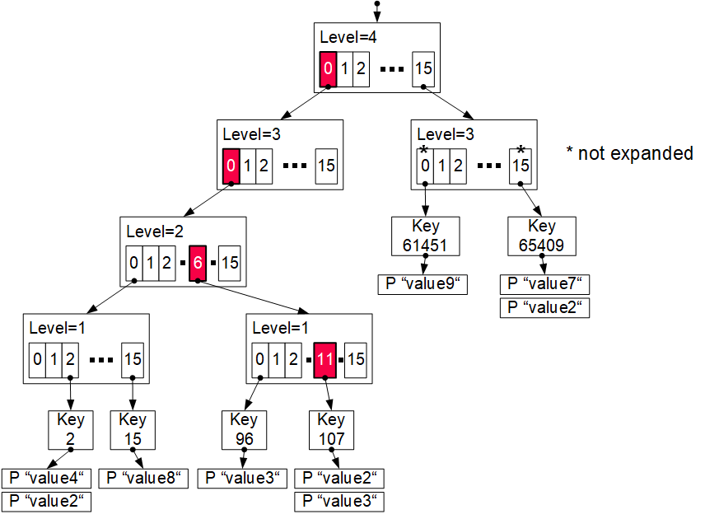
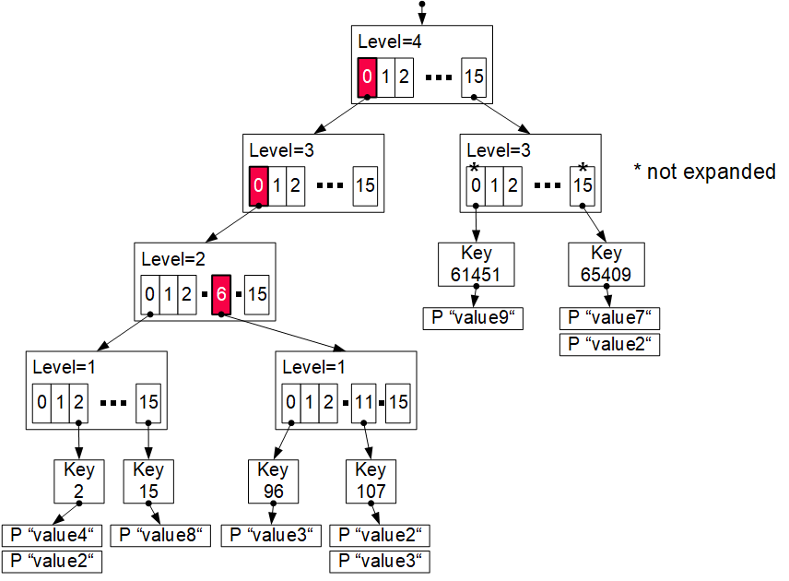
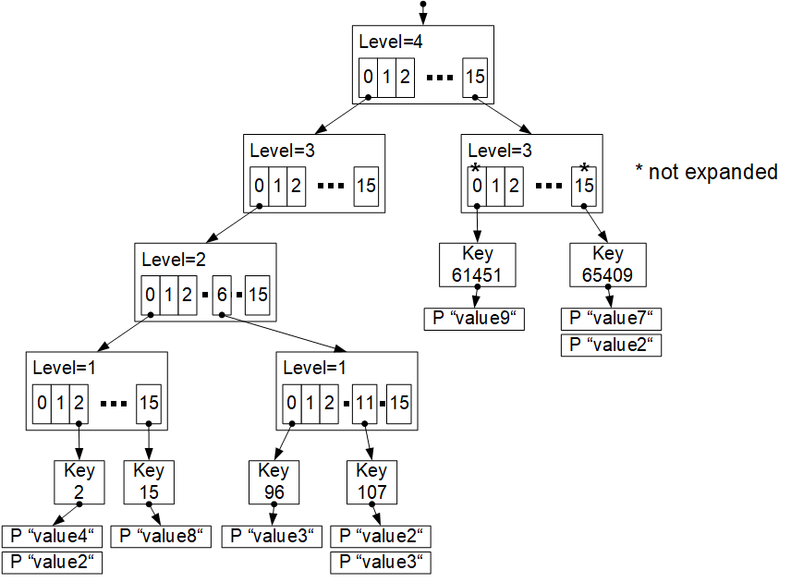
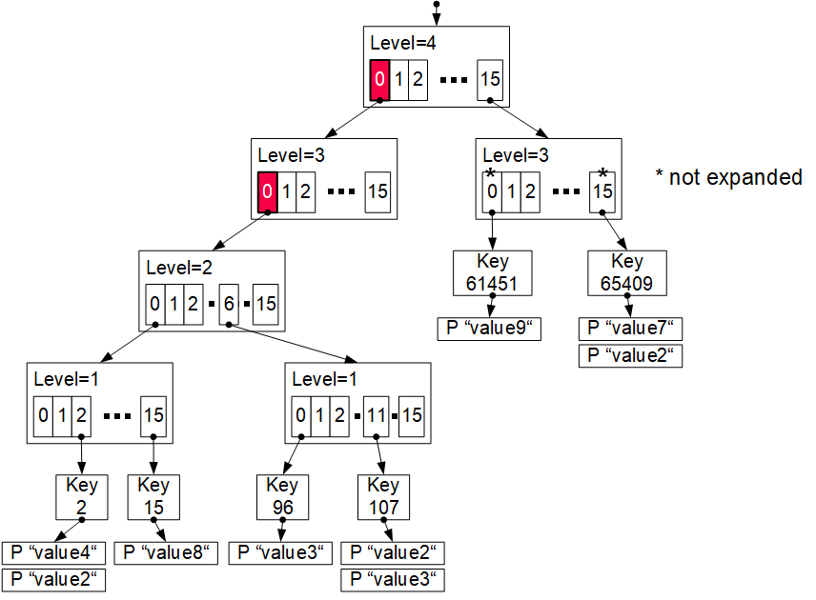
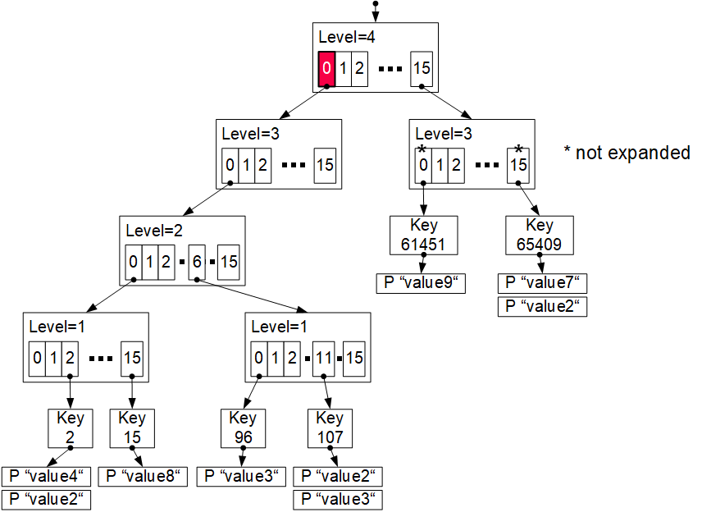
Reference Implementation DEXTER, cont.
Excursus: Prefix Trees (Radix Trees, Tries)
insert (107,value4)
0000
0000
0110
1011
0000
0000
0110
1011
Generalized Prefix Tree
  Arbitrary data types (byte sequences)
  Configurable prefix length k’
  Node size: s = 2^{k’} references
  Fixed maximum height h = k/k‘
  Secondary index structure
Characteristics
  Partitioned data structure
  Order-preserving (for range scans)
  Update-friendly
Properties
  Deterministic paths
  Worst-case complexity O(h)
k = 16
k’ = 4
Bypass array
Adaptive trie expansion
Memory preallocation + reduced pointers

Slide 18
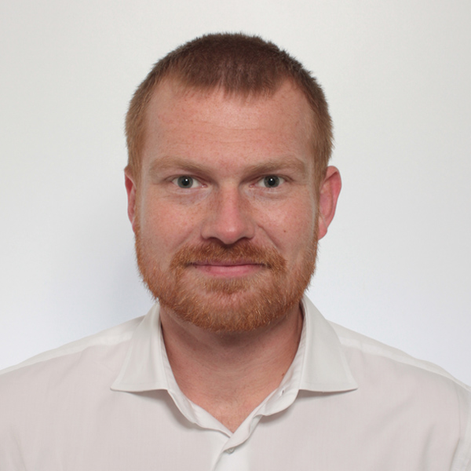

Additional Course Logistics
Each teams gets a mentor
Q&A sessions on demand
Staff
  Lecturer: Prof. Dr. Matthias Boehm
  Teaching Assistant: Christina Dionysio, and others if needed
Next Dates/Lectures
  Oct 26: Course Selection; team preferences, otherwise assignment
  Oct 27: Background Index Structures
  Nov 10: Background Transaction Processing
  Dec 08: Experiments and Reproducibility
  Jan 26: Project submissions (performance target: 400K TX/second)
  Feb 02: Project presentations (10min per team, mandatory attendance)
Infrastructure
  Setup your own private Github/Gitlab repository
Example Speedtest Output:
Creating 100 indices
Populating indices 100
Time to populate: 29ms
Testing the indices
Time to test: 1106ms
Testing complete.
NUM_DEADLOCK: 0
NUM_TXN_FAIL: 0
NUM_TXN_COMP: 1,600,000
Overall time to run: 1135ms

Slide 19
#2 Duplicate Detection (D2IP)

Slide 20
#3 Provenance Tracking in ML Pipelines (DEEM)

Slide 21
Course Selection/Enrolment

Slide 22
Select Your Course
Thanks
#1 Transactional In-memory Indexing (DAMS)
  Capacity: 12/36
#2 Duplicate Detection (D2IP)
  Capacity: 12/36
#3 Provenance Tracking in ML Pipeline (DEEM)
  Capacity: 12/36
Course Selection/Enrolment by Oct 26 EOD
https://tinyurl.com/mr6fy476

