Slide 1

Programmierpraktikum: Datensysteme 02 Background Index Structures
Prof. Dr. Matthias Boehm
Technische Universität Berlin
Berlin Institute for the Foundations of Learning and Data
Big Data Engineering (DAMS Lab)
Last update: Oct 27, 2025

Slide 2

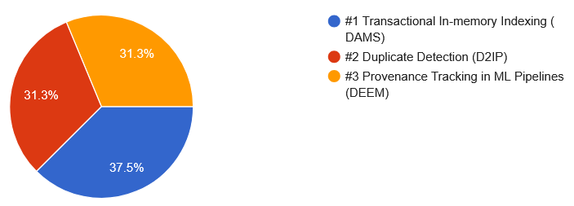
Announcements / Administrative Items
#1 Video Recording
Hybrid lectures: in-person H 0111, zoom live streaming, video recording
https://tu-berlin.zoom.us/j/9529634787?pwd=R1ZsN1M3SC9BOU1OcFdmem9zT202UT09
#2 Team Selection
Oct 26 team building/selection, afterwards assignment → 7 (5) DAMS
Assignment: grouping of self-assignments (2 Java groups a 2/3 students, 1 preassembled)

Slide 3
Agenda
Overview Access Methods
Index Structures
Learned Indexing
How to implement your own custom Index Structure

Slide 4
Overview Access Methods

Slide 5

DBMS System Architecture
[Theo Härder, Erhard Rahm: Datenbanksysteme: Konzepte und Techniken der Implementierung, 2001]
Q_{i}
Set-Oriented Interface
SELECT * FROM R
Data System
Data System (Nonprocedural access)
Record-Oriented Interface
FIND NEXT record
(Data) Access System (Navigational access)
Internal Record Interface
B-Tree getNext
Access System
(Record) Storage System (Access path mgmt)
ACCESS
page j
System buffer Interface
Storage System
Buffer Management (Propagation control)
File Interface
READ
block k
Operating System (File Mgmt)
Device Interface

Slide 6
Background Storage System
Segments, Pages, Blocks
Segments: storage unit of DB objects like relations (heap) and indexes
Page: fixed-size memory region
Block: smallest addressable unit on disk (e.g., POSIX block devices)
Buffer & Storage Management
Buffer management at granularity of pages
PostgreSQL default: 8KB
Different table/page layouts (e.g., NSM, DSM, PAX, column)
TID/RID Concept (pageID, slotID) → stable ID, even if records reorganized
Segment / Tablespace
Page 1
Page 2
Page 3
Blk 1
Blk 2
Blk 3
Blk 4
Blk 5
Blk 6
115
136
81
136
Header
115
175
Header
tuple
tuple
tuple offsets
TID/RID Concept (pageID, slotID)

Slide 7
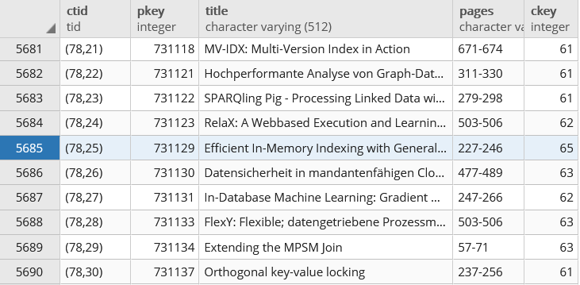
Background Storage System, cont.
TID Concept (p, s)
TID := (page number, slot index)
Page slot directory holds tuple offsets (byte position) within page
Example PostgreSQL
Papers(PKey, Title, Pages, CKey, JKey)
Hidden CTID system column (not shown on *, but usable)
SELECT CTID, PKey, Title, Pages
FROM Papers

Slide 8
Access Methods and Physical Design
Performance Tuning via Physical Design
Select physical data structures for relational schema and query workload
#1: User-level, manual physical design by DBA
#2: User/system-level automatic physical design
Example
Base Tables
R
S
T
⋈
Mat Views
SELECT * FROM R, S, T WHERE R.c = S.d AND S.e = T.f
AND R.b BETWEEN 12 AND 73
MV₁
MV₂
⋈_{e=f}
Parti- tioning
⋈_{c=d}
T
10
σ_{12≤R.b≤73}
S
Physical Access Paths
1000000
B⁺-Tree
BitMap
Hash
Compression
R

Slide 9

Overview Index Structures
Table Scan
Index Scan
Table Scan vs Index Scan
For highly selective predicates, index scan asymptotically much better than table scan
Index scan higher per tuple overhead (break even ~5% output ratio)
Multi-column predicates: fetch/RID-list intersection
Use Cases for Indexes
ix
sorted
Lookups / Range Scans
Unique Constraints
Index Nested Loop Joins
Aggregates (count, min/max)
contains key 107?
$$\text{⋈}$$
ix
size= 7100
table data
ix
R
ix
ix
S

Slide 10
Additional Terminology
CREATE INDEX ixStudLname ON Students USING btree (Lname ASC NULLS FIRST);
Create Index
Create a secondary (non-clustered) index on a set of attributes
Clustered: tuples sorted by index
Non-clustered: sorted attribute with tuple references
Can specify uniqueness, order, and indexing method
PostgreSQL methods: btree, hash, gist, and gin
Binary Search
pos = binarySearch(data,key=23)
Given sorted data, find key position (insert position if non-existing)
k-ary search for SIMD data-parallelism
Interpolation search: probe expected pos in key range (e.g., search([1:10000], 9700))
DROP INDEX ixStudLname;
ix
TID refs
table data
10 13 14 17 18 19 23 25 27 29
10 13 14 17 18 19 23 25 27 29
10 13 14 17 18 19 23 25 27 29

Slide 11
Index Structures

Slide 12
[Theo Härder, Erhard Rahm: Datenbanksysteme: Konzepte und Techniken der Implementierung, 2001]
Classification of Index Structures
1D Access Methods
ND Access Methods
Linearization of ND key space + 1D indexing (Z order, Gray code, Hilbert curve)
Multi-dimensional trees and hashing (e.g., UB tree, k-d tree, gridfile)
Spatial index structures (e.g., R tree)
1D Access Methods
Key Comparison
Key Transformation
Sequential
Tree-Based
Sort-Based
Hash-Based
Sequential Lists
Linked Lists
Binary Search Trees
Multiway Trees (B-Tree)
Prefix Trees (Tries)
Static
Dynamic

Slide 13
B-Tree Overview
History B-Tree
Bayer and McCreight 1972, Block-based, Balanced, Boeing Labs
Multiway tree (node size = page size); designed for DBMS
Extensions: B+-Tree/B*-Tree (data only in leafs, double-linked leaf nodes)
Definition B-Tree (k, h)
All paths from root to leafs have equal length h
All nodes (except root) have [k, 2k] key entries
All nodes (except root, leafs) have [k+1, 2k+1] successors
Data is a record or a reference to the record (RID)
[Rudolf Bayer, Edward M. McCreight: Organization and Maintenance of Large Ordered Indices. Acta Inf. (1) 1972]
All nodes adhere to max constraints
P₀
Key K₁
Data D₁
P₁
Key K₂
Data D₂
P₂
Key K₃
Data D₃
P₃
Key K₄
Data D₄
P₄
k=2
Subtree w/ keys ≤ K₁
Subtree w/ K₂ < keys ≤ K₃

Slide 14
B-Tree Search
25
Example B-Tree k=2
Get 38 → D38
Get 20 → D20
Get 6 → NULL
Lookup Q_{K} within a node
Scan / binary search keys for Q_{K}, if K_{i}=Q_{K}, return D_{i}
If node does not contain key
If leaf node, abort search w/ NULL (not found), otherwise
Decent into subtree Pi with K_{i} < Q_{K} ≤ K_{i+1}
Range Scan Q_{L<K<U}
Lookup Q_{L} and call next K while K<Q_{U} (keep current position and node stack)
10
20
30
40
2
5
7
8
41
42
45
46
13
14
15
18
32
35
38
22
24
26
27
28

Slide 15
B-Tree Insert
Basic Insertion Approach
Always insert into leaf nodes!
Find position similar to lookup, insert and maintain sorted order
If node overflows (exceeds 2k entries) ➔ node splitting
Node Splitting Approach
Split the 2k+1 entries into two leaf nodes
Left node: first k entries
Right node: last k entries
(k+1)th entry inserted into parent node ➔ can cause recursive splitting
Special case: root split (h++)
B-Tree is self-balancing
30
40
2k+1
41
42
45
46
47
overflow
30
40
45
1
41
42
46
47
first k
last k

Slide 16
B-Tree Insert, cont. (Example w/ k=1)
Insert 1
Insert 5
Insert 2 (split)
Insert 6
Insert 7 (split)
Insert 4
Insert 8
Insert 3 (2x split)
1
2
6
1
4
5
7
1
5
2
6
2
1
4
5
7
8
1
5
2
4
1
5
6
2
6
1
3
5
7
8
2
6
1
5
7

Slide 17
B-Tree Delete
Basic Deletion Approach
Lookup deletion key, abort if non-existing
Case inner node: move entry from fullest successor node into position
Case leaf node: if underflows (<k entries) ➔ merge w/ sibling
Example
Case inner
Case leaf
4
4
2
6
2
7
1
3
5
7
8
1
3
5
8
4
under- flow
4
2
7
7
4
7
1
3
5
8
1
2
5
8
1
2
5
8
underflow

Slide 18
B-Tree Insert and Delete w/ k=2
10
20
Insert/Delete Examples
Original
Insert 16
Insert 26
Delete 20
Delete 16
3
5
7
4
11
18
19
25
28
30
31
10
20
3
5
7
4
11
16
18
25
28
30
31
10
20
28
3
5
7
4
11
16
18
25
26
30
31
30
31
30
31
10
18
28
3
5
7
4
11
16
18
25
26
30
31
30
31
30
31
10
28
3
5
7
4
11
18
25
26
30
31
30
31

Slide 19
[Goetz Graefe: Modern B-Tree Techniques. Found. Trends Databases 3(4): 203-402, 2011]
B-tree – Advanced Aspects
Variable-Length Fields
In-page slot-array to variable length fields → direct lookup
With fixed page size, no guarantees on min/max entries
Various approaches: overflow pages, pick separators during bulk loading
Concurrent Access
DB locks: only leaf nodes for B+ tree in practice at value/value ranges
Concurrent threads require page latching (parent-child)
Duplicate Keys
#1 use prefix truncation for compression → store common prefix once)
#2 concatenate key-TID for unique lockups w/ O(log N)
Duplicate records as replicates or once w/ counter

Slide 20
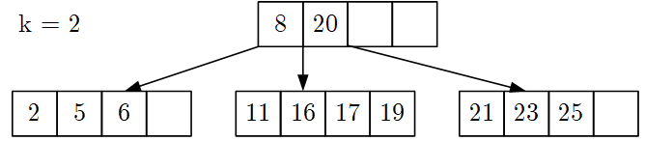
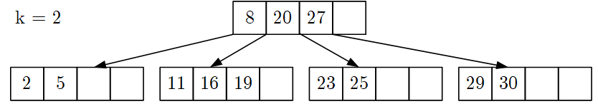
TEST YOURSELF: B-tree Understanding
Given B-tree below, insert key 9 and draw resulting B-tree (5/100 points)
Given B-tree below, delete key 27, and draw resulting B-tree (5/100 points)
8
16
20
2
5
6
4
9
11
17
19
21
23
25
8
20
2
5
6
4
11
16
19
23
25
29
30

Slide 21


TEST YOURSELF: B-tree Understanding, cont.
Which of the following trees are valid – i.e., satisfy the constraints of – B-trees with k=1? Mark each tree as valid or invalid and name the violations (4/100 points)
(empty leaf node, underflow)
(invalid # of pointers and subtrees)
(invalid ordering of data items, 6>5 but in left subtree)

Slide 22
Other In-Memory Trees
Balanced Binary Trees
Red-Black Tree, AVL Tree (left/right height diff 1)
T tree (combines pros of AVL and B trees)
CSB⁺-Tree
Align node size to cache line (64B)
Reduce pointers via node groups
More keys, higher fan-out, at cost of slower insert
Skip Lists
Linked list w/ multiple levels
Fractions p w/ pointers
[G. M. Adel'son-Vel'skii and E. M. Landis: An algorithm for the organization of information, Soviet Mathematics Doklady, 3, 1962]
2
4
5
7
[Tobin J. Lehman, Michael J. Carey: A Study of Index Structures for Main Memory Database Management Systems. VLDB 1986]
left <= 2
right >= 7
2
[Jun Rao, Kenneth A. Ross: Making B+-Trees Cache Conscious in Main Memory. SIGMOD 2000]
1
5
insert 17
[William Pugh: Skip Lists: A Probabilistic Alternative to Balanced Trees. CACM 1990]

Slide 23
Hashing Overview
Static vs Dynamic Hashing
Hash table of buckets B, compute h=hash(key), find bucket B[h mod |B|]
Static: pre-allocation of buckets, over- and under-provisioning (open addressing: linear probe, robin hood, cuckoo)
Dynamic: extend as needed (chained bucket, extendible, linear)
Chained Bucket Hashing
Handle hash collisions via overflow list of linked buckets
Reorganization if fill factor reached
On disk: buckets are pages
Common Hash Functions
MurmurHash 2, MurmurHash 3, Jenkins, CRC
Google CityHash, Google FarmHash, Facebook XXHash3 (http://cyan4973.github.io/xxHash/)
hashing
17
2
7
1
3
5
15
18
2
Key comparisons
9
16
14
20
[Andy Palvo: Database Systems – Hash Tables, CMU Lecture, 2019]

Slide 24
[Ronald Fagin, Jürg Nievergelt, Nicholas Pippenger, H. Raymond Strong: Extendible Hashing - A Fast Access Method for Dynamic Files. TODS 4(3), 1979]
Extendible Hashing
Overview
Dynamic resizing on demand, w/o rehashing/reassigning tuples to pages
h=hash(key), use d bits and directory of 2^{d} entries (with max table size, then bucket chaining)
Directory entries point to buckets, multiple refs to one bucket possible
Example d = 1
Example d = 2
0
A
B
1
C
0
A
1
B
C
00
01
A
D
10
[Thomas Neumann: Datenbanksysteme und moderne CPU-Architekturen – Access Paths, TU Munich, 2019]
11
B
C
D

Slide 25
[Theo Härder, Erhard Rahm: Datenbanksysteme: Konzepte und Techniken der Implementierung, 2001]
Linear Hashing
Overview
Improved Extensible Hashing scheme, w/o exponential directory growth
First start chaining, then incrementally split individual buckets (in order)
Example
p=0
h0
h0
h0
h0
h0
h0 := key % 5
105
111
512
413
144
Before
790
076
477
243
335
837
888
995
002
055
117
010
h1
p=1
h0
h0
h0
h0
h1
h1 := key % 10
790
111
512
413
144
105
After Split
010
076
477
243
335
837
888
995
002
055
117

Slide 26
Overview Prefix Trees (Tries)
Overview
From information retrieval, mostly for string indexing
Trie: “A tree for storing strings in which there is one node for every common prefix. The strings are stored in extra leaf nodes.” (NIST DADS)
PATRICIA Trie
Extended binary (character-level) trie, with compressed substrings
Variants
Radix Tree, key alteration radix tree (Kart), digital search trees
SIGKDD
SIGMETRICS
SIGMOD
SIGPLAN
SIG
KDD
PLAN
[Donald R. Morrison: PATRICIA - Practical Algorithm To Retrieve Information Coded in Alphanumeric. J. ACM 15(4) 1968]
M
ETRICS
OD

Slide 27
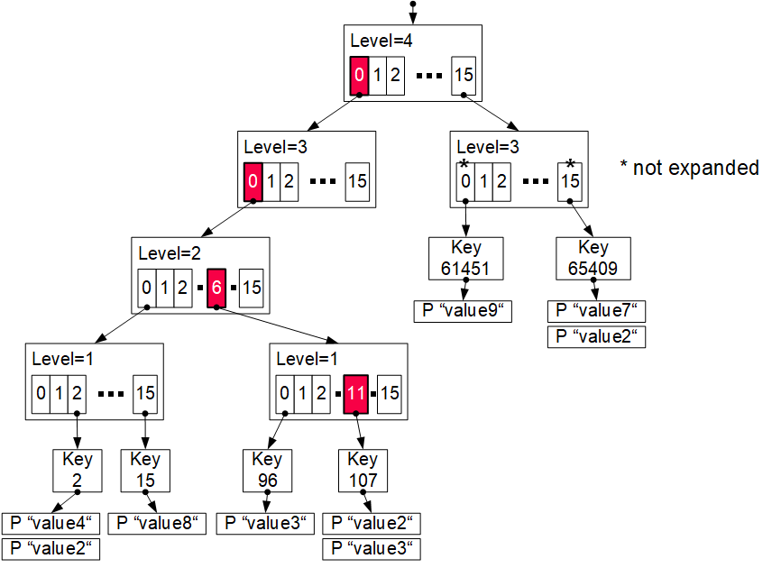
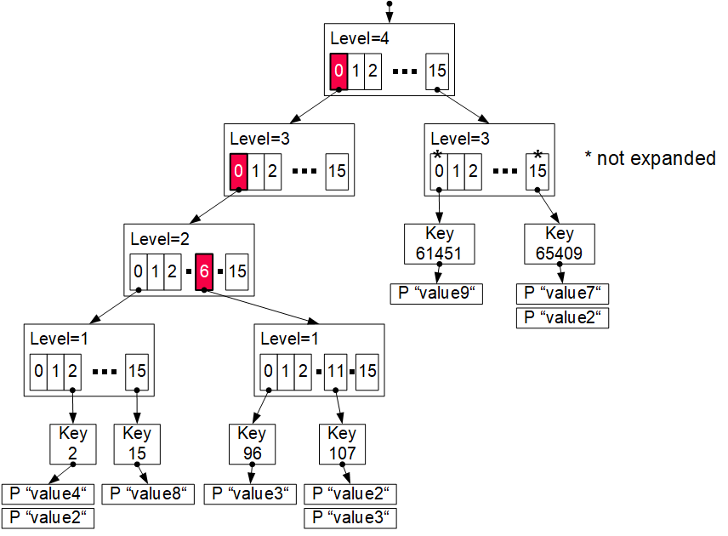
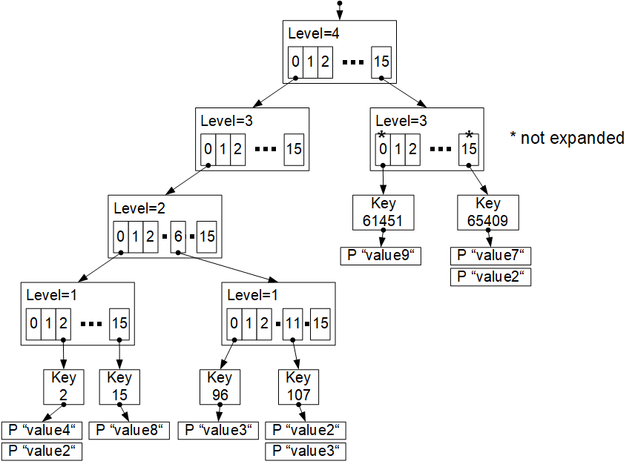
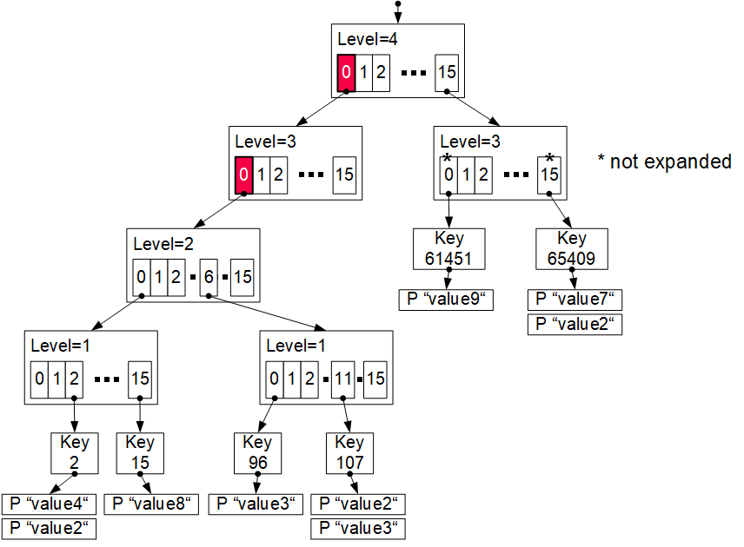
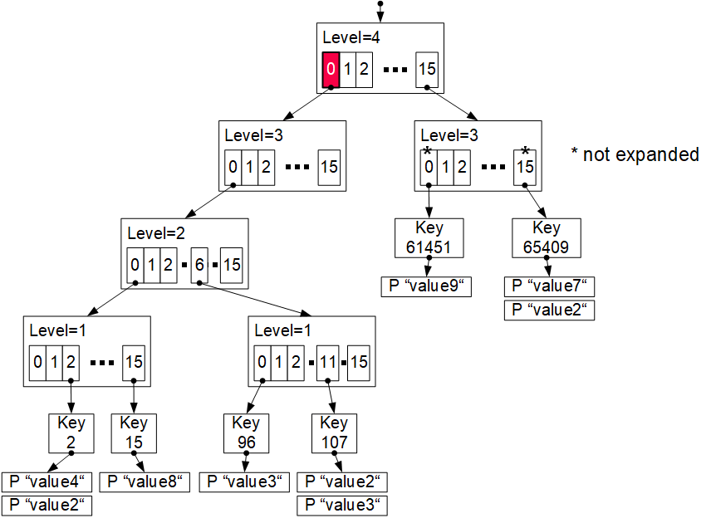
[Matthias Boehm et al: Efficient In-Memory Indexing with Generalized Prefix Trees. BTW 2011]
Generalized Prefix Tree
Generalized Prefix Tree
Arbitrary data types (byte sequences)
Configurable prefix length k’
Node size: s = 2^{k’} references
Fixed maximum height h = k/k‘
Secondary index structure
Characteristics
Partitioned data structure
Order-preserving (for range scans)
Update-friendly
Properties
Deterministic paths
Worst-case complexity O(h)
insert (107,value4)
0000
0000
0110
1011
0000
0000
0110
1011
k = 16
k’ = 4
Node size (k’=4): 128B → 64B
Bypass array
Adaptive trie expansion
Memory preallocation + reduced pointers
Notes:
Byte order: big-endian (asc order left to right)

Slide 28
[Viktor Leis, Alfons Kemper, Thomas Neumann: The adaptive radix tree: ARTful Indexing for Main-Memory Databases. ICDE 2013]
Adaptive Radix Trees
Motivation and Overview
Small trie height/high fan-out, but with low space overhead
Prefix k’=8 → 256 children
Adaptive nodes 4, 16, 48, 256 entries
Lazy expansion and path compression
Node Types
Linear/binary search for keys
256 element arrays of indexes / child pointers

Slide 29
Hybrid Prefix Trees
 | Binary | B-Tree | CSB-Tree | Hash | T-Tree | Skip List | Trie
Prefix Hash Tree ’70 |  |  |  | X |  |  | X
Prefix B-Tree ’77 |  | X |  |  |  |  | X
Ternary Search Tree ’97 | X |  |  |  |  |  | X
Partial Keys ’01 |  | X |  |  | X |  | X
Burst-Trie ’02 | X | X | X | X | X |  | X
HAT-Trie ’07 |  |  |  | X |  |  | X
J⁺-Tree ’09 |  | X |  |  | X |  | X
CS-Prefix Tree ’09 |  |  | X |  |  |  | X
SkipTrie ’13 |  |  |  |  |  | X | X
SuRF ’18 |  |  |  | X |  |  | X

Slide 30
[Patrick E. O'Neil, Edward Cheng, Dieter Gawlick, Elizabeth J. O'Neil: The Log-Structured Merge-Tree (LSM-Tree). Acta Inf. 1996]
Log-structured Merge Trees (LSM)
LSM Overview
Many KV-stores rely on LSM-trees as their storage engine (e.g., BigTable, DynamoDB, LevelDB, Riak, RocksDB, Cassandra, HBase)
Approach: Buffers writes in memory, flushes data as sorted runs to storage, merges runs into larger runs of next level (compaction)
LSM System Architecture
Writes in C0
Reads against C0 and C1 (w/ buffer for C1)
Compaction (rolling merge): sort, merge, incl deduplication
C0
in-memory buffer (C0) max capacity T
writes
reads
compaction
C1_{t}
on-disk storage (C1)
C1_{t+1}
Notes:
Note: LSM write optimized by buffering writes, read-optimized by sort-merging on-disk runs
C1 and Ci also trees similar to B-tree but nodes kept 100% full single node pages packed into multi-page blocks
→ Better insert performance, worse lookup costs

Slide 31
Probabilistic Set Containment
Motivation
Many use cases for applying cheap pre-filters
Requirement: no false negatives, small number of false positives (FP)
#1 Bloom Filter
Array X of m bits, initialized w/ zeros
k different hash functions applied on each key
Insert: k x h_{i}(key), set all hashed positions to 1
Query: k x h_{i}(key), return (sum(X[h_{i}(key)])==k)
#2 Cuckoo Filter
Cuckoo hash table with key signatures
2 hash functions w/ displacements
Allows deletes, duplicates, smaller FP rate
key=7
h1
h3
1 | 0 | 1 | 0 | 1 | 1
[Harald Lang, Thomas Neumann, Alfons Kemper, Peter A. Boncz: Performance-Optimal Filtering: Bloom overtakes Cuckoo at High-Throughput. PVLDB 12(5), 2019]

Slide 32
Learned Indexing

Slide 33
[Pedro Holanda et al: Progressive Indexes: Indexing for Interactive Data Analysis. PVLDB 2019]
Excursus: Database Cracking
[Stratos Idreos, Martin L. Kersten, Stefan Manegold: Database Cracking. CIDR 2007]
Core Idea: Queries trigger physical reorganization (partitioning and indexing)
A
17
3
8
6
2
12
13
4
15
A_{CRK}
3
4
2
the more we crack, the more we learn
A_{CRK}
2
4
3
8
6
8
6
copy
in-place
12
15
17
13
12
13
#1 Automatic Partitioning
#2 AVL/B-tree over Partitions
17
15

Slide 34
Learned Index Structures
[Tim Kraska, Alex Beutel, Ed H. Chi, Jeffrey Dean, Neoklis Polyzotis: The Case for Learned Index Structures. SIGMOD 2018]
A Case For Learned Index Structures
Sorted data array, predict position of key
Hierarchy of simple models (stages models)
Tries to approximate the CDF similar to interpolation search (uniform data)
Follow-up Work on SageDBMS
Systems for ML,
ML for Systems
[Tim Kraska, Mohammad Alizadeh, Alex Beutel, Ed H. Chi, Ani Kristo, Guillaume Leclerc, Samuel Madden, Hongzi Mao, Vikram Nathan: SageDB: A Learned Database System. CIDR 2019]

Slide 35
Learned Index Structures, cont.
FITing-Tree
Adapt to underlying data and patterns
Piecewise linear functions
Maximum pos error guarantees
Segment pages w/ free space
PGM-index
Piecewise geometric model index
Recursive, compressed segment tree
RadixSpline
Lookup table to spline points, selected w/ max error guarantee
[Alex Galakatos, Michael Markovitch, Carsten Binnig, Rodrigo Fonseca, Tim Kraska: FITing-Tree: A Data-aware Index Structure. SIGMOD 2019]
[Paolo Ferragina, Giorgio Vinciguerra: The PGM-index: a fully-dynamic compressed learned index with provable worst-case bounds. PVLDB 13(8) 2020]
[Andreas Kipf, Ryan Marcus, Alexander van Renen, Mihail Stoian, Alfons Kemper, Tim Kraska, Thomas Neumann: RadixSpline: a single-pass learned index. aiDM@SIGMOD 2020]

Slide 36
Summary & QA
Thanks
Overview Access Methods
Index Structures
Learned Indexing
Next Lectures
Nov 10: Background Transaction Processing
Dec 08: Experiments and Reproducibility
Additional lectures / Q&A sessions on demand

