Slide 1

Data Integration and Large-scale Analysis (DIA)
01 Introduction and Overview
Prof. Dr. Matthias Boehm
Technische Universität Berlin
Berlin Institute for the Foundations of Learning and Data
Big Data Engineering (DAMS Lab)
Last update: Oct 15, 2026

Slide 2


Announcements / Org
#1 Hybrid & Video Recording
  Hybrid lectures (in-person, zoom) with optional attendance
  https://tu-berlin.zoom.us/j/9529634787?pwd=R1ZsN1M3SC9BOU1OcFdmem9zT202UT09
  Zoom video recordings, links from website
  https://mboehm7.github.io/teaching/ws2627_dia/index.htm
#2 Course Registrations
  TU Berlin ISIS registrations as of Oct 11
  Bachelor/Master, CS/ISM/other ratios
#3 Hackathon on AI in Medicine
  BIFOLD/Charité hackathon in planning
  Help us find suitable dates that work for you
~300

Slide 3

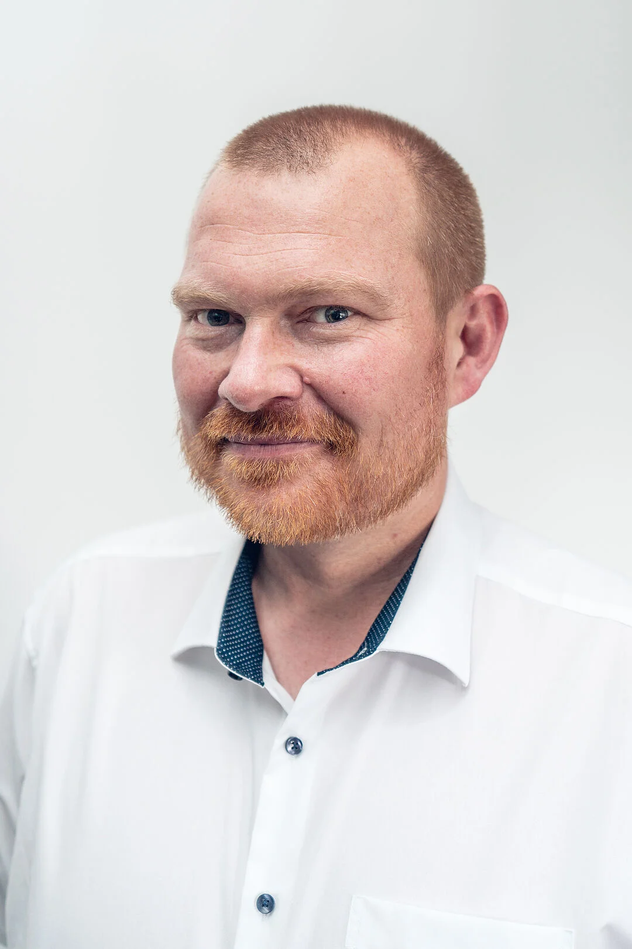
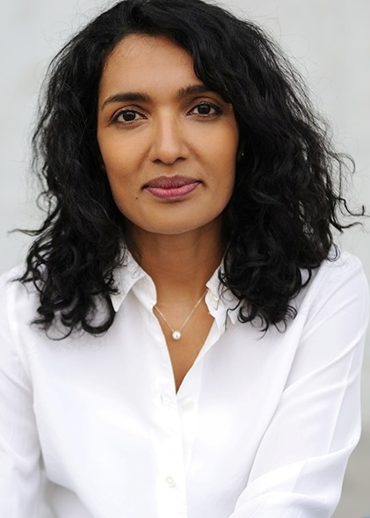
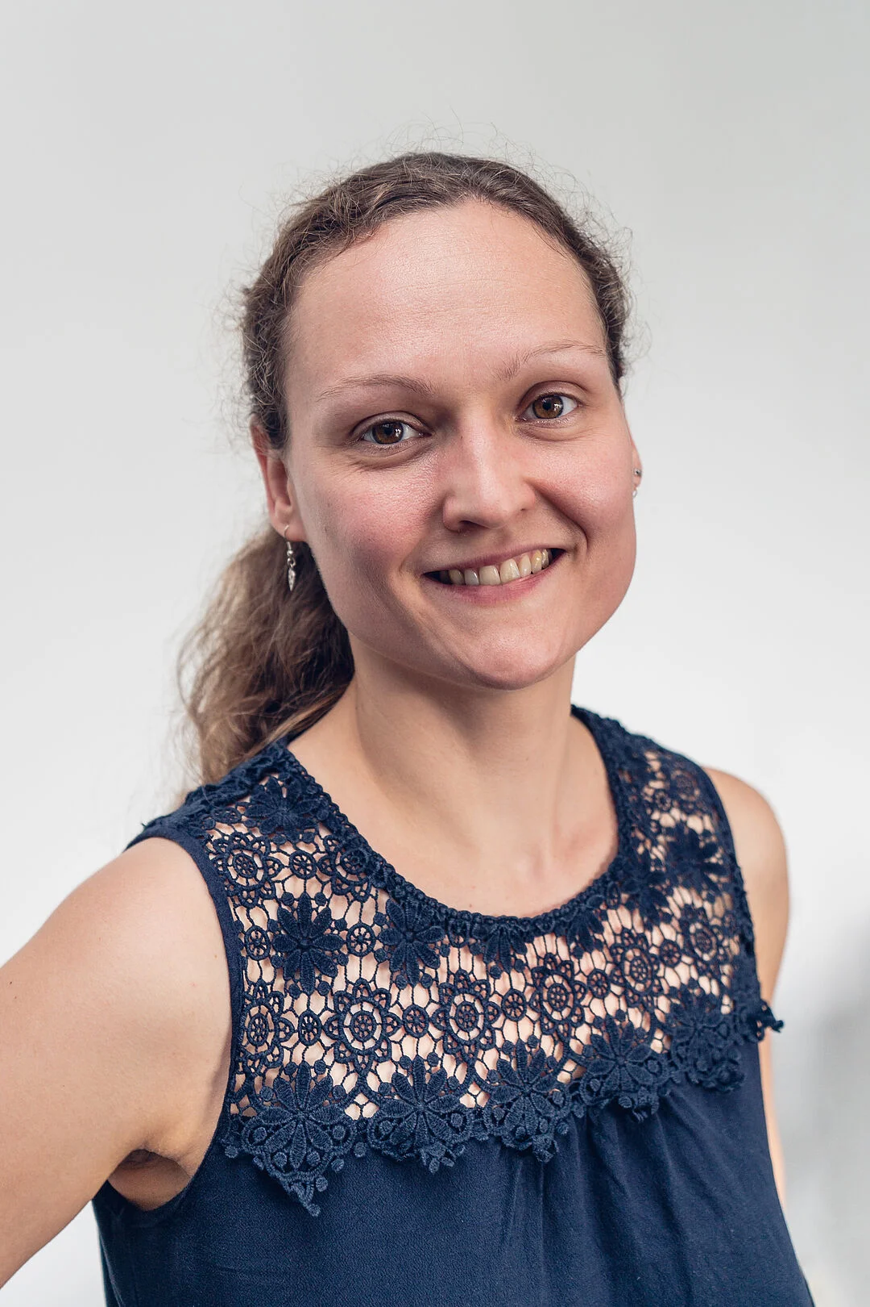
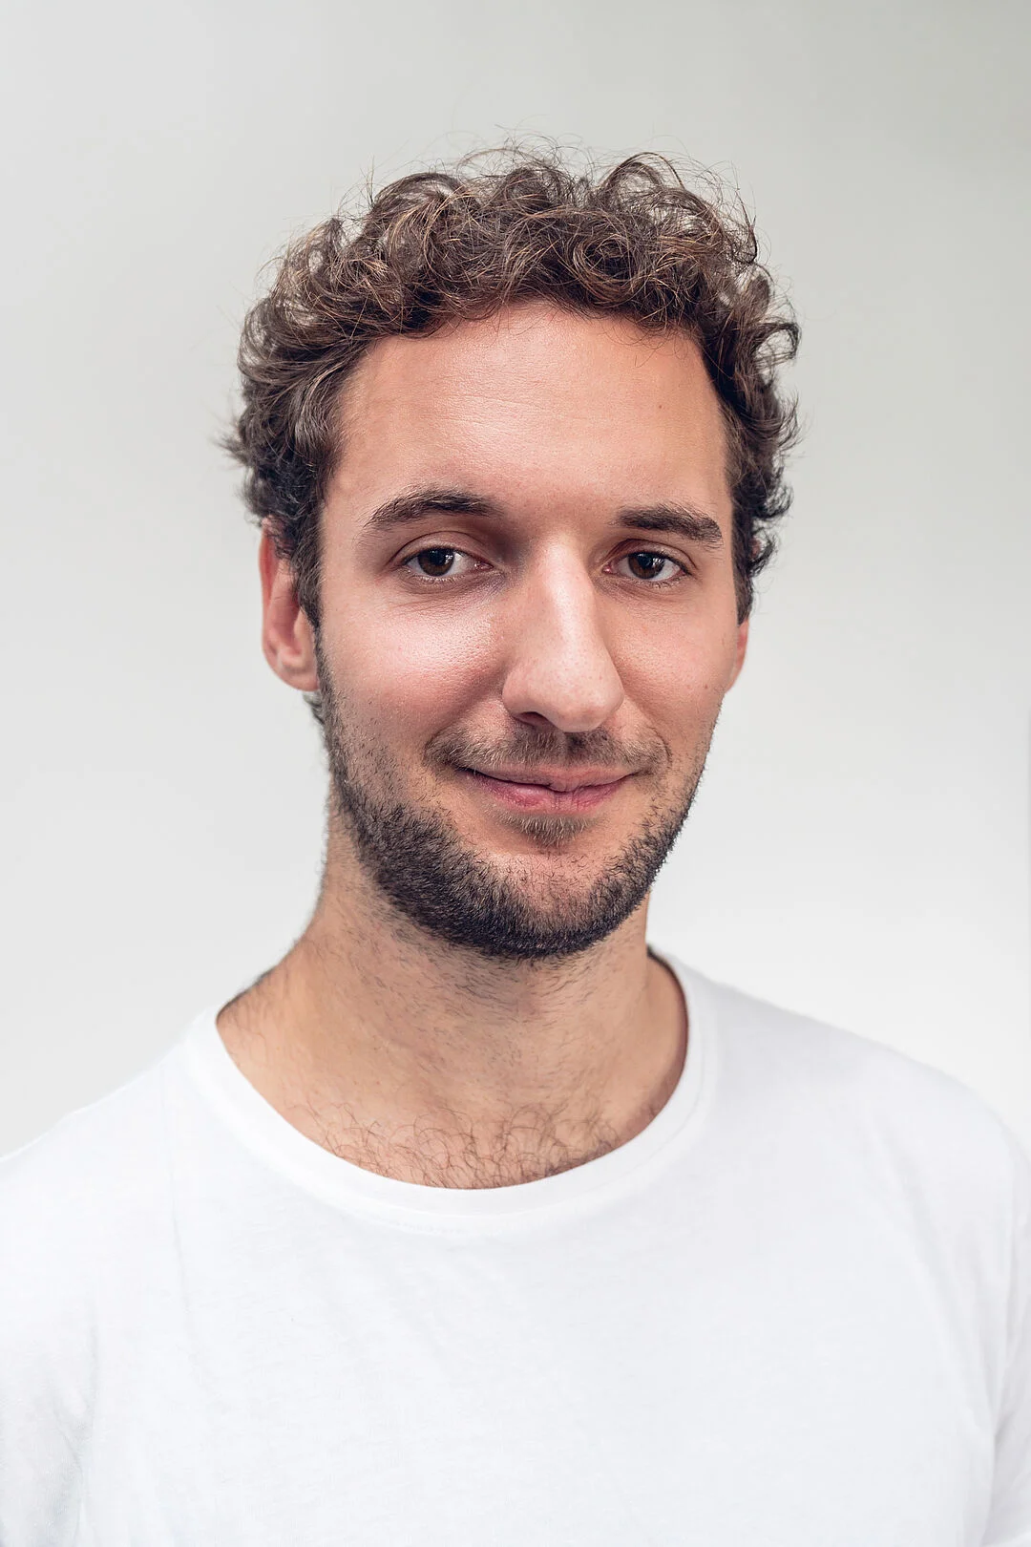
#4 Faculty IV - Team Awareness and Antidiscrimination
https://www.tu.berlin/eecs/awan
Goal: Low-barrier approachability for spectrum of awareness and antidiscrimination issues
Team
  Irene Hube-Achter (MTSV)
  Matthias Boehm (professors)
  Ceenu George (professors)
  Nadine Karsten (scientific staff)
  Maria Fleßner-Jung (mentoring)
  N.N. (students)
Mission Statement
  Account for heterogeneity and complexity of modern societies at TU Berlin
  #1 Treat all persons with fairness and respect
  #2 Ensure a safe environment for all
  #3 Comply with our duty of care towards others
  #4 Actively support the implementation of the above guidelines and contribute
Contact: private email,
eecs-TB-awareness@win.tu-berlin.de,
or AwAn@dams.tu-berlin.de
Notes:
All employees and students are committed to

Slide 4




FG Big Data Engineering (DAMS Lab) – About Me
Since 09/2022 TU Berlin, Germany
  University professor for Big Data Engineering (DAMS)
2018-2022 TU Graz, Austria
  BMK endowed chair for data management + research area manager
  Data management for data science (DAMS), SystemDS & DAPHNE
2012-2018 IBM Research – Almaden, CA, USA
  Declarative large-scale machine learning
  Optimizer and runtime of Apache SystemML
2007-2011 PhD TU Dresden, Germany
  Cost-based optimization of integration flows
  Time series forecasting / in-memory indexing & query processing
DB group

Slide 5
FG Big Data Engineering (DAMS Lab) – Teaching
Successfully Established TUB Teaching Portfolio (modules, slides)
Architecture of
Database Systems
(ADBS, WS)
DB system internals
+ prog. project
Architecture of
ML Systems
(AMLS, SoSe)
ML system internals,
data science lifecycle
+ prog. project
PR Project
ML Systems
(PMLS, WiSe)
Architecture of
ML Systems
(AMLS, SS)
SE Joint ML and DM (MLDM, SoSe+WiSe)
Master
Data Integration and Large-Scale Analysis
(DIA, WS)
Data Integration and Large-Scale Analysis
(DIA, WiSe)
Distributed
Data Management
SE/PR Large-scale Data Engineering
(LDE, SoSe+WiSe)
Bachelor
Intro to Scientific Methods (WS)
Data Management and Systems
(DMS, WiSe)
Data Management / Databases
(DM, SS+WS)
Data management from user/application perspective
PP Prog.-Practicals Data Systems
(PPDS, SoSe+WiSe)

Slide 6
Agenda
Course Organization
Course Motivation and Goals
Course Outline and Projects/Exercise
Excursus: Apache SystemDS

Slide 7
Course Organization

Slide 8
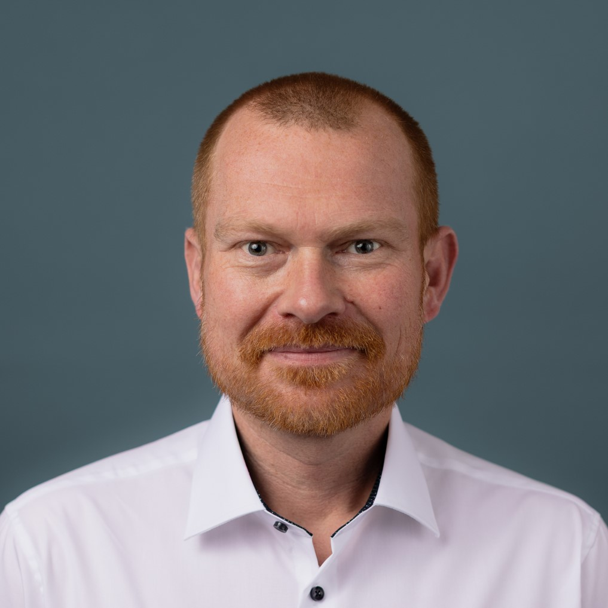
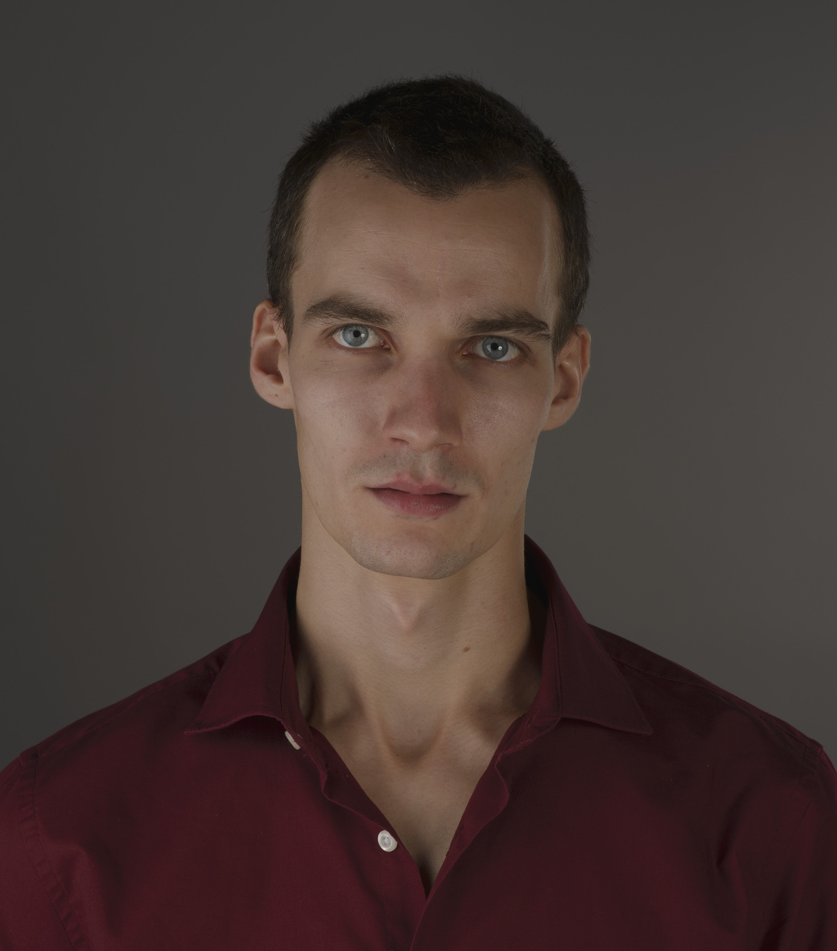
Course Logistics
Staff
  Lecturer: Prof. Dr. Matthias Boehm, DAMS
  Teaching Assistant: David Weissteiner, DAMS
Language
  Lectures and slides: English
  Communication and examination: English/German
Course Format
  VL/UE 3/2 SWS, 6 ECTS (3 ECTS + 3 ECTS), bachelor/master; no capacity restrictions
  Weekly lectures (Thu 4.15pm sharp, in-person & zoom livestreaming/recording), optional attendance
  Mandatory exercises or programming project (3 ECTS), office hour Wed 2pm-3pm (sharp)
  Recommended papers for additional reading on your own
Prerequisites
  Basic understanding of SQL / RA (or willingness to fill gaps)
  Basic programming skills (Python, R, Java, C++)

Slide 9

Course Logistics, cont.
Website / ISIS Course / Zoom
  https://mboehm7.github.io/teaching/ws2627_dia/index.htm (public)
  https://isis.tu-berlin.de/user/index.php?id=49228 (TUB-internal)
  https://tu-berlin.zoom.us/j/9529634787?pwd=R1ZsN1M3SC9BOU1OcFdmem9zT202UT09
Communication
  Informal language (first name is fine); immediate feedback welcome
  ISIS Forum for offline Q&A on projects/exercises as well as
  TA Office hours: Wednesday 2-3pm, starting in second week
Academic Honesty / No Plagiarism (incl LLMs like ChatGPT)
Exam
  Exam Prerequisite: Completed exercises or project (checked by teaching assistants)
  Final written exam (oral exam if <35 students take the exam): Feb 04, 4pm / Feb 25, 4pm / Mar 18, 4pm
  Grading (project/exercises pass/fail, 100% exam) → 5 extra points in exam if exercises with >= 90%

Slide 10
Course Applicability
Bachelor study programs computer science, information systems management,
computer engineering, and electrical engineering
Master study programs computer science, information systems management,
computer engineering, and electrical engineering
  Data and software engineering
  Cognitive systems
  Distributed systems and networks
Free subject course in any other study program or university
Different than “Data Integration: Algorithms and Systems (DI)”

Slide 11
Course Motivation and Goals

Slide 12
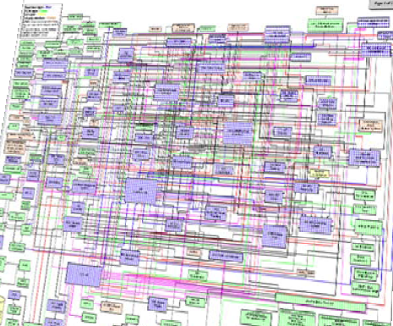
Data Sources and Heterogeneity
Terminology
  Integration (Latin integer = whole): consolidation of data objects / sources
  Homogeneity (Greek homo/homoios = same): similarity
  Heterogeneity: dissimilarity, different representation / meaning
Heterogeneous IT Infrastructure
  Common enterprise IT infrastructure contains >100s of
  heterogeneous and distributed systems and applications
  E.g., health care data management: 20 - 120 systems
Multi-Modal Data (example health care)
  Structured patient data, patient records incl. prescribed drugs
  Knowledge base drug APIs (active pharmaceutical ingredients) + interactions
  Doctor notes (text), diagnostic codes, outcomes
  Radiology images (e.g., MRI scans), patient videos
  Time series (e.g., EEG, ECoG, heart rate, blood pressure)
[Credit: Albert Maier]

Slide 13


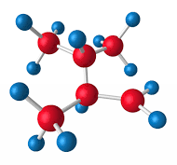

Recap: The Data Science Lifecycle
(aka KDD Process, aka CRISP-DM)
Data-centric View:
Application perspective
Workload perspective
System perspective
Data Scientist
Data Integration
Data Cleaning
Data Preparation
Data Integration
Data Cleaning
Data Preparation
Model Selection
Training
Hyper-parameters
Validate & Debug
Deployment
Scoring & Feedback
Exploratory Process
(experimentation, refinements, ML pipelines)
Data/SW Engineer
DevOps Engineer

Slide 14
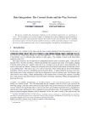
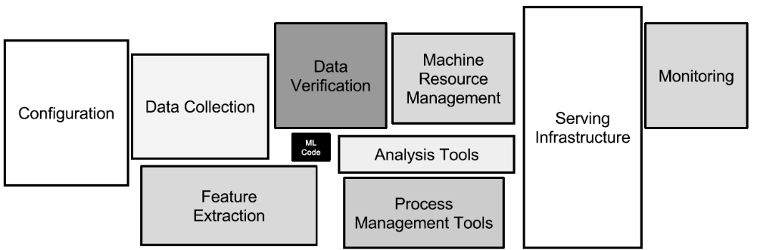
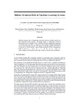
The 80% Argument
Data Sourcing Effort
  Data scientists spend 80-90% time on finding, integrating, cleaning datasets
Technical Debts in ML Systems
  Glue code, pipeline jungles, dead code paths
  Plain-old-data types (arrays), multiple languages, prototypes
  Abstraction and configuration debts
  Data testing, reproducibility, process management, and cultural debts
[Michael Stonebraker, Ihab F. Ilyas: Data Integration: The Current Status and the Way Forward.
IEEE Data Eng. Bull. 41(2) (2018)]
[D. Sculley et al.: Hidden
Technical Debt in Machine Learning Systems. NeurIPS 2015]
ML

Slide 15

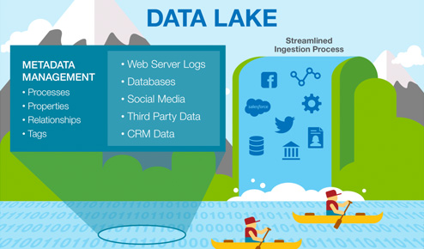

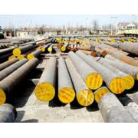



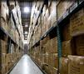
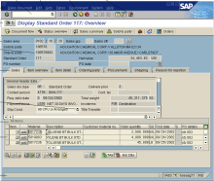
Complementary System Architectures
#1 Information System Pyramid
Distributed Computation
Frameworks
Operational Systems
Strategic
Systems
Analytical Systems
DSS
Vertical Integration
(e.g., ETL)
#2 Data
Lake
Audio, Image, Video, Text, Streams, Logs
DWH
Catalogs
Distributed Data Stores
Material
ERP
CRM
SCM
eCommerce
Horizontal Integration (e.g., EAI)

Slide 16
Course Goals
Common Data and System Characteristics
  Heterogeneous data sources and formats, often distributed
  Large data collections → distributed data storage and analysis
#1 Major data integration architectures
#2 Key techniques for data integration and cleaning
#3 Methods for large-scale data storage and analysis

Slide 17
Course Outline and Projects/Exercise

Slide 18
Part A: Data Integration and Preparation
Data Integration Architectures
01 Introduction and Overview [Oct 15]
02 Data Warehousing, ETL, and SQL/OLAP [Oct 22]
03 Message-oriented Middleware, EAI, and Replication [Oct 29]
Key Integration Techniques
04 Schema Matching and Mapping [Nov 05]
05 Entity Linking and Deduplication [Nov 12]
06 Data Cleaning and Data Fusion [Nov 19]
07 Data Provenance and Catalogs [Nov 26]

Slide 19
Part B: Large-Scale Data Management & Analysis
Cloud Computing
08 Cloud Computing Foundations [Dec 03]
09 Cloud Resource Management and Scheduling [Dec 10]
10 Distributed Data Storage [Dec 17]
Large-Scale Data Analysis
11 Distributed, Data-Parallel Computation [Jan 14]
12 Distributed Stream Processing [Jan 21]
13 Distributed Machine Learning Systems [Jan 28]
+ Q&A and Exam Preparation

Slide 20
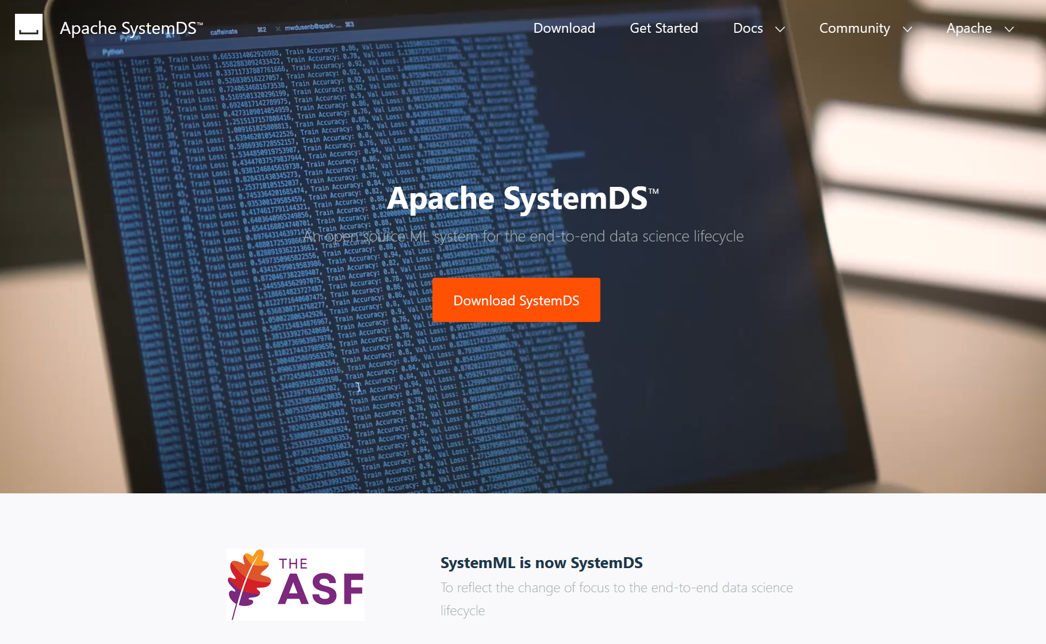
Overview Projects or Exercises
Team
  1-3 person teams (w/ clearly separated responsibilities)
Objectives
  Non-trivial programming project in DIA context (3 ECTS → 80-90 hours)
  Preferred: Open-source contribution to Apache SystemDS
  https://github.com/apache/systemds (from HW to high-level scripting)
  https://issues.apache.org/jira/secure/
  Dashboard.jspa?selectPageId=12335852#Filter-Results/12365413
  Alternative Exercise: “Ship Collision Detection” (most students)
Timeline
  Oct 23: Binding project/exercise selection (via google forms)
  Jan 28: Project/exercise submission deadline
https://forms.gle/
XcmRZxmxQ9AZvVjj7

Slide 21
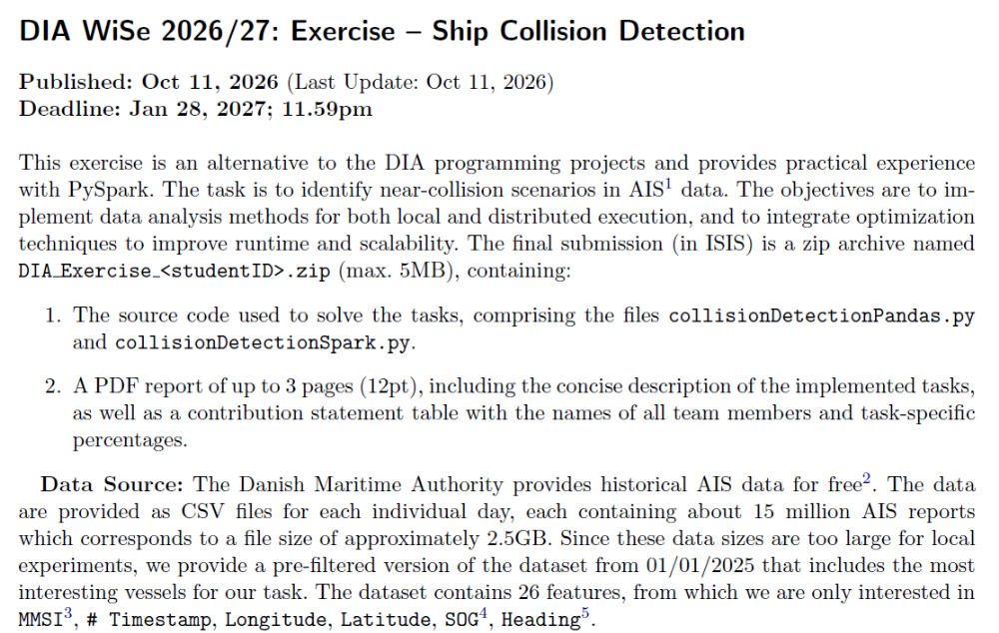
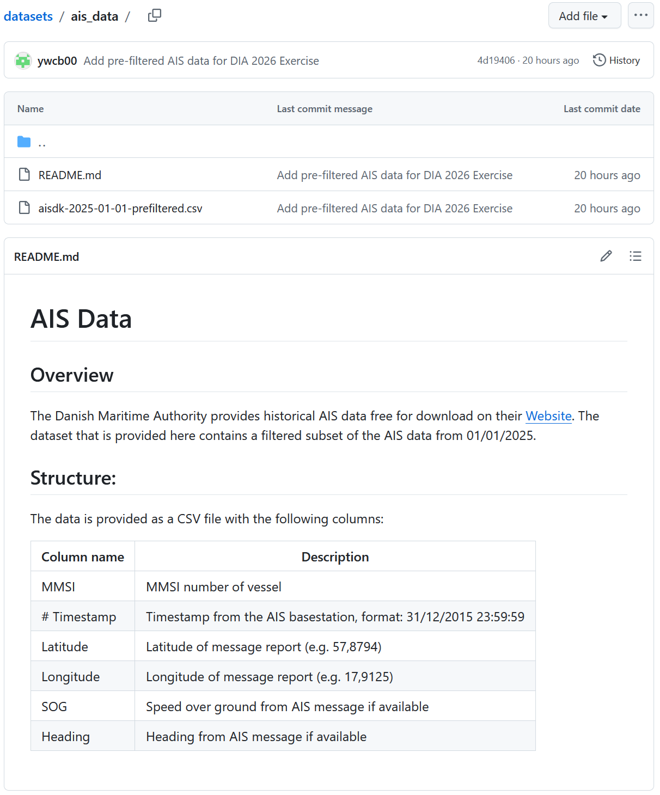
DIA Exercise (alternative to projects), cont.
[https://github.com/damslab/datasets/tree/master/ais_data]

Slide 22


Apache SystemDS: A Declarative ML System for the End-to-End Data Science Lifecycle
https://github.com/apache/systemds

Slide 23
What is an ML System?
Classification
Regression
Recommenders
Clustering
Dim Reduction
Neural Networks
Statistics
Data Mining
Machine Learning (ML)
ML Applications
(entire KDD/DS lifecycle)
Rapidly Evolving
Runtime Techniques (Execution, Data Access)
ML System
Compilation Techniques
Distributed Systems
HPC
Data Management
Accelerators
Operating Systems
Prog. Language Compilers
HW Architecture

Slide 24

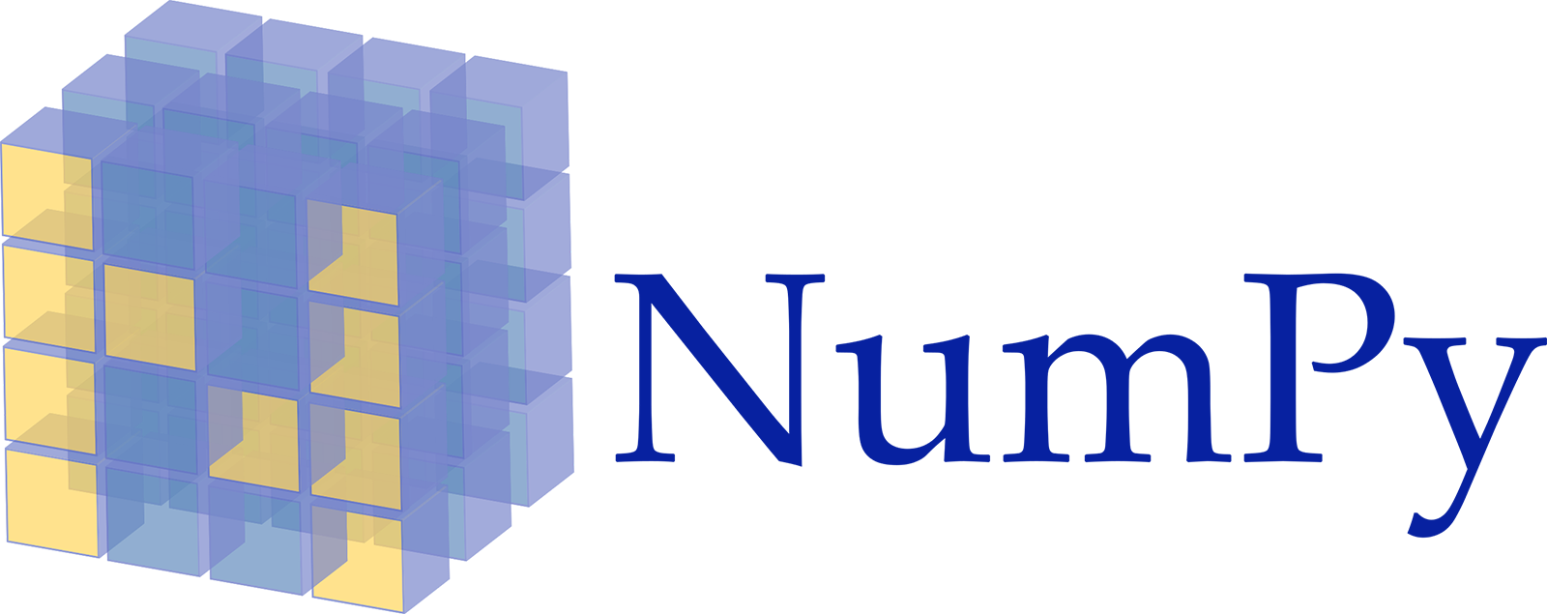











Landscape of ML Systems
Existing ML Systems
  #1 Numerical computing frameworks
  #2 ML Algorithm libraries (local, large-scale)
  #3 Linear algebra ML systems (large-scale)
  #4 Deep neural network (DNN) frameworks
  #5 Model management, and deployment
Exploratory Data-Science Lifecycle
  Open-ended problems w/ underspecified objectives
  Hypotheses, data integration, run analytics
  Unknown value → lack of system infrastructure
  → Redundancy of manual efforts and computation
Data Preparation Problem
  80% Argument: 80-90% time for finding, integrating, cleaning data
  Diversity of tools ➔ boundary crossing, lack of optimization
“Take these datasets and show value or competitive advantage”
[NIPS 2015]
[DEBull 2018]

Slide 25
The Data Science Lifecycle
(aka KDD Process, aka CRISP-DM)
Data extraction, schema alignment, entity resolution, data validation, data cleaning, outlier detection, missing value imputation, semantic type detection, data augmentation, feature selection, feature engineering, feature transformations
Key observation: SotA data integration/cleaning based on ML
Data Scientist
Data Integration
Data Cleaning
Data Preparation
Data Integration
Data Cleaning
Data Preparation
Model Selection
Training
Hyper-parameters
Validate & Debug
Deployment
Scoring & Feedback
Exploratory Process
(experimentation, refinements, ML pipelines)
Data/SW Engineer
DevOps Engineer

Slide 26
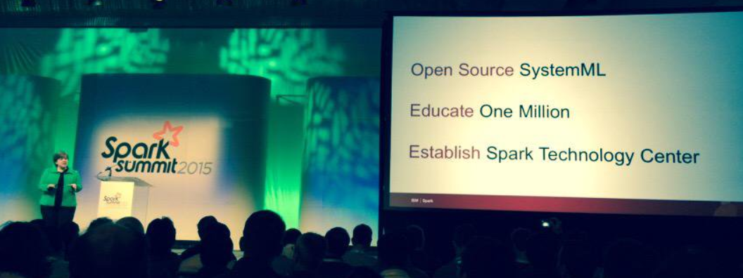



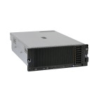
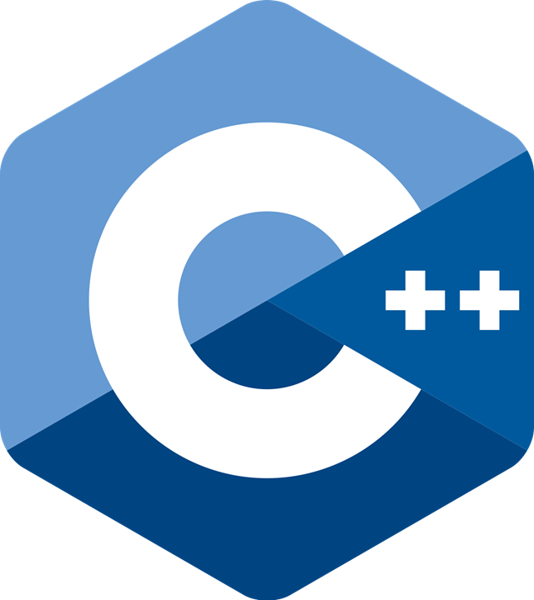
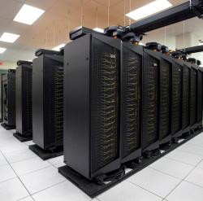
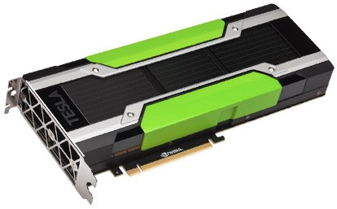
Apache SystemDS [https://github.com/apache/systemds]
DML Scripts
APIs: Command line, JMLC, Python
Spark MLContext, Spark ML,
(Scalable Algorithms + Primitives)
Language
Compiler
07/2020 Renamed to Apache SystemDS
05/2017 Apache Top-Level Project
11/2015 Apache Incubator Project
08/2015 Open Source Release
[SIGMOD’15,’17,’19,’21abc,’23abc,’24ab]
[PVLDB’14,’16ab,’18,’22]
[ICDE’11,’12,’15]
[EDBT’25][BTW’25ab]
[CIDR’17,’20]
[VLDBJ’18] [TODS’26]
[CIKM’22]
[DEBull’14]
[PPoPP’15]
Runtime
Write Once, Run Anywhere
In-Memory Single Node
(scale-up)
Hadoop or Spark Cluster
(scale-out)
Federated
(LA progs, PS)
In-Progress:
GPU
Others: Netezza
Apache Flink
since 2019
since 2014/16
since 2012
since 2010/11
since 2015

Slide 27
Language Abstractions and APIs
Data Independence + Impl-Agnostic Ops
➔ “Separation of Concerns”
User Script
Built-in Functions
Example:
Stepwise
Linear
Regression
X = read(‘features.csv’)
Y = read(‘labels.csv’)
[B,S] = steplm(X, Y,
icpt=0, reg=0.001)
write(B, ‘model.txt’)
m_steplm = function(...) {
while( continue ) {
parfor( i in 1:n ) {
if( !fixed[1,i] ) {
Xi = cbind(Xg, X[,i])
B[,i] = lm(Xi, y, ...)
} }
# add best to Xg
# (AIC)
} }
m_lmCG = function(...) {
while( i<maxi&nr2>tgt ) {
q = (t(X) %*% (X %*% p))
+ lambda * p
beta = ... }
}
m_lm = function(...) {
if( ncol(X) > 1024 )
B = lmCG(X, y, ...)
else
B = lmDS(X, y, ...)
}
Linear Algebra Programs
Feature Selection
Facilitates optimization across data science lifecycle tasks
ML Algorithms
m_lmDS = function(...) {
l = matrix(reg,ncol(X),1)
A = t(X) %*% X + diag(l)
b = t(X) %*% y
beta = solve(A, b) ...}

Slide 28
Basic HOP and LOP DAG Compilation
LinregDS (Direct Solve)
X = read($1);
y = read($2);
intercept = $3;
lambda = 0.001;
...
if( intercept == 1 ) {
ones = matrix(1, nrow(X), 1);
X = append(X, ones);
}
I = matrix(1, ncol(X), 1);
A = t(X) %*% X + diag(I)*lambda;
b = t(X) %*% y;
beta = solve(A, b);
...
write(beta, $4);
HOP DAG
(after rewrites)
8KB
Cluster Config:
driver mem: 20 GB
exec mem: 60 GB
CP
write
Scenario:
X: 10⁸ x 10³, 10¹¹
y: 10⁸ x 1, 10⁸
8MB
16MB
CP
b(solve)
CP
172KB
b(+)
1.6TB
CP
SP
800GB
r(diag)
ba(+*)
ba(+*)
SP
1.6TB
r(t)
8KB
SP
CP
800GB
800MB
dg(rand)
(10³x1,10³)
X
(10⁸x10³,10¹¹)
y
(10⁸x1,10⁸)
Distributed Matrices
  Fixed-size matrix blocks
  Data-parallel operations
LOP DAG
(after rewrites)
16KB
r’(CP)
mapmm(SP)
tsmm(SP)
X_{1,1}
Hybrid Runtime Plans:
  Size propagation / memory estimates
  Integrated CP / Spark runtime
  Dynamic recompilation during runtime
800MB
1.6GB
X_{2,1}
r’(CP)
X
(persisted in MEM_DISK)
X_{m,1}
y

Slide 29
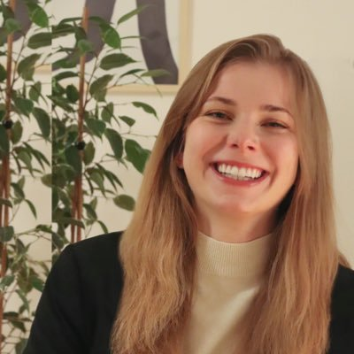
Static and Dynamic Rewrites
trace(X%*%Y) → sum(X*t(Y))
Example Static Rewrites (size-independent)
  Common Subexpression Elimination
  Constant Folding / Branch Removal /
  Block Sequence Merge
  Static Simplification Rewrites
  Right/Left Indexing Vectorization
  For Loop Vectorization
  Spark checkpoint/repartition injection
Example Dynamic Rewrites (size-dependent)
  Dynamic Simplification Rewrites
  Matrix Mult Chain Optimization
Y
O(n³)
O(n²)
X
X
Y ┬
→
*
sum(λ*X) → λ*sum(X)
sum(X+Y) → sum(X)+sum(Y)
rowSums(X) → X, iff ncol(X)=1
sum(X^2) → X%*%t(X), iff ncol(X)=1
t(X)
1kx1k
X
1kx1k
Z
1
t(X)
1kx1k
X
1kx1k
p
1
→
Sparsity Estimation & Sparse DP Enum
[SIGMOD’19]
2,002 MFLOPs
4 MFLOPs
Size propagation and sparsity estimation

Slide 30
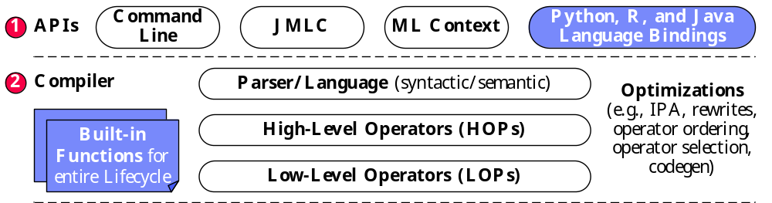
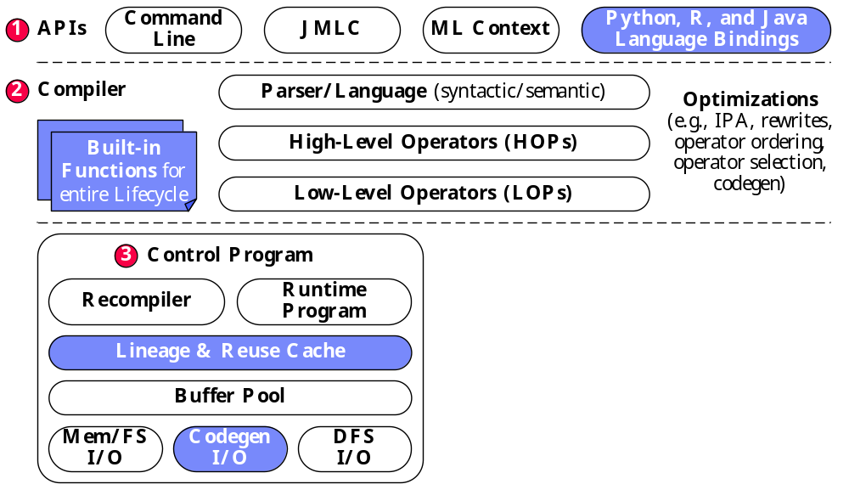
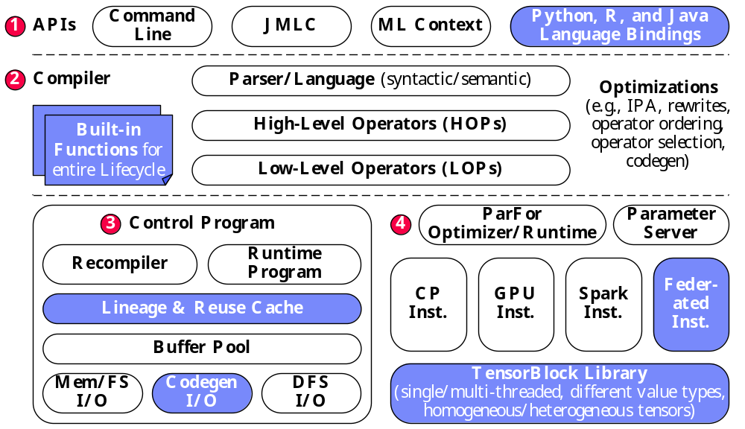
Apache SystemDS Architecture
> 500K tests
> 10K DSL tests
[CIDR’20]

Slide 31

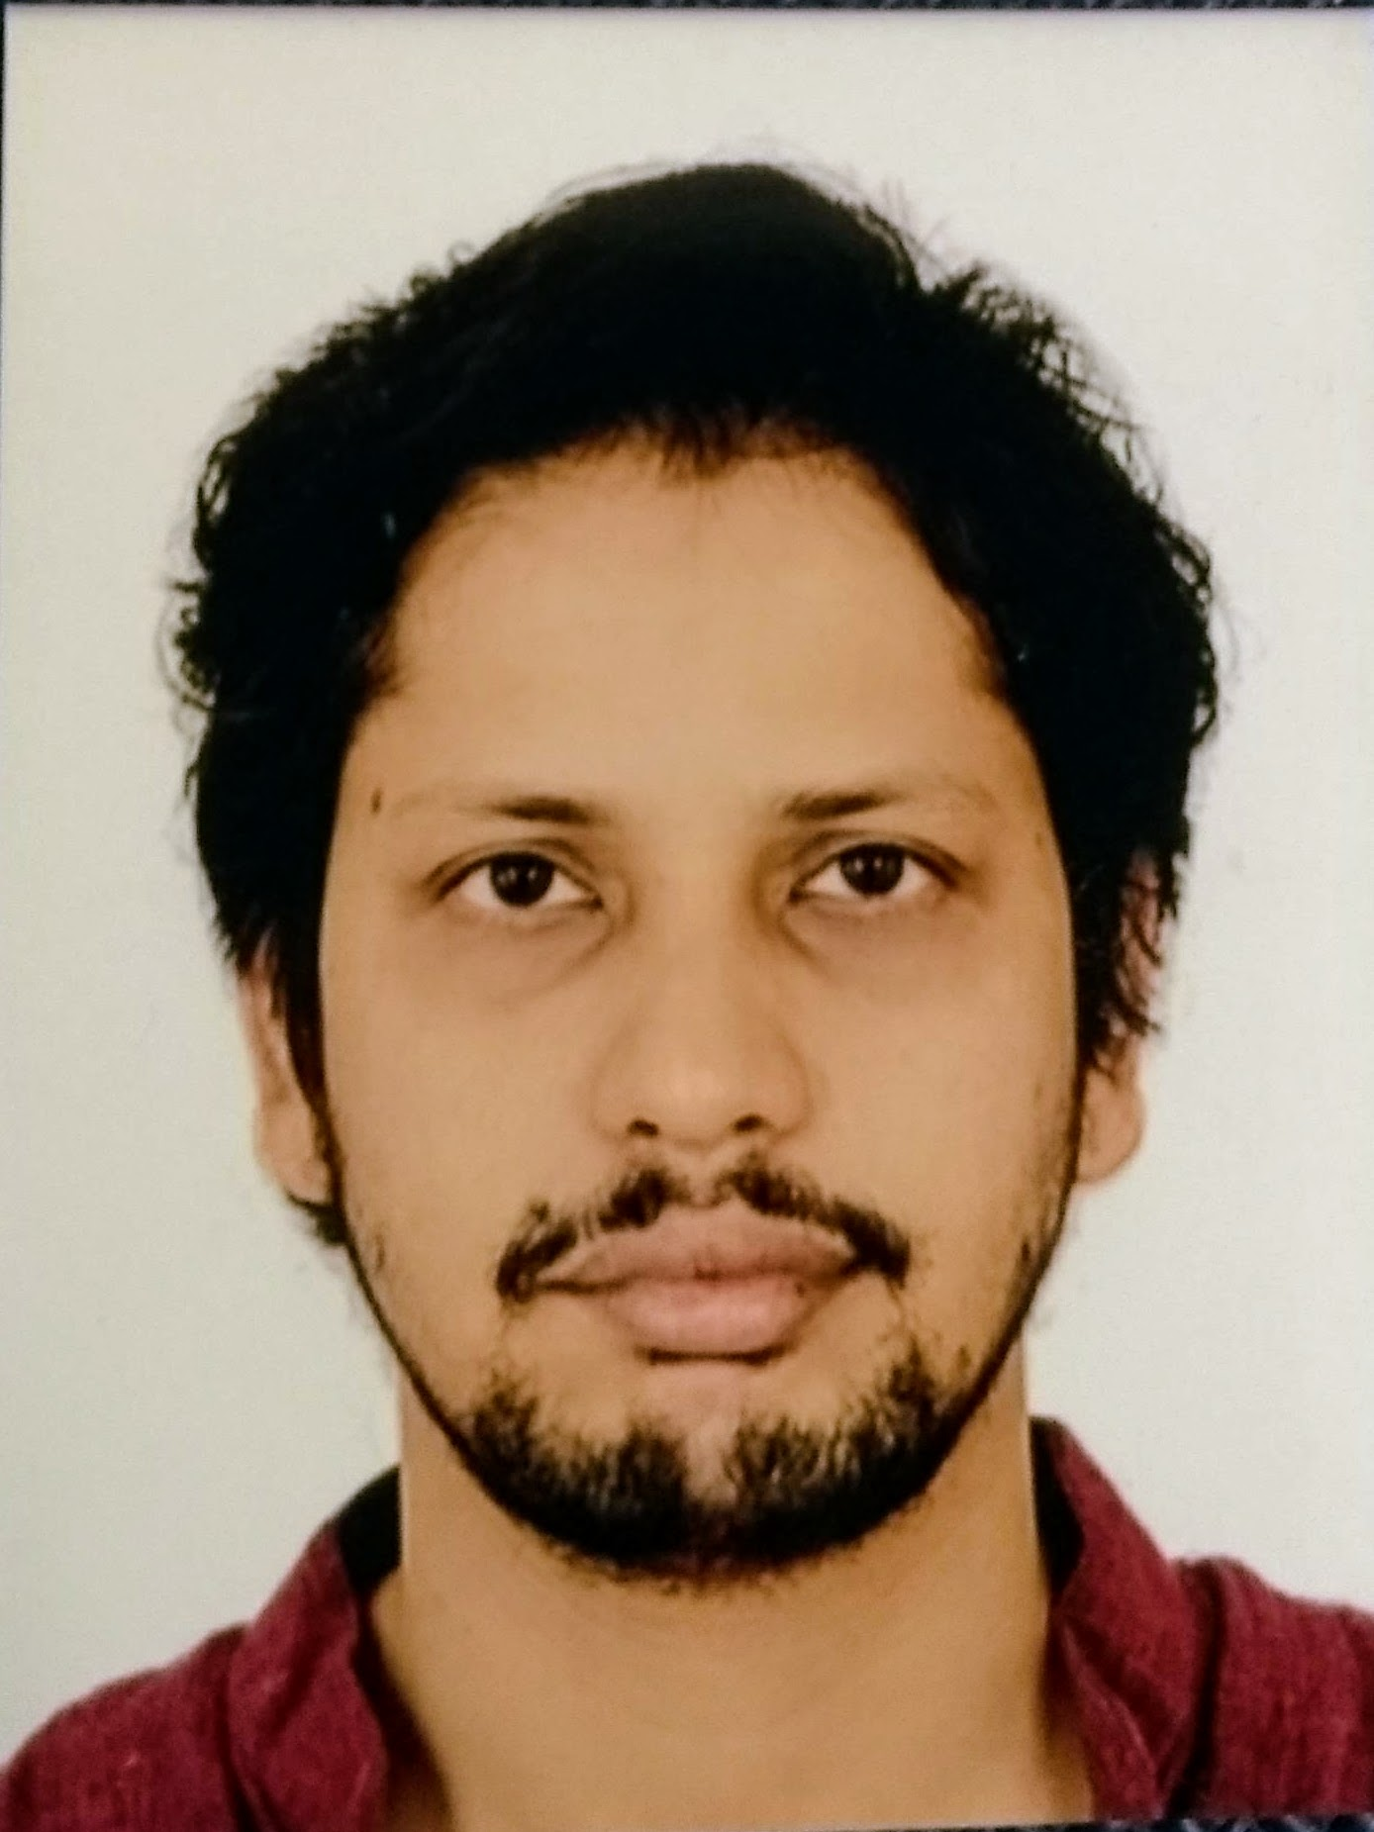

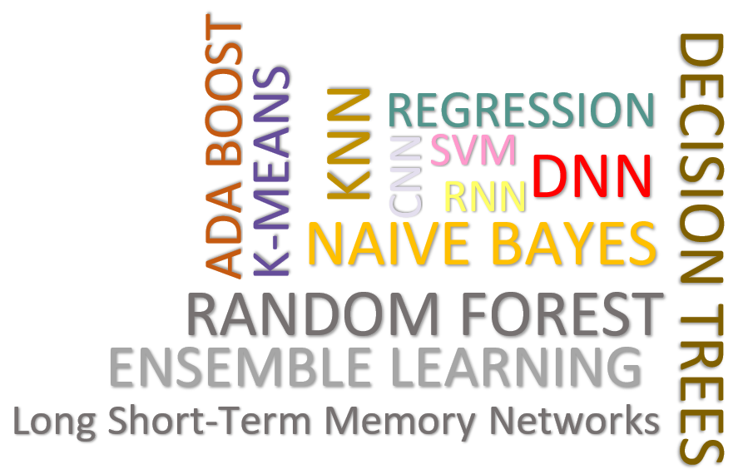
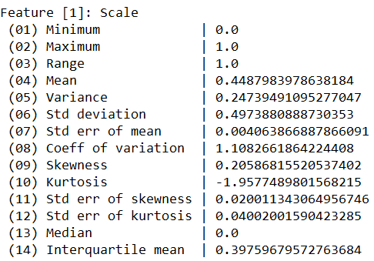
Data Cleaning Pipelines
[SIGMOD’24a, TODS’26]
Automatic Generation of Cleaning Pipelines
  Library of robust, parameterized data cleaning primitives,
  Enumeration of DAGs of primitives & hyper-parameter optimization (evolutionary, HB)
[best paper runner-up w/ Shafaq and Roman]
Data- and Task-parallel Computation
Data Samples
Logical
O
Physical
LP₁
LP₂
…
LP_{n}
Top-k Pipelines
Target
App
…
…
…
PP₁
PP_{n}
PP₁
PP_{n}
PP₁
PP_{n}
Rules/Objectives
Outlier Detection → MVI → Deduplication → Resolve Mislabels
P_{1:} gmm → imputeFD → mergeDup → delML
P_{n:} outlierBySd→ mice → delDup → voting
Debugging
University | Country
TU Graz | Austria
TU Graz | Austria
TU Graz | Germany
IIT | India
IIT | IIT
IIT | Pakistan
IIT | India
SIBA | Pakistan
SIBA | null
SIBA | null
University | Country
TU Graz | Austria
TU Graz | Austria
TU Graz | Austria
IIT | India
IIT | India
IIT | India
IIT | India
SIBA | Pakistan
SIBA | Pakistan
SIBA | Pakistan
A | B | C | D
0.77 | 0.80 | 1 | 1
0.96 | 0.12 | 1 | 1
0.66 | 0.09 | null | 1
0.23 | 0.04 | 17 | 1
0.91 | 0.02 | 17 | null
0.21 | 0.38 | 17 | 1
0.31 | null | 17 | 1
0.75 | 0.21 | 20 | 1
null | null | 20 | 1
0.19 | 0.61 | 20 | 1
0.64 | 0.31 | 20 | 1
A | B | C | D
0.77 | 0.80 | 1 | 1
0.96 | 0.12 | 1 | 1
0.66 | 0.09 | 17 | 1
0.23 | 0.04 | 17 | 1
0.91 | 0.02 | 17 | 1
0.21 | 0.38 | 17 | 1
0.31 | 0.29 | 17 | 1
0.75 | 0.21 | 20 | 1
0.41 | 0.24 | 20 | 1
0.19 | 0.61 | 20 | 1
0.64 | 0.31 | 20 | 1
Dirty Data
After imputeFD(0.5)
Dirty Data
After MICE

Slide 32


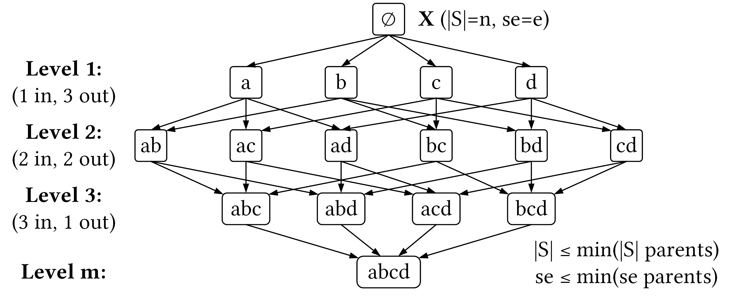
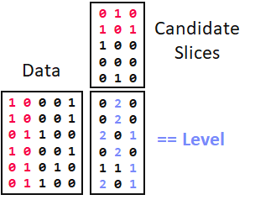

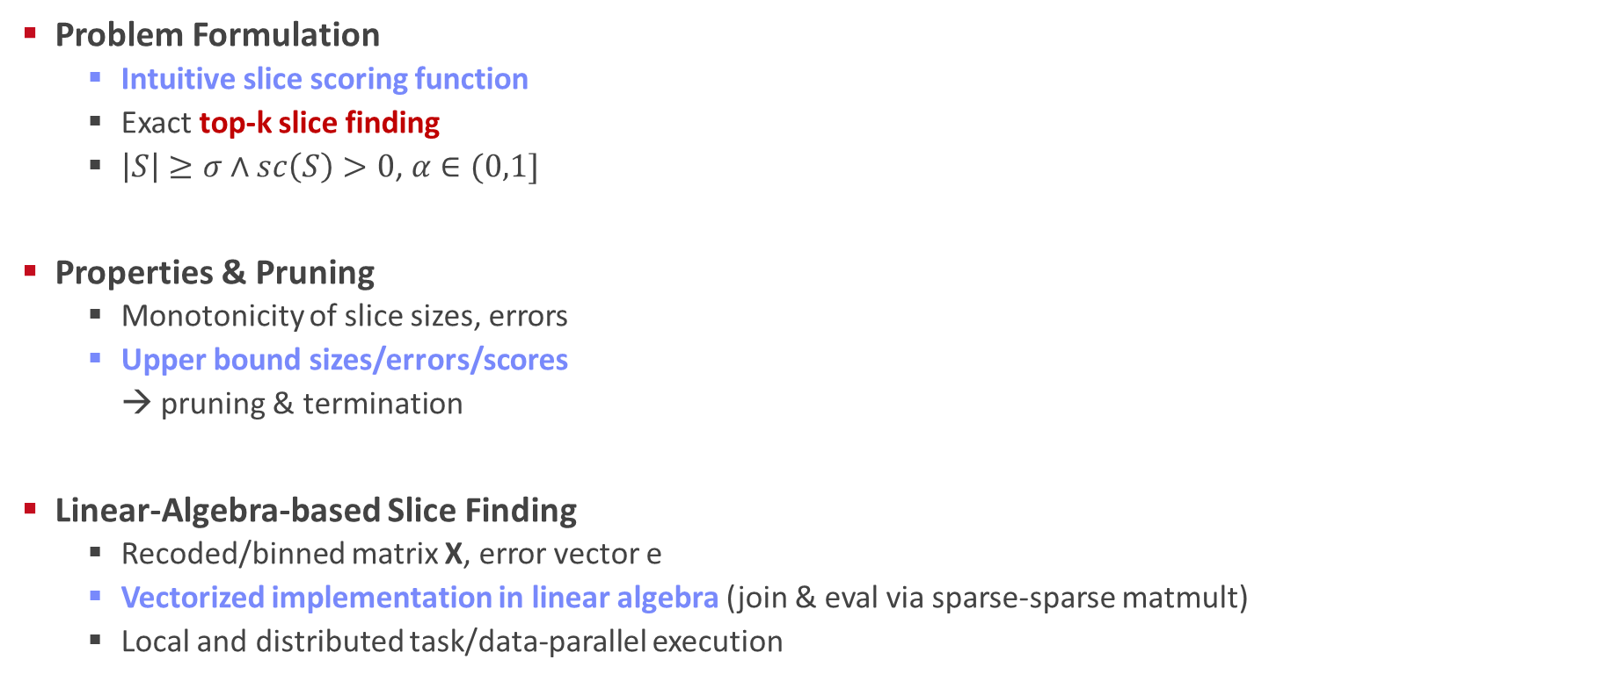
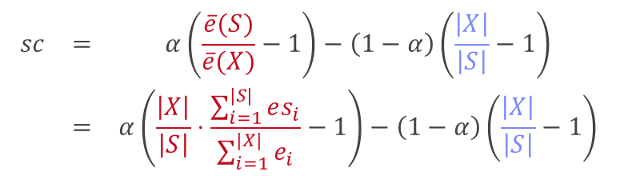
SliceLine for Model Debugging
[SIGMOD’21b, BTW’25a]
[Credit: sliceline,
Silicon Valley, HBO]
Problem Formulation
  Intuitive slice scoring function
  Exact top-k slice finding
  $\left|S\right|≥σ∧sc\left(S\right)>0$, $α∈(0,1]$
Properties & Pruning
  Monotonicity of slice sizes, errors
  Upper bound sizes/errors/scores
  → pruning & termination
Linear-Algebra-based Slice Finding
  Recoded/binned matrix X, error vector e
  Vectorized implementation in linear algebra (join & eval via sparse-sparse matmult)
  Local and distributed task/data-parallel execution
$$\begin{matrix}sc & = & α\left(\frac{\overline{e}(S)}{\overline{e}(X)}−1\right)−\left(1−α\right)\left(\frac{\left|X\right|}{\left|S\right|}−1\right) \\ & = & α\left(\frac{\left|X\right|}{\left|S\right|}⋅\frac{\sum_{i=1}^{|S|}{es_{i}}}{\sum_{i=1}^{|X|}{e_{i}}}−1\right)−\left(1−α\right)\left(\frac{\left|X\right|}{\left|S\right|}−1\right)\end{matrix}$$
slice error
slice size
$$O(2^{l}−\sum_{j=1}^{m}{2^{d_{j}}}+ l+m)$$
Notes:
Compelling properties:
The components are balanced under α = 0.5.
The score of the original X is always sc = 0.
For α = 0 (all weight on size), the maximum feasible score is 0, and no slice smaller than X can reach it.
All components of Equation (1) are either constants, or slice errors and sizes, which makes this function amenable to pruning.

Slide 33


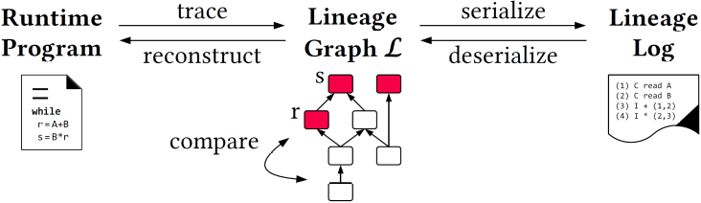
Multi-level Lineage Tracing & Reuse
[CIDR’20, SIGMOD’21a, EDBT’25]
Lineage as Key Enabling Technique
  Trace lineage of ops (incl. non-determinism), dedup for loops/funcs
  Model versioning, data reuse, incr. maintenance, autodiff, debugging
Full Reuse of Intermediates
  Before executing instruction, probe output lineage in cache
  Map<Lineage, MatrixBlock>
  Cost-based/heuristic caching and eviction decisions
  (compiler-assisted)
Partial Reuse of Intermediates
  Problem: Often partial result overlap
  Reuse partial results via dedicated rewrites (compensation plans)
  Example: steplm
Next Steps: multi-backend, unified mem mgmt
for( i in 1:numModels )
R[,i] = lm(X, y, lambda[i,], ...)
m_lmDS = function(...) {
l = matrix(reg,ncol(X),1)
A = t(X) %*% X + diag(l)
b = t(X) %*% y
beta = solve(A, b) ...}
m_steplm = function(...) {
while( continue ) {
parfor( i in 1:n ) {
if( !fixed[1,i] ) {
Xi = cbind(Xg, X[,i])
B[,i] = lm(Xi, y, ...)
} }
# add best to Xg (AIC)
} }
X
m>>n
t(X)

Slide 34

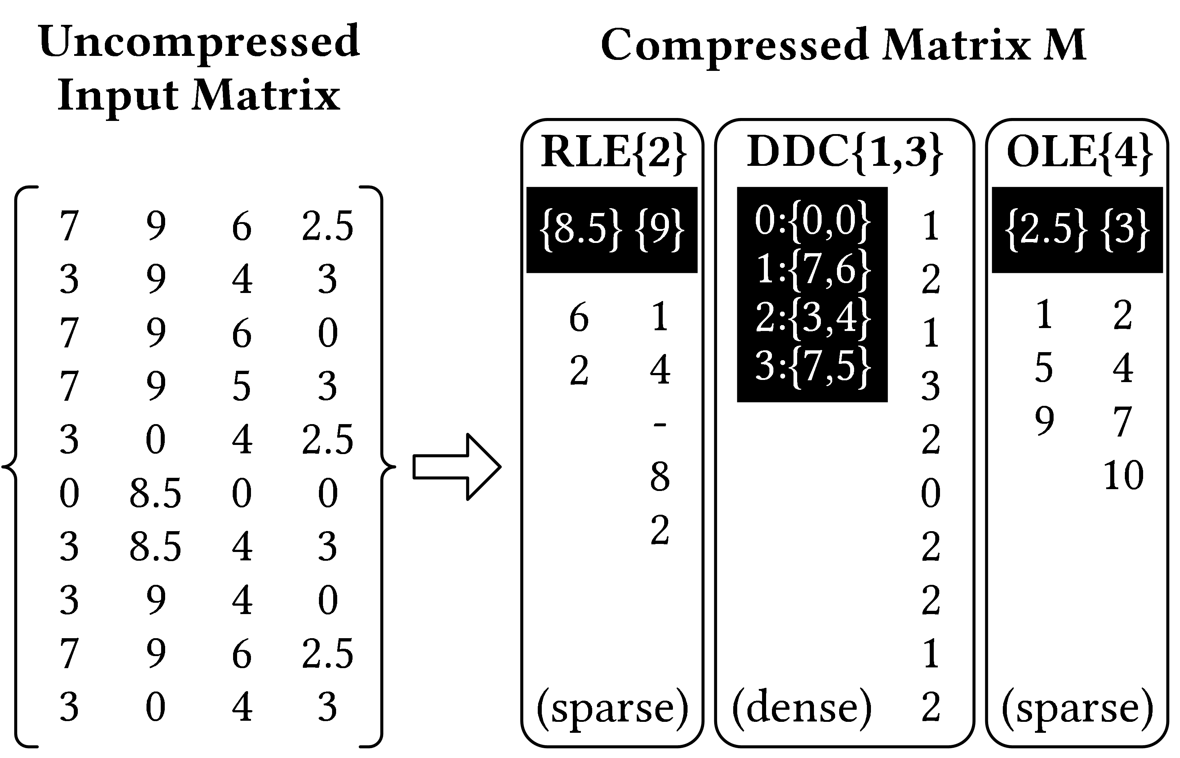
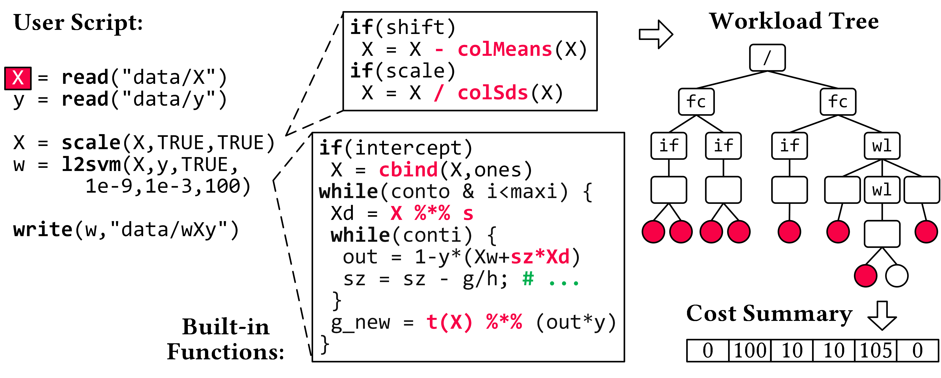
Compressed Linear Algebra Extended
[PVLDB’16a, VLDBJ’18, SIGMOD’23a,
PVLDB’26a]
Lossless Matrix Compression
  Improved general applicability (adaptive compression time,
  new compression schemes, new kernels, intermediates, workload-aware)
  Sparsity → Redundancy exploitation
  (data redundancy, structural redundancy)
Workload-aware Compression
  Workload summary
  → compression
  Compressed Representation
  → execution planning
BWARE: Compressed Feature Engineering
  Frame compression, compressed I/O
  Compressed feature transformations
  Morphing of compressed data

Slide 35





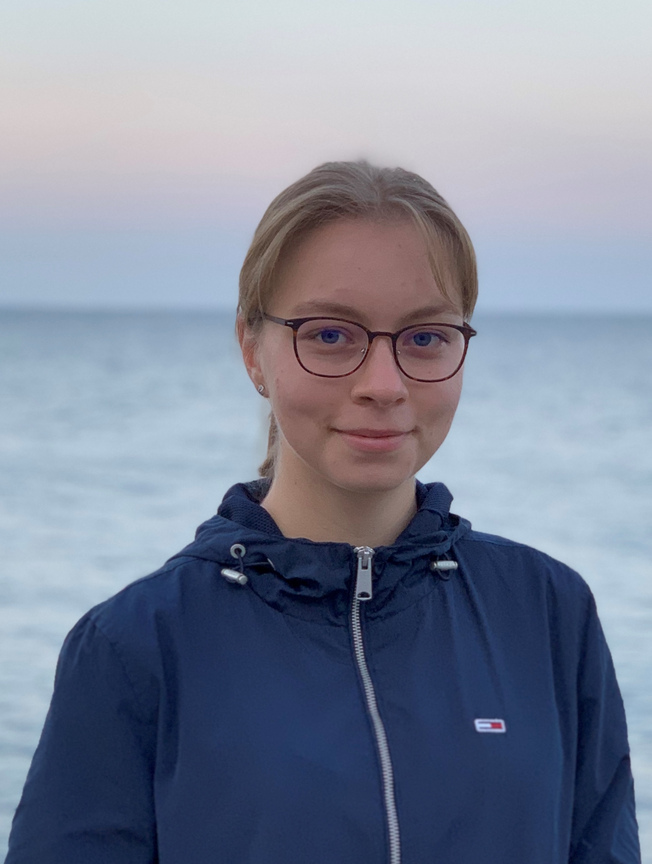
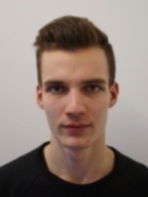

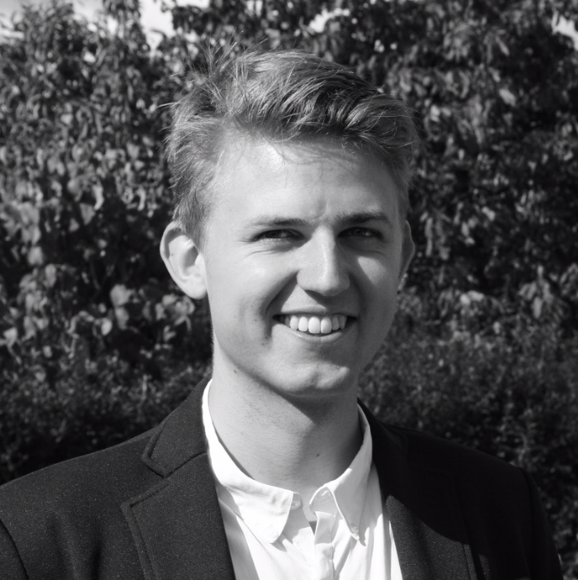
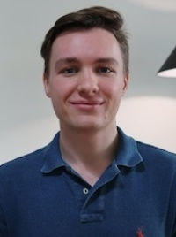
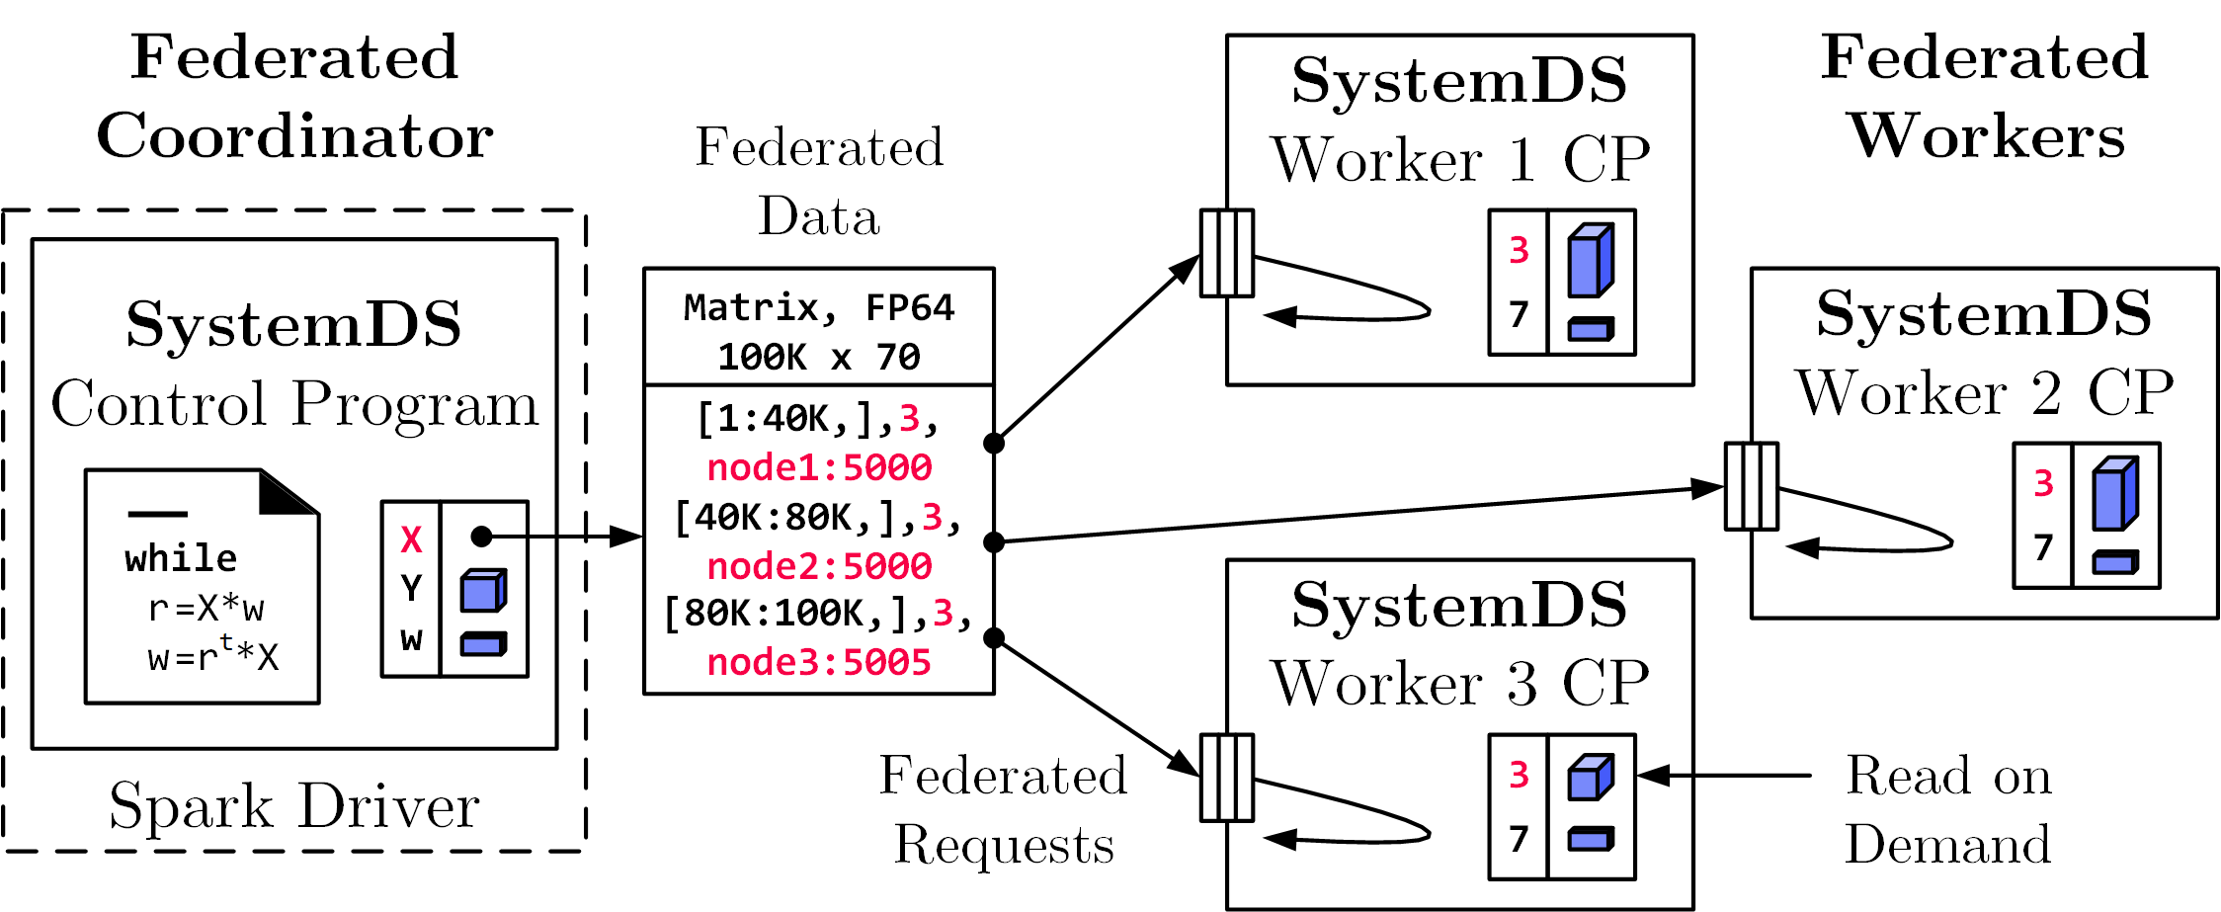
Federated Learning
[SIGMOD’21c, CIKM’22]
Federated Backend
  Federated data (matrices/frames) as meta data objects
  Federated linear algebra, (and federated parameter server)
X = federated(addresses=list(node1, node2, node3),
ranges=list(list(0,0), list(40K,70), ..., list(80K,0), list(100K,70)));
Federated Requests:
READ, PUT, GET, EXEC_INST,
EXEC_UDF, CLEAR
➔ Design Simplicity:
(1) reuse instructions
(2) federation hierarchies

Slide 36
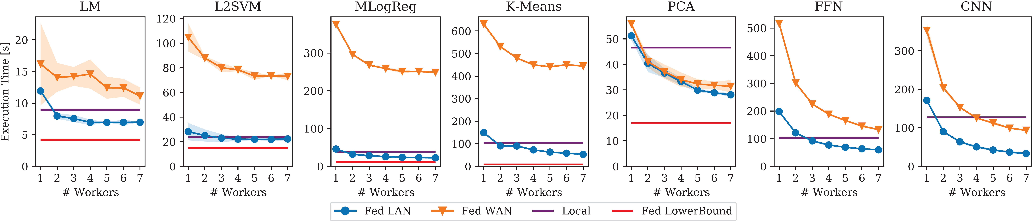
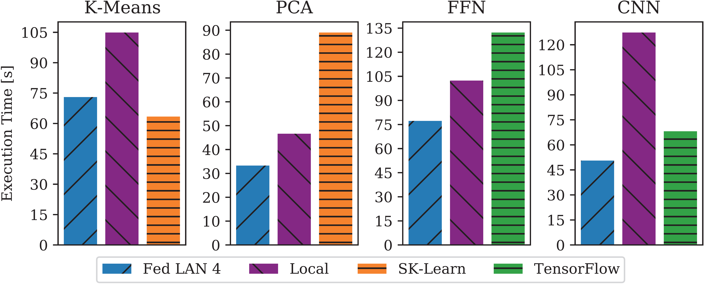
Reproducible Results
Federated Learning – Experiments
Workloads and Baselines
  LM: linear regression, lmCG
  L2SVM: l2-regularized SVM
  MLogReg: multinomial logreg
  K-Means: Lloyd’s alg. w/ K-Means++ init
  PCA: principal component analysis
  FFN: fully-connected feed-forward NN
  CNN: convolutional NN
Comparisons w/
Scikit-learn and TensorFlow

Slide 37
Summary and Q&A
Thanks
Course Goals
  #1 Major data integration architectures
  #2 Key techniques for data integration and cleaning
  #3 Methods for large-scale data storage and analysis
Programming Projects
  Unique project in Apache SystemDS (teams or individuals), or
  Exercise on data engineering / analytics
  Project selection by Oct 23 EOD
Next Lectures
  02 Data Warehousing, ETL, and SQL/OLAP [Oct 22]
  03 Message-oriented Middleware, EAI, and Replication [Oct 29]
https://forms.gle/
XcmRZxmxQ9AZvVjj7

