Slide 1

Data Management and Systems (DMS)
Introduction and Overview
Prof. Dr. Matthias Boehm
Technische Universität Berlin
Berlin Institute for the Foundations of Learning and Data
Big Data Engineering (DAMS Lab)
Last update: Oct 13, 2026

Slide 2


Announcements / Org
#1 Hybrid & Video Recording
  Hybrid lectures (in-person, zoom) with optional attendance
  https://tu-berlin.zoom.us/j/9529634787?pwd=R1ZsN1M3SC9BOU1OcFdmem9zT202UT09
  Zoom video recordings, links from website
  https://mboehm7.github.io/teaching/ws2627_dms/index.htm
#2 Course Registrations
  TU Berlin ISIS registrations as of Oct 13
  Bachelor CS/ISM vs others ratio?
#3 Hackathon on AI in Medicine
  BIFOLD/Charité hackathon in planning
  Help us find suitable dates that work for you
~230

Slide 3

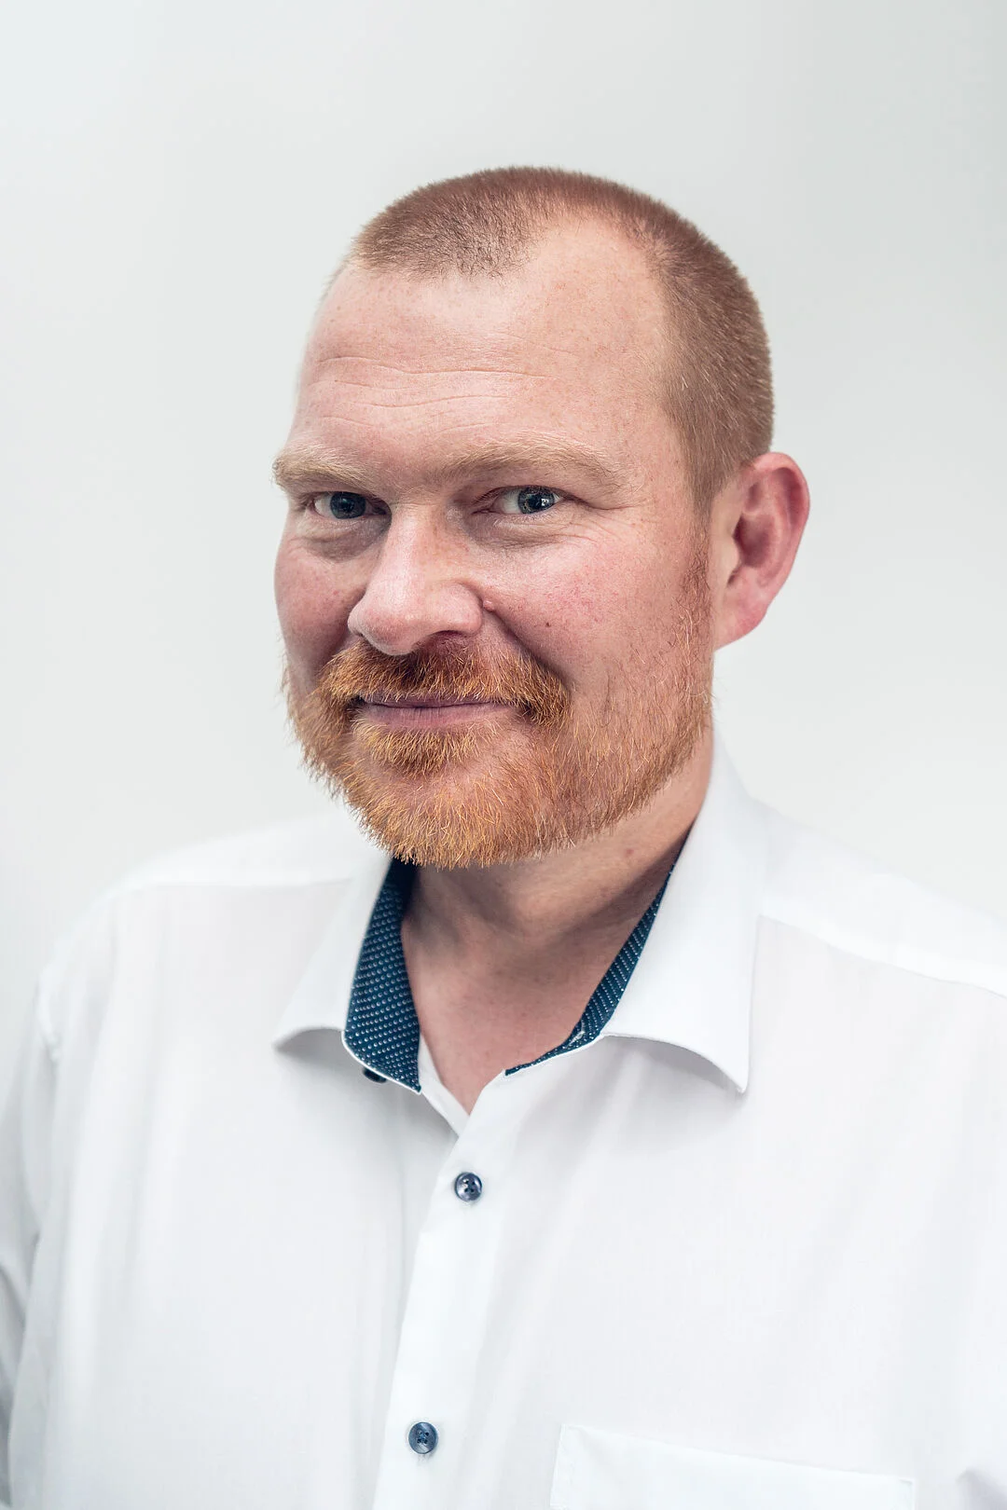
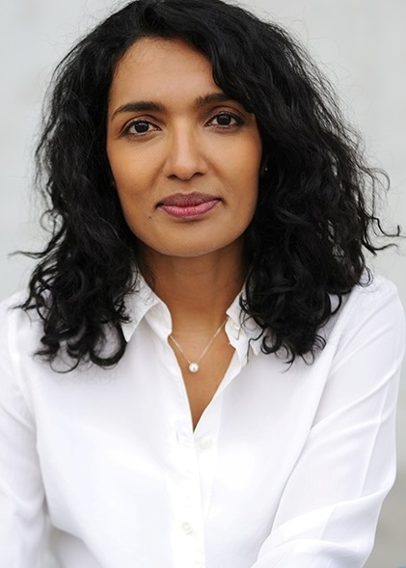
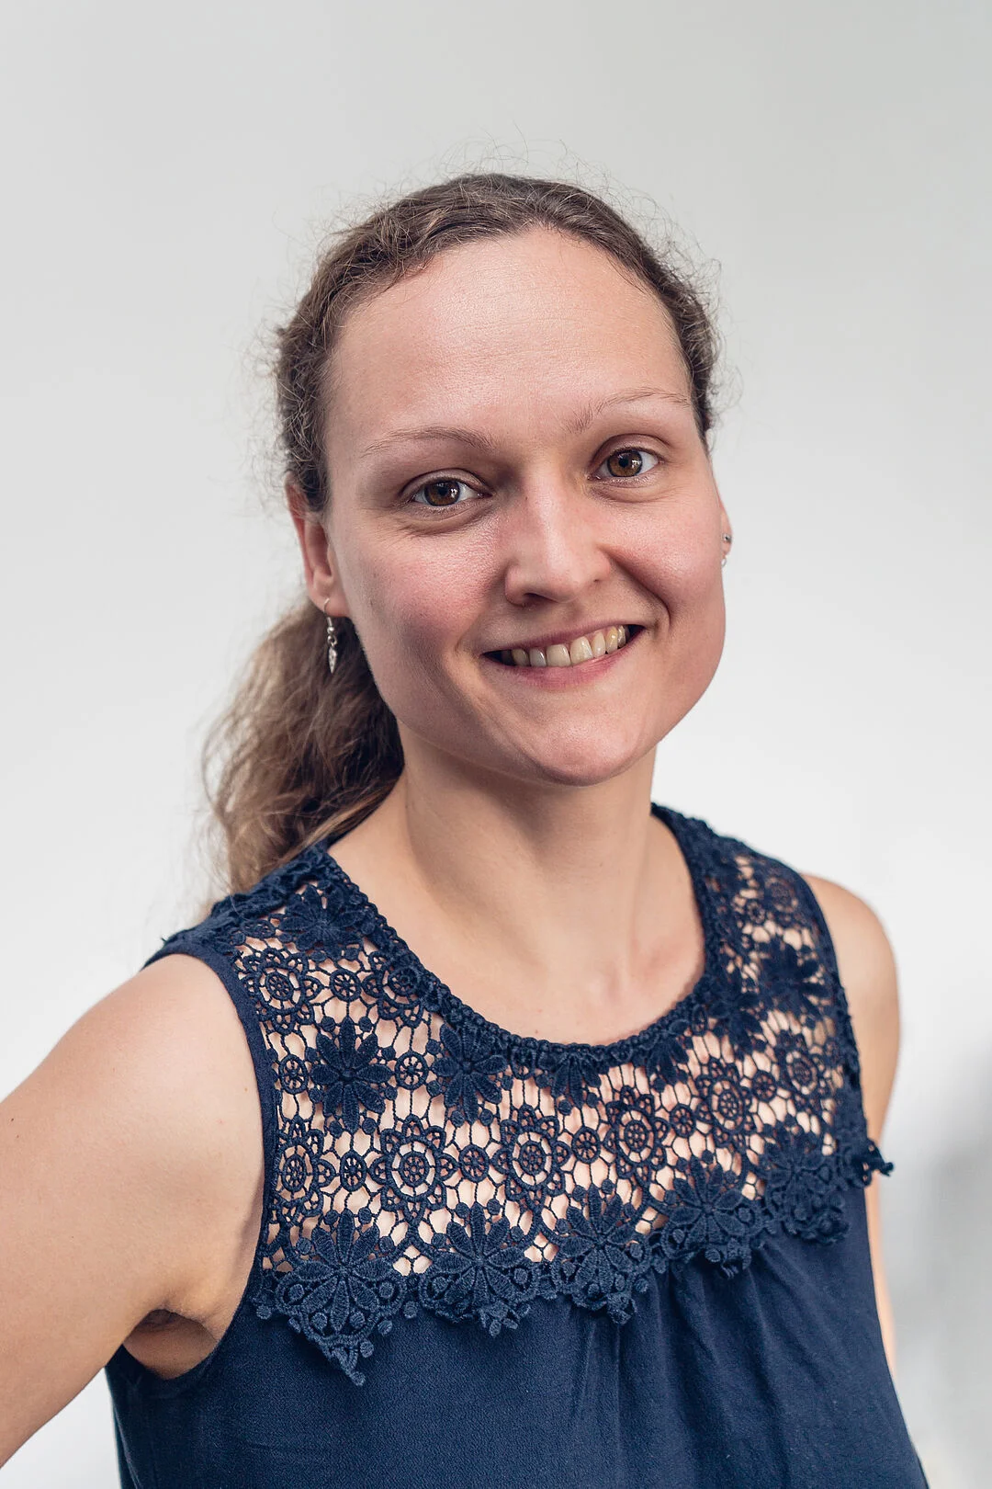

#4 Faculty IV - Team Awareness and Antidiscrimination
https://www.tu.berlin/eecs/awan
Goal: Low-barrier approachability for spectrum of awareness and antidiscrimination issues
Team
  Irene Hube-Achter (MTSV)
  Matthias Boehm (professors)
  Ceenu George (professors)
  Nadine Karsten (scientific staff)
  Maria Fleßner-Jung (mentoring)
  N.N. (students)
Mission Statement
  Account for heterogeneity and complexity of modern societies at TU Berlin
  #1 Treat all persons with fairness and respect
  #2 Ensure a safe environment for all
  #3 Comply with our duty of care towards others
  #4 Actively support the implementation of the above guidelines and contribute
Contact: private email,
eecs-TB-awareness@win.tu-berlin.de,
or AwAn@dams.tu-berlin.de
Notes:
All employees and students are committed to

Slide 4
Agenda
Data Management Group(s)
Course Motivation, Goals, and Outline
Course Organization and Logistics
History of Data Management

Slide 5
Data Management Group(s)

Slide 6




About Me
Since 09/2022 TU Berlin, Germany
  University professor for Big Data Engineering (DAMS)
2018-2022 TU Graz, Austria
  BMK endowed chair for data management + research area manager
  Data management for data science (DAMS), SystemDS & DAPHNE
2012-2018 IBM Research – Almaden, CA, USA
  Declarative large-scale machine learning
  Optimizer and runtime of Apache SystemML
2007-2011 PhD TU Dresden, Germany
  Cost-based optimization of integration flows
  Time series forecasting / in-memory indexing & query processing
DB group

Slide 7
FG Big Data Engineering (DAMS Lab) – Teaching
Successfully Established TUB Teaching Portfolio (modules, slides)
Architecture of
Database Systems
(ADBS, WS)
DB system internals
+ prog. project
Architecture of
ML Systems
(AMLS, SoSe)
ML system internals,
data science lifecycle
+ prog. project
PR Project
ML Systems
(PMLS, WiSe)
Architecture of
ML Systems
(AMLS, SS)
SE Joint ML and DM (MLDM, SoSe+WiSe)
Master
Data Integration and Large-Scale Analysis
(DIA, WS)
Data Integration and Large-Scale Analysis
(DIA, WiSe)
Distributed
Data Management
SE/PR Large-scale Data Engineering
(LDE, SoSe+WiSe)
Bachelor
Intro to Scientific Methods (WS)
Data Management and Systems
(DMS, WiSe)
Data Management / Databases
(DM, SS+WS)
Data management from user/application perspective
PP Prog.-Practicals Data Systems
(PPDS, SoSe+WiSe)

Slide 8
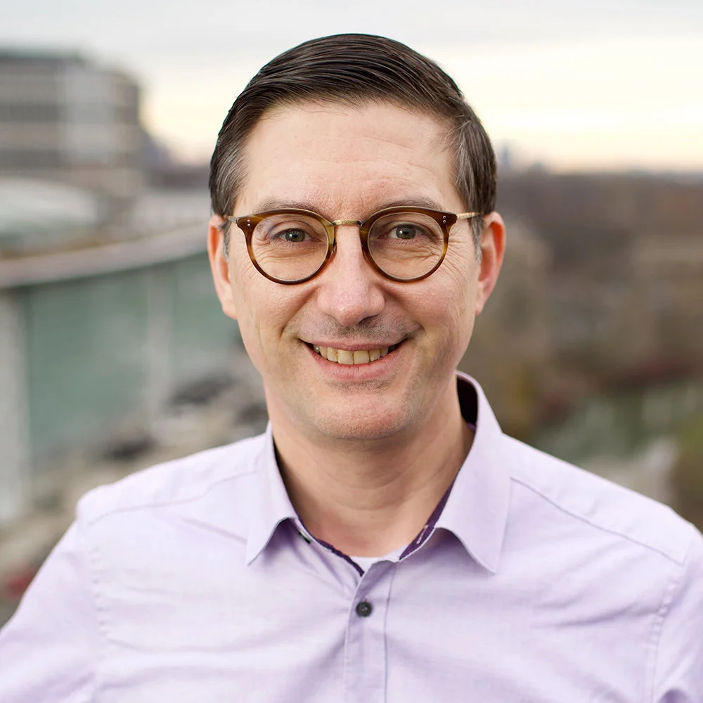
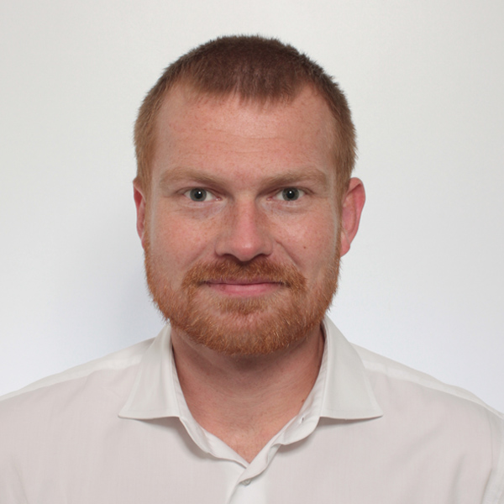
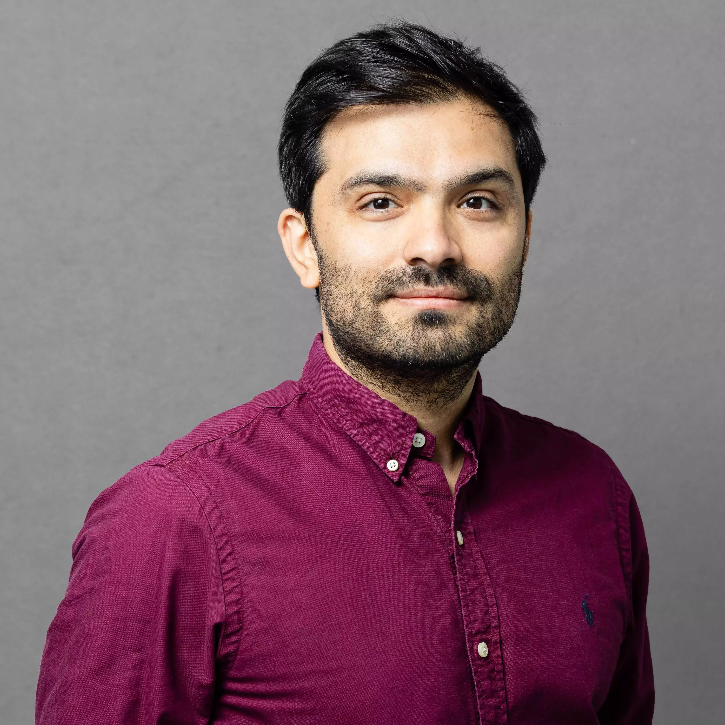

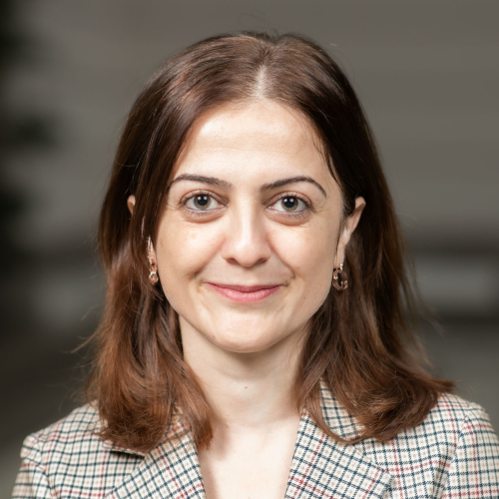
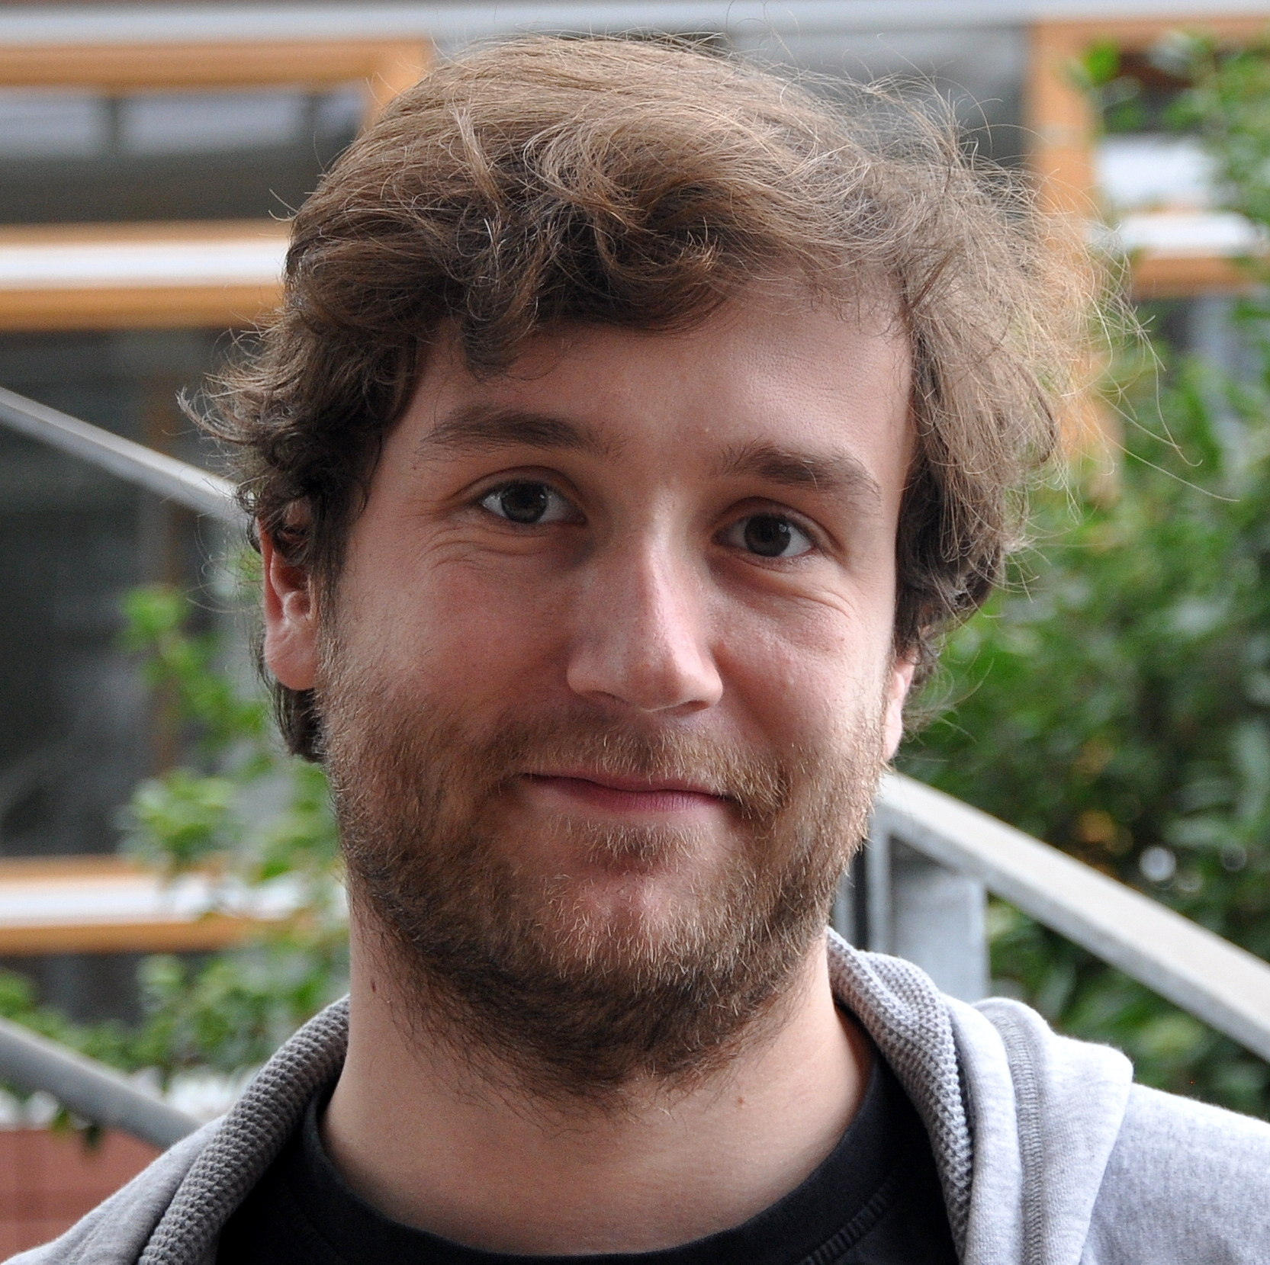
BIFOLD Data Management Groups
DIMA (Database Systems and Information Management)
Prof Dr. Volker Markl
DAMS (Big Data Engineering)
Prof. Dr. Matthias Boehm
D2IP (Information Integration and Data Preparation)
Prof. Dr. Ziawach Abedjan
DEEM (Data Engineering for Machine Learning)
Prof. Dr. Sebastian Schelter
RSiM (Big Data Analytics for Earth Observation)
Prof. Dr. Begüm Demir
IoT (Distributed Stream Processing in Heterogeneous Environments)
Dr. Steffen Zeuch

Slide 9
Course Motivation, Goals, and Outline

Slide 10
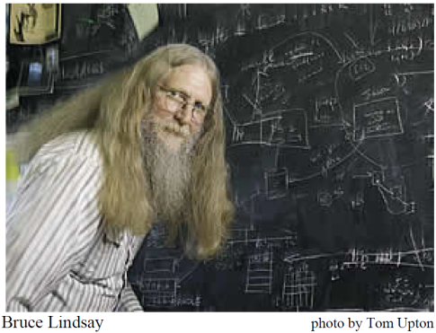
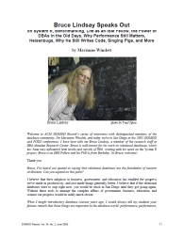
Definition and Impact
User 2
User 1
User 3
Def: Database System
  Overall system of DBMS + DBs
  DBMS: Database Management
  System (SW to handle DBs)
  DBs: Database (data/metadata
  collection of conceptual mini-world)
  Note: DB also a short for DBS/DBMS
  Data System: broader term for database systems
Importance in Practice
  Market Volume: 100-250B $US
  Foundation of
  many applications
  in various domains
DBS
DBMS
DBs
[Marianne Winslett: Bruce Lindsay speaks out: […]. SIGMOD Record 34(2), 2005]
“Relational databases
are the foundation of western civilization”
Notes:
2023: 100B -> 2030: 250 projected

Slide 11
Motivation Database Systems
Application development and maintenance costs
  Declarative queries (what not how) and data independence
  Efficient, correct, and independent data organization, size, access
Multi-user operations and access control
  Synchronization of concurrent user queries and updates
  Enforce access control (e.g., permissions on tables, views)
Consistency and data integrity
  Eliminates redundancy and thus, enforces consistency
  Enforces integrity constraints (e.g., semantic rules)
Logging and Recovery
  Recovery of consistent state after HW or SW failure
Performance and Scalability
  High performance for large datasets (with low resource req.) or high transaction throughput

Slide 12
Goals
Course Goals
  A: Understanding of database systems (from user perspective)
  B: Understanding of modern data management (from user perspective)
  C: Insights into internals of data systems → deeper understanding of algorithms & data structures, computer organization & distributed systems, foundations of programming paradigms, and logic & discrete structures
Meta Goals
  Understand, use, debug, and evaluate data management systems
  Awareness of system alternatives and their tradeoffs
  Fundamental concepts as basis for advanced courses and other areas
➔ How: (1) from basics to modern data systems, (2) practical skills, (3) breadth and depth

Slide 13
Outline: Part A (Relational) Database Systems
01 Introduction and Overview [Oct 13]
02 Data Modeling I [Oct 20]
03 Data Modeling II and Normalization [Oct 27]
04 Relational Algebra [Nov 03]
05 Query Languages I (SQL, XML, JSON) [Nov 10]
06 Query Languages II and APIs [Nov 17]
07 Physical Design and Tuning [Nov 24]
08 Query Processing and Optimization [Dec 01]
09 Transaction Processing and Concurrency [Dec 08]
Exercise 1:
Database Creation
[Nov 11 – Dec 01]
Exercise 2: Queries
[Nov 25 – Dec 15]

Slide 14
Outline: Part B: Modern Data Management (Systems)
10 Arrays and Vector Processing [Dec 15]
11 NoSQL (key-value, document, graph processing) [Jan 05]
12 Time Series Databases and Analytics [Jan 12]
13 Distributed Storage and Data Analysis [Jan 19]
14 Data Stream Processing Systems [Jan 26]
15 Q&A and Exam Preparation [Feb 02]
Exercise 3: Vector DBs
[Dec 16 – Jan 21]

Slide 15
Course Organization

Slide 16





Basic Course Organization
Staff
  Lecturer: Prof. Dr. Matthias Boehm (DAMS)
  Teaching Assistants
    Gereon Dusella (DIMA)
    David Justen (DAMS)
    Leonardo Dominici (DEEM)
    Philipp Ortner (DAMS, backup)
  Student Teaching Assistants: Vincent Johannes Kaulich, Sebastian Alberto Rodriguez Schmidt
Language
  Lectures and slides: English
  Communication and examination: English/German
Course Format
  DMS lecture + exercise 2/2 (3+3 ECTS)
  Weekly lectures (start 4.15pm, including Q&A), attendance optional
  Weekly tutorials (3x, start Oct 20)
previous ISDA TAs

Slide 17

Course Logistics
Communication
  Informal language (first name is fine)
  Please, immediate feedback (unclear content, missing background)
  ISIS Q&A forum, and email for private matters
  Office hour: separately announced before exercise submission
Exercises
  Written and programming exercises, submitted/graded through ISIS; completed if >75% each
  Deadlines are important (at most 7 late days in total)
  Individual assignments (academic honesty / no plagiarism, incl GenAI)
Website
  https://mboehm7.github.io/teaching/ws2627_dms/index.htm
Exams
  Feb 22, 2026, 3pm (first) and Mar 24, 2026, 2pm (second); laptop in-presence w/o private devices/materials

Slide 18
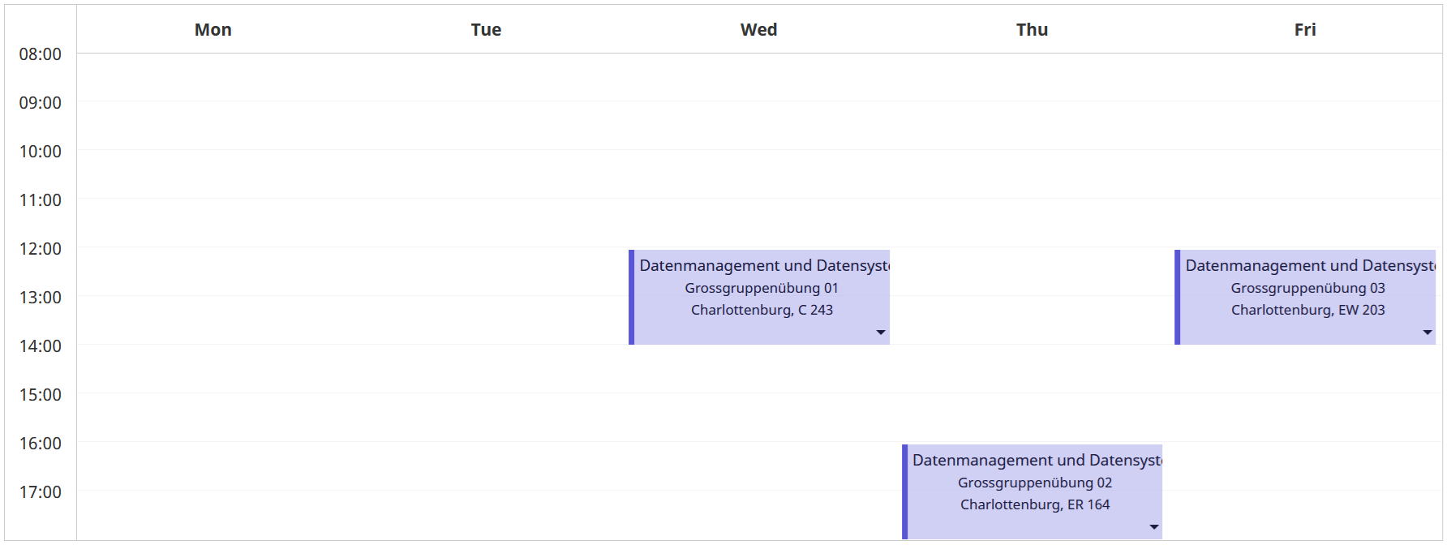
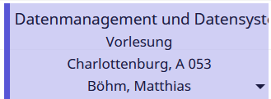
For tutorials: sign-up for the tutorials
in MOSES by Oct 14 6pm
Timetable Lectures / Tutorials

Slide 19
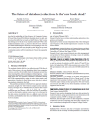
Literature
Not needed for lectures / exercises (course is self-contained), but second perspective
Raghu Ramakrishnan, Johannes Gehrke: Database Management Systems
(3. ed.). McGraw-Hill 2003, ISBN 978-0-07-115110-8, pp. I-XXXII, 1-1065
Jeffrey D. Ullman, Jennifer Widom: A first course in database systems
(2. ed.). Prentice Hall 2002, ISBN 978-0-13-035300-9, pp. I-XVI, 1-511
Ramez Elmasri, Shamkant B. Navathe: Fundamentals of Database Systems,
3rd Edition. Addison-Wesley-Longman 2000, ISBN 978-0-8053-1755-8, pp. I-XXVII, 1-955
Alfons Kemper, André Eickler: Datenbanksysteme - Eine Einführung,
10. Auflage. De Gruyter Studium, de Gruyter Oldenbourg 2015,
ISBN 978-3-11-044375-2, pp. 1-879
[Zachary G. Ives, Rachel Pottinger, Arun Kumar, Johannes Gehrke, Jana Giceva: The future of data(base) education: Is the "cow book" dead?, VLDB 2021]
Additional Perspective:

Slide 20
History of Data Management

Slide 21
History 1960/70s (pre-relational)
Hierarchical Model
  Tree of records
  E.g., IBM Information Management System
  (IMS) – IMS 15 (Oct 2017)
Network Model
  CODASYL (COBOL, DB interfaces)
  Graph of records
  Charles Bachman (Turing Award ‘73)
  E.g., Integrated Data Store (IDS)
Pros and Cons (see NoSQL Doc-Stores)
  Performance by directly traversing static links
  Duplicates → inconsistencies on updates, data dependence
Dep
Cust
Emp
Mgr
Parts
Ordr
Parts
Mgr
Dep
Cust
Emp
Ordr
CODASYL: Conference on Data Systems Languages
COBOL: Common Business Oriented Language
Parts

Slide 22
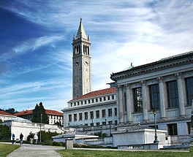
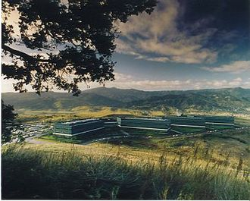
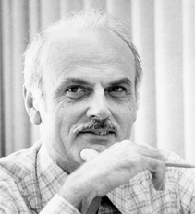
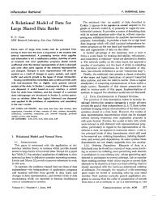
SQL Standard
(SQL-86)
Oracle, IBM DB2, Informix, Sybase → MS SQL
History 1970/1980s (relational)
SEQUEL
QUEL
System R @ IBM Research – Almaden
(Jim Gray et al.,
Turing Award ‘98)
Ingres @ UC Berkeley (Stonebraker et al.,
Turing Award ‘14)
Tuple Calculus
Relational Algebra
Relational Model
Edgar F. “Ted” Codd @ IBM
Research (Turing Award ‘81)
Goal: Data Independence
(physical data independence)
  Ordering Dependence
  Indexing Dependence
  Access Path Dependence
[E. F. Codd: A Relational Model of Data for Large Shared Data Banks.
Comm. ACM 13(6), 1970]

Slide 23
Success of SQL / Relational Model
#1 Declarative: what not how
#2 Flexibility:
closure property → composability
Query:
SELECT O_OID, sum(L_Price)
FROM Orders, Lineitem, Customer
WHERE O_OID = L_OID AND O_CID = C_CID
AND O_Odate >= ‘2018-11-14’
AND C_Msegment = ‘AUTOMOBILE’
GROUP BY O_OID
Logical Query Plans
C(P)=1.32M
C(P)=2.2G
C(P)=0.34M
Physical Query Plan
Γ
sum(Price)
Hash
GrpJoin
Γ
Γ
0.001
σ
>=2018-11-14
⋈
⋈
#4 Physical Data
Independence
0.2
σ
Hash
Join
TScan L
⋈
L
⋈
σ
AUTOMOBILE
⋈
σ
σ
σ
L
C
σ
⋈
10K
IXScan
O
C
O
C
O
Date
TScan C
O
1G
L
#3 Automatic Optimization
100M

Slide 24
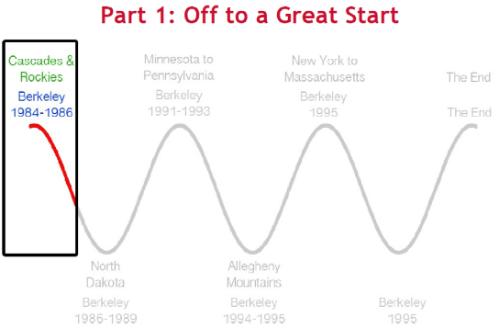
Excursus: PostgreSQL
History of PostgreSQL (used in examples/exercises)
  Postgres is the successor project of commercialized Ingres
  Focus on abstract data types, commercialized as Illustra
  Prototype w/ SQL open sourced as Postgres95 → PostgreSQL
  Heavily used as basis for research projects / startups
Recommended Reading
  Michael Stonebraker: The land sharks are on the squawk box.
  Commun. ACM 59(2): 74-83 (2016), Turing Award Lecture, https://dl.acm.org/citation.cfm?doid=2886013.2869958
  Video: http://www.youtube.com/watch?v=sEPTZVGk3WY
  Slides: http://vldb.org/2015/wp-content/uploads/2015/09/stonebraker.pdf

Slide 25
History 1980/90/2000s
OLTP … Online Transaction Processing
OLAP … Online Analytical Processing
ETL … Extract, Transform, Load
Enterprise DBMS
  Heavy investment in research and development ➔ adoption
  Oracle, IBM DB2, Informix, Sybase, MS SQL, PostgreSQL, MySQL
  Other technologies: OODBMS, Multimedia, Spatiotemporal, Web, XML
Information/Data Warehousing (DWH)
  Workload separation into OLTP and OLAP
  Classical DWH architecture: operational,
  staging, DWH, data marts + mining
  ETL Process (Extract, Transform, Load)
Different Personas
  Domain Experts (e.g., BI Tools, SAP R/3)
  DB Application Developers (e.g., ABAP)
  DB Developers and DB Admins
DWH
analytical
ETL
DSS
SCM, MM, ERP, CRM
transactional
SQL

Slide 26
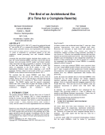
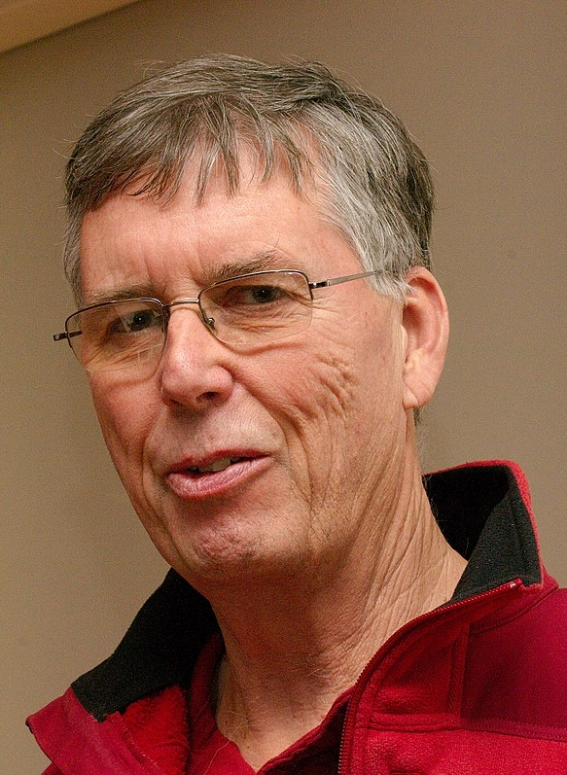
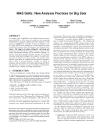
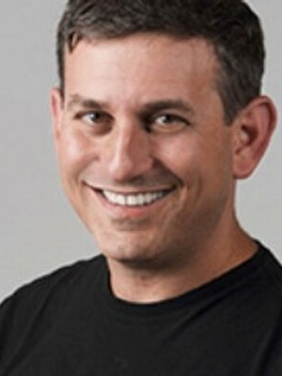

History 2000s / Early 2010s
Specialized Systems
  Column stores + compression for OLAP
  Main memory systems for OLTP and OLAP
  Data streaming, scientific and graph databases
  Information extraction / retrieval, and XML
Other Research Trends
  Approximate QP / Adaptive QP / tuning tools
  Large-scale data management (DFS, MR) / cloud computing
Toward Flexible, Large-Scale Data Management
(DWH … a bygone era)
  MAD Skills (magnetic, agile, deep), MADlib
  Integration of R, Python in data analysis
  Open data and its integration, query processing over raw (open) data formats
[M. Stonebraker, S. Madden, D. J. Abadi, S. Harizopoulos, N. Hachem, P. Helland: The End of an Architectural Era (It's Time for a Complete Rewrite). VLDB 2007]
[J. Cohen, B. Dolan, M. Dunlap, J. M. Hellerstein, C. Welton: MAD Skills: New Analysis Practices for Big Data. PVLDB 2(2) 2009]

Slide 27
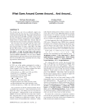
History 2010s – Present
Two Key Drivers of DB Research
  New analysis workloads (NLP, key/value, RDF/graphs,
  documents, time series, ML) and applications
  New HW/infrastructure (multi-/many-core, cloud, scale-up/
  scale-out, NUMA/HBM, RDMA, SSD/NVM, FPGA/GPU/ASIC)
Excursus: A retrospective view of specialized systems
  Goal #1: Avoid boundary crossing ➔ General-purpose
  Goal #2: New workload + Performance ➔ Specialized systems
  Some Examples
New Workloads
DBMS
New HW/Env
RDF/
graphs
MR/Spark
NLP
OODBMS
XML
Docs
OLAP
Time
ML Sys
[Michael Stonebraker, Andrew Pavlo: What Goes Around Comes Around... And Around... SIGMOD Rec. 2024.]
RDBMS
OR
Hybrid
JSON Datatype
HTAP
SQL on Hadoop
In-DB alternatives
Notes:
Stonebraker: made a similar case, and mentioned that vector DBs are integrated too – existing DBMS show respective features, and ANN indexes alone are not the foundation of new system

Slide 28
History 2010s – Present, cont.
Motivation NoSQL Systems
  Flexible schema (no upfront costs), scalability, or specific data types
  Relaxed ACID (atomicity, consistency, isolation, durability) requirements
  ➔ BASE (basically available, soft state, eventual consistency)
Example NoSQL Systems (local and distributed):
  Key/Value-Stores: simple put/get/delete, massive scalability
  Document-Stores: store nested documents (tree)
  RDF Stores: store subject-predicate-object triples
  Graph DBs: store nodes/edges/attributes, vertex-centric
  Time Series DBs: store sequences of observations
  Vector DBs: store vector embeddings of different modalities, similarity search

Slide 29
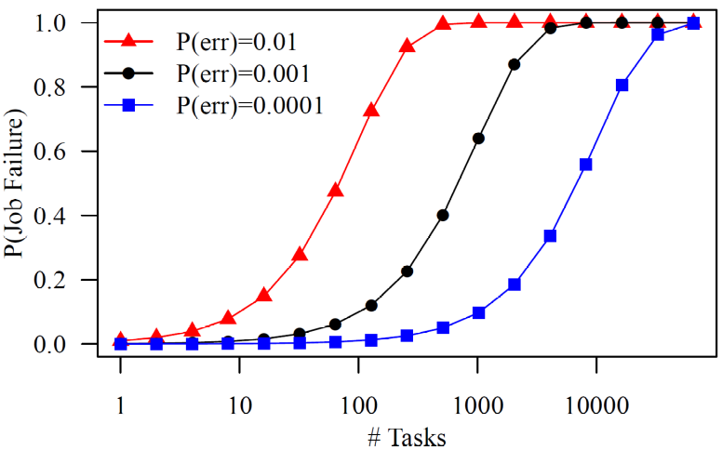
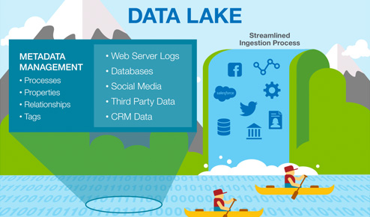
History 2010s – Present, cont.
Motivation Large-Scale Data Management
  Massive scalability (data/compute) on demand,
  cost effective fault tolerance, flexibility
  Example Facebook 2014:
  300PB DWH, 600TB daily ingest
  Cost-effective commodity hardware
  Error rate increases with increasing scale
Examples Large-Scale Data Management
  Distributed file systems w/ replication (e.g., GPFS, HDFS)
  Cloud object storage (e.g., Amazon s3, OpenStack Swift)
  Data-parallel data analysis with Spark/Flink, incl streaming
  Automatic cloud resource elasticity (pay as you go)
Data Lake
Audio, Image, Video, Text, Streams, Logs

Slide 30
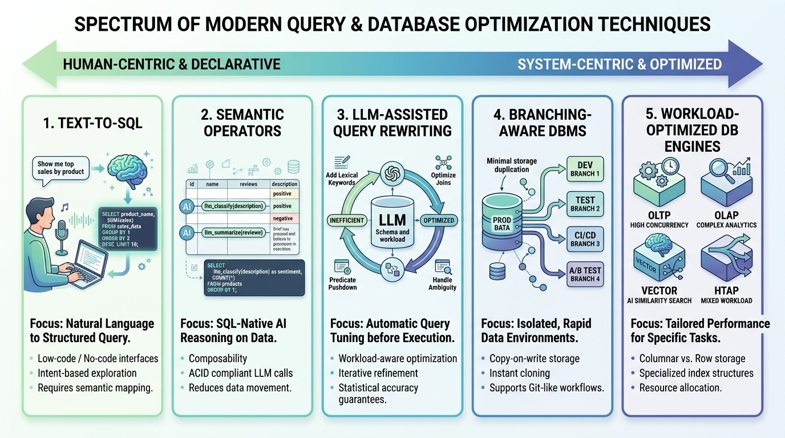
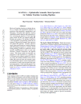
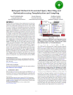
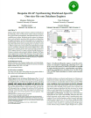
History 2020s – Present
New Trends w/ Large
Language Models (LLMs),
GenAI, and Coding Agents
[Generated with Gemini 3.1 Pro]
[Olga Ovcharenko, Matthias Boehm, Sebastian Schelter: SemPipes - Optimizable Semantic Data Operators for Tabular Machine Learning Pipelines. arxiv, under submission 2026]
[Johannes Wehrstein, Timo Eckmann, Matthias Jasny, Carsten Binnig: Bespoke OLAP: Synthesizing Workload-Specific One-size-fits-one Database Engines. PVLDB 2026]
[Saeed Fathollahzadeh, Essam Mansour, Matthias Boehm: ReSequel: Robust LLM-assisted Query Rewriting and Optimization using Templatization and Sampling. PVLDB 2026]
Notes:
Note: European AI Act, Article 50 – declaration of generated/modified content, since Aug 02, 2026

Slide 31
Summary and Q&A
#1 Database Systems
  Mature and established technology ➔ broadly applicable & eco system
  General concepts: abstraction, data modeling, query optimization & processing,
  transaction processing and recovery, physical design and tuning
#2 Modern Data Management
  Multiple specialized systems for specific scale / data types
  General trend toward less upfront cost, flexibility, and higher scalability
➔ Variety of data management tools → Course meta goals
  Understand, use, debug, and evaluate data management systems
  Fundamental concepts as basis for advanced courses and other areas
Next Lectures
  02 Data Modeling I [Oct 20] (ER Diagrams)
  03 Data Modeling II and Normalization [Oct 27] (ERD → Relational Model)

