Slide 1

Data Management and Systems (DMS)
Data Modeling I – Conceptual Design
Prof. Dr. Matthias Boehm
Technische Universität Berlin
Berlin Institute for the Foundations of Learning and Data
Big Data Engineering (DAMS Lab)
Last update: Oct 20, 2026

Slide 2

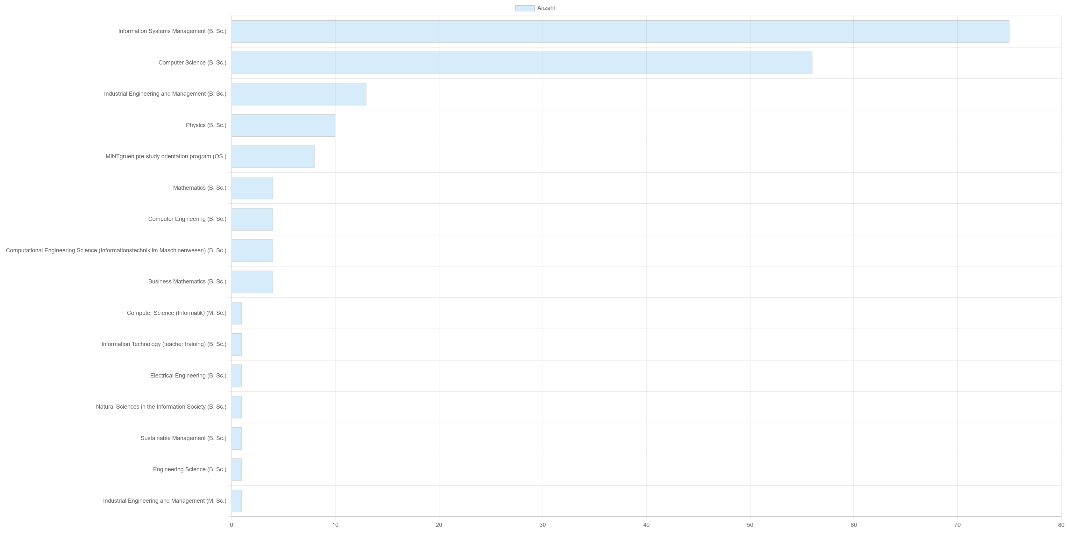
Announcements / Org
#1 Hybrid & Video Recording
  Hybrid lectures (in-person, zoom) with optional attendance
  https://tu-berlin.zoom.us/j/9529634787?pwd=R1ZsN1M3SC9BOU1OcFdmem9zT202UT09
  Zoom video recordings, links from website
  https://mboehm7.github.io/teaching/ws2627_dms/index.htm
#2 Course Registrations
  TU Berlin ISIS registrations as of Oct 18
#3 Other Administrative Questions
  Tutorial registrations by Oct 14 → 184, majority in ISM/CS
  Equivalence of ISDA w/ and w/o attempts → rules in progress
  Hybrid format of tutorials?
~270
Notes:
ISM, CS, IEM, Physics, MINGgruen

Slide 3

Agenda
DB Design Lifecycle
ER Model and Diagrams
[Credit: Alfons Kemper, André Eickler: Datenbanksysteme - Eine Einführung, 10. Auflage. De Gruyter Studium, de Gruyter Oldenbourg 2015, ISBN 978-3-11-044375-2, pp. 1-879]

Slide 4
Database Design Lifecycle

Slide 5
Data Modeling
Data Model
  Concepts for describing data objects and their relationships (meta model)
  Schema: Description (structure, semantics)
  of specific data collection
Discourse of real mini world
Lecture 02
Manual Modeling
Conceptual Schema
(ER diagram)
Semi-automatic Transformation
Lecture 03
Relational Schema
XML
Schema
Network Schema
Object-ori.
Schema

Slide 6
Data Models
Conceptual Data Models
  Entity-Relationship Model (ERM), focus on data, ~1975
  Unified Modeling Language (UML), focus on data and behavior, ~1990
Logical Data Models
  Relational (Object/Relational)
  Key-Value
  Document (XML, JSON)
  Graph
  Time Series
  Vector/Matrix/Tensor
  Object-oriented
  Network
  Hierarchical
Partly covered
in part B
Mostly obsolete
Notes:
UML: class diagrams, Data Model Profiles (conceptual, logical and physical)

Slide 7

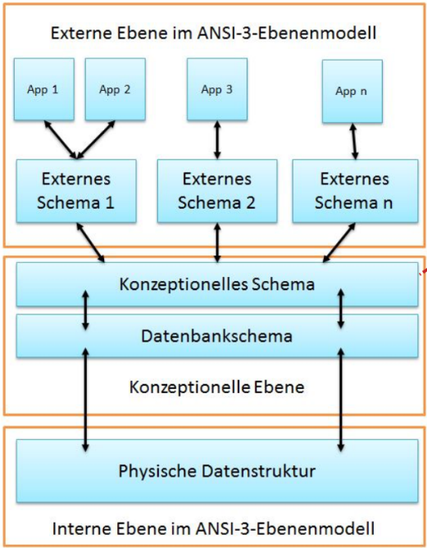
Employee DB
DB Design Lifecycle Phases
#1 Requirements engineering
  Collect and analyze data and application requirements
  ➔ Specification documents
#2 Conceptual Design (lecture 02, exercise 1 / tutorials)
  Model data semantics and structure, independent of logical data model
  ➔ ER model / diagram
#3 Logical Design (lecture 03, exercise 1 / tutorials)
  Model data with implementation primitives of concrete data model
  ➔ e.g., relational schema + integrity constraints, views, permissions, etc
#4 Physical Design (lecture 07, tutorials)
  Model user-level data organization in a specific DBMS (and data model)
  Account for deployment environment and performance requirements

Slide 8
Relevance in Practice
Analogy ERM-UML
  Model-driven development (self-documenting, but quickly outdated)
  But: Once data is loaded, data model and schema harder to change
Observation: Full-fledged ER modeling rarely used in practice
  Often the logical schema (relational schema) is directly created,
  maintained and used for documentation
  Reasons: redundancy, indirection, single target (relational)
  Simplified ER modeling used for brainstorming and early ideas
Goals
  Understanding of proper database design from conceptual to physical schema
  ER modeling as a helpful tool in database design
  Schema transformation and normalization as blueprint for good designs

Slide 9
Tool Support
#1 Visual Design Tools
  Draw ER diagrams in any presentation software (e.g., MS PowerPoint, LibreOffice)
  Many desktop or web-based tools support ER diagrams directly (e.g., MS Visio, creately.com, drawio.com)
#2 Design Tools w/ Code Generation
  Draw and validate ER diagrams
  Generate relational schemas as SQL DDL scripts
  Examples: SAP (Sybase) PowerDesigner, MS Visual Studio plugins (SQL server), IDE plugins etc.
➔ Note: For the exercises/tutorials, please use basic drawing tools / existing ISIS integration
(existing tools use slightly diverging notations)

Slide 10
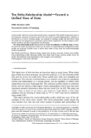

Entity-Relationship (ER) Model and Diagrams
[Peter P. Chen: The Entity-Relationship Model - Toward a Unified View of Data. ACM Trans. Database Syst. 1(1) 1976]
[Peter P. Chen: The Entity-Relationship Model: Toward a Unified View of Data. VLDB 1975]
Note: ER 2026 conference (45th International Conference on Conceptual Modeling)
Notes:
ER’26 in St. Johns Canada

Slide 11

ER Diagram Components (Chen Notation)
Weak entities
Entity Type (noun)
  Entities are objects of the real world
  An entity type (or entity set) represents a collection of entities
Relationship Type (verb)
  Relationships are concrete associations of entities
  Relationship type (or relationship set)
  or relationship of entity types
Attribute
  Entities or relationships are characterized by attribute-value pairs
  Attribute types (or value sets) describe entity and relationship types
  Extended attributes: composite, multi-valued, derived
Employee
works in
$$works⊆A×B$$
Multi-valued
attributes
First Name

Slide 12
ER Diagram Components (Chen Notation), cont.
Keys
  Attributes that uniquely identify an entity
  Every entity type must have such a key
  Natural or surrogate (artificial) keys
Role
  Optional description of relationship types
  Useful for recursive relationships
EmpID
employed
works in
employs

Slide 13
[Peter P. Chen: The Entity-Relationship Model - Toward a Unified View of Data. ACM Trans. Database Syst. 1(1) 1976]
An EmployeeDB Example
Name
Department
Name
Dept-Emp
Percentage
Start
End
EmpID
works
in
First Name
Employee
Project
manage
Last Name
DoB

Slide 14
E1
R
E2
Multiplicity/Cardinality –
Chen Notation
…
…
R ⊆ E1×E2
1:1 (one-to-one)
  Each e1 relates to at most one e2
  Each e2 relates to at most one e1
1:N (one-to-many)
  Each e1 relates to many e2 (0,1,…N)
  Each e2 relates to at most one e1
N:1 (many-to-one)
  Symmetric to 1:N
N:M (many-to-many)
  Each e1 relates to many e2 (0,1,…M)
  Each e2 related to many e1 (0,1,…N)
E1
E2
E1
E2
E1
E2
E1
E2
1 .. [0,1]
N ... [0,1,N]

Slide 15
[Peter P. Chen: The Entity-Relationship Model - Toward a Unified View of Data. ACM Trans. Database Syst. 1(1) 1976]
An EmployeeDB Example, cont.
Department
(an employee belongs to 1 department)
1
Dept-Emp
(a project is done by M employees)
(an employee can work on N projects)
(a department contains N employees)
works
in
N
M
N
Employee
Project
1
manage
N
(a project is managed by 1 employee)
(an employee can manage N projects)
Partial Function
Employee ↛ Department
Notes:
Partial function: every employee belongs to at most one department

Slide 16

Multiplicity/Cardinality – Modified Chen Notation
4 alternatives (1, C, M, MC)
→ 4*4 = 16 combinations
(symmetric combinations omitted)
Extension: C (“choice”/“can”) to model 0 or 1,
while 1 means exactly 1 and M means at least 1.
1:1 – [1] to [1]
1:C – [1] to [0 or 1]
1:M – [1] to [at least 1]
1:MC – [1] to [arbitrary many]
M:M – [at least 1] to [at least 1]
M:MC – [at least 1] to [arbitrary many]
MC:MC – [arbitrary many] to [arbitrary many]
→ see M:N in Chen
1 1 1 1
0 1 1 1
0 0 1 1
0 0 0 1
$$\frac{n⋅(n+1)}{2}=10$$
C:C – [0 or 1] to [0 or 1]
→ see 1:1 in Chen
C:M – [0 or 1] to [at least 1]
C:MC – [0 or 1] to [arbitrary many]
→ see 1:N in Chen

Slide 17
Multiplicity/Cardinality – (min,max)-Notation
Alternative Cardinality Notation
  Indicate concrete min/max constraints
  (each entity is part of at least/at most x relationships)
  Chen and (min,max) notation generally incomparable
  Wildcard * indicates arbitrary many (i.e., N)
Examples
(min₁,max₁)
(min₂,max₂)
E1
R
E2
(each department has
1 – 70 employees)
(each employee in exactly one department)
(1,70)
(1,1)
(0,*)
(0,1)
Department
Dept-Emp
Employee
Chen notation (for comparison)
1
N

Slide 18
Multiplicity/Cardinality – (min,max)-Notation, cont.
Problem: Where do these conflicting notations come from?
Understanding (min, max)-Notation
  Focus on relationships!
  Describes number of outgoing
  relationships for each entity
Understanding Chen- /
Modified-Chen-Notation
  Focus on entities!
  Describes number of target entities
  (over relationships) for each entity
(0,*)
(0,1)
E1
E2
1
N
E1
E2

Slide 19
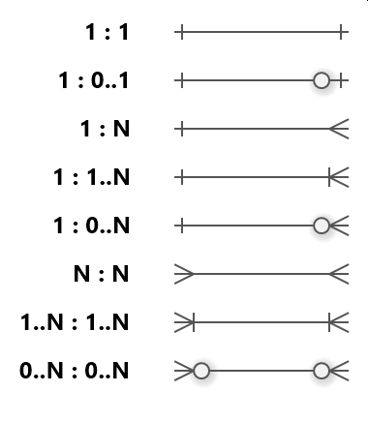
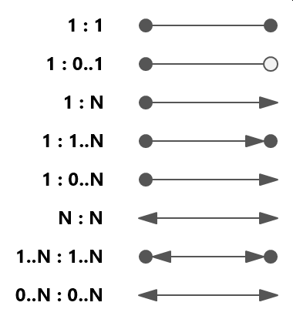
Multiplicity/Cardinality – Other Notations
#1 Crow’s Foot Notation
#2 Bachman Notation
(Bachman diagrams)
[Credit: https://www.softwareideas.net/erd-relation-arrows ]

Slide 20
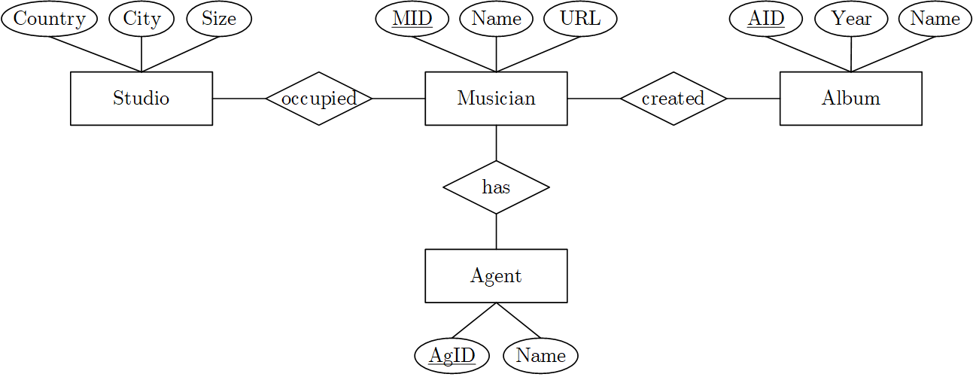
BREAK (and Test Yourself)
Task: Cardinalities in Modified-Chen Notation (prev. exam 6/100 points)
  A musician might have created none or arbitrary many albums,
  and any album is created by at least one musician.
  Every musician has exactly one agent, and an agent might be responsible for one to ten musicians.
  Every musician occupies exactly one studio, and musicians never share a studio.
Task: Cardinalities
in (min,max) Notation
(5/100 points)
1
C
M
MC
(0,1)
(1,1)
(0,*)
(1,*)
(1,1)
M
(1,10)
1

Slide 21
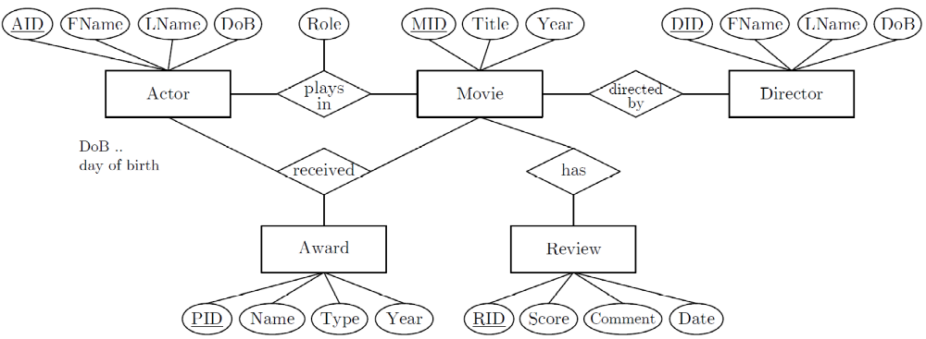
BREAK (and Test Yourself), cont.
Task: Cardinalities in Modified-Chen Notation (prev. exam 9/100 points)
  An actor may play roles in an arbitrary number of movies (incl. none),
  every movie has a cast of at least one but potentially many actors
  A movie is directed by 1 director, directors produce arbitrary many movies
  A movie review refers to 1
  movie, but there can be
  0-many reviews per movie
  Actors (incl a single actor)
  may receive multiple awards
  for a single movie. An actor
  can receive a specific award
  for only one movie.
  Awards to 1-many actors are possible.
M
MC
MC
1
M
1
1
MC
MC

Slide 22
Weak Entity Types
Existence Dependencies
  Entities E2 whose existence depends on the other entities E1
  Visualized as a special rectangle with double border
  Primary key of E2 contains primary key of E1
  Relationship between strong and weak entity types 1:N (sometimes 1:1)
Examples
  Dependents of an employee (spouse, children)
  Rooms of a building
Employee
1
dep.
Dependent

Slide 23
N-ary Relationships
Use of n-ary relationships
  Relationship type among multiple entity types
  N-ary relationship can be converted to binary relationships
  Design choice: simplicity and
  consistency constraints
Multiplicity
  1 Project and 1 Supplier → supply P parts
  1 Project and 1 Part → supplied by N suppliers (1 instead of N?)
  1 Supplier and 1 Part → supply for M projects
Supplier
N
Project
M
SPP
P
Part

Slide 24
Recursive Relationships
Definition
  Recursive relationships are relations between entities of the same type
  Use roles to differentiate cardinalities
Examples
Beware of [at least 1] constraints in recursive relationships
(e.g., (min,max)-notation, or MC notation)
parent
Part
n-ary possible
part
subpart
1
N
1
Person
M
N
comp.
1
1
married

Slide 25
[Peter P. Chen: The Entity-Relationship Model - Toward a Unified View of Data. ACM Trans. Database Syst. 1(1) 1976]
An EmployeeDB Example, cont.
Department
Supplier
1
N-ary
relationship type
N
Dept-Emp
SPP
M
P
N
works
in
M
N
Employee
Project
M
PP
N
Part
1
1
manage
N
M
N
Emp-Dep.
comp.
Recursive
relationship type
Dependent
Weak
entity type

Slide 26
Extended ER Diagrams: Specialization and Aggregation
Specialization via Subclasses
  Tree of specialized entity types
  (no multi-inheritance)
  Graphical symbol: triangle (or hexagon, or subset)
  Each entity of subclass is entity
  of superclass, but not vice versa
Aggregation (composition, not specialization)
  #1: Recursive relationship types, or
  #2: Explicit tree of entity and relationship types
  Design choice: number of types known
  and finite, and heterogeneous attributes
Beware: Simplicity is key
Employee
isa
Manager
Researcher
Admin
Car
Engine
Chassis
Frame
Wheel

Slide 27
Types of Attributes
First Name
Employee
Last Name
Atomic Attributes
  Basic, single-valued attributes
Composite Attributes
  Attributes as structured data types
  Can be represented as a hierarchy
Derived Attributes
  Attributes derived from other data
  Examples: Number of employees in dep,
  employee age, employee yearly salary
Multi-valued Attributes
  Attributes with list of homogeneous entries
DoB
First Name
Employee
Name
Last Name
DoB
Employee
Age
Employee
Phone

Slide 28

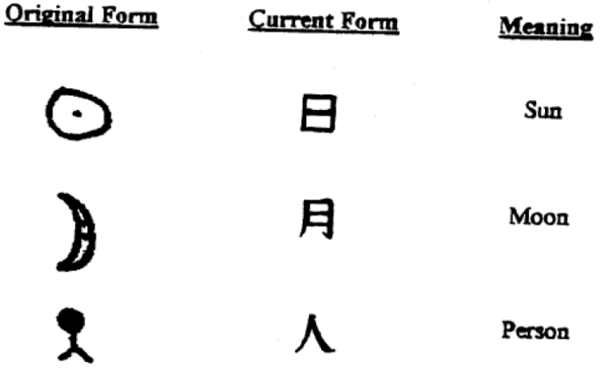

Excursus: Influence of Chinese Characters?
[Peter Pin-Shan Chen: Entity-Relationship Modeling: Historical Events, Future Trends, and Lessons Learned. Software Pioneers 2002]
“What does the Chinese character construction principles have
to do with ER modeling? The answer is: both Chinese characters
and the ER model are trying to model the world – trying to use
graphics to represent the entities in the real world. […]”
Chinese characters
representing real-world entities
Composition of two
Chinese characters

Slide 29
Avoid redundancy
Avoid unnecessary complexity
Design Decisions
Meta-Level:
  Which notations to use (Chen, Modified Chen, (min,max)-notation)?
Entities
  What are the entity types (entity vs relationship vs attribute)?
  What are the attributes of each entity type?
  What are key attributes (one or many)?
  What are weak entities (with partial keys)?
Relationships
  What are the relationship types between entities (binary, n-ary)?
  What are the attributes of each relationship type?
  What are the cardinalities?
Attributes
  What are composite, multi-valued, or derived attributes?

Slide 30
Design Decisions – Examples of Poor Choices
Name
#1 Overuse of weak entity types
#2 Redundant attributes
  Redundant supplier name in Part and Supplier
#3 Repeated information
  Missing person entity type
  → redundancy per purchase
#4 Unnecessary Complexity
  Unnecessary entity type Date
  Avoid single-attribute entity types
  unless in many relationships
Supplier
Name
Part
PS
Supplier
Address
Date
Product
buy
Store
Person Name
PersonAddress
Product
Store
buy
Person
Date
Date

Slide 31
A UniversityDB Example
Discourse of Real Mini World
  Students (with SID, name, and semester) attend courses (CID, title, ECTS),
  and take graded exams per course
  Professors teach courses and have positions, assistants work for professors
  A course may have another course as prerequisites
  Both professors and assistants are university employees (EID, name,
  and room number); professors also have a position
Task: Create an ER diagram in Chen notation
  Include entity types, relationship types, attributes, and generalizations
  Mark primary keys, roles for recursive relationships, and derived attributes

Slide 32
prereq.
A UniversityDB Example, cont.
is
req.
req.
M
N
SID
CID
Student
M
attend
N
Course
Name
Title
M
N
N
ECTS
Start
Grade
exam
teach
Semester
1
1
Assistant
N
work
1
Professor
Position
Name
EID
Employee
Room

Slide 33
Summary and Q&A
Summary
  DB Design lifecycle from requirements to physical design
  Entity-Relationship (ER) Model and Diagrams
Importance of Good Database Design
  Poor database design ➔ development and maintenance costs,
  as well as performance problems
  Once data is loaded, schema changes very difficult
  (data model, or conceptual and logical schema)
Next Lectures
  03 Data Modeling II and Normalization [Oct 27] (ERD → Relational Model)

