Slide 1

Programmierpraktikum: Datensysteme
01 Kickoff and Introduction
Prof. Dr. Matthias Boehm
Technische Universität Berlin
Berlin Institute for the Foundations of Learning and Data
Big Data Engineering (DAMS Lab)
Last update: Oct 04, 2026

Slide 2

Announcements / Org
#1 Hybrid & Video Recording
  Hybrid lectures (in-person, zoom) with optional attendance
  https://tu-berlin.zoom.us/j/9529634787?pwd=R1ZsN1M3SC9BOU1OcFdmem9zT202UT09
  Zoom video recordings, links from website
  https://mboehm7.github.io/teaching/ws2627_ppds/index.htm
#2 Course Registrations
  TU Berlin ISIS / Fak IV Meta registrations
  Bachelor/Master ratio? CS/WINF/others ratio?
31
~45

Slide 3


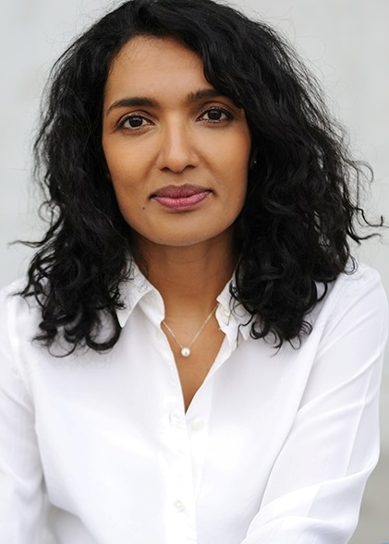
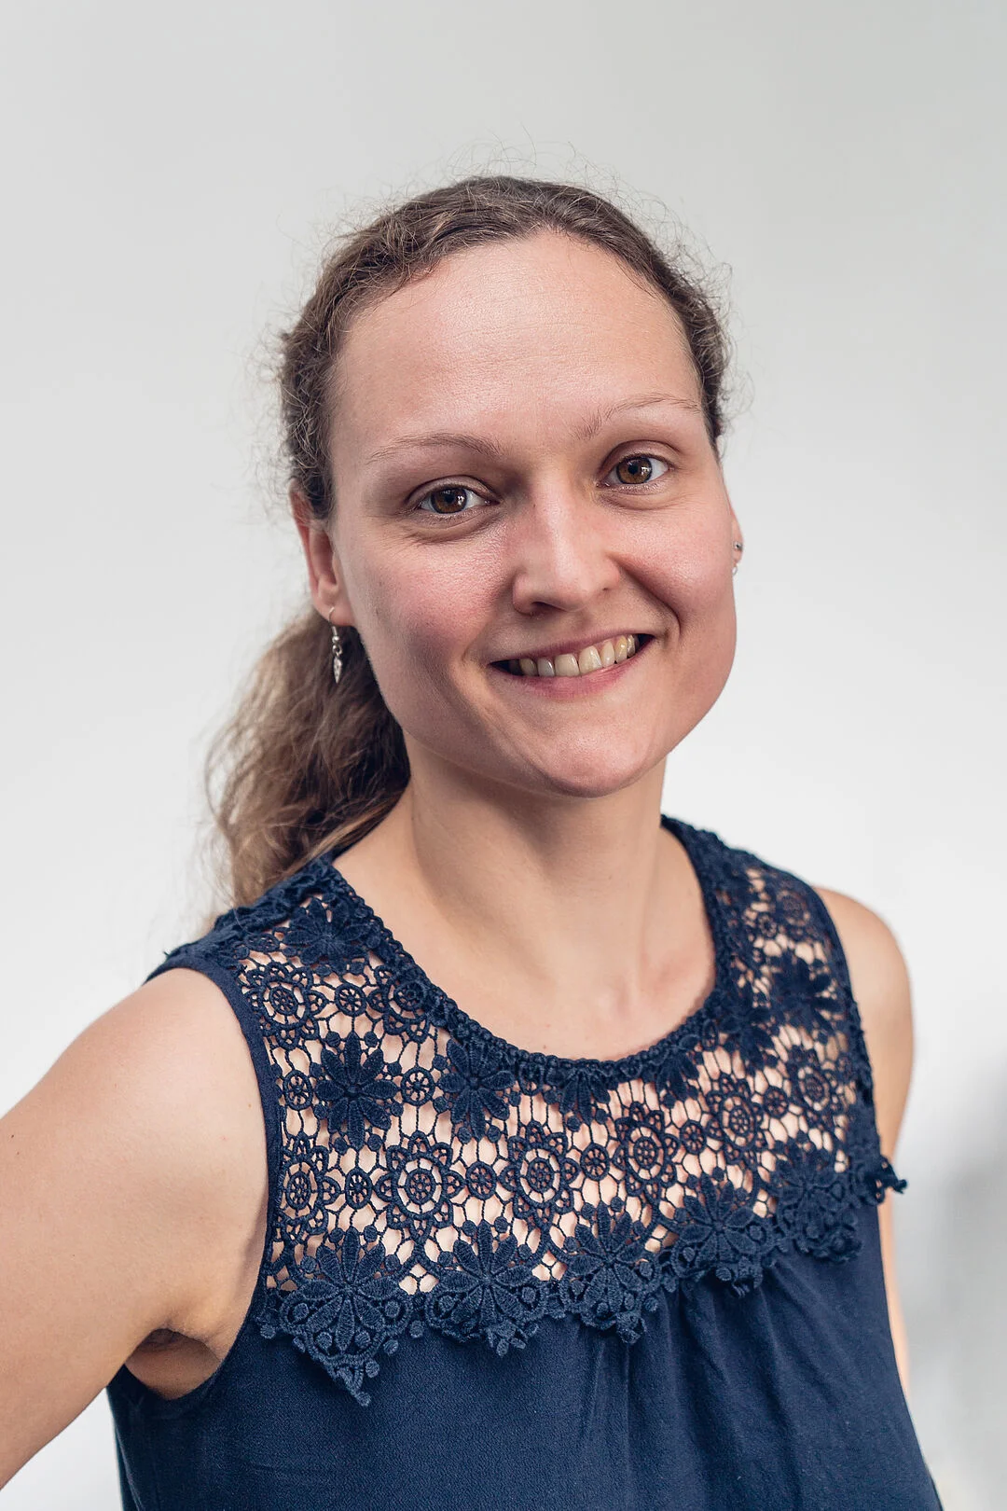

#3 Faculty IV - Team Awareness and Antidiscrimination
https://www.tu.berlin/eecs/awan
Goal
  Low-barrier approachability for spectrum of awareness and antidiscrimination issues
Team
  Irene Hube-Achter (MTSV)
  Matthias Boehm (professors)
  Ceenu George (professors)
  Nadine Karsten (scientific staff)
  Tom Hersperger (students)
Mission Statement
  Account for heterogeneity and complexity of modern societies at TU Berlin
  #1 Treat all persons with fairness and respect
  #2 Ensure a safe environment for all
  #3 Comply with our duty of care towards others
  #4 Actively support the implementation of the above guidelines and contribute
Contact: private email,
eecs-TB-awareness@win.tu-berlin.de,
or AwAn@dams.tu-berlin.de
Notes:
All employees and students are committed to

Slide 4
Agenda
Course Organization
#1 Transactional In-memory Indexing (DAMS)
#2 Duplicate Detection (D2IP)
#3 Provenance Tracking in ML Pipelines (DEEM)
#4 Fairness Auditing for ML Pipelines (DEEM)
Course Selection/Enrolment

Slide 5
Course Organization

Slide 6
Basic Course Organization
Language
  Lectures and slides: English (German if preferred)
  Communication and presentations: English/German
  Informal language (first name is fine)
  Offline Q&A in forum, answered by teaching assistants
Course Format
  6 ECTS (4 SWS) bachelor computer science / information systems
  Every-other-week lectures (Mon 4.15pm sharp, including Q&A), attendance optional
Prerequisites
  Basic programming skills in languages such as C, C++, Java, Rust, Python, etc
  Basic understanding of data management SQL / RA (or willingness to fill gaps)

Slide 7

Course Goals and Structure
Objectives
  Apply basic programming skills to more complex problem (in self-organized team work)
  Technical focus on data management and data systems
  Holistic programming projects: prototyping, design, versioning, tests, experiments, benchmarks
Grading: Pass/Fail
  Project Implementation (project source code) [45%]
  Component and Functional Tests (test source code) [10%]
  Runtime Experiments (achieve performance target) [15%]
  Documentation (design document up to 5 pages / code documentation) [15%]
  Result Presentation (10min talk) [15%]
Academic Honesty / No Plagiarism (incl LLMs like ChatGPT)

Slide 8
Sub-Course Offerings
#1 Efficient Join Pipeline Executor
  Capacity: 16/48
  Organized by DAMS group
  Focus on query processing
#2 Duplicate Detection
  Capacity: 16/48
  Organized by D2IP group
  Focus on entity resolution
#3 Provenance Tracking in ML Pipelines
#4 Fairness Auditing for ML Pipelines
  Capacity: 16/48
  Organized by DEEM group
  Focus on ML pipelines
➔ Admitted Students:
  31 + ~15 on ISIS (incl duplicates)
  Total registrations: up to 48

Slide 9
#1 Transactional In-memory Indexing (DAMS)

Slide 10




About Me
Since 09/2022 TU Berlin, Germany
  University professor for Big Data Engineering (DAMS)
2018-2022 TU Graz, Austria
  BMK endowed chair for data management + research area manager
  Data management for data science (DAMS), SystemDS & DAPHNE
2012-2018 IBM Research – Almaden, CA, USA
  Declarative large-scale machine learning
  Optimizer and runtime of Apache SystemML
2007-2011 PhD TU Dresden, Germany
  Cost-based optimization of integration flows
  Time series forecasting / in-memory indexing & query processing
DB group

Slide 11

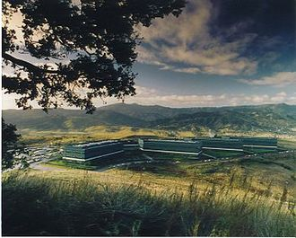
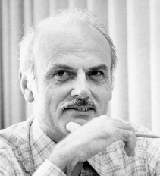
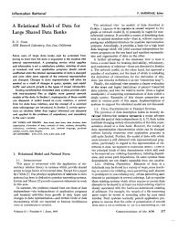
SQL Standard
(SQL-86)
Oracle, IBM DB2, Informix, Sybase → MS SQL
History 1970/1980s
Relational Database Systems
SEQUEL
QUEL
System R @ IBM Research – Almaden
(Jim Gray et al.,
Turing Award ‘98)
Ingres @ UC Berkeley (Stonebraker et al.,
Turing Award ‘14)
Tuple Calculus
Relational Algebra
Relational Model
Edgar F. “Ted” Codd @ IBM
Research (Turing Award ‘81)
Goal: Data Independence
(physical data independence)
  Ordering Dependence
  Indexing Dependence
  Access Path Dependence
[E. F. Codd: A Relational Model of Data for Large Shared Data Banks.
Comm. ACM 13(6), 1970]

Slide 12
Success of SQL / Relational Model
#1 Declarative: what not how
#2 Flexibility:
closure property → composability
Query:
SELECT O_OID, sum(L_Price)
FROM Orders, Lineitem, Customer
WHERE O_OID = L_OID AND O_CID = C_CID
AND O_Odate >= ‘2018-11-14’
AND C_Msegment = ‘AUTOMOBILE’
GROUP BY O_OID
Logical Query Plans
C(P)=1.32M
C(P)=2.2G
C(P)=0.34M
Physical Query Plan
Γ
sum(Price)
Hash
GrpJoin
Γ
Γ
0.001
σ
>=2018-11-14
⋈
⋈
#4 Physical Data
Independence
0.2
σ
Hash
Join
TScan L
⋈
L
⋈
σ
AUTOMOBILE
⋈
σ
σ
σ
L
C
σ
⋈
10K
IXScan
O
C
O
C
O
Date
TScan C
O
1G
L
#3 Automatic Optimization
100M

Slide 13
Terminology of Transactions
Database Transaction
  A transaction (TX) is a series of steps that brings a database from
  a consistent state into another (not necessarily different) consistent state
  ACID properties (atomicity, consistency, isolation, durability)
Terminology
by Example
#1 Isolation level (defined by addressed anomalies)
#2 Start/begin of TX (BOT/BT)
START TRANSACTION ISOLATION LEVEL SERIALIZABLE;
UPDATE Account SET Balance=Balance-100
WHERE AID = 107;
UPDATE Account SET Balance=Balance+100
WHERE AID = 999;
SELECT Balance INTO lbalance
FROM Account WHERE AID=107;
IF lbalance < 0 THEN
ROLLBACK TRANSACTION;
END IF
COMMIT TRANSACTION;
#3 Reads and writes of data objects
#6 Savepoints (checkpoint for partial rollback)
#4 Abort/rollback TX (unsuccessful end of transaction, EOT/ET)
#5 Commit TX (successful end of transaction, EOT/ET)

Slide 14
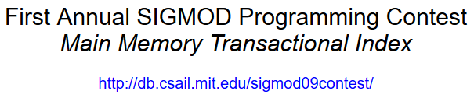
Overview Programming Project
Team
  4 person teams (self-organized team work, but everybody needs to contribute)
Task: SIGMOD’09
Programming Contest
  Transactional, in-memory index for VARCHAR128, INT32, INT64 w/ duplicates
  C test / performance suites, multi-threaded lookup/scan/insert/delete ops
  Programming language: C or C++ recommended, Java possible

Slide 15
API Summary
Create a functional implementation of the provided application programming interface (API) that ensures result correctness and high performance for different data types and characteristics
API
Functions
server.h
// Index Handling
ErrCode create(KeyType type, char *name);
ErrCode drop(char *name);
ErrCode openIndex(const char *name, IdxState **idxState);
ErrCode closeIndex(IdxState *idxState);
// Transaction Handling
ErrCode beginTransaction(TxnState **txn);
ErrCode abortTransaction(TxnState *txn);
ErrCode commitTransaction(TxnState *txn);
// Read and Write Operations
ErrCode get(IdxState *idxState, TxnState *txn, Record *record);
ErrCode getNext(IdxState *idxState, TxnState *txn, Record *record);
ErrCode insertRecord(IdxState *idxState, TxnState *txn, Key *k, const char* payload);
ErrCode deleteRecord(IdxState *idxState, TxnState *txn, Record *record);

Slide 16

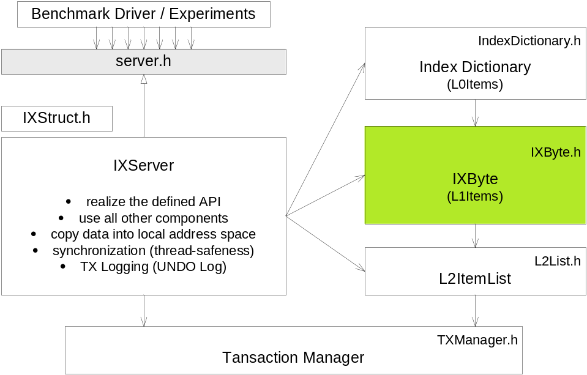


[Matthias Boehm et al: Efficient In-Memory Indexing with Generalized Prefix Trees. BTW 2011]
Reference Implementation DEXTER
System Architecture
  Transactional main memory index server
  Manages a set of indices
  of different data types
  Supports point and range queries
  as well as inserts and deletes
  Optimistic concurrency control
  TX UNDO log
  Implemented in C
Several Subprojects
  Core indexing
  Query processing (HPI Future SOC Lab project)
  Mobile devices, GPUs

Slide 17
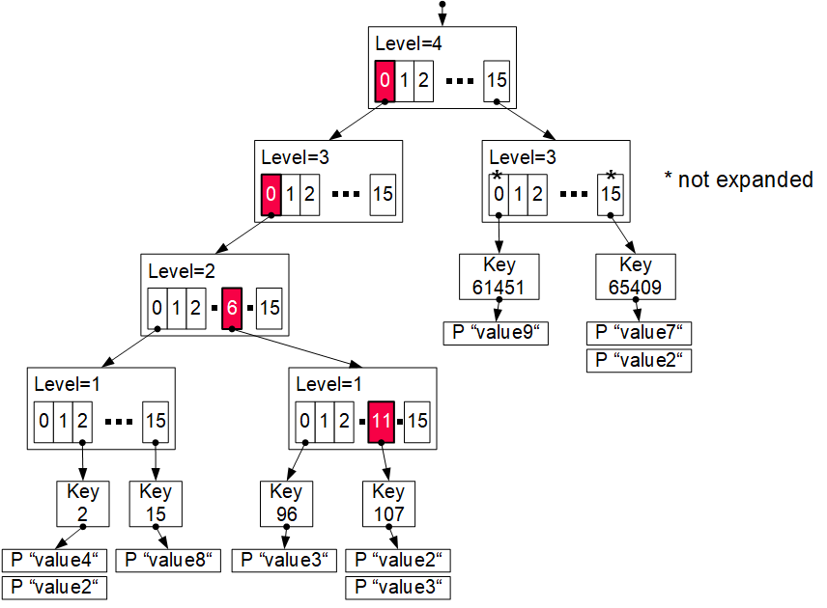
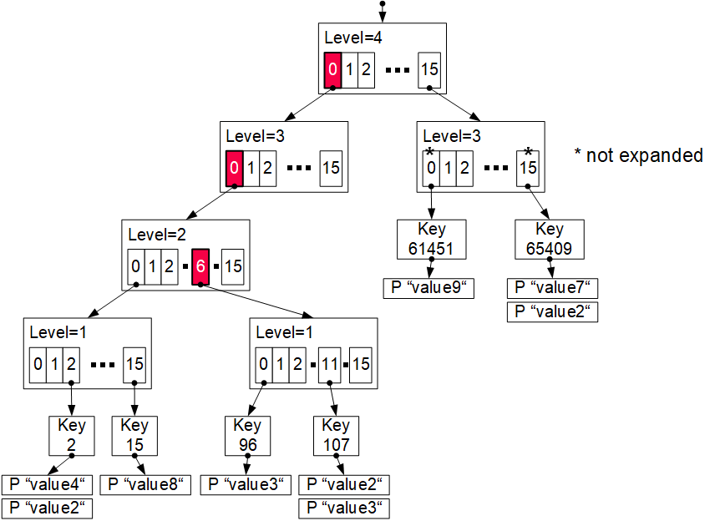
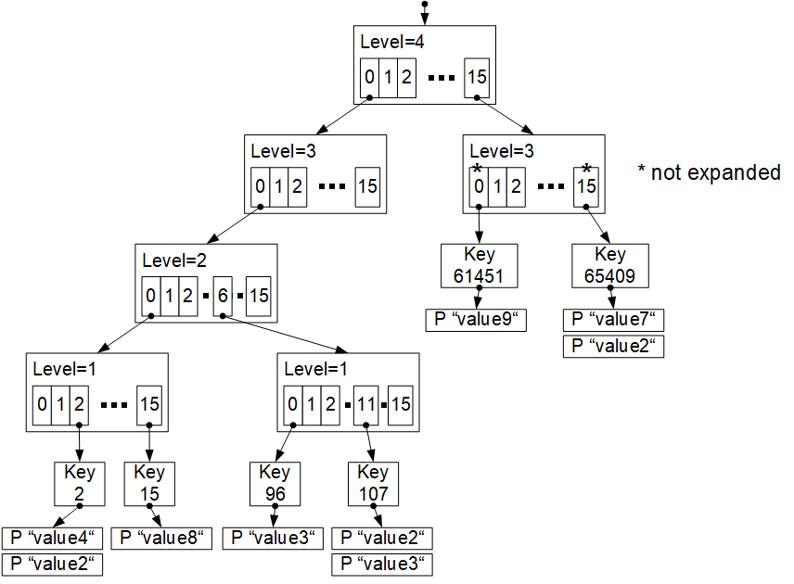
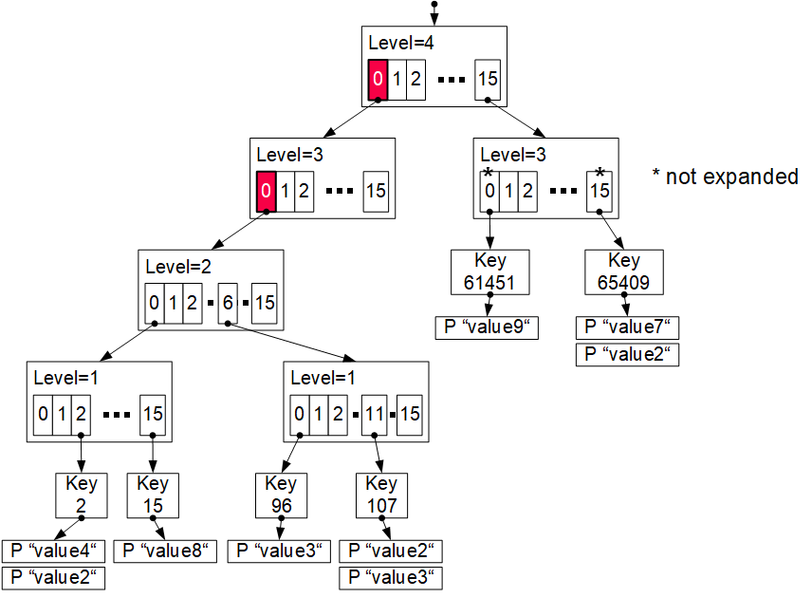
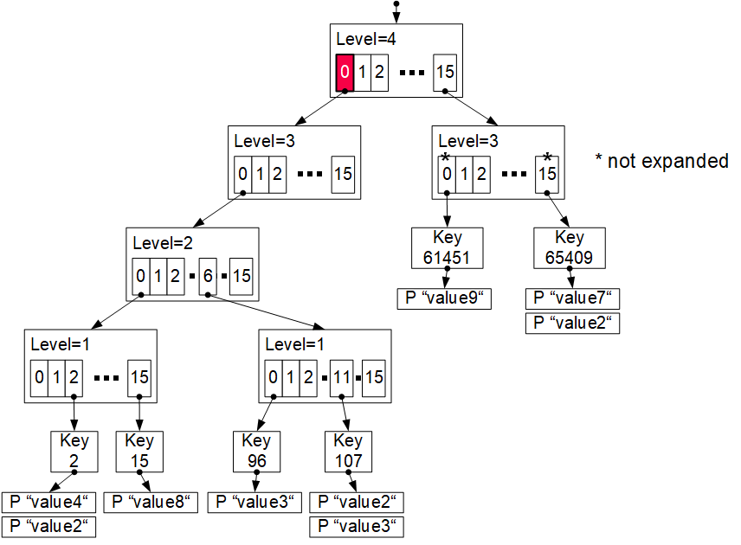
Reference Implementation DEXTER, cont.
Excursus: Prefix Trees (Radix Trees, Tries)
insert (107,value4)
0000
0000
0110
1011
0000
0000
0110
1011
Generalized Prefix Tree
  Arbitrary data types (byte sequences)
  Configurable prefix length k’
  Node size: s = 2^{k’} references
  Fixed maximum height h = k/k‘
  Secondary index structure
Characteristics
  Partitioned data structure
  Order-preserving (for range scans)
  Update-friendly
Properties
  Deterministic paths
  Worst-case complexity O(h)
k = 16
k’ = 4
Bypass array
Adaptive trie expansion
Memory preallocation + reduced pointers

Slide 18
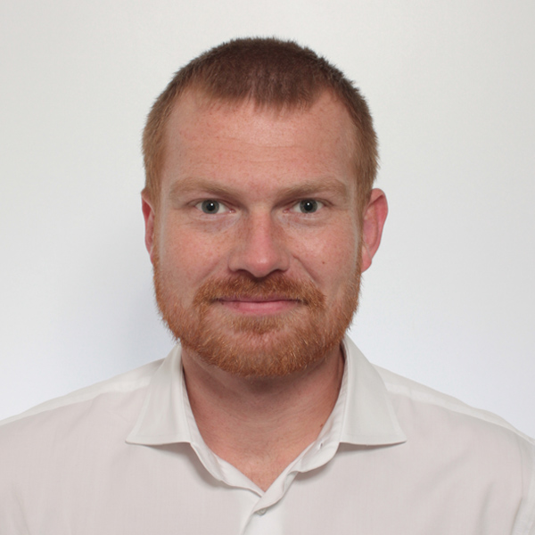

Additional Course Logistics
Each teams gets a mentor
Q&A sessions on demand
Staff
  Lecturer: Prof. Dr. Matthias Boehm
  Teaching Assistant: Christina Dionysio, and others if needed
Next Dates/Lectures
  Oct 23: Course Selection; team preferences, otherwise assignment
  Oct 26: Background Index Structures
  Nov 09: Background Transaction Processing
  Dec 07: Experiments and Reproducibility
  Jan 25: Project submissions (performance target: 400K TX/second)
  Feb 01: Project presentations (10min per team, mandatory attendance)
Infrastructure
  Setup your own private Github/Gitlab repository
Example Speedtest Output:
Creating 100 indices
Populating indices 100
Time to populate: 29ms
Testing the indices
Time to test: 1106ms
Testing complete.
NUM_DEADLOCK: 0
NUM_TXN_FAIL: 0
NUM_TXN_COMP: 1,600,000
Overall time to run: 1135ms

Slide 19
#2 Duplicate Detection (D2IP)

Slide 20
#3 Provenance Tracking in ML Pipelines (DEEM)

Slide 21
#4 Fairness Auditing for ML Pipelines (DEEM)

Slide 22
Course Selection/Enrolment

Slide 23
Select Your Course
Thanks
#1 Efficient Join Pipeline Executor (DAMS)
  Capacity: 16/48
#2 Duplicate Detection (D2IP)
  Capacity: 16/48
#3 Provenance Tracking in ML Pipeline (DEEM)
#4 Fairness Auditing for ML Pipelines (DEEM)
  Capacity: 16/48
Course Selection/Enrolment by Oct 23 EOD
https://forms.gle/bgEkEPaKBaTvBZg37

